Slide 1




Accountability & Capacity
Understanding the disconnect between resources and results
Nic Spaull
IJR Discussion on Accountability in South Africa– 2 December 2013

Slide 2

Outline
Brief overview of SA education system
Motivations for increasing resources
Pro-poor allocation of resources
Accountability without capacity
(overview of IJR Transformation Audit chapter)
5. Capacity without accountability
6. Way forward…

Slide 3



Not all schools are born equal
?
Pretoria Boys High School
SA public schools?

Slide 4
Labour Market
17%
Unemployed
(Broad - 33%)
Unskilled
(19%)
Semi-Skilled (31%)
University/FET
Type of institution (FET or University)
Quality of institution
Type of qualification (diploma, degree etc.)
Field of study (Engineering, Arts etc.)
High productivity jobs and incomes (17%)
Mainly professional, managerial & skilled jobs
Requires graduates, good quality matric or good vocational skills
Historically mainly white
High quality secondaryschool
High SES background
+ECD
High quality primary school
Minority (20%)
Some motivated, lucky or talented students make the transition
Unequal society
Big demand for good schools despite fees
Some scholarships/bursaries
Vocational training
Affirmative action
Majority (80%)
Quality
Low quality secondary
school
Attainment
Type
Low productivity jobs & incomes
Often manual or low skill jobs
Limited or low quality education
Minimum wage can exceed productivity
Low SES background
Low quality primary school
cf. Servaas van der Berg – QLFS 2011
Notes:
The QLFS classifies professions as follows: Highly skilled (legislators, senior officials and managers, professionals, technicians and associate profesionals); Semi-skilled (Clerks, service workers and shop and market personnel, skilled agricultural and fishery workers, craft and related trade workers, plant and machinery operators and assembly), Unskilled (Elementary occupations, domestic workers).

Slide 5
Expenditure on education
2010/11
Total government expenditure
(31% GDP in 2010/11 – R733.5bn)
Government exp on education
(19.5% of Gov exp: R143.1bn)
17%
5%
Notes:
Figures from 2012 Public Expenditure Analysis report for UNICEF/DBE (Oxford Policy Management / Stellenbosch Economics) Education exp = 6.1% of GDP
Personnel exp = 78% of educ exp
Personnel exp = 4.8% of GDP

Slide 6
Motivation for increasing resources
Basic dignity rationale (ethics / human rights)
  Water, sanitation, electricity, brick buildings
  (Minimum Norms and Standards now published)
    Power, water and sanitation within 3 years
    Classrooms, e-connectivity and fencing within 7 years
    Libraries and laboratories within 10 years
Improving learning outcomes rationale (achievement)
  Existing research in SA shows exceedingly weak link between increased expenditures and improved outcomes
  Allocation of new resources rarely based on evidence (‘I had a dream’ approach to policymaking)
  LTSM / workbooks
  Grade R
  Libraries and laboratories? (difficult to motivate)
  Nutrition programs

Slide 7
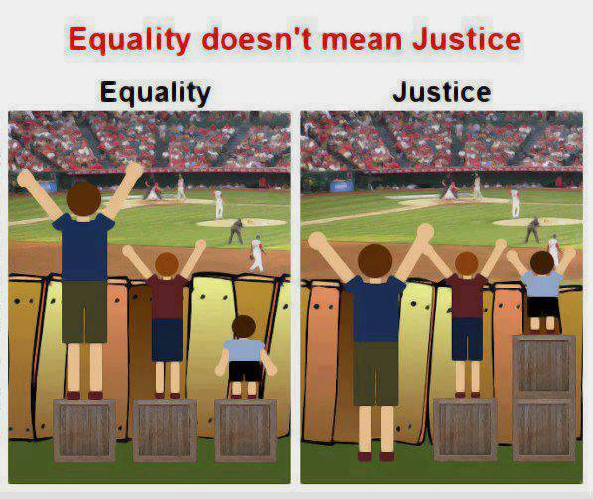
Pro-poor allocation of resources?
Are there real/significant differences in household SES and school resources between Q1, Q2 and Q3?
  Rethinking how we measure quintiles
Is the allocation of financial resources pro-poor?
  Allocated resources vs realized resources (differential efficiency) (Taylor 2011)
  Pre and post parental ‘top-ups’/fees?
Is the allocation of human resources pro-poor?
  How do we incentivize the best teachers to teach in the poorest schools?
  Innovate, test and adapt → need to experiment to see what can work → 150% of teacher salaries for ‘high quality’ teachers to teach in township schools?

Slide 8
Important distinctions
Improved student outcomes
Increased resources “on-the-ground”
Increased allocation of resources
Often these 3 are spoken about interchangeably

Slide 9
Important distinctions
Improved student outcomes
Increased resources “on-the-ground”
Increased allocation of resources
Inefficiency / corruption

Slide 10
Important distinctions
Improved student outcomes
Increased resources “on-the-ground”
Increased allocation of resources
Inefficiency / corruption
Lack of capacity

Slide 11
Important distinctions
Improved student outcomes
Increased resources “on-the-ground”
Increased allocation of resources
Inefficiency / corruption
Lack of capacity
Lack of accountability

Slide 12
Accountability & Capacity

Slide 13
Accountability without capacity
“Accountability systems and incentive structures, no matter how well designed, are only as effective as the capacity of the organization to respond. The purpose of an accountability system is to focus the resources and capacities of an organization towards a particular end. Accountability systems can’t mobilize resources that schools don’t have...the capacity to improve precedes and shapes schools’ responses to the external demands of accountability systems (Elmore, 2004b, p. 117).
“If policy-makers rely on incentives for improving either a school or a student, then the question arises, incentives to do what? What exactly should educators in failing schools do tomorrow - that they do not do today - to produce more learning? What should a failing student do tomorrow that he or she is not doing today?” (Loveless, 2005, pp. 16, 26).
Notes:
Elmore, R. (2004b). School reform from the inside out: Policy, practice and performance. Cambridge, MA: Harvard Education Press.
Loveless, T. (2005). Test-Based Accountability: The Promise and the Perils. The Brookings Institution No. 8, 7-45.

Slide 14
Capacity without accountability
“In the absence of accountability sub-systems, support measures are very much a hit and miss affair. Accountability measures provide motivation for and direction to support measures, by identifying capacity shortcomings, establishing outcome targets, and setting in place incentives and sanctions which motivate and constrain teachers and managers throughout the system to apply the lessons learned on training courses in their daily work practices. Without these, support measures are like trying to push a piece of string: with the best will in the world, it has nowhere to go. Conversely, the performance gains achieved by accountability measures, however efficiently implemented, will reach a ceiling when the lack of leadership and technical skills on the part of managers, and curricular knowledge on the part of teachers, places a limit on improved performance. Thus, the third step in improving the quality of schooling is to provide targeted training programs to managers and teachers. To achieve optimal effects, these will need to connect up with and be steered by accountability measures” (Taylor, 2002, p. 17).
Notes:
Taylor, N. (2002). Accountability and Support: Improving Public Schooling in South Africa. Johannesburg: JET Education.

Slide 15

Notes:
From a forthcoming report on accountability on the

Slide 20


Slide 21
“Only when schools have both the incentive to respond to an accountability system as well as the capacity to do so will there be an improvement in student outcomes.” (p22)

Slide 22
Way forward?
Binding constraints approach
(Hausmann, Klinger & Wagner,2008)

Slide 23
The binding constraints approach
It is “based on the idea that not all constraints bind equally, and that a sensible and practical strategy consists of identifying the most serious constraint(s) at work” (Rodrik, 2009: 6)
Hypothetical example…

Slide 24


Slide 27
“The left hand barrel has horizontal wooden slabs, while the right hand side barrel has vertical slabs. The volume in the first barrel depends on the sum of the width of all slabs. Increasing the width of any slab will increase the volume of the barrel. So a strategy on improving anything you can, when you can, while you can, would be effective. The volume in the second barrel is determined by the length of the shortest slab. Two implications of the second barrel are that the impact of a change in a slab on the volume of the barrel depends on whether it is the binding constraint or not. If not, the impact is zero. If it is the binding constraint, the impact will depend on the distance between the shortest slab and the next shortest slab” (Hausmann, Klinger, & Wagner, 2008, p. 17).
Notes:
Hausmann, R., Klinger, G., & Wagner, R. (2008). Doing Growth Diagnostics in Practice: A 'Mindbook'. CID Workinf Paper No. 177. Center for International Development at Harvard University.

Slide 28

Conclusion
Ensuring that public funding is actually pro-poor and also that it actually reaches the poor.
Understanding whether the motivation is for human dignity reasons or improving learning outcomes.
Ensuring that additional resources are allocated based on evidence rather than anecdote.
The need for BOTH accountability AND capacity.
Identify binding constraints and work from there.

Slide 29
Thank you
Comments & Questions welcome
Presentation available online at www.nicspaull.com/research

Slide 30
Basic Literacy and Numeracy (Gr 6)
What proportion of South African grade 6 children were functionally literate and functionally numerate?
Functionally illiterate: a functionally illiterate learner cannot read a short and simple text and extract meaning.
Functionally innumerate: a functionally innumerate learner cannot translate graphical information into fractions or interpret everyday units of measurement.

Slide 31

SACMEQ III (Spaull & Taylor, 2012)
Literacy
Numeracy

Slide 32


SA primary school: Gr6 Literacy –
SACMEQ III (2007)
Never enrolled
2%
Functionally illiterate
25%
Basic skills
46%
Higher order skills : 27%
Forthcoming paper with Stephen Taylor
Notes:
Technically it is never enrolled or dropped out before grade 6 (using DHS data)

Slide 33
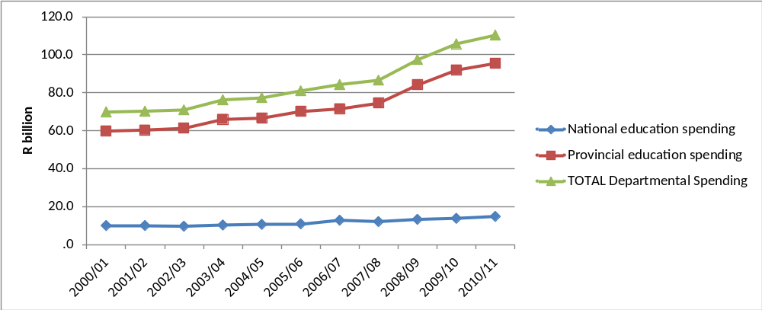
Spending
Spending by education departments, real (2005) Rand
2000/01 to 2010/11
← OSD
(Oxford Policy Management & Stellenbosch Economics, 2012)
Notes:
In the decade since 2000, public education spending increased significantly in real terms with real provincial expenditure on education rising by 60% between 2000/01 and 2010/11. The rapid growth in expenditure from 2007 is largely due to the Occupation Specific Dispensation (OSD) for educators which raised teacher salaries significantly.

Slide 34

Grade 6 Literacy
SA Gr 6 Literacy
Kenya Gr 6 Literacy
1%
5%
7%
25%
49%
46%
39%
Public current expenditure per pupil: $1225
Additional resources is not the answer
Public current expenditure per pupil: $258
27%
Notes:
Technically it is never enrolled or dropped out before grade 6 (using DHS data) – see Taylor and Spaull (Forthcoming)

Slide 35
Accountability: teacher absenteeism
(SACMEQ III – 2007 – 996 teachers)
4th/15
Notes:
Absenteeism here is average between both maths and reading teachers

Slide 36
Accountability: teacher absenteeism
(SACMEQ III – 2007 – 996 teachers)
15th/15
Notes:
Absenteeism here is average between both maths and reading teachers

Slide 37


Benefits of education
Ed
S
H
Ec
Improved human rights
Empowerment of women
Reduced societal violence
Promotion of a national (as opposed to regional or ethnic) identity
Increased social cohesion
Lower fertility
Improved child health
Preventative health care
Demographic transition
Improvements in productivity
Economic growth
Reduction of inter-generational cycles of poverty
Reductions in inequality
$
Health
Economy
Society
Specific references: lower fertility (Glewwe, 2002), improved child health (Currie, 2009), reduced societal violence (Salmi, 2006), promotion of a national - as opposed to a regional or ethnic - identity (Glewwe, 2002), improved human rights (Salmi, 2006), increased social cohesion (Heyneman, 2003), Economic growth – see any decent Macro textbook, specifically for cognitive skills see (Hanushek & Woessman 2008)

Slide 38
Accountability: teacher absenteeism
  Teacher absenteeism is regularly found to be an issue in many studies
    2007: SACMEQ III conducted – 20 days average in 2007
    2008: Khulisa Consortium audit – HSRC (2010) estimates that 20-24 days of regular instructional time were lost due to leave in 2008
    2010: “An estimated 20 teaching days per teacher were lost during the 2010 teachers’ strike” (DBE, 2011: 18)
    Importantly this does not include time lost where teachers were at school but not teaching scheduled lessons
      A recent study observing 58 schools in the North West concluded that “Teachers did not teach 60% of the lessos they were scheduled to teach in North West” (Carnoy & Chisholm et al, 2012)
Notes:
Also see Chisholm (2005) and Shisana et al (2005) quoted in HSRC (2010)

Slide 39




Accountability: teacher absenteeism
(SACMEQ III – 2007 – 996 teachers)
Western Cape
Eastern Cape
Limpopo
KwaZulu-Natal
% absent > 1 week striking
32%
81%
97%
82%
% absent > 1 month (20 days)
22%
62%
48%
73%
% absent > 2 months (40 days)
5%
12%
0%
10%
1.3 days a week
Notes:
Given that SACMEQ was done in September 2007, a maximum of 159 school days could have passed, hence 3 months = 1.3 days a week

Slide 40
SACMEQ III (Spaull & Taylor, 2012)
Literacy
Numeracy

Slide 41
Gr 1 - Gr 2 - Gr 3 – Gr 4 – Gr 5 – Gr 6 – Gr 7 – Gr 8 – Gr 9 - Gr 10 – Gr 11 – Gr 12
Foundation Phase
Intermediate Phase
Senior Phase
FET Phase
Matric
Grade 12 – Various
Roughly half the cohort
____________________________________
Underperformance
Of 100 students that enroll in grade 1 approximately 50 will make it to matric, 40 will pass and 12 will qualify for university
Inequality
Subject combinations differ between rich and poor – differential access to higher education
Maths / Maths-lit case in point
Are more students taking maths literacy because THEY cannot do pure-maths, or because their TEACHERS cannot teach pure-maths?

Slide 42
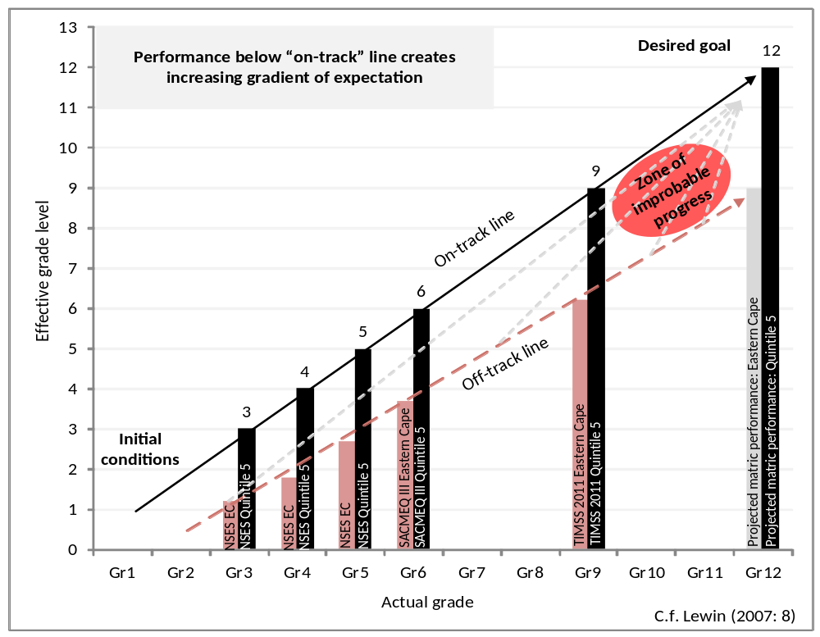
Insurmountable learning deficits
Gradients of achievement in the EASTERN Cape and in Quintile 5 (National)
NB: Key assumption, 0.5 SD of national learning achievement is equivalent to one grade level of learning
-agreement from TIMSS/PIRLS
Spaull, 2013
Spaull 2013

Slide 43
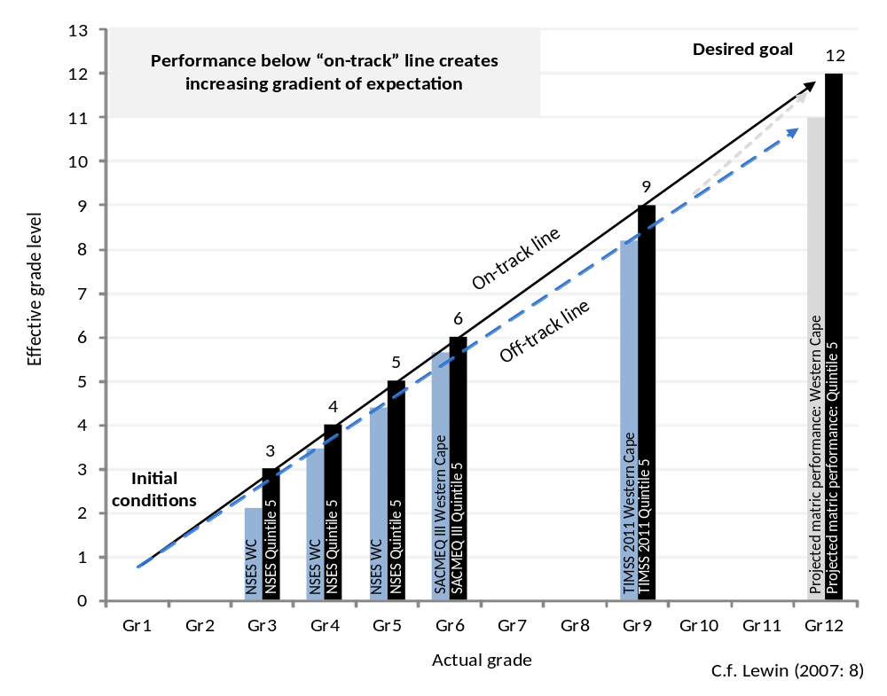
Insurmountable learning deficits
Gradients of achievement in the WESTERN Cape and in Quintile 5 (National)
NB: WC has relatively high % of Q5 schools thus it should be more convergent by construction.
Spaull, 2013
Spaull 2013

Slide 44


What are the root causes of low and unequal achievement?
Matric pass rate
Subject choice
No. endorsements
Throughput
Media sees only this→
Quality?
MATRIC
Pre-MATRIC
50% dropout
Low curric coverage
Weak culture of T&L
Low accountability
Vested interests
Low time-on-task
No early cognitive stimulation
Low quality teachers
HUGE learning deficits…

Slide 45
2 education systems not 1

Slide 46
2 education systems
Dysfunctional Schools (75% of schools) | Functional Schools (25% of schools)
Weak accountability | Strong accountability
Incompetent school management | Good school management
Lack of culture of learning, discipline and order | Culture of learning, discipline and order
Inadequate LTSM | Adequate LTSM
Weak teacher content knowledge | Adequate teacher content knowledge
High teacher absenteeism (1 month/yr) | Low teacher absenteeism (2 week/yr)
Slow curriculum coverage, little homework or testing | Covers the curriculum, weekly homework, frequent testing
High repetition & dropout (Gr10-12) | Low repetition & dropout (Gr10-12)
Extremely weak learning: most students fail standardised tests | Adequate learner performance (primary and matric)

Slide 47

Two school systems not one?
Socioeconomic Status
Grade 6 [2007]
Data: SACMEQ
(Spaull, 2011)

Slide 48


Gr 1 - Gr 2 - Gr 3 – Gr 4 – Gr 5 – Gr 6 – Gr 7 – Gr 8 – Gr 9 - Gr 10 – Gr 11 – Gr 12
Foundation Phase
Intermediate Phase
Senior Phase
FET Phase
PIRLS 2006 – see Shepherd (2011)
prePIRLS 2011
Grade 4 – all 11 languages
433 schools, 19259 students
____________________________________
Underperformance
29% of gr4 students did not reach the low international benchmark – they could not read
SA performs similarly to Botswana, but 3 years learning behind average Columbian Gr4
Inequality
Linguistic inequalities: Large differences by home language – Xitsonga, Tshivenda and Sepedi students particularly disadvantaged
PIRLS (2006) showed LARGE differences between African language schools and Eng/Afr schools
Howie et al (2011)
*Data now available for download

Slide 49

→
In most government reports outcomes and inputs are not usually reported by quintile, only national averages
→

Slide 50
Implications for reporting and modeling??

Slide 51
3 biggest challenges - SA
Failure to get the basics right
  Children who cannot read, write and compute properly (Functionally illiterate/innumerate) after 6 years of formal full-time schooling
  Often teachers lack even the most basic knowledge
Equity in education
  2 education systems – dysfunctional system operates at bottom of African countries, functional system operates at bottom of developed countries.
  More resources is NOT the silver bullet – we are not using existing resources
Lack of accountability
  Little accountability to parents in majority of school system
  Little accountability between teachers and Department
  Teacher unions abusing power and acting unprofessionally

Slide 52
Way forward?
Acknowledge the extent of the problem
  Low quality education is one of the three largest crises facing our country (along with HIV/AIDS and unemployment). Need the political will and public support for widespread reform.
Focus on the basics
  Every child MUST master the basics of foundational numeracy and literacy these are the building blocks of further education – weak foundations = recipe for disaster
  Teachers need to be in school teaching (re-introduce inspectorate?)
  Every teacher needs a minimum competency (basic) in the subjects they teach
  Every child (teacher) needs access to adequate learning (teaching) materials
  Use every school day and every school period – maximise instructional time
Increase information, accountability & transparency
  At ALL levels – DBE, district, school, classroom, learner
  Strengthen ANA
  Set realistic goals for improvement and hold people accountable

Slide 53
When faced with an exceedingly low and unequal quality of education do we….
A) Increase accountability {US model}
    Create a fool-proof highly specified, sequenced curriculum (CAPS/workbooks)
    Measure learning better and more frequently (ANA)
    Increase choice/information in a variety of ways
B) Improve the quality of teachers {Finnish model}
    Attract better candidates into teaching degrees → draw candidates from the top (rather than the bottom) of the matric distribution
    Increase the competence of existing teachers (Capacitation)
    Long term endeavor which requires sustained, committed, strategic, thoughtful leadership (something we don’t have)
C) All of the above {Utopian model}
Perhaps A while we set out on the costly and difficult journey of B??

