Slide 1




An overview of South African schooling Understanding inequality and underperformance
Nic Spaull
SALDRU Seminar
13 February 2013

Slide 2
Outline
Overview of SA educational outcomes
  Theoretical links between schooling and the labour-market in SA
  What do we know empirically about underperformance and inequality from SA data Grades 1→12?
What are some of the implications following from this?
  Labour-market outcomes for youth (18-24) since 1995
  When you have 2 education systems how does this affect:
    Reporting
    Modelling
Conclusions & Recommendations

Slide 3



Not all schools are born equal
?
Pretoria Boys High School
SA public schools?

Slide 4
Education and inequality?
Duration of education
Quality of education
Type of education
IQ
Motivation
Social networks
Discrimination
SA is one of the top 3 most unequal countries in the world
Between 78% and 85% of total inequality is explained by wage inequality
Wages
Notes:
78% and 85% figures were taken from research reports by Van der Berg and Leibbrandt

Slide 5
Labour Market
17%
Unemployed
(Broad - 33%)
Unskilled
(19%)
Semi-Skilled (31%)
University/FET
Type of institution (FET or University)
Quality of institution
Type of qualification (diploma, degree etc.)
Field of study (Engineering, Arts etc.)
High productivity jobs and incomes (17%)
Mainly professional, managerial & skilled jobs
Requires graduates, good quality matric or good vocational skills
Historically mainly white
High quality secondaryschool
High SES background
+ECD
High quality primary school
Minority (20%)
Some motivated, lucky or talented students make the transition
Unequal society
Big demand for good schools despite fees
Some scholarships/bursaries
Vocational training
Affirmative action
Majority (80%)
Quality
Low quality secondary
school
Attainment
Type
Low productivity jobs & incomes
Often manual or low skill jobs
Limited or low quality education
Minimum wage can exceed productivity
Low SES background
Low quality primary school
cf. Servaas van der Berg – QLFS 2011
Notes:
The QLFS classifies professions as follows: Highly skilled (legislators, senior officials and managers, professionals, technicians and associate profesionals); Semi-skilled (Clerks, service workers and shop and market personnel, skilled agricultural and fishery workers, craft and related trade workers, plant and machinery operators and assembly), Unskilled (Elementary occupations, domestic workers).

Slide 6
Gr 1 - Gr 2 - Gr 3 – Gr 4 – Gr 5 – Gr 6 – Gr 7 – Gr 8 – Gr 9 - Gr 10 – Gr 11 – Gr 12
ECD
Foundation Phase
Intermediate Phase
Senior Phase
FET Phase
Foundation Phase
Intermediate Phase
Senior Phase
FET Phase
Mother-tongue instruction
De facto / De jure ?
Primary school
High school
Main drop-out zone

Slide 7

Gr 1 - Gr 2 - Gr 3 – Gr 4 – Gr 5 – Gr 6 – Gr 7 – Gr 8 – Gr 9 - Gr 10 – Gr 11 – Gr 12
Foundation Phase
Intermediate Phase
Senior Phase
FET Phase
National School Effectiveness Study (NSES)
Grade 3 (2007); Grade 4 (2008); Grade 5 (2009) – Panel 268 schools
[All provinces except Gauteng]
____________________________________
Underperformance
Language: In 44% of Gr4 and 32% of Gr5 classes there was no paragraph writing done over the year (from best learner).
Mathematics: 88% of Gr5 maths teachers covered no more than 35 of the 89 topics (40%) in the gr5 maths curriculum
Inequality
Frequency of paragraph writing (half a page or less) EC/KZN=1.7; WC=5.8 /year
Grade 3 students in historically white schools perform much better on the same test than grade 5 students from historically black schools
Taylor, 2011

Slide 8


Gr 1 - Gr 2 - Gr 3 – Gr 4 – Gr 5 – Gr 6 – Gr 7 – Gr 8 – Gr 9 - Gr 10 – Gr 11 – Gr 12
Foundation Phase
Intermediate Phase
Senior Phase
FET Phase
PIRLS 2006 – see Shepherd (2011)
prePIRLS 2011
Grade 4 – all 11 languages
433 schools, 19259 students
____________________________________
Underperformance
29% of gr4 students did not reach the low international benchmark – they could not read
SA performs similarly to Botswana, but 3 years learning behind average Columbian Gr4
Inequality
Linguistic inequalities: Large differences by home language – Xitsonga, Tshivenda and Sepedi students particularly disadvantaged
PIRLS (2006) showed LARGE differences between African language schools and Eng/Afr schools
Howie et al (2011)
*Data now available for download

Slide 9

Gr 1 - Gr 2 - Gr 3 – Gr 4 – Gr 5 – Gr 6 – Gr 7 – Gr 8 – Gr 9 - Gr 10 – Gr 11 – Gr 12
Foundation Phase
Intermediate Phase
Senior Phase
FET Phase
SACMEQ 2007
Grade 6 – Numeracy and literacy
392 schools, 9071 students
____________________________________
Underperformance
27% of students functionally illiterate
SA performs worse than many low-income African countries (Tanzania, Kenya, Swaziland, Zimbabwe)
No improvement between SACMEQ II (2000) and SACMEQ III (2007)
Although majority (98%) of students are enrolled, sometimes almost no learning
Inequality
Large differences between quintiles (see table later)
Large inequalities in maths teacher content knowledge
Gr 6 Teacher Content Knowledge - see McKay & Spaull (2013)

Slide 10

SACMEQ III (Spaull & Taylor, 2012)
Literacy
Numeracy

Slide 11
Gr 1 - Gr 2 - Gr 3 – Gr 4 – Gr 5 – Gr 6 – Gr 7 – Gr 8 – Gr 9 - Gr 10 – Gr 11 – Gr 12
Foundation Phase
Intermediate Phase
Senior Phase
FET Phase
TIMSS 2011
Grade 9 – Maths and science
285 schools, 11969 students
____________________________________
Underperformance
76% of Gr9 students had not acquired a basic understanding about whole numbers, decimals, operations or basic graphs (i.e. had not reached low int. benchmark)
Avg. Gr 9 SA student is 2yrs (2.8yrs) behind the average Gr8 student from a middle income country in maths (science)
Contrary to popular belief, even South Africa’s “top” schools do not perform well by international standards…
Inequality
Avg Q1/Q2 Gr9 student is 3yrs (4yrs) worth of learning behind the average Q5 student in maths (science)
Avg Gr 9 student in ECA is 2yrs worth of learning behind avg Gr9 student in GAU
*Data now available for download

Slide 12
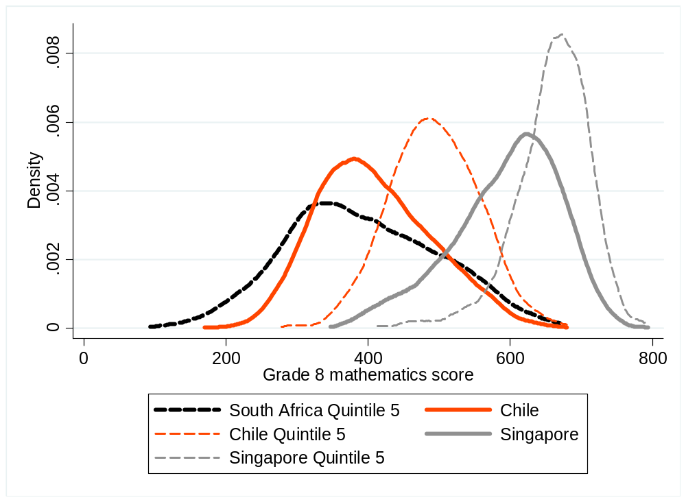
Performance of quintile five schools in TIMSS 2003 Maths
– see Taylor MST (2011)
Even Q5 schools in SA perform at a comparatively low level

Slide 13
Gr 1 - Gr 2 - Gr 3 – Gr 4 – Gr 5 – Gr 6 – Gr 7 – Gr 8 – Gr 9 - Gr 10 – Gr 11 – Gr 12
Foundation Phase
Intermediate Phase
Senior Phase
FET Phase
Matric
Grade 12 – Various
Roughly half the cohort
____________________________________
Underperformance
Of 100 students that enroll in grade 1 approximately 50 will make it to matric, 40 will pass and 12 will qualify for university
Inequality
Subject combinations differ between rich and poor – differential access to higher education
Maths / Maths-lit case in point
Are more students taking maths literacy because THEY cannot do pure-maths, or because their TEACHERS cannot teach pure-maths?

Slide 14
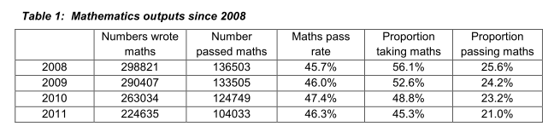
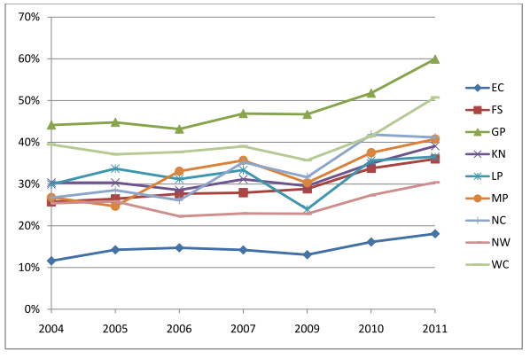
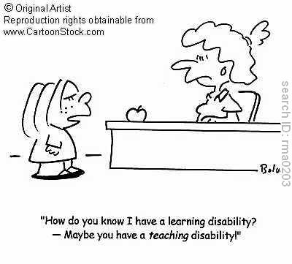
Matric
More students making it to grade 10 but not more making it to matric
  Partially due to less repetition at lower grades
LARGE differences in the ability of provinces to “convert” grade 1 enrolments into matric passes
Why are more students taking maths literacy?
See Taylor (2012)
The ratio of grade 2 enrolments ten years prior to matric to matric passes by province
See Taylor (2012)

Slide 15


What are the root causes of low and unequal achievement?
Matric pass rate
Subject choice
No. endorsements
Throughput
Media sees only this→
Quality?
MATRIC
Pre-MATRIC
50% dropout
Low curric coverage
Weak culture of T&L
Low accountability
Vested interests
Low time-on-task
No early cognitive stimulation
Low quality teachers
HUGE learning deficits…

Slide 16
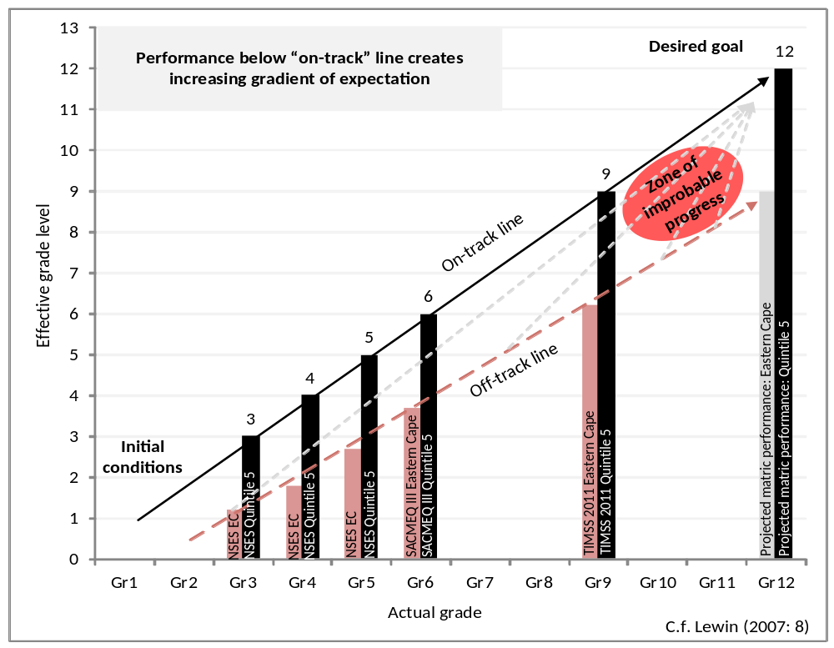
Insurmountable learning deficits
Gradients of achievement in the EASTERN Cape and in Quintile 5 (National)
NB: Key assumption, 0.5 SD of national learning achievement is equivalent to one grade level of learning
-agreement from TIMSS/PIRLS
Spaull, 2013
Spaull 2013

Slide 17
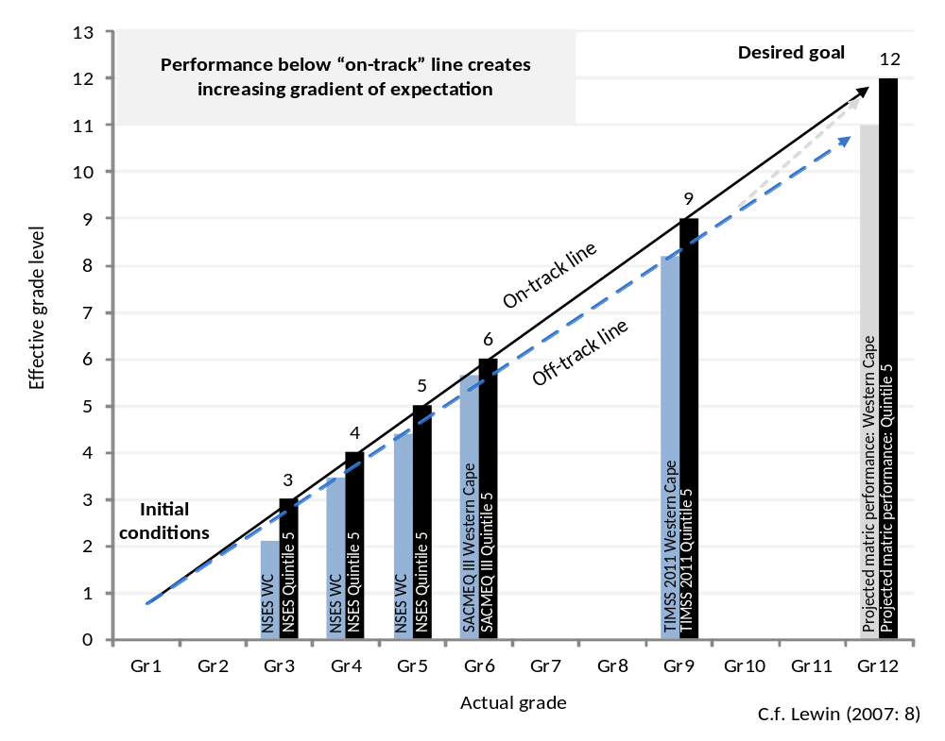
Insurmountable learning deficits
Gradients of achievement in the WESTERN Cape and in Quintile 5 (National)
NB: WC has relatively high % of Q5 schools thus it should be more convergent by construction.
Spaull, 2013
Spaull 2013

Slide 18
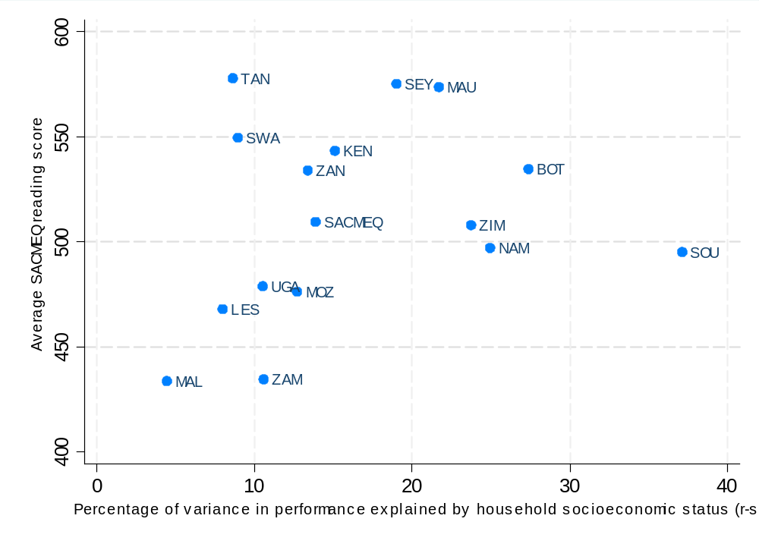
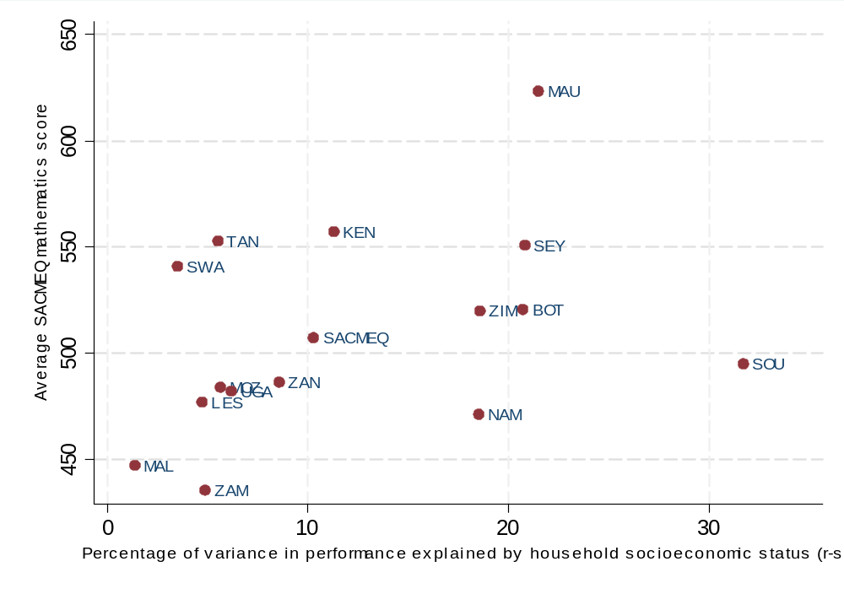
The impact of SES on reading/maths (SACMEQ III – 2007 Gr 6)
Almost 40% of SA student reading achievement can be explained by socioeconomic status (31 assets, books, parental education) alone.
In South Africa socioeconomic status largely determines outcomes (with a very small number of exceptions – see newspapers for examples)
Indication of wasted human capital potential (see Schleicher, 2009)
Spaull, 2013

Slide 19



Bimodality – indisputable fact
PIRLS / TIMSS / SACMEQ / NSES / ANA / Matric… by Wealth / Language / Location / Dept…

Slide 20
Poverty & Privilege paper
If there are indeed two education systems in SA and not one – as the background research seems to suggest - where/how do we draw the line between one and the other?

Slide 21

Background: Data
SACMEQ
  Southern and Eastern African Consortium for Monitoring Educational Quality
  14 participating countries
  SACMEQ II (2000), SACMEQ III (2007)
  Background survey
  Testing :
    Gr 6 Numeracy
    Gr 6 Literacy
    HIV/AIDS Health knowledge
SACMEQ III: South Africa
  9071 Grade 6 students
  1163 Grade 6 teachers
  392 primary schools
See SACMEQ website for research

Slide 22
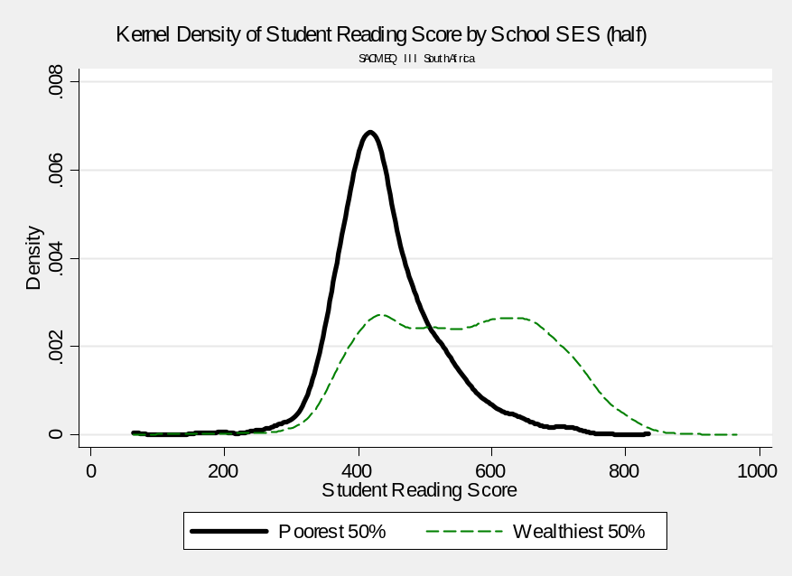
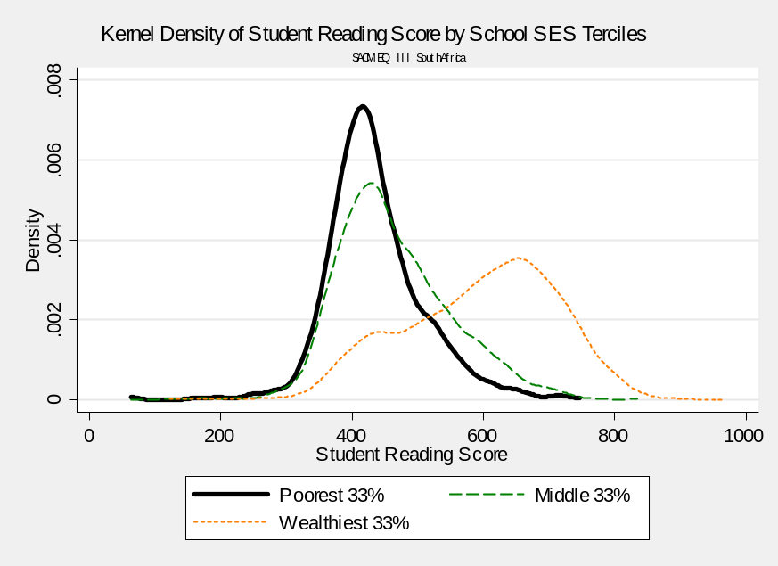
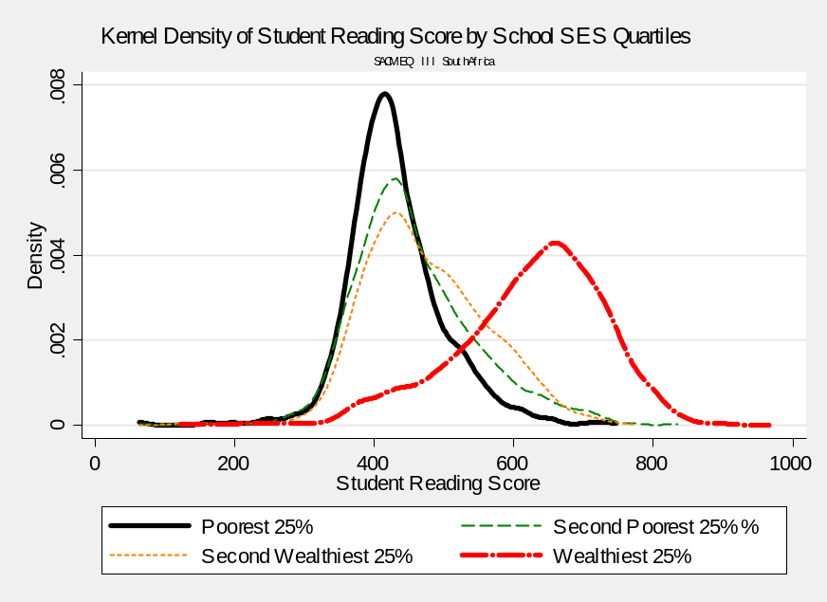
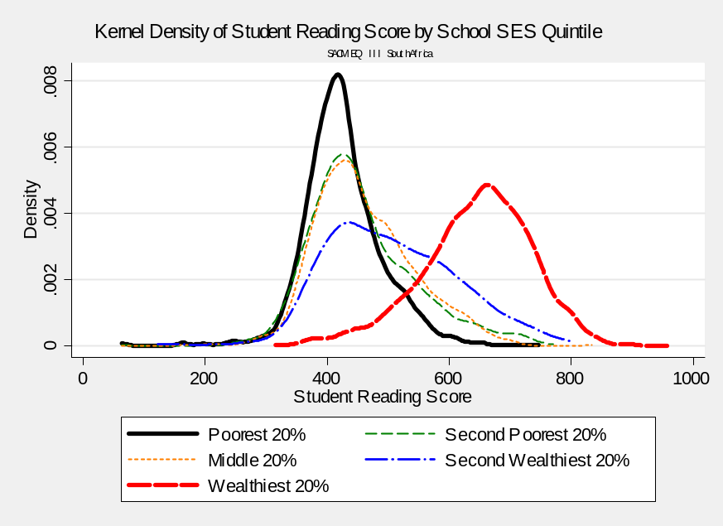

Slide 23
Two school systems not one?
Socioeconomic Status
Grade 6 [2007]
Data: SACMEQ
(Spaull, 2011)

Slide 24
Corroborating evidence?
Latest data? ANA?
Teacher knowledge
Teacher absenteeism
Textbook access
Literacy/numeracy rates
Grade repetition
Parental education
Homework frequency

Slide 25

→
In most government reports outcomes and inputs are not usually reported by quintile, only national averages
→

Slide 26
Implications for reporting and modeling??

Slide 27
Do the ends justify the means?
Government reporting – means are misleading
Notes:
“Then there is the man who drowned crossing a stream with an average depth of six inches”
– W. Gates

Slide 28
Modelling student performance
Two data-generating processes. Little reason to believe there is the same underlying DGP
Split samples
  Wealthiest 25% of schools
  Poorest 75% of schools
Which coefficients are large & significant across the two regressions?

Slide 29
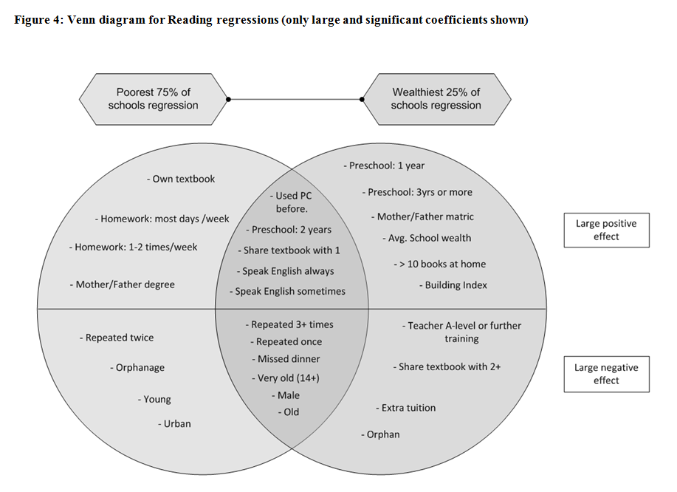
11/29 variables common

Slide 30
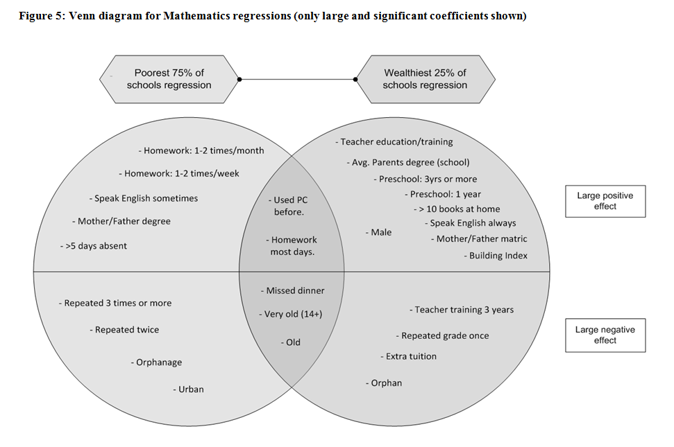
5/27 variables common

Slide 31
All of these things have serious ramifications for the labour market and thus income inequality…

Slide 32
Percentage of youth in employment by highest educational attainment (Van Broekhuizen, 2013)
Since 2007 more youth have matric
Employment rates of youth are stagnant at 20% since 1995
For 18-24yr matric-only or less-than-matric doesn’t make much of a difference
Demand-Supply interaction between labour market and schooling
Composition of 18 - 24-year-olds by highest level of education completed (Van Broekhuizen, 2013)
Notes:
Source: Own calculations, OHS 1995 – 1999, LFS 2000a – 2007b, QLFS2008Q1 – QLFS2011Q4. Notes: Estimates are weighted and are calculated only for 18-24-year-olds. “Less than Matric” includes all individuals with between 0 years of schooling and completed grade 11. “Diplomas” include all post-secondary certificate and diploma qualifications or their equivalents. “Degrees” include all Bachelor’s degrees or higher qualifications.

Slide 33
Percentage of unemployed 18-24-yr olds that have never worked (Van Broekhuizen, 2013)
In 2011 more than 70% of youth in unemployment had never been employed before
Durations of youth unemployment have been increasing since 1995
Proportion of job-seeking youth unemployed for more than 3 years has increased from 42% in 2008 to 50% in 2011
Percentage of unemployed 18-24-year-olds by duration of unemployment
(Van Broekhuizen, 2013)
Notes:
Source: Own calculations, OHS 1995 – 1999, LFS 2000a – 2007b, QLFS2008Q1 – QLFS2011Q4. Notes: Estimates are weighted and are calculated only for 18-24-year-olds. “Less than Matric” includes all individuals with between 0 years of schooling and completed grade 11. “Diplomas” include all post-secondary certificate and diploma qualifications or their equivalents. “Degrees” include all Bachelor’s degrees or higher qualifications.

Slide 34
Conclusions & Implications
Reporting education statistics in SA
  Averages are uniquely misleading in SA – the average child does not exist in any meaningful sense
  Report educational statistics by quintile in addition to province
  You can’t solve a problem that doesn’t officially exist
Modelling educational performance in SA
  Modelling a single education system when there are two can lead to spurious results
Policy differentiation
  Policies suited to one system are not necessarily suited to the other
  Don’t interfere with high-performing schools →If it aint broke don’t (try) fix it
  LITNUM intervention in WC → Blanket approach
We have 2 education systems in South Africa

Slide 35
When faced with an exceedingly low and unequal quality of education do we….
A) Increase accountability {US model}
    Create a fool-proof highly specified, sequenced curriculum (CAPS/workbooks)
    Measure learning better and more frequently (ANA)
    Increase choice/information in a variety of ways
B) Improve the quality of teachers {Finnish model}
    Attract better candidates into teaching degrees → draw candidates from the top (rather than the bottom) of the matric distribution
    Increase the competence of existing teachers (Capacitation)
    Long term endeavor which requires sustained, committed, strategic, thoughtful leadership (something we don’t have)
C) All of the above {Utopian model}
Perhaps A while we set out on the costly and difficult journey of B??

Slide 36
Conclusions & Implications
Hereditary poverty
Low social mobility
Low quality education
Persistent patterns of poverty and privilege

Slide 37
More research on…
Things we don’t really understand:
  The impact of LOLT switching at grade 4 – should we be teaching in mother-tongue for longer?
  Why districts are so dysfunctional
  How to do in-service teacher training (existing programs don’t work)
  The existing system of incentives facing national and provincial bureaucrats/politicians and how to change this
  What the SA version of an accountable system of education looks like ^{Nic’s PhD}

Slide 38


Thanks.
Comments & questions…
Website: nicspaull.com/research
Email: nicholasspaull@gmail.com
Twitter: @NicSpaull

Slide 39
References
Fleisch, B. (2008). Primary Education in Crisis: Why South African schoolchildren underachieve in reading and mathematics. Cape Town. : Juta & Co.
Hoadley, U. (2010). What doe we know about teaching and learning in primary schools in South Africa? A review of the classroom-based research literature. Report for the Grade 3 Improvement project of the University of Stellenbosch. Western Cape Education Department.
Hungi, N., Makuwa, D., Ross, K., Saito, M., Dolata, S., van Capelle, F., et al. (2011). SACMEQ III Project Results: Levels and Trends in School Resources among SACMEQ School Systems. Paris: Southern and Eastern Africa Consortium for Monitoring Educational Quality.
Ross, K., Saito, M., Dolata, S., Ikeda, M., Zuze, L., Murimba, S., et al. (2005). The Conduct of the SACMEQ III Project. In E. Onsomu, J. Nzomo, & C. Obiero, The SACMEQ II Project in Kenya: A Study of the Conditions of Schooling and the Quality of Education. Harare: SACMEQ.
Shepherd, D. (2011). Constraints to School Effectiveness: What prevents poor schools from delivering results? Stellenbosch Economic Working Papers 05/11. [PIRLS]
Spaull, N. (2011a). A Preliminary Analysis of SACMEQ III South Africa.Stellenbosch Economic Working Papers.
Spaull, N. (2011). Primary School Performance in Botswana, Mozambique, Namibia and South Africa. Paris: Southern and Eastern African Consortium for Monitoring Educational Quality (SACMEQ) Working Paper no.8.
Spaull, N. 2012 Equity & Efficiency in South African primary schools : a preliminary analysis of SACMEQ III South Africa Masters Thesis. Economics. Stellenbosch University
Taylor, S. (2011). Uncovering indicators of effective school management in South Africa using the National School Effectiveness Study.Stellenbosch Economic Working Papers 10/11, 1-51. [NSES]
Van der Berg, S., Burger, C., Burger, R., de Vos, M., du Rand, G., Gustafsson, M., Shepherd, D., Spaull, N., Taylor, S., van Broekhuizen, H., and von Fintel, D. (2011). Low quality education as a poverty trap. Stellenbosch: University of Stellenbosch, Department of Economics. Research report for the PSPPD project for Presidency.

Slide 40
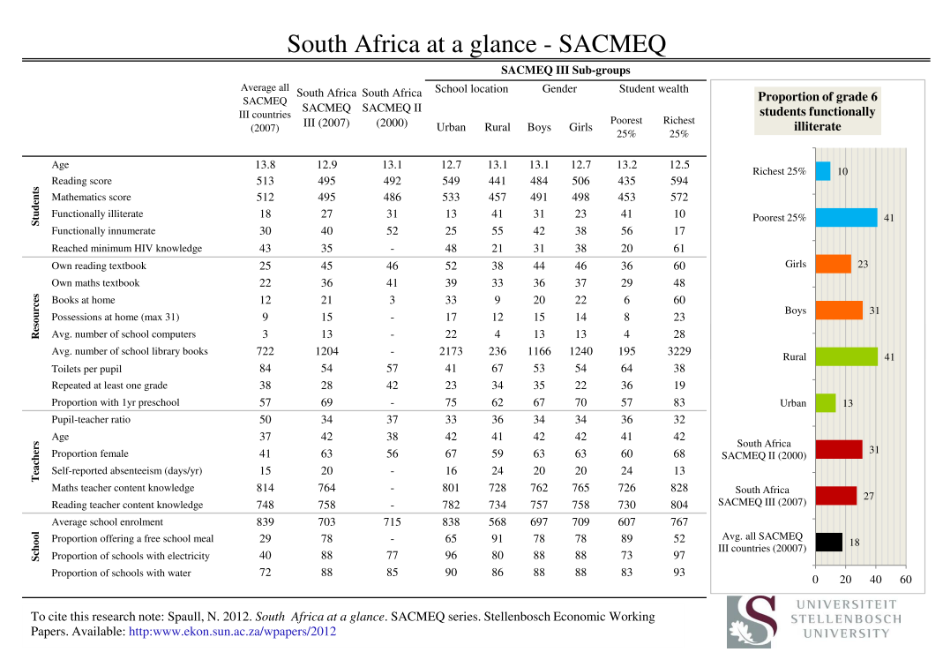
Notes:
Forthcoming on RESEP website

Slide 41

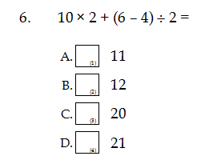
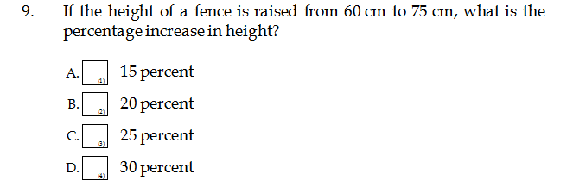
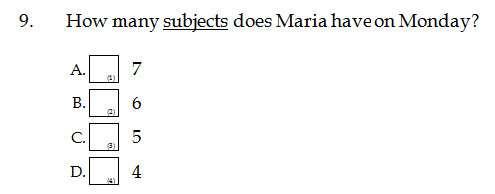
Teacher knowledge...
← Q6: 53% correct (D)
Q9: 24% correct (C)
English Q9: 57% correct (D)

Slide 42
Description of levels | Range on 500 point scale | Skills
Level 1 Pre-reading | < 373 | Matches words and pictures involving concrete concepts and everyday objects. Follows short simple written instructions.
Level 2 Emergent reading | 373 → 414 | Matches words and pictures involving prepositions and abstract concepts; uses cuing systems (by sounding out, using simple sentence structure, and familiar words) to interpret phrases by reading on.
Level 3 Basic reading | 414 → 457 | Interprets meaning (by matching words and phrases, completing a sentence, or matching adjacent words) in a short and simple text by reading on or reading back.
Level 4 Reading for meaning | 457 → 509 | Reads on or reads back in order to link and interpret information located in various parts of the text.
Level 5 Interpretive reading | 509 → 563 | Reads on and reads back in order to combine and interpret information from various parts of the text in association with external information (based on recalled factual knowledge) that “completes” and contextualizes meaning.
Level 6 Inferential reading | 563 → 618 | Reads on and reads back through longer texts (narrative, document or expository) in order to combine information from various parts of the text so as to infer the writer’s purpose.
Level 7 Analytical reading | 618 → 703 | Locates information in longer texts (narrative, document or expository) by reading on and reading back in order to combine information from various parts of the text so as to infer the writer’s personal beliefs (value systems, prejudices, and/or biases).
Level 8 Critical reading | 703+ | Locates information in a longer texts (narrative, document or expository) by reading on and reading back in order to combine information from various parts of the text so as to infer and evaluate what the writer has assumed about both the topic and the characteristics of the reader – such as age, knowledge, and personal beliefs (value systems, prejudices, and/or biases).
Source: (Hungi, et al., 2010)
^{[1]} See Ross et al. (2005, p. 95).
Notes:
SACMEQ levels – see SACMEQ website and Ross et al 2005 for more information

Slide 43
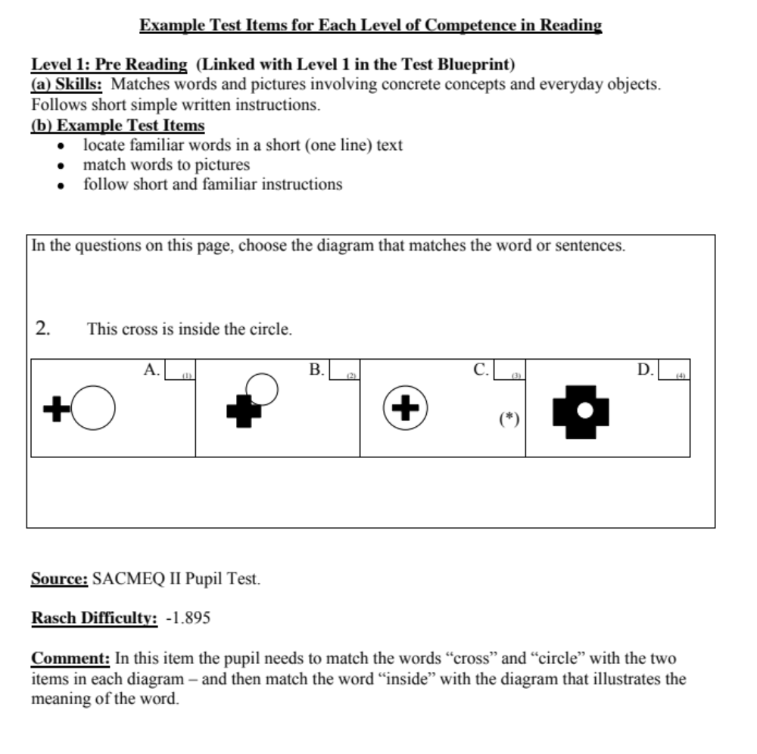
Literacy
See Ross et al. (2005) Kenya Report

Slide 44
Description of levels | Range on 500 point scale | Skills
Level 1 Pre-numeracy | < 364 | Applies single step addition or subtraction operations. Recognizes simple shapes. Matches numbers and pictures. Counts in whole numbers.
Level 2 Emergent numeracy | 364 → 462 | Applies a two-step addition or subtraction operation involving carrying, checking (through very basic estimation), or conversion of pictures to numbers. Estimates the length of familiar objects. Recognizes common two-dimensional shapes.
Level 3 Basic numeracy | 462 → 532 | Translates verbal information presented in a sentence, simple graph or table using one arithmetic operation in several repeated steps. Translates graphical information into fractions. Interprets place value of whole numbers up to thousands. Interprets simple common everyday units of measurement.
Level 4 Beginning numeracy | 532 → 587 | Translates verbal or graphic information into simple arithmetic problems. Uses multiple different arithmetic operations (in the correct order) on whole numbers, fractions, and/or decimals.
Level 5 Competent numeracy | 587 → 644 | Translates verbal, graphic, or tabular information into an arithmetic form in order to solve a given problem. Solves multiple-operation problems (using the correct order of arithmetic operations) involving everyday units of measurement and/or whole and mixed numbers. Converts basic measurement units from one level of measurement to another (for example, metres to centimetres).
Level 6 Mathematically skilled | 644 → 720 | Solves multiple-operation problems (using the correct order of arithmetic operations) involving fractions, ratios, and decimals. Translates verbal and graphic representation information into symbolic, algebraic, and equation form in order to solve a given mathematical problem. Checks and estimates answers using external knowledge (not provided within the problem).
Level 7 Concrete problem solving | 720 → 806 | Extracts and converts (for example, with respect to measurement units) information from tables, charts, visual and symbolic presentations in order to identify, and then solves multi-step problems.
Level 8 Abstract problem solving | > 806 | Identifies the nature of an unstated mathematical problem embedded within verbal or graphic information, and then translate this into symbolic, algebraic, or equation form in order to solve the problem.
Source: (Hungi, et al., 2010)
Notes:
SACMEQ levels – see SACMEQ website and Ross et al 2005 for more information

Slide 45
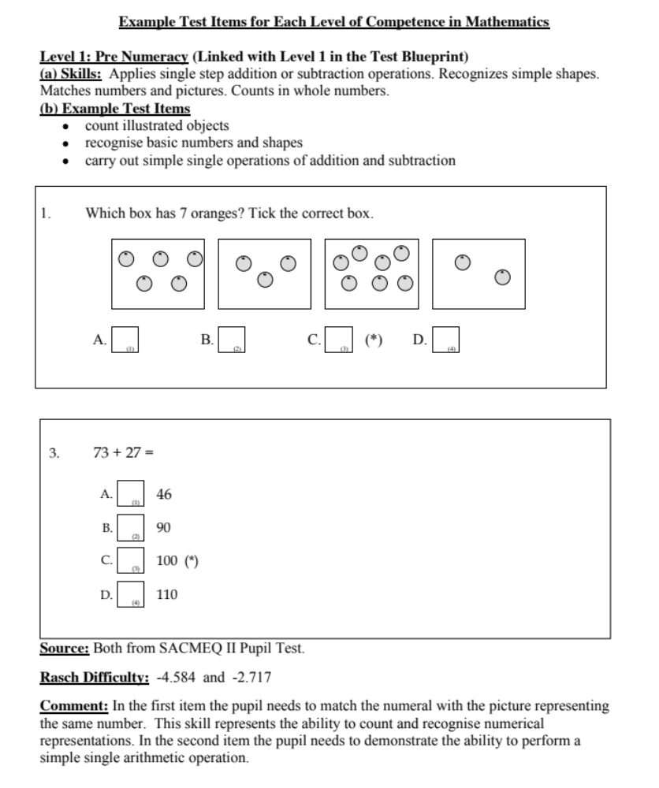
Numeracy
See Ross et al. (2005) Kenya Report

Slide 46
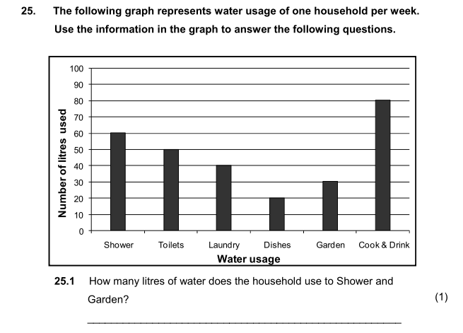
Grade 6 Numeracy
(V-ANA 2011)
Correct answer (90 litres): 32% of Gr 6 students
Verification ANA 2011 | Quintile
Gr6 Numeracy (Quest 25.1) | 1 | 2 | 3 | 4 | 5 | Total
Wrong | 74% | 75% | 70% | 68% | 50% | 68%
Right | 26% | 25% | 30% | 32% | 50% | 32%
Total | 100% | 100% | 100% | 100% | 100% | 100%
Notes:
If we interpret this using SACMEQ’s framework this is a relatively low level task (Level 4: Beginning Numeracy) which requires students to “Translate verbal or graphic information into simple arithmetic problems” See Hungi et al (2011)

Slide 47
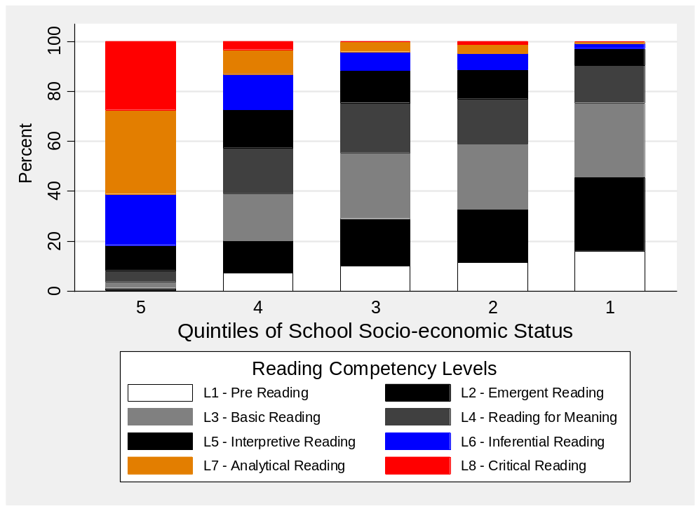
Student competency levels
What proportion of students are reaching higher order competency levels?

Slide 48
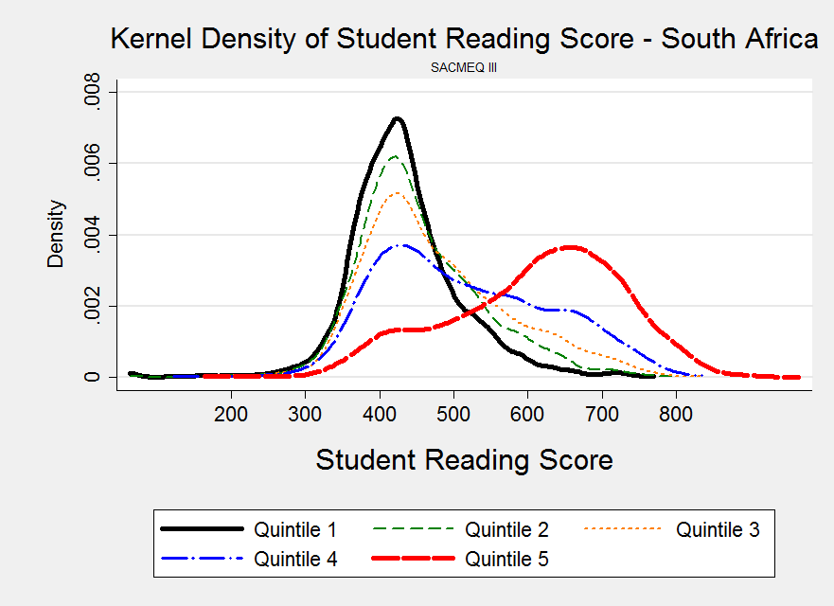
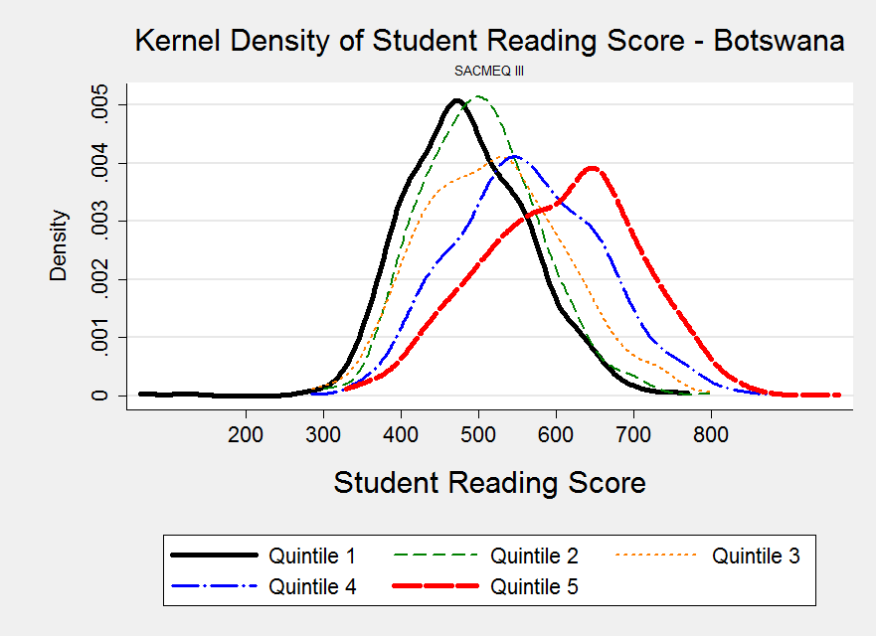
Comparing SA & Botswana
Source: Spaull, 2011
Notes:
Paper available at: http://www.sacmeq.org/downloads/Working%20Papers/08_Comparison_Final_18Oct2011.pdf

Slide 49
Two school systems not one
Ex-department
Grade 4 [2008]
Data: NSES
(Taylor, 2011)

Slide 50
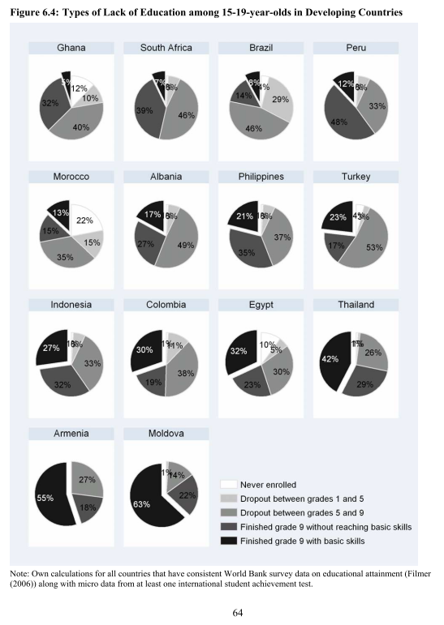
(Hanushek & Woessmann, 2008)
(Spaull & Taylor, 2012)

Slide 51
School system “success” - literacy

Slide 52
School system “success” - numeracy

Slide 53
2 education systems
Dysfunctional Schools (75% of schools) | Functional Schools (25% of schools)
Weak accountability | Strong accountability
Incompetent school management | Good school management
Lack of culture of learning, discipline and order | Culture of learning, discipline and order
Inadequate LTSM | Adequate LTSM
Weak teacher content knowledge | Adequate teacher content knowledge
High teacher absenteeism (1 month/yr) | Low teacher absenteeism (2 week/yr)
Slow curriculum coverage, little homework or testing | Covers the curriculum, weekly homework, frequent testing
High repetition & dropout (Gr10-12) | Low repetition & dropout (Gr10-12)
Extremely weak learning: most students fail standardised tests | Adequate learner performance (primary and matric)
See Hoadley (2010), Fleisch (2008), Van der Berg et al (2011), Taylor (2012) as a few of many

Slide 54
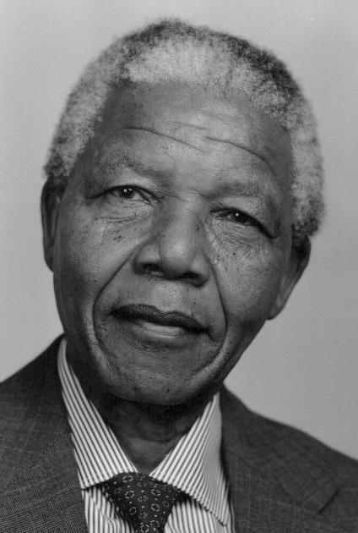
Education
“Education is the great engine of personal development. It is through education that the daughter of a peasant can become a doctor, that the son of a mineworker can become the head of the mine, that a child of farm-workers can become the president”
– Nelson Mandela
If we looked at 200 black Grade 1 children 12 years ago and then look at them again in matric, according to the 2007 results, only 1 out of the 200 were eligible for a maths or science degree based on their matric marks – the corresponding figure for white children was 15 times higher.

Slide 55

Teacher absenteeism
SACMEQ III (2007)
What is the distribution of teacher absenteeism across school SES quintiles?

Slide 56
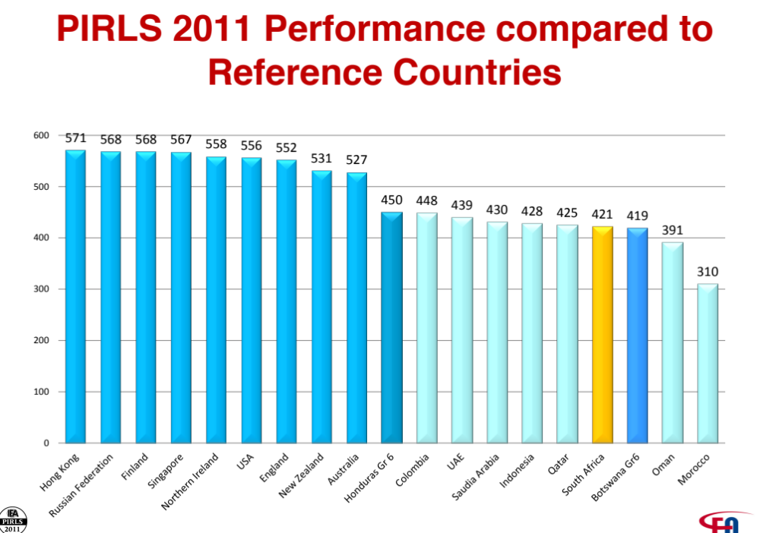
Only Eng/Afr Gr 5 home language (wealthier) schools participated in PIRLS 2011. (Other countries tested Gr4)

Slide 57
What does a dualistic school system look like in practice?

Slide 58
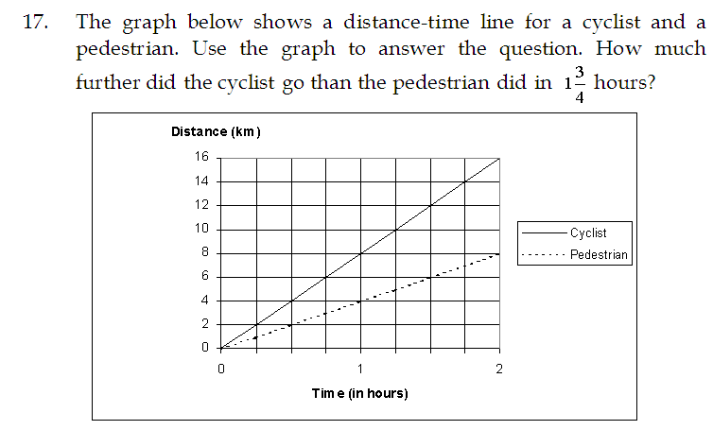
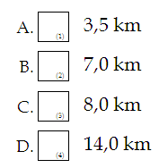

Teacher knowledge
SACMEQ III (2007) → 401/498 Gr6 Mathematics teachers
7
Correct answer (7km):
38% of Gr 6 Maths teachers
2 education systems
SACMEQ Maths teacher test Q17 | Quintile |  |  |  |  | Avg
 | 1 | 2 | 3 | 4 | 5
Correct | 23% | 22% | 38% | 40% | 74% | 38%
Notes:
See Ross et al (2005) for a discussion of the teacher test.

