Slide 1




Effective Enrolment
Creating a composite measure of educational access and educational quality to accurately describe education system performance in Sub-Saharan Africa
Nic Spaull & Stephen Taylor
UFS Economics Seminar
August 2013

Slide 2

Access & Quality
“Defining the scope of the problem of “lack of education” must begin with the objectives of education – which is to equip people with the range of competencies…necessary to lead productive and fulfilling lives fully integrated into their societies and communities. Many of the international goals are framed exclusively as targets for universal enrolments or universal completion. But getting and keeping children “in school” is merely a means to the more fundamental objectives of…. creating competencies and learning achievement” (Pritchett, 2004, p. 1).

Slide 3
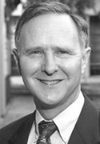

Access & Quality
“It is both conventional and convenient in policy discussions to concentrate on such things as years of school attainment or enrolment rates at schools. These things are readily observed and measured. They appear in administrative data, and they are published on a consistent basis in virtually all countries of the world. And they are very misleading in the policy debates. Cognitive skills are related, among other things, to both quantity and quality of schooling. But schooling that does not improve cognitive skills, measured here by comparable international tests of mathematics, science, and reading, has limited impact on aggregate economic outcomes and on economic development…We provide strong evidence that ignoring differences in cognitive skills significantly distorts the picture about the relationship between education and economic outcomes”
(Hanushek & Woessmann, 2008, p. 608).

Slide 4
Context of research
Universal Declaration of Human Rights (1948) – Article 26
  “Everyone has the right to education. Education shall be free, at least in the elementary and fundamental stages. Elementary education shall be compulsory.”
Education For All (EFA)
  Jomtien (Thailand), 1990
  Dakar (Senegal), 2000
    Goal 2 – Provide free and compulsory primary education for all
    Goal 6 – Improve the quality of education
Difficult to combine access and quality
  Monitoring reports and research groups usually focus on one or the other – i.e. EFA (access), SACMEQ/PASEC (quality)
  UNESCO NER’s unreliable in many instances
    Depend on two different data sources (population estimates and school census)
    NER’s very dependent on whether students are correctly aged or not (low NER due to late enrolment)
    (See Stukel & Feroz-Zada, 2010 of UIS)

Slide 5
Context of research (cont.)
Trade-off between access & quality
Fashionable to say: “We have made progress with access; now the challenge is quality.”
Crouch and Vinjevold (2006) argue that while most countries managed to improve both access and quality, the region of Southern Africa is unique in that many countries have over-emphasized “access at the expense of learning” (p. 8), thus creating an imbalance between access and quality and demonstrating that “the tension between access and quality is real” (p. 1).
Colclough, Kingdon and Patrinos (2009, p. 2) suggest that “in some African cases, the expansion of the primary system appears to have been accompanied by sharp declines in school quality, such that literacy and numeracy are no longer so readily delivered by the primary system.”
Zuze and Leibbrandt (2011), in view of the low quality of education observed in Uganda, suggest that the expansion should perhaps have been phased in more slowly so as to allow better planning and preparation.
Chimombo (2009, p. 309) argues that, “the impressive achievements made in improving access to school have to be balanced against issues of declining quality” and that the poor are most at risk of a consequently low quality education.
  All of these statements contributes to an almost unquestioned perception that there is a trade-off between access to education and the quality thereof.
  What causes a trade-off?
  Children of lower SES entering the system
  Resources are stretched due to more children
  In some countries (e.g. Kenya & Tanzania) expansion was driven partly by the abolishment of fees. This further limits resources available to schools.

Slide 6
Status quo
The extant literature on education in Africa is bifurcated in that reports either focus on:
  This is problematic for 2 reasons:
  Observing access to education without regard for the quality of that education clouds the analysis, primarily because labour-market prospects and social mobility are driven by cognitive skills acquired, not years of education attained, and
  Analysing the quality of education without taking cognizance of the enrolment and dropout profiles of the countries under review is likely to bias the results due to sample selection
Quality of education (SACMEQ/PASEC/ TIMSS/PIRLS)
Access to education (MDG/EFA/WB/IMF)
But not both
OR

Slide 7
Aim of the research
Provide a composite measure of educational system performance
    Combine measures of access and quality
    Data: SACMEQ III and DHS
Is there really an access-quality trade-off in SSA?
    Compare 13 SSA countries’ education systems in 2000 and 2007
    Data: SACMEQ II (2000) and SACMEQ III (2007)

Slide 8
Current research
Quality of education [SACMEQ]
Access to education [DHS]
Effective enrolment
Core assumptions:
Schooling that does not improve cognitive outcomes is of limited value.
  Simple enrolment rates overstate the success of education systems in Africa.
Children should have acquired basic numeracy and literacy skills by the end of grade 6.
Children who have either dropped out prior to grade 6 or never enrolled in the first place are functionally illiterate and functionally innumerate.

Slide 9

Background: Data
SACMEQ
  Southern and Eastern African Consortium for Monitoring Educational Quality
  14 participating countries
  SACMEQ II (2000), SACMEQ III (2007)
  Background survey
  Testing :
    Gr 6 Numeracy
    Gr 6 Literacy
    HIV/AIDS Health knowledge
SACMEQ III: South Africa
  9071 Grade 6 students
  1163 Grade 6 teachers
  392 primary schools
See SACMEQ website for research

Slide 10
Creating a composite measure of access and quality

Slide 11
Net Attendance Rates (NAR) as per Filmer/World Bank/DHS
Country | Year of DHS | Median Grade 6 age | NAR for Median age of SACMEQ grade 6 | Gender |  | Location |  | Wealth quintiles
 |  |  |  | Male | Female | Urban | Rural | Q1 | Q2 | Q3 | Q4 | Q5
Kenya | 2008/9 | 13.5 | 94.9 | 93.8 | 96.1 | 92.8 | 95.1 | 91.2 | 94.8 | 96.4 | 97.4 | 95.2
Lesotho | 2009 | 13.9 | 88.9 | 82.3 | 94.7 | 96.2 | 86.7 | 80.5 | 85.3 | 91.9 | 94.4 | 93.7
Malawi | 2010 | 14.0 | 85.7 | 88.8 | 82.4 | 91.5 | 84.9 | 75 | 79.5 | 90.3 | 89.8 | 93.1
Namibia | 2006-7 | 13.2 | 92.7 | 91.5 | 93.9 | 95.3 | 91.6 | 86.6 | 93.4 | 93 | 95.9 | 98.3
South Africa | GHS 2006 | 12.6 | 98.0 | 97.5 | 98.5 | 97.5 | 98.2 | 96.5 | 97.2 | 98.3 | 99.2 | 99.7
Swaziland | 2006/7 | 13.6 | 89.5 | 89.5 | 89.4 | 90.3 | 89.4 | 89.2 | 86.4 | 87.2 | 92.5 | 93.6
Tanzania | 2010 | 14.3 | 85.3 | 83.8 | 86.9 | 88.9 | 84.3 | 79.9 | 83 | 89.2 | 85.7 | 89
Uganda | 2006 | 14.0 | 89.1 | 90.5 | 87.6 | 87.1 | 89.3 | 77.8 | 90.6 | 89.6 | 95.9 | 89.2
Zambia | 2007 | 13.9 | 88.1 | 89.1 | 87.1 | 92.4 | 85.6 | 79.9 | 84.2 | 84.1 | 93.8 | 96.4
Zimbabwe | 2005/6 | 12.3 | 92.3 | 92.2 | 92.5 | 94.9 | 91.6 | 89.2 | 90.3 | 94.4 | 92.1 | 98

Slide 12
Functionally literate/numerate
SACMEQ
  If a student reaches Level 3 for Reading and Mathematics, they are classified as being functionally literate and functionally literate.
  If not, they are classified as functionally illiterate and functionally innumerate. By this definition, a functionally illiterate learner cannot read a short and simple text and extract meaning, while a functionally innumerate learner cannot translate graphical information into fractions or interpret everyday units of measurement.
  An important innovation in the paper is our assumption that grade-6 aged students that are not attending school (due to dropout or non-enrolment) are functionally illiterate and functionally innumerate….this allows us to combine access (binary) and quality (continuous) variables.
  See Shabalala, 2005: p222
Basic reading (L3)
Interprets meaning (by matching words and phrases, completing a sentence, or matching adjacent words) in a short and simple text by reading on or reading back.
Basic numeracy (L3)
Translates verbal information presented in a sentence, simple graph or table using one arithmetic operation in several repeated steps. Translates graphical information into fractions. Interprets place value in whole numbers up to thousands. Interprets simple common everyday units of measurement.

Slide 13

Combine access and quality
Assume those of grade 6 age that are not in school are illiterate and innumerate
“Correcting” for differential enrolment rates across countries and across sub-groups within a country

Slide 14
SA compared to Kenya

Slide 15
Functional literacy
& functional numeracy
6th
5th
Basic reading (L3)
Interprets meaning (by matching words and phrases, completing a sentence, or matching adjacent words) in a short and simple text by reading on or reading back.
Basic numeracy (L3)
Translates verbal information presented in a sentence, simple graph or table using one arithmetic operation in several repeated steps. Translates graphical information into fractions. Interprets place value in whole numbers up to thousands. Interprets simple common everyday units of measurement.

Slide 16
League tables
 | Literate rankings (pre-correction)
Rank | Ranking overall | Urban ranking | Rural ranking | Q1 ranking | Q5ranking
1 | SWA | SWA | SWA | SWA | SWA
2 | TAN | TAN | TAN | TAN | TAN
3 | KEN | ZIM | KEN | KEN | KEN
4 | NAM | KEN | NAM | NAM | NAM
5 | ZIM | NAM | ZIM | ZIM | SOU
6 | UGA | UGA | UGA | LES | ZIM
7 | LES | SOU | LES | UGA | UGA
8 | SOU | LES | MAL | MAL | LES
9 | MAL | MAL | SOU | SOU | MAL
10 | ZAM | ZAM | ZAM | ZAM | ZAM
 | Literate rankings (post-correction)
Rank | Overall ranking | Urban ranking | Rural ranking | Q1 ranking | Q5 ranking
1 | SWA | ZIM | SWA | SWA | SWA
2 | KEN | SWA | KEN | KEN | SOU
3 | TAN | NAM | TAN | TAN | NAM
4 | NAM | KEN | NAM | ZIM | KEN
5 | ZIM | TAN | ZIM | NAM | TAN
6 | SOU | SOU | UGA | LES | ZIM
7 | UGA | LES | LES | UGA | LES
8 | LES | UGA | SOU | SOU | UGA
9 | MAL | MAL | MAL | MAL | MAL
10 | ZAM | ZAM | ZAM | ZAM | ZAM

Slide 17
Differential access by subgroups
Different enrolment & achievement profiles for different sub-groups of the national population (averages shroud inequalities)
  Urban vs Rural (multiply enrolment and literacy rates)
  Boys vs Girls (multiply enrolment and literacy rates)
  Wealthy vs Poor (CANNOT simply multiply enrolment and literacy rates)

Slide 18
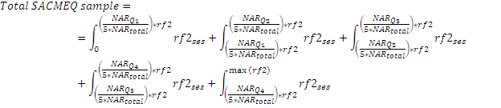
Correcting for differential access by quintile
Functionally illiterate
21% of SACMEQ students come from quintile 5
19% of SACMEQ students come from quintile 1
 | NAR by quintile | Quintile | from DHS | As proportion | F-Lit (SACMEQ)
Q1 | 79.9 | 20 | 16.0 | 18.7 | 94%
Q2 | 83 | 20 | 16.6 | 19.4 | 95%
Q3 | 89.2 | 20 | 17.8 | 20.9 | 97%
Q4 | 85.7 | 20 | 17.1 | 20.1 | 99%
Q5 | 89 | 20 | 17.8 | 20.9 | 98%

Slide 19
Change in proportion literate/numerate post NAR correction
Country | Median Grade 6 age | Gender |  | Location |  | Wealth quintiles
 |  | Male | Female | Urban | Rural | Q1 | Q2 | Q3 | Q4 | Q5
Kenya | -5.1 | -6.2 | -3.9 | -7.2 | -4.9 | -8.9 | -5.2 | -3.9 | -2.8 | -4.8
Lesotho | -11.1 | -17.7 | -5.3 | -3.8 | -13.3 | -19.7 | -14.2 | -8.7 | -4.9 | -5.9
Malawi | -14.3 | -11.2 | -17.6 | -8.5 | -15.1 | -25.0 | -22.3 | -7.1 | -11.3 | -7.6
Namibia | -7.3 | -8.5 | -6.1 | -4.7 | -8.4 | -13.3 | -7.7 | -8.5 | -4.7 | -1.9
South Africa | -2 | -2.5 | -1.5 | -2.5 | -1.8 | -3.7 | -4.7 | -2.0 | -2.5 | -0.9
Swaziland | -10.5 | -10.5 | -10.6 | -9.7 | -10.6 | -10.8 | -13.6 | -12.8 | -7.5 | -6.4
Tanzania | -14.7 | -16.2 | -13.1 | -11.1 | -15.7 | -20.3 | -16.3 | -11.6 | -14.4 | -10.9
Uganda | -10.9 | -9.5 | -12.4 | -12.9 | -10.7 | -21.0 | -11.7 | -10.8 | -3.5 | -11.1
Zambia | -11.9 | -10.9 | -12.9 | -7.6 | -14.4 | -20.3 | -18.2 | -16.7 | -3.8 | -6.3
Zimbabwe | -7.7 | -7.8 | -7.5 | -5.1 | -8.4 | -11.3 | -9.2 | -5.6 | -7.5 | -3.1

Slide 20
Literacy gaps by gender, location & wealth
Does gender deserve the priority it gets when location and wealth gaps are MUCH larger for these ten countries?

Slide 21
Numeracy gaps by gender, location & wealth
Does gender deserve the priority it gets when location and wealth gaps are MUCH larger for these ten countries?

Slide 22
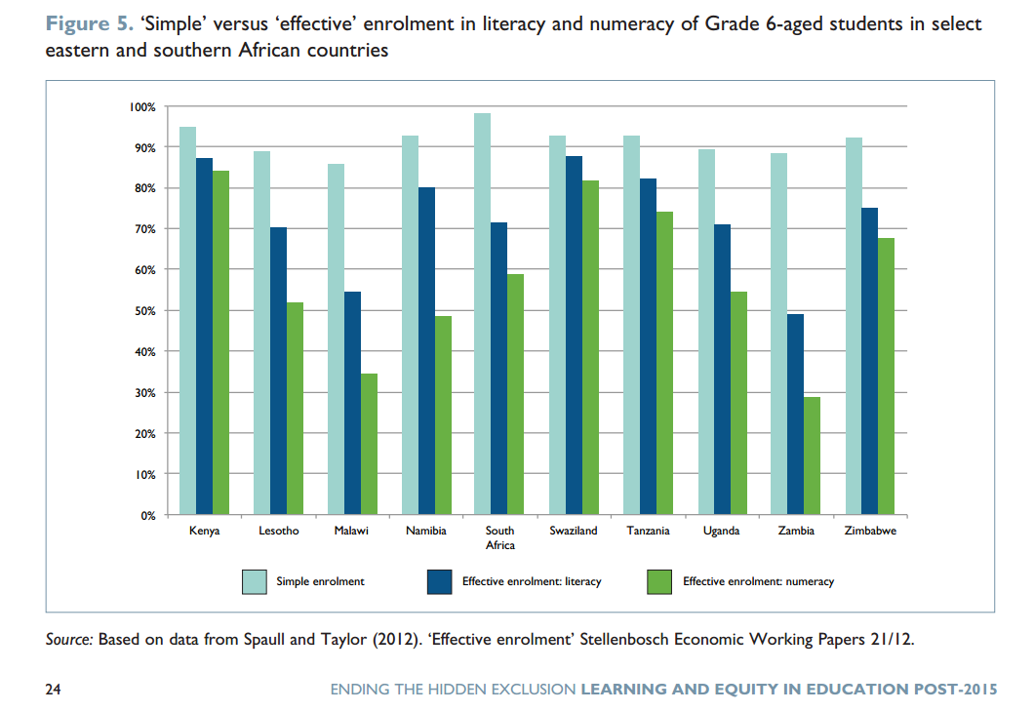
Policy impact – post 2015 MDGs?
(Save the Children, 2013)
Notes:
http://www.savethechildren.net/sites/default/files/libraries/Ending_the_hidden_exclusion_full_report.pdf

Slide 23
Is there a trade-off between access & basic quality?

Slide 24
A trade-off between access & quality?
The numbers of grade 6 children reaching each level of achievement: Mozambique reading
Population growth (2000-2007) 20.6%.
Notes:
RF2 is used to estimate the population figures.
The rf2 factor is based on the inverse of the probability of selection of the sample members and makes the total weighted number of students equal to the ESTIMATED population size.
The calculation of rf2 includes taking account of the actual numbers of Grade 6 pupils in a school at the time of the actual data collection (as well as the number from the school census). It also includes attempts at adjustments for missing data due to non-response.
The main message is that rf2 is a mixture of school census and sample data and adjustments for non-response. You should therefore treat it as a sampling weight that provides estimates of the population figures. Estimates using rf2 as a sample weight will have sampling errors and confidence limits (just as estimates using pweight2 have sampling errors and confidence limits). These can be estimated via the complex sampling options in STATA
Distribution of this graph will influence whether there was an increase in the average SACMEQ score or a decrease

Slide 25
A trade-off between access & quality?
The numbers of grade 6 children reaching each level of achievement: Tanzania maths
Population growth (2000-2007) 16.8%.

Slide 26
A trade-off between access & quality?
TAULL ratios:
The number functionally literate (numerate) in 2007:
The number functionally literate (numerate) in 2000

Slide 27
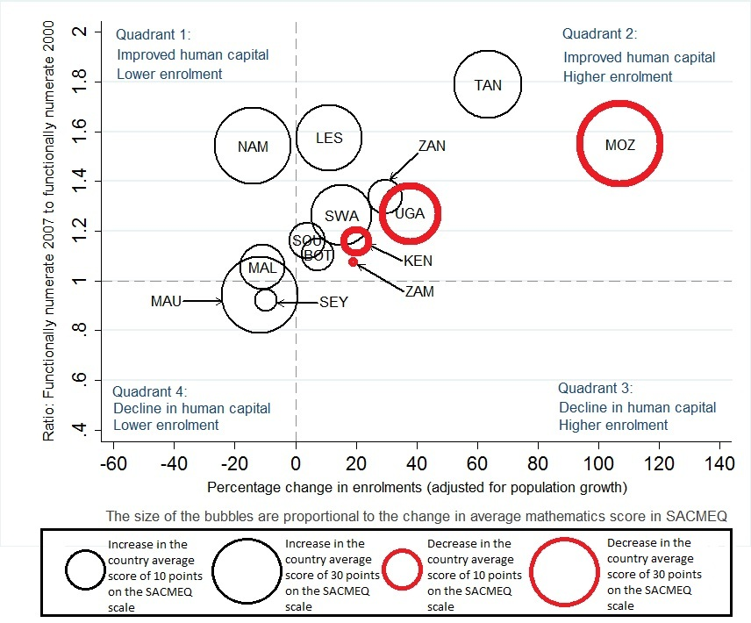
A trade-off between access & quality?
The TAULL story:
Putting everything together

Slide 28
Concluding discussion
Our method of combining access (NAR) and quality (literacy/numeracy) is the most accurate, reliable and well-rounded measure of overall educational performance in SSA (as far as we are aware).
  The main innovation is the assumption that grade-6 aged students that are not attending school (dropout or non-enrolment) are functionally illiterate and functionally innumerate, allowing us to combine binary and continuous measures.
  Although it is uncomplicated it has not been done before for SSA
  Using DHS for cross-country comparisons of attendance rates is methodologically more sound than UNESCO’s NER
The case for a trade-off between access and quality (as measured by outcomes) has been overstated, at least for most countries included here. Countries can and have managed to increase both access to education, and the quality thereof.
  Resources are often stretched → however, limited impact on performance – able to do more with less per pupil.
  Only one country could not keep up with population growth: Malawi

Slide 29
Papers
Full papers available on Stellenbosch Economics Website (WP Series):
  “Effective enrolment” - Creating a composite measure of educational access and educational quality to accurately describe education system performance in sub-Saharan Africa http://www.ekon.sun.ac.za/wpapers/2012/wp212012
  The effects of rapidly expanding primary school access on effective learning: The case of Southern and Eastern Africa since 2000 http://www.ekon.sun.ac.za/wpapers/2013/wp012013

Slide 30
Comments, suggestions & questions welcome

Slide 31
References
Filmer, D. (2010). Educational Attainment and Enrollment around the World. The World Bank. econ.worldbank.org/projects/edattain: Development Research Group.
Filmer, D., & Pritchett, T. (1999). The Effect of Household Wealth on Educational Attainment: Evidence from 35 Countries. Population and Development Review, 25(1), 85-120.
Hanushek, E., & Woessmann, L. (2008). The Role of Cognitive Skills in Economic Development. Journal of Economic Literature, 46(3), 607-668.
Hungi, N. (2010). What are the levels and trends in grade repetition? www.sacmeq.org: Southern and East African Consortium for Monitoring Educational Quality .
Hungi, N., Makuwa, D., Ross, K., Saito, M., Dolata, S., van Capelle, F., et al. (2010). SACMEQ III Project Results: Pupil Achievement Levels in Reading and Mathematics. Paris: Southern and Eastern Africa Consortium for Monitoring Educational Quality.
Lambin, R. (1995). "What can Planners Expect from International Quantitative Studies?" Reflections on Educational Achievement: Papers in Honour of T. Neville Postlethwaite. Waxmann Verlag.
Lewin, K. (2007). Improving Access, Equity and Transitions in Education: Creating a Research Agenda. Co. Sussex: Consortium for research on Educational Access, Transitions and Equity (CREATE).
Lewin, K. (2009). Access to education in sub-Saharan Africa: patterns, problems and possibilities. Comparative Education, 45(2).
Pritchett, L. Towards a New Consensus for Addressing the Global Challenge of the Lack of Education. Copenhagen: Copenhagen Consensus, 2004.
Ross, K., Saito, M., Dolata, S., Ikeda, M., Zuze, L., Murimba, S., et al. (2005). The Conduct of the SACMEQ II Project. In E. Onsomu, J. Nzomo, & C. Obiero, The SACMEQ II Project in Kenya: A Study of the Conditions of Schooling and the Quality of Education. Harare: SACMEQ.
SACMEQ. (2010). SACMEQ III Project Results: Pupil Achievement Levels in Reading and Mathematics. Retrieved January 2011, from Southern and Eastern Africa Consortium for Monitoring Educational Quality: http://www.sacmeq.org/downloads/sacmeqIII/WD01_SACMEQ_III_Results_Pupil_Achievement.pdf
Sen, A. (1999). Development as Freedom. Oxford: Oxford University Press
UIS. (2009). Global Education Digest 2009: Comparing Education Statistics Across the World. Montreal: UNESCO Institute for Statistics.
UNESCO. (2005). Education For All Global Monitoring Report 2005. Paris: UNESCO Publishing.

Slide 32
Potential objections…

Slide 33
Sense-check
Table 3: Grade survival rate [Data: World Bank survey data, Filmer (2010)]
What about literate pre-Grade 6 dropout?
Perhaps children from SWA / TAN / KEN (where literacy rates in Gr6 are high) will be literate even though they dropout in Gr5?
% children who survive to grade 5 but not grade six is never > 5%
School system has still “failed” these children
 | Gr 1 | Gr 2 | Gr 3 | Gr 4 | Gr 5 | Gr 6 | Gr 7 | Gr 8 | Gr 9
Tanzania | 91% | 90% | 89% | 88% | 85% | 84% | 82% | 55% | 55%
Malawi | 94% | 92% | 90% | 86% | 83% | 79% | 74% | 69% | 61%
Zambia | 95% | 95% | 93% | 92% | 89% | 87% | 84% | 75% | 71%
Kenya | 96% | 96% | 96% | 95% | 94% | 93% | 91% | 88% | 76%
Uganda | 96% | 95% | 94% | 91% | 88% | 82% | 74% | 59% | 56%
Namibia | 96% | 96% | 95% | 94% | 93% | 91% | 90% | 86% | 83%
Swaziland | 97% | 96% | 95% | 94% | 92% | 90% | 85% | 79% | 74%
Lesotho | 97% | 97% | 96% | 94% | 91% | 89% | 84% | 72% | 68%
Zimbabwe | 99% | 99% | 98% | 97% | 96% | 94% | 91% | 74% | 69%
South Africa | 99% | 99% | 99% | 99% | 98% | 98% | 96% | 94% | 91%

Slide 34
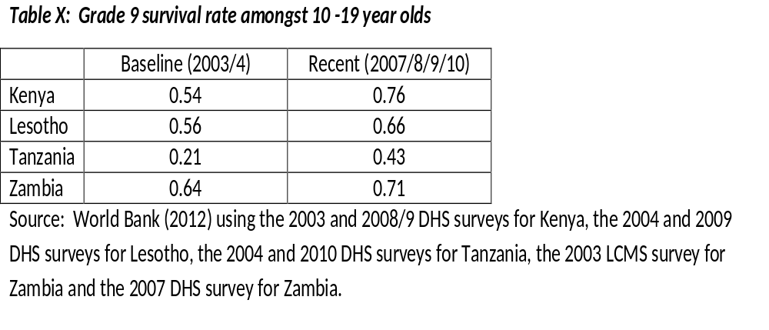
Persistence of benefits?

Slide 35
Geographical differences
6th
8th

Slide 36
Wealth differences

Slide 37
Wealth differences

Slide 38
High level skills
Inferential reading (L6)
Reads on and reads back through longer texts (narrative, document or expository) in order to combine information from various parts of the text so as to infer the writer’s purpose.
Mathematically skilled (L6)
Solves multiple-operation problems (using the correct order of arithmetic operations) involving fractions, ratios, and decimals. Translates verbal and graphic representation information into symbolic, algebraic, and equation form in order to solve a given mathematical problem. Checks and estimates answers using external knowledge (not provided within the problem).

Slide 39
High level skills
Analytical reading (L7)
Locates information in longer texts (narrative, document or expository) by reading on and reading back in order to combine information from various parts of the text so as to infer the writer’s personal beliefs (value systems, prejudices, and/or biases).
Concrete Problem solving (L7)
Extracts and converts (for example, with respect to measurement units) information from tables, charts, visual and symbolic presentations in order to identify, and then solves multi-step problems.

Slide 40
Funding
6th
5th

Slide 41
Is there a trade-off between access & quality?

Slide 42
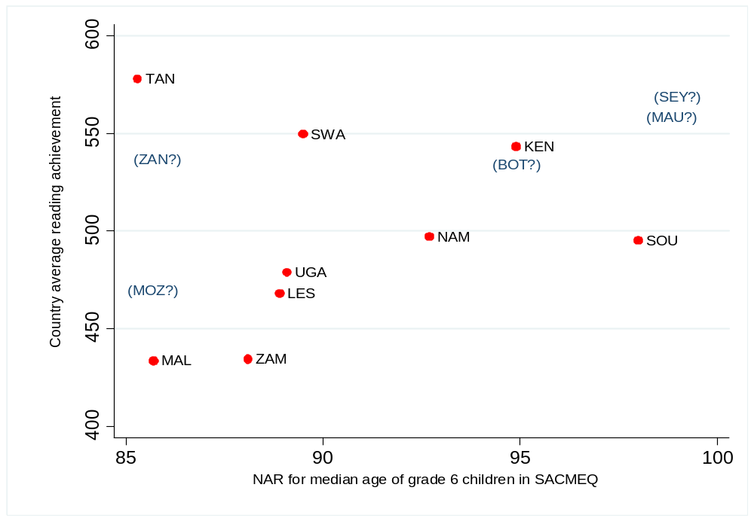
A trade-off between access & quality?
SACMEQ achievement vs. Net Attendance Rates
Notes:
This is a static picture: SACMEQ 2007 and estimates of NAR from nearest DHS (as described earlier).
The countries in brackets are very rough ballpark estimates based on general knowledge and stuff like Primary School GERs from UNESCO.
It’s worth including them to show that the trend is upward sloping. But the relationship is to some extent simply a by-product of the country’s level of development.

Slide 43
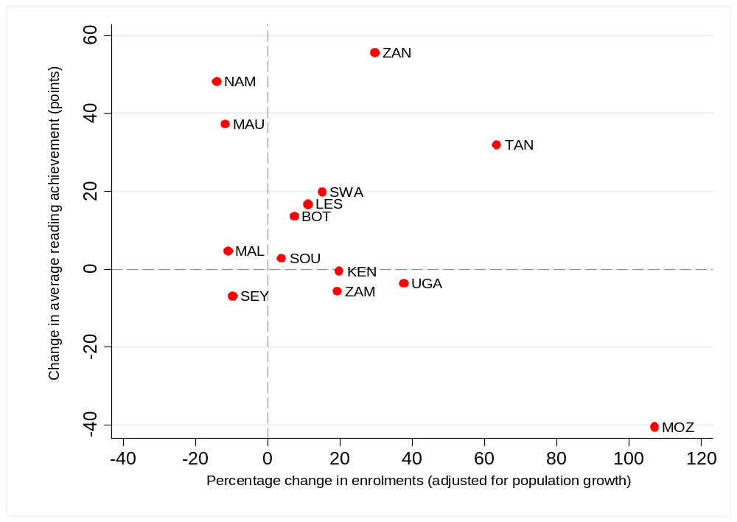
A trade-off between access & quality?
Change in SACMEQ achievement vs. Change in grade 6 enrolments
Notes:
This is a dynamic analysis. The enrolment change here is estimated from rf2.
The number of grade 6 children according to rf2 for SACMEQ 2007 was deflated based on the population growth rate between 2000 and 2007 amongst 10-14 year-olds in these countries. I.e. A percentage change in enrolments of zero may have involved an increase in the number of grade 6 children but only to the exact same extent as the age-specific population grew.
Population data taken from United Nations, medium variant estimates. http://esa.un.org/unpd/wpp/unpp/panel_population.htm
The point here: For SWA, LES, ZAN & TAN there appears to be no trade-off. But for KEN, ZAM, UGA & especially MOZ one might be tempted to conclude from this figure that there was a trade-off.... So, was there really a trade-off in these countries?

Slide 44
A trade-off between access & quality?
The numbers of grade 6 children reaching each level of achievement: Kenya reading
Population growth (2000-2007) 6.3%.

Slide 45
A trade-off between access & quality?
The numbers of grade 6 children reaching each level of achievement: Uganda maths
Population growth (2000-2007) 25.6%.

Slide 46
A trade-off between access & quality?
The numbers of grade 6 children reaching each level of achievement: Malawi reading
Population growth (2000-2007) 26.8%.
Notes:
Malawi is kind of the opposite scenario: It did slightly worse in 2007 (although one shouldn’t over-read into it) despite having a higher SACMEQ average score. So the drop in the numbers reaching every level was due to lower enrolment.

Slide 47
A trade-off between access & quality?
The TAULL story:
Putting everything together
Country | Average maths teacher score |  | Proportion of children who have their own reading textbook or shared with only one other |  | Leaners per permanent classroom |  | Pupil-teacher ratio (zsptrati) |  | Total school enrolment
 | SACMEQ 3 | % inc from S2 | SACMEQ 3 | % inc from S2 | SACMEQ 3 | % inc from S2 | SACMEQ 3 | % inc from S2 | SACMEQ 3 | % inc from S2
KEN | 906.1 | -6.1% | 39% | -21.9% | 63.5 | 33.9% | 42.9 | 27.0% | 665.7 | 29.2%
MOZ | 745.6 | -4.8% | 67% | -8.8% | 190.0 | 20.2% | 58.0 | 13.0% | 1801.8 | 14.3%
TAN | 825.8 | 4.0% | 13% | -17.0% | 100.2 | 4.0% | 62.9 | 33.6% | 796.4 | 13.7%
UGA | 833.3 | 1.3% | 32% | 20.2% | 114.1 | -14.0% | 55.7 | -4.0% | 782.0 | 4.9%

Slide 48
Concluding discussion
Our method of combining access (NAR) and quality (literacy/numeracy) is the most accurate, reliable and well-rounded measure of overall educational performance in SSA (as far as we are aware).
  The main innovation is the assumption that grade-6 aged students that are not attending school (dropout or non-enrolment) are functionally illiterate and functionally innumerate, allowing us to combine binary and continuous measures.
  Although it is uncomplicated it has not been done before for SSA
  Using DHS for cross-country comparisons of attendance rates is methodologically more sound than UNESCO’s NER
The case for a trade-off between access and quality (as measured by outcomes) has been overstated, at least for most countries included here. Countries can and have managed to increase both access to education, and the quality thereof.
  Resources are often stretched → however, limited impact on performance – able to do more with less per pupil.
  Only one country could not keep up with population growth: Malawi

Slide 49
Further research
Does increased access to primary school lead to increase access to secondary and tertiary education?
  Somerset (2007) argues that the abolition of school fees in Kenya in 1974 led to a massive increase in grade 1 enrolments accompanied by a huge increase in drop-out thereafter.
  Our preliminary analysis suggests that the big expanders in SACMEQ also improved wrt survival to grade 9 and enrolment amongst 16 year-olds (using consecutive DHS’s)
  However, bottlenecks can mean that expanded access can have the perverse impact of SES becoming a more important determinant of access to higher levels of education. (Lewin, 2007)

Slide 50
Geographical differences
5th
7th

