Slide 1




Matric 2013: In Retrospect
Overview and selected highlights of Matric 2013
www.NicSpaull.com/research
UJ – Kagiso Trust Education Conversation 19 Feb 2014

Slide 2

Matric results 2013
Conceptual overview of SA education system
Matric 2013 – the good, the bad and the ugly
Focus on mathematics
Focus on dropout
Focus on higher education
Conclusion

Slide 3
Labour Market
17%
Unemployed
(Broad - 33%)
Unskilled
(19%)
Semi-Skilled (31%)
University/FET
Type of institution (FET or University)
Quality of institution
Type of qualification (diploma, degree etc.)
Field of study (Engineering, Arts etc.)
High productivity jobs and incomes (17%)
Mainly professional, managerial & skilled jobs
Requires graduates, good quality matric or good vocational skills
Historically mainly white
High quality secondaryschool
High SES background
+ECD
High quality primary school
Minority (20%)
Some motivated, lucky or talented students make the transition
Unequal society
Big demand for good schools despite fees
Some scholarships/bursaries
Vocational training
Affirmative action
Majority (80%)
Quality
Low quality secondary
school
Attainment
Type
Low productivity jobs & incomes
Often manual or low skill jobs
Limited or low quality education
Minimum wage can exceed productivity
Low SES background
Low quality primary school
cf. Servaas van der Berg – QLFS 2011
Notes:
The QLFS classifies professions as follows: Highly skilled (legislators, senior officials and managers, professionals, technicians and associate profesionals); Semi-skilled (Clerks, service workers and shop and market personnel, skilled agricultural and fishery workers, craft and related trade workers, plant and machinery operators and assembly), Unskilled (Elementary occupations, domestic workers).

Slide 4
Qualifications by age (birth cohort), 2011 (Van der Berg, 2013)

Slide 5
Basic overview of matric 2013
The good…
Matric pass rate increased to 78%
Bachelor pass rate increased to 31%
More students passing mathematics
The bad…
Some questioning quality of matric pass
Public starting to ask questions about why uni’s are using NBTs
Concerns over “culling” and whether this lead to increases in NWP and FST
The ugly…
Grade 8→12 dropout is 2x as high (50%) in Q1 rel to Q5 (25%)
A white child is 7 times more likely than a black child to obtain a Maths D+ and 38 times as likely to get an A- aggregate (using earlier matric data)

Slide 6
Focus on mathematics – things are improving
Number of students taking mathematics (as opposed to maths-lit) has declined since 2008, but proportion passing has risen
  Not necessarily a bad thing since many of those students shouldn’t have been taking mathematics in the first place
Source: Taylor (2014)

Slide 7
What proportion of matrics take and pass mathematics?
Important statistic is the number passing which was declining from 2008 → 2011 but has increased between 2011 → 2013
Source: Taylor (2014)

Slide 8
Matric mathematics statistics (Taylor 2014)
 | Numbers wrote maths | Number passed maths | Maths pass rate | Proportion taking maths | Proportion passing maths
2008 | 298821 | 136503 | 45.70% | 56.10% | 25.60%
2009 | 290407 | 133505 | 46.00% | 52.60% | 24.20%
2010 | 263034 | 124749 | 47.40% | 48.80% | 23.20%
2011 | 224635 | 104033 | 46.30% | 45.30% | 21.00%
2012 | 225874 | 121970 | 54.00% | 44.19% | 23.86%
2013 | 241509 | 142666 | 59.10% | 42.96% | 25.38%
Source: Taylor (2014)
NOTE: All of the above is under the proviso that that quality of the mathematics exam has remained constant over the period. If not then we can’t say much.

Slide 9
Focus on dropout

Slide 10
550,000 students drop out before matric
99% do not get a non-matric qualification (Gustafsson, 2011: p11)
What happens to them? 50% youth unemployment.

Slide 11
Proportion of a cohort of students that do not survive to grade 12, fail matric, pass matric, and pass matric with a Bachelor's pass in each province in 2011

Slide 12
Dropout between Gr8 and Gr12
Of 100 Gr8 quintile 1 students in 2009, 36 passed matric and 10 qualified for university
Of 100 Gr8 quintile 5 students in 2009, 68 passed matric and 39 qualified for university
“Contrary to what some would like the nation and the public to believe that our results hide inequalities, the facts and evidence show that the two top provinces (Free State and North West) are rural and poor.” (Motshekga, 2014)

Slide 13


Slide 14
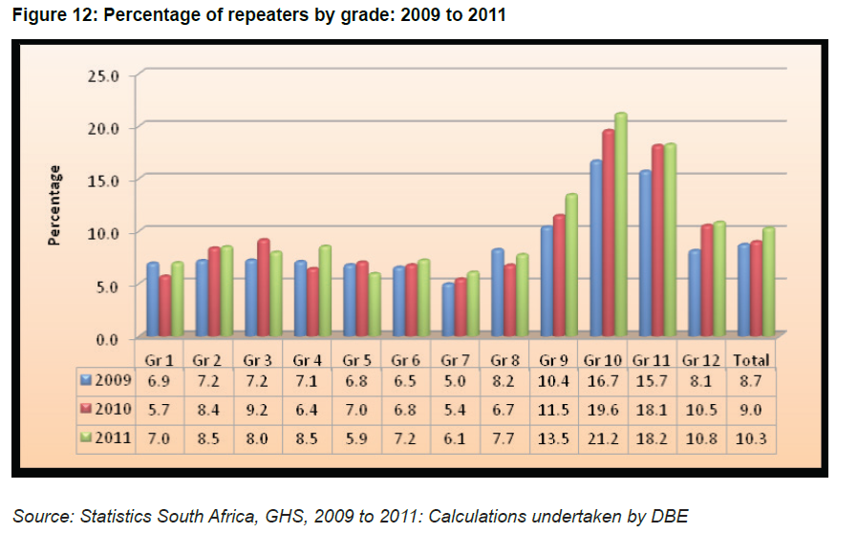
When does grade repetition happen?

Slide 15
Focus on higher education

Slide 16
Are matriculants prepared for higher education?
"It is widely accepted that student underpreparedness is the dominant learning-related cause of the poor performance patterns in higher education. It follows that it is the school sector that is most commonly held responsible. However, if higher education is to rely on improvement in schooling to deal with the systemic faults affecting it, there needs to be a rigorous assessment of the prospects of sufficient improvement being achieved within that sector. While the Task Team believes that the level of dysfunction in schooling must continue to be a primary focus of corrective effort, it has concluded that the overwhelming weight of evidence from current analyses of the school sector is that there is effectively no prospect that it will be able, in the foreseeable future, to produce the numbers of well-prepared matriculants that higher education requires.“
CHE (2013) ”Proposal for undergraduate curriculum reform” http://www.che.ac.za/announcements/task-team-report-extended-curriculum-released
Why are universities using the National Benchmarking Tests (NBTs) now when they didn’t use them 10 years ago? Why for admission?
  Presumably these tests are better able to distinguish between students that will and won’t be able to succeed at university

Slide 17

Higher education in perspective
When speaking about higher education it’s important to remember that this is only a very small proportion of the population
Source: DBE (2013) Internal Efficiency of the schooling System

Slide 18

Gustafsson, 2011 – When & how WP
“What do the magnitudes from Figure 4 mean in terms of the holding of qualifications? In particular, what widely recognised qualifications do the 60% of youths who do not obtain a Matric hold? …Only around 1% of youths hold no Matric but do hold some other non-school certificate or diploma issued by, for instance, an FET college”
(Gustafsson, 2011: p.11)
10%

Slide 19

How does SA fair internationally?
Gustafsson (2011) “The when and how of leaving school”

Slide 20
Dropout and weak performance in matric is essentially a function of low-quality of education in earlier grades and accumulated learning deficits

Slide 21
Insurmountable learning deficits: 0.3 SD

Slide 22

NSES question 42
NSES followed about 15000 students (266 schools) and tested them in Grade 3 (2007), Grade 4 (2008) and Grade 5 (2009).
Grade 3 maths curriculum: “Can perform calculations using appropriate symbols to solve problems involving: division of at least 2-digit by 1-digit numbers”
At the end of Grade 5 most (55%+) quintile 1-4 students cannot answer this simple Grade-3-level problem.
Notes:
Taylor, N., & Reddi, B. (2013). Writing and learning mathematics. In N. Taylor, S. Van der Berg, & T. Mabogoane, Creating Effective Schools. Cape Town: Pearson.

Slide 23
Take home points…
What does it mean to the economy?
  Low quality of education continues to condemn majority of black children to an underclass where poverty & unempl. are the norm
What should we continue doing and what should we change?
  Continue with ANAs and workbooks (keep CAPS, obviously)
  Draw public attention to primary schooling (root of the problem)
  More public acknowledgement of dropout. Measure throughput not just pass rates
  Aim should NOT be for 100% of students to reach and pass matric. Need for an effective vocational system (something we don’t have)
What does the certificate mean to matriculants/higher-ed?
  Matric is a necessary but not sufficient condition for employment (increasingly insufficient). What is the purpose of matric?
Are we moving in the right direction?
  Yes-ish. Need a better commitment to SUBSTANCE not just FORM
  Too much focus on “illustrating improvement” as opposed to actually getting down to it. ANAs a good example – really useful & imp but absolutely (unequivocally) cannot be used to show changes over time yet this is what the DBE is doing

Slide 24
Further reading
DBE (2013) The internal efficiency of the school system: Report on selected aspects of access to education, grade repetition and learner performance. Available: http://www.education.gov.za/LinkClick.aspx?fileticket=Jaaol0vqeR4%3d&tabid=36
Gustafsson, M. (2013) The when and how of leaving school: The policy implications of new evidence on secondary schooling in South Africa. Stellenbosch Economic Working Papers 09/11. Available: http://www.ekon.sun.ac.za/wpapers/2011/wp092011

Slide 25
Thank you
Presentation available at www.nicspaull.com/research

Slide 26
Figure 13: Matric pass rates as a percentage of Grade 2 enrolments 10 years earlier for selected provinces – see Taylor (2012: p. 9)

Slide 27
Important distinctions
Improved student outcomes
Increased resources “on-the-ground”
Increased allocation of resources
Often these 3 are spoken about interchangeably

Slide 28

Notes:
From a forthcoming report on accountability on the

Slide 33


Slide 34
“Only when schools have both the incentive to respond to an accountability system as well as the capacity to do so will there be an improvement in student outcomes.” (p22)

Slide 35

Conclusion
Ensuring that public funding is actually pro-poor and also that it actually reaches the poor.
Understanding whether the motivation is for human dignity reasons or improving learning outcomes.
Ensuring that additional resources are allocated based on evidence rather than anecdote.
The need for BOTH accountability AND capacity.

Slide 36
Binding constraints approach

Slide 37


Slide 40
“The left hand barrel has horizontal wooden slabs, while the right hand side barrel has vertical slabs. The volume in the first barrel depends on the sum of the width of all slabs. Increasing the width of any slab will increase the volume of the barrel. So a strategy on improving anything you can, when you can, while you can, would be effective. The volume in the second barrel is determined by the length of the shortest slab. Two implications of the second barrel are that the impact of a change in a slab on the volume of the barrel depends on whether it is the binding constraint or not. If not, the impact is zero. If it is the binding constraint, the impact will depend on the distance between the shortest slab and the next shortest slab” (Hausmann, Klinger, & Wagner, 2008, p. 17).
Notes:
Hausmann, R., Klinger, G., & Wagner, R. (2008). Doing Growth Diagnostics in Practice: A 'Mindbook'. CID Workinf Paper No. 177. Center for International Development at Harvard University.

Slide 41
Basic Literacy and Numeracy (Gr 6)
What proportion of South African grade 6 children were functionally literate and functionally numerate?
Functionally illiterate: a functionally illiterate learner cannot read a short and simple text and extract meaning.
Functionally innumerate: a functionally innumerate learner cannot translate graphical information into fractions or interpret everyday units of measurement.

Slide 42

SACMEQ III (Spaull & Taylor, 2012)
Literacy
Numeracy

Slide 43


SA primary school: Gr6 Literacy –
SACMEQ III (2007)
Never enrolled
2%
Functionally illiterate
25%
Basic skills
46%
Higher order skills : 27%
Forthcoming paper with Stephen Taylor
Notes:
Technically it is never enrolled or dropped out before grade 6 (using DHS data)

Slide 44
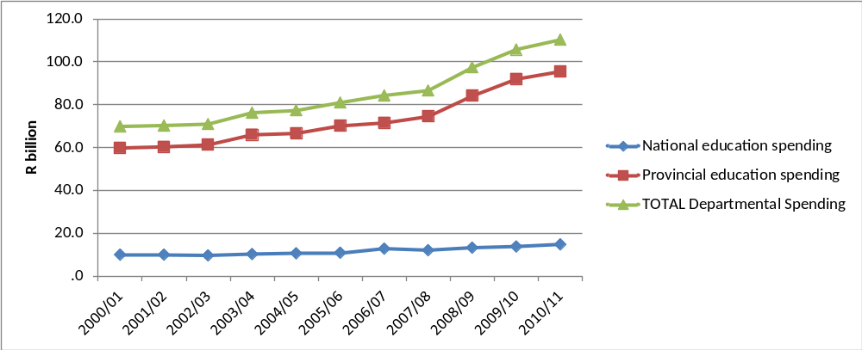
Spending
Spending by education departments, real (2005) Rand
2000/01 to 2010/11
← OSD
(Oxford Policy Management & Stellenbosch Economics, 2012)
Notes:
In the decade since 2000, public education spending increased significantly in real terms with real provincial expenditure on education rising by 60% between 2000/01 and 2010/11. The rapid growth in expenditure from 2007 is largely due to the Occupation Specific Dispensation (OSD) for educators which raised teacher salaries significantly.

Slide 45

Grade 6 Literacy
SA Gr 6 Literacy
Kenya Gr 6 Literacy
1%
5%
7%
25%
49%
46%
39%
Public current expenditure per pupil: $1225
Additional resources is not the answer
Public current expenditure per pupil: $258
27%
Notes:
Technically it is never enrolled or dropped out before grade 6 (using DHS data) – see Taylor and Spaull (Forthcoming)

Slide 46
Accountability: teacher absenteeism
(SACMEQ III – 2007 – 996 teachers)
4th/15
Notes:
Absenteeism here is average between both maths and reading teachers

Slide 47
Accountability: teacher absenteeism
(SACMEQ III – 2007 – 996 teachers)
15th/15
Notes:
Absenteeism here is average between both maths and reading teachers

Slide 48


Benefits of education
Ed
S
H
Ec
Improved human rights
Empowerment of women
Reduced societal violence
Promotion of a national (as opposed to regional or ethnic) identity
Increased social cohesion
Lower fertility
Improved child health
Preventative health care
Demographic transition
Improvements in productivity
Economic growth
Reduction of inter-generational cycles of poverty
Reductions in inequality
$
Health
Economy
Society
Specific references: lower fertility (Glewwe, 2002), improved child health (Currie, 2009), reduced societal violence (Salmi, 2006), promotion of a national - as opposed to a regional or ethnic - identity (Glewwe, 2002), improved human rights (Salmi, 2006), increased social cohesion (Heyneman, 2003), Economic growth – see any decent Macro textbook, specifically for cognitive skills see (Hanushek & Woessman 2008)

Slide 49
Accountability: teacher absenteeism
  Teacher absenteeism is regularly found to be an issue in many studies
    2007: SACMEQ III conducted – 20 days average in 2007
    2008: Khulisa Consortium audit – HSRC (2010) estimates that 20-24 days of regular instructional time were lost due to leave in 2008
    2010: “An estimated 20 teaching days per teacher were lost during the 2010 teachers’ strike” (DBE, 2011: 18)
    Importantly this does not include time lost where teachers were at school but not teaching scheduled lessons
      A recent study observing 58 schools in the North West concluded that “Teachers did not teach 60% of the lessos they were scheduled to teach in North West” (Carnoy & Chisholm et al, 2012)
Notes:
Also see Chisholm (2005) and Shisana et al (2005) quoted in HSRC (2010)

Slide 50




Accountability: teacher absenteeism
(SACMEQ III – 2007 – 996 teachers)
Western Cape
Eastern Cape
Limpopo
KwaZulu-Natal
% absent > 1 week striking
32%
81%
97%
82%
% absent > 1 month (20 days)
22%
62%
48%
73%
% absent > 2 months (40 days)
5%
12%
0%
10%
1.3 days a week
Notes:
Given that SACMEQ was done in September 2007, a maximum of 159 school days could have passed, hence 3 months = 1.3 days a week

Slide 51
SACMEQ III (Spaull & Taylor, 2012)
Literacy
Numeracy

Slide 52
Gr 1 - Gr 2 - Gr 3 – Gr 4 – Gr 5 – Gr 6 – Gr 7 – Gr 8 – Gr 9 - Gr 10 – Gr 11 – Gr 12
Foundation Phase
Intermediate Phase
Senior Phase
FET Phase
Matric
Grade 12 – Various
Roughly half the cohort
____________________________________
Underperformance
Of 100 students that enroll in grade 1 approximately 50 will make it to matric, 40 will pass and 12 will qualify for university
Inequality
Subject combinations differ between rich and poor – differential access to higher education
Maths / Maths-lit case in point
Are more students taking maths literacy because THEY cannot do pure-maths, or because their TEACHERS cannot teach pure-maths?

Slide 53
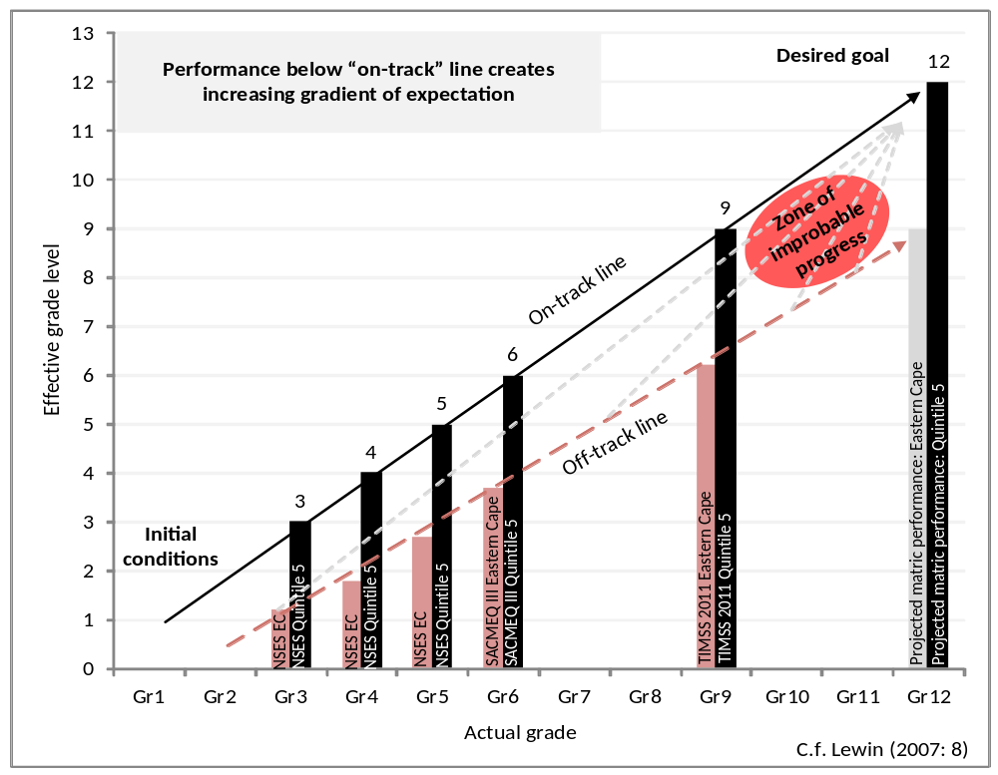
Insurmountable learning deficits
Gradients of achievement in the EASTERN Cape and in Quintile 5 (National)
NB: Key assumption, 0.5 SD of national learning achievement is equivalent to one grade level of learning
-agreement from TIMSS/PIRLS
Spaull, 2013
Spaull 2013

Slide 54
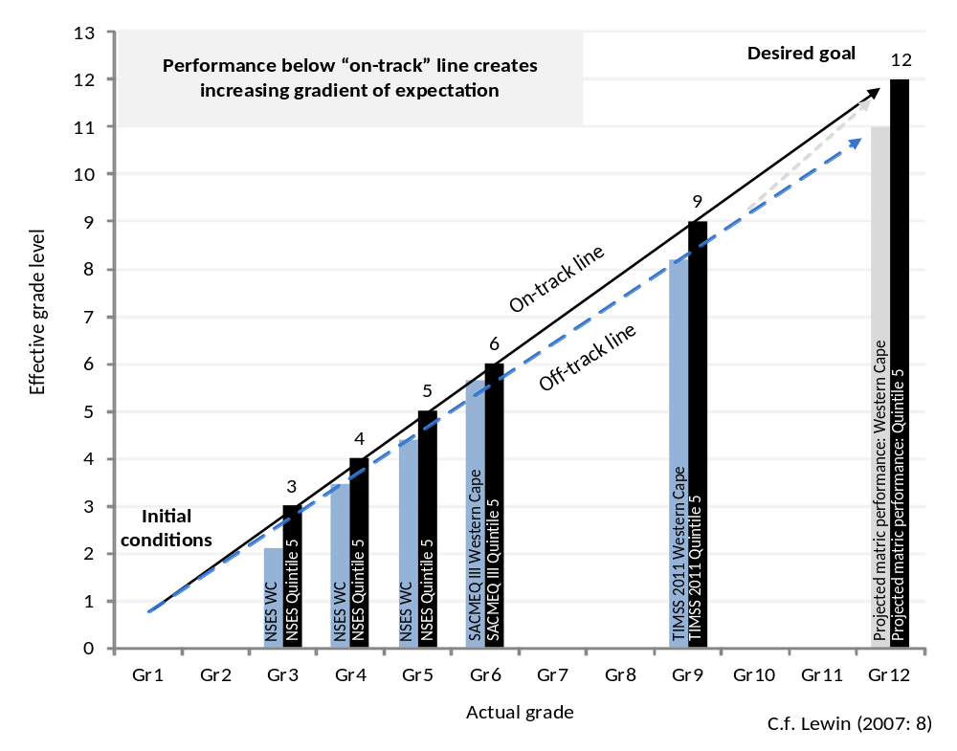
Insurmountable learning deficits
Gradients of achievement in the WESTERN Cape and in Quintile 5 (National)
NB: WC has relatively high % of Q5 schools thus it should be more convergent by construction.
Spaull, 2013
Spaull 2013

Slide 55
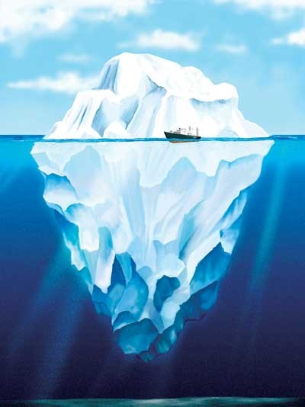

What are the root causes of low and unequal achievement?
Matric pass rate
Subject choice
No. endorsements
Throughput
Media sees only this→
Quality?
MATRIC
Pre-MATRIC
50% dropout
Low curric coverage
Weak culture of T&L
Low accountability
Vested interests
Low time-on-task
No early cognitive stimulation
Low quality teachers
HUGE learning deficits…

Slide 56
2 education systems not 1

Slide 57
2 education systems
Dysfunctional Schools (75% of schools) | Functional Schools (25% of schools)
Weak accountability | Strong accountability
Incompetent school management | Good school management
Lack of culture of learning, discipline and order | Culture of learning, discipline and order
Inadequate LTSM | Adequate LTSM
Weak teacher content knowledge | Adequate teacher content knowledge
High teacher absenteeism (1 month/yr) | Low teacher absenteeism (2 week/yr)
Slow curriculum coverage, little homework or testing | Covers the curriculum, weekly homework, frequent testing
High repetition & dropout (Gr10-12) | Low repetition & dropout (Gr10-12)
Extremely weak learning: most students fail standardised tests | Adequate learner performance (primary and matric)

Slide 58

Two school systems not one?
Socioeconomic Status
Grade 6 [2007]
Data: SACMEQ
(Spaull, 2011)

Slide 59


Gr 1 - Gr 2 - Gr 3 – Gr 4 – Gr 5 – Gr 6 – Gr 7 – Gr 8 – Gr 9 - Gr 10 – Gr 11 – Gr 12
Foundation Phase
Intermediate Phase
Senior Phase
FET Phase
PIRLS 2006 – see Shepherd (2011)
prePIRLS 2011
Grade 4 – all 11 languages
433 schools, 19259 students
____________________________________
Underperformance
29% of gr4 students did not reach the low international benchmark – they could not read
SA performs similarly to Botswana, but 3 years learning behind average Columbian Gr4
Inequality
Linguistic inequalities: Large differences by home language – Xitsonga, Tshivenda and Sepedi students particularly disadvantaged
PIRLS (2006) showed LARGE differences between African language schools and Eng/Afr schools
Howie et al (2011)
*Data now available for download

Slide 60

→
In most government reports outcomes and inputs are not usually reported by quintile, only national averages
→

Slide 61
Implications for reporting and modeling??

Slide 62
3 biggest challenges - SA
Failure to get the basics right
  Children who cannot read, write and compute properly (Functionally illiterate/innumerate) after 6 years of formal full-time schooling
  Often teachers lack even the most basic knowledge
Equity in education
  2 education systems – dysfunctional system operates at bottom of African countries, functional system operates at bottom of developed countries.
  More resources is NOT the silver bullet – we are not using existing resources
Lack of accountability
  Little accountability to parents in majority of school system
  Little accountability between teachers and Department
  Teacher unions abusing power and acting unprofessionally

Slide 63
Way forward?
Acknowledge the extent of the problem
  Low quality education is one of the three largest crises facing our country (along with HIV/AIDS and unemployment). Need the political will and public support for widespread reform.
Focus on the basics
  Every child MUST master the basics of foundational numeracy and literacy these are the building blocks of further education – weak foundations = recipe for disaster
  Teachers need to be in school teaching (re-introduce inspectorate?)
  Every teacher needs a minimum competency (basic) in the subjects they teach
  Every child (teacher) needs access to adequate learning (teaching) materials
  Use every school day and every school period – maximise instructional time
Increase information, accountability & transparency
  At ALL levels – DBE, district, school, classroom, learner
  Strengthen ANA
  Set realistic goals for improvement and hold people accountable

Slide 64
When faced with an exceedingly low and unequal quality of education do we….
A) Increase accountability {US model}
    Create a fool-proof highly specified, sequenced curriculum (CAPS/workbooks)
    Measure learning better and more frequently (ANA)
    Increase choice/information in a variety of ways
B) Improve the quality of teachers {Finnish model}
    Attract better candidates into teaching degrees → draw candidates from the top (rather than the bottom) of the matric distribution
    Increase the competence of existing teachers (Capacitation)
    Long term endeavor which requires sustained, committed, strategic, thoughtful leadership (something we don’t have)
C) All of the above {Utopian model}
Perhaps A while we set out on the costly and difficult journey of B??

