Slide 1

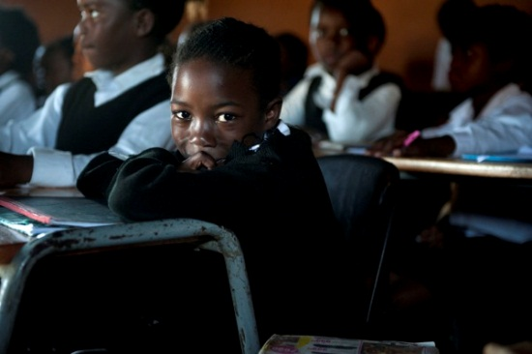


Accountability & Capacity in the South African Education System
Nic Spaull
www.nicspaull.com/research
NAPTOSA Gauteng Conference
1 March 2014

Slide 2
Overview
Background information to SA education system
Learning trajectories & insurmountable learning deficits
New research on mathematics teacher content knowledge in South Africa
Accountability & Capacity in South Africa

Slide 3
Bird’s-eye view of the South African education system

Slide 4



Not all schools are born equal
?
Pretoria Boys High School
SA public schools?
→ Different resources (Capacity)
→ Different pressures (Accountability)

Slide 5
Labour Market
17%
Unemployed
(Broad - 33%)
Unskilled
(19%)
Semi-Skilled (31%)
University/FET
Type of institution (FET or University)
Quality of institution
Type of qualification (diploma, degree etc.)
Field of study (Engineering, Arts etc.)
High productivity jobs and incomes (17%)
Mainly professional, managerial & skilled jobs
Requires graduates, good quality matric or good vocational skills
Historically mainly white
High quality secondaryschool
High SES background
+ECD
High quality primary school
Minority (20%)
Some motivated, lucky or talented students make the transition
Unequal society
Big demand for good schools despite fees
Some scholarships/bursaries
Vocational training
Affirmative action
Majority (80%)
Quality
Low quality secondary
school
Attainment
Type
Low productivity jobs & incomes
Often manual or low skill jobs
Limited or low quality education
Minimum wage can exceed productivity
Low Socioeconomic status background
Low quality primary school
cf. Servaas van der Berg – QLFS 2011
Notes:
The QLFS classifies professions as follows: Highly skilled (legislators, senior officials and managers, professionals, technicians and associate profesionals); Semi-skilled (Clerks, service workers and shop and market personnel, skilled agricultural and fishery workers, craft and related trade workers, plant and machinery operators and assembly), Unskilled (Elementary occupations, domestic workers).

Slide 6
Insurmountable learning deficits
How much learning takes place in classrooms in South Africa?
(Grades 3, 4 & 5)

Slide 7
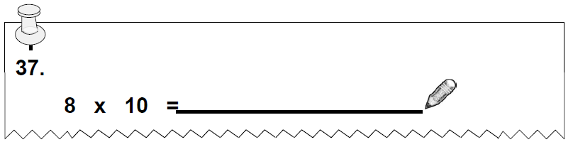
NSES question 37
NSES followed about 15000 students (266 schools) and tested them in Grade 3 (2007), Grade 4 (2008) and Grade 5 (2009).
Grade 3 maths curriculum: “Can perform calculations using approp symbols to solve problems involving: MULTIPLICATION of at least 2-digit by 1-digit numbers”
Even at the end of Grade 5 more than a third of quintile 1-4 students cannot answer this simple Grade-3-level problem.
“The powerful notions of ratio, rate and proportion are built upon the simpler concepts of whole number, multiplication and division, fraction and rational number, and are themselves the precursors to the development of yet more complex concepts such as triangle similarity, trigonometry, gradient and calculus” (Taylor & Reddi, 2013: 194)
Notes:
Taylor, N., & Reddi, B. (2013). Writing and learning mathematics. In N. Taylor, S. Van der Berg, & T. Mabogoane, Creating Effective Schools. Cape Town: Pearson.

Slide 8

NSES question 42
NSES followed about 15000 students (266 schools) and tested them in Grade 3 (2007), Grade 4 (2008) and Grade 5 (2009).
Grade 3 maths curriculum: “Can perform calculations using appropriate symbols to solve problems involving: division of at least 2-digit by 1-digit numbers”
Even at the end of Grade 5 most (55%+) quintile 1-4 students cannot answer this simple Grade-3-level problem.
“The powerful notions of ratio, rate and proportion are built upon the simpler concepts of whole number, multiplication and division, fraction and rational number, and are themselves the precursors to the development of yet more complex concepts such as triangle similarity, trigonometry, gradient and calculus” (Taylor & Reddi, 2013: 194)
Notes:
Taylor, N., & Reddi, B. (2013). Writing and learning mathematics. In N. Taylor, S. Van der Berg, & T. Mabogoane, Creating Effective Schools. Cape Town: Pearson.

Slide 9
Insurmountable learning deficits: 0.3 SD
How does this affect matric?
(Spaull & Viljoen, Forthcoming)

Slide 10
550,000 students drop out before matric
99% of those who don’t get matric don’t get a non-matric qualification (Gustafsson, 2011: p11)
What happens to them? 50% youth unemployment.

Slide 11


What are the root causes of low and unequal achievement?
Matric pass rate
Subject choice
No. endorsements
Throughput
Media sees only this→
Quality?
MATRIC
Pre-MATRIC
50% dropout
Low curric coverage
Weak culture of T&L
Low accountability
Vested interests
Low time-on-task
No early cognitive stimulation
Low quality teachers
HUGE learning deficits…

Slide 12
New research on mathematics teacher content knowledge in SA

Slide 13

What are the content knowledge (CK) levels of South African Gr6 Maths teachers? (SACMEQ 2007)
To be classified at a Grade-level, teachers must achieve at least 60% correct on grade-level items (adjusted for guessing)
(Venkatakrishnan & Spaull, Forthcoming)

Slide 14
What are the content knowledge (CK) levels of South African Gr6 Maths teachers? (SACMEQ 2007) [By school quintile]
To be classified at a Grade-level, teachers must achieve at least 60% correct on grade-level items (adjusted for guessing)
(Venkatakrishnan & Spaull, Forthcoming)

Slide 15
Maths teacher content knowledge in SA
Critically low levels of CK in SA
Teachers cannot teach what they do not know
Urgent need to provide teachers with meaningful learning opportunities (ala Shalem, 2003)
  How?!
  Not a single program proven to raise maths teacher CK at scale (proper evaluation)
  Q&A with Prof Muller
    Q: “What do you think is the most under-researched area in SA education?
    A: “We have no idea what it will take to make knowledgeable teachers out of clueless ones, at least not while they are actually on-the-job”
    http://nicspaull.com/2014/02/28/qa-with-johan-muller/

Slide 16
Solutions?
Accountability & Capacity

Slide 17
Important distinctions
Increased allocation of resources (budget)
Increased resources “on-the-ground”
Improved student outcomes
Often these 3 are spoken about interchangeably

Slide 18
Important distinctions
Increased allocation of resources (budget)
Increased resources “on-the-ground”
Improved student outcomes
Inefficiency / corruption

Slide 19
Important distinctions
Increased allocation of resources (budget)
Increased resources “on-the-ground”
Improved student outcomes
Lack of capacity
Inefficiency / corruption

Slide 20
Important distinctions
Increased allocation of resources (budget)
Increased resources “on-the-ground”
Improved student outcomes
Lack of capacity
Lack of accountability
Inefficiency / corruption

Slide 21
Accountability & Capacity

Slide 22
Accountability without capacity
“Accountability systems and incentive structures, no matter how well designed, are only as effective as the capacity of the organization to respond. The purpose of an accountability system is to focus the resources and capacities of an organization towards a particular end. Accountability systems can’t mobilize resources that schools don’t have...the capacity to improve precedes and shapes schools’ responses to the external demands of accountability systems (Elmore, 2004b, p. 117).
“If policy-makers rely on incentives for improving either a school or a student, then the question arises, incentives to do what? What exactly should educators in failing schools do tomorrow - that they do not do today - to produce more learning? What should a failing student do tomorrow that he or she is not doing today?” (Loveless, 2005, pp. 16, 26).

Slide 23
Capacity without accountability
“In the absence of accountability sub-systems, support measures are very much a hit and miss affair. Accountability measures provide motivation for and direction to support measures, by identifying capacity shortcomings, establishing outcome targets, and setting in place incentives and sanctions which motivate and constrain teachers and managers throughout the system to apply the lessons learned on training courses in their daily work practices. Without these, support measures are like trying to push a piece of string: with the best will in the world, it has nowhere to go. Conversely, the performance gains achieved by accountability measures, however efficiently implemented, will reach a ceiling when the lack of leadership and technical skills on the part of managers, and curricular knowledge on the part of teachers, places a limit on improved performance. Thus, the third step in improving the quality of schooling is to provide targeted training programs to managers and teachers. To achieve optimal effects, these will need to connect up with and be steered by accountability measures” (Taylor, 2002, p. 17).

Slide 24

Notes:
From a forthcoming report on accountability on the

Slide 25
EG: Teacher training that doesn’t change behavior [training on how to teach with a workbook but no incr in curric coverage because workbooks aren’t monitored or outcomes (like reading) regularly assessed

Slide 26
EG: Imposing sanctions & rewards for doing things that teachers can’t do [if a teacher isn’t teaching fractions because she can’t do fractions herself, no amount of pressure can force her to cover that topic]

Slide 29


Slide 30
“Only when schools have both the incentive to respond to an accountability system as well as the capacity to do so will there be an improvement in student outcomes.” (p22)

Slide 31
Take home points
SA’s educational performance is extremely low and highly unequal
Decreasing inequality not possible without changing wages of majority which isn’t possible without improving the quality of education
Very little learning taking place in many SA schools
SA children 3-4 yrs behind the curriculum. Acquire learning deficits early on and this handicaps them as they progress
Maths teacher CK is extremely low in large parts of the system
  What role for teacher testing & training?
Solutions: can’t focus on either accountability (pressure/incentives) or capacity (resources/support), must focus on both

Slide 32
References & reading
Spaull, N. 2014. Accountability in South African Education. Ch4 in “Transformation Audit 2013: Confronting Exclusion” Institute for Justice and Reconciliation. Cape Town. http://ijr.org.za/publications/pdfs/TA%202013%20text%20and%20cover%20web.pdf
Spaull, N. 2013. South Africa’s Education Crisis: The Quality of Education in South Africa 1995-2011. Centre for Development and Enterprise. http://www.cde.org.za/images/pdf/South%20Africas%20Education%20Crisis%20N%20Spaull%202013.pdf
Elmore, R. (2004a). Agency, Reciprocity, and Accountability in Democratic Education. Cambridge, MA: Consortium for Policy Research in Education.
Elmore, R. (2008). Leadership as the practice of improvement. In OECD, Improving School Leadership. Volume 2: Case Studies on System Leadership (pp. 37-67). Paris: OECD Publishing.

Slide 33
Thank you
Comments & Questions?
This presentation & others are available online at: www.nicspaull.com/research
NicholasSpaull@gmail.com

Slide 34
Qualifications by age (birth cohort), 2011 (Van der Berg, 2013)

Slide 35
Binding constraints approach

Slide 36


Slide 39
“The left hand barrel has horizontal wooden slabs, while the right hand side barrel has vertical slabs. The volume in the first barrel depends on the sum of the width of all slabs. Increasing the width of any slab will increase the volume of the barrel. So a strategy on improving anything you can, when you can, while you can, would be effective. The volume in the second barrel is determined by the length of the shortest slab. Two implications of the second barrel are that the impact of a change in a slab on the volume of the barrel depends on whether it is the binding constraint or not. If not, the impact is zero. If it is the binding constraint, the impact will depend on the distance between the shortest slab and the next shortest slab” (Hausmann, Klinger, & Wagner, 2008, p. 17).
Notes:
Hausmann, R., Klinger, G., & Wagner, R. (2008). Doing Growth Diagnostics in Practice: A 'Mindbook'. CID Workinf Paper No. 177. Center for International Development at Harvard University.

Slide 40
Accountability stages...
SA is a few decades behind many OECD countries. Predictable outcomes as we move from stage to stage. Loveless (2005: 7) explains the historical sequence of accountability movements for students – similar movements for teachers?
  Stage 1 – Setting standards
  (defining what students should learn),
      CAPS
  Stage 2 - Measuring achievement
  (testing to see what students have learned),
      ANA
  Stage 3 - Holding educators & students accountable
  (making results count).
      Western Cape performance agreements?
Stages in accountability movements:
3) Holding accountable
2) Measuring achievement
1) Setting standards
TRAINING
CAPACITY! “For every increment of performance I demand from you, I have an equal responsibility to provide you with the capacity to meet that expectation. Likewise, for every investment you make in my skill and knowledge, I have a reciprocal responsibility to demonstrate some new increment in performance” (Elmore, 2004b, p. 93).

Slide 41
South African teacher content knowledge

Slide 42
Teacher Content Knowledge
  Conference Board of the Mathematical Sciences (2001, ch.2) recommends that mathematics teachers need:
  “A thorough mastery of the mathematics in several grades beyond that which they expect to teach, as well as of the mathematics in earlier grades” (2001 report ‘The Mathematical Education of Teachers’)
Ball et al (2008, p. 409)
  “Teachers who do not themselves know the subject well are not likely to have the knowledge they need to help students learn this content. At the same time just knowing a subject may well not be sufficient for teaching.”
Shulman (1986, p. 9)
  “We expect that the subject matter content understanding of the teacher be at least equal to that of his or her lay colleague, the mere subject matter major”

Slide 43
South Africa specifically…
Taylor & Vinjevold’s (1999, p. 230) conclusion in their book “Getting Learning Right” is particularly explicit:
“The most definite point of convergence across the [President’s Education Initiative] studies is the conclusion that teachers’ poor conceptual knowledge of the subjects they are teaching is a fundamental constraint on the quality of teaching and learning activities, and consequently on the quality of learning outcomes.”

Slide 44
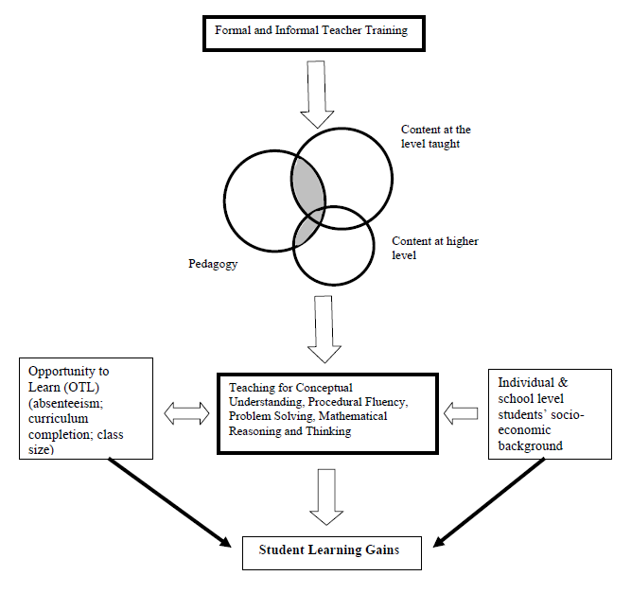
Carnoy & Chisholm (2008: p. 22) conceptual framework

Slide 45
Teacher knowledge
Teachers cannot teach what they do not know.
Student understands & can calculate fractions
PCK – how to teach fractions
CK – How to do fractions
Demonizing teachers is popular, but unhelpful
“For every increment of performance I demand from you, I have an equal responsibility to provide you with the capacity to meet that expectation. Likewise, for every investment you make in my skill and knowledge, I have a reciprocal responsibility to demonstrate some new increment in performance”
(Elmore, 2004b, p. 93).
Notes:
Elmore, R. (2004b). School reform from the inside out: Policy, practice and performance. Cambridge, MA: Harvard Education Press.

Slide 46
Solutions?

Slide 47
Possible solution…
The DBE cannot afford to be idealistic in its implementation of teacher training and testing
  Aspirational planning approach: All primary school mathematics teachers should be able to pass the matric mathematics exam
    (benchmark = desirable teacher CK)
  Realistic approach: (e.g.) minimum proficiency benchmark where teachers have to achieve at least 90% in the ANA of the grades in which they teach, and 70% in Grade 9 ANA
  (benchmark = basic teacher CK)
Pilot the system with one district. Imperative to evaluate which teacher training option (of hundreds) works best in urban/rural for example. Rigorous impact evaluations are needed before selecting a program and then rolling it out
Tests are primarily for diagnostic purposes not punitive purposes
Notes:
Implement a nation-wide system of minimum-proficiency diagnostic teacher testing and capacitation for numeracy and literacy starting with the Foundation Phase.
“The existing body of evidence suggests that a large proportion of South African teachers have below-basic content knowledge in the subjects that they teach – largely as a result of inadequate apartheid-era teacher training and the ineffectiveness of in-service teacher training initiatives. In light of this, and following the premise that teachers cannot teach what they do not know, it is a logical imperative that a system of identifying which teachers need what help is urgently required. Given the current state of teacher content knowledge in poor and rural schools, the Department cannot afford to be idealistic in its implementation of this system of teacher testing and training. Rather than ascribing to the aspirational planning approach that has become characteristic of South African policy - where one might set an impractically high benchmark for desirable teacher content knowledge - one should first aim to ensure that every teacher in the system has the basic content knowledge required to cover the curriculum that they currently teach. For example, rather than decreeing that every primary school mathematics teacher should be able to pass the matric mathematics exam, it would be far more realistic to take an incremental approach and set the minimum-proficiency benchmark at a 70% mark on the grade nine annual national assessment, combined with at least a 90% mark in the ANA of the grade which they are currently teaching. If a grade six mathematics teacher cannot achieve 70% on the grade nine ANA for mathematics, and achieve 90% for the grade six mathematics ANA, one can say that they do not currently possess the requisite content knowledge to teach grade six mathematics. As a matter of urgency, they should be required to undergo minimum-proficiency teacher training for the subjects which they teach and then re-assessed at the end of the training. Before trying to get every teacher to a desirable level, first ensure that all teachers have the basic content knowledge in the subjects that they teach.
Given the logistics involved with implementing a testing and training operation of this scale, it is advisable to pilot the system with one district and then to roll out the system nationally in a progressive way. For example the Department could start with Foundation Phase (FP) mathematics teachers in a particular district and require all FP maths teachers to register and write the minimum proficiency test within six months. Teachers who do not meet the minimum-proficiency benchmark for the subjects that they teach should be given six months to complete the minimum-proficiency training which should be free of charge and accessible. Importantly, the training provided should be dignified, highly practical, structured and sequenced, with formative testing built into each module to assess whether or not the teacher has acquired the necessary knowledge and skills.
In order to get teacher and union buy in, it will need to be made explicit that these tests are primarily for diagnostic rather than punitive purposes. Through a variety of mechanisms (such as contracts and confidentiality clauses) it is possible to reassure all parties involved that these tests are truly developmental in nature. The ultimate aim of such a system should not be to vilify and demean teachers and the teaching profession, but to increase the capacity and dignity of teachers. Elmore (2004b, p. 93) provides a useful description of the interplay between accountability and capacitation:
“For every increment of performance I demand from you, I have an equal responsibility to provide you with the capacity to meet that expectation. Likewise, for every investment you make in my skill and knowledge, I have a reciprocal responsibility to demonstrate some new increment in performance.”
Spaull 2013 CDE Report

Slide 48
How have educational outcomes changed in Gauteng between 1995 and 2011?

Slide 49
Figure 1: Provincial scores for Grade 8 Mathematics, TIMSS 1995*, 1999, 2002 (with 95% confidence interval)

Slide 50
Figure 5: Provincial average for Grade 9 Mathematics, TIMSS 2002 and TIMSS 2011 (with 95% confidence interval) - TIMSS benchmark used here is the average TIMSS middle-income Grade 8 mathematics mean score

Slide 51
Figure 7: Provincial improvement between TIMSS 2002 and TIMSS 2011 - Grade 9 Mathematics (with 95% confidence interval)

Slide 52
Provincial matric pass rates as a percentage of Grade 2 enrolments 10 years earlier

Slide 53
Matric pass rates as a percentage of Grade 2 enrolments 10 years earlier for selected provinces – see Taylor (2012: p. 9)

Slide 54
Conclusions
Below-basic teacher content knowledge is a binding constraint to progress
  Teachers cannot teach what they do not know
The average Grade 6 mathematics teacher in South Africa has lower CK than Grade 6 maths teachers from other African countries and lower levels of CK than Grade 8 students from some OECD countries.
  Serious problem which needs well-thought out, rigorous, proven ways of improving CK to basic levels
Teachers in South Africa have highly variable content knowledge (urban/rural, rich/poor)
  High quality teachers in SA are the minority and are highly unequally distributed
The Department does not seem to have a credible plan to address the crisis in teacher content knowledge.
  Programs should be piloted and evaluated before roll out
  Billions have been wasted on ineffective teacher training, partially because the impact of those programs was not proven prior to implementation
Of all the nine provinces, Gauteng has improved the most and is most efficient in “converting” Grade 2 enrolments into matric passes

Slide 55
Comments, questions and suggestions welcome…
NicholasSpaull@gmail.com
@NicSpaull
www.nicspaull.com/research
www.resep.sun.ac.za

