Slide 1


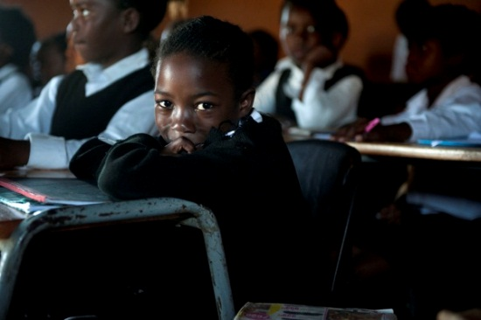


Literacy & the South African Education System
Nic Spaull
www.nicspaull.com/research
SHINE Seminar
7 March 2014

Slide 2
Overview
Background information to SA education system
Learning trajectories & insurmountable learning deficits
Language of learning and teaching (LOLT) in South Africa
Accountability & Capacity in South Africa

Slide 3
Bird’s-eye view of the South African education system

Slide 4



Not all schools are born equal
?
Pretoria Boys High School
SA public schools?
→ Different resources (Capacity)
→ Different pressures (Accountability)

Slide 5





State of SA education since transition
“Although 99.7% of South African children are in school…the outcomes in education are abysmal” (Manuel, 2011)
“Without ambiguity or the possibility of misinterpretation, the pieces together reveal the predicament of South African primary education” (Fleisch, 2008: 2)
“Our researchers found that what students know and can do is dismal” (Taylor & Vinjevold, 1999)
“It is not an overstatement to say that South African education is in crisis.” (Van der Berg & Spaull, 2011)

Slide 6









Student performance 2003-2011
TIMSS (2003)
→ PIRLS (2006)
→ SACMEQ (2007)
→ ANA (2011)
→ TIMSS (2011)
→ prePIRLS (2011)
TIMSS 2003 (Gr8 Maths & Science)
Out of 50 participating countries (including 6 African countries) SA came last
Only 10% reached low international benchmark
No improvement from TIMSS 1999-TIMSS 2003
PIRLS 2006 (Gr 4/5 – Reading)
Out of 45 participating countries SA came last
87% of gr4 and 78% of Gr 5 learners deemed to be “at serious risk of not learning to read”
SACMEQ III 2007 (Gr6 – Reading & Maths)
SA came 10/15 for reading and 8/15 for maths behind countries such as Swaziland, Kenya and Tanzania
ANA 2011 (Gr 1-6 Reading & Maths)
Mean literacy score gr3: 35%
Mean numeracy score gr3: 28%
Mean literacy score gr6: 28%
Mean numeracy score gr6: 30%
TIMSS 2011 (Gr9 – Maths & Science)
SA has joint lowest performance of 42 countries
Improvement by 1.5 grade levels (2003-2011)
76% of grade nine students in 2011 still had not acquired a basic understanding about whole numbers, decimals, operations or basic graphs, and this is at the improved level of performance
prePIRLS2011 (Gr 4 Reading)
29% of SA Gr4 learners completely illiterate (cannot locate & retrieve an explictly identified detail)
NSES 2007/8/9
Systemic Evaluations 2007
Matric exams
Notes:
The most comprehensive reports for each of these datasets are as follows: SACMEQ (Moloi & Chetty, 2011), TIMSS (Reddy, 2006), PIRLS (Howie, et al., 2008), Systemic Evaluations (Department of Education, 2008), National School Effectiveness Study (Taylor, 2011b),and the Annual National Assessments (Department of Basic Education, 2011).

Slide 7
Labour Market
17%
Unemployed
(Broad - 33%)
Unskilled
(19%)
Semi-Skilled (31%)
University/FET
Type of institution (FET or University)
Quality of institution
Type of qualification (diploma, degree etc.)
Field of study (Engineering, Arts etc.)
High productivity jobs and incomes (17%)
Mainly professional, managerial & skilled jobs
Requires graduates, good quality matric or good vocational skills
Historically mainly white
High quality secondaryschool
High SES background
+ECD
High quality primary school
Minority (20%)
Some motivated, lucky or talented students make the transition
Unequal society
Big demand for good schools despite fees
Some scholarships/bursaries
Vocational training
Affirmative action
Majority (80%)
Quality
Low quality secondary
school
Attainment
Type
Low productivity jobs & incomes
Often manual or low skill jobs
Limited or low quality education
Minimum wage can exceed productivity
Low Socioeconomic status background
Low quality primary school
cf. Servaas van der Berg – QLFS 2011
Notes:
The QLFS classifies professions as follows: Highly skilled (legislators, senior officials and managers, professionals, technicians and associate profesionals); Semi-skilled (Clerks, service workers and shop and market personnel, skilled agricultural and fishery workers, craft and related trade workers, plant and machinery operators and assembly), Unskilled (Elementary occupations, domestic workers).

Slide 8
Insurmountable learning deficits
How much learning takes place in classrooms in South Africa?
(Grades 3, 4 & 5)

Slide 9

NSES question 42
NSES followed about 15000 students (266 schools) and tested them in Grade 3 (2007), Grade 4 (2008) and Grade 5 (2009).
Grade 3 maths curriculum: “Can perform calculations using appropriate symbols to solve problems involving: division of at least 2-digit by 1-digit numbers”
Even at the end of Grade 5 most (55%+) quintile 1-4 students cannot answer this simple Grade-3-level problem.
“The powerful notions of ratio, rate and proportion are built upon the simpler concepts of whole number, multiplication and division, fraction and rational number, and are themselves the precursors to the development of yet more complex concepts such as triangle similarity, trigonometry, gradient and calculus” (Taylor & Reddi, 2013: 194)
Notes:
Taylor, N., & Reddi, B. (2013). Writing and learning mathematics. In N. Taylor, S. Van der Berg, & T. Mabogoane, Creating Effective Schools. Cape Town: Pearson.

Slide 10
Insurmountable learning deficits: 0.3 SD
How does this affect matric?
(Spaull & Viljoen, Forthcoming)

Slide 11
550,000 students drop out before matric
99% of those who don’t get matric don’t get a non-matric qualification (Gustafsson, 2011: p11)
What happens to them? 50% youth unemployment.

Slide 12
Qualifications by age (birth cohort), 2011 (Van der Berg, 2013)

Slide 13


What are the root causes of low and unequal achievement?
Matric pass rate
Subject choice
No. endorsements
Throughput
Media sees only this→
Quality?
MATRIC
Pre-MATRIC
50% dropout
Low curric coverage
Weak culture of T&L
Low accountability
Vested interests
Low time-on-task
No early cognitive stimulation
Low quality teachers
HUGE learning deficits…

Slide 14
Language dynamics in SA

Slide 15
LOLT
According to the 2011 census, only about 23% of South Africans speak Afrikaans or English as their first language (Statistics South Africa, 2012).
Vast majority of SA children learn in their MT for Grades 1-3 (taking subject Eng as well) and then switch to Eng in Gr4
Some schools choose straight-for-English approach
Important to remember all the factors that are correlated with language – wealth, location, preschool (quality), parental education, teacher quality, resources etc..

Slide 16
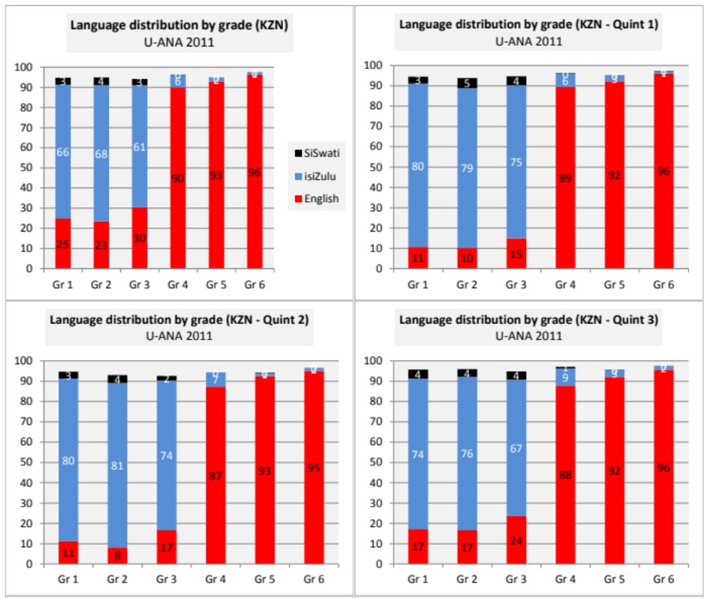
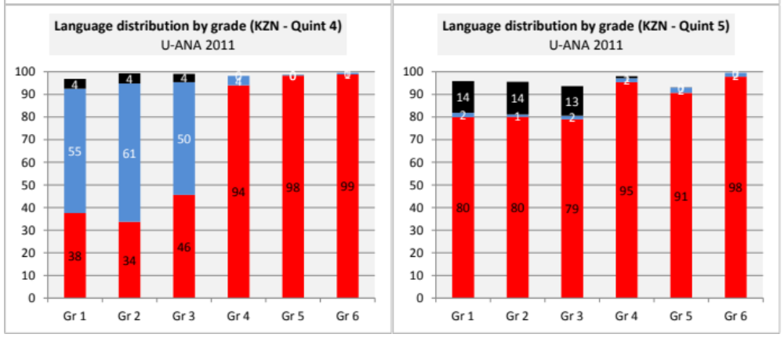

Slide 17
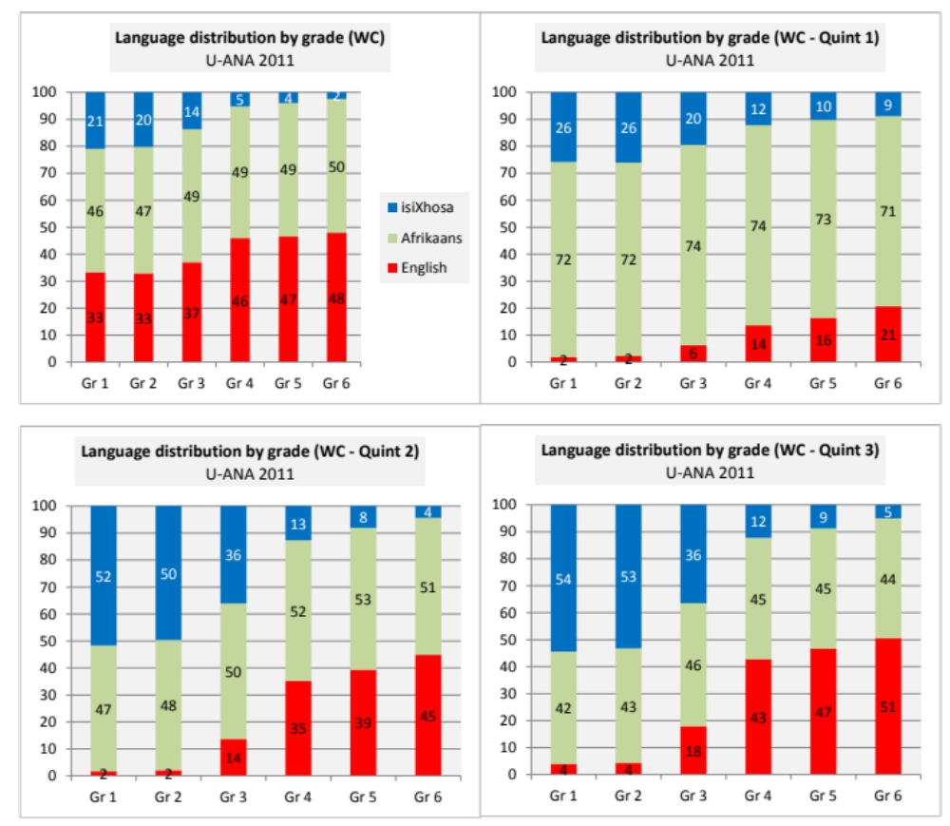
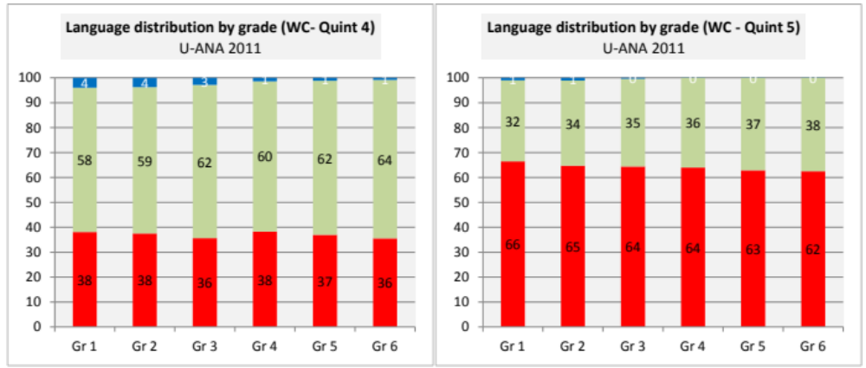

Slide 18
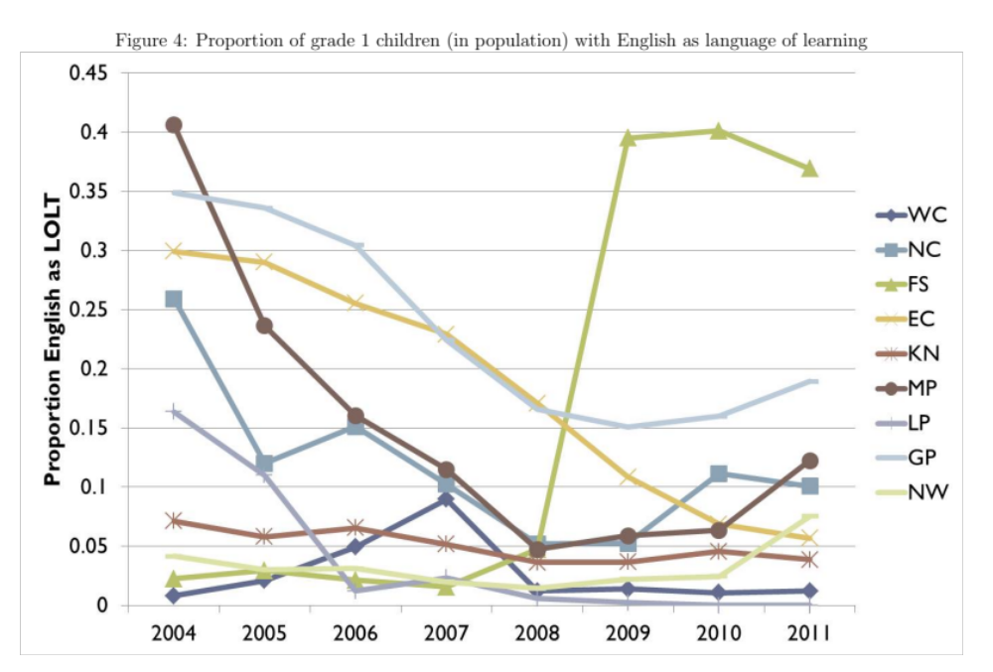
Changes in LOLT policies
(Taylor & Coetzee, 2013)
http://www.ekon.sun.ac.za/wpapers/2013/wp212013

Slide 19


By Gr 3 all children should be able to read, Gr 4 children should be transitioning from “learning to read” to “reading to learn”
By LOLT of school
Red sections here show the
proportion of children that are
completely illiterate in Grade 4
i.e. they cannot locate & retrieve
an explicitly stated detail
Notes:
If we consider the performance of the learners per test language, the following observations are made:
Overall 29% of learners in SA don’t meet the low benchmark
However, in Afrikaans and English, there are only 12 and 10% who do not meet the low benchmark
Of serious concern is that more than half the learners tested in Sepedi and Tshivenda do not reach the low benchmark putting them at risk educationally.
More than 15% of learners in Afrikaans and English reach the advanced level in contrast to less than 1% in African languages.

Slide 20
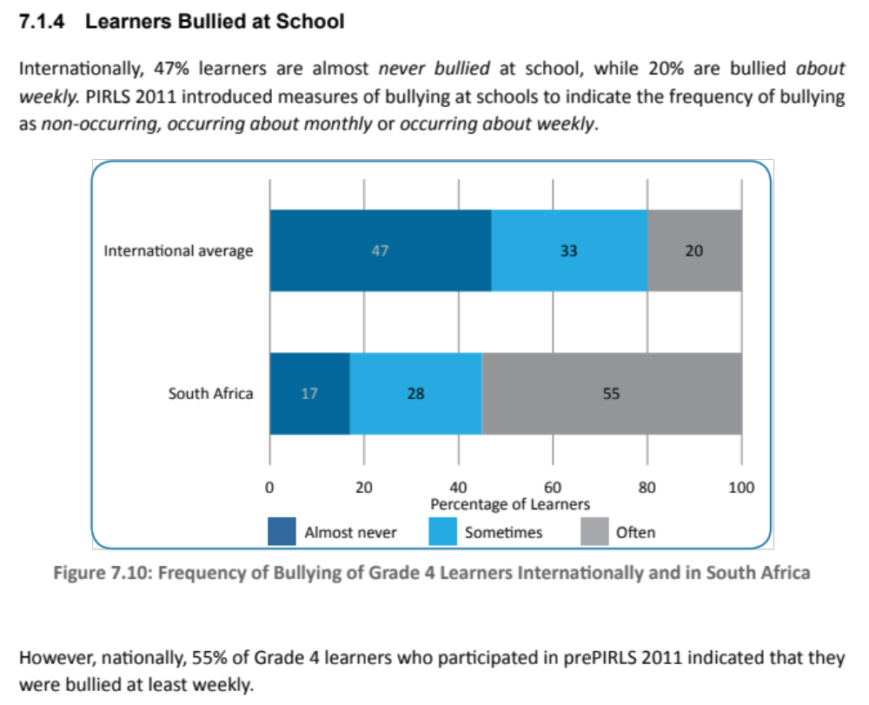
(Aside) Bullying in SA schools

Slide 21
Solutions?
Accountability & Capacity

Slide 22
Important distinctions
Increased allocation of resources (budget)
Increased resources “on-the-ground”
Improved student outcomes
Often these 3 are spoken about interchangeably

Slide 23
Important distinctions
Increased allocation of resources (budget)
Increased resources “on-the-ground”
Improved student outcomes
Inefficiency / corruption

Slide 24
Important distinctions
Increased allocation of resources (budget)
Increased resources “on-the-ground”
Improved student outcomes
Lack of capacity
Inefficiency / corruption

Slide 25
Important distinctions
Increased allocation of resources (budget)
Increased resources “on-the-ground”
Improved student outcomes
Lack of capacity
Lack of accountability
Inefficiency / corruption

Slide 26
Accountability & Capacity

Slide 27
Accountability without capacity
“Accountability systems and incentive structures, no matter how well designed, are only as effective as the capacity of the organization to respond. The purpose of an accountability system is to focus the resources and capacities of an organization towards a particular end. Accountability systems can’t mobilize resources that schools don’t have...the capacity to improve precedes and shapes schools’ responses to the external demands of accountability systems (Elmore, 2004b, p. 117).
“If policy-makers rely on incentives for improving either a school or a student, then the question arises, incentives to do what? What exactly should educators in failing schools do tomorrow - that they do not do today - to produce more learning? What should a failing student do tomorrow that he or she is not doing today?” (Loveless, 2005, pp. 16, 26).

Slide 28
Capacity without accountability
“In the absence of accountability sub-systems, support measures are very much a hit and miss affair. Accountability measures provide motivation for and direction to support measures, by identifying capacity shortcomings, establishing outcome targets, and setting in place incentives and sanctions which motivate and constrain teachers and managers throughout the system to apply the lessons learned on training courses in their daily work practices. Without these, support measures are like trying to push a piece of string: with the best will in the world, it has nowhere to go. Conversely, the performance gains achieved by accountability measures, however efficiently implemented, will reach a ceiling when the lack of leadership and technical skills on the part of managers, and curricular knowledge on the part of teachers, places a limit on improved performance. Thus, the third step in improving the quality of schooling is to provide targeted training programs to managers and teachers. To achieve optimal effects, these will need to connect up with and be steered by accountability measures” (Taylor, 2002, p. 17).

Slide 29

Notes:
From a forthcoming report on accountability on the

Slide 30
EG: Teacher training that doesn’t change behavior [training on how to teach with a workbook but no incr in curric coverage because workbooks aren’t monitored or outcomes (like reading) regularly assessed

Slide 31
EG: Imposing sanctions & rewards for doing things that teachers can’t do [if a teacher isn’t teaching fractions because she can’t do fractions herself, no amount of pressure can force her to cover that topic]

Slide 34


Slide 35
“Only when schools have both the incentive to respond to an accountability system as well as the capacity to do so will there be an improvement in student outcomes.” (p22)

Slide 36
Take home points
SA’s educational performance is extremely low and highly unequal
Decreasing inequality not possible without changing wages of majority which isn’t possible without improving the quality of education
Things improving slowly but still very little learning taking place in most SA schools
SA children 3-4 yrs behind the curriculum. Acquire learning deficits early on and this handicaps them as they progress
Solutions: can’t focus on either accountability (pressure/incentives) or capacity (resources/support), must focus on both
What can SHINE do to help?
  Keep doing what you are doing!
  Think of scalability. Implications for 1-on-1 model?
  Extending model to work for under-resourced communities and in African languages?

Slide 37
References & reading
Spaull, N. 2014. Accountability in South African Education. Ch4 in “Transformation Audit 2013: Confronting Exclusion” Institute for Justice and Reconciliation. Cape Town. http://ijr.org.za/publications/pdfs/TA%202013%20text%20and%20cover%20web.pdf
Spaull, N. 2013. South Africa’s Education Crisis: The Quality of Education in South Africa 1995-2011. Centre for Development and Enterprise. http://www.cde.org.za/images/pdf/South%20Africas%20Education%20Crisis%20N%20Spaull%202013.pdf
Taylor & Coetzee, 2013. http://www.ekon.sun.ac.za/wpapers/2013/wp212013
Elmore, R. (2004a). Agency, Reciprocity, and Accountability in Democratic Education. Cambridge, MA: Consortium for Policy Research in Education.
Elmore, R. (2008). Leadership as the practice of improvement. In OECD, Improving School Leadership. Volume 2: Case Studies on System Leadership (pp. 37-67). Paris: OECD Publishing.

Slide 38
Thank you
Comments & Questions?
This presentation & others are available online at: www.nicspaull.com/research
NicholasSpaull@gmail.com

Slide 39
Binding constraints approach

Slide 40


Slide 43
“The left hand barrel has horizontal wooden slabs, while the right hand side barrel has vertical slabs. The volume in the first barrel depends on the sum of the width of all slabs. Increasing the width of any slab will increase the volume of the barrel. So a strategy on improving anything you can, when you can, while you can, would be effective. The volume in the second barrel is determined by the length of the shortest slab. Two implications of the second barrel are that the impact of a change in a slab on the volume of the barrel depends on whether it is the binding constraint or not. If not, the impact is zero. If it is the binding constraint, the impact will depend on the distance between the shortest slab and the next shortest slab” (Hausmann, Klinger, & Wagner, 2008, p. 17).
Notes:
Hausmann, R., Klinger, G., & Wagner, R. (2008). Doing Growth Diagnostics in Practice: A 'Mindbook'. CID Workinf Paper No. 177. Center for International Development at Harvard University.

Slide 44
Accountability stages...
SA is a few decades behind many OECD countries. Predictable outcomes as we move from stage to stage. Loveless (2005: 7) explains the historical sequence of accountability movements for students – similar movements for teachers?
  Stage 1 – Setting standards
  (defining what students should learn),
      CAPS
  Stage 2 - Measuring achievement
  (testing to see what students have learned),
      ANA
  Stage 3 - Holding educators & students accountable
  (making results count).
      Western Cape performance agreements?
Stages in accountability movements:
3) Holding accountable
2) Measuring achievement
1) Setting standards
TRAINING
CAPACITY! “For every increment of performance I demand from you, I have an equal responsibility to provide you with the capacity to meet that expectation. Likewise, for every investment you make in my skill and knowledge, I have a reciprocal responsibility to demonstrate some new increment in performance” (Elmore, 2004b, p. 93).

Slide 45
South African teacher content knowledge

Slide 46
Teacher Content Knowledge
  Conference Board of the Mathematical Sciences (2001, ch.2) recommends that mathematics teachers need:
  “A thorough mastery of the mathematics in several grades beyond that which they expect to teach, as well as of the mathematics in earlier grades” (2001 report ‘The Mathematical Education of Teachers’)
Ball et al (2008, p. 409)
  “Teachers who do not themselves know the subject well are not likely to have the knowledge they need to help students learn this content. At the same time just knowing a subject may well not be sufficient for teaching.”
Shulman (1986, p. 9)
  “We expect that the subject matter content understanding of the teacher be at least equal to that of his or her lay colleague, the mere subject matter major”

Slide 47
South Africa specifically…
Taylor & Vinjevold’s (1999, p. 230) conclusion in their book “Getting Learning Right” is particularly explicit:
“The most definite point of convergence across the [President’s Education Initiative] studies is the conclusion that teachers’ poor conceptual knowledge of the subjects they are teaching is a fundamental constraint on the quality of teaching and learning activities, and consequently on the quality of learning outcomes.”

Slide 48
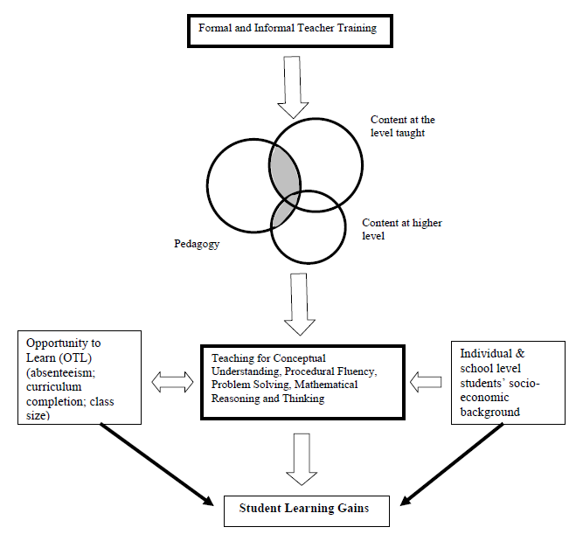
Carnoy & Chisholm (2008: p. 22) conceptual framework

Slide 49
Teacher knowledge
Teachers cannot teach what they do not know.
Student understands & can calculate fractions
PCK – how to teach fractions
CK – How to do fractions
Demonizing teachers is popular, but unhelpful
“For every increment of performance I demand from you, I have an equal responsibility to provide you with the capacity to meet that expectation. Likewise, for every investment you make in my skill and knowledge, I have a reciprocal responsibility to demonstrate some new increment in performance”
(Elmore, 2004b, p. 93).
Notes:
Elmore, R. (2004b). School reform from the inside out: Policy, practice and performance. Cambridge, MA: Harvard Education Press.

Slide 50
Solutions?

Slide 51
Possible solution…
The DBE cannot afford to be idealistic in its implementation of teacher training and testing
  Aspirational planning approach: All primary school mathematics teachers should be able to pass the matric mathematics exam
    (benchmark = desirable teacher CK)
  Realistic approach: (e.g.) minimum proficiency benchmark where teachers have to achieve at least 90% in the ANA of the grades in which they teach, and 70% in Grade 9 ANA
  (benchmark = basic teacher CK)
Pilot the system with one district. Imperative to evaluate which teacher training option (of hundreds) works best in urban/rural for example. Rigorous impact evaluations are needed before selecting a program and then rolling it out
Tests are primarily for diagnostic purposes not punitive purposes
Notes:
Implement a nation-wide system of minimum-proficiency diagnostic teacher testing and capacitation for numeracy and literacy starting with the Foundation Phase.
“The existing body of evidence suggests that a large proportion of South African teachers have below-basic content knowledge in the subjects that they teach – largely as a result of inadequate apartheid-era teacher training and the ineffectiveness of in-service teacher training initiatives. In light of this, and following the premise that teachers cannot teach what they do not know, it is a logical imperative that a system of identifying which teachers need what help is urgently required. Given the current state of teacher content knowledge in poor and rural schools, the Department cannot afford to be idealistic in its implementation of this system of teacher testing and training. Rather than ascribing to the aspirational planning approach that has become characteristic of South African policy - where one might set an impractically high benchmark for desirable teacher content knowledge - one should first aim to ensure that every teacher in the system has the basic content knowledge required to cover the curriculum that they currently teach. For example, rather than decreeing that every primary school mathematics teacher should be able to pass the matric mathematics exam, it would be far more realistic to take an incremental approach and set the minimum-proficiency benchmark at a 70% mark on the grade nine annual national assessment, combined with at least a 90% mark in the ANA of the grade which they are currently teaching. If a grade six mathematics teacher cannot achieve 70% on the grade nine ANA for mathematics, and achieve 90% for the grade six mathematics ANA, one can say that they do not currently possess the requisite content knowledge to teach grade six mathematics. As a matter of urgency, they should be required to undergo minimum-proficiency teacher training for the subjects which they teach and then re-assessed at the end of the training. Before trying to get every teacher to a desirable level, first ensure that all teachers have the basic content knowledge in the subjects that they teach.
Given the logistics involved with implementing a testing and training operation of this scale, it is advisable to pilot the system with one district and then to roll out the system nationally in a progressive way. For example the Department could start with Foundation Phase (FP) mathematics teachers in a particular district and require all FP maths teachers to register and write the minimum proficiency test within six months. Teachers who do not meet the minimum-proficiency benchmark for the subjects that they teach should be given six months to complete the minimum-proficiency training which should be free of charge and accessible. Importantly, the training provided should be dignified, highly practical, structured and sequenced, with formative testing built into each module to assess whether or not the teacher has acquired the necessary knowledge and skills.
In order to get teacher and union buy in, it will need to be made explicit that these tests are primarily for diagnostic rather than punitive purposes. Through a variety of mechanisms (such as contracts and confidentiality clauses) it is possible to reassure all parties involved that these tests are truly developmental in nature. The ultimate aim of such a system should not be to vilify and demean teachers and the teaching profession, but to increase the capacity and dignity of teachers. Elmore (2004b, p. 93) provides a useful description of the interplay between accountability and capacitation:
“For every increment of performance I demand from you, I have an equal responsibility to provide you with the capacity to meet that expectation. Likewise, for every investment you make in my skill and knowledge, I have a reciprocal responsibility to demonstrate some new increment in performance.”
Spaull 2013 CDE Report

Slide 52
How have educational outcomes changed in Gauteng between 1995 and 2011?

Slide 53
Figure 1: Provincial scores for Grade 8 Mathematics, TIMSS 1995*, 1999, 2002 (with 95% confidence interval)

Slide 54
Figure 5: Provincial average for Grade 9 Mathematics, TIMSS 2002 and TIMSS 2011 (with 95% confidence interval) - TIMSS benchmark used here is the average TIMSS middle-income Grade 8 mathematics mean score

Slide 55
Figure 7: Provincial improvement between TIMSS 2002 and TIMSS 2011 - Grade 9 Mathematics (with 95% confidence interval)

Slide 56
Provincial matric pass rates as a percentage of Grade 2 enrolments 10 years earlier

Slide 57
Matric pass rates as a percentage of Grade 2 enrolments 10 years earlier for selected provinces – see Taylor (2012: p. 9)

Slide 58
Conclusions
Below-basic teacher content knowledge is a binding constraint to progress
  Teachers cannot teach what they do not know
The average Grade 6 mathematics teacher in South Africa has lower CK than Grade 6 maths teachers from other African countries and lower levels of CK than Grade 8 students from some OECD countries.
  Serious problem which needs well-thought out, rigorous, proven ways of improving CK to basic levels
Teachers in South Africa have highly variable content knowledge (urban/rural, rich/poor)
  High quality teachers in SA are the minority and are highly unequally distributed
The Department does not seem to have a credible plan to address the crisis in teacher content knowledge.
  Programs should be piloted and evaluated before roll out
  Billions have been wasted on ineffective teacher training, partially because the impact of those programs was not proven prior to implementation
Of all the nine provinces, Gauteng has improved the most and is most efficient in “converting” Grade 2 enrolments into matric passes

Slide 59
Comments, questions and suggestions welcome…
NicholasSpaull@gmail.com
@NicSpaull
www.nicspaull.com/research
www.resep.sun.ac.za

