Slide 1




Accountability & Corruption in Africa
Understanding the disconnect between resources and results
Nic Spaull | NicholasSpaull@gmail.com | nicspaull.com
Columbia Teachers College (Guest Lecture) – 8 April 2014

Slide 2
Main outcomes today
Understand why additional resources may not translate into improved outcomes in developing countries.
Three important concepts:
  Accountability and corruption
  Isomorphic mimicry & the purpose of schooling
  Accountability and capacity

Slide 3
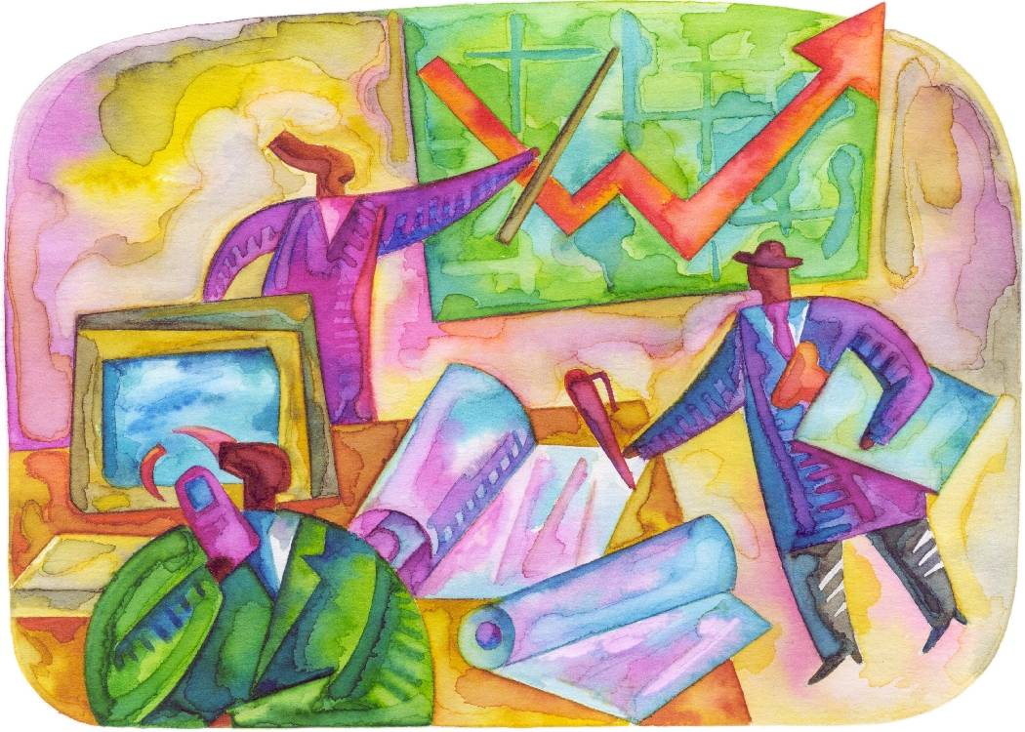
Research-led-teaching = Lecture format
Provide an example of current research and apply theory/lesson to those examples
  South Africa (background)
    Accountability & corruption
  Access & quality in sub-Saharan Africa
    Isomorphic mimicry

Slide 4
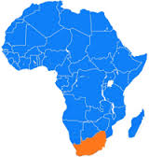
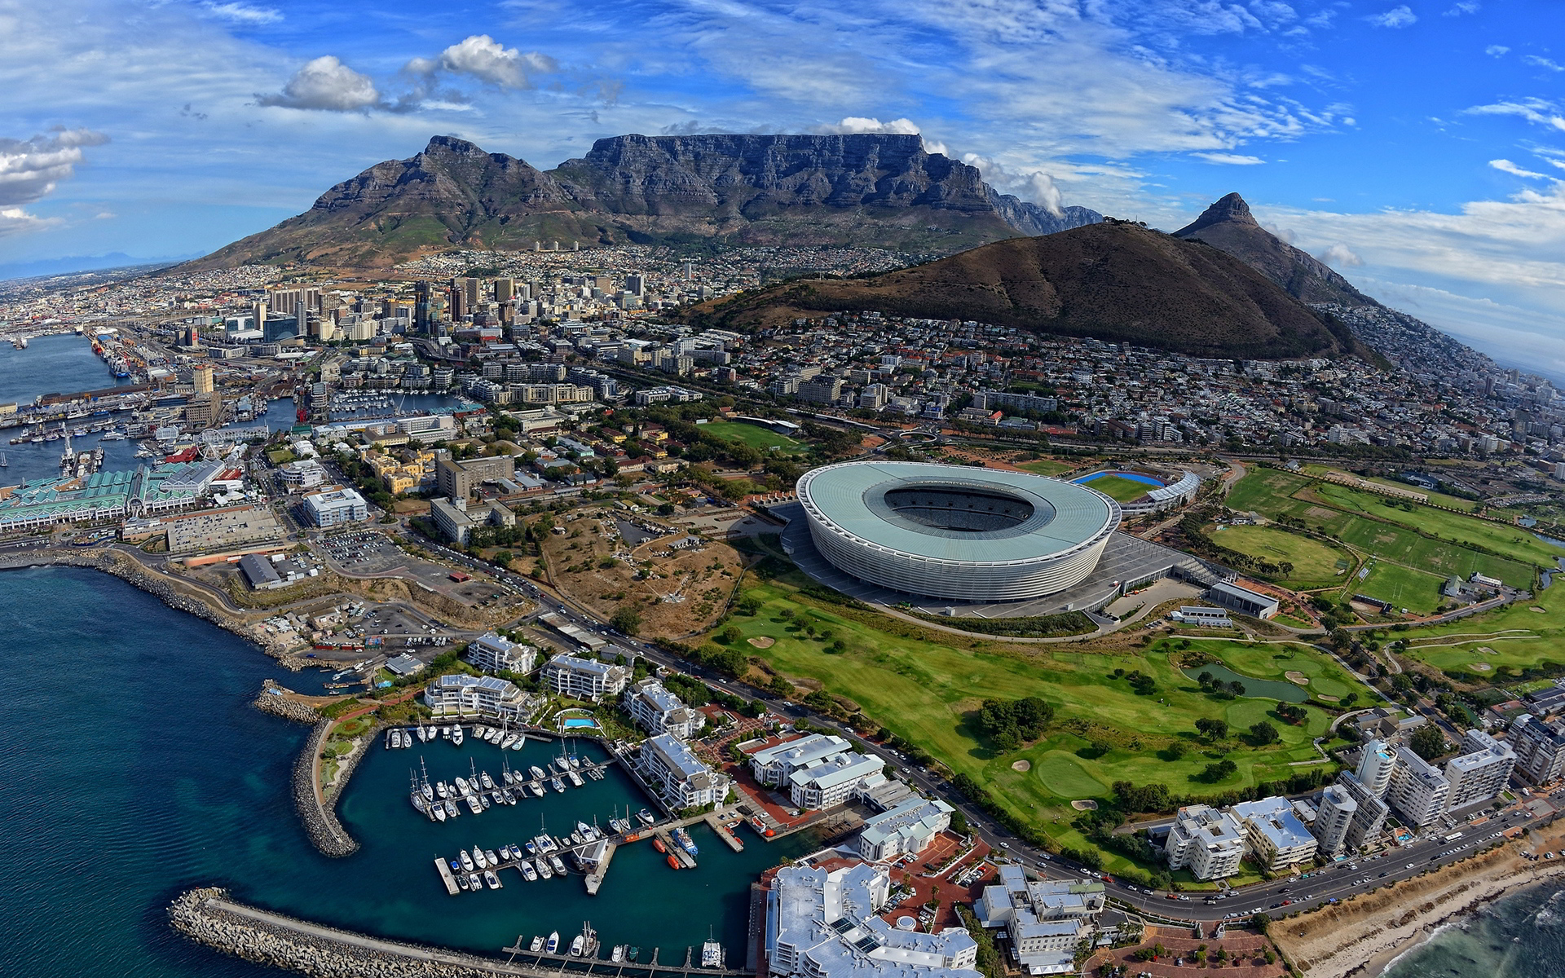
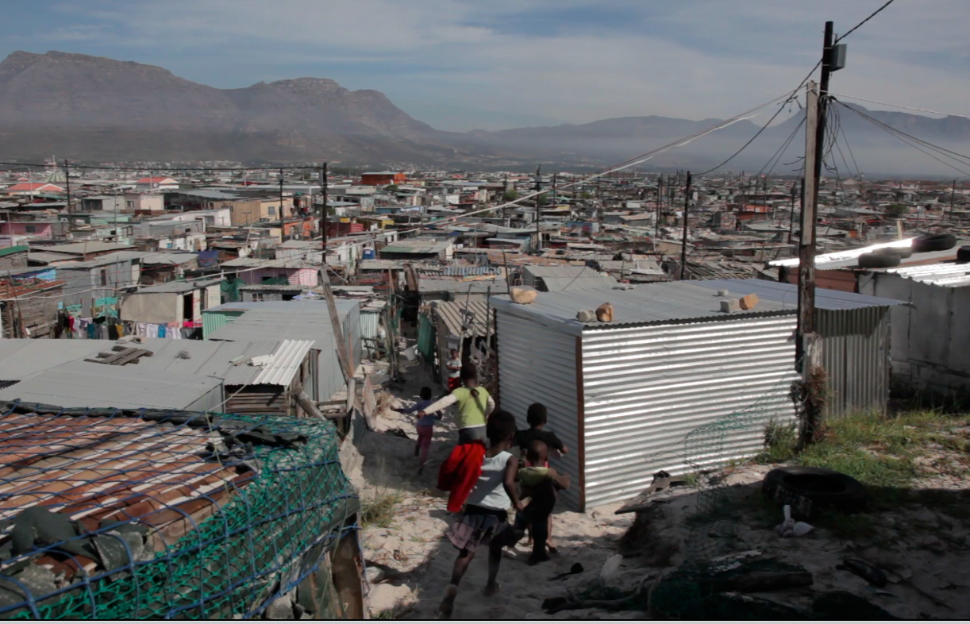
Research example #1:
The case of South Africa

Slide 5
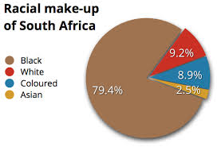
Background information
Approximately 50 million people
Apartheid 1948 - 1994
11 official languages
98% primary school enrolment (but only 50% reach matric)
Most unequal society in world (Gini = 0.63!)

Slide 6
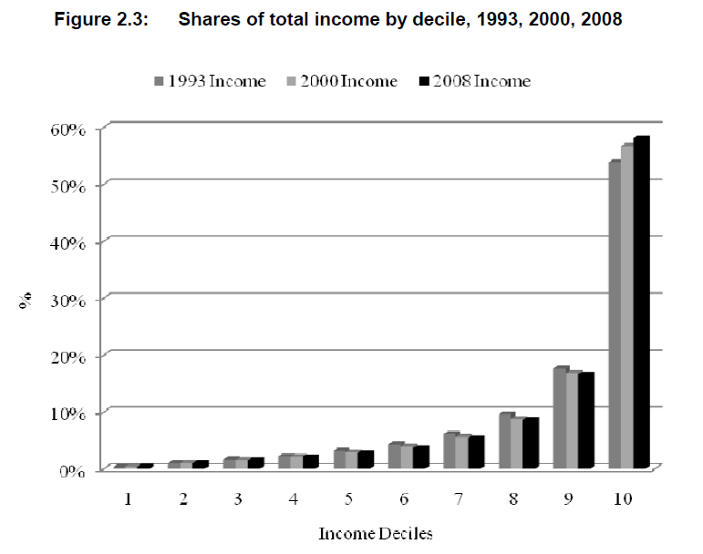
Inequality - SA

Slide 7


Slide 8



Not all schools are born equal
?
Pretoria Boys High School
SA public schools?
→ Different resources (Capacity)
→ Different pressures (Accountability)

Slide 9
Implications for reporting and modeling??

Slide 10
Labour Market
17%
Unemployed
(Broad - 33%)
Unskilled
(19%)
Semi-Skilled (31%)
University/FET
Type of institution (FET or University)
Quality of institution
Type of qualification (diploma, degree etc.)
Field of study (Engineering, Arts etc.)
High productivity jobs and incomes (17%)
Mainly professional, managerial & skilled jobs
Requires graduates, good quality matric or good vocational skills
Historically mainly white
High quality secondaryschool
High SES background
+ECD
High quality primary school
Minority (20%)
Some motivated, lucky or talented students make the transition
Unequal society
Big demand for good schools despite fees
Some scholarships/bursaries
Vocational training
Affirmative action
Majority (80%)
Quality
Low quality secondary
school
Attainment
Type
Low productivity jobs & incomes
Often manual or low skill jobs
Limited or low quality education
Minimum wage can exceed productivity
Low SES background
Low quality primary school
cf. Servaas van der Berg – QLFS 2011
Notes:
The QLFS classifies professions as follows: Highly skilled (legislators, senior officials and managers, professionals, technicians and associate profesionals); Semi-skilled (Clerks, service workers and shop and market personnel, skilled agricultural and fishery workers, craft and related trade workers, plant and machinery operators and assembly), Unskilled (Elementary occupations, domestic workers).

Slide 11

NSES question 42
NSES followed about 15000 students (266 schools) and tested them in Grade 3 (2007), Grade 4 (2008) and Grade 5 (2009).
Grade 3 maths curriculum: “Can perform calculations using appropriate symbols to solve problems involving: division of at least 2-digit by 1-digit numbers”
Even at the end of Grade 5 most (55%+) quintile 1-4 students cannot answer this simple Grade-3-level problem.
“The powerful notions of ratio, rate and proportion are built upon the simpler concepts of whole number, multiplication and division, fraction and rational number, and are themselves the precursors to the development of yet more complex concepts such as triangle similarity, trigonometry, gradient and calculus” (Taylor & Reddi, 2013: 194)
(Spaull & Viljoen, forthcoming)
Notes:
Taylor, N., & Reddi, B. (2013). Writing and learning mathematics. In N. Taylor, S. Van der Berg, & T. Mabogoane, Creating Effective Schools. Cape Town: Pearson.

Slide 12
Expenditure on education
2010/11
Total government expenditure
(31% GDP in 2010/11 – R733.5bn)
Government exp on education
(19.5% of Gov exp: R143.1bn)
17%
5%
Notes:
Figures from 2012 Public Expenditure Analysis report for UNICEF/DBE (Oxford Policy Management / Stellenbosch Economics) Education exp = 6.1% of GDP
Personnel exp = 78% of educ exp
Personnel exp = 4.8% of GDP

Slide 13




Accountability: teacher absenteeism
(SACMEQ III – 2007 – 996 teachers)
Western Cape
Eastern Cape
Limpopo
KwaZulu-Natal
% absent > 1 week striking
32%
81%
97%
82%
% absent > 1 month (20 days)
22%
62%
48%
73%
% absent > 2 months (40 days)
5%
12%
0%
10%
1.3 days a week
Notes:
Given that SACMEQ was done in September 2007, a maximum of 159 school days could have passed, hence 3 months = 1.3 days a week

Slide 14
Practical examples of corruption…
Bribes
  Anecdotal evidence that the “going rate” for an HOD position in SA is R85,000 ($8,500)
Kickbacks
  Anecdotal evidence that some principals and teachers arrange to split the teacher’s salary and the teacher is allowed to come only a few days a week.
Fraud
  Ghost teachers→ teachers who exist only on paper (implications for student:teacher ratio
Extortion
  Teachers who require their students to pay their “tuckshop money” in order to come to school
Favoritism
  Certain ethnic groups can be favored when services (upgrading schools) are being rolled out
All of the above have equity considerations given that they are usually more prominent in less affluent communities (which have less parental accountability)

Slide 15
Caveat: NB to remember…
Corruption is a problem but it is often correlated with many other important impediments:
  Lack of capacity to implement (bureaucrats)
  Lack of capacity to teach (teachers)
  Weak civil society
  Unhelpful norms/standards/expectations
    Eg of plastic surgeon & receipts in Portugal
Quite difficult to isolate causal impact of corruption alone

Slide 16

Research example #2:
Combining access to education (enrolment) and the quality of education (learning)

Slide 17
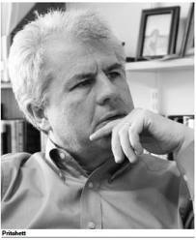
Access & Quality
“Defining the scope of the problem of “lack of education” must begin with the objectives of education – which is to equip people with the range of competencies…necessary to lead productive and fulfilling lives fully integrated into their societies and communities. Many of the international goals are framed exclusively as targets for universal enrolments or universal completion. But getting and keeping children “in school” is merely a means to the more fundamental objectives of…. creating competencies and learning achievement” (Pritchett, 2004, p. 1).

Slide 18

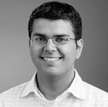
Access & Quality
“While nearly all countries’ education systems are expanding quantitatively nearly all are failing in their fundamental purpose….. A goal of school completion alone is an increasingly inadequate guide for action…focusing on the learning achievement of all children in a cohort a [Millennium Learning Goal] eliminates the false dichotomy between “access/enrolment” and “quality of those in school”: reaching an MLG depends on both”
(Filmer, Hasan, & Pritchett, 2006, p. 1).

Slide 19
Status quo
The extant literature on education in Africa is bifurcated in that reports either focus on:
  This is problematic for 2 reasons:
  The underlying assumption that enrolment and attainment are correlated with learning is often not true;
  Comparing learning outcomes without taking cognizance of the enrolment and dropout profiles of the countries under review is likely to bias the results. Countries with lower enrolments and higher dropout rates perform better on average, than otherwise similar countries that have higher enrolments and fewer dropouts (UNESCO, 2005, p. 48).
    Depend on two different data sources (population estimates and school census)
    NER’s very dependent on whether students are correctly aged or not (low NER due to late enrolment)
    (See Stukel & Feroz-Zada, 2010 of UIS)
Quality of education (SACMEQ/PASEC/ TIMSS/PIRLS)
Access to education (MDG/EFA/WB/IMF)
But not both
OR

Slide 20
Current research
Quality of education [SACMEQ]
Access to education [DHS]
Access to literacy/ numeracy
Core assumptions:
Schooling that does not improve cognitive outcomes is of limited value.
  Simple enrolment rates overstate the success of education systems in Africa.
Children should have acquired basic numeracy and literacy skills by the end of grade 6.
Children who do not survive to grade 6 or never enrolled in the first place are functionally illiterate and functionally innumerate.

Slide 21
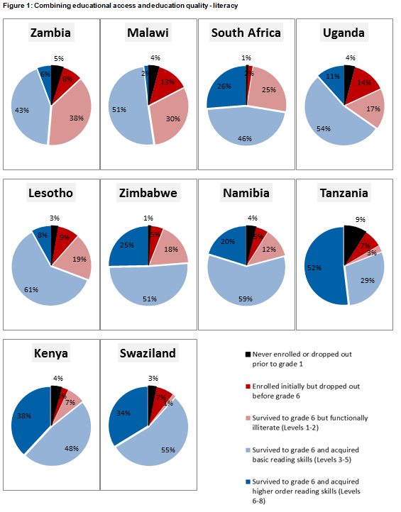
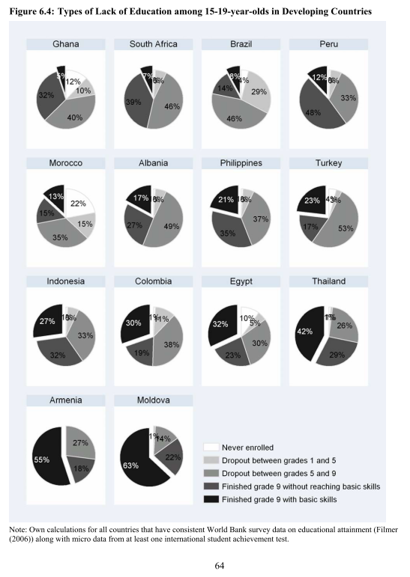
(Hanushek & Woessmann, 2008)
(Spaull & Taylor, 2014)

Slide 22
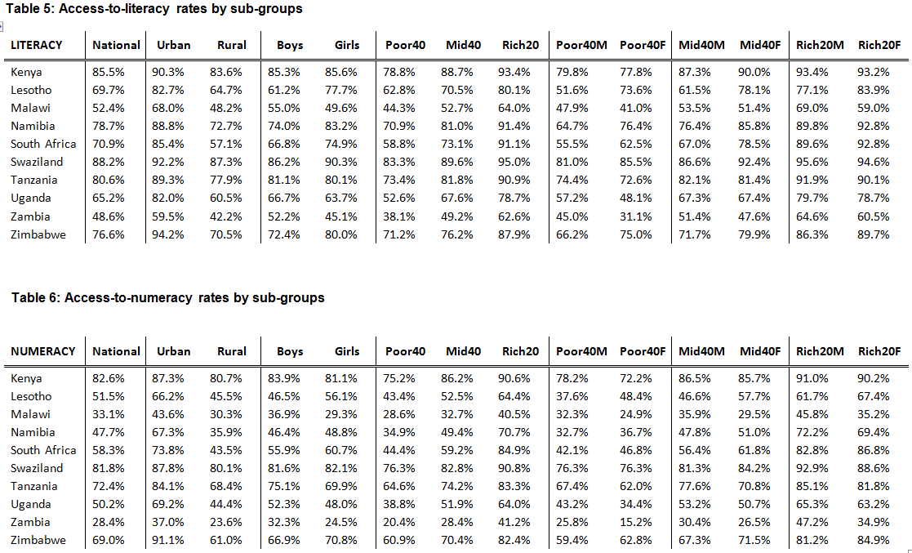
Access-to-literacy & Access-to-numeracy

Slide 23
Literacy gaps by gender, location & wealth

Slide 24
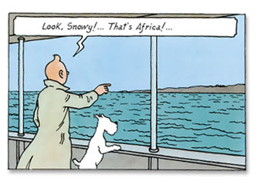
5 stylized facts about primary education in SSA…

Slide 25
In all countries the access-to-literacy gap between rich & poor >>> boys & girls
1)

Slide 26
In poorer countries boys have higher access-to-literacy and access-to-numeracy rates than girls, while in wealthier countries girls have higher access-to-literacy and access-to-numeracy rates than boys.
2)

Slide 27
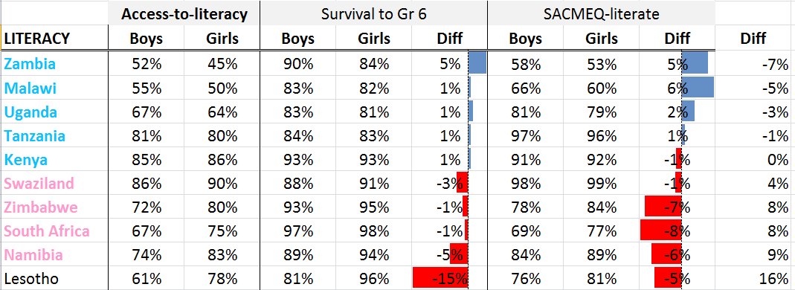
In looking at gender there is both a pro-boy access component and a pro-boy learning component in poorer (pro-boy) countries. In wealthier countries pro-girl A-to-L rates primarily due to more learning in school than access/survival advantages
2b)

Slide 28
Poor girls in poor countries face a double disadvantage of being socially excluded from education (Lewis & Lockheed, 2007)
3)

Slide 29
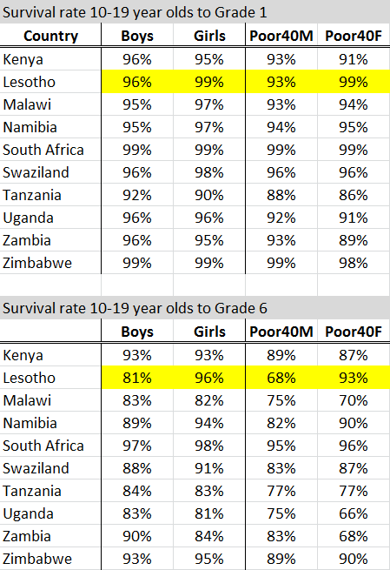
Lesotho is a peculiar case
4)

Slide 30
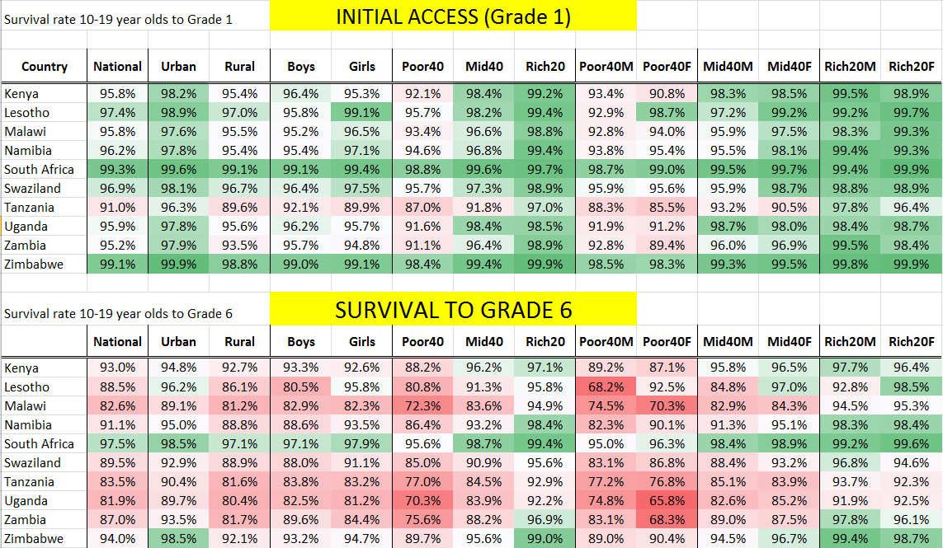
Even for the most disadvantaged country/group, INITIAL access is far less of a problem than SURVIVAL to grade 6
5)

Slide 31
But how does all of this link to corruption/accountability?

Slide 32
Accountability & corruption
CORRUPTION
Increased allocation of resources
Increased resources “on-the-ground”
Improvement in student outcomes
CORRUPTION
CORRUPTION
Often people speak about these three things interchangeably

Slide 33
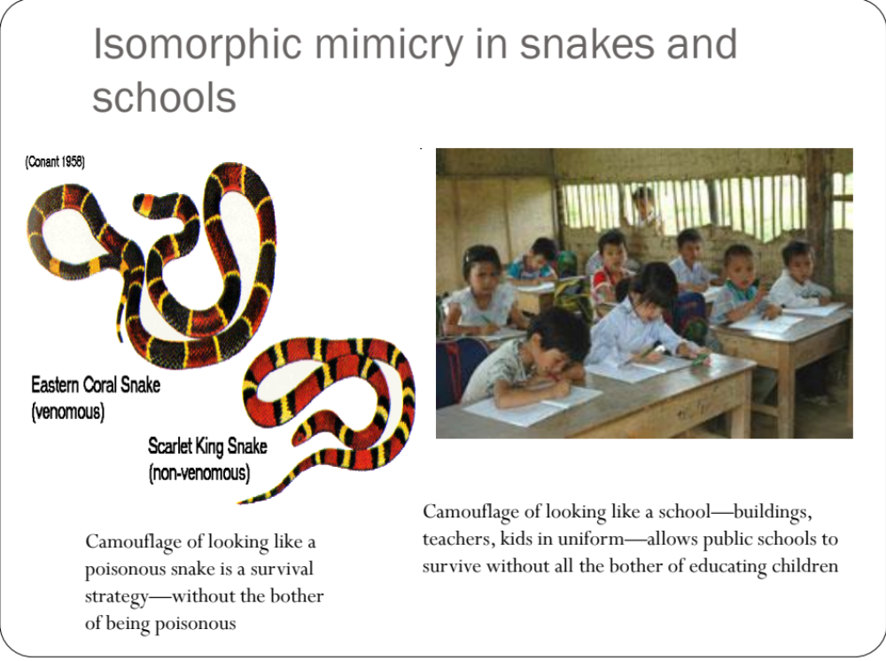
Pritchett, 2011

Slide 34
 | Embezzlement | Bribery | Fraud | Extortion | Favoritism
DEFINITION | Theft of public resources by public officials | Payment (in money or in kind) given or taken in a corrupt relationship | Economic crime that involved some kind of trickery, swindle or deceit | Money & other resources extracted by the use of coercion, violence or threats to use force | Mechanism of power abuse implying ‘privatization’ and a highly biased distribution of state resources
FAMILY OF TERMS | Misappropriation, diversion, leakage, capture of funds | Kickbacks, gratuities, baksheesh, pay-offs, speed and grease money | Forgery, smuggling, counterfeit | Blackmail, informal taxation | Nepotism, cronyism, clientelism, bias
EXAMPLES FROM EDUCATION SECTOR | Educational funds used for political campaigns. School funds diverted for private interest. | Bribes paid to be recruited as a teacher. Bribes paid to be admitted to university | Ghost teachers. Paper mills and diploma mills | Illegal fees collected to be admitted to school. Sexual harassment for promotion | Recruitment of administrators based on their membership of a political party. Good marks obtained due to favoritism.
(Source: Amundsen, 2000 cited in Kurpe, Olive & Reeve 2011)

Slide 35
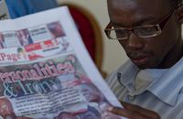
Practical examples: leakages in Uganda
Capitation grant covering non-wage expenditure, financed and run by central govt (using province & district as distribution channels) sending money to schools.
In 1995 only 20% of money allocated to the school actually reached the school (funding leaks)
Information campaign published budget-flows to districts (incl amounts and dates) in national newspapers incl local-language editions.
By 2001 80% of money allocated to the school actually reached the school.
See Reinikka & Svensson (2005, 2006)

Slide 36
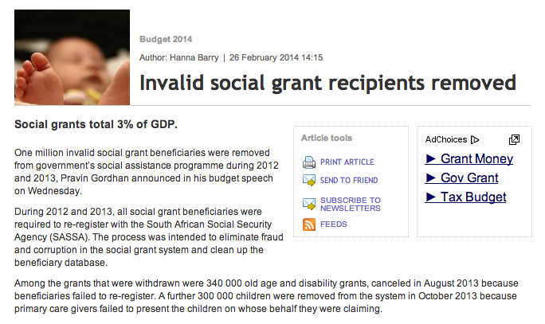
Practical examples: leakages in CSG

Slide 37
Conclusions
Important to understand what form/level of corruption we are talking about
  (limited number of million $ tenders or thousands of small-scale bribes?)
Why do/should we care about corruption?
To what extent are everyday corrupt behaviors embedded in the institutional/cultural/societal norms and expectations? Important when thinking about remedies.
  (i.e. is it opportunistic or is it systemic?)
Understanding the scale of the problem and where corruption fits into the overall “diagnosis” of the education problem – corruption may not be the binding constraint to progress
  There is some level of corruption in every country (often it just takes different forms. For the US, highlighting corruption as the most important problem to eliminate in order to improve education is silly, likewise with many developing countries. See these problems in perspective.

Slide 38
Comments & Questions?
Slides & research available at nicspaull.com/research
NicholasSpaull@gmail.com

Slide 39
Accountability and the principal-agent problem

Slide 40
Principal-Agent Problem
Asymmetric information
(Parents do not know what’s going on in the classroom)
PRINCIPAL
(Parents)
Employs
Accountable to
On behalf of
AGENT
(Teacher)
To perform
Task
(Teaching)

Slide 41
Principal-Agent Problem
Principal (country’s MoE) would like to ensure that its agents (school directors and teachers) deliver schooling that results in learning
Difficult because education is:
  Discretionary
    Teachers use judgment to decide what to teach and how
  Variable
    Teacher must customize services to students with different aptitudes, motivations and learning styles
  Transaction intensive
    Repeated & frequent interactions between teachers and students
  (Bruns, Filmer & Patrinos, 2013: 11)

Slide 42
Accountability framework
Bruns, Filmer & Patrinos (2013) and WDR (2004)
The State
Voice/politics
Long route of accountability
Compact
Client power
Citizens/clients
Providers
Short route to accountability
Notes:
See also https://blogs.worldbank.org/futuredevelopment/what-2004-wdr-got-wrong

Slide 43
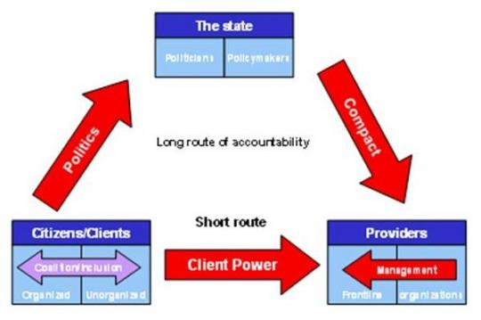
WDR 2004

Slide 44
Breaks in the chain
Often the long-route to accountability involves many links…
  Citizens→ government → Ministry of education→ service providers → district officials → circuit officials → principals → teachers
  A break in the chain at any of these levels means that the accountability “chain” is broken.
Link 1: Poor people may not have sufficient “voice” to influence politicians → lions share of public schooling expenditures may go to urban schools
Link 2: Policy-makers may not be able to hold providers accountable → eg. absentee teachers

Slide 45
Breaks in the chain
Often there is a focus on the second link (for example trying to decrease absenteeism using camera’s in classroom’s) but if the first link is broken (dysfunctional politics) nothing will happen
Before trying to fix incentives to providers we need to work on incentives facing politicians
Notes:
http://www.povertyactionlab.org/publication/absenteeism-showing-first-step

Slide 46
Principal-agent problem – multiple principals and multiple agents. Who to please?
 | AGENT
PRINCIPAL |  | Government | Min of Ed | District | Principal | Teachers
 | Citizen
 | Government
 | Ministry of Education
 | District officials
 | Principal
 | Parents
Depending on who the “agent” sees as their “principal”, they will act differently. Often concerns of parents not major factor.
NB power relations between parents and principals in Africa

Slide 47
When it’s not corruption: Accountability and capacity

Slide 48
Accountability & capacity
CAPACITY
Increased allocation of resources
Increased resources “on-the-ground”
Improvement in student outcomes
CAPACITY
CAPACITY

Slide 49
Accountability and capacity
Many of the arguments put forward by Elmore et al have relevance when discussing the break-down between resources and results in Africa

Slide 50
Accountability without capacity
“Accountability systems and incentive structures, no matter how well designed, are only as effective as the capacity of the organization to respond. The purpose of an accountability system is to focus the resources and capacities of an organization towards a particular end. Accountability systems can’t mobilize resources that schools don’t have...the capacity to improve precedes and shapes schools’ responses to the external demands of accountability systems (Elmore, 2004b, p. 117).
“If policy-makers rely on incentives for improving either a school or a student, then the question arises, incentives to do what? What exactly should educators in failing schools do tomorrow - that they do not do today - to produce more learning? What should a failing student do tomorrow that he or she is not doing today?” (Loveless, 2005, pp. 16, 26).

Slide 51
Capacity without accountability
“In the absence of accountability sub-systems, support measures are very much a hit and miss affair. Accountability measures provide motivation for and direction to support measures, by identifying capacity shortcomings, establishing outcome targets, and setting in place incentives and sanctions which motivate and constrain teachers and managers throughout the system to apply the lessons learned on training courses in their daily work practices. Without these, support measures are like trying to push a piece of string: with the best will in the world, it has nowhere to go. Conversely, the performance gains achieved by accountability measures, however efficiently implemented, will reach a ceiling when the lack of leadership and technical skills on the part of managers, and curricular knowledge on the part of teachers, places a limit on improved performance. Thus, the third step in improving the quality of schooling is to provide targeted training programs to managers and teachers. To achieve optimal effects, these will need to connect up with and be steered by accountability measures” (Taylor, 2002, p. 17).

Slide 52

Notes:
From a forthcoming report on accountability on the

Slide 57


Slide 58
“Only when schools have both the incentive to respond to an accountability system as well as the capacity to do so will there be an improvement in student outcomes.” (p22)

Slide 59
Why don’t resources translate into results in most African countries?
Principal-agent problem
Widespread corruption
  No accountability (i.e. no consequences for non-performance)
Inability/incapacity to implement policy
  Lack of skills and institutional capacity to implement (sometimes complex) policies.
Usually a mixture of all of the above.
  Example of the Limpopo textbook saga in SA

Slide 60
Motivation for increasing resources
Basic dignity rationale (ethics / human rights)
  Water, sanitation, electricity, brick buildings
  (Minimum Norms and Standards)
Improving learning outcomes rationale (achievement)
  Existing research in SA shows exceedingly weak link between increased expenditures and improved outcomes
  Allocation of new resources rarely based on evidence (‘I had a dream’ approach to policymaking)
  LTSM / workbooks
  Grade R
  Libraries and laboratories? (difficult to motivate)
  Nutrition programs (extending to high school?)

Slide 61
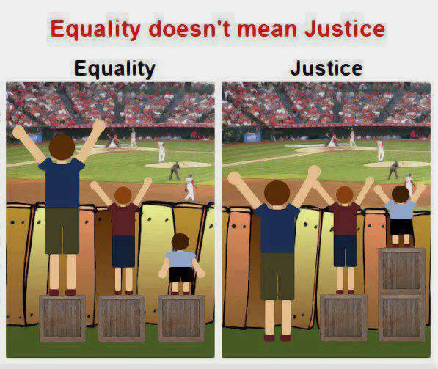
Pro-poor allocation of resources?
Are there real/significant differences in household SES and school resources between Q1, Q2 and Q3?
  Rethinking how we measure quintiles
Is the allocation of financial resources pro-poor?
  Allocated resources vs realized resources (differential efficiency) (Taylor 2011)
  Pre and post parental ‘top-ups’/fees?
Is the allocation of human resources pro-poor?
  How do we incentivize the best teachers to teach in the poorest schools?

Slide 62
Important distinctions
Improved student outcomes
Increased resources “on-the-ground”
Increased allocation of resources
Often these 3 are spoken about interchangeably

Slide 63
Important distinctions
Improved student outcomes
Increased resources “on-the-ground”
Increased allocation of resources
Inefficiency / corruption

Slide 64
Important distinctions
Improved student outcomes
Increased resources “on-the-ground”
Increased allocation of resources
Inefficiency / corruption
Lack of capacity

Slide 65
Important distinctions
Improved student outcomes
Increased resources “on-the-ground”
Increased allocation of resources
Inefficiency / corruption
Lack of capacity
Lack of accountability

Slide 66
Accountability & Capacity

Slide 67

Conclusion
Ensuring that public funding is actually pro-poor and also that it actually reaches the poor.
Understanding whether the motivation is for human dignity reasons or improving learning outcomes.
Ensuring that additional resources are allocated based on evidence rather than anecdote.
The need for BOTH accountability AND capacity.

Slide 68
Some questions to think about:
In the South African education system,
  What are the capacity-building opportunities available to teachers?
  What consequences (if any) revert in the event of non-performance?
  How can ANA be used for accountability?
    Example of balancing the rights and concernes

Slide 69
Binding constraints approach

Slide 70


Slide 73
“The left hand barrel has horizontal wooden slabs, while the right hand side barrel has vertical slabs. The volume in the first barrel depends on the sum of the width of all slabs. Increasing the width of any slab will increase the volume of the barrel. So a strategy on improving anything you can, when you can, while you can, would be effective. The volume in the second barrel is determined by the length of the shortest slab. Two implications of the second barrel are that the impact of a change in a slab on the volume of the barrel depends on whether it is the binding constraint or not. If not, the impact is zero. If it is the binding constraint, the impact will depend on the distance between the shortest slab and the next shortest slab” (Hausmann, Klinger, & Wagner, 2008, p. 17).
Notes:
Hausmann, R., Klinger, G., & Wagner, R. (2008). Doing Growth Diagnostics in Practice: A 'Mindbook'. CID Workinf Paper No. 177. Center for International Development at Harvard University.

Slide 74
Basic Literacy and Numeracy (Gr 6)
What proportion of South African grade 6 children were functionally literate and functionally numerate?
Functionally illiterate: a functionally illiterate learner cannot read a short and simple text and extract meaning.
Functionally innumerate: a functionally innumerate learner cannot translate graphical information into fractions or interpret everyday units of measurement.

Slide 75


Grade 6 Literacy
SA Gr 6 Literacy
Kenya Gr 6 Literacy
1%
5%
7%
25%
49%
46%
39%
Public current expenditure per pupil: $1225
Additional resources is not the answer
Public current expenditure per pupil: $258
27%
Notes:
Technically it is never enrolled or dropped out before grade 6 (using DHS data) – see Taylor and Spaull (Forthcoming)

Slide 76
Accountability: teacher absenteeism
(SACMEQ III – 2007 – 996 teachers)
4th/15
Notes:
Absenteeism here is average between both maths and reading teachers

Slide 77
Accountability: teacher absenteeism
(SACMEQ III – 2007 – 996 teachers)
15th/15
Notes:
Absenteeism here is average between both maths and reading teachers

Slide 78


Benefits of education
Ed
S
H
Ec
Improved human rights
Empowerment of women
Reduced societal violence
Promotion of a national (as opposed to regional or ethnic) identity
Increased social cohesion
Lower fertility
Improved child health
Preventative health care
Demographic transition
Improvements in productivity
Economic growth
Reduction of inter-generational cycles of poverty
Reductions in inequality
$
Health
Economy
Society
Specific references: lower fertility (Glewwe, 2002), improved child health (Currie, 2009), reduced societal violence (Salmi, 2006), promotion of a national - as opposed to a regional or ethnic - identity (Glewwe, 2002), improved human rights (Salmi, 2006), increased social cohesion (Heyneman, 2003), Economic growth – see any decent Macro textbook, specifically for cognitive skills see (Hanushek & Woessman 2008)

Slide 79
Accountability: teacher absenteeism
  Teacher absenteeism is regularly found to be an issue in many studies
    2007: SACMEQ III conducted – 20 days average in 2007
    2008: Khulisa Consortium audit – HSRC (2010) estimates that 20-24 days of regular instructional time were lost due to leave in 2008
    2010: “An estimated 20 teaching days per teacher were lost during the 2010 teachers’ strike” (DBE, 2011: 18)
    Importantly this does not include time lost where teachers were at school but not teaching scheduled lessons
      A recent study observing 58 schools in the North West concluded that “Teachers did not teach 60% of the lessos they were scheduled to teach in North West” (Carnoy & Chisholm et al, 2012)
Notes:
Also see Chisholm (2005) and Shisana et al (2005) quoted in HSRC (2010)

Slide 80

Two school systems not one?
Socioeconomic Status
Grade 6 [2007]
Data: SACMEQ
(Spaull, 2011)

Slide 81


Gr 1 - Gr 2 - Gr 3 – Gr 4 – Gr 5 – Gr 6 – Gr 7 – Gr 8 – Gr 9 - Gr 10 – Gr 11 – Gr 12
Foundation Phase
Intermediate Phase
Senior Phase
FET Phase
PIRLS 2006 – see Shepherd (2011)
prePIRLS 2011
Grade 4 – all 11 languages
433 schools, 19259 students
____________________________________
Underperformance
29% of gr4 students did not reach the low international benchmark – they could not read
SA performs similarly to Botswana, but 3 years learning behind average Columbian Gr4
Inequality
Linguistic inequalities: Large differences by home language – Xitsonga, Tshivenda and Sepedi students particularly disadvantaged
PIRLS (2006) showed LARGE differences between African language schools and Eng/Afr schools
Howie et al (2011)
*Data now available for download

Slide 82
3 biggest challenges - SA
Failure to get the basics right
  Children who cannot read, write and compute properly (Functionally illiterate/innumerate) after 6 years of formal full-time schooling
  Often teachers lack even the most basic knowledge
Equity in education
  2 education systems – dysfunctional system operates at bottom of African countries, functional system operates at bottom of developed countries.
  More resources is NOT the silver bullet – we are not using existing resources
Lack of accountability
  Little accountability to parents in majority of school system
  Little accountability between teachers and Department
  Teacher unions abusing power and acting unprofessionally

Slide 83
Way forward?
Acknowledge the extent of the problem
  Low quality education is one of the three largest crises facing our country (along with HIV/AIDS and unemployment). Need the political will and public support for widespread reform.
Focus on the basics
  Every child MUST master the basics of foundational numeracy and literacy these are the building blocks of further education – weak foundations = recipe for disaster
  Teachers need to be in school teaching (re-introduce inspectorate?)
  Every teacher needs a minimum competency (basic) in the subjects they teach
  Every child (teacher) needs access to adequate learning (teaching) materials
  Use every school day and every school period – maximise instructional time
Increase information, accountability & transparency
  At ALL levels – DBE, district, school, classroom, learner
  Strengthen ANA
  Set realistic goals for improvement and hold people accountable

Slide 84
When faced with an exceedingly low and unequal quality of education do we….
A) Increase accountability {US model}
    Create a fool-proof highly specified, sequenced curriculum (CAPS/workbooks)
    Measure learning better and more frequently (ANA)
    Increase choice/information in a variety of ways
B) Improve the quality of teachers {Finnish model}
    Attract better candidates into teaching degrees → draw candidates from the top (rather than the bottom) of the matric distribution
    Increase the competence of existing teachers (Capacitation)
    Long term endeavor which requires sustained, committed, strategic, thoughtful leadership (something we don’t have)
C) All of the above {Utopian model}
Perhaps A while we set out on the costly and difficult journey of B??

