Slide 1




Is education in SA improving?
How do we know it is or it isn’t?
www.NicSpaull.com/research
Equal Education Society UCT | 25 March 2014

Slide 2
1) South Africa performs extremely poorly on local and international assessments of educational achievement

Slide 3





State of SA education since transition
“Although 99.7% of South African children are in school…the outcomes in education are abysmal” (Manuel, 2011)
“Without ambiguity or the possibility of misinterpretation, the pieces together reveal the predicament of South African primary education” (Fleisch, 2008: 2)
“Our researchers found that what students know and can do is dismal” (Taylor & Vinjevold, 1999)
“It is not an overstatement to say that South African education is in crisis.” (Van der Berg & Spaull, 2011)

Slide 4


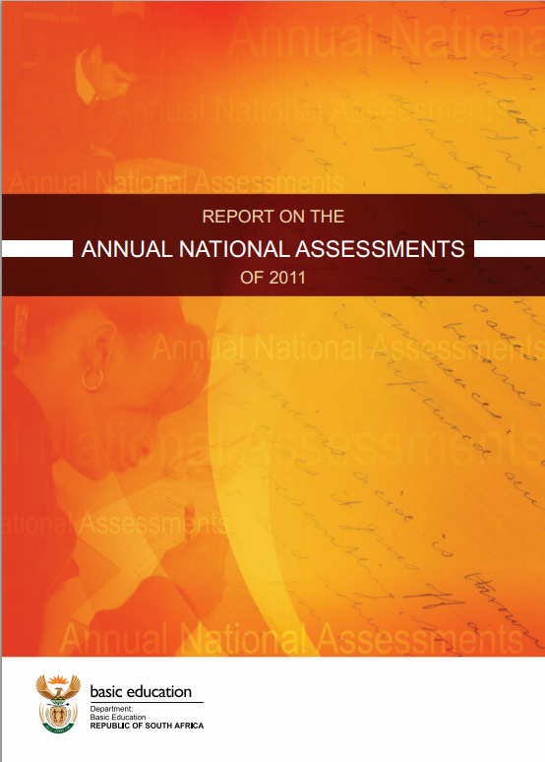






Student performance 2003-2011
TIMSS (2003)
→ PIRLS (2006)
→ SACMEQ (2007)
→ ANA (2011)
→ TIMSS (2011)
→ prePIRLS (2011)
TIMSS 2003 (Gr8 Maths & Science)
Out of 50 participating countries (including 6 African countries) SA came last
Only 10% reached low international benchmark
No improvement from TIMSS 1999-TIMSS 2003
PIRLS 2006 (Gr 4/5 – Reading)
Out of 45 participating countries SA came last
87% of gr4 and 78% of Gr 5 learners deemed to be “at serious risk of not learning to read”
SACMEQ III 2007 (Gr6 – Reading & Maths)
SA came 10/15 for reading and 8/15 for maths behind countries such as Swaziland, Kenya and Tanzania
ANA 2011 (Gr 1-6 Reading & Maths)
Mean literacy score gr3: 35%
Mean numeracy score gr3: 28%
Mean literacy score gr6: 28%
Mean numeracy score gr6: 30%
TIMSS 2011 (Gr9 – Maths & Science)
SA has joint lowest performance of 42 countries
Improvement by 1.5 grade levels (2003-2011)
76% of grade nine students in 2011 still had not acquired a basic understanding about whole numbers, decimals, operations or basic graphs, and this is at the improved level of performance
prePIRLS2011 (Gr 4 Reading)
29% of SA Gr4 learners completely illiterate (cannot decode text in any langauge)
NSES 2007/8/9
Systemic Evaluations 2007
Matric exams
Notes:
The most comprehensive reports for each of these datasets are as follows: SACMEQ (Moloi & Chetty, 2011), TIMSS (Reddy, 2006), PIRLS (Howie, et al., 2008), Systemic Evaluations (Department of Education, 2008), National School Effectiveness Study (Taylor, 2011b),and the Annual National Assessments (Department of Basic Education, 2011).

Slide 5
Qualifications by age (birth cohort), 2011 (Van der Berg, 2013)

Slide 6
Basic overview of matric 2013
The good…
Matric pass rate increased to 78%
Bachelor pass rate increased to 31%
More students passing mathematics
The bad…
Some questioning quality of matric pass
Public starting to ask questions about why uni’s are using NBTs
Concerns over “culling” and whether this lead to increases in NWP and FST
The ugly…
Grade 8→12 dropout is 2x as high (50%) in Q1 rel to Q5 (25%)
Because of differences in average quality of education, a white child is 7 times more likely than a black child to obtain a Maths D+ and 38 times as likely to get an A- aggregate (using earlier matric data)

Slide 7
Focus on mathematics – things are improving
Number of students taking mathematics (as opposed to maths-lit) has declined since 2008, but proportion passing has risen
  Not necessarily a bad thing since many of those students shouldn’t have been taking mathematics in the first place
Source: Taylor (2014)

Slide 8
What proportion of matrics take and pass mathematics?
Important statistic is the number passing which was declining from 2008 → 2011 but has increased between 2011 → 2013
Source: Taylor (2014)

Slide 9
Matric mathematics statistics (Taylor 2014)
 | Numbers wrote maths | Number passed maths | Maths pass rate | Proportion taking maths | Proportion passing maths
2008 | 298821 | 136503 | 45.70% | 56.10% | 25.60%
2009 | 290407 | 133505 | 46.00% | 52.60% | 24.20%
2010 | 263034 | 124749 | 47.40% | 48.80% | 23.20%
2011 | 224635 | 104033 | 46.30% | 45.30% | 21.00%
2012 | 225874 | 121970 | 54.00% | 44.19% | 23.86%
2013 | 241509 | 142666 | 59.10% | 42.96% | 25.38%
Source: Taylor (2014)
NOTE: All of the above is under the proviso that that quality of the mathematics exam has remained constant over the period. If not then we can’t say much.

Slide 10
Focus on dropout

Slide 11
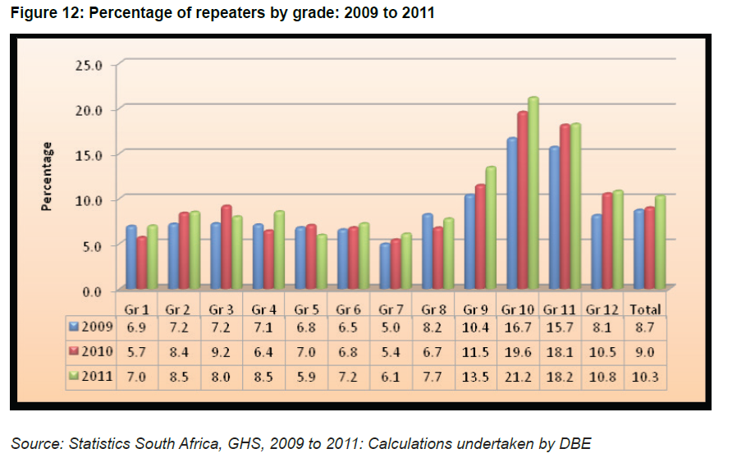
When does grade repetition happen?

Slide 12
Dropout between Gr8 and Gr12
Of 100 Gr8 quintile 1 students in 2009, 36 passed matric and 10 qualified for university
Of 100 Gr8 quintile 5 students in 2009, 68 passed matric and 39 qualified for university
“Contrary to what some would like the nation and the public to believe that our results hide inequalities, the facts and evidence show that the two top provinces (Free State and North West) are rural and poor.” (Motshekga, 2014)

Slide 13
550,000 students drop out before matric
99% do not get a non-matric qualification (Gustafsson, 2011: p11)
What happens to them? 50% youth unemployment.

Slide 14
Proportion of a cohort of students that do not survive to grade 12, fail matric, pass matric, and pass matric with a Bachelor's pass in each province in 2011

Slide 15


Slide 16
Labour Market
17%
Unemployed
(Broad - 33%)
Unskilled
(19%)
Elementary occupations & domestic workers
Semi-Skilled (31%)
Clerks, service workers, shop personnel, skilled agric/fishery workers, plant and machinery operators)
University/FET
Type of institution (FET or University)
Quality of institution
Type of qualification (diploma, degree etc.)
Field of study (Engineering, Arts etc.)
High productivity jobs and incomes (17%)
Mainly professional, managerial & skilled jobs
Requires graduates, good quality matric or good vocational skills
Historically mainly white
High quality secondaryschool
High SES background
+ECD
High quality primary school
Minority (20%)
Some motivated, lucky or talented students make the transition
Unequal society
Big demand for good schools despite fees
Some scholarships/bursaries
Vocational training
Affirmative action
Majority (80%)
Quality
Low quality secondary
school
Attainment
Type
Low productivity jobs & incomes
Often manual or low skill jobs
Limited or low quality education
Minimum wage can exceed productivity
Low SES background
Low quality primary school
cf. Servaas van der Berg – QLFS 2011
Notes:
The QLFS classifies professions as follows: Highly skilled (legislators, senior officials and managers, professionals, technicians and associate profesionals); Semi-skilled (Clerks, service workers and shop and market personnel, skilled agricultural and fishery workers, craft and related trade workers, plant and machinery operators and assembly), Unskilled (Elementary occupations, domestic workers).

Slide 17
Are things improving?
What should we be using to measure changes over time?
  DEFINITELY *NOT* ANAs
    Not psychometrically calibrated to be comparable year-on-year
    No anchor items
    No Item Response Theory
    Not externally evaluated and independently marked
    No, no, no.
    Need a broader discussion of the potential perils of ANAs. Under-appreciated at the moment. ANA Fridays?!
  Matric – sort of yes
    Considerable institutional memory (decades of expertise and precedent)
    Excludes half the cohort so not a good reflection of total education system
    Can be tricky to tease out *real* trends. Things like subject combinations, culling, pass thresholds and clumping around the threshold etc.
  Cross-national assessments – yes.
    Best way of determining if there are changes over long periods of tims
      TIMSS, PIRLS/prePIRLS/SACMEQ/ (perhaps PISA in SA soon)
Education and schooling (the main vehicle we use to “do/get it”) cannot be reduced to test scores or particular subjects (numeracy and literacy). However, that does *NOT* mean that there is no place for testing. Many educational outcomes are measurable and providing feedback to everyone (DBE, principals, parents, students) is an important form of accountability.

Slide 18
TIMSS 1995 → 2011
Figure 1: South African mathematics and science performance in the Trends in International Mathematics and Science Study (TIMSS 1995-2011) with 95% confidence intervals around the mean

Slide 19
Conclusion?
“The only cross-national survey of educational achievement that has shown any improvement has been TIMSS 2011 where there was a one and a half grade-level improvement in mathematics and science over the 2002-2011 period at the grade nine level. While this shows that there have been some recent improvements, it is difficult to celebrate when one considers how low the post-improvement level of performance really is. Three quarters (76%) of grade nine students in 2011 still had not acquired a basic understanding about whole numbers, decimals, operations or basic graphs, and this is at the improved level of performance. Part of the reason for the improvement is the fact that we started from an exceedingly low base in 2002. To place this in perspective, South Africa’s post-improvement level of performance is still the lowest of all participating countries, with the average South African grade nine child performing between two and three grade levels lower than the average grade eight child from middle-income countries”
  (Spaull 2013 CDE report)
Yes, things are starting to improve in SA education. Starting from a VERY low base there are relatively clear indications that things are improving. Difficult to celebrate when one considers how low post-improvement level of performance.

Slide 20
Way forward?
Acknowledge the extent of the problem
  Low quality education is one of the three largest crises facing our country (along with HIV/AIDS and unemployment). Need the political will and public support for widespread reform.
Focus on the basics
  Every child MUST master the basics of foundational numeracy and literacy these are the building blocks of further education – weak foundations = recipe for disaster
  Teachers need to be in school teaching (re-introduce inspectorate?)
  Every teacher needs a minimum competency (basic) in the subjects they teach
  Every child (teacher) needs access to adequate learning (teaching) materials
  Use every school day and every school period – maximise instructional time
  Have to make sure we don’t make the same mistakes with Grade R as we have with the rest of schooling
Increase information, accountability & transparency
  At ALL levels – DBE, district, school, classroom, learner
  Strengthen ANA. Get psychometrics right (so comparable across years), externally evaluate @ 1 grade
  Set realistic goals for improvement and hold people accountable
Focus on teachers
  Have to find a way of raising the quality of both (1) new, but especially (2) existing teachers
  Q&A - Prof Muller (UCT): What do you think is the most under-researched area in South African education?
    “We have no idea what it will take to make knowledgeable teachers out of clueless ones, at least not while they are actually on-the-job.”

Slide 21
Further issues we can discuss
Solution: Accountability & capacity
Solution: Identifying binding constraints
Mathematics teacher CK in SA
Grade R in SA
New and existing RESEP projects
What proportion of SA kids make it to uni?
Things to think about when introducing automated/tech solutions in SA (or anywhere)
  Especially with reference to Dell Dashboards

Slide 22
Thank you
Comments & Questions?
This presentation and papers available online at: www.nicspaull.com/research

Slide 23
Important distinctions
Improved student outcomes
Increased resources “on-the-ground”
Increased allocation of resources
Often these 3 are spoken about interchangeably

Slide 24

Notes:
From a forthcoming report on accountability on the

Slide 29


Slide 30
“Only when schools have both the incentive to respond to an accountability system as well as the capacity to do so will there be an improvement in student outcomes.” (p22)

Slide 31
Focus on higher education

Slide 32
Are matriculants prepared for higher education?
"It is widely accepted that student underpreparedness is the dominant learning-related cause of the poor performance patterns in higher education. It follows that it is the school sector that is most commonly held responsible. However, if higher education is to rely on improvement in schooling to deal with the systemic faults affecting it, there needs to be a rigorous assessment of the prospects of sufficient improvement being achieved within that sector. While the Task Team believes that the level of dysfunction in schooling must continue to be a primary focus of corrective effort, it has concluded that the overwhelming weight of evidence from current analyses of the school sector is that there is effectively no prospect that it will be able, in the foreseeable future, to produce the numbers of well-prepared matriculants that higher education requires.“
CHE (2013) ”Proposal for undergraduate curriculum reform” http://www.che.ac.za/announcements/task-team-report-extended-curriculum-released
Why are universities using the National Benchmarking Tests (NBTs) now when they didn’t use them 10 years ago? Why for admission?
  Presumably these tests are better able to distinguish between students that will and won’t be able to succeed at university

Slide 33

Higher education in perspective
When speaking about higher education it’s important to remember that this is only a very small proportion of the population
Source: DBE (2013) Internal Efficiency of the schooling System

Slide 34

Gustafsson, 2011 – When & how WP
“What do the magnitudes from Figure 4 mean in terms of the holding of qualifications? In particular, what widely recognised qualifications do the 60% of youths who do not obtain a Matric hold? …Only around 1% of youths hold no Matric but do hold some other non-school certificate or diploma issued by, for instance, an FET college”
(Gustafsson, 2011: p.11)
10%

Slide 35

How does SA fair internationally?
Gustafsson (2011) “The when and how of leaving school”

Slide 36
Dropout and weak performance in matric is essentially a function of low-quality of education in earlier grades and accumulated learning deficits

Slide 37
Insurmountable learning deficits: 0.3 SD

Slide 38

NSES question 42
NSES followed about 15000 students (266 schools) and tested them in Grade 3 (2007), Grade 4 (2008) and Grade 5 (2009).
Grade 3 maths curriculum: “Can perform calculations using appropriate symbols to solve problems involving: division of at least 2-digit by 1-digit numbers”
At the end of Grade 5 most (55%+) quintile 1-4 students cannot answer this simple Grade-3-level problem.
Notes:
Taylor, N., & Reddi, B. (2013). Writing and learning mathematics. In N. Taylor, S. Van der Berg, & T. Mabogoane, Creating Effective Schools. Cape Town: Pearson.

Slide 39
Take home points…
What does it mean to the economy?
  Low quality of education continues to condemn majority of black children to an underclass where poverty & unempl. are the norm
What should we continue doing and what should we change?
  Continue with ANAs and workbooks (keep CAPS, obviously)
  Draw public attention to primary schooling (root of the problem)
  More public acknowledgement of dropout. Measure throughput not just pass rates
  Aim should NOT be for 100% of students to reach and pass matric. Need for an effective vocational system (something we don’t have)
What does the certificate mean to matriculants/higher-ed?
  Matric is a necessary but not sufficient condition for employment (increasingly insufficient). What is the purpose of matric?
Are we moving in the right direction?
  Yes-ish. Need a better commitment to SUBSTANCE not just FORM
  Too much focus on “illustrating improvement” as opposed to actually getting down to it. ANAs a good example – really useful & imp but absolutely (unequivocally) cannot be used to show changes over time yet this is what the DBE is doing

Slide 40
Further reading
DBE (2013) The internal efficiency of the school system: Report on selected aspects of access to education, grade repetition and learner performance. Available: http://www.education.gov.za/LinkClick.aspx?fileticket=Jaaol0vqeR4%3d&tabid=36
Gustafsson, M. (2013) The when and how of leaving school: The policy implications of new evidence on secondary schooling in South Africa. Stellenbosch Economic Working Papers 09/11. Available: http://www.ekon.sun.ac.za/wpapers/2011/wp092011

Slide 41
Thank you
Presentation available at www.nicspaull.com/research

Slide 42
Figure 13: Matric pass rates as a percentage of Grade 2 enrolments 10 years earlier for selected provinces – see Taylor (2012: p. 9)

Slide 43

Conclusion
Ensuring that public funding is actually pro-poor and also that it actually reaches the poor.
Understanding whether the motivation is for human dignity reasons or improving learning outcomes.
Ensuring that additional resources are allocated based on evidence rather than anecdote.
The need for BOTH accountability AND capacity.

Slide 44
Binding constraints approach

Slide 45


Slide 48
“The left hand barrel has horizontal wooden slabs, while the right hand side barrel has vertical slabs. The volume in the first barrel depends on the sum of the width of all slabs. Increasing the width of any slab will increase the volume of the barrel. So a strategy on improving anything you can, when you can, while you can, would be effective. The volume in the second barrel is determined by the length of the shortest slab. Two implications of the second barrel are that the impact of a change in a slab on the volume of the barrel depends on whether it is the binding constraint or not. If not, the impact is zero. If it is the binding constraint, the impact will depend on the distance between the shortest slab and the next shortest slab” (Hausmann, Klinger, & Wagner, 2008, p. 17).
Notes:
Hausmann, R., Klinger, G., & Wagner, R. (2008). Doing Growth Diagnostics in Practice: A 'Mindbook'. CID Workinf Paper No. 177. Center for International Development at Harvard University.

Slide 49
Basic Literacy and Numeracy (Gr 6)
What proportion of South African grade 6 children were functionally literate and functionally numerate?
Functionally illiterate: a functionally illiterate learner cannot read a short and simple text and extract meaning.
Functionally innumerate: a functionally innumerate learner cannot translate graphical information into fractions or interpret everyday units of measurement.

Slide 50

SACMEQ III (Spaull & Taylor, 2012)
Literacy
Numeracy

Slide 51


SA primary school: Gr6 Literacy –
SACMEQ III (2007)
Never enrolled
2%
Functionally illiterate
25%
Basic skills
46%
Higher order skills : 27%
Forthcoming paper with Stephen Taylor
Notes:
Technically it is never enrolled or dropped out before grade 6 (using DHS data)

Slide 52
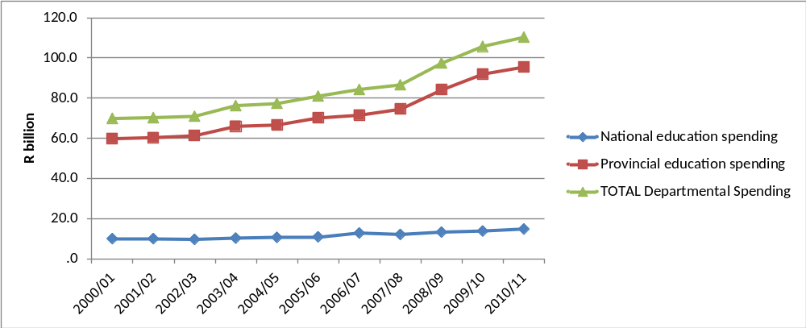
Spending
Spending by education departments, real (2005) Rand
2000/01 to 2010/11
← OSD
(Oxford Policy Management & Stellenbosch Economics, 2012)
Notes:
In the decade since 2000, public education spending increased significantly in real terms with real provincial expenditure on education rising by 60% between 2000/01 and 2010/11. The rapid growth in expenditure from 2007 is largely due to the Occupation Specific Dispensation (OSD) for educators which raised teacher salaries significantly.

Slide 53

Grade 6 Literacy
SA Gr 6 Literacy
Kenya Gr 6 Literacy
1%
5%
7%
25%
49%
46%
39%
Public current expenditure per pupil: $1225
Additional resources is not the answer
Public current expenditure per pupil: $258
27%
Notes:
Technically it is never enrolled or dropped out before grade 6 (using DHS data) – see Taylor and Spaull (Forthcoming)

Slide 54
Accountability: teacher absenteeism
(SACMEQ III – 2007 – 996 teachers)
4th/15
Notes:
Absenteeism here is average between both maths and reading teachers

Slide 55
Accountability: teacher absenteeism
(SACMEQ III – 2007 – 996 teachers)
15th/15
Notes:
Absenteeism here is average between both maths and reading teachers

Slide 56


Benefits of education
Ed
S
H
Ec
Improved human rights
Empowerment of women
Reduced societal violence
Promotion of a national (as opposed to regional or ethnic) identity
Increased social cohesion
Lower fertility
Improved child health
Preventative health care
Demographic transition
Improvements in productivity
Economic growth
Reduction of inter-generational cycles of poverty
Reductions in inequality
$
Health
Economy
Society
Specific references: lower fertility (Glewwe, 2002), improved child health (Currie, 2009), reduced societal violence (Salmi, 2006), promotion of a national - as opposed to a regional or ethnic - identity (Glewwe, 2002), improved human rights (Salmi, 2006), increased social cohesion (Heyneman, 2003), Economic growth – see any decent Macro textbook, specifically for cognitive skills see (Hanushek & Woessman 2008)

Slide 57
Accountability: teacher absenteeism
  Teacher absenteeism is regularly found to be an issue in many studies
    2007: SACMEQ III conducted – 20 days average in 2007
    2008: Khulisa Consortium audit – HSRC (2010) estimates that 20-24 days of regular instructional time were lost due to leave in 2008
    2010: “An estimated 20 teaching days per teacher were lost during the 2010 teachers’ strike” (DBE, 2011: 18)
    Importantly this does not include time lost where teachers were at school but not teaching scheduled lessons
      A recent study observing 58 schools in the North West concluded that “Teachers did not teach 60% of the lessos they were scheduled to teach in North West” (Carnoy & Chisholm et al, 2012)
Notes:
Also see Chisholm (2005) and Shisana et al (2005) quoted in HSRC (2010)

Slide 58




Accountability: teacher absenteeism
(SACMEQ III – 2007 – 996 teachers)
Western Cape
Eastern Cape
Limpopo
KwaZulu-Natal
% absent > 1 week striking
32%
81%
97%
82%
% absent > 1 month (20 days)
22%
62%
48%
73%
% absent > 2 months (40 days)
5%
12%
0%
10%
1.3 days a week
Notes:
Given that SACMEQ was done in September 2007, a maximum of 159 school days could have passed, hence 3 months = 1.3 days a week

Slide 59
SACMEQ III (Spaull & Taylor, 2012)
Literacy
Numeracy

Slide 60
Gr 1 - Gr 2 - Gr 3 – Gr 4 – Gr 5 – Gr 6 – Gr 7 – Gr 8 – Gr 9 - Gr 10 – Gr 11 – Gr 12
Foundation Phase
Intermediate Phase
Senior Phase
FET Phase
Matric
Grade 12 – Various
Roughly half the cohort
____________________________________
Underperformance
Of 100 students that enroll in grade 1 approximately 50 will make it to matric, 40 will pass and 12 will qualify for university
Inequality
Subject combinations differ between rich and poor – differential access to higher education
Maths / Maths-lit case in point
Are more students taking maths literacy because THEY cannot do pure-maths, or because their TEACHERS cannot teach pure-maths?

Slide 61
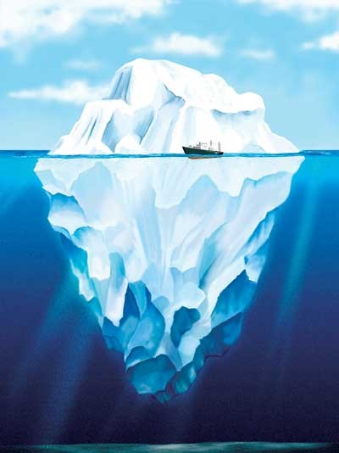

What are the root causes of low and unequal achievement?
Matric pass rate
Subject choice
No. endorsements
Throughput
Media sees only this→
Quality?
MATRIC
Pre-MATRIC
50% dropout
Low curric coverage
Weak culture of T&L
Low accountability
Vested interests
Low time-on-task
No early cognitive stimulation
Low quality teachers
HUGE learning deficits…

Slide 62
2 education systems not 1

Slide 63
2 education systems
Dysfunctional Schools (75% of schools) | Functional Schools (25% of schools)
Weak accountability | Strong accountability
Incompetent school management | Good school management
Lack of culture of learning, discipline and order | Culture of learning, discipline and order
Inadequate LTSM | Adequate LTSM
Weak teacher content knowledge | Adequate teacher content knowledge
High teacher absenteeism (1 month/yr) | Low teacher absenteeism (2 week/yr)
Slow curriculum coverage, little homework or testing | Covers the curriculum, weekly homework, frequent testing
High repetition & dropout (Gr10-12) | Low repetition & dropout (Gr10-12)
Extremely weak learning: most students fail standardised tests | Adequate learner performance (primary and matric)

Slide 64

Two school systems not one?
Socioeconomic Status
Grade 6 [2007]
Data: SACMEQ
(Spaull, 2011)

Slide 65


Gr 1 - Gr 2 - Gr 3 – Gr 4 – Gr 5 – Gr 6 – Gr 7 – Gr 8 – Gr 9 - Gr 10 – Gr 11 – Gr 12
Foundation Phase
Intermediate Phase
Senior Phase
FET Phase
PIRLS 2006 – see Shepherd (2011)
prePIRLS 2011
Grade 4 – all 11 languages
433 schools, 19259 students
____________________________________
Underperformance
29% of gr4 students did not reach the low international benchmark – they could not read
SA performs similarly to Botswana, but 3 years learning behind average Columbian Gr4
Inequality
Linguistic inequalities: Large differences by home language – Xitsonga, Tshivenda and Sepedi students particularly disadvantaged
PIRLS (2006) showed LARGE differences between African language schools and Eng/Afr schools
Howie et al (2011)
*Data now available for download

Slide 66

→
In most government reports outcomes and inputs are not usually reported by quintile, only national averages
→

Slide 67
Implications for reporting and modeling??

Slide 68
3 biggest challenges - SA
Failure to get the basics right
  Children who cannot read, write and compute properly (Functionally illiterate/innumerate) after 6 years of formal full-time schooling
  Often teachers lack even the most basic knowledge
Equity in education
  2 education systems – dysfunctional system operates at bottom of African countries, functional system operates at bottom of developed countries.
  More resources is NOT the silver bullet – we are not using existing resources
Lack of accountability
  Little accountability to parents in majority of school system
  Little accountability between teachers and Department
  Teacher unions abusing power and acting unprofessionally

Slide 69
Way forward?
Acknowledge the extent of the problem
  Low quality education is one of the three largest crises facing our country (along with HIV/AIDS and unemployment). Need the political will and public support for widespread reform.
Focus on the basics
  Every child MUST master the basics of foundational numeracy and literacy these are the building blocks of further education – weak foundations = recipe for disaster
  Teachers need to be in school teaching (re-introduce inspectorate?)
  Every teacher needs a minimum competency (basic) in the subjects they teach
  Every child (teacher) needs access to adequate learning (teaching) materials
  Use every school day and every school period – maximise instructional time
Increase information, accountability & transparency
  At ALL levels – DBE, district, school, classroom, learner
  Strengthen ANA
  Set realistic goals for improvement and hold people accountable

Slide 70
When faced with an exceedingly low and unequal quality of education do we….
A) Increase accountability {US model}
    Create a fool-proof highly specified, sequenced curriculum (CAPS/workbooks)
    Measure learning better and more frequently (ANA)
    Increase choice/information in a variety of ways
B) Improve the quality of teachers {Finnish model}
    Attract better candidates into teaching degrees → draw candidates from the top (rather than the bottom) of the matric distribution
    Increase the competence of existing teachers (Capacitation)
    Long term endeavor which requires sustained, committed, strategic, thoughtful leadership (something we don’t have)
C) All of the above {Utopian model}
Perhaps A while we set out on the costly and difficult journey of B??

