Slide 1


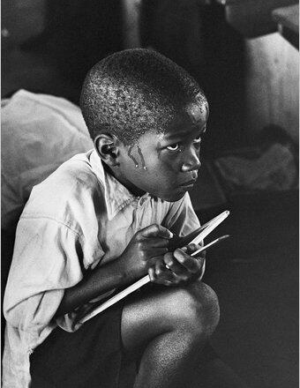


An Overview of South Africa’s
Schooling System
www.nicspaull.com/research
Moneyweb Ibandla Conference| 24 May 2014

Slide 2
Things to discuss?
Teacher CK
Unions
Teacher training
Civil service capacity
Resources
Access vs Quality
Grade R / ECD
ANAs & assessment
LOLT
Student performance
Inequality
Learning deficits

Slide 3
Things to discuss?
Teacher CK
Unions
Teacher training
Civil service capacity
Resources
Access vs Quality
Grade R / ECD
ANAs & assessment
LOLT
Student performance
Inequality
Learning deficits

Slide 4
Overview of education in SA
12.4m students
  4 % of students are in independent schools (i.e. 96% public)
25,826 schools
  6% of schools are independent schools
425,000 teachers
  8% of teachers are in independent schools
Near universal access up to Grade 9 (quality?!)
FET | SP | GET | FET
Gr1-3 | Gr 4-6 | Gr 7-9 | Gr10-12

Slide 5
SADTU membership

Slide 6
Expenditure on education
2010/11
Total government expenditure
(31% GDP in 2010/11 – R733.5bn)
Government exp on education
(19.5% of Gov exp: R143.1bn)
17%
5%
Notes:
Figures from 2012 Public Expenditure Analysis report for UNICEF/DBE (Oxford Policy Management / Stellenbosch Economics) Education exp = 6.1% of GDP
Personnel exp = 78% of educ exp
Personnel exp = 4.8% of GDP

Slide 7
Some contextual eg.’s
SACMEQ 2007 (Gr6) | School Wealth Quartiles
 | Poorest 25% | 2nd Poorest 25% | 2nd Richest 25% | Richest 25%
Gets homework "Most days of the week" | 50% | 52% | 46% | 76%
Self-reported teacher absenteeism (days) | 24 | 23 | 20 | 12
Speaks English at home 'Always' | 6% | 7% | 9% | 40%
More than 10 books at home | 17% | 23% | 31% | 67%
At least one parent has matric | 30% | 41% | 49% | 77%

Slide 8
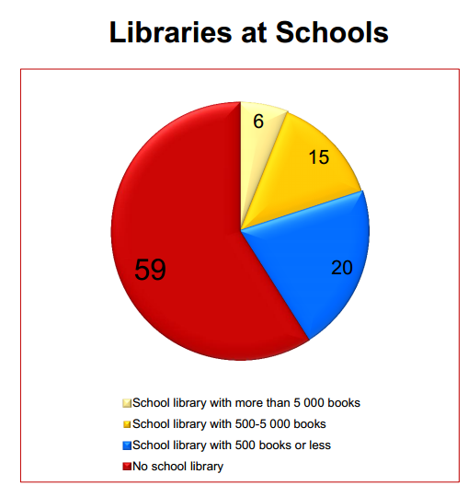
#Perspective
Anon: “My school is in the poorest category possible – we don’t even have a full time librarian”
(Graph from Howie & Van Staden (2012) study at Gr4 level)

Slide 9
(1)
South Africa performs extremely poorly on local and international assessments of educational achievement

Slide 10





State of SA education since transition
“Although 99.7% of South African children are in school…the outcomes in education are abysmal” (Manuel, 2011)
“Without ambiguity or the possibility of misinterpretation, the pieces together reveal the predicament of South African primary education” (Fleisch, 2008: 2)
“Our researchers found that what students know and can do is dismal” (Taylor & Vinjevold, 1999)
“It is not an overstatement to say that South African education is in crisis.” (Van der Berg & Spaull, 2011)
Notes:
Fleisch, B. (2008). Primary Education in Crisis: Why South African schoolchildren underachieve in reading and mathematics. Cape Town. : Juta & Co.
Taylor, N., Muller, J., & Vinjevold, P. (2003). Getting Schools Working. Cape Town: Pearson Education.
South African education: the poorest choice [M&G, 8 Apr 2011] (Co-authored with Prof Servaas van der Berg)

Slide 11








Student performance 2003-2011
TIMSS (2003)
→ PIRLS (2006)
→ SACMEQ (2007)
→ TIMSS (2011)
→ prePIRLS (2011)
TIMSS 2003 (Gr8 Maths & Science)
Out of 50 participating countries (including 6 African countries) SA came last
Only 10% reached low international benchmark
No improvement from TIMSS 1999-TIMSS 2003
See Reddy et al (2006)
PIRLS 2006 (Gr 4/5 – Reading)
Out of 45 participating countries SA came last
87% of gr4 and 78% of Gr 5 learners deemed to be “at serious risk of not learning to read”
See Howie et al. (2006)
SACMEQ III 2007 (Gr6 – Reading & Maths)
SA came 10/15 for reading and 8/15 for maths behind countries such as Swaziland, Kenya and Tanzania
See Moloi & Chetty (2010) & Spaull (2012)
TIMSS 2011 (Gr9 – Maths & Science)
SA has joint lowest performance of 42 countries
Improvement by 1.5 grade levels (2003-2011)
76% of grade nine students in 2011 still had not acquired a basic understanding about whole numbers, decimals, operations or basic graphs, and this is at the improved level of performance
See Reddy et al. (2012) & Spaull (2013)
prePIRLS2011 (Gr 4 Reading)
29% of SA Gr4 learners completely illiterate (cannot decode text in any langauge)
See Howie et al (2012)
NSES 2007/8/9
  Gr 3/4/5
  See Taylor, Van der Berg & Mabogoane (2013)
Systemic Evaluations 2007
  Gr 3/6
Matric exams
  Gr 12
Notes:
The most comprehensive reports for each of these datasets are as follows: SACMEQ (Moloi & Chetty, 2011), TIMSS (Reddy, 2006), PIRLS (Howie, et al., 2008), Systemic Evaluations (Department of Education, 2008), National School Effectiveness Study (Taylor, 2011b),and the Annual National Assessments (Department of Basic Education, 2011).

Slide 12
(2)
The South African education system is HIGHLY unequal

Slide 13
Averages are uniquely misleading in SA
SACMEQ 2007 (Gr6) | School Wealth Quartiles
 | Poorest 25% | 2nd Poorest 25% | 2nd Richest 25% | Richest 25% | Average
Gets homework "Most days of the week" | 50% | 52% | 46% | 76% | 56%
Self-reported teacher absenteeism (days) | 24 | 23 | 20 | 12 | 20
Speaks English at home 'Always' | 6% | 7% | 9% | 40% | 15%
More than 10 books at home | 17% | 23% | 31% | 67% | 34%
At least one parent has matric | 30% | 41% | 49% | 77% | 49%

Slide 14
Education & Inequality: DIMENSIONS
Essentially two public schooling systems, not one
Averages in SA are uniquely misleading, they represent no one.
The majority (75-80%) of children are in the dysfunctional part of the schooling system.
Given the apartheid-era policies, it is unsurprising that the inequalities we see in South Africa can be seen along a number of correlated dimensions, including
  Language,
  Geographical location (both provinces and urban/rural)
  Socioeconomic status (parental wealth/occupation/education)
  Race
  Former education department
  Some empirical examples…. EXPLAIN BIMODALITY

Slide 15
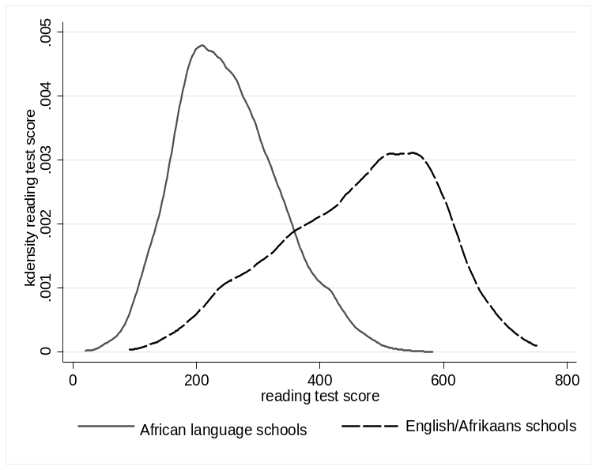
Language...
Averages in SA are uniquely misleading
PIRLS 2006
PIRLS Gr 5
(Shepherd, 2011)
prePIRLS 2011
prePIRLS Gr 4
(Howie & Van Staden, 2012)
But practically speaking what do these figures mean? What does it mean for the average Sepedi child to get a score of 388 on this test??
Notes:
http://web.up.ac.za/sitefiles/File/publications/2013/PIRLS_2011_Report_12_Dec.PDF

Slide 16



By Gr 3 all children should be able to read, Gr 4 children should be transitioning from “learning to read” to “reading to learn”
Red sections here show the
proportion of children that are
completely illiterate in Grade 4
, i.e. they cannot read in any
language
Notes:
If we consider the performance of the learners per test language, the following observations are made:
Overall 29% of learners in SA don’t meet the low benchmark
However, in Afrikaans and English, there are only 12 and 10% who do not meet the low benchmark
Of serious concern is that more than half the learners tested in Sepedi and Tshivenda do not reach the low benchmark putting them at risk educationally.
More than 15% of learners in Afrikaans and English reach the advanced level in contrast to less than 1% in African languages.
http://web.up.ac.za/sitefiles/File/publications/2013/PIRLS_2011_Report_12_Dec.PDF

Slide 17

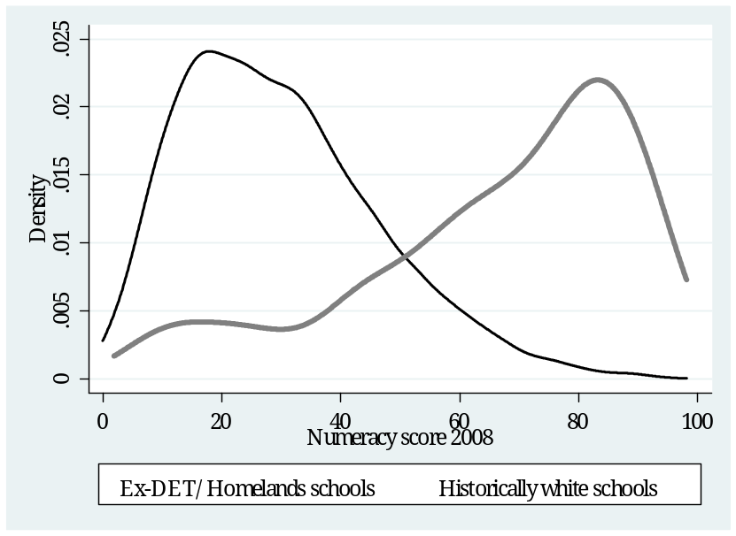
Former department…
NSES 2008 – Gr4
(Taylor, 2011)
We can see how much learning is taking place in each schooling system
Taylor, 2011

Slide 18

Socioeconomic status...
SACMEQ III (2007)
SACMEQ III (2007) Distribution of student reading scores by quartiles of
school socioeconomic status (Spaull, 2013)
Notes:
http://www.cde.org.za/images/pdf/South%20Africas%20Education%20Crisis%20N%20Spaull%202013.pdf

Slide 19
Figure 2: Average Grade Eight mathematics test scores for middle-income countries participating in TIMSS 2011 (+95% confidence intervals around the mean)
TIMSS Maths (2011)

Slide 20

How do SA’s wealthiest 20% of school perform?
RE Max DuPreez’s comments yesterday that our Model-C schools are “good”, even by international stds
Important to remember size of SA schooling system (25,000 schools, the top 2% =500 schools!)
Top 1% probably, not top 15% →
Graph via Stephen Taylor (TIMSS 2003)

Slide 21
“…you are data mining…”

Slide 22



Bimodality – indisputable fact
PIRLS / TIMSS / SACMEQ / NSES / ANA / Matric… by Wealth / Language / Location / Dept…

Slide 23
(3)
Content knowledge of SA teachers (esp maths teachers) particularly problematic

Slide 24
Teacher content knowledge
Taylor & Vinjevold (1999, p. 230) summarize the 54 studies that made up this initiative and conclude as follows: “The most definite point of convergence across the [President’s Education Initiative] studies is the conclusion that teachers’ poor conceptual knowledge of the subjects they are teaching is a fundamental constraint on the quality of teaching and learning activities, and consequently on the quality of learning outcomes.”
Carnoy & Chisholm (2008, p.33): “The relatively low level of mathematics knowledge that teachers have in all but the highest student [socioeconomic status] schools is somewhat troubling. It raises some doubts about the preparation of the teacher force”.
Taylor & Taylor (2013, p. 230): “The subject knowledge base of the majority of South African grade 6 mathematics teachers is simply inadequate to provide learners with a principled understanding of the discipline…providing teachers with a deep conceptual understanding of their subject should be the main focus for both pre- and in-service teacher training”.

Slide 25
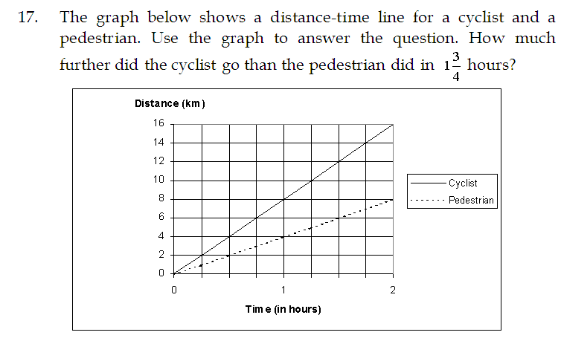
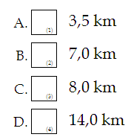

Rate of change example (Q17)
SACMEQ III (2007) → 401/498 Gr6 Mathematics teachers
7
Correct answer (7km):
38% of Gr 6 Maths teachers
2 education systems
SACMEQ Maths teacher test Q17 | Quintile |  |  |  |  | Avg
 | 1 | 2 | 3 | 4 | 5
Correct | 23% | 22% | 38% | 40% | 74% | 38%
Notes:
See Ross et al (2005) for a discussion of the teacher test.

Slide 26
Percentage of Grade 6 mathematics teachers with correct answer on Q17 of the SACMEQ III (2007) mathematics teacher test

Slide 27
Forthcoming work on primary school mathematics teachers in SA (Spaull & Venkat, forthcoming)
Figure 1: Proportion of South African grade 6 mathematics teachers by content knowledge (CK) group - SACMEQ 2007 (with 95% confidence interval) [401 Gr6 maths teachers]

Slide 28
Forthcoming work on primary school mathematics teachers in SA (Spaull & Venkat, forthcoming)
Figure 4: Average percentage correct on all 42 items in SACMEQ 2007 mathematics teacher test by quintile of school socioeconomic status and school location (corrected for guessing) [401 Gr6 maths teachers]

Slide 29

Forthcoming work on primary school mathematics teachers in SA (Spaull & Venkat, forthcoming)
Figure 5: Proportion of Grade 6 mathematics teachers by CK grouping and quintile of school socioeconomic status (SACMEQ 2007) - with 95% confidence intervals [401 Gr6 maths teachers]

Slide 30
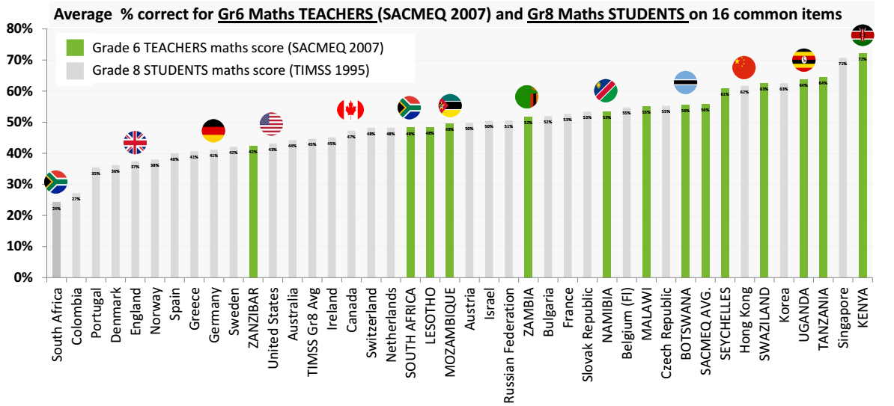
Maths teacher CK in 12 African countries
Spaull & Van der Berg (2014)

Slide 31
(4)
In large parts of the schooling system there is very little learning taking place.

Slide 32
Practical examples…
of South African Grade 3 learners could not answer the following Grade 1 level problem, which, importantly, has no language content:
“20 – 6 = ____ “
(Systemic Evaluation, Grade 3, 2009)
“At the end of the Foundation Phase, learners have only a rudimentary grasp of the principles of reading and writing ... it is very hard for learners to make up this cumulative deficit in later years...particularly in those subjects that ... [have] vertical demarcation requirements (especially mathematics and science), the sequence, pacing, progression and coverage requirements of the high school curriculum make it virtually impossible for learners who have been disadvantaged by their early schooling to ‘catch-up’ later sufficiently to do themselves justice at the high school exit level.” (Taylor, Muller Vinjevold, 2003, p. 129)

Slide 33
Practical examples…
42% of South African Grade 3 learners could not answer the following Grade 1 level problem, which, importantly, has no language content:
“20 – 6 = ____ “
(Systemic Evaluation, Grade 3, 2009)
“At the end of the Foundation Phase, learners have only a rudimentary grasp of the principles of reading and writing ... it is very hard for learners to make up this cumulative deficit in later years...particularly in those subjects that ... [have] vertical demarcation requirements (especially mathematics and science), the sequence, pacing, progression and coverage requirements of the high school curriculum make it virtually impossible for learners who have been disadvantaged by their early schooling to ‘catch-up’ later sufficiently to do themselves justice at the high school exit level.” (Taylor, Muller Vinjevold, 2003, p. 129)

Slide 34

NSES question 42
NSES followed about 15000 students (266 schools) and tested them in Grade 3 (2007), Grade 4 (2008) and Grade 5 (2009).
Grade 3 maths curriculum: “Can perform calculations using appropriate symbols to solve problems involving: division of at least 2-digit by 1-digit numbers”
Even at the end of Grade 5 most (55%+) quintile 1-4 students cannot answer this simple Grade-3-level problem.
“The powerful notions of ratio, rate and proportion are built upon the simpler concepts of whole number, multiplication and division, fraction and rational number, and are themselves the precursors to the development of yet more complex concepts such as triangle similarity, trigonometry, gradient and calculus” (Taylor & Reddi, 2013: 194)
(Spaull & Viljoen, forthcoming)
Notes:
Taylor, N., & Reddi, B. (2013). Writing and learning mathematics. In N. Taylor, S. Van der Berg, & T. Mabogoane, Creating Effective Schools. Cape Town: Pearson.

Slide 35
Insurmountable learning deficits: 0.3 SD
Spaull & Viljoen, 2014 (SAHRC Report)

Slide 36
How does this affect matric?

Slide 37
550,000 students drop out before matric
99% do not get a non-matric qualification (Gustafsson, 2011: p11)
What happens to them? 50% youth unemployment…

Slide 38

Notes:
http://africacheck.org/2014/01/10/the-economic-value-of-matric-and-the-potential-of-further-education-colleges/

Slide 39
Dropout between Gr8 and Gr12
Of 100 Gr8 quintile 1 students in 2009, 36 passed matric and 10 qualified for university
Of 100 Gr8 quintile 5 students in 2009, 68 passed matric and 39 qualified for university
“Contrary to what some would like the nation and the public to believe that our results hide inequalities, the facts and evidence show that the two top provinces (Free State and North West) are rural and poor.” (Motshekga, 2014)
Notes:
http://nicspaull.com/2014/01/12/education-in-sa-still-separate-and-unequal-extended-version-of-citypress-article/

Slide 40
(5)
How does all of this affect the labour-market and South African society?

Slide 41
Education and inequality?
Duration of education
Quality of education
Type of education
IQ
Motivation
Social networks
Discrimination
SA is one of the top 3 most unequal countries in the world
Between 78% and 85% of total inequality is explained by wage inequality
Wages
Notes:
78% and 85% figures were taken from research reports by Van der Berg and Leibbrandt

Slide 42
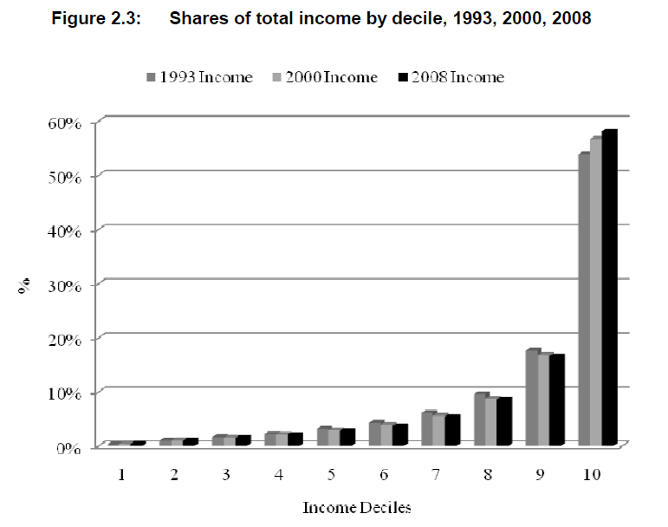
Inequality - SA

Slide 43
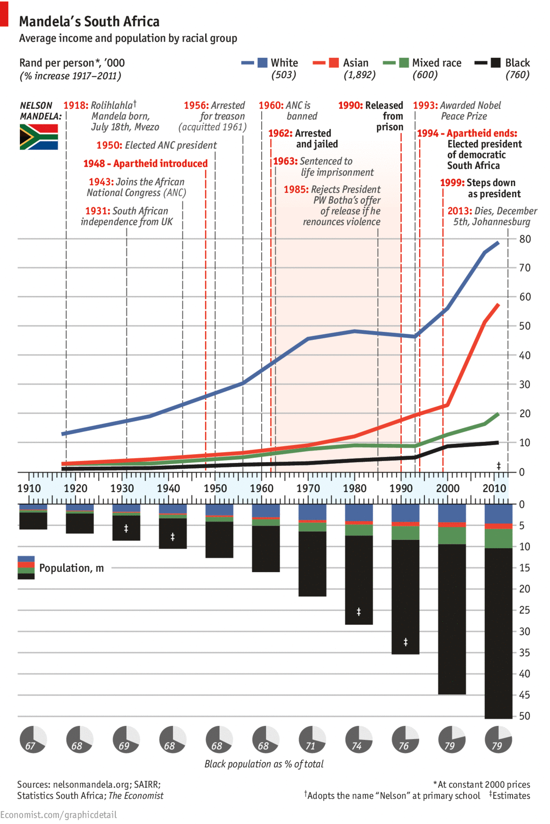
Earnings inequality in South Africa

Slide 44
Labour Market
17%
Legislators, managers, assoc professionals
Unemployed
(Broad - 33%)
Unskilled
(19%)
Elementary occupations & domestic workers
Semi-Skilled (31%)
Clerks, service workers, shop personnel, skilled agric/fishery workers, plant and machinery operators)
University/FET
Type of institution (FET or University)
Quality of institution
Type of qualification (diploma, degree etc.)
Field of study (Engineering, Arts etc.)
High productivity jobs and incomes (17%)
Mainly professional, managerial & skilled jobs
Requires graduates, good quality matric or good vocational skills
Historically mainly white
High quality secondaryschool
High SES background
+ECD
High quality primary school
Minority (20%)
Some motivated, lucky or talented students make the transition
Unequal society
Big demand for good schools despite fees
Some scholarships/bursaries
Vocational training
Affirmative action
Majority (80%)
Quality
Low quality secondary
school
Attainment
Type
Low productivity jobs & incomes
Often manual or low skill jobs
Limited or low quality education
Minimum wage can exceed productivity
Low SES background
Low quality primary school
cf. Servaas van der Berg – QLFS 2011
Notes:
The QLFS classifies professions as follows: Highly skilled (legislators, senior officials and managers, professionals, technicians and associate profesionals); Semi-skilled (Clerks, service workers and shop and market personnel, skilled agricultural and fishery workers, craft and related trade workers, plant and machinery operators and assembly), Unskilled (Elementary occupations, domestic workers).

Slide 45
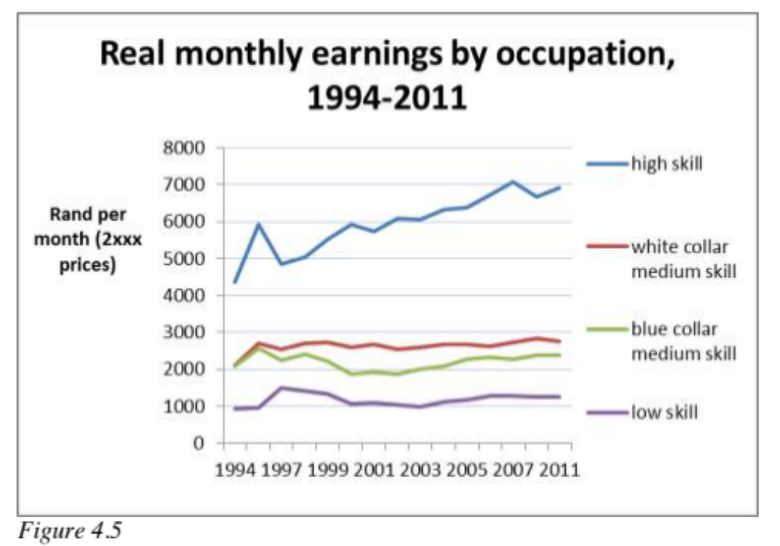
Skills premium in SA
Seekings 2014

Slide 46
Qualifications by age (birth cohort), 2011 (Van der Berg, 2013)

Slide 47
Links between education & the labour-market
Intervening in the labour-market (BBBEE) is too late
  Need to do this but MORE focus on (pre) school.
Social grants important to reduce abject poverty but cannot change inequality much
Wages account for 80% of total inequality
Unless you can increase the wages of black labour-market entrants cannot change structure of SA income distribution
(4) not possible without improving quality of education.

Slide 48
SOLUTION?
Accountability AND
Capacity

Slide 49

Notes:
From: http://ijr.org.za/publications/pdfs/TA%202013%20text%20and%20cover%20web.pdf

Slide 54


Slide 55
“Only when schools have both the incentive to respond to an accountability system as well as the capacity to do so will there be an improvement in student outcomes.” (p22)
Notes:
http://ijr.org.za/publications/pdfs/TA%202013%20text%20and%20cover%20web.pdf

Slide 56
There are signs of hope…
The DBE has begun to focus on the basics
  CAPS curriculum
  Workbooks (numeracy and literacy)
  ANAs (not without problems)
Some improvement in Gr9 student outcomes between TIMSS 2003 and TIMSS 2011
  1.5 Grade levels (but post-improvement still exceedingly low)

Slide 57
Way forward?
Acknowledge the extent of the problem
  Low quality education is one of the three largest crises facing our country (along with HIV/AIDS and unemployment). Need the political will and public support for widespread reform.
Focus on the basics
  Every child MUST master the basics of foundational numeracy and literacy these are the building blocks of further education – weak foundations = recipe for disaster. Read by 10 goal!
  Teachers need to be in school teaching (re-introduce inspectorate?)
  Every teacher needs a minimum competency (basic) in the subjects they teach
  Every child (teacher) needs access to adequate learning (teaching) materials
  Use every school day and every school period – maximise instructional time
  Have to make sure we don’t make the same mistakes with Grade R as we have with the rest of schooling
Increase information, accountability & transparency
  At ALL levels – DBE, district, school, classroom, learner
  Strengthen ANA. Get psychometrics right (so comparable across years), externally evaluate @ 1 grade
  Set realistic goals for improvement and hold people accountable
Focus on teachers
  Have to find a way of raising the quality of both (1) new, but especially (2) existing teachers
  Q&A - Prof Muller (UCT): What do you think is the most under-researched area in South African education?
    “We have no idea what it will take to make knowledgeable teachers out of clueless ones, at least not while they are actually on-the-job.”

Slide 58
5 “Take-Home” points
Many things we have not discussed – Grade-R/ECD, teacher unions and politics, civil service capacity constraints, LOLT, teacher training (in- and pre-), RCTs, resources, etc.
South Africa performs extremely poorly on local and international assessments of educational achievement.
In SA we have two public schooling systems not one.
Teacher content knowledge in South Africa is extremely low
In large parts of the schooling system there is very little learning taking place.
Strategies for improvement need to focus on 1) accountability, 2) capacity, 3) alignment.
Low quality education
Low social mobility
Hereditary poverty

Slide 59
Further issues we can discuss
Solution: Identifying binding constraints
Grade R in SA – not more of the same
Resources
New and existing RESEP projects
What proportion of SA kids make it to uni?
What can businesses do to help?
  Warm-glow effect or turning the ship?

Slide 60
Thank you
Comments & Questions?
This presentation and papers available online at: www.nicspaull.com/research

Slide 61
References & further reading
For work on poverty and inequality – SALDRU/RESEP websites & working papers good start.
Fiske, E., & Ladd, H. (2004). Elusive Equity: Education Reform in Post-apartheid South Africa. Washington: Brookings Institution Press / HSRC Press.
Fleisch, B. (2008). Primary Education in Crisis: Why South African schoolchildren underachieve in reading and mathematics. Cape Town. : Juta & Co.
Donalson, A. (1992). Content, Quality and Flexibility: The Economics of Education System Change. Spotlight 5/92. Johannesburg: South African Institute of Race Relations.
Taylor, S., & Yu, D. (2009). The Importance of Socioeconomic Status in Determining Educational Achievement in South Africa. Stellenbosch Economic Working Papers.
Van der Berg, S., Burger, C., Burger, R., de Vos, M., du Rand, G., Gustafsson, M., Shepherd, D., Spaull, N., Taylor, S., van Broekhuizen, H., and von Fintel, D. (2011). Low quality education as a poverty trap. Stellenbosch: University of Stellenbosch, Department of Economics. Research report for the PSPPD project for Presidency.
Spaull, N. 2013. Poverty & Privilege: Primary School Inequality in South Africa. International Journal of Educational Development. 33 (2013) pp. 436-447 (WP here)
Spaull, N. 2013. South Africa’s Education Crisis: The Quality of Education in South Africa 1995-2011. Centre for Development and Enterprise.

Slide 62
Binding constraints approach

Slide 63


Slide 66
“The left hand barrel has horizontal wooden slabs, while the right hand side barrel has vertical slabs. The volume in the first barrel depends on the sum of the width of all slabs. Increasing the width of any slab will increase the volume of the barrel. So a strategy on improving anything you can, when you can, while you can, would be effective. The volume in the second barrel is determined by the length of the shortest slab. Two implications of the second barrel are that the impact of a change in a slab on the volume of the barrel depends on whether it is the binding constraint or not. If not, the impact is zero. If it is the binding constraint, the impact will depend on the distance between the shortest slab and the next shortest slab” (Hausmann, Klinger, & Wagner, 2008, p. 17).
Notes:
Hausmann, R., Klinger, G., & Wagner, R. (2008). Doing Growth Diagnostics in Practice: A 'Mindbook'. CID Workinf Paper No. 177. Center for International Development at Harvard University.

Slide 67
Current concerns of DBE
(according to me)
Teacher content knowledge
- Extremely low
- Politically sensitive given strength of teacher unions
-Testing & training?!
Grade R & ECD
- Funding: Current exp on Grade R pupil (R3K) 1/3 of ordinary school child (R10K)
-Training/qualifications and $ of ECD teachers?
Teacher Salaries
– Make up 80% of Educ Exp ating infrastructure backlogs
- Legal implications of MN&S (provinces held to acc)
FP Numeracy & literacy and ANAS
- Ensuring they are comparable across years
- Using them to raise numeracy & literacy outcomes
-
Min Norms/Stds
- Eradicating infrastructure backlogs & providing basics (and then non-basics)
- Legal implications of MN&S (provinces held to acc)
Elections & Relations with teacher unions
- Teacher unions (esp SADTU) wield considerable power)
-Appointments (DBE/district/principal/teacher) politicised, competence not primary concern
Post-provisioning
- Ghost teachers
-Over/under supply in certain schools (esp ECA)
-limiting the salary bill

Slide 68
Grade R/ECD issues needing to be fleshed out?
Qualitatively/practically, when is enrolment considered “Grade R” and when just child-minding?
Where should Grade R teachers be trained?
  Universities? More of the same?
  FET colleges? Quality problems? Status?
Practically, how does one monitor quality of ECD? What instruments? What surveys?
What should Grade R teachers be paid?
  Teacher salaries (and class sizes) obviously major cost-drivers

Slide 69



Slide 70


Size of South African economy/population

Slide 71


Slide 72

Geographic distribution of poverty

Slide 73

Sources of deprivation?

Slide 74


Benefits of education
Ed
S
H
Ec
Improved human rights
Empowerment of women
Reduced societal violence
Promotion of a national (as opposed to regional or ethnic) identity
Increased social cohesion
Lower fertility
Improved child health
Preventative health care
Demographic transition
Improvements in productivity
Economic growth
Reduction of inter-generational cycles of poverty
Reductions in inequality
$
Health
Economy
Society
Specific references: lower fertility (Glewwe, 2002), improved child health (Currie, 2009), reduced societal violence (Salmi, 2006), promotion of a national - as opposed to a regional or ethnic - identity (Glewwe, 2002), improved human rights (Salmi, 2006), increased social cohesion (Heyneman, 2003), Economic growth – see any decent Macro textbook, specifically for cognitive skills see (Hanushek & Woessman 2008)

Slide 75
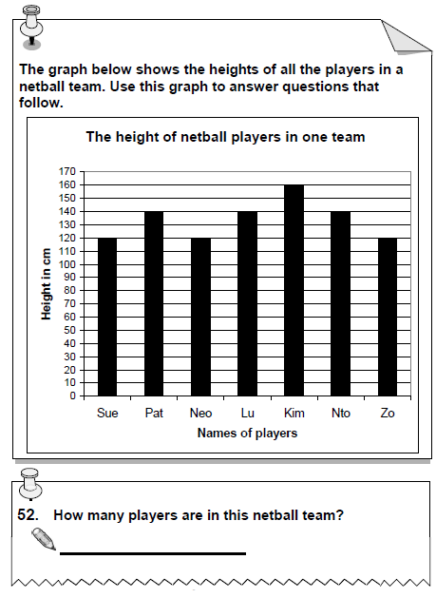
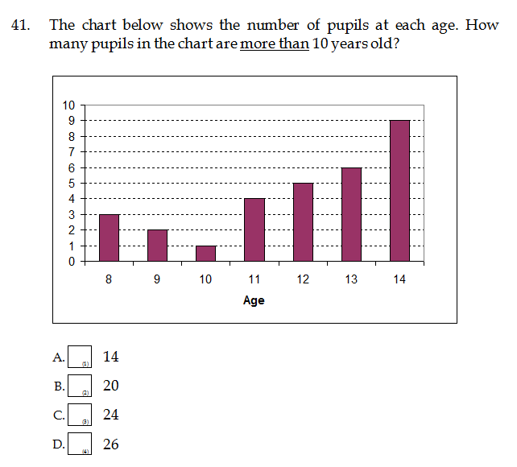
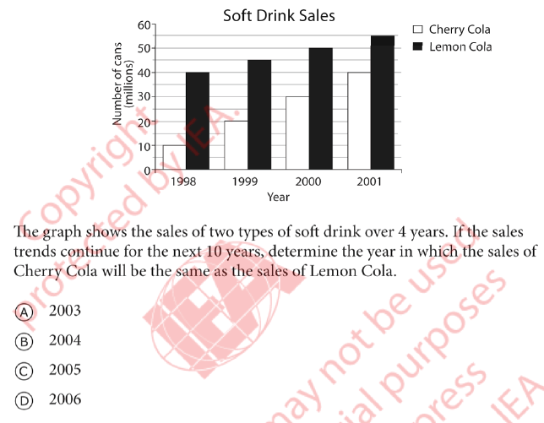
Systemic 2007 Gr3 NSES 2009 Gr5
Systemic 2007: Grade 3 tested in HL → 41% correct
NSES 2009: Grade 5 tested in English→ 43% correct
SACMEQ 2007 Gr6
SACMEQ 2007: Grade 6 tested in English→ 21% correct (c)
On a 4-choice MCQ random guessing would produce 25% correct on average
TIMSS 2011 Gr9
TIMSS 2011: Grade 9 tested in Engl/Afr → 27% correct (b)
Notes:
(TIMSS item M032721

Slide 76
Notes:
Howie & Van Staden 2012

Slide 77
Possible solution…
The DBE cannot afford to be idealistic in its implementation of teacher training and testing
  Aspirational planning approach: All primary school mathematics teachers should be able to pass the matric mathematics exam
    (benchmark = desirable teacher CK)
  Realistic approach: (e.g.) minimum proficiency benchmark where teachers have to achieve at least 90% in the ANA of the grades in which they teach, and 70% in Grade 9 ANA
  (benchmark = basic teacher CK)
First we need to figure out what works!
Pilot the system with one district. Imperative to evaluate which teacher training option (of hundreds) works best in urban/rural for example. Rigorous impact evaluations are needed before selecting a program and then rolling it out
Tests are primarily for diagnostic purposes not punitive purposes
Notes:
Implement a nation-wide system of minimum-proficiency diagnostic teacher testing and capacitation for numeracy and literacy starting with the Foundation Phase.
“The existing body of evidence suggests that a large proportion of South African teachers have below-basic content knowledge in the subjects that they teach – largely as a result of inadequate apartheid-era teacher training and the ineffectiveness of in-service teacher training initiatives. In light of this, and following the premise that teachers cannot teach what they do not know, it is a logical imperative that a system of identifying which teachers need what help is urgently required. Given the current state of teacher content knowledge in poor and rural schools, the Department cannot afford to be idealistic in its implementation of this system of teacher testing and training. Rather than ascribing to the aspirational planning approach that has become characteristic of South African policy - where one might set an impractically high benchmark for desirable teacher content knowledge - one should first aim to ensure that every teacher in the system has the basic content knowledge required to cover the curriculum that they currently teach. For example, rather than decreeing that every primary school mathematics teacher should be able to pass the matric mathematics exam, it would be far more realistic to take an incremental approach and set the minimum-proficiency benchmark at a 70% mark on the grade nine annual national assessment, combined with at least a 90% mark in the ANA of the grade which they are currently teaching. If a grade six mathematics teacher cannot achieve 70% on the grade nine ANA for mathematics, and achieve 90% for the grade six mathematics ANA, one can say that they do not currently possess the requisite content knowledge to teach grade six mathematics. As a matter of urgency, they should be required to undergo minimum-proficiency teacher training for the subjects which they teach and then re-assessed at the end of the training. Before trying to get every teacher to a desirable level, first ensure that all teachers have the basic content knowledge in the subjects that they teach.
Given the logistics involved with implementing a testing and training operation of this scale, it is advisable to pilot the system with one district and then to roll out the system nationally in a progressive way. For example the Department could start with Foundation Phase (FP) mathematics teachers in a particular district and require all FP maths teachers to register and write the minimum proficiency test within six months. Teachers who do not meet the minimum-proficiency benchmark for the subjects that they teach should be given six months to complete the minimum-proficiency training which should be free of charge and accessible. Importantly, the training provided should be dignified, highly practical, structured and sequenced, with formative testing built into each module to assess whether or not the teacher has acquired the necessary knowledge and skills.
In order to get teacher and union buy in, it will need to be made explicit that these tests are primarily for diagnostic rather than punitive purposes. Through a variety of mechanisms (such as contracts and confidentiality clauses) it is possible to reassure all parties involved that these tests are truly developmental in nature. The ultimate aim of such a system should not be to vilify and demean teachers and the teaching profession, but to increase the capacity and dignity of teachers. Elmore (2004b, p. 93) provides a useful description of the interplay between accountability and capacitation:
“For every increment of performance I demand from you, I have an equal responsibility to provide you with the capacity to meet that expectation. Likewise, for every investment you make in my skill and knowledge, I have a reciprocal responsibility to demonstrate some new increment in performance.”
Spaull 2013 CDE Report

Slide 78
Accountability stages...
SA is a few decades behind many OECD countries. Predictable outcomes as we move from stage to stage. Loveless (2005: 7) explains the historical sequence of accountability movements for students – similar movements for teachers?
  Stage 1 – Setting standards
  (defining what students should learn),
      CAPS
  Stage 2 - Measuring achievement
  (testing to see what students have learned),
      ANA
  Stage 3 - Holding educators & students accountable
  (making results count).
      Western Cape performance agreements?
Stages in accountability movements:
3) Holding accountable
2) Measuring achievement
1) Setting standards
TRAINING
“For every increment of performance I demand from you, I have an equal responsibility to provide you with the capacity to meet that expectation. Likewise, for every investment you make in my skill and knowledge, I have a reciprocal responsibility to demonstrate some new increment in performance” (Elmore, 2004b, p. 93).

Slide 79


What are the root causes of low and unequal achievement?
Matric pass rate
Subject choice
No. endorsements
Throughput
Media sees only this→
Quality?
MATRIC
Pre-MATRIC
50% dropout
Low curric coverage
Weak culture of T&L
Low accountability
Vested interests
Low time-on-task
No early cognitive stimulation
Low quality teachers
HUGE learning deficits…

Slide 80
Basic overview of matric 2013
The good…
Matric pass rate increased to 78%
Bachelor pass rate increased to 31%
More students passing mathematics
The bad…
Some questioning quality of matric pass
Public starting to ask questions about why uni’s are using NBTs
Concerns over “culling” and whether this lead to increases in NWP and FST
The ugly…
Grade 8→12 dropout is 2x as high (50%) in Q1 rel to Q5 (25%)
Because of differences in average quality of education, a white child is 7 times more likely than a black child to obtain a Maths D+ and 38 times as likely to get an A- aggregate (using earlier matric data)

Slide 81
Focus on mathematics – things are improving
Number of students taking mathematics (as opposed to maths-lit) has declined since 2008, but proportion passing has risen
  Not necessarily a bad thing since many of those students shouldn’t have been taking mathematics in the first place
Source: Taylor (2014)

Slide 82
What proportion of matrics take and pass mathematics?
Important statistic is the number passing which was declining from 2008 → 2011 but has increased between 2011 → 2013
Source: Taylor (2014)

Slide 83
Matric mathematics statistics (Taylor 2014)
 | Numbers wrote maths | Number passed maths | Maths pass rate | Proportion taking maths | Proportion passing maths
2008 | 298821 | 136503 | 45.70% | 56.10% | 25.60%
2009 | 290407 | 133505 | 46.00% | 52.60% | 24.20%
2010 | 263034 | 124749 | 47.40% | 48.80% | 23.20%
2011 | 224635 | 104033 | 46.30% | 45.30% | 21.00%
2012 | 225874 | 121970 | 54.00% | 44.19% | 23.86%
2013 | 241509 | 142666 | 59.10% | 42.96% | 25.38%
Source: Taylor (2014)
NOTE: All of the above is under the proviso that that quality of the mathematics exam has remained constant over the period. If not then we can’t say much.

Slide 84
Are things improving?
What should we be using to measure changes over time?
  DEFINITELY *NOT* ANAs
    Not psychometrically calibrated to be comparable year-on-year
    No anchor items
    No Item Response Theory
    Not externally evaluated and independently marked
    No, no, no.
    Need a broader discussion of the potential perils of ANAs. Under-appreciated at the moment. ANA Fridays?!
  Matric – sort of yes
    Considerable institutional memory (decades of expertise and precedent)
    Excludes half the cohort so not a good reflection of total education system
    Can be tricky to tease out *real* trends. Things like subject combinations, culling, pass thresholds and clumping around the threshold etc.
  Cross-national assessments – yes.
    Best way of determining if there are changes over long periods of tims
      TIMSS, PIRLS/prePIRLS/SACMEQ/ (perhaps PISA in SA soon)
Education and schooling (the main vehicle we use to “do/get it”) cannot be reduced to test scores or particular subjects (numeracy and literacy). However, that does *NOT* mean that there is no place for testing. Many educational outcomes are measurable and providing feedback to everyone (DBE, principals, parents, students) is an important form of accountability.

Slide 85

Higher education in perspective
When speaking about higher education it’s important to remember that this is only a very small proportion of the population
Source: DBE (2013) Internal Efficiency of the schooling System

Slide 86

Gustafsson, 2011 – When & how WP
“What do the magnitudes from Figure 4 mean in terms of the holding of qualifications? In particular, what widely recognised qualifications do the 60% of youths who do not obtain a Matric hold? …Only around 1% of youths hold no Matric but do hold some other non-school certificate or diploma issued by, for instance, an FET college”
(Gustafsson, 2011: p.11)
10%
Notes:
http://www.ekon.sun.ac.za/wpapers/2011/wp092011

Slide 87

How does SA fair internationally?
Gustafsson (2011) “The when and how of leaving school”
Notes:
http://www.ekon.sun.ac.za/wpapers/2011/wp092011

Slide 88
TIMSS 1995 → 2011
Figure 1: South African mathematics and science performance in the Trends in International Mathematics and Science Study (TIMSS 1995-2011) with 95% confidence intervals around the mean

Slide 89
Accountability: teacher absenteeism
  Teacher absenteeism is regularly found to be an issue in many studies
    2007: SACMEQ III conducted – 20 days average in 2007
    2008: Khulisa Consortium audit – HSRC (2010) estimates that 20-24 days of regular instructional time were lost due to leave in 2008
    2010: “An estimated 20 teaching days per teacher were lost during the 2010 teachers’ strike” (DBE, 2011: 18)
    Importantly this does not include time lost where teachers were at school but not teaching scheduled lessons
      A recent study observing 58 schools in the North West concluded that “Teachers did not teach 60% of the lessos they were scheduled to teach in North West” (Carnoy & Chisholm et al, 2012)
Notes:
Also see Chisholm (2005) and Shisana et al (2005) quoted in HSRC (2010)

Slide 90
2 education systems
Dysfunctional Schools (75% of schools) | Functional Schools (25% of schools)
Weak accountability | Strong accountability
Incompetent school management | Good school management
Lack of culture of learning, discipline and order | Culture of learning, discipline and order
Inadequate LTSM | Adequate LTSM
Weak teacher content knowledge | Adequate teacher content knowledge
High teacher absenteeism (1 month/yr) | Low teacher absenteeism (2 week/yr)
Slow curriculum coverage, little homework or testing | Covers the curriculum, weekly homework, frequent testing
High repetition & dropout (Gr10-12) | Low repetition & dropout (Gr10-12)
Extremely weak learning: most students fail standardised tests | Adequate learner performance (primary and matric)

Slide 91

Implications for reporting and modeling??

