Slide 1

Programme for International Student Assessment
PISA 2009
Evaluating systems to improve education
The yardstick for success is no longer improvement by national standards alone but the best performing education systems
Andreas Schleicher
Special advisor to the Secretary-General on Education Policy
Head of the Indicators and Analysis Division, EDU
Notes:
I want to start with a brief overview of the objectives and origins of PISA, then show you where the US stands and what the most effective school systems show can be achieved, and conclude with what all of this means for education policy.
I need to remind you that the material remains under embargo until next Tuesday.

Slide 2
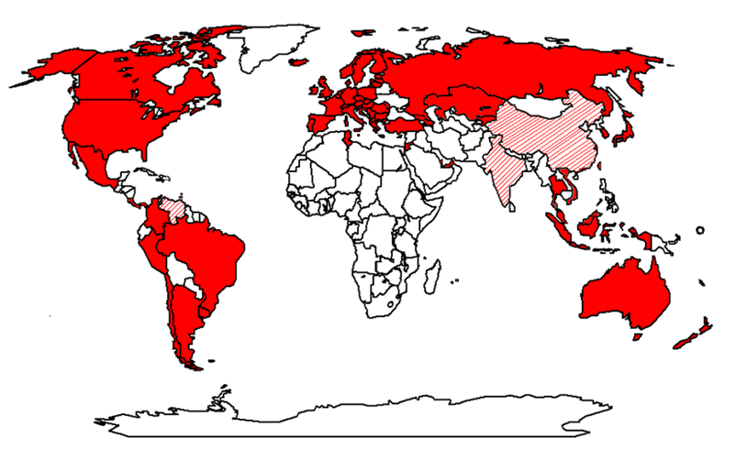
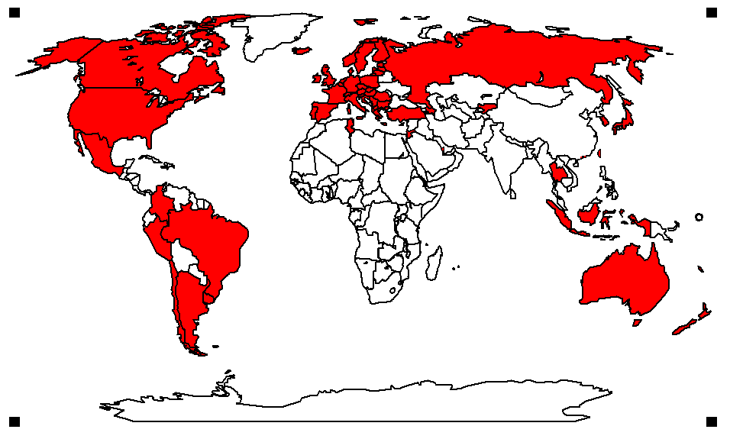
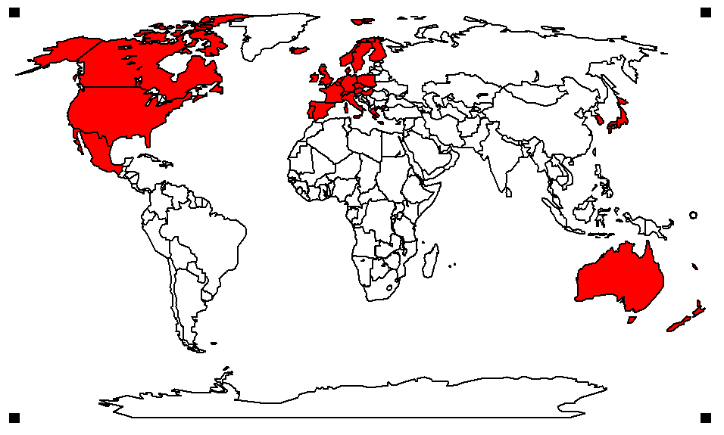
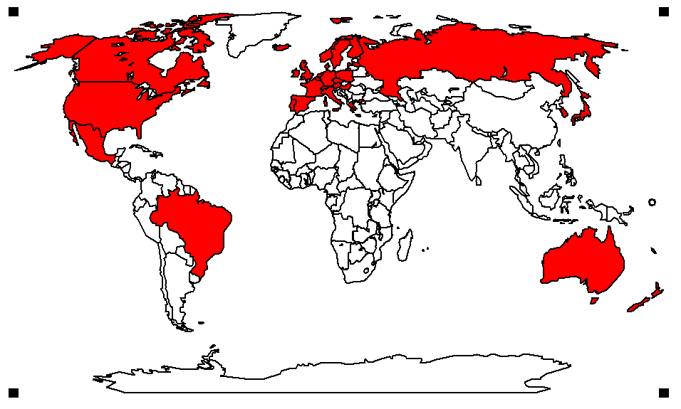


PISA 2009 in brief
PISA countries in
2003
2000
2001
2006
2009
1998
Coverage of world economy
83%
77%
81%
85%
86%
87%
Over half a million students…
  representing 28 million 15-year-olds in 74* countries/economies
… took an internationally agreed 2-hour test…
  Goes beyond testing whether students can
  reproduce what they were taught…
  … to assess students’ capacity to extrapolate from what they know and creatively apply their knowledge in novel situations
… and responded to questions on…
  their personal background, their schools
  and their engagement with learning and school
Parents, principals and system leaders provided data on…
  school policies, practices, resources and institutional factors that help explain performance differences .
  * Data for Costa Rica, Georgia, India, Malaysia, Malta, Mauritius, Venezuela and Vietnam will be published in December 2011
Notes:
We started to develop PISA in 1998 with 28 OECD countries, but since then country participation has grown and our latest PISA assessment covers 74 education systems that make up 86% of the world economy. Coverage in China and India is still patchy though, in China we have now covered 12 provinces and in India we are working in two states only.
One aspect that makes PISA stand apart from traditional school tests is that PISA puts less emphasis on whether students can reproduce what they were taught, but focuses on their capacity to extrapolate from what they know and creatively apply what they know in novel situations. Some people complain that PISA is unfair, because it confronts students with tasks they have not dealt with before, but if you take that line, then you should consider life unfair, because in this fast-changing world, that is precisely what will expect students later in life.
Students also provided data on their socio-economic context, their schools and their attitudes and engagement with school and learning.
In addition, PISA collected data from parents, principals and system leaders to yield insights on school policies, practices, resources and institutional factors that help explain performance differences.

Slide 3
PISA 2009 in brief
PISA countries in
2003
2000
2001
2006
2009
1998
Coverage of world economy
PISA seeks to…
  … Support governments to prepare students…
    … to deal with more rapid change than ever before…
    … for jobs that have not yet been created…
    … using technologies that have not yet been invented…
    … to solve problems that we don’t yet know will arise
  … Provide a basis for policy dialogue and global collaboration in defining and implementing educational goals, policies and practices
    Show countries what achievements are possible
    Help governments set policy targets in terms of measurable goals achieved elsewhere
    Gauge the pace of educational progress
    Facilitate peer-learning on policy and practice .
83%
77%
81%
85%
86%
87%
Notes:
The idea of PISA is to support governments in preparing students for life.
In a sense, PISA provides schools and nations with a mirror in which they can judge their performance in light of what other systems show is possible to achieve.

Slide 4
PISA 2009 in brief
PISA countries in
2003
2000
2001
2006
2009
1998
Key principles
  ‘Crowd sourcing’ and collaboration
    PISA draws together leading expertise and institutions from participating countries to develop instruments and methodologies…
    … guided by governments on the basis of shared policy interests
  Cross-national relevance and transferability of policy experiences
    Emphasis on validity across cultures, languages and systems
    Frameworks built on well-structured conceptual understanding
    of assessment areas and contextual factors
  Triangulation across different stakeholder perspectives
    Systematic integration of insights from students, parents,
    school principals and system-leaders
  Advanced methods with different grain sizes
    A range of methods to adequately measure intended constructs with different grain sizes to serve different decision-making needs
    Productive feedback, at appropriate levels of detail, to fuel improvement at multiple levels .
Coverage of world economy
83%
77%
81%
85%
86%
87%
Notes:
Let me conclude this introduction with a couple of factors that were key to the success of PISA
At the heart of PISA is not a bureaucracy but the largest international network of educators and researchers. These experts develop and validate the assessment material and methodologies, guided by governments on the basis of shared policy interests.
Whenever you engage in cross-national collaboration, you will run into the question of whether measures and policy lessons travels well across cultural and national contexts. That is an area where PISA has made unprecedented progress.
Third, in the field of education, nobody really knows how learning occurs in the classroom, but everybody has a view on this. So in PISA, we approached the issues from many perspectives, collecting data from students, parents, school principals, experts and system leaders and then through triangulation tried to get to the bottom to the issues.
Finally, PISA employs a range of methods to ensure adequate measurement at different grain size to serve different decision-making needs.

Slide 5
What 15-year-olds can do
Notes:
With that introduction, let us turn to the results. The first thing you can do is to see how countries line up with regard to the competencies of their 15-year-olds.

Slide 6
High reading performance
Average performance
of 15-year-olds in reading – extrapolate and apply
Performance distribution in US
18% do not reach baseline Level 2 (16% when excluding immigrants) (Finland 6%, Canada 9%)
  Economic cost: 72 trillion $
10% are top performers
(Shanghai 20%)
Suburban schools
Northeast
Midwest
Urban schools
West
South
… 17 countries perform below this line
Low reading performance
Notes:
This chart illustrates the reading literacy scale, from below the OECD average, marked in red, to around the OECD average, marked in yellow, to high performance, marked in green.
You see that Shanghai, Korea, Hong-Kong, Singapore, New Zealand and Japan in Asia, Finland in Europe and Canada in North America do particularly well. Some will attribute the high performance of the East Asian countries to the Confucian culture, but be careful, for example, Chinese Taipei or Macao come from that same culture and don’t do particularly well. They tend to excel in rote learning, but don’t do well on the kind of creative skills that PISA values.

Slide 7


High reading performance
Average performance
of 15-year-olds in science – extrapolate and apply
High average performance
Large socio-economic disparities
High average performance
High social equity
Strong socio-economic impact on student performance
Socially equitable distribution of learning opportunities
Low average performance
Large socio-economic disparities
Low average performance
High social equity
Low reading performance
Notes:
But I do want to introduce a second dimension into this picture, that PISA pays great attention to. When you look at the distribution of student performance within each country, there are some countries in which social background has a strong impact on student performance, in other words, where educational opportunities are very unequally distributed, where there is a large gap between winners and losers and where a lot of the potential that children bring with them is wasted. There are other countries, where it matters much less into which social context students are born, where outcomes are socially equitably distributed.
If you look at this, it is clear where we all want to be, namely where performance and equity are both strong. And nobody, and no country, can accept to be where performance is low and opportunities are very unequally distributed. Whether it is better to have high performance at the price of large disparities, or better to invest in small disparities at the price of mediocracy, that is subject to debate.

Slide 8
High reading performance
2009
Durchschnittliche Schülerleistungen im Bereich Mathematik
High average performance
Large socio-economic disparities
High average performance
High social equity
Strong socio-economic impact on student performance
Socially equitable distribution of learning opportunities
Low average performance
Large socio-economic disparities
Low average performance
High social equity
Low reading performance
Notes:
When you look at how countries come out on this picture, you will see that there are a number of countries that feature in the upper right quadrant, which signals that these countries have advanced from providing excellence for some to providing excellence for all.
Some of the countries you see here have taken part in PISA over the last decade and I will mark each of those countries with a colored bubble now.

Slide 9
High reading performance
2009
Durchschnittliche Schülerleistungen im Bereich Mathematik
High average performance
Large socio-economic disparities
High average performance
High social equity
Strong socio-economic impact on student performance
Socially equitable distribution of learning opportunities
Low average performance
Large socio-economic disparities
Low average performance
High social equity
Low reading performance
Notes:
And I am changing the size of the bubble now to reflect the amount of money these countries spend per student. If money would tell you everything about the quality of an education system, you would find all the large bubbles at the top of the chart, but that is not what you see, money only explains about 10% of the performance variation among countries. This means that two countries with similar levels of spending can produce very different educational results. PISA shows also that an image of a world divided neatly into rich and well-educated countries and poor and badly-educated countries is now out of date.

Slide 10
High reading performance
2000
Durchschnittliche Schülerleistungen im Bereich Mathematik
High average performance
Large socio-economic disparities
High average performance
High social equity
Strong socio-economic impact on student performance
Socially equitable distribution of learning opportunities
Low average performance
Large socio-economic disparities
Low average performance
High social equity
Low reading performance
Notes:
For a moment, let us go back to the year 2000. Remember, that was the year before the iPod was invented. This is how the world looked then in terms of PISA literacy performance. The first thing you can see is that the bubbles were generally much smaller, we spent around a quarter less per student. So was the increase in spending matched by better outcomes?

Slide 11
High reading performance
2000
Durchschnittliche Schülerleistungen im Bereich Mathematik
High average performance
Large socio-economic disparities
High average performance
High social equity
Strong socio-economic impact on student performance
Socially equitable distribution of learning opportunities
Other rapid improvers in reading:
Peru, Indonesia, Latvia, Israel and Brazil
Rapid improvers in mathematics:
Mexico, Brazil, Turkey, Greece, Portugal, Italy and Germany
Rapid improvers in science:
Qatar, Turkey, Portugal, Korea, Brazil, Colombia, Italy, Norway, United States, Poland
Low average performance
Large socio-economic disparities
Low average performance
High social equity
Low reading performance
Notes:
Not generally, but I want to highlight a few countries that have seen impressive improvements.
Korea’s average performance was already high in 2000, yet Korean policy makers were concerned that only a small elite achieved levels of excellence in the PISA assessment of reading back then. Within less than a decade, Korea was able to double the share of students demonstrating excellence in reading literacy. If you raise performance at the top end of the scale only, that of course increases disparities in outcomes, and you see Korea moving slightly backwards on the equity dimension. But it is still a strong and equitable performer.
At the other end of the spectrum we have seen impressive gains as well. Chile provides an example. In 2000, Chile performed so low that you would not even see it on this chart. 9 years later the performance of 15-year-olds was roughly a school year better. A major overhaul of Poland’s school system helped to dramatically reduce performance variability among schools, turn around the lowest performing schools and raise overall performance by the equivalent of more than half a school year. So is Portugal, which improved both overall performance and equity. And so did Hungary. Finally, Germany was jolted into action when PISA 2000 revealed below-average performance and large social disparities in their results, and has been able to make progress on both fronts.
And this is not the complete list, also Peru, Indonesia, Latvia, Israel and Brazil raised their outcomes and in Mathematics impressive improvements have been realised by Mexico, Brazil, Turkey, Greece, Portugal, Italy and Germany.

Slide 12
Quality differences between schools

Slide 13


Variability in student performance between and within schools
Variance
Performance differences between schools
Performance variation of students within schools
Notes:
The yellow bar on this chart shows you the performance variability among schools. The larger the bar, the more school quality varies. The orange bar tells you about performance variation within schools.
What the yellow bar tells you is that the quality of schools differs greatly in countries such as Italy, Turkey, Israel or Germany, while in Finland the yellow bar is very short, virtually every school performs at high levels. Now you might say Finland is a special case because it is not so heterogeneous, but then take Shanghai, a socio-economically every heterogeneous province and you see also here a fairly consistent high level of performance among schools. That has not come about by chance, but is the result of a concerted effort to convert “weaker schools” into stronger schools. If you are a successful school principal in a high performing school in Shanghai, you will get a salary raise, but they then put you in a disadvantaged school to create another success. And you will not be alone but you can take part of your teachers with you. Listen to how the Director of the Education Bureau in Pudong explains that success.

Slide 14
How do social background and learning outcomes interact?

Slide 15
School performance and socio-economic background
United States
Private school
Public school in rural area
Public school in urban area
School performance and schools’ socio-economic background
Student performance and students’ socio-economic background within schools
700
Student performance
Disadvantage
PISA Index of socio-economic background
Advantage

Slide 16
Percentage of resilient students among disadvantaged students
%
Resilient student: Comes from the bottom quarter of the socially most disadvantaged students but performs among the top quarter of students internationally (after accounting for social background)
Less than 15% resilient students among disadvantaged students
More than 30% resilient students among disadvantaged students
Between 15%-30% of resilient students among
disadvantaged students

Slide 17
Does it all matter?
Notes:
You have seen very large performance differences among schools and countries, but how predictive are these for the success of students and nations?

Slide 18

Increased likelihood of postsec. particip. at age 19/21 associated with PISA reading proficiency at age 15 (Canada) after accounting for school engagement, gender, mother tongue, place of residence, parental, education and family income (reference group PISA Level 1)
Odds ratio
higher education entry
School marks at age 15
PISA performance at age 15
Notes:
To what extent is performance in school predictive of success in later life?
The best way to find out whether what students have learned at school matters for their life is to actually watch what happens to them after they leave school.
This is exactly what we have done that with around 30,000 students in Canada. We tested them in the year 2000 when they were 15 years old in reading, math and science, and since then we are following up with them each year on what choices they make and how successful they are in their transition from school to higher education and work.
The horizontal axis shows you the PISA level which 15-year-old Canadians had scored in 2000. Level 2 is the baseline level on the PISA reading test and Level 5 the top level in reading.
The red bar shows you how many times more successful someone who scored Level 2 at age 15 was at age 19 to have made a successful transition to university, as compared to someone who did not make it to the baseline PISA level 1. And to ensure that what you see here is not simply a reflection of social background, gender, immigration or school engagement, we have already statistically accounted for all of these factors.
The orange bar. …
How would you expect the picture to be like at age 21?
We are talking about test scores here, but for a moment, lets go back to the judgements schools make on young people, for example through school marks. You can do the same thing here, you can see how well school marks at age 15 predict the subsequent success of youths. You see that there is some relationship as well, but that it is much less pronounced than when we use the direct measure of skills. What this tells you how important reliable measures of student performance are, an area where the UK is leading the field since some years.

Slide 19
Policy
Policies and practices
R
System
School
Equity
Learning climate
Discipline
Teacher behaviour
Parental pressure
Teacher-student relationships
Dealing with heterogeneity
Grade repetition
Prevalence of tracking
Expulsions
Ability grouping
(all subjects)
Standards /accountability
Nat. examination
Standardised tests
Posting results
Governing schools
Choice and competition
Private schools
Managing resources
Prioritising pay
Student-staff ratios
Length of pre-school
☺
R
☺
☺
☺
☺
☹
☹
☹
☺
☺
☺
☹
☹
☹
☺☹
☺
☺
School autonomy (content)
☺☹
☺
☹
☹
☹
☹
☹
☺
E
Notes:
Let me briefly summarise the influences that we have measured in PISA.

Slide 20
What does it all mean?

Slide 21
Commitment to universal achievement
Goals, gateways, instructional systems
Capacity at point of delivery
Incentives and accountability
Resources where they yield most
A learning system
Coherence
A commitment to education and the belief that competencies can be learned and therefore all children can achieve
  Universal educational standards and personalisation as the approach to heterogeneity in the student body…
  … as opposed to a belief that students have different destinations to be met with different expectations, and selection/stratification as the approach to heterogeneity
  Clear articulation who is responsible for ensuring student success and to whom
Lessons from PISA
on successful education systems
Notes:
First, there is no question that most nations declare that education is important. But the test comes when these commitments are weighed against others. How do countries pay teachers, compared to other highly-skilled workers? How are education credentials weighed against other qualifications when people are being considered for jobs? Would you want your child to be a teacher? How much attention do the media pay to schools and schooling? What we have learned from PISA is that in high performing systems political and social leaders have persuaded citizens to make choices that show they value education more than other things.
But placing a high value on education is only part of the equation. Another part is belief in the possibilities for all children to achieve success. In some countries, students are separated into different tracks at an early age, reflecting a notion shared by teachers, parents and citizens that only a subset of the nation’s children can or need to achieve world class standards. Our analysis shows that systems that track students in this way, based differing expectations for different destinations, tend to be fraught with large social disparities.
By contrast, the best performing systems deliver strong and equitable learning outcomes across very different cultural and economic contexts. In Finland, Japan, Singapore, Shanghai-China and Hong Kong-China, parents, teachers and the public at large share the belief that all students are capable of achieving high standards and need to do so, and they provide great examples for how public policy can support the achievement of universal high standards.

Slide 22
High reading performance
2009
Durchschnittliche Schülerleistungen im Bereich Mathematik
High average performance
Large socio-economic disparities
High average performance
High social equity
Strong socio-economic impact on student performance
Socially equitable distribution of learning opportunities
Early selection and
institutional differentiation
  High degree of stratification
  Low degree of stratification
Low average performance
Large socio-economic disparities
Low average performance
High social equity
Low reading performance
Notes:
Canada comes out as a country that does well on equity too.

Slide 23
Commitment to universal achievement
Goals, gateways, instructional systems
Capacity at point of delivery
Incentives and accountability
Resources where they yield most
A learning system
Coherence
Clear ambitious goals that are shared across the system and aligned with high stakes gateways and instructional systems
  Well established delivery chain through which curricular goals translate into instructional systems, instructional practices and student learning (intended, implemented and achieved)
  High level of metacognitive content of instruction
Lessons from PISA
on successful education systems
Notes:
High-performing education systems also share clear and ambitious standards across the board. Everyone knows what is required to get a given qualification, both in terms of the content studied and the level of performance needed to earn it. Students cannot go on to the next stage—be it in work or in further education—unless they show that they are qualified to do so. They know what they have to do to realise their dream, and they put in the work that is needed to do it.

Slide 24

Commitment to universal achievement
Goals, gateways, instructional systems
Capacity at point of delivery
Incentives and accountability
Resources where they yield most
A learning system
Coherence
Capacity at the point of delivery
  Attracting, developing and retaining high quality teachers and school leaders and a work organisation in which they can use their potential
  Instructional leadership and human resource management in schools
  Keeping teaching an attractive profession
  System-wide career development
Lessons from PISA
on successful education systems
Notes:
Third, the quality of an education system cannot exceed the quality of its teachers and principals. Just like companies, high quality school systems pay attention to how they select and train their staff. They watch how they improve the performance of those who are struggling; how structure teachers’ pay packets; and how they reward their best teachers. They provide an environment in which teachers work together to frame good practice. That is where teachers conduct field-based research to confirm or disprove the approaches they develop, and they judge their colleagues by the degree to which they use these practices in their classrooms. Listen to what the Finnish Minister had to say about that.

Slide 25
Commitment to universal achievement
Goals, gateways, instructional systems
Capacity at point of delivery
Incentives and accountability
Resources where they yield most
A learning system
Coherence
Incentives, accountability, knowledge management
  Aligned incentive structures
    For students
    How gateways affect the strength, direction, clarity and nature of the incentives operating on students at each stage of their education
    Degree to which students have incentives to take tough courses and study hard
    Opportunity costs for staying in school and performing well
    For teachers
    Make innovations in pedagogy and/or organisation
    Improve their own performance
    and the performance of their colleagues
    Pursue professional development opportunities
    that lead to stronger pedagogical practices
  A balance between vertical and lateral accountability
  Effective instruments to manage and share knowledge and spread innovation – communication within the system and with stakeholders around it
  A capable centre with authority and legitimacy to act
Lessons from PISA
on successful education systems
Notes:
Fourth, as you have seen, success has to do with incentives and accountability, and how these are aligned in the system. It has also to do with how vertical accountability to superiors is balanced with horizontal or professional accountability towards peers, how knowledge is shared and spread.
have we learned?

Slide 26
School autonomy, accountability and student performance
Impact of school autonomy on performance in systems with and without accountability arrangements
PISA score in reading

Slide 27
Local responsibility and system-level prescription
Trend in OECD countries
System-level prescription
‘Tayloristic’ work organisation
Schools today
The industrial model, detailed prescription of what schools do
Schools tomorrow?
Building capacity
Finland today
Every school an effective school
Schools leading reform
Teachers as ‘knowledge workers’

Slide 28
Public and private schools
%
Score point difference
Private schools
perform better
Public schools
perform better

Slide 29

Commitment to universal achievement
Goals, gateways, instructional systems
Capacity at point of delivery
Incentives and accountability
Resources where they yield most
A learning system
Coherence
Lessons from PISA
on successful education systems
Investing resources where they can make most of a difference
  Alignment of resources with key challenges (e.g. attracting the most talented teachers to the most challenging classrooms)
  Effective spending choices that prioritise high quality teachers over smaller classes
Notes:
The most impressive outcome of world class education systems is perhaps that they deliver high quality learning consistently across the entire education system so that every student benefits from excellent learning opportunity. To achieve this, they invest educational resources where they can make most of a difference, they attract the most talented teachers into the most challenging classroom, and they establish effective spending choices that prioritise the quality of teachers. Let me come back to the example of Shanghai once more here. Let us have a look at the struggling schools six years later.

Slide 30
Commitment to universal achievement
Goals, gateways, instructional systems
Capacity at point of delivery
Incentives and accountability
Resources where they yield most
A learning system
Coherence
A learning system
  An outward orientation of the system to keep the system learning, international benchmarks as the ‘eyes’ and ‘ears’ of the system
  Recognising challenges and potential future threats to current success, learning from them, designing responses and implementing these
Lessons from PISA
on successful education systems
Notes:
Some of the most successful systems are also actively looking outward, realising that the benchmark for success is no longer simply improvement by national standards, but the best performing systems internationally. Whether Singapore is interested in designing a better sewer system, retirement system or school system, it sends key people in the relevant sector to visit those countries that are the world’s best performers in those areas with instructions to find out how they do it, and to put together a design for Singapore that is superior to anything that they have seen anywhere.

Slide 31

Commitment to universal achievement
Goals, gateways, instructional systems
Capacity at point of delivery
Incentives and accountability
Resources where they yield most
A learning system
Coherence
Coherence of policies and practices
  Alignment of policies
  across all aspects of the system
  Coherence of policies
  over sustained periods of time
  Consistency of implementation
  Fidelity of implementation
  (without excessive control)
Lessons from PISA
on successful education systems
Notes:
Last but not least, in high performing systems these policies and practices are aligned across all aspects of the system, they are coherent over sustained periods of time, and they are consistently implemented.
And PISA shows, success is within the reach for nations that have the capacity to creating and executing policies with maximum coherence in the system.
Of course, the path to reform is not easy and it can be fraught with political controversy. Moving away from administrative and bureaucratic control toward professional norms of control can be counterproductive if a nation does not yet have teachers and schools with the capacity to implement these policies and practices. Pushing authority down to lower levels can be as problematic if there is not agreement on what the students need to know and should be able to do. Recruiting high quality teachers is not of much use if those who are recruited are so frustrated by what they perceive to be a mindless system of initial teacher education that they will not participate in it and turn to another profession. Or if they become school teachers, but are so turned off by the bureaucratic forms of work organisation they find there that they leave teaching for some other occupation. So this is all about alignment.

Slide 32
Beyond schooling

Slide 33
Parental support at the beginning of primary school
Score point difference between students whose parents often do (weekly or daily) and those who do not:
"talk about what they had done"
Notes:
Figure II.5.8

Slide 34
Performance difference between students who had attended pre-primary school for more than one year and those who did not
Score point difference
Observed performance advantage
Performance advantage after accounting for socio-economic factors
Notes:
Figure II.5.9

Slide 35
Education reform trajectories
The old bureaucratic system
The modern enabling system
Student inclusion
Some students learn at high levels
All students need to learn at high levels
Curriculum, instruction and assessment
Routine cognitive skills, rote learning
Learning to learn, complex ways of thinking, ways of working
Teacher quality
Few years more than secondary
High-level professional knowledge workers
Work organisation
‘Tayloristic’, hierarchical
Flat, collegial
Accountability
Primarily to authorities
Primarily to peers and stakeholders
Notes:
I want to conclude with what we have learned about successful reform trajectories
In the past when you only needed a small slice of well-educated people it was efficient for governments to invest a large sum in a small elite to lead the country. But the social and economic cost of low educational performance has risen substantially and all young people now need to leave school with strong foundation skills.
When you could still assume that what you learn in school will last for a lifetime, teaching content and routine cognitive skills was at the centre of education. Today, where you can access content on Google, where routine cognitive skills are being digitised or outsourced, and where jobs are changing rapidly, the focus is on enabling people to become lifelong learners, to manage complex ways of thinking and complex ways of working that computers cannot take over easily.
In the past, teachers had sometimes only a few years more education than the students they taught. When teacher quality is so low, governments tend to tell their teachers exactly what to do and exactly how they want it done and they tend to use Tayloristic methods of administrative control and accountability to get the results they want. Today the challenge is to make teaching a profession of high-level knowledge workers.
But such people will not work in schools organised as Tayloristic workplaces using administrative forms of accountability and bureaucratic command and control systems to direct their work.
To attract the people they need, successful education systems have transformed the form of work organisation in their schools to a professional form of work organisation in which professional norms of control complement bureaucratic and administrative forms of control.

Slide 36
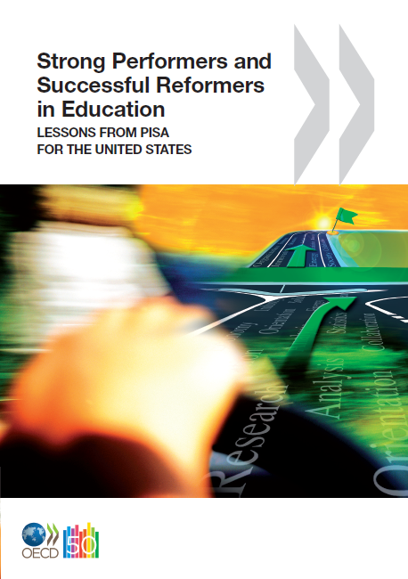
Thank you !
  Find out more about PISA at…
  OECD www.pisa.oecd.org
    All national and international publications
    The complete micro-level database
  U.S. White House www.data.gov
  Email: Andreas.Schleicher@OECD.org
  … and remember:
  Without data, you are just another person with an opinion

Slide 37
PISA 2009 results
Five volumes released on 7 December
  Volume I, What Students Know and can Do: Student Performance in Reading, Mathematics and Science
  Volume II, Overcoming Social Background: Equity in Learning Opportunities and Outcomes
  Volume III, Learning to Learn: Student Engagement, Strategies and Practices
  Volume IV, What Makes a School Successful? Resources, Policies and Practices
  Volume V, Learning Trends: Changes in student Performance since 2000
One volume to be released in June 2011
  Volume VI, Students On Line: Reading and Using Digital Information

