Slide 1




Education Report Card 1996-2011:
An Ailing System?
NAPTOSA
Annual Conference – 24 August 2012
Nicholas Spaull
nicholasspaull@gmail.com
www.nicspaull.com/research
Notes:
Unknown source for the picture

Slide 2
Outline
Spending on education (1994-2011)
  Provincial spending on education
  Overall spending on education
Access to education
Quality: South African student performance (2003-2011)
  Locally and internationally
  Teacher knowledge and student knowledge
  Teacher absenteeism in context
Conclusion

Slide 3
Spending 1994
(Fiske & Ladd, 2004: 104)

Slide 4
Spending 2000
(Fiske & Ladd, 2004: 104)

Slide 5
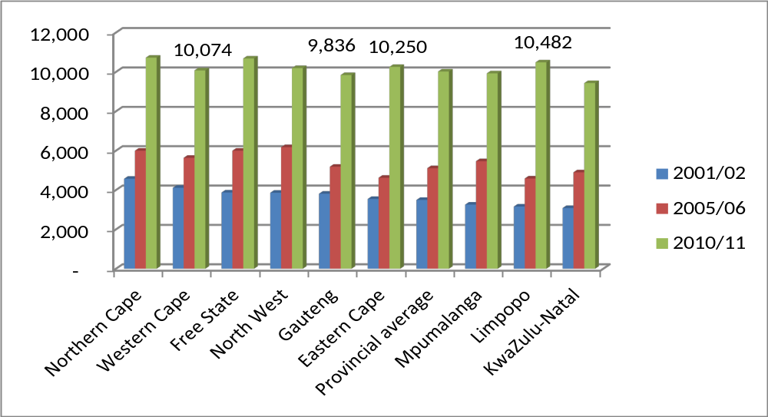
Spending 2000-2011
Spending on public ordinary schools per public school per learner by province in 2001/2 and 2010/11
(Oxford Policy Management & Stellenbosch Economics, 2012)

Slide 6
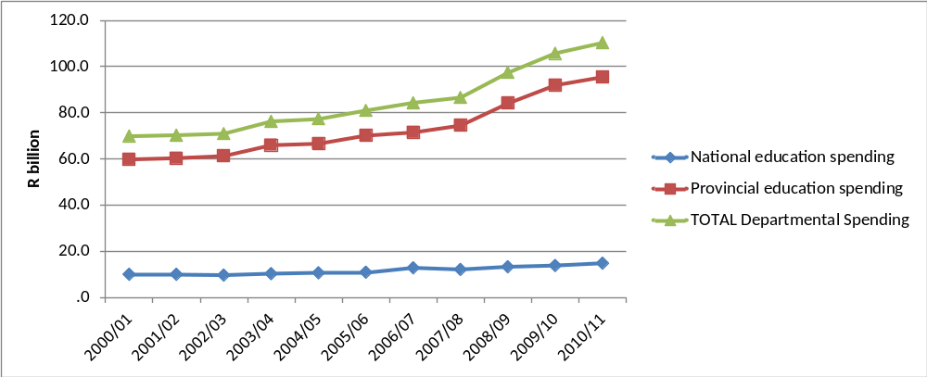
Spending
Spending by education departments, real (2005) Rand
2000/01 to 2010/11
← OSD
(Oxford Policy Management & Stellenbosch Economics, 2012)
Notes:
In the decade since 2000, public education spending increased significantly in real terms with real provincial expenditure on education rising by 60% between 2000/01 and 2010/11. The rapid growth in expenditure from 2007 is largely due to the Occupation Specific Dispensation (OSD) for educators which raised teacher salaries significantly.

Slide 7
Expenditure on education
2010/11
Total government expenditure
(31% GDP in 2010/11 – R733.5bn)
Government exp on education
(19.5% of Gov exp: R143.1bn)
17%
5%
Notes:
Figures from 2012 Public Expenditure Analysis report for UNICEF/DBE (Oxford Policy Management / Stellenbosch Economics) Education exp = 6.1% of GDP
Personnel exp = 78% of educ exp
Personnel exp = 4.8% of GDP

Slide 8

Expenditure
Post-apartheid government has equalised government expenditures across provinces and has adopted pro-poor public spending

Slide 9
Access
Percentage of learners enrolled in grade 1 who attended a pre-primary programme increased from 61% in 2006 to 71% in 2009
At least 99% of children enter formal schooling and only a few drop out in primary school.
In the last ten years the proportion of youths attaining grade 9 has risen from 76% to 86%.

Slide 10
Access
Post-apartheid government has expanded the education system with almost universal coverage in the primary and early secondary grades.

Slide 11
Quality of education: outcomes
What are the educational outcomes in SA?
What do South African students know?
  Compared to local standards?
  Compared to other countries?

Slide 12
Matric performance

Slide 13
Matric performance
Matric passes as % of Gr 2 learners 10 years earlier:
  2009: 28%
  2010: 34%
  2011: 38%
In the bottom 4 quintiles of schools, only 1% of learners in grade 8 will go on to pass matric and obtain a C symbol or higher (60%) for Mathematics and slightly fewer for Physical Science
Approximately ten times as many will do so in Quintile 5 schools
(Oxford Policy Management & Stellenbosch Economics, 2012)

Slide 14
Source of the problem?
Matric is the only externally-evaluated standardised exam
High and lenient grade progression
High drop out in grades 10, 11 and 12
“Low quality education combined with high and lenient grade progression up until grade 11 means that when a standardised assessment occurs, i.e. the Matric examination, this serves to filter a large proportion of weak students out of further attainment…Therefore, low-quality education up until grade 11 can be regarded as the root cause of low attainment beyond grade 11.” (Van der Berg et al, 2011: 4)
i.e. the REAL problem is at the primary grades
Focus on primary school

Slide 15
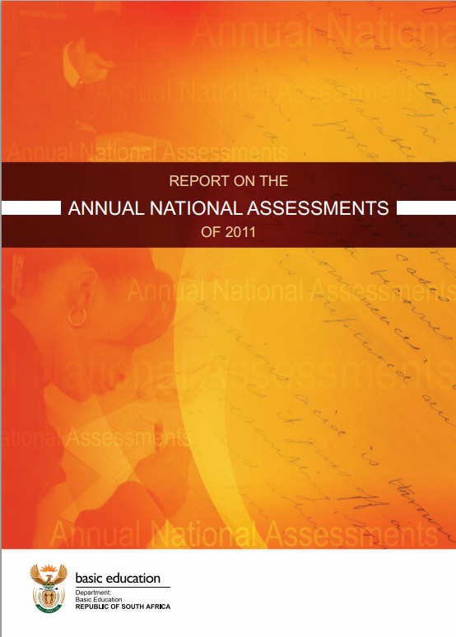






Student performance 2003-2011
TIMSS (2003)
→ PIRLS (2006)
→ SACMEQ (2007)
→ ANA (2011)
TIMSS 2003 (Gr8 Maths & Science)
Out of 50 participating countries (including 6 African countries) SA came last
Only 10% reached low international benchmark
No improvement from TIMSS 1999-TIMSS 2003
PIRLS 2006 (Gr 4/5 – Reading)
Out of 45 participating countries SA came last behind Botswana and Morocco
87% of gr4 and 78% of Gr 5 learners deemed to be “at serious risk of not learning to read”
SACMEQ III 2007 (Gr6 – Reading & Maths)
SA came 10/15 for reading and 8/15 for maths behind countries such as Swaziland, Kenya and Tanzania
ANA 2011 (Gr 1-6 Reading & Maths)
Mean literacy score gr3: 35%
Mean numeracy score gr3: 28%
Mean literacy score gr6: 28%
Mean numeracy score gr6: 30%
Notes:
The most comprehensive reports for each of these datasets are as follows: SACMEQ (Moloi & Chetty, 2011), TIMSS (Reddy, 2006), PIRLS (Howie, et al., 2008), Systemic Evaluations (Department of Education, 2008), National School Effectiveness Study (Taylor, 2011b),and the Annual National Assessments (Department of Basic Education, 2011).

Slide 16

Background: SACMEQ
SACMEQ
  Southern and Eastern African Consortium for Monitoring Educational Quality
    Gr 6 Numeracy
    Gr 6 Literacy
SACMEQ: South Africa 2007
  9071 Grade 6 students
  1163 Grade 6 teachers
  392 primary schools
See SACMEQ website for research

Slide 17
Basic Literacy and Numeracy (Gr 6)
What proportion of South African grade 6 children were functionally literate and functionally numerate?
Functionally illiterate: a functionally illiterate learner cannot read a short and simple text and extract meaning.
Functionally innumerate: a functionally innumerate learner cannot translate graphical information into fractions or interpret everyday units of measurement.

Slide 18


SA primary school: Gr6 Literacy –
SACMEQ III (2007)
Never enrolled
2%
Functionally illiterate
25%
Basic skills
46%
Higher order skills : 27%
Notes:
Technically it is never enrolled or dropped out before grade 6 (using DHS data)

Slide 19

Grade 6 Literacy
SA Gr 6 Literacy
Kenya Gr 6 Literacy
25% illiterate
7% illiterate
2%
5%
49%
46%
39%
Public current expenditure per pupil: $1225
Additional resources is not the answer
Public current expenditure per pupil: $258
27%
Notes:
Technically it is never enrolled or dropped out before grade 6 (using DHS data) – see Taylor and Spaull (Forthcoming)

Slide 20
Grade 6 Literacy
$258
$459
$668
$66
$1225
Notes:
Based on a forthcoming paper with Stephen Taylor. Importantly these estimates have already corrected for unenrolled students by assuming that they are illiterate. So they are in fact comparable even though drop out and enrolment rates are different across the countries. Amounts spent are taken from EFA reports that refer to the 2007 period when SACMEQ III was conducted

Slide 21
Labour Market
10%
Unemployed
(35%)
Low productivity jobs & incomes
(55%)
University/FET
Type of institution (FET or University)
Quality of institution
Type of qualification (diploma, degree etc.)
Field of study (Engineering, Arts etc.)
High quality secondaryschool
High SES background
High productivity jobs and incomes (10%)
High quality primary school
Minority (20%)
Unequal society
Majority (80%)
Low productivity jobs & incomes
Low quality secondary
school
Low SES background
Low quality primary school

Slide 22
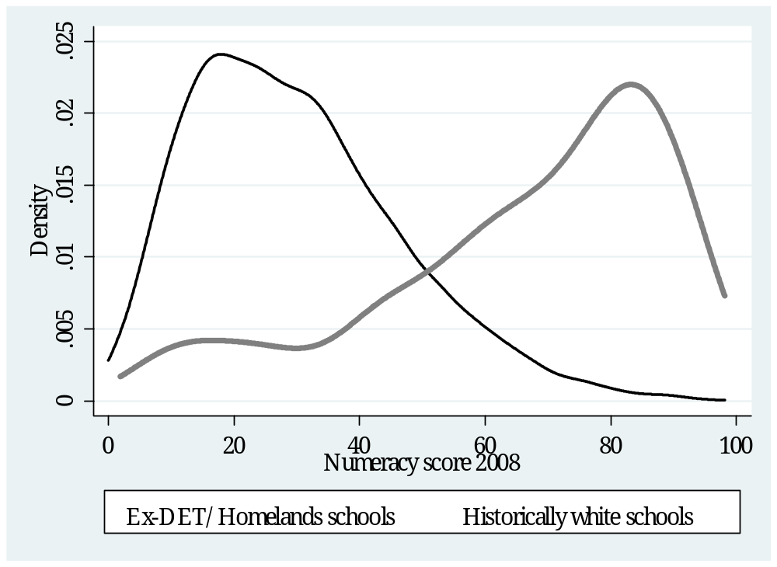
Two school systems not one
Ex-department
Grade 4 [2008]
Data: NSES
(Taylor, 2011)

Slide 23

Two school systems not one
Language
Grade 5 [2006]
Data: PIRLS
(Shepherd, 2011)

Slide 24

Two school systems not one
Socioeconomic Status
Grade 6 [2007]
Data: SACMEQ
(Spaull, 2011)
Abstract…

Slide 25
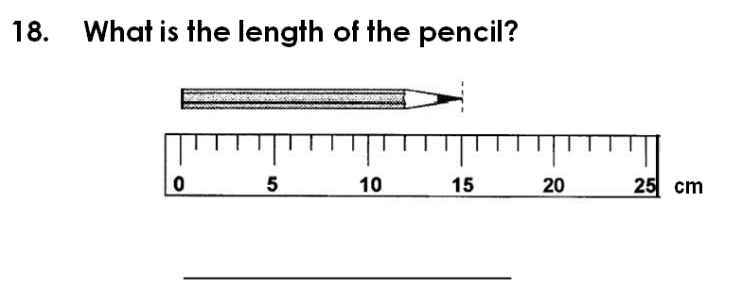
Grade 3 Numeracy
(V-ANA 2011)
Correct answer (15cm): 40% of Gr 3 students
Verification ANA | Quintile
Gr3 Numeracy (Quest 18) | 1 | 2 | 3 | 4 | 5 | Total
Wrong | 63% | 68% | 63% | 57% | 42% | 60%
Right | 37% | 32% | 37% | 43% | 58% | 40%
Total | 100% | 100% | 100% | 100% | 100% | 100%
NB: Test conducted in home language LOLT
Notes:
Introduction to formal measurement (using cm’s) is in the CAPS documentation for grade 3 numeracy

Slide 26
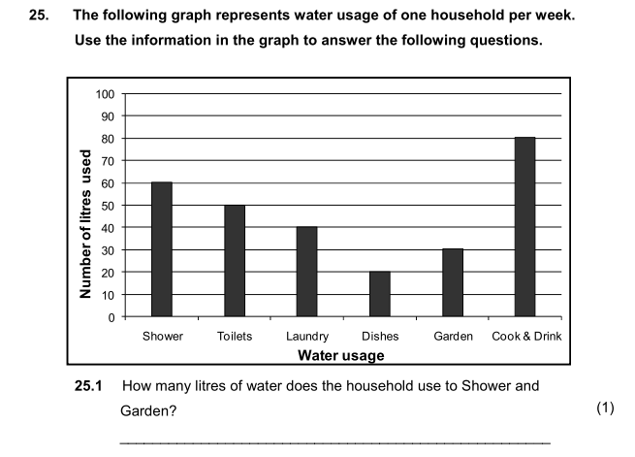
Grade 6 Numeracy
(V-ANA 2011)
Correct answer (90 litres): 32% of Gr 6 students
Verification ANA 2011 | Quintile
Gr6 Numeracy (Quest 25.1) | 1 | 2 | 3 | 4 | 5 | Total
Wrong | 74% | 75% | 70% | 68% | 50% | 68%
Right | 26% | 25% | 30% | 32% | 50% | 32%
Total | 100% | 100% | 100% | 100% | 100% | 100%
Notes:
If we interpret this using SACMEQ’s framework this is a relatively low level task (Level 4: Beginning Numeracy) which requires students to “Translate verbal or graphic information into simple arithmetic problems” See Hungi et al (2011)

Slide 27
Determinants of low quality?
What are some of the determinants of the low quality education in South Africa?
What do South African teachers know?
  Teacher content knowledge
What are the levels of teacher absenteeism?
  Time on task and curriculum coverage

Slide 28
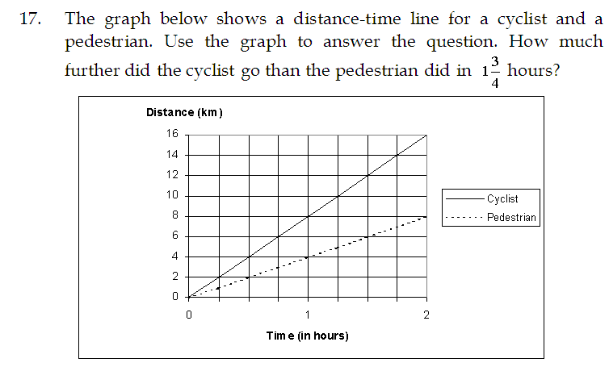
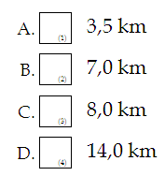

Teacher knowledge
SACMEQ III (2007) → 401/498 Gr6 Mathematics teachers
7
Correct answer (7km):
38% of Gr 6 Maths teachers
SACMEQ Maths teacher test Q17 | Quintile |  |  |  |  | Avg
 | 1 | 2 | 3 | 4 | 5
Correct | 23% | 22% | 38% | 40% | 74% | 38%
2 education systems
Notes:
See Ross et al (2005) for a discussion of the teacher test.

Slide 29

Teacher knowledge...
Maths teacher content knowledge
(SACMEQ III)
Source: Stephen Taylor
Notes:
South African teachers are on the lower end of the distribution of SSA maths teachers, but the average score hides the real truth (as it always does in SA) that some maths teachers in SA perform far below the mean which explains why the variance in maths-teachers maths score in South Africa is so high. The least knowledgeable SA teachers know marginally more than the average STUDENT in South African.
“The solution to the weaknesses in teacher capacity is not simply to train more teachers or for existing teachers to gain higher qualifications. Teachers certified as qualified increased from 54% in 1990 to 94%, but outcomes remained poor. South Africa needs to improve the quality of teacher training, and recruit higher calibre candidates...In the short to medium term, recruit foreign teachers in the areas of critical shortages and grant seven-year working permits to foreign students graduating in South African universities.” NPC NDP 2012
Also, see Makuwa 2010 (on SACMEQ website) for comparable figures for reading teacher content knowledge

Slide 30
Accountability: teacher absenteeism
(SACMEQ III – 2007 – 996 teachers)
4th/15
Notes:
Absenteeism here is average between both maths and reading teachers

Slide 31
Accountability: teacher absenteeism
(SACMEQ III – 2007 – 996 teachers)
15th/15

Slide 32
Accountability: teacher absenteeism
  Teacher absenteeism is regularly found to be an issue in many studies in SA
    2007: SACMEQ III conducted – 20 days average in 2007
    2008: Khulisa Consortium audit – HSRC (2010) estimates that 20-24 days of regular instructional time were lost due to leave in 2008
    2010: “An estimated 20 teaching days per teacher were lost during the 2010 teachers’ strike” (DBE, 2011: 18)
    Importantly this does not include time lost where teachers were at school but not teaching scheduled lessons
      A recent study observing 58 schools in the North West concluded that “Teachers did not teach 60% of the lessons they were scheduled to teach in North West” (Carnoy & Chisholm et al, 2012)
Notes:
Also see Chisholm (2005) and Shisana et al (2005) quoted in HSRC (2010)

Slide 33




Accountability: teacher absenteeism
(SACMEQ III – 2007 – 996 teachers)
Western Cape
Eastern Cape
Limpopo
KwaZulu-Natal
% absent > 1 week striking
32%
81%
97%
82%
% absent > 1 month (20 days)
22%
62%
48%
73%
% absent > 2 months (40 days)
5%
12%
0%
10%
1.3 days a week
Notes:
Given that SACMEQ was done in September 2007, a maximum of 159 school days could have passed, hence 3 months = 1.3 days a week

Slide 34
2 education systems
Dysfunctional Schools (75% of schools) | Functional Schools (25% of schools)
Weak accountability | Strong accountability
Incompetent school management | Good school management
Lack of culture of learning, discipline and order | Culture of learning, discipline and order
Inadequate LTSM | Adequate LTSM
Weak teacher content knowledge | Adequate teacher content knowledge
High teacher absenteeism (1 month/yr) | Low teacher absenteeism (2 week/yr)
Slow curriculum coverage, little homework or testing | Covers the curriculum, weekly homework, frequent testing
High repetition & dropout (Gr10-12) | Low repetition & dropout (Gr10-12)
Extremely weak learning: most students fail standardised tests | Adequate learner performance (primary and matric)

Slide 35

Quality
Quality of education and educational outcomes are very low and highly unequal

Slide 36
2 Significant recent improvements (2010/11)
Annual National Assessments
  2 main aims are (1) accountability, and (2) support
  Provide comparable information on student learning & school performance & provides benchmarks for assessment
  Support can be targeted to specific schools, teachers and learners
  NB: Needs to be externally evaluated (Umalusi?) at at least one primary grade
Workbooks
  A workbook for every child for maths and language
  High quality learning/teaching resources
  Helps teacher pace learning & cover curriculum
  4 worksheets/term ; 8 weeks/term ; 2 terms per volume (4 workbooks per year – 2 for maths and 2 for language

Slide 37





State of SA education since transition…consensus?
“Although 99.7% of South African children are in school…the outcomes in education are abysmal” (Manuel, 2011)
“Without ambiguity or the possibility of misinterpretation, the pieces together reveal the predicament of South African primary education” (Fleisch, 2008: 2)
“Our researchers found that what students know and can do is dismal” (Taylor & Vinjevold, 1999)
“It is not an overstatement to say that South African education is in crisis.” (Van der Berg & Spaull, 2011)

Slide 38

Scorecard
Equalize expenditure
Expand access
Improve quality/outcomes

Slide 39

Verdict?
The post-apartheid government inherited a divided and mostly dysfunctional education system. While it has successfully managed to increase access, equalize government expenditures and ensure that government spending is pro-poor, on the most important task of providing all children with a basic education, irrespective of race, class or geography, it has failed dysmally.
It is unfortunate but true that the current educational system lacks the ability to educate most of the youth in South Africa. Most of South Africa’s primary schools perform worse than poorer schools in poorer African countries. It is without question that the majority of South Africa’s schooling system remains dysfunctional in that it lacks the ability to educate most of the youth in South Africa. Every survey that we have testifies to this fact. Children may be in school, but most are simply not learning what they should be.
F

Slide 40
Conclusions
Some important successes (access, spending, and recently, ANA workbooks and CAPS)
Two education systems not one. Quality of education in most SA schools is far too low – this cannot continue without social consequences
Equalizing resources has not equalized outcomes – need accountability
Most of South Africa performs worse than many poorer African countries – more resources is not the answer
SA has the highest teacher absenteeism in 14 African countries
Failure to get the basics right – large numbers of students (30%) are failing to acquire BASIC numeracy and literacy skills
Hereditary poverty
Low social mobility
Low quality education

Slide 41
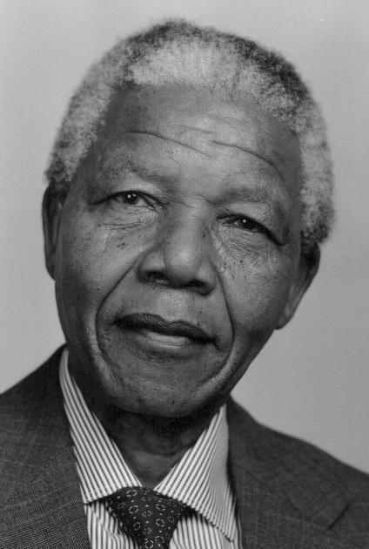
Education
“Education is the great engine of personal development. It is through education that the daughter of a peasant can become a doctor, that the son of a mineworker can become the head of the mine, that a child of farm-workers can become the president”
– Nelson Mandela
If we looked at 200 black Grade 1 children 12 years ago and then look at them again in matric, only 1 out of the 200 (<1%) were eligible for a maths or science degree based on their matric marks – the correspodning figure for white children was 15 times higher.
*based on 2007 matric cohort statistics
Notes:
These stats are from the 2007 co-hort. In 2007 Just over 1% of all black matric candidates qualified for admission to mathematical and scientific degree programmes, compared to 15% of their white counterparts. Given that less than half of the Grade 1 Black cohort actually make it to matric, we can say that less than 1 in 200 Black Grade 1 children were eligible for a maths or science degree at university.
See Moses, E. 2011. Quality of education and the labour market. SUN Working papers.
Nelson Mandela in his Book Long Walk to Freedom famously said that “Education is the great engine of personal development. It is through education that the daughter of a peasant can become a doctor, that the son of a mineworker can become the head of the mine, that a child of farm-workers can become the president”
South Africa simply does not have that type of education.
It is without question that the majority of South Africa’s schooling system is dysfunctional. Every survey that we have testifies to this fact. Instead of being a ladder of social mobility, the educational system is a propagating mechanism favouring the status quo. The fact that South Africa performs worse than many low income African countries should be alarming to parents and policy-makers alike. While educational reform will not be easy, it is absolutely imperative. Improving the quality of teaching, assessment, accountability and school-management will yield large long-term benefits, particularly for the poor.
It is unfortunate but true that the current educational system lacks the ability to educate most of the youth in South Africa. It is not effective. It is not efficient. It is not fair. Until such a time as the education system in South Africa can provide a quality education to all learners, not only the wealthy, we will be stuck with the current patterns of poverty and privilege.

Slide 42
References
Fleisch, B. (2008). Primary Education in Crisis: Why South African schoolchildren underachieve in reading and mathematics. Cape Town. : Juta & Co.
Hoadley, U. (2010). What doe we know about teaching and learning in primary schools in South Africa? A review of the classroom-based research literature. Report for the Grade 3 Improvement project of the University of Stellenbosch. Western Cape Education Department.
Hungi, N., Makuwa, D., Ross, K., Saito, M., Dolata, S., van Capelle, F., et al. (2011). SACMEQ III Project Results: Levels and Trends in School Resources among SACMEQ School Systems. Paris: Southern and Eastern Africa Consortium for Monitoring Educational Quality.
Ross, K., Saito, M., Dolata, S., Ikeda, M., Zuze, L., Murimba, S., et al. (2005). The Conduct of the SACMEQ III Project. In E. Onsomu, J. Nzomo, & C. Obiero, The SACMEQ II Project in Kenya: A Study of the Conditions of Schooling and the Quality of Education. Harare: SACMEQ.
Shepherd, D. (2011). Constraints to School Effectiveness: What prevents poor schools from delivering results? Stellenbosch Economic Working Papers 05/11. [PIRLS]
Spaull, N. (2011a). A Preliminary Analysis of SACMEQ III South Africa.Stellenbosch Economic Working Papers.
Spaull, N. (2011). Primary School Performance in Botswana, Mozambique, Namibia and South Africa. Paris: Southern and Eastern African Consortium for Monitoring Educational Quality (SACMEQ) Working Paper no.8.
Spaull, N. 2012 Equity & Efficiency in South African primary schools : a preliminary analysis of SACMEQ III South Africa Masters Thesis. Economics. Stellenbosch University
Taylor, S. (2011). Uncovering indicators of effective school management in South Africa using the National School Effectiveness Study.Stellenbosch Economic Working Papers 10/11, 1-51. [NSES]
Van der Berg, S., Burger, C., Burger, R., de Vos, M., du Rand, G., Gustafsson, M., Shepherd, D., Spaull, N., Taylor, S., van Broekhuizen, H., and von Fintel, D. (2011). Low quality education as a poverty trap. Stellenbosch: University of Stellenbosch, Department of Economics. Research report for the PSPPD project for Presidency.

Slide 43

Thank you
www.nicspaull.com/research
nicholasspaull@gmail.com
@NicSpaull

Slide 44
3 biggest challenges - SA
Failure to get the basics right
  Children who cannot read, write and compute properly (Functionally illiterate/innumerate) after 6 years of formal full-time schooling
  Often teachers lack even the most basic knowledge
Equity in education
  2 education systems – dysfunctional system operates at bottom of African countries, functional system operates at bottom of developed countries.
  More resources is NOT the silver bullet – we are not using existing resources
Lack of accountability
  Little accountability to parents in majority of school system
  Little accountability between teachers and Department
  Most teacher unions focus almost exclusively on wage negotatiations with little emphasis on professional development & improving quality

Slide 45
Way forward?
Acknowledge the extent of the problem
  Low quality education is one of the three largest crises facing our country (along with HIV/AIDS and unemployment). Need the political will and public support for widespread reform.
Focus on the basics
  Every child MUST master the basics of foundational numeracy and literacy these are the building blocks of further education – weak foundations = recipe for disaster
  Teachers need to be in school teaching (re-introduce inspectorate?)
  Every teacher needs a minimum competency (basic) in the subjects they teach
  Every child (teacher) needs access to adequate learning (teaching) materials
  Use every school day and every school period – maximise instructional time
Increase information, accountability & transparency
  At ALL levels – DBE, district, school, classroom, learner
  Strengthen ANA
  Set realistic goals for improvement and hold people accountable

Slide 46
Teaching Characterised by:
High cognitive demand
Full curriculum coverage
Adequate LTSM
Frequent assessment
Schools Characterised by:
Strong accountability
Well managed & organized
Good school discipline
Culture of L & T
Labour Market
10%
Unemployed
(35%)
Low productivity jobs & incomes
(55%)
University/FET
Type of institution (FET or University)
Quality of institution
Type of qualification (diploma, degree etc.)
Field of study (Engineering, Arts etc.)
High productivity jobs and incomes (10%)
Mainly professional, managerial & skilled jobs
Requires graduates, good quality matric or good vocational skills
Historically mainly white
High quality secondaryschool
High SES background
High quality primary school
Minority (20%)
Some motivated, lucky or talented students make the transition
Unequal society
Vocational training
Affirmative action
Big demand for good schools despite fees
Some scholarships/bursaries
Majority (80%)
Low productivity jobs & incomes
Often manual or low skill jobs
Limited or low quality education
Minimum wage can exceed productivity
Quality
Low quality secondary
school
Attainment
Type
Low SES background
Low quality primary school
Teaching Characterised by:
Low cognitive demand
Slow curriculum coverage
Inadequate LTSM
Weak & infrequent assessment
Weak teacher content knowledge
Schools Characterised by:
Little parental involvement
No accountability
Little discipline
Weak management
High teacher absenteeism

Slide 47
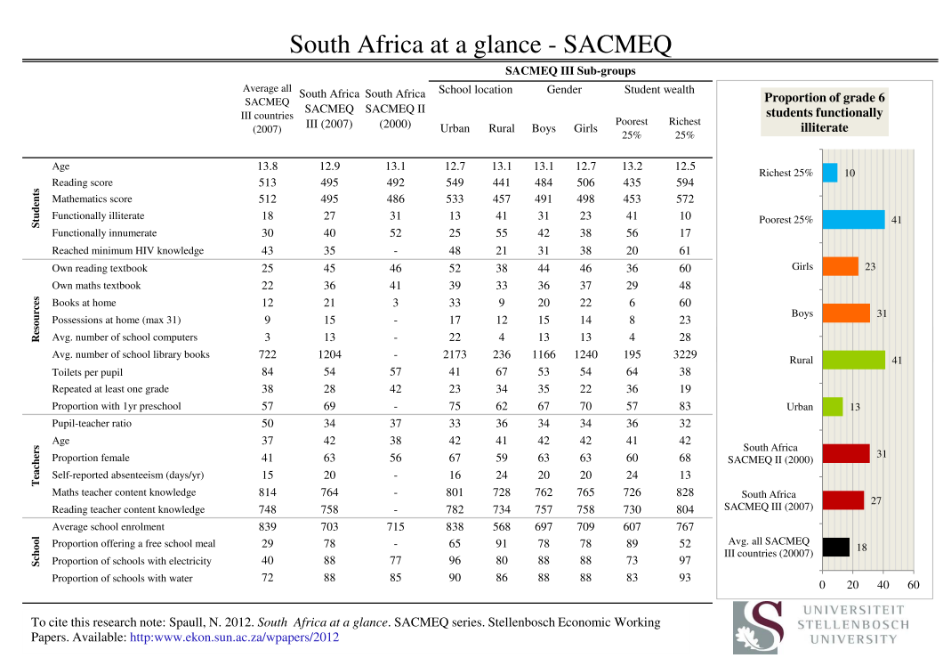
Notes:
Forthcoming on RESEP website

Slide 48
Accountability: teacher absenteeism
(SACMEQ III – 2007 – 996 teachers)
 | Total teacher abseteeism (days) | Teacher strikes only (days) | Percentage absent for > 1 week due to strikes | Percentage absent for > 1 month due to strikes | Percentage absent > 1 month | Percentage absent > 2 month | Percentage absent > 3 month
ECA | 22 | 14 | 81% | 0% | 62% | 12% | 9%
FST | 17 | 9 | 62% | 3% | 25% | 7% | 2%
GTN | 12 | 6 | 41% | 0% | 16% | 3% | 3%
KZN | 26 | 15 | 82% | 56% | 73% | 10% | 5%
LMP | 21 | 14 | 97% | 0% | 48% | 0% | 0%
MPU | 24 | 13 | 87% | 9% | 48% | 6% | 4%
NCA | 18 | 11 | 62% | 32% | 50% | 2% | 0%
NWP | 19 | 10 | 73% | 8% | 45% | 11% | 8%
WCA | 11 | 5 | 32% | 12% | 22% | 5% | 2%
Total | 20 | 12 | 71% | 24% | 47% | 7% | 4%
Notes:
Based on own calculations using the SACMEQ III (2007) South Africa dataset

Slide 49
Description of levels | Range on 500 point scale | Skills
Level 1 Pre-reading | < 373 | Matches words and pictures involving concrete concepts and everyday objects. Follows short simple written instructions.
Level 2 Emergent reading | 373 → 414 | Matches words and pictures involving prepositions and abstract concepts; uses cuing systems (by sounding out, using simple sentence structure, and familiar words) to interpret phrases by reading on.
Level 3 Basic reading | 414 → 457 | Interprets meaning (by matching words and phrases, completing a sentence, or matching adjacent words) in a short and simple text by reading on or reading back.
Level 4 Reading for meaning | 457 → 509 | Reads on or reads back in order to link and interpret information located in various parts of the text.
Level 5 Interpretive reading | 509 → 563 | Reads on and reads back in order to combine and interpret information from various parts of the text in association with external information (based on recalled factual knowledge) that “completes” and contextualizes meaning.
Level 6 Inferential reading | 563 → 618 | Reads on and reads back through longer texts (narrative, document or expository) in order to combine information from various parts of the text so as to infer the writer’s purpose.
Level 7 Analytical reading | 618 → 703 | Locates information in longer texts (narrative, document or expository) by reading on and reading back in order to combine information from various parts of the text so as to infer the writer’s personal beliefs (value systems, prejudices, and/or biases).
Level 8 Critical reading | 703+ | Locates information in a longer texts (narrative, document or expository) by reading on and reading back in order to combine information from various parts of the text so as to infer and evaluate what the writer has assumed about both the topic and the characteristics of the reader – such as age, knowledge, and personal beliefs (value systems, prejudices, and/or biases).
Source: (Hungi, et al., 2010)
^{[1]} See Ross et al. (2005, p. 95).
Notes:
SACMEQ levels – see SACMEQ website and Ross et al 2005 for more information

Slide 50
Description of levels | Range on 500 point scale | Skills
Level 1 Pre-numeracy | < 364 | Applies single step addition or subtraction operations. Recognizes simple shapes. Matches numbers and pictures. Counts in whole numbers.
Level 2 Emergent numeracy | 364 → 462 | Applies a two-step addition or subtraction operation involving carrying, checking (through very basic estimation), or conversion of pictures to numbers. Estimates the length of familiar objects. Recognizes common two-dimensional shapes.
Level 3 Basic numeracy | 462 → 532 | Translates verbal information presented in a sentence, simple graph or table using one arithmetic operation in several repeated steps. Translates graphical information into fractions. Interprets place value of whole numbers up to thousands. Interprets simple common everyday units of measurement.
Level 4 Beginning numeracy | 532 → 587 | Translates verbal or graphic information into simple arithmetic problems. Uses multiple different arithmetic operations (in the correct order) on whole numbers, fractions, and/or decimals.
Level 5 Competent numeracy | 587 → 644 | Translates verbal, graphic, or tabular information into an arithmetic form in order to solve a given problem. Solves multiple-operation problems (using the correct order of arithmetic operations) involving everyday units of measurement and/or whole and mixed numbers. Converts basic measurement units from one level of measurement to another (for example, metres to centimetres).
Level 6 Mathematically skilled | 644 → 720 | Solves multiple-operation problems (using the correct order of arithmetic operations) involving fractions, ratios, and decimals. Translates verbal and graphic representation information into symbolic, algebraic, and equation form in order to solve a given mathematical problem. Checks and estimates answers using external knowledge (not provided within the problem).
Level 7 Concrete problem solving | 720 → 806 | Extracts and converts (for example, with respect to measurement units) information from tables, charts, visual and symbolic presentations in order to identify, and then solves multi-step problems.
Level 8 Abstract problem solving | > 806 | Identifies the nature of an unstated mathematical problem embedded within verbal or graphic information, and then translate this into symbolic, algebraic, or equation form in order to solve the problem.
Source: (Hungi, et al., 2010)
^{[1]} See (Ross, et al., 2005, p. 95).
Notes:
SACMEQ levels – see SACMEQ website and Ross et al 2005 for more information

Slide 51
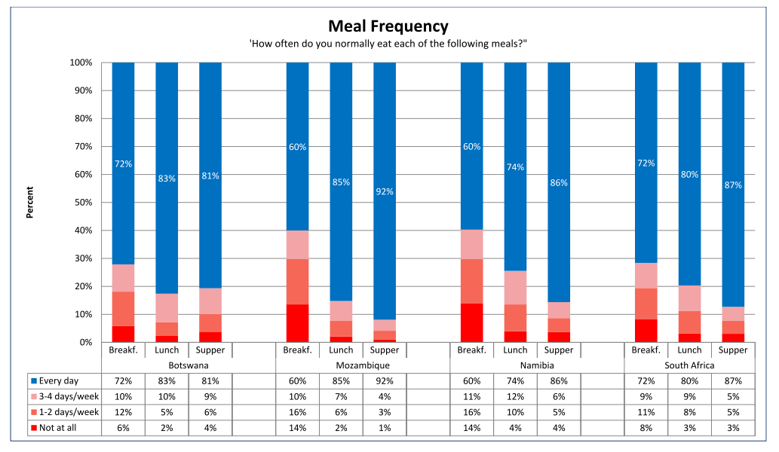
Notes:
See Spaull 2011 comparison paper

Slide 52
Country | Total population (mil) | Adult literacy rate | Net Enrolment Rate (2008) | GNP/cap PPP US$ (2008) | Public Current expenditure on primary education per pupil (unit cost) 2007 – [PPP constant 2006 US$] | Survival rate to Grade 5: school year ending 2007
Botswana | 1.92 | 83% | 87% | 13100 | 1228 | 89%³
Mozambique | 22.38 | 54% | 80% | 770 | 79² | 60%
Namibia | 2.13 | 88% | 89% | 6270 | 668 | 87%³
South Africa | 49.67 | 89% | 87% | 9780 | 1225 | 98%
Source | (UNESCO, 2011) | (UNESCO, 2011) | (UNESCO, 2011) | (UNESCO, 2011) | (UIS, 2009) | (UNESCO, 2011)
SACMEQ III (2007) | Self-reported teacher absenteeism | Proportion of Grade 6 students functionally illiterate | Proportion of Grade 6 students functionally innumerate | Proportion of students with own reading textbook | Proportion of students with own mathematics textbook
Botswana | 10.6 days | 10.62% | 22.48% | 63% | 62%
Mozambique | 6.4 days | 21.51% | 32.73% | 53% | 52%
Namibia | 9.4 days | 13.63% | 47.69% | 32% | 32%
South Africa | 19.4 days | 27.26% | 40.17% | 45% | 36%

Slide 53
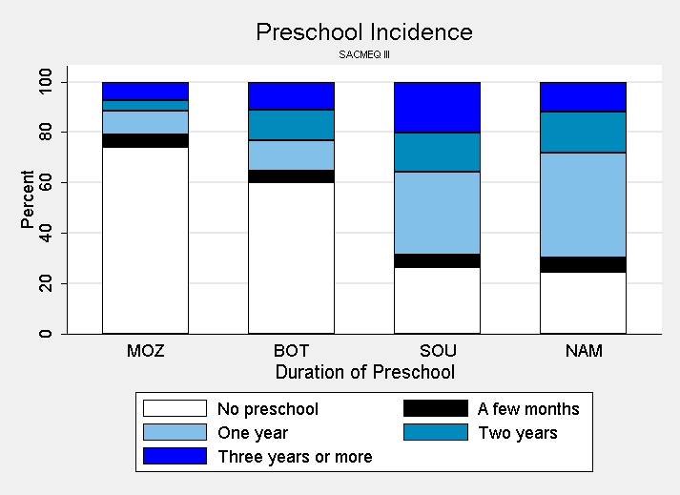
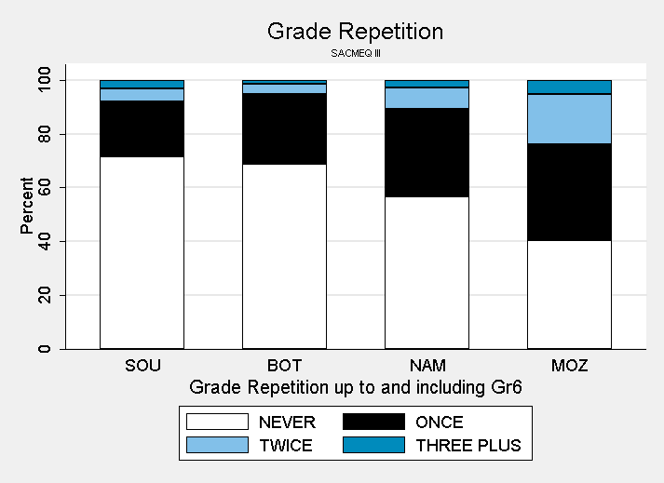
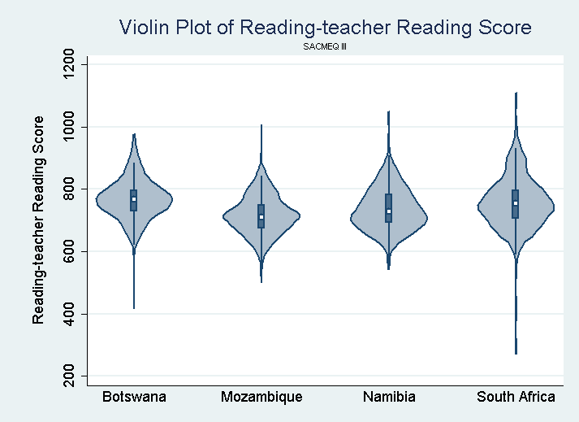
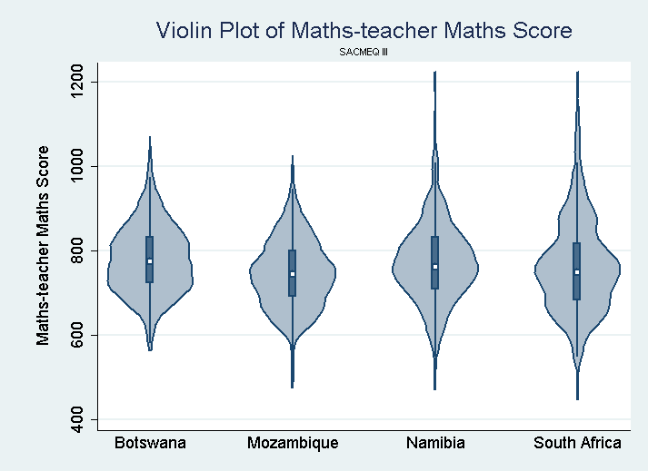
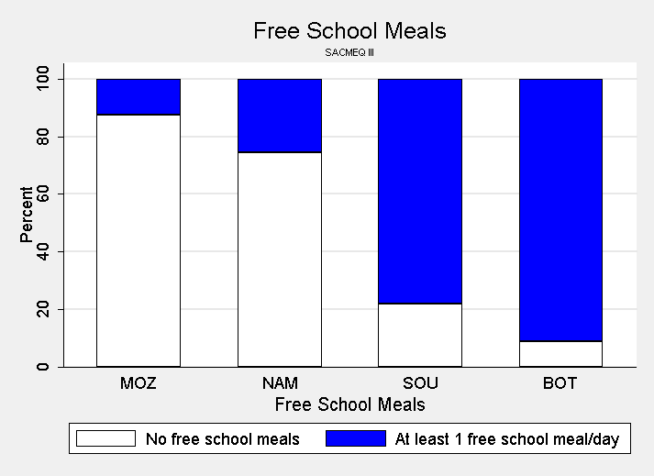

Slide 54

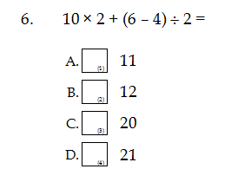
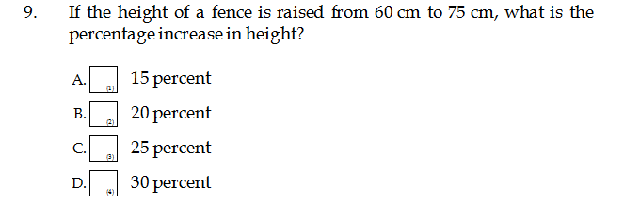
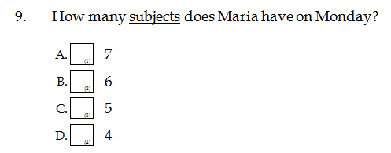
Teacher knowledge...
← Q6: 53% correct (D)
Q9: 24% correct (C)
English Q9: 57% correct (D)

Slide 55
Passing relative to cohort (2008)

