Slide 1




Getting Early Learning Right
Nic Spaull (PhD)
ISASA ECD Conference 2017 | Lebone II College | 19 March 2017

Slide 2

#FeesMustFall

Slide 3
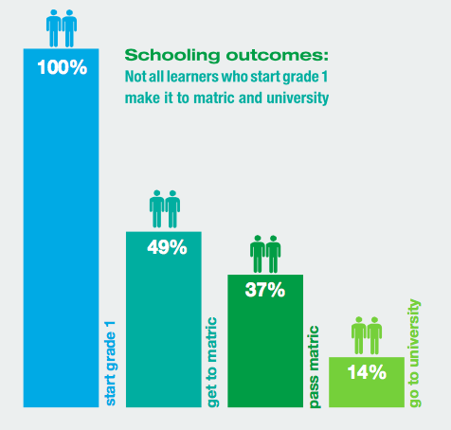
How many make it to university?
 | Numbers
Grade 2 (2004) | 1085570
Grade 9 (2011) | 1049904
Grade 12 (2014) | 532860
Passed (2014) | 403874
Bachelors (2014) | 150752

Slide 4
So the problem starts before matric… perhaps in the FET phase or in the Senior Phase?
Let’s look at maths and reading outcomes...

Slide 5
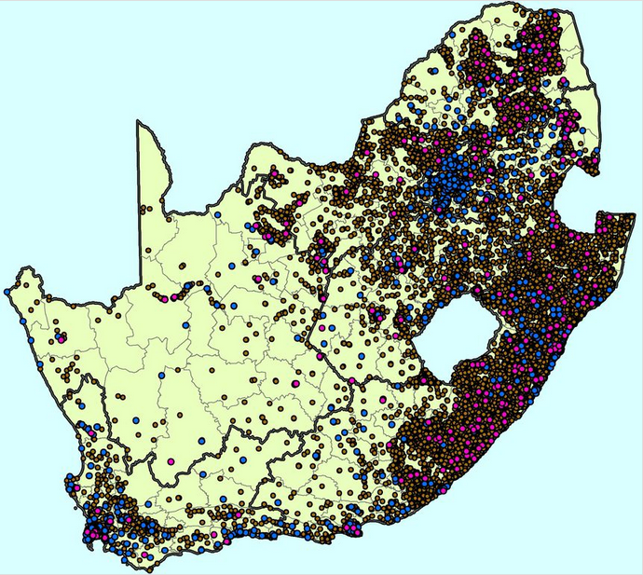
Nationally-representative samples
Source: Marisa Von Fintel
Purple dots = Schools selected for the National School Effectiveness Study
Notes:
Brown dots = former black schools
Blue dots = former white schools
Purple dots = school included in NSES
(courtesy of Marisa Coetzee)

Slide 6
MATHEMATICS: Insurmountable learning deficits
Figure 10b: South African mathematics learning trajectories by national socioeconomic quintiles using a variable standard deviation for a year of learning (0.28 in grade 3 to 0.2 in grade 8 with interpolated values for in-between grades (Based on NSES 2007/8/9 for grades 3/4/5, SACMEQ 2007 for grade 6 and TIMSS 2011 for grade 9, including 95% confidence interval
Spaull & Viljoen, 2015

Slide 7

NSES question 42
NSES followed about 15000 students (266 schools) and tested them in Grade 3 (2007), Grade 4 (2008) and Grade 5 (2009).
Grade 3 maths curriculum: “Can perform calculations using appropriate symbols to solve problems involving: division of at least 2-digit by 1-digit numbers”
Even at the end of Grade 5 most (55%+) quintile 1-4 students cannot answer this simple Grade-3-level problem.
“The powerful notions of ratio, rate and proportion are built upon the simpler concepts of whole number, multiplication and division, fraction and rational number, and are themselves the precursors to the development of yet more complex concepts such as triangle similarity, trigonometry, gradient and calculus” (Taylor & Reddi, 2013: 194)
(Spaull & Viljoen, 2015)
Notes:
Taylor, N., & Reddi, B. (2013). Writing and learning mathematics. In N. Taylor, S. Van der Berg, & T. Mabogoane, Creating Effective Schools. Cape Town: Pearson.

Slide 8
READING: What % of Gr4 students do not learn to read for meaning in any language? prePIRLS 2011
Richest 5% of schools
Poorest 5% of schools
Advanced
High
Intermediate
< Intermediate
(Cannot read for meaning)

Slide 9
So the problem starts long before Grade 3...

Slide 10
Labour Market
15%
Legislators, managers, assoc professionals
Unemployed
(Broad - 35%)
Unskilled
(18%)
Elementary occupations & domestic workers
Semi-Skilled (32%)
Clerks, service workers, shop personnel, skilled agric/fishery workers, plant and machinery operators)
University/FET
Type of institution (FET or University)
Quality of institution
Type of qualification (diploma, degree etc.)
Field of study (Engineering, Arts etc.)
High productivity jobs and incomes (15%)
Mainly professional, managerial & skilled jobs
Requires graduates, good quality matric or good vocational skills
High quality secondaryschool
High SES background + ECD
High quality primary school
ECD
Minority (20%)
Some motivated, lucky or talented students make the transition
Unequal society
Big demand for good schools despite fees
Some scholarships/bursaries
Vocational training
Affirmative action
(few make this transition)
Majority (80%)
Quality
Low quality secondary
school
Attainment
Type
Low productivity jobs & incomes
Often manual or low skill jobs
Limited or low quality education
Low socioeconomic status background
Low quality primary school
ECD
None or
low-quality
Statistics from Quarterly Labour Force Survey (QLFS) 2014 Q4
Notes:
The QLFS classifies professions as follows: Highly skilled (legislators, senior officials and managers, professionals, technicians and associate profesionals); Semi-skilled (Clerks, service workers and shop and market personnel, skilled agricultural and fishery workers, craft and related trade workers, plant and machinery operators and assembly), Unskilled (Elementary occupations, domestic workers).

Slide 11
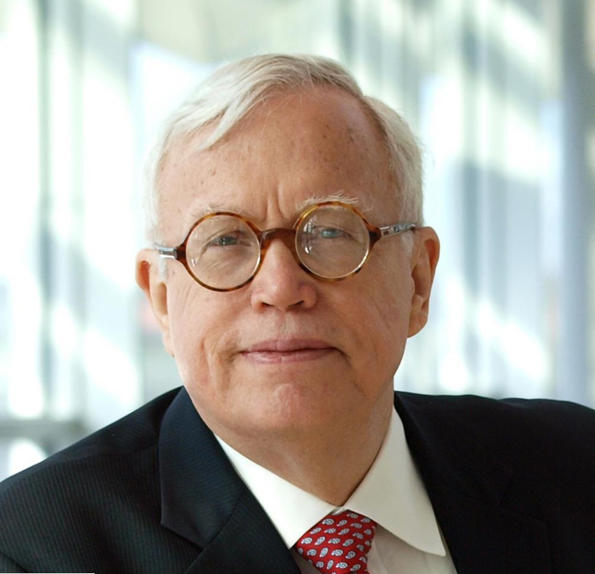
Why focus on ECD?
“Policies that seek to remedy deficits incurred in early years are much more costly than early investments wisely made, and do not restore lost capacities even when large costs are incurred. The later in life we attempt to repair early deficits, the costlier the remediation becomes”
(Heckman, 2000, p. 5).
Nobel Laureate James Heckman
Notes:
Heckman, J.J., 2000. Policies to foster human capital. Res. Econ. 54, 3–56.

Slide 12
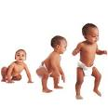
Life course development
Foetal development
Inter-generational effects
Infant- child growth & development
Adult wellbeing & human capital
Adolescent education & wellbeing
Notes:
Kerr
Nicolson

Slide 13
Life course development
Foetal development
Heightened susceptibility to harms and benefits
Inter-generational effects
Infant- child growth & development
Adult wellbeing & human capital
Adolescent education & wellbeing
Notes:
Kerr
Nicolson

Slide 14
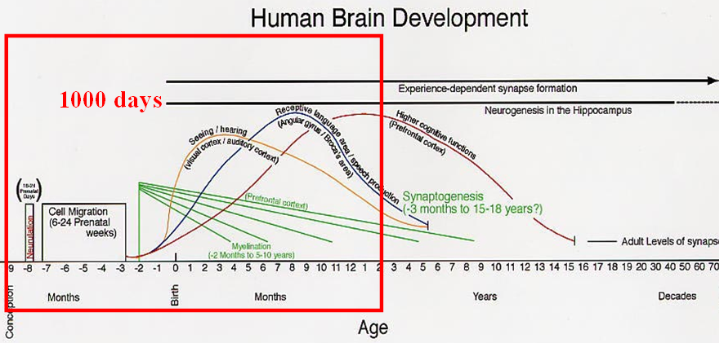
Rapid functional development
Structural features of the brain supporting sensory, language and cognitive functions are developed by 2 years of age
Thompson & Nelson, 2001, American Psychologist

Slide 15
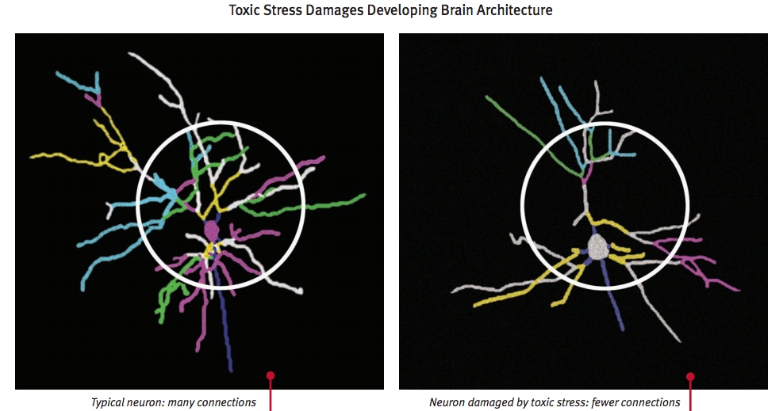
The impact of neglect
Source: www.developingchild.harvard.edu

Slide 16
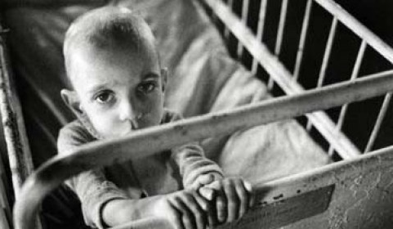
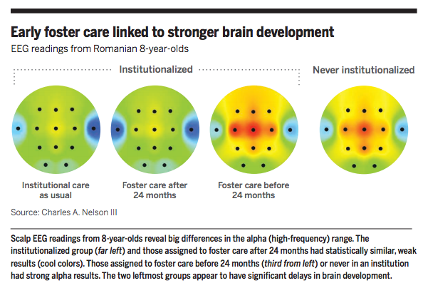
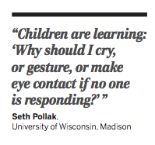
Romanian Orphans
Notes:
In the 1960s’ under Ceausescu government taxed women who had fewer than 5 children. By 1980s Romanian orphanages housed 170,000 orphans. Sometimes a single caregiver would be in charge of 10-15 children and a child might come into contact with 17 different caregivers in a week.
http://sci-hub.cc/10.1126/science.345.6198.752

Slide 17
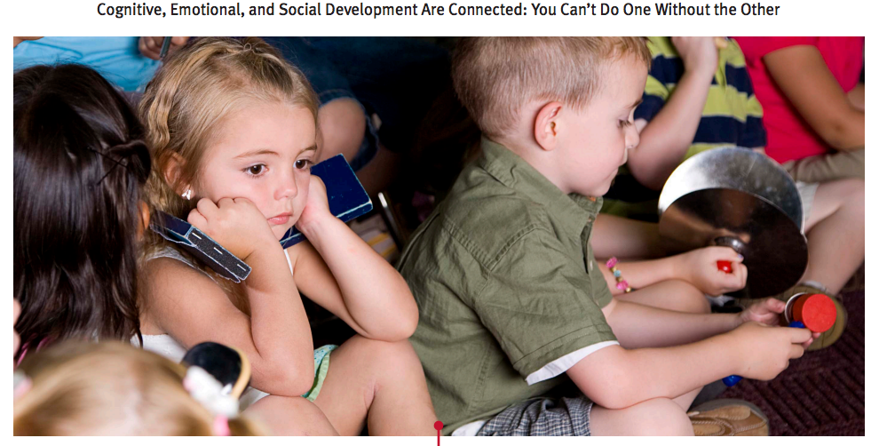
Cognitive, Social & Emotional
Source: www.developingchild.harvard.edu

Slide 18
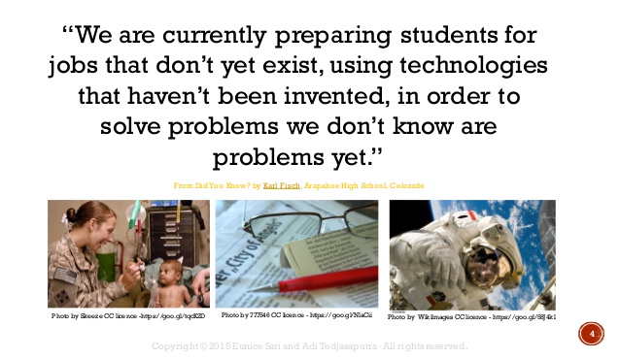
ECD: Preparing students to thrive now and in the future

Slide 19
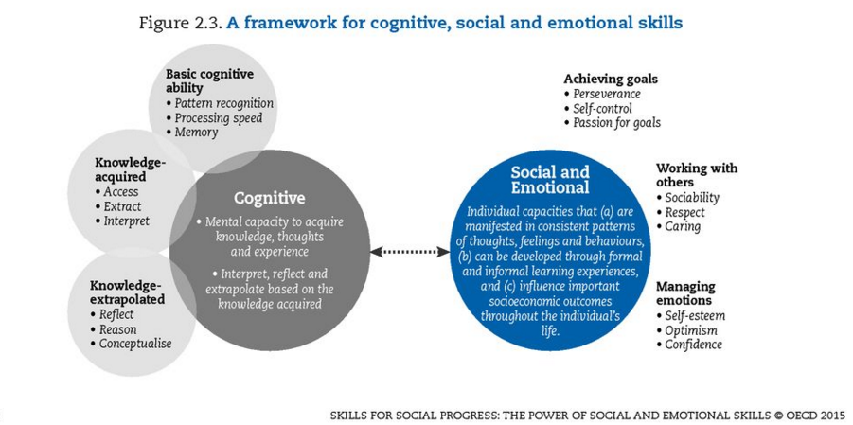

Slide 20


Slide 21


Slide 22
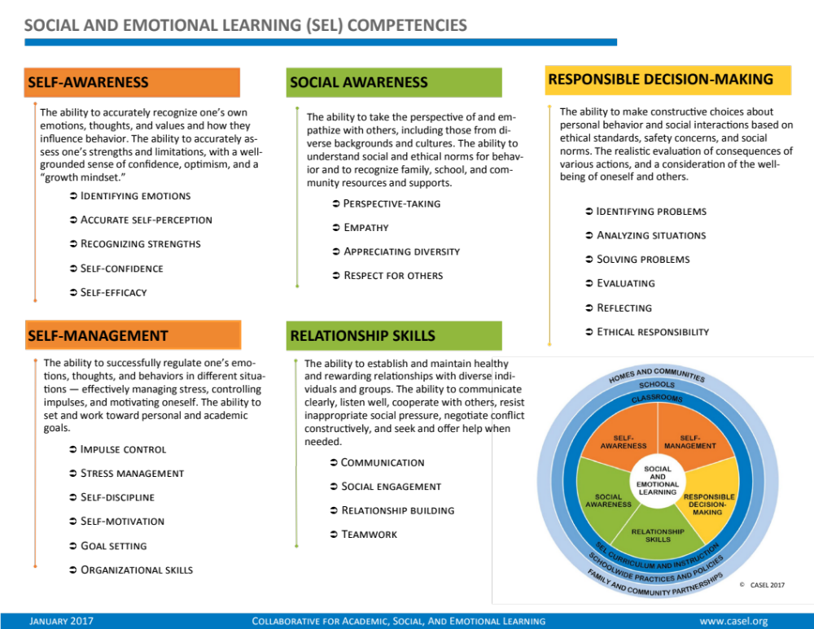

Slide 23
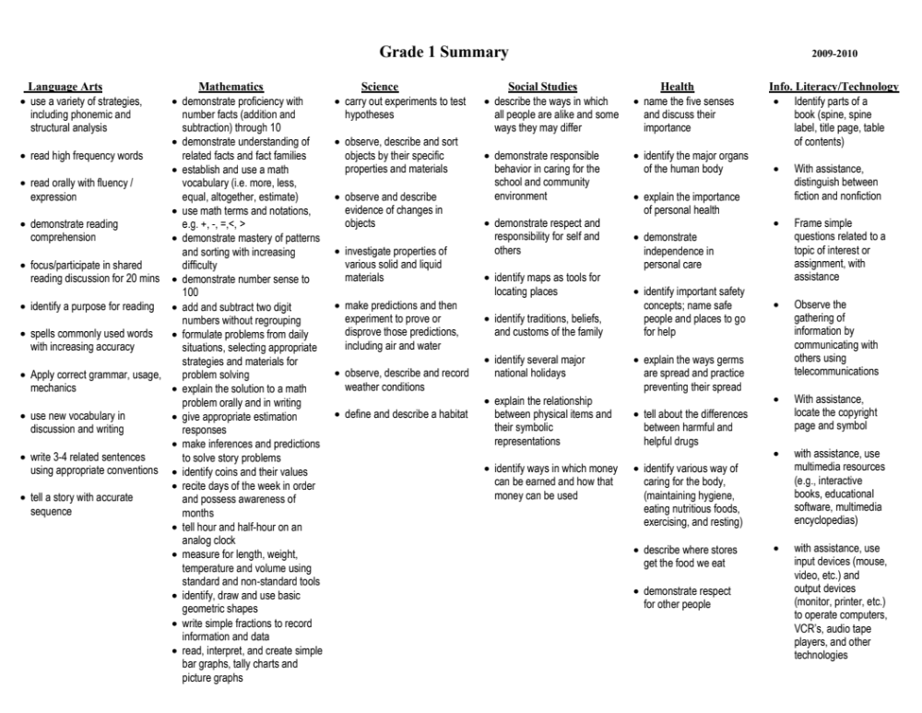
Londonderry Gr 1 expectations

Slide 24
Cognitive, Social & Emotional
Source: www.developingchild.harvard.edu

Slide 25
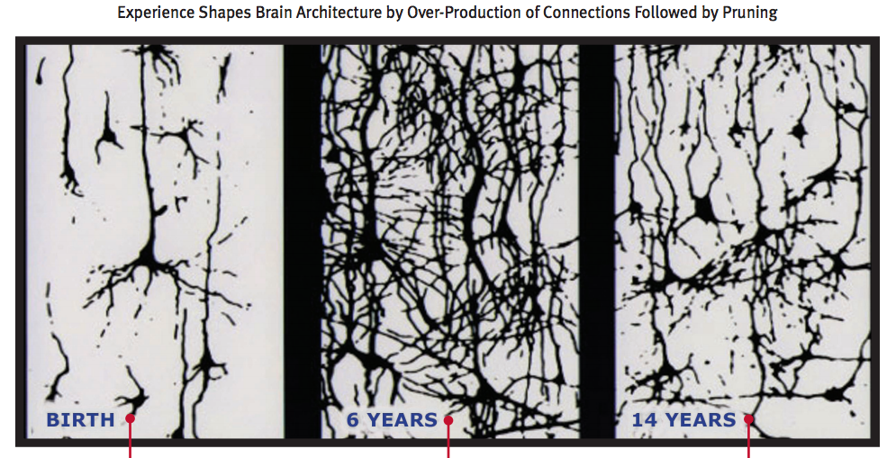
Early brain development
Source: www.developingchild.harvard.edu
Notes:
“The basic architecture of the brain is constructed through an ongoing process that begins before birth and continues into adulthood. During the first few years of life, 700 new synapses (neural connections) are formed every second. After a period of rapid proliferation, connections are reduced through a process called pruning, so that brain circuits can become more efficient. Early experiences affect the nature and quality of the brain’s developing architecture by determining which circuits are reinforced and which are pruned through lack of use. Some people refer to this as “use it or lose it." Graphic Source: Chugani, H.T. Synaptic Density. [Drawing]. In R. Shore, Rethinking the Brain: New Insights into Early Development (p. 20). New York: Families and Work Institute, 1997

Slide 26
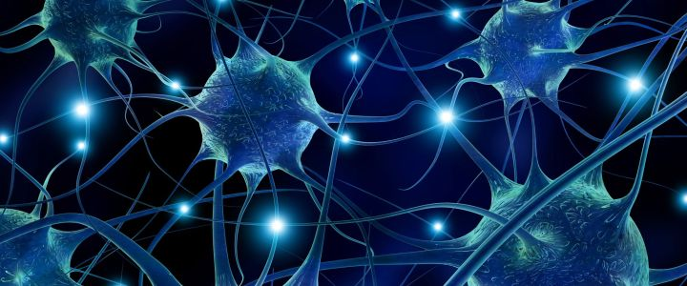
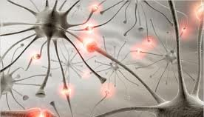
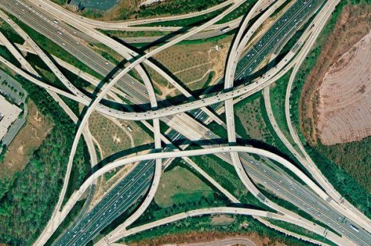
Road analogy

Slide 27
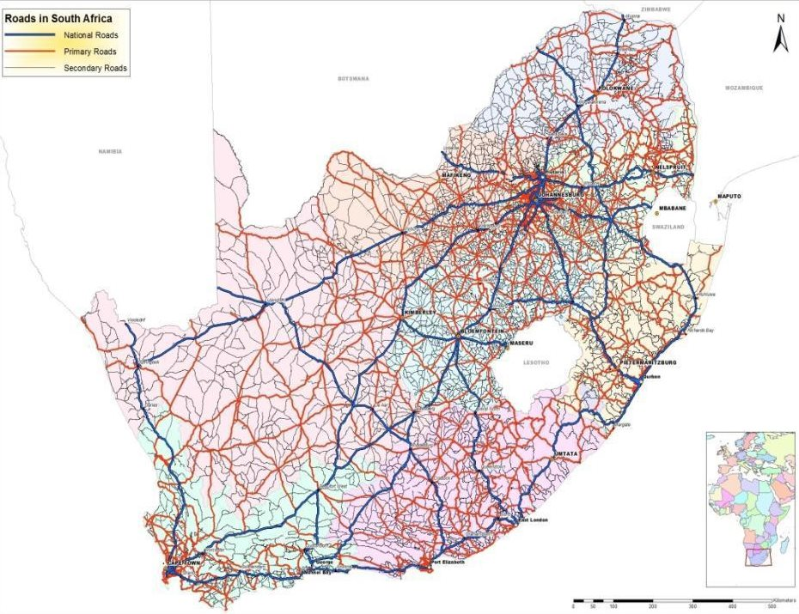
747,000km of roads in SA (paved and unpaved)
Assume an interchange every 100m = 7,470,000 interchanges in SA
Notes:
747,000 km (747,000,000m) of roads in South africa. If we assume that there was an interchange every 100m that’s 7, 470,000 interchanges (world=300mil interchanges if you assume that there are 1,500,000 interchanges per country)
700 synapses/s = 42,000 in a minute = 2,520 000 in an hour. 142,857. It would take a child under 3-days to build it from scratch. For every single interchange in the entire world it would take 3 months.
http://www.tradingeconomics.com/south-africa/roads-total-network-km-wb-data.html

Slide 28
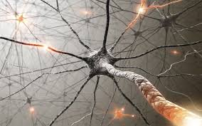
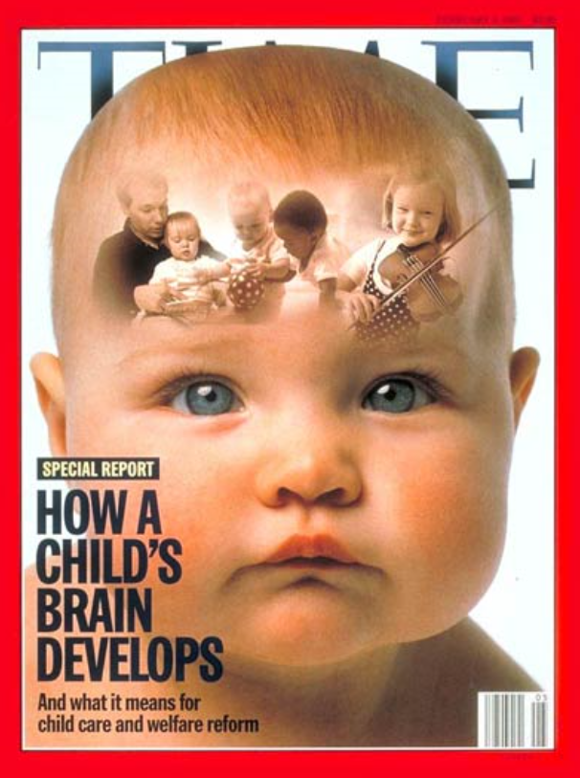
How ‘big’ is a child’s brain?

Slide 29

333,000 planet Earth’s roads and interchanges = 1 child’s brain
Notes:
SA is a big country. Maybe 1,500,000 interchanges in the average country
300 million road interchanges on the earth…

Slide 30
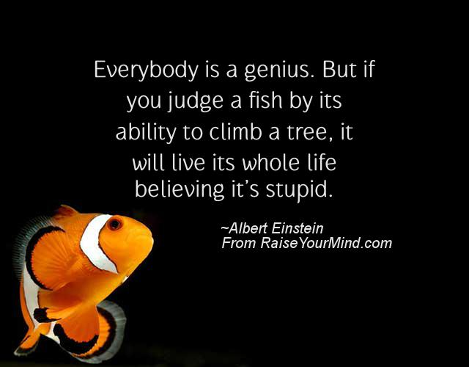
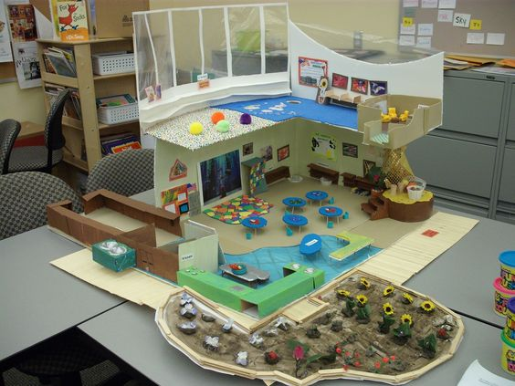

Slide 31

Raising the status of ECD
(1) ECD can no longer be seen as child-minding where the least capable go as “employment of last resort.”
(2) Rigorous scientific research is consistently showing us that this (together with parenting) is the critical lever for success.
(3) We need to lobby government to prioritize ECD in accordance with the evidence. Qualifications? Professionalization? Pay?
(4) We need to find ways of decreasing the unequal quality in ECD services. NB for partnering and professional development internships

Slide 32





Credit & resources
Prof Jack Shonkoff - Harvard
Prof Linda Richter - Wits

Slide 33
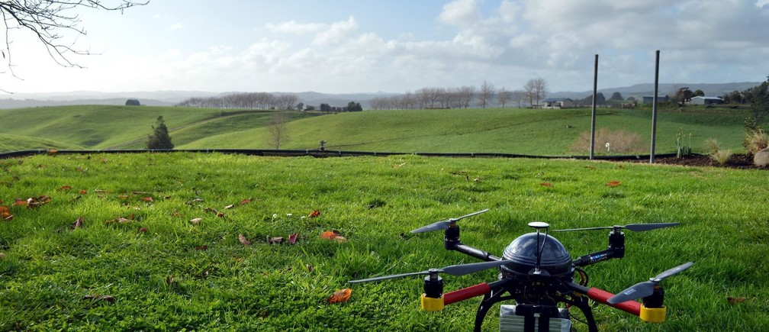
Questions & comments?
Presentation available at nicspaull.com

Slide 34
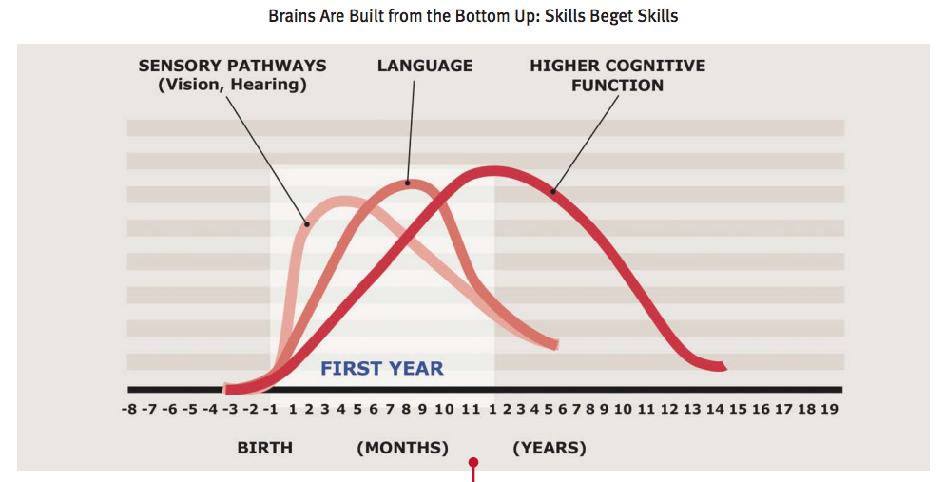
Brain development
Source: www.developingchild.harvard.edu

Slide 35
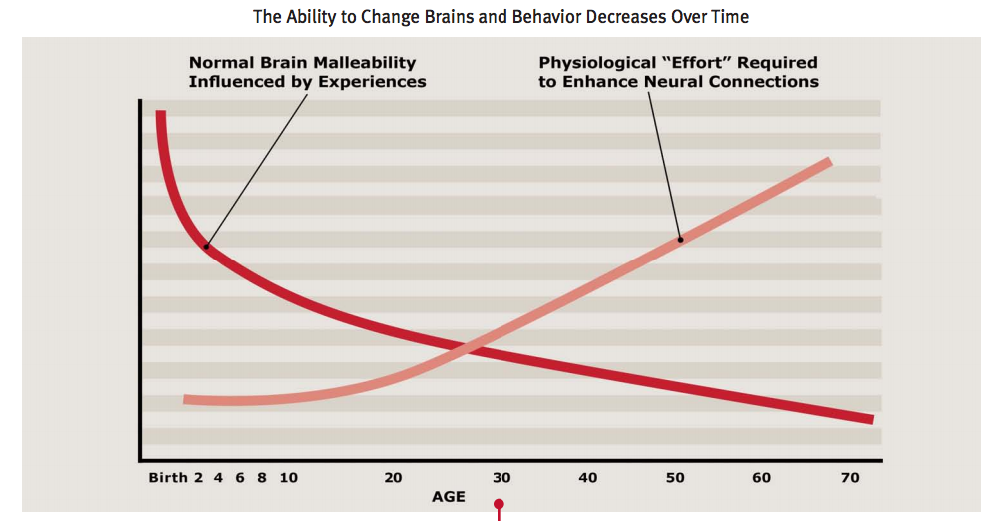
Brain malleability
Source: www.developingchild.harvard.edu

Slide 37
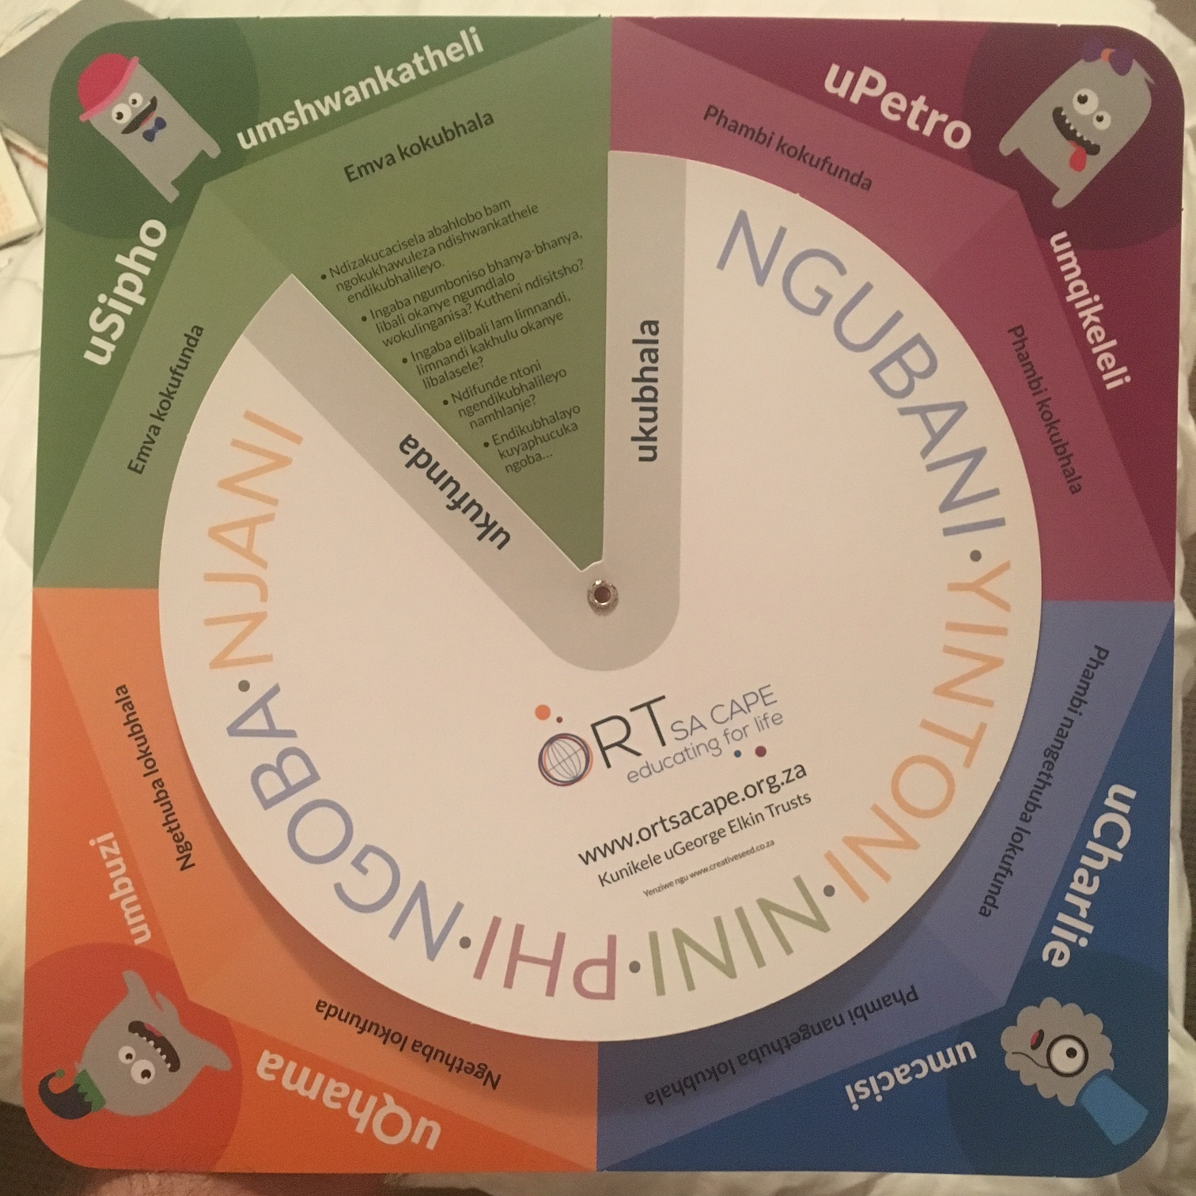
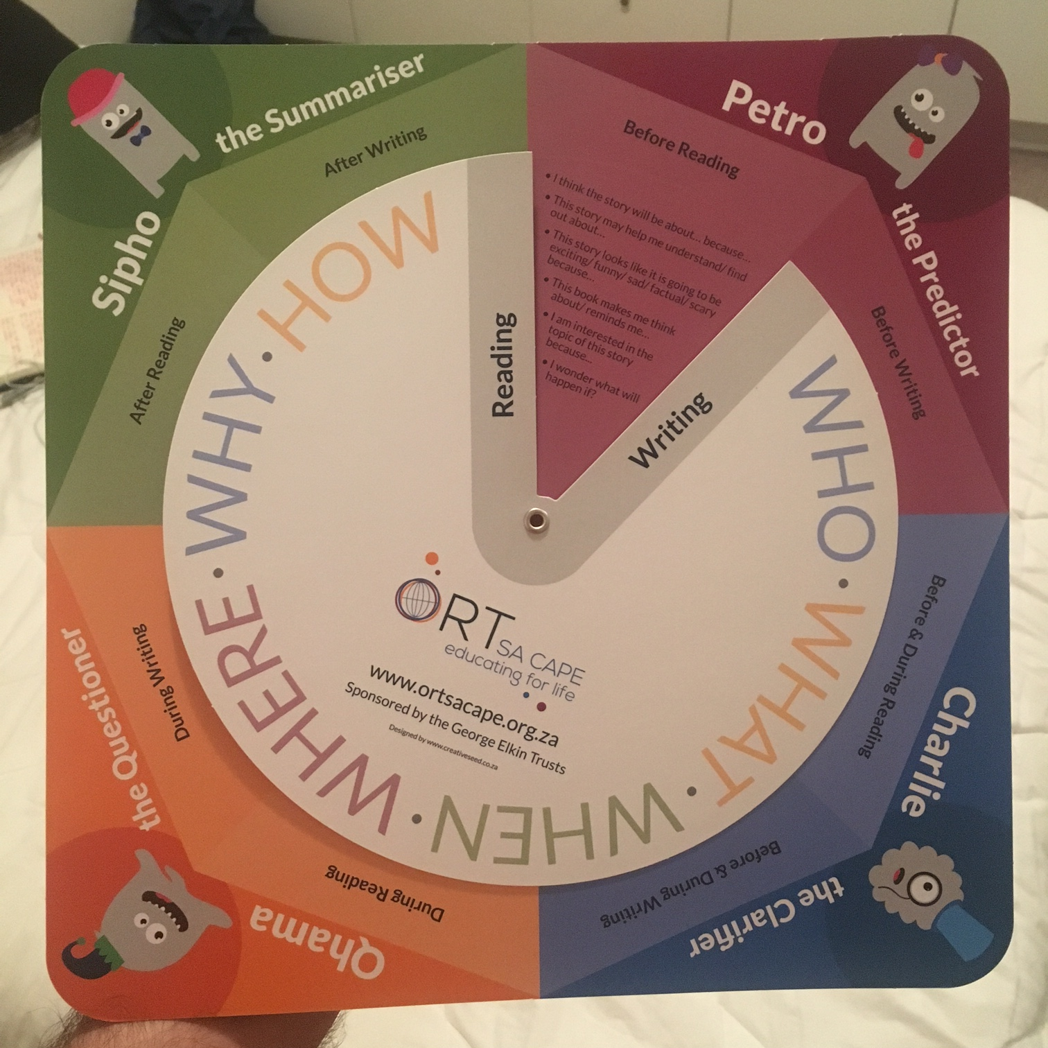

Slide 38
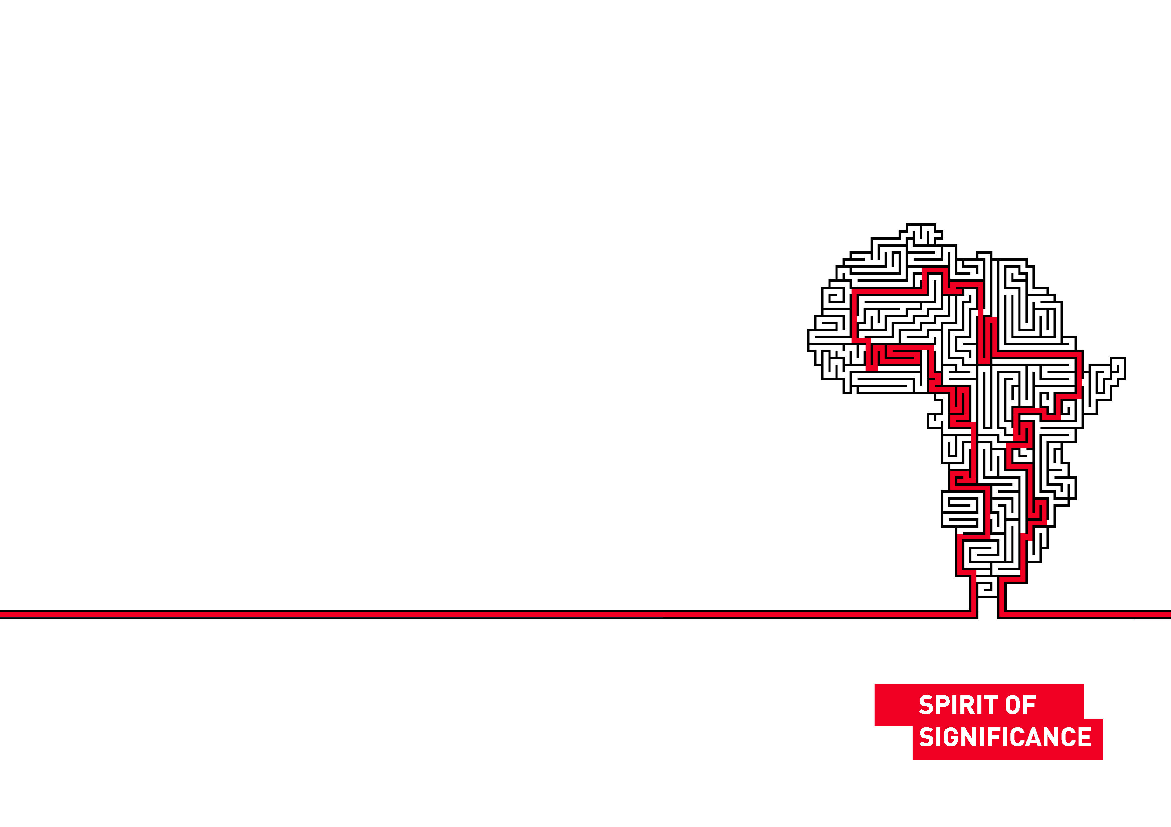
READING: What % of Gr4 students do not learn to read in any language?

Slide 39

Early child development is important
“The Sustainable Development Goals recognize that early childhood development can help drive the transformation we hope to achieve over the next 15 years”
UN Secretary-General Ban Ki-moon, UN Headquarters
22 September 2015

Slide 40
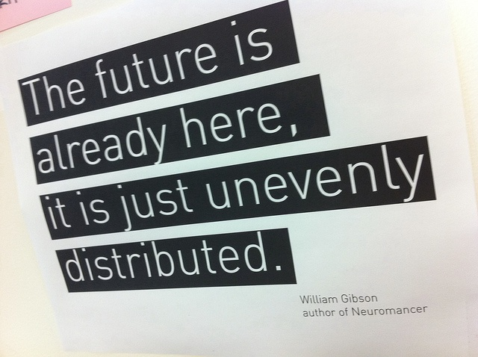

Slide 41
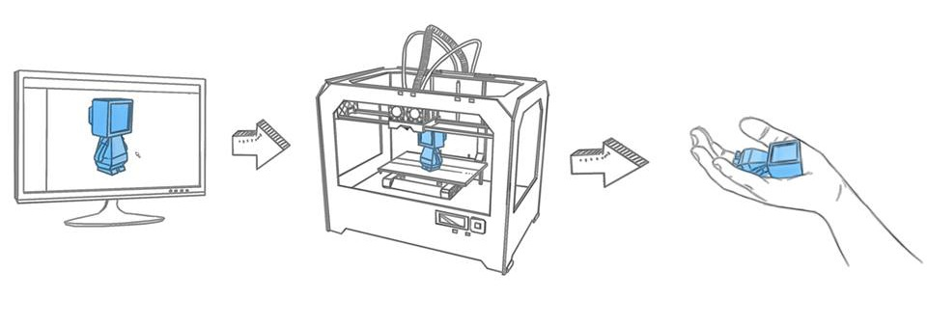
3-D Printing

Slide 42
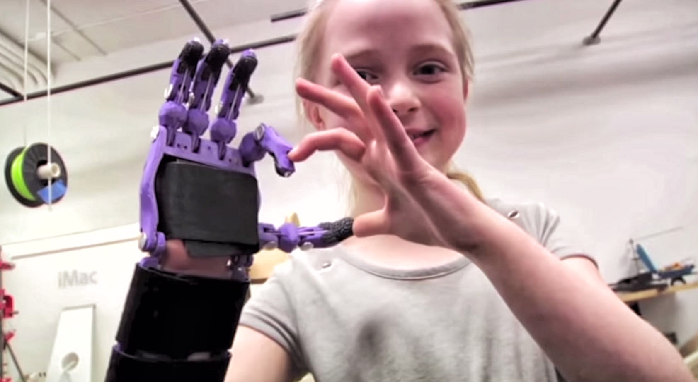
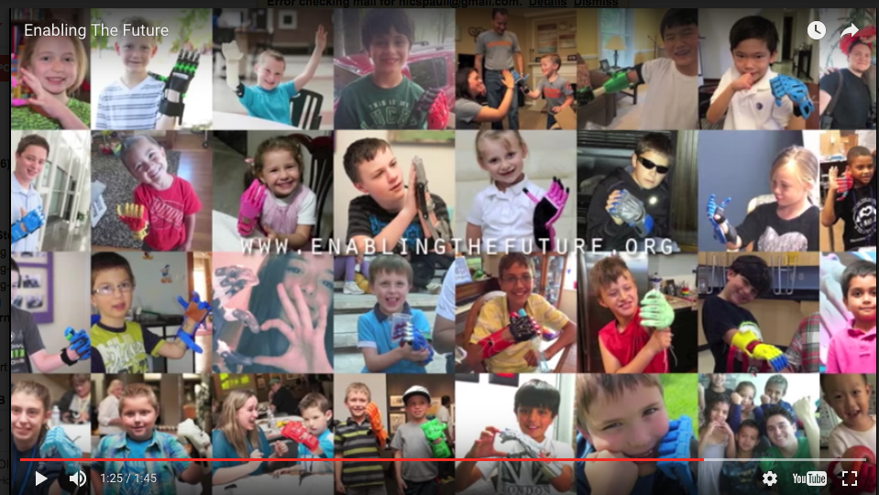
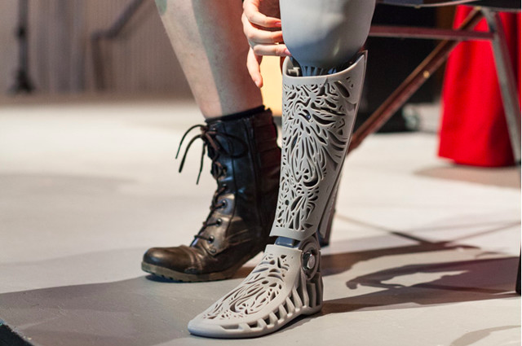

Crawford College La Lucia Grade 8’s are helping print a prosthetic hand for Bongani.

Slide 43
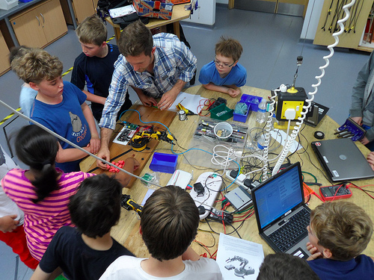
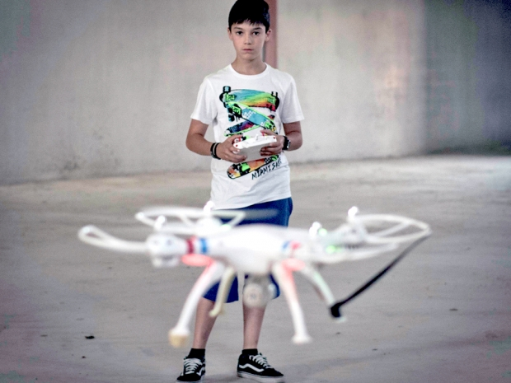
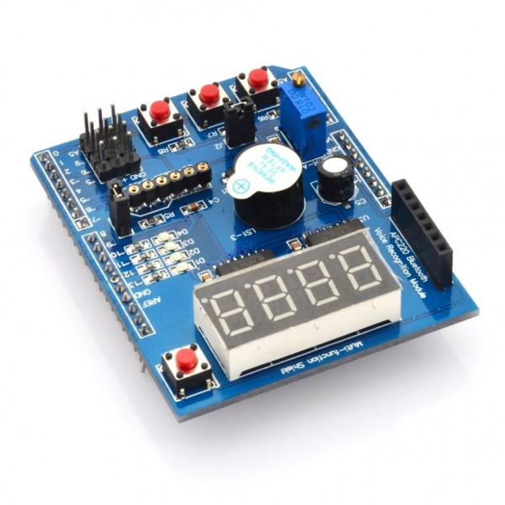
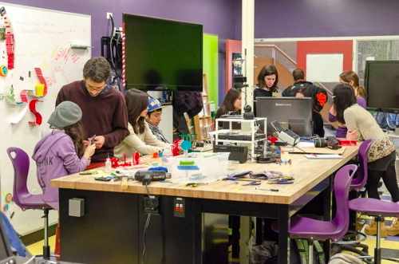
Examples
-Inter-grade teaching
-team teaching
-combined-subject teaching
-Explicitly teaching a curriculum of socio-emotional skills like empathy (21C skills)
- ‘FuckUp Nights’ – stories of failure
-Permanent high-speed wifi (obvs)
-Drone-building classes
-robotics classes in school time
-Arduinos
-Raspberry Pi (costs R500)
-coding classes
-MakerSpace labs / FabLabs
-3D-printers

Slide 44


