Slide 1
For-profit schooling in SA
An overview and discussion for the IEB
--2 September 2015– Nic Spaull

Slide 2
outline
An overview of SA education
Overview of public system: Rationale for expansion in independent & for-profit sector→ understanding how dysfunctional majority of public education is in SA.
Overview of the independent sector (for-profit and not-for-profit)
Models of school governance and profit
Talking points
Further concerns the IEB may want to be aware of

Slide 3
Overview of education in SA
12.4m students
  4 % of students are in independent schools (i.e. 96% public)
25,826 schools
  7% of schools are independent schools (i.e. 94% public)
425,000 teachers
  8% of teachers are in independent schools (i.e. 92% public)
Near universal access up to Grade 9 (quality?!)
Foundation Phase | Intermediate Phase | Senior Phase | FET Phase
Gr1-3 | Gr 4-6 | Gr 7-9 | Gr10-12

Slide 4





State of SA education since transition
“Although 99.7% of South African children are in school…the outcomes in education are abysmal” (Manuel, 2011)
“Without ambiguity or the possibility of misinterpretation, the pieces together reveal the predicament of South African primary education” (Fleisch, 2008: 2)
“Our researchers found that what students know and can do is dismal” (Taylor & Vinjevold, 1999)
“It is not an overstatement to say that South African education is in crisis.” (Van der Berg & Spaull, 2011)
Notes:
Fleisch, B. (2008). Primary Education in Crisis: Why South African schoolchildren underachieve in reading and mathematics. Cape Town. : Juta & Co.
Taylor, N., Muller, J., & Vinjevold, P. (2003). Getting Schools Working. Cape Town: Pearson Education.
South African education: the poorest choice [M&G, 8 Apr 2011] (Co-authored with Prof Servaas van der Berg)

Slide 5

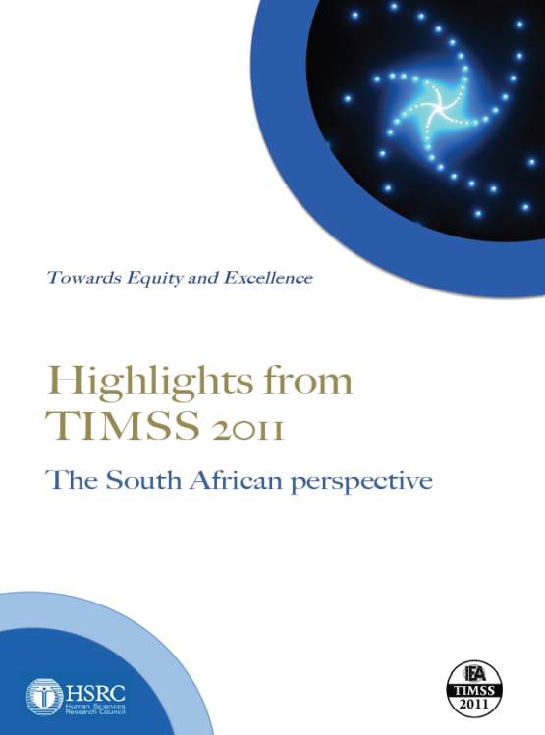
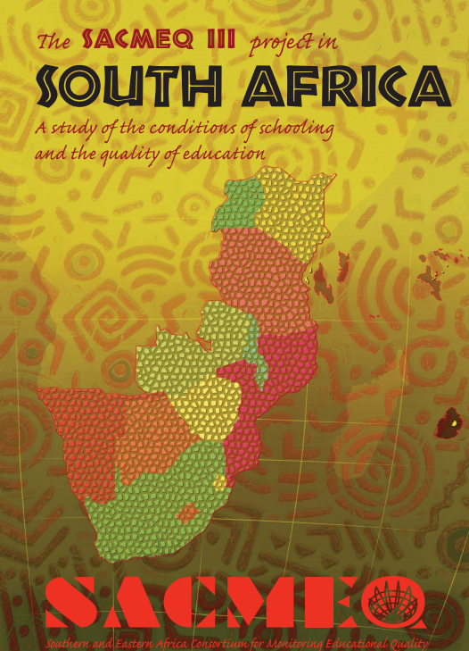





Student performance 2003-2011
TIMSS
(2003)
PIRLS
(2006)
SACMEQ
(2007)
TIMSS
(2011)
prePIRLS
(2011)
TIMSS 2003 (Gr8 Maths & Science)
Out of 50 participating countries (including 6 African countries) SA came last
Only 10% reached low international benchmark
No improvement from TIMSS 1999-TIMSS 2003
See Reddy et al (2006)
PIRLS 2006 (Gr 4/5 – Reading)
Out of 45 participating countries SA came last
87% of gr4 and 78% of Gr 5 learners deemed to be “at serious risk of not learning to read”
See Howie et al. (2006)
SACMEQ III 2007 (Gr6 – Reading & Maths)
SA came 10/15 for reading and 8/15 for maths behind countries such as Swaziland, Kenya and Tanzania
See Moloi & Chetty (2010) & Spaull (2012)
TIMSS 2011 (Gr9 – Maths & Science)
SA has joint lowest performance of 42 countries
Improvement by 1.5 grade levels (2003-2011)
76% of grade nine students in 2011 still had not acquired a basic understanding about whole numbers, decimals, operations or basic graphs, and this is at the improved level of performance
See Reddy et al. (2012) & Spaull (2013)
prePIRLS2011 (Gr 4 Reading)
29% of SA Gr4 learners completely illiterate (cannot decode text in any langauge)
See Howie et al (2012)
NSES 2007/8/9
  Gr 3/4/5
  See Taylor, Van der Berg & Mabogoane (2013)
Systemic Evaluations 2007
  Gr 3/6
Matric exams
  Gr 12
Notes:
Fortunately there are alternative measures of educational quality or learning that are available to view the entire iceberg structure. In post Apartheid, South Africa has participated in a number of international tests of assessment.
The most comprehensive reports for each of these datasets are as follows: SACMEQ (Moloi & Chetty, 2011), TIMSS (Reddy, 2006), PIRLS (Howie, et al., 2008), Systemic Evaluations (Department of Education, 2008), National School Effectiveness Study (Taylor, 2011b),and the Annual National Assessments (Department of Basic Education, 2011).
Now lets look at TIMSS 2011 in more detail.

Slide 6
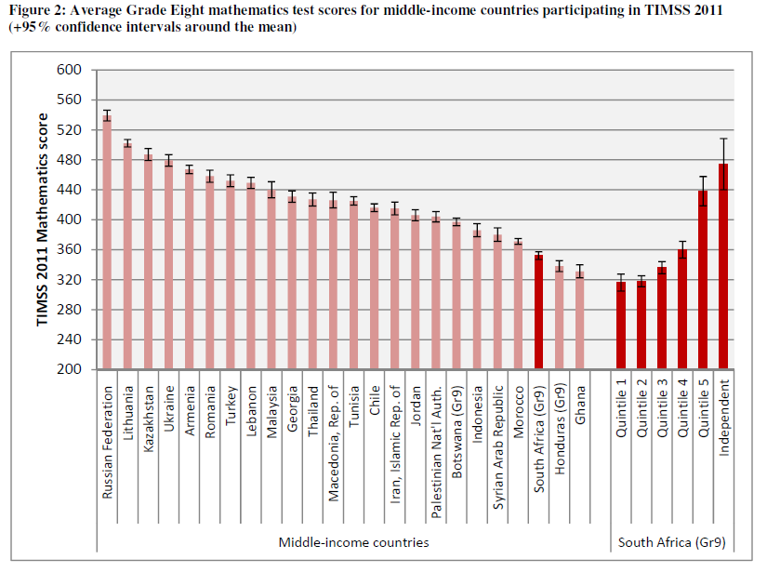
Independent schools only achieving an intermediate benchmark of 475 on average
SA is far from attaining the low international benchmark of 400 “Students have some knowledge of whole numbers and decimals, operations, and basic graphs.”
Source: Spaull, 2013 (CDE report)
Notes:
The figure here is a cross country comparison of average TIMSS scores in 2011 in Mathematics for middle-income countries that participated in the test. The short bars reflect confidence intervals.
South Africa comes out third to last in terms of our average scores here, only better than Honduras and Ghana. The mean score for the test was 360 in South Africa. What does this mean? On the average students are not faring at the low international benchmark, in other words“Students have not reached an elementary level of understanding of whole numbers, decimals, operations, and basic graphs.” On the average students have not grasped a basic level of mathematical concepts.
To make matters worse it must be noted that in South Africa grade 9s wrote the test, not grade 8s as in the all the other countries except Botswana and Honduras.
A second and very important point note is that within South Africa we see very different results. In quintile 1 to 3 schools we are seeing exceptionally low performance far below achieving the low international benchmark. Quintile 5 and independent schools are clearly performing notably better on the average reaching or nearly reaching the intermediate international benchmark.

Slide 7
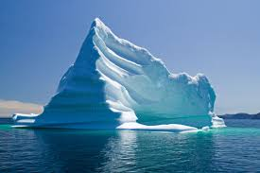
Notes:
The problem, with using the matric pass rate as a measure of quality of the system is that we are only seeing the tip of the ice berg if we use this is a our picture of quality. We are measuring the quality of the system on the basis of a very select proportion of students who actually make it to the matriculation exam.

Slide 8

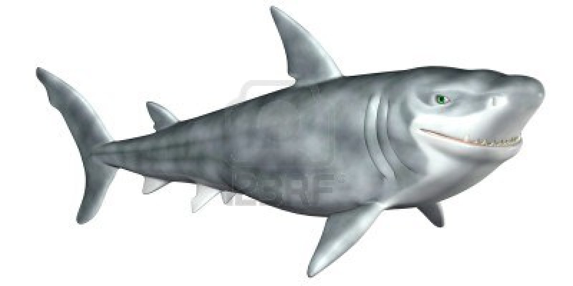
What are the root causes of low and unequal achievement?
Matric pass rate
Subject choice
No. endorsements
Throughput
Media sees only this→
Quality?
MATRIC
Pre-MATRIC
50% dropout
Low curric coverage
Weak culture of T&L
Low accountability
Vested interests
Low time-on-task
No early cognitive stimulation
Low quality teachers
HUGE learning deficits…

Slide 9
Matric 2014 (relative to Gr 2 in 2004)
 | Numbers
Grade 2 (2004) | 1085570
Grade 9 (2011) | 1049904
Grade 12 (2014) | 532860
Passed (2014) | 403874
Bachelors (2014) | 150752
550,000 students drop out before matric
99% do not get a non-matric qualification (Gustafsson, 2011: p11)
What happens to them? 50% youth unemployment…

Slide 10
Maths: Insurmountable learning deficits
Figure 10b: South African mathematics learning trajectories by national socioeconomic quintiles using a variable standard deviation for a year of learning (0.28 in grade 3 to 0.2 in grade 8 with interpolated values for in-between grades (Based on NSES 2007/8/9 for grades 3/4/5, SACMEQ 2007 for grade 6 and TIMSS 2011 for grade 9, including 95% confidence interval
Spaull & Viljoen, 2015

Slide 11

Inequality: Two public schooling systems

Slide 12
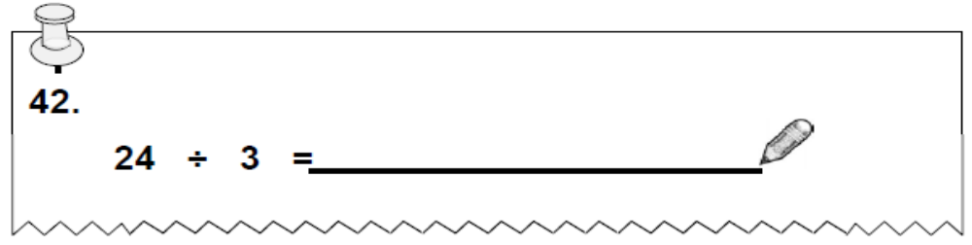
NSES question 42
NSES followed about 15000 students (266 schools) and tested them in Grade 3 (2007), Grade 4 (2008) and Grade 5 (2009).
Even at the end of Grade 5 most (55%+) quintile 1-4 students cannot answer this simple Grade-3-level problem.
“The powerful notions of ratio, rate and proportion are built upon the simpler concepts of whole number, multiplication and division, fraction and rational number, and are themselves the precursors to the development of yet more complex concepts such as triangle similarity, trigonometry, gradient and calculus” (Taylor & Reddi, 2013: 194)
(Spaull & Kotze, 2014)
Notes:
Taylor, N., & Reddi, B. (2013). Writing and learning mathematics. In N. Taylor, S. Van der Berg, & T. Mabogoane, Creating Effective Schools. Cape Town: Pearson.

Slide 13
Labour Market
15%
Legislators, managers, assoc professionals
Unemployed
(Broad - 35%)
Unskilled
(18%)
Elementary occupations & domestic workers
Semi-Skilled (32%)
Clerks, service workers, shop personnel, skilled agric/fishery workers, plant and machinery operators)
University/FET
Type of institution (FET or University)
Quality of institution
Type of qualification (diploma, degree etc.)
Field of study (Engineering, Arts etc.)
High productivity jobs and incomes (15%)
Mainly professional, managerial & skilled jobs
Requires graduates, good quality matric or good vocational skills
High quality secondaryschool
High SES background
High quality primary school
ECD
Minority (20%)
Some motivated, lucky or talented students make the transition
Unequal society
Big demand for good schools despite fees
Some scholarships/bursaries
Vocational training
Affirmative action
(few make this transition)
Majority (80%)
Quality
Low quality secondary
school
Attainment
Type
Low productivity jobs & incomes
Often manual or low skill jobs
Limited or low quality education
Low socioeconomic status background
Low quality primary school
ECD
None or
low-quality
Statistics from Quarterly Labour Force Survey (QLFS) 2014 Q4
Notes:
The QLFS classifies professions as follows: Highly skilled (legislators, senior officials and managers, professionals, technicians and associate profesionals); Semi-skilled (Clerks, service workers and shop and market personnel, skilled agricultural and fishery workers, craft and related trade workers, plant and machinery operators and assembly), Unskilled (Elementary occupations, domestic workers).

Slide 14
Independent schools

Slide 15
Important trends – see CDE 2015 report
In Sub-Saharan Africa 16% of pupils were private primary schools and 21% in private secondary schools (in southern Asia the figures are 18% and 40% respectively)*
  In South Africa this figure curently stands at 6.5% (2014)
Between 1990 and 2010 the percentage of students in low-income countries attending private primary schools doubled from 11% to 22% **
Developing countries are driving interest in private schooling. Largely based on a view that private schools can do a better job than public schools, particularly where public sector teachers are politically powerful (unionised), unaccountable, incompetent (patronage appointments).
        Using technology to aid learning (Rocketship Education in CA – SPARK in SA)
**D. Baum, L. Lewis, O. Lusk-Stove, H.A. Patrinos, ‘What Matters Most for Engaging the Private Sector in
Education: A framework paper’, SABER Working Paper Series (Washington, DC: The World Bank, 2014).
*UNESCO Institute of Statistics, http://data.uis.unesco.org/ (2013)

Slide 16
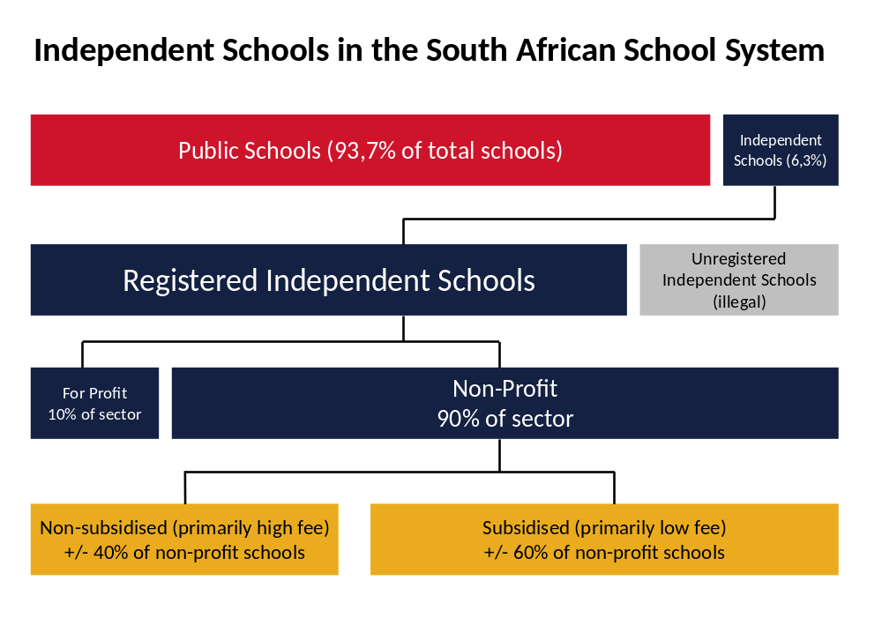
Overview of independent schools in SA
Hofmeyer, J. 2014. Change, access, quality and choice: The independent school sector in Gauteng.

Slide 17
Overview of education in SA
12.4m students
  4 % of students are in independent schools (i.e. 96% public)
25,826 schools
  7% of schools are independent schools (i.e. 94% public)
425,000 teachers
  8% of teachers are in independent schools (i.e. 92% public)
Near universal access up to Grade 9 (quality?!)
Foundation Phase | Intermediate Phase | Senior Phase | FET Phase
Gr1-3 | Gr 4-6 | Gr 7-9 | Gr10-12

Slide 18
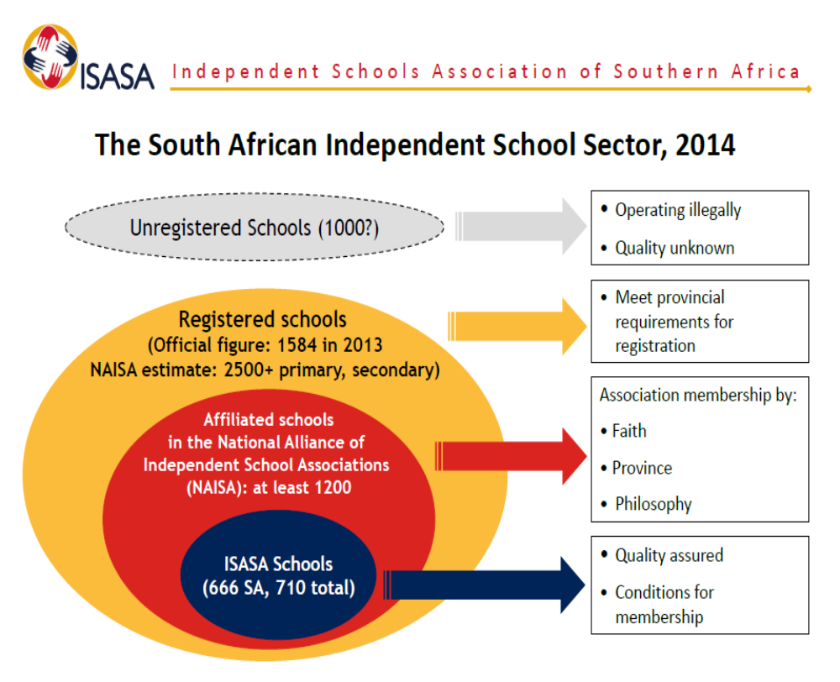
Independent School Sector (2014)
– Jane Hofmeyr

Slide 19
Change and Growth
– Jane Hofmeyr (CDE)
Demographic shift post apartheid
Majority white ➔ majority black learners (73%)
Majority trad. high-fee ➔ majority mid- and low-fee schools
Rapid growth (but off low base)
2000 - 2012: 61.8% increase in IS schools (public schools -9.5%)
2000 - 2012: IS learners doubled to ½ m (4 % of all learners)
    public school learners grew by 2,3%
Undercounted sector
DBE stats: 2013 - 1584 indep schools (from 1571 in 2012?)
DBE stats: 2014 - 1681 indep schools (97 more), 538 421 pupils
Umalusi estimate: 2013 - 3500 schools

Slide 20
Review of For-Profit Chains in SA
AdvTech
      Listed company on JSE
      CrawfordSchools (19 schools) & Trinityhouse (5 schools)
      Bought Centurus Colleges & Maravest Group
      Most schools charge R60,000-R90,000 p.a.
      Old AdvTech CEO said “R3 billion capex for the next 10 years would be focussed on the “lower fee” independent school market (24,000-R36,000). However new CEO as of March 2015, not clear??
      Curro recently made a R6billion takeover attempt for AdvTech. Rebuffed by AdvTech and subsequently dropped by PSG/Curro

Slide 21
Curro
Listed on JSE in 2011, expnding rapidly
31 schools in 2014 (10 new school developments) – 42 schools in 2015
27,263 students
Curro owns 65% of Meridian which is owned by “Campus and Property Management Company (CAPMAC)
  Types of Curro schools [Fees assume a 10-month school year]
      Select [R45,000-62,000 p.a]
      Curro [R20,000-R42,000 p.a]
          Max 25 learners,
          Usually 1200-2000 learners per school
      Curro Academy [R13,000-R17,000 p.a.]
      Meridian [R10,000-R15,000 p.a.]
      --------------------------------------------------------------------------
      Curro Castle [R18,000-R25,500 p.a.]
        3mo-5yrs
      Embury Institute for Teacher Educ.
Some speculation as to whether some of the for-profit chains are not primarily property investment companies. Property values rise close to prospective schools

Slide 22
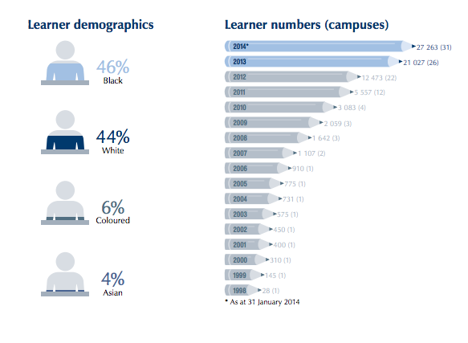
Rapid growth - curro
Growth in the low-fee (R12,000 and under) sector (FP and NFP) is likely to grow and perhaps even accelerate now that teething problems are being resolved, and that high-level politicians are bullish

Slide 23
For-profit chains of independent schools
Reddam House Group
6 schools in SA, 2 in Australia, 2 in UK
R40,000-R80,000
SPARK Schools / eAdvance
Began in 2013
4 schools, 1100 children enrolled. Aims for 60 low-fee schools in next 10yrs
In 2016 four new SPARK schools will open (3-GAU, 1-WC)
R15,750 fees p.a.
Pearson invested R28m in 2014.
Prestige College
New chain of schools. R17,080 p.a. (Shoshanguve township)
5 schools by 2017
(Also Kagiso Trust/Capital intends to enter low-fee private sector focusing on townships)
15 schools

Slide 24
Not-for-profit chains
The 2 Oceans Education Foundation
3 primary and 2 high schools in CT and Gauteng
Receives 60% state subsidy and donor support
  The Love Trust
  2 schools
  African School of Excellence
  1 now, 5 by 2017 (JHB) R2,400-R8400
  Streetlight Schools
  A school in 2016
  Pioneer Academies
  1 school in JHB (R24,000-R33,250) , plan for 50 in SA in 10 years
  Royals Management Company
  2 high schools in PTA (R12,000-R17,000)
11 schools

Slide 25
Not-Profit-Chains
25 schools
Vuleka schools
3 primary, 3 early learning centres, 1 high school
R10,340-R14,080 for primary; R21,560 for high school
Get Ahead Project
4 schools in Eastern Cape
R6,070-R9,400 for primary; R10,000 for high school
BASA Educational Institute Trust
6 schools in JHB
R7,000-R12,000 for primary & high school
Summit Education South Africa
2 schools in CT
R44,400-R47,640 p.a.
LEAP
6 schools in townships
Donor support (R420 per year from parents/volunteers
Understanding how ‘not-for-profit’ a ‘not-for-profit’ really is
For-profit service-provider
NFP school
State subsidy can only legally go to NFP
NFP school
NFP school
NFP school

Slide 26
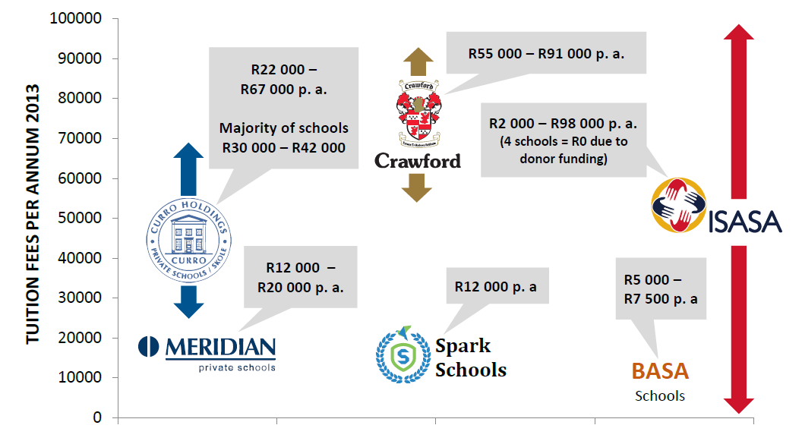
Players in the Sector 2013 – Jane Hofmeyr (CDE)

Slide 27
Models of school governance and profit
There are various different ways that schools can be managed and resourced. These are the most popular:
PUBLIC - Totally government funded school, i.e. no-fee (Maximum subsidy of about R14,000 per learner)
PUBLIC-ish - Partially government funded, partially fee/donation funded school (sliding scale)
PUBLICLY OWNED, PRIVATELY MANAGED SCHOOLS – government funded but run with private management (currently being talked about / experimented with in Gauteng and Western Cape
      “3 conditions” schools →Independent/autonomous schools that are state-funded provided they are (1) no-fee, (2) not-for-profit, (3) non-selective. [100% state subisdiy not current 60% max]
PRIVATE not-for-profit schools
PRIVATE for-profit schools

Slide 28
Talking points
What are the potential downsides of chains using IEB?
What are the upsides and downsides of for-profit schooling in SA
What are the positives and negatives of schooling ‘chains’ in SA?
Questions for discussion for IEB

Slide 29
Potential downsides of chains using IEB
The main source of revenue is from assessment fees that schools pay when their students write IEB exams (R6000).
A chain of 30+ schools has increased bargaining power given that an exit of 30 schools is of far more concern to the IEB than the exit of 1 or 2 or 3. This is for two main reasons:
Reputational risk → a mass exodus could cause other IEB schools / parents to doubt the quality of the assessment.
Financial risk → cash flow & planning problems around large changes in income year to year.
What are the most probable reasons that could cause a clash?
Cultural/values clash → Challenges independence. Curro Roodepoot example. Difficult to speak out against influential clients. “Make your exams easier so more get A’s & get into university or we’ll leave.
Group-level discount → asking for better ‘rates’ (
[Perhaps require chains to ‘buy-in’ for 3 years and give one year notice before stopping IEB?]

Slide 30
Upsides and downsides of for-profit schooling
Upsides
High degree of accountability
For-profit motive → clear driving force for expansion
Can bring in high-capacity managers into schooling
If subsidized by State then can provide options for low-income households
Counter-factual is a disastrous public education
Downsides
What gets measured gets valued/optimized/maximized. Numeracy and literacy? ANAs? In high-income contexts (Crawford) high degree of parental oversight and accountability. In low-income contexts far less so; uneducated parents, power-dynamics, language. Narrowing of curriculum
Ideological issues→ should education be for-profit? Should money allocated to educate children be flowing into corporate profits. We’d be OK with 5-10% flowing to shareholders but what about 60%?
Concerns around values and unintended consequences of for-profit motive. Interests of the children/society come second. Curro Roodepoot?

Slide 31
Positives and negatives of chains
Positives
In a sense resources (human and financial) are pooled and can be allocated to where they are most needed. Redploying a principal for example.
Lower fixed-costs.
      (1) Teacher training, (2) setting up online learning systems, (3) printing costs
  Reputational risk means that there is arguably more accountability (think Curro Roodepoot)
  Negatives
  Principals lose some degree of autonomy
  The chain can lean-on or bully principals/teachers/parents due to increased influence, larger budgets etc.

Slide 32
Questions
Perhaps for-profit schooling is ideologically dodgy but the most expedient way of providing a basic quality of education for poor children?
Are the long-term consequences of encouraging growth in for-profit sector knowable? Desirable? [Rowan Williams Faust→ Frakenstein]
Can we not get the same ‘benefits’ from a 100% subsidy for the ‘3 Conditions’ model: (1) not-for-profit, (2) no-fee, (3) non-selective. Will it not morph into an ‘extractor’ model with a for-profit holding company? Do we care?
Could IEB involvement in the for-profit sector be a force for good in the sense that it could prevent a narrowing of the curriculum and provide independence?
Are chains likely to exert pressure on the IEB? On what issues? What are the IEB options? (perhaps a notice-period before leaving or 3-year terms for 5+ chains)
Are chains such a bad thing in South Africa? Good examples of how chains can set up their own ecosystems (ARK in the U.K.; successful charters in the U.S)
Do the positives outweigh the negatives if a rapidly growing sector of South African education (NFP or FP) start using IEB exams?

Slide 33
Other points to consider
Internship model of teacher training
      Highlighting to all stakeholders that teacher development needs to be addressed by ALL stakeholders not just DHET/DBE
  Given the advances in technology and the ubiquity of responsive devices, are we on the verge of a change in the way we do schooling?
      Flipped classroom
      Technological literacy
  The need to develop 21st century skills and competencies
      Empathy and other emotional competencies are one of the most important competencies people need, we we do not teach it explicitly
  Alternative/competing curricula are going to start emerging that offer relatively large shifts in (1) what we teach, (2) how we teach it and (3) how we assess it. Given SA’s relatively conservative nature (even among the elite) I think we will move towards a modularized approach rather than wholesale change. Adding coding, mandarin, data analytics rather than abandoning grades and moving for competency-based progression, for example.

Slide 34
Centre for development & enterprise
“South Africa’s dialogue about reform has focused largely on the public sector: how can government improve the delivery of quality schooling? Historically the private sector has played a role in improving education, but this has been largely as a provider of funds to initiatives within the public sector. However, South Africa could be leveraging the contribution of business, markets, ‘edupreneurs’ and philanthropic resources far more effectively to deliver better quality schooling to disadvantaged learners in the education system.” (CDE 2015)
“In the last few years, private equity, individuals, donors and companies have recognized the potential of affordable independent schools and begun to invest in chains of both low- and mid-fee schools.
In the case of private schools for the poor, South Africa is behind the curve relative to many developing countries, and the independent sector as a whole is a relatively small one in international terms. (Although CDE would argue that it is a much larger sector than the official figure of 6.5 per cent of South African schools.) Thus, while the sector is expanding rapidly, it is doing so from a low base.” (CDE 2015)
“Private education has expanded rapidly in India: enrolment in elementary schools is approximately 35 per cent and over 50 per cent at the secondary level. In-depth studies in cities like Mumbai and Patna show that upward of 75 per cent of children in these cities are attending private schools.12 According to the 2014 Annual Status of Education Report (ASER), enrolment in private elementary schools in rural India has increased from 19 per cent to 29 per cent in the seven-year-period from 2006 to 2013” (CDE 2015)

