Slide 1




Large scale quantitative studies in educational research
Nic Spaull
SAERA conference | Durban
Presentation available online: nicspaull.com/presentations | 12 August 2014

Slide 2
Objectives of the workshop
For participants to leave with…
  A good idea of what large-scale data exist in SA and which assessments SA participates in.
  To appreciate why we need them
  Which areas of research are most amenable to analysis using quantitative data?
  (The focus here is on non-technical, usually descriptive, analyses of large-scale education data. There is obviously an enormous field of complex multivariate research using quantitative data. See Hanushek and Woessman, 2013)

Slide 3
1. What do we mean by “large-scale quantitative research”?

Slide 4
1. What the heck do we mean by “large-scale quantitative research” ?
Firstly, what do we mean when we say “large-scale quantitative studies”
  Large-scale: usually implies some sort of representivity of an underlying population (if sample-based) or sometimes the whole population.
  There are two “main” sources of large-scale data in education
      Assessment data and concomitant background info (PIRLS/TIMSS/SACMEQ/ANA/Matric/NSES)
      Administrative data like EMIS, HEMIS, PERSAL etc..
  Quantitative: The focus is more on breadth than depth.
    As an aside in the economics of education, qualitative research that uses numerical indicators for the 15 (?) schools it is looking at would not really be considered quantitative research. The focus is still qualitative.

Slide 5
Personal reflections – please challenge me on these…
 | Qualitative | Quantitative
Number of schools | Usually a small number of schools (1-50?) selected without intending to be representative (statistically speaking) | Usually a large number of schools (250+) that may be representative of an underlying population or not
Over-arching interest | Depth over breadth | Breadth over depth
Can make population-wide claims? | No. This is one of the major limitations. | Yes. This is one of the major advantages
Scope of research | Usually very specific getting detailed information pertinent to the specific research topic. | Often quite broad but shallow (one dataset might be analysed from a SLM perspective, a content perspective, a resourcing perspective etc.)
Numerical summaries of data | Less important | More important

Slide 6
1. What are we talking about?
Types of research questions that are amenable to quantitative research:
  How many students in South Africa are literate by the end of Grade 4?
  What proportion of students have their own textbook?
  What do grade 6 mathematics teachers know relative to the curriculum?
  Which areas of the grade 9 curriculum do students battle with the most?
  How large are learning deficits in Gr3? Gr6? Gr9?
Types of research questions that are LESS amenable to quantitative research:
  Which teaching practices and styles promote/hinder learning?
  Questions relating to personal motivation, school culture, leadership style etc. (all of which require in-depth observation and analysis)
  All the ‘philosophical’ areas of research: what is education for? What is knowledge? Says who? Who should decide what goes into the curriculum? How should they decide? Should education be free?
That being said, researchers do focus on some of “type-B” questions (non-philosophical ones) using quantitative data – (and have often made important contributions) but the scope of questions is usually quite limited, but the breadth/coverage and ability to control for other variables often makes the analysis insightful

Slide 7
1. What are we talking about?
To provide one example. If we look at something like school leadership and management (SLM), there are various approaches to researching this including:
  In-depth study of a small number (15) of schools (something like the SPADE analysis of Galant & Hoadley)
  Using existing large-scale data sets to try and understand how proxies of SLM are related to performance. To provide some examples…

Slide 8
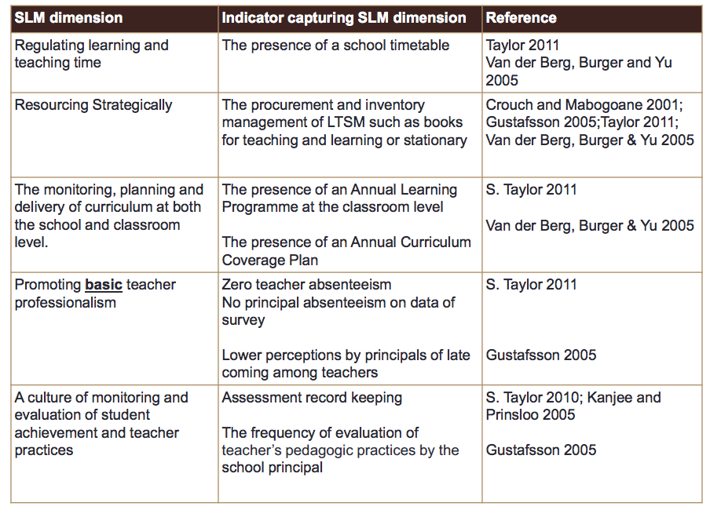
The above analysis is taken from Gabi Wills (2013)

Slide 9
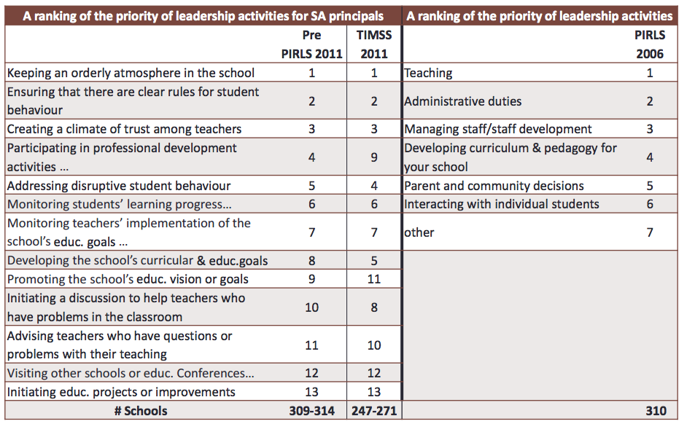
The above analysis is taken from Gabi Wills (2013)

Slide 10
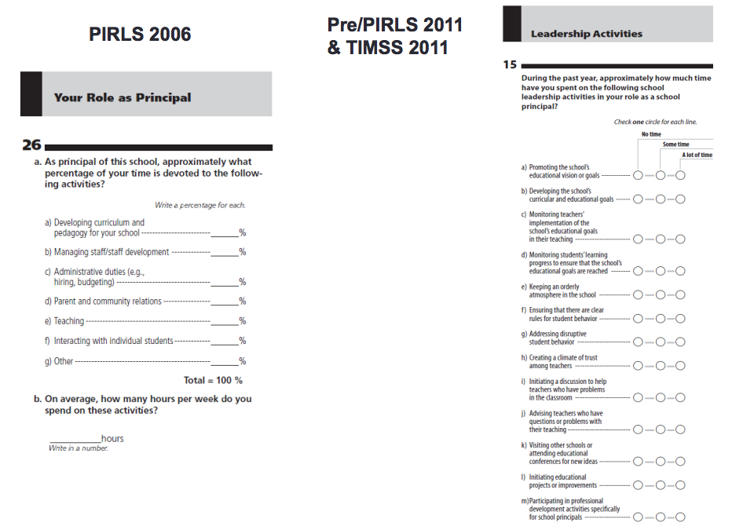

Slide 11
 | Sample-based | Census-based | Number of schools? | Number of students? | Comparable over time?
Cross-national studies of educational achievement | TIMSS 1995, 1999, 2003, 2011 | - | 285 | 11969 | Yes
 | SACMEQ 2000, 2007, 2013 | - | 392 | 9071 | Yes
 | PIRLS 2006, 2011 (Eng/Afr only) | - | 92 | 3515 | Sort of
 | prePIRLS 2011 |  | 341 | 15744 | NA
National assessments (diagnostic) | Systemic Evaluations 2004 (Gr6), 2007 (Gr3) | - | 2340 | 54 | Sort-of
 | - | ANA 2011/12/13/14 | 24 | 7mil | Definitely not
 | Verification-ANA 2011, 2013 (Gr 3 & 6) |  | 2164 (125/prov) |  | No
 | NSES* Gr3 (2007) Gr4 (2008) Gr5 (2009) |  | 266 | 24000 (8383 panel) | Yes (+ longitudinal)
National assessments (certification) | - | Matric | 6591 | about 550,000
*Number of schools and students is for the most recent round of assessments

Slide 12
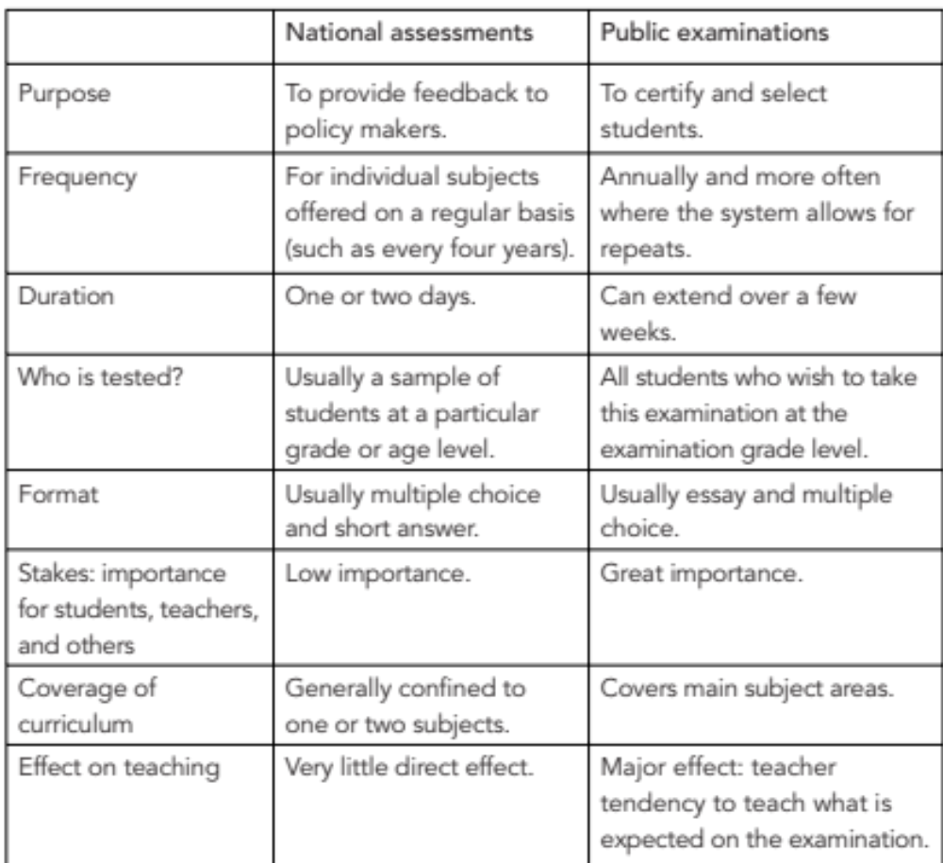
Differences between national assessment and public exams
Like TIMSS/PIRLS/SACMEQ
Like matric

Slide 13
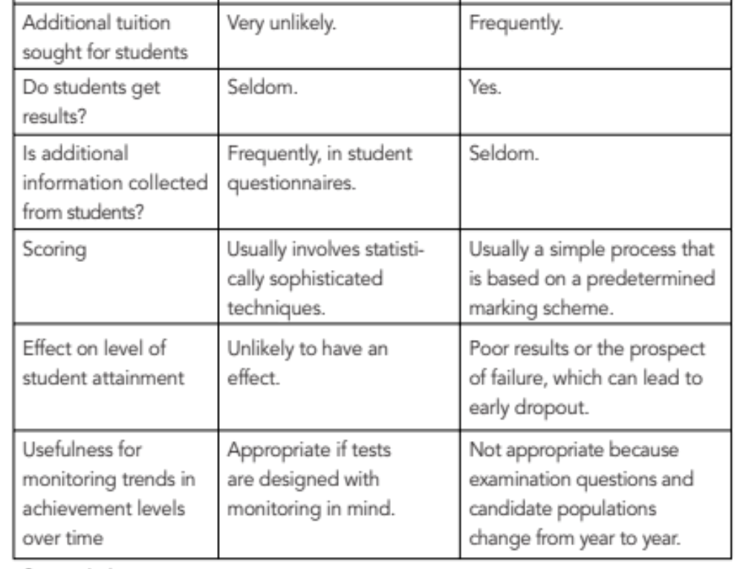
Source: Greaney & Kellaghan (2008)

Slide 14
There are also other assessments which SA doesn’t take part in…
School-based
PISA: Program for International Student Assessment [OECD]
ICCS: International Civic and Citizenship Education Study [IEA]
Home-based
IALS: International Adult Literacy Survey [OECD]
ALLS: Adult Literacy and Life Skills Survey [OECD]
PIAAC: Programme for the International Assessment of Adult Competencies [OECD]
For more information see: http://www.ierinstitute.org/

Slide 15
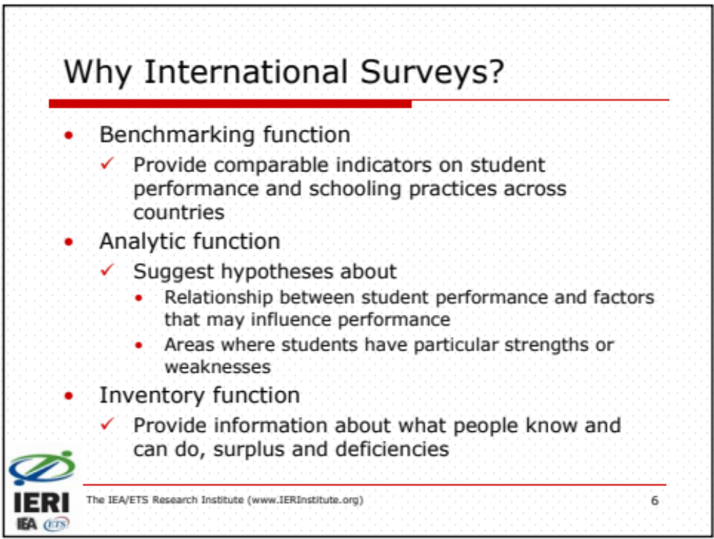
Source: IERI Spring Academy 2013

Slide 16
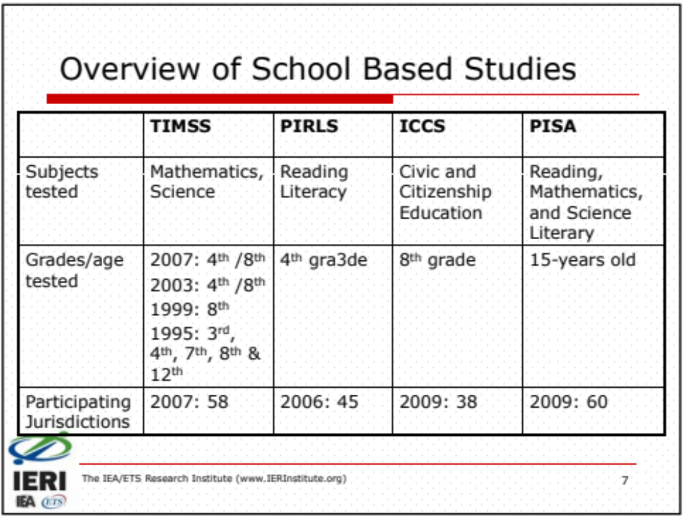
Source: IERI Spring Academy 2013

Slide 17
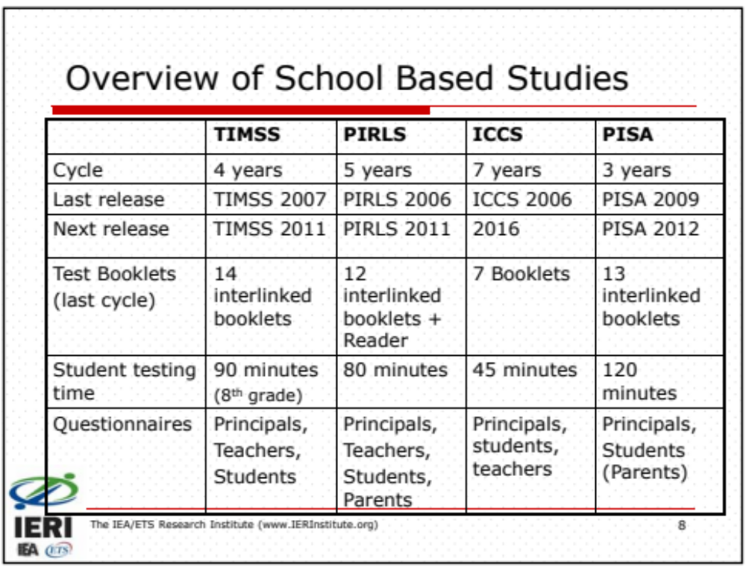
Source: IERI Spring Academy 2013

Slide 18
An aside on matrix sampling…
Because one
  can only test students for a limited amount of time (due to practical reasons and cognitive fatigue),
  and because one cannot cover the full curriculum in a 2 hour test (at least not in sufficient detail for diagnostic purposes)
  It becomes necessary to employ what is called matrix sampling.
If you have 200 questions that cover the full range of the maths curriculum you could split this into 20 modules of 10 questions.
If a student can cover 40 questions in 2 hours then they can write 4 modules.
Different students within the same class will therefore write different tests with overlapping modules.
Matrix sampling allows authorities to cover the full curriculum and thus get more insight into specific problem-areas, something that isn’t possible with a (much) shorter test.
TIMSS/PIRLS/PISA all employ matrix sampling. SACMEQ 2000 and 2007 did not employ matrix sampling (all children wrote the same test) but from 2013 I think they are doing matrix sampling as well.
This highlights one of the important features of sample-based assessments: the aim is NOT to get an accurate indication of any specific child or specific school but rather some aggregated population (girls/boys/provinces/etc.)

Slide 19
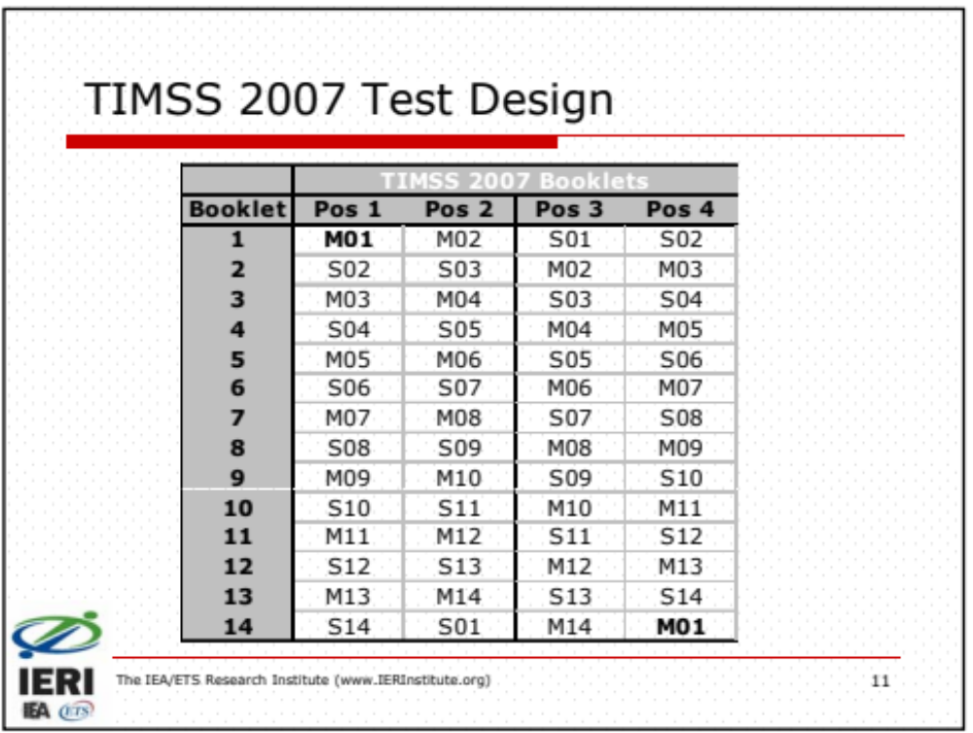

Slide 20
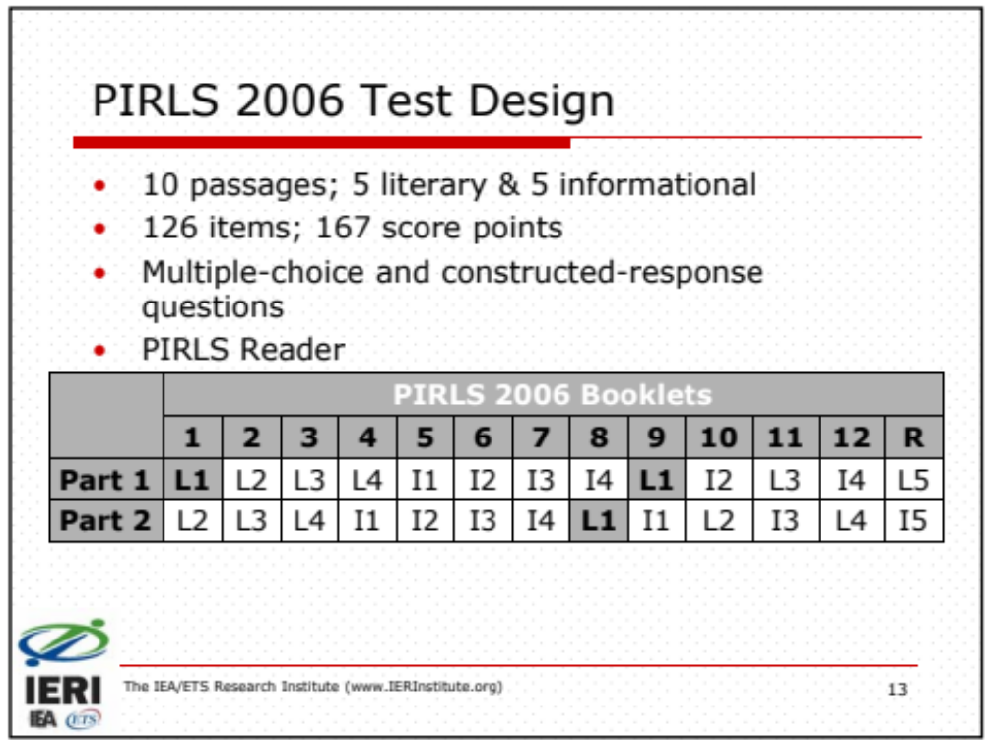

Slide 21
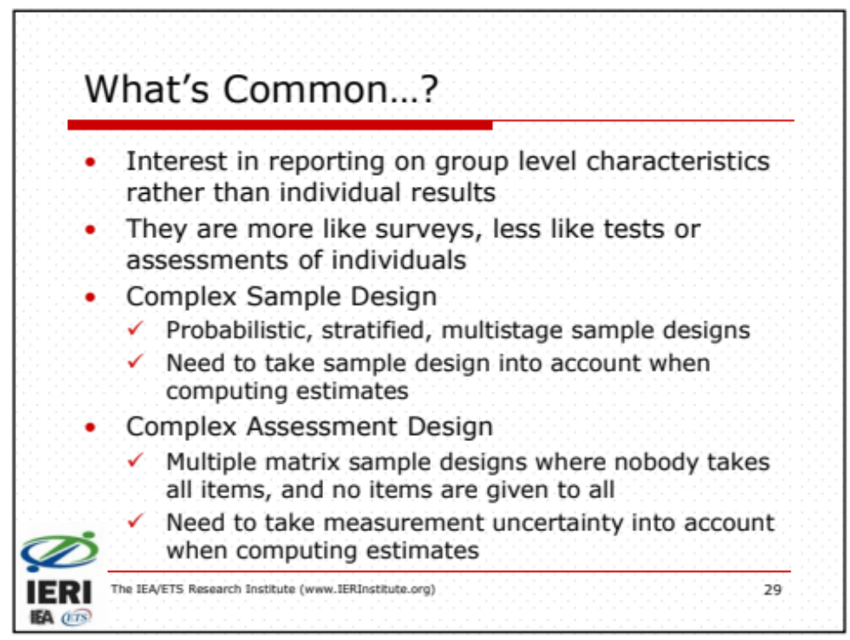

Slide 22
Sample-based assessments (cont.)
The aim of sample-based assessments is to be able to gain insight (and make statements) that pertain to an underlying population AND NOT the sampled schools.
For example in SACMEQ the sample was drawn such that the sampling accuracy was at least equivalent to a Simple Random Sample of 400 students which guarantees a 95% confidence interval for sample means that is plus or minus 1/10th of a student standard deviation (see Ross et al. 2005).
  This is largely based on the intra-class correlation coefficient (ICC) which is a measure of the relationship between the variance between schools and within schools.
  In South Africa this meant we needed to sample 392 schools in SACMEQ 2007
Important to understand that there are numerous sources of error and uncertainty, especially sampling error and measurement error. Consequently one should ALWAYS report confidence intervals or standard errors.

Slide 23
Sample-based assessments (cont.)
Once you know the ICC and therefore the number of schools you need to sample, you need a sampling frame (i.e. the total number of schools).
One can also use stratification to ensure representivity at lower levels than the whole country (i.e. province or language group)
Randomly select schools from sampling frame.
For example, for the NSES 2007/8/9….

Slide 24
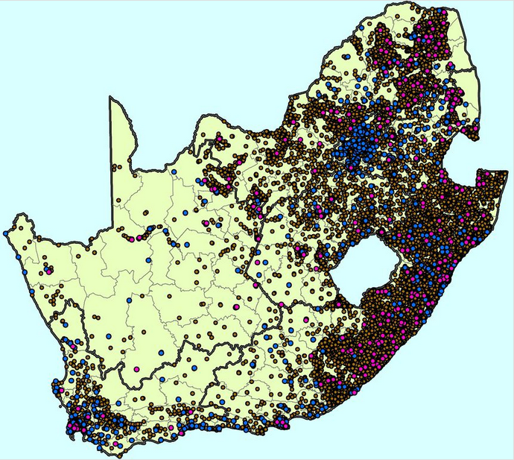
Brown dots = former black schools
Blue dots = former white schools
Purple dots = school included in NSES
(courtesy of Marisa Coetzee)

Slide 25
What kinds of administrative data exist?
Education Management Information Systems (EMIS)
  Annual Survey of Schools
  SNAP
  LURITZ. System aimed at being able to identify and follow individual learners using unique IDs
  SA-SAMS
HEMIS – EMIS but for higher education
PERSAL – payroll database
School Monitoring Survey
Infrastructure survey
ECD Audit 2013

Slide 26
Overview
Main educational datasets in South Africa:
PIRLS 2006 2011
TIMSS 1995 1999 2002 2011
SACMEQ 2000 2007 2013
V-ANA 2011
ANA 2011 2012
NSES 2007 2008 2009
EMIS (various)
Matric (annual)
Household surveys (various

Slide 27

PIRLS 2006 – see Shepherd (2011)
PIRLS
What:
Progress in International Reading and Literacy Study
Tests the reading literacy of grade four children from 49 countries
Run by CEA at UP on behalf of IEA (http://timss.bc.edu/)
When and Who:
PIRLS 2006 (grade 4 and 5)
PIRLS* 2011 (grade 5 Eng/Afr only)
prePIRLS (grade 4)
Examples of how we can use it?
Issues related to LOLT
Track reading performance over time
International comparisons
prePIRLS 2011 – see Howie et al (2012)

Slide 28
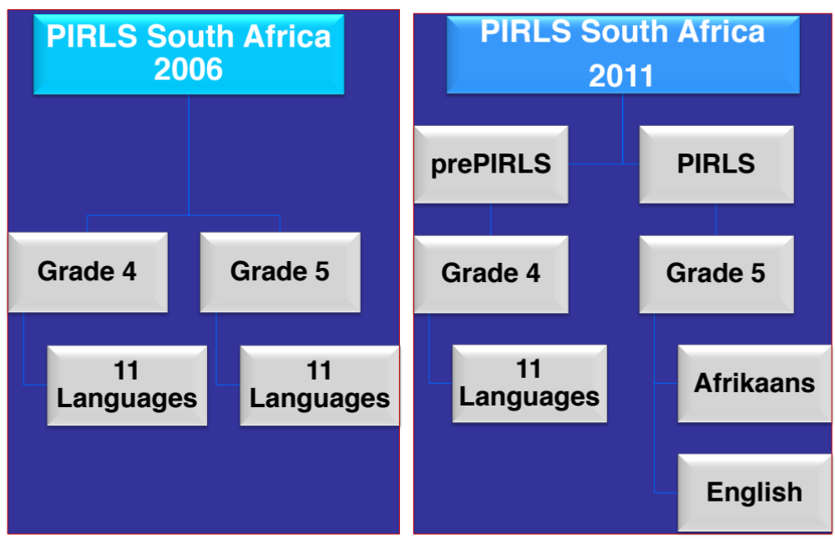

Slide 29
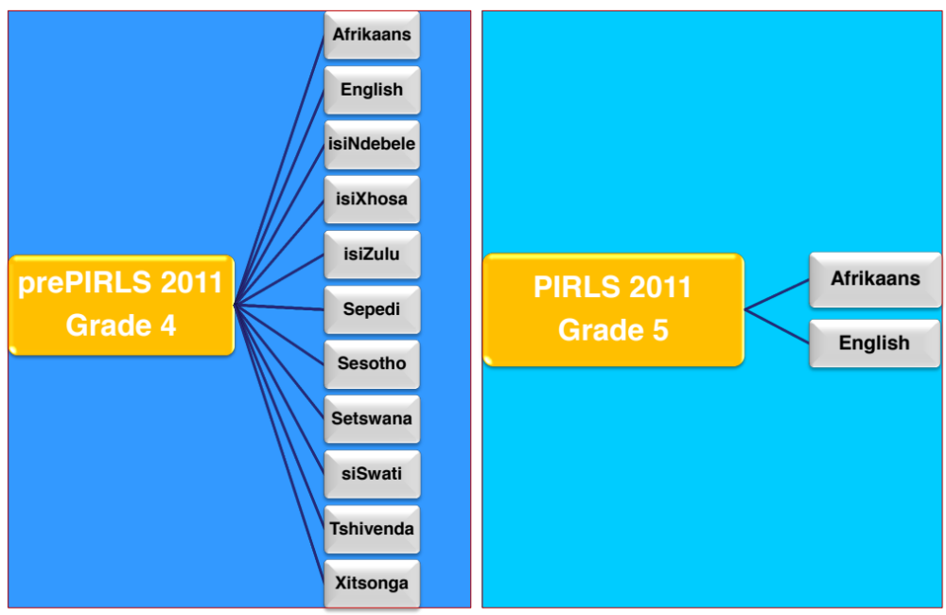

Slide 30


Slide 31

TIMSS 2003 Maths – see Taylor (2011)
TIMSS
What:
Trends in International Mathematics and Science Study
Tests mathematics and science achievement of grade 4 and grade 8 pupils
Run by HSRC in SA on behalf of IEA (http://timss.bc.edu/)
When and Who:
TIMSS 1995, 1999 (grade 8 only)
TIMSS 2002 (grade 8 and 9)
TIMSS 2011 (grade 9 only)
Examples of how we can we use it?
Interaction between maths and science
Comparative performance of maths and science achievement
Changes over time
TIMSS 2011 Science – see Spaull (2013)

Slide 32
TIMSS 2011
South African mathematics and science performance in the Trends in International Mathematics and
Science Study (TIMSS 1995-2011) with 95% confidence intervals around the mean (Spaull, 2013)

Slide 33

SACMEQ III – see Spaull (2013)
SACMEQ
What:
Southern and East African Consortium for Monitoring Educational Quality
Tests the reading and maths performance of grade six children from 15 African countries
Run by DBE – Q.Moloi (http://www.sacmeq.org/)
When and Who:
SACMEQ II – 2000 (grade 6)
SACMEQ III – 2007 (grade 6)
SACMEQ IV – 2013 (grade 6)
Examples of how can we use it?
Regional performance over time
Teacher content knowledge
Understanding the determinants of numeracy and literacy
SACMEQ III – see McKay & Spaull (2013)

Slide 34
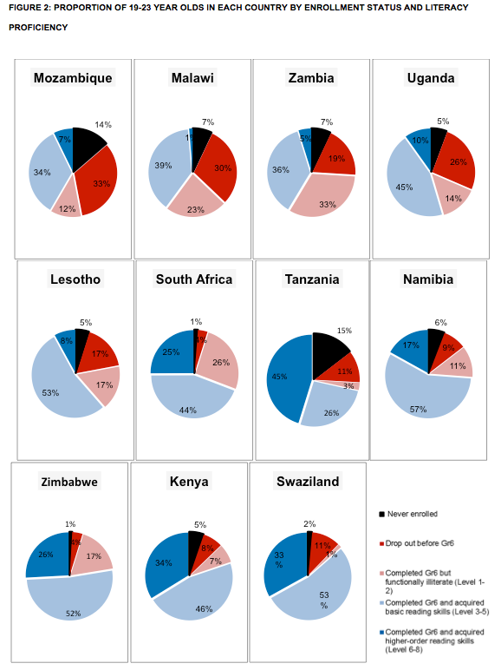
SACMEQ III (Spaull & Taylor, 2014)

Slide 35
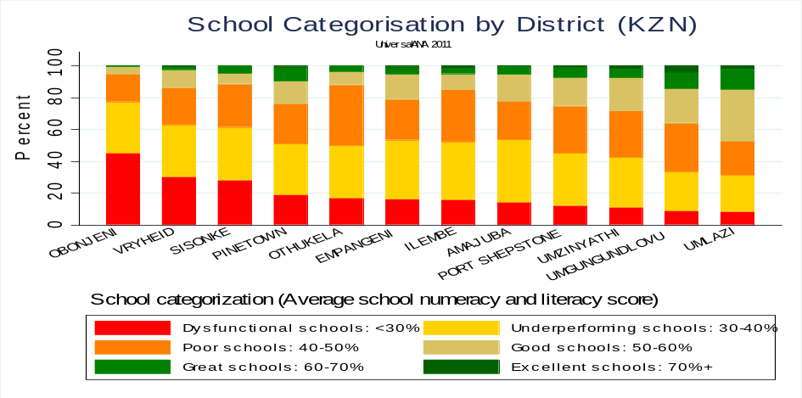
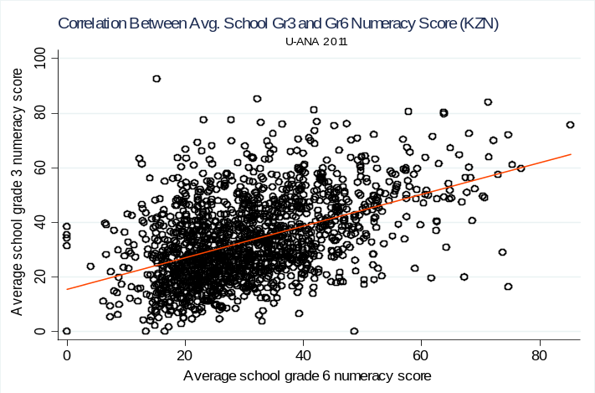
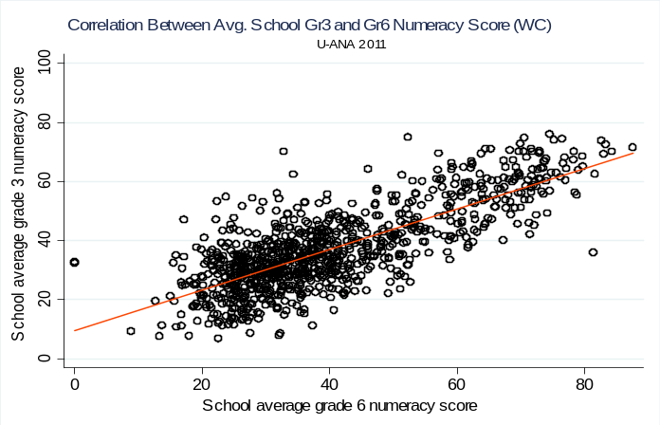
ANA – see Spaull (2012)
ANA
What:
Annual National Assessments
Administrative data on enrolments, staff, schools etc.
Collected by DBE
When and Who:
Grades 1-6 and 9 (maths and language - FAL and HL)
Examples of how can we use it?
Analyse performance at primary grades, potentially at the micro-level (district/circuit)
Create indicators for dashboards
Report cards (once ANA is externally evaluated at one grade)
Early indicators of problems/deficits
Planning at primary school level
Serious comparability problems between ANA 2011 and ANA 2012 (see SVDB and Spaull interview)

Slide 36
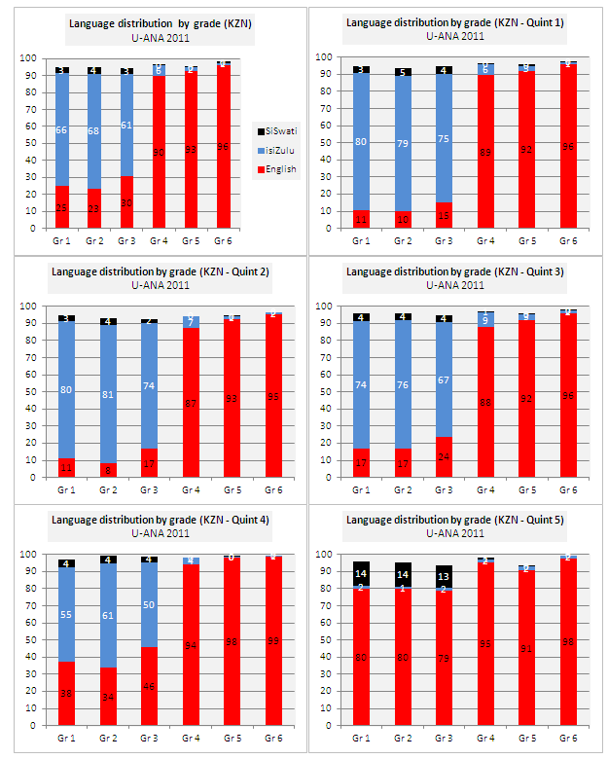
ANA
Language by grade/quintile (KZN)

Slide 37
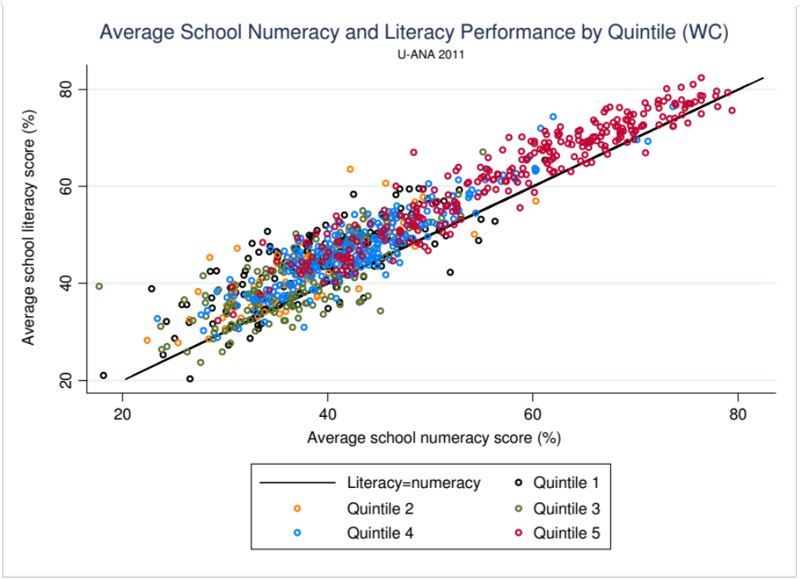

Slide 38
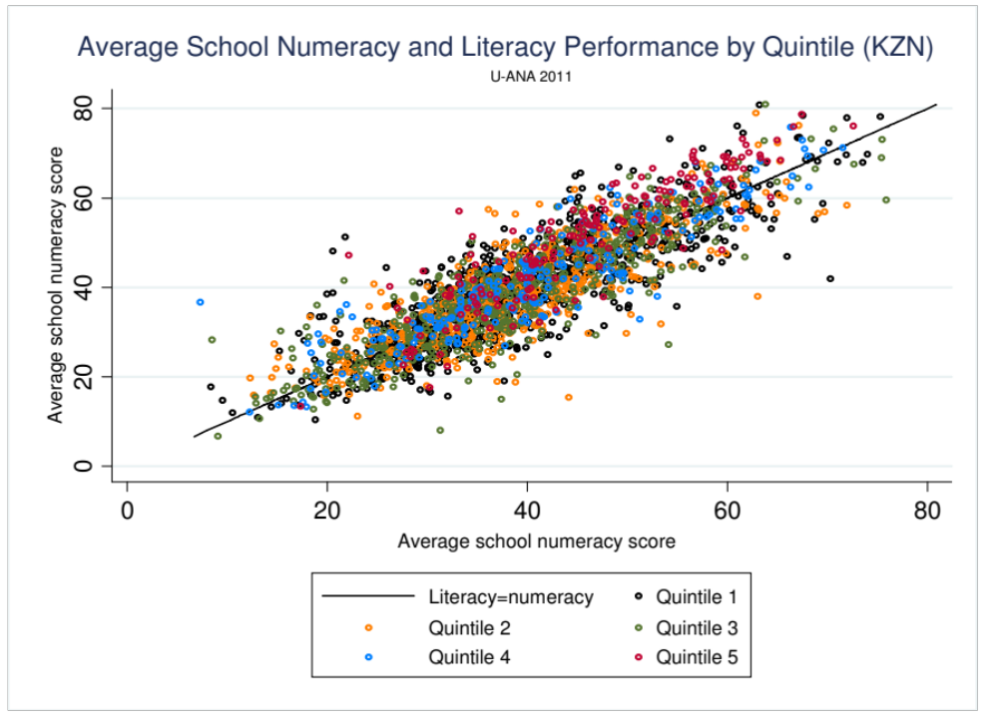

Slide 39
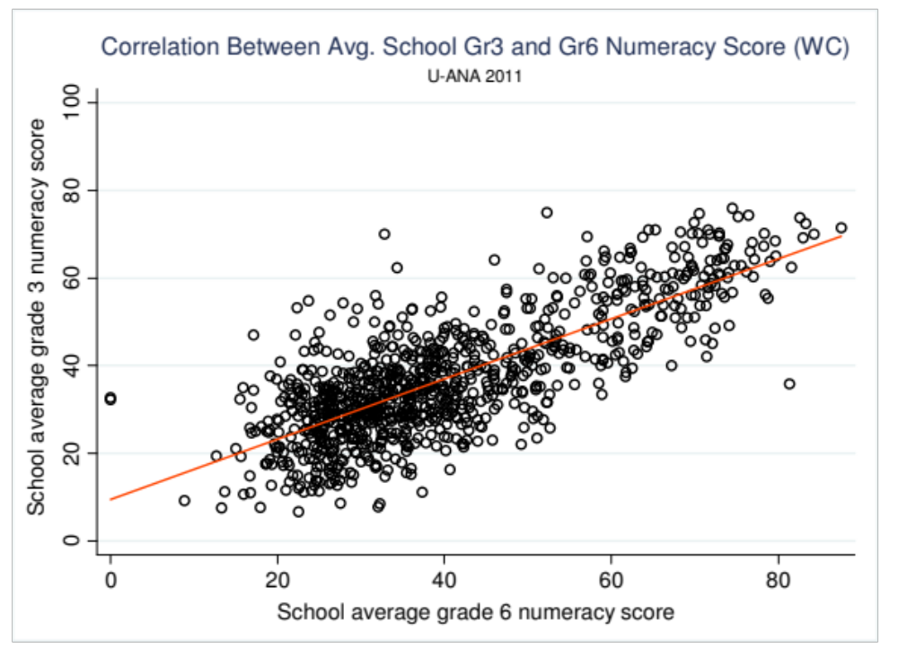
Correlation 0.82

Slide 40
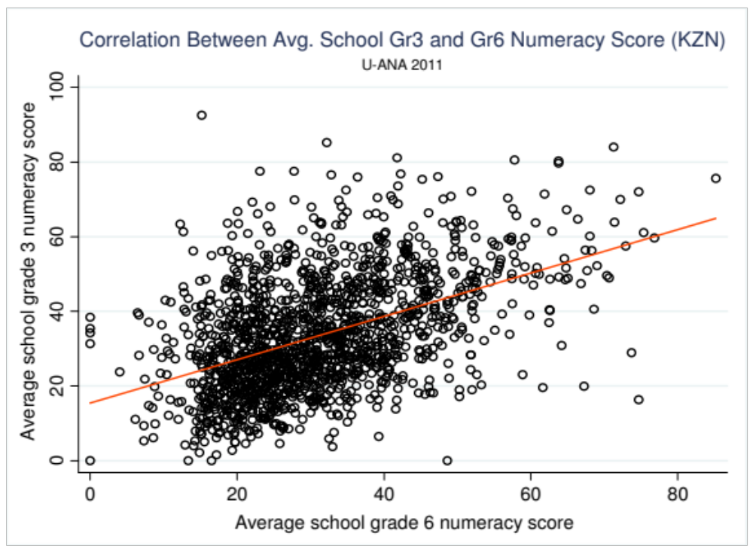
Correlation 0.51

Slide 41
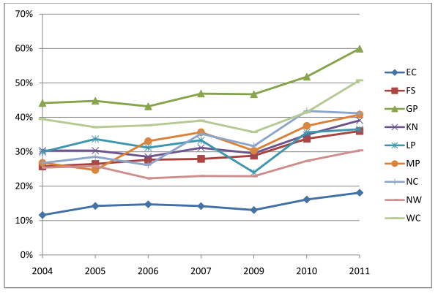
EMIS – see Taylor (2012)
EMIS
What:
Education Management Information System
Administrative data on enrolments, staff, schools etc.
Collected by DBE (http://www.education.gov.za/EMIS/tabid/57/Default.aspx)
When and Who:
Various
Examples of how can we use it?
Analyse flow-through
Create indicators for dashboards
  PTR, school size, LOLT etc
Provide an up-to-date and accurate picture of elements of the education system
Planning
The ratio of grade 2 enrolments ten years prior to matric to matric passes by province
EMIS – see Taylor (2012)

Slide 42
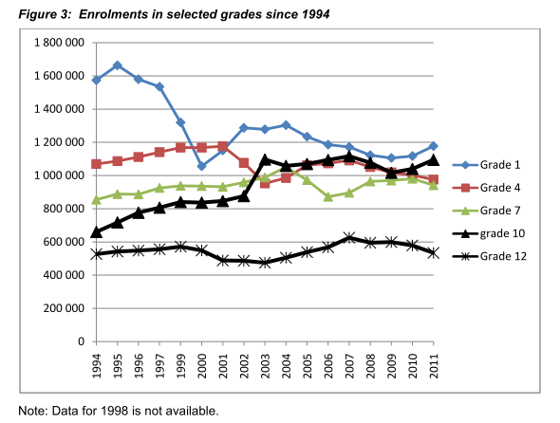
“In 1999 and 2000 the numbers enrolling in grade 1 dropped substantially, by about half a million. Crucially, it is these cohorts who make up the bulk of the matric class of 2011. This was due to a change in the policy stipulating age of entry into grade 1. According to Notice 2433 of 1998, it was stipulated that children should only be allowed to enrol in grade 1 if they turned seven in that calendar year. Therefore children who previously might have entered in the year in which they turned six were now not allowed to. The policy change was announced in October 1998 and schools were expected to comply by January 2000. This would explain why grade 1 enrolments declined somewhat in 1999 and then again even more so in 2000. The reason why numbers declined as the policy was phased in is that some children who turned 7 in the 2000 calendar year had already entered in the previous year under the previous policy. “
- Taylor 2012

Slide 43
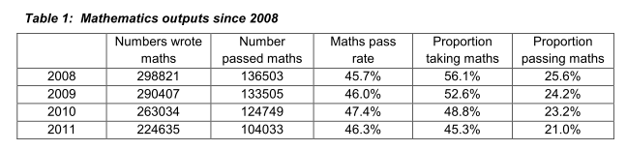
EMIS – see Taylor (2012)
Matric
What:
Grade 12 examinations results
Performance data
Collected by DBE
When and Who:
Various
Examples of how can we use it?
Analyse subject choices/combinations
Create indicators for dashboards
  % taking maths/science
  Proportion of Gr 8’s passing matric
Relatively trustworthy and regular indication of student outcomes in SA.
Planning
EMIS – see Taylor (2012)

Slide 44
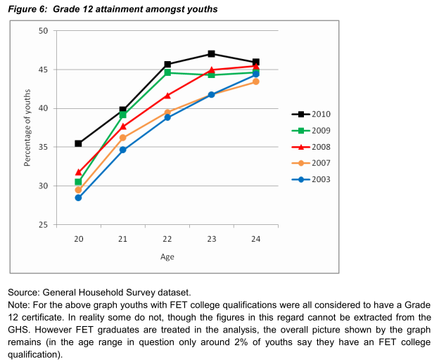
Household Surveys
What:
Grade 12 examinations results
Performance data
Collected by DBE
When and Who:
Various
Examples of how can we use it?
Research
Link education to other social outcomes like employment and health
HH-Surveys – see Taylor (2012)

Slide 45
Household Surveys
Percentage of youth in employment by highest educational attainment (Van Broekhuizen, 2013)
Composition of 18 - 24-year-olds by highest level of education completed (Van Broekhuizen, 2013)

Slide 46
Some other research…
(Discuss if time permits)

Slide 47




Context: low and unequal learner performance
PIRLS / TIMSS / SACMEQ / NSES / ANA / Matric… by Wealth / Language / Location / Dept…

Slide 48
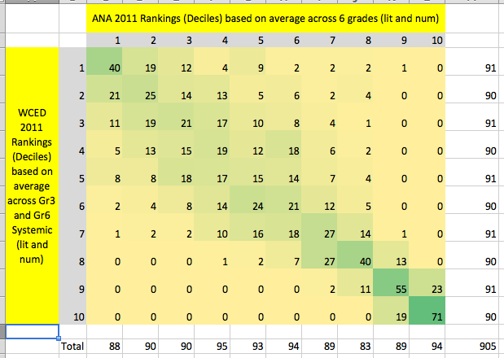
Comparing WCED Systemic Evaluation and DBE ANA WC 2011

Slide 49
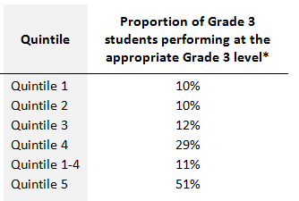
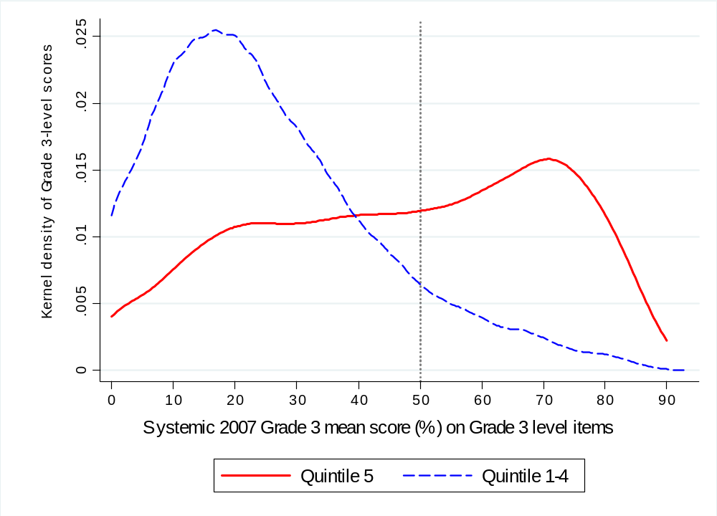
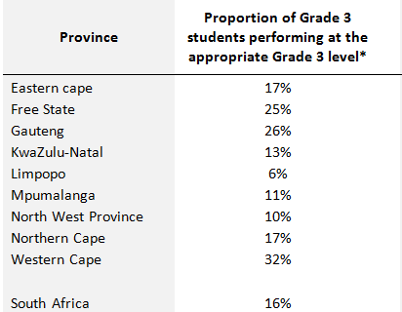
Quantifying learning deficits in Gr3
Figure 1: Kernel density of mean Grade 3 performance on Grade 3 level items by quintiles of student socioeconomic status (Systemic Evaluation 2007)
16%
Only the top 16% of grade 3 students are performing at a Grade 3 level
(Grade-3-appropriate level)
51%
11%
Following Muralidharan & Zieleniak (2013) we classify students as performing at the grade-appropriate level if they obtain a mean score of 50% or higher on the full set of Grade 3 level questions.
(Spaull & Viljoen, 2014)

Slide 50

NSES question 42
NSES followed about 15000 students (266 schools) and tested them in Grade 3 (2007), Grade 4 (2008) and Grade 5 (2009).
Grade 3 maths curriculum: “Can perform calculations using appropriate symbols to solve problems involving: division of at least 2-digit by 1-digit numbers”
Even at the end of Grade 5 most (55%+) quintile 1-4 students cannot answer this simple Grade-3-level problem.
“The powerful notions of ratio, rate and proportion are built upon the simpler concepts of whole number, multiplication and division, fraction and rational number, and are themselves the precursors to the development of yet more complex concepts such as triangle similarity, trigonometry, gradient and calculus” (Taylor & Reddi, 2013: 194)
(Spaull & Viljoen, 2014)
Notes:
Taylor, N., & Reddi, B. (2013). Writing and learning mathematics. In N. Taylor, S. Van der Berg, & T. Mabogoane, Creating Effective Schools. Cape Town: Pearson.

Slide 51
Insurmountable learning deficits: 0.3 SD
(Spaull & Viljoen, 2014)

Slide 52
Data and analysis
In order to answer research questions and engage with the data requires some level of analytic proficiency with a statistical software package like STATA or SPSS (or R if you are hardcore)
Education faculties in South Africa really need to up their game as far as quantitative analysis is concerned. For whatever reason there seems to be an anti-empirical, anti-quantitative bias across the board. This filters through into course-load priorities and expectations (or lack of expectations) on graduate students.
Without an ability to interact with a large data set and do BASIC data analysis any graduate student’s research opportunities are severely (and unnecessarily) limited (the same applies to faculty members)
SALDRU (UCT) runs a free online STATA course to teach the basics of data analysis
  http://www.saldru.uct.ac.za/training/online-stata-course
  There is also a two-week ”UCT Summer training Programme in Social Science research Using Survey Data” run in January every year and well worth going to if you already have a basic background in statistics

Slide 53
Conclusion
Data is essential for making informed decisions
To be able to use these data sets requires some level of analytic proficiency. Basic proficiency can take as little as 4 months but is infinitely valuable.
Nationally representative datasets allow us to draw conclusions for each province and the whole country – something that is not possible from small local studies.
DBE has access to a wealth of useful but under-utilized data
  ANA, EMIS, MATRIC, HH-SURVEYS (also PERSAL & SYSTEMIC)
Many datasets are publicly available on request
  SACMEQ, TIMSS, PIRLS (SACMEQ 2013 soon to be available)
“Without data you are just another person with an opinion” – Andreas Schleicher

Slide 54
References and useful websites
Fleisch, B. (2008). Primary Education in Crisis: Why South African Schoolchildren underachieve in reading and mathematics (pp. 1–162). Cape Town: Juta & Co.
Greaney, V., & Kellaghan, T. (2008). Assessing national achievement levels in education (Vol. 1). World Bank Publications.
Reddy, V., Prinsloo, C., Visser, M., Arends, F., Winnaar, L., & Rogers, S. (2012). Highlights from TIMSS 2011: The South African perspective. Pretoria.
Ross, K. N., Dolata, S., Ikeda, M., Zuze, L., & Murimba, S. (2005). The Conduct of the SACMEQ II Project in Kenya. Harare.
Taylor, N., Van der berg, S., & Mabogoane, T. (2013). What makes schools effective? Report of the National School Effectiveness Study. Cape Town: Pearson.
Taylor, S., & Yu, D. (2009). The importance of socioeconomic status in determining educational achievement in South Africa (No. 1). Stellenbosch.
Van der berg, S., Burger, C., Burger, R., De Vos, M., Du Rand, G., Gustafsson, M., … Von Fintel, D. (2011). Low quality education as a poverty trap. Stellenbosch.
http://www.sacmeq.org/ www.oecd.org/pisa http://timssandpirls.bc.edu

Slide 55
Group exercise
Last 45 minutes
  Split into groups of 5 (8 groups)
  Using questionnaires provided, come up with at least 5 research questions that could (potentially) be answered using that data
    Explain which variables you would use and how (what would the graph/table look like or be populated with? Sketch the axes)
    Why did you choose those research questions?
    Which other large-scale data do you think you could look at to further investigate the issue?

Slide 56
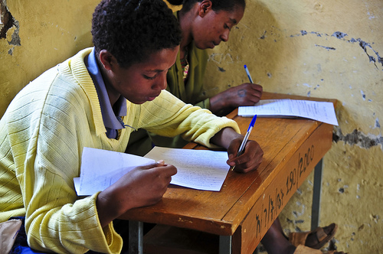
Thank you
www.nicspaull.com/research nicholasspaull@gmail.com
@NicSpaull

Slide 57
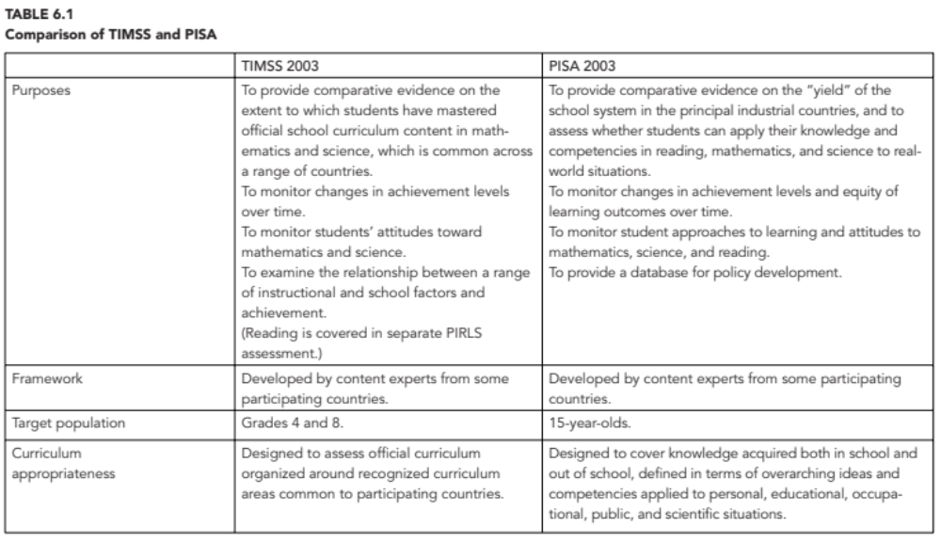
Difference between TIMSS & PISA

Slide 58
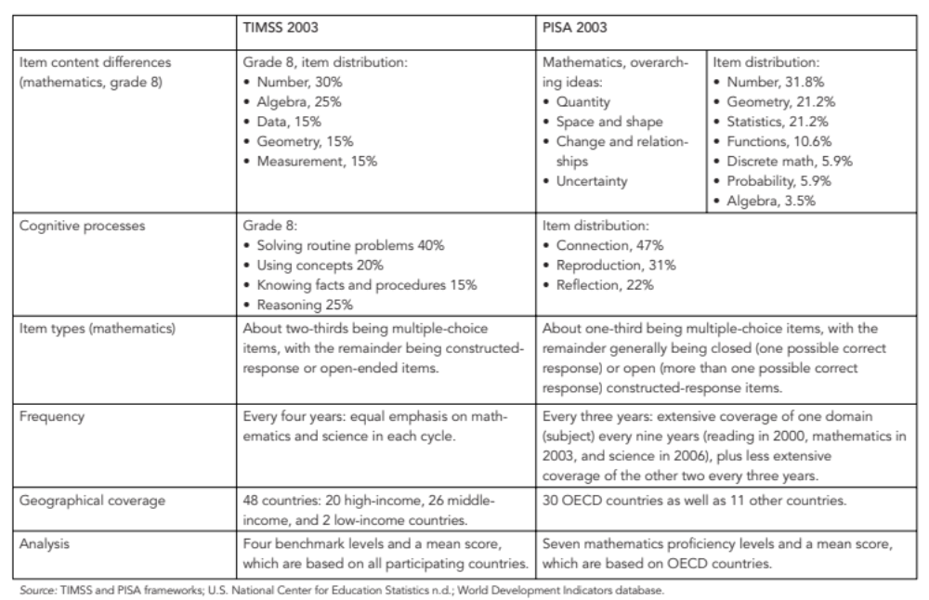
Difference between TIMSS & PISA

