Slide 1

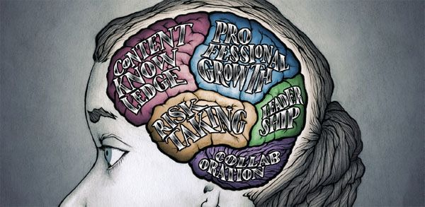


Teachers & teacher content knowledge in SA
Finding a way forward
www.nicspaull.com/presentations
CPLO Roundtable on Teachers | 13 October 2014

Slide 2
Outline
An axiomatic approach to talking about teachers
Framing: The SA education system
Focusing on teachers
  Teacher content knowledge
  Teacher training (esp in-service teacher training)
  The need to differentiate
Some thoughts on the way forward

Slide 3
An axiomatic approach:
Teachers exist because we care about learning
The teaching profession does not have an independent reason to exist (i.e. independent of students learning).
It should not exist ‘for its own sake’
It is not an employment agency.
It is not a voting bloc for hire.
It serves a function and gains legitimacy by serving that function.
It exists because we care about learning/education and teachers are an essential & integral part of learning/education.
Given the above the correct thing to focus on when discussing teachers is student learning – how do we improve and increase the ‘quality’ of what students learn and ‘volume’ of what they learn.
Schooling is essentially about (1) the student, and (2) the teacher in the presence of (3) content. (ala Elmore 2008)
In all of our discussions around teachers we must keep in mind that the end goal is the STUDENT, not the teacher (although the teacher is often an ‘intermediate end-goal’, but not final end-goal). #perspective

Slide 4
Framing: The SA education system

Slide 5

Inequality: Two public schooling systems

Slide 6





Bimodality – indisputable fact
PIRLS / TIMSS / SACMEQ / NSES / ANA / Matric… by Wealth / Language / Location / Dept…

Slide 7
Labour Market
17%
Legislators, managers, assoc professionals
Unemployed
(Broad - 33%)
Unskilled
(19%)
Elementary occupations & domestic workers
Semi-Skilled (31%)
Clerks, service workers, shop personnel, skilled agric/fishery workers, plant and machinery operators)
University/FET
Type of institution (FET or University)
Quality of institution
Type of qualification (diploma, degree etc.)
Field of study (Engineering, Arts etc.)
High productivity jobs and incomes (17%)
Mainly professional, managerial & skilled jobs
Requires graduates, good quality matric or good vocational skills
Historically mainly white
High quality secondaryschool
High SES background
+ECD
High quality primary school
Minority (20%)
Some motivated, lucky or talented students make the transition
Unequal society
Big demand for good schools despite fees
Some scholarships/bursaries
Vocational training
Affirmative action
Majority (80%)
Quality
Low quality secondary
school
Attainment
Type
Low productivity jobs & incomes
Often manual or low skill jobs
Limited or low quality education
Minimum wage can exceed productivity
Low SES background
Low quality primary school
cf. Servaas van der Berg – QLFS 2011
Notes:
The QLFS classifies professions as follows: Highly skilled (legislators, senior officials and managers, professionals, technicians and associate profesionals); Semi-skilled (Clerks, service workers and shop and market personnel, skilled agricultural and fishery workers, craft and related trade workers, plant and machinery operators and assembly), Unskilled (Elementary occupations, domestic workers).

Slide 8
Overview of education in SA
12.4m students
  4 % of students are in independent schools (i.e. 96% public)
25,826 schools
  6% of schools are independent schools (i.e. 94% public)
425,000 teachers
  8% of teachers are in independent schools (i.e. 92% public)
Near universal access up to Grade 9 (quality?!)

Slide 9
From an expenditure point of view it makes sense to look at teachers (3-5% GDP) Expenditure on education 2010/11
Total government expenditure
(31% GDP in 2010/11 – R733.5bn)
Government exp on education
(19.5% of Gov exp: R143.1bn)
17%
5%
Notes:
Figures from 2012 Public Expenditure Analysis report for UNICEF/DBE (Oxford Policy Management / Stellenbosch Economics) Education exp = 6.1% of GDP
Personnel exp = 78% of educ exp
Personnel exp = 4.8% of GDP

Slide 10
Union membership

Slide 11
Looking at primary school maths teachers (Gr 6) specifically…

Slide 12
Teacher content knowledge
Taylor & Vinjevold (1999, p. 230) summarize the 54 studies that made up this initiative and conclude as follows: “The most definite point of convergence across the [President’s Education Initiative] studies is the conclusion that teachers’ poor conceptual knowledge of the subjects they are teaching is a fundamental constraint on the quality of teaching and learning activities, and consequently on the quality of learning outcomes.”
Carnoy & Chisholm (2008, p.33): “The relatively low level of mathematics knowledge that teachers have in all somewhat troubling. It raises some doubts about the preparation of the teacher forcebut the highest student [socioeconomic status] schools is”.
Taylor & Taylor (2013, p. 230): “The subject knowledge base of the majority of South African grade 6 mathematics teachers is simply inadequate to provide learners with a principled understanding of the discipline…providing teachers with a deep conceptual understanding of their subject should be the main focus for both pre- and in-service teacher training”.

Slide 13
New (2014) research on mathematics teacher content knowledge
Using SACMEQ 2007 teacher test, Venkat & Spaull classify the 42 items in the SACMEQ maths teacher test according to content strand and grade level
  9 items at Gr4/5 level
  19 items at Gr6/7 level
  14 items at Gr 8/9 level
Classify teachers based on grade-level using a 60% minimum mark requirement for threshold
  Less than grade 4/5 content knowledge
  Grades 4 & 5 content knowledge
  Grades 4, 5, 6 ,7 content knowledge
  Grades 4, 5, 6, 7, 8 and 9 content knowledge
  *Given that the test items were structured in MCQ format all responses were corrected using Frary’s correction formula

Slide 14
Forthcoming work on primary school mathematics teachers in SA (Spaull & Venkat, 2014)
Figure 1: Proportion of South African grade 6 mathematics teachers by content knowledge (CK) group - SACMEQ 2007 (with 95% confidence interval) [401 Gr6 maths teachers]
Notes:
http://www.ekon.sun.ac.za/wpapers/2014/wp132014

Slide 15
Primary school mathematics teachers in SA
(Venkat & Spaull, 2014)
Figure 4: Average percentage correct on all 42 items in SACMEQ 2007 mathematics teacher test by quintile of school socioeconomic status and school location (corrected for guessing) [401 Gr6 maths teachers]

Slide 16

Primary school mathematics teachers in SA
(Venkat & Spaull, 2014)
Figure 5: Proportion of Grade 6 mathematics teachers by CK grouping and quintile of school socioeconomic status (SACMEQ 2007) - with 95% confidence intervals [401 Gr6 maths teachers]

Slide 17
Teacher knowledge
Teachers cannot teach what they do not know.
Content knowledge – How to do fractions
Pedagogical content knowledge– how to teach fractions
Student understands and can do fractions
Demonizing teachers is popular, but unhelpful
“For every increment of performance I demand from you, I have an equal responsibility to provide you with the capacity to meet that expectation. Likewise, for every investment you make in my skill and knowledge, I have a reciprocal responsibility to demonstrate some new increment in performance” (Elmore, 2004b, p. 93).
Notes:
Elmore, R. (2004b). School reform from the inside out: Policy, practice and performance. Cambridge, MA: Harvard Education Press.

Slide 18
IN-service vs PRE-service
teacher training/development
Don’t focus only, or primarily, on initial teacher-ed (cue opposition from the folk in ed-faculties ☺)
You cannot improve the quality of teaching unless we somehow improve the quality of existing teachers and existing teaching practices
Useful to think about STOCK vs FLOW of teachers…

Slide 19
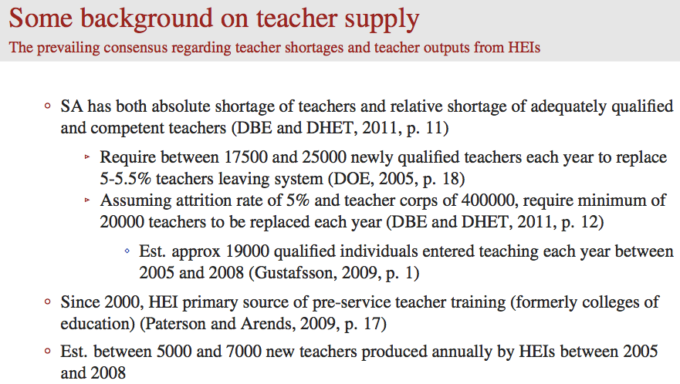
From Hendrik van Broekhuizen (ongoing research)

Slide 20
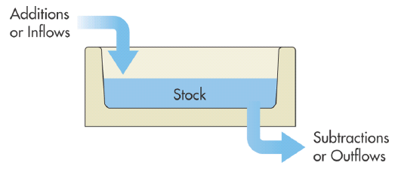
‘Stock’ vs ‘Flow’ of teachers in SA
New teachers (B.Ed)
New teachers (PGCE)
New teachers (foreigners)
New teachers (unregistered)
← Martin Gustafsson estimated that 19 100 qualified educators joined the education system annually between 2005 and 2008
5%
In 2012 there were 425,167
teachers
(Education Statistics 2012, p4)
If we don’t crack the issue of in-service teacher development in the next 20 years (i.e. providing existing teachers with meaningful learning opportunities) we are basically “screwed”
Teachers retiring
Teachers moving into other professions
Teachers immigrating
Teachers dying
Notes:
http://www.education.gov.za/LinkClick.aspx?fileticket=U%2bEemf%2boy2g%3d&tabid=93&mid=2399&forcedownload=true

Slide 21
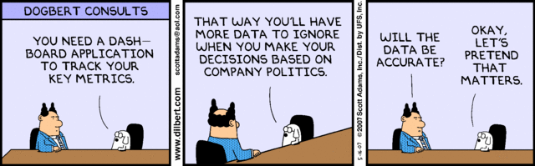
(1b) Find substance and reject form
  If we want to make headway with teacher development (which is in everyone’s interests) we need to be basing interventions on reliable evidence NOT on politics or fads or what looks good on paper
  Nothing is properly evaluated. Evaluation is always an after-thought in education. Imagine if we used the same logic in health “This treatment for cancer looks great on paper, let’s do it”, “This homeopathic remedy worked for my cousin’s daughter so let’s roll it out to the whole country”
  We currently don’t know what works when it comes to in-service teacher training programs. Maybe we know what works in those 5 schools with that one inspirational manager and those few academics in that one circuit, but no one knows what works at anything like scale (circuit+). No one. Not the academics (educationists or economists), not the NGOs, not DBE, not the unions, not GPLMS, not LITNUM, not Pearson, not NEEDU. No one.

Slide 22
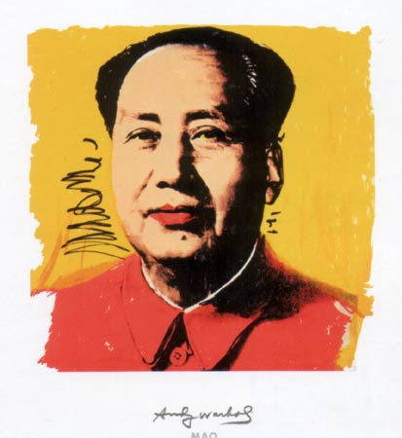
(1b) Commitment to substance not form
Evaluation is key – unless we are evaluating what we are doing we don’t know if it works. We are scattering bricks in a room as opposed to building a wall. We should only ever take things to scale IF they have been evaluated and shown to be effective in various settings and at various scales (ala Borko).
Identify master-teachers – To improve the quality of teachers currently in schools we need a small army of high-quality teacher-trainers (GPLMS?).
  We have to find a way of identifying master-teachers and create the institutional frameworks to give them time and incentives to develop programs that help teachers.
  There are brilliant teachers in all different types of schools but we currently have no idea who they are or where they are
  Serves the dual purpose of giving prestige (and benefits) to excellent teachers AND they are our best bet if getting out of the quagmire (not academics or NGOs or government)
“Let a thousand flowers bloom”

Slide 23
(2) Need to be more nuanced when talking about “teachers”
There are large inter-provincial and inter-quintile differences in school practices…but also intra-province and intra-quintile differences → need to differentiate

Slide 24
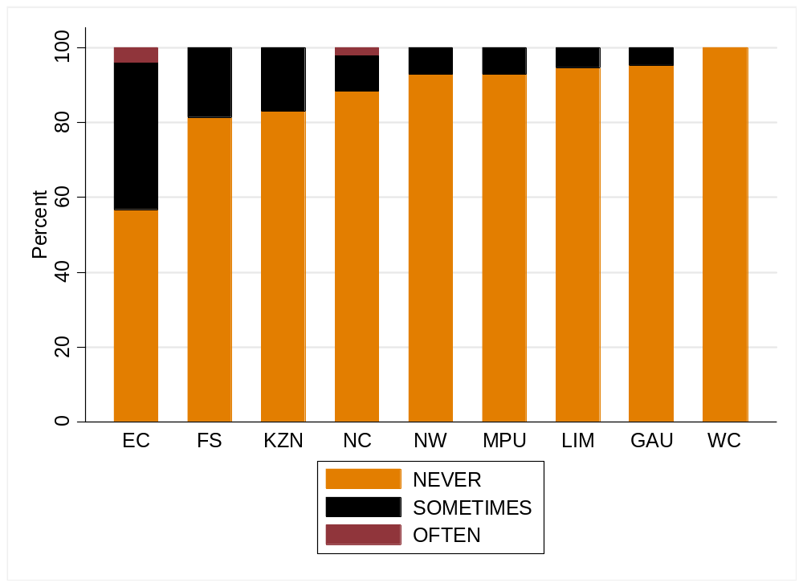
School practices
How often do you send pupils home when the teacher is absent? (SACMEQ 3)
(S Taylor, 2011)

Slide 25
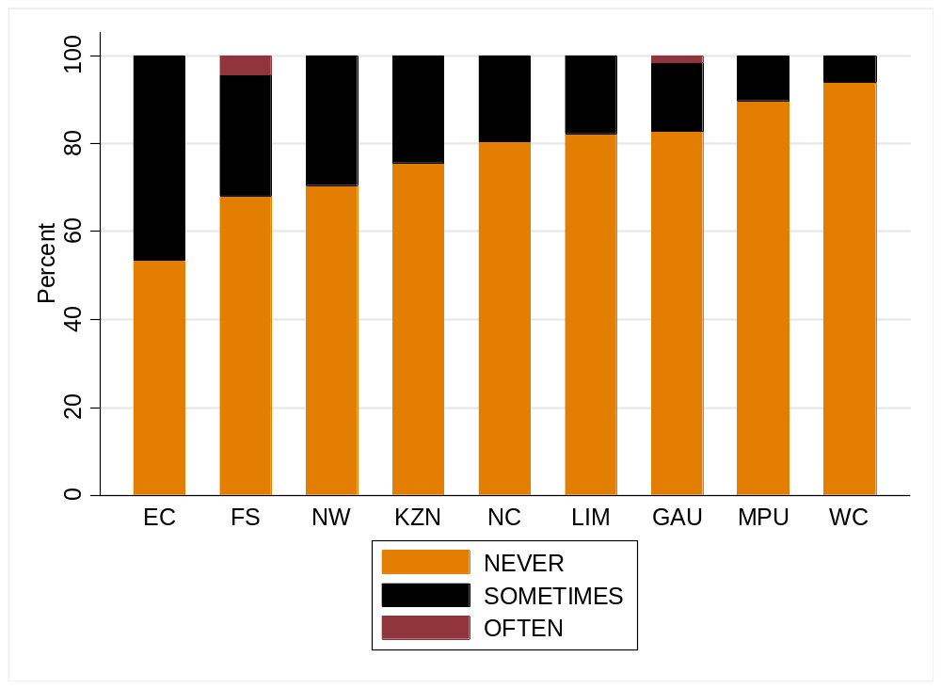
School practices
How often do you leave pupils on their own when the teacher is absent? (SACMEQ 3)
(S Taylor, 2011)

Slide 26
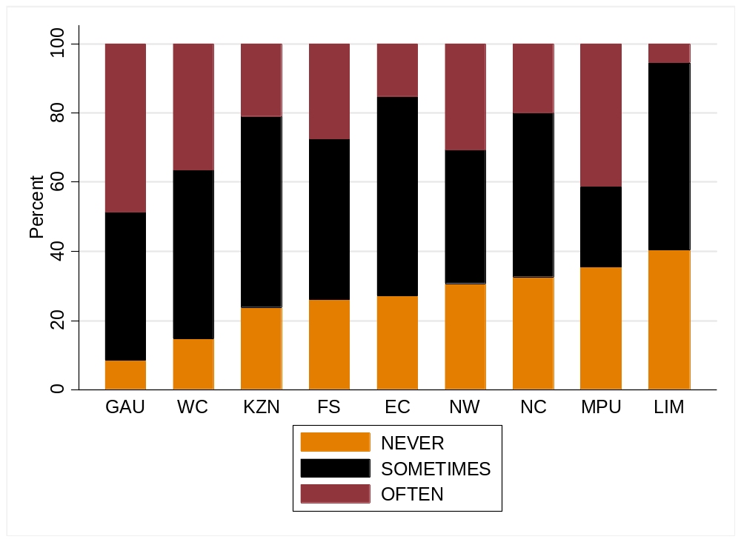
School practices
How often do you substitute an absent teacher with a qualified teacher? (SACMEQ 3)
(S Taylor, 2011)

Slide 27

Teacher absenteeism
SACMEQ III (2007)
What is the distribution of teacher (self-reported) absenteeism across school SES quintiles?
See 2010 HSCR report on Khulisa Consortium Audit data → Mondays and Fridays and 1-2 day leave instances make up vast majority

Slide 28
(2) Averages are uniquely misleading in SA
Talking about “South African teachers” isn’t that meaningful/helpful and in many instances is downright misleading
Irrespective of your views about differential teacher pay we have a serious need for differentiating between teachers (in discussion, in the media, in analysis).
  To attract competent people into the profession these individuals need to be able to identify with a desirable sub-set of the teacher core.
  Hearts-and-minds campaign celebrating excellent/passionate/intelligent/ dedicated/self-sacrificial/empathetic/motivational teachers and differentiating them from a tainted minority. This CANNOT be a model-C vs non-model-C categorization. We have some excellent teachers in rural areas and Q1-3 schools which we should identify and hold them up as shining examples of what it means to be a teacher.
  We need to isolate and stigmatize “bad practices” rather than stigmatizing “teachers in general” which is the status quo
    These bad practices might be widespread (absenteeism, shirking etc.), or rare (rape, abuse, corruption) and in both instances we need to consistently differentiate and avoid statements like “teachers are incompetent” or “teachers are professional” – some teachers ARE incompetent but not all, and some teachers are professional but not all. We may disagree on whether we are talking about 5%, 10% or 40% but we don’t mean 100% and we don’t mean 0% can we PLEASE get away from talking about absolutes. False dichotomies help politicians not kids.

Slide 29

What does the way forward look like?
What are the tangible things that we all (and specifically EE) can do going forward regarding teachers and teaching?
Find substance and reject form in teacher training
Differentiate between teachers
Hearts and minds campaign
Everyone needs to come to the table and play ball → can’t afford to keep going with the stalemate that we have (no DG for 2 years?! WTF?)

Slide 30
Thank you
Comments?
This presentation and papers available online at: www.nicspaull.com/research

Slide 31
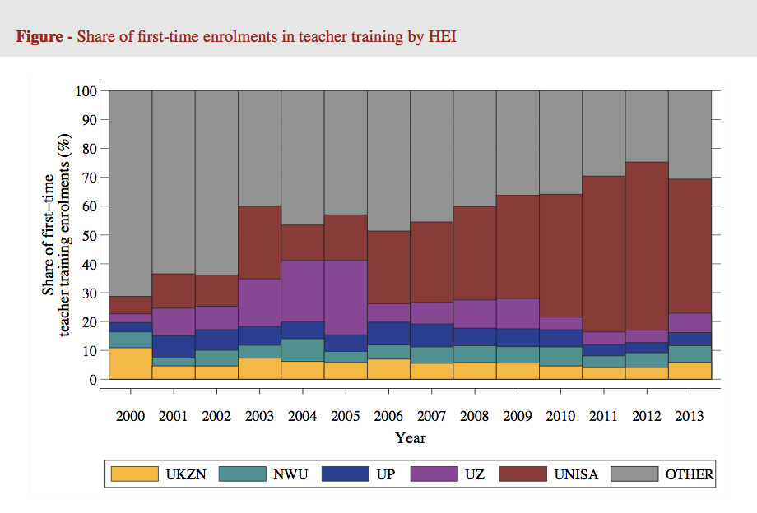
Hendrik van Broekhuizen (ongoing research)

Slide 32
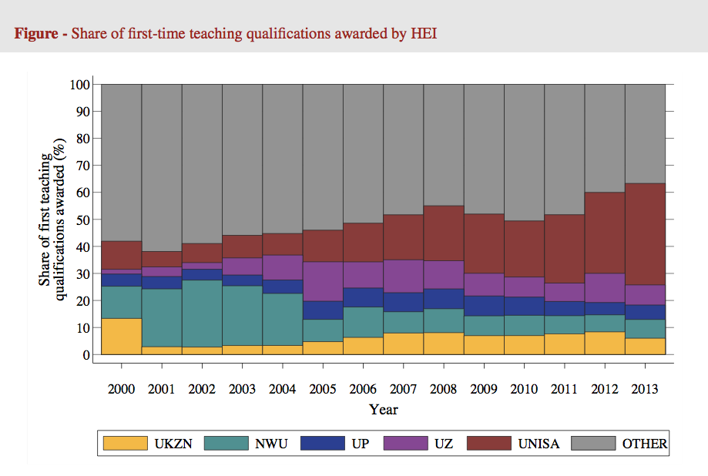
Hendrik van Broekhuizen (ongoing research)

Slide 33
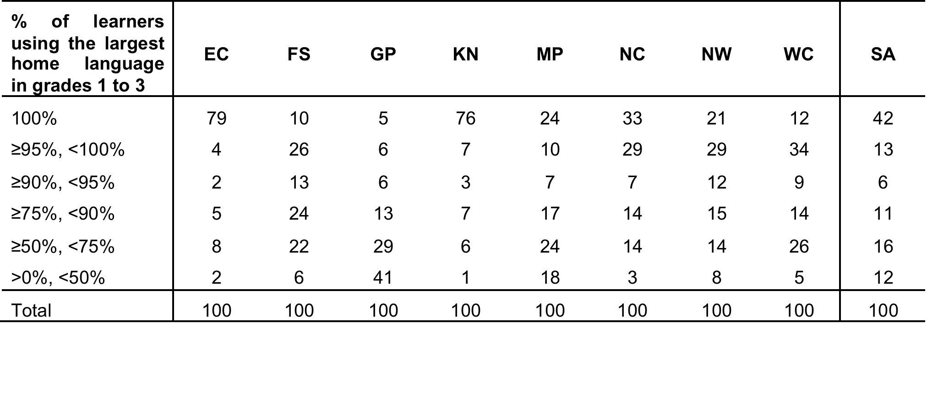
Language and province
(Analysis by Martin Gustafsson using ASS)
This should also make us cautious about extrapolating the findings of GPLMS to other provinces

Slide 34
Possible solution…
The DBE cannot afford to be idealistic in its implementation of teacher training and testing
  Aspirational planning approach: All primary school mathematics teachers should be able to pass the matric mathematics exam
    (benchmark = desirable teacher CK)
  Realistic approach: (e.g.) minimum proficiency benchmark where teachers have to achieve at least 90% in the ANA of the grades in which they teach, and 70% in Grade 9 ANA
  (benchmark = basic teacher CK)
First we need to figure out what works!
Pilot the system with one district. Imperative to evaluate which teacher training option (of hundreds) works best in urban/rural for example. Rigorous impact evaluations are needed before selecting a program and then rolling it out
Tests are primarily for diagnostic purposes not punitive purposes
Notes:
Implement a nation-wide system of minimum-proficiency diagnostic teacher testing and capacitation for numeracy and literacy starting with the Foundation Phase.
“The existing body of evidence suggests that a large proportion of South African teachers have below-basic content knowledge in the subjects that they teach – largely as a result of inadequate apartheid-era teacher training and the ineffectiveness of in-service teacher training initiatives. In light of this, and following the premise that teachers cannot teach what they do not know, it is a logical imperative that a system of identifying which teachers need what help is urgently required. Given the current state of teacher content knowledge in poor and rural schools, the Department cannot afford to be idealistic in its implementation of this system of teacher testing and training. Rather than ascribing to the aspirational planning approach that has become characteristic of South African policy - where one might set an impractically high benchmark for desirable teacher content knowledge - one should first aim to ensure that every teacher in the system has the basic content knowledge required to cover the curriculum that they currently teach. For example, rather than decreeing that every primary school mathematics teacher should be able to pass the matric mathematics exam, it would be far more realistic to take an incremental approach and set the minimum-proficiency benchmark at a 70% mark on the grade nine annual national assessment, combined with at least a 90% mark in the ANA of the grade which they are currently teaching. If a grade six mathematics teacher cannot achieve 70% on the grade nine ANA for mathematics, and achieve 90% for the grade six mathematics ANA, one can say that they do not currently possess the requisite content knowledge to teach grade six mathematics. As a matter of urgency, they should be required to undergo minimum-proficiency teacher training for the subjects which they teach and then re-assessed at the end of the training. Before trying to get every teacher to a desirable level, first ensure that all teachers have the basic content knowledge in the subjects that they teach.
Given the logistics involved with implementing a testing and training operation of this scale, it is advisable to pilot the system with one district and then to roll out the system nationally in a progressive way. For example the Department could start with Foundation Phase (FP) mathematics teachers in a particular district and require all FP maths teachers to register and write the minimum proficiency test within six months. Teachers who do not meet the minimum-proficiency benchmark for the subjects that they teach should be given six months to complete the minimum-proficiency training which should be free of charge and accessible. Importantly, the training provided should be dignified, highly practical, structured and sequenced, with formative testing built into each module to assess whether or not the teacher has acquired the necessary knowledge and skills.
In order to get teacher and union buy in, it will need to be made explicit that these tests are primarily for diagnostic rather than punitive purposes. Through a variety of mechanisms (such as contracts and confidentiality clauses) it is possible to reassure all parties involved that these tests are truly developmental in nature. The ultimate aim of such a system should not be to vilify and demean teachers and the teaching profession, but to increase the capacity and dignity of teachers. Elmore (2004b, p. 93) provides a useful description of the interplay between accountability and capacitation:
“For every increment of performance I demand from you, I have an equal responsibility to provide you with the capacity to meet that expectation. Likewise, for every investment you make in my skill and knowledge, I have a reciprocal responsibility to demonstrate some new increment in performance.”
Spaull 2013 CDE Report

Slide 35
Current situation RE teacher development
Currently there are no in-service training programs that have been rigorously evaluated and shown to improve mathematics teacher content knowledge, at least not at any scale (circuit or higher).
  This is one of the SCANDALS of higher education post-apartheid
Although there are many small NGO initiatives, most are not evaluated and it is unclear if the training:
  Actually works (does what it intends to do)
  changes classroom behavior,
  improves student learning
  Is scalable from capacity, cost and/or program-design perspectives

Slide 36
What can unions do going forward?
Stage 1 - Develop well-specified professional development programs which aim to improve mathematics teacher content knowledge (CK) & pedagogical content knowledge (PCK)
Stage 2 – Evaluate the best candidates from Stage 1 in a small-scale setting (i.e. 50-150 teachers).
(If programs are successful proceed to stage 3)
Stage 3 – Determine whether programs that were successful at Stage 2 (i.e. small scale) can be enacted with integrity in different settings and by different professional development providers (i.e. 300-1000 teachers)
Stage 4 – If programs can have been shown to be effective at raising teachers’ mathematics content knowledge at scale (i.e. Stage 3). Roll out to an entire districts/provinces. Evaluate province-wide interventions.
See Borko, H. (2004) Professional development and teacher learning: Mapping the terrain.
Educational Researcher, 33(8), 3-15.

Slide 37
What can unions do going forward?
Main contribution of unions.
Identify master-teachers from existing members, provide time and resources to develop teacher-training programs
Stage 1 - Develop well-specified professional development programs which aim to improve mathematics teacher content knowledge (CK) & pedagogical content knowledge (PCK)
Stage 2 – Evaluate the best candidates from Stage 1 in a small-scale setting (i.e. 50-150 teachers).
(If programs are successful proceed to stage 3)
Stage 3 – Determine whether programs that were successful at Stage 2 (i.e. small scale) can be enacted with integrity in different settings and by different professional development providers (i.e. 300-1000 teachers)
Stage 4 – If programs can have been shown to be effective at raising teachers’ mathematics content knowledge at scale (i.e. Stage 3). Roll out to an entire districts/provinces. Evaluate province-wide interventions.
See Borko, H. (2004) Professional development and teacher learning: Mapping the terrain.
Educational Researcher, 33(8), 3-15.

Slide 38
Accountability: teacher absenteeism
(SACMEQ III – 2007 – 996 teachers)
4th/15
Notes:
Absenteeism here is average between both maths and reading teachers

Slide 39
Accountability: teacher absenteeism
(SACMEQ III – 2007 – 996 teachers)
15th/15
Yes, BUT…2007 was a bad year
Notes:
Absenteeism here is average between both maths and reading teachers

Slide 40
Accountability: teacher absenteeism
  Teacher absenteeism is regularly found to be an issue in many studies
    2007: SACMEQ III conducted – 20 days average in 2007 (Spaull, 2011)
    2008: Khulisa Consortium audit – HSRC (2010) estimates that 20-24 days of regular instructional time were lost due to leave in 2008
    2010: “An estimated 20 teaching days per teacher were lost during the 2010 teachers’ strike” (DBE, 2011: 18)
    Importantly this does not include time lost where teachers were at school but not teaching scheduled lessons
      A recent study observing 58 schools in the North West concluded that “Teachers did not teach 60% of the lessos they were scheduled to teach in North West” (Carnoy & Chisholm et al, 2012)
Notes:
Also see Chisholm (2005) and Shisana et al (2005) quoted in HSRC (2010)

Slide 41




Accountability: teacher absenteeism
(SACMEQ III – 2007 – 996 teachers)
Western Cape
Eastern Cape
Limpopo
KwaZulu-Natal
% absent > 1 week striking
32%
81%
97%
82%
% absent > 1 month (20 days)
22%
62%
48%
73%
% absent > 2 months (40 days)
5%
12%
0%
10%
1.3 days a week
Notes:
Given that SACMEQ was done in September 2007, a maximum of 159 school days could have passed, hence 3 months = 1.3 days a week

Slide 42
Outline
Overview of the SA education system
State of education since the transition
Overview of teacher union membership in SA
Teacher content knowledge in South Africa
What is the role of school management in addressing the problem?
Conclusion

Slide 43
Things to discuss?
Teacher CK
Teacher unions
Teacher training
(in & pre)
Civil service capacity
Resources
Access vs Quality
Grade R / ECD
Accountability & Capacity
LOLT
Student performance
Teacher absenteeism
Learning deficits

Slide 44
Things to discuss?
Teacher CK
Teacher unions
Teacher training
(in & pre)
Civil service capacity
Resources
Access vs Quality
Grade R / ECD
Accountability & Capacity
LOLT
Student performance
Teacher absenteeism
Learning deficits

Slide 45
(1)
An overview of the South African education system

Slide 46





State of SA education since transition
“Although 99.7% of South African children are in school…the outcomes in education are abysmal” (Manuel, 2011)
“Without ambiguity or the possibility of misinterpretation, the pieces together reveal the predicament of South African primary education” (Fleisch, 2008: 2)
“Our researchers found that what students know and can do is dismal” (Taylor & Vinjevold, 1999)
“It is not an overstatement to say that South African education is in crisis.” (Van der Berg & Spaull, 2011)
Notes:
Fleisch, B. (2008). Primary Education in Crisis: Why South African schoolchildren underachieve in reading and mathematics. Cape Town. : Juta & Co.
Taylor, N., Muller, J., & Vinjevold, P. (2003). Getting Schools Working. Cape Town: Pearson Education.
South African education: the poorest choice [M&G, 8 Apr 2011] (Co-authored with Prof Servaas van der Berg)

Slide 47








Student performance 2003-2011
TIMSS (2003)
→ PIRLS (2006)
→ SACMEQ (2007)
→ TIMSS (2011)
→ prePIRLS (2011)
TIMSS 2003 (Gr8 Maths & Science)
Out of 50 participating countries (including 6 African countries) SA came last
Only 10% reached low international benchmark
No improvement from TIMSS 1999-TIMSS 2003
See Reddy et al (2006)
PIRLS 2006 (Gr 4/5 – Reading)
Out of 45 participating countries SA came last
87% of gr4 and 78% of Gr 5 learners deemed to be “at serious risk of not learning to read”
See Howie et al. (2006)
SACMEQ III 2007 (Gr6 – Reading & Maths)
SA came 10/15 for reading and 8/15 for maths behind countries such as Swaziland, Kenya and Tanzania
See Moloi & Chetty (2010) & Spaull (2012)
TIMSS 2011 (Gr9 – Maths & Science)
SA has joint lowest performance of 42 countries
Improvement by 1.5 grade levels (2003-2011)
76% of grade nine students in 2011 still had not acquired a basic understanding about whole numbers, decimals, operations or basic graphs, and this is at the improved level of performance
See Reddy et al. (2012) & Spaull (2013)
prePIRLS2011 (Gr 4 Reading)
29% of SA Gr4 learners completely illiterate (cannot decode text in any langauge)
See Howie et al (2012)
NSES 2007/8/9
  Gr 3/4/5
  See Taylor, Van der Berg & Mabogoane (2013)
Systemic Evaluations 2007
  Gr 3/6
Matric exams
  Gr 12
Notes:
The most comprehensive reports for each of these datasets are as follows: SACMEQ (Moloi & Chetty, 2011), TIMSS (Reddy, 2006), PIRLS (Howie, et al., 2008), Systemic Evaluations (Department of Education, 2008), National School Effectiveness Study (Taylor, 2011b),and the Annual National Assessments (Department of Basic Education, 2011).

Slide 48
“But what does this low & unequal performance look like in practice, on the ground, in the classroom?”

Slide 49

NSES question 42
NSES followed about 15000 students (266 schools) and tested them in Grade 3 (2007), Grade 4 (2008) and Grade 5 (2009).
Grade 3 maths curriculum: “Can perform calculations using appropriate symbols to solve problems involving: division of at least 2-digit by 1-digit numbers”
Even at the end of Grade 5 most (55%+) quintile 1-4 students cannot answer this simple Grade-3-level problem.
“The powerful notions of ratio, rate and proportion are built upon the simpler concepts of whole number, multiplication and division, fraction and rational number, and are themselves the precursors to the development of yet more complex concepts such as triangle similarity, trigonometry, gradient and calculus” (Taylor & Reddi, 2013: 194)
(Spaull & Viljoen, 2014)
Notes:
Taylor, N., & Reddi, B. (2013). Writing and learning mathematics. In N. Taylor, S. Van der Berg, & T. Mabogoane, Creating Effective Schools. Cape Town: Pearson.

Slide 50
Insurmountable learning deficits: 0.3 SD
Spaull & Viljoen, 2014 (SAHRC Report)

Slide 51
550,000 students drop out before matric
99% do not get a non-matric qualification (Gustafsson, 2011: p11)
What happens to them? 50% youth unemployment…

Slide 52
(2)
Mathematics content knowledge of SA teachers

Slide 53

Background: Data
SACMEQ
  Southern and Eastern African Consortium for Monitoring Educational Quality
  14 participating countries
  SACMEQ II (2000), SACMEQ III (2007)
  Nationally representative
  Testing :
    Gr 6 Numeracy
    Gr 6 Literacy
    HIV/AIDS Health knowledge
SACMEQ III: South Africa
  9071 SA Grade 6 students
  498 SA Grade 6 math teachers
  392 SA primary schools
See SACMEQ website for research

Slide 54

Maths teacher content knowledge (SACMEQ 2007)
But this is the AVERAGE Grade 6 maths teacher. Extremely high levels of inequality in SA means that the average score hides the real truth. What does it look like if we disaggregate it…
Source: Stephen Taylor
Notes:
South African teachers are on the lower end of the distribution of SSA maths teachers, but the average score hides the real truth (as it always does in SA) that some maths teachers in SA perform far below the mean which explains why the variance in maths-teachers maths score in South Africa is so high. The least knowledgeable SA teachers know marginally more than the average STUDENT in South African.
Also, see Makuwa 2010 (on SACMEQ website) for comparable figures for reading teacher content knowledge

Slide 55
“But what does this low performance look like in practice, on the ground, in the classroom?”

Slide 56
(3)
What is the role of school management in addressing problem areas?

Slide 57
Role of SMT
Utilizing existing capacity better.
  There is existing capacity within schools, within groups of schools and within teacher unions that is currently under-utilized.
    Master-teachers
    Mentoring new teachers better (internships? Shadowing?)
Developing a collaborative culture
  “My classroom, my kingdom” thinking is unhelpful. Develop a culture of teachers observing each other teach – not to catch each other out or to punish but to learn and improve.
    “Why do you think no one seemed to understand this particular example?”
    “What works for you?” “How do you teach this?” “How do you think I can do this better?”
  Some teachers are better at teaching some subjects/topics than others. Teachers can learn from each other. We mustn’t be afraid to differentiate and say “We all agree that this teacher is the best at teaching XYZ topic, let them observe our teaching and help us improve”
  Publicly recognizing exceptional teachers. At prize-giving or at big sporting days or other prestigious events, recognize master teachers.
Instructional leadership
  Placing learning at the center of EVERYTHING that the school does. Not rugby or sports or anything else. The chief function of the school is learning. Everyone must know this.
  Leading teacher development – take charge in advocating for improvements to teaching practices
  Protecting instructional time
  Setting clear learning goals
  Understanding what is going on in your classrooms – what are teachers doing? Lesson observations are important, providing constructive feedback on potential improvements
Notes:
http://www.ekon.sun.ac.za/wpapers/2014/wp132014

Slide 58
Instructional leadership
Instructional leadership is about the leadership practices that create the conditions for enhanced teaching and learning, it is about LEADING LEARNING. This is the core function of every principal.
“Management in education is not an end in itself. Good management is an essential aspect of any education service, but its central goal is the promotion of effective teaching and learning…The task of management at all levels of in the education service is ultimately the creation and support of conditions under which teachers and their students are able to achieve learning…the extent to which effective learning is achieved therefore becomes the criterion against which the quality of management is to be judged” (Bush & Heysteck, 2007 p.73)

Slide 59
Instructional leadership
Meta-analysis of 27 published studies of the effect of instructional leadership on student outcomes yielded the following five aspects of school leadership:
  Establishing goals and expectations
    “Goals provide a sense of purpose and priority in an environment where a multitude of tasks can seem equally important and overwhelming. Clear goals focus attention and effort and enable individuals, groups and organizations to use feedback to regulate their performance (p. 661)”
  Resourcing strategically
  Planning, coordinating and evaluating teaching and the curriculum
  Promoting and participating in teacher-learning and development
    “The leader participates in the learning as leader, learner, or both. The contexts for such learning are both formal (staff meetings and professional development) and informal (discussions about specific teaching problems)” (p663)
  Ensuring an orderly and supportive environment
  (Robinson, Lloyd and Rowe, 2008 p.635)

Slide 60
“Managing to Learn” – Hoadley & Ward (2007)
Most SA principals described their main activity in school as administration and the disciplining of learners rather than the managing of teaching and instruction
Factors associated with better performance included
  Curriculum coverage
  Parental valuing of and support for education
  Willingness of the SGB to help the school
  Structuring of the school day for maximum student learning
  Effective management of learning and teacher support materials
  Positive relationships between staff members at the school
  Collaboration between teachers at the school
  School having a plan to improve students results

Slide 61
Questions that need to be answered:
How will we identify “master-teachers” in the profession?
  Teachers who are universally acknowledged to be exceptional teachers and have a desire to help other teachers.
Once we have a successful “Stage 3” intervention, how will we identify teachers that lack content knowledge and pedagogical content knowledge and need the training?
  Testing?
    Who creates the test?
    At what level? Cannot be idealistic (everyone must pass matric math exam). Need to be realistic.
    Voluntary/compulsory?
    VERY important to stress that these tests are DEVELOPMENTAL, not PUNITIVE
Who will provide the funding for these “master-teachers” to develop the professional development program?
  DBE? Teachers need to be given a reduced teaching load (replacement-time funded by DBE?) so that they can develop and implement the program.
Is it possible for the major teacher unions to collaborate?

Slide 62
Conclusion
It is not an exaggeration to say that there is an ongoing crisis in education in South Africa.
Severe inequalities in education translate into severe inequalities in society.
It is not an exaggeration to say that there is an ongoing crisis in mathematics teacher content knowledge .
Teacher unions and SMTs need to act pre-emptively. You know who the best teachers are. You know who should be developing teacher training programs. You cannot just leave it to universities or DBE or NGOs. We need you.

Slide 63
Thank you
Comments & Questions?
This presentation and papers available online at: www.nicspaull.com/research

Slide 64
Teacher union membership in SA
(as at 31 December 2012)
Breakdown as at 31 December 2012 (Audited stats for December 2013 will be availabkle mid-year)
These Stats include educators and a small numebr of support staff
Union | EC | GP | FS | KZN | LP | MP | NC | NW | WP | TOTAL
SADTU | 45968 | 29307 | 13853 | 57086 | 43706 | 25750 | 5826 | 18572 | 12944 | 253012
NAPTOSA | 12508 | 14805 | 4171 | 7346 | 687 | 2701 | 934 | 3335 | 9651 | 56138
SAOU | 2957 | 8090 | 4925 | 1244 | 1174 | 2452 | 1581 | 2242 | 4197 | 28862
PEU | 380 | 2807 | 71 | 193 | 7824 | 1728 | 128 | 1210 | 0 | 14341
NATU | 380 | 580 | 416 | 25424 | 55 | 1334 | 0 | 284 | 0 | 28473
TOTALS | 16225 | 26282 | 9583 | 34207 | 9740 | 8215 | 2643 | 7071 | 13848 | 127814
Thanks to Mike Myburgh (NAPTOSA) for supplying data
Notes:
There are two sources for the data: the main one is the PSCBC – Public Service Co-ordinating Bargaining Council (this is the forum where all of the public sector unions, including educator unions, bargain with the State on matters of mutual interest) And secondly the ELRC – Education Labour Relations Council (this is specifically for educator unions and the DBE to negotiate on matters not part of the PSCBC). Both conduct audits on an annual basis. These are not without errors! I tried to correct one or two of the significant figures and as indicated added in the Ind Sch and SGB members for NAPTOSA. SAOU may have about 2000 such members in addition to their State employed members (not certain of this though).

Slide 65
Accountability: teacher absenteeism
(SACMEQ III – 2007 – 996 teachers)
Notes:
Absenteeism here is average between both maths and reading teachers

Slide 66
Teacher absenteeism
SACMEQ III (2007)
What is the distribution of teacher absenteeism across school SES quintiles?

Slide 67



By Gr 3 all children should be able to read, Gr 4 children should be transitioning from “learning to read” to “reading to learn”
Red sections here show the
proportion of children that are
completely illiterate in Grade 4
, i.e. they cannot read in any
language
Notes:
If we consider the performance of the learners per test language, the following observations are made:
Overall 29% of learners in SA don’t meet the low benchmark
However, in Afrikaans and English, there are only 12 and 10% who do not meet the low benchmark
Of serious concern is that more than half the learners tested in Sepedi and Tshivenda do not reach the low benchmark putting them at risk educationally.
More than 15% of learners in Afrikaans and English reach the advanced level in contrast to less than 1% in African languages.
http://web.up.ac.za/sitefiles/File/publications/2013/PIRLS_2011_Report_12_Dec.PDF

Slide 68
Figure 2: Average Grade Eight mathematics test scores for middle-income countries participating in TIMSS 2011 (+95% confidence intervals around the mean)
TIMSS Maths (2011)

Slide 69

How do SA’s wealthiest 20% of school perform?
RE Max DuPreez’s comments yesterday that our Model-C schools are “good”, even by international stds
Important to remember size of SA schooling system (25,000 schools, the top 2% =500 schools!)
Top 1% probably, not top 15% →
Graph via Stephen Taylor (TIMSS 2003)

Slide 70

Notes:
http://africacheck.org/2014/01/10/the-economic-value-of-matric-and-the-potential-of-further-education-colleges/

Slide 71
Dropout between Gr8 and Gr12
Of 100 Gr8 quintile 1 students in 2009, 36 passed matric and 10 qualified for university
Of 100 Gr8 quintile 5 students in 2009, 68 passed matric and 39 qualified for university
“Contrary to what some would like the nation and the public to believe that our results hide inequalities, the facts and evidence show that the two top provinces (Free State and North West) are rural and poor.” (Motshekga, 2014)
Notes:
http://nicspaull.com/2014/01/12/education-in-sa-still-separate-and-unequal-extended-version-of-citypress-article/

Slide 72
Qualifications by age (birth cohort), 2011 (Van der Berg, 2013)

Slide 73
Links between education & the labour-market
Intervening in the labour-market (BBBEE) is too late
  Need to do this but MORE focus on (pre) school.
Social grants important to reduce abject poverty but cannot change inequality much
Wages account for 80% of total inequality
Unless you can increase the wages of black labour-market entrants cannot change structure of SA income distribution
(4) not possible without improving quality of education.

Slide 74
SOLUTION?
Accountability AND
Capacity

Slide 75

Notes:
From: http://ijr.org.za/publications/pdfs/TA%202013%20text%20and%20cover%20web.pdf

Slide 80


Slide 81
“Only when schools have both the incentive to respond to an accountability system as well as the capacity to do so will there be an improvement in student outcomes.” (p22)
Notes:
http://ijr.org.za/publications/pdfs/TA%202013%20text%20and%20cover%20web.pdf

Slide 82
There are signs of hope…
The DBE has begun to focus on the basics
  CAPS curriculum
  Workbooks (numeracy and literacy)
  ANAs (not without problems)
Some improvement in Gr9 student outcomes between TIMSS 2003 and TIMSS 2011
  1.5 Grade levels (but post-improvement still exceedingly low)

Slide 83
Way forward?
Acknowledge the extent of the problem
  Low quality education is one of the three largest crises facing our country (along with HIV/AIDS and unemployment). Need the political will and public support for widespread reform.
Focus on the basics
  Every child MUST master the basics of foundational numeracy and literacy these are the building blocks of further education – weak foundations = recipe for disaster. Read by 10 goal!
  Teachers need to be in school teaching (re-introduce inspectorate?)
  Every teacher needs a minimum competency (basic) in the subjects they teach
  Every child (teacher) needs access to adequate learning (teaching) materials
  Use every school day and every school period – maximise instructional time
  Have to make sure we don’t make the same mistakes with Grade R as we have with the rest of schooling
Increase information, accountability & transparency
  At ALL levels – DBE, district, school, classroom, learner
  Strengthen ANA. Get psychometrics right (so comparable across years), externally evaluate @ 1 grade
  Set realistic goals for improvement and hold people accountable
Focus on teachers
  Have to find a way of raising the quality of both (1) new, but especially (2) existing teachers
  Q&A - Prof Muller (UCT): What do you think is the most under-researched area in South African education?
    “We have no idea what it will take to make knowledgeable teachers out of clueless ones, at least not while they are actually on-the-job.”

Slide 84
5 “Take-Home” points
Many things we have not discussed – Grade-R/ECD, teacher unions and politics, civil service capacity constraints, LOLT, teacher training (in- and pre-), RCTs, resources, etc.
South Africa performs extremely poorly on local and international assessments of educational achievement.
In SA we have two public schooling systems not one.
Teacher content knowledge in South Africa is extremely low
In large parts of the schooling system there is very little learning taking place.
Strategies for improvement need to focus on 1) accountability, 2) capacity, 3) alignment.
Low quality education
Low social mobility
Hereditary poverty

Slide 85
Further issues we can discuss
Solution: Identifying binding constraints
Grade R in SA – not more of the same
Resources
New and existing RESEP projects
What proportion of SA kids make it to uni?
What can businesses do to help?
  Warm-glow effect or turning the ship?

Slide 86
References & further reading
For work on poverty and inequality – SALDRU/RESEP websites & working papers good start.
Fiske, E., & Ladd, H. (2004). Elusive Equity: Education Reform in Post-apartheid South Africa. Washington: Brookings Institution Press / HSRC Press.
Fleisch, B. (2008). Primary Education in Crisis: Why South African schoolchildren underachieve in reading and mathematics. Cape Town. : Juta & Co.
Donalson, A. (1992). Content, Quality and Flexibility: The Economics of Education System Change. Spotlight 5/92. Johannesburg: South African Institute of Race Relations.
Taylor, S., & Yu, D. (2009). The Importance of Socioeconomic Status in Determining Educational Achievement in South Africa. Stellenbosch Economic Working Papers.
Van der Berg, S., Burger, C., Burger, R., de Vos, M., du Rand, G., Gustafsson, M., Shepherd, D., Spaull, N., Taylor, S., van Broekhuizen, H., and von Fintel, D. (2011). Low quality education as a poverty trap. Stellenbosch: University of Stellenbosch, Department of Economics. Research report for the PSPPD project for Presidency.
Spaull, N. 2013. Poverty & Privilege: Primary School Inequality in South Africa. International Journal of Educational Development. 33 (2013) pp. 436-447 (WP here)
Spaull, N. 2013. South Africa’s Education Crisis: The Quality of Education in South Africa 1995-2011. Centre for Development and Enterprise.

Slide 87
Current concerns of DBE
(according to me)
Teacher content knowledge
- Extremely low
- Politically sensitive given strength of teacher unions
-Testing & training?!
Grade R & ECD
- Funding: Current exp on Grade R pupil (R3K) 1/3 of ordinary school child (R10K)
-Training/qualifications and $ of ECD teachers?
Teacher Salaries
– Make up 80% of Educ Exp ating infrastructure backlogs
- Legal implications of MN&S (provinces held to acc)
FP Numeracy & literacy and ANAS
- Ensuring they are comparable across years
- Using them to raise numeracy & literacy outcomes
-
Min Norms/Stds
- Eradicating infrastructure backlogs & providing basics (and then non-basics)
- Legal implications of MN&S (provinces held to acc)
Elections & Relations with teacher unions
- Teacher unions (esp SADTU) wield considerable power)
-Appointments (DBE/district/principal/teacher) politicised, competence not primary concern
Post-provisioning
- Ghost teachers
-Over/under supply in certain schools (esp ECA)
-limiting the salary bill

Slide 88
Binding constraints approach

Slide 89


Slide 92
“The left hand barrel has horizontal wooden slabs, while the right hand side barrel has vertical slabs. The volume in the first barrel depends on the sum of the width of all slabs. Increasing the width of any slab will increase the volume of the barrel. So a strategy on improving anything you can, when you can, while you can, would be effective. The volume in the second barrel is determined by the length of the shortest slab. Two implications of the second barrel are that the impact of a change in a slab on the volume of the barrel depends on whether it is the binding constraint or not. If not, the impact is zero. If it is the binding constraint, the impact will depend on the distance between the shortest slab and the next shortest slab” (Hausmann, Klinger, & Wagner, 2008, p. 17).
Notes:
Hausmann, R., Klinger, G., & Wagner, R. (2008). Doing Growth Diagnostics in Practice: A 'Mindbook'. CID Workinf Paper No. 177. Center for International Development at Harvard University.

Slide 93
Grade R/ECD issues needing to be fleshed out?
Qualitatively/practically, when is enrolment considered “Grade R” and when just child-minding?
Where should Grade R teachers be trained?
  Universities? More of the same?
  FET colleges? Quality problems? Status?
Practically, how does one monitor quality of ECD? What instruments? What surveys?
What should Grade R teachers be paid?
  Teacher salaries (and class sizes) obviously major cost-drivers

Slide 94



Slide 95


Size of South African economy/population

Slide 96


Slide 97

Geographic distribution of poverty

Slide 98

Sources of deprivation?

Slide 99


Benefits of education
Ed
S
H
Ec
Improved human rights
Empowerment of women
Reduced societal violence
Promotion of a national (as opposed to regional or ethnic) identity
Increased social cohesion
Lower fertility
Improved child health
Preventative health care
Demographic transition
Improvements in productivity
Economic growth
Reduction of inter-generational cycles of poverty
Reductions in inequality
$
Health
Economy
Society
Specific references: lower fertility (Glewwe, 2002), improved child health (Currie, 2009), reduced societal violence (Salmi, 2006), promotion of a national - as opposed to a regional or ethnic - identity (Glewwe, 2002), improved human rights (Salmi, 2006), increased social cohesion (Heyneman, 2003), Economic growth – see any decent Macro textbook, specifically for cognitive skills see (Hanushek & Woessman 2008)

Slide 100
Accountability stages...
SA is a few decades behind many OECD countries. Predictable outcomes as we move from stage to stage. Loveless (2005: 7) explains the historical sequence of accountability movements for students – similar movements for teachers?
  Stage 1 – Setting standards
  (defining what students should learn),
      CAPS
  Stage 2 - Measuring achievement
  (testing to see what students have learned),
      ANA
  Stage 3 - Holding educators & students accountable
  (making results count).
      Western Cape performance agreements?
Stages in accountability movements:
3) Holding accountable
2) Measuring achievement
1) Setting standards
TRAINING
“For every increment of performance I demand from you, I have an equal responsibility to provide you with the capacity to meet that expectation. Likewise, for every investment you make in my skill and knowledge, I have a reciprocal responsibility to demonstrate some new increment in performance” (Elmore, 2004b, p. 93).

Slide 101


What are the root causes of low and unequal achievement?
Matric pass rate
Subject choice
No. endorsements
Throughput
Media sees only this→
Quality?
MATRIC
Pre-MATRIC
50% dropout
Low curric coverage
Weak culture of T&L
Low accountability
Vested interests
Low time-on-task
No early cognitive stimulation
Low quality teachers
HUGE learning deficits…

Slide 102
Basic overview of matric 2013
The good…
Matric pass rate increased to 78%
Bachelor pass rate increased to 31%
More students passing mathematics
The bad…
Some questioning quality of matric pass
Public starting to ask questions about why uni’s are using NBTs
Concerns over “culling” and whether this lead to increases in NWP and FST
The ugly…
Grade 8→12 dropout is 2x as high (50%) in Q1 rel to Q5 (25%)
Because of differences in average quality of education, a white child is 7 times more likely than a black child to obtain a Maths D+ and 38 times as likely to get an A- aggregate (using earlier matric data)

Slide 103
Focus on mathematics – things are improving
Number of students taking mathematics (as opposed to maths-lit) has declined since 2008, but proportion passing has risen
  Not necessarily a bad thing since many of those students shouldn’t have been taking mathematics in the first place
Source: Taylor (2014)

Slide 104
What proportion of matrics take and pass mathematics?
Important statistic is the number passing which was declining from 2008 → 2011 but has increased between 2011 → 2013
Source: Taylor (2014)

Slide 105
Matric mathematics statistics (Taylor 2014)
 | Numbers wrote maths | Number passed maths | Maths pass rate | Proportion taking maths | Proportion passing maths
2008 | 298821 | 136503 | 45.70% | 56.10% | 25.60%
2009 | 290407 | 133505 | 46.00% | 52.60% | 24.20%
2010 | 263034 | 124749 | 47.40% | 48.80% | 23.20%
2011 | 224635 | 104033 | 46.30% | 45.30% | 21.00%
2012 | 225874 | 121970 | 54.00% | 44.19% | 23.86%
2013 | 241509 | 142666 | 59.10% | 42.96% | 25.38%
Source: Taylor (2014)
NOTE: All of the above is under the proviso that that quality of the mathematics exam has remained constant over the period. If not then we can’t say much.

Slide 106
Are things improving?
What should we be using to measure changes over time?
  DEFINITELY *NOT* ANAs
    Not psychometrically calibrated to be comparable year-on-year
    No anchor items
    No Item Response Theory
    Not externally evaluated and independently marked
    No, no, no.
    Need a broader discussion of the potential perils of ANAs. Under-appreciated at the moment. ANA Fridays?!
  Matric – sort of yes
    Considerable institutional memory (decades of expertise and precedent)
    Excludes half the cohort so not a good reflection of total education system
    Can be tricky to tease out *real* trends. Things like subject combinations, culling, pass thresholds and clumping around the threshold etc.
  Cross-national assessments – yes.
    Best way of determining if there are changes over long periods of tims
      TIMSS, PIRLS/prePIRLS/SACMEQ/ (perhaps PISA in SA soon)
Education and schooling (the main vehicle we use to “do/get it”) cannot be reduced to test scores or particular subjects (numeracy and literacy). However, that does *NOT* mean that there is no place for testing. Many educational outcomes are measurable and providing feedback to everyone (DBE, principals, parents, students) is an important form of accountability.

Slide 107

Higher education in perspective
When speaking about higher education it’s important to remember that this is only a very small proportion of the population
Source: DBE (2013) Internal Efficiency of the schooling System

Slide 108

Gustafsson, 2011 – When & how WP
“What do the magnitudes from Figure 4 mean in terms of the holding of qualifications? In particular, what widely recognised qualifications do the 60% of youths who do not obtain a Matric hold? …Only around 1% of youths hold no Matric but do hold some other non-school certificate or diploma issued by, for instance, an FET college”
(Gustafsson, 2011: p.11)
10%
Notes:
http://www.ekon.sun.ac.za/wpapers/2011/wp092011

Slide 109

How does SA fair internationally?
Gustafsson (2011) “The when and how of leaving school”
Notes:
http://www.ekon.sun.ac.za/wpapers/2011/wp092011

Slide 110
TIMSS 1995 → 2011
Figure 1: South African mathematics and science performance in the Trends in International Mathematics and Science Study (TIMSS 1995-2011) with 95% confidence intervals around the mean

Slide 111
Accountability: teacher absenteeism
  Teacher absenteeism is regularly found to be an issue in many studies
    2007: SACMEQ III conducted – 20 days average in 2007
    2008: Khulisa Consortium audit – HSRC (2010) estimates that 20-24 days of regular instructional time were lost due to leave in 2008
    2010: “An estimated 20 teaching days per teacher were lost during the 2010 teachers’ strike” (DBE, 2011: 18)
    Importantly this does not include time lost where teachers were at school but not teaching scheduled lessons
      A recent study observing 58 schools in the North West concluded that “Teachers did not teach 60% of the lessos they were scheduled to teach in North West” (Carnoy & Chisholm et al, 2012)
Notes:
Also see Chisholm (2005) and Shisana et al (2005) quoted in HSRC (2010)

Slide 112
2 education systems
Dysfunctional Schools (75% of schools) | Functional Schools (25% of schools)
Weak accountability | Strong accountability
Incompetent school management | Good school management
Lack of culture of learning, discipline and order | Culture of learning, discipline and order
Inadequate LTSM | Adequate LTSM
Weak teacher content knowledge | Adequate teacher content knowledge
High teacher absenteeism (1 month/yr) | Low teacher absenteeism (2 week/yr)
Slow curriculum coverage, little homework or testing | Covers the curriculum, weekly homework, frequent testing
High repetition & dropout (Gr10-12) | Low repetition & dropout (Gr10-12)
Extremely weak learning: most students fail standardised tests | Adequate learner performance (primary and matric)

Slide 113

Implications for reporting and modeling??

