Slide 1


Measuring access to learning over a period of increased access to schooling
The case of Southern and Eastern Africa 2000-2007
Spaull, N., Taylor, S., (2015). Access to what? Creating a composite measure of educational quantity and educational quality for 11 African countries. Comparative Education Review. Vol. 58, No. 1.
Taylor, S., and Spaull, N. (2015). Measuring access to learning over a period of increased access to schooling: The case of Southern and Eastern Africa since 2000. International Journal of Educational Development. Vol. 41 (March) p.47-59
Stephen Taylor
Department of Basic Education
South Africa
Nicholas Spaull
Department of Economics
Stellenbosch University

Slide 2
Motivation for the research
  South African educational context & MDGs
    Search for meaningful indicators. SA has near universal enrolment but very weak poor learning outcomes.
  Previous research by economists
    Pritchett, (2004; 2013), Filmer, Hasan & Pritchett (2006), Hanushek & Woessman (2008)
  Near complete lack of evidence on the “trade-off” between access and quality in education
    Bifurcation of the literature. Either reports focus on access to education (UNESCO, EFA, MDG) or on the quality of education (TIMSS, PIRLS, PISA, SACMEQ) but not both simultaneously. Problematic due to 2 reasons (1) if you ignore access→ sample selection problem, (2) if you ignore quality you assume enrolment/attainment/completion are good proxies for education…they aren’t.

Slide 3



Motivation behind the research #2
“Defining the scope of the problem of “lack of education” must begin with the objectives of education – which is to equip people with the range of competencies…necessary to lead productive and fulfilling lives fully integrated into their societies and communities. Many of the international goals are framed exclusively as targets for universal enrolments or universal completion. But getting and keeping children “in school” is merely a means to the more fundamental objectives of…. creating competencies and learning achievement”
(Pritchett, 2004, p. 1)
“While nearly all countries’ education systems are expanding quantitatively nearly all are failing in their fundamental purpose….. A goal of school completion alone is an increasingly inadequate guide for action…focusing on the learning achievement of all children in a cohort a [Millennium Learning Goal] eliminates the false dichotomy between “access/enrolment” and “quality of those in school”: reaching an MLG depends on both”
(Filmer, Hasan, & Pritchett, 2006, p. 1).

Slide 4
Motivation #3
Access/Quality “trade-off” assumed but rarely tested empirically
  “In some African cases, the expansion of the primary system appears to have been accompanied by sharp declines in school quality, such that literacy and numeracy are no longer so readily delivered by the primary system.” (Colclough, Kingdon and Patrinos 2009, p. 2)
  “The impressive achievements made in improving access to school have to be balanced against issues of declining quality” (Chimombo, 2009, p. 309)
  “The rapid increases in school enrolment almost certainly have reduced school quality as schools became overcrowded and existing resources were strained.” (Glewwe, Maiga & Zheng. 2014, p. 391) [speaking of “SSA” when using SA, Ghana and Botswana - elsewhere Zimbabwe - dubious]
  “It has been argued that the narrow agenda set by MDGs ended up promoting schooling rather than education and advanced access at the expense of equity and quality (The World We Want).” (Winthrop, Anderson & Cruzalegui 2015)
Notes:
Chimombo, J., 2009. Changing patterns of access to basic education in Malawi: a story of a mixed bag? Comput. Educ. 45, 297–312, http://dx.doi.org/10.1080/ 03050060902921003.
Colclough, C., Kingdon, G., Patrinos, H., 2009. The pattern of returns to education and its implications In: Research Consortium on Educational Outcomes and Poverty Policy Brief. , Number 4.
Glewwe, P., Maiga, E., Zheng, H., 2014. The contribution of education to economic growth: a review of the evidence, with special attention and an application to Sub-Saharan Africa. World Dev. 59, 379–393.
Winthrop, R., Anderson, K., & Cruzalegui. 2015. A review of the policy debates around learning in the post-2015 education and development agenda. International Journal of Educational Development. 40 (2015) 297-307

Slide 5
Creating a composite indicator
Access
Various possible measures of access
  NERs (UNESCO/EFA/everyone)
    See UIS (2010) for problems
    ___________________________________
  2a) Kaplan Meier estimates of grade completion 10-19yrs, DHS
    Filmer (2010) but this assumes independence between censoring & survival.
  2b) Grade completion of an older cohort
    DHS (Pritchett, 2013)
    Can’t use 15-19 year olds due to widespread grade-repetition and over-age enrolment
    EG→ 23% of 15-19 yr old Ugandans still enrolled in Gr1-6 (Moz=35%, Mal=18%)
    Gr6 completion rates for Uganda 2006
      36% for 14-16 year olds
      64% for 17-18 year olds
  2c) Grade completion of a sufficiently older cohort (DHS)→19-23yrs
    In all countries <5% of 19-23 year olds enrolled in Gr1-6
    Use lagged DHS to get closer to matched cohorts between SACMEQ and DHS
Quality
Use SACMEQ II (2000) & SACMEQ III (2007)
  SACMEQ 2000
    14 education systems
    41,686 students
    2294 schools
  SACMEQ 2007
    15 education systems (+Zimbabwe)
    61,396 students
    2779 schools
Use SACMEQ levels (Levels 1-8) and use level 3 as threshold of literacy and numeracy.
  If a child does not achieve level 3 they are illiterate(innumerate) (see Spaull, 2013; Shabalala, 2005; Ross, 2005)
  Assume that non-enrolled children and those who do not complete grade 6 are illiterate & innumerate
Notes:
UNESCO Institute for Statistics. 2010. “Measuring Educational Participation: Analysis of Data Quality and Methodology Based on Ten Studies.” Technical Paper no. 4, UNESCO, Bangkok.
“Use Kaplan-Meier survival probabilities to estimate grade survival.—In the second iteration of the current study (Spaull and Taylor 2014), we used Filmer’s (2010) estimates of grade survival probabilities to grade 6 for the 10–19-year-old cohort in each country. However, this method requires independence between censoring and survival (Szklo and Nieto 2012, 55). That is to say that individuals who are censored, or “lost to follow up” (i.e., no longer in the sample), have the same prospect of survival as those who continued to be followed (i.e., remained in the sample). If this assumption is not met, the resulting probabilities will be biased. In Filmer’s educational application of the method, the number who have dropped out of school is analogous to the number in the medical sample who died, while the number of children who are delayed (i.e., who have not dropped out of school but are behind their age-appropriate peers) are analogous to those who are “lost to follow up” (censored observations) in the medical sample. Because the Kaplan-Meier method assumes that censored ob- servations have the same probability of survival as those who remain in the sample, Filmer is essentially as- suming that those who are delayed have the same probability of dropping out of school as those who are not delayed (i.e., those who are progressing at the appropriate rate), something that is almost certainly not true. Research has consistently shown that overage students are more likely to drop out than their age-appropriate peers (Lewin and Little 2011). In addition to the above, students who drop out before grade 6 may still return and complete grade 6, leading to a further underestimation of grade 6 completion. “

Slide 6
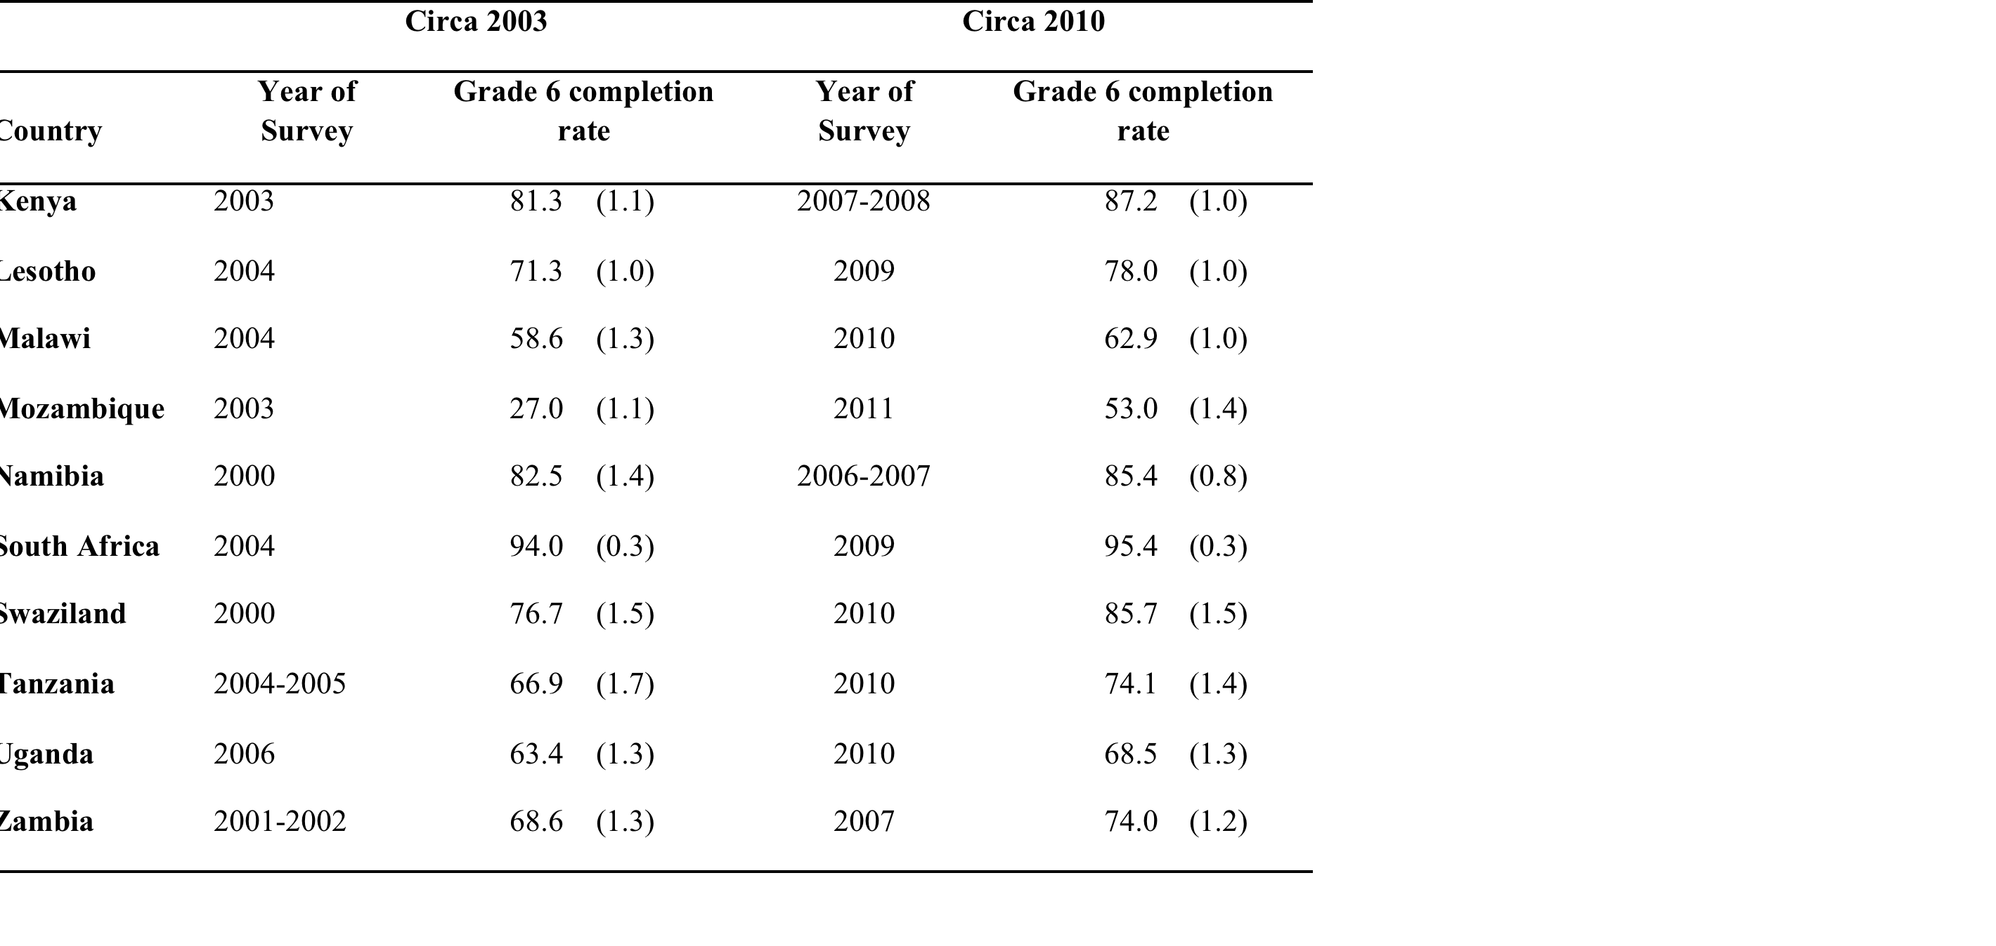
Grade 6 completion rates around 2003 and around 2010 (19-23 year-olds)
Take Mozambique circa 2010:
Gr6 comp rate (DHS): 53%
Gr6 literacy rate (SACMEQ): 79%
Access-to-literacy rate: 42%
Source: Own calculations using DHS, MICS (for Swaziland) and GHS (for South Africa) data
Note: Standard errors in parentheses

Slide 7
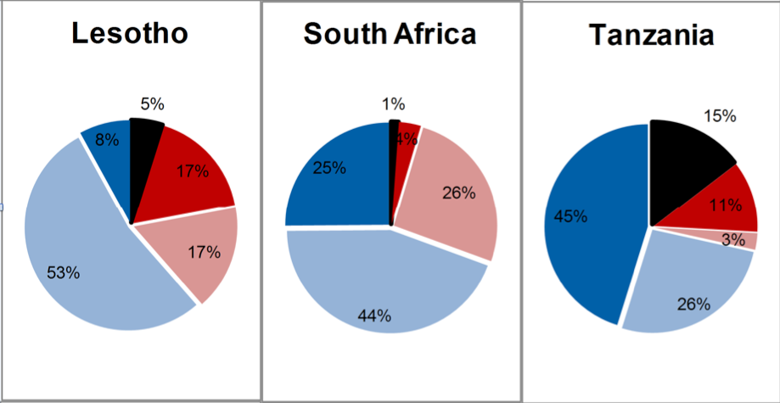
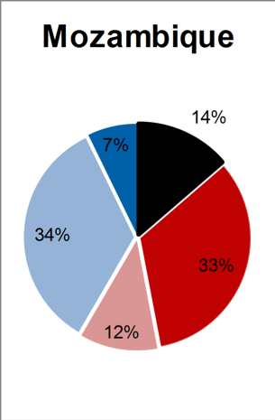
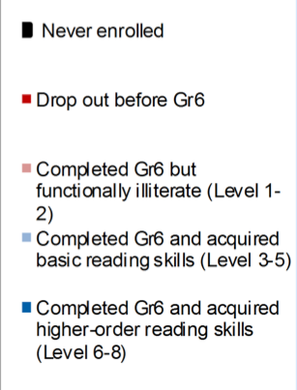
Combining access and quality

Slide 8
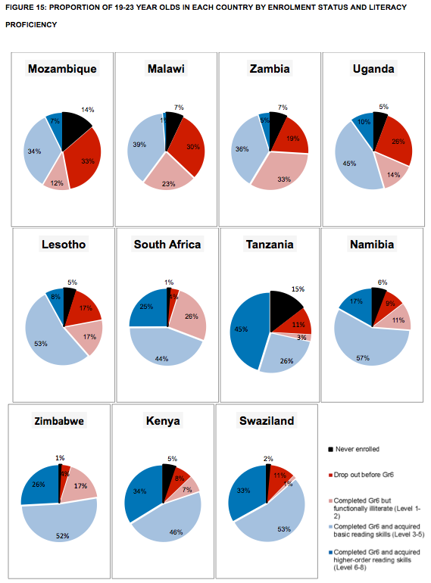
Chapter 4: Access to what? Creating a composite indicator of educational access and educational quality for 11 African countries
Take Mozambique circa 2007:
Gr6 comp rate (DHS): 53%
Gr6 literacy rate (SACMEQ): 79%
Access-to-literacy rate: 42%
Do this for gender and wealth groups
→ Boys, Girls
→ Poorest40%, Middle 40%, Wealthiest 20%
→ Poorest 40% Girls, Poorest 40% Boys
→ Etc..

Slide 9
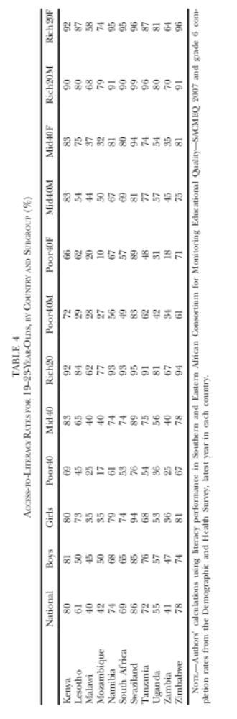
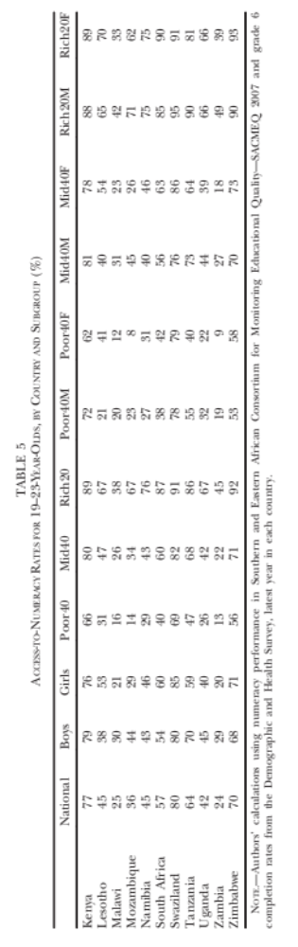
Access to literacy and access to numeracy rates 2007
“The proportion of a cohort of students that complete grade 6 AND acquire basic literacy skills”
15
60
17

Slide 10
Access to what? Creating a composite indicator of educational access and educational quality for 11 African countries
Figure 17: Gaps in Access-to-literacy rates by gender, gender-wealth interaction, and wealth with 95% confidence intervals
SES gaps in A2L are MUCH larger than gender gaps in all countries.
Poorer countries → Boys > girls
(Primarily access story not learning)
Richer countries → Girls > boys
(Primarily a learning story)
Combining access and quality shows the true extent of differences between subgroups (eg Mozambique Poorest=17%A2l, wealthiest=77% A2L).

Slide 11
Moving from a static analysis (CER paper) to an inter-temporal analysis (IJED paper)

Slide 12
Finding #1:
Access to basic learning improved in all countries between 2000 & 2007
Figure 24: Access-to-literacy rates in 2000 and 2007
What proportion of students completed grade 6 and acquired basic literacy skills?
Figure 24: Access-to-NUMERACY rates in 2000 and 2007
What proportion of students completed grade 6 and acquired basic numeracy skills?

Slide 13
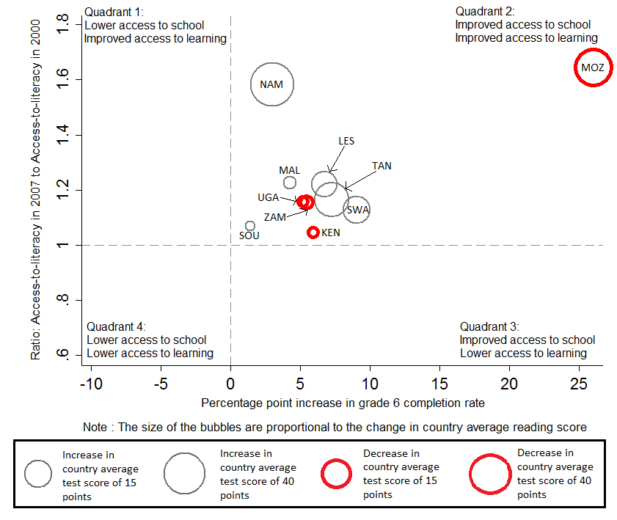
Access to literacy 2000-2007

Slide 14
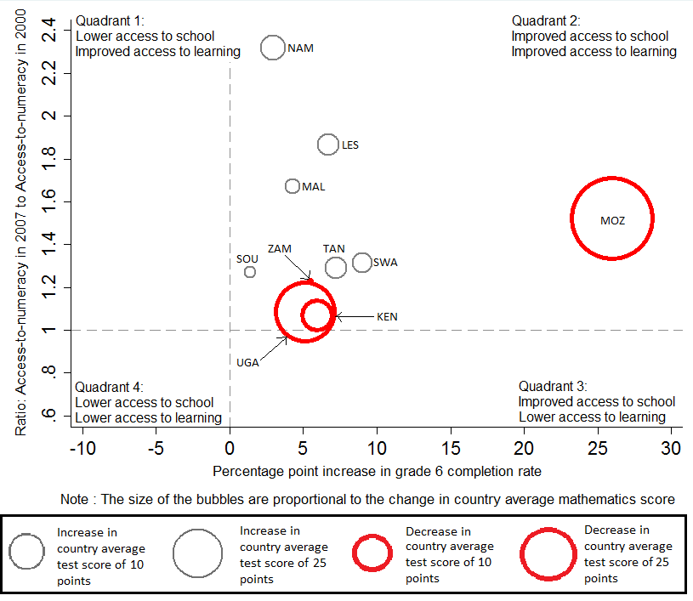
Access to numeracy 2000-2007

Slide 15
Access to literacy (Mozambique)
A lower mode can decrease the average score but still be consistent with overall improvements if there are many more students at every level (as here)

Slide 16
Finding #2:
Girls benefited disproportionately more than boys*
Figure 29: Gender Parity Index with respect to Access-to-literacy in 2000 and 2007
  < 1 = favours boys
  > 1 = favours girls
Figure 30: Gender Parity Index with respect to Access-to-NUMERACY in 2000 and 2007
  < 1 = favours boys
  > 1 = favours girls

Slide 17
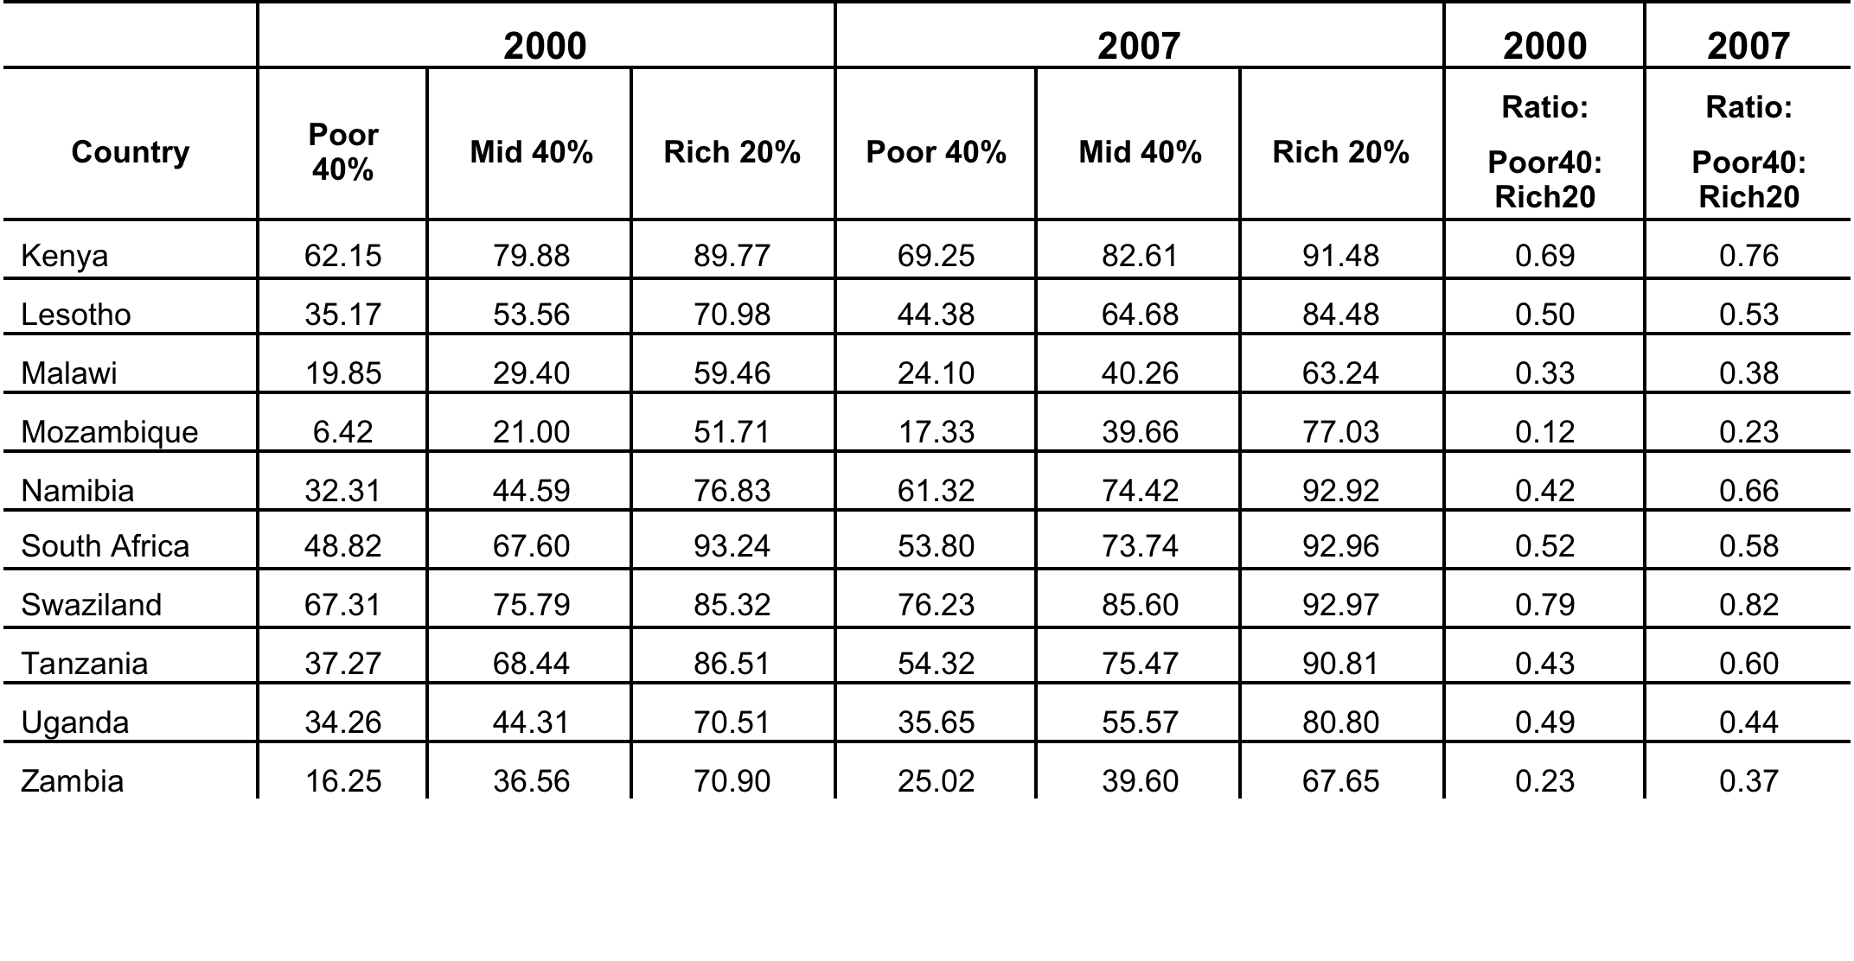
Finding #3:
The poor benefited disproportionately more than the rich

Slide 18
Sensitivity analysis & critiques
CRITIQUE #1: “Perhaps basic skills did improve but it came at the cost of ‘dumbing down’ the curriculum such that fewer students acquired higher-order thinking skills”
  → It doesn’t seem so. In most countries there was also an increase in higher order learning

Slide 19
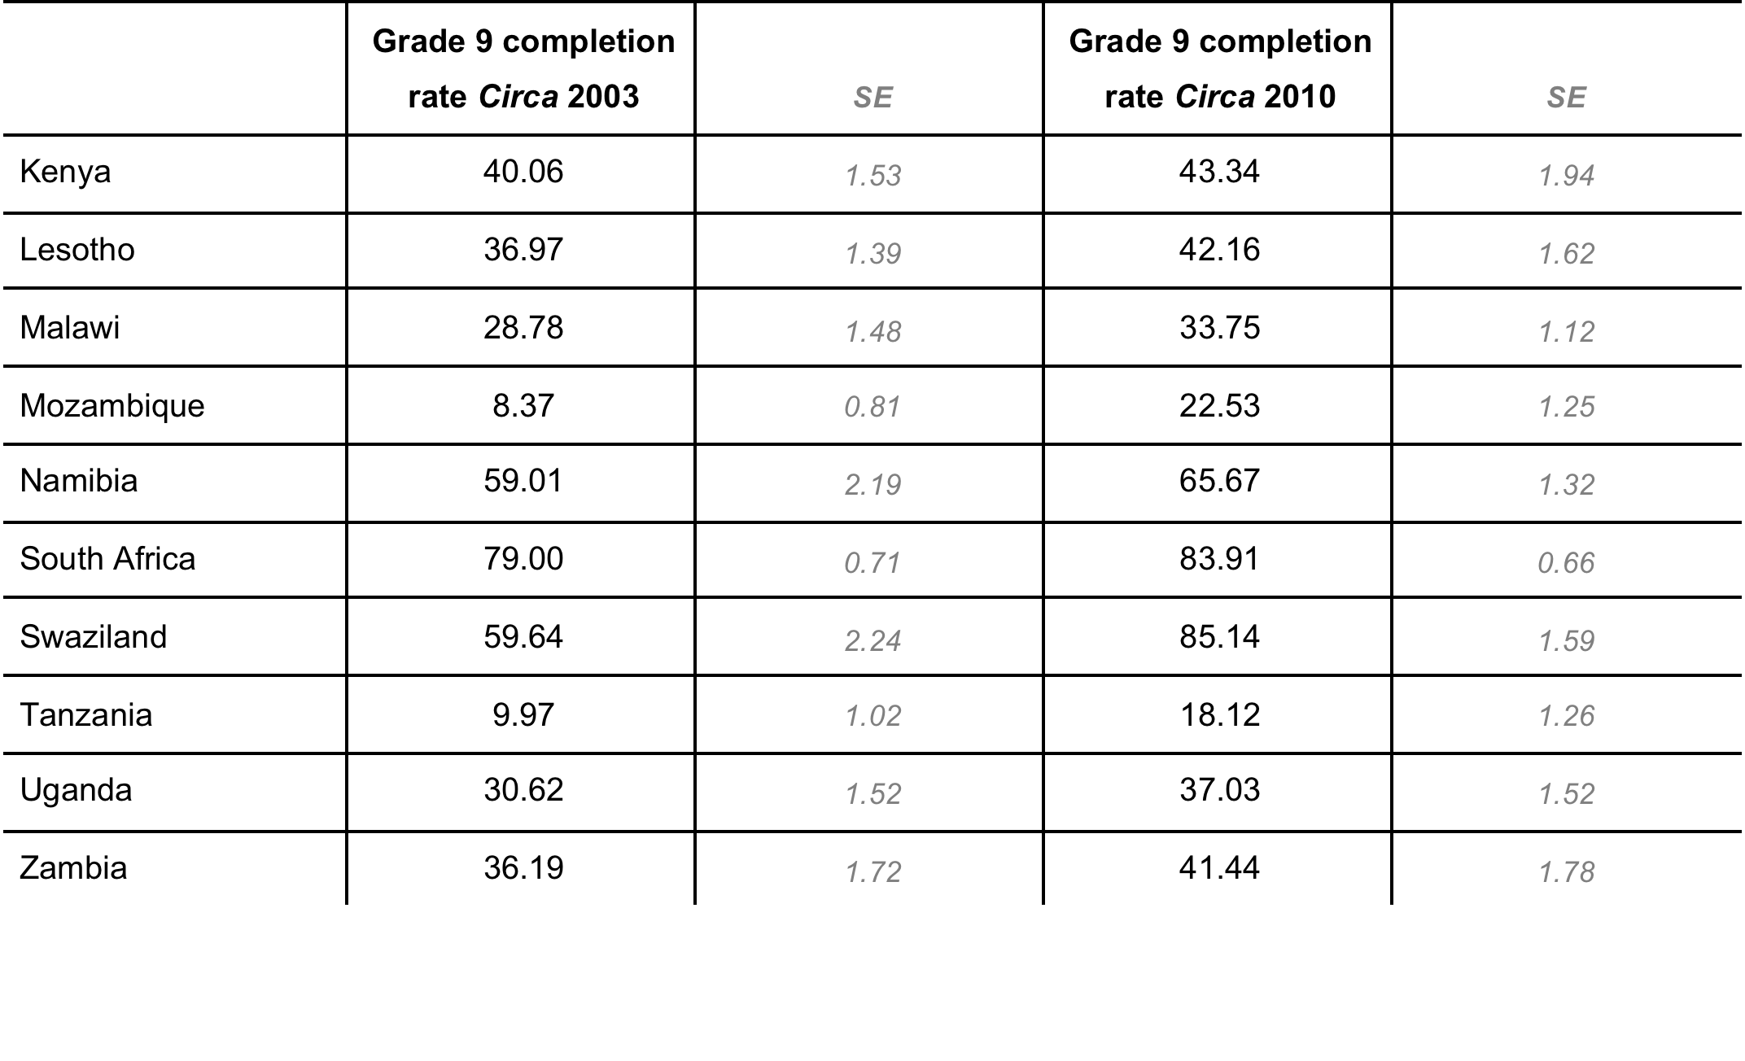
Sensitivity analysis & critiques
CRITIQUE #2: “Perhaps the expansion of access to primary schooling was not accompanied by an expansion of access to secondary schooling creating a bottleneck at the end of primary? Basically delaying dropout. See Lewin (2007) and also Somerset (2007) discussing Kenya 1974 fee abolition.”
  → It doesn’t seem so. All countries had higher Gr9 completion rates in 2007 than in 2000

Slide 20
Sensitivity analysis & critiques
CRITIQUE #3: “Perhaps this is reliant on the fact that you are using DHS data rather than administrative data? Or perhaps due to the uneven spacing of DHS surveys?”
  To check that this is not the case we use the school enrolment data that SACMEQ uses when calculating their sampling frame.
  Using SACMEQ’s ‘rf2’ variable we can calculate the total number of functionally literate and numerate children in the population
    This is essentially an ‘updated’ (more accurate) estimate of grade 6 enrolments
  We then deflate these (to take account of population growth)
    Using the UN medium variant population estimates
  The ratio of A2L-2007/A2L-2000 is always > 1 (same story for numeracy)

Slide 21
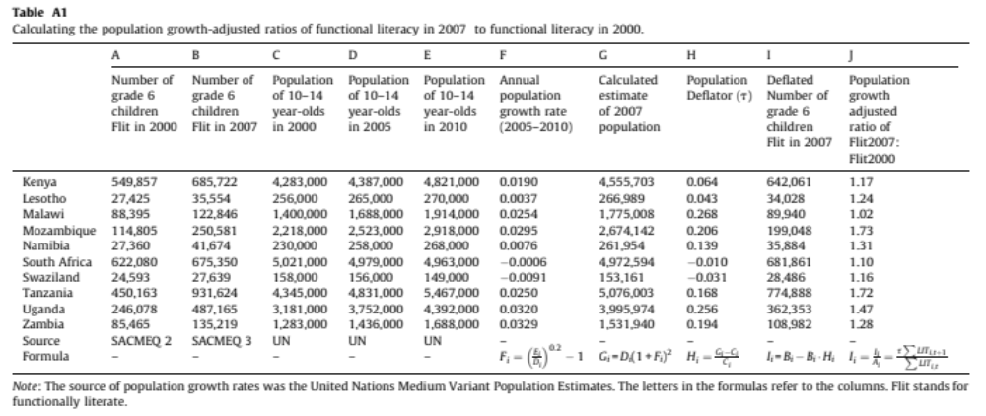
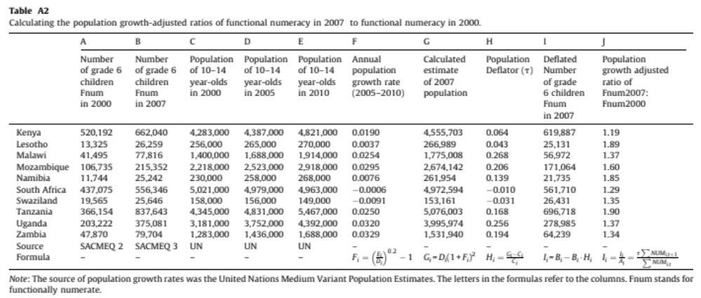

Slide 22
Conclusions
Viewing country average test scores or enrolment rates in isolation is misleading, (esp RE trends)
Delayed age-for-grade progression is very common in SSA. Not taking this into account underestimates access
Education system performance should be reconceptualised as the amount of learning that takes place in the overall population of children (enrolled and non-enrolled)
Expansion of access to primary schooling in these 10 countries contributed to improved access to learning (literacy & numeracy)
  Girls and the poor benefitted disproportionately
  Also accompanied by
    access to higher order literacy and numeracy
    Increased attainment of higher levels of schooling (Gr9 completion)
  Results robust to alternative measure of access (using augmented administrative data) rather than HH survey data
The perception of an access-quality trade-off has less empirical support than was previously thought to be the case
Important to develop these types of statistics for post-2015 MDG

Slide 23
Questions that remain…
How reliable are cross-national assessments of educational achievement in developing countries?
  Higher stakes mean greater incentive to select schools/students. Why hasn’t anyone done any item analysis on SACMEQ along the lines of Jacob and Levitt (2003, QJE)?
Need to triangulate the ‘quick-and-dirty’ assessments like UWEZO and ACER with the more robust assessments like SACMEQ. Are they telling us the same message?
If we believe these results (and at the moment we don’t have reasons not to) we should be figuring out what these countries did
  Swaziland →highly equitable and almost universal acquisition of basic skills of those in school).
  Namibia → MASSIVE increase in functional literacy rates driven by improvements in learning (not enrolment)
  Lesotho → Large increase in functional numeracy rates
  Kenya → high levels of achievement
There needs to be more inter-assessment collaboration with more common items between SACMEQ and TIMSS/PIRLS/PISA to allow for more accurate equating rather than the nonlinear programming approach / bridging of Gustafsson (2013) , Hanushek and Woessman (2008) etc. IRT much better than making strong assumptions about the distributions in each country.

Slide 24
References
Filmer, D. (2010). Educational Attainment and Enrollment around the World. The World Bank. econ.worldbank.org/projects/edattain: Development Research Group.
Filmer, D., & Pritchett, T. (1999). The Effect of Household Wealth on Educational Attainment: Evidence from 35 Countries. Population and Development Review, 25(1), 85-120.
Hanushek, E., & Woessmann, L. (2008). The Role of Cognitive Skills in Economic Development. Journal of Economic Literature, 46(3), 607-668.
Hungi, N. (2010). What are the levels and trends in grade repetition? www.sacmeq.org: Southern and East African Consortium for Monitoring Educational Quality .
Hungi, N., Makuwa, D., Ross, K., Saito, M., Dolata, S., van Capelle, F., et al. (2010). SACMEQ III Project Results: Pupil Achievement Levels in Reading and Mathematics. Paris: Southern and Eastern Africa Consortium for Monitoring Educational Quality.
Lambin, R. (1995). "What can Planners Expect from International Quantitative Studies?" Reflections on Educational Achievement: Papers in Honour of T. Neville Postlethwaite. Waxmann Verlag.
Lewin, K. (2007). Improving Access, Equity and Transitions in Education: Creating a Research Agenda. Co. Sussex: Consortium for research on Educational Access, Transitions and Equity (CREATE).
Lewin, K. (2009). Access to education in sub-Saharan Africa: patterns, problems and possibilities. Comparative Education, 45(2).
Pritchett, L. Towards a New Consensus for Addressing the Global Challenge of the Lack of Education. Copenhagen: Copenhagen Consensus, 2004.
Ross, K., Saito, M., Dolata, S., Ikeda, M., Zuze, L., Murimba, S., et al. (2005). The Conduct of the SACMEQ II Project. In E. Onsomu, J. Nzomo, & C. Obiero, The SACMEQ II Project in Kenya: A Study of the Conditions of Schooling and the Quality of Education. Harare: SACMEQ.
SACMEQ. (2010). SACMEQ III Project Results: Pupil Achievement Levels in Reading and Mathematics. Retrieved January 2011, from Southern and Eastern Africa Consortium for Monitoring Educational Quality: http://www.sacmeq.org/downloads/sacmeqIII/WD01_SACMEQ_III_Results_Pupil_Achievement.pdf
Sen, A. (1999). Development as Freedom. Oxford: Oxford University Press
UIS. (2009). Global Education Digest 2009: Comparing Education Statistics Across the World. Montreal: UNESCO Institute for Statistics.
UNESCO. (2005). Education For All Global Monitoring Report 2005. Paris: UNESCO Publishing.

Slide 25
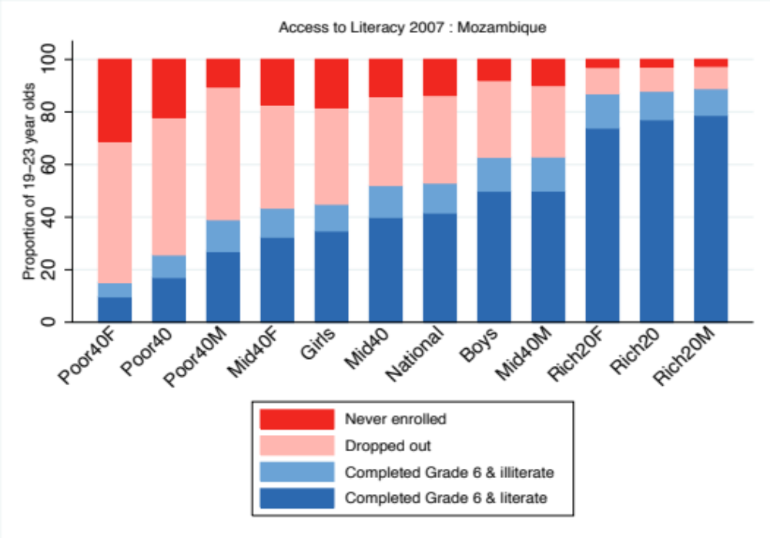
Figure 19: Access to literacy rates for Mozambican sub-groups (DHS 2011, SACMEQ 2007)

Slide 26
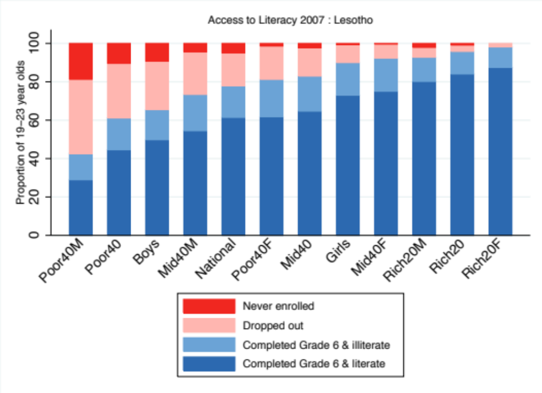
Figure 22: Access to literacy for Lesotho 19-23 year old sub-groups (DHS 2009, SACMEQ 2007)

Slide 27
Publications
  Spaull, N., and Taylor, S. (2015). Access to what? Creating a composite measure of educational quantity and educational quality for 11 African countries. Comparative Education Review. Vol. 58, No. 1.
  Taylor, S., and Spaull, N. (2015). Measuring access to learning over a period of increased access to schooling: The case of Southern and Eastern Africa since 2000. International Journal of Educational Development. (accepted)

Slide 28
Figure 23: Grade 6 completion differential (access) and numeracy and literacy differential (quality) between richest 20% and poorest 40% of students with 95% confidence interval (all calculations are Richest 20% minus Poorest 40%)

Slide 29
Research questions
In each country what proportion of children:
  …never enrol,
  …enrol but drop out prior to grade 6,
  …enrol and survive to grade 6 but remain functionally illiterate and functionally innumerate,
  …enrol and survive to grade 6 and acquire basic numeracy and literacy skills,
  …enrol and survive to grade 6 and acquire higher order numeracy and literacy skills.
In each country how do the proportions of children identified above differ by the sub-national categories of:
  geographical location (urban and rural),
  gender (boys and girls),
  wealth (poorest 40%, middle 40% and wealthiest 20%), and
  a gender-wealth interaction (poorest 40% of girls compared to poorest 40% of boys, middle 40% of girls compared to middle 40% of boys, and wealthiest 20% of girls compared to the wealthiest 20% of boys).

Slide 30
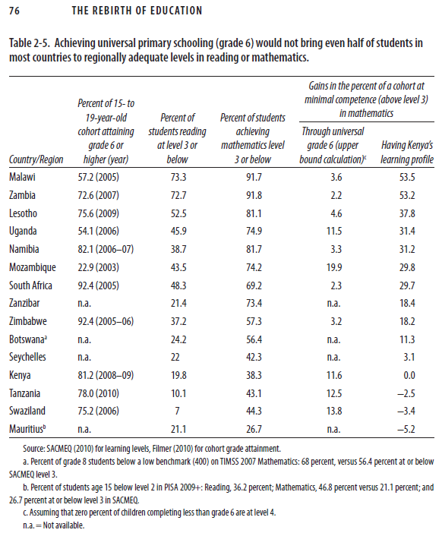
Measures of access
  % of 15-19 year old cohort attaining grade 6 or higher (Pritchett, 2013) →
  NAR for median aged Gr6 students in SACMEQ (Spaull & Taylor, 2012)
  Grade survival probabilities to Grade 6 (Filmer, 2007)

Slide 31
Measure of access: Kaplan-Meier survival probabilities
“Starting from a cohort of children and youth (aged 10 to 19 in this case) one can estimate the probability that each has completed grade 1. Among those, one can derive the probability that each has completed grade 2 and so on. Multiplying these probabilities results in what is known as the Kaplan-Meier survival probabilities and yields the expected probability that a child or youth will complete a given grade. The method implicitly accounts for the fact that some in the cohort are still in school and will ultimately complete a higher grade than they are currently observed to be in” (Filmer, 2007, p. 166).

Slide 32

Differential access by subgroups
Different enrolment & achievement profiles for different sub-groups of the national population (averages shroud inequalities)
  Urban vs Rural (multiply enrolment and literacy rates)
  Boys vs Girls (multiply enrolment and literacy rates)
  Wealthy vs Poor (CANNOT simply multiply enrolment and literacy rates)

Slide 33
A trade-off between access & quality?
The numbers of grade 6 children reaching each level of achievement: Mozambique reading
Population growth (2000-2007) 20.6%.
Notes:
RF2 is used to estimate the population figures.
The rf2 factor is based on the inverse of the probability of selection of the sample members and makes the total weighted number of students equal to the ESTIMATED population size.
The calculation of rf2 includes taking account of the actual numbers of Grade 6 pupils in a school at the time of the actual data collection (as well as the number from the school census). It also includes attempts at adjustments for missing data due to non-response.
The main message is that rf2 is a mixture of school census and sample data and adjustments for non-response. You should therefore treat it as a sampling weight that provides estimates of the population figures. Estimates using rf2 as a sample weight will have sampling errors and confidence limits (just as estimates using pweight2 have sampling errors and confidence limits). These can be estimated via the complex sampling options in STATA
Distribution of this graph will influence whether there was an increase in the average SACMEQ score or a decrease

Slide 34
A trade-off between access & quality?
The numbers of grade 6 children reaching each level of achievement: Kenya reading
Population growth (2000-2007) 6.3%.

Slide 35
A trade-off between access & quality?
The numbers of grade 6 children reaching each level of achievement: Tanzania maths
Population growth (2000-2007) 16.8%.

Slide 36
A trade-off between access & quality?
The numbers of grade 6 children reaching each level of achievement: Uganda maths
Population growth (2000-2007) 25.6%.

Slide 37
A trade-off between access & quality?
The numbers of grade 6 children reaching each level of achievement: Malawi reading
Population growth (2000-2007) 26.8%.
Notes:
Malawi is kind of the opposite scenario: It did slightly worse in 2007 (although one shouldn’t over-read into it) despite having a higher SACMEQ average score. So the drop in the numbers reaching every level was due to lower enrolment.

Slide 38
Comments, suggestions & questions welcome

Slide 39
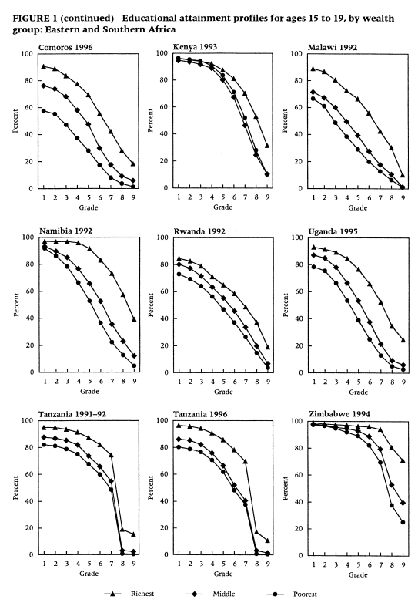
Filmer & Pritchett 1999

Slide 40
Functionally literate/numerate
  If a student reaches Level 3 for Reading and Mathematics, they are classified as being functionally literate and functionally literate.
  If not, they are classified as functionally illiterate and functionally innumerate. By this definition, a functionally illiterate learner cannot read a short and simple text and extract meaning, while a functionally innumerate learner cannot translate graphical information into fractions or interpret everyday units of measurement.
  An important innovation in the paper is our assumption that grade-6 aged students that are not attending school (due to dropout or non-enrolment) are functionally illiterate and functionally innumerate….this allows us to combine access (binary) and quality (continuous) variables.
  See Shabalala, 2005: p222
Basic reading (L3)
Interprets meaning (by matching words and phrases, completing a sentence, or matching adjacent words) in a short and simple text by reading on or reading back.
Basic numeracy (L3)
Translates verbal information presented in a sentence, simple graph or table using one arithmetic operation in several repeated steps. Translates graphical information into fractions. Interprets place value in whole numbers up to thousands. Interprets simple common everyday units of measurement.

