Slide 1



An Overview and Interrogation of the
Annual National Assessments (ANAs) in South Africa
Nic Spaull
Catholic Parliamentary Liaison Office (CPLO) Roundtable Discussion
4 May 2015

Slide 2
Questions we would like to answer
What are the ANAs?
When and why were they implemented?
What are their strengths and weaknesses?
What can (and can’t) they show us?
What can (and should) we use them for?
  As they stand now and in the future
What should we be focusing on for the road ahead?

Slide 3
1) What are the ANAs?
The ANAs are a set of nationally standardised exams covering grades 1-6 and 9 testing numeracy/mathematics and literacy/language.
There are meant to be 2 types of the ANAS:
  Universal ANA – all students in government (and state-subsidised independent schools) write the ANAs. They are invigilated by teachers within the school and marked by teachers within the school.
  Verification ANA – A nationally-representative sample of schools are randomly selected where there are additional moderating/verifying procedures conducted at grades 3, 6 and 9 by an independent agent. In the past this has been conducted by the HSRC (2011) and Deloitte (2013). There was no verification process in 2012 because the tender for service providers went out too late.
    Verification ANA also includes a number of background questionnaires which are answered by students, teachers and principals. Questions about resources, workbooks/textbooks, curriculum coverage, training, confidence, school management etc.
Notes:
ANA 2014 report - http://www.education.gov.za/LinkClick.aspx?fileticket=ajR9otls4HM%3d&tabid=569&mid=2131

Slide 4
2) When were they implemented?
The ANAs have been done 4 times:
  2009 → ANAs piloted in almost 1000 schools
  2010 → Provincial departments agreed to test all students in grades 1-6.
  2011 → Tested grades 1-6 early in 2011 on 2010 content (i.e. previous grade)
  2012 → Tested grades 1-6 (sample of grade 9’s tested)
  2013 → Tested grades 1-6 and 9
  2014 → Tested grades 1-6 and 9 (sample of grades 7 and 8’s tested)
  2015 → Will test grades 1-9 (?)
To give an idea about the huge scale of this operation, in 2014 there were 7,376,334 students from 24,454 schools. Next to the Census this is the largest data-collection exercise that we undertake in SA
“Special schools” also participate with adapted tests. In 2014 116 special schools participated with 11837 learners

Slide 5
2b) Why were they implemented?
There are differing views on the purpose/function of the ANAs:
  High-level: At DBE they are mainly seen as a tool for increased accountability (summative assessment)
  Ground level: At province and school level, people want ANAs to fill a more diagnostic role → informing classroom practice (summative and formative assessment)
Accountability and support
Need for primary school exam.
  Leading up to the ANAs there was a growing acknowledgement that there needed to be a national assessment at earlier grades. Both to identify when children are falling behind, and to hold primary schools accountable.
Need for more consistent marking.
  There was also considerable qualitative and anecdotal evidence to show that primary-school teachers were not assessing at the correct level. A grade 5 teacher was setting tests at a grade 2 level.
ANA should encourage teachers to assess learners using appropriate standards and methods
ANA should encourage better targeting of support to schools
ANA should encourage the celebration of success schools
ANA should encourage greater parental involvement in improving the learning process

Slide 6
Stages in accountability movements
3) Holding accountable
2) Measuring achievement
1) Setting standards
1
Defining what students should learn
2
3
Testing to see what students have learned
Making results count
CAPS
ANA
???
Loveless, (2005: 7)

Slide 7
Problem of independence
The DBE sets the tests
The DBE marks the tests
The DBE reports the results
The ANAs currently lack independence. Unlike with the matric exams which have an independent quality-assurance body (Umalusi), the ANAs have nothing. V-ANA not currently fit for that purpose.
Incentive for the Minister to ensure that the ANA results improve given that he/she has a performance agreement with the president linked to ANA performance
The bureaucratic functioning of the ANA system is tainted by politics because it has been used for political purposes before it is of sufficient quality & independence to do so.

Slide 8
3) What are their strengths and weaknesses?
Strengths
Raising the profile of discourse around performance standards
Increased attention on primary schooling
Aligning of marking practices to a standardized level
Some indication of what learning (and how much) is taking place
Development of institutional capacity to run a large-scale testing system and to analyze the data coming from it
Weaknesses
Non-standard implementation
Evidence of cheating, particularly in some provinces (ECA)
ANAs are not comparable across grades (i.e. grade 3 to 4) or across cycles of ANA (i.e. 2013 to 2014). If ANAs are to be used for higher-stakes decision making (for schools or students) they MUST be comparable. (NB!!)
Teaching to the test and the narrowing of the curriculum: “ANA Fridays”
ANA tests yielding results that contradict well-established findings from SA research. Major problems in FP. ANAs show opposite.
No item-level data capturing (except for V-ANA) which is necessary for statistical adjustments
No rational benchmarking. Currently no methodological justification for interpreting student scores relative to standards. DBE assumes 50% maps to “adequate achievement” but no rationale.
7-categories of achievement have no basis for interpretation

Slide 9
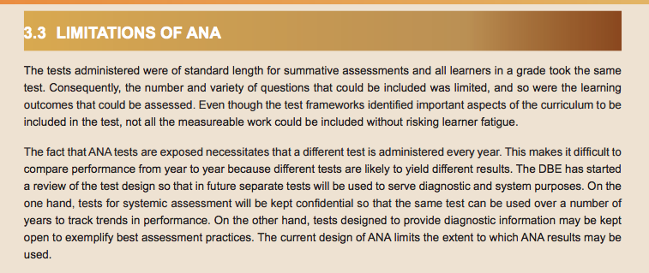
From ANA 2014 report
However, the report then goes on to make many explicit comparisons… ☹
Notes:
http://www.education.gov.za/LinkClick.aspx?fileticket=ajR9otls4HM%3d&tabid=569&mid=2131

Slide 10

3) What can and can’t they show us?
The can show us…
Which children are performing better/worse on the test within a class
  provided the teacher marks uniformly across students.
Which classes are performing better/worse on the test within a school
  provided the schools’ marking procedures are standard across classes
Which schools are performing better/worse on the test within a province or between provinces
  Provided that schools’ marking procedures are standard within provinces and between provinces
They can’t show us…
Improvements or deteriorations over time. For this there need to be anchor items and psychometric analysis (IRT/Rasch) to make tests comparable.
Improvements or deteriorations across the grades.
For further discussion on this read:
“Assessment results don’t add up”
  [M&G, 12 Dec 2014]
“Assessment results don’t make sense”
  [M&G, 13 Dec 2013]
“Improved annual national assessment results impossible, say academics”
  [M&G, 7 Dec 2012]
Notes:
“Assessment results don’t add up”
[M&G, 12 Dec 2014]
http://mg.co.za/article/2014-12-12-assessment-results-dont-add-up/
“Assessment results don’t make sense”
[M&G, 13 Dec 2013]
http://mg.co.za/article/2013-12-05-ana-results-are-not-comparable
“Improved annual national assessment results impossible, say academics”
[M&G, 7 Dec 2012]
http://mg.co.za/article/2012-12-07-improved-annual-national-assessment-results-impossible-say-academics

Slide 11
4) What can and should we use them for?
We can (and should) use them to teach teachers how and why to assess students
We should use the ANA results to give information to parents on the achievement of their children (can’t and shouldn’t do this yet)
We should use them to identify what learning areas students are battling with (but can’t as they currently stand)
We should be providing district officials, principals and teachers with useful actionable information on their schools/teachers/students

Slide 12
5) What should we be focusing on for the road ahead?
Better reporting and communication
Better articulation of what the ANAs will and won’t be used for and how teachers should and shouldn’t see/use them.
Better reporting to schools and teachers
  Current reports don’t provide guidance/direction on what to focus on and what to improve
  Current reports are not sufficiently differentiated (Provincial, district, principal, teacher, student).
Stop talking about “improvements” and “deteriorations” when the ANAs do not (and currently cannot) show changes over time or grades
Do not use ANA results to reward or punish principals or teachers. They can be used to target interventions if they consistently show low performance.
More rigorous test-setting and adjusting procedures
Use local and international experts that understand psychometric testing to make tests comparable.
Develop an item-bank of questions per subject per grade and index them to curricular learning objectives
Foster greater collaboration between DBE departments that deal with (1) curriculum, (2) ANAs and (3) the workbooks, to ensure alignment.
Logistical concerns
Verification-ANA tenders need to be requested earlier
Bigger issues to think about
Do we really need an ANA test at every grade? Why not V-ANA all schools annually at grades 3, 6 and 9 and then all grades every 3 years?
Should ANA be institutionalized outside of the DBE to ensure independence and continuity (like Umalusi). Perhaps in NEEDU?

Slide 13
Questions for discussion...
A number of important questions need to be answered before strengthening existing accountability mechanisms, or introducing new accountability mechanisms. Some of these questions include:
What can the international literature point to as possible ‘red-flags’ or ‘early-warning-signs’ for unintended consequences resulting from tightening accountability mechanisms?
What will be the effect of empowering parents with understandable information about their child’s ANA performance?
  Do we know how they will react to this? Predictable?
How will the specific South African context (low teacher competence and strong unions) influence the emergent form of accountability in South Africa?
To what extent does the national Department of Basic Education possess the resources (financial and human) to successfully implement, monitor and adjust new accountability mechanisms?
What combination of accountability mechanisms could South Africa implement to raise the quality of education with limited unintended consequences?

Slide 14
Major conclusions
The ANAs are a very important part of our education system. They should not be scrapped but should be improved.
Need to pay more attention to comparability issues and be clear on what we can and can’t say using them. Psychometrics/communication/reporting. Need for more institutional capacity.
Currently an independence issue given that the ANAs are written, marked and reported on by the DBE, who also uses these for political purposes (claims of improvements)
Current ANA results suggest the real flaw in the system is higher up (Gr7/8) rather than lower down (Gr1-3) which is what most other research suggests. This is not helpful. Real focus needs to be on getting foundations right in grades 1-3.
Question of whether the resources needed to undertake ANA properly mean that we should just test grades 3, 6 and 9 but do it properly rather than grades 1-9 and do it poorly.

Slide 15
(If time) Some examples of analysis using ANA data

Slide 16
ANA vs Systemic 2011
 |  | ANA 2011 Rankings (Deciles) based on average across 6 grades (lit and num)
 |  | 1 | 2 | 3 | 4 | 5 | 6 | 7 | 8 | 9 | 10
WCED 2011 Rankings (Deciles) based on average across Gr3 and Gr6 (lit and num) | 1 | 40 | 19 | 12 | 4 | 9 | 2 | 2 | 2 | 1 | 0 | 91
 | 2 | 21 | 25 | 14 | 13 | 5 | 6 | 2 | 4 | 0 | 0 | 90
 | 3 | 11 | 19 | 21 | 17 | 10 | 8 | 4 | 1 | 0 | 0 | 91
 | 4 | 5 | 13 | 15 | 19 | 12 | 18 | 6 | 2 | 0 | 0 | 90
 | 5 | 8 | 8 | 18 | 17 | 15 | 14 | 7 | 4 | 0 | 0 | 91
 | 6 | 2 | 4 | 8 | 14 | 24 | 21 | 12 | 5 | 0 | 0 | 90
 | 7 | 1 | 2 | 2 | 10 | 16 | 18 | 27 | 14 | 1 | 0 | 91
 | 8 | 0 | 0 | 0 | 1 | 2 | 7 | 27 | 40 | 13 | 0 | 90
 | 9 | 0 | 0 | 0 | 0 | 0 | 0 | 2 | 11 | 55 | 23 | 91
 | 10 | 0 | 0 | 0 | 0 | 0 | 0 | 0 | 0 | 19 | 71 | 90
 | Total | 88 | 90 | 90 | 95 | 93 | 94 | 89 | 83 | 89 | 94 | 905

Slide 17
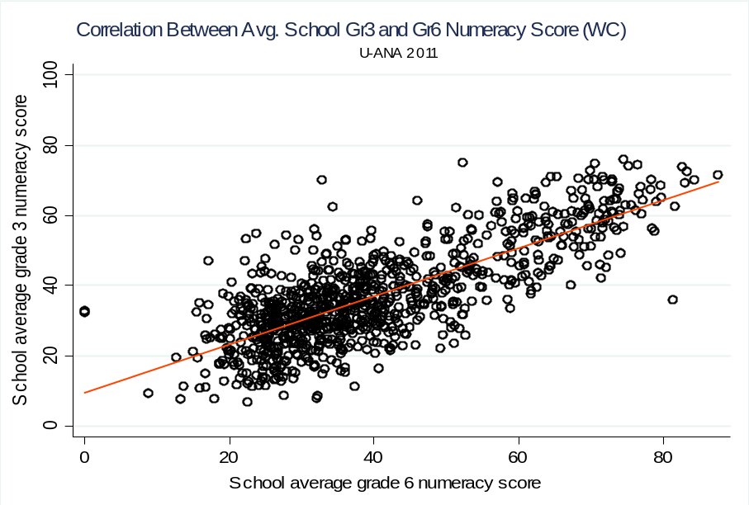
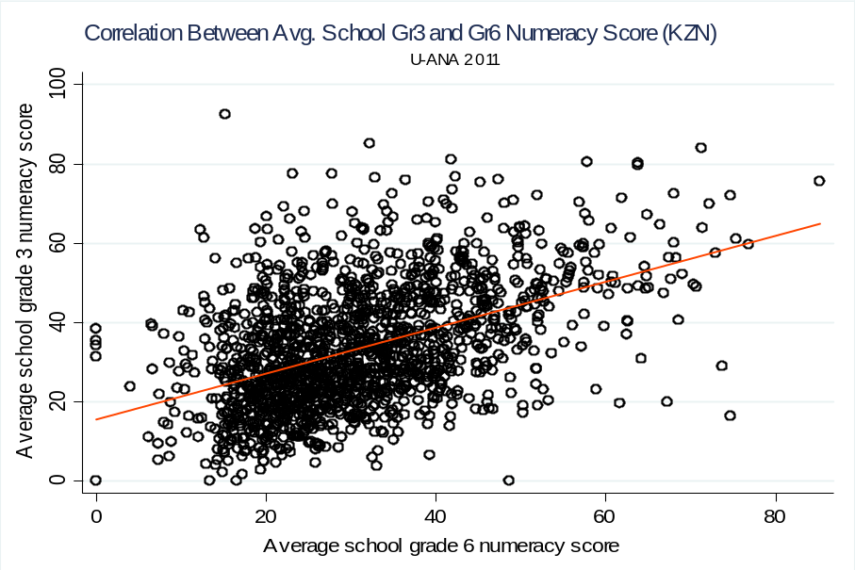
Inter-grade correlations
0.82 0.51
“The fact that learning is supposed to occur in schools is no guarantee that it actually
does, nor does the existence of the school as an organization assure that the learning
that occurs in one classroom bears any necessary relationship to that which occurs in
any other classroom” (Elmore, 2004a, p. 9).

Slide 18
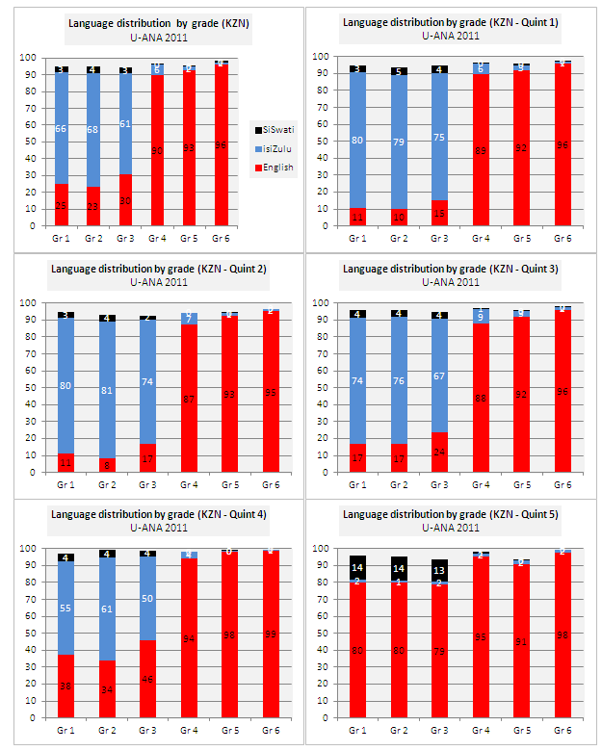
Language by grade/quintile (KZN)

Slide 19
School classification
Identify schools that need support
Identify and reward excellence
Creating discrete categories allows administrators to create partially-generic solutions
    Parallel with student scores ranging from 1-100 versus competency levels → functionally illiterate.
    Cost savings and can avoid the “schools are infinitely complex” booby-trap which tends to imply bespoke solutions for EVERY school and paralyzes policy-makers and principals
Technicalities
    Exclude grades were there are less than 10 students
    Exclude schools where there are less than 6 grade scores across numeracy and literacy
    i.e. avoid misclassification based on small sample size. Ideal is multiple years.

Slide 20
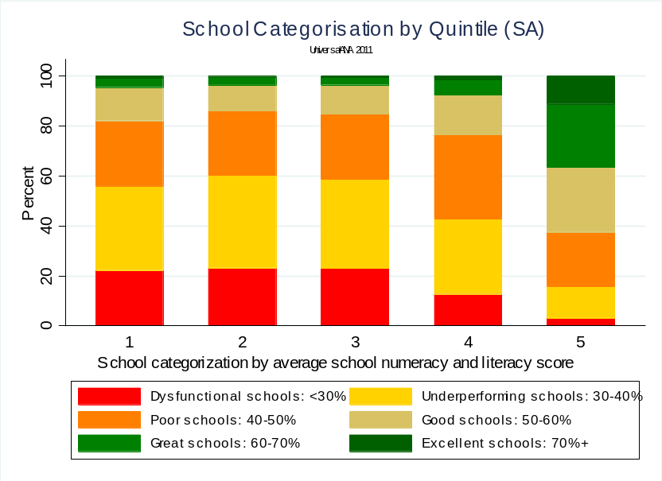
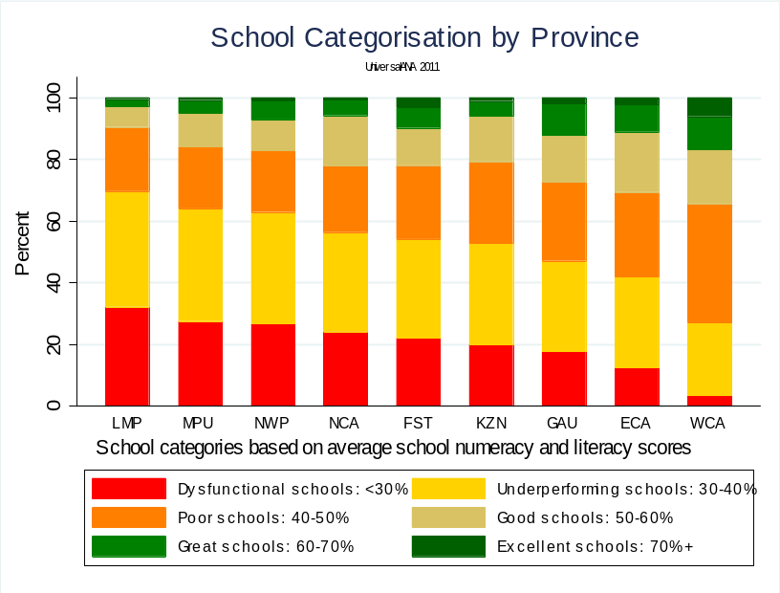
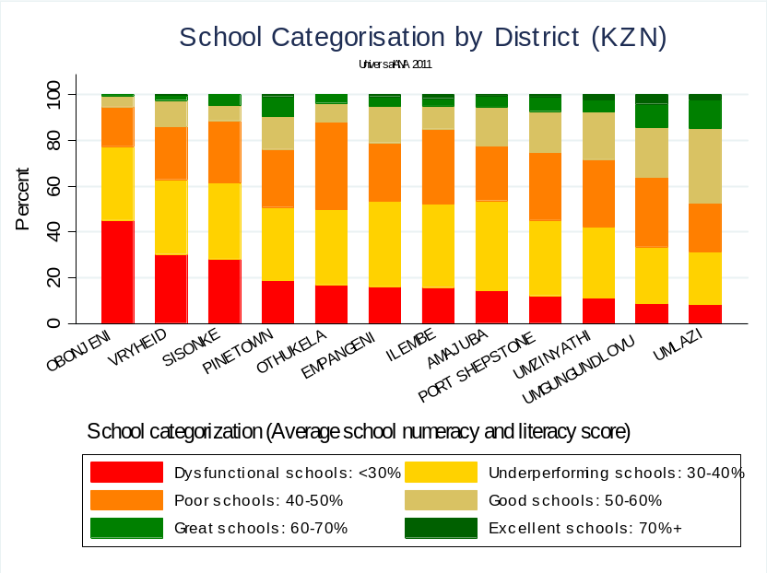
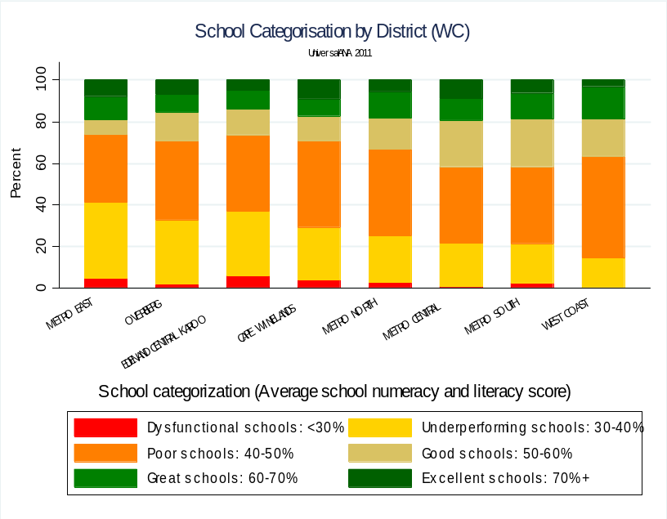
Quintile
Province
District
District
Notes:
Please note that the provincial rankings are REALLY suspect

Slide 21

Proportion of ANA data captured per province 2011
 | EC | FS | GP | LP | MP | NC | NW | WC | ZN | All
Information relating to duplicate records
Number of records | 135 396 | 257 443 | 750 177 | 190 958 | 133 757 | 121 479 | 117 588 | 477 654 | 677 575 | 2 862 027
Number of unique learners identified by province, EMIS number, grade, ID number, DOB, surname, name, literacy score, numeracy score | 132 030 | 257 431 | 493 218 | 186 327 | 130 809 | 121 003 | 109 557 | 477 640 | 641 890 | 2 549 905
Unique learners / records | 98% | 100% | 66% | 98% | 98% | 100% | 93% | 100% | 95% | 89%
Indicators relating to the completeness of the data
Schools offering some grades in Grades 1 to 6 range (EMIS 2010 ASS) | 4 721 | 1 098 | 1 405 | 2 577 | 1 310 | 453 | 1 095 | 1 132 | 4 235 | 16 168
Schools in the ANA dataset | 1 109 | 895 | 781 | 1 452 | 720 | 434 | 450 | 1 124 | 3 059 | 10 024
Schools in dataset / Estimated target schools | 23% | 82% | 56% | 56% | 55% | 96% | 41% | 99% | 72% | 62%
Non-random returns means SERIOUS sample selection issue

Slide 22
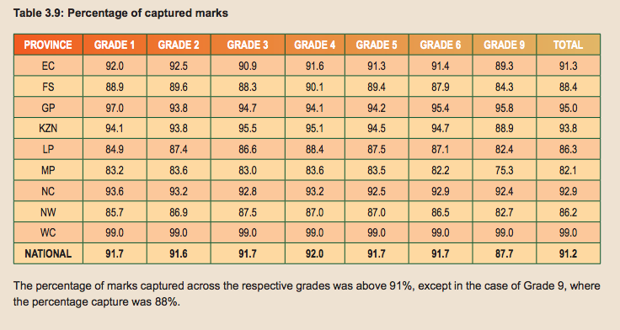
Marks captured in 2014

Slide 23
School classification
Number of schools per school quintile by school categorization
School categorization by average school numeracy and literacy score | School quintile
 | Q1 | Q2 | Q3 | Q4 | Q5 | Total
Dysfunctional schools: <30% | 571 | 390 | 355 | 119 | 28 | 1463
Underperforming schools: 30-40% | 866 | 625 | 550 | 280 | 113 | 2434
Poor schools: 40-50% | 673 | 435 | 402 | 314 | 193 | 2017
Good schools: 50-60% | 344 | 171 | 180 | 148 | 229 | 1072
Great schools: 60-70% | 95 | 56 | 48 | 57 | 226 | 482
Excellent schools: 70%+ | 27 | 8 | 11 | 16 | 102 | 164
Total | 2576 | 1685 | 1546 | 934 | 891 | 7632

Slide 24
Dysfunctional & Excellent schools

Slide 25
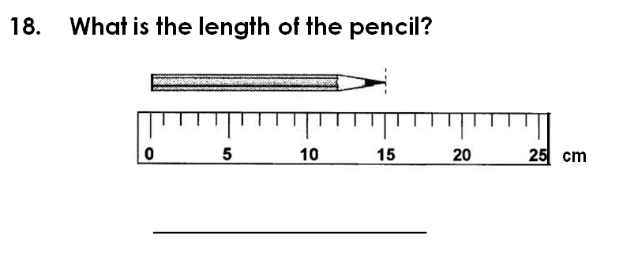
Grade 3 Numeracy
(V-ANA 2011)
Correct answer (15cm): 40% of Gr 3 students
Verification ANA | Quintile
Gr3 Numeracy (Quest 18) | 1 | 2 | 3 | 4 | 5 | Total
Wrong | 63% | 68% | 63% | 57% | 42% | 60%
Right | 37% | 32% | 37% | 43% | 58% | 40%
Total | 100% | 100% | 100% | 100% | 100% | 100%
Notes:
Introduction to formal measurement (using cm’s) is in the CAPS documentation for grade 3 numeracy and this is BEFORE the LOLT switch in grade 4

Slide 26
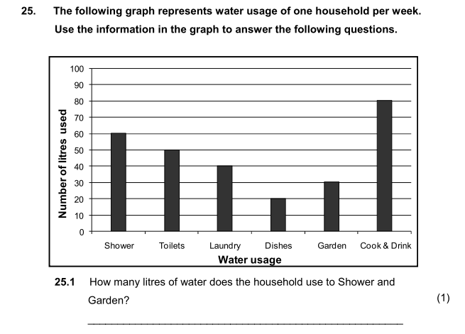
Grade 6 Numeracy
(V-ANA 2011)
Correct answer (90 litres): 32% of Gr 6 students
Verification ANA 2011 | Quintile
Gr6 Numeracy (Quest 25.1) | 1 | 2 | 3 | 4 | 5 | Total
Wrong | 74% | 75% | 70% | 68% | 50% | 68%
Right | 26% | 25% | 30% | 32% | 50% | 32%
Total | 100% | 100% | 100% | 100% | 100% | 100%
Notes:
If we interpret this using SACMEQ’s framework this is a relatively low level task (Level 4: Beginning Numeracy) which requires students to “Translate verbal or graphic information into simple arithmetic problems” See Hungi et al (2011)

Slide 27
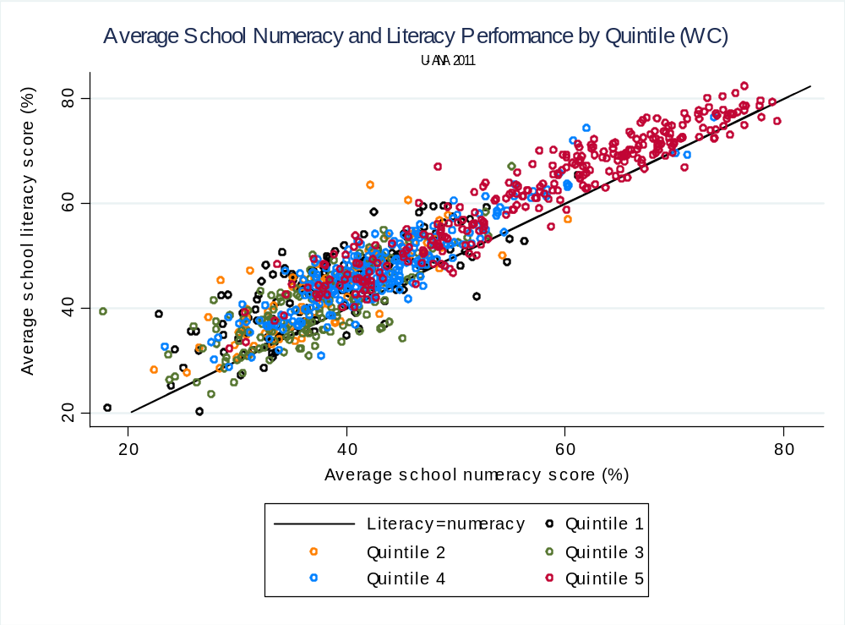

Slide 28
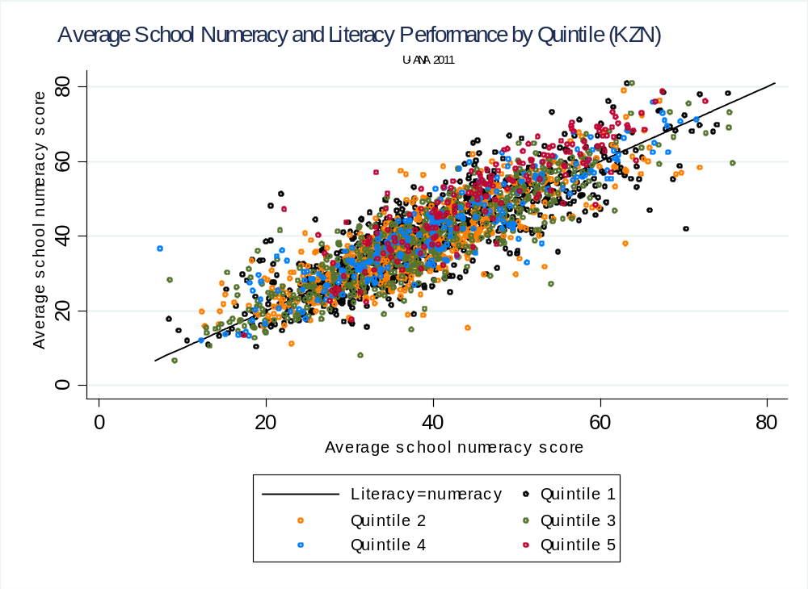

Slide 29
KwaZulu-Natal province: Correlations between average grade performance within a school
 |  | Literacy |  |  |  |  |  | Numeracy
 |  | Gr1 | Gr2 | Gr3 | Gr4 | Gr5 | Gr6 | Gr1 | Gr2 | Gr3 | Gr4 | Gr5 | Gr6
Literacy | Gr1 | 1.00
 | Gr2 | 0.47 | 1.00
 | Gr3 | 0.35 | 0.44 | 1.00 |  |  |  |  | Number of schools: 1145
 | Gr4 | 0.44 | 0.44 | 0.54 | 1.00
 | Gr5 | 0.44 | 0.44 | 0.51 | 0.76 | 1.00
 | Gr6 | 0.42 | 0.41 | 0.52 | 0.71 | 0.76 | 1.00
Numeracy | Gr1 | 0.69 | 0.37 | 0.31 | 0.33 | 0.29 | 0.30 | 1.00
 | Gr2 | 0.45 | 0.69 | 0.45 | 0.45 | 0.43 | 0.39 | 0.44 | 1.00
 | Gr3 | 0.36 | 0.42 | 0.71 | 0.57 | 0.52 | 0.54 | 0.33 | 0.49 | 1.00
 | Gr4 | 0.42 | 0.43 | 0.57 | 0.73 | 0.66 | 0.62 | 0.34 | 0.45 | 0.65 | 1.00
 | Gr5 | 0.40 | 0.42 | 0.52 | 0.66 | 0.75 | 0.66 | 0.31 | 0.45 | 0.57 | 0.70 | 1.00
 | Gr6 | 0.39 | 0.38 | 0.48 | 0.62 | 0.68 | 0.72 | 0.27 | 0.39 | 0.51 | 0.63 | 0.72 | 1.00
Western Cape province: Correlations between average grade performance within a school
 |  | Literacy |  |  |  |  |  | Numeracy
 |  | Gr1 | Gr2 | Gr3 | Gr4 | Gr5 | Gr6 | Gr1 | Gr2 | Gr3 | Gr4 | Gr5 | Gr6
Literacy | Gr1 | 1.00
 | Gr2 | 0.73 | 1.00
 | Gr3 | 0.64 | 0.70 | 1.00 |  |  |  |  | Number of schools: 924
 | Gr4 | 0.76 | 0.73 | 0.74 | 1.00
 | Gr5 | 0.77 | 0.71 | 0.71 | 0.88 | 1.00
 | Gr6 | 0.73 | 0.70 | 0.71 | 0.86 | 0.88 | 1.00
Numeracy | Gr1 | 0.84 | 0.68 | 0.65 | 0.67 | 0.66 | 0.64 | 1.00
 | Gr2 | 0.71 | 0.88 | 0.70 | 0.73 | 0.71 | 0.70 | 0.72 | 1.00
 | Gr3 | 0.70 | 0.71 | 0.89 | 0.79 | 0.78 | 0.78 | 0.70 | 0.74 | 1.00
 | Gr4 | 0.73 | 0.72 | 0.77 | 0.90 | 0.84 | 0.82 | 0.70 | 0.75 | 0.84 | 1.00
 | Gr5 | 0.73 | 0.72 | 0.75 | 0.85 | 0.89 | 0.85 | 0.69 | 0.75 | 0.83 | 0.89 | 1.00
 | Gr6 | 0.73 | 0.72 | 0.75 | 0.85 | 0.86 | 0.88 | 0.68 | 0.75 | 0.82 | 0.88 | 0.93 | 1.00

Slide 30
Interesting questions ANA can help answer
Which are the quintile 1-3 schools that are performing well in spite of poverty?
How well does ANA data correlate with administrative data on student numbers?
Which schools/districts/provinces are improving or deteriorating over time?
Help people answer questions like:
    Which is the best performing district in my province?
    Which is the best performing school in my district?
    Which is the best performing teacher in my school?
    Which is the best performing student in my class?

Slide 31
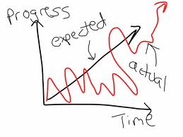
Information dissemination
Information is a fundamental prerequisite for accountability
Without reliable measurement
one cannot track progress or deterioration
In the absence of standardized testing, how does a district official know which primary school needs what support?
    Seriously, how do they currently do this?!
Examples of school & student reports…

Slide 32
Types of reports
Comprehensive national report on the ANA’s showing performance breakdown by race, language, gender, grade, province, school location and quintile. Extensive analysis of each category as well as discussion regarding key issues such as LOLT, functional illiteracy and innumeracy, and which pre-specified goals were and were not achieved. Key areas for improvement should also be identified and discussed.
Comprehensive provincial reports on the levels and trends of student performance in numeracy and literacy by race, language, gender, grade, and district.
Concise district reports on the comparative performance of that district relative to similar districts provincially and nationally, as well as detailed information on the performance of schools in that district both relative to each other, and relative to socioeconomically similar schools in other districts and provinces. Also to provide a comprehensive, accessible list of schools categorized by average school performance (from Dysfunctional to Excellent). This information will ensure that interventions and district support can be targeted to where they are most needed, and are most pedagogically appropriate for the types of difficulties experienced in that school.
Detailed school reports for every school indicating the average numeracy and literacy scores for that school as well as for each grade and each learner. Results should be linked to specific teachers and classes. Comparative information should be provided in an accessible format on the performance of the school nationally, provincially and within the district, as well as relative to socioeconomically similar schools in the district and province. This information should be sufficiently detailed and specific (for example, include other school names and rankings).
Concise learner reports should be provided to the parents of every primary school child in South Africa. They should be understandable and make it clear how their child has performed in the recent tests. The report should show if the child has reached certain measurable educational milestones for their age (for example if they can read and write at a basic level by 8 years of age), as well as the performance of their child relative to other children in his grade, and socioeconomically-similar students of the same age in other schools in the province. One could also provide information on the relative performance of their school as compared to similar schools in the district and the province. These reports should be clear and understandable to all parents, including illiterate and innumerate parents. The reports could also indicate what the parents can do to help their child improve (encourage homework, reading aloud etc.).

Slide 33
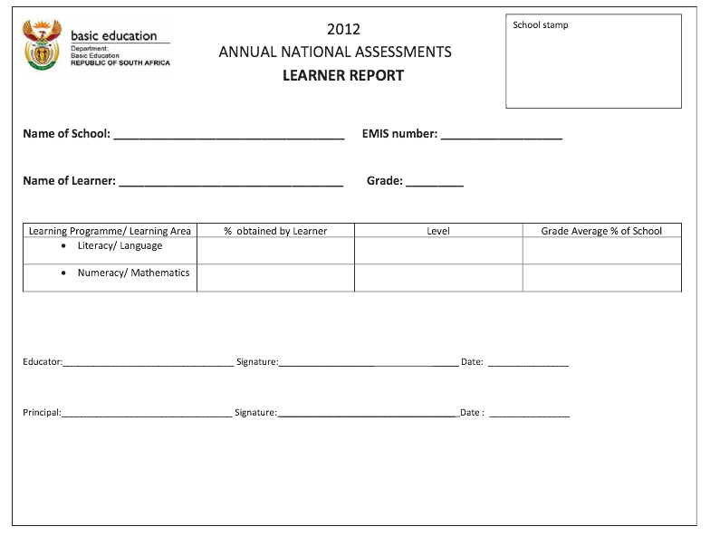
Existing ANA reports

Slide 34
Possibilities for SA report cards…

Slide 35
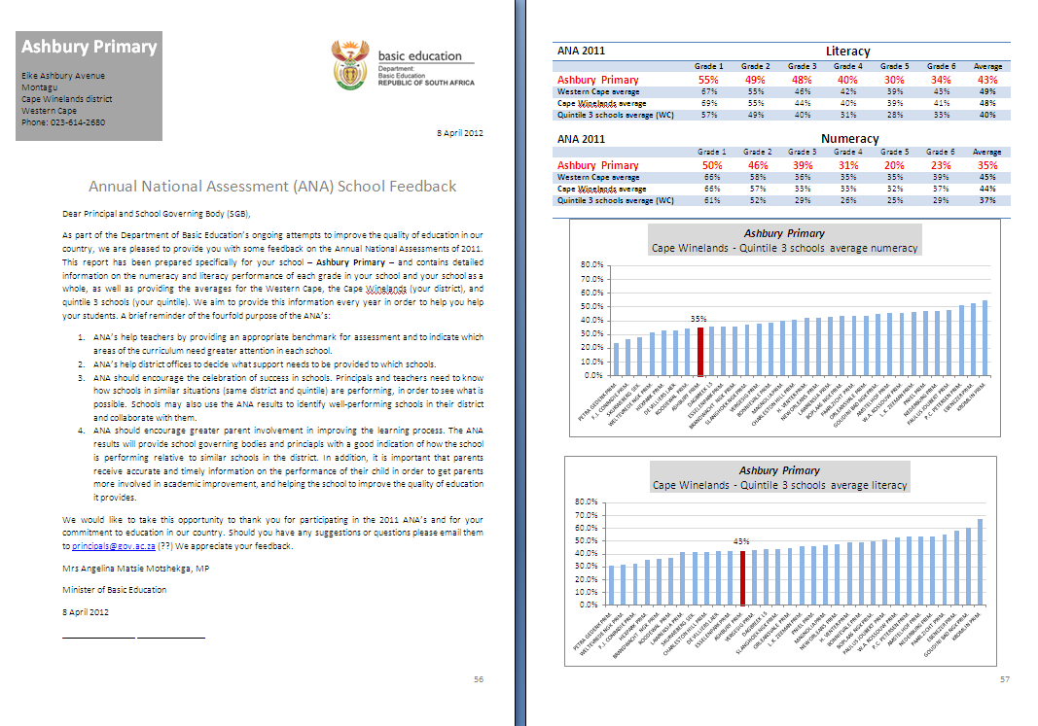

Slide 36
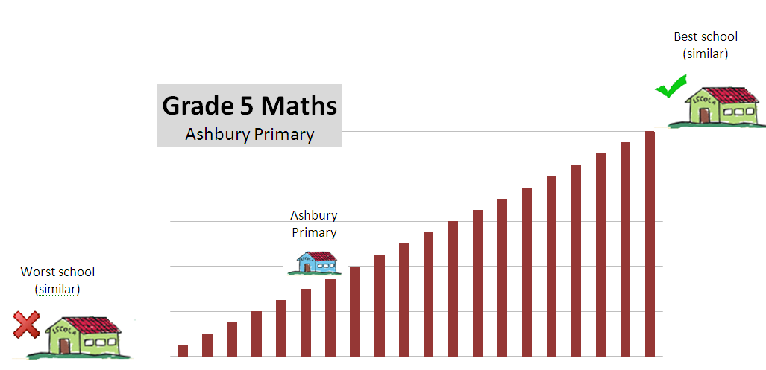
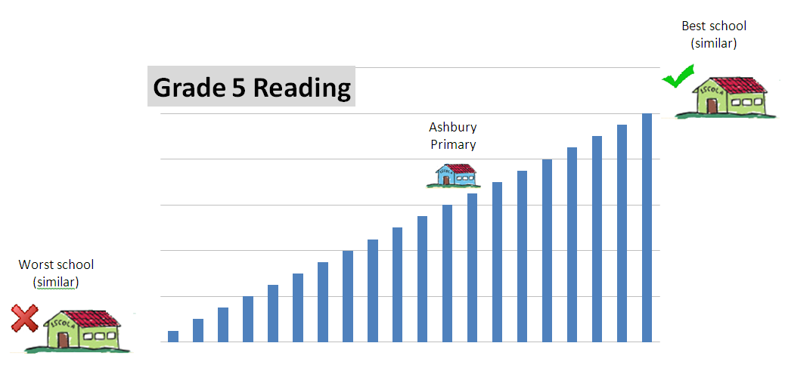
Ashbury Primary

Slide 37
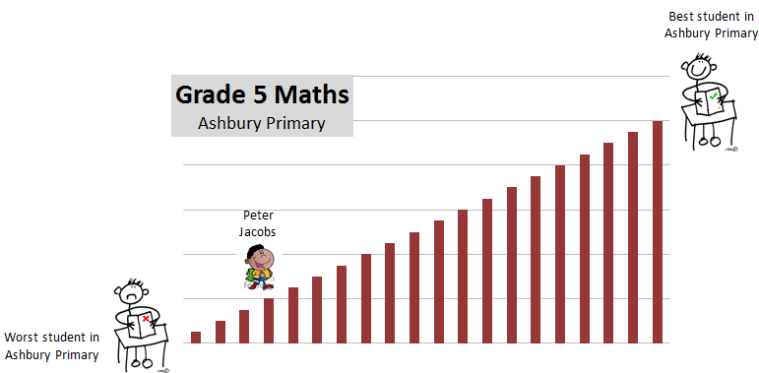
Peter Jacobs

Slide 38
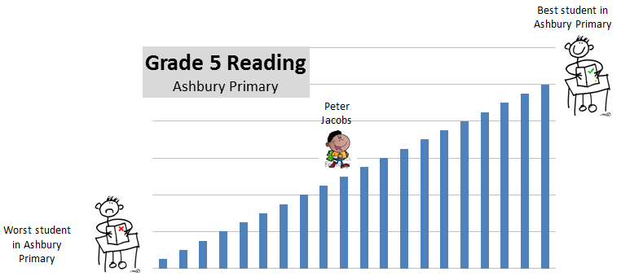
Peter Jacobs

Slide 39
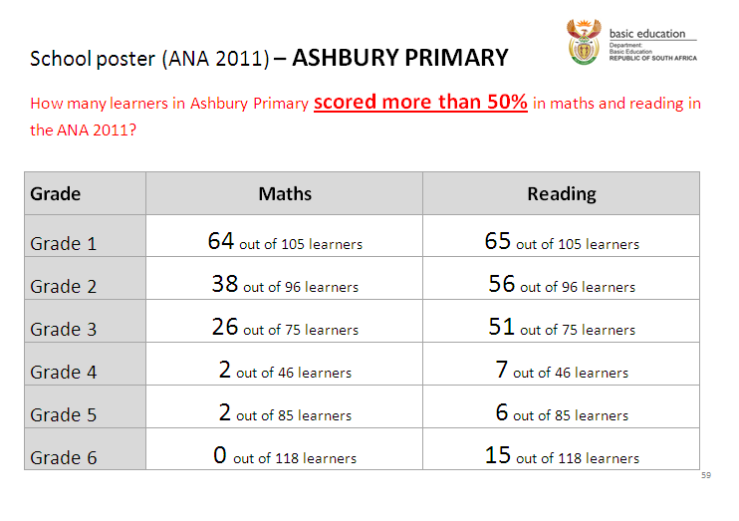
School Poster

Slide 40
Comparative information
There is a SERIOUS need for comparative information.
  Is my school performing better/worse/same as similar schools in my area?
  Using questionnaire data we can create comparator groups that really are comparable. Quintile system is too blunt.
    Socioeconomically schools (similar language, parental education, home resources etc.)
Ideally we want principals, teachers and (particularly) parents to ask why other equally poor schools in the area are performing better than their school → ACCOUNTABILITY

Slide 41
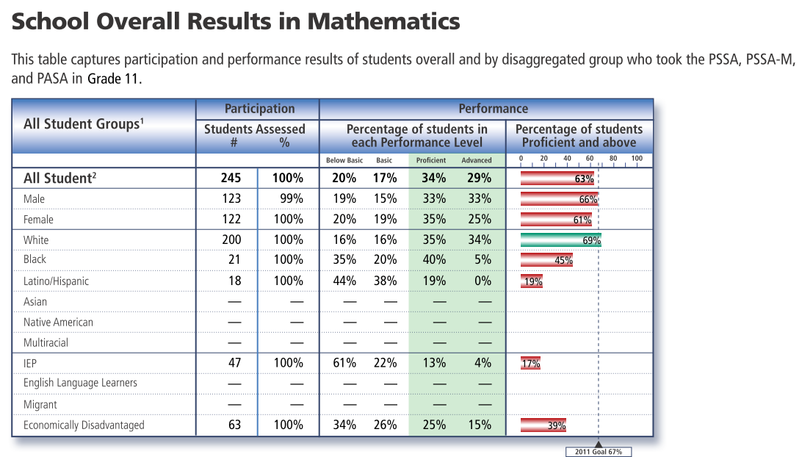
Pennsylvania school report cards

Slide 42
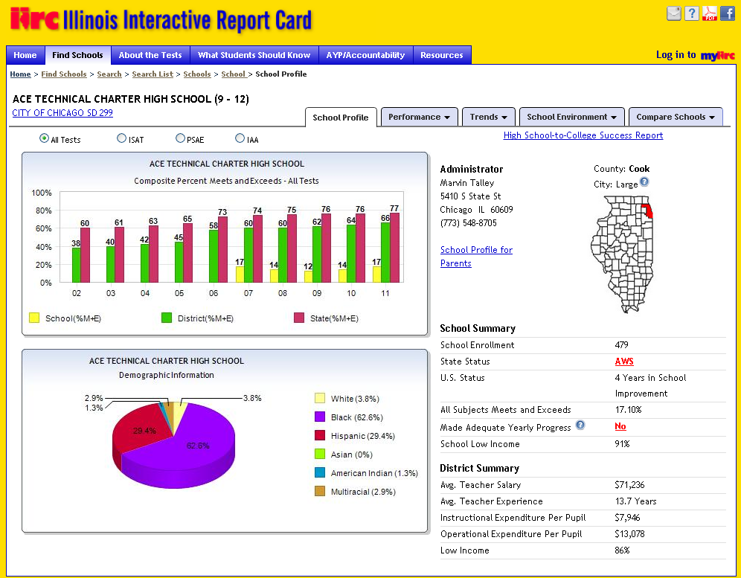
Illinois online report card tool

Slide 43
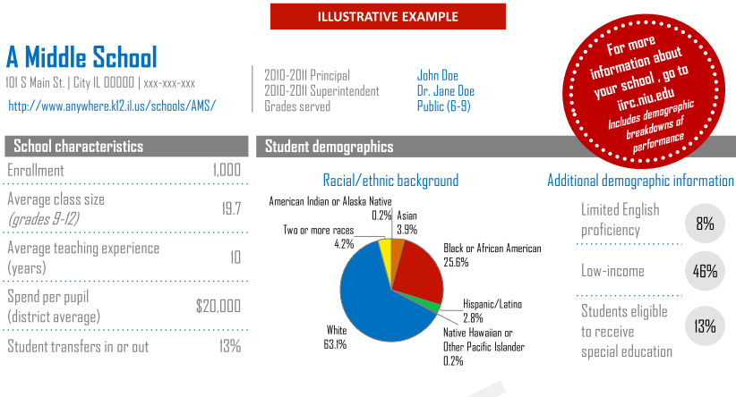
Illinois State School Reports - 2013

Slide 44
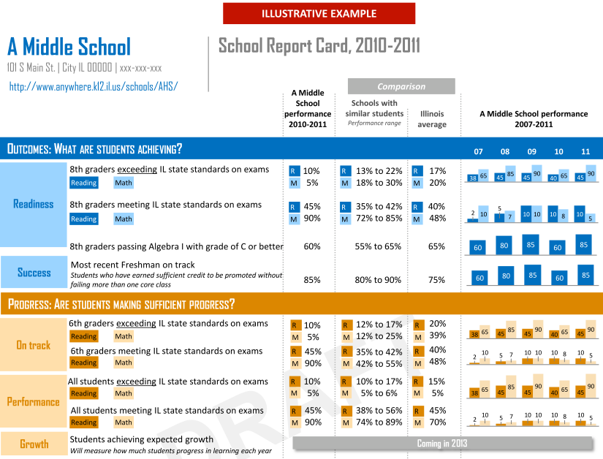

Slide 45
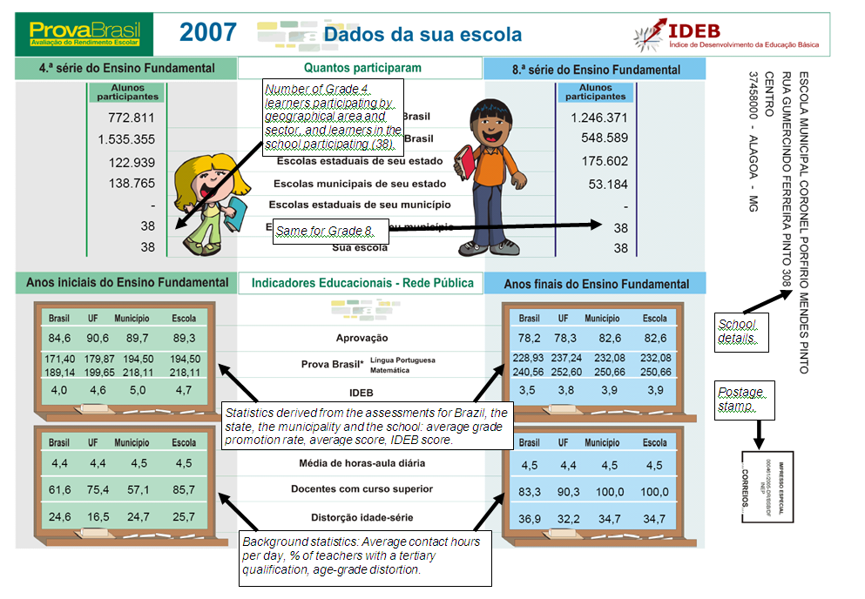
ProvaBrasil report card

Slide 46
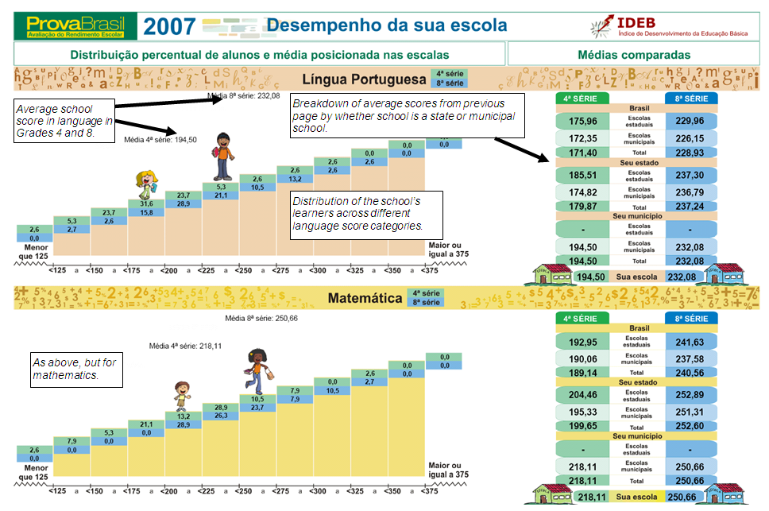
ProvaBrasil report card

Slide 47
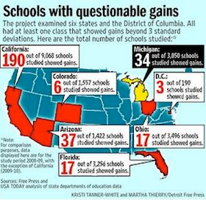
CAVEAT!
Cannot use test results for practically ANY purpose unless they are:
    Well aligned with the curriculum
    Accurate, trustworthy, reliable indicators of student and school performance
  This usually means tests are
  conducted by an independent
  external body or at the very least
  centrally marked
  Perhaps at one primary grade per
  year (similar to WCED) rotated year
  on year

Slide 48
SA ANA reports
What could be included in school/student reports?
What should be included in school/student reports?
What are the likely effects of increasing school and student performance information to parents?
Should ANA reports be implemented? If so, how?

Slide 49
References
Fleisch, B. (2008). Primary Education in Crisis: Why South African schoolchildren underachieve in reading and mathematics. Cape Town. : Juta & Co.
Hoadley, U. (2010). What doe we know about teaching and learning in primary schools in South Africa? A review of the classroom-based research literature. Report for the Grade 3 Improvement project of the University of Stellenbosch. Western Cape Education Department.
Hungi, N., Makuwa, D., Ross, K., Saito, M., Dolata, S., van Capelle, F., et al. (2011). SACMEQ III Project Results: Levels and Trends in School Resources among SACMEQ School Systems. Paris: Southern and Eastern Africa Consortium for Monitoring Educational Quality.
Ross, K., Saito, M., Dolata, S., Ikeda, M., Zuze, L., Murimba, S., et al. (2005). The Conduct of the SACMEQ III Project. In E. Onsomu, J. Nzomo, & C. Obiero, The SACMEQ II Project in Kenya: A Study of the Conditions of Schooling and the Quality of Education. Harare: SACMEQ.
Shepherd, D. (2011). Constraints to School Effectiveness: What prevents poor schools from delivering results? Stellenbosch Economic Working Papers 05/11. [PIRLS]
Spaull, N. (2011a). A Preliminary Analysis of SACMEQ III South Africa.Stellenbosch Economic Working Papers.
Spaull, N. (2011). Primary School Performance in Botswana, Mozambique, Namibia and South Africa. Paris: Southern and Eastern African Consortium for Monitoring Educational Quality (SACMEQ) Working Paper no.8.
Spaull, N. 2012 Equity & Efficiency in South African primary schools : a preliminary analysis of SACMEQ III South Africa Masters Thesis. Economics. Stellenbosch University
Taylor, S. (2011). Uncovering indicators of effective school management in South Africa using the National School Effectiveness Study.Stellenbosch Economic Working Papers 10/11, 1-51. [NSES]
Van der Berg, S., Burger, C., Burger, R., de Vos, M., du Rand, G., Gustafsson, M., Shepherd, D., Spaull, N., Taylor, S., van Broekhuizen, H., and von Fintel, D. (2011). Low quality education as a poverty trap. Stellenbosch: University of Stellenbosch, Department of Economics. Research report for the PSPPD project for Presidency.

Slide 50



www.nicspaull.com/research
nicholasspaull@gmail.com
@NicSpaull

Slide 51
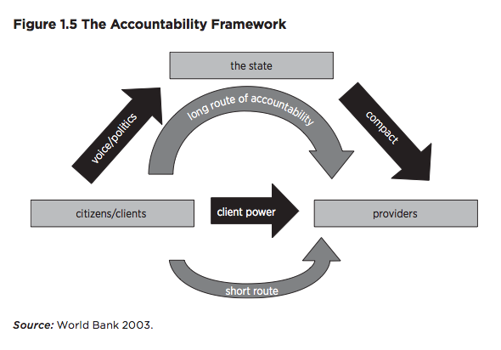
Making schools work
(Bruns, Filmer Patrinos)

Slide 52
Capacity precedes accountability
“Accountability systems and incentive structures, no matter how well designed, are only as effective as the capacity of the organization to respond. The purpose of an accountability system is to focus the resources and capacities of an organization towards a particular end. Accountability systems can’t mobilize resources that schools don’t have...the capacity to improve precedes and shapes schools’ responses to the external demands of accountability systems (Elmore, 2004b, p. 117).
“For every increment of performance I demand from you, I have an equal responsibility to provide you with the capacity to meet that expectation. Likewise, for every investment you make in my skill and knowledge, I have a reciprocal responsibility to demonstrate some new increment in performance” (Elmore, 2004b, p. 93).
Accountability AND SUPPORT

Slide 53
Theory of change??
1) What are the causal mechanisms linking policy to achievement?
  “If policy-makers rely on incentives for improving either a school or a student, then the question arises, incentives to do what? What exactly should educators in failing schools do tomorrow – that they do not do today- to produce more learning? What should a failing student do tomorrow that he or she is not doing today?” (Loveless, 2005: 16)
  “In order for an accountability system to be based on improvement, it has to embody an underlying theory of how schools improve their performance. Simply constructing an incentive structure of standards and testing around the expectation of steady improvements in performance is not a theory of improvement. A theory of improvement actually has to account for how people in schools learn what they need to know in order to meet the expectations of the accountability system” (Elmore, 2004a, p. 21).

