Slide 1

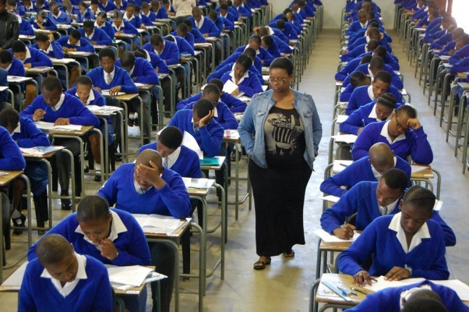


Matric 2014
Understanding the results, interrogating the issues
Nic Spaull
Ed-tech discussion on Matric 2014 | 22 January 2015

Slide 2
Issues
First time the matric exams were testing CAPS curriculum
Understanding dropout
  Extent
  Provincial rankings
Subjects that students are taking
Indicators of progress/deterioration

Slide 3
Matric 2014 (relative to Gr 2 in 2004)
 | Numbers
Grade 2 (2004) | 1085570
Grade 9 (2011) | 1049904
Grade 12 (2014) | 532860
Passed (2014) | 403874
Bachelors (2014) | 150752

Slide 4
Throughput over time
(Public ordinary schools only)
 | Grade 2 students 10 years earlier (i.e. in 2000, 2001, 2002, 2003, 2004) | Students writing matric in 2014 | Students passing matric in 2014 | Traditional matric pass rate | Throughput pass-rate from grade 2 to matric (proportion of grade 2's 10 years earlier who passed matric)
2010 | 1,071,053 | 537,543 | 364,147 | 68% | 34%
2011 | 925,761 | 496,090 | 348,117 | 70% | 38%
2012 | 992,797 | 511,152 | 377,829 | 74% | 38%
2013 | 1,087,933 | 562,112 | 439,779 | 78% | 40%
2014 | 1,085,570 | 532,860 | 403,874 | 76% | 37%
Notes:
From Education Statistics at a Glance (various years) and the 2014

Slide 5
Throughput rates and dropouts by province
(analysis by Stephen Taylor)
 | Passed/ (Gr9 in 2011) | Passed/ (Gr10 in 2012) | Passed/ (Gr11 in 2013) | Matric pass rate | Differences between matric pass and pass/Gr9
EC | 31% | 29% | 36% | 65% | 35%
FS | 34% | 37% | 58% | 83% | 49%
GP | 49% | 44% | 62% | 85% | 36%
KN | 40% | 37% | 43% | 70% | 30%
LP | 32% | 30% | 43% | 73% | 41%
MP | 42% | 38% | 48% | 79% | 37%
NC | 31% | 31% | 44% | 76% | 46%
NW | 35% | 32% | 53% | 85% | 50%
WC | 44% | 51% | 66% | 82% | 38%
NAT | 38% | 37% | 48% | 76% | 37%
Usually competition between GAU and WCA for #1, and throughput pass rate depends on which denominator you use, i.e. Gr9 figures 3 years earlier or Gr10 figures 2 years earlier
We think this is because of the patterns of dropout in the WCA where more students are dropping out pre-Gr10 whereas post-Gr10 in many other provinces

Slide 6



Not all schools are born equal
?
Pretoria Boys High School
When making provincial comparisons we must remember that the thing we really care about is VALUE-ADDED at the school level. The average student in the Eastern Cape is far more disadvantaged than the average student in the Western Cape/Gauteng. We need to acknowledge that the “raw materials” that schools are starting with are very, very different across contexts.
SA public schools?

Slide 7


What are the root causes of low and unequal achievement?
Matric pass rate
Subject choice
No. endorsements
Throughput
Media sees only this→
Quality?
MATRIC
Pre-MATRIC
50% dropout
Low curric coverage
Weak culture of T&L
Low accountability
Vested interests
Low time-on-task
No early cognitive stimulation
Low quality teachers
HUGE learning deficits…

Slide 8

NSES question 42
NSES followed about 15000 students (266 schools) and tested them in Grade 3 (2007), Grade 4 (2008) and Grade 5 (2009).
Grade 3 maths curriculum: “Can perform calculations using appropriate symbols to solve problems involving: division of at least 2-digit by 1-digit numbers”
Even at the end of Grade 5 most (55%+) quintile 1-4 students cannot answer this simple Grade-3-level problem.
“The powerful notions of ratio, rate and proportion are built upon the simpler concepts of whole number, multiplication and division, fraction and rational number, and are themselves the precursors to the development of yet more complex concepts such as triangle similarity, trigonometry, gradient and calculus” (Taylor & Reddi, 2013: 194)
(Spaull & Viljoen, 2014)
Notes:
Taylor, N., & Reddi, B. (2013). Writing and learning mathematics. In N. Taylor, S. Van der Berg, & T. Mabogoane, Creating Effective Schools. Cape Town: Pearson.
Spaull, N. & Kotze, J. (2015). Starting behind and staying behind in South Africa: The case of insurmountable learning deficits in mathematics.International Journal of Educational Development. Vol 41 (March) pp12-24 (WP here)

Slide 9
Insurmountable learning deficits: 0.3 SD
South African Mathematics Learning Trajectories by national socioeconomic quintiles (Based on NSES 2007/8/9 for Grades 3/4/5, SACMEQ 2007 for Grade 6 and TIMSS 2011 for Grade 9, including 95% confidence interval)
Spaull & Kotze (2015)
Notes:
Spaull, N. & Kotze, J. (2015). Starting behind and staying behind in South Africa: The case of insurmountable learning deficits in mathematics.International Journal of Educational Development. Vol 41 (March) pp12-24 (WP here)

Slide 10
Labour Market
17%
Unemployed
(Broad - 33%)
Unskilled
(19%)
Semi-Skilled (31%)
University/FET
Type of institution (FET or University)
Quality of institution
Type of qualification (diploma, degree etc.)
Field of study (Engineering, Arts etc.)
High productivity jobs and incomes (17%)
Mainly professional, managerial & skilled jobs
Requires graduates, good quality matric or good vocational skills
Historically mainly white
High quality secondaryschool
High SES background
+ECD
High quality primary school
Minority (20%)
Some motivated, lucky or talented students make the transition
Unequal society
Big demand for good schools despite fees
Some scholarships/bursaries
Vocational training
Affirmative action
Majority (80%)
Quality
Low quality secondary
school
Attainment
Type
Low productivity jobs & incomes
Often manual or low skill jobs
Limited or low quality education
Minimum wage can exceed productivity
Low SES background
Low quality primary school
cf. Servaas van der Berg – QLFS 2011
Notes:
The QLFS classifies professions as follows: Highly skilled (legislators, senior officials and managers, professionals, technicians and associate profesionals); Semi-skilled (Clerks, service workers and shop and market personnel, skilled agricultural and fishery workers, craft and related trade workers, plant and machinery operators and assembly), Unskilled (Elementary occupations, domestic workers).

Slide 11
The kinds of things we SHOULD be asking
What proportion of students are writing matric relative to the previous year and earlier enrolments (taking into account cohort sizes),
What subjects are they taking and how has this changed relative to previous years? (i.e. are they taking easier or more challenging subject combinations). Are more students taking maths literacy or mathematics than previous years?
What level are the maths/science/language passes at and how has this changed (i.e. at 40%, at 50%, at 60% etc.) This is really important because thresholds (like a specific pass rate) can lead to a situation where there are big jumps in pass rates based on people moving just over the threshold but the underlying distribution didn’t change much.
How have the number of bachelor passes changed relative to previous years? Ideally we would also want to know not just how many students received bachelor passes but how many actually ‘used’ those passes and got into university. If the same number of students got bachelor passes but more of them successfully entered (and ideally completed) degreees/diplomas/certificates, this is a great thing which should be measured, announced and celebrated.
How have the performance levels of EFAL students changed relative to previous years? Basically everyone passes this exam but achieve at very low levels. For example in 2013 99% of students passed EFAL but only 30% scored higher than 60%. In the WCA 38% scored higher than 60%. This is a critically important subject taken by 81% of all matrics in the country.
For diagnostic/support/accountability purposes analyse results at the school level. Which schools have the highest number of matrics taking (and passing) mathematics by quintile. Which are the poor schools performing well in spite of poverty? Which are the ‘wealthy’ schools performing badly in spite of wealth? How many WCA schools account for 30% of all failures in mathematics? Science? Matric? Research in the US reported this and the number of schools was surprisingly low. We haven’t done the analysis on this but it is possible. What proportion of schools account for 75% of all bachelor passes? Often these numbers are quite surprising and insightful.
Looking at equity across the schooling system. Are more poorer schools performing better/worse? Is the gap between wealthy and poor schools/children increasing or decreasing?

Slide 12
Other issues
Accountability and perverse incentives
  “Any district that drops, even if it’s by 0.01 percent, before you give me the results, put the resignation letter on top.” MEC Lesufi (Gauteng)
Vocational subjects
  40% of matrics take Business Studies
  20% take Tourism
  “Vast numbers of our children enrol for semi-vocational subjects that are not teaching them either robust academic skills by building concepts and knowledge, nor preparing them for work in any meaningful way.” – Stephanie Allais (Wits)
What to do about the pass mark
  Some have suggested just reporting the mark not pass/fail, however, pass/fail is conceptually important for accountability, especially in a system that lacks accountability
Notes:
http://wiser.wits.ac.za/system/files/documents/Allais%20-%202014%20-%20Matric%20-%20PublicPositions.pdf

Slide 13
English First Additional Language
Taken by 81% of all matrics (2014 pass rate = 98%)
“EFAL does not and cannot fulfil the same purpose in the curriculum as the other 10 First Additional Languages.”
  - Ministerial Task Team on the NSC
“reliance on testing memorisation and recall, rather than critical thinking and analytical and evaluation skills” was a major problem. – Cambridge International Examinations Body
“The cognitive levels assessed in the examination questions are heavily weighted towards lower-order skills…The grammatical activities themselves are meaningless and reflect a drill and practice approach to language learning which does not support the need to develop students’ language for work and participation in the broader community.”
  – Australian Board of Studies new South Wales

Slide 14
Conclusions
End infantile obsession with the matric pass rate
  There are other indicators which we should be placing as much emphasis on
Matric starts in grade 1
  Weak performance in matric (and dropout pre-matric) is rooted in weak foundations in primary school
Serious need to look at EFAL as a subject (and also some of the semi-vocational subjects)
  Both assessment and curriculum
Given that matric exams are not psychometrically calibrated to be comparable across years, and that they only reflect the performance of half the cohort, there are better measures of the “health” of the education system
  Including TIMSS, PIRLS, prePIRLS, PISA-for-Development, SACMEQ
    All psychometrically calibrated to be comparable over time

Slide 15
Questions and comments?

Slide 16
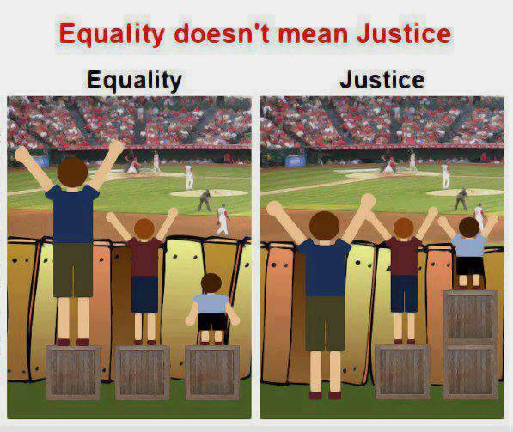
Pro-poor allocation of resources?
Are there real/significant differences in household SES and school resources between Q1, Q2 and Q3?
  Rethinking how we measure quintiles
Is the allocation of financial resources pro-poor?
  Allocated resources vs realized resources (differential efficiency) (Taylor 2011)
  Pre and post parental ‘top-ups’/fees?
Is the allocation of human resources pro-poor?
  How do we incentivize the best teachers to teach in the poorest schools?

Slide 17
Motivation for increasing resources
Basic dignity rationale (ethics / human rights)
  Water, sanitation, electricity, brick buildings
  (Minimum Norms and Standards)
Improving learning outcomes rationale
  LTSM / workbooks
  Libraries and laboratories?
  Nutrition programs (extending to high school?)

Slide 18


Grade 6 Literacy
SA Gr 6 Literacy
Kenya Gr 6 Literacy
1%
5%
7%
25%
49%
46%
39%
Public current expenditure per pupil: $1225
Additional resources is not the answer
Public current expenditure per pupil: $258
27%
Notes:
Technically it is never enrolled or dropped out before grade 6 (using DHS data) – see Taylor and Spaull (Forthcoming)

Slide 19
Grade 6 Literacy
$258
$459
$668
$66
$1225
Notes:
Based on a forthcoming paper with Stephen Taylor. Importantly these estimates have already corrected for unenrolled students by assuming that they are illiterate. So they are in fact comparable even though drop out and enrolment rates are different across the countries

Slide 20
Accountability & Capacity

Slide 21
Accountability without capacity
“Accountability systems and incentive structures, no matter how well designed, are only as effective as the capacity of the organization to respond. The purpose of an accountability system is to focus the resources and capacities of an organization towards a particular end. Accountability systems can’t mobilize resources that schools don’t have...the capacity to improve precedes and shapes schools’ responses to the external demands of accountability systems (Elmore, 2004b, p. 117).
“If policy-makers rely on incentives for improving either a school or a student, then the question arises, incentives to do what? What exactly should educators in failing schools do tomorrow - that they do not do today - to produce more learning? What should a failing student do tomorrow that he or she is not doing today? For both parties, perhaps it is as simple as trying harder, a behavioural change ripe for incentives to influence. If the solution is not that simple, however, trying harder will lead to marginal gains. Greater gains will materialize only for those who know what to do. There will be students and teachers who try hard and fail – and they will be penalized for their failures. The spectre of that entails political risks … At the classroom level, even teachers who have been motivated to change by accountability must know what to do differently to convert struggling learners into accomplished ones…It is difficult to sanction someone for an unacceptable outcome – and, in democratically governed institutions, to justify the sanctioning as fair – when no one can describe, with reliability and precision, how to produce an acceptable outcome” (Loveless, 2005, pp. 16, 26).

Slide 22
Capacity without accountability
“In the absence of accountability sub-systems, support measures are very much a hit and miss affair. Accountability measures provide motivation for and direction to support measures, by identifying capacity shortcomings, establishing outcome targets, and setting in place incentives and sanctions which motivate and constrain teachers and managers throughout the system to apply the lessons learned on training courses in their daily work practices. Without these, support measures are like trying to push a piece of string: with the best will in the world, it has nowhere to go. Conversely, the performance gains achieved by accountability measures, however efficiently implemented, will reach a ceiling when the lack of leadership and technical skills on the part of managers, and curricular knowledge on the part of teachers, places a limit on improved performance. Thus, the third step in improving the quality of schooling is to provide targeted training programs to managers and teachers. To achieve optimal effects, these will need to connect up with and be steered by accountability measures” (Taylor, 2002, p. 17).

Slide 23


Slide 28


Slide 29
Binding constraints approach

Slide 30

Binding constraints approach

Slide 31


Slide 34
“The left hand barrel has horizontal wooden slabs, while the right hand side barrel has vertical slabs. The volume in the first barrel depends on the sum of the width of all slabs. Increasing the width of any slab will increase the volume of the barrel. So a strategy on improving anything you can, when you can, while you can, would be effective. The volume in the second barrel is determined by the length of the shortest slab. Two implications of the second barrel are that the impact of a change in a slab on the volume of the barrel depends on whether it is the binding constraint or not. If not, the impact is zero. If it is the binding constraint, the impact will depend on the distance between the shortest slab and the next shortest slab” (Hausmann, Klinger, & Wagner, 2008, p. 17).
Notes:
Hausmann, R., Klinger, G., & Wagner, R. (2008). Doing Growth Diagnostics in Practice: A 'Mindbook'. CID Workinf Paper No. 177. Center for International Development at Harvard University.

