Slide 1
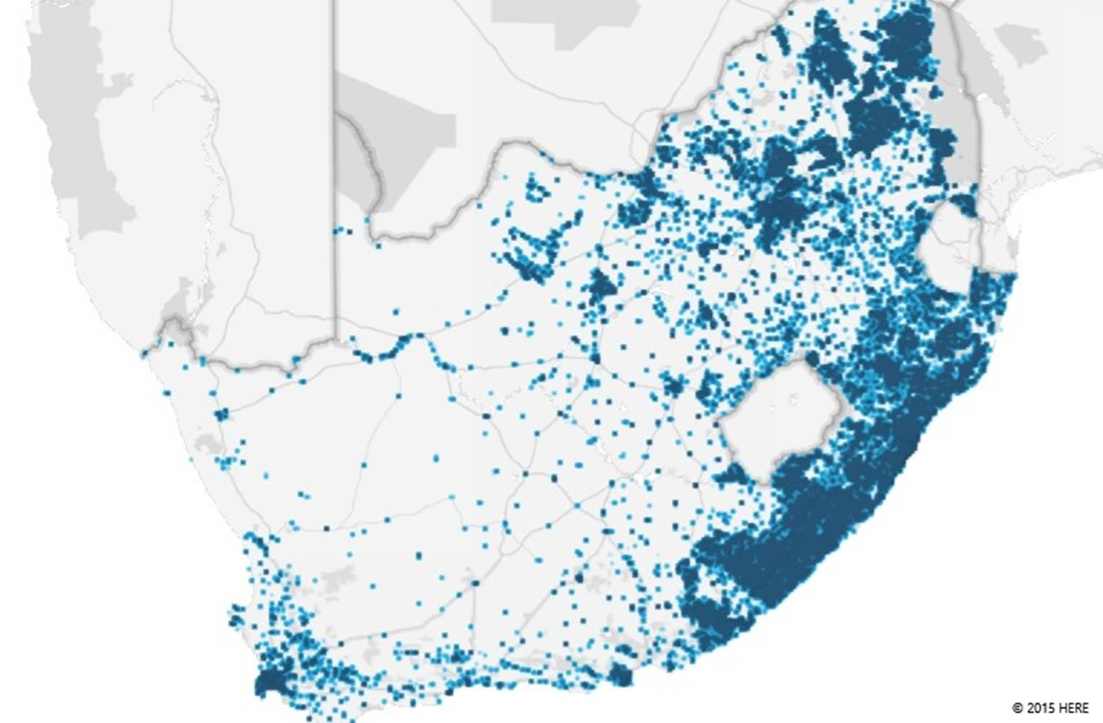
An overview of education in South Africa and children with disabilities that are out of school
SANASE Conference
Nic Spaull
21 August 2015

Slide 2
Some good news first
Considerable redistribution of spending to the poorest schools… government spending is nearly equalised across the poorest and wealthiest schools.
In terms of government spending, education is prioritised in national budgets.
Amount allocated in 2014/15
+/ R189.5 billion
% of total govt. exp in 2014/15
+/ 15.2%
Expected Growth in 2015/16
7.6%
Notes:
Before we go any further, I think its necessary to celebrate some successes in our system. In post Apartheid we have seen substantial changes at an administrative level with considerable redistribution of spending to the poorest schools.
We have almost got a point where government spending has nearly equalised across the poorest and wealthiest schools.
Education has also been prioritised as identified in spending of the national budget. Nearly R190 billion was spent by government on education in the 2014/15 FY. As a % of total government expenditure this amounts to 15% and will continue to grow at above inflation in the next financial year. By developing country standards we are spending a notable amount of money on education even when expressed as a proportion of GDP. Of course whether this is being efficiently used is another question?
OLD:
Figures from 2012 Public Expenditure Analysis report for UNICEF/DBE (Oxford Policy Management / Stellenbosch Economics) Education exp = 6.1% of GDP
Personnel exp = 78% of educ exp |Personnel exp = 4.8% of GDP

Slide 3
Some good news first
Considerable redistribution of spending to the poorest schools… government spending is nearly equalised across the poorest and wealthiest schools.
Fees. The General Household Survey (GHS) of 2013 showed that 66% of students reported paying zero school fees, showing that the no-fee policy is working quite well.
Grade R. The GHS indicates that 96% of all first-time Grade 1 learners in 2014 received schooling in the previous year (Grade-R/ECD)
School meals. Approximately 70% of students receive at least 1 free school meal as part of the National School Nutrition Programme (SMS 2011, GHS).
In terms of government spending, education is prioritised in national budgets.
Considerable improvements in access to education.
  Nearly universal access of non-disabled children, even high secondary enrolment ratios relative to developing world.
  97% participation for the cohort 7 to 15 years
  83% for 16 to 18 year olds (NPC 2012:302)
Notes:
We have seen a notable expansion of the nutrition programme in post Apartheid South Africa which has expanded to 6 million learners. In this respect education is serving an important role in child nutrition.
There has also been a dramatic expansion of pre-school education and specifically, the Grade R programme.
And then of course, we have seen substantial improvements in access to education. We have achieved nearly universal access of children to schooling, and even high school secondary enrolment ratios are high relative to the developing world. Roughly 97% of children aged 7 to 15 are in school and among 16-18 year olds about 83% are in school (NPC 2012).

Slide 4





State of SA education since transition
“Although 99.7% of South African children are in school…the outcomes in education are abysmal” (Manuel, 2011)
“Without ambiguity or the possibility of misinterpretation, the pieces together reveal the predicament of South African primary education” (Fleisch, 2008: 2)
“Our researchers found that what students know and can do is dismal” (Taylor & Vinjevold, 1999)
“It is not an overstatement to say that South African education is in crisis.” (Van der Berg & Spaull, 2011)
Notes:
Fleisch, B. (2008). Primary Education in Crisis: Why South African schoolchildren underachieve in reading and mathematics. Cape Town. : Juta & Co.
Taylor, N., Muller, J., & Vinjevold, P. (2003). Getting Schools Working. Cape Town: Pearson Education.
South African education: the poorest choice [M&G, 8 Apr 2011] (Co-authored with Prof Servaas van der Berg)

Slide 5








Student performance 2003-2011
TIMSS
(2003)
→ PIRLS (2006)
→ SACMEQ (2007)
TIMSS
(2011)
prePIRLS
(2011)
TIMSS 2003 (Gr8 Maths & Science)
Out of 50 participating countries (including 6 African countries) SA came last
Only 10% reached low international benchmark
No improvement from TIMSS 1999-TIMSS 2003
See Reddy et al (2006)
PIRLS 2006 (Gr 4/5 – Reading)
Out of 45 participating countries SA came last
87% of gr4 and 78% of Gr 5 learners deemed to be “at serious risk of not learning to read”
See Howie et al. (2006)
SACMEQ III 2007 (Gr6 – Reading & Maths)
SA came 10/15 for reading and 8/15 for maths behind countries such as Swaziland, Kenya and Tanzania
See Moloi & Chetty (2010) & Spaull (2012)
TIMSS 2011 (Gr9 – Maths & Science)
SA has joint lowest performance of 42 countries
Improvement by 1.5 grade levels (2003-2011)
76% of grade nine students in 2011 still had not acquired a basic understanding about whole numbers, decimals, operations or basic graphs, and this is at the improved level of performance
See Reddy et al. (2012) & Spaull (2013)
prePIRLS2011 (Gr 4 Reading)
29% of SA Gr4 learners completely illiterate (cannot decode text in any langauge)
See Howie et al (2012)
NSES 2007/8/9
  Gr 3/4/5
  See Taylor, Van der Berg & Mabogoane (2013)
Systemic Evaluations 2007
  Gr 3/6
Matric exams
  Gr 12
Notes:
Fortunately there are alternative measures of educational quality or learning that are available to view the entire iceberg structure. In post Apartheid, South Africa has participated in a number of international tests of assessment.
The most comprehensive reports for each of these datasets are as follows: SACMEQ (Moloi & Chetty, 2011), TIMSS (Reddy, 2006), PIRLS (Howie, et al., 2008), Systemic Evaluations (Department of Education, 2008), National School Effectiveness Study (Taylor, 2011b),and the Annual National Assessments (Department of Basic Education, 2011).
Now lets look at TIMSS 2011 in more detail.

Slide 6
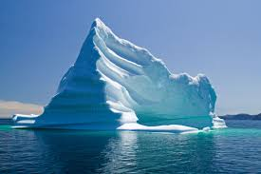
Notes:
The problem, with using the matric pass rate as a measure of quality of the system is that we are only seeing the tip of the ice berg if we use this is a our picture of quality. We are measuring the quality of the system on the basis of a very select proportion of students who actually make it to the matriculation exam.

Slide 7

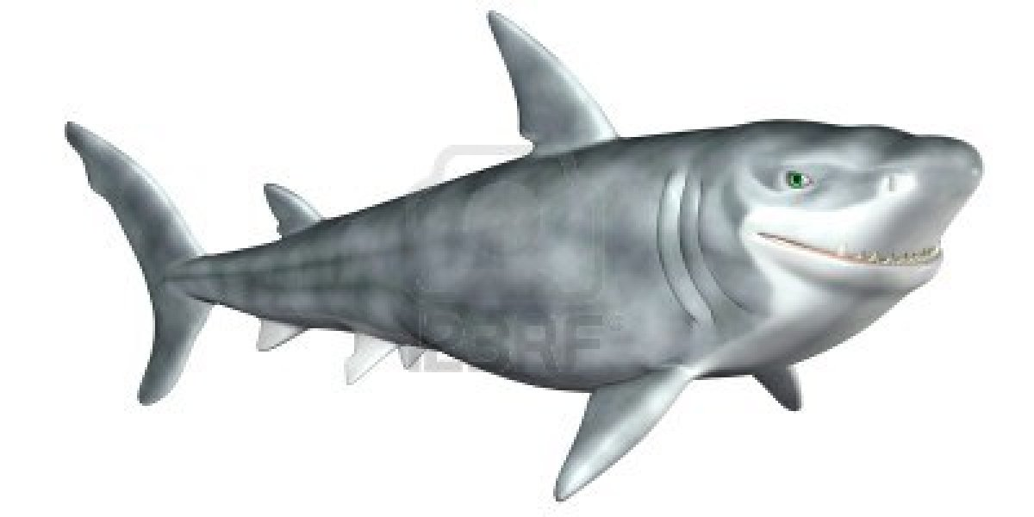
What are the root causes of low and unequal achievement?
Matric pass rate
Subject choice
No. endorsements
Throughput
Media sees only this→
Quality?
MATRIC
Pre-MATRIC
50% dropout
Low curric coverage
Weak culture of T&L
Low accountability
Vested interests
Low time-on-task
No early cognitive stimulation
Low quality teachers
HUGE learning deficits…

Slide 8
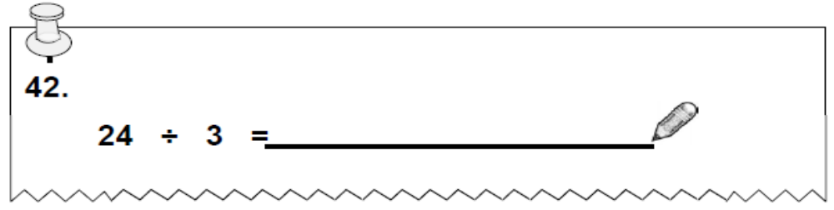
NSES question 42
NSES followed about 15000 students (266 schools) and tested them in Grade 3 (2007), Grade 4 (2008) and Grade 5 (2009).
Even at the end of Grade 5 most (55%+) quintile 1-4 students cannot answer this simple Grade-3-level problem.
“The powerful notions of ratio, rate and proportion are built upon the simpler concepts of whole number, multiplication and division, fraction and rational number, and are themselves the precursors to the development of yet more complex concepts such as triangle similarity, trigonometry, gradient and calculus” (Taylor & Reddi, 2013: 194)
(Spaull & Kotze, 2014)
Notes:
Taylor, N., & Reddi, B. (2013). Writing and learning mathematics. In N. Taylor, S. Van der Berg, & T. Mabogoane, Creating Effective Schools. Cape Town: Pearson.

Slide 9

Inequality: Two public schooling systems

Slide 10
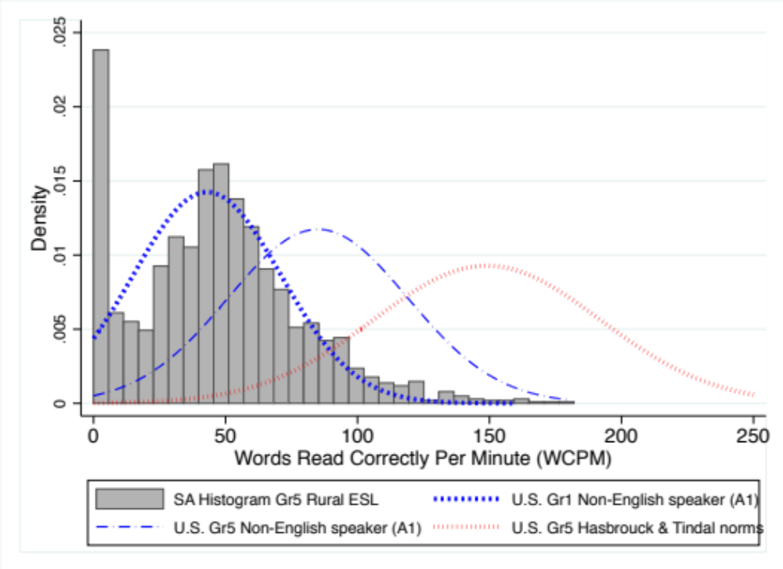
Grade 5 Oral Reading Fluency (English) in rural schools (214 schools)
“11% could not read a single word…41% of the sample was reading so slowly (<41 WCPM) that they effectively do not undertand anything that they are reading”

Slide 11
Maths: Insurmountable learning deficits
Figure 10b: South African mathematics learning trajectories by national socioeconomic quintiles using a variable standard deviation for a year of learning (0.28 in grade 3 to 0.2 in grade 8 with interpolated values for in-between grades (Based on NSES 2007/8/9 for grades 3/4/5, SACMEQ 2007 for grade 6 and TIMSS 2011 for grade 9, including 95% confidence interval
Spaull & Viljoen, 2015

Slide 12
Matric 2014 (relative to Gr 2 in 2004)
 | Numbers
Grade 2 (2004) | 1085570
Grade 9 (2011) | 1049904
Grade 12 (2014) | 532860
Passed (2014) | 403874
Bachelors (2014) | 150752
550,000 students drop out before matric
99% do not get a non-matric qualification (Gustafsson, 2011: p11)
What happens to them? 50% youth unemployment…

Slide 13



Not all schools are born equal
?
Pretoria Boys High School
SA public schools?
→ Different resources (Capacity)
→ Different pressures (Accountability)

Slide 14
Labour Market
15%
Legislators, managers, assoc professionals
Unemployed
(Broad - 35%)
Unskilled
(18%)
Elementary occupations & domestic workers
Semi-Skilled (32%)
Clerks, service workers, shop personnel, skilled agric/fishery workers, plant and machinery operators)
University/FET
Type of institution (FET or University)
Quality of institution
Type of qualification (diploma, degree etc.)
Field of study (Engineering, Arts etc.)
High productivity jobs and incomes (15%)
Mainly professional, managerial & skilled jobs
Requires graduates, good quality matric or good vocational skills
High quality secondaryschool
High SES background
High quality primary school
ECD
Minority (20%)
Some motivated, lucky or talented students make the transition
Unequal society
Big demand for good schools despite fees
Some scholarships/bursaries
Vocational training
Affirmative action
(few make this transition)
Majority (80%)
Quality
Low quality secondary
school
Attainment
Type
Low productivity jobs & incomes
Often manual or low skill jobs
Limited or low quality education
Low socioeconomic status background
Low quality primary school
ECD
None or
low-quality
Statistics from Quarterly Labour Force Survey (QLFS) 2014 Q4
Notes:
The QLFS classifies professions as follows: Highly skilled (legislators, senior officials and managers, professionals, technicians and associate profesionals); Semi-skilled (Clerks, service workers and shop and market personnel, skilled agricultural and fishery workers, craft and related trade workers, plant and machinery operators and assembly), Unskilled (Elementary occupations, domestic workers).

Slide 15
Important distinctions
Improved student outcomes
Increased resources “on-the-ground”
Increased allocation of resources
ALLOCATED resources
REALIZED resources
UTILIZED resources
Often these 3 are spoken about interchangeably

Slide 16
Important distinctions
Improved student outcomes
Increased resources “on-the-ground”
Increased allocation of resources
Inefficiency/ corruption

Slide 17
Important distinctions
Improved student outcomes
Increased resources “on-the-ground”
Increased allocation of resources
Inefficiency / corruption
Lack of capacity

Slide 18
Important distinctions
Improved student outcomes
Increased resources “on-the-ground”
Increased allocation of resources
Inefficiency / corruption
Lack of capacity
Lack of accountability

Slide 19
Accountability & Capacity

Slide 20
Accountability without capacity
“Accountability systems and incentive structures, no matter how well designed, are only as effective as the capacity of the organization to respond. The purpose of an accountability system is to focus the resources and capacities of an organization towards a particular end. Accountability systems can’t mobilize resources that schools don’t have...the capacity to improve precedes and shapes schools’ responses to the external demands of accountability systems (Elmore, 2004b, p. 117).
“If policy-makers rely on incentives for improving either a school or a student, then the question arises, incentives to do what? What exactly should educators in failing schools do tomorrow - that they do not do today - to produce more learning? What should a failing student do tomorrow that he or she is not doing today?” (Loveless, 2005, pp. 16, 26).
“People who are being asked to do things they don’t know how to do, and being rewarded and punished on the basis of what they don’t know, rather than what they are learning, become skilled at subverting the purposes and authority of the systems in which they work. Bad policies produce bad behaviour. Bad behaviour produces value for no one” (Elmore, 2004a, p. 22).

Slide 21
Capacity without accountability
“In the absence of accountability sub-systems, support measures are very much a hit and miss affair. Accountability measures provide motivation for and direction to support measures, by identifying capacity shortcomings, establishing outcome targets, and setting in place incentives and sanctions which motivate and constrain teachers and managers throughout the system to apply the lessons learned on training courses in their daily work practices. Without these, support measures are like trying to push a piece of string: with the best will in the world, it has nowhere to go. Conversely, the performance gains achieved by accountability measures, however efficiently implemented, will reach a ceiling when the lack of leadership and technical skills on the part of managers, and curricular knowledge on the part of teachers, places a limit on improved performance. Thus, the third step in improving the quality of schooling is to provide targeted training programs to managers and teachers. To achieve optimal effects, these will need to connect up with and be steered by accountability measures” (Taylor, 2002, p. 17).

Slide 22

Notes:
From a forthcoming report on accountability on the

Slide 27


Slide 28
“Only when schools have both the incentive to respond to an accountability system as well as the capacity to do so will there be an improvement in student outcomes.” (p22)

Slide 29
Setting goals that are actually attainable
“Now that you don’t have to be perfect, you can be good” (Steinbeck)
“Perfect is the enemy of good”
Aspirational planning may seem harmless but it isn’t. The problem is that people who are being held accountable for totally unrealistic targets are usually let off the hook
  “How on earth do you expect us to be able to do _____ with this amount of money and in this time?!”
  This means that we need to go through our list of “demands” and drop the nice-to-haves. What are the essential (the absolute minimum) ingredients needed for us to offer basic quality education to ALL children with disabilities?
  But then we MUST hold the Department(s) accountable for achieving these realistic goals.

Slide 30

Where should we be focusing our interventions?
Notes:
But what are these policies? Where should our focus be if we want to see improvement?

Slide 31
Children with disabilities in South Africa

Slide 32
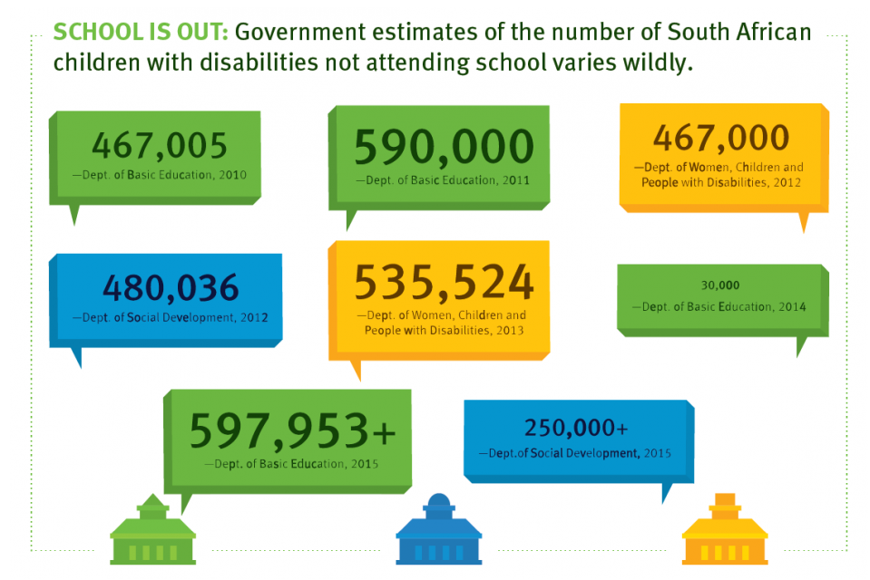
How many children with disabilities are not attending school?
Human Rights Watch, “Complicit in Exclusion” (2015)
Notes:
https://www.hrw.org/news/2015/08/18/south-africa-education-barriers-children-disabilities

Slide 33
Focusing our interventions
Poor to fair
Achieving the basics of
literacy and numeracy
Fair to good
Getting the foundations
in place
Good to Great
Shaping the professional
Great to Excellent
Improving through peers and innovation
Source: Mourshed, Chijioke and Barber (Mckinsey and Company), 2010
Data: How many children are there with disabilities? (in and outside the system). Accurate figures are a prerequisite.
Funding: Setting Minimum Norms and Standards for Funding.
Measuring basics: Clear, well-articulated benchmarks for learning for children with different types of disabilities (social audit similar to ACER in India or Uwezo in East Africa). Limited categories.
Notes:
In 2010, Mckinsey produced a report entitled “How the world’s most improved education systems keep getting better”.
They interviewed various stakeholders in education systems that had improved to identify if there was anything generic that one could learn from these improvement stories. One of the most logical findings coming out is that these systems first and foremost face the facts about where they were in a performance trajectory. Take stock of where we really are. This is not just the responsibility of government but we need civil awareness of the state of learning in South Africa, across all communities. This needs to become a national priority in the eyes of every citizen, that each member of society starts making it their responsibility.
Then these systems that improved designed their package of policy interventions that were commensurate with where they were in terms of learning. In systems with good or great learning to start off with they can target interventions at higher order issues. At the bottom end however one has to get to the basics. Systems with poor student performance can only improve if they focus on achieving the basics of literacy and numeracy.

Slide 34
Issues & advocacy
Issues
  Children with disabilities that are out of school
    Those that never enrol
    Those that drop out
  Quality of instruction/services at Special Schools experienced by children with disabilities that have places in them
  Quality of instruction/services at Ordinary Schools experienced by children with disabilities that have places in them
Advocacy
  What does “accountability” mean? It means consequences for non-performance. Currently there are NO consequences for non-performance for anyone. From the top to the bottom.
  Draw strategic, targetted, sustained media attention to the plight of children with disabilities
  Organize and advocate on specifics. Pick specific issues and hold government accountable for those specific issues. Difficult to mobilize around “quality education for all” but easier to mobilize around “mud schools” or “textbooks” → tangible, specific, clear, measurable goals. Social audit. Documentaries. Articles. Wheel-ins. Etc.
  Without serious pressure from civil society and specifically from those affected (parents and communities) it is highly unlikely this will receive the political attention/funding/priority it deserves.
  No “external locus of change” → the solutions will come from YOU
The company that won the tender to do Braille teaching in the Eastern Cape (Peakford) sent trainers who couldn’t read or write in Braille. The company had no experience in Braille-teaching yet was somehow still selected??
http://mg.co.za/article/2015-06-11-blind-schooling-in-shocking-state

Slide 35
Comments and questions?
Research and presentations available at nicspaull.com

Slide 36
NEEDU 2012/13 Recommendations
Province | Total students in ordinary school sector (2014 School Realities) | Children with disabilities that are out of school | Total number of children with disabilities in some form of schooling | Enrolled in Special Schools (2014 SNAP) | Enrolled in Ordinary Schools (2014) | Enrolled in Full-Service Schools (2014)
NC | 289004 |  |  | 1897 | 2326 | 489
FS | 672290 |  |  | 6149 | 21330 | 8110
NW | 800316 |  |  | 6943 | 2209 | 2546
MP | 1057788 |  |  | 3872 | 2433 | 1471
WC | 1075396 |  |  | 19605 | 7291 | 1720
LP | 1720585 |  |  | 8530 | 2608
EC | 1946885 |  |  | 9236 | 28288 | 2272
GT | 2191475 |  |  | 44065 | 4988 | 4310
KZ | 2901697 |  |  | 17180 | 9229 | 4295
SA | 12655436 |  | 222903 | 117477 | 80702 | 24724
Out of school |  | 500000

