Slide 1

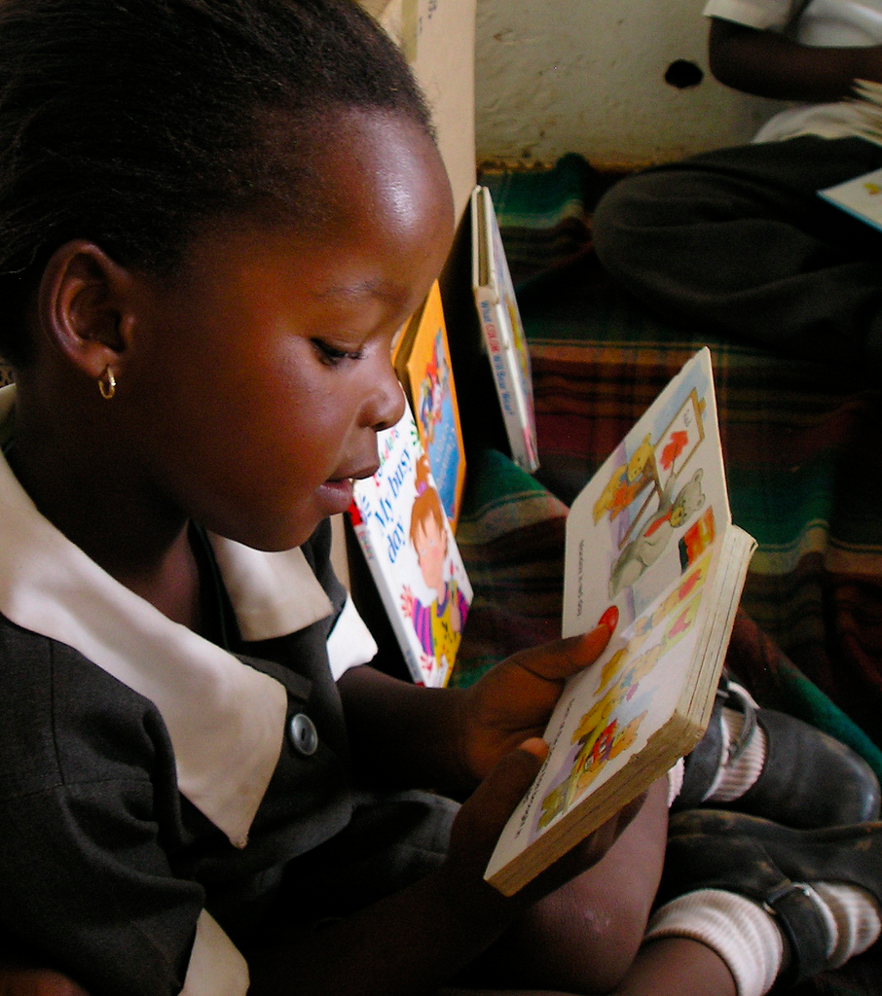



Exploring relationships between oral reading fluency and reading comprehension amongst English second language learners in South Africa
Elizabeth Pretorius & Nic Spaull

Slide 2
Background - SA
In PIRLS 2006 only 13% of SA Grade 4s could achieve the lowest reading benchmarks, viz. being able to answer literal questions, compared to 94% of their international peers (Venter et al. 2008).
In prePIRLS 2011 (341 schools) 29% of grade 4 students were completely illiterate in the LOLT (Gr1-3). Average hides huge inequality. (Howie & Van Staden, 2012)
  English (10%), Afrikaans (12%), isiXhosa (38%), Sepedi (57%), Tshivenda (53%), Xitsonga (47%)
In NSES 2007/8/9 (268 schools) there was no paragraph writing done in the year in 44% of grade 4 and 32% of grade 5 classes (Taylor, Van der Berg & Mabogoane, 2013)
2013 NEEDU report (114 classes) - No individual reading in 83% of rural multigrade classes observed.

Slide 3
Background - SA
Hoadley (2015) summarizes the SA classroom-based research and finds the following descriptive features:
  Lack of opportunities for reading and writing (oral discourse dominates)
  Classroom interaction patterns that privilege the collective (chorusing)
  Weak forms of assessment and lack of feedback on student responses
Similarly Pretorius & co-authors have found that a number of instructional practices (prevalent in SA) contribute to poor reading development:
  The tendency of teachers to rely on whole class oral chorusing of reading,
  The lack of reading homework
  Minimal reading of extended texts in the early grades
  (Pretorius & Machet 2004; Pretorius & Mokhwesana 2009; Pretorius 2014).

Slide 4
ORF literature
Oral reading fluency, defined in terms of accuracy and speed in word recognition, has been found to be a reliable indicator of reading comprehension (Fuchs et al, 2001; Spear-Swerling 2006). Although prosody is part of fluency, difficult to measure objectively.
There is a strong empirical basis attesting to a relationship between fluency and reading comprehension. Fluency typically measured as total words read correct per minute.
Fuchs et al. (2001) report high correlations (0.8) between ORF and various kinds of reading comprehension measure such as high stakes state mandated comprehension tests, as well as a variety of other comprehension tests using different formats (e.g. multiple choice or open questions, cloze procedures or story recall protocols).
The relationship obtains across schools serving children from different socioeconomic backgrounds or instructional programmes, and occurs with children without reading difficulties as well as with children with learning disabilities with reading (Deno et al. 2001; Wolf & Katzir-Cohen 2001).

Slide 5
ORF literature and our research questions
Most of these studies have been conducted in the developed North (the USA, Canada and the UK) and with L1 readers.
We have not found studies looking at ORF and comprehension in L2 students and none in developing countries.
The main purpose of this study is to determine whether,
  There is a relationship between the L2 learners’ ORF measures and their reading comprehension and if so,
  What the nature of the relationship is

Slide 6
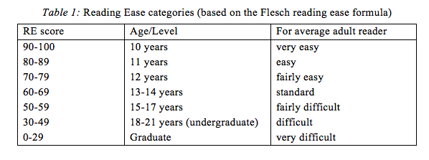
Test materials
No standardised reading tests for Grades 4-6 in SA. Therefore a reading test was designed for this study.
Grade 5 level passage was selected and modified slightly to assess reading comprehension in the written mode (literal and inferential questions in a mixed-mode format).
Two passages were selected from Grade 4 textbooks to assess oral reading fluency with five accompanying oral comprehension questions. Assessed text readability…
Comprehension and ORF tests were piloted in early 2013 in 16 schools (570 Grade 5 learners) across all 9 provinces. 168 did ORF 1; 115 did ORF2.
 | Total words | Words/sentence | Characters per word | Flesch RE | Flesch-Kincaid grade-level
ORF Test 1 Leopard | 205 | 9,8 | 4,1 | 84,7 | Gr 3,8
ORF Test 2 Hare | 269 | 10,8 | 4,1 | 83,3 | Gr 4,3

Slide 7
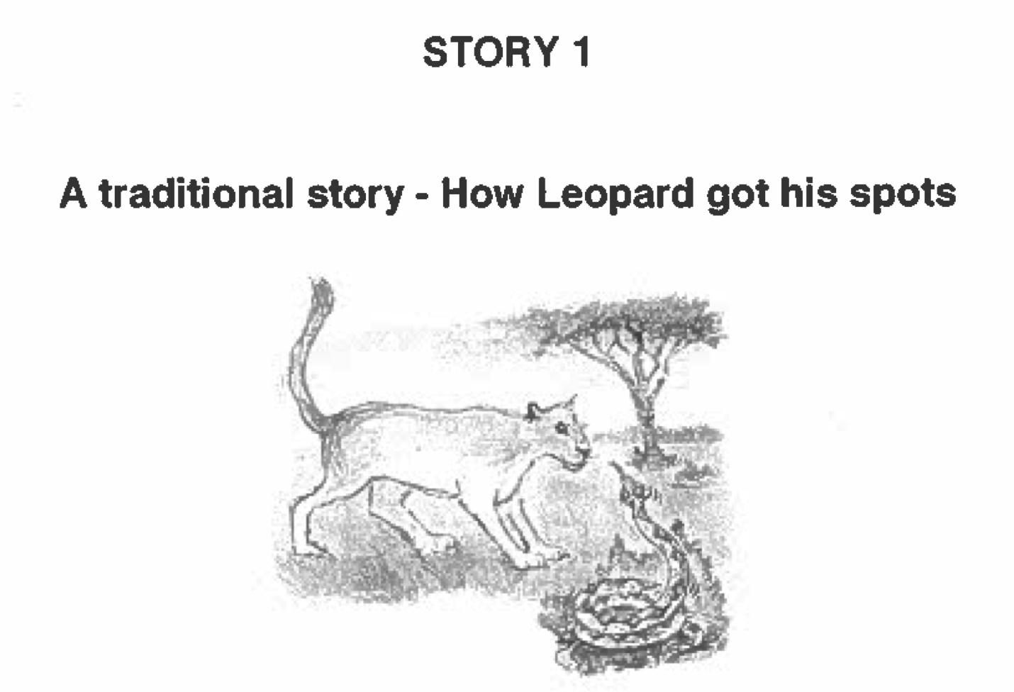
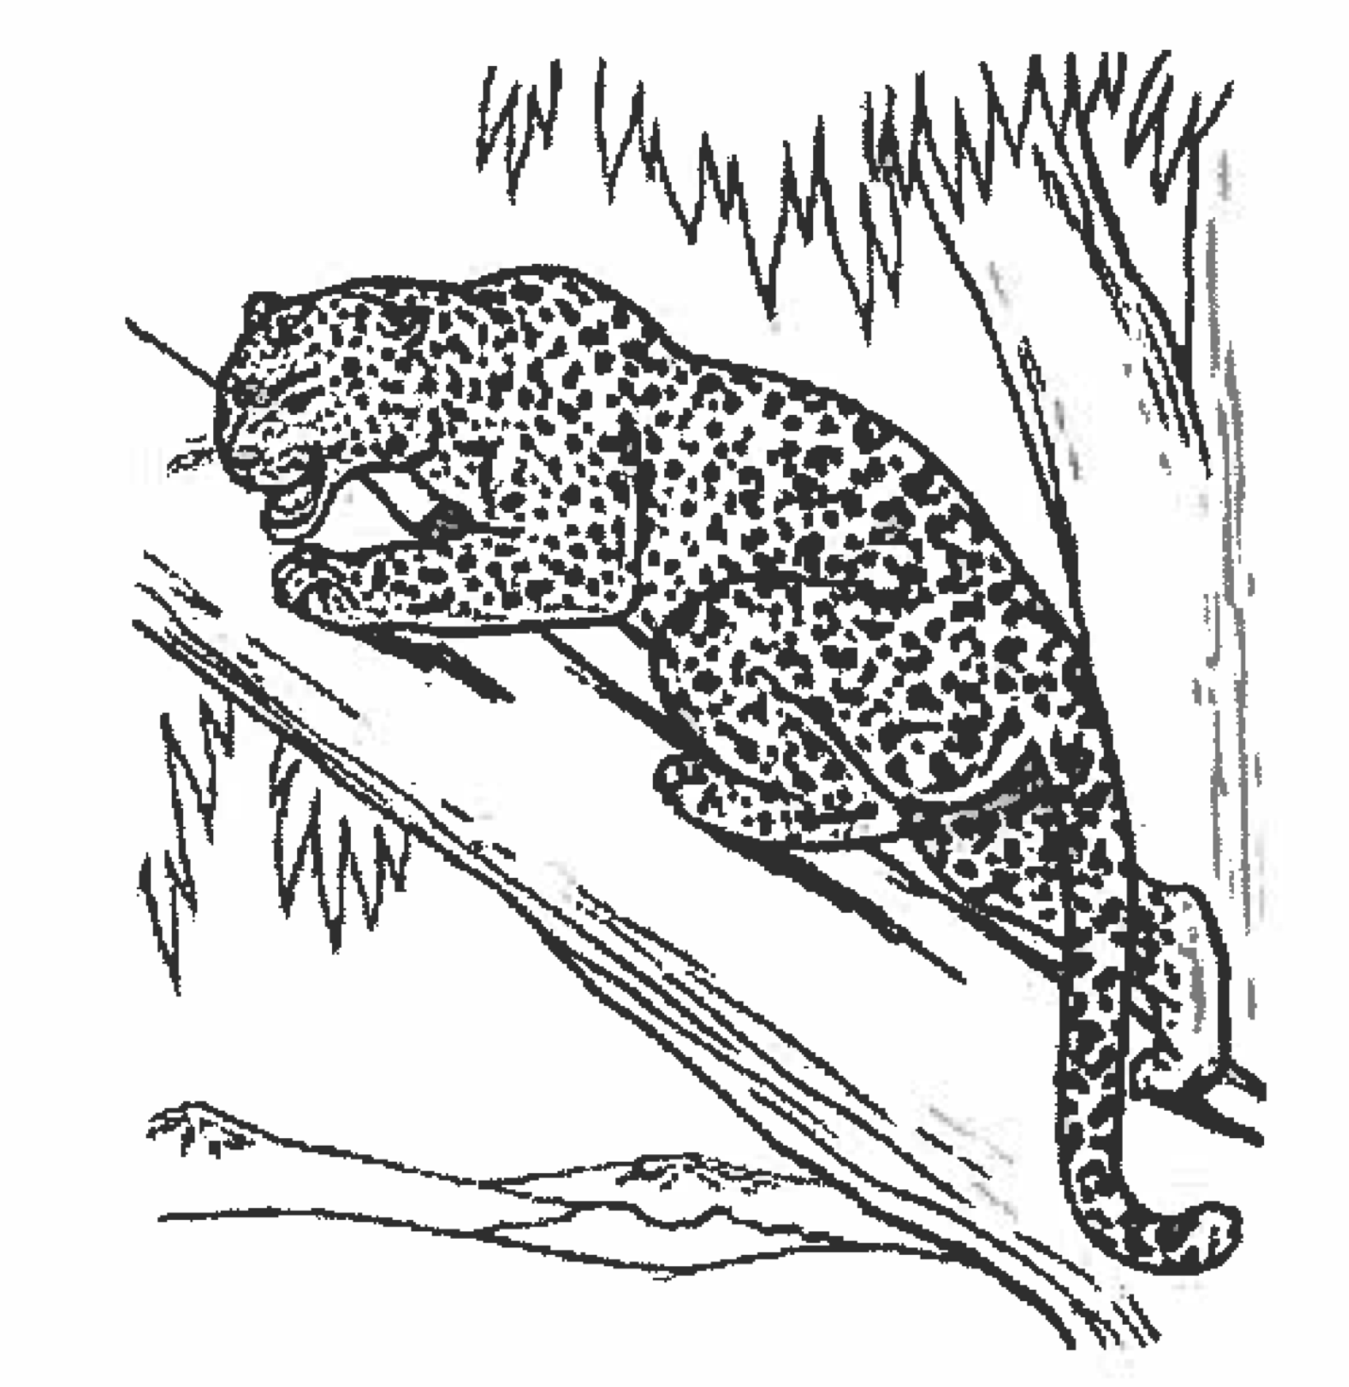

ORF Test 1

Slide 8
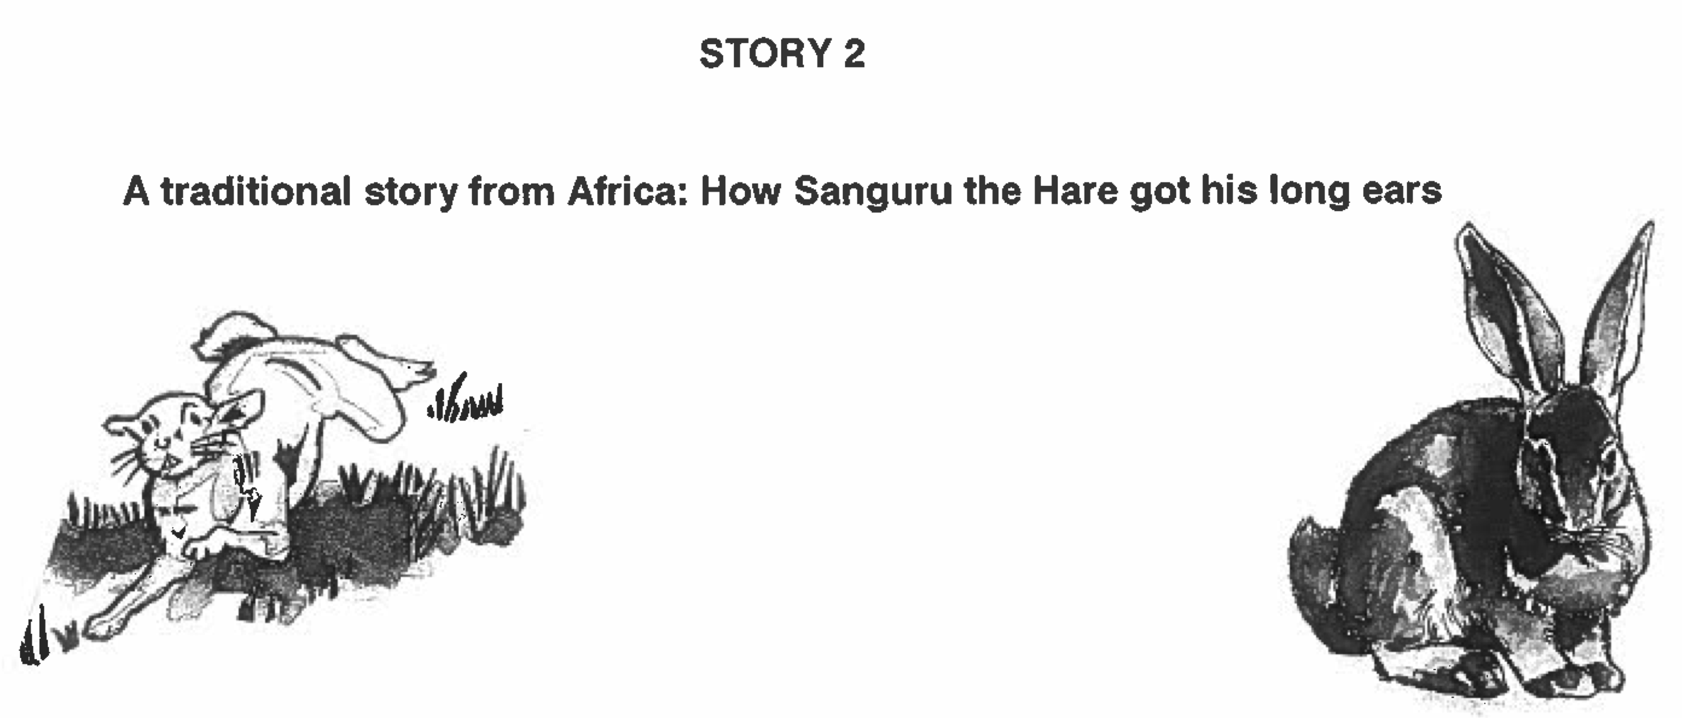
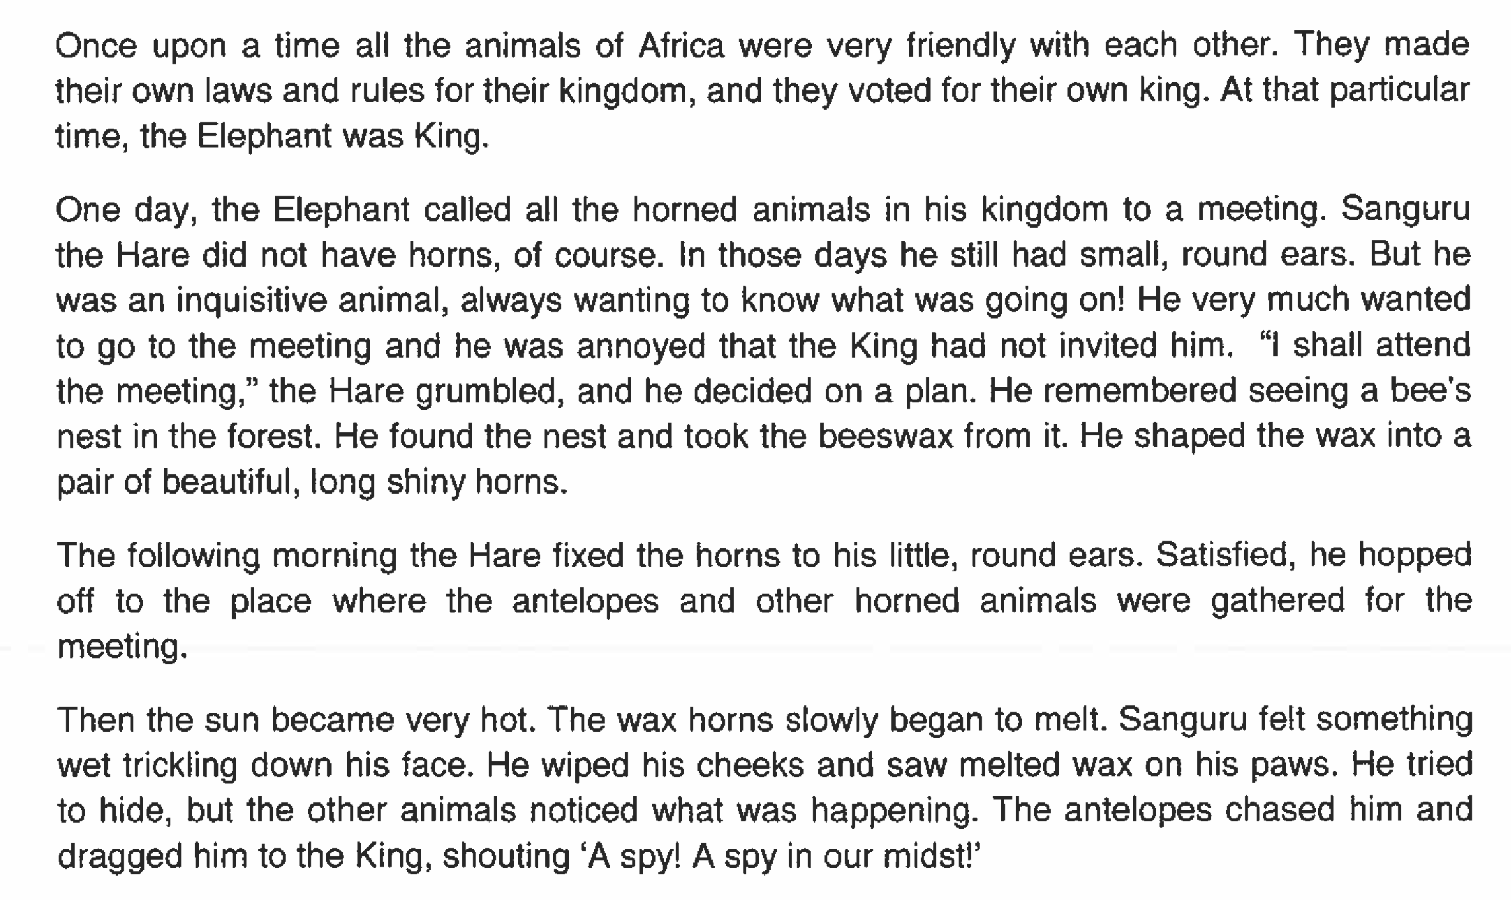
ORF Test 2

Slide 9
Testing procedure - 2013
214 rural primary schools
All grade 5 students in one class were selected to participate
4697 grade 5 students wrote a comprehension test (San-Hunter /20)
The top 3, middle 4 and bottom 3 students did the ORF 1 test
1786 students selected to write Oral Reading Fluency Test 1 (next day)
(+ comprehension
Test /5)
If students read 50 WCPM they did the more difficult ORF test 2
878 students selected to write ORF Test 2
(+ comprehension
Test /5)
Tests were administered at different times in the year. Preliminary analysis shows little
Relation between time of test and results.

Slide 10
Initial comprehension /20

Slide 11
WRCPM – ORF Test 1

Slide 12
ORF 1 Cumulative Density Function
NEEDU Grade 5 (Rural)
Median Gr1
child USA (53 WCPM)
Median Gr2
child USA (89 WCPM)
Hasbrouck & Tindal (2006) recommend that L1 speakers who are below 40 WCPM at the end of Grade 1 are vulnerable reader and needs remedial teaching.

Slide 13
NEEDU Gr5 Comprehension and ORF

Slide 14
CDF for those students scoring 40% + on comprehension

Slide 15
Descriptive findings
Of those scoring less than 15% on comprehension almost all (80%) have WCPM<50 and most (60%) have WCPM<30 – i.e. these are abysmally slow readers.
Of those scoring 15-29% almost all (80%) have WCPM<60 and most (60%) have WCPM<50
For those that score 30-60% on the comprehension test, most of the ‘action’ is around 50-70/80 WCPM. (look at where the lines are steepest).
For those that scored 30-39%, only 30% of students have WCPM<50 but double that amount (60%) have WCPM<60. Or alternatively 70% have WCPM>50 but only 40% have WCPM>60. So clearly a large proportion of these students are in-between 50 and 60 WCPM.
Students achieving 40-49% and 50-59% are very similar in WCPM

Slide 16
ORF1 range; showing the CDF of the range (max-min ORF in each school)
Suggests huge variation WITHIN rural schools (in 50% of these 214 schools, the gap between best and worst student is >75 WCPM

Slide 17
ORF 1 comprehension /5

Slide 18
Multivariate analysis
Stage 1: OLS cascade regression explaining variation in reading comprehension scores using a variety of student variables (age, gender); school variables (LOLT and multigrade) and fluency variables (WCPM, Words read incorrect per minute, words skipped
Stage 2: Use school fixed-effects to account for all school-level variables
Stage 3: Use school fixed-effects and create splines at progressive break-points. Use marginal effects to test for statistical significance in the difference.

Slide 19
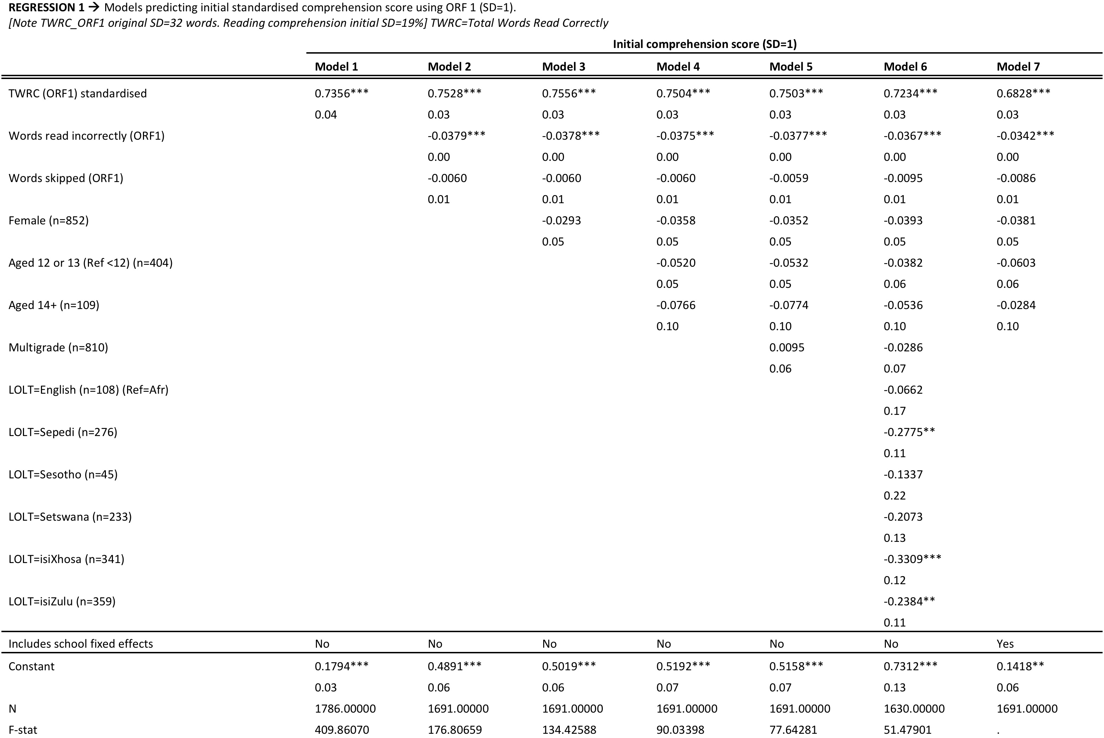

Slide 20
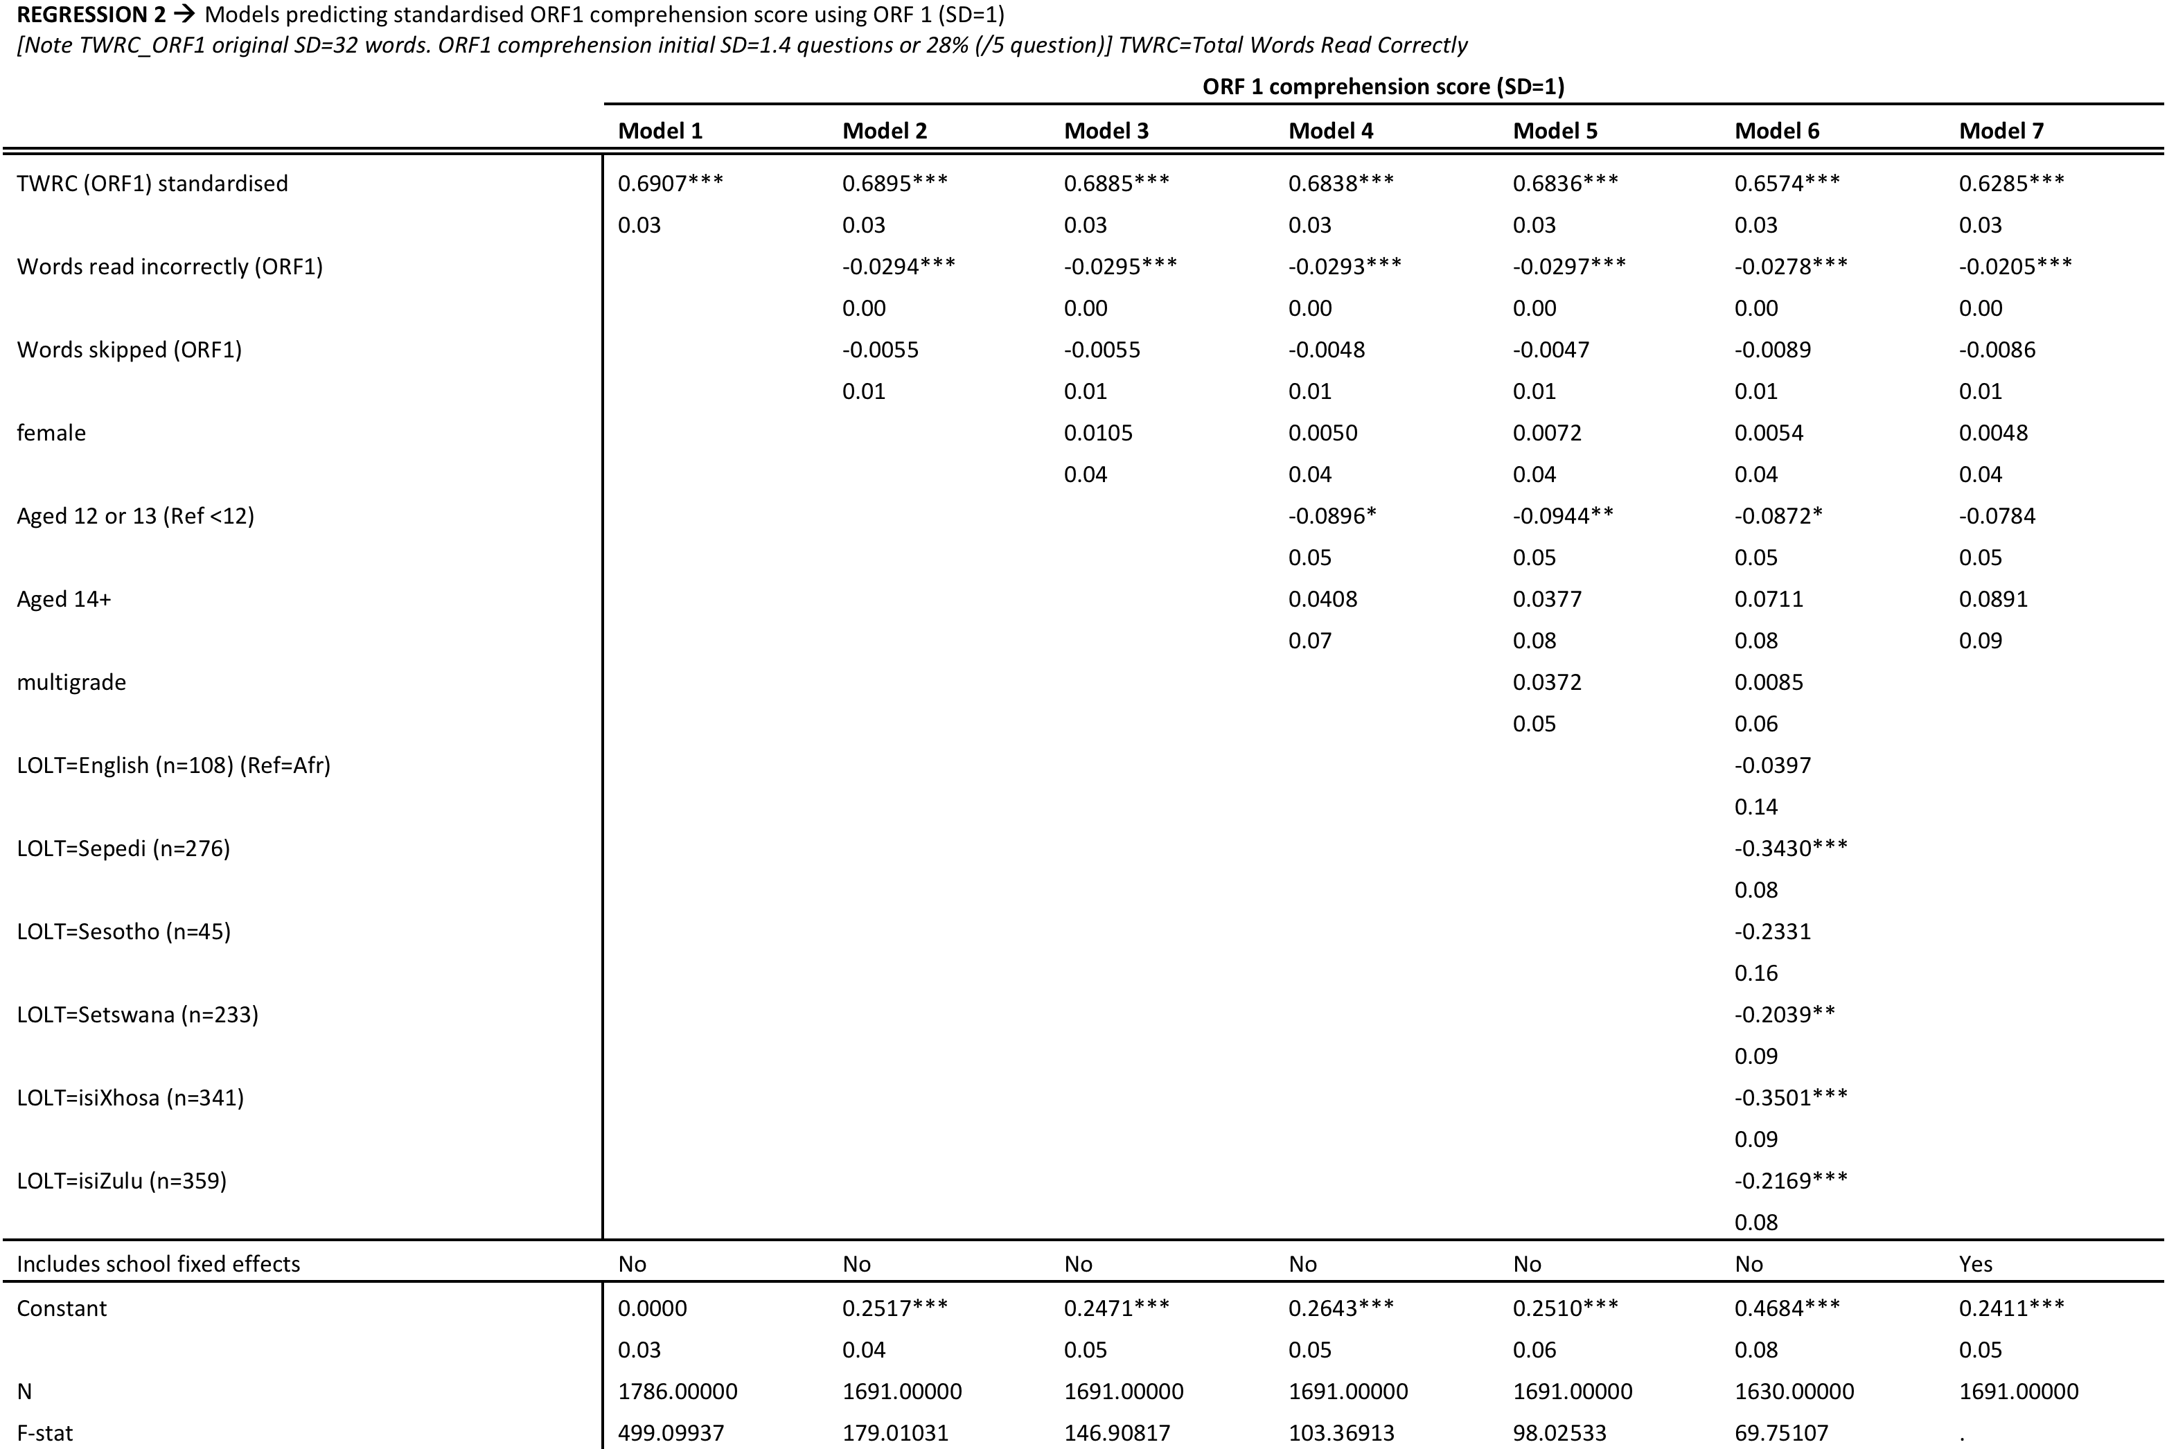

Slide 21
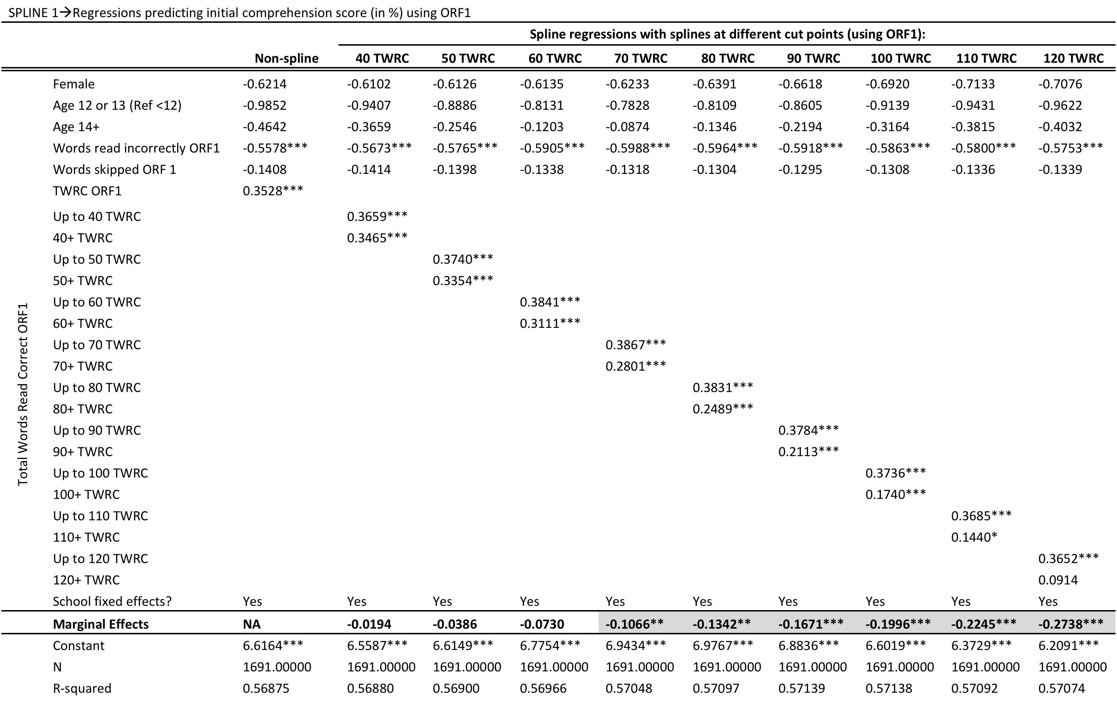

Slide 22
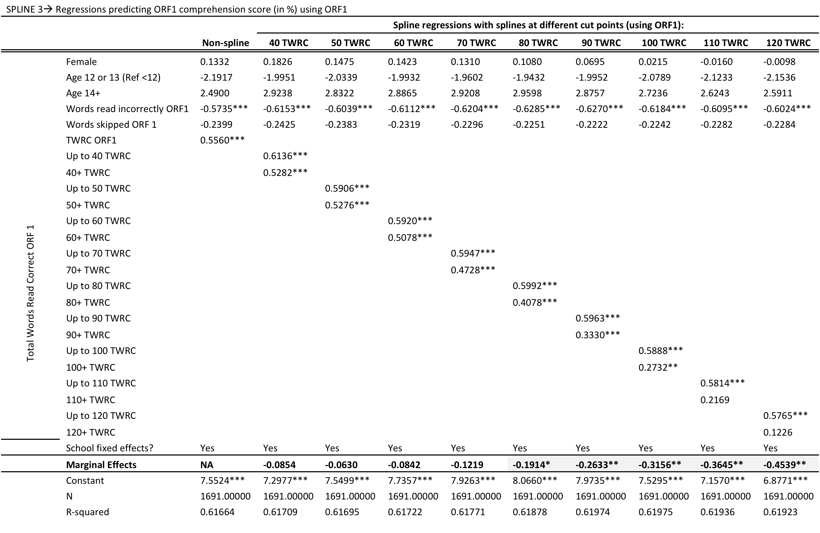

Slide 23
Current work: semi-parametric approach using residuals from fixed-effects

Slide 24
Tentative conclusions
New study testing oral reading fluency among L2 learners in SA.
  Confirms existing research; strong relationship between fluency and comprehension
  Stresses the importance of acquiring foundational reading skills in the early years (Gr1-3) – Grade 5 is MUCH too late.
  Extremely low levels of reading fluency. 60% of grade 5 rural learners are reading at a grade 1 level.
  High intra-class range in WCPM; in 50% of classes range (top-bot) >75 WCPM
A lack of automaticity is a binding constraint to reading (and comprehension) for most of these rural learners
  Automaticity develops through practice
  No reading homework
  No reading in the classroom
  Little access to books (60% of all SA primary schools have no library at all)
If these students are still battling with the ‘conscious-attention mechanism’ (i.e. no automaticity and not using ‘automatic activation processes’) little working memory can be freed up for comprehension.
  Schreiner (2003) suggests that automaticity in cognitive function frees up 90% of working memory for higher-order skills.
Strong relationship between fluency and comprehension.
  1 standard deviation increase in WCPM is associated with a 0.7 SD increase in comprehension. (Alternatively 20 additional WCPM associated with 10 percentage point increase in comprehension)
  Returns to fluency are highest up to about 70 WCPM and decline from there. In contrast to 90 WCPM for L1 speakers (McGuiness, 2005)
Policy

Slide 25
Vast majority of kids do switch
Language of learning and teaching (LOLT), ANA 2013

Slide 26
Background
Readability ease
Readability refers, broadly, to the ease or difficulty with which texts are read. Various readability formulae are employed to quantify aspects of texts that are deemed to play a role in determining the ease with which texts are read. These readability formulae typically incorporate word length and sentence length in relation to overall text length, the assumption being that short words and short sentences are easier to read than longer words and sentences. Examples of readability formulae include the Flesch Reading Ease (RE), the Dale-Chall and the Grammatik formulae that are available on software programmes such as MS Word. The assumptions underlying the readability formulae have not been without their critics, the main charge being that such formulae oversimplify the reading process, since there are also several text-based and reader-based factors that affect reading ease. Notwithstanding such criticisms, readability formulae continue to enjoy popularity as gross predictors of text difficulty.
The Flesch Reading Ease formula, based on syllables per 100 words, words per sentence and number of passive constructions used in a text, was used for the purposes of this study, primarily because it is easily available and in the absence of standardised test instruments in the local educational context, serves as a rough guideline for establishing consistency across texts at specific grade levels.
The higher the reading ease (RE) score, the easier the text is regarded as being; the lower the number, the more difficult the text. The scores have been measured in terms of readability categories, as shown in Table 1 below. Grade 4 and 5 textbooks fall within the 90-70 range of scores.

Slide 27
Distributions
ORF1 (1786)
ORF2 (867)

Slide 28
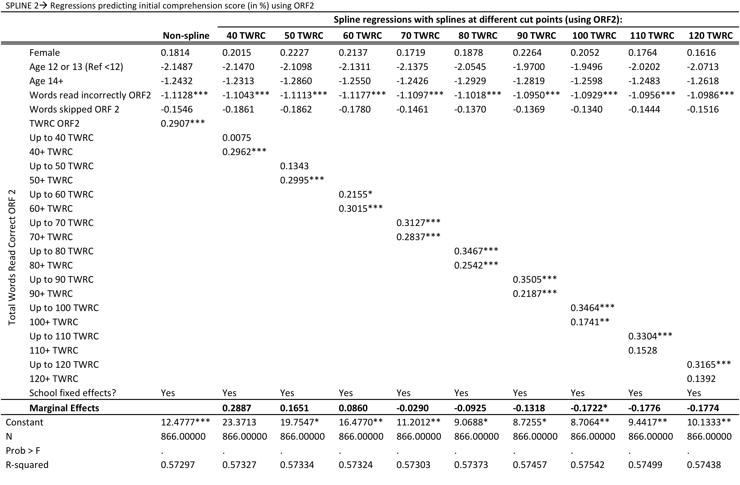

Slide 29
