Slide 1




Measuring access to learning over a period of increased access to schooling: The case of Southern and Eastern Africa since 2000
- Stephen Taylor & Nicholas Spaull
17 Feb 2015
Presentation at University of the Western Cape (UWC) Economics Department

Slide 2
Introduction & background
Since its inception, the discipline of economics has always had a keen interest in education and skills
Essentially three periods in the education-in-economics literature
  Period 1: up to 1960 – economists discuss importance of education and skills but not within a single unified theory.
    “The improved dexterity of a workman may be considered in the same light as a machine or instrument of trade which facilitates and abridges labour, and which, though it costs a certain expense, repays that expense with a profit” (Smith, 1776, p. 166).
    “Capital consists in a great part of knowledge and organisation…Knowledge is our most powerful engine of production; it enables us to subdue Nature and force her to satisfy our wants” (Marshall, 1890, p. 115).
  Period 2: Establishment of Human Capital literature, primarily by Mincer (1958), Schultz (1961) and particularly Becker (1962)
  1960- 2001 where education was included in economic analyses but proxied using enrolment rates and/or grade attainment (i.e. quantity)
  Not unacknowledged but unsolved
    Blaug speaks about the “unresolved problem” in rate of return studies and explains that “students choose, not just schooling, but schooling of a certain type and quality, and few rate-of-return calculations have succeeded in successfully standardizing the calculated yields for quality of educational institutions” (Blaug, 1976, p. 841).
  Period 3: 2000+ Hanushek & Kimko (2000), Hanushek & Woessman (2008) [later others] incorporated education quality into economic analyses
    When trying to explain economic growth using a model of income and years of schooling, the share of the variation in economic growth explained by the model jumps from 0,25 to 0,73 when cognitive skills are added to the model.

Slide 3
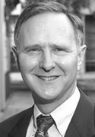

Access & Quality
“It is both conventional and convenient in policy discussions to concentrate on such things as years of school attainment or enrolment rates at schools. These things are readily observed and measured. They appear in administrative data, and they are published on a consistent basis in virtually all countries of the world. And they are very misleading in the policy debates. …schooling that does not improve cognitive skills…has limited impact on aggregate economic outcomes and on economic development…We provide strong evidence that ignoring differences in cognitive skills significantly distorts the picture about the relationship between education and economic outcomes” (Hanushek & Woessmann, 2008, p. 608).

Slide 4

Access & Quality
“Defining the scope of the problem of “lack of education” must begin with the objectives of education – which is to equip people with the range of competencies…necessary to lead productive and fulfilling lives fully integrated into their societies and communities. Many of the international goals are framed exclusively as targets for universal enrolments or universal completion. But getting and keeping children “in school” is merely a means to the more fundamental objectives of…. creating competencies and learning achievement” (Pritchett, 2004, p. 1).

Slide 5


Access & Quality
“While nearly all countries’ education systems are expanding quantitatively nearly all are failing in their fundamental purpose….. A goal of school completion alone is an increasingly inadequate guide for action…focusing on the learning achievement of all children in a cohort a [Millennium Learning Goal] eliminates the false dichotomy between “access/enrolment” and “quality of those in school”: reaching an MLG depends on both”
(Filmer, Hasan, & Pritchett, 2006, p. 1).

Slide 6
Access to what? Creating a composite indicator of educational access and educational quality for 11 African countries
Aim
  Create a single composite indicator that combines educational quantity (enrolment & grade survival) with educational quality (educational outcomes)
  Identify what proportion of students
    never enroll,
    enroll but dropout before completing Gr6,
    complete Gr6 but remain illiterate/innumerate,
    complete Gr6 with basic skills,
    complete Gr6 with higher order skills
    All of the above for important subgroups of gender and wealth.
Literature
  Large literature illustrating that in many developing countries children often learn little despite being enrolled in school
    (Filmer, 2006; Pritchett, 2013; Muralidharan & Zieleniak, 2013; Taylor et al, 2013)
  Pioneering work of Hanushek & Kimko/Woessman (2000/2008) shifted the focus from the quantity of educ (enrolment/attainment) to educ quality (outcomes)
Notes:
Spaull, N., and Taylor, S. (2015). Access to what? Creating a composite measure of educational quantity and educational quality for 11 African countries. Comparative Education Review. Vol. 58, No. 1.

Slide 7
Chapter 4: Access to what? Creating a composite indicator of educational access and educational quality for 11 African countries
Method
  Access: Use Demographic and Health Survey (DHS) data for enrolment and grade survival rates (highest grade completed)
  We use 19-23 year olds because <5% of those 19yrs+ are currently enrolled in grades 1-6.
    Serious problems with using NERs, NARs, & Kaplan-Meier estimates
  Quality: Use SACMEQ Gr6 numeracy and literacy test results
  Combine the two by assuming that children who do not complete grade 6 are illiterate and innumerate (i.e. do not reach SACMEQ level 3) which provides the proportion of a cohort who complete grade 6 and acquire basic reading/mathematical skills.
  Termed “access-to-literacy” and “access-to-numeracy” (alternatives were ‘efficacious enrolment’, ‘effective enrolment’)
  For national and gender-specific rates one can multiply DHS grade 6 completion rates with SACMEQ literacy rates to get access-to-literacy
  For SES sub-groups this is not possible due to differential grade 6 completion rates by SES group (40:40:20). I correct for this.

Slide 8
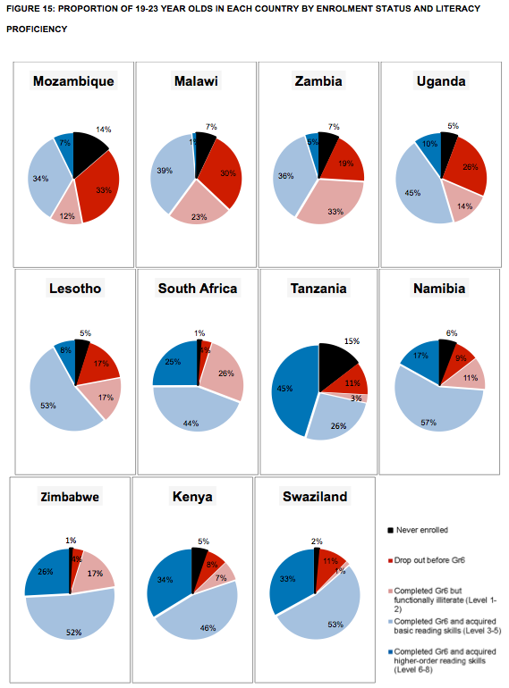
Chapter 4: Access to what? Creating a composite indicator of educational access and educational quality for 11 African countries
Take Mozambique:
Gr6 comp rate (DHS): 53%
Gr6 literacy rate (SACMEQ): 79%
Access-to-literacy rate: 42%

Slide 9
Access to what? Creating a composite indicator of educational access and educational quality for 11 African countries
Figure 17: Gaps in Access-to-literacy rates by gender, gender-wealth interaction, and wealth with 95% confidence intervals
SES gaps in A2L are larger than gender gaps in all countries.
Poorer countries
Boys > girls
Richer countries
girls > boys
Combining access and quality shows the true extent of differences between subgroups (eg Mozambique, Lesotho).

Slide 10
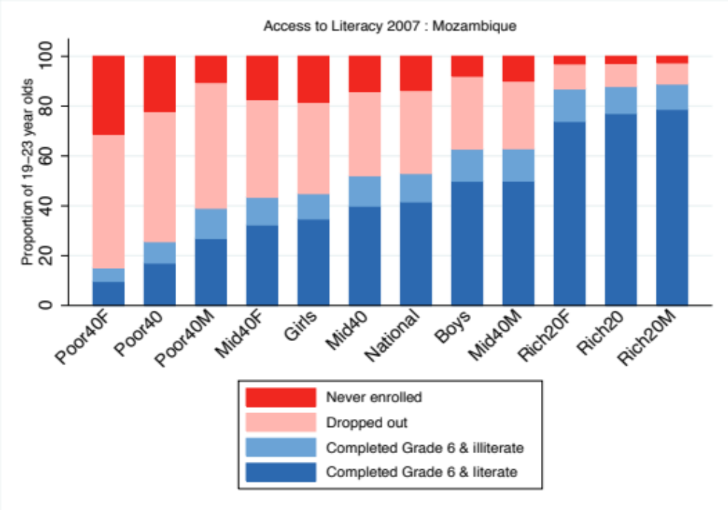
Figure 19: Access to literacy rates for Mozambican sub-groups (DHS 2011, SACMEQ 2007)

Slide 11
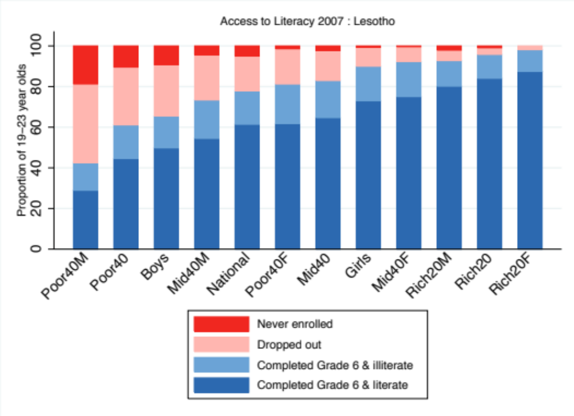
Figure 22: Access to literacy for Lesotho 19-23 year old sub-groups (DHS 2009, SACMEQ 2007)

Slide 12
Measuring access to learning over a period of increased access to schooling: The case of Southern and Eastern Africa 2000-2007
Aim
  Use the newly developed access-to-literacy measure to compare education system performance over time (2000-2007)
Data
  Access: 2x DHS data sets per country circa 2003 and circa 2010
  Quality: SACMEQ 2000 and SACMEQ 2007
Literature
  Strong perception of an access-quality trade-off (rarely tested empirically)
  “In some African cases, the expansion of the primary system appears to have been accompanied by sharp declines in school quality, such that literacy and numeracy are no longer so readily delivered by the primary system.” (Colclough, Kingdon and Patrinos 2009, p. 2).
  “The impressive achievements made in improving access to school have to be balanced against issues of declining quality” (Chimombo, 2009, p. 309).
  “The rapid increases in school enrolment almost certainly have reduced school quality as schools became overcrowded and existing resources were strained” (Glewwe et al. 2014, p. 391).

Slide 13
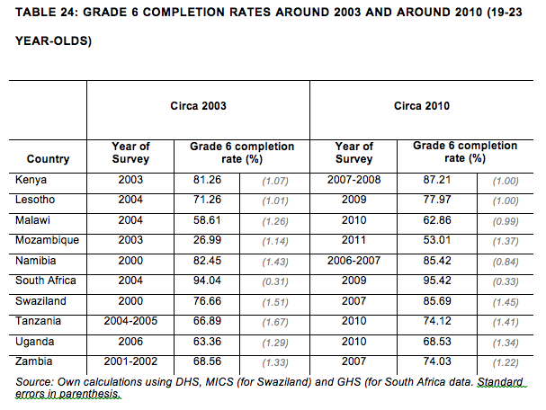
Access to quality

Slide 14
Findings
Figure 24: Access-to-literacy rates in 2000 and 2007
Figure 24: Access-to-NUMERACY rates in 2000 and 2007

Slide 15
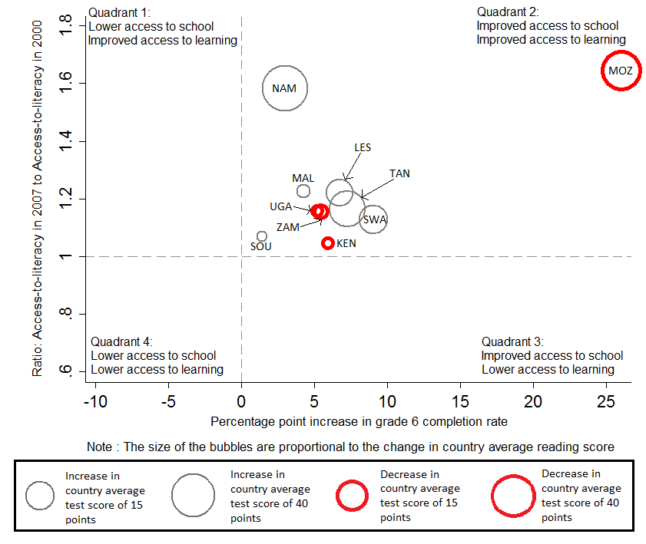
Access to literacy 2000-2007

Slide 16
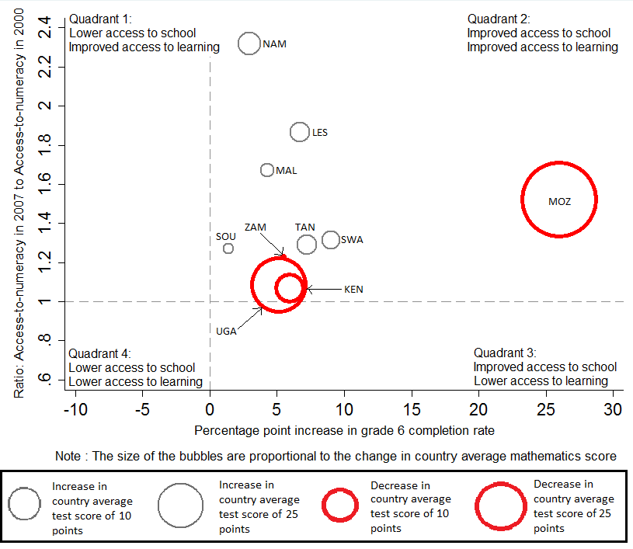
Access to numeracy 2000-2007

Slide 17
Access to literacy (Mozambique)
A lower mode can decrease the average score but still be consistent with overall improvements if there are many more students at every level (as here)

Slide 18
Access to quality & GPI
Analysing gender inequalities in access to schooling OR learning outcomes (quality) understates the overall gender gap.
For example in Mozambique
  Access (Gr6 completion): 63% for boys; 45% for girls (GPI=0.72)
  Quality (numerate): 70% for boys; 64% for girls (GPI=0.91)
  Access-to-numeracy: 44% for boys; 29% for girls (GPI=0.65)
Congruent with the literature, for example Lewis and Lockheed (2006; 2007; 2008) who talk of a “double disadvantage”

Slide 19
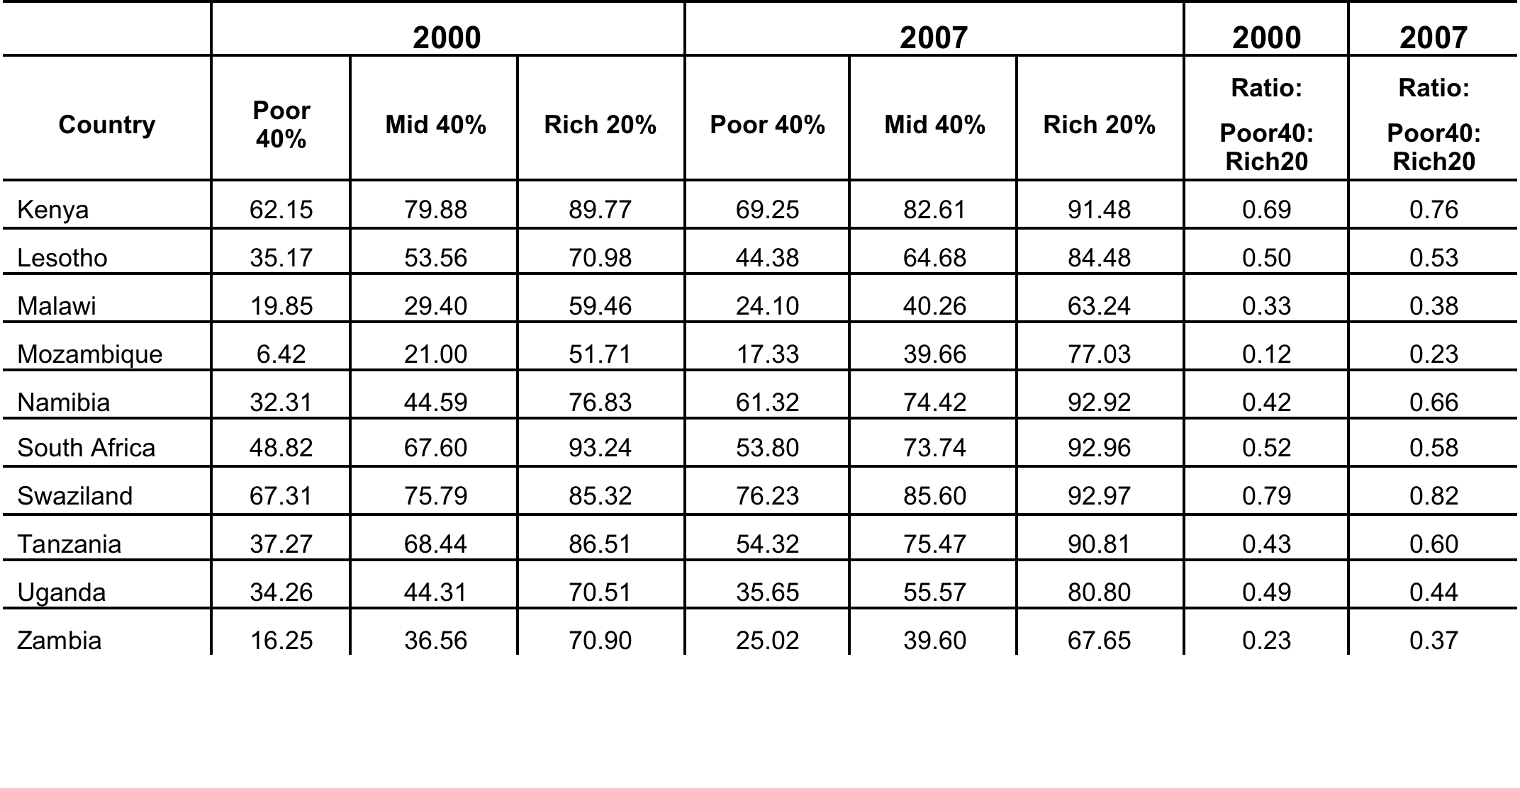
Access to literacy (SES)

Slide 20
Access to literacy, gender
Figure 29: Gender Parity Index with respect to Access-to-literacy in 2000 and 2007
Figure 30: Gender Parity Index with respect to Access-to-NUMERACY in 2000 and 2007

Slide 21
Access to higher order skills?

Slide 22
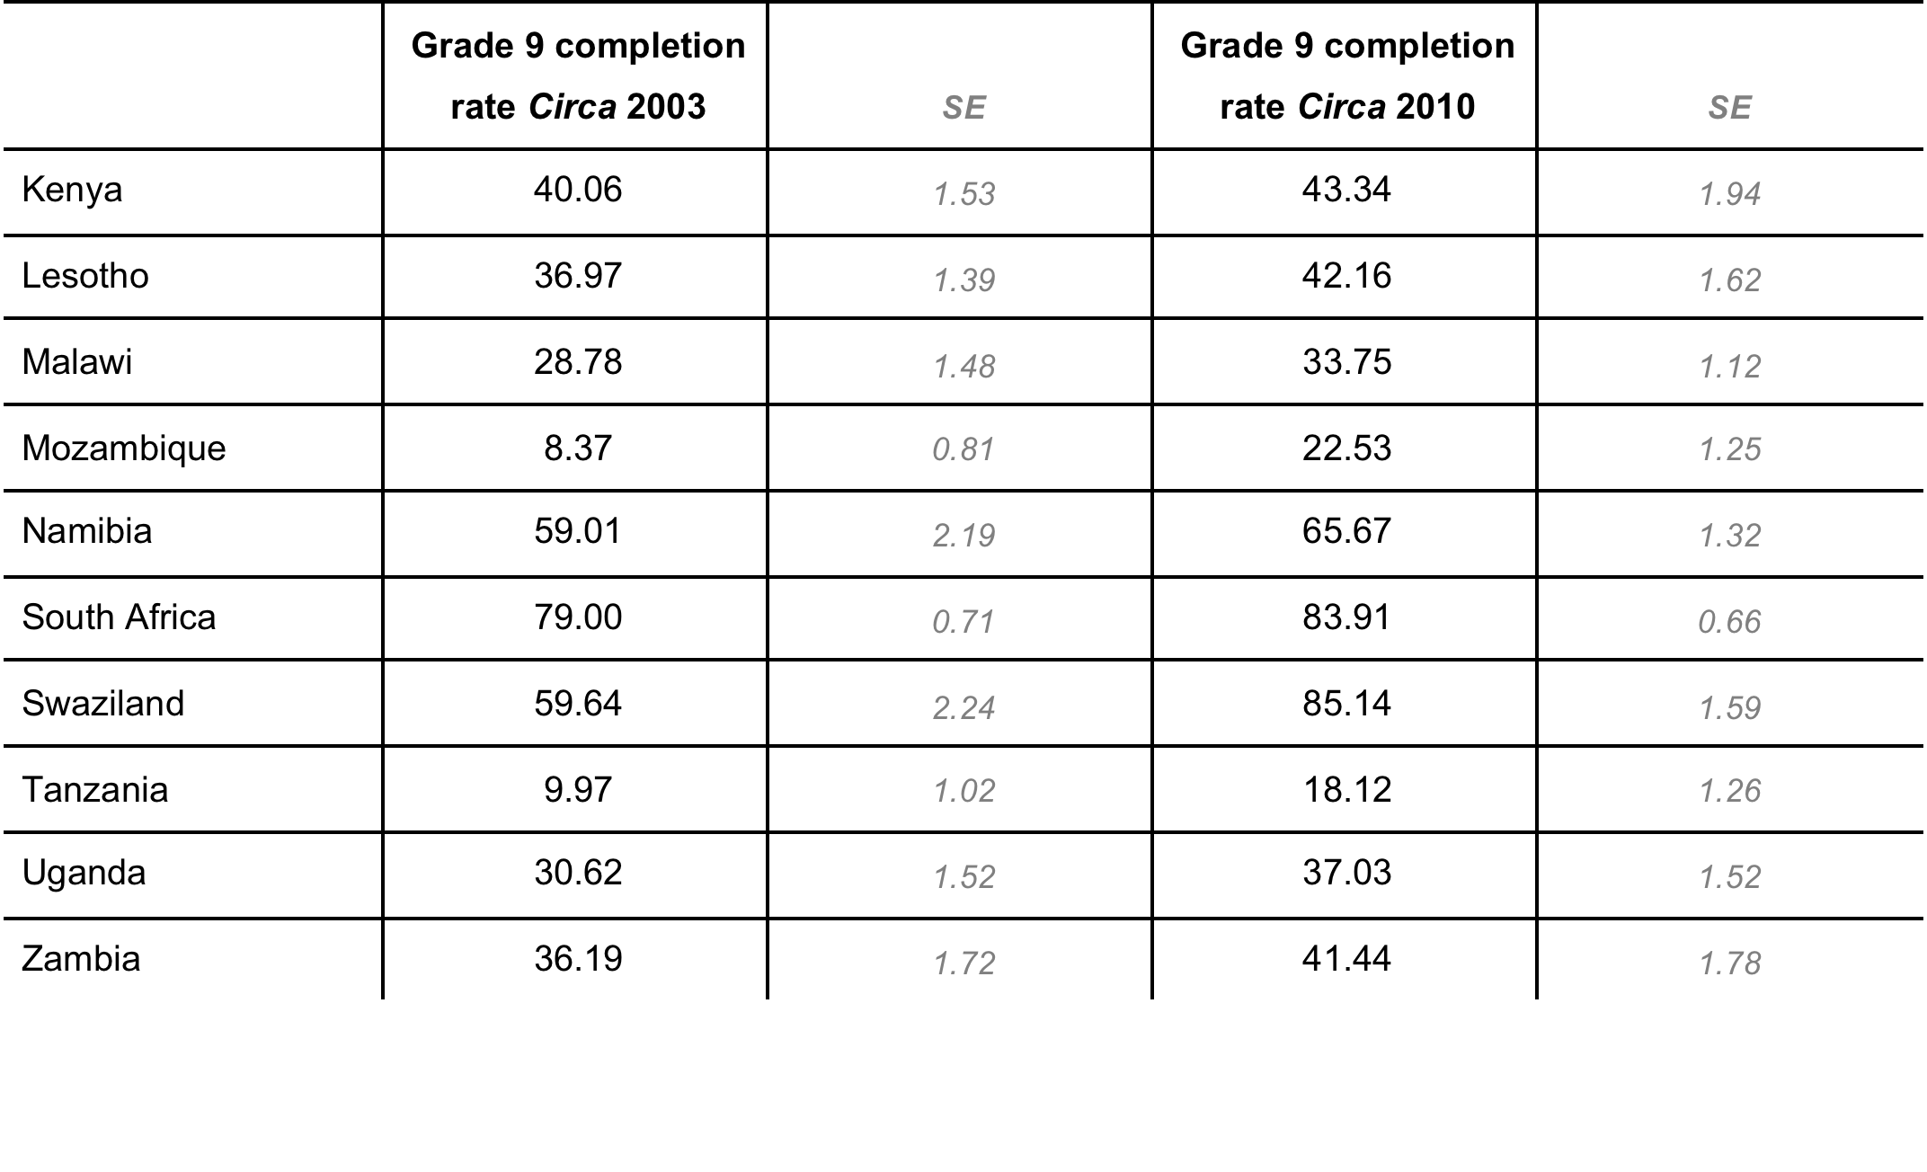
Access to higher grades?

Slide 23
Conclusions
Viewing country average test scores or enrolment rates in isolation is misleading, (esp RE trends)
Education system performance should be reconceptualised as the amount of learning that takes place in the overall population of children (enrolled and non-enrolled)
Expansion of access to primary schooling in these 10 countries contributed to improved access to literacy & numeracy
  Girls and the poor benefitted disproportionately
  Also accompanied by
    access to higher order literacy and numeracy
    Increased attainment of higher levels of schooling (Gr9 completion)
  Results robust to alternative measure of access (using augmented administrative data) rather than HH survey data
The perception of an access-quality trade-off has less empirical support than was previously thought to be the case
Important to develop these types of statistics for post-2015 MDG

Slide 24
Publications
  Spaull, N., and Taylor, S. (2015). Access to what? Creating a composite measure of educational quantity and educational quality for 11 African countries. Comparative Education Review. Vol. 58, No. 1.
  Taylor, S., and Spaull, N. (2015). Measuring access to learning over a period of increased access to schooling: The case of Southern and Eastern Africa since 2000. International Journal of Educational Development. (accepted)

Slide 25
Thank you
Comments, suggestions & questions welcome

Slide 26
A trade-off between access & quality?
The numbers of grade 6 children reaching each level of achievement: Mozambique reading
Population growth (2000-2007) 20.6%.
Notes:
RF2 is used to estimate the population figures.
The rf2 factor is based on the inverse of the probability of selection of the sample members and makes the total weighted number of students equal to the ESTIMATED population size.
The calculation of rf2 includes taking account of the actual numbers of Grade 6 pupils in a school at the time of the actual data collection (as well as the number from the school census). It also includes attempts at adjustments for missing data due to non-response.
The main message is that rf2 is a mixture of school census and sample data and adjustments for non-response. You should therefore treat it as a sampling weight that provides estimates of the population figures. Estimates using rf2 as a sample weight will have sampling errors and confidence limits (just as estimates using pweight2 have sampling errors and confidence limits). These can be estimated via the complex sampling options in STATA
Distribution of this graph will influence whether there was an increase in the average SACMEQ score or a decrease

Slide 27
A trade-off between access & quality?
The numbers of grade 6 children reaching each level of achievement: Kenya reading
Population growth (2000-2007) 6.3%.

Slide 28
A trade-off between access & quality?
The numbers of grade 6 children reaching each level of achievement: Tanzania maths
Population growth (2000-2007) 16.8%.

Slide 29
A trade-off between access & quality?
The numbers of grade 6 children reaching each level of achievement: Uganda maths
Population growth (2000-2007) 25.6%.

Slide 30
A trade-off between access & quality?
The numbers of grade 6 children reaching each level of achievement: Malawi reading
Population growth (2000-2007) 26.8%.
Notes:
Malawi is kind of the opposite scenario: It did slightly worse in 2007 (although one shouldn’t over-read into it) despite having a higher SACMEQ average score. So the drop in the numbers reaching every level was due to lower enrolment.

Slide 31
A trade-off between access & quality?
The TAULL story:
Social composition:

Slide 32
A trade-off between access & quality?
The TAULL story:
Returns to parental education:

Slide 33
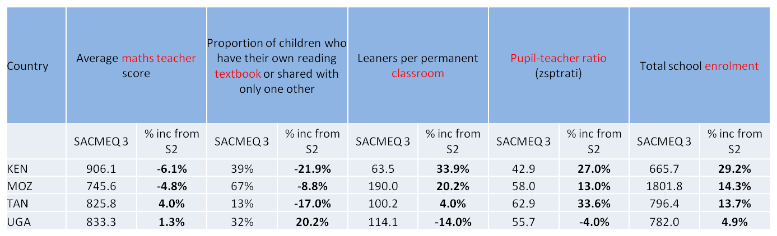
Stretch on school resources
Possibly consistent with production function literature: Teacher quality more NB than physical resources

Slide 34
Concluding discussion (Nic’s section)
We take the view that schooling that does not improve cognitive outcomes is only of limited value → Therefore enrolment rates are incomplete and inaccurate → Effectual enrolment rates are more informative
Our method of combining access (NAR) and quality (literacy/numeracy) is the most accurate, reliable and well-rounded measure of overall educational performance in SSA (as far as we are aware).
  The main innovation is the assumption that grade-6 aged students that are not attending school (dropout or non-enrolment) are functionally illiterate and functionally innumerate, allowing us to combine binary and continuous measures.
  Although it is uncomplicated it has not been done before for SSA
  Using DHS for cross-country comparisons of attendance rates is methodologically more sound than UNESCO’s NER

Slide 35
Concluding discussion (Stephen’s section)
The case for a trade-off between access and quality (as measured by outcomes) has been overstated, at least for most countries included here. Countries can and have managed to increase both access to education, and the quality thereof.
  Resources are often stretched → however, limited impact on performance – able to do more with less per pupil.
  Only one country could not keep up with population growth: Malawi

Slide 36
Further research
Does increased access to primary school lead to increase access to secondary and tertiary education?
  Somerset (2007) argues that the abolition of school fees in Kenya in 1974 led to a massive increase in grade 1 enrolments accompanied by a huge increase in drop-out thereafter.
  Our preliminary analysis suggests that the big expanders in SACMEQ also improved wrt survival to grade 9 and enrolment amongst 16 year-olds (using consecutive DHS’s)
  However, bottlenecks can mean that expanded access can have the perverse impact of SES becoming a more important determinant of access to higher levels of education. (Lewin, 2007)

Slide 37
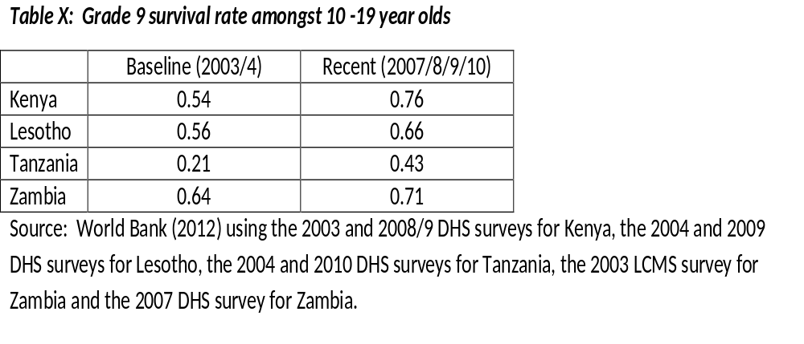
Persistence of benefits?

Slide 38
Questions we have:
How to link SACMEQ/skills distribution of the student population to skills distribution of the labour force?
DHS enrolment rates are based on a questionnaire that says something like “Were you at school for at least one day in the past year?” → very coarse measure of attendance
Including SACMEQ scores in cross-country growth regressions ala H&W? – useful? Interesting? Martin?

Slide 39
References
Filmer, D. (2010). Educational Attainment and Enrollment around the World. The World Bank. econ.worldbank.org/projects/edattain: Development Research Group.
Filmer, D., & Pritchett, T. (1999). The Effect of Household Wealth on Educational Attainment: Evidence from 35 Countries. Population and Development Review, 25(1), 85-120.
Hanushek, E., & Woessmann, L. (2008). The Role of Cognitive Skills in Economic Development. Journal of Economic Literature, 46(3), 607-668.
Hungi, N. (2010). What are the levels and trends in grade repetition? www.sacmeq.org: Southern and East African Consortium for Monitoring Educational Quality .
Hungi, N., Makuwa, D., Ross, K., Saito, M., Dolata, S., van Capelle, F., et al. (2010). SACMEQ III Project Results: Pupil Achievement Levels in Reading and Mathematics. Paris: Southern and Eastern Africa Consortium for Monitoring Educational Quality.
Lambin, R. (1995). "What can Planners Expect from International Quantitative Studies?" Reflections on Educational Achievement: Papers in Honour of T. Neville Postlethwaite. Waxmann Verlag.
Lewin, K. (2007). Improving Access, Equity and Transitions in Education: Creating a Research Agenda. Co. Sussex: Consortium for research on Educational Access, Transitions and Equity (CREATE).
Lewin, K. (2009). Access to education in sub-Saharan Africa: patterns, problems and possibilities. Comparative Education, 45(2).
Pritchett, L. Towards a New Consensus for Addressing the Global Challenge of the Lack of Education. Copenhagen: Copenhagen Consensus, 2004.
Ross, K., Saito, M., Dolata, S., Ikeda, M., Zuze, L., Murimba, S., et al. (2005). The Conduct of the SACMEQ II Project. In E. Onsomu, J. Nzomo, & C. Obiero, The SACMEQ II Project in Kenya: A Study of the Conditions of Schooling and the Quality of Education. Harare: SACMEQ.
SACMEQ. (2010). SACMEQ III Project Results: Pupil Achievement Levels in Reading and Mathematics. Retrieved January 2011, from Southern and Eastern Africa Consortium for Monitoring Educational Quality: http://www.sacmeq.org/downloads/sacmeqIII/WD01_SACMEQ_III_Results_Pupil_Achievement.pdf
Sen, A. (1999). Development as Freedom. Oxford: Oxford University Press
UIS. (2009). Global Education Digest 2009: Comparing Education Statistics Across the World. Montreal: UNESCO Institute for Statistics.
UNESCO. (2005). Education For All Global Monitoring Report 2005. Paris: UNESCO Publishing.

Slide 40
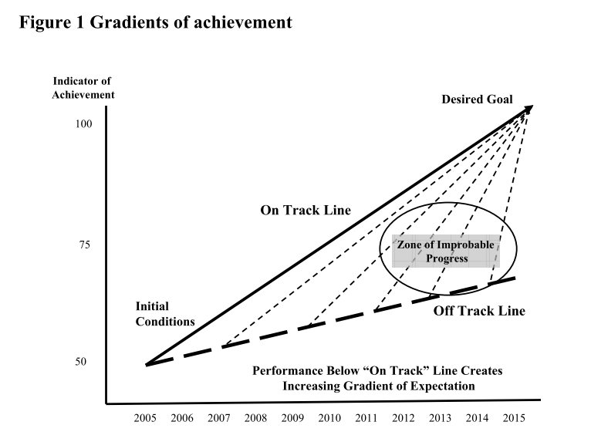
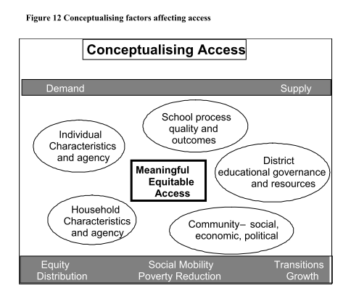
Lewin 2007

Slide 41
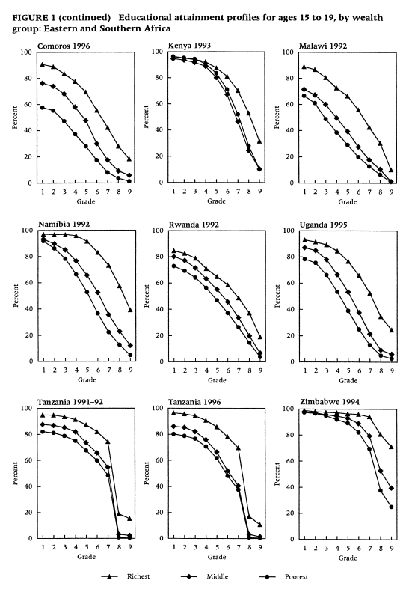
Filmer & Pritchett 1999

Slide 42
Wealth differences

Slide 43
Functionally literate/numerate
  If a student reaches Level 3 for Reading and Mathematics, they are classified as being functionally literate and functionally literate.
  If not, they are classified as functionally illiterate and functionally innumerate. By this definition, a functionally illiterate learner cannot read a short and simple text and extract meaning, while a functionally innumerate learner cannot translate graphical information into fractions or interpret everyday units of measurement.
  An important innovation in the paper is our assumption that grade-6 aged students that are not attending school (due to dropout or non-enrolment) are functionally illiterate and functionally innumerate….this allows us to combine access (binary) and quality (continuous) variables.
  See Shabalala, 2005: p222
Basic reading (L3)
Interprets meaning (by matching words and phrases, completing a sentence, or matching adjacent words) in a short and simple text by reading on or reading back.
Basic numeracy (L3)
Translates verbal information presented in a sentence, simple graph or table using one arithmetic operation in several repeated steps. Translates graphical information into fractions. Interprets place value in whole numbers up to thousands. Interprets simple common everyday units of measurement.

Slide 44
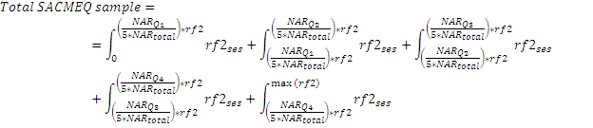
Correcting for differential access by quintile
Functionally illiterate
21% of SACMEQ students come from quintile 5
19% of SACMEQ students come from quintile 1
 | NAR by quintile | Quintile | from DHS | As proportion | F-Lit (SACMEQ)
Q1 | 79.9 | 20 | 16.0 | 18.7 | 94%
Q2 | 83 | 20 | 16.6 | 19.4 | 95%
Q3 | 89.2 | 20 | 17.8 | 20.9 | 97%
Q4 | 85.7 | 20 | 17.1 | 20.1 | 99%
Q5 | 89 | 20 | 17.8 | 20.9 | 98%

Slide 45
Sense-check
Table 3: Grade survival rate [Data: World Bank survey data, Filmer (2010)]
What about literate pre-Grade 6 dropout?
Perhaps children from SWA / TAN / KEN (where literacy rates in Gr6 are high) will be literate even though they dropout in Gr5?
% children who survive to grade 5 but not grade six is never > 5%
School system has still “failed” these children
 | Gr 1 | Gr 2 | Gr 3 | Gr 4 | Gr 5 | Gr 6 | Gr 7 | Gr 8 | Gr 9
Tanzania | 91% | 90% | 89% | 88% | 85% | 84% | 82% | 55% | 55%
Malawi | 94% | 92% | 90% | 86% | 83% | 79% | 74% | 69% | 61%
Zambia | 95% | 95% | 93% | 92% | 89% | 87% | 84% | 75% | 71%
Kenya | 96% | 96% | 96% | 95% | 94% | 93% | 91% | 88% | 76%
Uganda | 96% | 95% | 94% | 91% | 88% | 82% | 74% | 59% | 56%
Namibia | 96% | 96% | 95% | 94% | 93% | 91% | 90% | 86% | 83%
Swaziland | 97% | 96% | 95% | 94% | 92% | 90% | 85% | 79% | 74%
Lesotho | 97% | 97% | 96% | 94% | 91% | 89% | 84% | 72% | 68%
Zimbabwe | 99% | 99% | 98% | 97% | 96% | 94% | 91% | 74% | 69%
South Africa | 99% | 99% | 99% | 99% | 98% | 98% | 96% | 94% | 91%

Slide 46
Sense-check
Figure 7: Percentage point decrease in grade survival rate relative to previous grade

