Slide 1

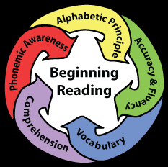
What do we know about reading outcomes in SA?
-Nic Spaull
(OECD/UJ/SU)
18 May 2016
BRIDGE

Slide 2
Overview
SA context
Why focus on reading?
Background research on reading in SA
What data is there on reading outcomes?
  How do sample-based assessments work?
  Inequality as the over-arching feature of SA education system
    Language, Province, Former-department, Socioeconomic status (SES)
  PIRLS (2011), prePIRLS (2011), SACMEQ 2007, NSES 2007-2009
New research on Oral Reading Fluency
  Draper & Spaull (2015)
Reading as THE binding constraint in the education system

Slide 3
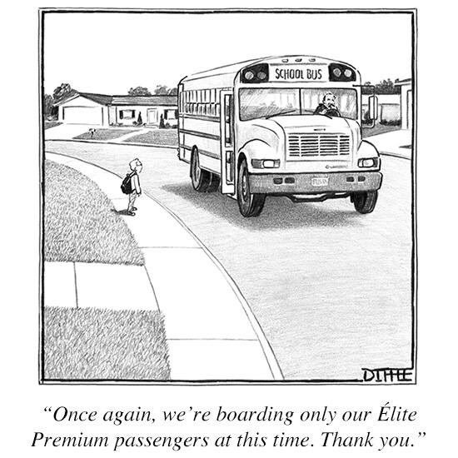
The curse of inequality

Slide 4



Not all schools are born equal
?
Pretoria Boys High School
SA public schools?

Slide 5
Complex language dynamics in SA
ANA 2013 Language of Assessment

Slide 6
Background: qualitative research on reading in SA
Hoadley (2016) summarizes the SA classroom-based research and finds the following descriptive features:
  Lack of opportunities for reading and writing (oral discourse dominates)
  Classroom interaction patterns that privilege the collective (chorusing)
  Weak forms of assessment and lack of feedback on student responses
  Students in poorer schools can usually mechanically decode text (i.e. pronounce sounds and words) but have little comprehension of the content of what they are reading
Similarly Pretorius & co-authors have found that a number of instructional practices (prevalent in SA) contribute to poor reading development:
  The tendency of teachers to rely on whole class oral chorusing of reading,
  The lack of reading homework
  Minimal reading of extended texts in the early grades
  (Pretorius & Machet 2004; Pretorius & Mokhwesana 2009; Pretorius 2014).

Slide 7
What data is there on reading outcomes in SA?
“Without data you are just another person with an opinion”
- Andreas Schleicher

Slide 8
How do sample-based assessments work?
 | Sample-based | Census-based | Number of schools? | Number of students? | Comparable over time?
Cross-national studies of educational achievement | TIMSS 1995, 1999, 2003, 2011, 2015 | - | 285 | 11969 | Yes
 | SACMEQ 2000, 2007, 2013 | - | 392 | 9071 | Yes
 | PIRLS 2006, 2011, 2015 (Eng/Afr only) | - | 92 | 3515 | Sort of
 | prePIRLS 2011, 2015 |  | 341 | 15744 | NA
National assessments (diagnostic) | Systemic Evaluations 2001 (Gr3) 2004 (Gr6), 2007 (Gr3) | - | 2340 | 54,000 | Sort-of
 | - | ANA 2011/12/13/14 | 24 | 7mil | Definitely not
 | Verification-ANA 2011, 2013 (Gr 3 & 6) |  | 2164 (125/prov) |  | No
 | NSES* Gr3 (2007) Gr4 (2008) Gr5 (2009) |  | 266 | 24000 (8383 panel) | Yes (+ longitudinal)
National assessments (certification) | - | Matric | 6591 | about 550,000
*Number of schools and students is for the most recent round of assessments
In addition to these, the Western Cape is the only province to have a population-based assessment at Grades 3, 6 and 9, also (confusingly) called the Systemic Evaluations (sometimes WCED SE)

Slide 9
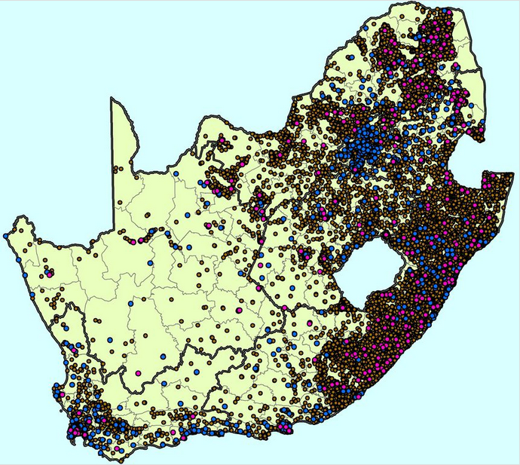
Purple dots = 266 NSES sampled schools
Brown dots = former black schools
Blue dots = former white schools
Purple dots = school included in NSES
(courtesy of Marisa Coetzee)

Slide 10
What do they show?

Slide 11
Numerous correlated dimensions
Inequality as the over-arching feature of education in SA
Given the apartheid-era policies, it is unsurprising that the inequalities we see in South Africa can be seen along a number of correlated dimensions, including
  Language,
  Geographical location,
  Socioeconomic status,
  Race
  Former department

Slide 12
Can children read in African languages?

Slide 13
Do children in English or Afrikaans LOLT schools learn to read?

Slide 14

Former department… (NSES)
NSES 2007-9
(Taylor, 2011)
Taylor, 2011

Slide 15

Socioeconomic status...
SACMEQ III (2007)
SACMEQ III (2007) Distribution of student reading scores by quartiles of
school socioeconomic status (Spaull, 2013)

Slide 16
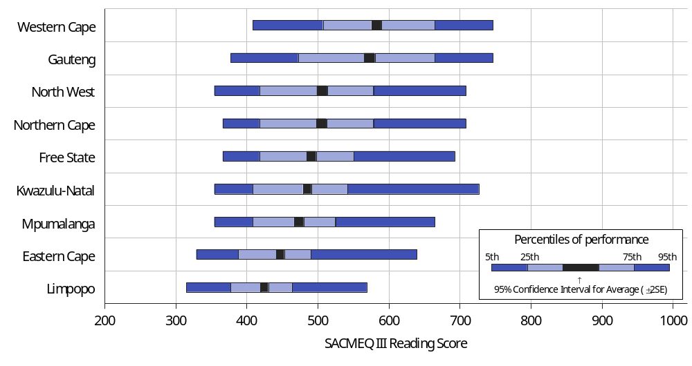
Province…SACMEQ III Reading (Gr6)

Slide 17

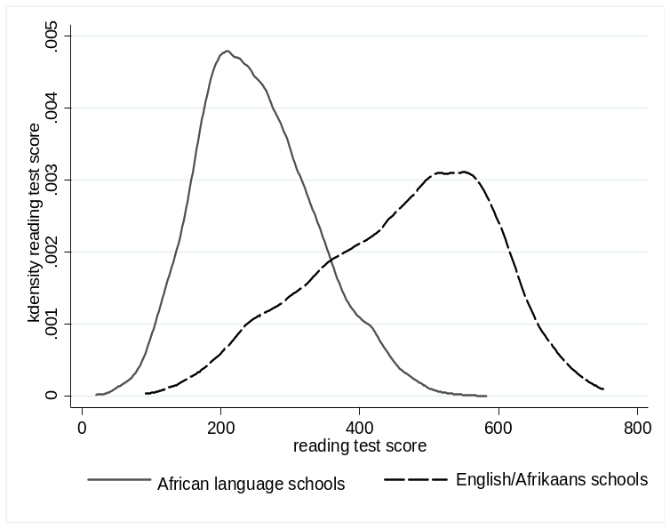



Bimodality – indisputable fact
PIRLS / TIMSS / SACMEQ / NSES / ANA / Matric… by Wealth / Language / Location / Dept…

Slide 18
Labour Market
15%
Legislators, managers, assoc professionals
Unemployed
(Broad - 35%)
Unskilled
(18%)
Elementary occupations & domestic workers
Semi-Skilled (32%)
Clerks, service workers, shop personnel, skilled agric/fishery workers, plant and machinery operators)
University/FET
Type of institution (FET or University)
Quality of institution
Type of qualification (diploma, degree etc.)
Field of study (Engineering, Arts etc.)
High productivity jobs and incomes (17%)
Mainly professional, managerial & skilled jobs
Requires graduates, good quality matric or good vocational skills
Historically mainly white
High quality secondaryschool
High SES background
+ECD
High quality primary school
Minority (20%)
Some motivated, lucky or talented students make the transition
Unequal society
Big demand for good schools despite fees
Some scholarships/bursaries
Vocational training
Affirmative action
Majority (80%)
Quality
Low quality secondary
school
Attainment
Type
Low productivity jobs & incomes
Often manual or low skill jobs
Limited or low quality education
Minimum wage can exceed productivity
Low SES background
Low quality primary school
QLFS 2014
Notes:
The QLFS classifies professions as follows: Highly skilled (legislators, senior officials and managers, professionals, technicians and associate profesionals); Semi-skilled (Clerks, service workers and shop and market personnel, skilled agricultural and fishery workers, craft and related trade workers, plant and machinery operators and assembly), Unskilled (Elementary occupations, domestic workers).

Slide 19
New research:
Oral Reading Fluency

Slide 20
ORF literature
Oral reading fluency, defined in terms of accuracy and speed in word recognition, has been found to be a reliable indicator of reading comprehension (Fuchs et al, 2001; Spear-Swerling 2006). Although prosody is part of fluency, difficult to measure objectively.
There is a strong empirical basis attesting to a relationship between fluency and reading comprehension. Fluency typically measured as total words read correct per minute.
Fuchs et al. (2001) report high correlations (0.8) between ORF and various kinds of reading comprehension measure such as high stakes state mandated comprehension tests, as well as a variety of other comprehension tests using different formats (e.g. multiple choice or open questions, cloze procedures or story recall protocols).
The relationship obtains across schools serving children from different socioeconomic backgrounds or instructional programmes, and occurs with children without reading difficulties as well as with children with learning disabilities with reading (Deno et al. 2001; Wolf & Katzir-Cohen 2001).

Slide 21
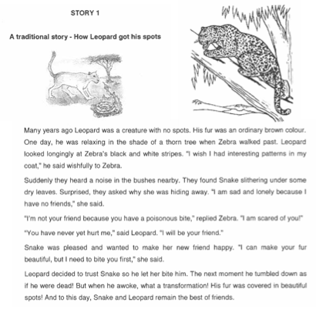
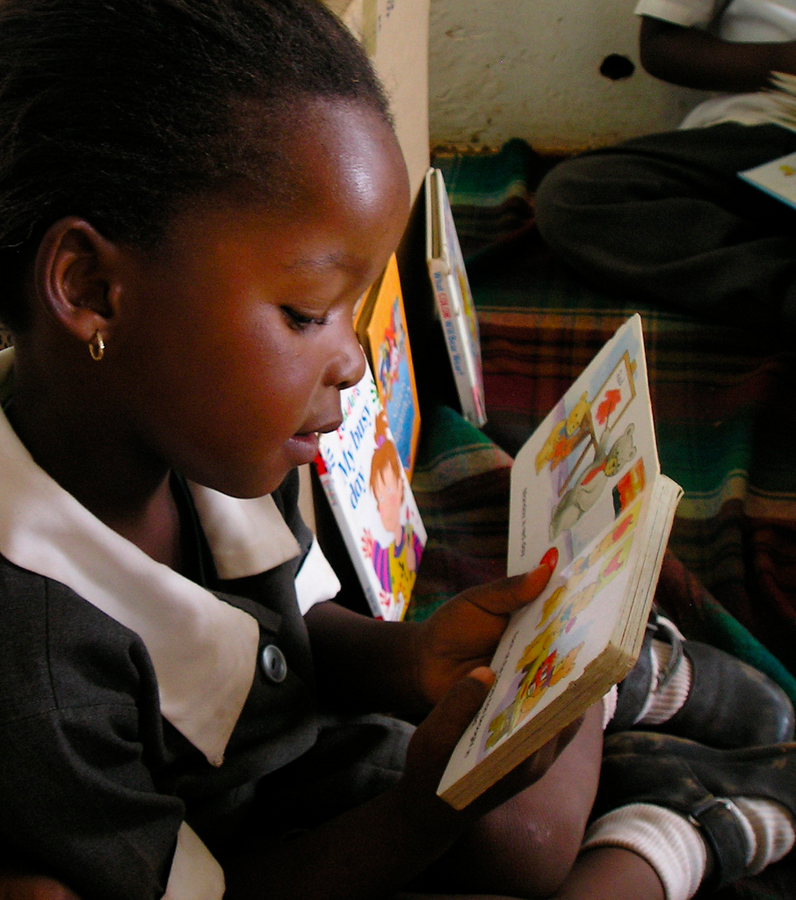
How do ORF assessments work?

Slide 22
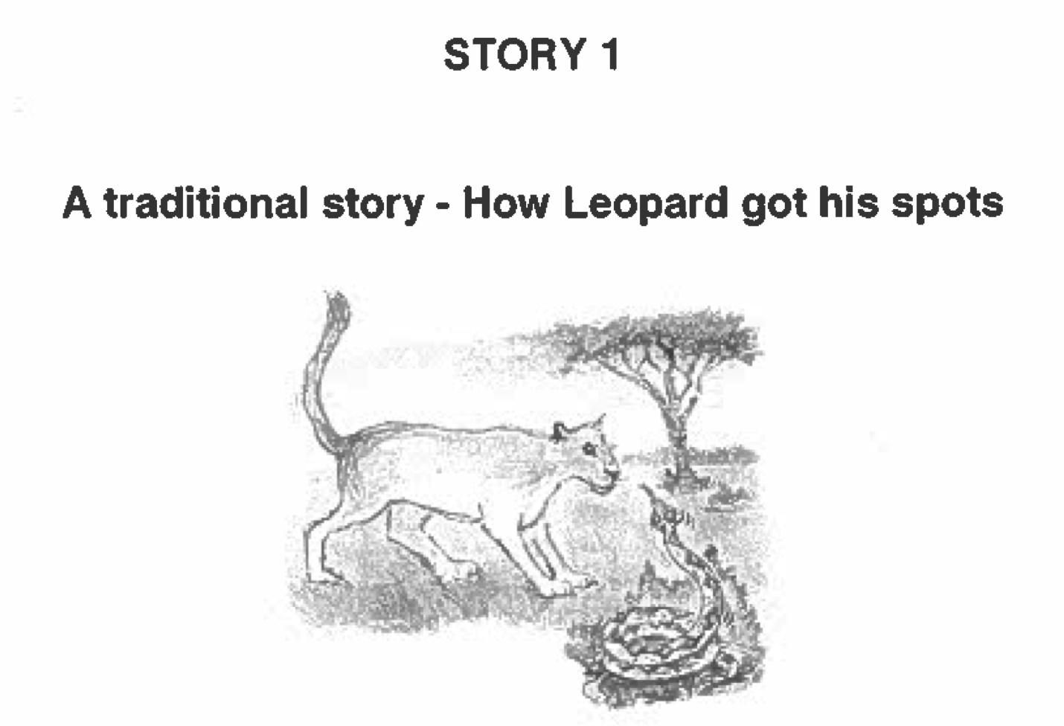
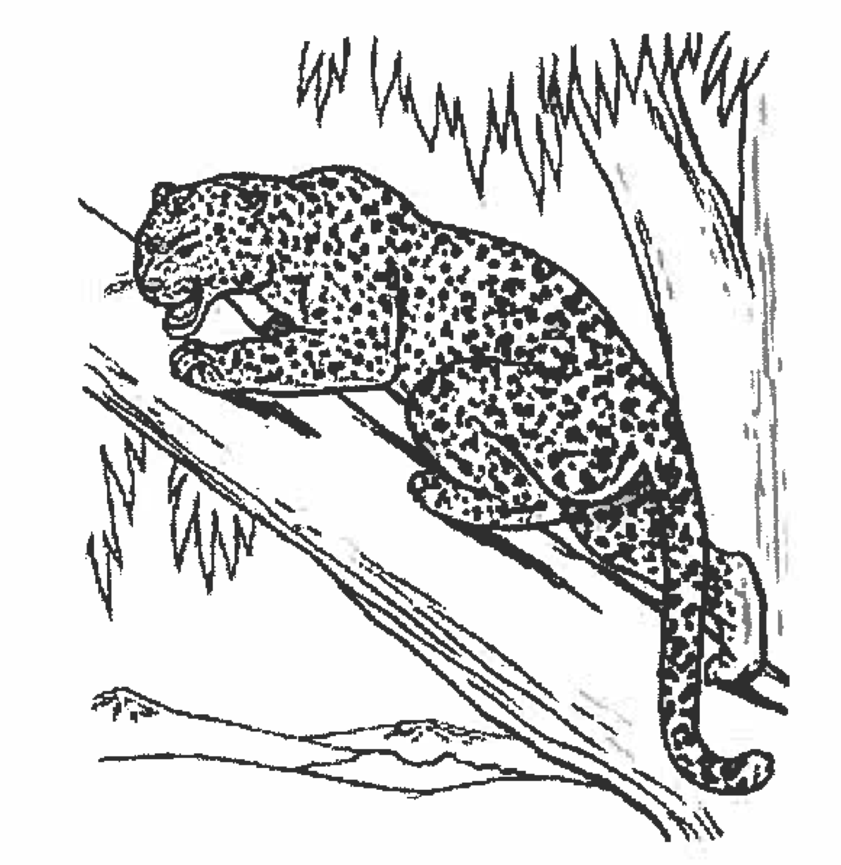
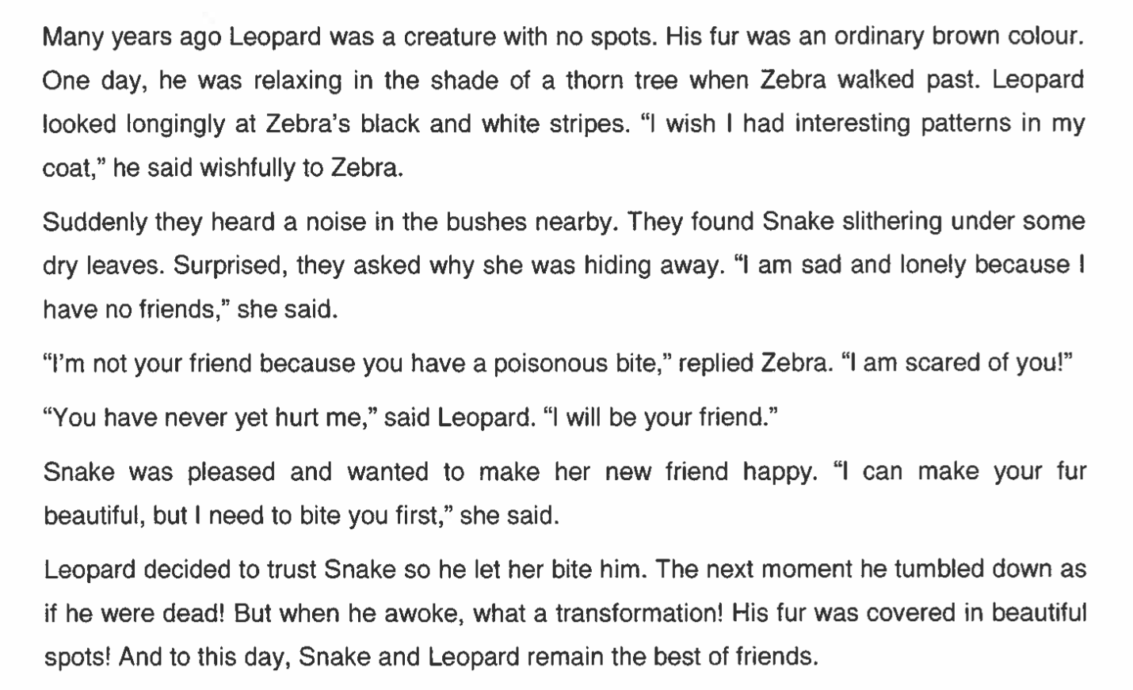
ORF Test 1

Slide 23
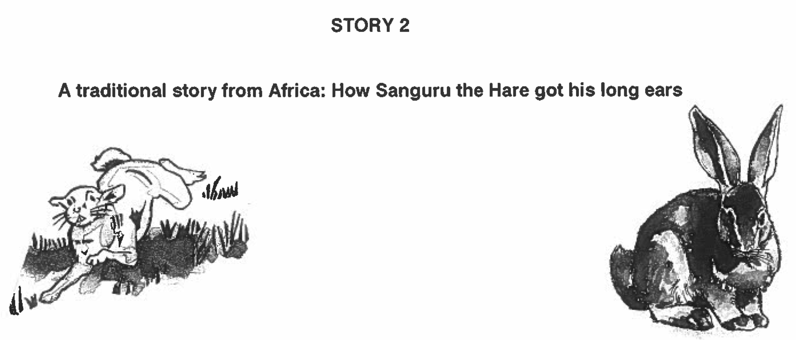
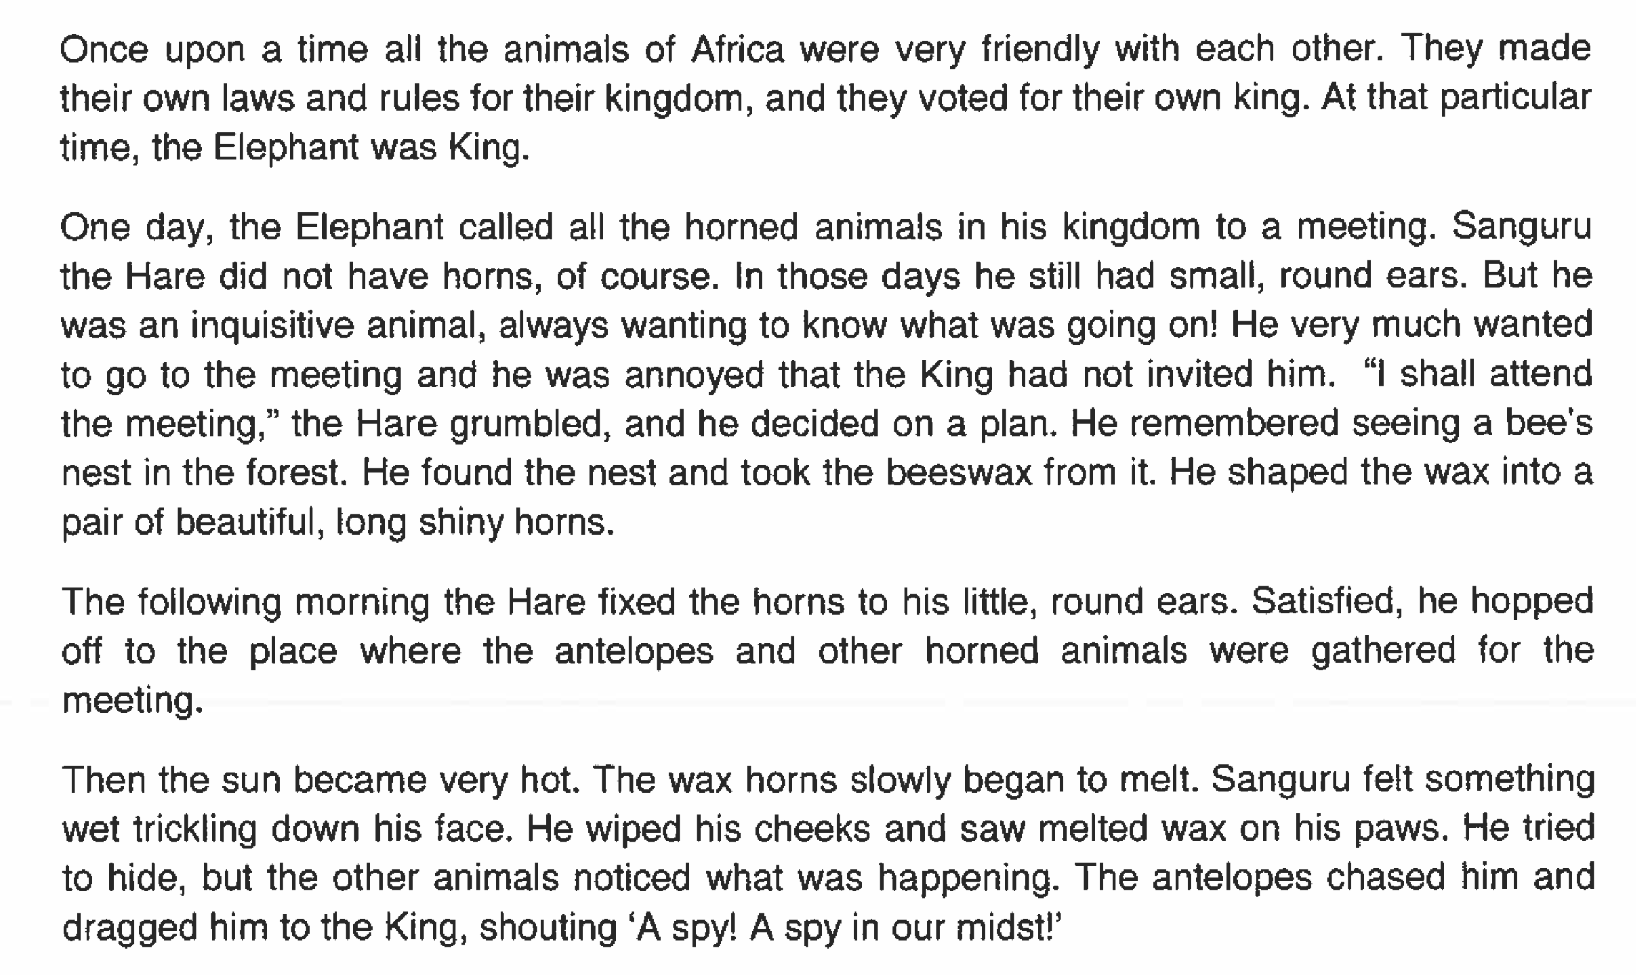
ORF Test 2

Slide 24
NEEDU testing procedure - 2013
214 rural primary schools
All grade 5 students in one class were selected to participate
4697 grade 5 students wrote a comprehension test (San-Hunter /20)
The top 3, middle 4 and bottom 3 students did the ORF 1 test
1786 students selected to write Oral Reading Fluency Test 1 (next day)
(+ comprehension
Test /5)
If students read 50 WCPM they did the more difficult ORF test 2
878 students selected to write ORF Test 2
(+ comprehension
Test /5)
Tests were administered at different times in the year. Preliminary analysis shows little
Relation between time of test and results.

Slide 25

What about ESL kids in rural areas?
“We found that South African Grade 5 second language learners from rural areas in South Africa had essentially the same distribution as Grade 1 second language learners in Florida, or Grade 2 second language remedial learners who had been removed from normal classes because they ‘cannot communicate meaning orally in English and demonstrate very little understanding in English’.
Draper & Spaull, 2015 (SAJCE)

Slide 26
2 Large Research Projects
Two large research projects are completed:
  Binding Constraints in Education in SA (PSPPD)
  Laying Firm Foundations: Getting Reading Right (Zenex)
Both make the argument that reading in the FP is the biggest solvable problem in our education system.

Slide 27
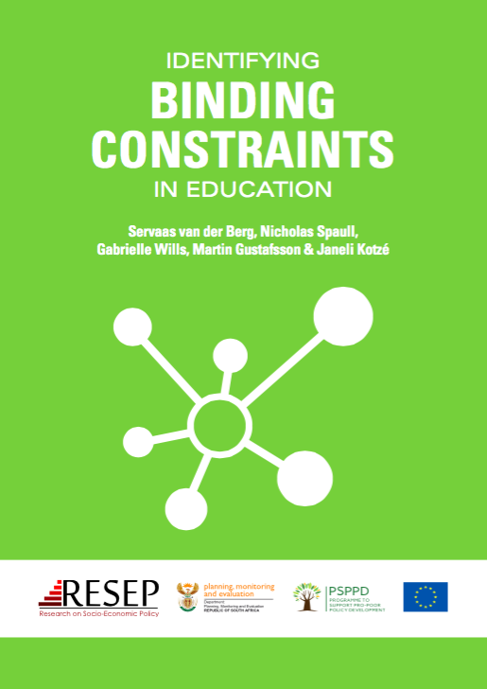
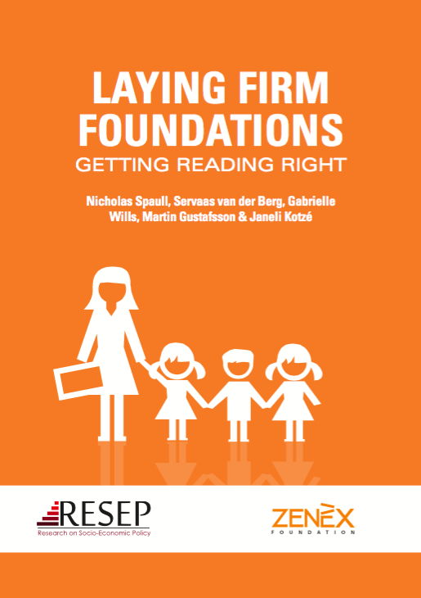
PSPPD & Zenex Report Launch 24 May 2016

Slide 28

Main conclusions
The majority of South African children are not learning to read in any language by the end of Grade 3.
This is the binding constraint to improved educational outcomes for the poor.
These students never get a firm hold on the first rung of the academic ladder and stumble forward into higher grades with low self esteem and compromised learning.

Slide 29
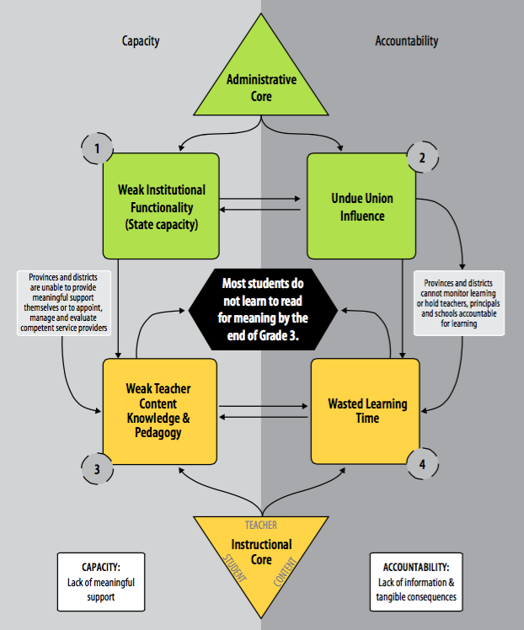
PSPPD: Binding Constraints in Education

Slide 30
Policy déjà vu? Plus que ça change?
“Reading is, without doubt, the most important linguistic skill that needs to be developed in young children. Reading serves as a building block upon which all other learning takes place…This National Reading Strategy takes as its focus that reading failure begins in early grades, and it is at that level that interventions must be made” (DoE, 2008: 18).
We’ve been on this rodeo before…
National Reading Strategy (DBE, 2008) – Pandor
Teaching Reading in the Early Grades: A Teacher’s Handbooks (DBE, 2008)
Western Cape Numeracy & Literacy Strategy 2006-2016 (WCED, 2006)
Foundations for Learning Campaign (DBE, 2008)
Gauteng Primary Literacy Strategy 2010-2014 (GDE, 2010)
NEED Reading Study 2013 (NEEDU, 2013)
Systematic Method for Reading Success (Hollingsworth & Gains, 2009)
Western Cape Living Labs Schools (WCED, 2015)
(See PSPPD Report (2016) for full discussion of previous reading initiatives)

Slide 31
Conclusions?
Unless we get reading right in the Foundation Phase we are “falling at the first hurdle” (Taylor, 1989)
Need to understand why previous reading initiatives failed
Need for both capacity & accountability - not one or the other
#1 Goal of the DBE must become:
“Every child must read for fluently and with comprehension by the end of Grade 3 (age 9)”

Slide 32
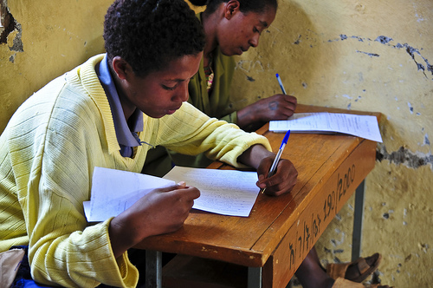
Thank you
www.nicspaull.com/research nicholasspaull@gmail.com
@NicSpaull

Slide 33
Zenex: Extreme class sizes in the Foundation Phase
Proportion of children in Grades 1-3 in class different class sizes (using ASS 2013 data)

Slide 34
My questions
What evidence do we have to say that FP teachers don’t know how to teach reading?
Is it possible to teach in-service FP teachers how to teach reading?
Is there consensus on the most effective way(s) to teach reading in the African languages?
Is the abrupt-switch model of language transition to English in Gr4 the only way or the best way?
Is there consensus on a ‘tight’/explicit definitions of “reading for meaning” or “basic reading” or “reading with fluency and comprehension” or “literate” or “reading grade appropriate texts”?
Measuring is only the first step, we need to know how to help teachers/kids who can’t read or teach reading. Programs? Evidence?

Slide 36
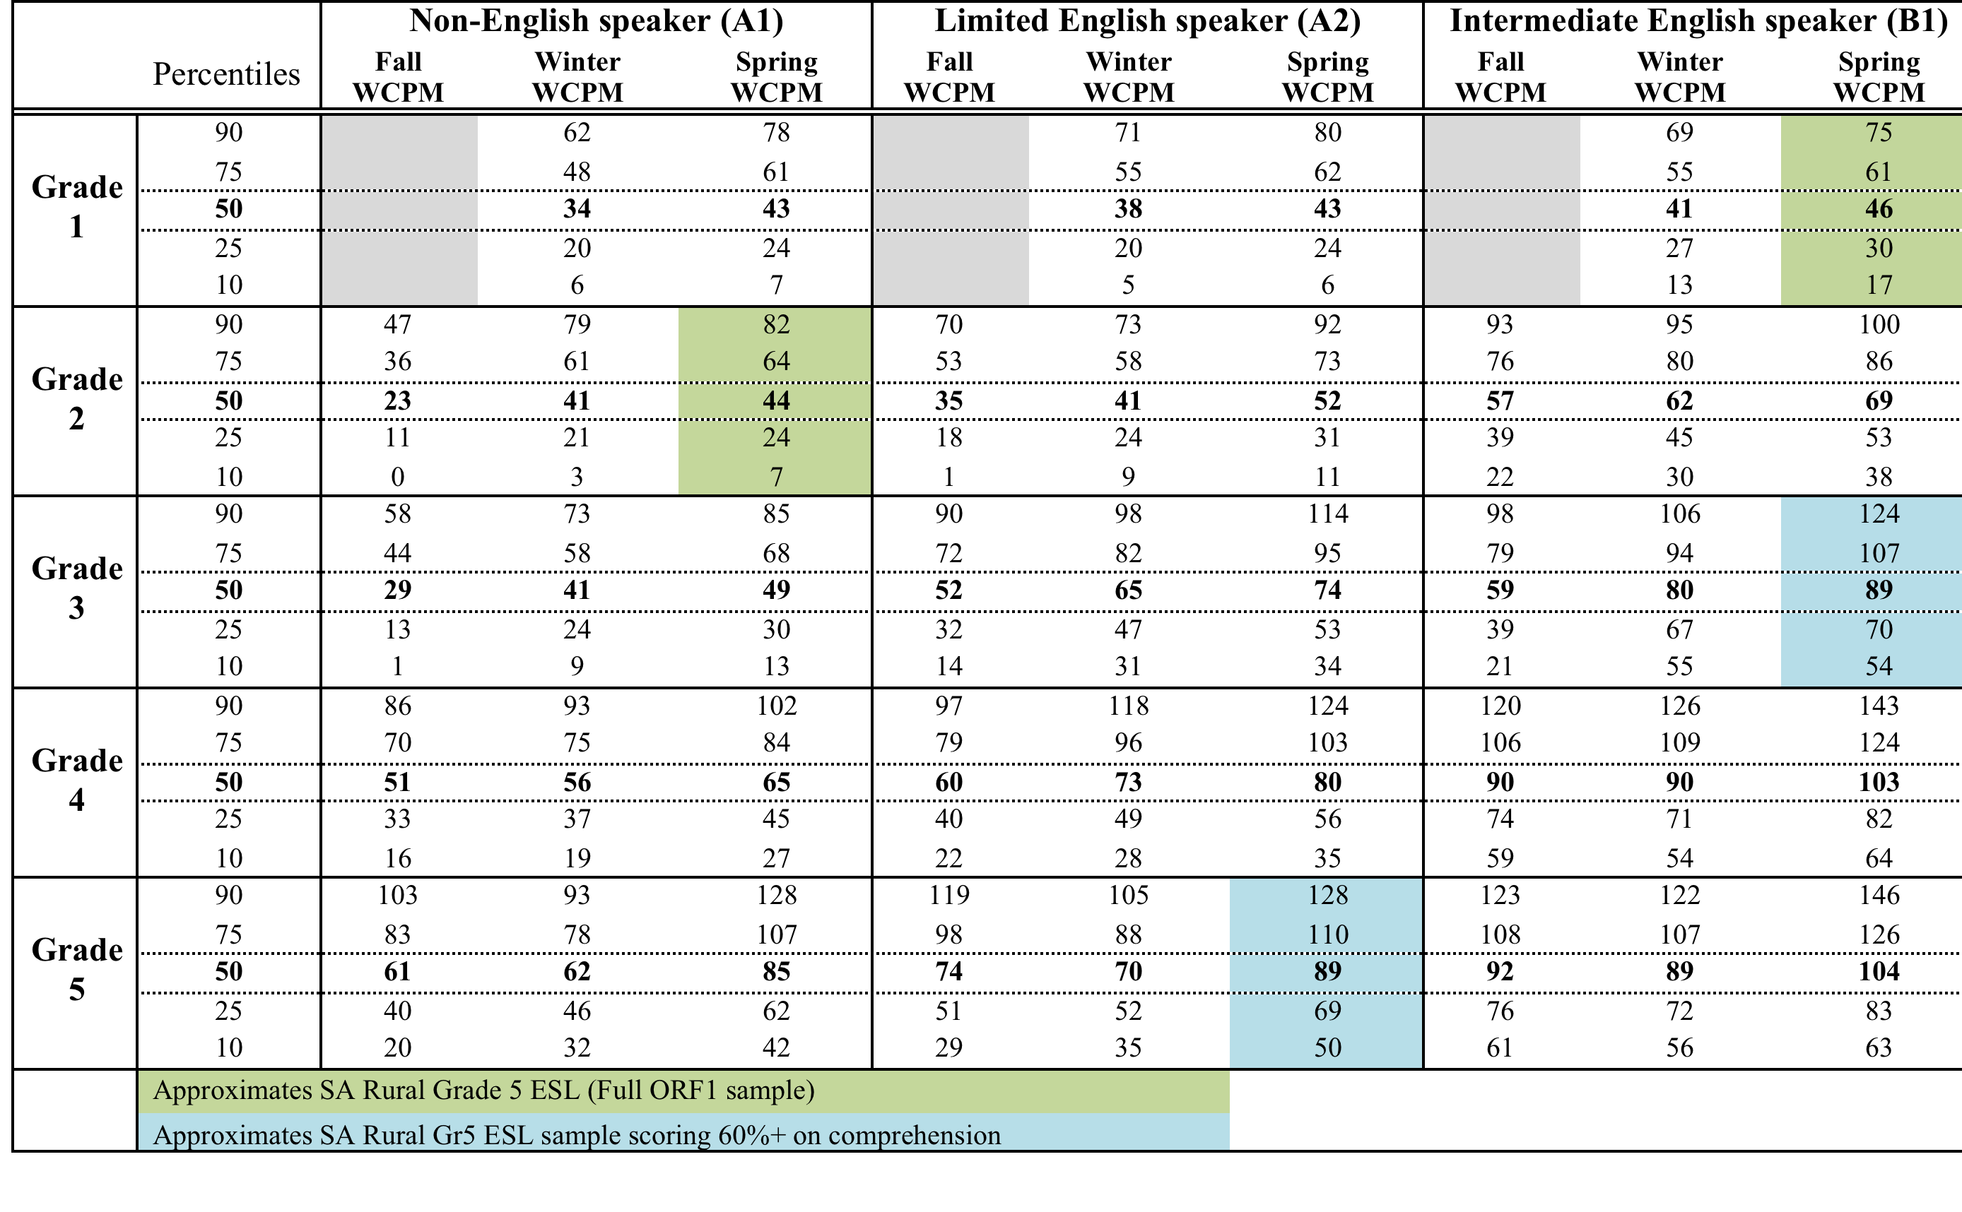
Table 13: Oral Reading Fluency scores for English Second Language (ESL/ELL) in Broward County Public Schools (Florida, US) (Broward County, 2012)

Slide 37
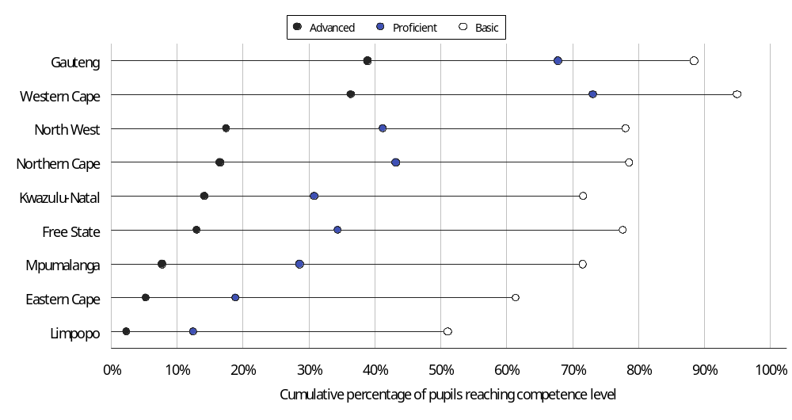
SACMEQ III Reading (Gr6)

Slide 38
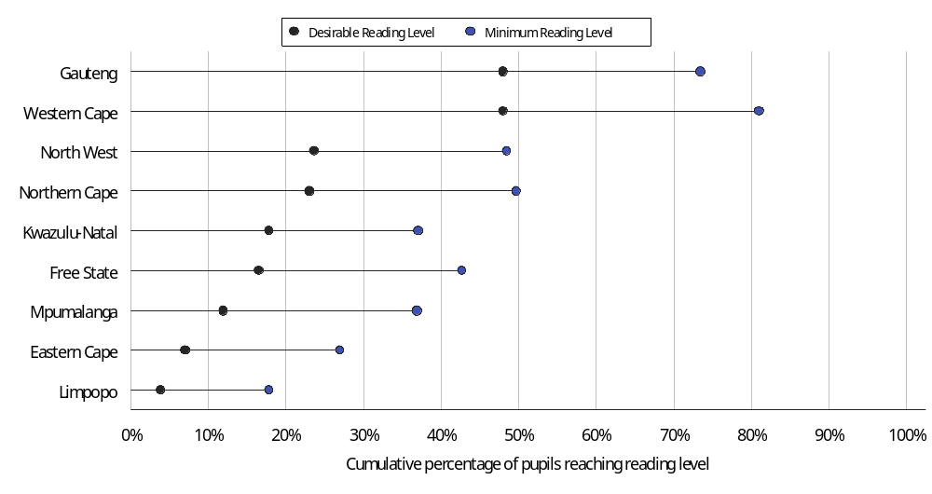
SACMEQ III Reading (Gr6)
the ‘minimum level’ – was the level of achievement they would expect from a student who would barely survive during the next year of schooling.
the ‘desirable level’ – was the level associated with a student that was guaranteed to cope with the next year of schooling.

Slide 39
Language...
PIRLS 2006
PIRLS Gr 5
(Shepherd, 2011)
prePIRLS 2011
prePIRLS Gr 4
(Howie & Van Staden, 2012)

Slide 40
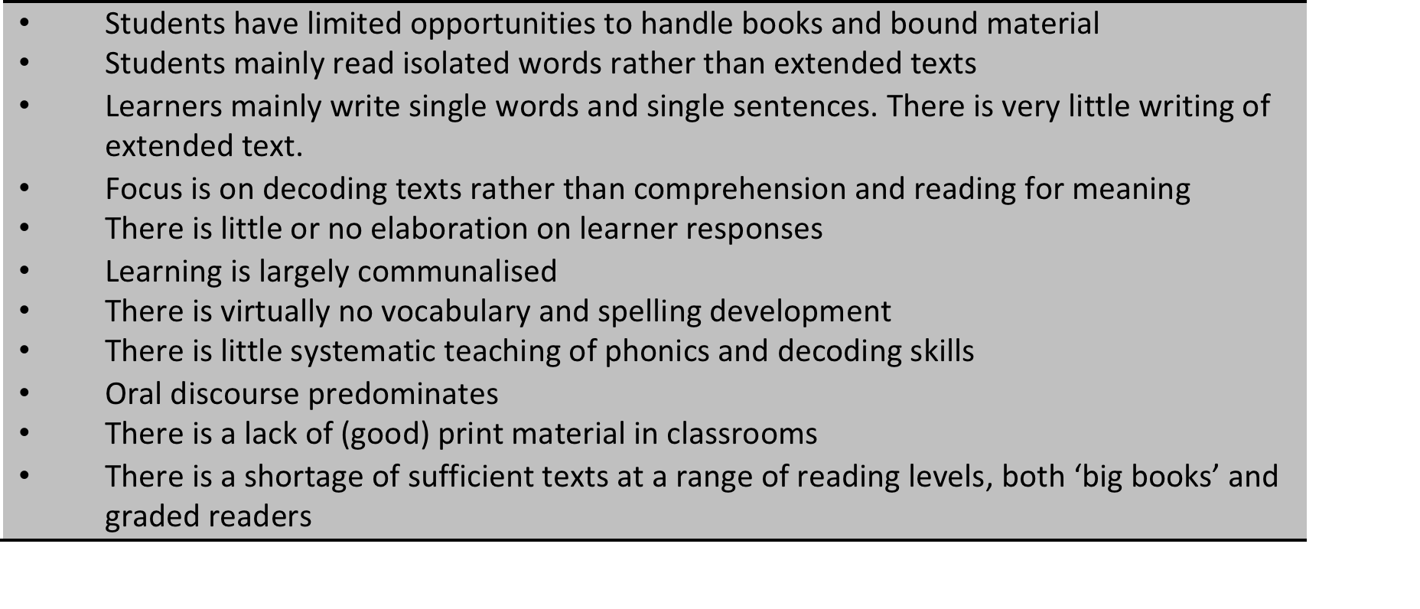
Hoadley (2016)
Descriptive features of Foundation Phase classrooms

