Slide 1




Remodeling the Annual National Assessments
Thoughts & suggestions for the road ahead
Nic Spaull
Department of Basic Education| 2 March 2016

Slide 2
What ongoing assessments do we have in SA?
TIMSS – Tests maths & science Gr8/9
PIRLS – Tests reading literacy in Eng/Afr (Gr5)
prePIRLS – Tests reading literacy all 11 languages (Gr4)
SACMEQ – Tests language and maths Eng/Afr (Gr6)
WC-Systemic Evaluations (WC only) – Tests Maths and langauge at Gr3, 6 and 9 every year.
NATIONAL: Matric – Tests many subjects, school-leaving exam
NATIONAL: ANAs – Tests Gr1-9 in Maths & Language

Slide 3
When were they conducted?
PIRLS 2006 2011 2015
prePIRLS 2011 2015
TIMSS 1995 1999 2002 2011 2015
TIMSS-N 2015
SACMEQ 2000 2007 2013
V-ANA 2011 2013
ANA 2011 2012 2013 2014
NSES 2007 2008 2009
Systemic Evaluation (Nat) 2001³ 2004⁶ 2007³
Matric (annual)

Slide 4
 | Sample-based | Census-based | Number of schools? | Number of students? | Comparable over time?
Cross-national studies of educational achievement | TIMSS 1995, 1999, 2003, 2011 | - | 285 | 11969 | Yes
 | SACMEQ 2000, 2007, 2013 | - | 392 | 9071 | Yes
 | PIRLS 2006, 2011 (Eng/Afr only) | - | 92 | 3515 | Sort of
 | prePIRLS 2011 |  | 341 | 15744 | NA
National assessments (diagnostic) | Systemic Evaluations 2001 (Gr3) 2004 (Gr6), 2007 (Gr3) | - | 2340 | 54,000 | Sort-of
 | - | U-ANA 2011/12/13/14 | 24,000 | 7mil | Definitely not
 | Verification-ANA 2011, 2013 (Gr 3 & 6) |  | 2164 |  | No
 | NSES* Gr3 (2007) Gr4 (2008) Gr5 (2009) |  | 266 | 24000 (8383 panel) | Yes (+ longitudinal)
National assessments (certification) | - | Matric | 6591 | about 550,000 | Strictly, no.
*Number of schools and students is for the most recent round of assessments
In addition to these, the Western Cape is the only province to have a population-based assessment at Grades 3, 6 and 9, also (confusingly) called the Systemic Evaluations (sometimes WCED SE)

Slide 5



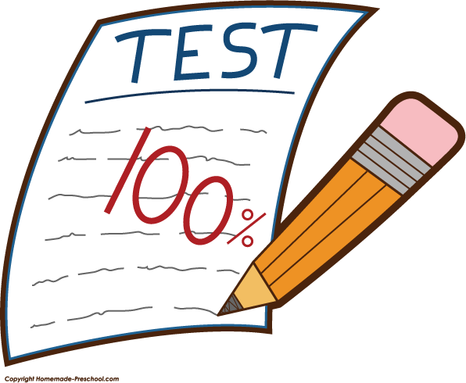
My starting assumptions
Targeting support: More support should be targeted at those schools with the largest challenges. Without learning outcomes (U-ANA) we cannot properly identify which schools need the most support (can’t be done with V-ANA).
Information: All parents have a right to know what their children are learning (or not learning). The DBE has a right to know what students are learning in primary school.
Consensus: There needs to be a nationally-agreed upon test at the primary school level so that everyone can have a common conversation about learning outcomes (matric is too late).
  Districts, SAs, NGOs, Interventions, support, evaluations
Assessment standards: Traditionally school-based-assessment at primary school is highly variable and problematic (Van der Berg et al. 2010).

Slide 6
What is the purpose of the ANA?
Before we can say what the ‘remodeled ANAs’ we need to look like, we have to agree on what they are for.
Our take:
  U-ANA: To provide teachers, officials, parents and students with accurate and nationally comparable information on what students know and can do in language and mathematics at key grades (especially at the primary school level).
  U-ANA: To provide information that can be used to target support and interventions to where it is most needed.
  U-ANA: To expose teachers to grade-appropriate assessment
  V-ANA: To provide an independent evaluation of whether or not mathematics and language outcomes are improving over time and where they are/aren’t improving (should be called Systemic ANA). [Not the same test as U-ANA, some common items]

Slide 7
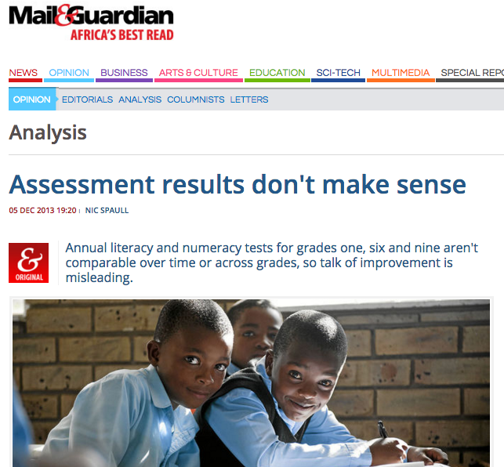

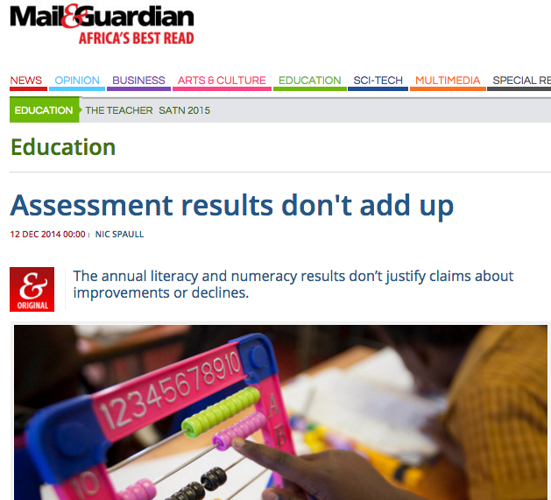
Critical of ANAs

Slide 8

Main problems with ANA at the moment…
Comparability: The ANAs are not at all comparable grade-on-grade or year-on-year (U-ANA or V-ANA). Despite DBE and the Minister making comparisons.
Public perception: The results do not mean much in the public’s eye. The public do not trust the results and do not know what they mean.
Undesirable behavior: ANA Fridays, cheating, selective absenteeism
Too much too soon: DBE doesn’t have the capacity, the people, the time or the budget to plan, set, moderate and administer tests for all 9 million (!!) children in Gr1-9, nor to mark, analyze, report and disseminate the results in meaningful ways. It has bitten off much more than it can chew. If something is worth doing it is worth doing properly. Only assess Grade 3, 6 and 9 (as in WC).
Over-testing: Teachers that must implement ANAs & province-tests & district tests & own classroom tests.
Reporting: When ANA results are given to students, teachers and parents they don’t mean much and are confusing. There is no intuitive explanation of what it means to get 25% or 45% or 65%? It is not a requirement for grade progression. …[See next slide]
Independence: Currently the DBE is setting, marking and reporting the results of the ANAs (DBE is player & referee). Needs to be some independence, like Umalusi for matric. V-ANA implemented by Umalusi?

Slide 9

Quick exercise on reporting…
Compare this to the well-respected NAEP in the U.S which has THREE levels:
Basic
(2) Proficient
(3) Advanced
Rank these 7 “levels” of achievement from worst performance to best performance…
Elementary Achievement
?
Substantial Achievement
Adequate Achievement
Meritorious Achievement
Moderate Achievement
Not achieved
Outstanding Achievement

Slide 10
BUT, also strong support for a national assessment at primary level
It is my view (and our view at RESEP, Stellenbosch University) that the introduction of Universal and Verification ANAs in 2011 was a profound step forward on the journey to improving the quality of education in our country.
Universal ANA should be improved and refined, not scrapped!
There are some fundamental problems with the way the ANAs are set, administered and used (as I have documented at length) BUT the principle of at least one nationally-standardised test at the primary school level is of utmost importance.
I do not know of a single educational researcher in the country who thinks it would be better to have no population-wide nationally-standardised exam at all at the primary level (i.e. 1994-2010). This would be a big step backwards.
All of the above is not to say there aren’t problems with the way that ANAs were implemented up to 2014 or that they don’t need to change. They do!

Slide 11
Clear need for a nationally-standardized test at primary school level
South Africa is one of the few countries that does not have a nationally standardised exam at the primary school level.
  Brazil: SAEB
  Australia: NAPLAN
  Botswana: PSLE
  Zambia: PSLCE
  Kenya: KCPE
  Malawi:
  UK: NCA/Sats
  Etc.
How are we meant to know how much learning is taking place in primary schools without a national assessment in all primary schools at least every 2nd year?
Why is SA unique in this area?

Slide 12
Suggestions
We must get a small number of grades ‘right’. Better to have accurate information on three grades than dodgy info on all grades.
Grades: ANA should only be done in Grade 3, 6 and 9
Frequency: ANA needs to be done every year in every school. V-ANA could be done every second year if it is done properly (i.e. can track trends).
Clarification: Separate Universal ANA and Verification ANA.
  Rename V-ANA Systemic ANA. It’s aim is to track progress over time
Independence: Expand Umalusi’s mandate to include quality controlling the Systemic-ANA in a sample of schools where an expanded test is used (ANA + Anchor items) and retrieved (i.e. kept secure). Entire Systemic-ANA must be marked by Umalusi or Service Provider.
Comparability: Use the Systemic-ANA sample to compare results over time using anchor items and IRT. Must bring in international experts with experience in large-scale assessment using IRT. No one in SA has experience conducting a country-wide assessment that is psychometrically comparable.
Marking U-ANA: All ANAs should be 50% multiple-choice questions (MCQs) and 50% open-response.
  Open-response questions should be marked by teachers at school and moderated by principal and circuit/district.
  MCQ sheets should be recorded on bubble-sheets and marked centrally using OCR-scanning machines.
Reporting: Provide meaningful feedback to teachers, principals and parents via school-specific reports. Possible by analysing MCQ responses.
One function of ANAs is to provide accurate information to parents. Not possible if every 2nd year.
  This is done everywhere with large-scale assessment (internationally and at local universities). MCQ-sheets from U-ANA should be collected and marked centrally using computers. Decreases the marking burden on teachers, provides external check on marking process, item-level feedback

Slide 13
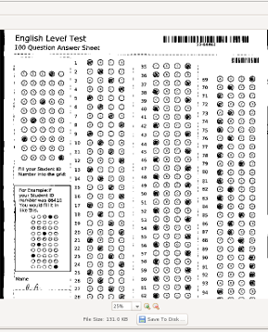

MCQ
All large-scale testing programs (TIMSS, PIRLS, SACMEQ, PISA) use a combination of MCQ questions and open-response.
Optical Character Recognition (OCR) machines scan these and automatically score & record in a data base.
Not clear why we haven’t been using these up to now?
Less marking for teachers + external check on marking
SA universities (and most school systems internationally) have been using them forever.

Slide 14
Types of reports
Comprehensive national report on the ANA’s showing performance breakdown by race, language, gender, grade, province, school location and quintile. Extensive analysis of each category as well as discussion regarding key issues such as LOLT, functional illiteracy and innumeracy, and which pre-specified goals were and were not achieved. Key areas for improvement should also be identified and discussed.
Comprehensive provincial reports on the levels and trends of student performance in numeracy and literacy by race, language, gender, grade, and district.
Concise district reports on the comparative performance of that district relative to similar districts provincially and nationally, as well as detailed information on the performance of schools in that district both relative to each other, and relative to socioeconomically similar schools in other districts and provinces. Also to provide a comprehensive, accessible list of schools categorized by average school performance (from Dysfunctional to Excellent). This information will ensure that interventions and district support can be targeted to where they are most needed, and are most pedagogically appropriate for the types of difficulties experienced in that school.
Detailed school reports for every school indicating the average numeracy and literacy scores for that school as well as for each grade and each learner. Results should be linked to specific teachers and classes. Comparative information should be provided in an accessible format on the performance of the school nationally, provincially and within the district, as well as relative to socioeconomically similar schools in the district and province. This information should be sufficiently detailed and specific (for example, include other school names and rankings).
Concise learner reports should be provided to the parents of every primary school child in South Africa. They should be understandable and make it clear how their child has performed in the recent tests. The report should show if the child has reached certain measurable educational milestones for their age (for example if they can read and write at a basic level by 8 years of age), as well as the performance of their child relative to other children in his grade, and socioeconomically-similar students of the same age in other schools in the province. One could also provide information on the relative performance of their school as compared to similar schools in the district and the province. These reports should be clear and understandable to all parents, including illiterate and innumerate parents. The reports could also indicate what the parents can do to help their child improve (encourage homework, reading aloud etc.).

Slide 15
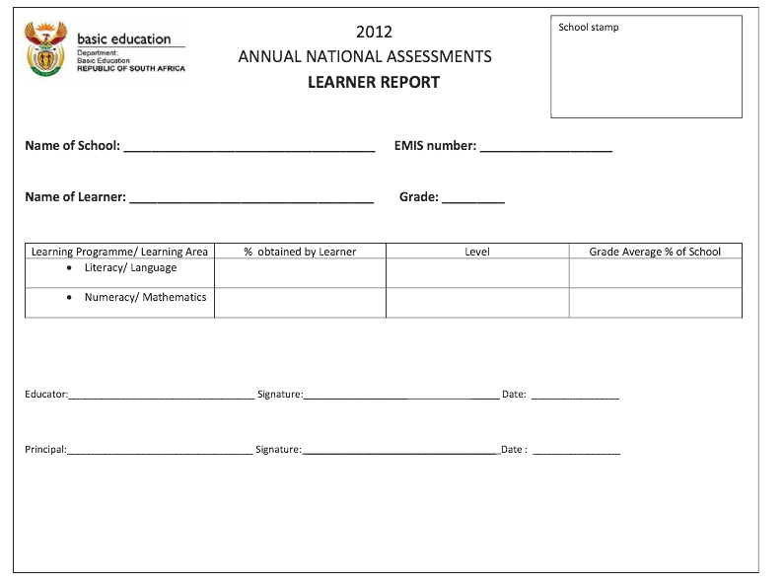
Existing ANA reports

Slide 16
Possibilities for SA report cards…

Slide 17
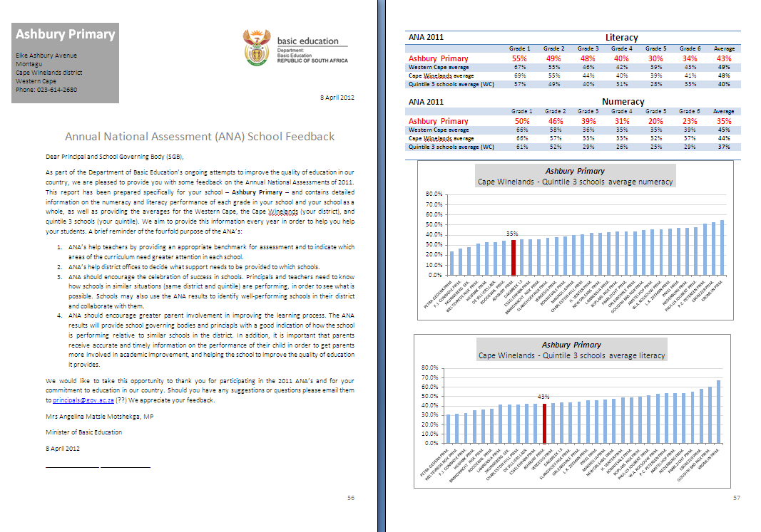

Slide 18
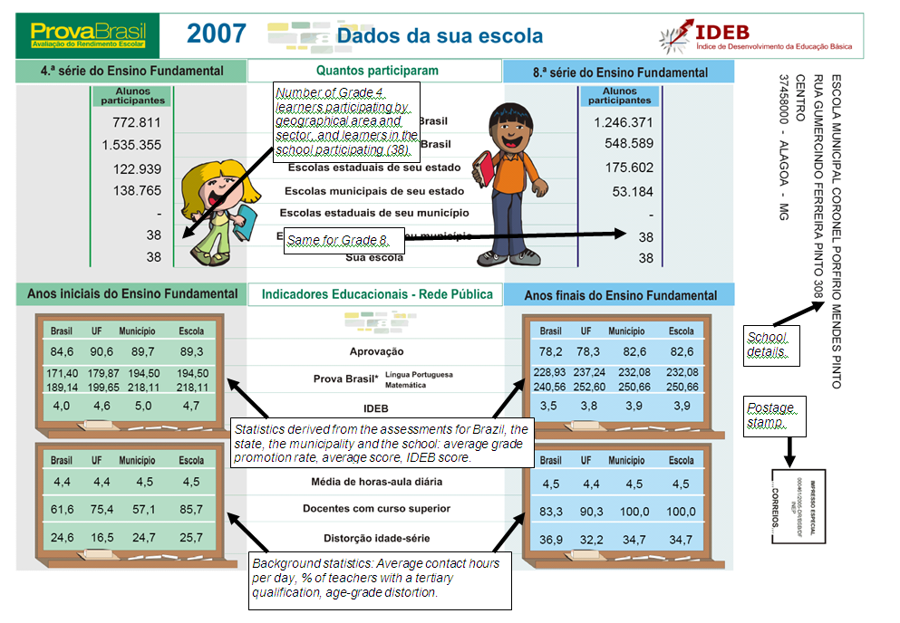
ProvaBrasil report card

Slide 19
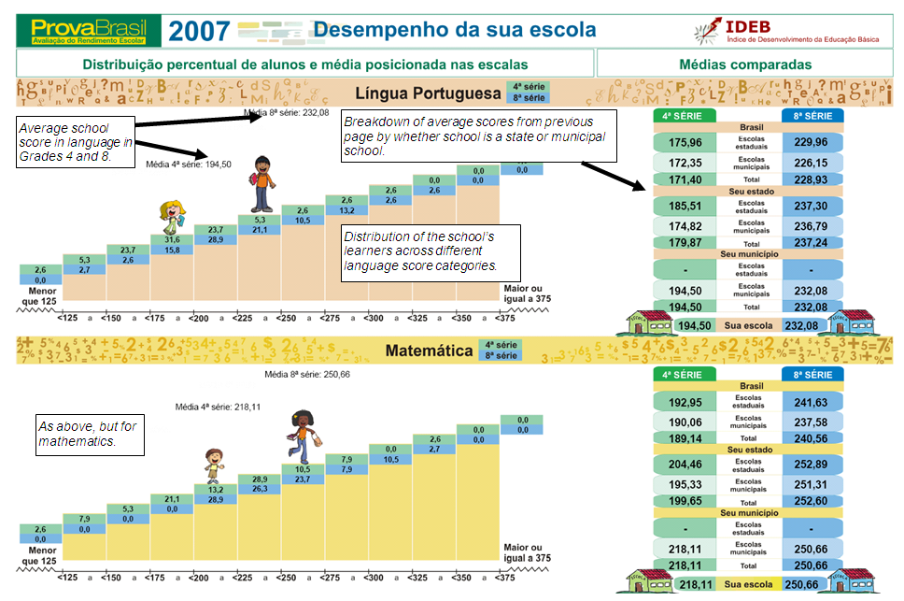
ProvaBrasil report card

Slide 20
EXAMPLE: Dashboard for districts (MSDF DELL Fdn)
Overall learner performance on standardised exams
TEMPLATE: District annual strategy on learner performance
Focus support
  Circuit 1
  Circuit 2
  Circuit 3
  Circuit 4
Monitor and evaluate
  Circuit 5
  Circuit 6
  Circuit 7
  Circuit 8
  Circuit 9
  Circuit 10
  Circuit 11
  Circuit 12
  Circuit 13
Celebrate and learn
  Circuit 14
  Circuit 15
  Circuit 16
  Circuit 17
  Circuit 18
  Circuit 19
+ P
14
How many circuits met their target? This year: Last year:
How many circuits improved performance? This year: Last year:
10
19
What change is there in GET progression? This year: Last year:
15
18
What change is there in FET progression? This year: Last year:
12
11
17
What change is there in NSC performance? This year: Last year:
- Δ
13
16
+ Δ
3
6
Areas to focus on red circuits
9
Circuit
Performance
Action steps
Target
Responsible
5
2
7
1
8
4
- P
Areas to focus on orange circuits
Circuit
Performance
Action steps
Target
Responsible
Overall learner performance and progression










28%
Fell behind in GET phase




















32%
Fell behind in FET phase




















26%
Did not pass NSC




















14%
Passed NSC successfully
Notes




















6%
Received bachelor’s certificate











Slide 21
What will happen if we have no U-ANA?
(1) More functional provinces will begin to create their own ‘ANAs’
  Gauteng decided to scrap it’s province-wide assessment because ANA was introduced in 2011. Almost certain it (and perhaps FST) will implement their own annual assessments. WC has SE which it has been running since 2004.
Problems:
    Each province’s tests will be different and thus not comparable. Different standards.
    Increased inequality as some provinces get more information, feedback, support, accountability. Not capacity in EC or LP (& others) to create a proper provincial testing system.
    Waste of resources as provinces unnecessarily replicate each others’ work. Each one has to employ service providers or in-house personnel to create tests, administer, mark etc.
    NGO and province-led interventions can no longer be evaluated using a common metric.
    Education research will suffer. Major breakthroughs in understanding impact of LOLT and impact of Grade-R using U-ANA.

Slide 22

What will happen if we have no U-ANA?
(2) We lose the focus on primary school learning outcomes (& go back to matric!)
  What’s important gets measured, what’s measured is important.
  What gets assessed gets taught.
  We move 3 steps backwards to a time when primary school was the neglected step-child of educ in SA.
  Short-sighted focus on matric (because most information on performance is at matric level).
  EG: Only 9% of primary schools were visited by a district director compared to 25% of high schools (School Monitoring Survey, 2011) #priorities

Slide 23
Maths: Insurmountable learning deficits
Figure 10b: South African mathematics learning trajectories by national socioeconomic quintiles using a variable standard deviation for a year of learning (0.28 in grade 3 to 0.2 in grade 8 with interpolated values for in-between grades (Based on NSES 2007/8/9 for grades 3/4/5, SACMEQ 2007 for grade 6 and TIMSS 2011 for grade 9, including 95% confidence interval
Spaull & Viljoen, 2015

Slide 24

Related to ANA…interventions
One of the major limitations with the way the ANAs were previously implemented is that:
  There was no useful feedback to teachers on how to use the results or what they were showing.
    If we had
  There were no clear guidelines on what to do differently or which interventions were available
We need interventions that have been proven to work that are available to teachers.
  “You are a grade 3 teacher and 65% of the children in your class were classified as “non-readers” in the most recent ANAs. It is recommended that you use the ’FP-Remedial-Reading-Workbook’ series for the next 6 weeks to catch up. This is available from your district office. There is also a training module on how to use the workbooks. You can register at www.dbe.gov.za/training ”

Slide 25
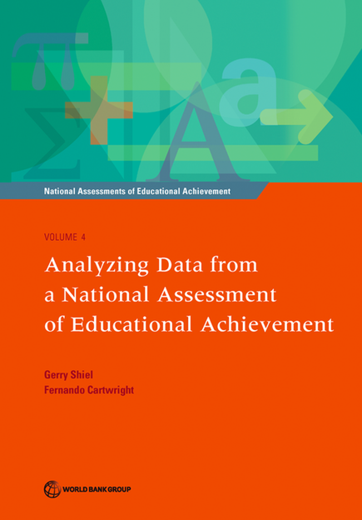
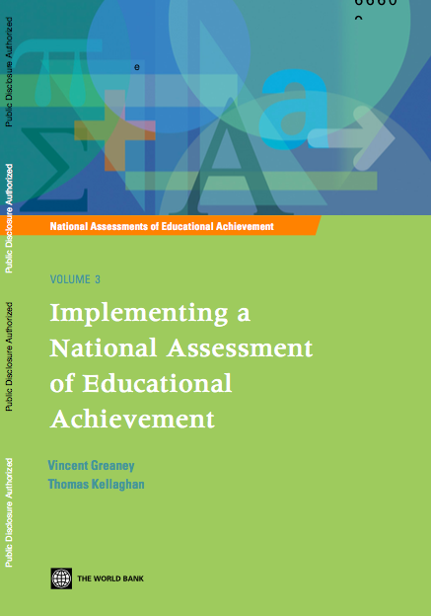
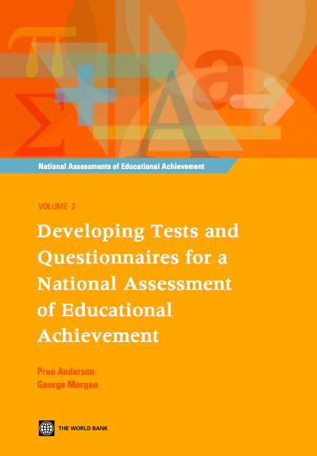
Further resources
World Bank. 2013. Review of the Annual National Assessment (ANA) program, South Africa. Report commissioned by DBE.

Slide 26
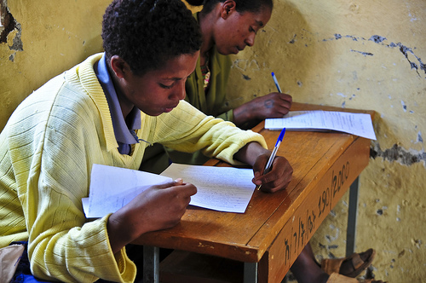
Thank you
www.nicspaull.com/research nicholasspaull@gmail.com
@NicSpaull

Slide 27
Figure 1: Proportion of Grade 4 students that are illiterate and the proportion who cannot read for meaning (in LOLT Gr1-3)
Using prePIRLS 2011 illiterate: cannot reach low benchmark. Read for meaning: reach intermediate benchmark. Note: prePIRLS not stratfied by province (Northern Cape and Free State excluded because they had less than 1000 learners)

Slide 28
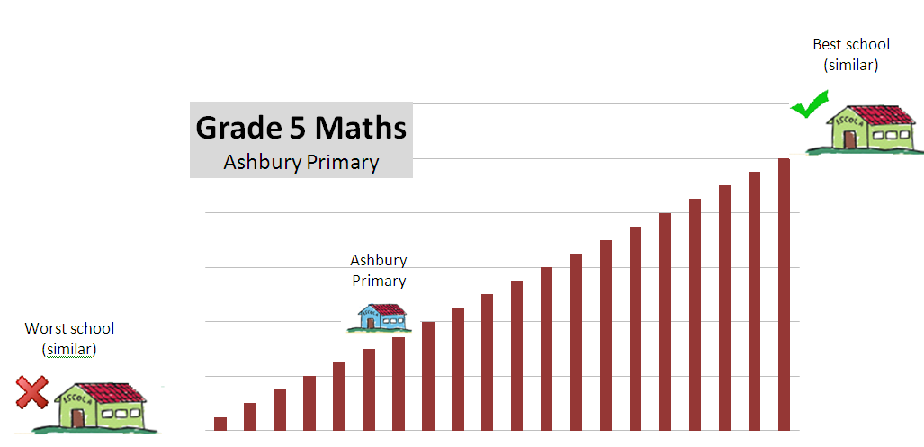
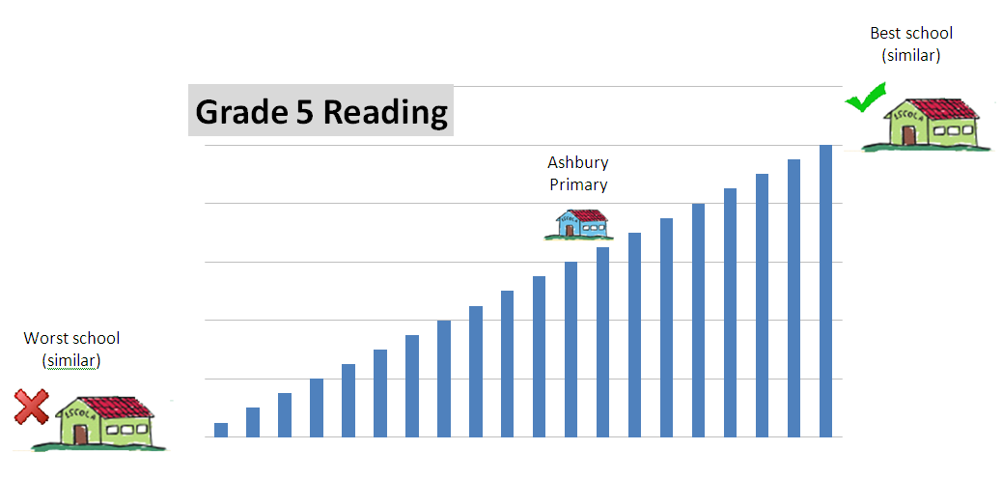
Ashbury Primary

Slide 29
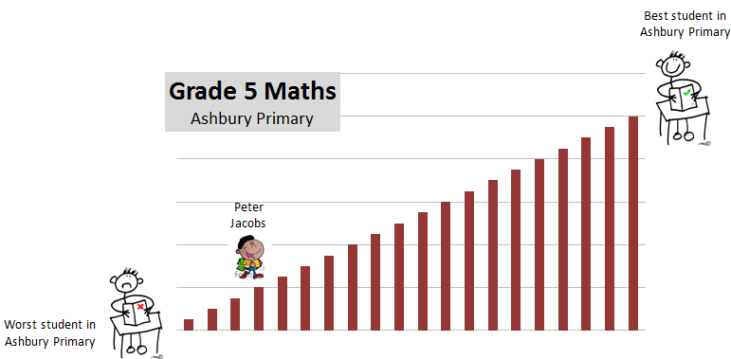
Peter Jacobs

Slide 30
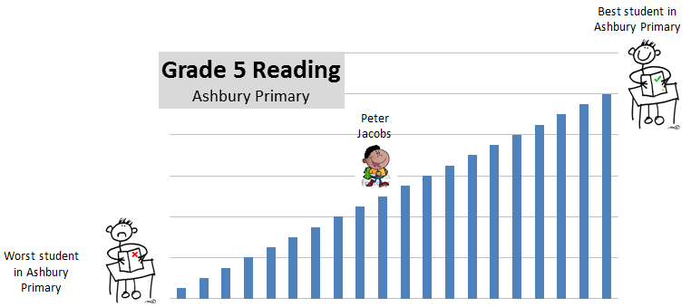
Peter Jacobs

Slide 31
Figure 2: Proportion of Gr5 students in English & Afrikaans schools acquiring basic reading skills by school location
Note: Proportion reaching low international benchmark in PIRLS 2011. SA tested 3515 grade 5 students in 92 schools where Eng/Afr was LOLT

Slide 32
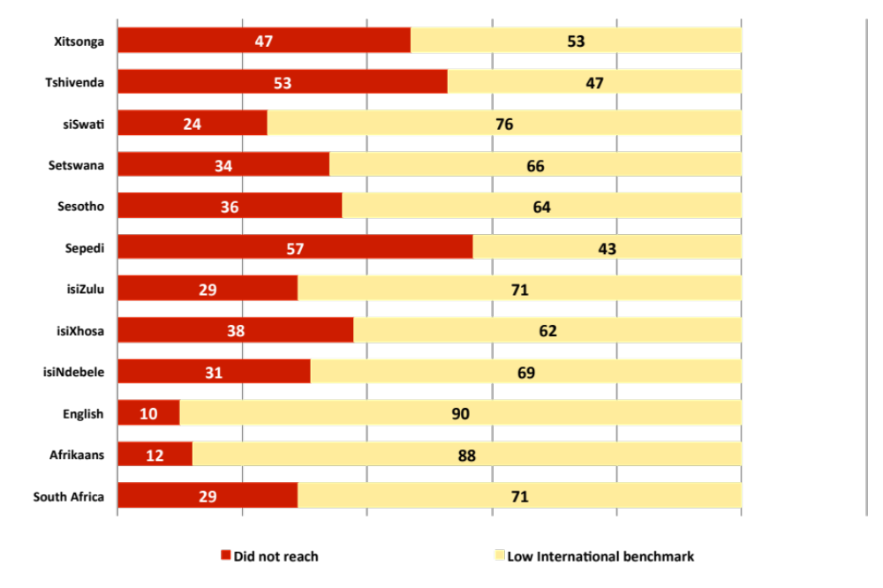


By Gr 3 all children should be able to read, Gr 4 children should be transitioning from “learning to read” to “reading to learn”
Red sections here show the
proportion of children that are
completely illiterate in Grade 4
, i.e. they cannot read in any
language
Notes:
If we consider the performance of the learners per test language, the following observations are made:
Overall 29% of learners in SA don’t meet the low benchmark
However, in Afrikaans and English, there are only 12 and 10% who do not meet the low benchmark
Of serious concern is that more than half the learners tested in Sepedi and Tshivenda do not reach the low benchmark putting them at risk educationally.
More than 15% of learners in Afrikaans and English reach the advanced level in contrast to less than 1% in African languages.

Slide 33

NSES question 42
NSES followed about 15000 students (266 schools) and tested them in Grade 3 (2007), Grade 4 (2008) and Grade 5 (2009).
Grade 3 maths curriculum: “Can perform calculations using appropriate symbols to solve problems involving: division of at least 2-digit by 1-digit numbers”
Even at the end of Grade 5 most (55%+) quintile 1-4 students cannot answer this simple Grade-3-level problem.
“The powerful notions of ratio, rate and proportion are built upon the simpler concepts of whole number, multiplication and division, fraction and rational number, and are themselves the precursors to the development of yet more complex concepts such as triangle similarity, trigonometry, gradient and calculus” (Taylor & Reddi, 2013: 194)
(Spaull & Viljoen, 2014)
Notes:
Taylor, N., & Reddi, B. (2013). Writing and learning mathematics. In N. Taylor, S. Van der Berg, & T. Mabogoane, Creating Effective Schools. Cape Town: Pearson.

Slide 34
What might we use them for?
Nationally representative information on some important aspect that does not exist in administrative data sets
  Teacher content knowledge (SACMEQ)
  Curriculum coverage (NSES)
  Focusing on curriculum learning areas (TIMSS)
Use the released items from TIMSS or PIRLS
  http://timssandpirls.bc.edu/timss2011/international-released-items.html
  When creating the Systemic Evaluation surveys and tests? In provincial surveys? For other kinds of assessments (teacher tests?)

Slide 35

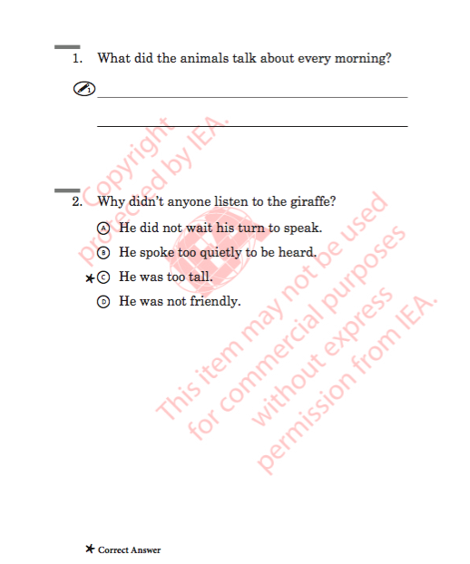
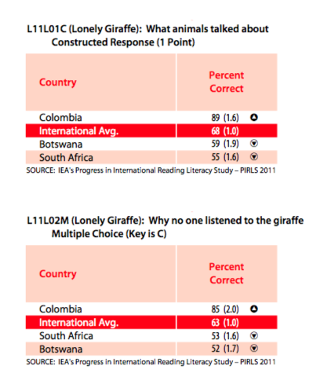
Released items

Slide 36
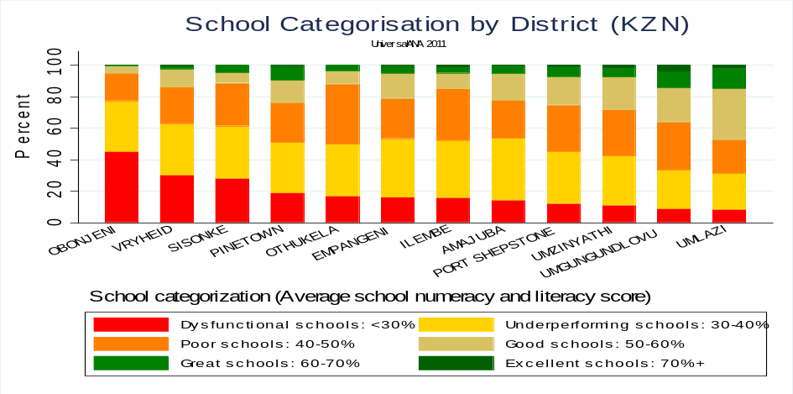
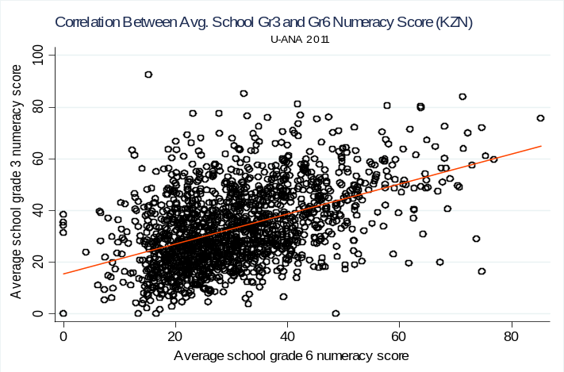
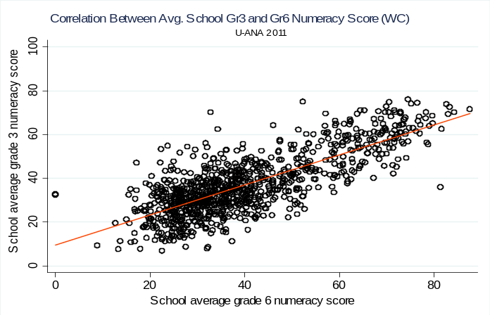
ANA – see Spaull (2012)
ANA
What:
Annual National Assessments
Administrative data on enrolments, staff, schools etc.
Collected by DBE
When and Who:
Grades 1-6 and 9 (maths and language - FAL and HL)
Examples of how can we use it?
Analyse performance at primary grades, potentially at the micro-level (district/circuit)
Create indicators for dashboards
Report cards (once ANA is externally evaluated at one grade)
Early indicators of problems/deficits
Planning at primary school level
Serious comparability problems between ANA 2011 and ANA 2012 (see SVDB and Spaull interview)

Slide 37
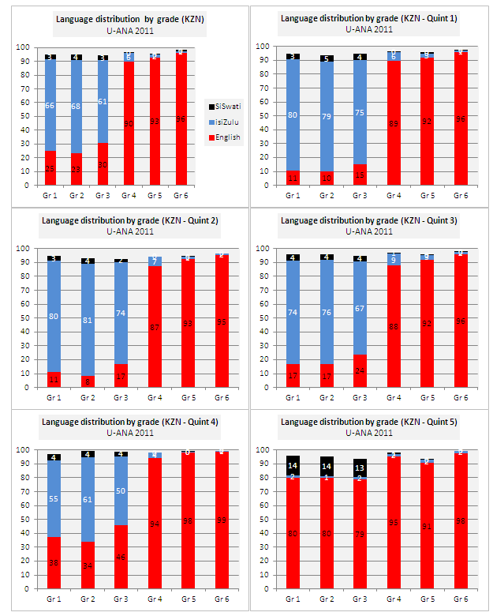
ANA
Language by grade/quintile (KZN)

Slide 38
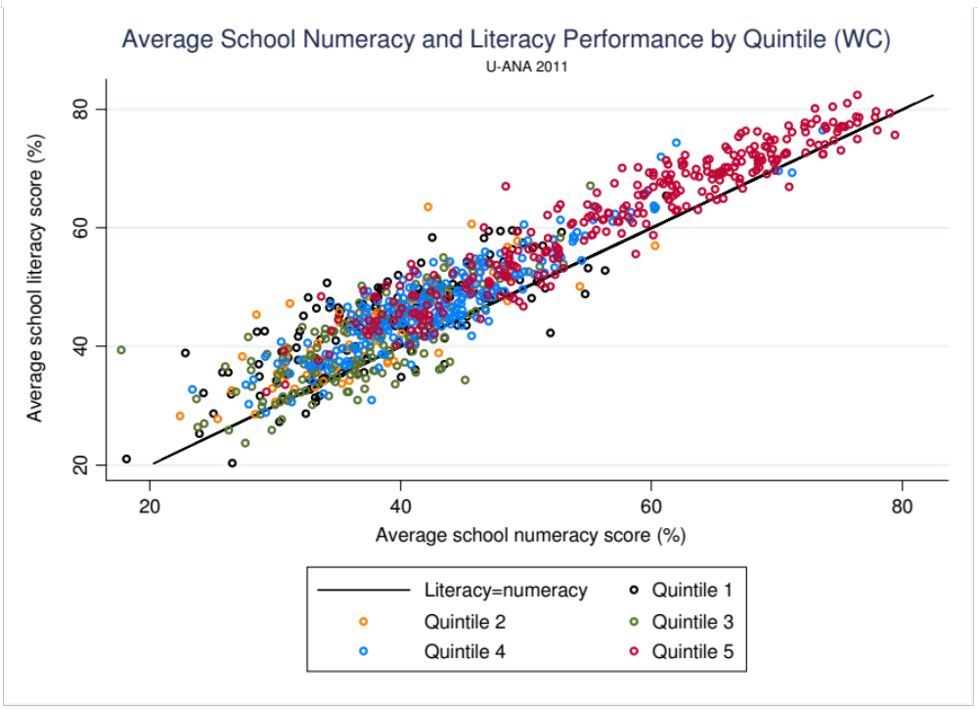

Slide 39
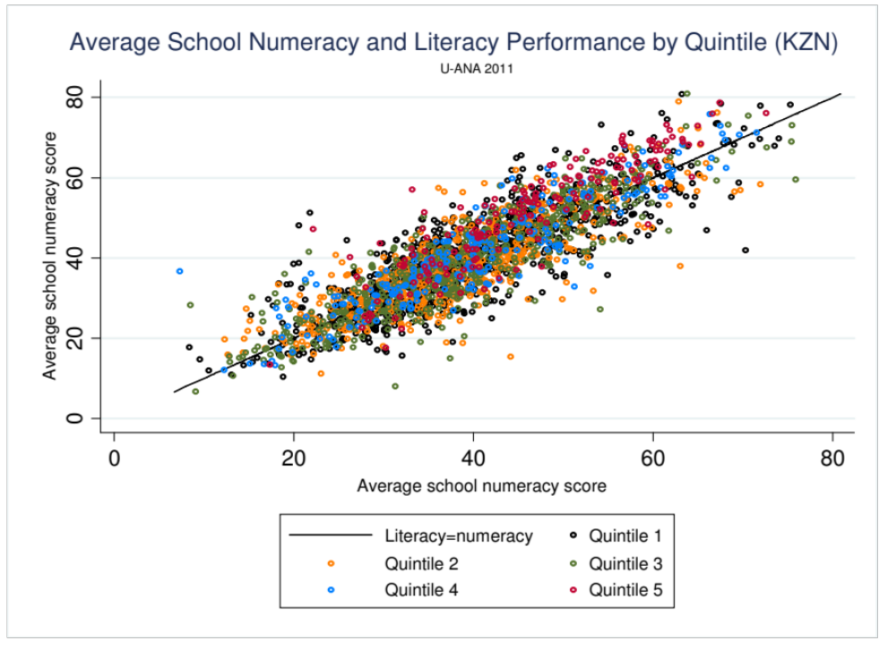

Slide 40
Conclusion
Data is essential for making informed decisions
To be able to use these data sets requires some level of analytic proficiency. Basic proficiency can take as little as 4 months but is infinitely valuable.
Nationally representative datasets allow us to draw conclusions for each province and the whole country – something that is not possible from small local studies.
DBE has access to a wealth of useful but under-utilized data
  ANA, EMIS, MATRIC, HH-SURVEYS (also PERSAL & SYSTEMIC)
Many datasets are publicly available on request
  SACMEQ, TIMSS, PIRLS (SACMEQ 2013 soon to be available)
“Without data you are just another person with an opinion” – Andreas Schleicher

