Slide 1



Getting Reading Right
Nic Spaull
24 May 2016

Slide 2
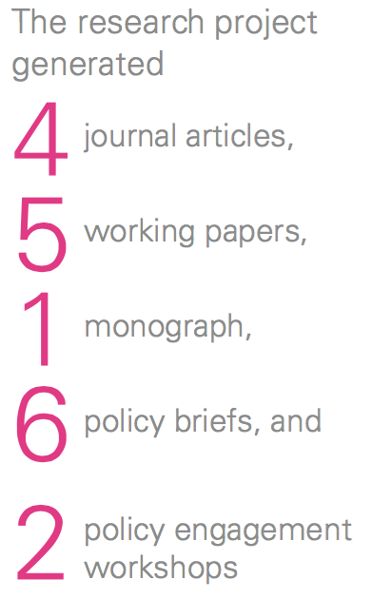


Slide 3

Accountability
&
Capacity

Slide 4



Learning
Deficits
“Already by Grade 2 more than 50% of students in quintiles 1-4 are not on track according to the ANAs” (Van der Berg, 2015)
Mother-Tongue Instruction
“Using ANA data from 9,180 schools Taylor & Von Fintel (2016) find that additional instruction in mother-tongue improves English acquisition by 0.17SD.”
District
Resources
“61% of Gr10-12 teachers were visited by a curriculum advisor compared to 45% of Grade 1-3 teachers” (Wills, 2016)

Slide 5



Gender Inequality
“71% primary school teachers are women
36% of primary school principals are women” (Wills, 2016)
Early Childhood Development
“The ECD Audit 2013 shows that ECD practitioners earn R1,400 - R2,000 per month and 70% have no qualifications whatsoever” (Kotze, 2015)
Weak Pedagogy
“In a review of the literature Hoadley (2016) finds that reading classroom practice is characterized by collective instruction or chorusing with little opportunity for reading & writing”

Slide 6

What percentage of Gr1-3 students were in large (45+) & very large (50+) classes in each province in 2013?

Slide 7
Linking Research & Policy
In 2009 the WCED commissioned Prof van der Berg et al. to look at causes of poor learner performance in Gr1-3
  One of the research recommendations of that research was that not Foundation Phase classroom should have more than 40 learners:
2010 WCED Media release:
  “Our R1,9 billion infrastructure programme is specifically targeted at the Foundation Phase, with over 120 relief classrooms currently being built to ensure that we reduce class sizes in Grades 1-3 to no more than 40 learners” (WCED, 2010)
  http://wced.pgwc.gov.za/comms/press/2010/100_12oct.html

Slide 8
What percentage of Gr1-3 students were in large (45+) & very large (50+) classes in each province in 2013?

Slide 9
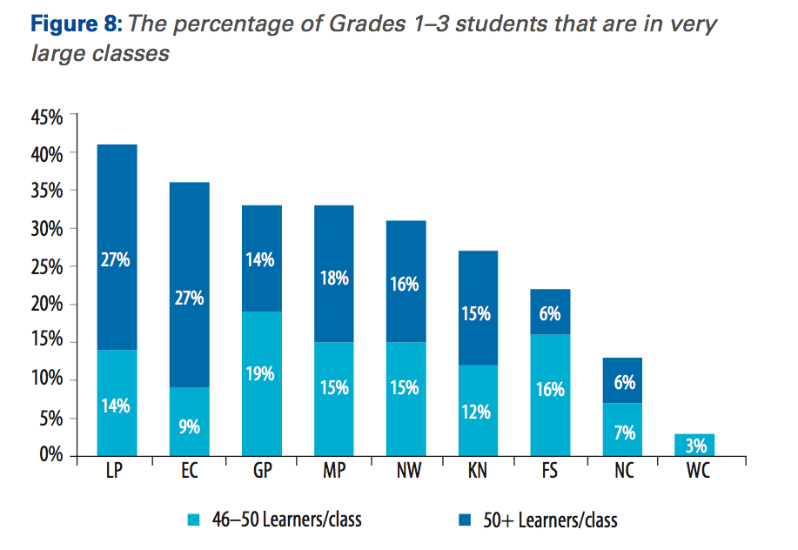
Spaull, 2016 “Excessive Class Sizes in the Foundation Phase” (Annual Survey of Schools, 2013)

Slide 10


Reading Aloud
in English
“40% of rural grade 5 students were reading slower than 40WCPM, i.e. too slow to understand what they were reading. 11% could not read one word (Draper & Spaull, 2015)
ESL Thresholds
“In the first multivariate analysis of Oral Reading Fluency & comprehension we found that ESL readers seem to have a lower threshold (70WCPM) before which returns to comprehension are highest” (Pretorius & Spaull, 2016)

Slide 11
How many rural Gr5 South African children can read in English?

Slide 12
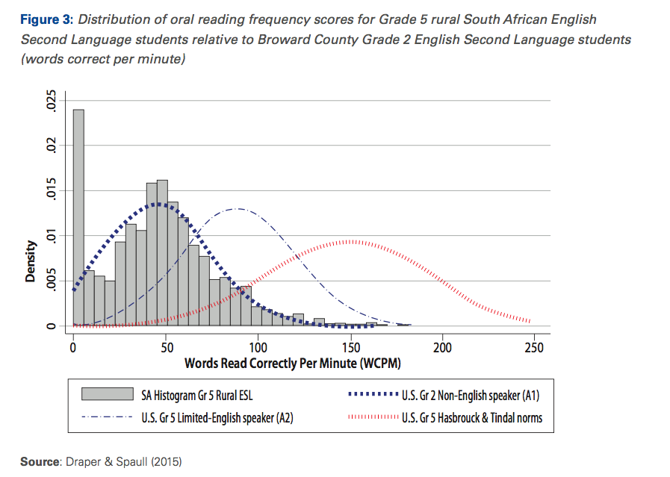

Slide 13
How many Gr4 South African children can read in African languages?

Slide 14
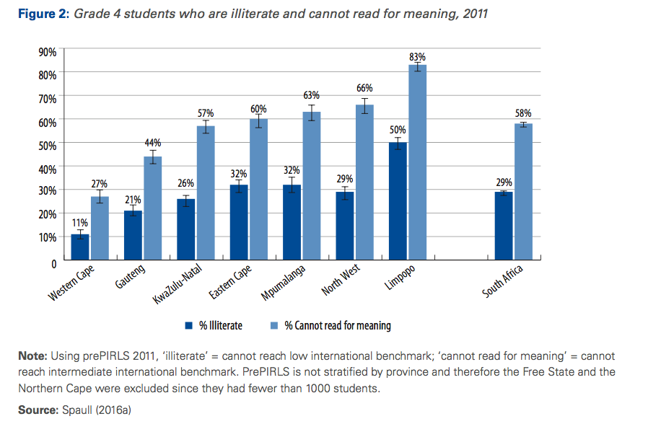
Cannot locate and retrieve an explicitly stated detail
Cannot interpret obvious reasons and causes

Slide 15
Policy déjà vu
We’ve been on this rodeo before…
National Reading Strategy (DBE, 2008) – Pandor
Teaching Reading in the Early Grades: A Teacher’s Handbooks (DBE, 2008)
Western Cape Numeracy & Literacy Strategy 2006-2016 (WCED, 2006)
Foundations for Learning Campaign (DBE, 2008)
Gauteng Primary Literacy Strategy 2010-2014 (GDE, 2010)
Systematic Method for Reading Success (Hollingsworth & Gains, 2009)
Western Cape Living Labs Schools (WCED, 2015)
Drop Everything & Read Campaign
(See PSPPD Report (2016) for full discussion of previous reading initiatives)

Slide 16
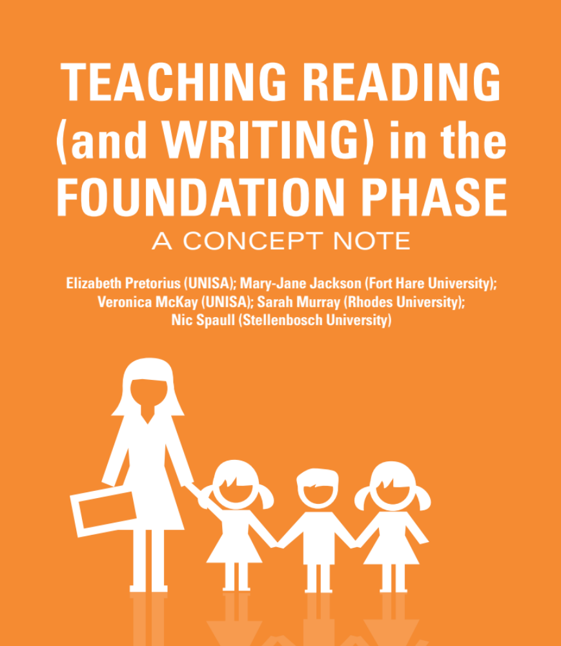
Developing a course to teach FP teachers how to teach reading

Slide 17
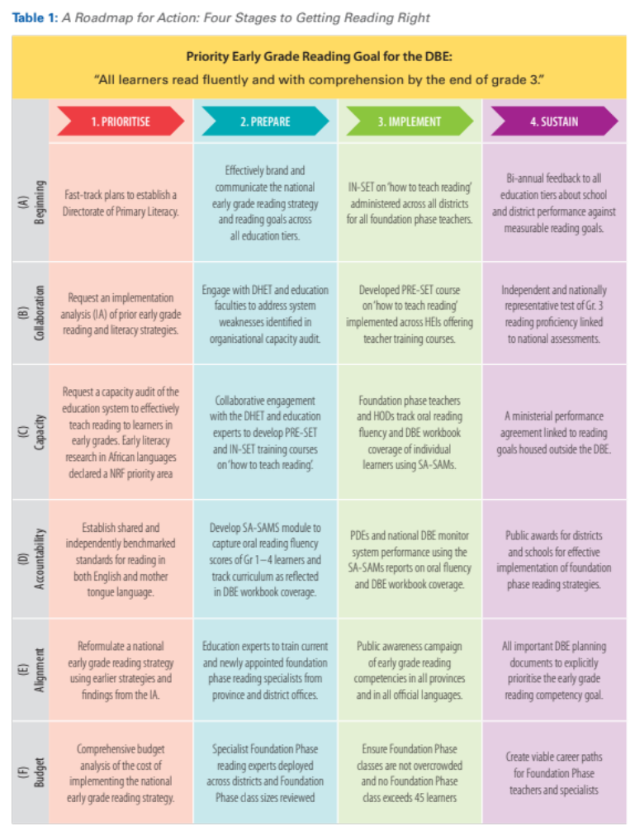


Slide 18
12 Policy Recommendations
Emphasize reading as a unifying goal for early primary schooling
Teaching primary school teachers how to teach reading in African languages and in English
Develop evidence-based interventions and evaluations and provide sustained support
Declare early literacy research (particularly in African languages) a NRF research priority area
Establish Oral Reading Fluency Norms for SA African languages
Use DBE workbooks to measure curriculum coverage

Slide 19
12 Policy Recommendations
Eliminate gender inequality in the appointment of principals
Continue to test students regularly through the ANAs
Review the allocation of district-level resources and personnel
Develop a course to teach Foundation Phase teachers how to teach reading
Investigate the extent of and reasons for extreme class-sizes in FP
Prioritize the elimination of extreme class sizes in the FP

Slide 20

Comments / Questions?
These research reports & policy briefs are available online at resep.sun.ac.za
NicholasSpaull@gmail.com

Slide 21
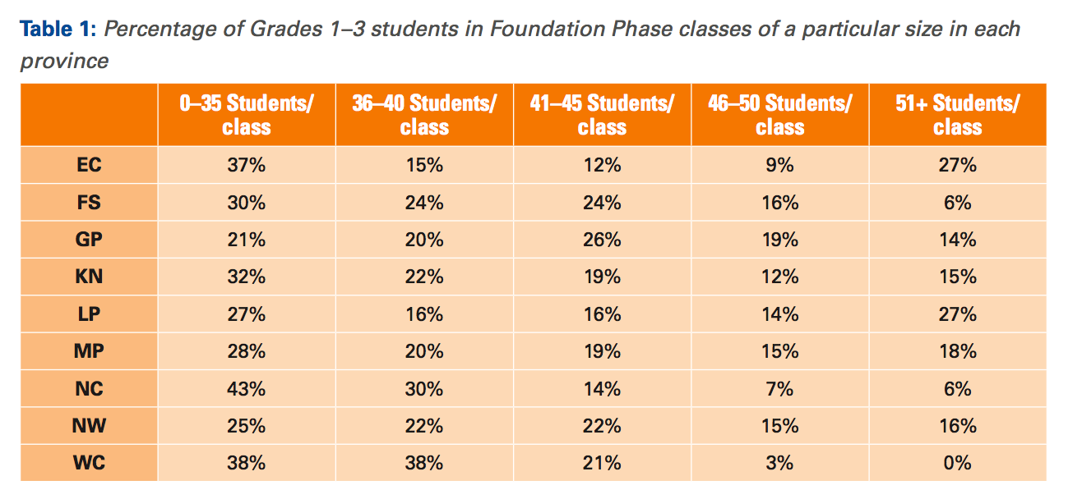

Slide 22
Reading
“Reading is, without doubt, the most important linguistic skill that needs to be developed in young children. Reading serves as a building block upon which all other learning takes place…This National Reading Strategy takes as its focus that reading failure begins in early grades, and it is at that level that interventions must be made” (DoE, 2008: 18).

