Slide 1
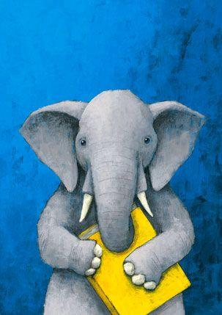
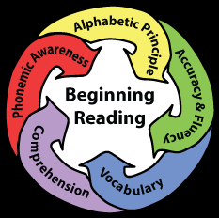
Reading in the Foundation Phase
Current developments and remaining gaps
27 April 2016
University of Johannesburg

Slide 2
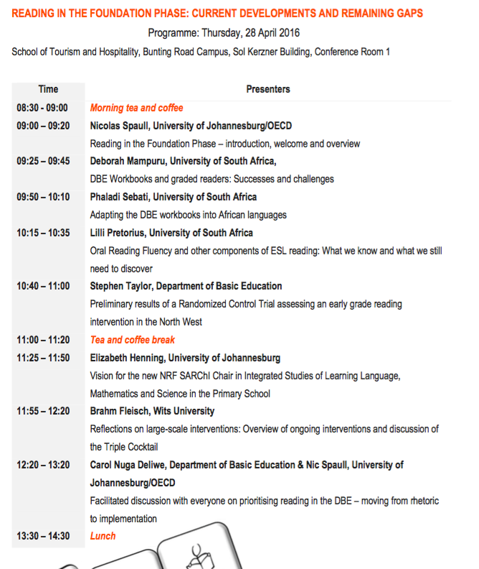

Slide 3
Overview
Two large research projects are now in the final stages:
  Binding Constraints project (PSPPD)
  Building Evidence for Policy-making (Zenex)
Both make the argument that reading in the FP is the biggest solvable problem in our education system.
TODAY: Stock-taking of where we’re at, what we know, what we still don’t know
Get some like-minded reading researchers in the same room to touch-base.

Slide 4
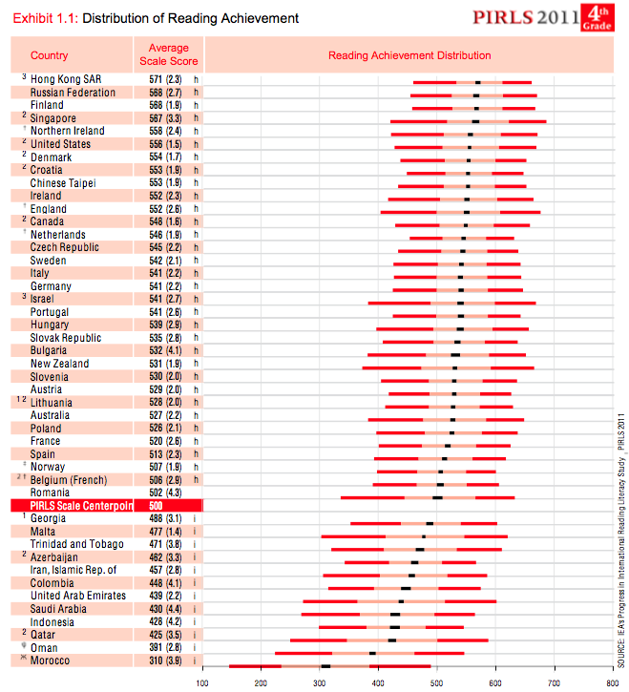
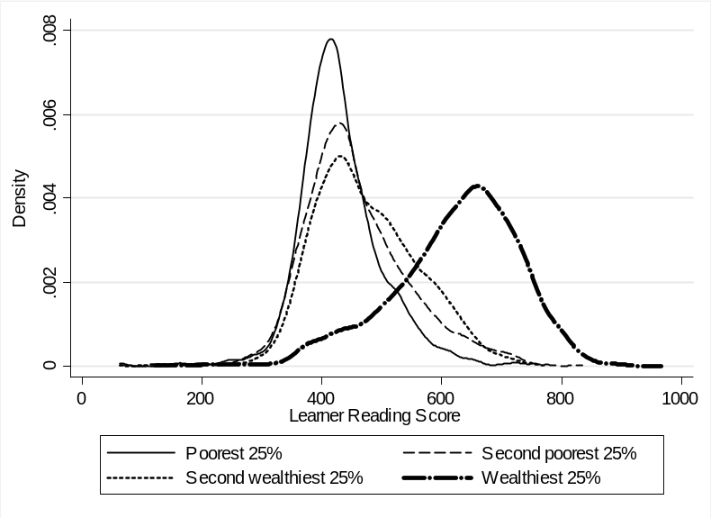
South African context
(1) Low achievement
  Pirls/prePirls 2011
(2) Unequal achievement
  SACMEQ 2007

Slide 5
(3) Complex language dynamics in SA
ANA 2013 Language of Assessment

Slide 6
How many South African children learn to read in lower primary school?

Slide 7
Can children read in African languages?

Slide 8
Do children in English or Afrikaans LOLT schools learn to read?

Slide 9
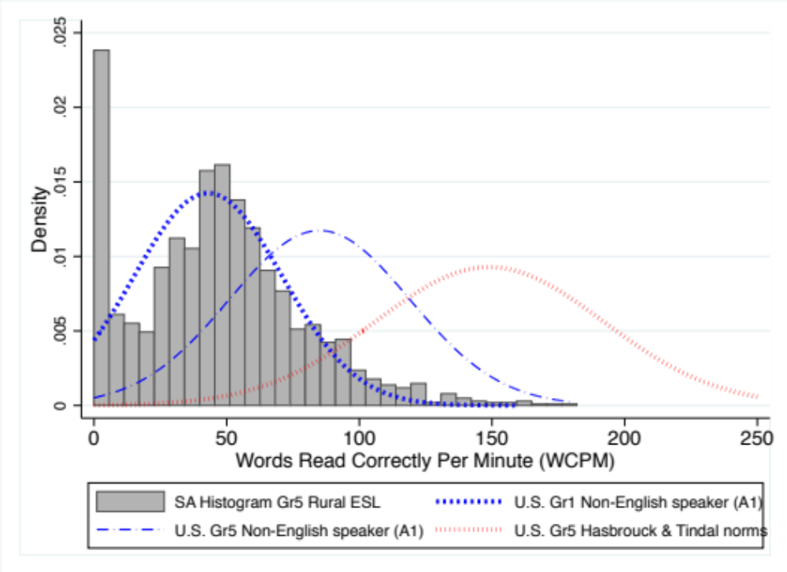
What about ESL kids in rural areas?
Draper & Spaull, 2015 (SAJCE)

Slide 10

Propositions
The majority of South African children are not learning to read in any language by the end of Grade 3.
This is the binding constraint to improved educational outcomes for the poor.
These students never get a firm hold on the first rung of the academic ladder and stumble forward into higher grades with low self esteem and compromised learning.

Slide 11
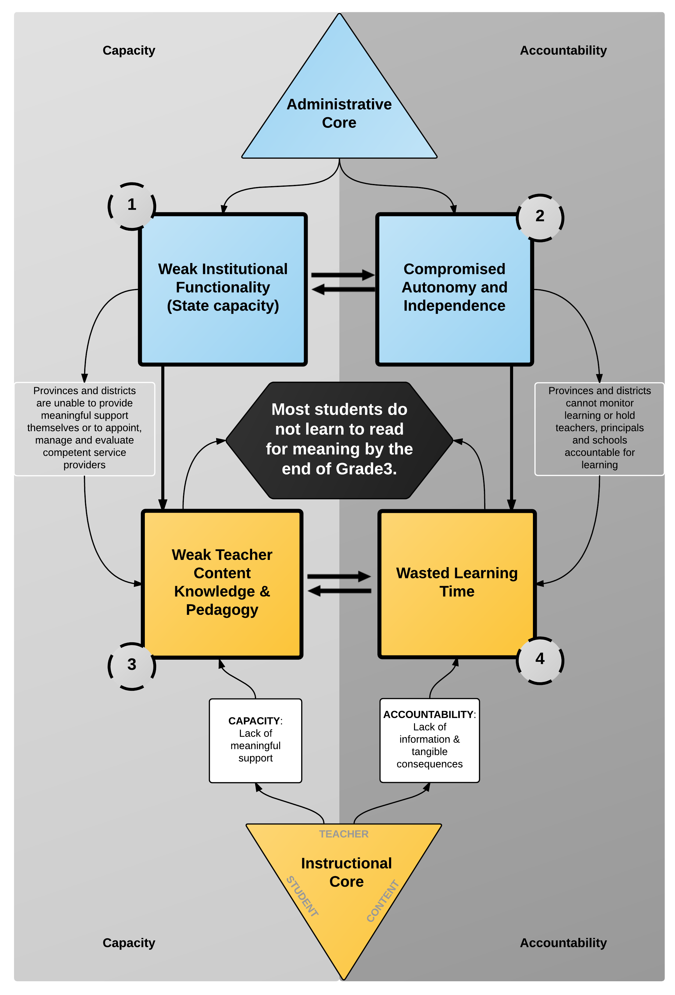
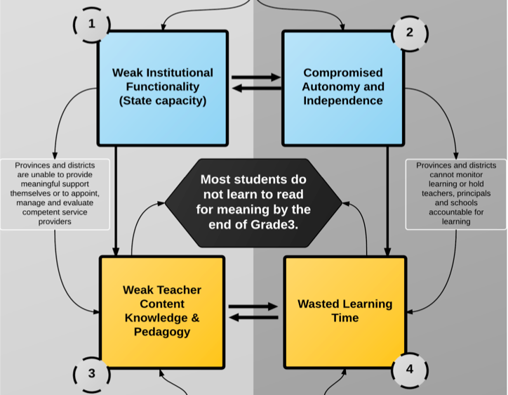
PSPPD

Slide 12
Zenex: Extreme class sizes in the Foundation Phase
Proportion of children in Grades 1-3 in class different class sizes (using ASS 2013 data)

Slide 13
My questions
What evidence do we have to say that FP teachers don’t know how to teach reading?
Is it possible to teach in-service FP teachers how to teach reading?
Is there consensus on the most effective way(s) to teach reading in the African languages?
Is the abrupt-switch model of language transition to English in Gr4 the only way or the best way?
Is there consensus on a ‘tight’/explicit definitions of “reading for meaning” or “basic reading” or “reading with fluency and comprehension” or “literate” or “reading grade appropriate texts”?
Measuring is only the first step, we need to know how to help teachers/kids who can’t read or teach reading. Programs? Evidence?

Slide 15
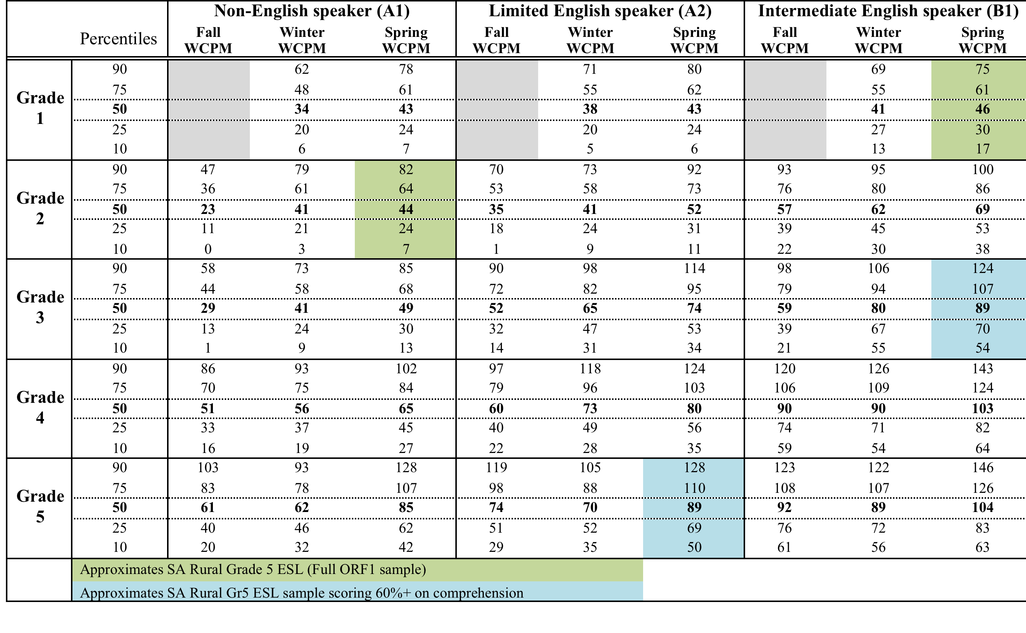
Table 13: Oral Reading Fluency scores for English Second Language (ESL/ELL) in Broward County Public Schools (Florida, US) (Broward County, 2012)

