Slide 1

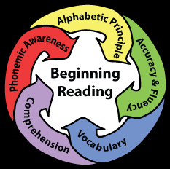
ECD and reading in South Africa?
-Nic Spaull
Stellenbosch University &
Allan Gray Orbis Foundation Endowment
20 March 2017
Akanyang ECD

Slide 2
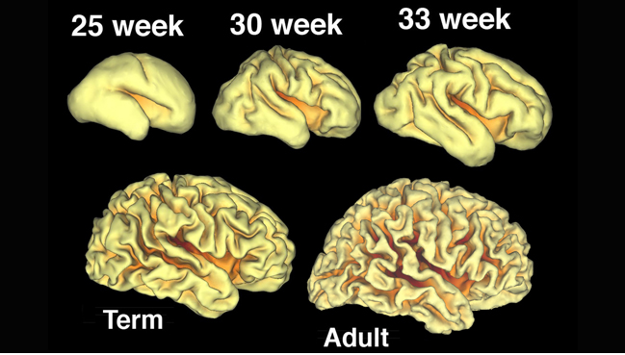
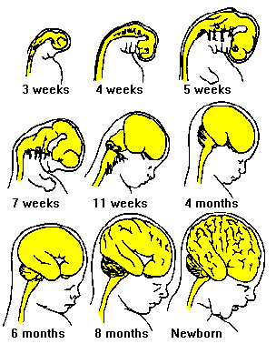
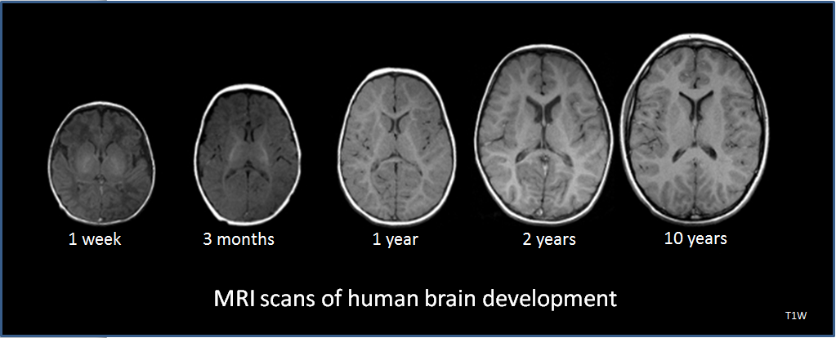
Brain development before birth
Pre-natal brain development
Post-natal brain development
During the 40 weeks of pregnancy, learning and adapting to the specific context in which a child is born
Source: Prof Linda Richter
Notes:
Click once: 3 images for 4 seconds

Slide 3
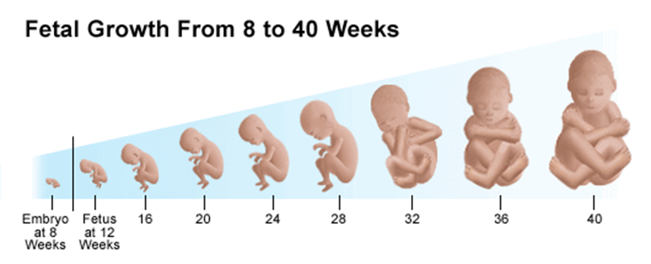
Illustrative functions before birth
By 4 months a sense of hearing and after birth recognition of music heard during pregnancy
Source: Prof Linda Richter

Slide 4
Illustrative functions before birth
By 6 months a basic sleep-wake cycle with open and closed eyes
Source: Prof Linda Richter

Slide 5
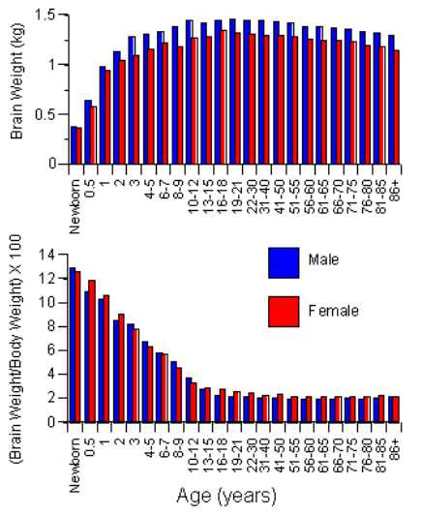
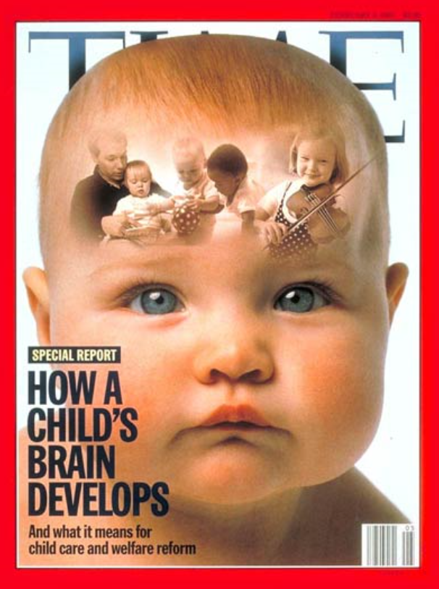
Grows 1% heavier per day for the first 3 months
At 3 years, is +80% the size of the adult brain
Age (yrs)
Rapid brain development after birth
Source: Prof Linda Richter
Notes:
Dekaban, A.S. and Sadowsky, D., Changes in brain weights during the span of human life: relation of brain weights to body heights and body weights, Annals of Neurology, 4:345-356, 1978

Slide 6
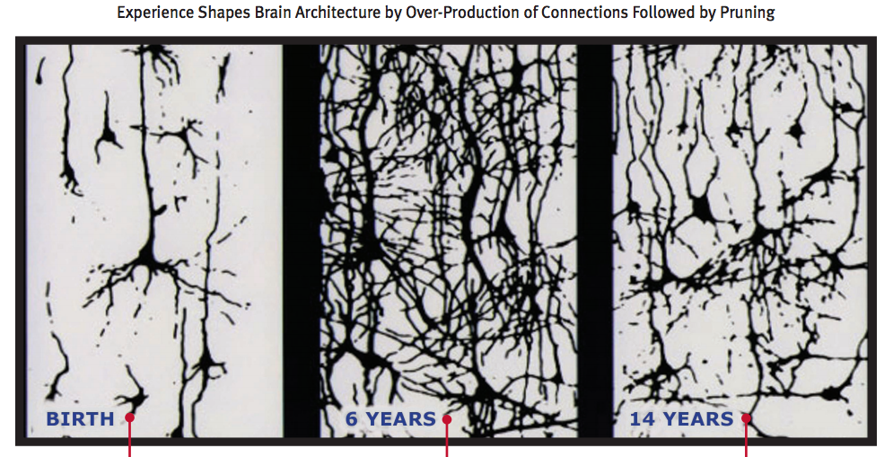
Early brain development
Source: www.developingchild.harvard.edu
Notes:
“The basic architecture of the brain is constructed through an ongoing process that begins before birth and continues into adulthood. During the first few years of life, 700 new synapses (neural connections) are formed every second. After a period of rapid proliferation, connections are reduced through a process called pruning, so that brain circuits can become more efficient. Early experiences affect the nature and quality of the brain’s developing architecture by determining which circuits are reinforced and which are pruned through lack of use. Some people refer to this as “use it or lose it." Graphic Source: Chugani, H.T. Synaptic Density. [Drawing]. In R. Shore, Rethinking the Brain: New Insights into Early Development (p. 20). New York: Families and Work Institute, 1997

Slide 7
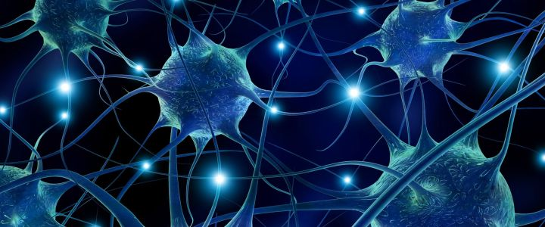
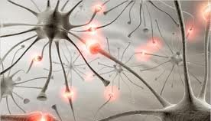
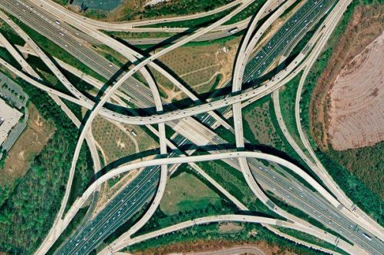
Road analogy

Slide 8
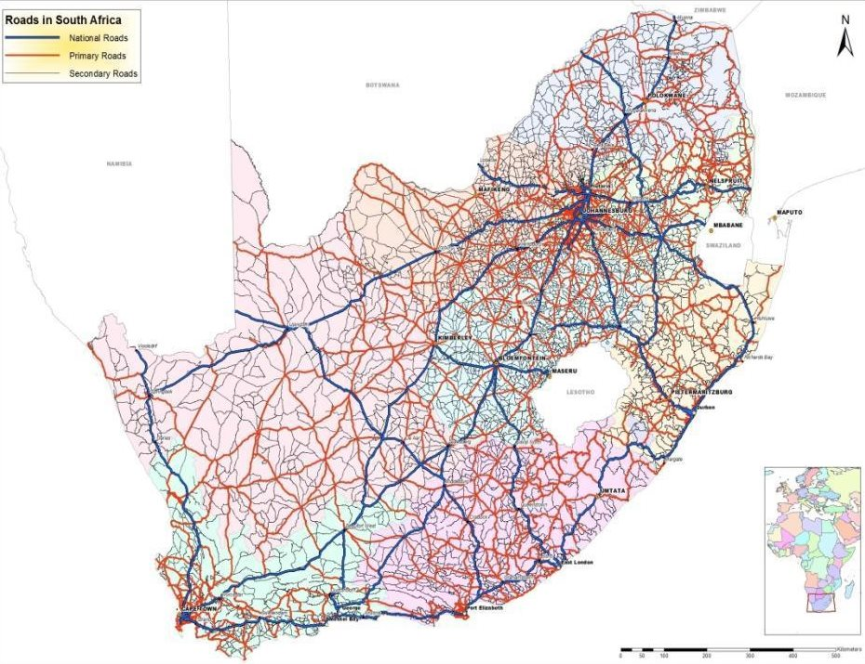
747,000km of roads in SA (paved and unpaved)
Assume an interchange every 100m = 7,470,000 interchanges in SA
Notes:
747,000 km (747,000,000m) of roads in South africa. If we assume that there was an interchange every 100m that’s 7, 470,000 interchanges (world=300mil interchanges if you assume that there are 1,500,000 interchanges per country)
700 synapses/s = 42,000 in a minute = 2,520 000 in an hour. 142,857. It would take a child under 3-days to build it from scratch. For every single interchange in the entire world it would take 3 months.
http://www.tradingeconomics.com/south-africa/roads-total-network-km-wb-data.html

Slide 9
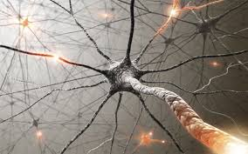

How ‘big’ is a child’s brain?

Slide 10

333,000 planet Earth’s roads and interchanges = 1 child’s brain
Notes:
SA is a big country. Maybe 1,500,000 interchanges in the average country
300 million road interchanges on the earth…

Slide 11


The centrality of reading
“Professional educators and the public at large have long known that reading is an enabling process that spans academic disciplines and translates into meaningful personal, social, and economic outcomes for individuals. Reading is the fulcrum of academics, the pivotal process that stabilizes and leverages children’s opportunities to success and become reflective, independent learners.
^{(Good, Simmons and Smith,} ^{1998:45) .}
“Reading is, without doubt, the most important linguistic skill that needs to be developed in young children. Reading serves as a building block upon which all other learning takes place…This National Reading Strategy takes as its focus that reading failure begins in early grades, and it is at that level that interventions must be made”
(DoE, 2008: 18).

Slide 12
READING: What % of Gr4 students do not learn to read in any language?

Slide 13
Location: What % of students do not learn to read for meaning in any language?
(prePIRLS 2011)

Slide 14
School wealth: What % of students do not learn to read for meaning in any language? prePIRLS 2011
Richest 5% of schools
Poorest 5% of schools
Advanced
High
Intermediate
< Intermediate

Slide 15

What does this look like in reality?
“We found that South African Grade 5 second language learners from rural areas in South Africa had essentially the same distribution as Grade 1 second language learners in Florida, or Grade 2 second language remedial learners who had been removed from normal classes because they “cannot communicate meaning orally in English and demonstrate very little understanding in English”.
Draper, K., and Spaull, S. (2015). Examining oral reading fluency among grade 5 rural English Second Language (ESL) learners in South Africa: Analysis of NEEDU 2013. South African Journal of Childhood Education 5(2) pp.44-77.

Slide 16


Slide 17
What does this look like in reality?
Many
years
ago
Leopard
was
a
creature
with
no
spots.
Recommended rate at Gr5
One
day,
he
was
relaxing
in
the
shade
of
a
thorn
tree
when
Zebra
walked
past.
Many
years
ago
Leopard
was
a
creature
with
no
spots.
40% of SA rural Gr5 learners (<40WCPM) WCPM
One
day,
he
was
relaxing
in
the
shade
of
a
thorn
tree
when
Zebra
walked
past.
Draper, K., and Spaull, S. (2015). Examining oral reading fluency among grade 5 rural English Second Language (ESL) learners in South Africa: Analysis of NEEDU 2013. South African Journal of Childhood Education 5(2) pp.44-77.
Notes:
40 words in 60s = 1,5s/word
130 words in 60s = 0,46s/word

Slide 18
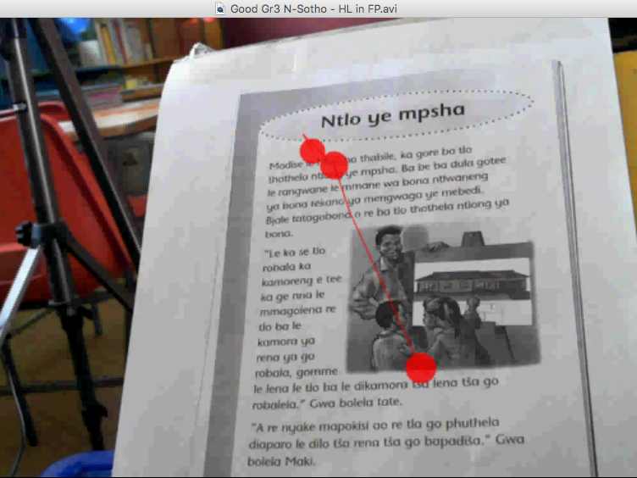
Eye-tracking research in SA

Slide 19
COMMON CLASSROOM PRACTICES RESEARCH IN SOUTH AFRICA 2004-2015 |  | OUTCOMES
Whole class teaching (little or no differentiated teaching) Whole class chorusing Collective teaching/learning Little attention to meaning Little or no attention to higher order skills (literal meaning) Little or no explicit instruction Little and ineffective feedback Low expectations Teaching reading from the blackboard Teacher reads a line and learners repeat it Very little time spent on reading No/little reading homework given Print poor classrooms Few books in classrooms Slow pace of teaching Poor time management in classrooms Minimal and ineffective assessment Very little writing done in classrooms |  | Children in primary school who can hardly read and write Passive, dependent learners Children who struggle with higher order thinking An education system producing mainly semi-literate and semi-numerate children; about 30% of children in Grade 4 are illiterate (Spaull 2015)
Source: Pretorius, 2017

Slide 20
But we are ECD teachers what has this got to do with us?

Slide 21
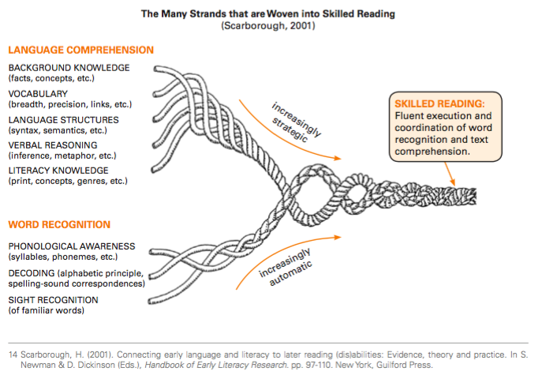
How children learn to read…

Slide 22
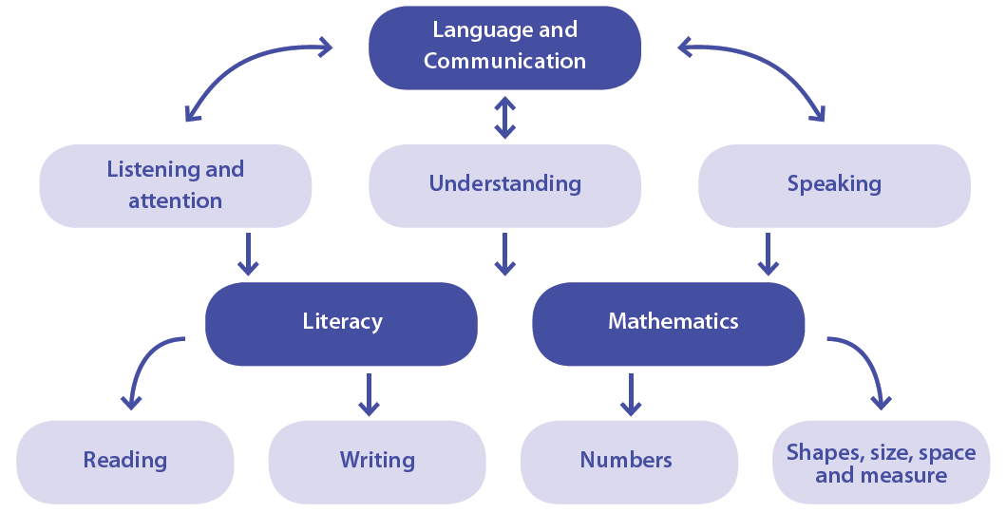

The essential role of language in early learning

Slide 23
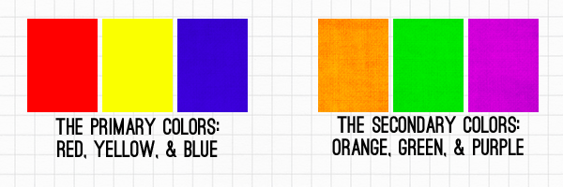
The importance of vocabulary – Colour analogy

Slide 24
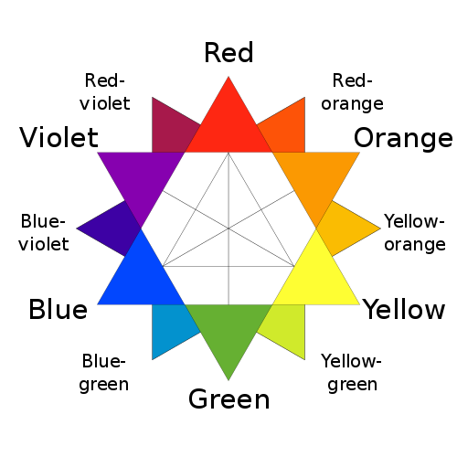
The importance of vocabulary

Slide 25
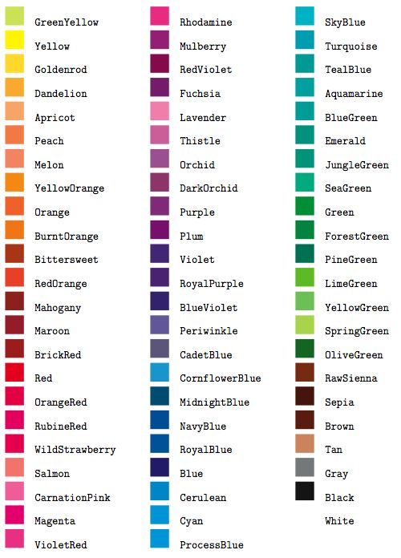
The importance of vocabulary

Slide 26
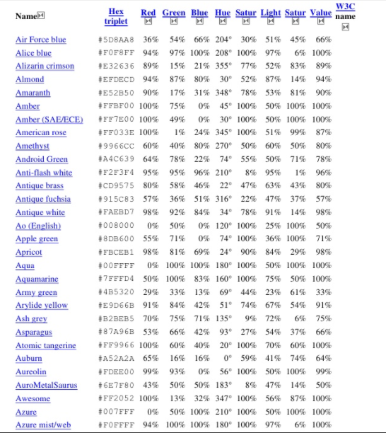
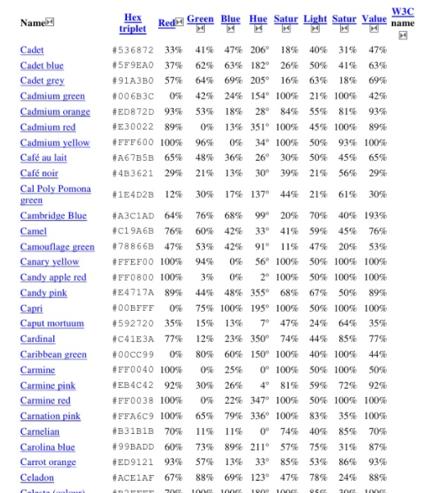

Slide 27
Core Vocabulary Lists
350 most frequent words account for approximately 80% of words actually spoken
    ∗ Derived from language samples collected during research studies: www.minspeak.com/CoreVocabulary.php
- Banajee list of 26 toddler core words*
- Marvin list of 333 alphabetized preschool core words
- Balandin list of 347 core words used by adults
- Stuart list of 174 core words used by seniors
- Hill list of the top 100 core words used by fluent augmented communicators
∗ From the above research studies, 250-350 words collected in the language samples accounted for approximately 75-80% of the words communicated. (* accounted for 96% )

Slide 28
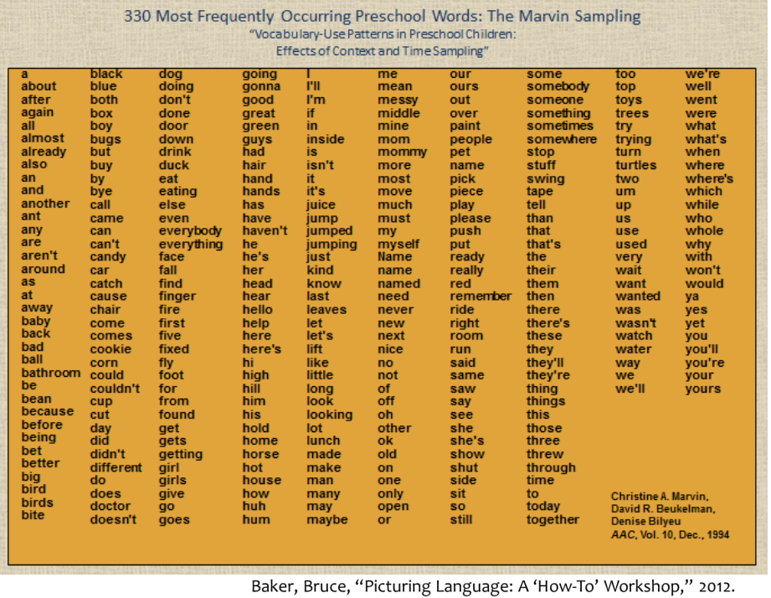

Slide 29
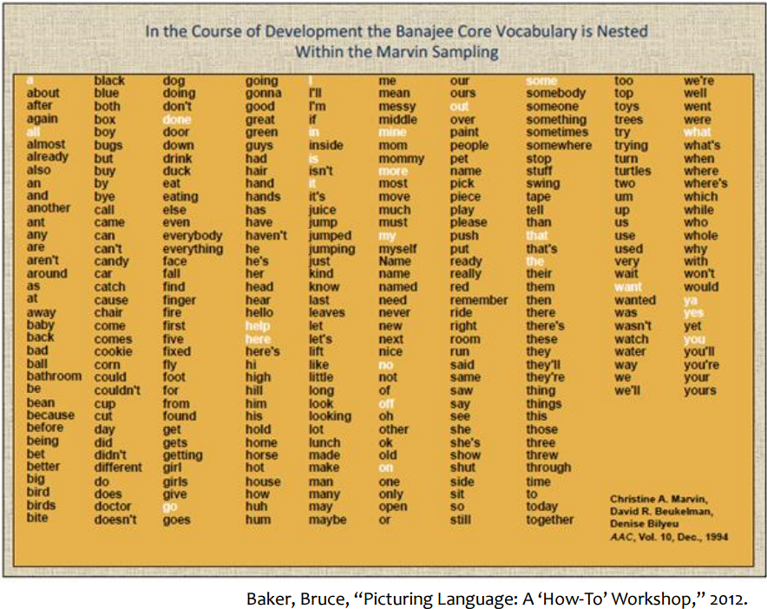

Slide 30
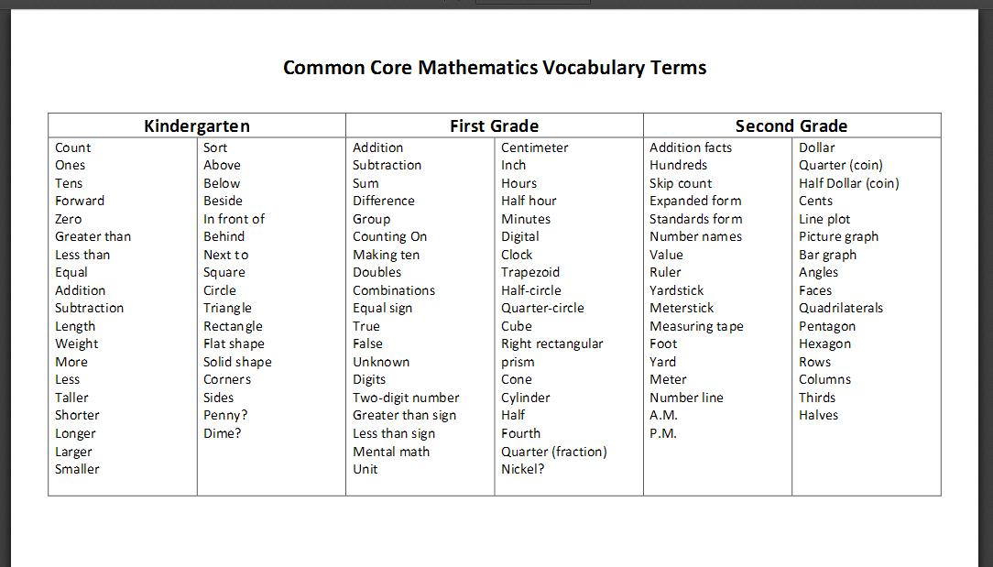
Teaching across the curriculum

Slide 31
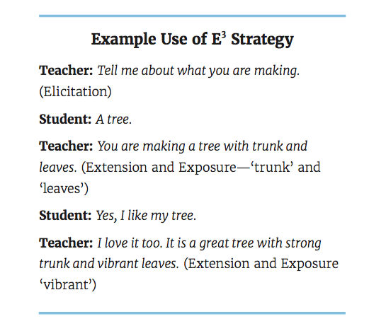
Developing Emergent Literacy Skills
Expose: “make something visible by uncovering it”
Elicit: “evoke or draw out (a reaction, answer or fact) from someone
Extend: “cause to cover a wider area, make larger”

Slide 32
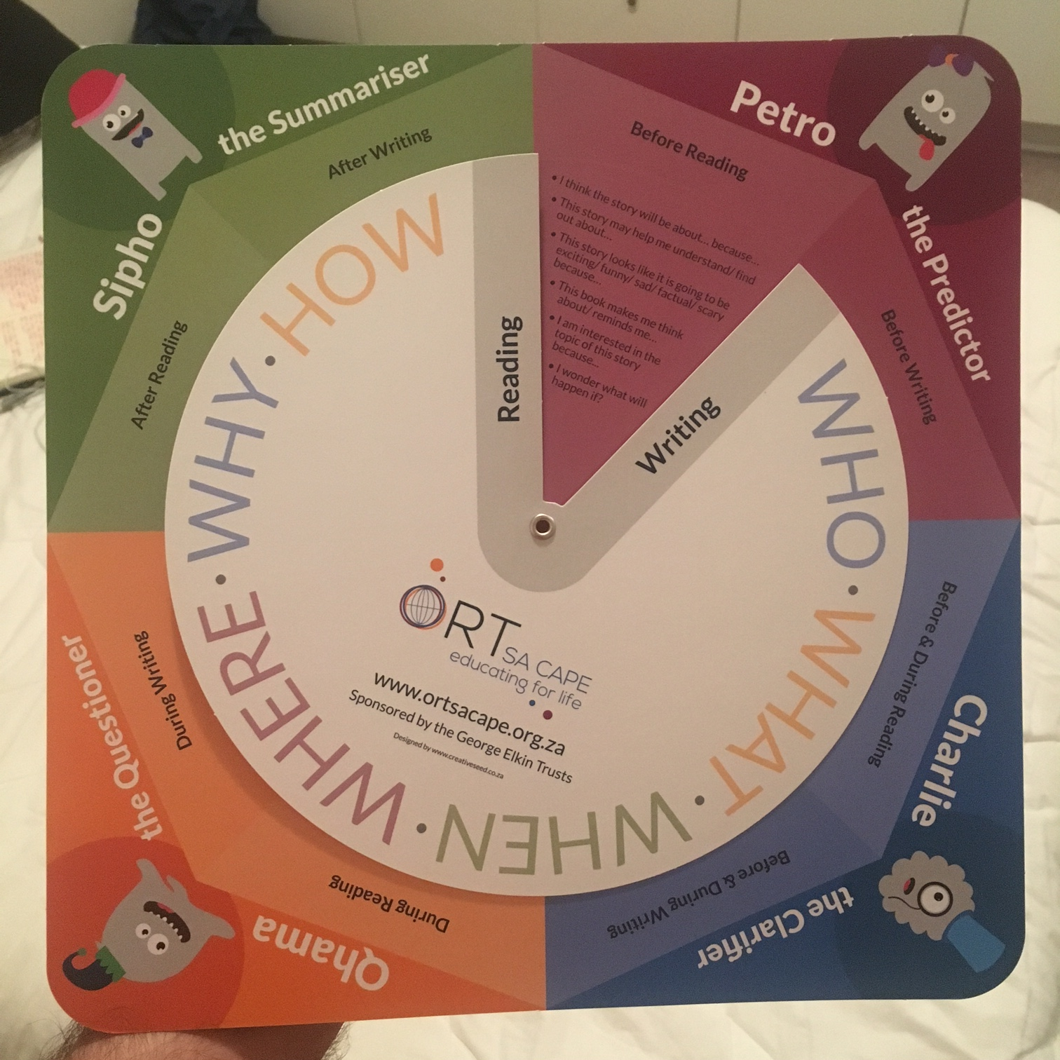

Slide 33
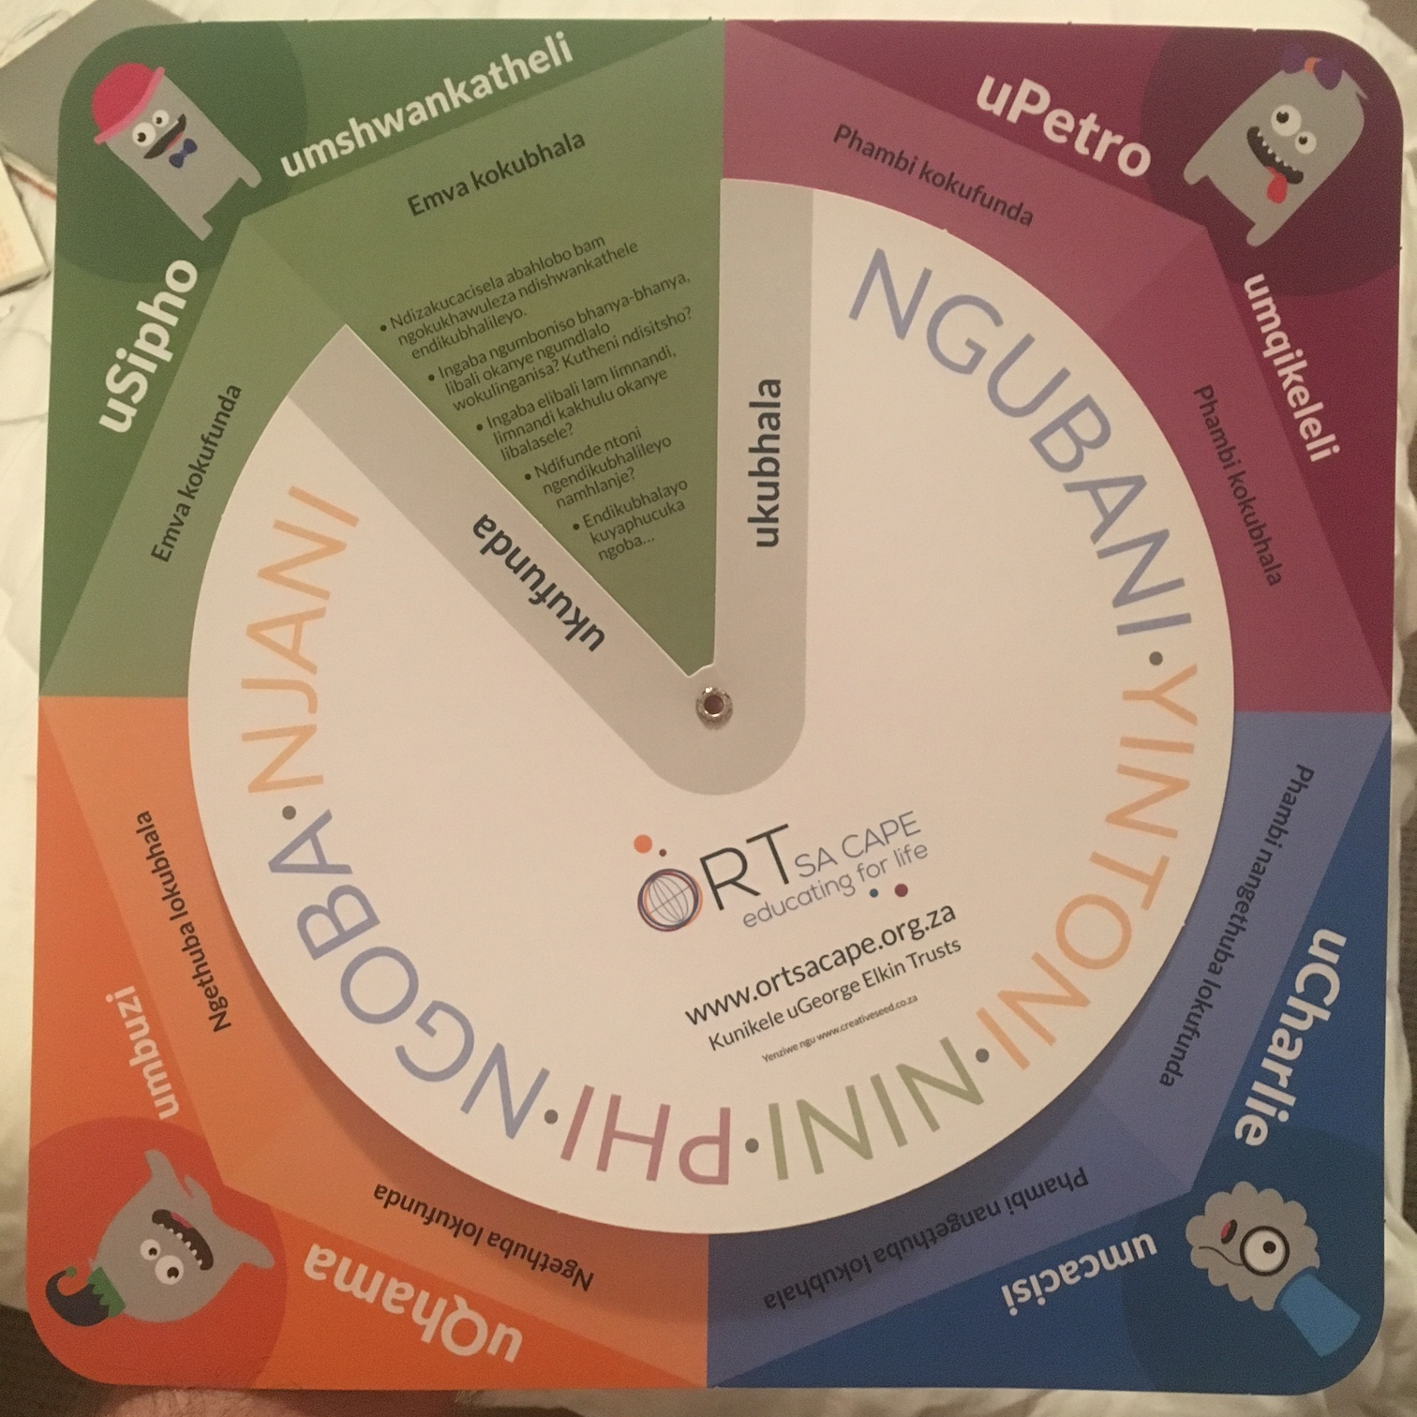

Slide 34
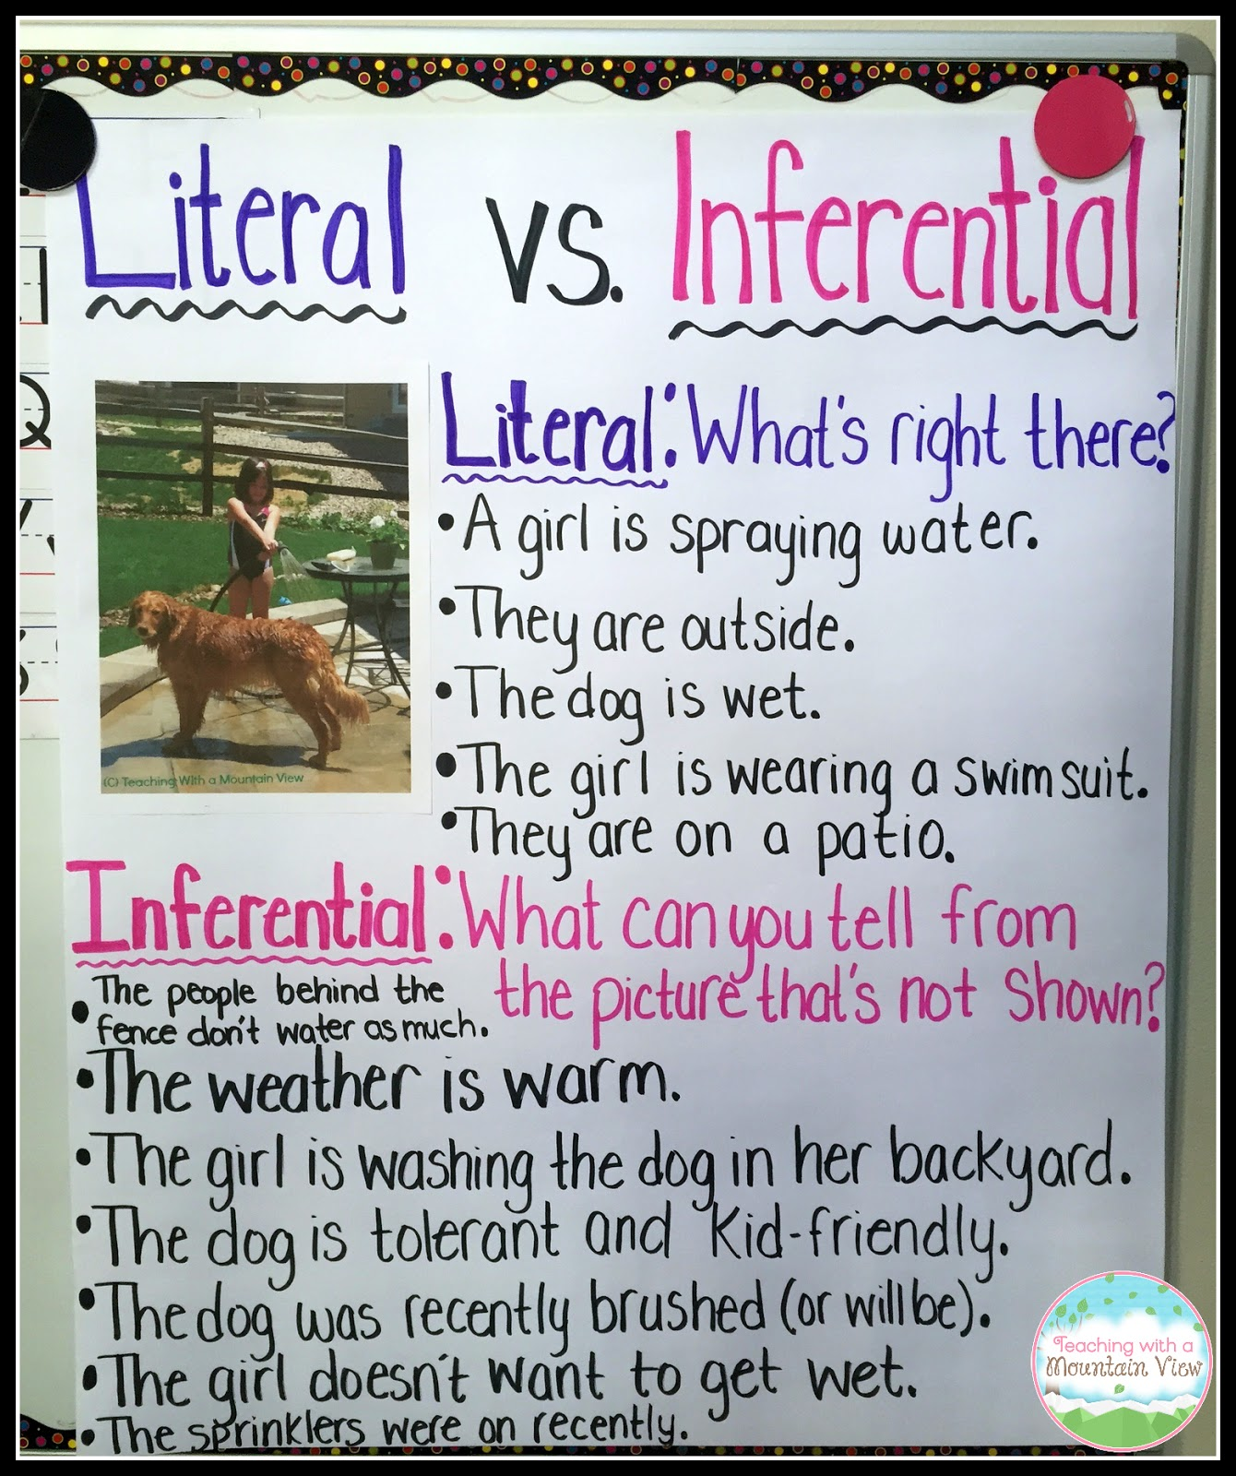
Literal and inferential questions
INFERENTIAL questions: Ones where the text does not actually tell us, but we can work out the answer by considering the hints and clues in the text in the light of our own knowledge and experience.
LITERAL questions: Ones where we can find the answer directly in the text.

Slide 35
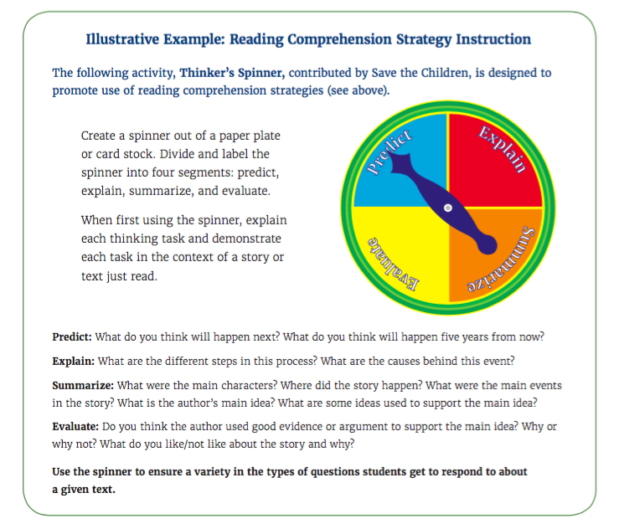
Source: USAID 2016

Slide 36
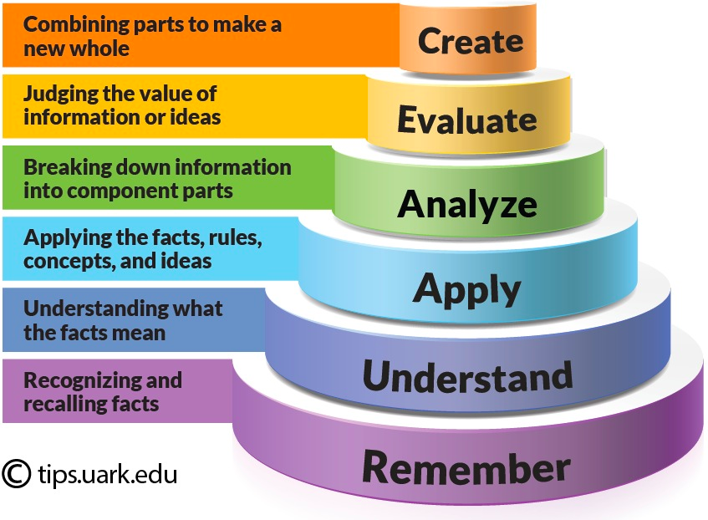
Bloom’s Taxonomy: Cognitive

Slide 37
One example of an intervention:
Zenex FP Literacy Project by Elizabeth Pretorius (UNISA) & Sarah Murray (RHODES)
(Slights courtesy of Lillie Pretorius)

Slide 38
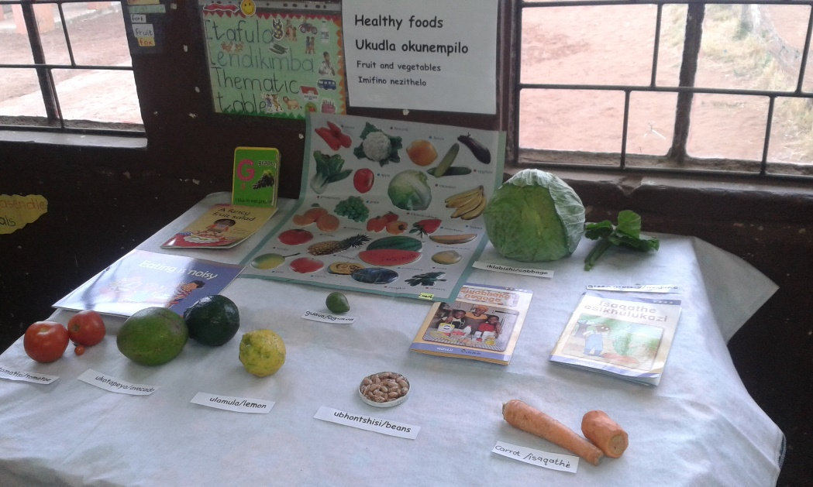
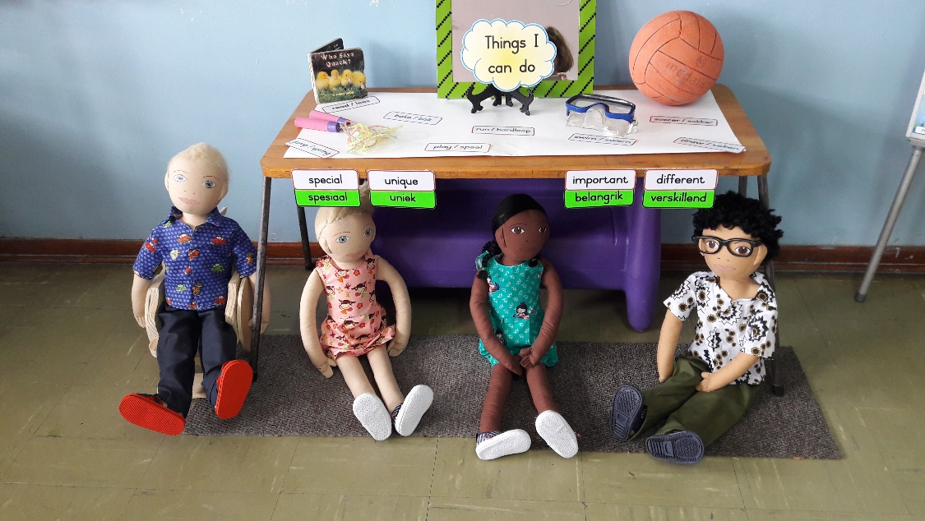
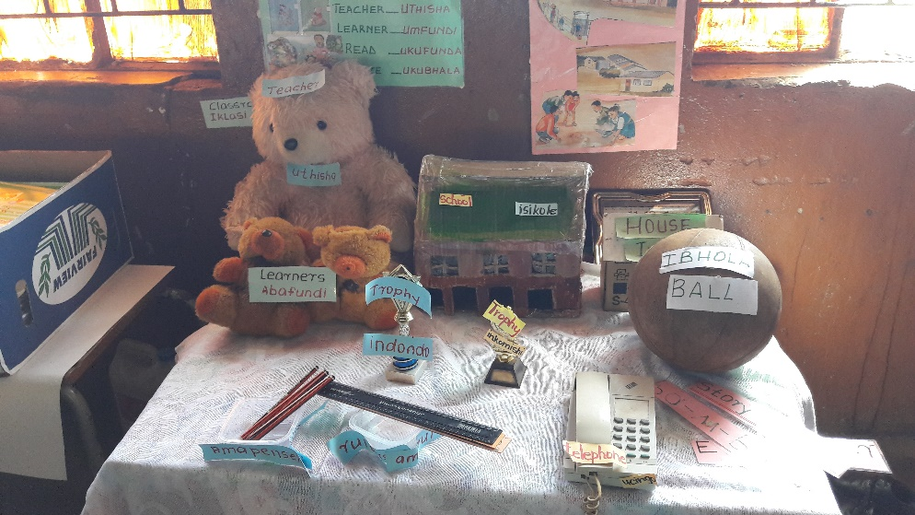
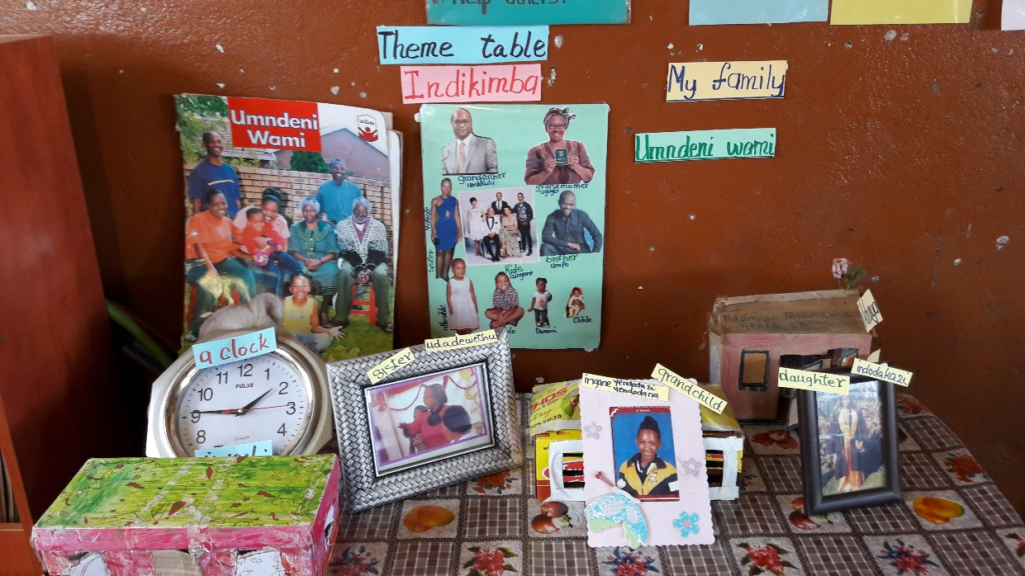
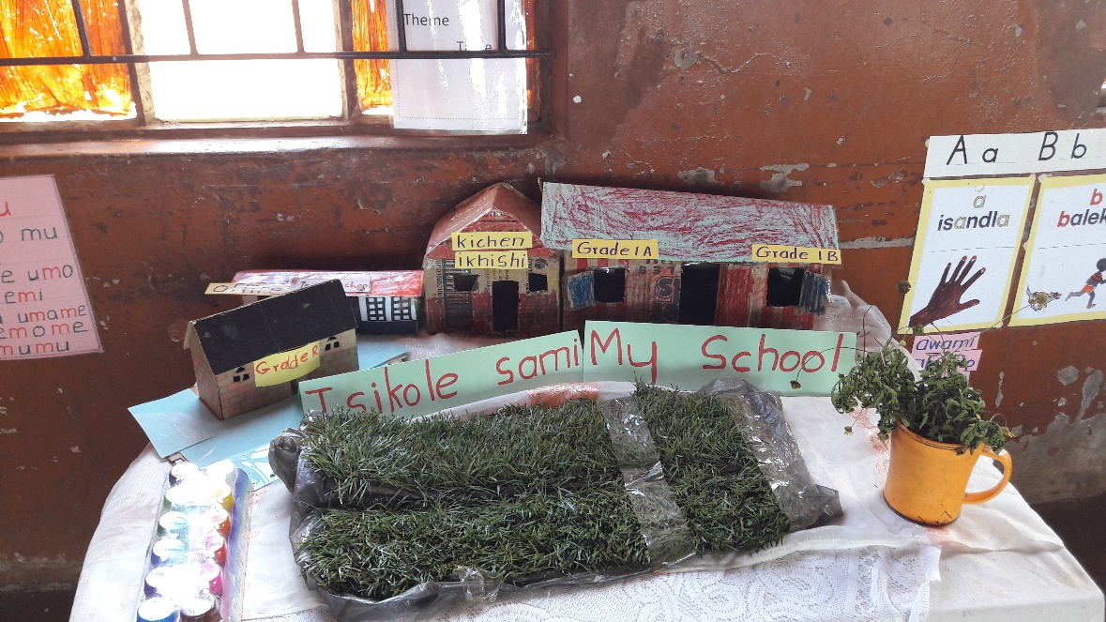
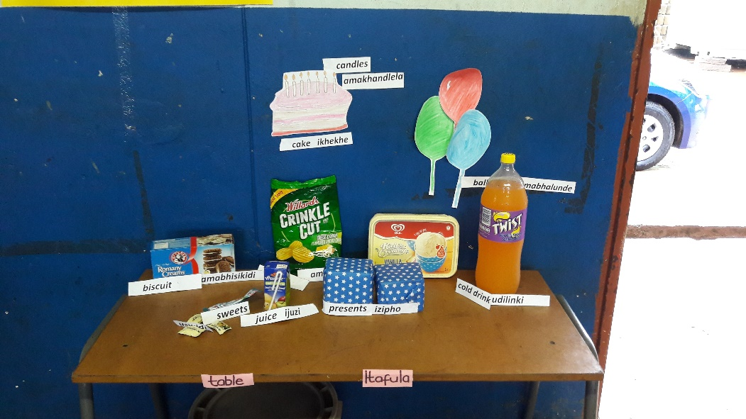
THEME TABLES – initially almost non-existent; now appearing in most of the classrooms; large qualitative differences across sites

Slide 39
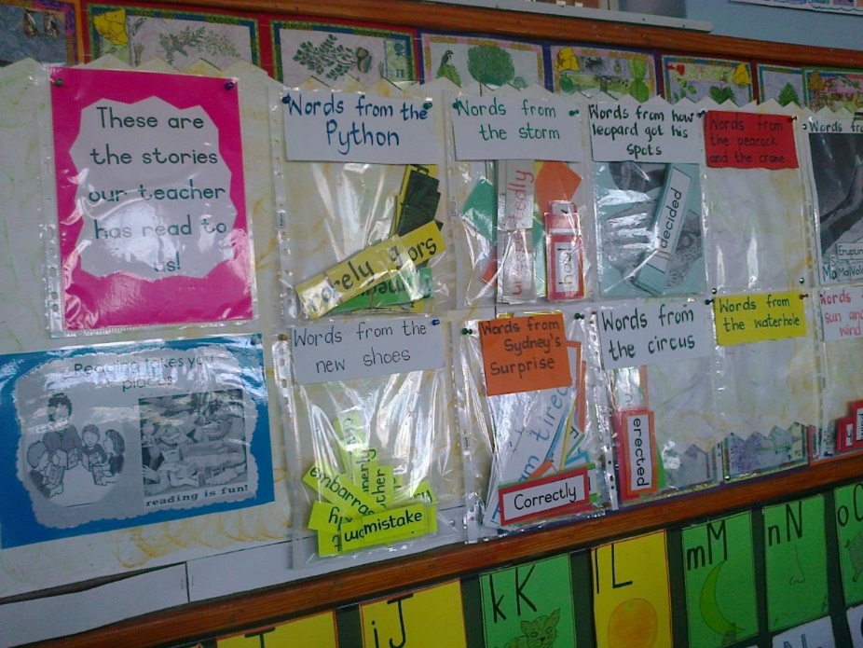
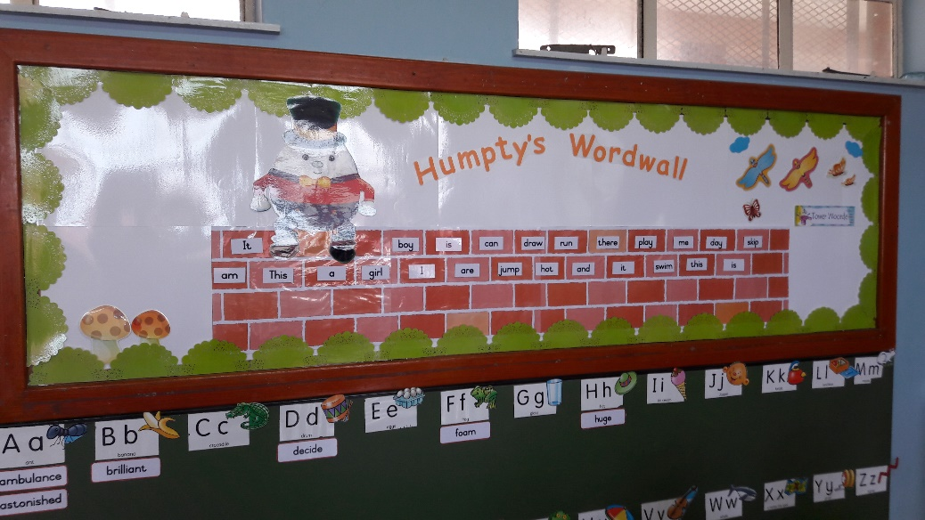
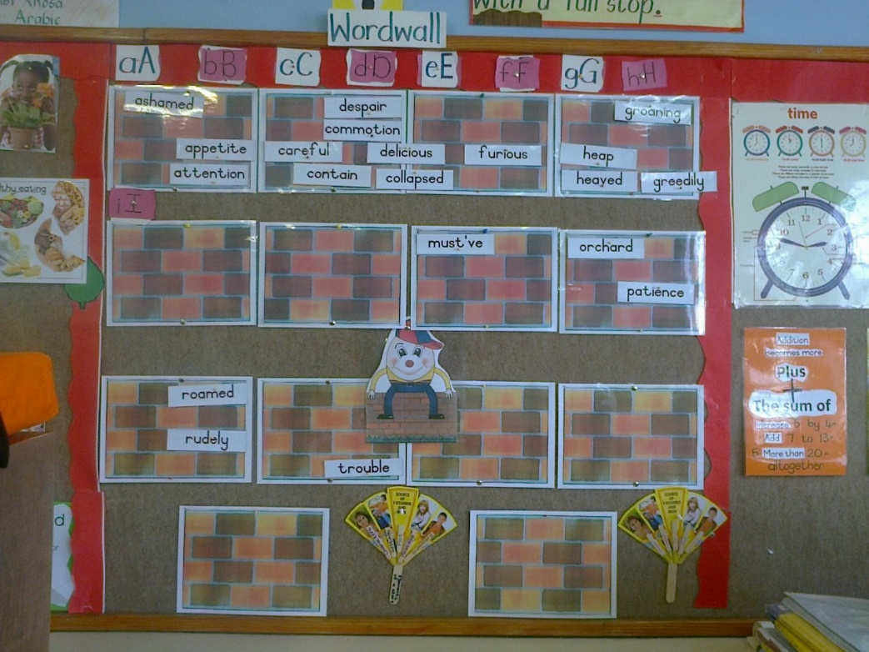
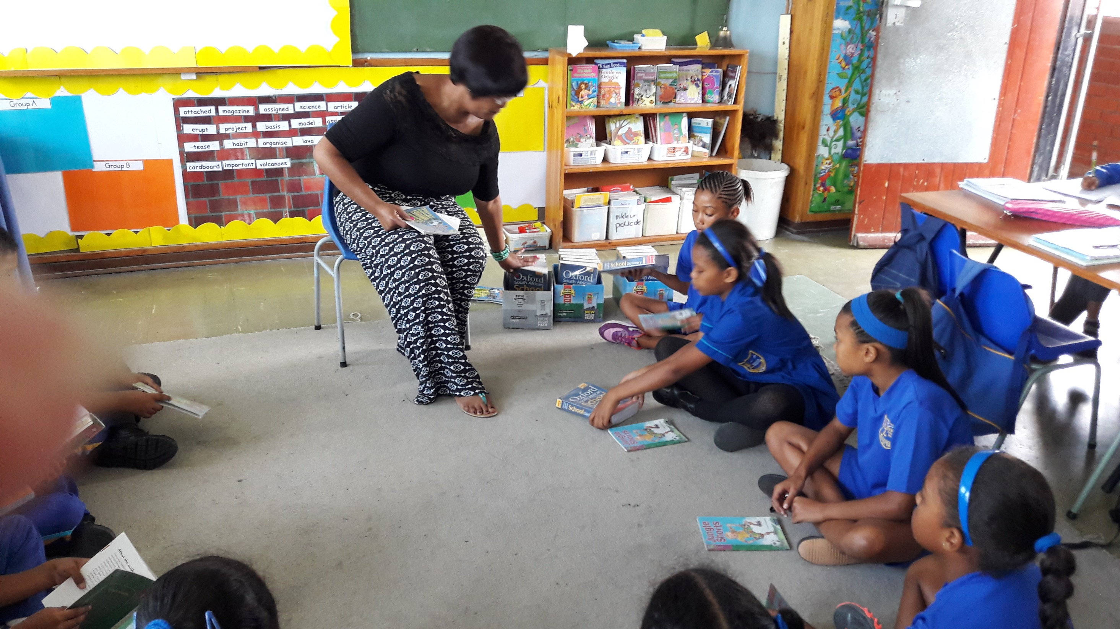
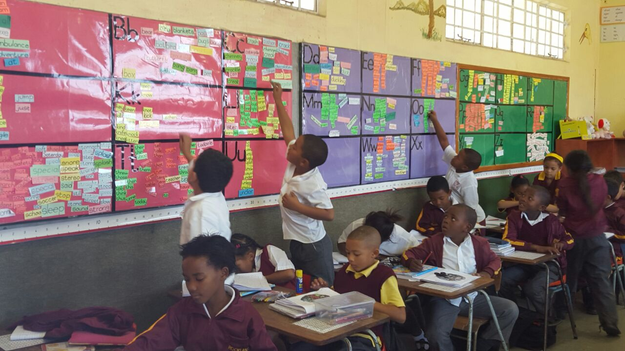
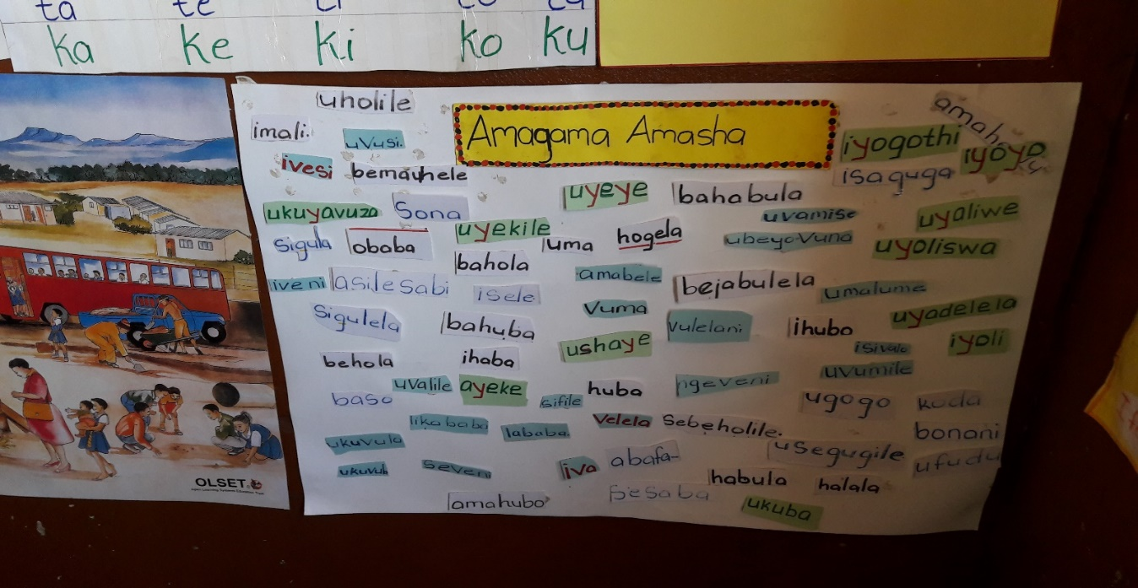
WORD WALLS now starting to appear in most classrooms; large qualitative differences across sites

Slide 40
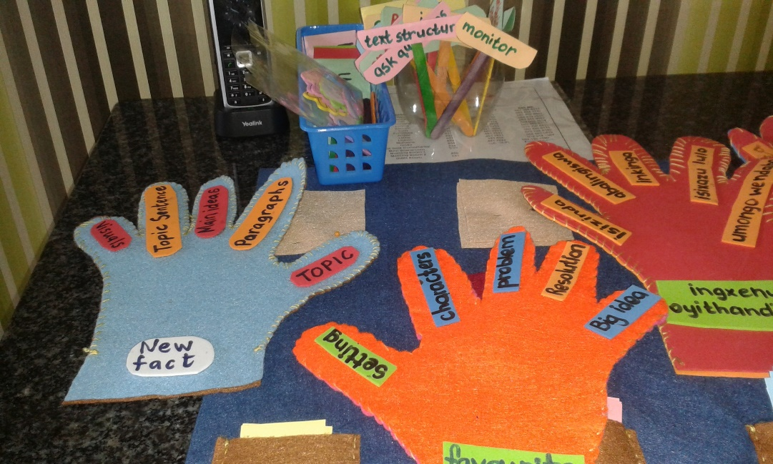
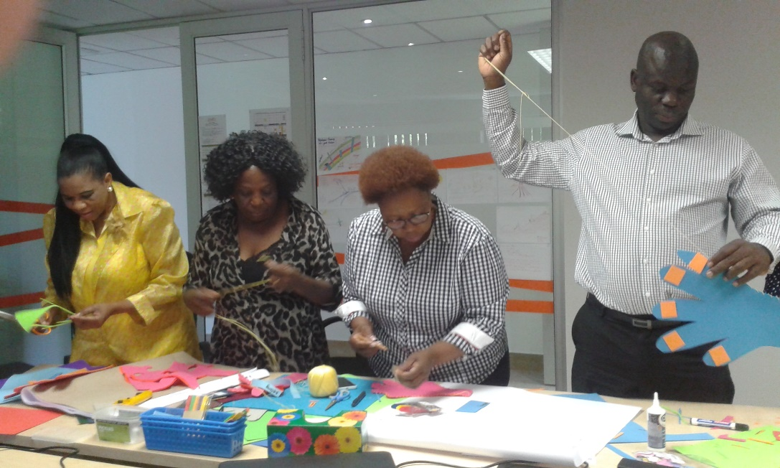
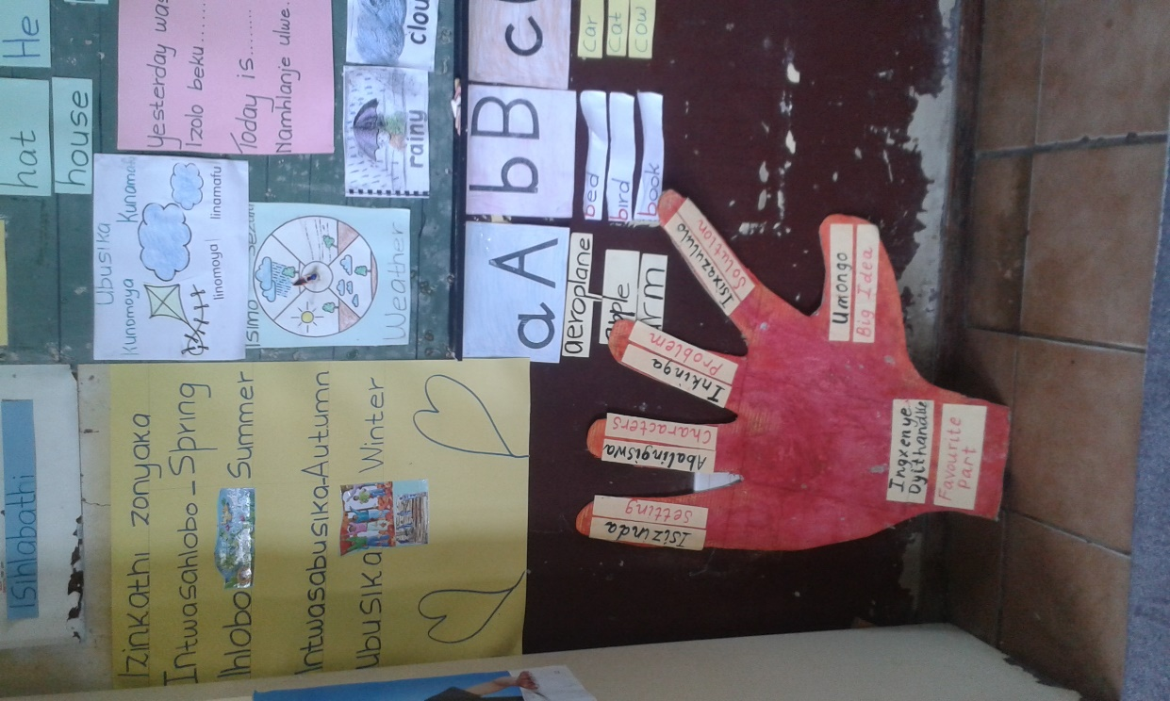
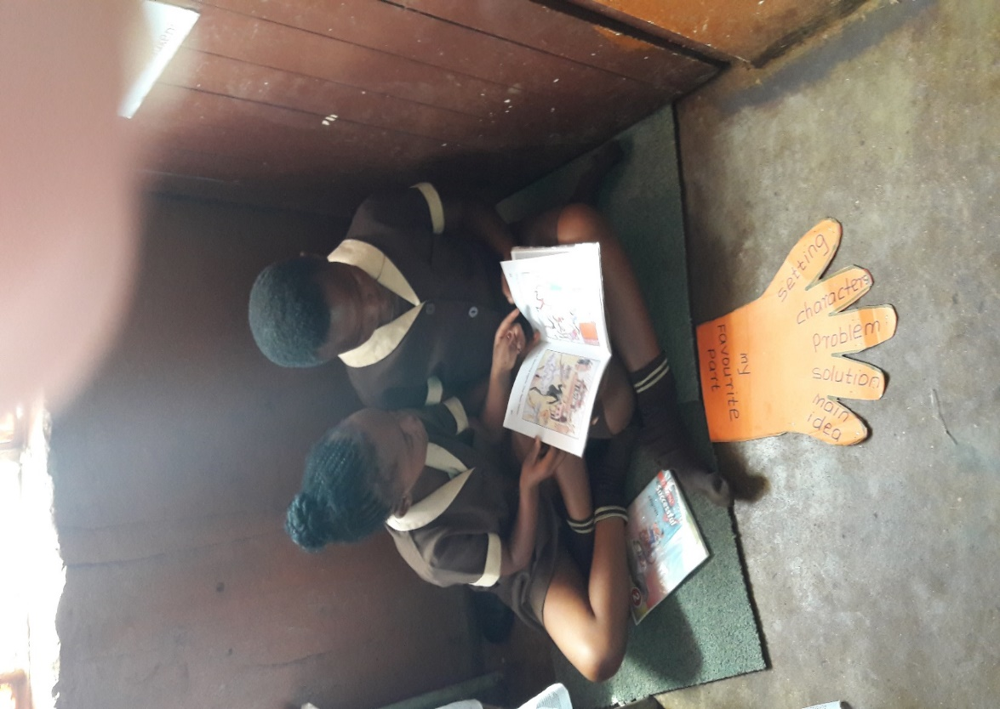
READING GLOVES – helping teachers

Slide 41
Questions to ask…
Am I consciously aware of the language I am using and developing with my students?
  Am I regularly extending their vocabulary?
  Am I exposing them to new words?
Am I asking my students ‘deeper’ (inferential) questions and not just ‘surface’ (literal) questions?
  Literal: “What color is the boy’s balloon?”
  Inferential: “How do you think the boy felt when his balloon popped?”

Slide 42
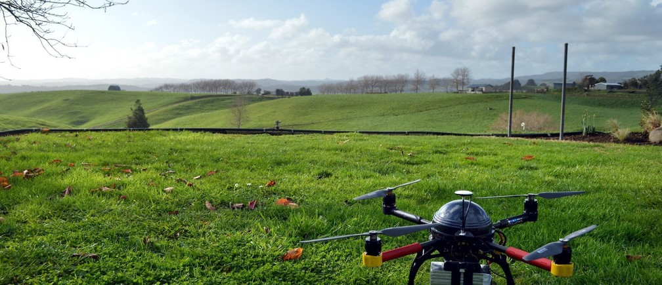
Questions & comments?
Presentation available at nicspaull.com

