Slide 1
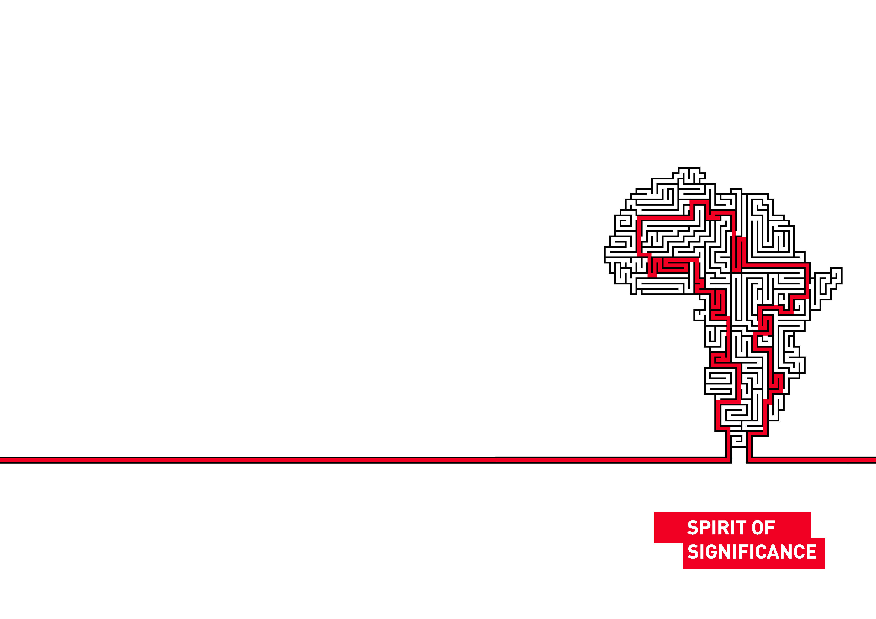

NicSpaull.com
Binding Constraints in Education
23 September 2016
Notes:
Introduce everyone to
Start off by thanking everyone for their contribution

Slide 2
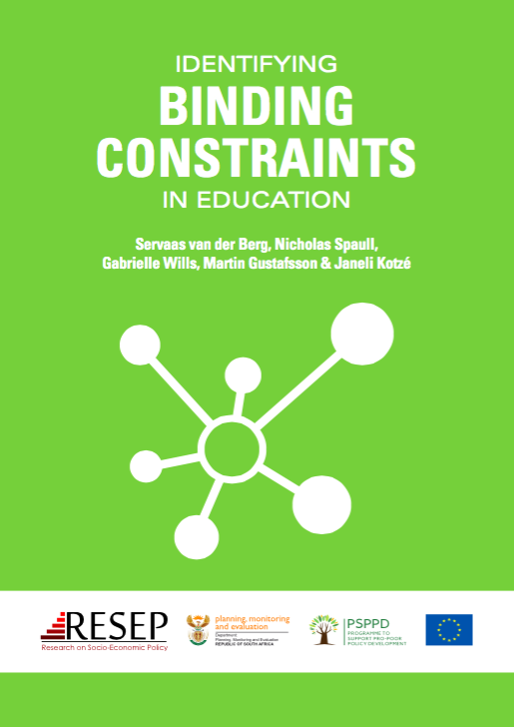

PSPPD & Zenex Report Launch

Slide 3
What do we know about education in SA?
High access: South Africa has relatively high access to education up to Grade 9. Expanding Grade R. Also new progression policies.
Low quality: South Africa has very low levels of educational achievement even by low/middle-income standards. OECD ranks SA 74/75 countries beating only Ghana.
Egregious inequality: The gap between the better performing 20% of schools and the 80% of dysfunctional schools is one of (or the) largest in the world. Gap between two systems is between 3 & 4 grade levels. Largely determined by ability-to-pay and location.
Weak accountability: The alliance between the ANC and COSATU/SADTU means that almost all accountability initiatives never get off the ground. (Volmink Report, ANAs, SACE)
Low capacity: Most teachers in quintiles 1-4 do not know enough about their subjects (content knowledge) or how to teach them (pedagogy) meaning that students rarely grasp the content either.
Notes:
OECD report- https://www.oecd.org/pisa/44417824.pdf

Slide 4
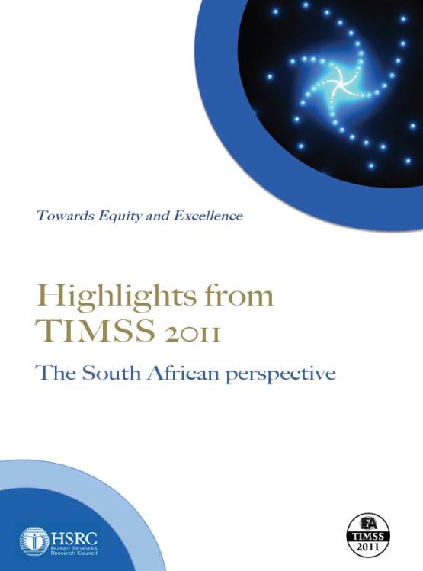

Low Quality: Student performance in SA
TIMSS 2011 (Gr9 – Maths & Science)
SA has joint lowest performance of 42 countries
Improvement by 1.5 grade levels (2003-2011)
76% of grade nine students in 2011 still had not acquired a basic understanding about whole numbers, decimals, operations or basic graphs, and this is at the improved level of performance
See Reddy et al. (2012) & Spaull (2013)
prePIRLS2011 (Gr 4 Reading)
29% of SA Gr4 learners completely illiterate (cannot decode text in any language)
58% cannot read for meaning
(New TIMSS 2015, PIRLS 2015 and SACMEQ 2013* results soon to be released) – see today’s M&G

Slide 5
England = 533, Turkey=480

Slide 6

NSES Question 42
NSES followed about 15000 students (266 schools) and tested them in Grade 3 (2007), Grade 4 (2008) and Grade 5 (2009).
Grade 3 maths curriculum: “Can perform calculations using appropriate symbols to solve problems involving: division of at least 2-digit by 1-digit numbers”
Even at the end of Grade 5 most (55%+) quintile 1-4 students cannot answer this simple Grade-3-level problem.
“The powerful notions of ratio, rate and proportion are built upon the simpler concepts of whole number, multiplication and division, fraction and rational number, and are themselves the precursors to the development of yet more complex concepts such as triangle similarity, trigonometry, gradient and calculus” (Taylor & Reddi, 2013: 194)
How does this affect learning as students move into higher grades?
Spaull, N. & Kotze, J. (2015). Starting behind and staying behind in South Africa: The case of insurmountable learning deficits in mathematics. International Journal of Educational Development. Vol 41 (March) pp12-24

Slide 7
Low capacity: teachers cannot teach what they do not know
Figure 1: Proportion of South African grade 6 mathematics teachers by content knowledge (CK) group - SACMEQ 2007 (with 95% confidence interval) [401 Gr6 maths teachers]
Venkat, H. and Spaull, N. (2015). What do we know about primary teachers’ mathematical content knowledge in South Africa? An analysis of SACMEQ 2007. International Journal of Educational Development. Vol 41. pp121-130.

Slide 8
Egregious inequality: Insurmountable Learning Deficits
Where should we be intervening?
Figure 10b: South African mathematics learning trajectories by national socioeconomic quintiles using a variable standard deviation for a year of learning (0.28 in grade 3 to 0.2 in grade 8 with interpolated values for in-between grades (Based on NSES 2007/8/9 for grades 3/4/5, SACMEQ 2007 for grade 6 and TIMSS 2011 for grade 9, including 95% confidence interval
How does this affect matric?
Spaull, N. & Kotze, J. (2015). Starting behind and staying behind in South Africa: The case of insurmountable learning deficits in mathematics. International Journal of Educational Development. Vol 41 (March) pp12-24

Slide 9
What are the “binding constraints" in education?
A binding constraint is one where, if you do not address it first, trying to address other constraints has almost no impact.
Uses

Slide 10
PSPPD: Researchers
Paula Armstrong
Annika Bergbauer
Carol Nuga Deliwe (DBE)
Jaamia Galant
Janet Graaff
Martin Gustafsson
Ursula Hoadley
Dumisani Hompashe
Janeli Kotzé
Nompumelelo Mohohlwane (DBE)
Megan Sager
Debra Shepherd
Nicholas Spaull
Stephen Taylor (DBE)
Hendrik van Broekhuizen
Servaas van der Berg
Surette van Staden
Chris van Wyk
Ntsizwa Vilakazi*
Marisa von Fintel
Gabrielle Wills
Uses

Slide 11
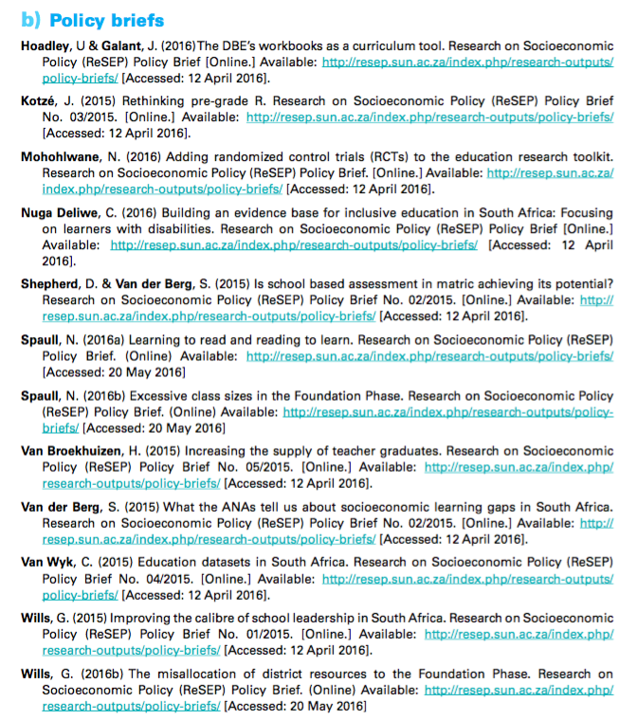
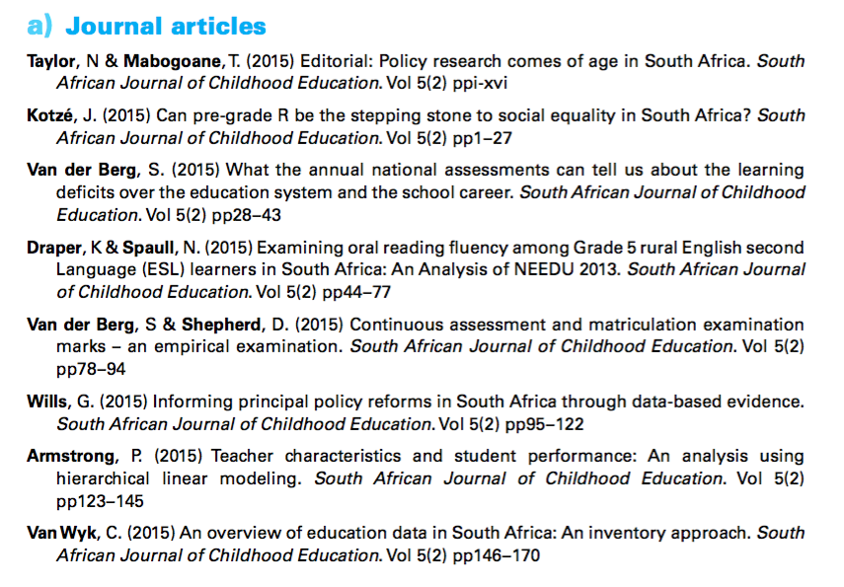

Slide 12
PSPPD & Zenex Report Launch

Slide 13

Accountability
&
Capacity
Richard Elmore & colleagues

Slide 14
What were the binding constraints?

Slide 15
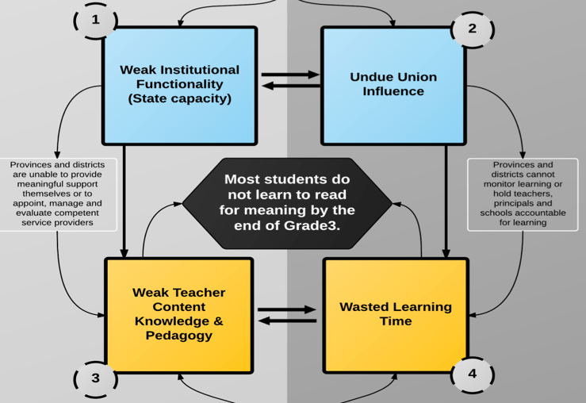
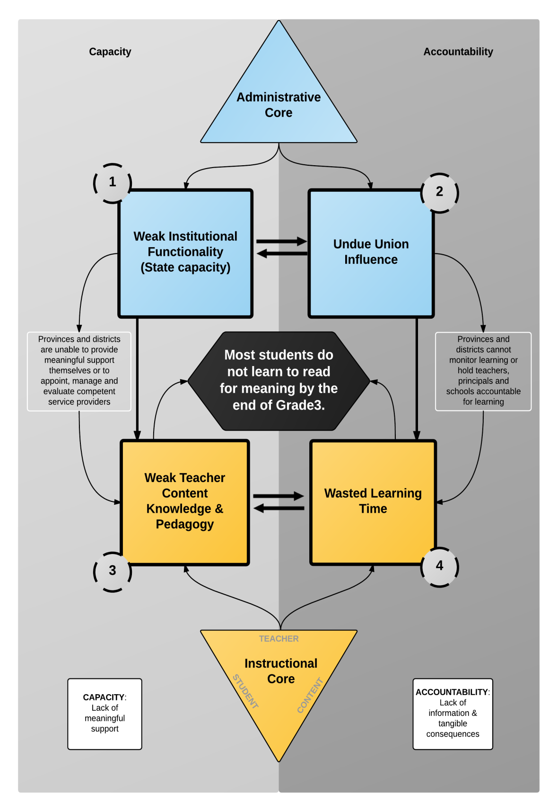

Slide 16
OK, so where to from here?
What should we focus on of all these problems?
What to prioritize?

Slide 17
It all comes back to reading
“Reading is, without doubt, the most important linguistic skill that needs to be developed in young children. Reading serves as a building block upon which all other learning takes place…This National Reading Strategy takes as its focus that reading failure begins in early grades, and it is at that level that interventions must be made”
(DoE, 2008: 18).

Slide 18
Do children in English or Afrikaans LOLT schools learn to read by Gr5?
Colombia all Gr4 = 72%
Honduras all Gr4 = 74%

Slide 19
What % of students learn to read in any language by Gr4?

Slide 20

What does this look like in reality?
“We found that South African Grade 5 second language learners from rural areas in South Africa had essentially the same distribution as Grade 1 second language learners in Florida, or Grade 2 second language remedial learners who had been removed from normal classes because they “cannot communicate meaning orally in English and demonstrate very little understanding in English”.
Draper, K., and Spaull, S. (2015). Examining oral reading fluency among grade 5 rural English Second Language (ESL) learners in South Africa: Analysis of NEEDU 2013. South African Journal of Childhood Education 5(2) pp.44-77.

Slide 21


Slide 22
What does this look like in reality?
Many
years
ago
Leopard
was
a
creature
with
no
spots.
Recommended rate at Gr5
One
day,
he
was
relaxing
in
the
shade
of
a
thorn
tree
when
Zebra
walked
past.
Many
years
ago
Leopard
was
a
creature
with
no
spots.
40% of SA rural Gr5 learners (<40WCPM) WCPM
One
day,
he
was
relaxing
in
the
shade
of
a
thorn
tree
when
Zebra
walked
past.
Draper, K., and Spaull, S. (2015). Examining oral reading fluency among grade 5 rural English Second Language (ESL) learners in South Africa: Analysis of NEEDU 2013. South African Journal of Childhood Education 5(2) pp.44-77.
Notes:
40 words in 60s = 1,5s/word
130 words in 60s = 0,46s/word

Slide 23
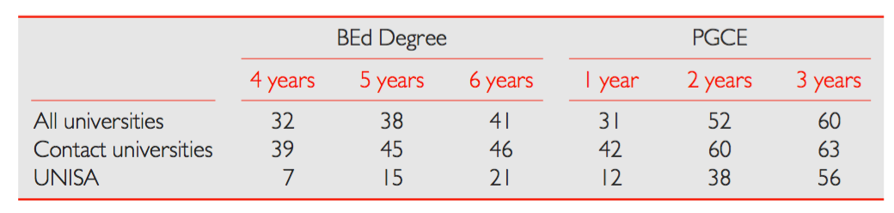

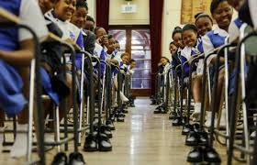
What can you do about this?
Use this coalition to train teachers (CoE): If you would like to help train teachers at your school (interns/induction) lobby as a group rather than individually. Op-eds? Private donors? Alumni?
Help those who want help: There ARE schools and teachers that want help. They aren’t always the closest school or the most obvious ones. You can lead a horse to water…
Build teaching/HOD/principal capacity – 1000 principals retiring a year for 10 years (Wills, 2016)
Build social justice into everything that you do at the school. Parktown Girls shoes, donate a book, project topics…
See Hendrik van Broekhuizen (2016)
Notes:
See Hendrik van Broekhuizen (2016)

Slide 24
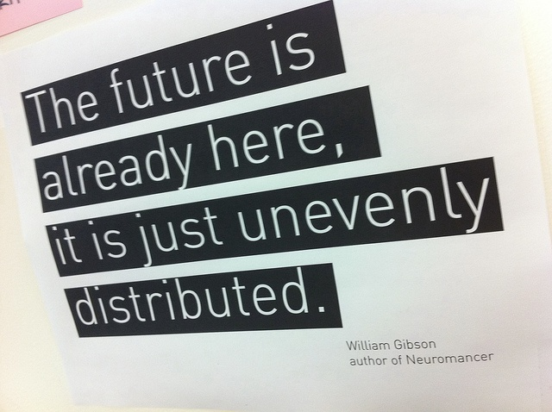

Slide 25
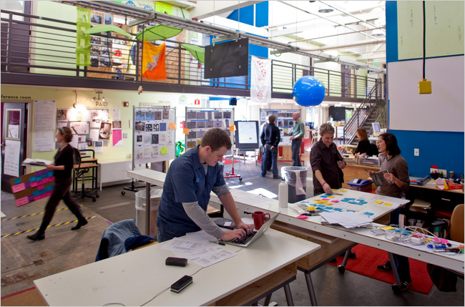
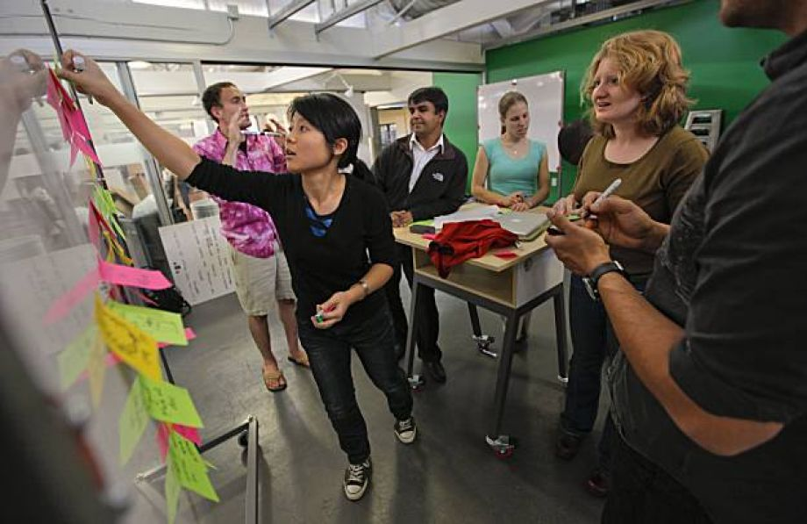
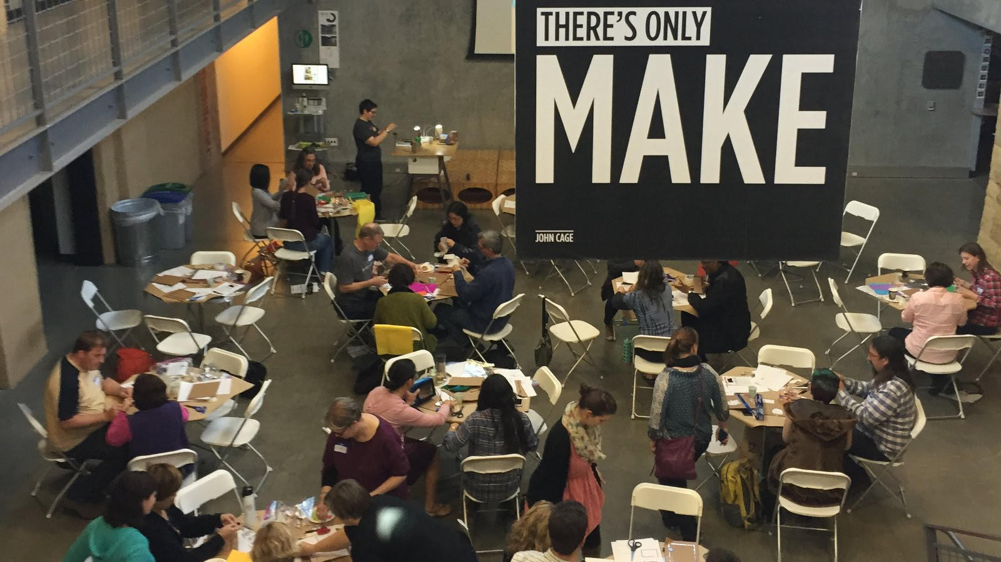
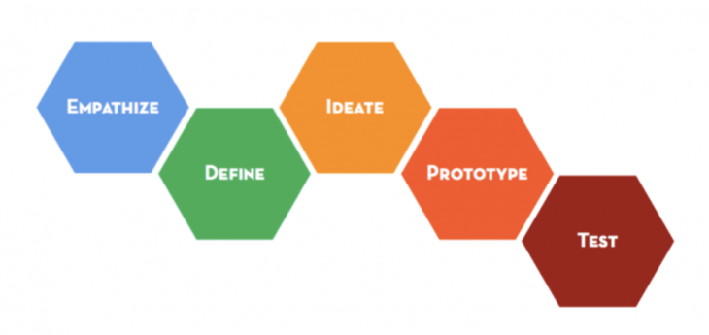
Design thinking…

Slide 26
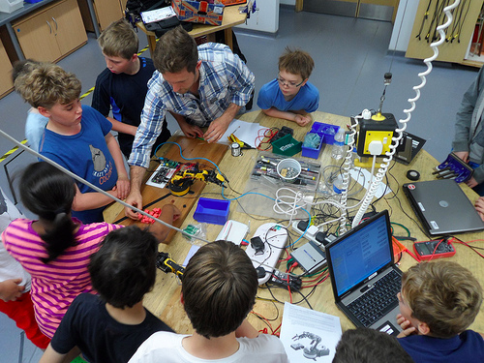
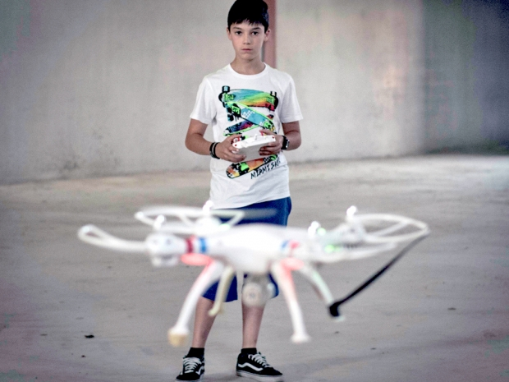
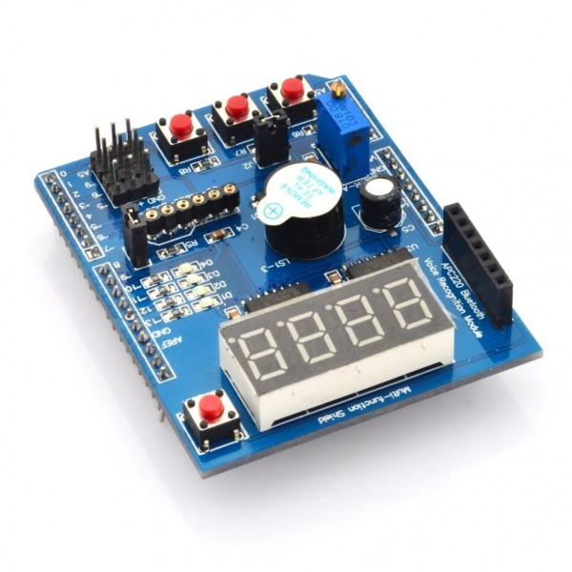
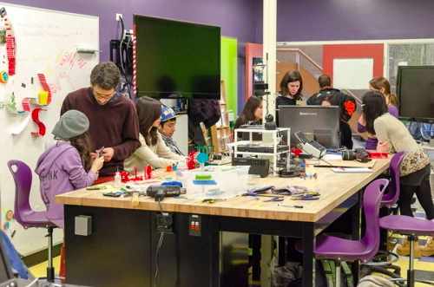
Examples
-Inter-grade teaching
-team teaching
-combined-subject teaching
-Explicitly teaching a curriculum of socio-emotional skills like empathy (21C skills)
- ‘FuckUp Nights’ – stories of failure
-Permanent high-speed wifi (obvs)
-Drone-building clubs
-robotics classes in school time
-arduinos
-Raspberry Pi (costs $35)
-coding classes
-MakerSpace labs / FabLabs
-3D-printers

Slide 27
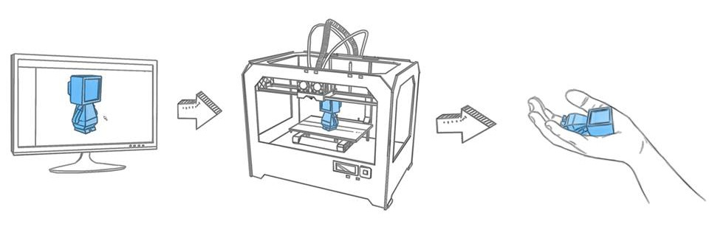
3-D Printing

Slide 28
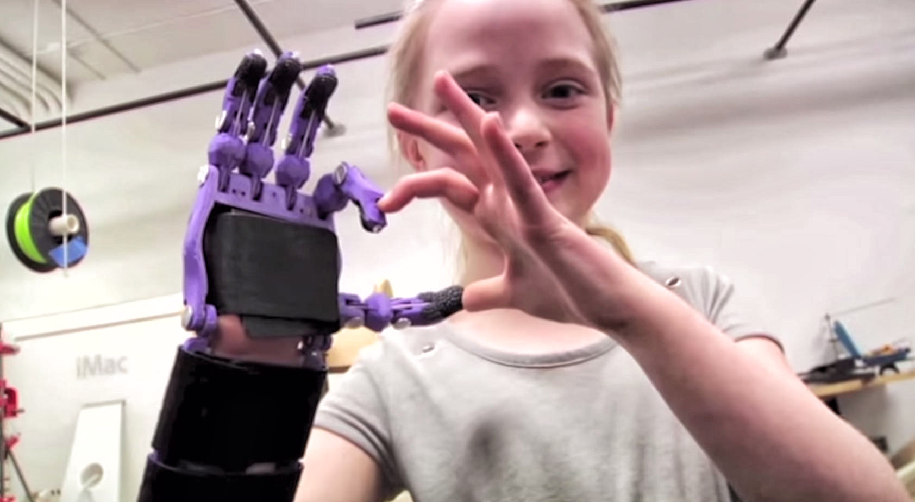
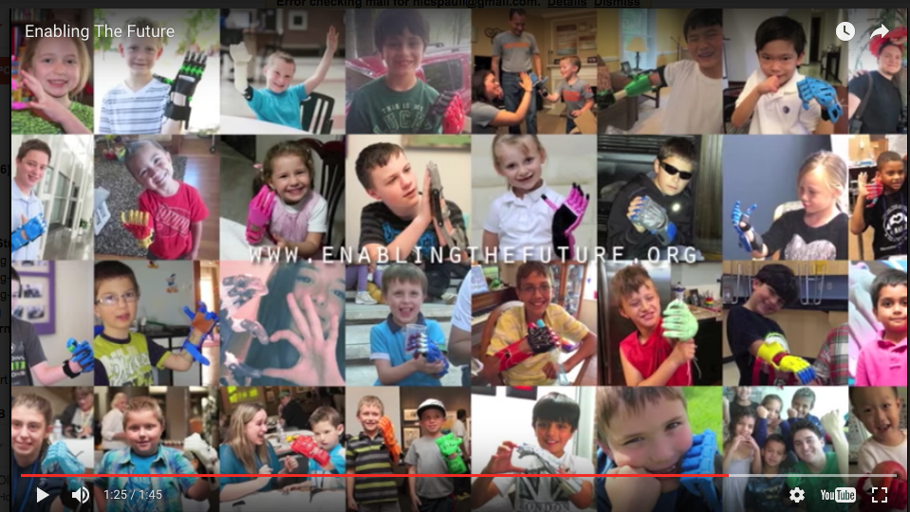

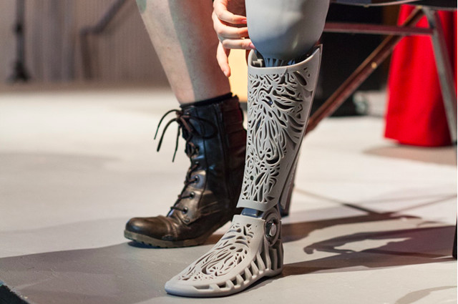
Crawford College La Lucia Grade 8’s are helping print a prosthetic hand for Bongani

Slide 29
You have an amazing set of assets (human and financial) at your disposal, are you using them as best you can?
If you aren’t regularly out of your comfort zone you aren’t trying hard enough.
☺

Slide 30
Comments / Questions?
These research reports & policy briefs are available online at resep.sun.ac.za
NicholasSpaull@gmail.com

Slide 31
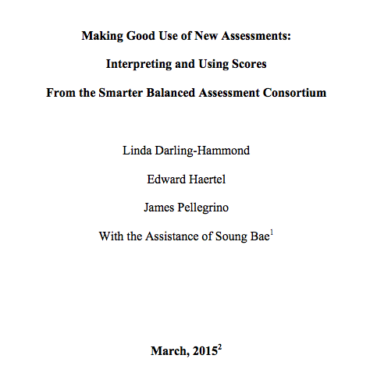
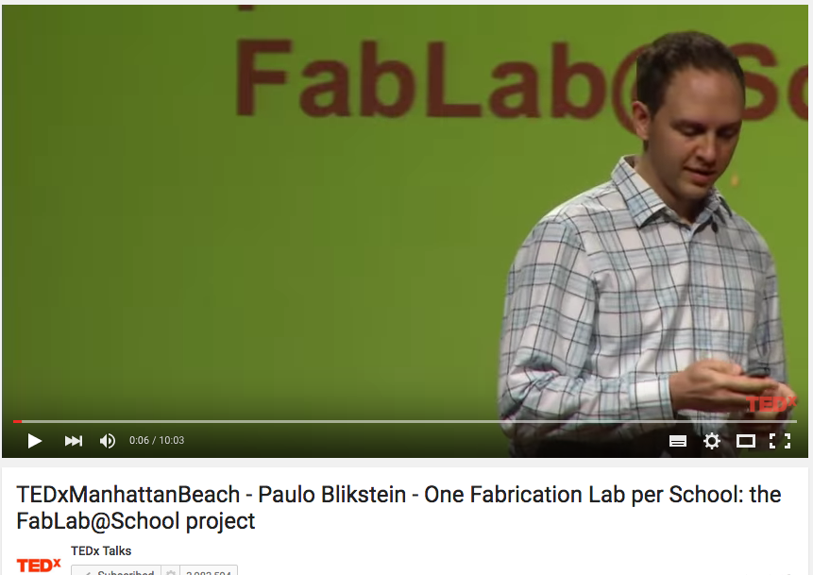
Resources
https://www.ideo.com/expertise/education/
https://vimeo.com/40895671
http://education.vermont.gov/documents/EDU-WhitePaper-Making_Good_Use-of_New_Assessments.pdf
Michael Fullan, Ken Robinson, Linda Darling-Hammond, Alaine De Botton, Carnegie Mellon University, d.school at Stanford
Released items - https://www.oecd.org/pisa/pisaproducts/PISA2015-Released-FT-Cognitive-Items.pdf

Slide 32
Access: How does all of this affect matric?
Uses national HEMIS/NSC data for the 2008 matric cohort between 2009 and 2014 (Van Broekhuizen, Van der Berg & Hofmeyr, 2016)

Slide 33
Labour Market
15%
Legislators, managers, assoc professionals
Unemployed
(Broad - 35%)
Unskilled
(18%)
Elementary occupations & domestic workers
Semi-Skilled (32%)
Clerks, service workers, shop personnel, skilled agric/fishery workers, plant and machinery operators)
University/FET
Type of institution (FET or University)
Quality of institution
Type of qualification (diploma, degree etc.)
Field of study (Engineering, Arts etc.)
High quality secondaryschool
High SES background
+ECD
High quality primary school
Minority (20%)
Some motivated, lucky or talented students make the transition
Unequal society
Big demand for good schools despite fees
Some scholarships/bursaries
Majority (80%)
Quality
Low quality secondary
school
Attainment
Type
Low SES background
Low qual ECD
Low quality primary school
QLFS 2014
Notes:
The QLFS classifies professions as follows: Highly skilled (legislators, senior officials and managers, professionals, technicians and associate profesionals); Semi-skilled (Clerks, service workers and shop and market personnel, skilled agricultural and fishery workers, craft and related trade workers, plant and machinery operators and assembly), Unskilled (Elementary occupations, domestic workers).

Slide 34
Qualifications by age (birth cohort), Census 2011 (Van der Berg, 2013)
How does all of this affect the labour market?

Slide 35



Brief headline findings from some new research
Learning
Deficits
“Already by Grade 2 more than 50% of students in quintiles 1-4 are not on track according to the ANAs” (Van der Berg, 2015)
Mother-Tongue Instruction
“Using ANA data from 9,180 schools Taylor & Von Fintel (2016) find that additional instruction in mother-tongue improves English acquisition by 0.17SD.”
District
Resources
“61% of Gr10-12 teachers were visited by a curriculum advisor compared to 45% of Grade 1-3 teachers” (Wills, 2016)

Slide 36



Gender Inequality
“71% of school teachers are women
36% of school principals are women” (Wills, 2016)
Early Childhood Development
“The ECD Audit 2013 shows that ECD practitioners earn R1,400 - R2,000 per month and 70% have no qualifications whatsoever” (Kotze, 2015)
Weak Pedagogy
“In a review of the literature Hoadley (2016) finds that reading classroom practice is characterized by collective instruction or chorusing with little opportunity for reading & writing”

Slide 37
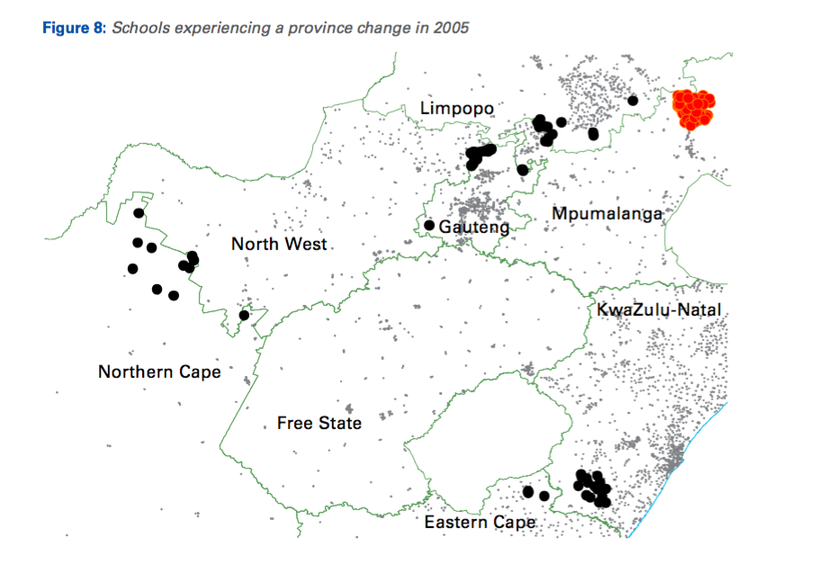
State Capacity: 158 schools “moved” in 2005 due to boundary changes (29 from NW→GP)
“The school-level improvements ultimately brought about were considerable, about as large as one year of progress in a rapidly improving schooling system elsewhere in the world.”

Slide 38
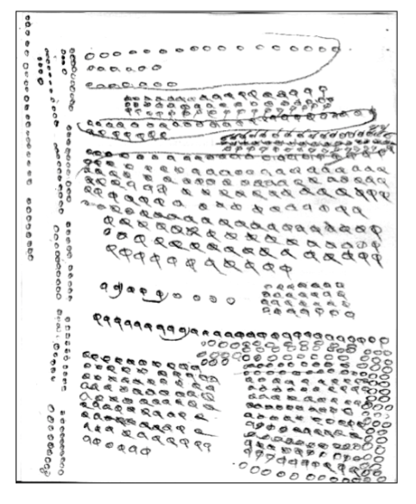
Grade 5 unit counting
Many students do not learn to move beyond a base-1 number system to a base-10 number system etc.
(Eric Scholar)

Slide 39
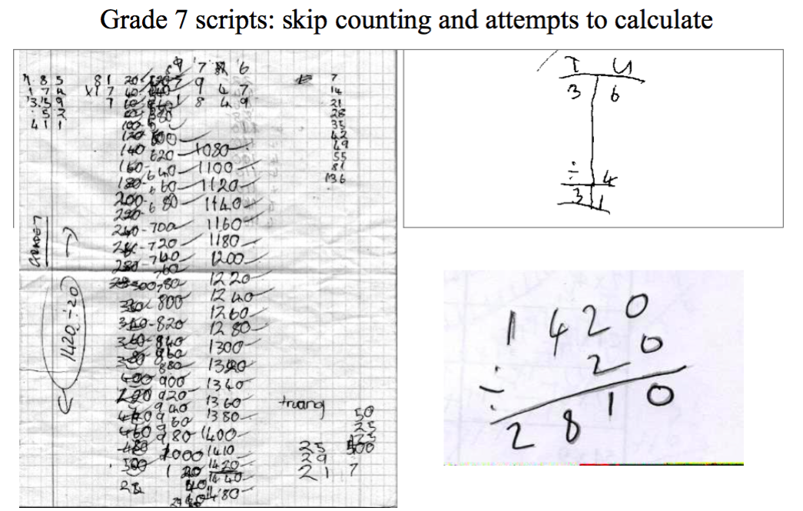
Ref: Eric Scholar

Slide 40


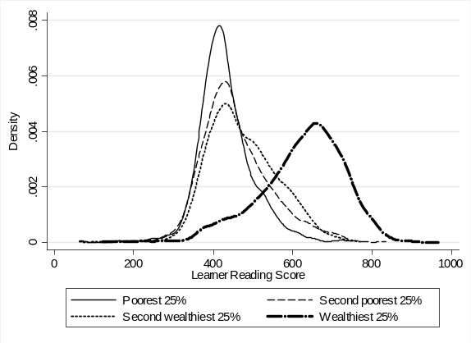



Egregious Inequality: Bimodality– indisputable fact
PIRLS / TIMSS / SACMEQ / NSES / ANA / Matric… by Wealth / Language / Location / Dept…

Slide 42
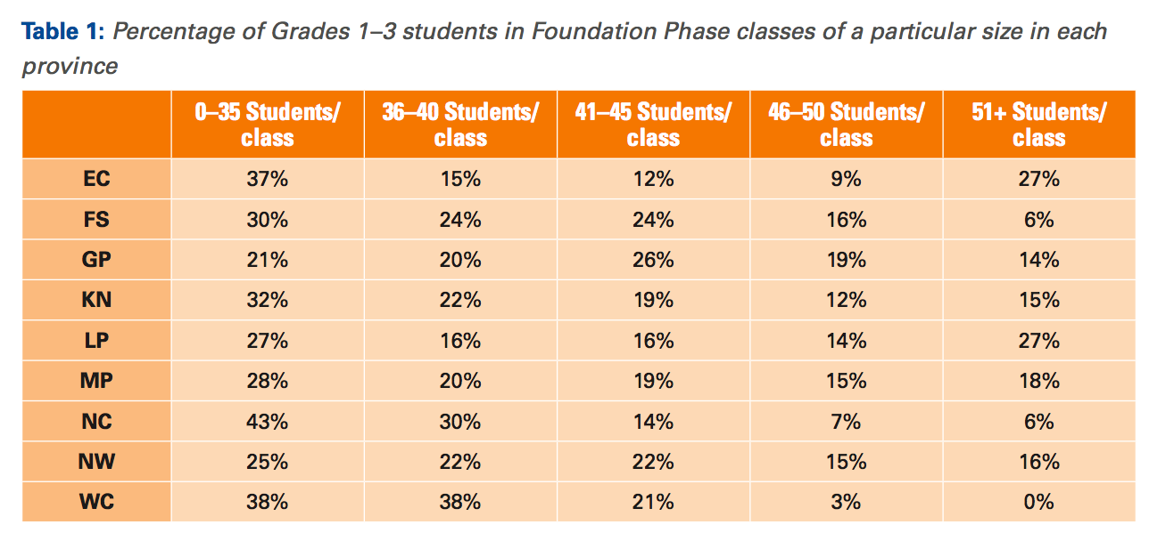

Slide 43
Policy déjà vu
We’ve been on this rodeo before…
National Reading Strategy (DBE, 2008) – Pandor
Teaching Reading in the Early Grades: A Teacher’s Handbooks (DBE, 2008)
Western Cape Numeracy & Literacy Strategy 2006-2016 (WCED, 2006)
Foundations for Learning Campaign (DBE, 2008)
Gauteng Primary Literacy Strategy 2010-2014 (GDE, 2010)
Systematic Method for Reading Success (Hollingsworth & Gains, 2009)
Western Cape Living Labs Schools (WCED, 2015)
Drop Everything & Read Campaign
(See PSPPD Report (2016) for full discussion of previous reading initiatives)

Slide 44
What do primary school mathematics teachers know about mathematics? (Spaull & Venkat, 2015)
Figure 1: Proportion of South African grade 6 mathematics teachers by content knowledge (CK) group - SACMEQ 2007 (with 95% confidence interval) [401 Gr6 maths teachers]

Slide 45
SADTU membership

Slide 46

“The left hand barrel has horizontal wooden slabs, while the right hand side barrel has vertical slabs. The volume in the first barrel depends on the sum of the width of all slabs. Increasing the width of any slab will increase the volume of the barrel. So a strategy on improving anything you can, when you can, while you can, would be effective. The volume in the second barrel is determined by the length of the shortest slab. Two implications of the second barrel are that the impact of a change in a slab on the volume of the barrel depends on whether it is the binding constraint or not. If not, the impact is zero. If it is the binding constraint, the impact will depend on the distance between the shortest slab and the next shortest slab” (Hausmann, Klinger, & Wagner, 2008, p. 17).
Notes:
Hausmann, R., Klinger, G., & Wagner, R. (2008). Doing Growth Diagnostics in Practice: A 'Mindbook'. CID Workinf Paper No. 177. Center for International Development at Harvard University.

Slide 47

Higher education in perspective
When speaking about higher education it’s important to remember that this is only a very small proportion of the population
Source: DBE (2013) Internal Efficiency of the schooling System

Slide 48

Gustafsson, 2011 – When & how WP
“What do the magnitudes from Figure 4 mean in terms of the holding of qualifications? In particular, what widely recognised qualifications do the 60% of youths who do not obtain a Matric hold? …Only around 1% of youths hold no Matric but do hold some other non-school certificate or diploma issued by, for instance, an FET college”
(Gustafsson, 2011: p.11)
10%
Notes:
http://www.ekon.sun.ac.za/wpapers/2011/wp092011

Slide 49
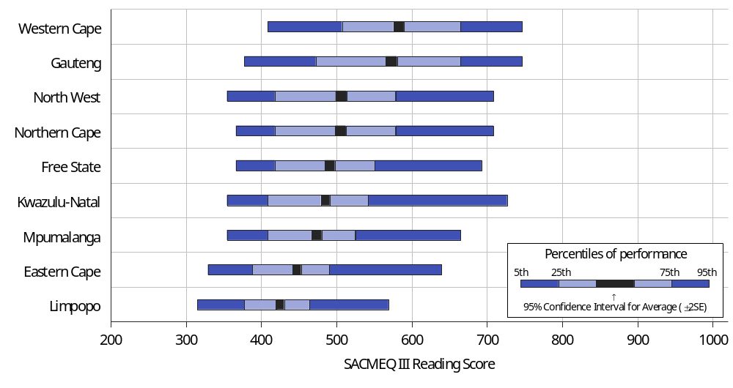
Province…SACMEQ III Reading (Gr6)

