Slide 1
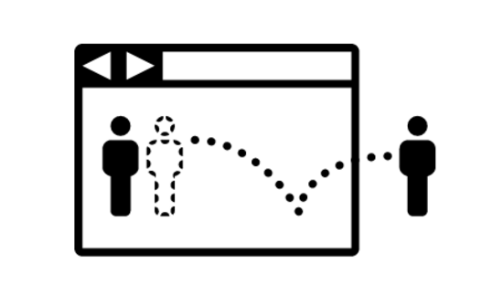



PISA
Who makes it into PISA?
Understanding the impact of sample eligibility using Turkey as a case study (PISA 2003-PISA 2012)
Dr Nicholas Spaull
Thomas J Alexander Fellow
ECER 2017 23 Aug 2017
@NicSpaull
nicspaull.com/research

Slide 2
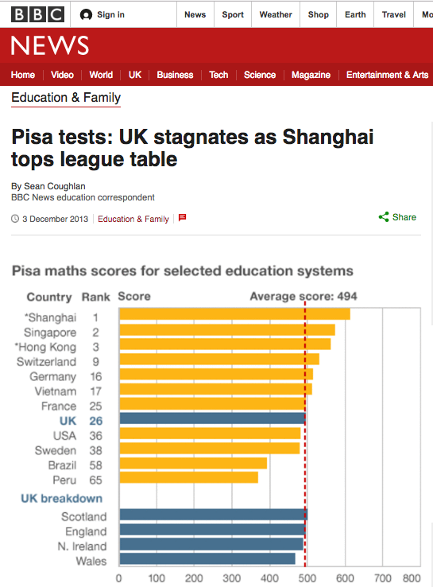
Let’s use Vietnam as an example

Slide 3
Cross-national assessments 101
  Test scores can change for 4 main reasons:
  There is a real/legitimate change
  The test scope/difficulty changes – what content is tested and how difficult it is.
  The sample changes – who writes the test changes.
  Extraneous factors – when the test is written in the year, age, modality etc (see Brazil especially –Carnoy et al, 2015; Klein, 2011)
Carnoy et al, 2015 - http://www.scielo.br/scielo.php?script=sci_arttext&pid=S0100-15742015000300450&lng=pt&nrm=iso&tlng=en
Klein, 2011 - http://www.scielo.br/scielo.php?script=sci_arttext&pid=S0104-40362011000500002

Slide 4
Who makes it into PISA? (sample eligibility)
For a 15* year old to be eligible for the PISA sampling frame they must meet two criteria:
    They must still be enrolled in school
    They must be in grade 7 or higher
This excludes the following students:
    Those who never enroll
    Those who enroll but dropout before age 15
    Those who enroll and remain in school but are ‘delayed’ and are still in grade 6 or lower at age 15.
PISA
So what does this look like in Vietnam?
*Technically 15yrs3mo to 16yrs2mo

Slide 5
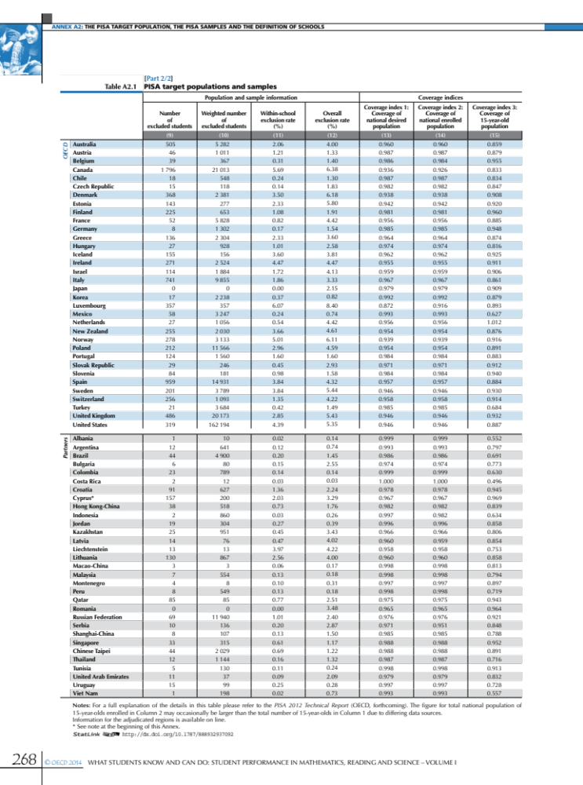

Coverage Index 3 is defined as the proportion of the national population of 15 year olds (enrolled and not enrolled) that are eligible for the PISA sample (OECD, 2014b, p. 177).

Slide 6
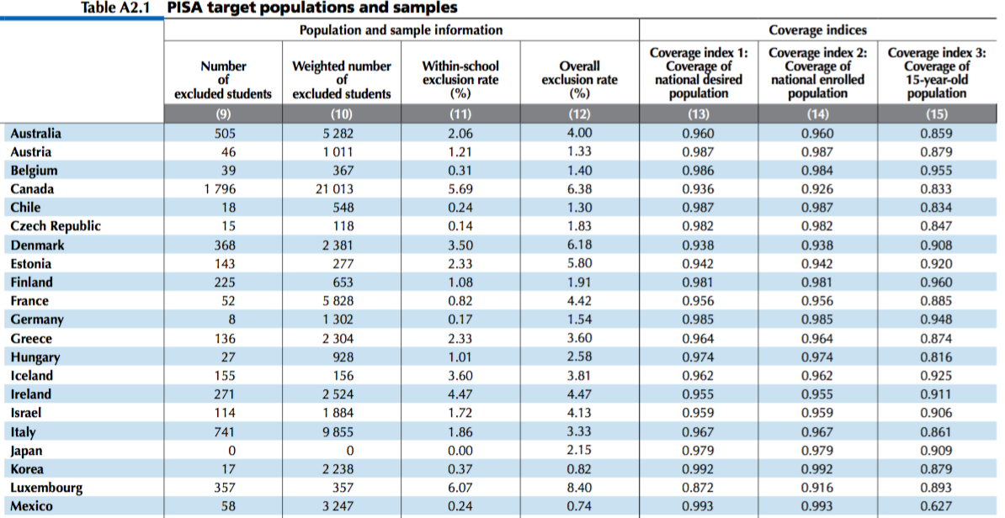
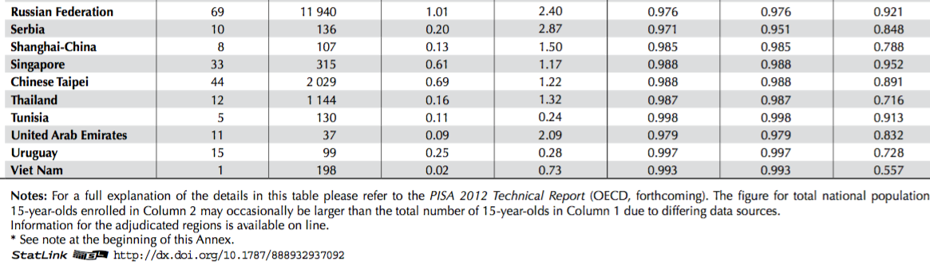
56% of Vietnamese 15 year olds were eligible for the PISA sample
(UK=93%, US=89%; Denmark: 91%)

Slide 7

Large existing literature on sample selection…
“The basic problem is student selectivity: The fewer the students who take the test, the higher the average score. That score is not a valid measure of the overall quality of the education system. It simply reflects the fact that the students represented in the test comparisons have been much more highly selected in some countries than in others” - Rotberg (1995, p. 1446)
“Selection would not be a problem if one were interested exclusively in the performance of 15 year-olds that are in school, and within a reasonable range of their expected grade of attendance. But this is likely to be an excessively narrow prism through which to assess a country’s education system and – even more so – to make international comparisons” - Ferreira & Gignoux (2014, p. 16)
“Non-random differences in patterns of school enrolment, sample exclusions, and non-response are clearly able to influence rankings of countries on international league tables of average student achievement….We find that countries having more schools and students excluded from the targeted sample, having schools and students who are less likely to participate in the test, and having higher overall school enrolment at the relevant age level tend to perform better on the international tests” - Hanushek & Woessmann (2011b, p. 79).
See also
Lambin, 1995
Filmer & Pritchett, 1999
Pritchett, 2013
Lewin, 2007

Slide 8
PISA Coverage Index 3
Shanghai – 79%
Singapore – 95%
Hong Kong – 84%
Switzerland – 91%
Germany – 95%
Vietnam – 56%
France – 88%
UK – 93%
USA – 89%
Sweden – 93%
Brazil – 69%
Peru – 72%

Slide 9
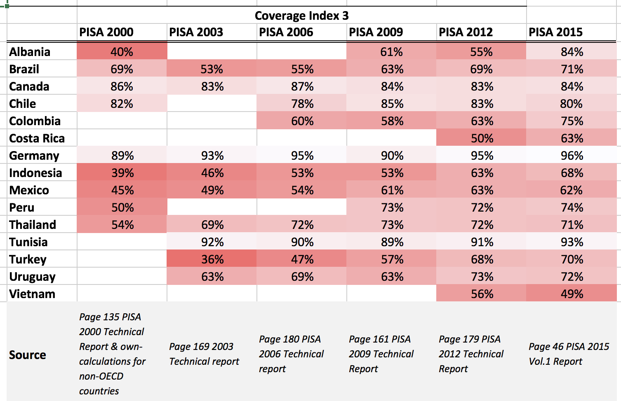
How many 15 year olds were actually eligible to take the PISA assessments in selected developing countries?
NB Errata: In the PISA 2003 Report the Coverage Index 3 reported for all countries (page 322) is different to that reported in the PISA 2003 Technical Report (pg169)
Have checked this with Miyako Ikeda and the PISA 2003 Technical Report has the correct figures and the PISA Report 2003 the wrong ones. The latter is not Coverage Index 3 despite being labeled as such. Unfortunately PISA 2012 Report analyses on impact of out of school children based on incorrect figures.
Is PISA really representative of the total 15 year old population in these countries?

Slide 10

Although it is almost never discussed in the PISA reports, or the PISA Technical Reports, or even the peer-reviewed literature critiquing PISA, this issue of expanding access and attainment has been one of the defining features of education systems in developing countries for the last two decades.
Access

Slide 11
PISA literature on sample eligibility
Bloem 2013 – Mentions the issue of sample eligibility in developing countries
One paragraph repeated in all PISA reports from 2003: “This high level of coverage contributes to the comparability of the assessment results. For example, even assuming that the excluded students would have systematically scored worse than those who participated, and that this relationship is moderately strong, an exclusion rate in the order of 5 per cent would likely lead to an overestimation of national mean scores of less than 5 score points … This assessment is based on the following calculations: If the correlation between the propensity of exclusions and student performance in 0.3, resulting mean scores would likely to overestimated by 1 score point if the exclusion rate is 1 per cent, by 3 score points if the exclusion rate is 5 per cent, and by 6 score points if the exclusion rate is 10 per cent. If the correlation between the propensity of exclusions and student performance in 0.5, resulting mean scores would be overestimated by 1 score point if the exclusion rate is 1 per cent, by 5 score points if the exclusion rate is 5 per cent, and by 10 score points if the exclusion rate is 10 per cent. For this calculation, a model was employed that assumes a bivariate normal distribution for the propensity to participate and performance” (OECD, 2004, p. 325)
Lockheed, Prokic-Breuer & Shadrova (2015) 130-page report: “As mentioned above, in some countries a substantial proportion of the 15-year-olds enrolled in school are enrolled in grades considerably lower than the modal grade for their age and country: often in grades 7 or 8, rather than grades 9 or 10 as in OECD countries. In addition, out-of-school rates for lower secondary school children are high in many low- and middle-income countries, exceeding 10% in Argentina, Bulgaria, Jordan, Mexico, Thailand and Turkey. The rate is exceptionally high in Viet Nam, at 37%. This implies selection bias among the population eligible for the PISA survey in these countries. The combination of these two exclusion mechanisms, plus other minor exclusion criteria,12 result in indices of coverage of the 15-year-old population as low as 50% in Costa Rica, 56% in Viet Nam, and 63% in Indonesia, compared with 96% for OECD countries. These relatively low levels of coverage limit the comparability of the results of middle-income countries with other countries“ Lockheed, Prokic-Breuer & Shadrova (2015, p. 99)
“Most countries would show no or very small changes in average performance after taking into account the performance of those outside the school system” –
  Providing Access to Schooling to All 15-year-olds” (OECD, 2012b, p. 53).
  Based on flawed Coverage Index 3 data from PISA Report 2003 (see paper)

Slide 12



Problem Statement
Problem 1: Generally misleading results Using small non-representative sub-samples as a proxy for a cohort of 15 year olds or an entire schooling system can lead to misleading results.
Problem 2: Inaccurate cross-country comparisons when using only PISA data, especially when countries have different levels of incomplete access or different proportions of delayed (& ineligible) students.
Problem 3: Underestimating progress of the real educational improvements over time for countries that have improved access/attainment.
Problem 4: Underestimating inequality When there is a sample selection process involved such that poorer students are more likely to be excluded from the sample, PISA will underestimate socioeconomic inequalities

Slide 13
Conceptual overview
Access & Quality – Post-SDG’s it is now a truism that we need to focus on both access and quality. But when Filmer, Hasan & Pritchett (2006) were arguing for it it wasn’t common cause. Coming from Sub-Saharan Africa this is a MAJOR issue. Comparing SACMEQ scores across countries for example (Spaull & Taylor, 2015)
Centre & periphery – While PISA was designed with OECD countries in mind, there has been a rapid expansion into ‘partner’ (typically developing) countries. PISA assumptions built on the ‘centre’ not the periphery
  “PISA provides an assessment of the cumulative yield of education and learning at a point at which most young adults are still enrolled in initial education” - OECD & UNESCO-UIS (2003, p. 249).
  Of the 88 economies/regions that have participated in PISA only 36 are OECD (https://www.oecd.org/pisa/aboutpisa/pisa-participants.htm).
Overlooking huge contextual differences - Problems that were initially overlooked as being overly technical or unimportant (sample selection & coverage) need to be revisited in light of changing PISA demographic. Much more nuanced analyses and interpretations are necessary for developing countries.

Slide 14
Firstly, moving beyond Coverage Index 3
Coverage Index 3 gives us one aggregate measure of how many 15 year-olds are PISA-eligible. But…
  It’s based on census data in each country and reported by the NRC. Censuses are infrequent and thus the figures may be out of date
    Colombia: 1985; 2005; Indonesia: 2000, 2010; Peru: 1993; 2005 Turkey: 1997; 2011
CI3 doesn’t provide disaggregated statistics of the ineligible 15 year olds. Who are they? Rich/poor? Boys/girls?
Need to move to household survey data
  DHS, MICS

Slide 15
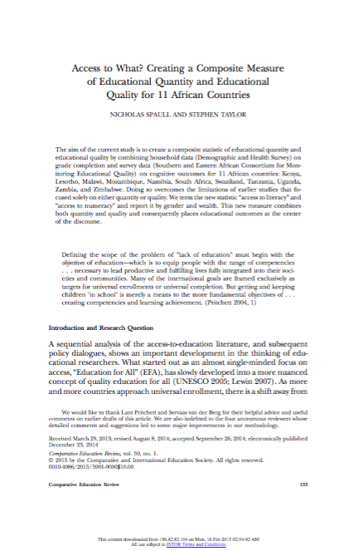
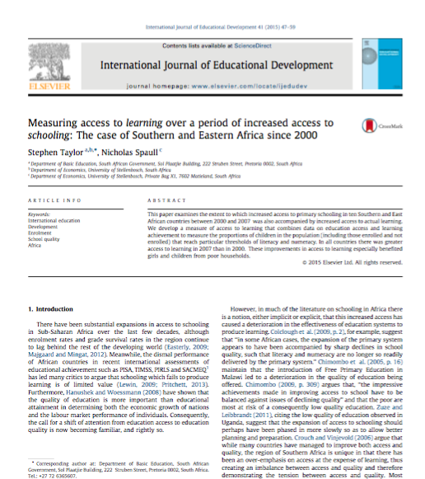
Method:
Spaull & Taylor (2015); Taylor & Spaull (2015); Spaull & Lillenstein (2016)

Slide 16
My research
Focus on 4 countries
  Colombia
  Indonesia
  Peru
  Turkey
At least 2 waves of PISA and matching DHS years
Combine statistics from surveys of achievement (PISA) and attainment (DHS)
DHS | PISA
Colombia 2005 | PISA 2006
Colombia 2010 | PISA 2009
Indonesia 2002/3 | PISA 2003
Indonesia 2007 | PISA 2006
Indonesia 2012 | PISA 2012
Peru 2000 | PISA 2000
Peru 2009 | PISA 2009
Peru 2012 | PISA 2012
Turkey 2003 | PISA 2003
Turkey 2008 | PISA 2009
Turkey 2012 | PISA 2012
COMBINE

Slide 17

Case Study
TURKEY

Slide 18
Literature: Turkey’s education system
Uncontested literature showing that Turkey has made significant progress, both in terms of learning outcomes, access & attainment.
  Access & attainment (Aydagül, 2008a; Dülger, 2004),
  Closing the gender gap (Tansel, 2002),
  But less successful in the eastern & south eastern regions of Turkey (Kırdar, 2009; O’Dwyer, Aksit, & Sands, 2010).
‘Rapid Coverage for Compulsory Education Program of 1997’ where over 1 million students enrolled in Grades 1-8 in the six year period 1997-2002 (Dülger, 2004)
Progress in equity in response to the Ninth Development Plan (covering 2007-2013) which “prioritizes girls and students in rural areas and addresses dropouts as important policy issues” (Aydagül, 2008a, p. 402). This included bussing students, expanding boarding schools as well as free textbooks and school meals to low-income students (Dülger, 2004).
Notwithstanding the above achievements, most authors also emphasise the high levels of inequality in the system. The major dimensions of inequality are typical of those found in the literature: household income, parental education and occupation, rural/urban status, ethnicity and school selectivity (Alacacı & Erbaş, 2010; Kırdar, 2009; Köseleci, 2015; Rankin & Aytac, 2006).

Slide 19
Turkey 2003→2012 (Coverage Index 3)

Slide 20
% of students per level
# of students per level

Slide 21
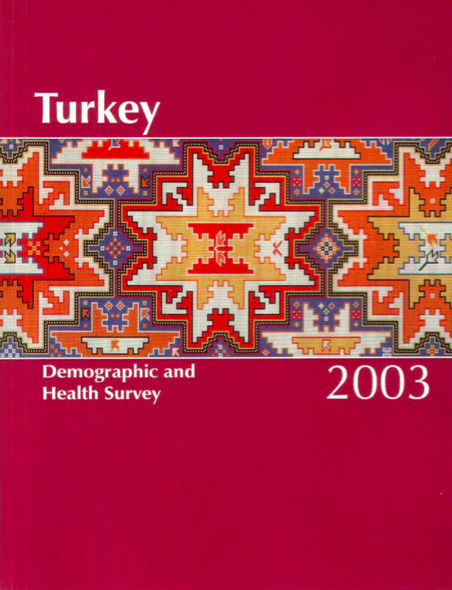
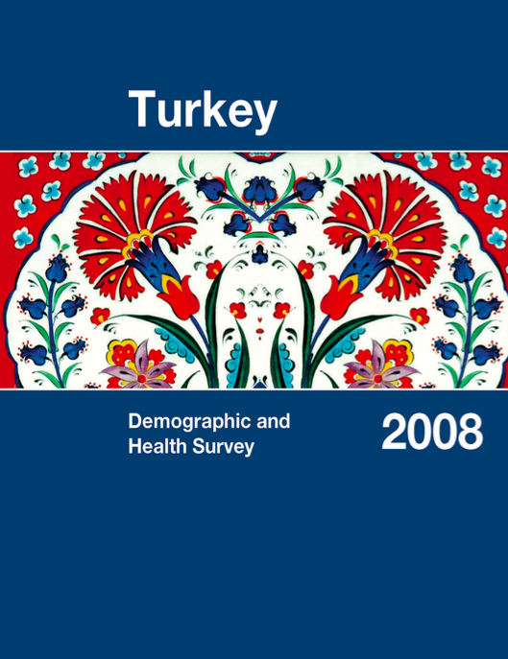

In order to disaggregate you need household survey data…

Slide 22
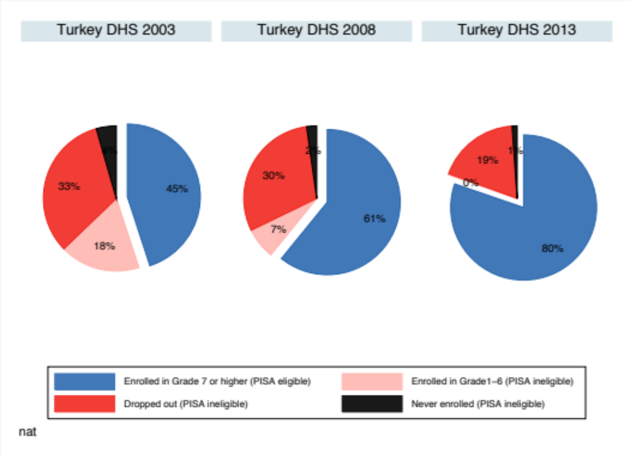
Alternatively one can use household survey data to ask the same question: DHS 2003, DHS 2008, DHS 2012

Slide 23
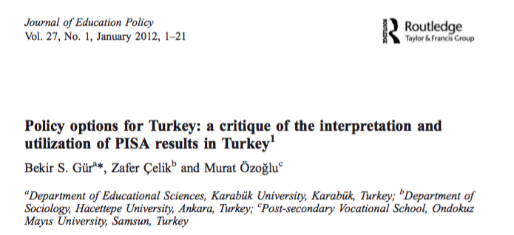
Existing Turkish academic literature
Almost no discussion in peer-reviewed literature using Turkey’s PISA results of the impact of low and changing sample representivity.
Gür, Çelik & Özoglu (2012) do not mention that less than half of Turkish 15 year olds were actually eligible for PISA 2003 in the first place, which is perhaps the most self-evident critique
Similarly Alacaci & Erbas (2010) analyse PISA 2006 data and focus on inequality but do not mention that less than half of 15 year olds (CI3=47%) were eligible for the PISA sample in Turkey
The same can be said for a more recent analysis by Özdemir (2016) on “Equity in the Turkish Education System” which analyses PISA 2012 data, which again, is only representative of 2 of every 3 (CI3=68%) 15-16 year olds, according to the OECD
One exception: Köseleci & Şaşmaz (2011, p. 128) who caution that “it should be kept in mind that PISA does not cover all 15-year-old children but students of this age.”
“When children who are not enrolled in schools, who are most likely at a lower knowledge and skill level are also accounted for, Turkey’s average performance and level distribution will be worse than what is reflected by PISA scores” (Köseleci & Sasmaz, 2011, p. 128).

Slide 24
Creating “access to numeracy”
Get estimates of:
  Percentage of 15-16 year-olds that are eligible for the PISA sample (enrolled and in Gr7+) (from DHS)
  (I choose to use 2 age years to increase the sample size and decrease the standard errors)
  Percentage of PISA sample that achieved Level 2+ in Maths (from PISA)
Multiply the two together, assuming that ineligible students would not have reached Level 2…
  eg 80% of 15-16 year-old girls reach Gr7+
  50% of girls in PISA reach Level 2+
    Access-to-numeracy = 0.8*0.5 = 40%
Correct for differential access-to-PISA-sample by SES…

Slide 25
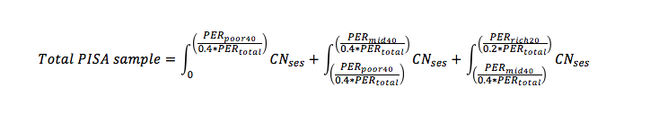
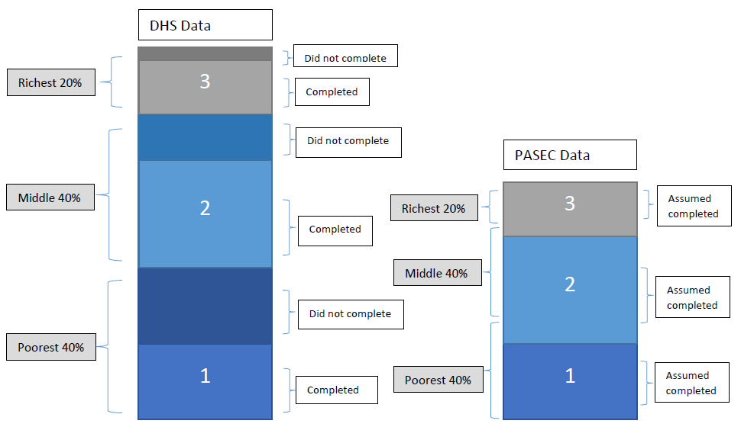
Adjusting PISA SES 40-40-20 categories to correspond with DHS categories
PISA Data

Slide 26
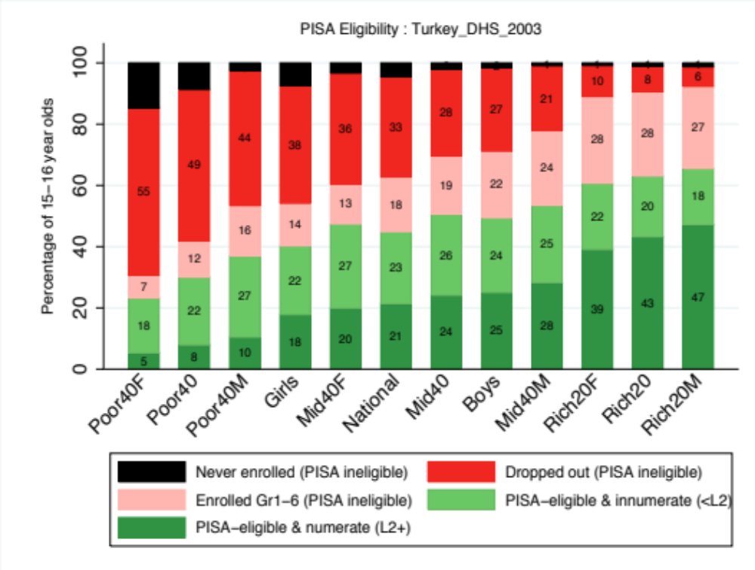
Figure 5 Access to Numeracy (Level 2) in Turkey 2003 (PISA 2003 and DHS 2003)

Slide 27
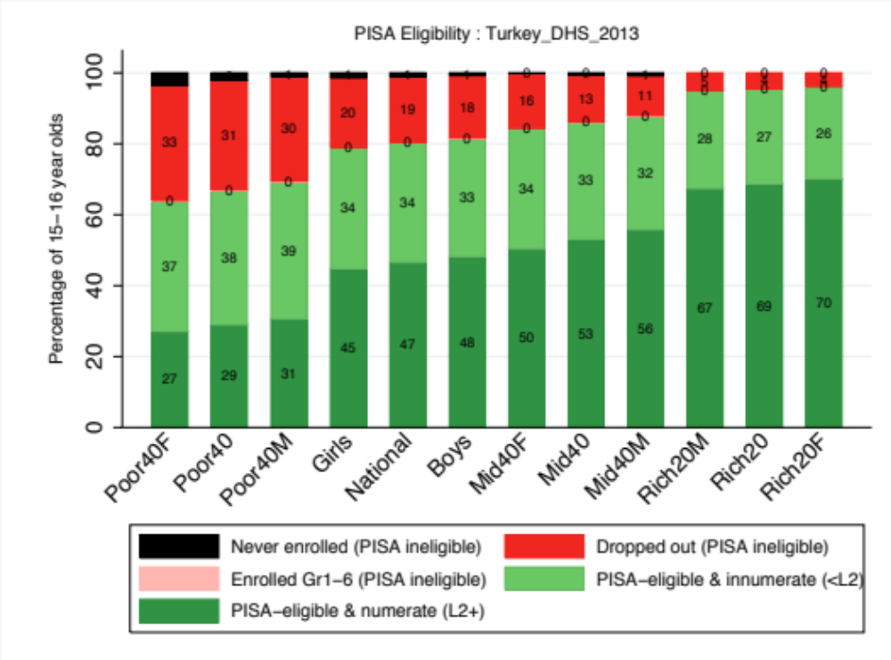
Figure 7 Access to Literacy (Level 2) in Turkey 2012 (PISA 2012 and DHS 2013)

Slide 28
Turkey: Numeracy
Who benefitted between 2003 → 2013?

Slide 29
9 Main Findings: Turkey
Significant increases in PISA sample eligibility over time
  Increased from 45% (2003) to 80% (2012) according to DHS’s
  Increased from 36% (2003) to 68% (2012) according to OECD CI-3
Improvement in % of 15-16 year olds reaching Level 2 in PISA is between 2 times (Literacy) and 5 times (Numeracy) larger than estimates in PISA reports
  PISA reports: % achieving L2+ in Literacy went from 63% to 78%
  This method: % achieving L2+ in Literacy went from 28% to 63%
There are considerably more functionally illiterate and functionally innumerate Turkish 15-16 year olds than PISA reports indicate

Slide 30
9 Main Findings: Turkey
Severe delays in progression have been virtually eliminated in Turkey.
Dropout among 15-16 year olds declined by 42% over the period.
The rich are twice as likely to be in PISA as compared to the poor.
Contrary to earlier research, the gap between rich and poor has not declined between 2003 and 2012. This gap is 2.3 times as large as was previously thought.
Although both boys and girls benefitted from increased access to literacy and numeracy, girls benefitted more
15-16 year olds in the East region are less likely to make it into the PISA sample

Slide 31
Take home points
Existing OECD and peer-reviewed research of developing countries using large-scale assessment ignore a big part of the story in developing countries
  Cross-country comparisons that ignore sample representivity of 15 year olds are inaccurate
More progress & more inequality than previously thought from the PISA literature
  Given sample selectivity and increasing access across the board, if you account for sample eligibility (assuming ordinality/monoticity in the selection process) this will increase estimates of both inequality and progress
Onus is on the OECD to do more to highlight where PISA results are, and are not, comparable

Slide 32
OECD are taking head of this…

Slide 33

on quality AND access
^

Slide 34

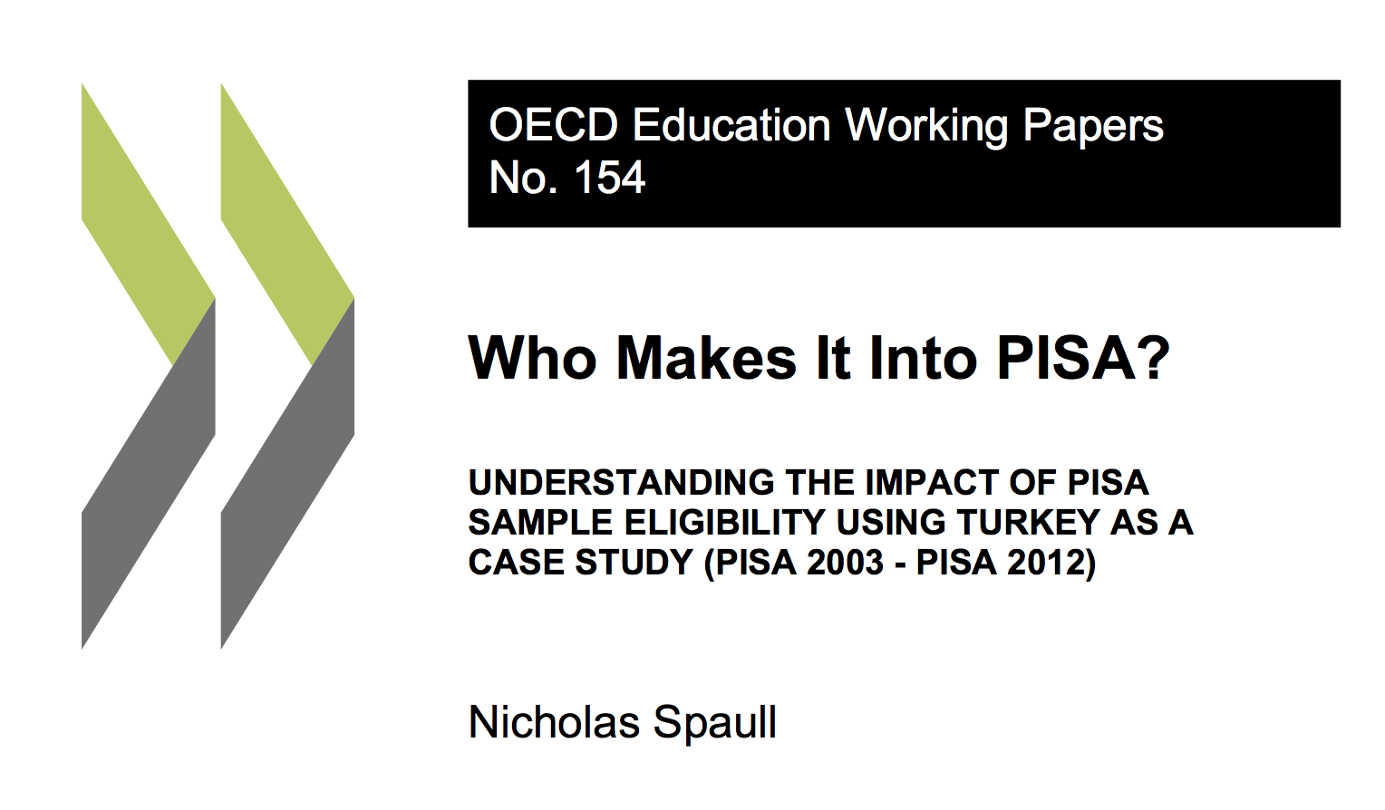
Comments / Questions?
NicholasSpaull@gmail.com

Slide 35
Figure 8: PISA eligibility among Turkish 15-16 year olds by region in the Turkish DHS 2003, 2008 and 2013

Slide 36
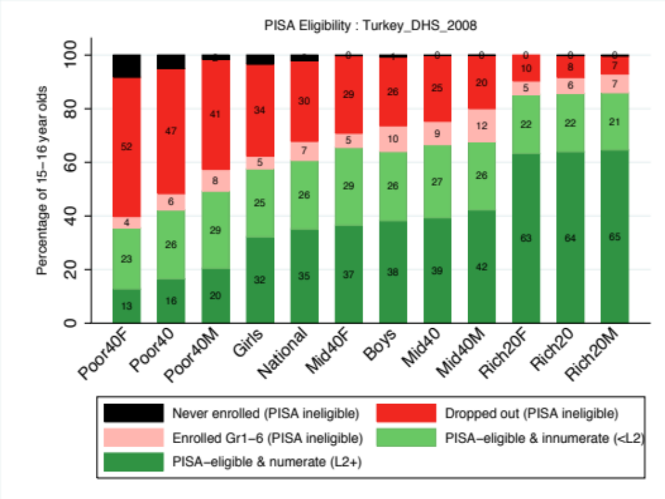
Figure 6 Access to Numeracy (Level 2) in Turkey 2009 (PISA 2009 and DHS 2008)

Slide 37
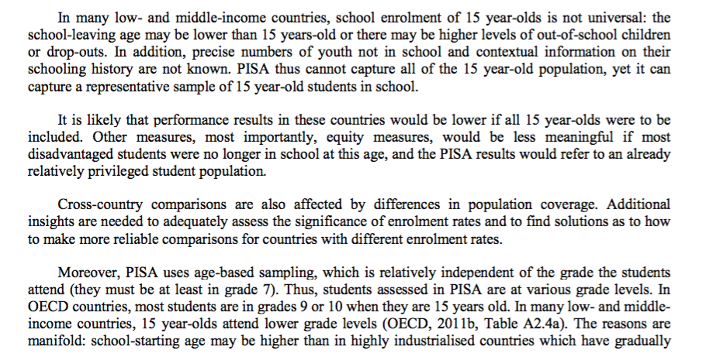
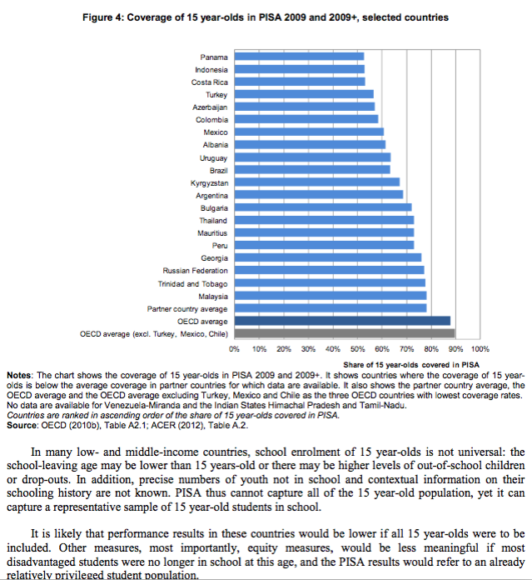
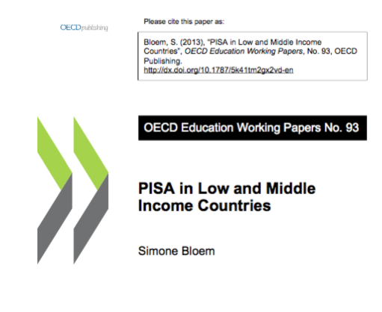
PISA Literature – Bloem 2013

Slide 38
Sensitivity Analysis & Limitations
Ineligible = illiterate? Large literature attesting to the fact that delayed students and those who drop out are more likely to come from poorer families, rural areas, be female and be low-performers prior to dropout (Lambin, 1995; Filmer & Pritchett, 1999; UNESCO, 2005; Lewin, 2007; Lewis & Lockheed, 2006)
Similar correlates in Turkey as shown in Köseleci’s (2015) review of the Turkish literature.
In PISA 2012, those delayed 2-3 grades 362 (Reading)
In PISA 2012, those ‘on-track’/modal-grade 500 (Reading)
(i.e. 1.6 SD’s lower)

Slide 39
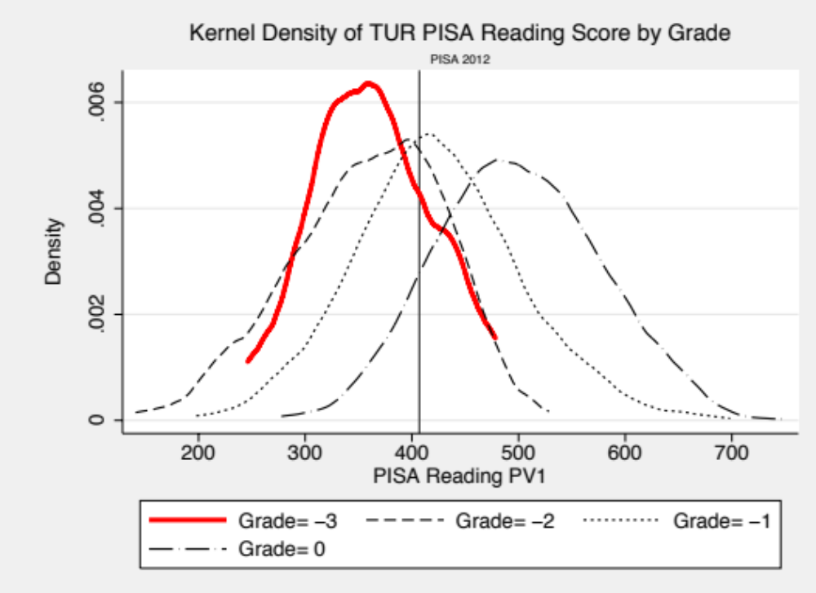
Very few extremely delayed students achieve Level 2 in PISA Reading. Gr1-6 even less likely
On-track students: 63% scored >L2 (2003) 89% (2009) 89%(2012)
Delayed 2-3 grades: 13% scores >L2 (2003) 14% (2009) 30% (2012)

Slide 40
Sensitivity analysis
If those students who were (a) severely delayed, and (b) had dropped out achieved the same performance as those who were in PISA but were delayed by 2-3 years, how would the access-to-literacy rates change?
  Access to literacy
    2003 28%→35% (compared to 63% in PISA report)
    2009 46%→51% (compared to 76% in PISA report)
    2012 63%→69% (compared to 78% in PISA report)
  Access to numeracy
    2003 21%→26% (compared to 48% in PISA report)
    2009 35%→36% (compared to 58% in PISA report)
    2012 47%→51% (compared to 58% in PISA report)
All changes < 7 percentage points

Slide 41
References
Adams, R., & Wu, M. (2002). PISA 2000 Technical Report. Paris: Organization for Economic Cooperation and Development.
Alacacı, C., & Erbaş, A. K. (2010). Unpacking the inequality among Turkish schools: Findings from PISA 2006. International Journal of Educational Development, 30(2), 182–192. http://doi.org/10.1016/j.ijedudev.2009.03.006
Avvisati, F., & Keslair, F. (2014). REPEST: Stata module to run estimations with weighted replicate samples and plausible values. Boston: Statistical Software Components, Boston College Departmenr of Economics. Retrieved from https://ideas.repec.org/c/boc/bocode/s457918.html.
Aydagül, B. (2008a). No shared vision for achieving Education for All: Turkey at risk. PROSPECTS, 38(3), 401–407. http://doi.org/10.1007/s11125-009-9085-2
Aydagül, B. (2008b). No shared vision for achieving Education for All: Turkey at risk. PROSPECTS, 38(3), 401–407. http://doi.org/10.1007/s11125-009-9085-2
Bloem, S. (2013). PISA for low- and middle-income countries. OECD Education Working Papers, (93), 40.
Bloem, S. (2015). PISA for low- and middle-income countries. Compare: A Journal of Comparative and International Education, 45(3), 481–486. http://doi.org/10.1080/03057925.2015.1027513
Demiray, U., & Adiyaman, Z. (2002). A Review of the Literature on the Open High School in Turkey Between the Years on its 10th Anniversary (1992-2002). Istanbul: Turkish republic: Ministry of National Education.
Dülger, I. (2004). Case Study on Turkey: Rapid Coverage for Compulsory Education Program. In Scaling Up Poverty Reduction (pp. 1–46). Shanghai, China.
Ferreira, F. H. G., & Gignoux, J. (2014). The Measurement of Educational Inequality: Achievement and Opportunity. The World Bank Economic Review, 28(2), 210–246. http://doi.org/10.1093/wber/lht004
Filmer, D., Hasan, A., & Pritchett, L. (2006). A Millennium Learning Goal: Measuring Real Progress in Education. SSRN Electronic Journal. http://doi.org/10.2139/ssrn.982968
Filmer, D., & Pritchett, L. (1999). The effect of household wealth on educational attainment: evidence from 35 countries. Population and Development Review, 25, 85–120. http://doi.org/10.1111/j.1728-4457.1999.00085.x
Filmer, D., & Pritchett, L. (2001). Estimating wealth effects without expenditure data—Or tears: An application to educational enrollments in states of India*. Demography. Retrieved from http://link.springer.com/article/10.1353/dem.2001.0003
Gur, B., Celik, Z., & Ozoglu, M. (2012). Policy options for Turkey: a critique of the interpretation and utilization of PISA results in Turkey. Journal of Education Policy, 27(1), 1–21.
Hacettepe-UIPS. (2003). Turkey Demographic and Health Survey 2003. Ankara, Turkey: Hacettepe University Institute of Population Studies.
Hacettepe-UIPS. (2009). Turkey Demographic and Health Survey, 2008. Ankara, Turkey: Hacettepe University Institute of Population Studies.
Hacettepe-UIPS. (2014). 2013 Turkey Demographic and Health Survey. Ankara, Turkey: Hacettepe University Institute of Population Studies.
Hanushek, E. A., & Woessmann, L. (2011a). Sample Selectivity and the Validity of International Student Achievement Tests in Economic Research. Economics Letters. Retrieved from http://www.sciencedirect.com/science/article/pii/S0165176510003605
Hanushek, E. A., & Woessmann, L. (2011b). Sample selectivity and the validity of international student achievement tests in economic research. Economics Letters, 110(2), 79–82. http://doi.org/10.1016/j.econlet.2010.10.022
Hanushek, E., & Woessmann, L. (2008). The role of cognitive skills in economic development. Journal of Economic Literature, 46(3), 607–668. Retrieved from http://www.jstor.org/stable/27647039
Hanushek, E., & Woessmann, L. (2011). Sample selectivity and the validity of international student achievement tests in economic research. Economics Letters (Vol. 110).
Kırdar, M. G. (2009). Explaining Ethnic Disparities in School Enrollment in Turkey. Economic Development and Cultural Change, 57(2), 297–333. http://doi.org/10.1086/592841
Köksal, S. (2014). Open and Distance Education in Turkey. Galatawaray University.
Köseleci, N. (2015). Progress towards good-quality education for all in Turkey: a qualified success? Comparative Education, 51(4), 555–574. http://doi.org/

Slide 42
Technical issues
DHS 2003 → available from DHS Program Website
DHS 2008 & 2013 → Available from Hacettepe UIPS
I used the de jure sample which is slightly larger than the de facto sample
  DHS 2003→ 1982 15-16 year olds from 1800 unique households
  DHS 2008→ 1780 15-16 year olds from 1629 unique households
  DHS 2013→ 1646 15-16 year olds from 1535 unique households
DHS eligibility rates (15-16 years enrolled in Gr7+) are higher than Coverage Index 3
  2003: 45% compared to 36%
  2008/9: 61% compared to 57%
  2012/13: 80% compared to 68%

Slide 43
10.1080/03050068.2015.1087211
Köseleci, N., & Sasmaz, A. (2011). PISA 2009: Where Does Turkey Stand? Turkish Policy Quarterly, 10(2), 125–134.
Lambin, R. (1995). What can Planners Expect from International Quantitative Studies ? Reflections on Educational Achievement: Papers in Honor of T. Neville Postlethwaite, 169–182.
Lewin, K. M. (2007). Transitions and Equity. Improving Access , Equity and Transitions in Education : Creating a Research Agenda (No. 1). CREATE.
Lewin, K. M. (2009). Access to education in sub‐Saharan Africa: patterns, problems and possibilities. Comparative Education, 45(2), 151–174. http://doi.org/10.1080/03050060902920518
Lewin, K. M., & Little, A. W. (2011). Access to education revisited: Equity, drop out and transitions to secondary school in South Asia and Sub-Saharan Africa. International Journal of Educational Development, 31(4), 333–337.
Lewis, M., & Lockheed, M. (2006). Inexcusable absence: Why 60 million girls still aren’t in school and what to do about it. Center for Global Development. Retrieved from http://scholar.google.com/scholar?hl=en&btnG=Search&q=intitle:Inexcusable+Absence:Why+60+Million+Girls+Still+Aren’t+in+School+and+What+to+Do+About+It#0
MoNE. (2016). National Education Statistics: Formal Education 2015/16. Istanbul: Turkish Republic Ministry of National Education.
O’Dwyer, J., Aksit, N., & Sands, M. (2010). Expanding educational access in Eastern Turkey: A new initiative. International Journal of Educational Development, 30(2), 193–203. http://doi.org/10.1016/j.ijedudev.2009.03.005
OECD. (2004). PISA Report 2003: Learning for Tomorrow’s World. Paris: Organization for Economic Cooperation and Development.
OECD. (2005). PISA 2003 Technical Report. Paris: Organization for Economic Cooperation and Development.
OECD. (2009). PISA 2006 Technical Report. Paris: Organization for Economic Cooperation and Development.
OECD. (2010). PISA 2009 Report: What Students Know and Can Do. Paris.
OECD. (2012a). PISA 2009 Technical Report. Paris: Organization for Economic Cooperation and Development.
OECD. (2012b). PISA 2012 Results: Excellence through Equity: Giving Every Student the Chance to Succeed (Vol.2). Paris: Organization for Economic Cooperation and Development.
OECD. (2014a). PISA 2012 Results: What Students Know and Can Do. Student Performance in Mathematics Reading and Science (Vol 1). Paris: Organization for Economic Cooperation and Development.
OECD. (2014b). PISA 2012 Technical Report. Paris: Organization for Economic Cooperation and Development.
OECD, & UNESCO-UIS. (2003). PISA 2000 Report. Paris: Organization for Economic Cooperation and Development.
Özdemir, C. (2016). Equity in the Turkish education system: A multilevel analysis of social background influences on the mathematics performance of 15-year-old students. European Educational Research Journal, 15(2), 193–217. http://doi.org/10.1177/1474904115627159
Pritchett, L. (2013). The Rebirth of Education: Schooling Ain’t Learning. 2013. Washington, DC.: Center for Global Development.
Rankin, B. H., & Aytac, I. A. (2006). Gender Inequality in Schooling: The Case of Turkey. Sociology of Education, 79(1), 25–43. http://doi.org/10.1177/003804070607900102
Rotberg, I. C., ELMORE, R. F., ELMORE, R. F., FERGUSON, R. F., GREANEY, V., GRISSMER, D. W., … ZIATOS, B. (1995). Myths About Test Score Comparisons. Science, 270(5241), 1446–1448. http://doi.org/10.1126/science.270.5241.1446
Schleicher, A. (2014). Strong Performers and Successful Reformers: Lessons from PISA for Turkey. Istanbul.
Spaull, N., & Taylor, S. (2015). Access to What? Creating a Composite Measure of Educational Quantity and Educational Quality for 11 African Countries. Comparative Education Review, 59(1), 133–165.
Tansel, A. (2002). Determinants of school attainment of boys and girls in Turkey: individual, household and community factors. Economics of Education Review, 21(5), 455–470. http://doi.org/10.1016/S0272-7757(01)00028-0
Taylor, S., & Spaull, N. (2015). Measuring access to learning over a period of increased access to schooling: The case of Southern and Eastern Africa since 2000. International Journal of Educational Development, 41, 47–59.
UNESCO. (2005). Education For All Global Monitoring Report 2005: The Quality Imperative. Paris.
UNESCO Institute for Statistics. (2010). Measuring educational participation: Analysis of data quality and methodology based on ten studies (Technical Paper 4).
World Bank. (2005). Turkey - Education Sector Study. Washington, DC.

Slide 44
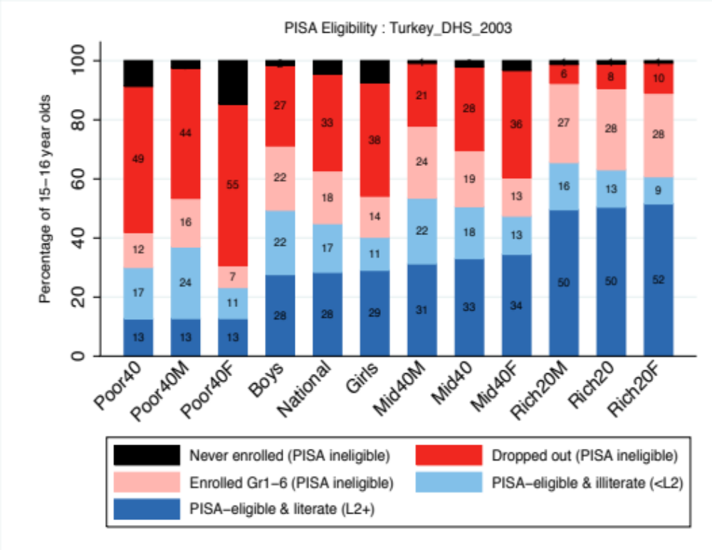
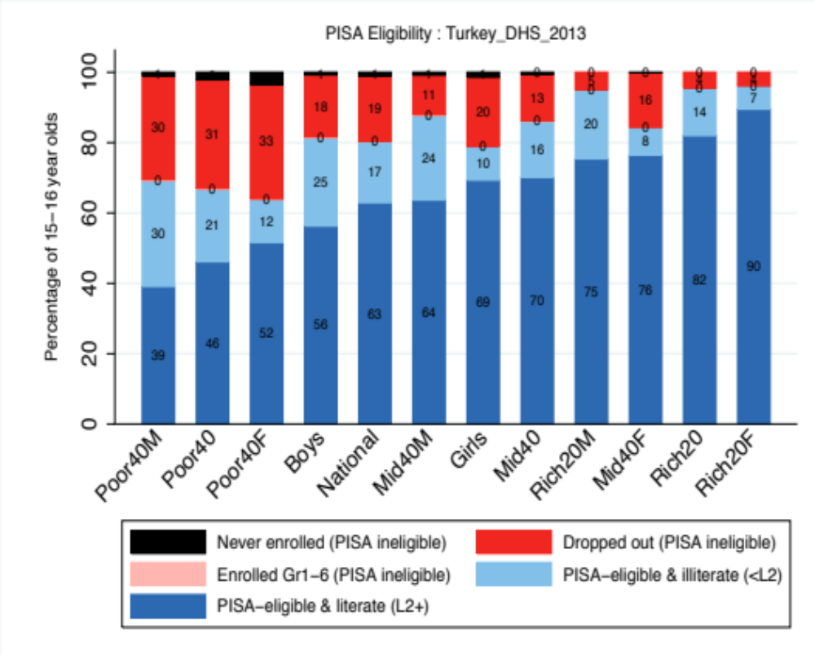
Turkey: Literacy
Who benefitted between 2003 → 2013?

Slide 45
Figure 2 Access to Literacy (Level 2) in Turkey 2003 (PISA 2003 and DHS 2003)

Slide 46
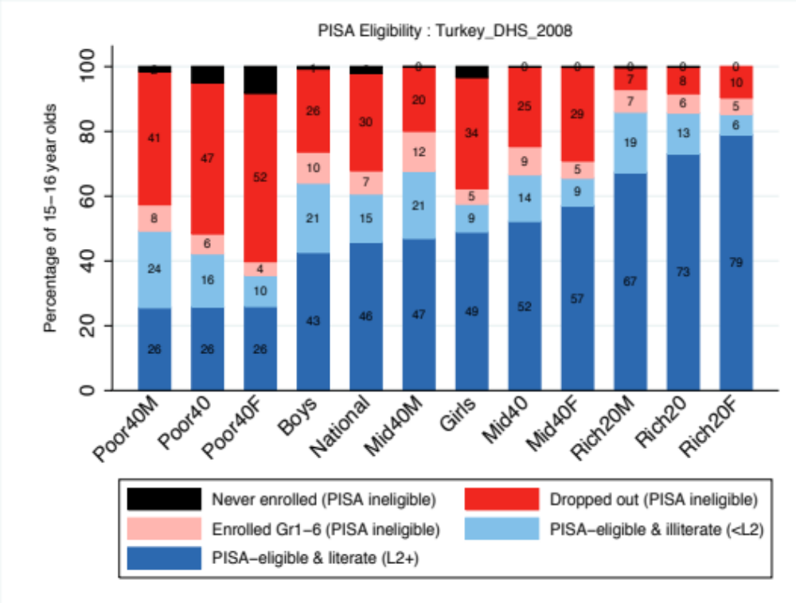
Figure 3 Access to Literacy (Level 2) in Turkey 2009 (PISA 2009 and DHS 2008)

Slide 47
Figure 4 Access to Literacy (Level 2) in Turkey 2012 (PISA 2012 and DHS 2013)

Slide 48
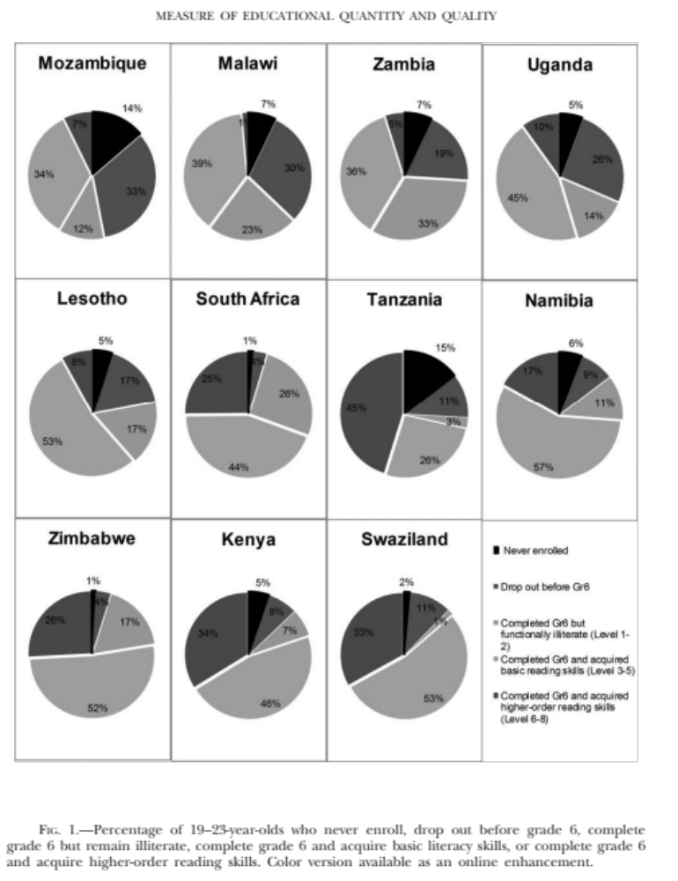
Sub-Saharan Africa
Spaull & Taylor, 2015

Slide 49
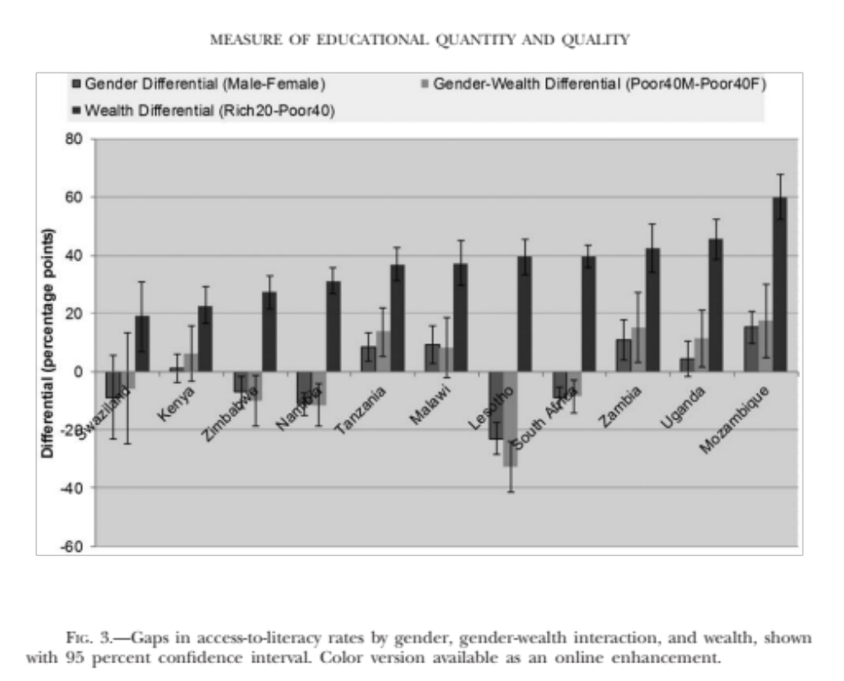
(Spaull & Taylor, 2015)

Slide 50
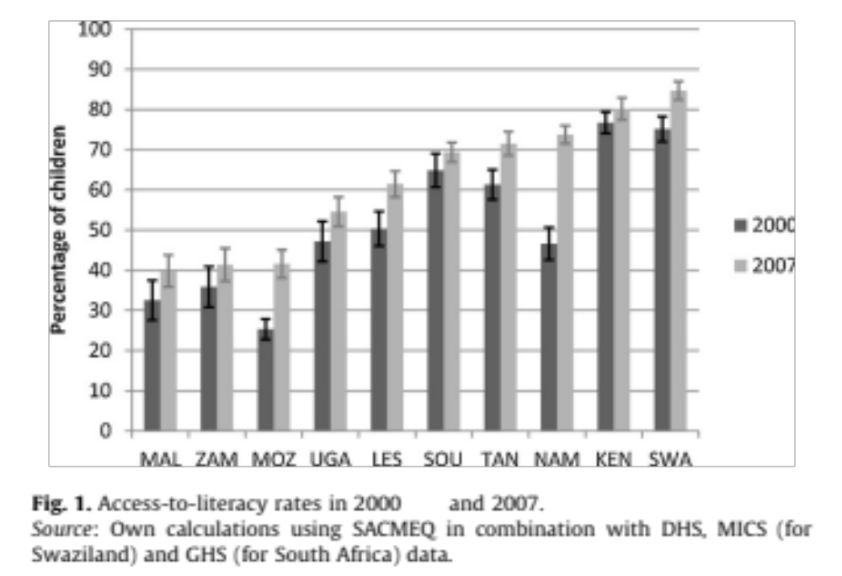
Sub-Saharan Africa over time
Taylor & Spaull, 2015

Slide 51
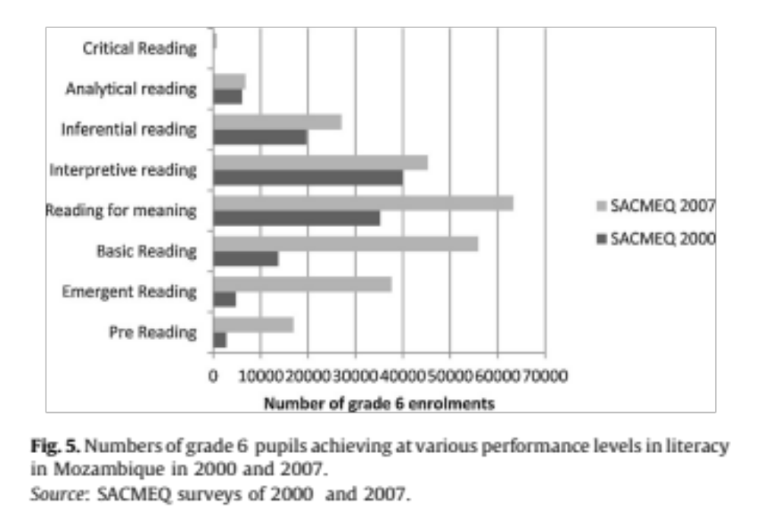
Sub-Saharan Africa over time
Taylor & Spaull, 2015

Slide 52
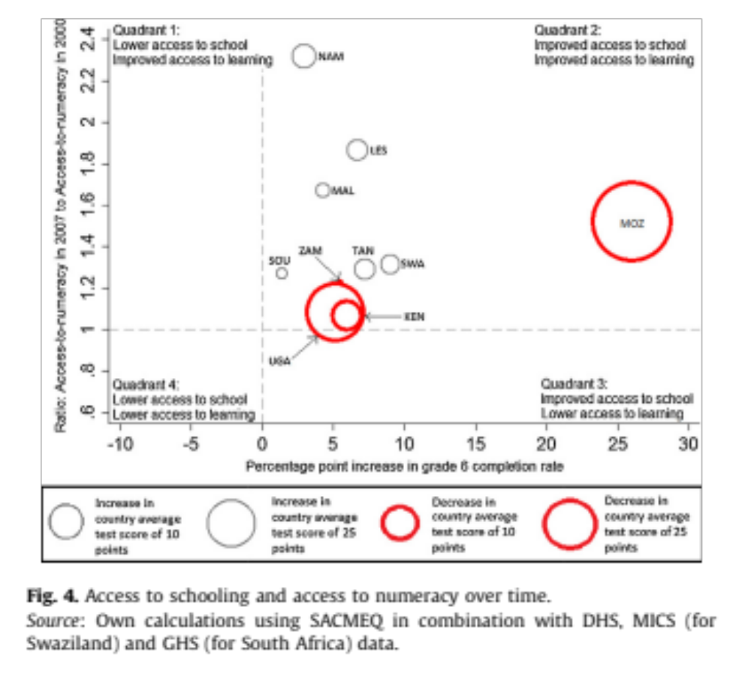
Sub-Saharan Africa over time
Taylor & Spaull, 2015

Slide 53
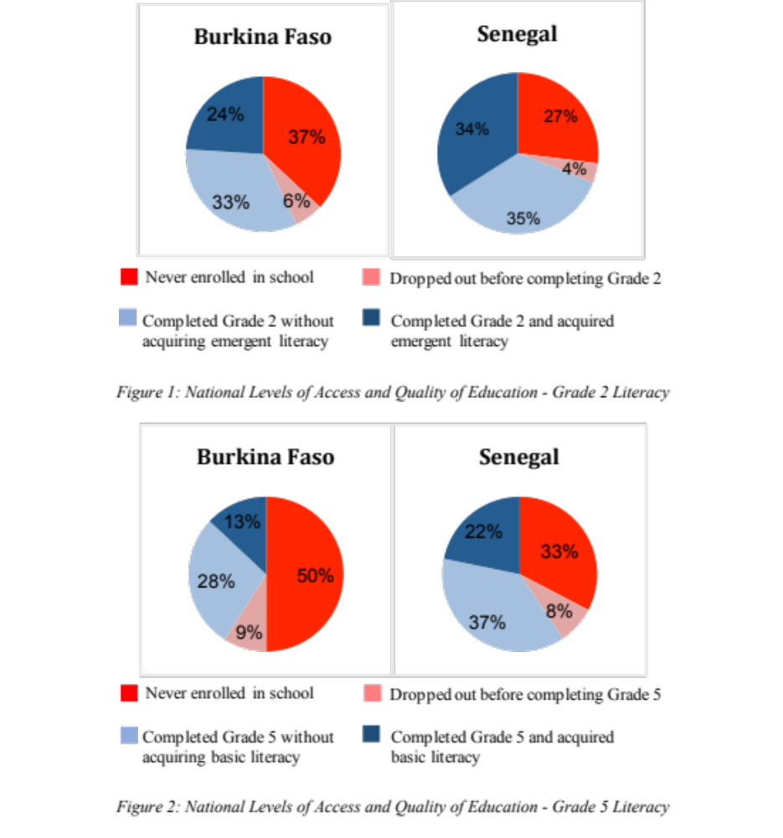
Francophone West Africa
DHS & PASEC
ASSESSING EARLY LITERACY OUTCOMES IN BURKINA FASO AND SENEGAL: USING DHS AND PASEC TO COMBINE ACCESS AND QUALITY
(Spaull & Lillenstein, 2017)

Slide 54
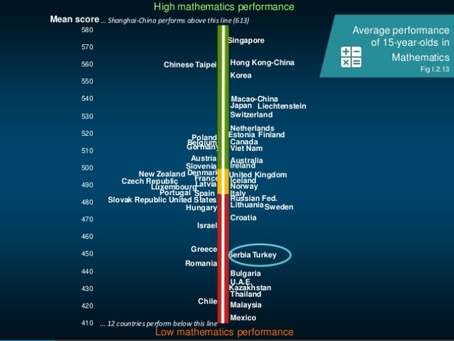
Serbia = 93 % coverage
Turkey = 68 % coverage

Slide 55
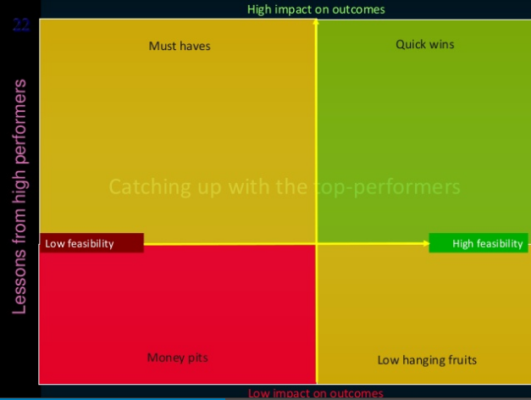
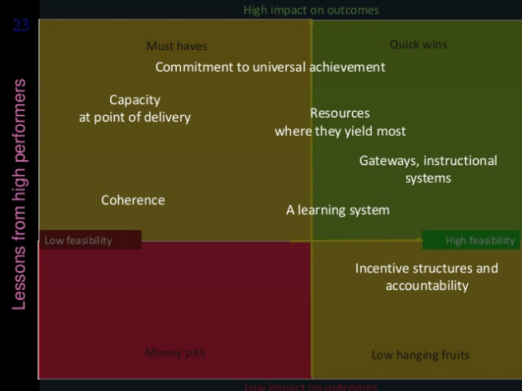
Although it is almost never discussed in the PISA reports, or the PISA Technical Reports, or even the peer-reviewed literature critiquing PISA, this issue of expanding access and attainment has been one of the defining features of education systems in developing countries for the last two decades and definitely in Turkey
Access

Slide 56
PISA literature on sample eligibility
One paragraph repeated in all PISA reports from 2003: “This high level of coverage contributes to the comparability of the assessment results. For example, even assuming that the excluded students would have systematically scored worse than those who participated, and that this relationship is moderately strong, an exclusion rate in the order of 5 per cent would likely lead to an overestimation of national mean scores of less than 5 score points … This assessment is based on the following calculations: If the correlation between the propensity of exclusions and student performance in 0.3, resulting mean scores would likely to overestimated by 1 score point if the exclusion rate is 1 per cent, by 3 score points if the exclusion rate is 5 per cent, and by 6 score points if the exclusion rate is 10 per cent. If the correlation between the propensity of exclusions and student performance in 0.5, resulting mean scores would be overestimated by 1 score point if the exclusion rate is 1 per cent, by 5 score points if the exclusion rate is 5 per cent, and by 10 score points if the exclusion rate is 10 per cent. For this calculation, a model was employed that assumes a bivariate normal distribution for the propensity to participate and performance” (OECD, 2004, p. 325)
Lockheed, Prokic-Breuer & Shadrova (2015) 130-page report: “As mentioned above, in some countries a substantial proportion of the 15-year-olds enrolled in school are enrolled in grades considerably lower than the modal grade for their age and country: often in grades 7 or 8, rather than grades 9 or 10 as in OECD countries. In addition, out-of-school rates for lower secondary school children are high in many low- and middle-income countries, exceeding 10% in Argentina, Bulgaria, Jordan, Mexico, Thailand and Turkey. The rate is exceptionally high in Viet Nam, at 37%. This implies selection bias among the population eligible for the PISA survey in these countries. The combination of these two exclusion mechanisms, plus other minor exclusion criteria,12 result in indices of coverage of the 15-year-old population as low as 50% in Costa Rica, 56% in Viet Nam, and 63% in Indonesia, compared with 96% for OECD countries. These relatively low levels of coverage limit the comparability of the results of middle-income countries with other countries“ Lockheed, Prokic-Breuer & Shadrova (2015, p. 99)
“Most countries would show no or very small changes in average performance after taking into account the performance of those outside the school system” –
  Providing Access to Schooling to All 15-year-olds” (OECD, 2012b, p. 53).
  Based on flawed Coverage Index 3 data from PISA Report 2003 (see paper)

Slide 57
Total number of 15 year olds & households in each DHS
DHS | 15 year olds | From __ unique households
Colombia 2005 | 3402 | 3307
Colombia 2010 | 4330 | 4247
Indonesia 2002/3 | 2960 | 2940
Indonesia 2007 | 3338 | 3282
Indonesia 2012 | 3265 | 3244
Peru 2000 | 2820 | 2779
Peru 2009 | 2312 | 2292
Peru 2012 | 2241 | 2205
Turkey 2003 | 929 | 915
Turkey 2008 | 879 | 868
Turkey 2013 | 786 | 781

Slide 58
Enrolled in Gr7+ | Poorest 40% | Middle 40% | Richest 2-% | Total
Colombia 2005 | 536 | 962 | 583 | 2081
 | 26% | 46% | 28% | 100%
Colombia 2010 | 904 | 1269 | 741 | 2915
 | 31% | 44% | 25% | 100%
Indonesia 2003 | 529 | 826 | 482 | 1837
 | 29% | 45% | 26% | 100%
Indonesia 2007 | 694 | 1000 | 604 | 2297
 | 30% | 44% | 26% | 100%
Indonesia 2012 | 856 | 1055 | 548 | 2459
 | 35% | 43% | 22% | 100%
Peru 2000 | 514 | 872 | 487 | 1874
 | 27% | 47% | 26% | 100%
Peru 2009 | 600 | 753 | 416 | 1769
 | 34% | 43% | 24% | 100%
Peru 2012 | 609 | 753 | 391 | 1753
 | 35% | 43% | 22% | 100%
Turkey 2003 | 106 | 178 | 79 | 362
 | 29% | 49% | 22% | 100%
Turkey 2008 | 167 | 259 | 164 | 591
 | 28% | 44% | 28% | 100%
Turkey 2013 | 218 | 275 | 152 | 645
 | 34% | 43% | 24% | 100%
Who makes it into PISA?
i.e. who in poorest 40%, middle 40% and richest 20% of 15 year olds are enrolled in Gr7 or higher?
If there was equal representation then these should all be 40% 40% 20%
Poor =under-represented
Rich = over-represented

Slide 59

Who benefited from the improved attainment in Colombia?

Slide 60
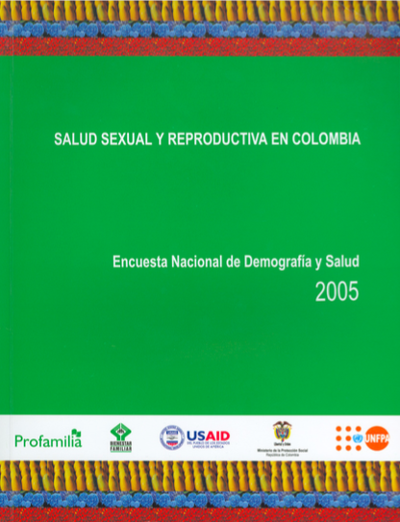
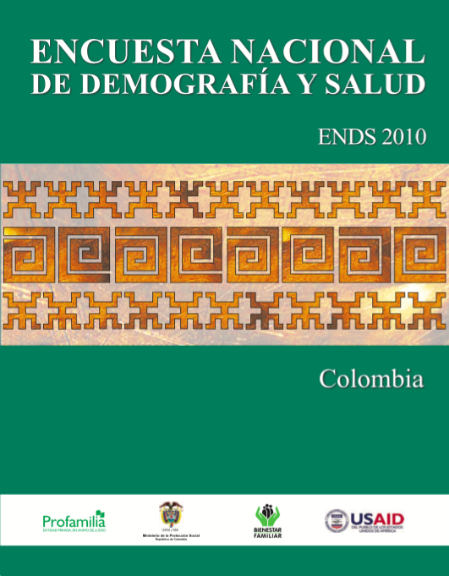

Slide 61
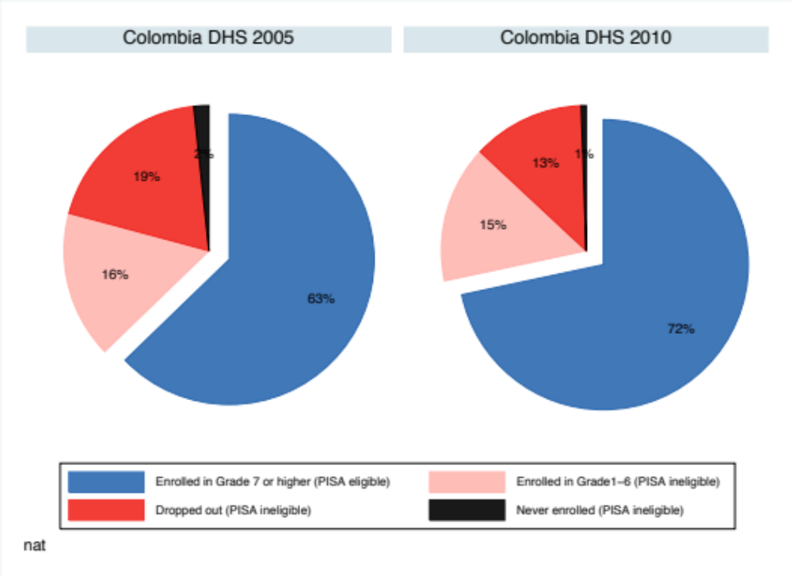
Colombia: 63% → 72%
PISA eligible 15 year olds increased from (2005→2010)

Slide 62
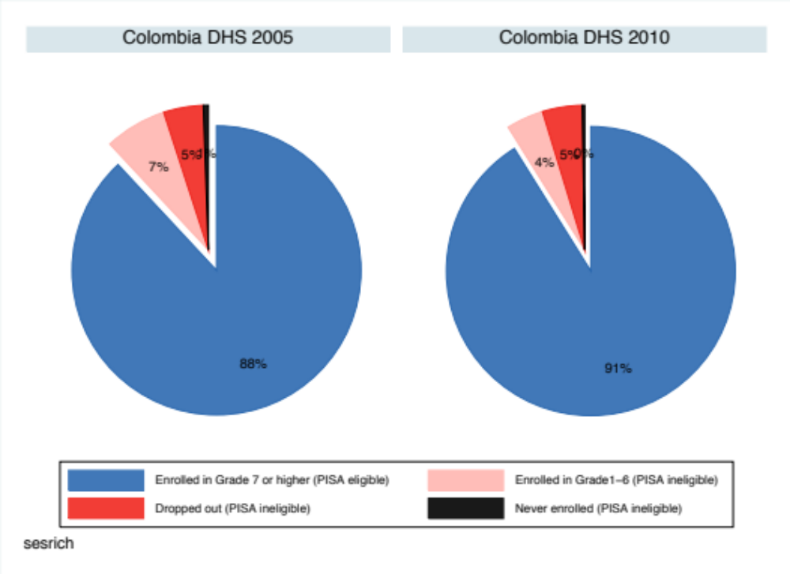
Colombia: 63% → 72%
Did the richest 20% benefit?
88%→91%

Slide 63
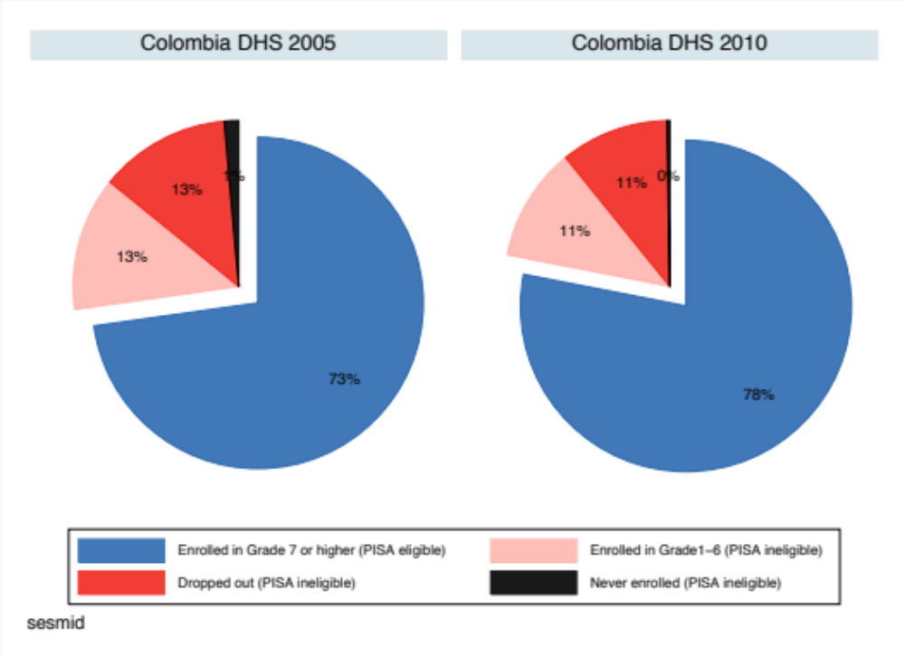
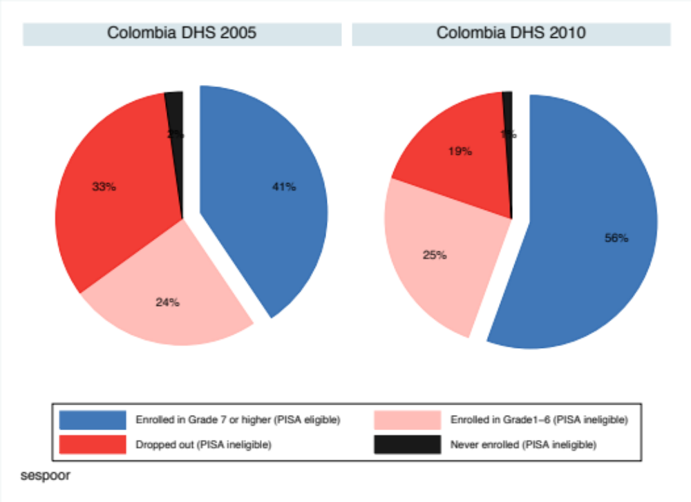
What about the middle 40%?
73%→78%
What about the poorest 40%?
41%→56%

Slide 64
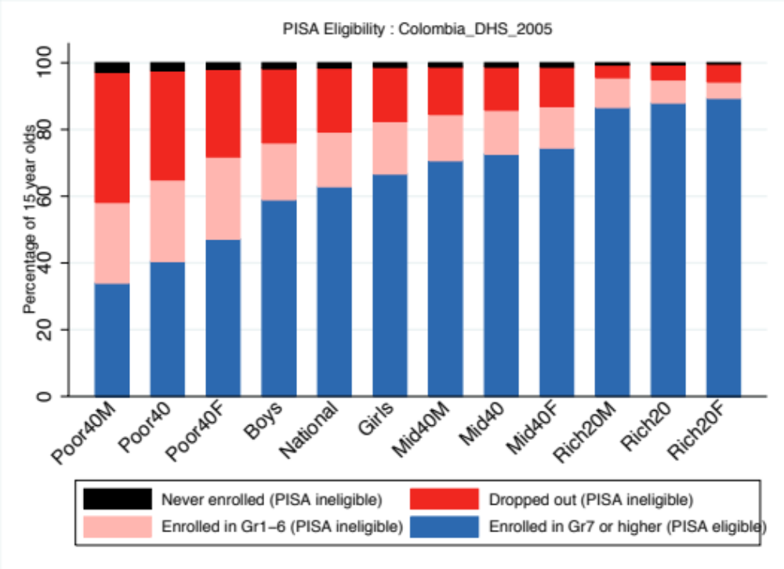
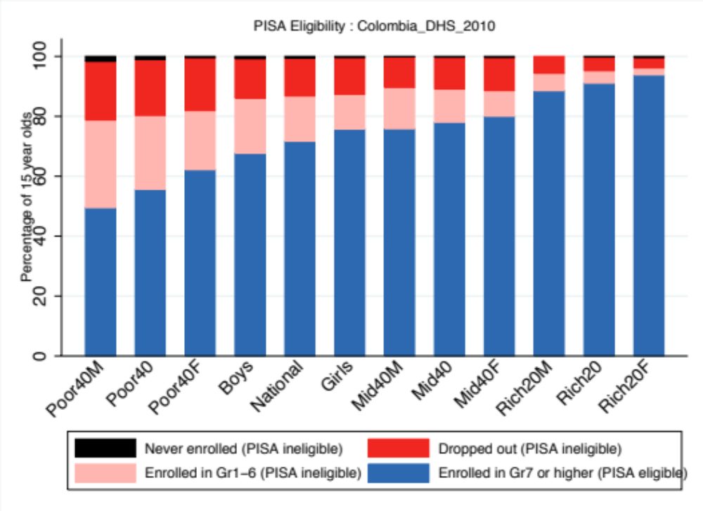
Decreased dropout among poor

Slide 65

Who benefited from the improved attainment in Indonesia?

Slide 66
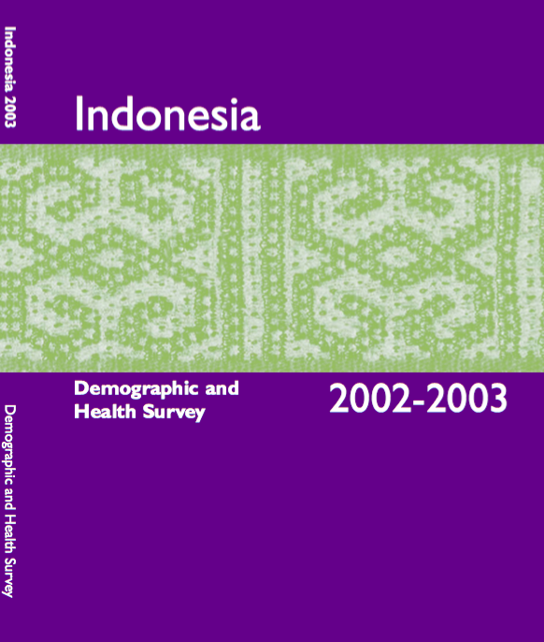
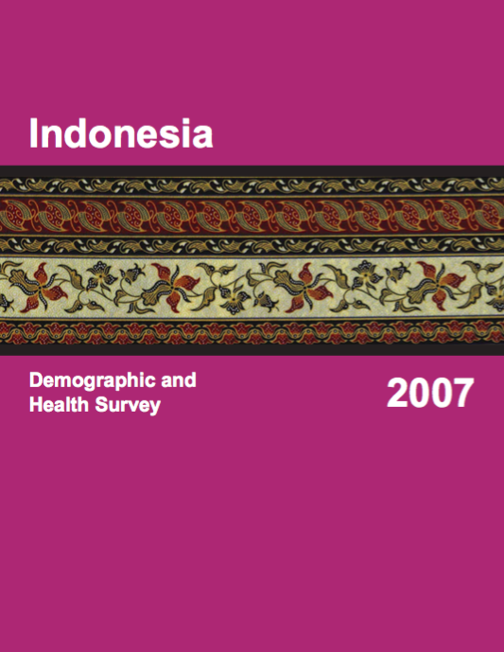
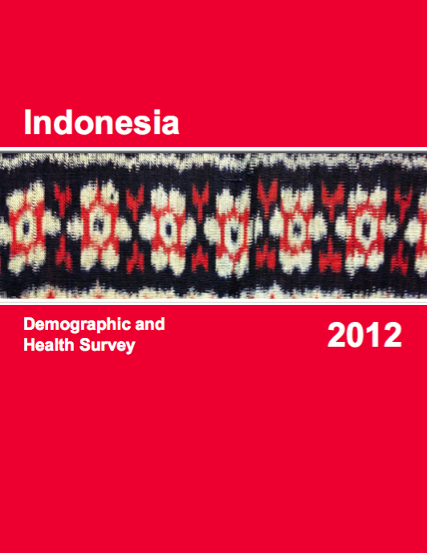

Slide 67
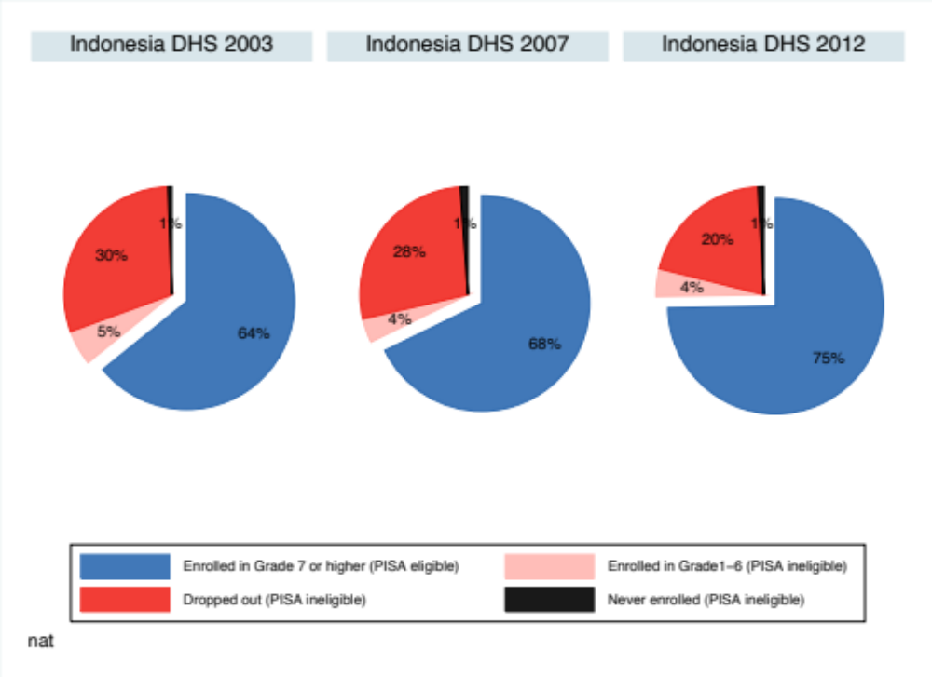
Indonesia: 64% → 68% → 75%
PISA eligible 15 year olds increased from (2003→2012)
64% → 68% → 75%

Slide 68
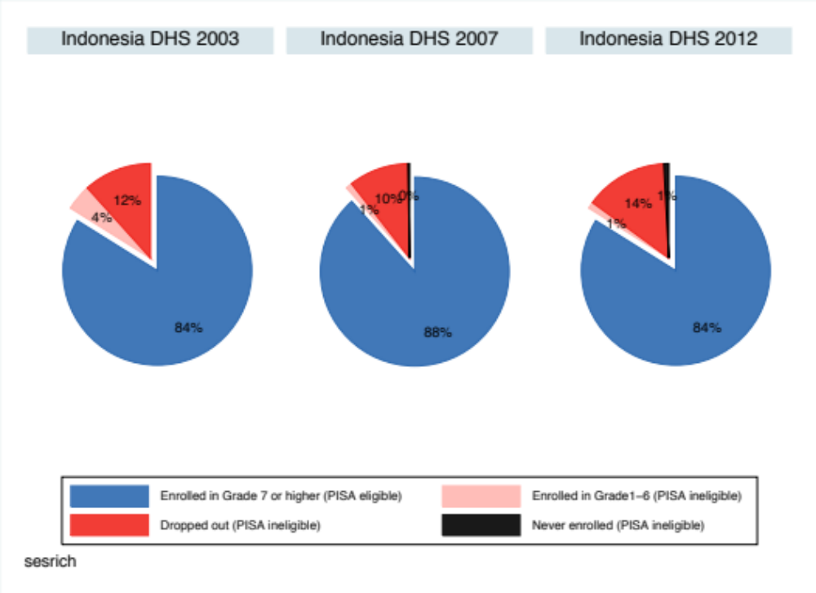
Indonesia: 64% → 68% → 75%
Did the richest 20% benefit?
84% → 88% → 84%

Slide 69
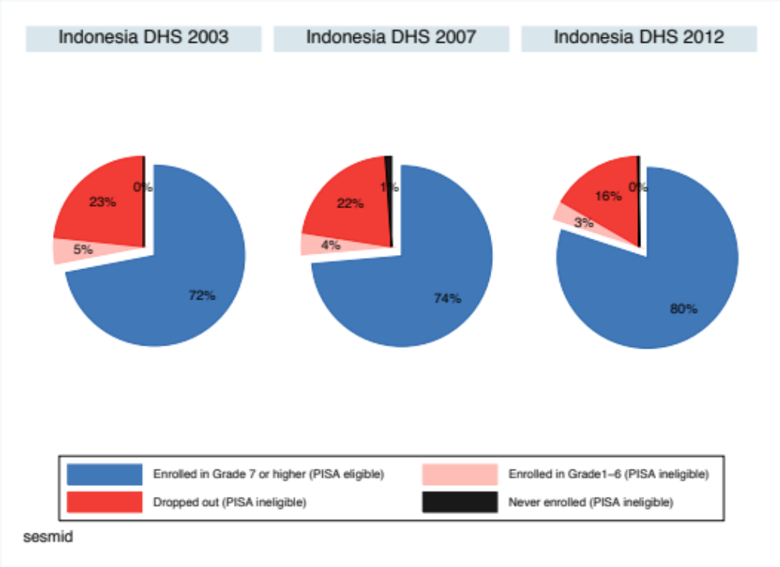
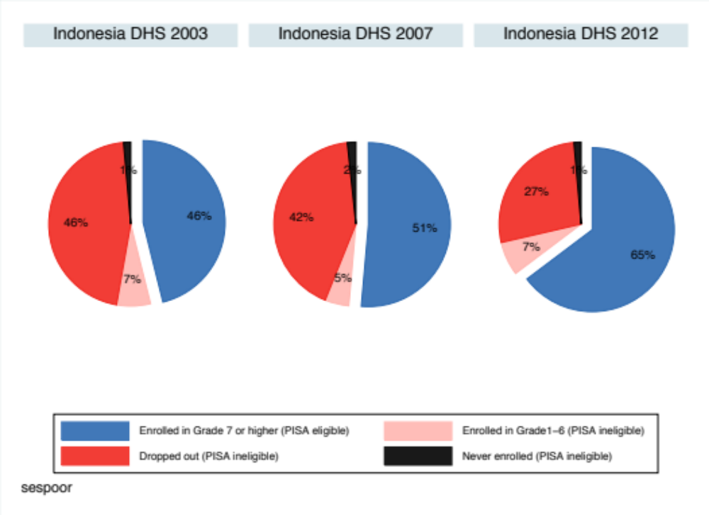
What about the middle 40%?
72%→74%→80%
What about the poorest 40%?
46%→51%→66%

Slide 70
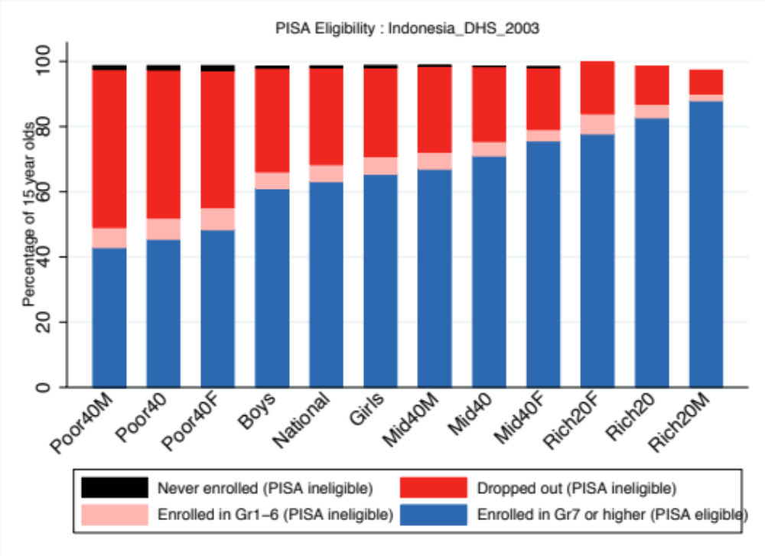


Decreased dropout among poor

Slide 71

Who benefited from the improved attainment in Peru?

Slide 72




Slide 73

Peru: 68% → 79% → 81%
PISA eligible 15 year olds increased from (2000→2012)
68% → 79% → 81%

Slide 74

Peru: 68% → 79% → 81%
Did the richest 20% benefit?
90% → 93% → 90%

Slide 75


What about the middle 40%?
80%→84%→87%
What about the poorest 40%?
47%→67%→71%

Slide 76



Decreased dropout & delay among poor

Slide 77
Who benefited from the improved attainment in Turkey?

Slide 78

Turkey: 40% → 69% → 83%
PISA eligible 15 year olds increased from (2003→2013)
40% → 69% → 83%

Slide 79

Turkey: 40% → 69% → 83%
Did the richest 20% benefit?
43% → 95% → 97%

Slide 80


What about the middle 40%?
49%→76%→89%
What about the poorest 40%?
29%→49%→71%

Slide 81




Slide 82
Turkey 2003→2012 (Coverage Index 3)

Slide 83
% of students per level
# of students per level

Slide 84
Indonesia 2000→2012 (Coverage Index 3)

Slide 85
Combining these results with PISA
(which is actually the focus of my work)
☺

Slide 86
Creating “access to literacy”
Get estimates of:
  Percentage of 15 year-olds that are eligible for the PISA sample (enrolled and in Gr7+) (from DHS)
  Percentage of PISA sample that achieved Level 2+ in Reading (from PISA)
Multiply the two together, assuming that ineligible students would not have reached Level 2…
  eg 80% of 15 year-old girls reach Gr7+
  50% of girls in PISA reach Level 2+
    Access-to-literacy = 0.8*0.5 = 40%
Correct for differential access-to-PISA-sample by SES…

Slide 87

Adjusting PISA SES 40-40-20 categories to correspond with DHS categories
PISA Data

Slide 88



Very few extremely delayed students achieve Level 2 in PISA Reading. Gr1-6 even less likely

Slide 89
(1) The gains in these countries have been larger than acknowledged by OECD

Slide 90
Table X. PISA Literate (L2+), with Standard Errors (%) - Uncorrected for sample ineligibility
Country | National | SE | Males | SE | Females | SE | Poor40 | SE | Mid40 | SE | Rich20 | SE
Colombia06 | 44 | 2,1 | 42 | 2,4 | 47 | 2,3 | 32 | 2,8 | 47 | 2,6 | 63 | 2,7
Colombia09 | 53 | 1,9 | 50 | 2,2 | 55 | 2,1 | 37 | 2,3 | 58 | 1,9 | 75 | 2,1
Indonesia03 | 37 | 1,8 | 31 | 1,7 | 43 | 2,4 | 29 | 1,6 | 39 | 2,2 | 47 | 2,9
Indonesia06 | 42 | 3,4 | 37 | 5,0 | 46 | 2,5 | 31 | 3,4 | 39 | 2,6 | 67 | 4,2
Indonesia12 | 45 | 2,2 | 37 | 2,6 | 52 | 2,4 | 36 | 2,5 | 45 | 2,4 | 61 | 3,9
Peru00 | 20 | 1,5 | 19 | 2,3 | 22 | 2,0 | 12 | 1,3 | 20 | 1,7 | 39 | 2,7
Peru09 | 35 | 1,7 | 30 | 1,8 | 40 | 2,2 | 17 | 1,2 | 39 | 1,8 | 64 | 3,4
Peru12 | 40 | 2,0 | 35 | 1,9 | 45 | 2,4 | 21 | 1,4 | 46 | 2,1 | 66 | 3,0
Turkey03 | 63 | 2,4 | 56 | 3,0 | 72 | 2,6 | 47 | 2,5 | 69 | 2,4 | 83 | 2,5
Turkey09 | 75 | 1,4 | 67 | 1,9 | 85 | 1,4 | 65 | 2,1 | 81 | 1,4 | 86 | 1,9
Turkey12 | 78 | 1,4 | 69 | 2,1 | 88 | 1,0 | 71 | 1,8 | 82 | 1,4 | 85 | 2,0
Access to Literacy (Level 2+) Corrected for sample ineligibility (assumes all ineligible students < Level 2)
Country | National | SE | Males | SE | Females | SE | Poor40 | SE | Mid40 | SE | Rich20 | SE
Colombia06 | 27,9 | 2,4 | 24,6 | 2,9 | 31,0 | 2,7 | 12,0 | 3,3 | 31,4 | 3,3 | 52,3 | 2,9
Colombia09 | 37,9 | 2,2 | 34,1 | 2,6 | 41,7 | 2,4 | 19,5 | 3,1 | 42,2 | 2,4 | 66,2 | 2,5
Indonesi03 | 23,2 | 2,6 | 18,7 | 3,0 | 28,0 | 3,3 | 12,6 | 3,1 | 26,4 | 3,7 | 38,0 | 3,8
Indonesi06 | 28,2 | 3,7 | 24,9 | 5,4 | 31,9 | 3,1 | 14,9 | 4,0 | 27,7 | 3,4 | 55,9 | 4,6
Indonesi12 | 33,4 | 2,5 | 26,8 | 3,1 | 40,6 | 3,0 | 22,9 | 3,2 | 35,3 | 3,0 | 50,6 | 4,7
Peru00 | 14,1 | 1,9 | 12,9 | 2,8 | 15,5 | 2,6 | 5,3 | 2,2 | 13,2 | 2,1 | 33,6 | 3,1
Peru09 | 27,9 | 2,0 | 23,4 | 2,4 | 32,7 | 2,6 | 10,4 | 2,2 | 30,4 | 2,4 | 57,7 | 3,7
Peru12 | 32,5 | 2,2 | 27,4 | 2,5 | 37,7 | 2,8 | 13,8 | 2,2 | 38,1 | 2,7 | 58,8 | 3,8
Turkey03 | 25,3 | 3,1 | 24,4 | 4,0 | 26,3 | 3,8 | 12,5 | 3,8 | 32,7 | 4,0 | 36,1 | 5,3
Turkey09 | 52,1 | 2,5 | 50,9 | 3,0 | 52,8 | 3,4 | 30,0 | 3,8 | 59,4 | 3,6 | 81,4 | 2,5
Turkey12 | 65,3 | 2,2 | 59,2 | 2,9 | 71,1 | 2,7 | 49,1 | 3,4 | 72,4 | 2,7 | 83,4 | 2,9

Slide 91
Access to literacy rates (Level 2+)
Country | National | SE | Males | SE | Females | SE | Poor40 | SE | Mid40 | SE | Rich20 | SE
Colombia06 | 27,9 | 2,4 | 24,6 | 2,9 | 31,0 | 2,7 | 12,0 | 3,3 | 31,4 | 3,3 | 52,3 | 2,9
Colombia09 | 37,9 | 2,2 | 34,1 | 2,6 | 41,7 | 2,4 | 19,5 | 3,1 | 42,2 | 2,4 | 66,2 | 2,5
Indones03 | 23,2 | 2,6 | 18,7 | 3,0 | 28,0 | 3,3 | 12,6 | 3,1 | 26,4 | 3,7 | 38,0 | 3,8
Indones06 | 28,2 | 3,7 | 24,9 | 5,4 | 31,9 | 3,1 | 14,9 | 4,0 | 27,7 | 3,4 | 55,9 | 4,6
Indones12 | 33,4 | 2,5 | 26,8 | 3,1 | 40,6 | 3,0 | 22,9 | 3,2 | 35,3 | 3,0 | 50,6 | 4,7
Peru00 | 14,1 | 1,9 | 12,9 | 2,8 | 15,5 | 2,6 | 5,3 | 2,2 | 13,2 | 2,1 | 33,6 | 3,1
Peru09 | 27,9 | 2,0 | 23,4 | 2,4 | 32,7 | 2,6 | 10,4 | 2,2 | 30,4 | 2,4 | 57,7 | 3,7
Peru12 | 32,5 | 2,2 | 27,4 | 2,5 | 37,7 | 2,8 | 13,8 | 2,2 | 38,1 | 2,7 | 58,8 | 3,8
Turkey03 | 25,3 | 3,1 | 24,4 | 4,0 | 26,3 | 3,8 | 12,5 | 3,8 | 32,7 | 4,0 | 36,1 | 5,3
Turkey09 | 52,1 | 2,5 | 50,9 | 3,0 | 52,8 | 3,4 | 30,0 | 3,8 | 59,4 | 3,6 | 81,4 | 2,5
Turkey12 | 65,3 | 2,2 | 59,2 | 2,9 | 71,1 | 2,7 | 49,1 | 3,4 | 72,4 | 2,7 | 83,4 | 2,9
But who benefited the most?
(Gains in percentage points A2L over the period)
Girls ☺
Richest 20% ☹
 | National | Males | Females | Poor40 | Mid40 | Rich20
Colombia06
Colombia09 | 10,1 | 9,6 | 10,7 | 7,5 | 10,7 | 13,8
Indonesia03
Indonesia06
Indonesia12 | 10,2 | 8,1 | 12,6 | 10,3 | 8,9 | 12,6
Peru00
Peru09
Peru12 | 18,4 | 14,5 | 22,3 | 8,5 | 24,9 | 25,3
Turkey03
Turkey09
Turkey12 | 40,0 | 34,8 | 44,8 | 36,6 | 39,7 | 47,3

Slide 92
(2) Gaps between rich and poor are larger than those reported by OECD/PISA

Slide 93
What can OECD do about this?
Start analyzing household survey data for countries where there is incomplete access
  There is a lot of already existing HH-survey data for each country.
  Not difficult to analyse
Be more sensitive to differences in attainment between countries and across time when comparing countries with each other and over time

Slide 94
Current OECD paradigm
When nearly all children are are still in school at age 15 (as in original OECD/PISA countries) then access isn’t such a big deal.
But 1/3rd of partner countries in 2012 had CI-3 rates of <80%
Quality
Equity
Education
Access

Slide 95
Thank you
Comments & Questions
Email: nicholas.spaull@gmail.com

Slide 96
Need for multiple errata
Perhaps the largest OECD ‘airtime’ given to this issue was in PISA 2012 Vol 2, p.210 which looked at changes in Coverage Index 3 between 2003 and 2012 but used Pisa Report 2003 table ☹ (i.e. the wrong one)
  Turkey CI-3 reported as 54% but actually 36%. Thailand 2003 CI3 reported as 84% but actually 69% etc.
  Not just Turkey/Thailand, all figures are out. Sometimes by a lot.

Slide 97

PISA 2003 Report page 322

Slide 98

PISA 2003 Technical report – page 169

