Slide 1
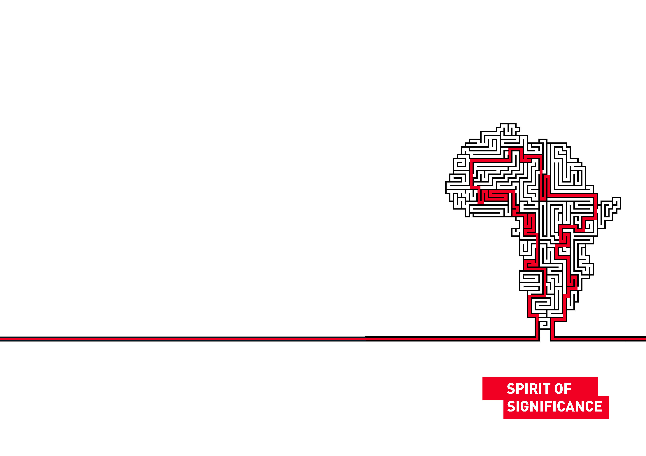

Nic Spaull
Binding Constraints in Education
23 September 2016
Notes:
Introduce everyone to
Start off by thanking everyone for their contribution

Slide 2
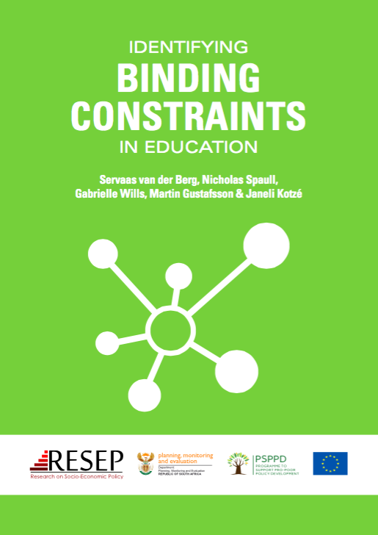

PSPPD & Zenex Report Launch

Slide 3
What do we know about education in SA?
High access: South Africa has relatively high access to education up to Grade 9. Expanding Grade R. Also new progression policies.
Low quality: South Africa has very low levels of educational achievement even by low/middle-income standards. OECD ranks SA 74/75 countries beating only Ghana.
Egregious inequality: The gap between the better performing 20% of schools and the 80% of dysfunctional schools is one of (or the) largest in the world. Gap between two systems is between 3 & 4 grade levels. Largely determined by ability-to-pay and location.
Weak accountability: The alliance between the ANC and COSATU/SADTU means that almost all accountability initiatives never get off the ground. (Volmink Report, ANAs, SACE)
Low capacity: Most teachers in quintiles 1-4 do not know enough about their subjects (content knowledge) or how to teach them (pedagogy) meaning that students rarely grasp the content either.
Notes:
OECD report- https://www.oecd.org/pisa/44417824.pdf

Slide 4








Low Quality: Student performance in SA
TIMSS (2003)
→ PIRLS (2006)
→ SACMEQ (2007)
→ TIMSS (2011)
→ prePIRLS (2011)
TIMSS 2003 (Gr8 Maths & Science)
Out of 50 participating countries (including 6 African countries) SA came last
Only 10% reached low international benchmark
No improvement from TIMSS 1999-TIMSS 2003
See Reddy et al (2006)
PIRLS 2006 (Gr 4/5 – Reading)
Out of 45 participating countries SA came last
87% of gr4 and 78% of Gr 5 learners deemed to be “at serious risk of not learning to read”
See Howie et al. (2006)
SACMEQ III 2007 (Gr6 – Reading & Maths)
SA came 10/15 for reading and 8/15 for maths behind countries such as Swaziland, Kenya and Tanzania
See Moloi & Chetty (2010) & Spaull (2012)
TIMSS 2011 (Gr9 – Maths & Science)
SA has joint lowest performance of 42 countries
Improvement by 1.5 grade levels (2003-2011)
76% of grade nine students in 2011 still had not acquired a basic understanding about whole numbers, decimals, operations or basic graphs, and this is at the improved level of performance
See Reddy et al. (2012) & Spaull (2013)
prePIRLS2011 (Gr 4 Reading)
29% of SA Gr4 learners completely illiterate (cannot decode text in any language)
58% cannot read for meaning
(New TIMSS 2015, PIRLS 2015 and SACMEQ 2013* results soon to be released) – see today’s M&G

Slide 5
Low capacity: teachers cannot teach what they do not know
Figure 1: Proportion of South African grade 6 mathematics teachers by content knowledge (CK) group - SACMEQ 2007 (with 95% confidence interval) [401 Gr6 maths teachers]
Venkat, H. and Spaull, N. (2015). What do we know about primary teachers’ mathematical content knowledge in South Africa? An analysis of SACMEQ 2007. International Journal of Educational Development. Vol 41. pp121-130.

Slide 6

Egregious inequality: 2 systems
But what does low and unequal achievement look like on the ground?
Spaull, N. (2013). “Poverty & privilege: Primary school inequality in South Africa”. International Journal of Educational Development” 33; 436-447

Slide 7

NSES Question 42
NSES followed about 15000 students (266 schools) and tested them in Grade 3 (2007), Grade 4 (2008) and Grade 5 (2009).
Grade 3 maths curriculum: “Can perform calculations using appropriate symbols to solve problems involving: division of at least 2-digit by 1-digit numbers”
Even at the end of Grade 5 most (55%+) quintile 1-4 students cannot answer this simple Grade-3-level problem.
“The powerful notions of ratio, rate and proportion are built upon the simpler concepts of whole number, multiplication and division, fraction and rational number, and are themselves the precursors to the development of yet more complex concepts such as triangle similarity, trigonometry, gradient and calculus” (Taylor & Reddi, 2013: 194)
How does this affect learning as students move into higher grades?
Spaull, N. & Kotze, J. (2015). Starting behind and staying behind in South Africa: The case of insurmountable learning deficits in mathematics. International Journal of Educational Development. Vol 41 (March) pp12-24

Slide 8
Egregious inequality: Insurmountable Learning Deficits
Where should we be intervening?
Figure 10b: South African mathematics learning trajectories by national socioeconomic quintiles using a variable standard deviation for a year of learning (0.28 in grade 3 to 0.2 in grade 8 with interpolated values for in-between grades (Based on NSES 2007/8/9 for grades 3/4/5, SACMEQ 2007 for grade 6 and TIMSS 2011 for grade 9, including 95% confidence interval
How does this affect matric?
Spaull, N. & Kotze, J. (2015). Starting behind and staying behind in South Africa: The case of insurmountable learning deficits in mathematics. International Journal of Educational Development. Vol 41 (March) pp12-24

Slide 9
Access: How does all of this affect matric?
Uses national HEMIS/NSC data for the 2008 matric cohort between 2009 and 2014 (Van Broekhuizen, Van der Berg & Hofmeyr, 2016)

Slide 10
Qualifications by age (birth cohort), Census 2011 (Van der Berg, 2013)
How does all of this affect the labour market?

Slide 11
Labour Market
15%
Legislators, managers, assoc professionals
Unemployed
(Broad - 35%)
Unskilled
(18%)
Elementary occupations & domestic workers
Semi-Skilled (32%)
Clerks, service workers, shop personnel, skilled agric/fishery workers, plant and machinery operators)
University/FET
Type of institution (FET or University)
Quality of institution
Type of qualification (diploma, degree etc.)
Field of study (Engineering, Arts etc.)
High quality secondaryschool
High SES background
+ECD
High quality primary school
Minority (20%)
Some motivated, lucky or talented students make the transition
Unequal society
Big demand for good schools despite fees
Some scholarships/bursaries
Majority (80%)
Quality
Low quality secondary
school
Attainment
Type
Low SES background
Low qual ECD
Low quality primary school
QLFS 2014
Notes:
The QLFS classifies professions as follows: Highly skilled (legislators, senior officials and managers, professionals, technicians and associate profesionals); Semi-skilled (Clerks, service workers and shop and market personnel, skilled agricultural and fishery workers, craft and related trade workers, plant and machinery operators and assembly), Unskilled (Elementary occupations, domestic workers).

Slide 12
What are the “binding constraints" in education?
A binding constraint is one where, if you do not address it first, trying to address other constraints has almost no impact.
Uses

Slide 13
PSPPD: Researchers
Paula Armstrong
Annika Bergbauer
Carol Nuga Deliwe (DBE)
Jaamia Galant
Janet Graaff
Martin Gustafsson
Ursula Hoadley
Dumisani Hompashe
Janeli Kotzé
Nompumelelo Mohohlwane (DBE)
Megan Sager
Debra Shepherd
Nicholas Spaull
Stephen Taylor (DBE)
Hendrik van Broekhuizen
Servaas van der Berg
Surette van Staden
Chris van Wyk
Ntsizwa Vilakazi*
Marisa von Fintel
Gabrielle Wills
Uses

Slide 14
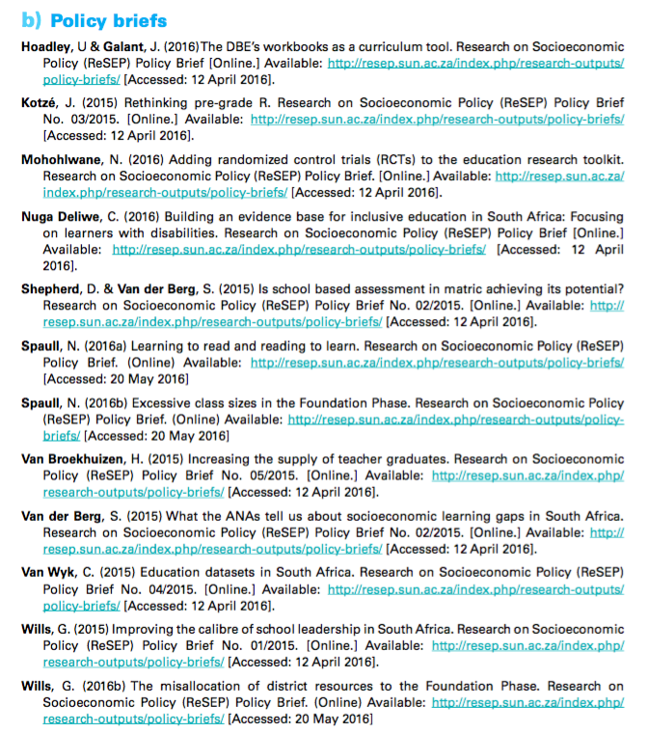
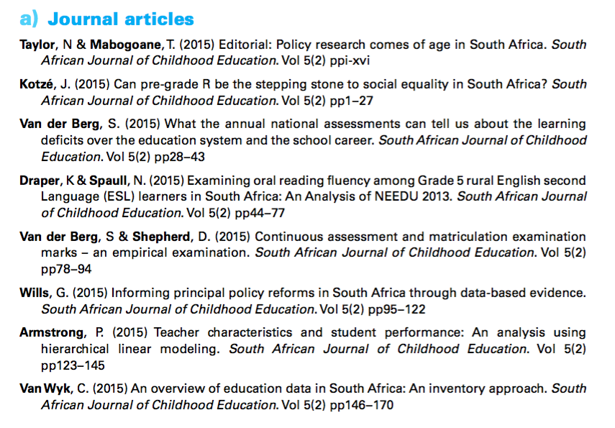
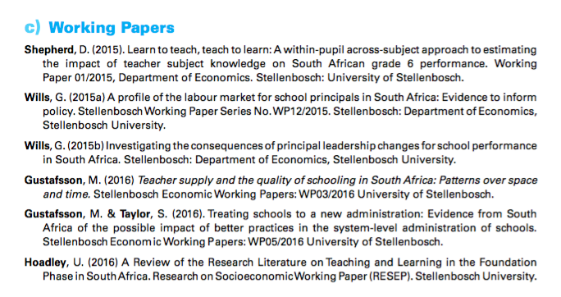

Slide 15
PSPPD & Zenex Report Launch

Slide 16

Accountability
&
Capacity
Richard Elmore & colleagues

Slide 17
What were the binding constraints?

Slide 18
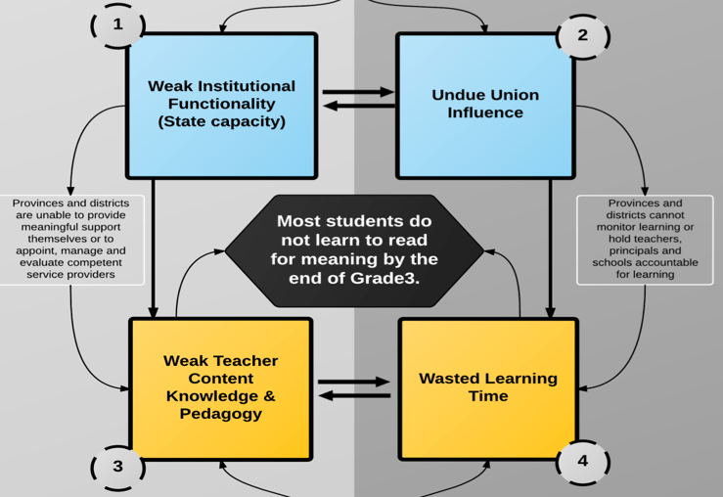
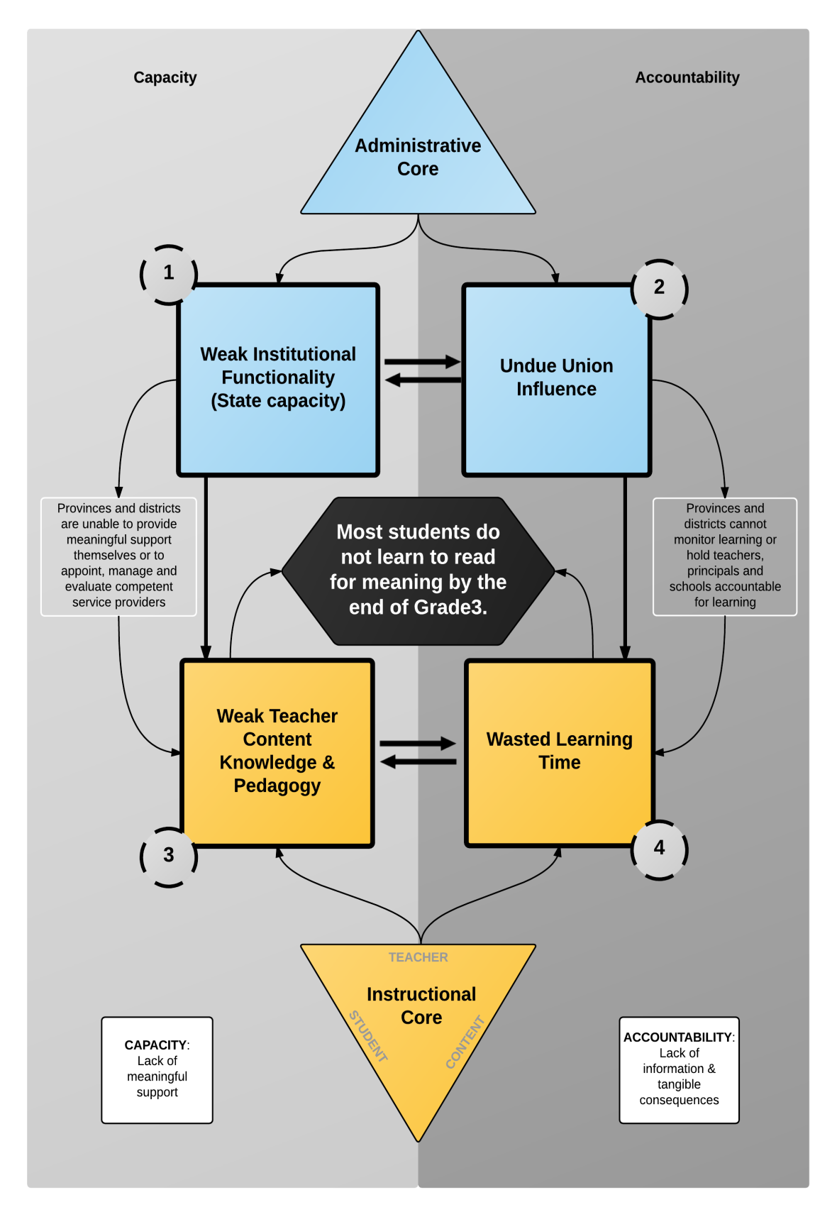
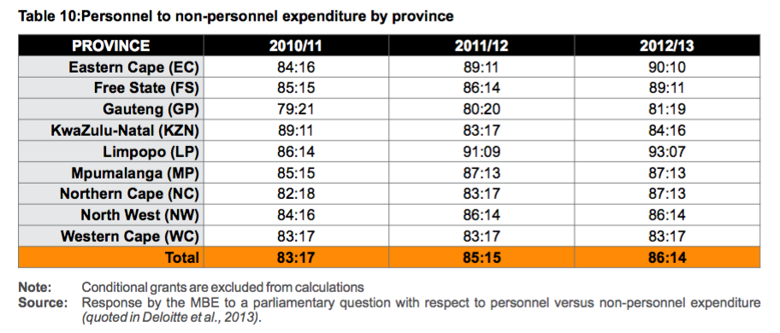

Slide 19
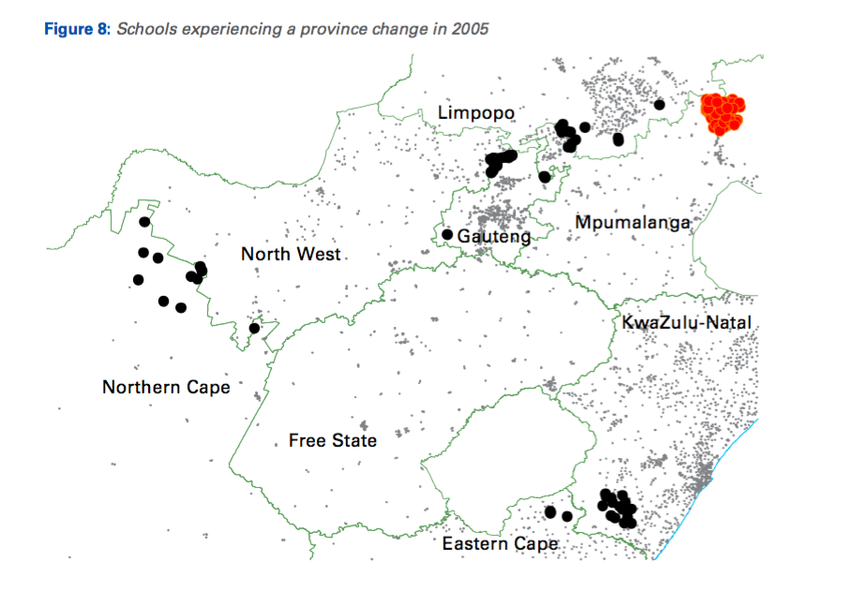
State Capacity: 158 schools “moved” in 2005 due to boundary changes (29 from NW→GP)
“The school-level improvements ultimately brought about were considerable, about as large as one year of progress in a rapidly improving schooling system elsewhere in the world.”

Slide 20
OK, so where to from here?
What should we focus on of all these problems?
What to prioritize?

Slide 21
It all comes back to reading
“Professional educators and the public at large have long known that reading is an enabling process that spans academic disciplines and translates into meaningful personal, social, and economic outcomes for individuals. Reading is the fulcrum of academics, the pivotal process that stabilizes and leverages children’s opportunities to success and become reflective, independent learners.
^{(Good, Simmons and Smith,} ^{1998:45) .}
“Reading is, without doubt, the most important linguistic skill that needs to be developed in young children. Reading serves as a building block upon which all other learning takes place…This National Reading Strategy takes as its focus that reading failure begins in early grades, and it is at that level that interventions must be made”
(DoE, 2008: 18).

Slide 22
Do children in English or Afrikaans LOLT schools learn to read?
Colombia all Gr4 = 72%
Honduras all Gr4 = 74%

Slide 23
What % of students learn to read in any language?

Slide 24

What does this look like in reality?
“We found that South African Grade 5 second language learners from rural areas in South Africa had essentially the same distribution as Grade 1 second language learners in Florida, or Grade 2 second language remedial learners who had been removed from normal classes because they “cannot communicate meaning orally in English and demonstrate very little understanding in English”.
Draper, K., and Spaull, S. (2015). Examining oral reading fluency among grade 5 rural English Second Language (ESL) learners in South Africa: Analysis of NEEDU 2013. South African Journal of Childhood Education 5(2) pp.44-77.

Slide 25


Slide 26
What does this look like in reality?
Many
years
ago
Leopard
was
a
creature
with
no
spots.
Recommended rate at Gr5
One
day,
he
was
relaxing
in
the
shade
of
a
thorn
tree
when
Zebra
walked
past.
Many
years
ago
Leopard
was
a
creature
with
no
spots.
40% of SA rural Gr5 learners (<40WCPM) WCPM
One
day,
he
was
relaxing
in
the
shade
of
a
thorn
tree
when
Zebra
walked
past.
Draper, K., and Spaull, S. (2015). Examining oral reading fluency among grade 5 rural English Second Language (ESL) learners in South Africa: Analysis of NEEDU 2013. South African Journal of Childhood Education 5(2) pp.44-77.
Notes:
40 words in 60s = 1,5s/word
130 words in 60s = 0,46s/word

Slide 27

Main Conclusions
The majority of South African children are not learning to read in any language by the end of Grade 3 and this is the over-arching constraint of the whole school system. These students never get a firm hold on the first rung of the academic ladder and stumble forward into higher grades with low self esteem and compromised learning.
Focusing on the binding constraints first is the best use of limited human and financial resources
Any attempt to solve SA’s root problems must address BOTH accountability and capacity related issues to get traction.
You cannot solve a political problem with a technical solution. The lack of accountability is rooted in politics and that is where the solution for that problem must be found.

Slide 28

What Can AG Orbis Foundation do about this?
Prioritize Grades 1-3: Build consensus that solving the problem must start in the early grades & prioritize learning to read for meaning and moving from counting to calculating. Matric starts in Grade 1
Capacity: Develop a course to teach Foundation Phase teachers how to teach reading. ITREP study shows total inadequacy of existing HEI’s to teach new teachers how to teach reading. Don’t throw good money after bad.
Build an “Allan Gray Teaching Institute” – hire the best and most experienced teachers to be teacher trainers. No fees. Highly practical. Focused on primary school teachers. Trains new teachers and offers short residential courses for existing teachers. Place of excellence for teachers and education (currently these do not exist).

Slide 29
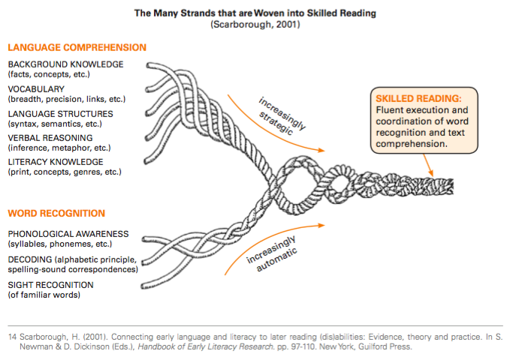
We know how to teach reading

Slide 30
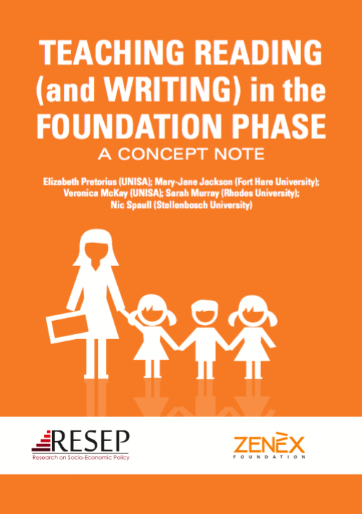
Course outlined developed…

Slide 31

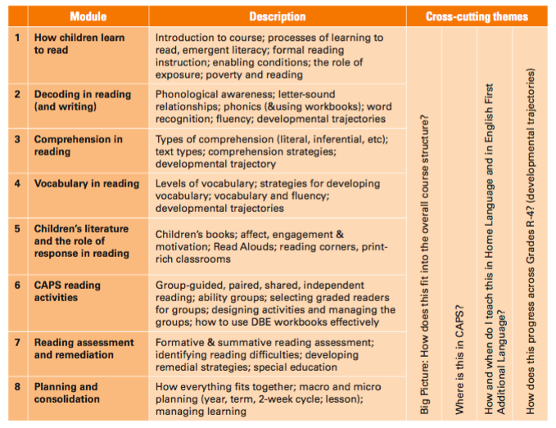
Teaching Reading (& Writing) in FP

Slide 32
Comments / Questions?
These research reports & policy briefs are available online at resep.sun.ac.za
NicholasSpaull@gmail.com

Slide 33



Brief headline findings from some new research
Learning
Deficits
“Already by Grade 2 more than 50% of students in quintiles 1-4 are not on track according to the ANAs” (Van der Berg, 2015)
Mother-Tongue Instruction
“Using ANA data from 9,180 schools Taylor & Von Fintel (2016) find that additional instruction in mother-tongue improves English acquisition by 0.17SD.”
District
Resources
“61% of Gr10-12 teachers were visited by a curriculum advisor compared to 45% of Grade 1-3 teachers” (Wills, 2016)

Slide 34



Gender Inequality
“71% of school teachers are women
36% of school principals are women” (Wills, 2016)
Early Childhood Development
“The ECD Audit 2013 shows that ECD practitioners earn R1,400 - R2,000 per month and 70% have no qualifications whatsoever” (Kotze, 2015)
Weak Pedagogy
“In a review of the literature Hoadley (2016) finds that reading classroom practice is characterized by collective instruction or chorusing with little opportunity for reading & writing”

Slide 35
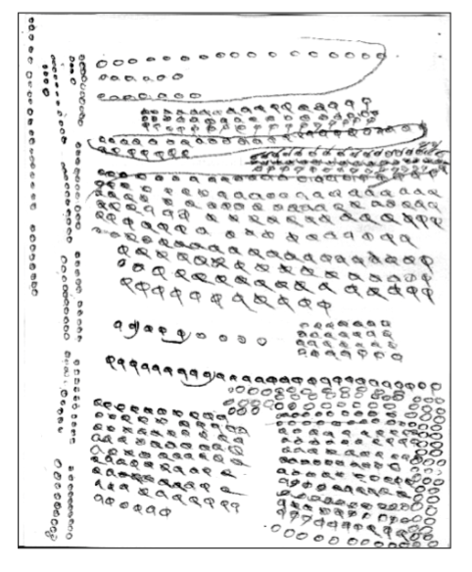
Grade 5 unit counting
Many students do not learn to move beyond a base-1 number system to a base-10 number system etc.
(Eric Scholar)

Slide 36
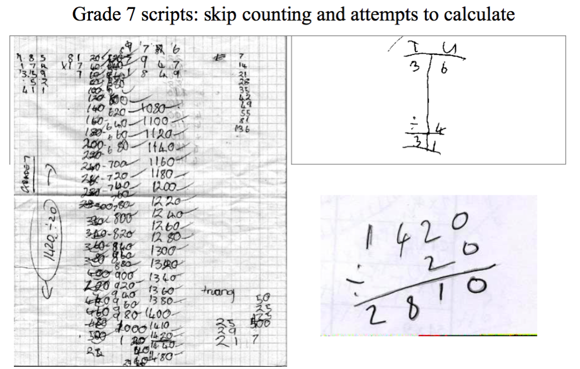
Ref: Eric Scholar

Slide 37





Egregious Inequality: Bimodality– indisputable fact
PIRLS / TIMSS / SACMEQ / NSES / ANA / Matric… by Wealth / Language / Location / Dept…

Slide 39
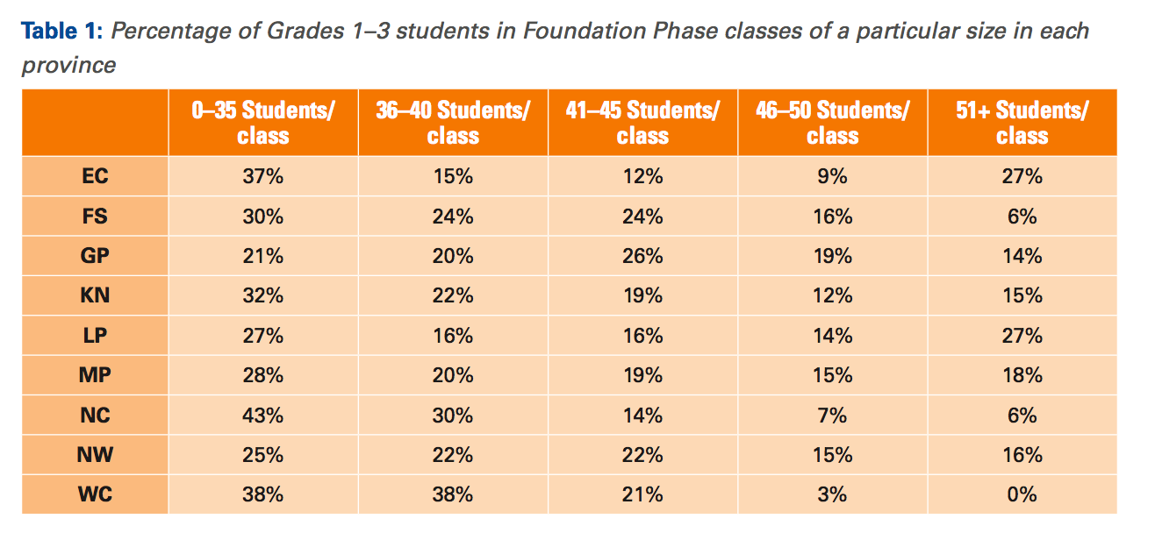

Slide 40
Policy déjà vu
We’ve been on this rodeo before…
National Reading Strategy (DBE, 2008) – Pandor
Teaching Reading in the Early Grades: A Teacher’s Handbooks (DBE, 2008)
Western Cape Numeracy & Literacy Strategy 2006-2016 (WCED, 2006)
Foundations for Learning Campaign (DBE, 2008)
Gauteng Primary Literacy Strategy 2010-2014 (GDE, 2010)
Systematic Method for Reading Success (Hollingsworth & Gains, 2009)
Western Cape Living Labs Schools (WCED, 2015)
Drop Everything & Read Campaign
(See PSPPD Report (2016) for full discussion of previous reading initiatives)

Slide 41
What do primary school mathematics teachers know about mathematics? (Spaull & Venkat, 2015)
Figure 1: Proportion of South African grade 6 mathematics teachers by content knowledge (CK) group - SACMEQ 2007 (with 95% confidence interval) [401 Gr6 maths teachers]

Slide 42
SADTU membership

Slide 43

“The left hand barrel has horizontal wooden slabs, while the right hand side barrel has vertical slabs. The volume in the first barrel depends on the sum of the width of all slabs. Increasing the width of any slab will increase the volume of the barrel. So a strategy on improving anything you can, when you can, while you can, would be effective. The volume in the second barrel is determined by the length of the shortest slab. Two implications of the second barrel are that the impact of a change in a slab on the volume of the barrel depends on whether it is the binding constraint or not. If not, the impact is zero. If it is the binding constraint, the impact will depend on the distance between the shortest slab and the next shortest slab” (Hausmann, Klinger, & Wagner, 2008, p. 17).
Notes:
Hausmann, R., Klinger, G., & Wagner, R. (2008). Doing Growth Diagnostics in Practice: A 'Mindbook'. CID Workinf Paper No. 177. Center for International Development at Harvard University.

Slide 44

Higher education in perspective
When speaking about higher education it’s important to remember that this is only a very small proportion of the population
Source: DBE (2013) Internal Efficiency of the schooling System

Slide 45

Gustafsson, 2011 – When & how WP
“What do the magnitudes from Figure 4 mean in terms of the holding of qualifications? In particular, what widely recognised qualifications do the 60% of youths who do not obtain a Matric hold? …Only around 1% of youths hold no Matric but do hold some other non-school certificate or diploma issued by, for instance, an FET college”
(Gustafsson, 2011: p.11)
10%
Notes:
http://www.ekon.sun.ac.za/wpapers/2011/wp092011

Slide 46
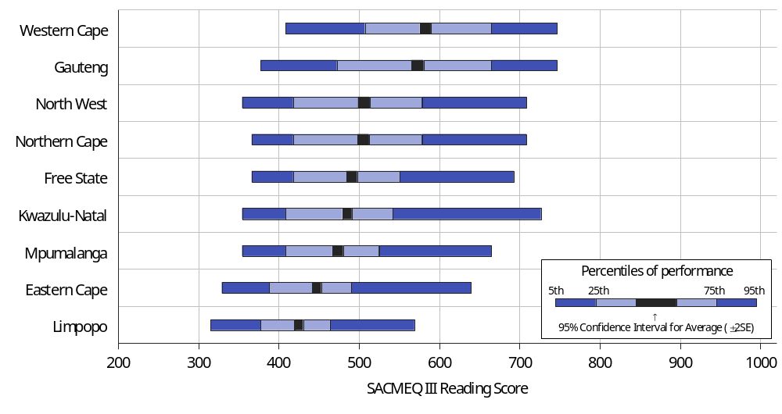
Province…SACMEQ III Reading (Gr6)

