Slide 1


The ‘Martha Effect’:
The Compounding Female Advantage in South African Higher Education
Dr Hendrik van Broekhuizen
Dr Nicholas Spaull
RESEP, Stellenbosch University
ESSA2017 30 Aug 2017

Slide 2
High-level findings
Figure 1: The percentage more females than males from the 2008 NSC Cohort (N=112,402) attaining higher education outcomes (2009-2014) (For corresponding figures see Table 1)

Slide 3
Literature
58% of bachelor’s degrees were awarded to women in OECD countries in 2014 (35 countries)
  European Union (60%)
  South Africa (61%) (OECD, 2016: 71).
Over 1985-2005 there was a 20% increase in % of women in higher education (Vincent-Lancrin (2008) (46%-55%)
In US driven by changing gender norms and rising female expectations of labor force participation (see also Diprete & Buchmann, 2006; Goldin, 2006).

Slide 4
Literature
Reasons for the increase?
Higher female post-secondary expectations (Fortin et al., 2014; OECD 2015)
Superior pre-university achievement (Conger & Long, 2010; Ewert, 2010)
Different choices in fields of study between men and women (Charles & Bradley, 2002; Alon & Gelbgiser, 2011).
Females have more and/or better non-cognitive* skills and thus have lower ‘total costs’ for education (Becker et al., 2010), Heckman et al., 2006: 420; Jacob, 2002; Duckworth & Seligman, 2005).
While this is interesting and important, this is NOT the focus of this paper. We want to measure it not explain it.
*Self-control, self-motivation, dependability, sociability, perceptions of self-worth, locus of control, time-preference and delayed gratification

Slide 5
Data
We use population-wide panel data to follow every South African student from the 2008 cohort as they enter into and progress through university, following them for six years (N=112,402).
Matric 2008: The 2008 National Senior Certificate (NSC) examinations data from the Department of Basic Education South Africa. This contains learner-level unit-record information for all grade 12 learners in South Africa who wrote the matric exam in 2008 (561,667 learners); and
HEMIS 2009-2014: Data on university outcomes for all learners who then accessed any type of higher education between 2009 and 2014 (112,402 learners), sourced from the Higher Education Management Information System (HEMIS) of the Department of Higher Education and Training South Africa (DHET).
If this is not a sample why are there standard errors? We see the 2008 matric cohort as a sample of all matric cohorts (and also we think there may be some measurement error)

Slide 6
School-level differences by gender
Dropout and progression
Western Cape longitudinal data:
Lam et al (2010: 3) find that “girls move through school faster than boys, with female schooling exceeding male schooling by about one full grade among recent African cohorts who have finished schooling.”
Van Wyk et al (2017: 20) use administrative data and follow all grade six learners in the Western Cape (N=77,633) over the period 2007-2013. They find that males are 29% more likely to have dropped out of school by 2013 compared to their female counterparts (male dropout rate: 47,8%, female dropout rate: 36,7%).
See also Perry (2003)

Slide 7
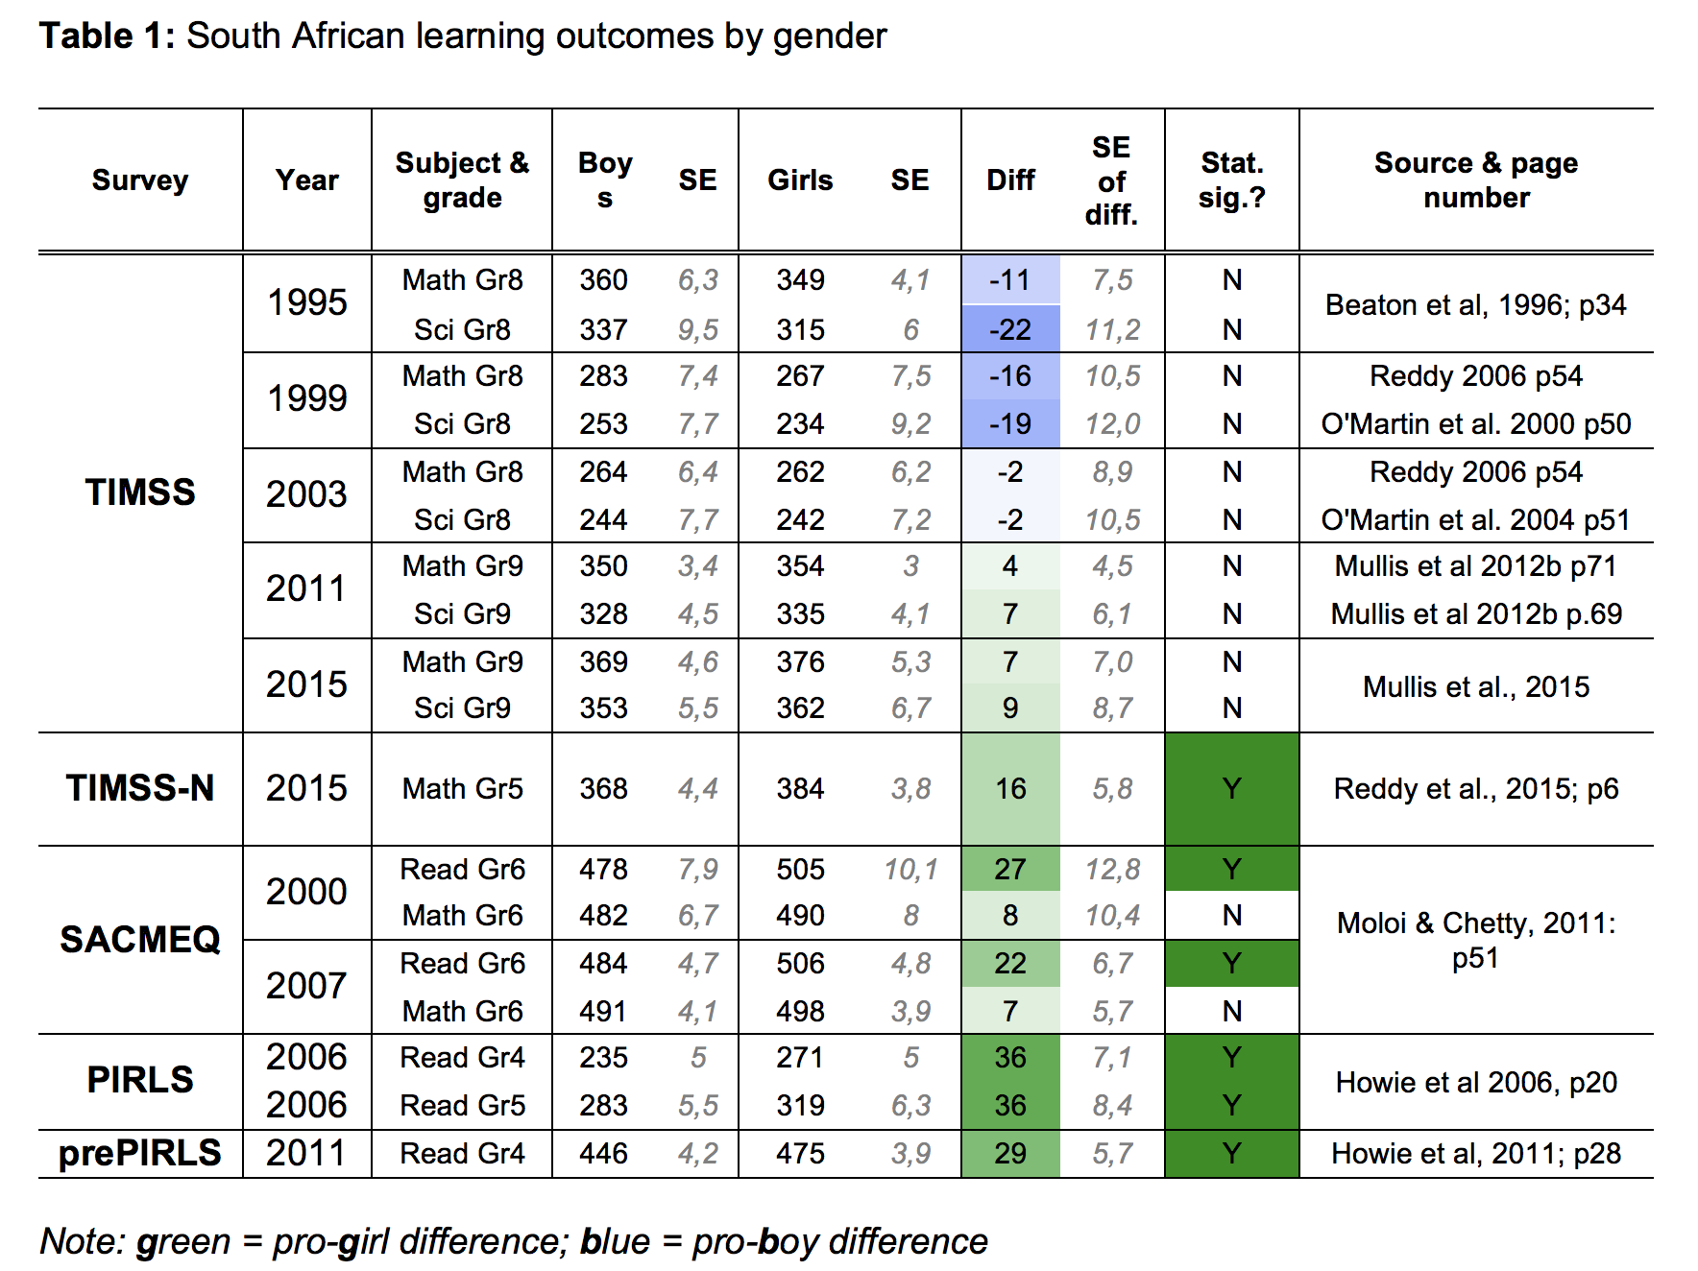
School-level differences by gender
Achievement in cross-national assessments

Slide 8
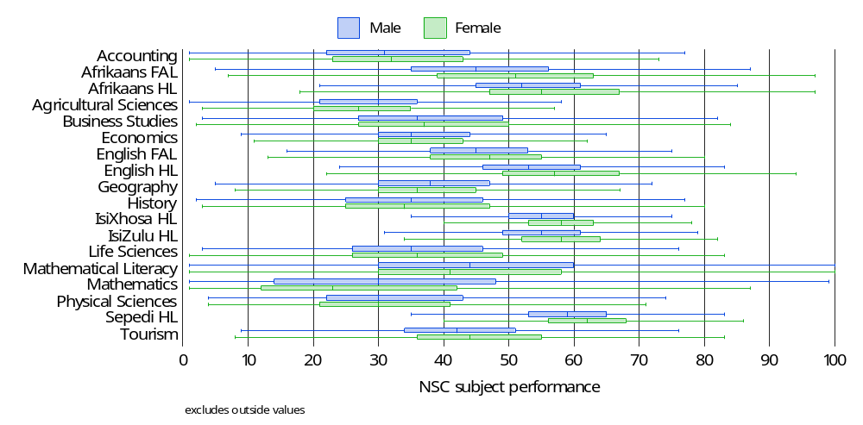
School-level differences by gender
Achievement in NSC 2008
Figure 1: Box plots of subject performance by gender in the 2008 NSC

Slide 9

Findings (1)
National HE outcomes by gender (2008 NSC cohort)
Figure 1: National higher education outcomes by gender (2008 NSC Cohort)

Slide 10
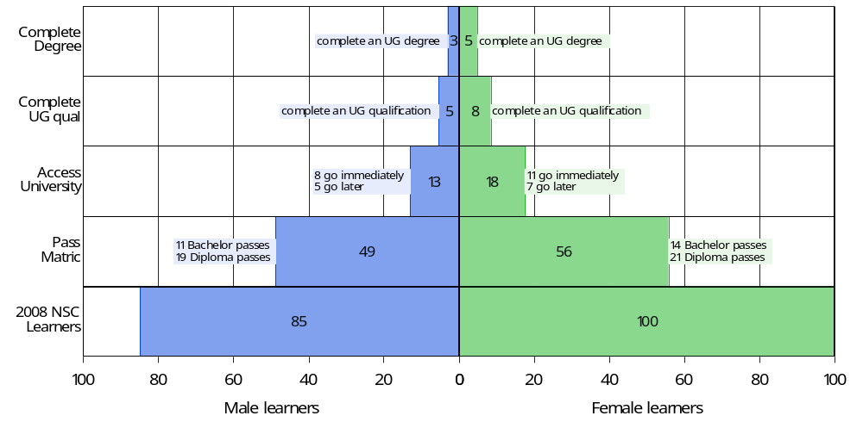
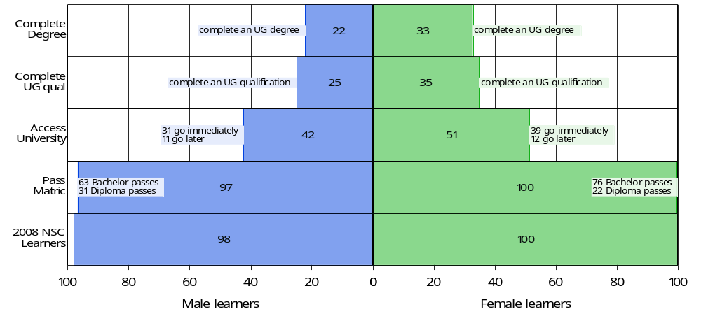
Black African cohort
White cohort

Slide 11
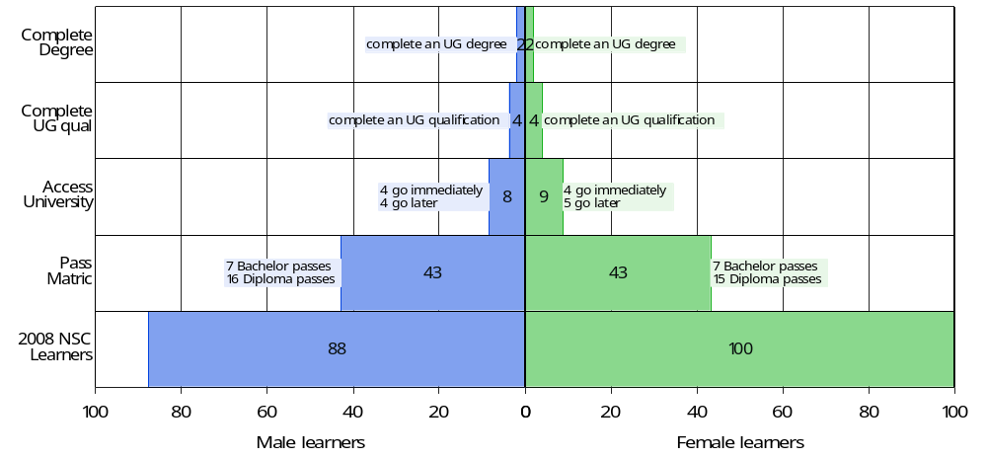
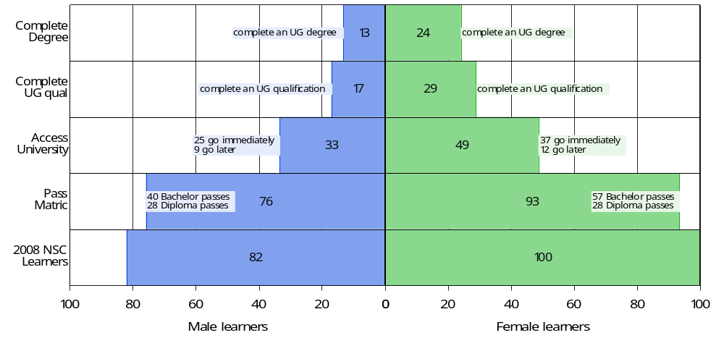
School Quintile 1 cohort
School Quintile 5 cohort

Slide 12
% of matric cohort attaining UG degrees

Slide 13
Defining higher education outcomes
One-year access rate (Access-1): the percentage of learners from the 2008 NSC cohort who accessed university immediately (2009) after finishing school (2008). [The average female matric learner in 2008 was 17 percent more likely to access university immediately after school than the average male matric learner.]
Six-year access rate (Access-6): the cumulative percentage of learners from the 2008 NSC cohort who accessed university at any time within the six-year period following matriculation in 2008, i.e. during 2009-2014. [The average female matric learner in 2008 was 14 percent more likely to access university within six years of finishing school than the average male matric learner.]
Six-year conversion rate (Conversion-6): The percentage of learners from the 2008 NSC cohort who enrolled in and completed an undergraduate university programme within six years (2009-2014). [The average female matric learner in 2008 is 33 percent more likely to access university and complete an undergraduate qualification within six years compared to the average male matric learner.]
Four-year completion rate (Completion-4): The percentage of students who accessed university in 2009 who complete their undergraduate programme within four years (2009-2012). [The average female university entrant in 2009 from the 2008 NSC cohort was 26% more likely to complete an undergraduate qualification within four years compared to the average male university entrant in 2009 from the 2008 NSC cohort.]
Six-year completion rate (Completion-6): The percentage of students who accessed university in 2009 who complete their undergraduate programme within six years (2009-2014). [The average female university entrant in 2009 from the 2008 NSC cohort was 16% more likely to complete an undergraduate qualification within six years compared to the average male university entrant in 2009 from the 2008 NSC cohort.]
Five-year dropout rate (Dropout-5): The percentage of students who accessed university in 2009 who drop out of the higher education system at some point in the subsequent five years (20010-2014). [The average female university entrant in 2009 from the 2008 NSC cohort was 20% less likely to dropout of university during the 2010-2014 period compared to the average male university entrant in 2009 from the 2008 NSC cohort.]

Slide 14
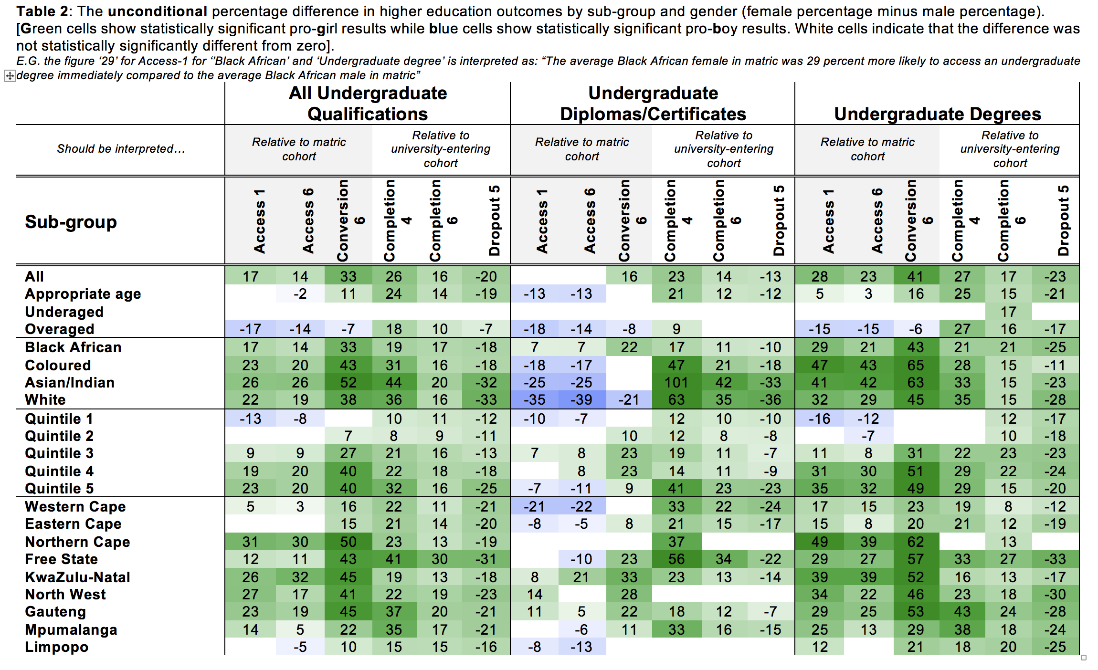
How we report the results:
For sake of space we only report DIFFERENCES between female rate and male rate
Note PERCENTAGE not PERCENTAGE POINTS
Unconditional estimates only report the percentage difference between males & females (females – males as %)
Example:
  Access1 males = 11,9%
  Access1 females = 13,9%
  Unconditional difference = (13,9% - 11,9%)/11,9% = 17%
i.e. females are 17% more likely to access an UG qualification immediately compared to their male counterparts
Throughout: green-cells = pro-girl and stat. sig.
blue cells = pro-boy and stat. sig.

Slide 15
Unconditional

Slide 16
What happens after controlling for matric achievement?

Slide 17
In conditional predictions what are we controlling for?
The conditional results (Table 3 and Table 5) control for five variables:
  matric pass type,
    The five pass types in increasing order of achievement are (1) not achieved, (2) Pass National Senior Certificate (NSC), (3) Pass NSC with Higher Certificate endorsement, (4) Pass NSC with Diploma endorsement, and (5) Pass NSC with Bachelor endorsement.
  matric average (similar to the American Grade Point Average),
  whether one took mathematics or mathematics literacy,
  whether one took English Home Language or English First Additional Language, and
  whether one took Physical Science or not In this paper, the matric average refers to the average across the six highest marks that a learner achieved among the subjects that they took in the NSC exam, provided that those subjects collectively satisfy the requirements for the NSC as described by the Department of Basic Education (DBE, 2010: 3 – 5).

Slide 18
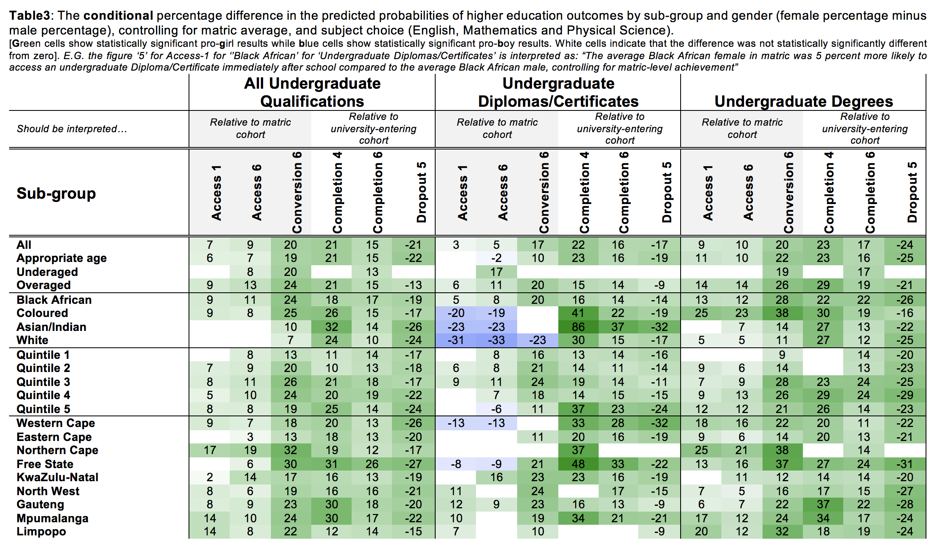
How we report the results:
396 sub-group regressions (6 outcomes, 22 sub-groups, qualification type)
342 field of study regressions (6 outcomes, 19 FOS, 3 qualifications types)
Conditional estimates report the percentage difference in the predicted probabilities of higher-education outcomes between males and females (females – males as a %)
Example:
  Predicted probability for Access1 males = 12,5%
  Access1 females = 13,4%
  Unconditional difference = (13,4 – 12,5%)/12,5% = 7%
i.e. after controlling for prior-achievement, females are 7% more likely to access an UG qualification immediately compared to their male counterparts
Unconditional

Slide 19
Conditional

Slide 20
Unconditional
Conditional

Slide 21
Is it because of differences in choice of field of study?
(Charles & Bradley, 2002; Alon & Gelbgiser, 2011).

Slide 22
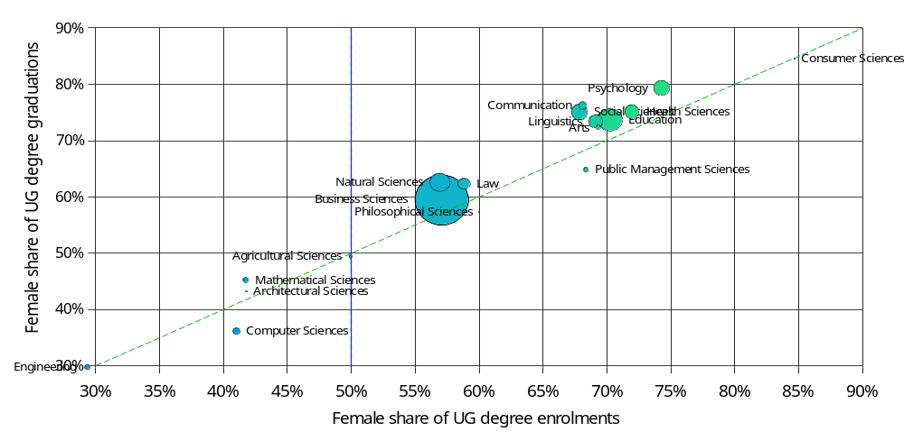
Is it because they enroll in different degrees?
Figure 9: Female share of undergraduate degree enrolments and graduations by field of study

Slide 23
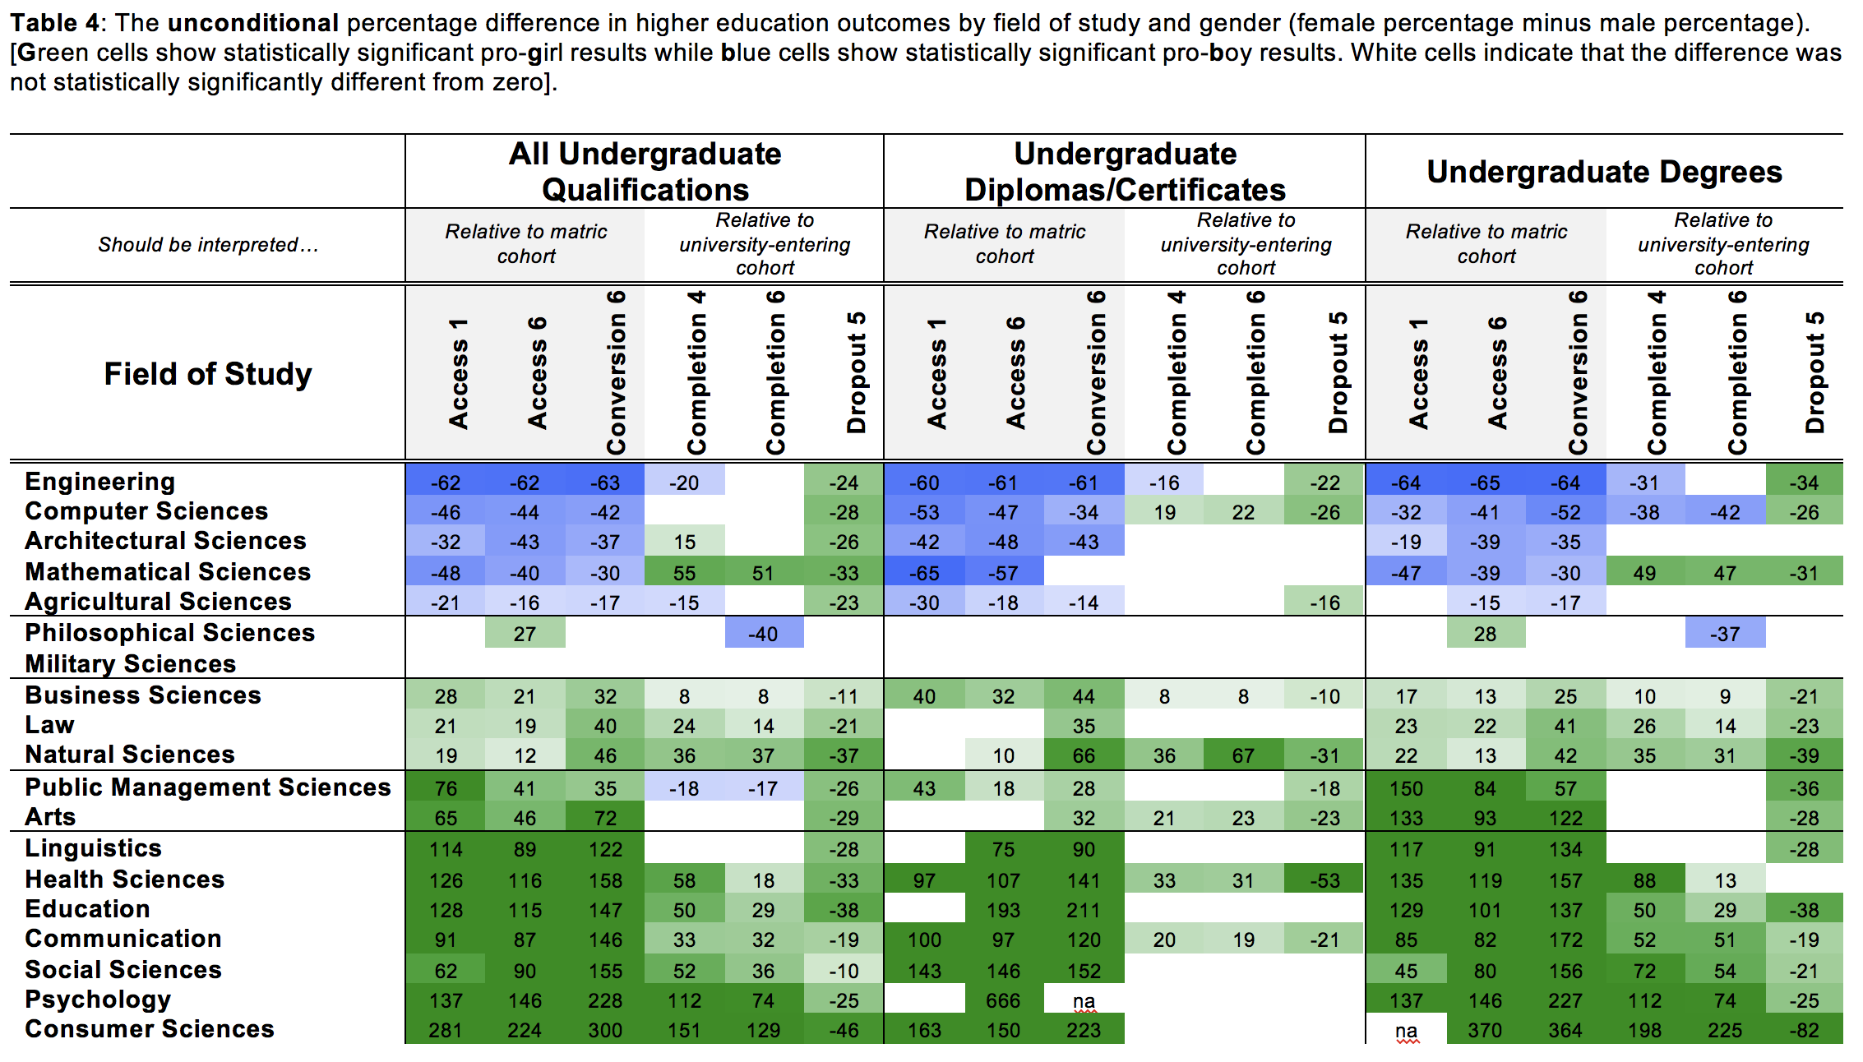
Unconditional

Slide 24
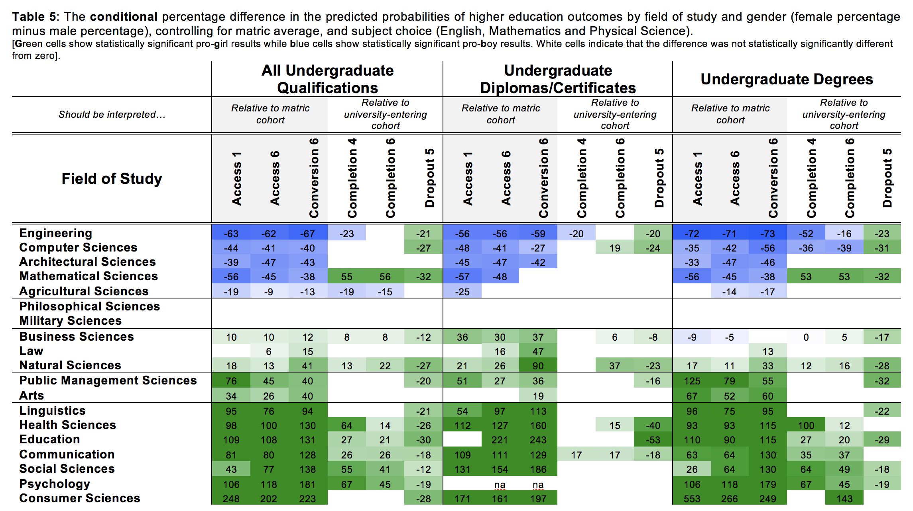
Conditional

Slide 25
Unconditional
Conditional

Slide 26
6 Main findings
The six most important findings of the analysis are listed below:
Overall: After controlling for pre-university achievement females are 20% more likely to access university and graduate with an undergraduate degree in six years than are their male counterparts.
Gendered access: We find much stronger evidence of gendered access effects rather than gendered completion effects. This is both for sub-groups and for fields of study.
Dropout: Relative to their male counterparts, females are always and everywhere 20% less likely to drop out of university programmes. This is not affected by pre-university achievement.
Socioeconomic status: Among the quintiles of socioeconomic school socioeconomic status, only females from the poorest 20-30% of schools do not exhibit an advantage in accessing university. Most pro-female advantages are largest among the wealthiest groups.
Pre-university achievement: A third of the overall female advantage (Conversion-6) can be explained by school-level achievement. However, among the best-performing sub-groups the female advantage is almost entirely (77%) explained by superior school-level achievement.
Gendered fields of study: While it is true that fewer females graduate with a degree in traditionally male fields of study (Engineering, Computer Sciences, Architectural Sciences, Mathematical Sciences and Agricultural Sciences) this is largely because females do not enter these fields, not because they do not do well in them once enrolled.

Slide 27
Conclusions
Still tentative research, but…
Impacts on the labour market?
Understanding male disadvantage?
  School/curriculum structure and its interaction with unevenly distributed non-cognitive skills?
Caveat: This is specifically for those who access university immediately after school. Non-random group. But Access1 and Access4 suggest it won’t change the results massively.

Slide 28
What are the implications of this?
Esping-Anderson (2009: 1):
“The quiet revolution of women’s roles, as Claudia Goldin (2006) calls it, is arguably a close rival to new technologies in terms of its seismic aftershocks touching, directly and indirectly, all major social institutions. And like its rivals, it has not yet come to full maturation. Incomplete revolutions tend to be associated with major disequilibria.”

Slide 29
Acknowledgements
The authors would like to thank the Department of Basic Education (DBE) and the Department of Higher Education and Training (DHET) who were jointly responsible for the provision of the NSC and HEMIS databases used in this research. In particular, we would like to thank Kirstin Barth for linking and anonymising the NSC and HEMIS datasets.
This research paper is part of the Labour Market Intelligence Partnership (LMIP).
We would also like to acknowledge funding from the Growth and Economic Opportunities for Women (GrOW) program.

Slide 30

Comments / Questions?
NicSpaull@gmail.com

Slide 31
Abstract
In this paper we use population-wide panel data to follow every South African student from the 2008 cohort as they enter into and progress through university, following them for six years (N=112,402). We find indisputable evidence of a large female advantage that continues to grow at each hurdle of the higher education process. To be specific, relative to their male counterparts we find 27% more females who qualified for university, 34% more who enroll in university, 56% more who complete any undergraduate qualification and 66% more who attain a bachelor’s degree. This despite there being roughly equal numbers of boys and girls at the start of school. We show that this female advantage remains after controlling for school-level performance, and exists for all subgroups of race, age, socioeconomic status, province of origin or institution attended. We examine 19 fields of study and find that females are significantly more likely to get a degree in 12 of the 19 fields (often by substantial margins), and are significantly less likely to get a degree in five of the 19 fields. However, this is almost entirely because they do not access these traditionally ‘male’ programs rather than due to lower completion rates. Irrespective of field of study, race, age, socioeconomic status, location or institution, females are always and everywhere 20% less likely to dropout than their male counterparts (including in traditionally ‘male’ fields like Engineering and Computer Science). Building on the idea of the ‘Matthew Effect’ in reading (the rich get richer), we present evidence of a gendered version of this phenomenon in higher education; what we call the ‘Martha Effect’.

Slide 32
Findings (1)
Socioeconomic status
The poorest females are the only group not to exhibit an advantage in accessing degrees
Female access and completion advantages are largest for wealthiest students
Access
Half of the female access advantage is explained by prior-achievement
Racial differences in accessing Diplomas/Certificates
Provincial differences in accessing degrees

Slide 33
Findings (2)
Completion
The female completion advantage cannot be explained by prior academic achievement
Females are considerably more likely to complete their qualification in 4 years rather than 6 years
Conversion
A third of the overall female advantage can be explained by prior academic achievement and most of the female advantage (76-78%) among top-achieving females can be explained by school-level achievement

Slide 34
Findings (3)
Completion
The female completion advantage cannot be explained by prior academic achievement
Females are considerably more likely to complete their qualification in 4 years rather than 6 years
Conversion
A third of the overall female advantage can be explained by prior academic achievement and most of the female advantage (76-78%) among top-achieving females can be explained by school-level achievement
Dropout
Females are always considerably less likely to dropout (about 20%) and this cannot be explained by prior achievement

Slide 35
Findings (4)
Fields of study
WRT Undergrad degrees: In six of the 18 fields of study, the gender differences in access seen across fields of study do not reappear as completion differences.
Gender determines access more than it does ‘success’ in a degree
Only in Engineering and Computer Sciences are males significantly more likely to complete their degree in four or six years.

Slide 36
School-level differences by gender
Achievement in NSC 2008
Figure 1: Box plots of subject performance by gender in the 2008 NSC

Slide 38
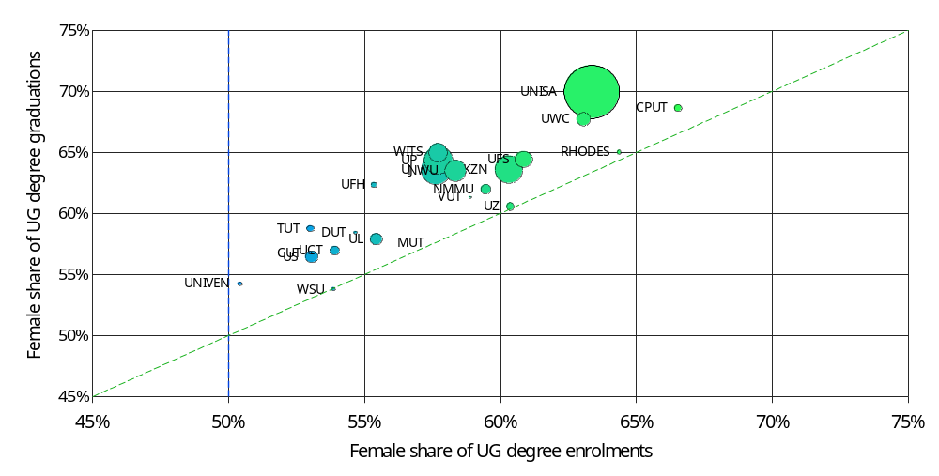
Does this differ by institution of access? (Degrees)
Figure 10: Female share of undergraduate degree enrolments and graduations by institution

Slide 39
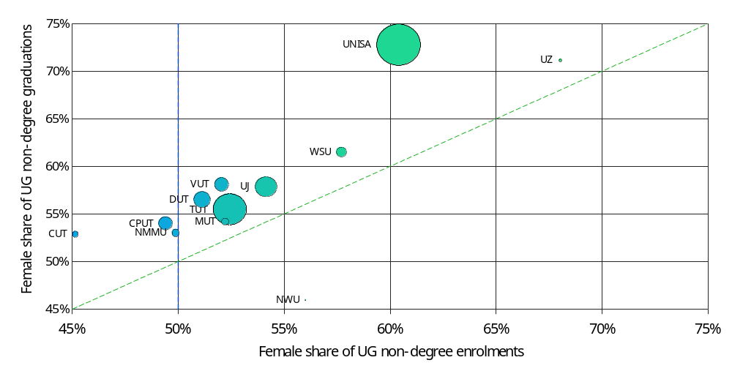
Does this differ by institution of access? (Certificates/Diplomas)
Figure 11: Female share of undergraduate non-degree (Diploma/Certificate) enrolments and graduations by institution

Slide 40
