Slide 1


Investigating the Comprehension Iceberg: Developing empirical benchmarks for early grade reading in agglutinating African languages
Nic Spaull (RESEP), Elizabeth Pretorius (UNISA), Nompumelelo Mohohlwane (DBE)
RESEP, Stellenbosch University
UKFIET 2017 4 Sept 2017

Slide 2

Reading outcomes in English
NEEDU 2013: Can students read in English in Grade 5?
“We found that South African Grade 5 second language learners from rural areas in South Africa had essentially the same distribution as Grade 1 second language learners in Florida (U.S) They “cannot communicate meaning orally in English and demonstrate very little understanding in English”.
Draper & Spaull (2015)
In PIRLS 2011 43% of Gr5 students attending Eng/Afr LOLT schools could not reach Gr4 Low International Benchmark
Draper & Spaull, 2015
Is this just because the tests are in English?

Slide 3
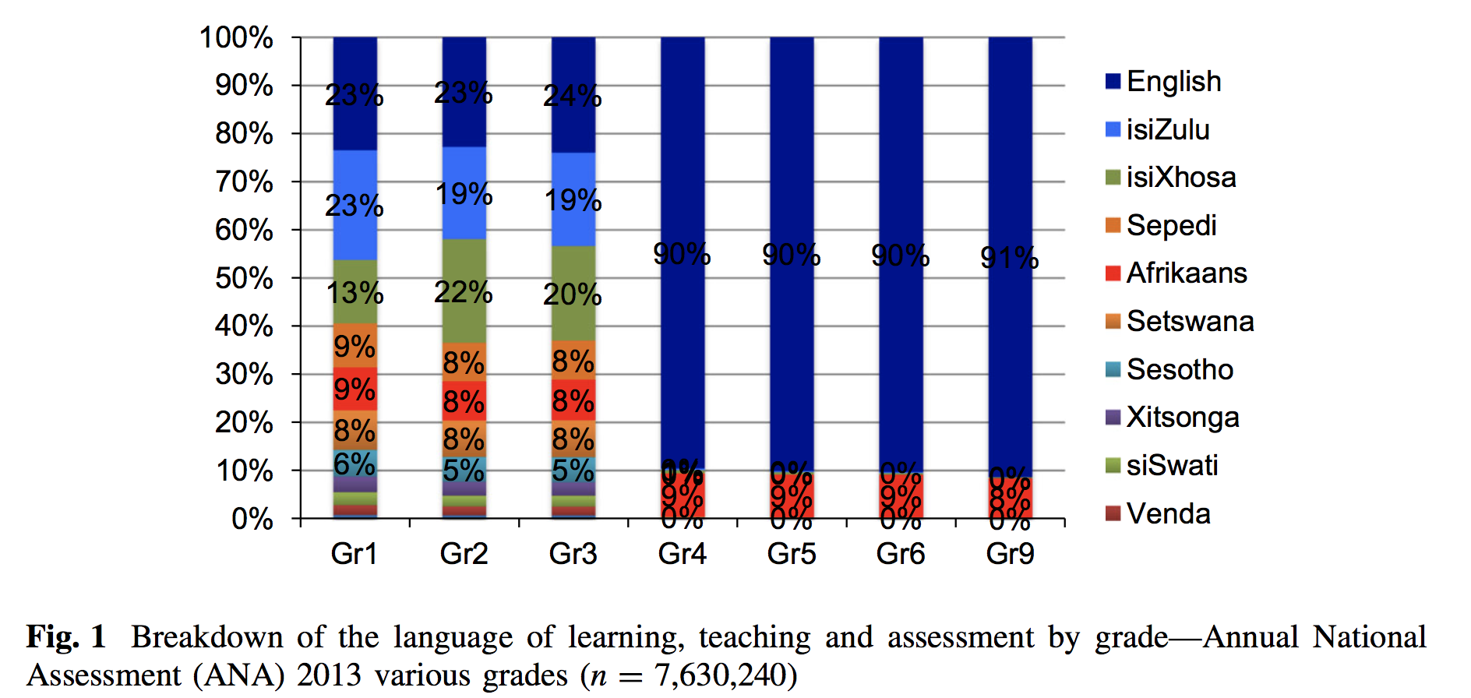
Language dynamics in SA
70%+ of Gr 1-3 learners in SA are learning to read in an African language and then switching to English in Grade 4.

Slide 4
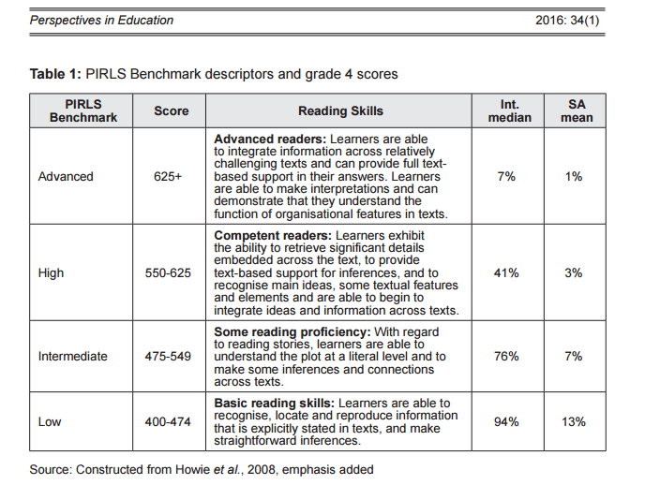
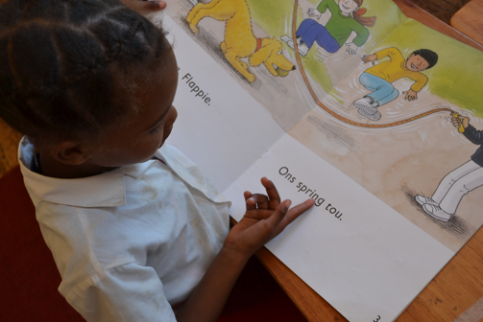
Reading outcomes in African languages (2006)
PIRLS 2006: How many South African learners can read in any language in Gr4?
US:
12%
47%
82%
96%
“South African learners are only given access to “an extremely basic and impoverished notion of what it means to read and a restrictive set of resources with which to critically and pleasurably engage with text.”
Prof Ursula Hoadley (2017)
(Taylor, 2016)
Notes:
https://nces.ed.gov/pubs2008/2008017.pdf

Slide 5
Reading outcomes in African languages (2011)
58% cannot read for meaning in any language by the end of Grade 4

Slide 6
Reading comprehension outcomes (2)
Heavily correlated with school socioecononomic status
Richest 5% of schools
Poorest 5% of schools
Advanced
High
Intermediate
< Intermediate
(Cannot read for meaning)
prePIRLS 2011: By school wealth: What % of Grade 4 students are (a) reading illiterate, (b) cannot read-for-meaning

Slide 7
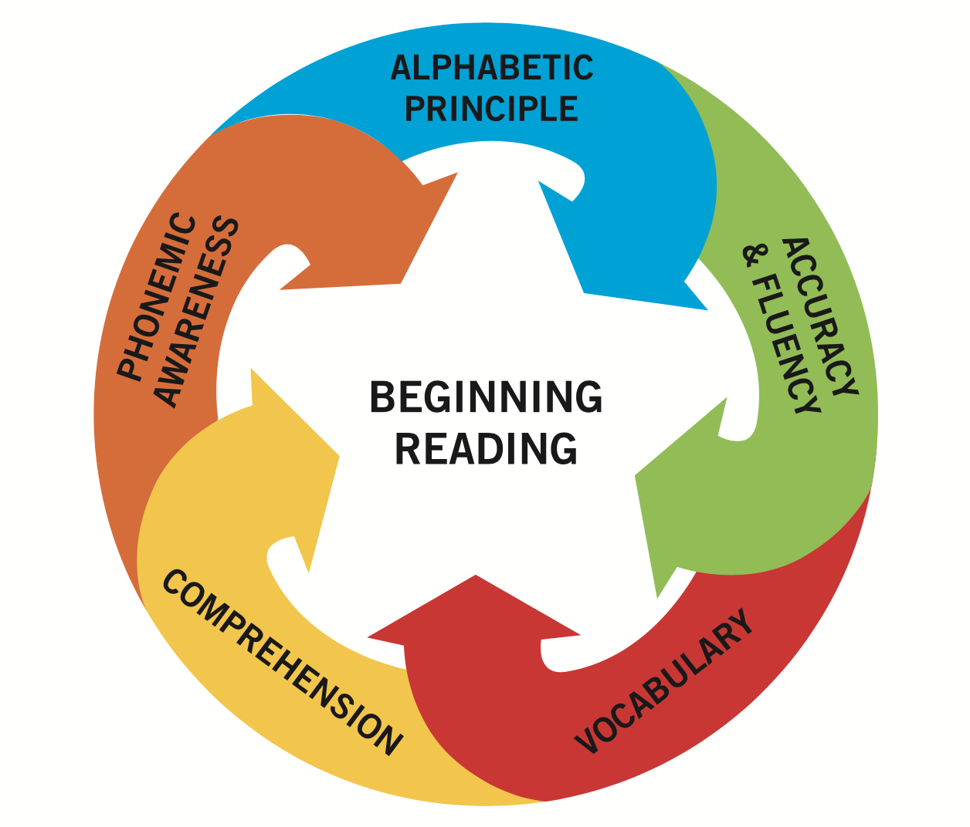
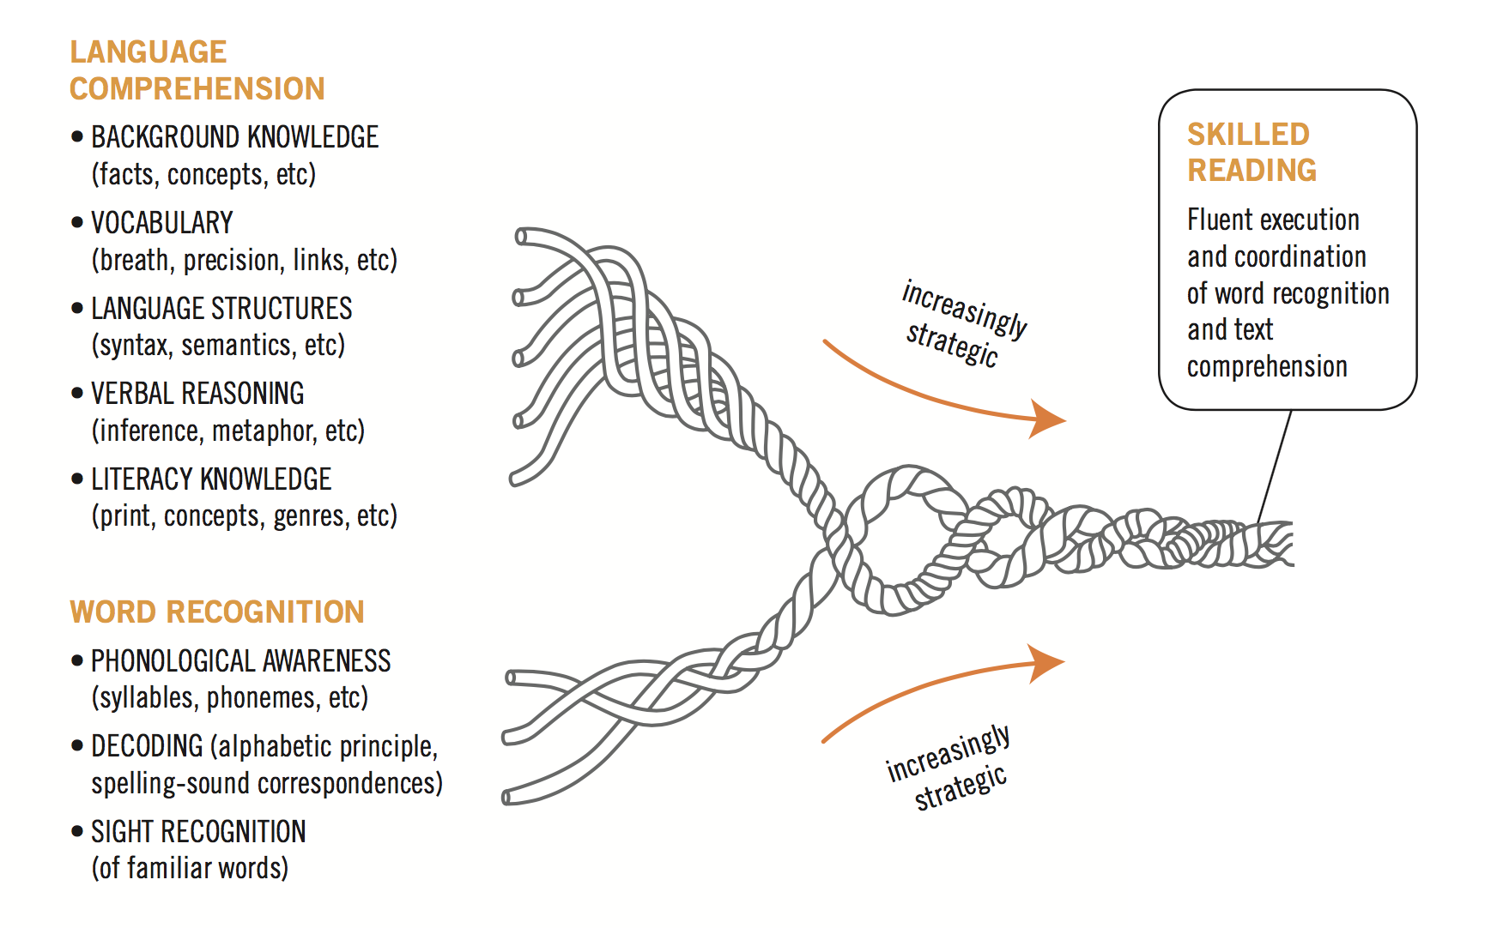
Reading comprehension outcomes (4)

Slide 8
ESRC Leadership for Literacy Study
Team: Servaas van der Berg, Gabrielle Wills, Nick Taylor, Ursula Hoadley, Jaamia Galant, Nompumelelo Mohohlwane and myself.
Aim was to identify ‘outlier’ Q1-3 schools. i.e. those that are performing well in spite of challenging circumstances and serving poor communities.
61 schools selected based on a matched-pair design (1 outlier, 1 ‘typical’ match)
  21 Gauteng
  21 KZN
  19 Limpopo
Panel: Surveyed and assessed in Feb 2017 and Oct 2017
Feb 2017: 785 Grade 3 learners assessed 1-on-1 using an adapted EGRA on a tablet platform (Tangerine)
  514 in isiZulu
  143 in Sepedi
  128 in Xitsonga

Slide 9
Developing benchmarks in African languages
There is no ‘one size fits all’ benchmark; reading benchmarks are language specific.
There are currently ZERO benchmarks for African languages in SA
Thal, Bates, Goodman and Jahn-Samilo (1997, p.241) argue that
  “If there are no clear criteria for identifying what is ‘normal’, then it is especially difficult to be certain that a child is delayed”.

Slide 10
Languages assessed
Southern Bantu language family in South Africa
Nguni language family
(Conjunctive orthography)
isiZulu
isiXhosa
Siswati
isiNdebele
Sotho language family
(disjunctive orthograhy)
Northern Sotho
Southern Sotho
Setswana
Minority languages
(Mainly disjunctive orthogrphy)
Tshivenda
Xitsonga

Slide 11
Morphology
Language | Text
N Sotho (Sepedi) | Ka le lengwe la matšatši mosepedi yo a bego a na le tlala. O fihlile motseng wo mongwe a kgopela dijo. Go be go se na yo a bego a na le dijo.
Xitsonga | Siku rin’wana mufambi loyi a ri na ndlala. U fikile emugangeni. A kombela swakudya, kambe a ku nga ri na loyi.
isiZulu | Kunesihambi esasilambile kakhulu. Sahamba sicela ukudla emizini yabantu. Abantu babengenakho ukudla.
Gloss | There was a stranger who was very hungry. He came to a village and asked for food. Nobody had any food.
 | Words in Sentence1 | Words in Sentence2 | Words in Sentence3 | Total words | Words per sentence | Letters per word | Total single syllable words: V/ CV
N Sotho | 13 | 8 | 12 | 33 | 11 | 3.2 | 21
Tsonga | 8 | 3 | 10 | 21 | 7 | 4 | 9
Zulu | 3 | 5 | 3 | 11 | 3.6 | 8 | 0

Slide 12
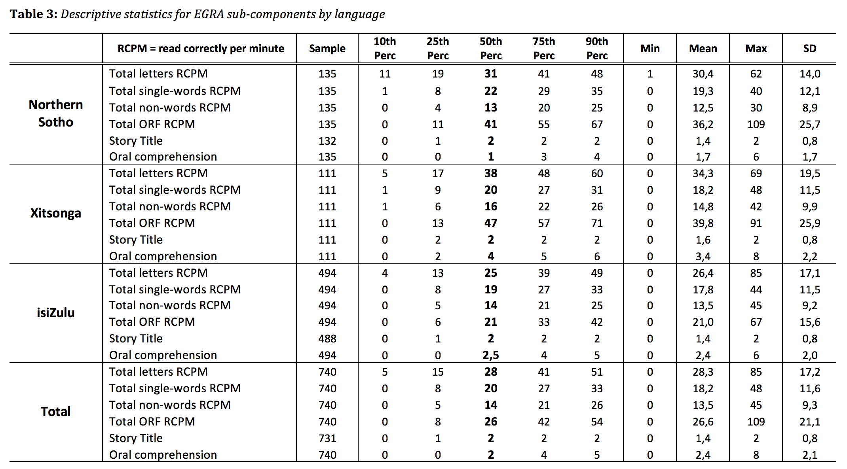
Descriptive statistics

Slide 13
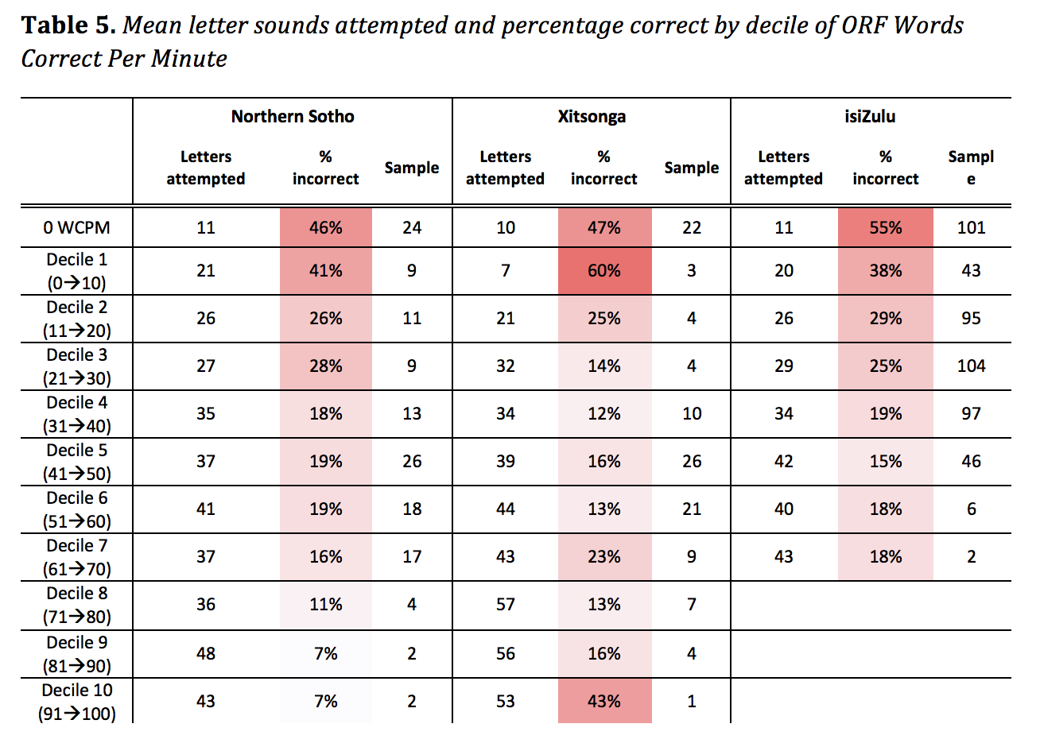
Accuracy and fluency: letters
27% of the sample

Slide 14
Accuracy and fluency: words
The ability to identify letters and read words accurately reduces comprehension complications (Adams, 1994; Spear-Swerling, 2006).
Independent reading level: word recognition is 99% and comprehension is 90% or better.
Instructional reading level: (the level at which the reader can be successfully instructed) word recognition is 95% and comprehension is 75% or better.
Frustration reading level: word recognition is 90% or less and comprehension is less than 50%. At this level the reader cannot really understand the text.
A grade level two years above one's reading level is usually considered the frustration level.
Rachel Kahn, Patricia A. Zapf, & Virginia G. Cooper, Readability Of Miranda Warnings And Waivers: Implications For Evaluating Miranda Comprehension, 30 L. & Psychol. Rev. 119, 127 (2006) (citing Daniel P. Greenfield et al., Retrospective Evaluation of Miranda Reading Levels and Waiver Competency, 19 Am. J. Forensic Psychol. 75, 79-80 (2001)).

Slide 15
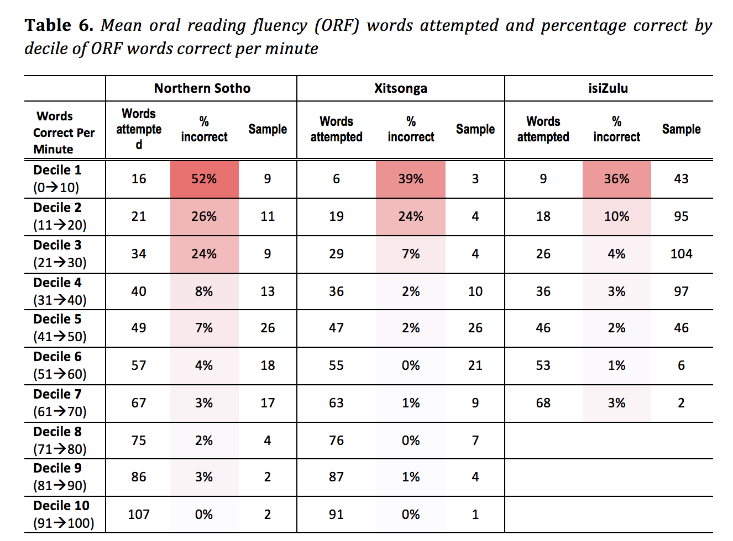
Accuracy and fluency: words

Slide 16
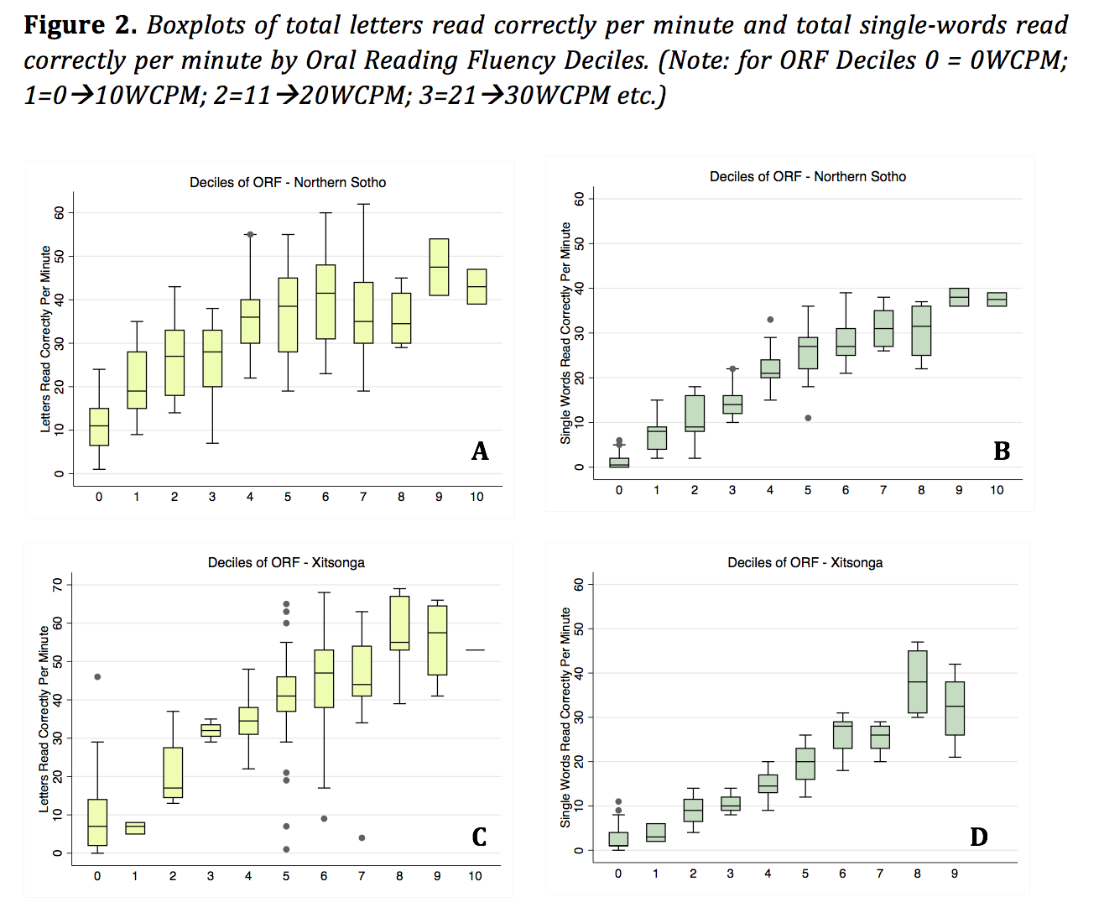

Slide 17
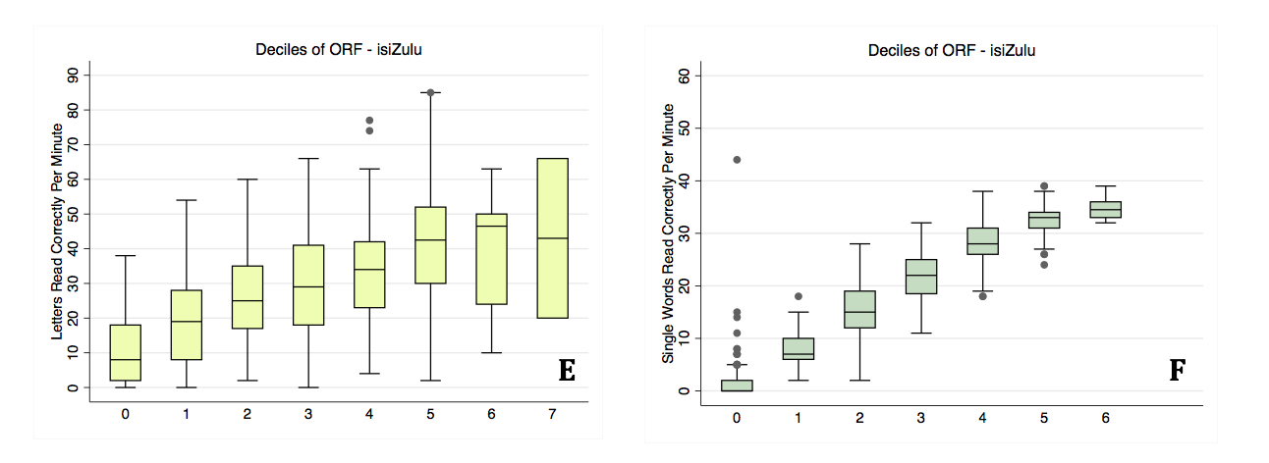

Slide 18
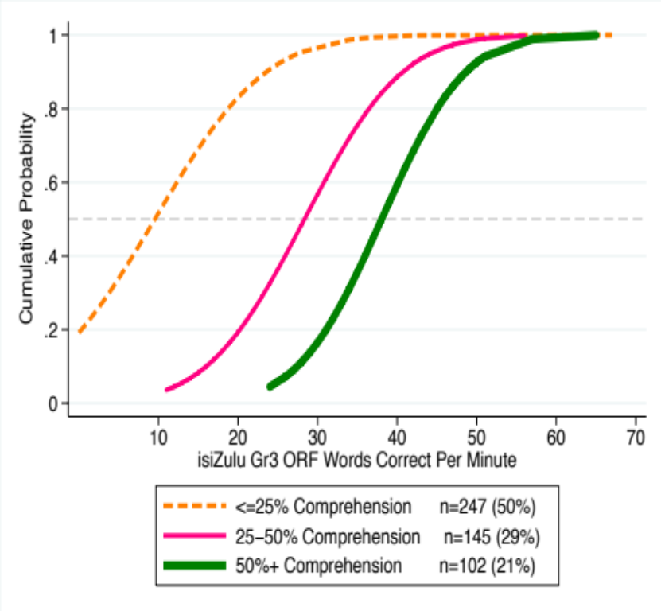
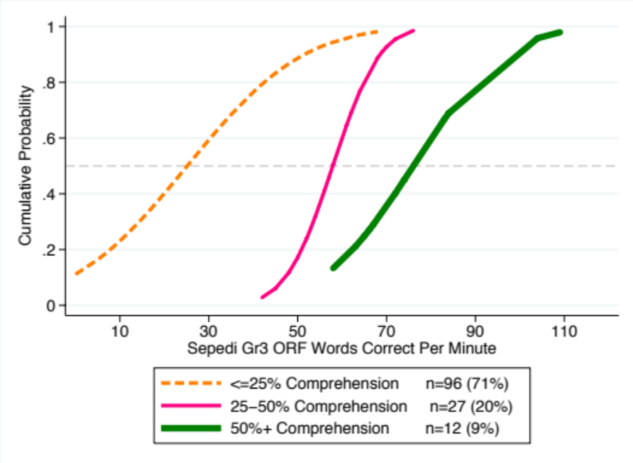
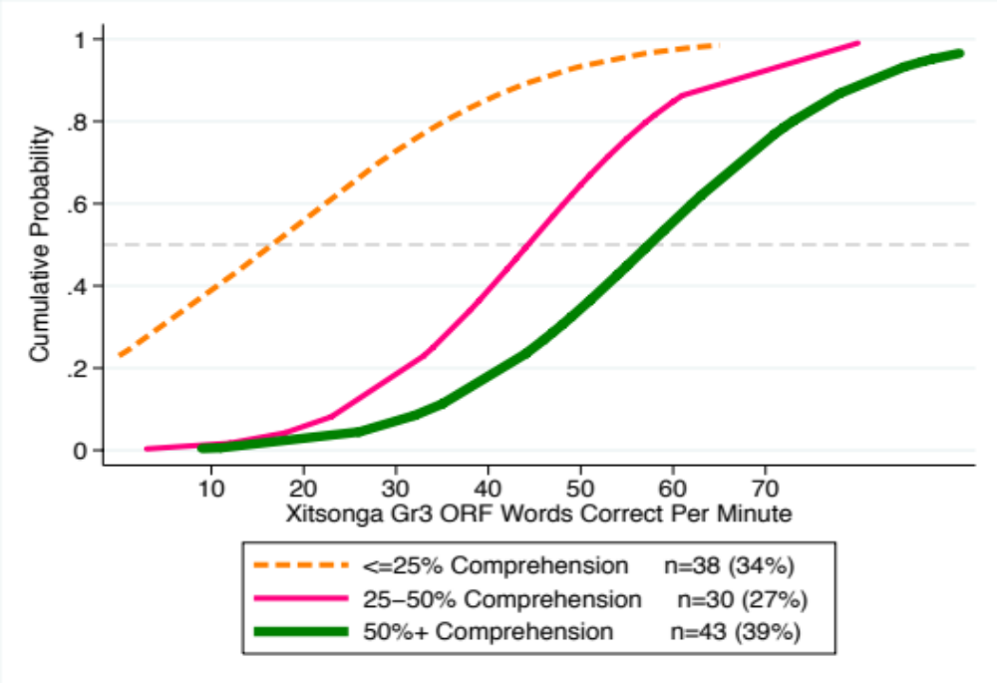

Slide 19
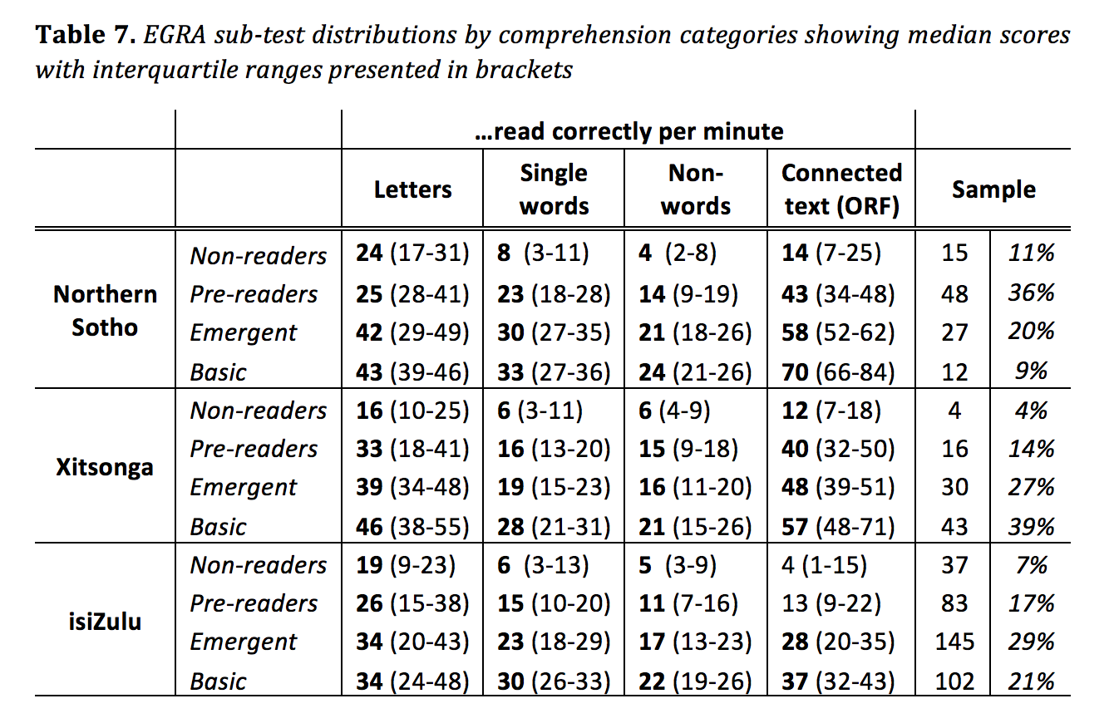
Tentative benchmarks for 3 African languages

Slide 20
Findings
Falling at the first hurdle
  27% of the learners at the start of Grade 3 were getting every second letter-sound incorrect. 25% of the sample could only correctly sound out 15 letters in a minute. This is insurmountable.
Accuracy thresholds differ by language
  Children reading with 95% accuracy or higher can read 51+ wcpm in N.Sotho; 31+ wcpm in Xitsonga; 21+ wcpm in isiZulu
Minimum fluency thresholds (very similar to accuracy thresholds)
  to get 25% or more on the comprehension questions (Emergent-reader) one would need to be reading at least
  53 WCPM in Northern-Sotho,
  39 WCPM in Xitsonga and
  20 WCPM in isiZulu
Minimum comprehension thresholds
  To get 62,5% or more, then learners need to be reading at least
  66 WCPM in Northern Sotho,
  48 WCPM in Xitsonga and
  32 WCPM in isiZulu.
Differences in word length in the disjunctive and conjunctive orthographies of Northern Sotho and isiZulu respectively affect reading rate. This has important implications for benchmarking and for identifying at-risk readers at different grade levels.

Slide 21
Moving forward
We need to move beyond a repetitive focus on low comprehension outcomes; this is simply the tip of the iceberg.
What is lacking is research on the different reading components or the “cognitive-linguistic processes involved in reading” (De Vos et al, 2014) in African languages’
We need to better understand this cognitive linguistic data generating process for African languages.
Below the surface there is widespread evidence that most children have not acquired the basic ‘tools’ for reading success – the ability to accurately and fluently decode letters and words and move from an effortful activity to an automated skill

Slide 22

Comments / Questions?
NicSpaull@gmail.com n.nyathin@gmail.com

Slide 23
Take home points
What is the question you want to answer?
  In what ways does sample eligibility affect PISA results and their interpretation.
Why should we care?
  Cross-national assessments and PISA in particular have serious sway in policy-making circles & international development discourse. Getting the interpretation right is important and non-trivial.
What do you have to say about the problem that is new?
  Very few scholars (& none for Turkey) have measured and estimated the impact of correcting for sample eligibility/selection for PISA or any other cross-national assessment. I do that here.
Why should we believe you?
  That sample selection occurs is uncontroversial – PISA acknowledges this but doesn’t correct for it. I do. The methods used here use arguably the best data for this purpose (DHS).
How convinced should I be?
  Pretty convinced. I report SE’s. Sensitivity analysis shows results aren’t very sensitive to core assumptions about ineligible = illiterate.
In what way should I change my view of the world due to your work?
  Next slide…
Columbia University “What makes for a successful paper and seminar?”

Slide 24
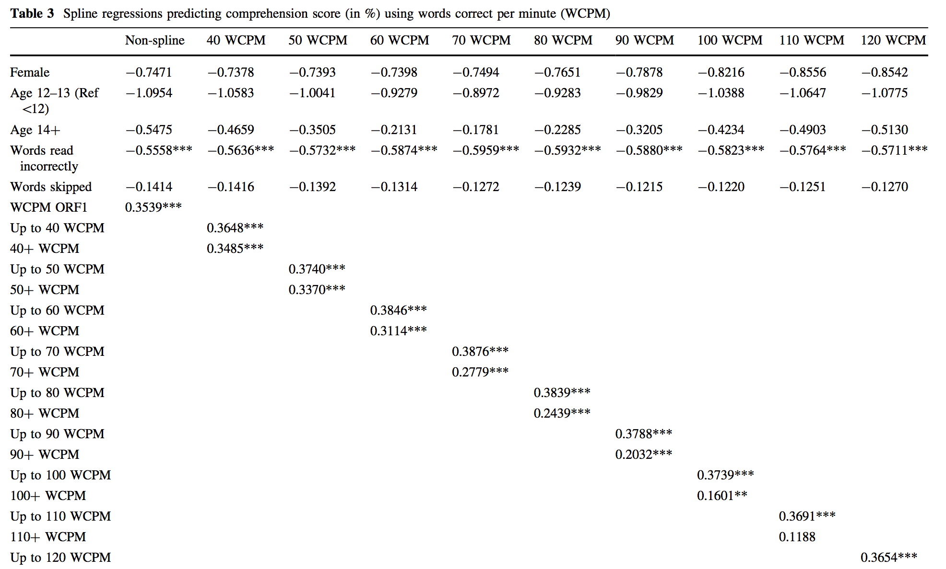
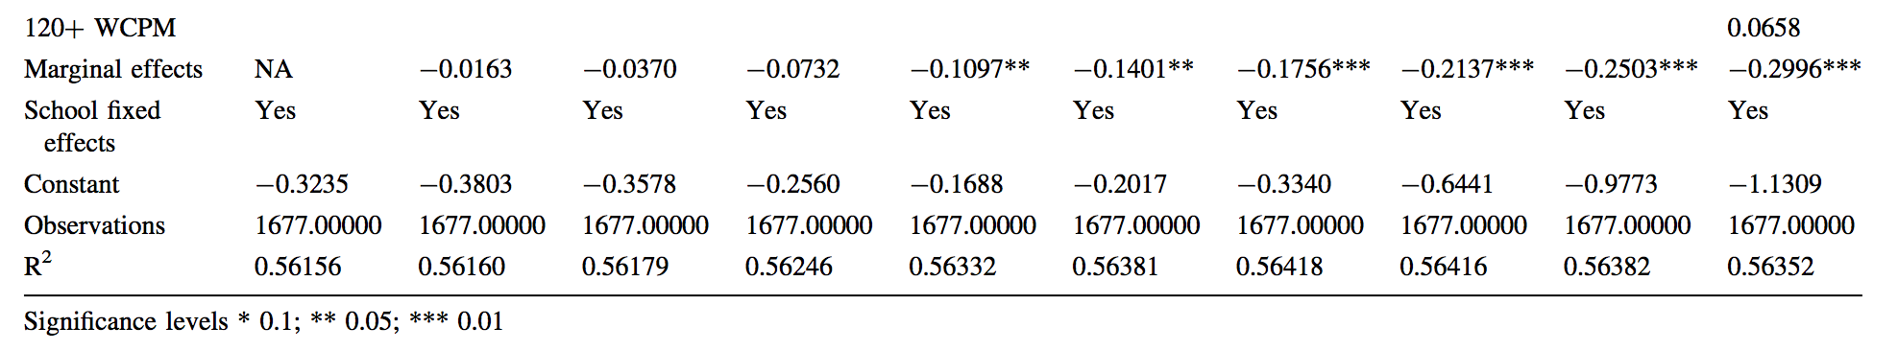
Spaull & Pretorius, 2016

