Slide 1

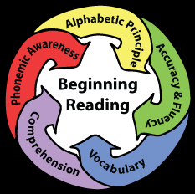
What can we do about reading outcomes in SA?
- Nic Spaull
Stellenbosch University &
Allan Gray Orbis Foundation Endowment
4 July 2017
SA Librarians Conference

Slide 2
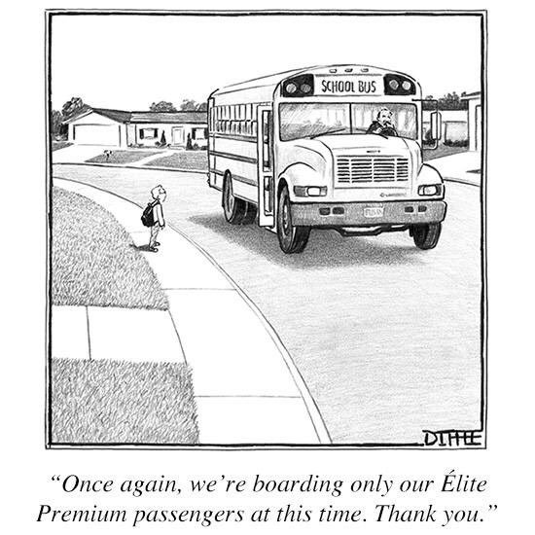
The curse of inequality

Slide 3
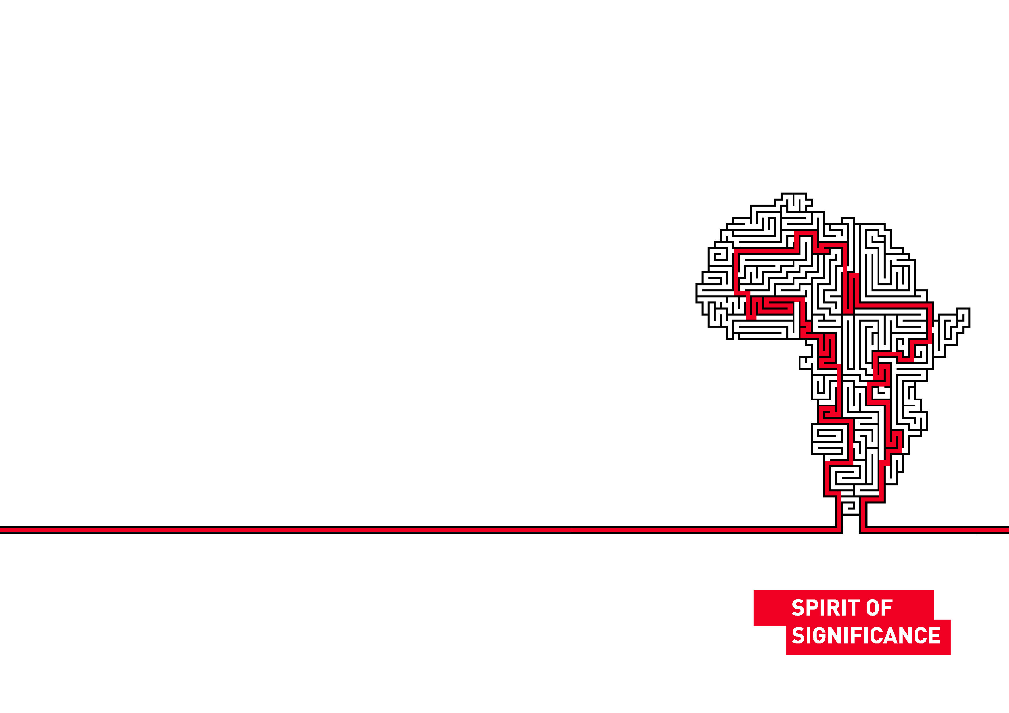

The centrality of reading
“Professional educators and the public at large have long known that reading is an enabling process that spans academic disciplines and translates into meaningful personal, social, and economic outcomes for individuals. Reading is the fulcrum of academics, the pivotal process that stabilizes and leverages children’s opportunities to success and become reflective, independent learners.
^{(Good, Simmons and Smith,} ^{1998:45) .}
“Reading is, without doubt, the most important linguistic skill that needs to be developed in young children. Reading serves as a building block upon which all other learning takes place…This National Reading Strategy takes as its focus that reading failure begins in early grades, and it is at that level that interventions must be made”
(DoE, 2008: 18).

Slide 4

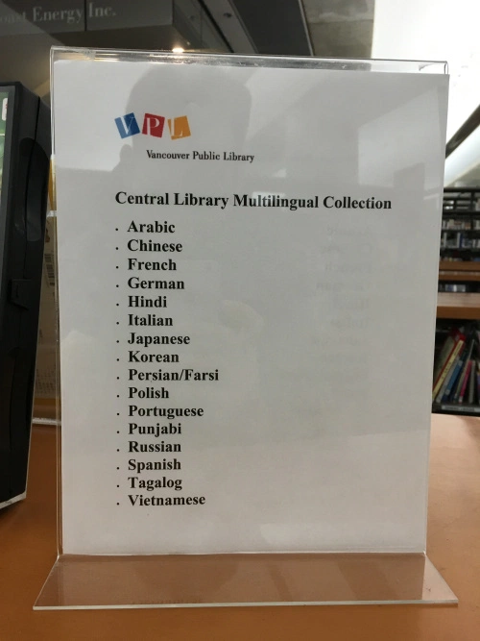


Vancouver Public Library
Celebrating multilingualism
How many books do you have in your African-language FAL?

Slide 5

To what extent are we exposing our students to the realities in South Africa? (or are we just solidifying the bubble they live in?)
- FeesMustFall, inequalities, other cultures & languages
- Apartheid, SA history etc.

Slide 6

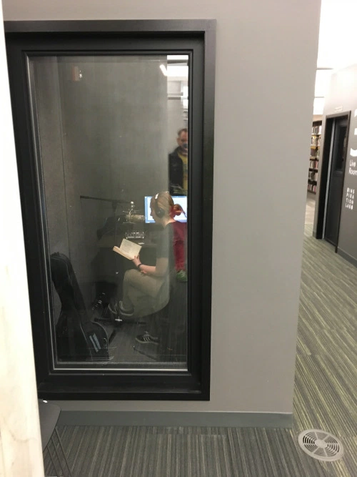
21st C Libraries
Encouraging students to become authors, bloggers, vloggers, reviewers

Slide 7


Celebrating previously marginalized cultures

Slide 8
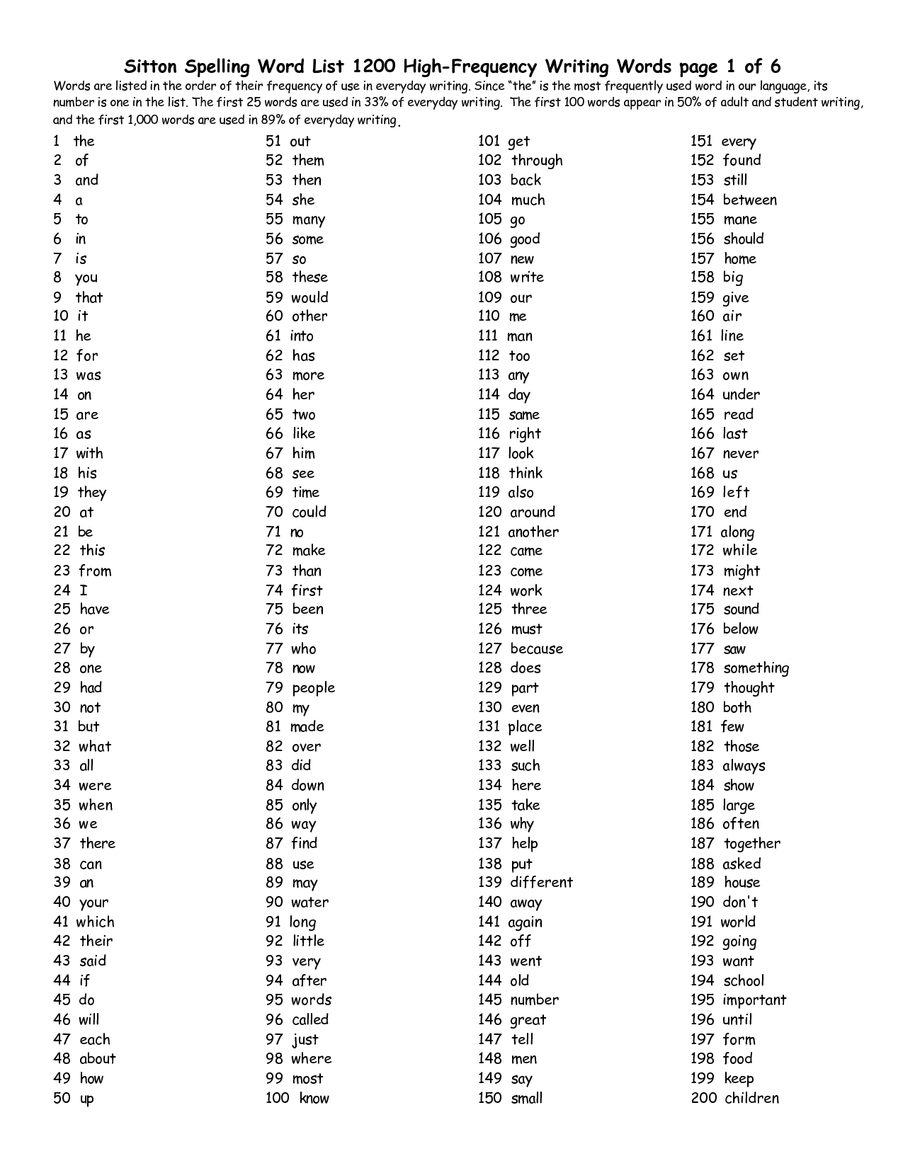
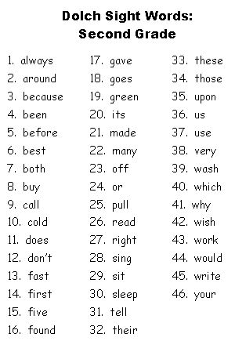
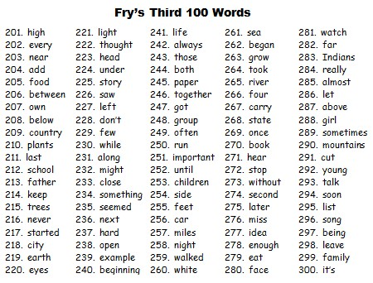
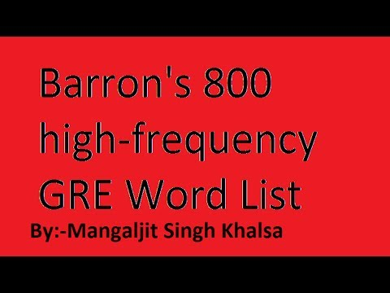
SA: High-frequency word lists…
High-frequency word lists do not exist in African languages!

Slide 9
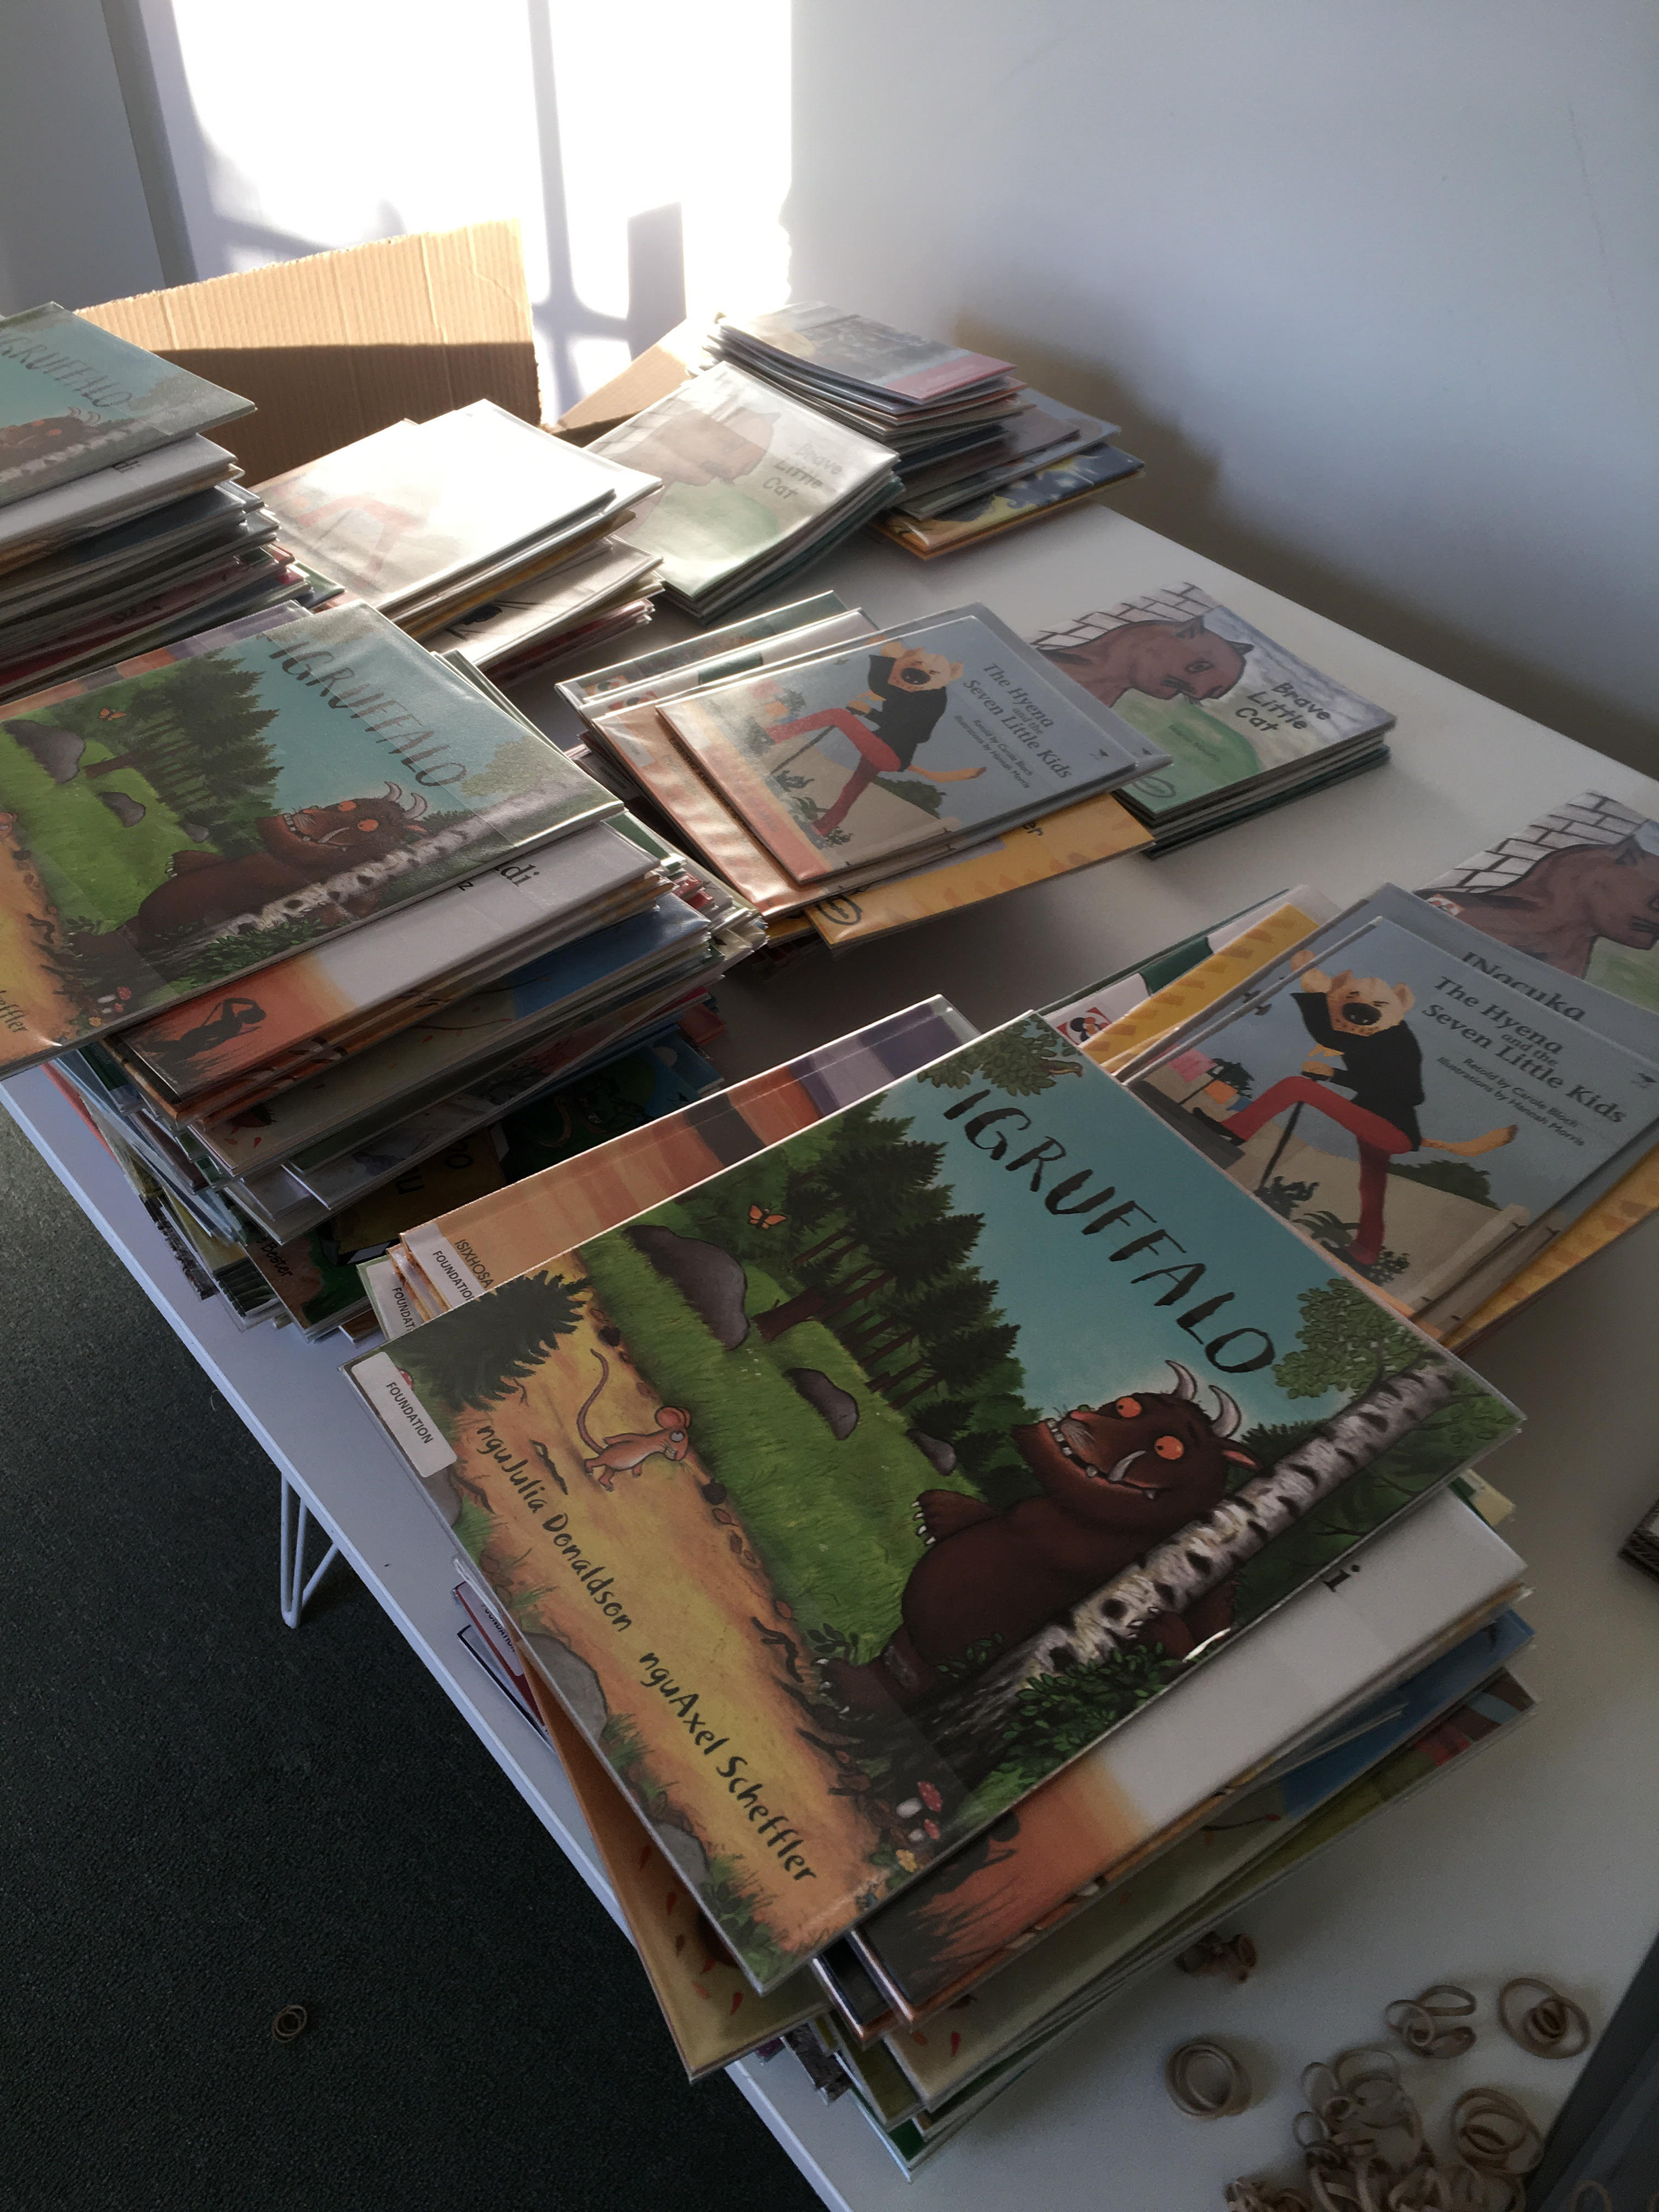
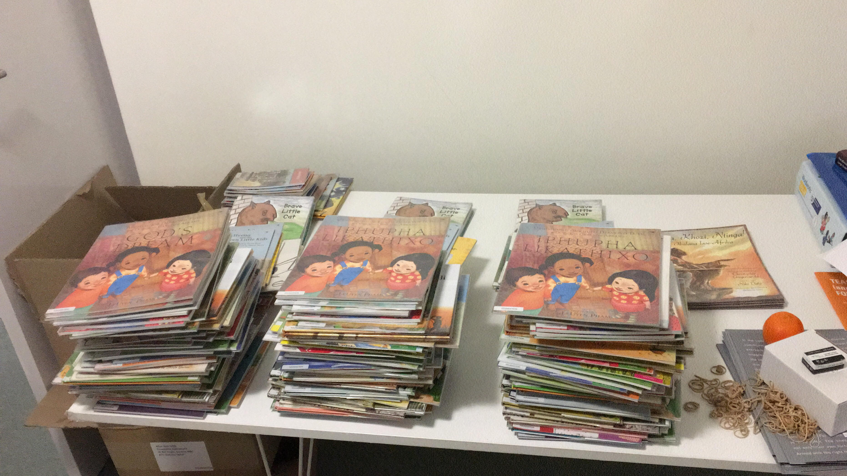
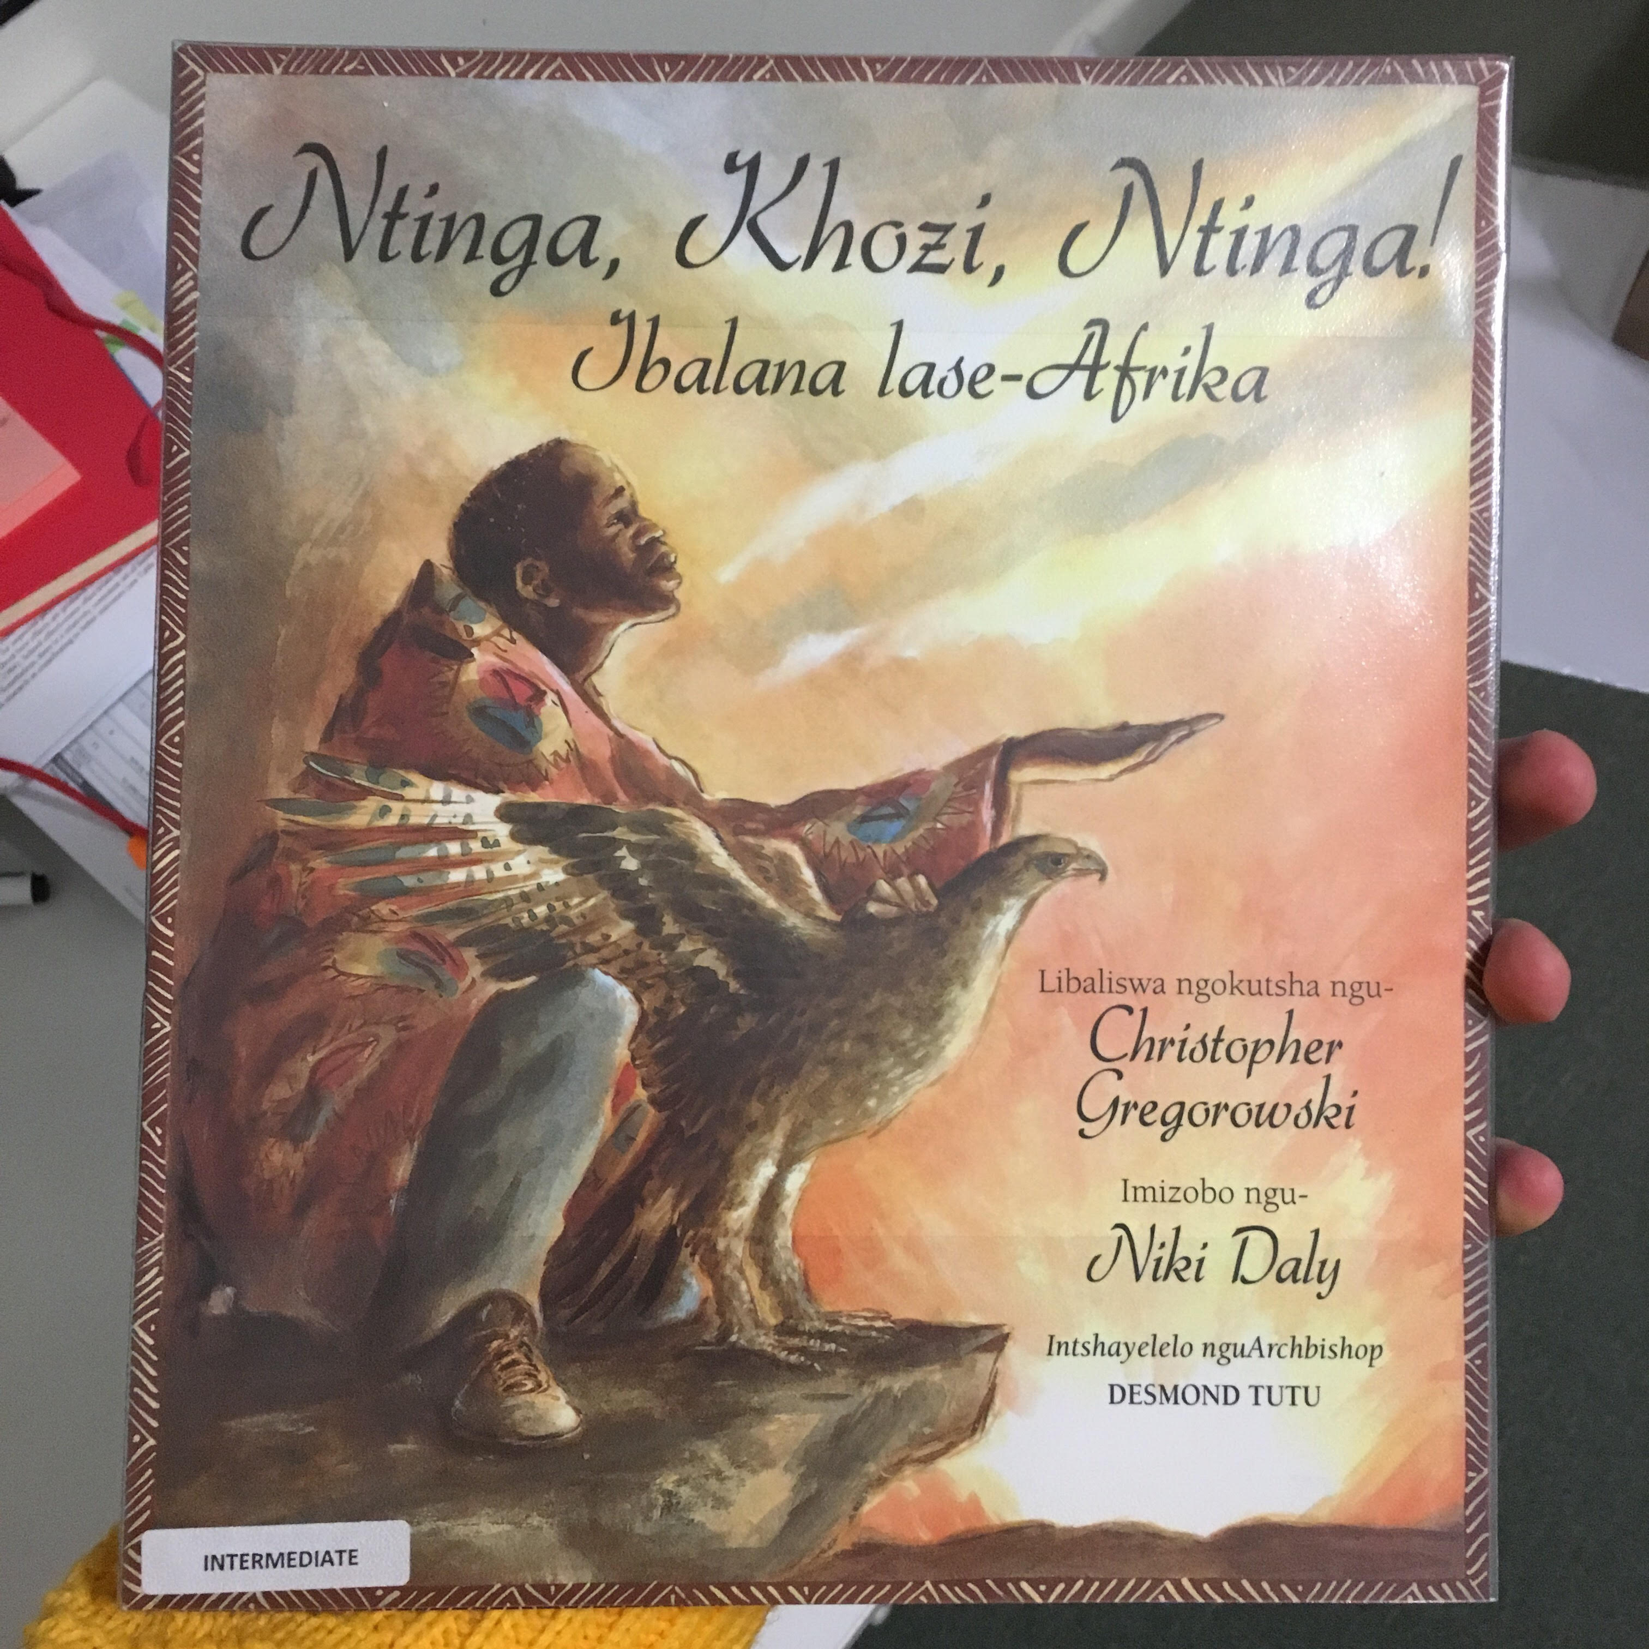
Biblionef: 225 titles in isiXhosa

Slide 10
Where to from here?
Interventions need to address one of the following:
Improving FP teacher’s knowledge and practice about teaching reading
Eliminating excessive class sizes in the FP
Improving availability and use of books at school & at home
Remedial teaching – helping those who have/are falling behind
Research needs to address one of the following:
How to teach reading in African languages
Setting norms and benchmarks for reading in African languages & EFAL
The best method(s) of improving teachers knowledge and practice of teaching reading (Coaches? Training? Materials?)

Slide 11
Where to from here??

Slide 12
Policy déjà vu
We’ve been on this rodeo before…
National Reading Strategy (DBE, 2008) – Pandor
Teaching Reading in the Early Grades: A Teacher’s Handbooks (DBE, 2008)
Western Cape Numeracy & Literacy Strategy 2006-2016 (WCED, 2006)
Foundations for Learning Campaign (DBE, 2008)
Gauteng Primary Literacy Strategy 2010-2014 (GDE, 2010)
Systematic Method for Reading Success (Hollingsworth & Gains, 2009)
Western Cape Living Labs Schools (WCED, 2015)
Drop Everything & Read Campaign
(See PSPPD Report (2016) for full discussion of previous reading initiatives)

Slide 13
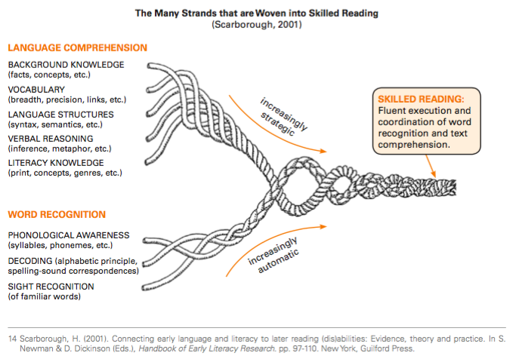
We know how to teach reading

Slide 14

Funda Wande
Teaching Reading for Meaning

Slide 15

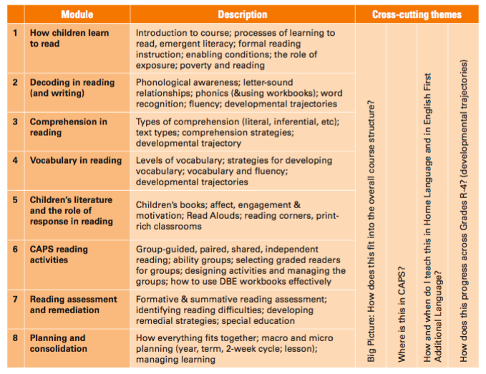
Funda Wande

Slide 16
Discussion
What do you think libraries could do to help improve reading outcomes in SA?
What innovative practices do you know of, or are implementing at your school?
If you have partnered with another school, what works well/badly?

Slide 17


Comments / Questions?
NicSpaull@gmail.com

Slide 18
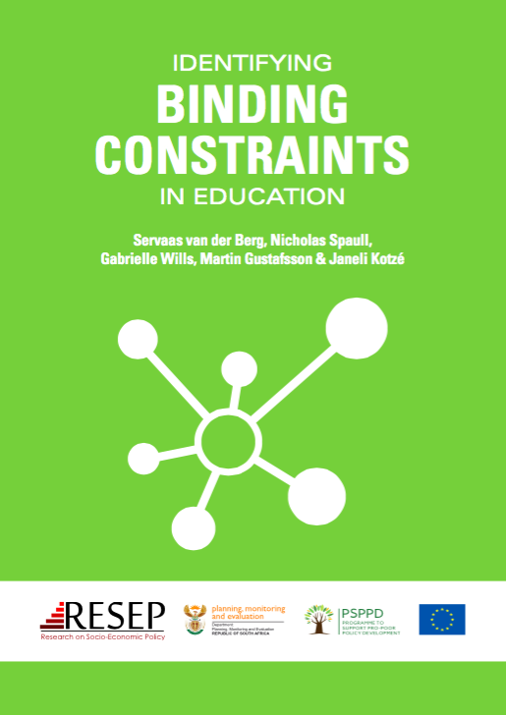

PSPPD & Zenex Report Launch

Slide 19
What do we know about education in SA?
High access: South Africa has relatively high access to education up to Grade 9. Expanding Grade R. Also new progression policies.
Low quality: South Africa has very low levels of educational achievement even by low/middle-income standards. OECD ranks SA 74/75 countries beating only Ghana.
Egregious inequality: The gap between the better performing 20% of schools and the 80% of dysfunctional schools is one of (or the) largest in the world. Gap between two systems is between 3 & 4 grade levels. Largely determined by ability-to-pay and location.
Weak accountability: The alliance between the ANC and COSATU/SADTU means that almost all accountability initiatives never get off the ground. (Volmink Report, ANAs, SACE)
Low capacity: Most teachers in quintiles 1-4 do not know enough about their subjects (content knowledge) or how to teach them (pedagogy) meaning that students rarely grasp the content either.
Notes:
OECD report- https://www.oecd.org/pisa/44417824.pdf

Slide 20
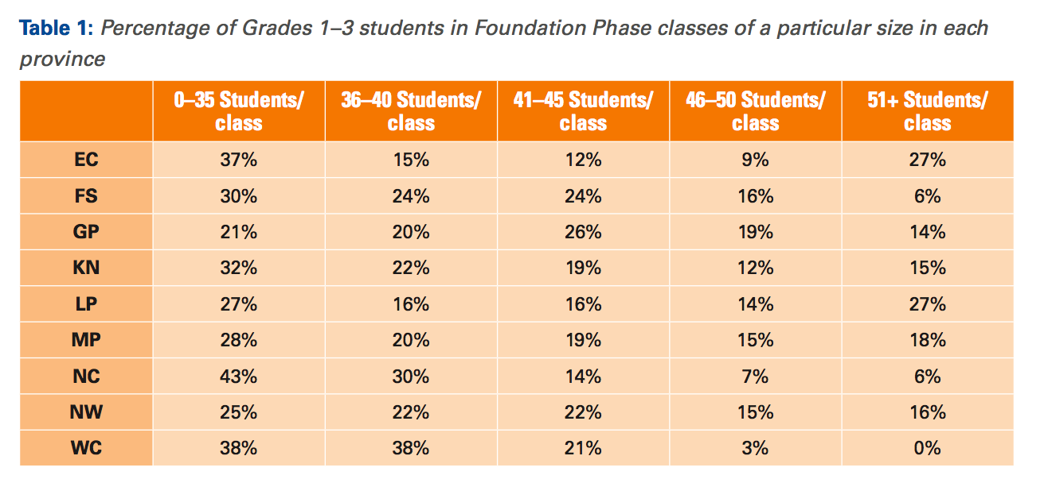
Finding innovative ways to address class sizes?

Slide 21
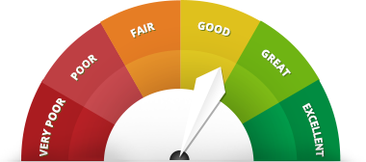
The importance of rigorous evaluation
In the absence of a rigorous independent evaluation, how can we reliably know if an intervention is working or not?
As a rule of thumb NGOs & interventions should allocate 5-10% of their overall budget for evaluation.

Slide 22


Lessons for Interventions Design and Policy
24 February 2017
Presentation to AGOFE

Slide 23
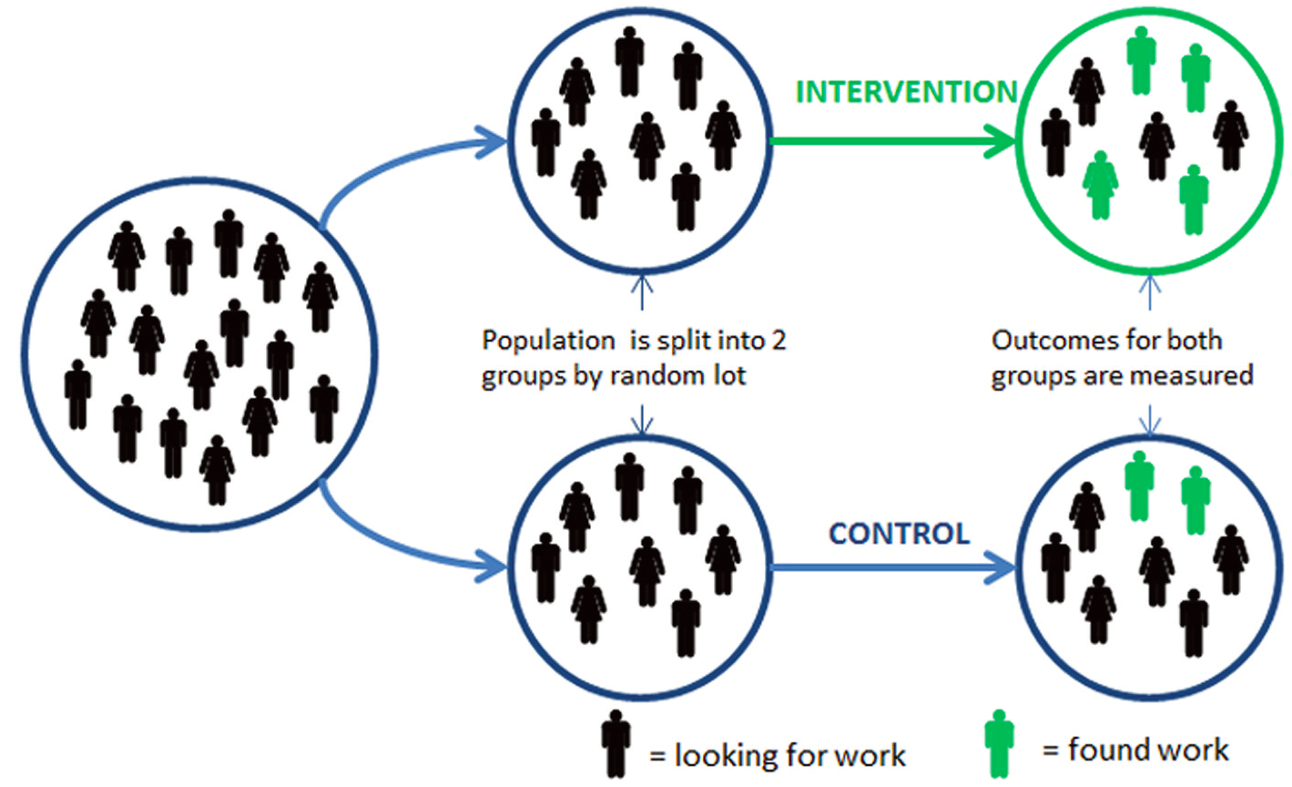
Randomised control trial

Slide 24
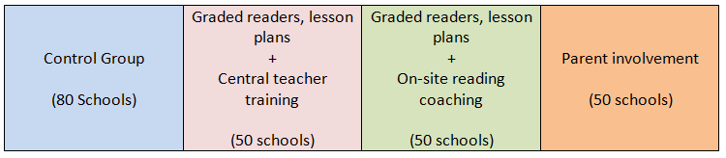

Description of Interventions

Slide 25
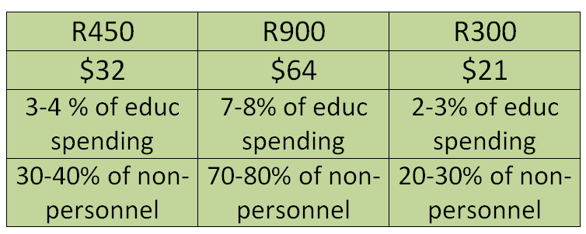
Description of Interventions
Per learner costs
Triple cocktail: Expensive for national roll-out, but R7m – R8m for one grade in 100 priority schools.

Slide 26
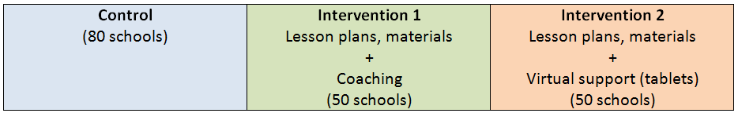

EGRS 2

Slide 27
Complex language dynamics in SA
ANA 2013 Language of Assessment

Slide 28
Labour Market
15%
Legislators, managers, assoc professionals
Unemployed
(Broad - 35%)
Unskilled
(18%)
Elementary occupations & domestic workers
Semi-Skilled (32%)
Clerks, service workers, shop personnel, skilled agric/fishery workers, plant and machinery operators)
University/FET
Type of institution (FET or University)
Quality of institution
Type of qualification (diploma, degree etc.)
Field of study (Engineering, Arts etc.)
High quality secondaryschool
High SES background
+ECD
High quality primary school
Minority (20%)
Some motivated, lucky or talented students make the transition
Unequal society
Big demand for good schools despite fees
Some scholarships/bursaries
Majority (80%)
Quality
Low quality secondary
school
Attainment
Type
Low SES background
Low qual ECD
Low quality primary school
QLFS 2014
Notes:
The QLFS classifies professions as follows: Highly skilled (legislators, senior officials and managers, professionals, technicians and associate profesionals); Semi-skilled (Clerks, service workers and shop and market personnel, skilled agricultural and fishery workers, craft and related trade workers, plant and machinery operators and assembly), Unskilled (Elementary occupations, domestic workers).

Slide 29
What are the “binding constraints" in education?
A binding constraint is one where, if you do not address it first, trying to address other constraints has almost no impact.
Uses

Slide 30
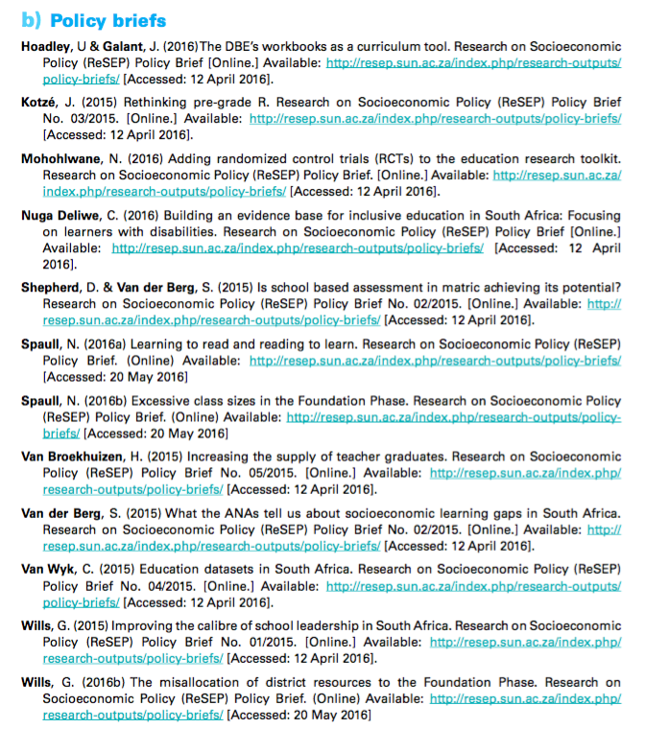
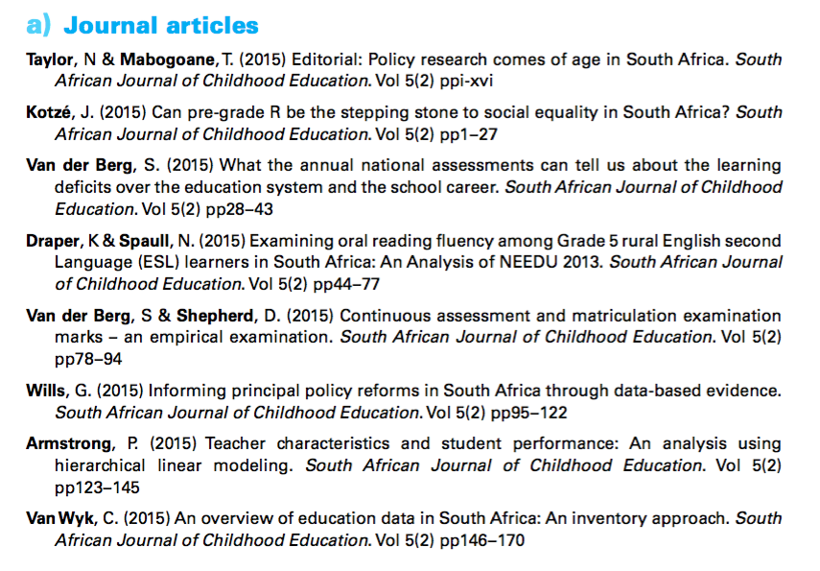
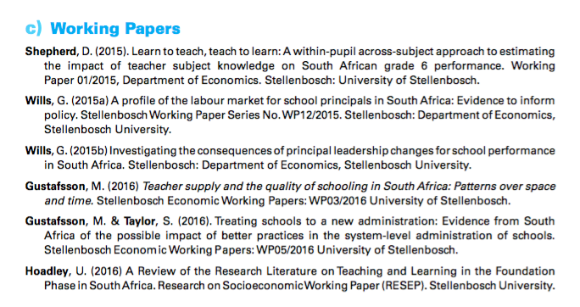

Slide 31
PSPPD & Zenex Report Launch

Slide 32



Brief headline findings from some new research
Learning
Deficits
“Already by Grade 2 more than 50% of students in quintiles 1-4 are not on track according to the ANAs” (Van der Berg, 2015)
Mother-Tongue Instruction
“Using ANA data from 9,180 schools Taylor & Von Fintel (2016) find that additional instruction in mother-tongue improves English acquisition by 0.17SD.”
District
Resources
“61% of Gr10-12 teachers were visited by a curriculum advisor compared to 45% of Grade 1-3 teachers” (Wills, 2016)

Slide 33



Gender Inequality
“71% of school teachers are women
36% of school principals are women” (Wills, 2016)
Early Childhood Development
“The ECD Audit 2013 shows that ECD practitioners earn R1,400 - R2,000 per month and 70% have no qualifications whatsoever” (Kotze, 2015)
Weak Pedagogy
“In a review of the literature Hoadley (2016) finds that reading classroom practice is characterized by collective instruction or chorusing with little opportunity for reading & writing”

Slide 34
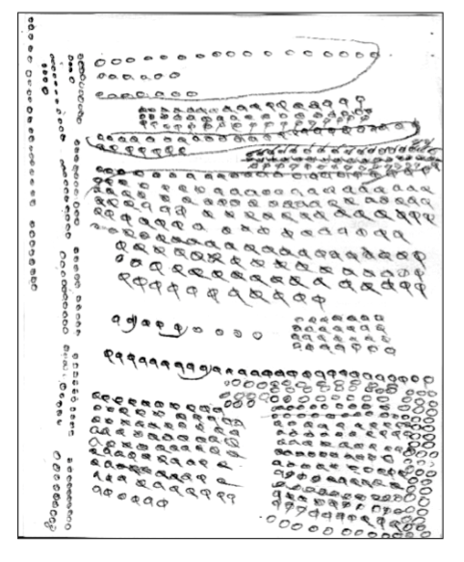
Grade 5 unit counting
Many students do not learn to move beyond a base-1 number system to a base-10 number system etc.
(Eric Scholar)

Slide 35
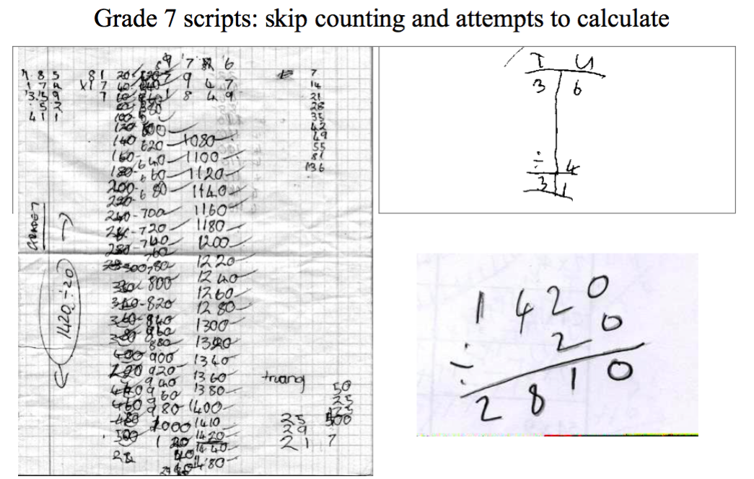
Ref: Eric Scholar

Slide 36
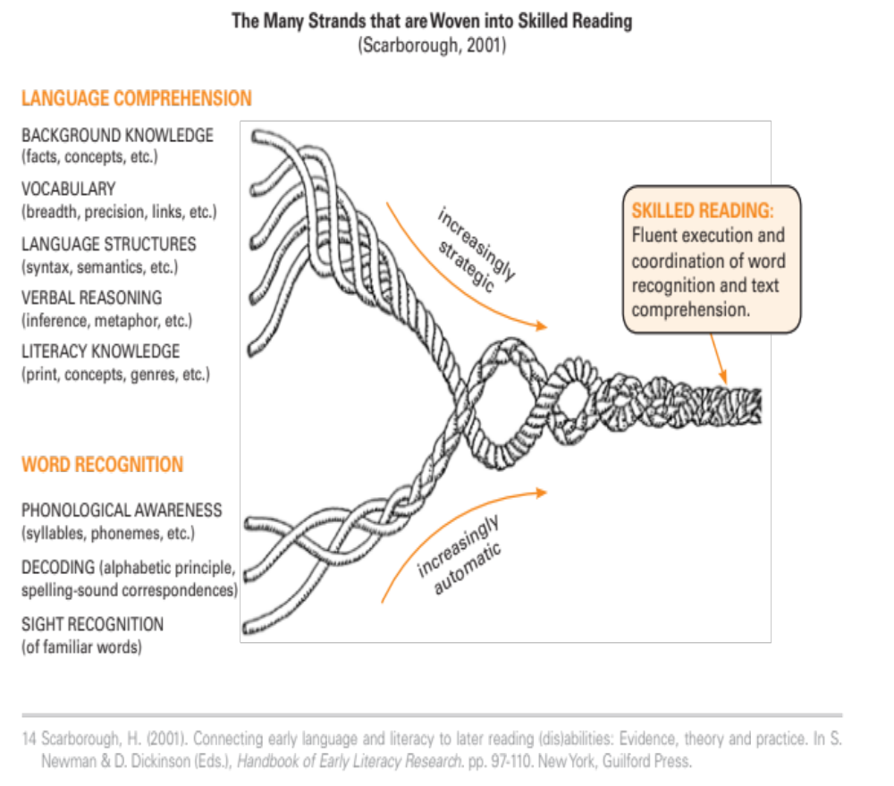
Learning to read for meaning is not ‘easy’ but there is a lot of evidence showing what the components are & how to teach them

Slide 37
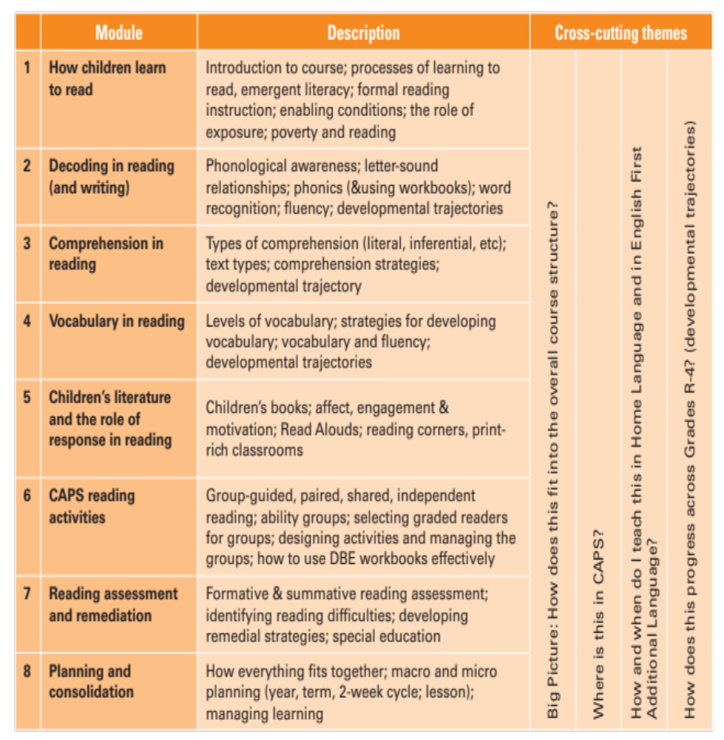
Course content

Slide 38
READING FOR MEANING
Current state of play…
Researchers
Setting norms/benchmarks in African languages
Figuring out the best way to teach African languages
Publishing & teaching
Implementers
Identifying modalities that ‘work’; coaches? Train-the-trainer?
Recruiting & training African-language coaches/trainers
Dealing with funding cycles and organizational funding
Setting up evaluation designs that get at causality & standardizing instruments
Marrying Quant & Qual to see what works and how
Determining cost effectiveness
Evaluators
Dealing with political & budgetary realities
Keeping an eye on scalability
Government
38

Slide 39
SADTU membership

Slide 40

“The left hand barrel has horizontal wooden slabs, while the right hand side barrel has vertical slabs. The volume in the first barrel depends on the sum of the width of all slabs. Increasing the width of any slab will increase the volume of the barrel. So a strategy on improving anything you can, when you can, while you can, would be effective. The volume in the second barrel is determined by the length of the shortest slab. Two implications of the second barrel are that the impact of a change in a slab on the volume of the barrel depends on whether it is the binding constraint or not. If not, the impact is zero. If it is the binding constraint, the impact will depend on the distance between the shortest slab and the next shortest slab” (Hausmann, Klinger, & Wagner, 2008, p. 17).
Notes:
Hausmann, R., Klinger, G., & Wagner, R. (2008). Doing Growth Diagnostics in Practice: A 'Mindbook'. CID Workinf Paper No. 177. Center for International Development at Harvard University.

