Slide 1

21st Century Skills
Nic Spaull | www.NicSpaull.com | 21 September 2017
& Expanding our Definition of Success

Slide 2

Preparing students for jobs that don’t yet exist
Notes:
Azadi Tower Iran

Slide 3

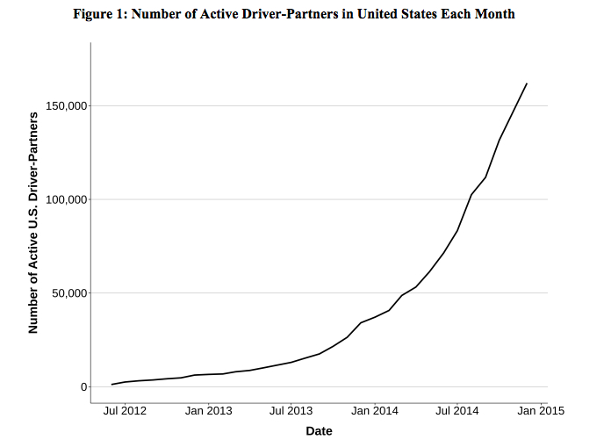
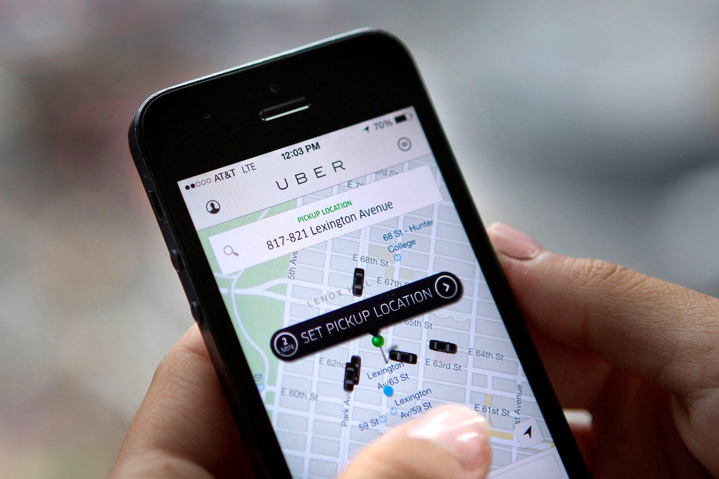

Slide 4
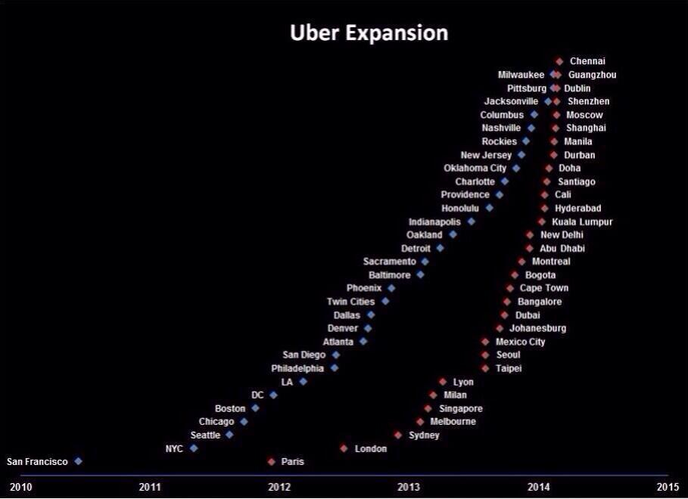
Uber now has 40 million monthly riders wordwide

Slide 5

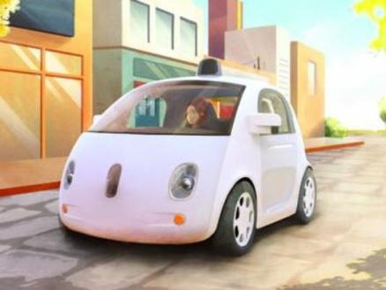
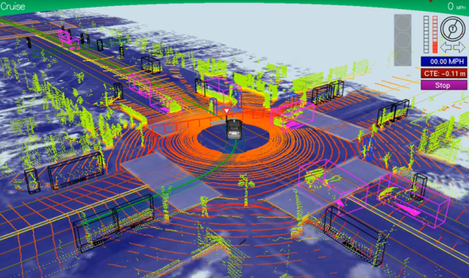
Robotics
The Auto-auto
>1m km,
one minor accident,
occasional human intervention

Slide 6


Slide 7



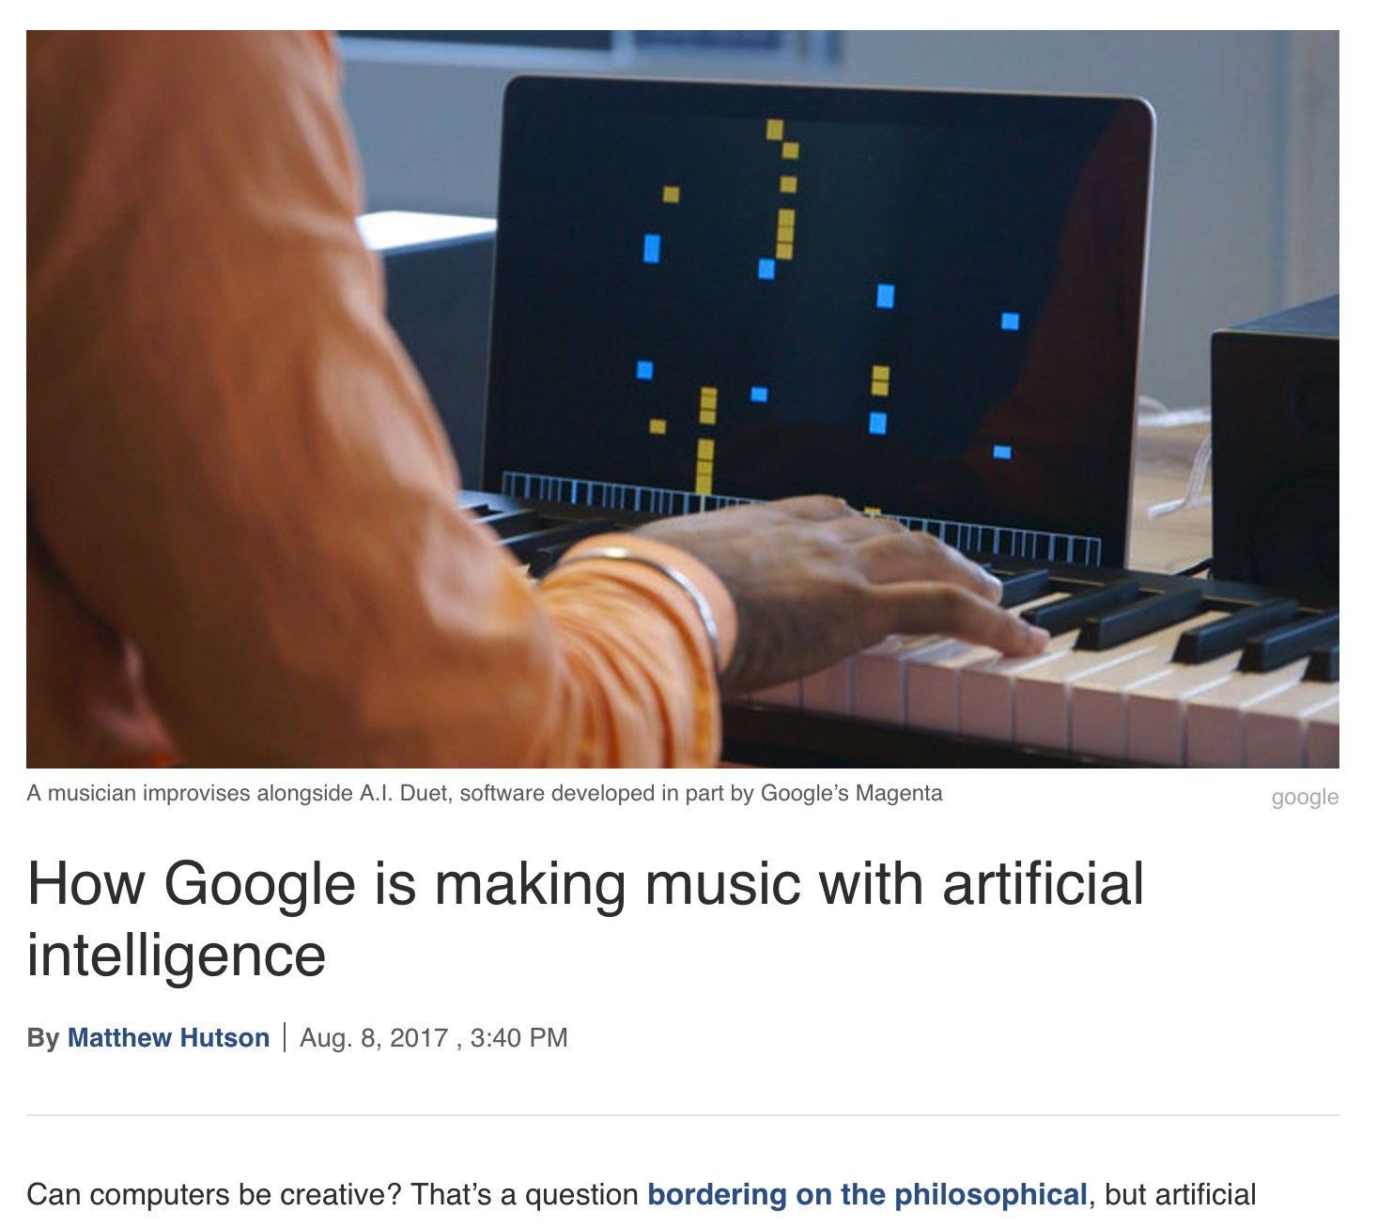
“The bots ran afoul of their Facebook overlords when they started to make up their own language to do things faster, not unlike the way football players have shorthand names for certain plays instead of taking the time in the huddle to describe where everyone should run. It’s not unusual for bots to make up a lingo that humans can’t comprehend, though it does stir worries that these things might gossip about us behind our back. Facebook altered the code to make the bots stick to plain English. “Our interest was having bots who could talk to people,” one of the researchers explained.”

Slide 8
Climate Change
Three ‘500-year’ storms have hit Houston in the last 50 years

Slide 9
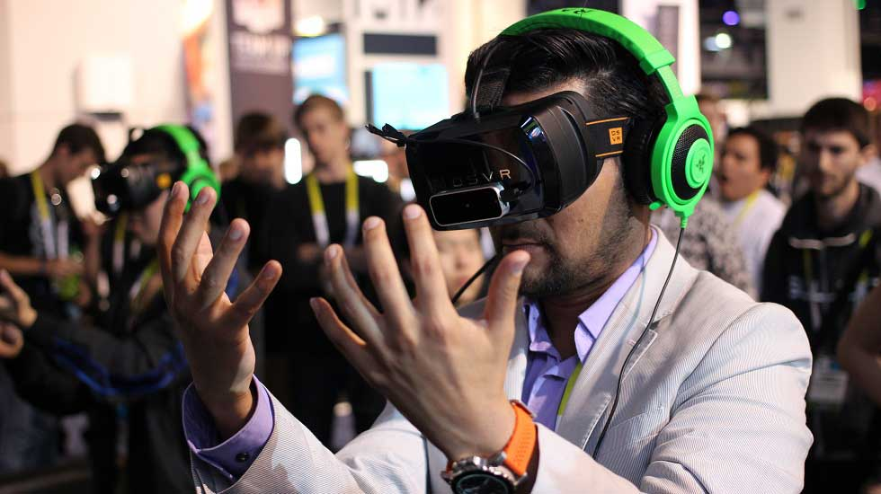

Virtual Reality (VR)

Slide 10
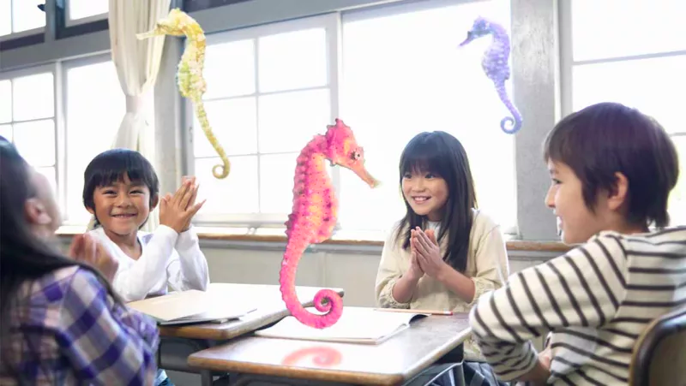
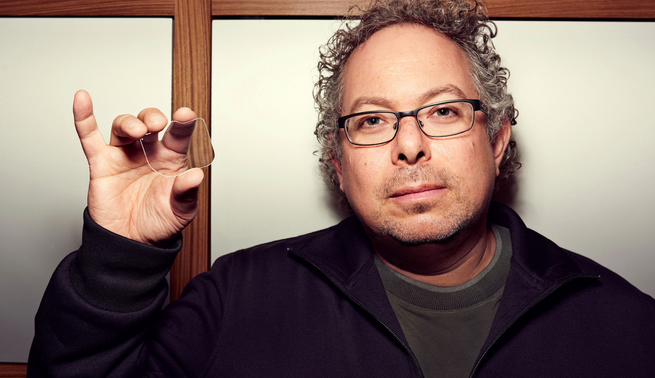


Mixed Reality (MR)

Slide 11

Waking up with Mixed reality…

Slide 12

The kind of things that are easy to teach are now easy to automate, digitize or outsource
Source: Schleicher (2016)

Slide 13


Slide 14
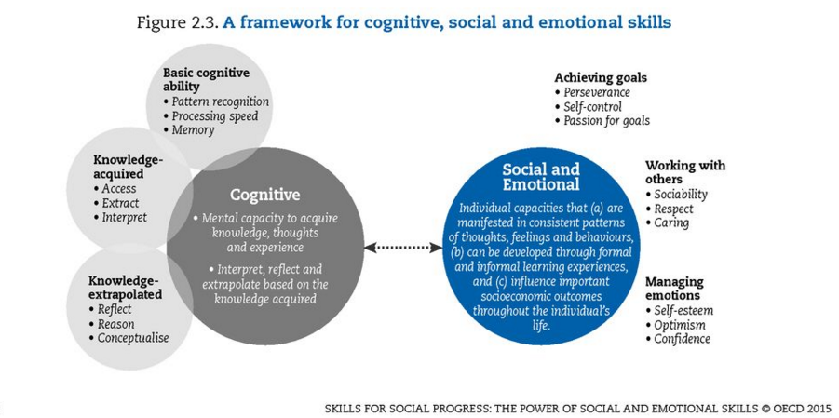

Slide 15
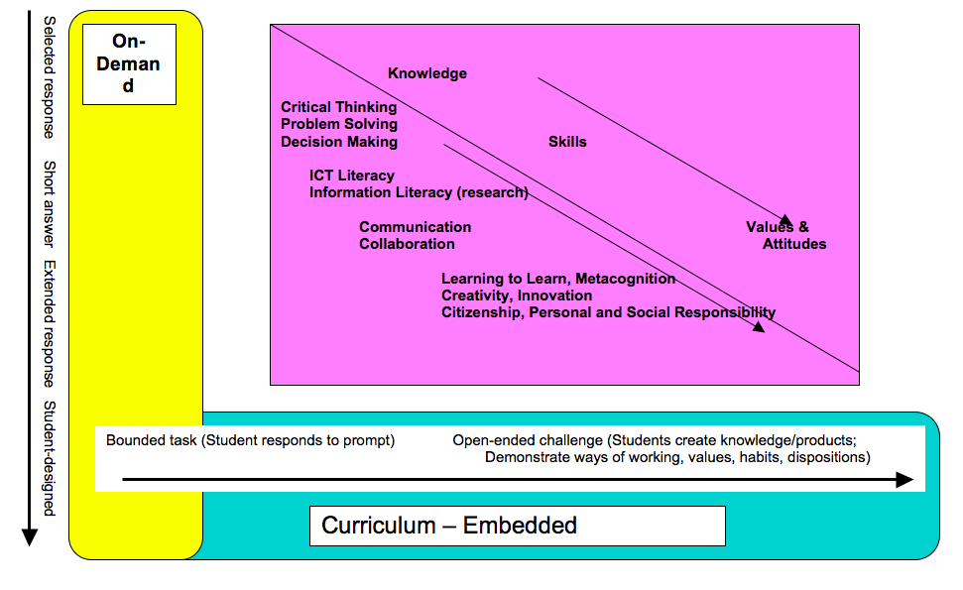
Draft White Paper 5 - Policy frameworks for new assessments
Linda Darling-Hammond 2015

Slide 16
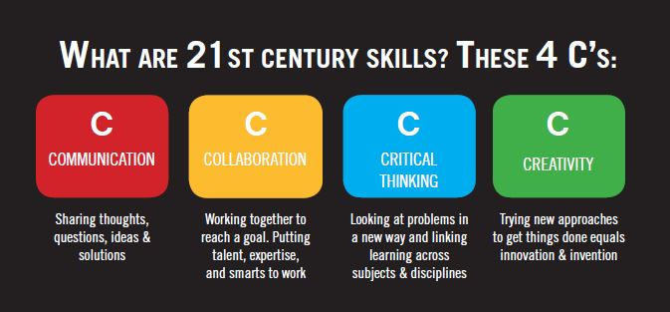

Slide 17
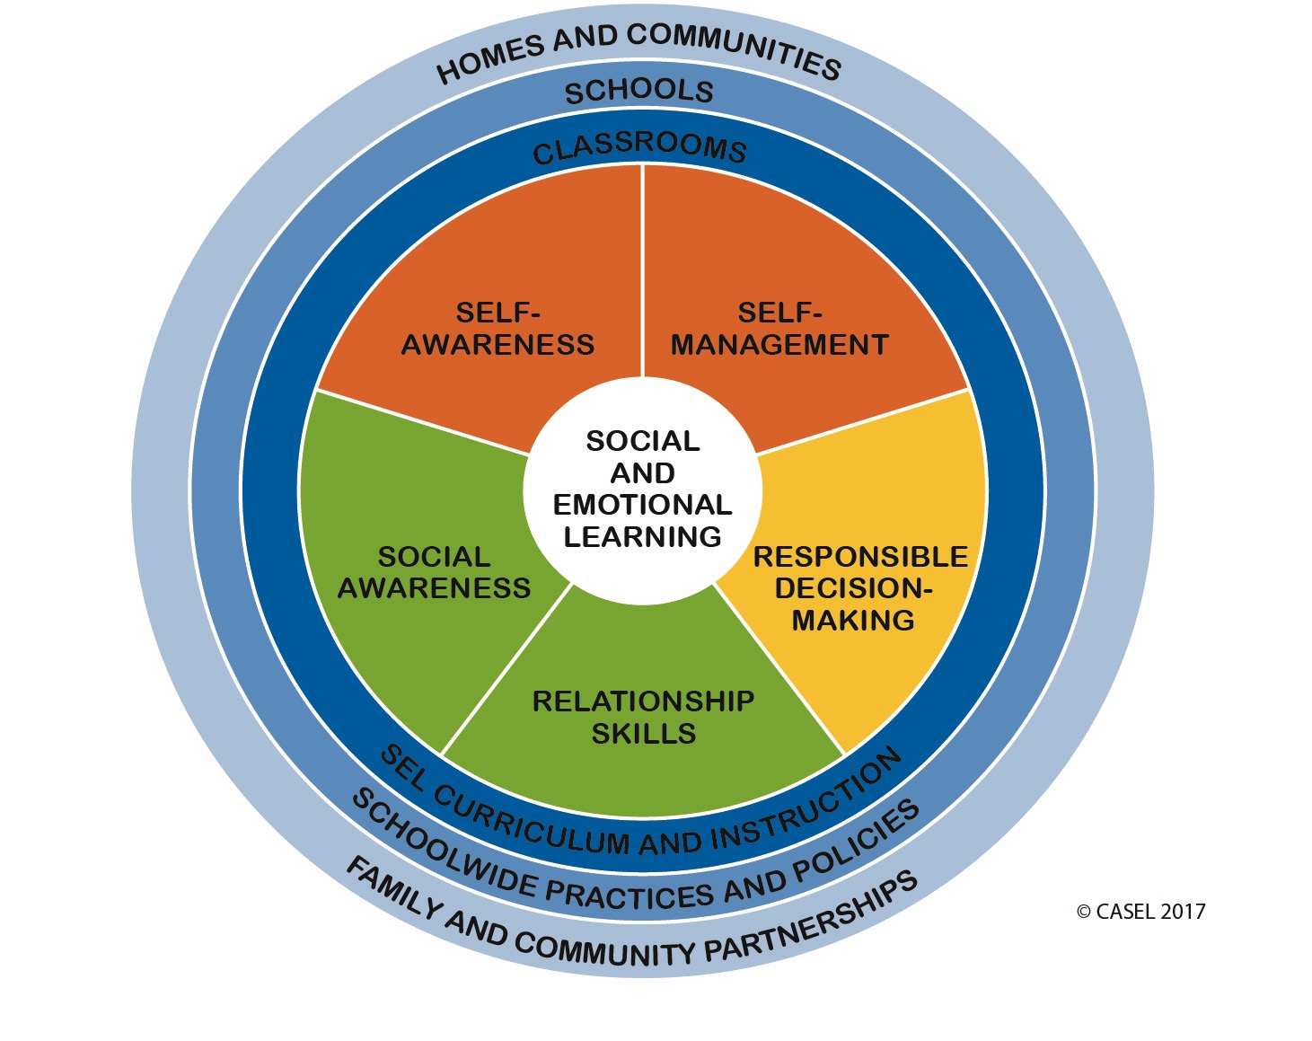

Slide 18
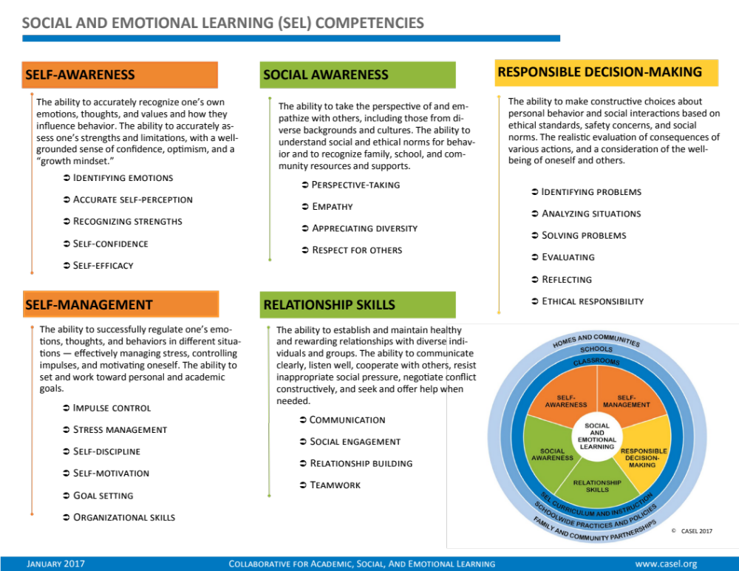

Slide 19
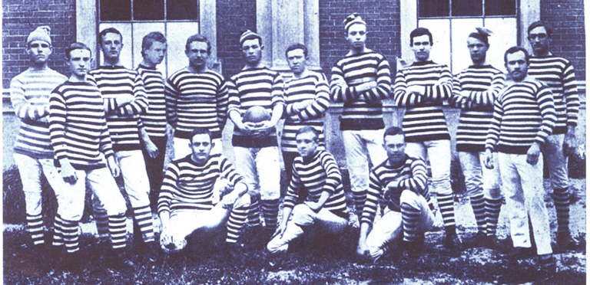
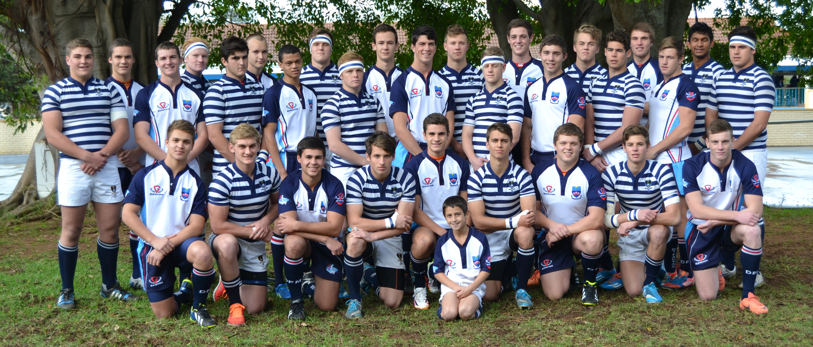
1882
2014

Slide 20
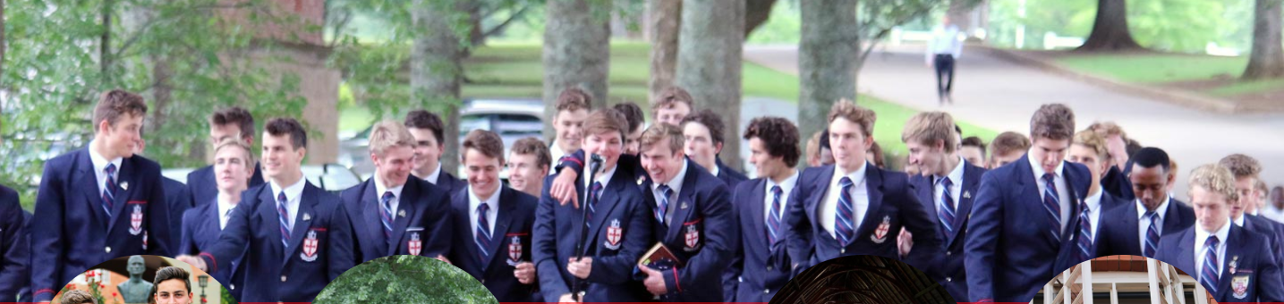
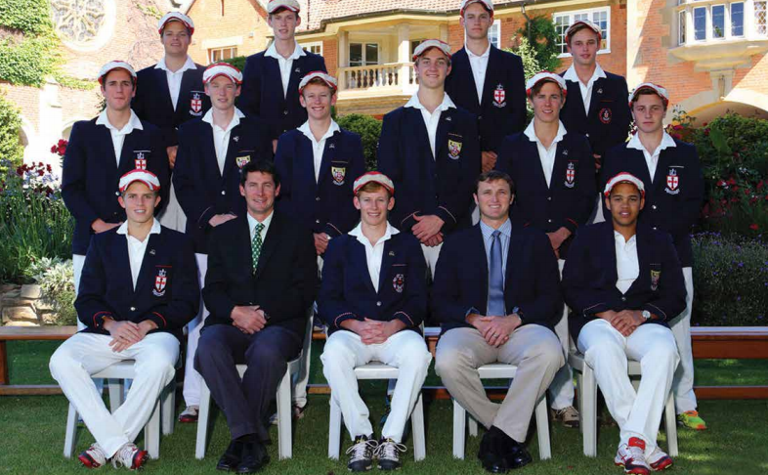
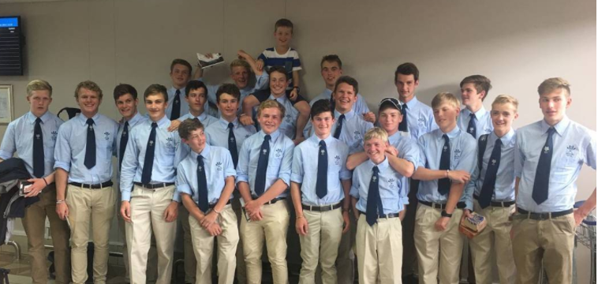


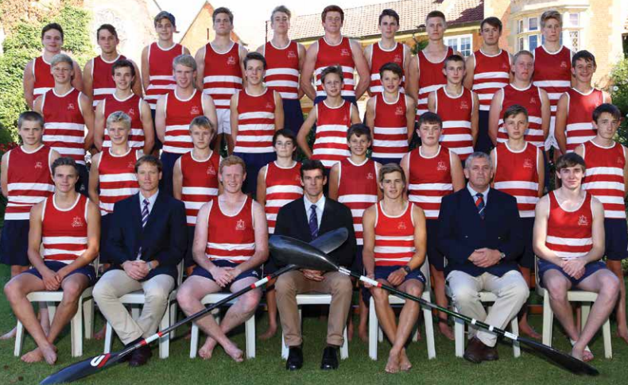

Slide 21
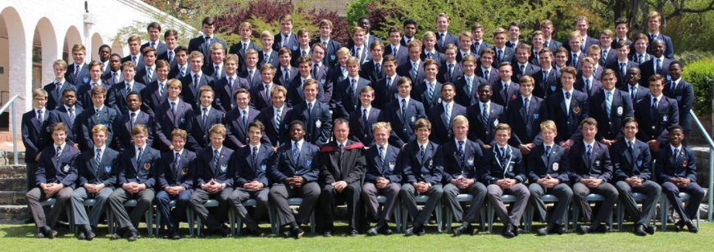
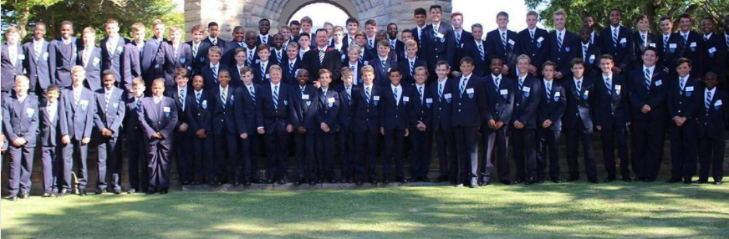
2016
2017

Slide 22


Slide 23
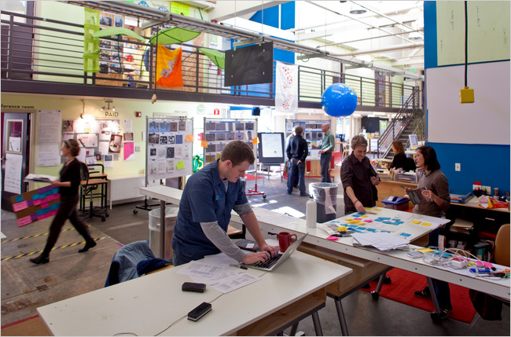
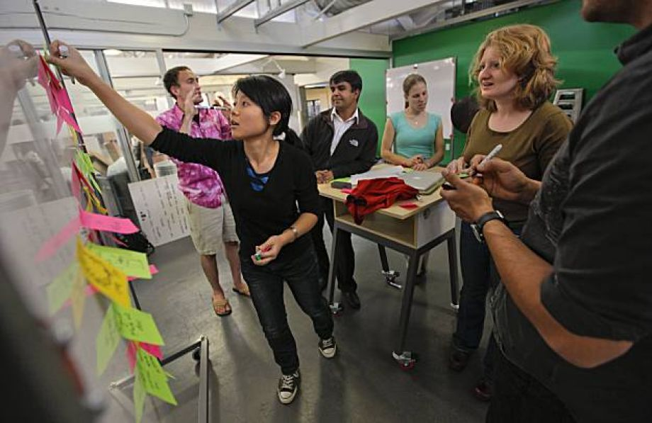
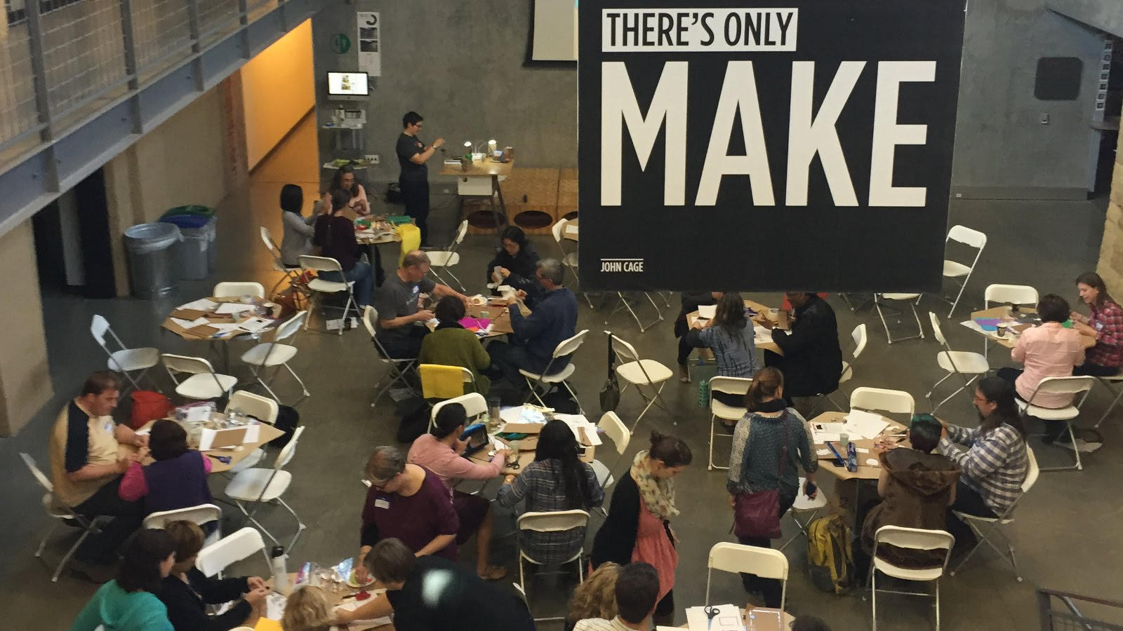
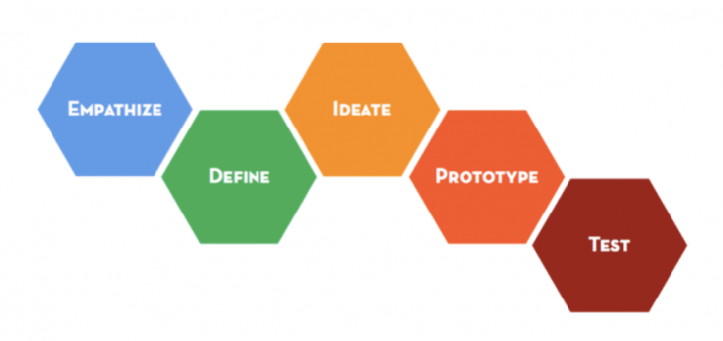
Design thinking…

Slide 24
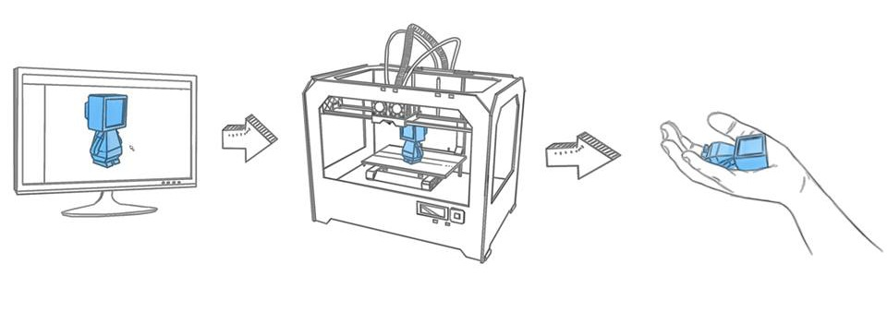
3-D Printing

Slide 25
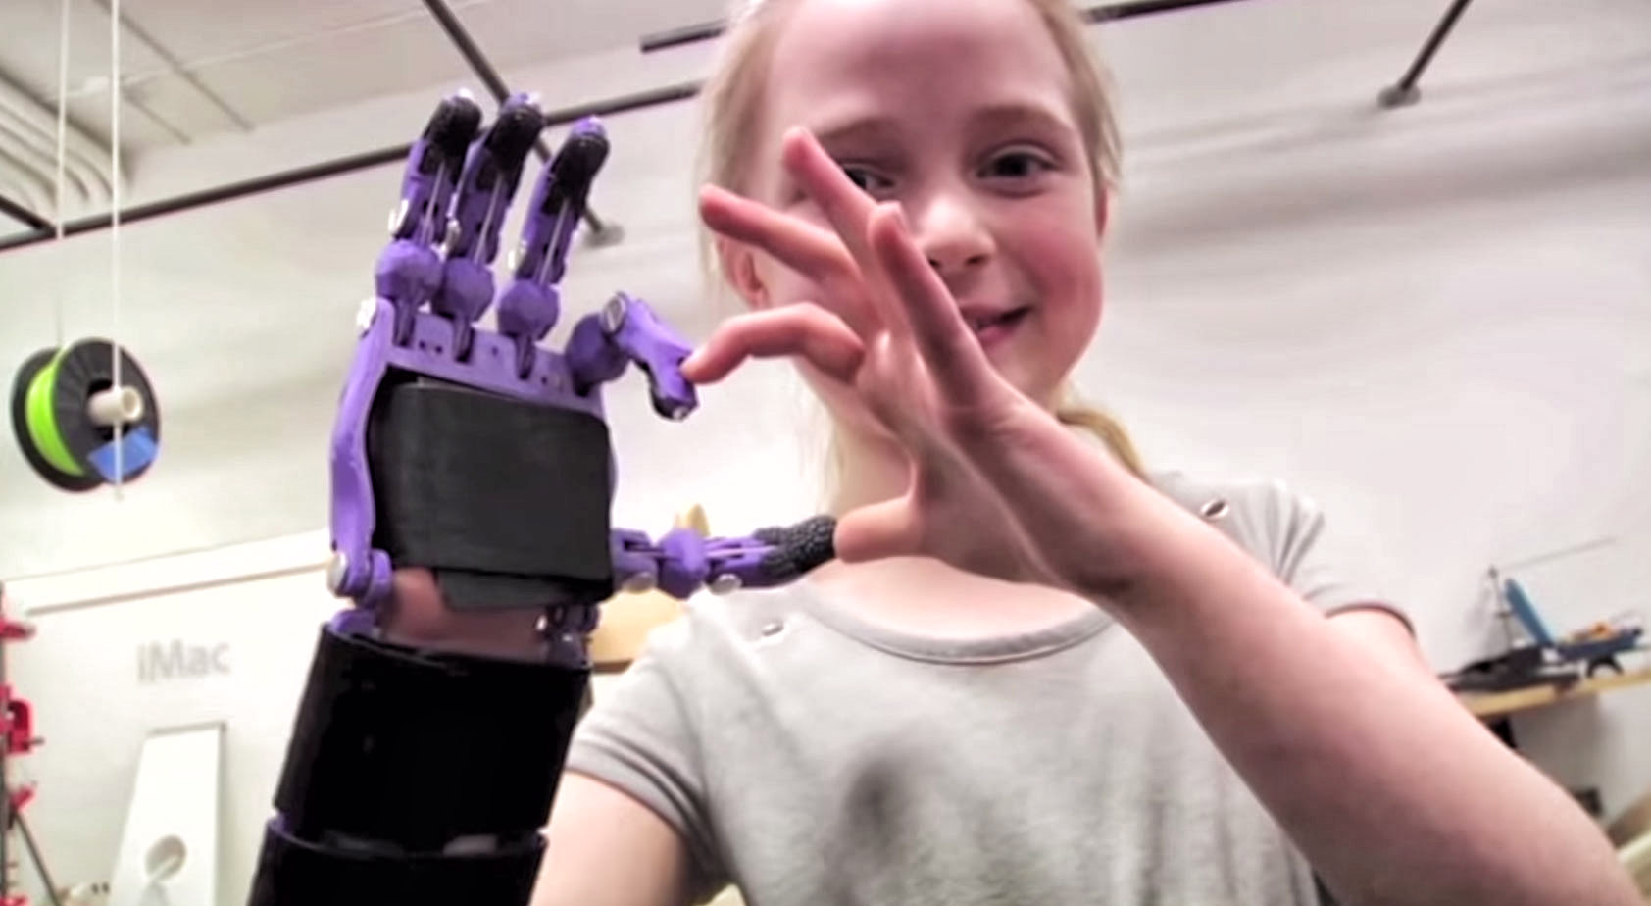
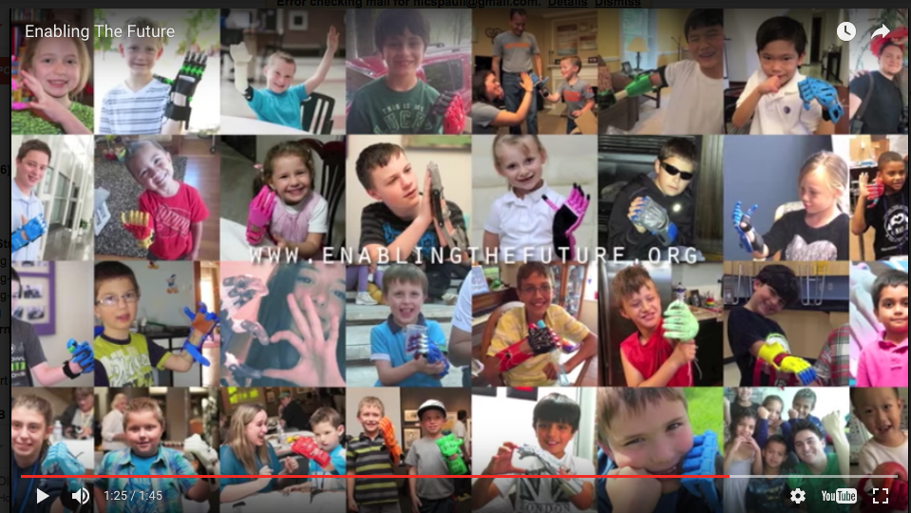
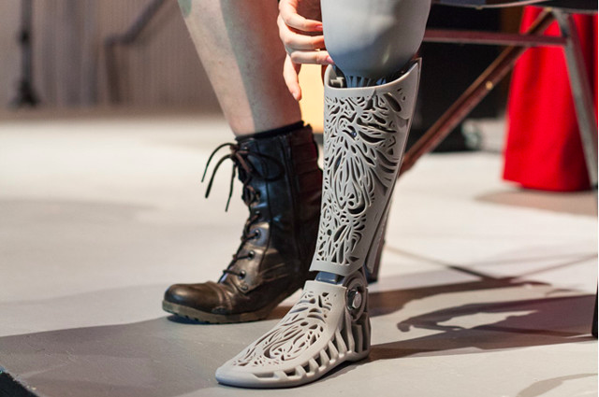

Crawford College La Lucia Grade 8’s are helping print a prosthetic hand for Bongani.

Slide 26
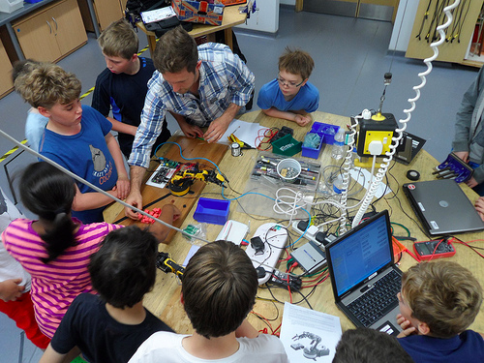
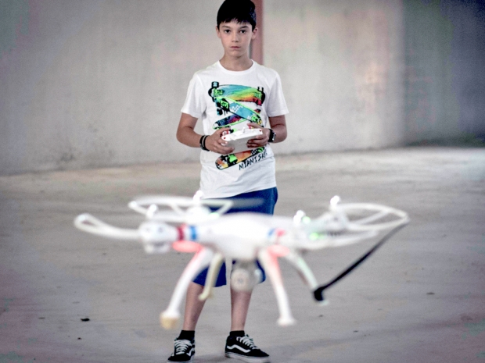

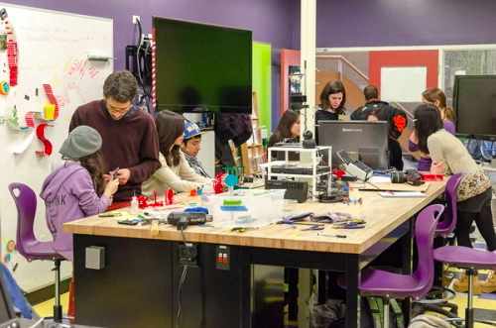
Examples
-Inter-grade teaching
-team teaching
-combined-subject teaching
-Explicitly teaching a curriculum of socio-emotional skills like empathy (21C skills)
- ‘FuckUp Nights’ – stories of failure
-Permanent high-speed wifi (obvs)
-Drone-building classes
-robotics classes in school time
-Arduinos
-Raspberry Pi (costs R500)
-coding classes
-MakerSpace labs / FabLabs
-3D-printers

Slide 27
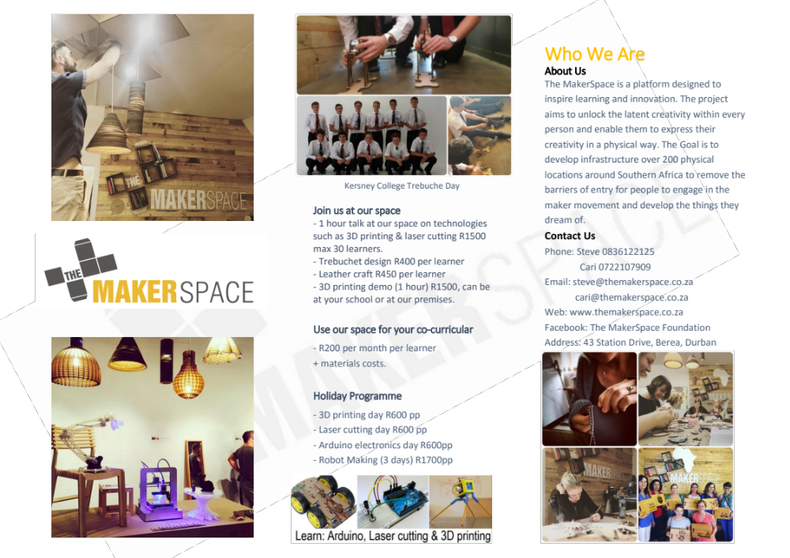

Slide 28
Expanding our
Definition of Success

Slide 29
Success for Some | Success for Many
Scarce: Only some can attain the very limited criteria of success | Expansive: Many can attain some version of an expansive vision of success
Exclusive: Typically those with power/privilege benefit most | Inclusive: Many benefit, including those without power/privilege
Individual focus | Team focus
Primarily competitive - only some can win or attain the scarce resource/goal | Primarily collaborative - 'winning' isn't the aim.
Ego and fear are driving force | Interest, passion & goals are driving forces (flow)
Your success means my failure | Your success and my success are both attainable

Slide 30
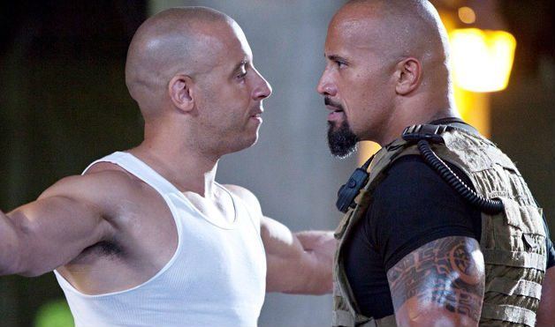
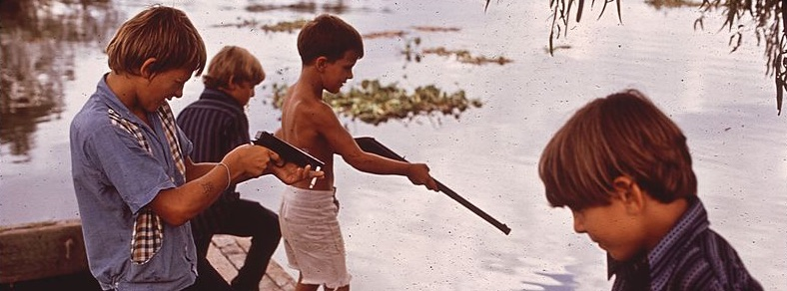
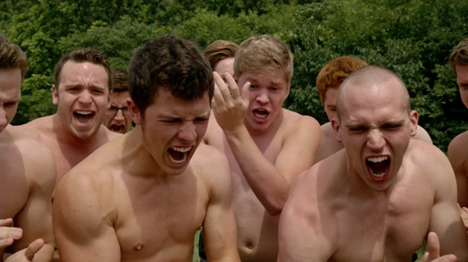


Toxic masculinity

Slide 31
Masculinity
Success for Some | Success for Many
Only some can attain & perform the narrow criteria of masculinity: physically strong, sporty, well-liked, alpha-male + hierarchy. | Universally attainable values are emphasised (courage, empathy, integrity, leadership, hard-work etc.)
Do not be perceived as weak | Do not be perceived as inauthentic
External is emphasised - appearance | Internal is emphasised
Achievement in traditional sports emphasised: Rugby, cricket, water-polo (strong hierachy of 'acceptable' sports) | Achievement in all areas praised equally: drama, music, debating, hockey, art, dance etc.
School approval is conditional on achievement | School approval is conditional on growth, effort & values
Self-worth tied to performance and outcomes | Self-worth is innate
Shame: I am something wrong | Guilt: I did something wrong
Values emphasised: leadership, resilience, heroism, toughness, individuality | Values emphasised: empathy, compassion, vulnerability, courage

Slide 32

(1) How many of our students can authentically succeed against the vision of success our school casts?
(2) Can we recast our vision of success away from a narrow, exclusionary and performance-driven one and towards and more generous one that is collaborative and inclusive and that more people can attain?
(3) Isn’t our ultimate goal to ensure the full flourishing of all our students, irrespective of the form of that flourishing?

Slide 33
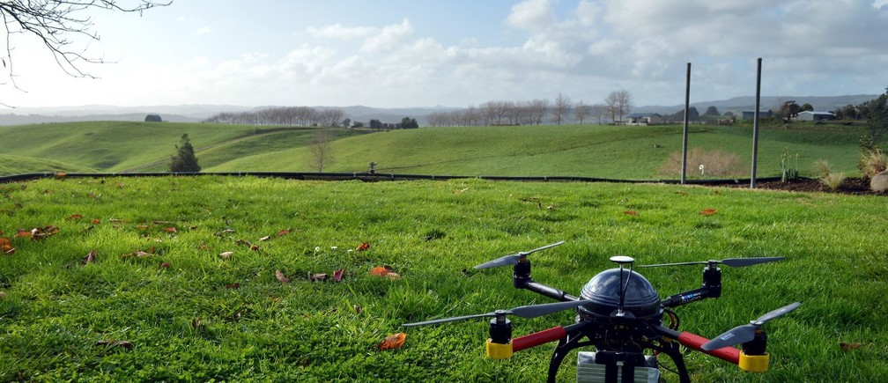
Questions & comments?
Presentation available at nicspaull.com

Slide 34
Some empirical questions to ask about your school:
Of your previous 10 guest speakers how many of them were women? People of color? Gay?
What percentage of your staff are people of colour?
Of your total discretionary budget what percentage is spent on activities/events/awards on sports vs arts/culture?
Of the amounts spent on sport what percentage is spent on rugby and cricket vs other sports like soccer and basketball?
Does your school offer full colors/honors for all arts/cultural activities (dance, debating, theatre etc) if not why not?
While we commemorate white people who died in battle - their heroism, courage and sacrifice – do we also commemorate black people who died - their heroism, courage and sacrifice?
Do you have a diversity policy? Is it on the website? Is it implemented?
What is your policy on gay students? Gay staff? Is it documented? Are you living in a don’t-ask-don’t-tell world or one that celebrates diversity?
What are the things that you and your staff “turn a blind eye” to? “They’re just being boys” = warning bell.
What do we currently do that may be offensive or exclusionary to some of our students?
How many of our prefects do not play in the first team for one of our sports?

Slide 35
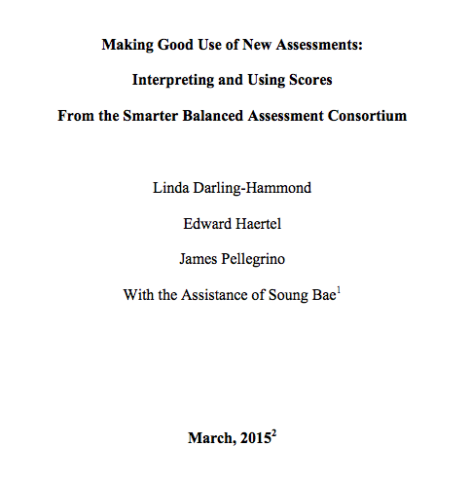
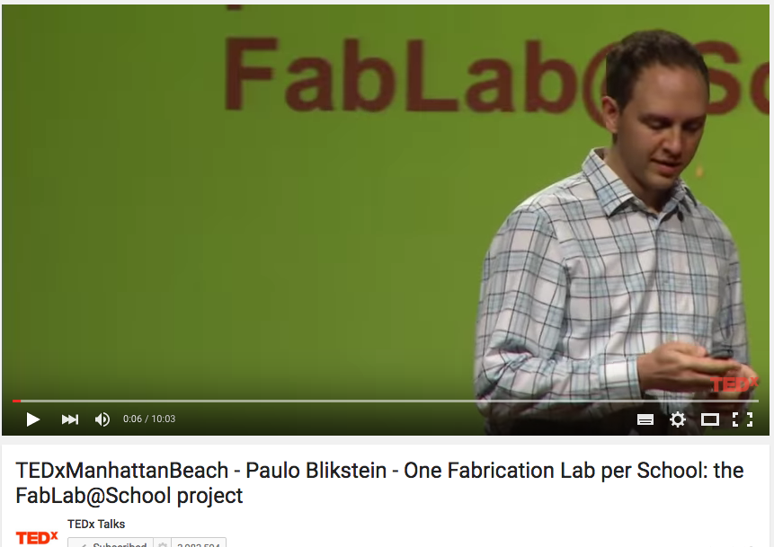
Resources
https://www.ideo.com/expertise/education/
https://vimeo.com/40895671
http://education.vermont.gov/documents/EDU-WhitePaper-Making_Good_Use-of_New_Assessments.pdf
Michael Fullan, Ken Robinson, Linda Darling-Hammond, Alaine De Botton, Carnegie Mellon University, d.school at Stanford
Released items - https://www.oecd.org/pisa/pisaproducts/PISA2015-Released-FT-Cognitive-Items.pdf

Slide 36
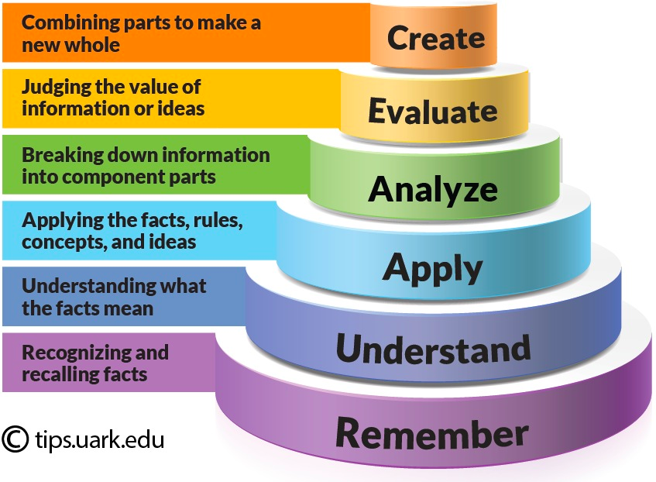
Bloom’s Taxonomy: Cognitive

Slide 37

You’re such a girl
Grow a pair.
Don’t be such a pussy.
My sister could throw further.
You’re such a homo.
Man up.
You’re such a naf.
Don’t be a wimp.
Faggot.
Don’t be a girl.
That’s so gay.

Slide 38

Expectations for Learning are Changing
The new context means new expectations.
Ability to communicate
Adaptability to change
Ability to work in teams
Preparedness to solve problems
Ability to analyse and conceptualise
Ability to reflect on & improve performance
Ability to manage oneself
Ability to create, innovate and criticise
Ability to engage in learning new things at all times
Ability to cross specialist borders
Chris Wardlaw, "Mathematics in Hong Kong/China – Improving on Being First in PISA"

Slide 39
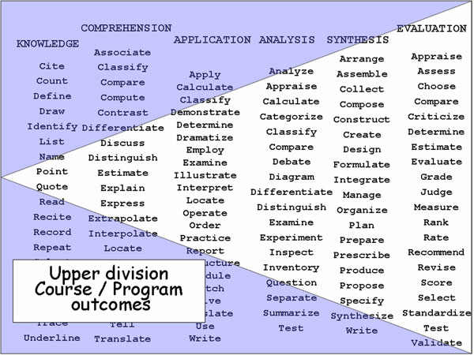

Slide 40
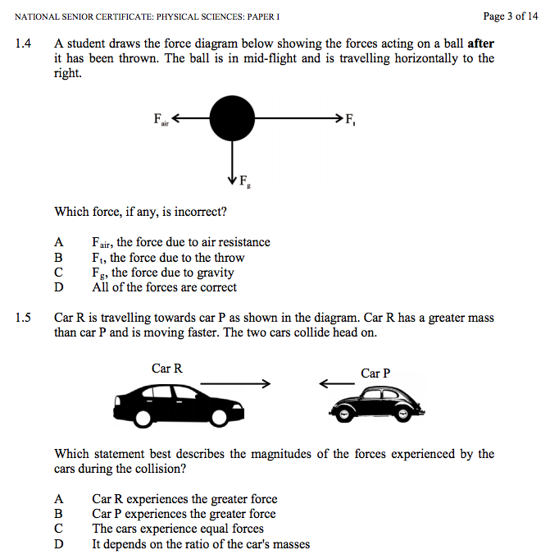
IEB NSC Physics P1 2015

Slide 41
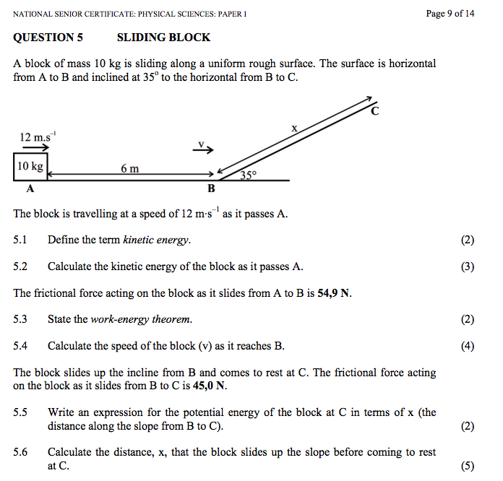

Slide 42
Expectations for Learning are Changing
The new context means new expectations. Most studies include:
Ability to communicate
Adaptability to change
Ability to work in teams
Preparedness to solve problems
Ability to analyse and conceptualise
Ability to reflect on and improve performance
Ability to manage oneself
Ability to create, innovate and criticise
Ability to engage in learning new things at all times
Ability to cross specialist borders
Chris Wardlaw, "Mathematics in Hong Kong/China – Improving on Being First in PISA"

Slide 43
Queensland Australia Gr9 Maths - Instruction to Students:
Your task is to design a space to store enough stackable chairs to seat all the staff and students in your school.
You will:
follow a series of steps to help you design a suitable space
use a research journal to record your ideas and rough working
write a report on the process and solutions.
Questions
1. Develop mathematical models for each dimension of a stack of chairs, where the number of chairs is unknown.
2. To help you think about the practicalities of storing chairs, use your mathematical models to find:
a. the greatest number of chairs in one stack that can fit into a storage area with a 4 m high ceiling
b. the number of stacks that fit across a 3.2 m wide area if there are 10 chairs in each stack
c. the height of a stack, if all the chairs for the school are put into one stack.
3. Use the understanding of the practicalities of storing chairs you developed in Question 2 to find a practical storage area for the chairs.
To answer these questions, work through the steps set out on the following pages. As you work, record everything you do in your research journal.
Using a research journal
A research journal is a record of what you and your group do. Your research journal should include:
what you and your group do in each class session, ideas, questions, plans, difficulties faced, how difficulties are managed, data collected, calculations, mathematical language, acknowledgment of any help you receive from friends, teachers or other people.
Your research journal should contain all the information you need to write your report. It will also help your teacher decide what you can do by yourself, and what you can do as part of a group.
Communicating your Findings
Write a report on your investigation. Your report should include:
(1) an introduction providing an overview of the scenario and the questions, (2) your solutions to the questions, (3) using mathematical language, data, calculations, diagrams, graphs and phrases or sentences that provide enough information for a person to know what you are calculating without having to read the questions, (4) a conclusion, summarising: your reflection on the practicalities of your solutions, any assumptions made or limitations to your answers, and suggestions for improving the investigation or strategies used.
Note: We are still testing the content and whether students have mastered the underlying skills

Slide 44
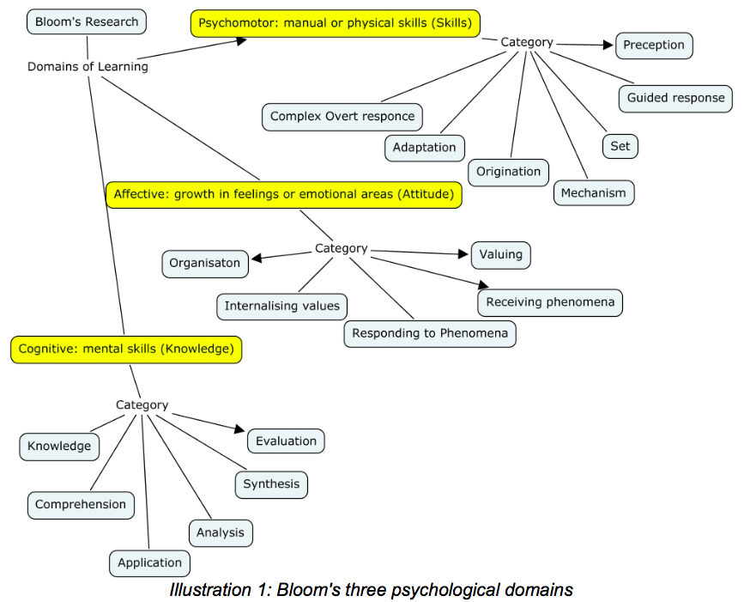
Bloom’s 3 psychological domains
Source: Andrew Churches – Bloom’s Digital Taxonomy
Notes:
Andrew Churches – Bloom’s Digital Taxonomy

Slide 45
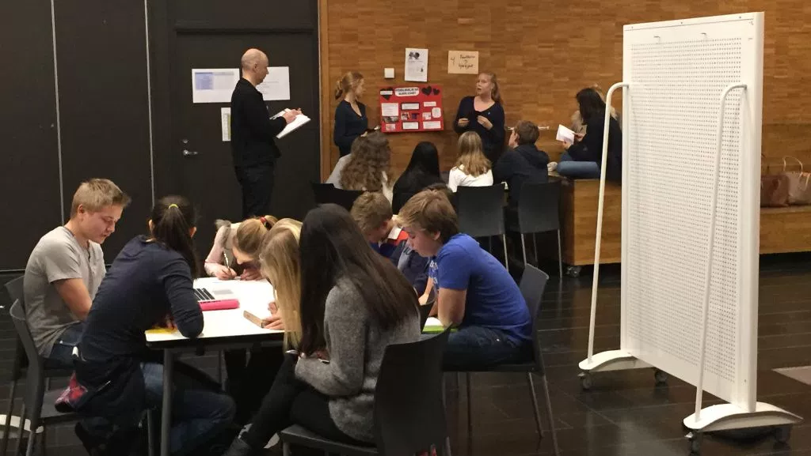
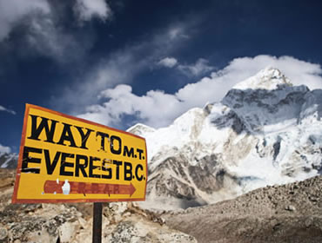
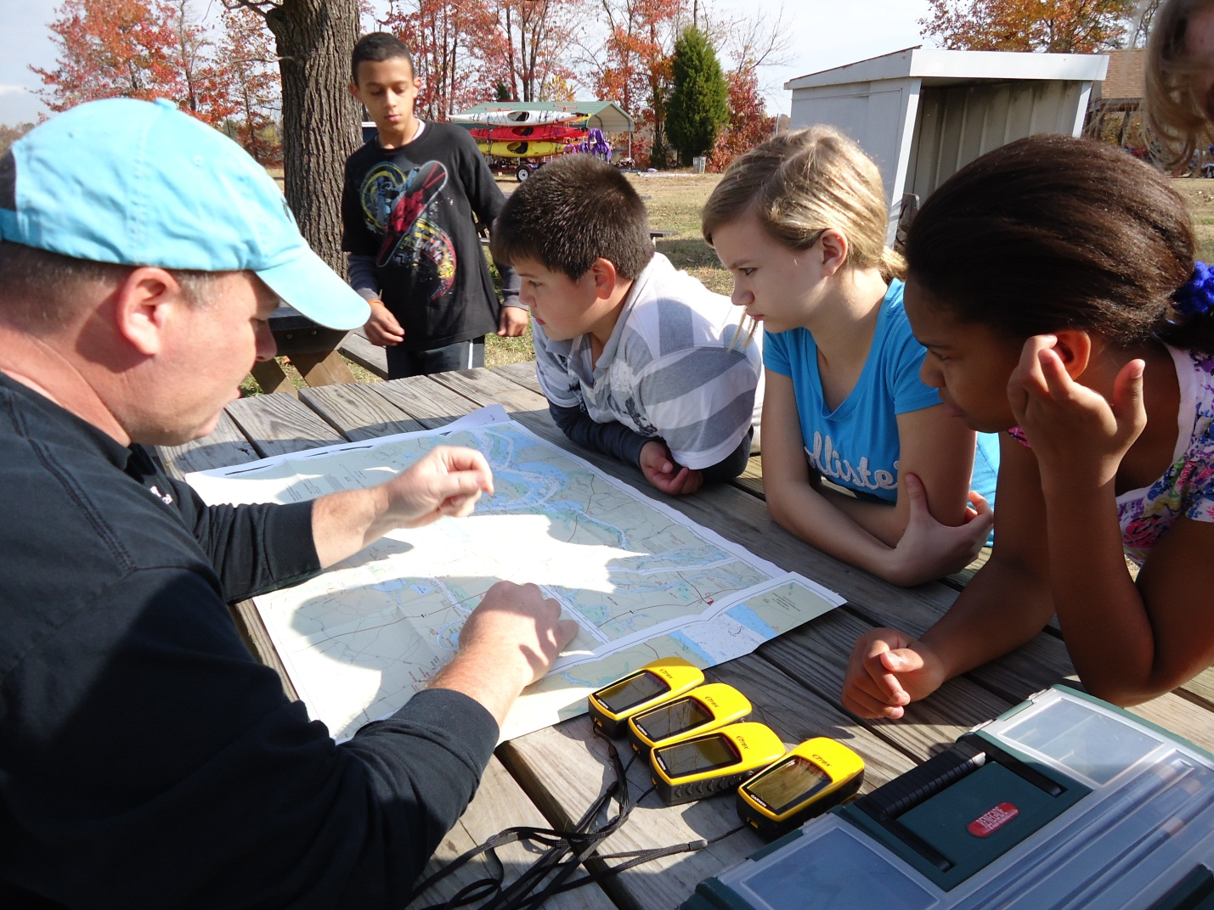
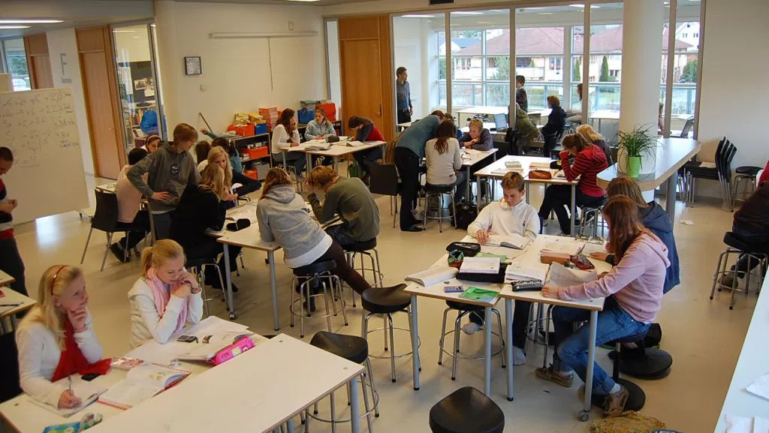
“Each team consists of four to six teachers and is responsible for 60 to 75 pupils. As an example of how they work, students in the eighth grade (13-year-olds) will often study earthquakes, volcanos and other earth forces - normally considered part of a geography or natural science lesson.
Now, however, teachers will come up with several different storylines for the lesson - encompassing other subjects In one, they pretend they have to climb Mount Everest.
It includes the study of maps, weather and climate, make a list of the equipment they need, calculate the time they will need, make a budget for the trip and apply for funding in English (a foreign language).”
Notes:
http://qz.com/377742/this-school-in-norway-abandoned-teaching-subjects-40-years-ago/

Slide 46
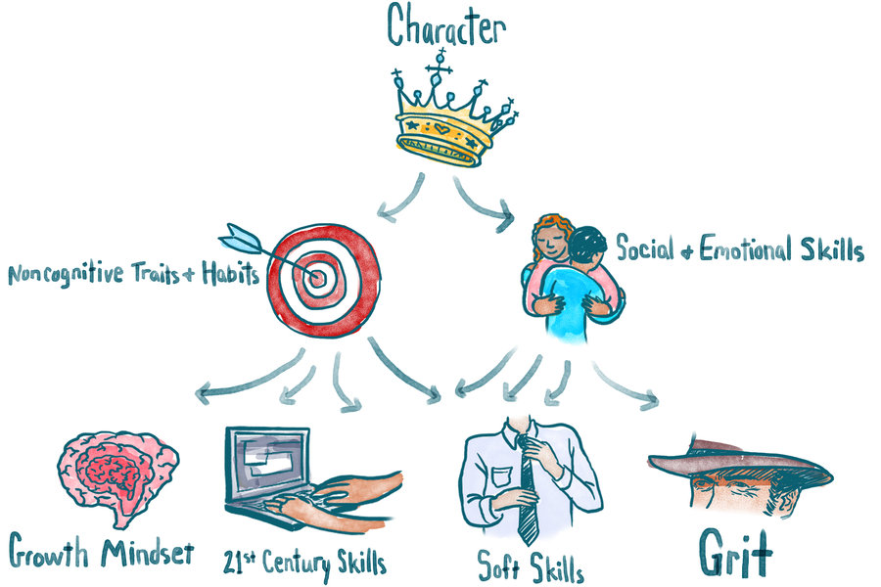
Notes:
http://www.npr.org/sections/ed/2015/05/28/404684712/non-academic-skills-are-key-to-success-but-what-should-we-call-them

Slide 47

New research: Grit
Angela Duckworth – U Penn
Carol Dweck - Stanford

Slide 48

Esther Wojcicki – Palo Alto High School’s journalism program
Student newspaper, website, magazine, videos etc.
Videography
Photography
Deadlines
Collaboration
Inter-personal relations management
Design
Planning
Writing
Editing
Project-management
Printing
Budgeting
Formatting
Students are judged by more complex outputs over a longer period of time.

