Slide 1

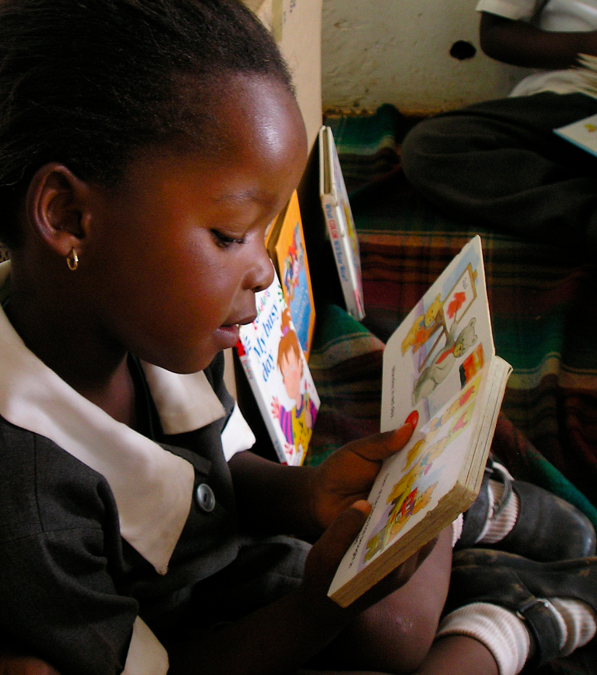
Getting Reading Right in the Foundation Phase
Dr Nic Spaull
(www.nicspaull.com)
VW Foundation | Sept 2015

Slide 2
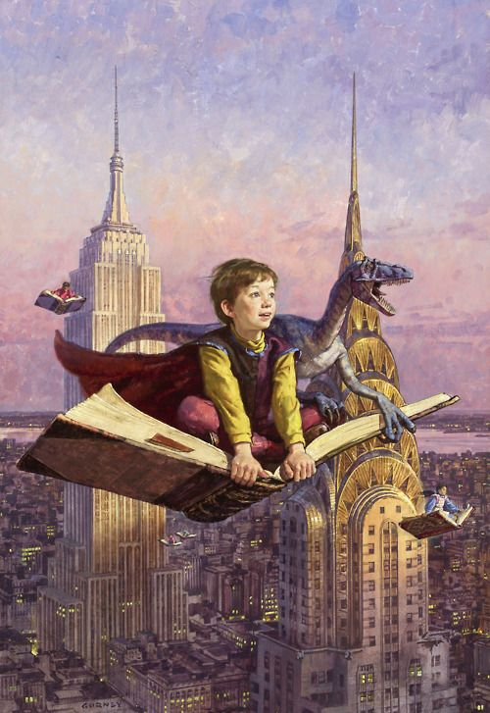
A story about a BOUNCING BALL & DINOSAURS

Slide 3
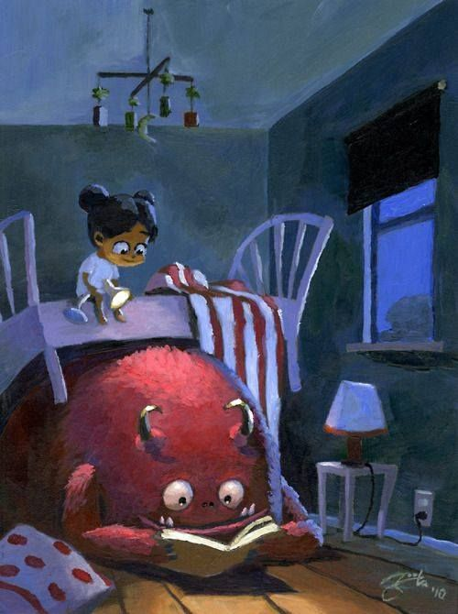

Slide 4
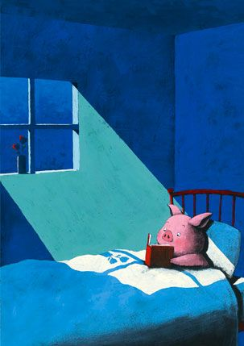
“We read to know we are not alone” C.S. Lewis

Slide 5

Hunza Valley, Pakistan, 5 Aug 2015, HONY

Slide 6
Why focus on reading in the Foundation Phase?

Slide 7
Reading
The ability to read for meaning and pleasure is arguably the most important skill children learn in primary school. Since almost all future learning will depend on this fundamental understanding of the relation between print and spoken language, it is unsurprising that literacy, built upon a firm foundation of basic reading, is used as one of the primary measures of school efficacy.

Slide 8


prePIRLS 2011 → By Gr 4 children should be transitioning from “learning to read” to “reading to learn”
Red sections here show the
proportion of children that are
completely illiterate in Grade 4
, i.e. they cannot “locate and retrieve
an explicitly stated detail in a short
and simple text”.
Notes:
If we consider the performance of the learners per test language, the following observations are made:
Overall 29% of learners in SA don’t meet the low benchmark
However, in Afrikaans and English, there are only 12 and 10% who do not meet the low benchmark
Of serious concern is that more than half the learners tested in Sepedi and Tshivenda do not reach the low benchmark putting them at risk educationally.
More than 15% of learners in Afrikaans and English reach the advanced level in contrast to less than 1% in African languages.

Slide 9
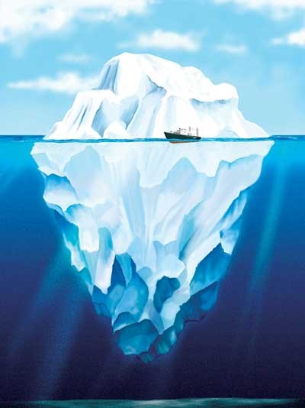
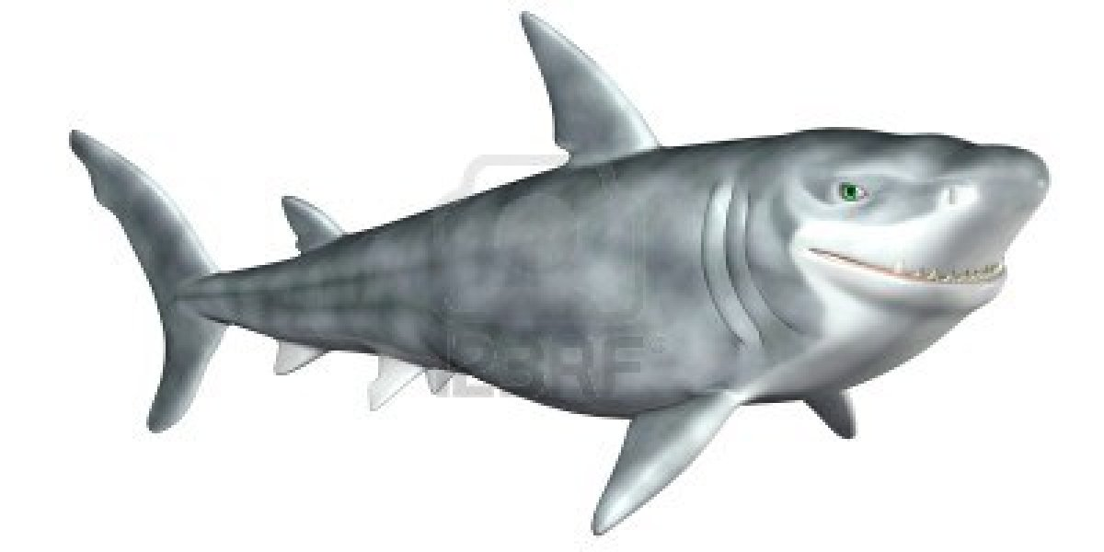
What are the root causes of low and unequal achievement?
Matric pass rate
Subject choice
No. endorsements
Throughput
Media sees only this→
Quality?
MATRIC
Pre-MATRIC
50% dropout
Low curric coverage
Weak culture of T&L
Low accountability
Vested interests
Low time-on-task
No early cognitive stimulation
Low quality teachers
HUGE learning deficits…

Slide 10
Matric 2014 (relative to Gr 2 in 2004)
 | Numbers
Grade 2 (2004) | 1085570
Grade 9 (2011) | 1049904
Grade 12 (2014) | 532860
Passed (2014) | 403874
Bachelors (2014) | 150752
550,000 students drop out before matric
99% do not get a non-matric qualification (Gustafsson, 2011: p11)
What happens to them? 50% youth unemployment…

Slide 11
Labour Market
15%
Legislators, managers, assoc professionals
Unemployed
(Broad - 35%)
Unskilled
(18%)
Elementary occupations & domestic workers
Semi-Skilled (32%)
Clerks, service workers, shop personnel, skilled agric/fishery workers, plant and machinery operators)
University/FET
Type of institution (FET or University)
Quality of institution
Type of qualification (diploma, degree etc.)
Field of study (Engineering, Arts etc.)
High productivity jobs and incomes (15%)
Mainly professional, managerial & skilled jobs
Requires graduates, good quality matric or good vocational skills
High quality secondaryschool
High SES background
High quality primary school
ECD
Minority (20%)
Some motivated, lucky or talented students make the transition
Unequal society
Big demand for good schools despite fees
Some scholarships/bursaries
Vocational training
Affirmative action
(few make this transition)
Majority (80%)
Quality
Low quality secondary
school
Attainment
Type
Low productivity jobs & incomes
Often manual or low skill jobs
Limited or low quality education
Low socioeconomic status background
Low quality primary school
ECD
None or
low-quality
Statistics from Quarterly Labour Force Survey (QLFS) 2014 Q4
Notes:
The QLFS classifies professions as follows: Highly skilled (legislators, senior officials and managers, professionals, technicians and associate profesionals); Semi-skilled (Clerks, service workers and shop and market personnel, skilled agricultural and fishery workers, craft and related trade workers, plant and machinery operators and assembly), Unskilled (Elementary occupations, domestic workers).

Slide 12
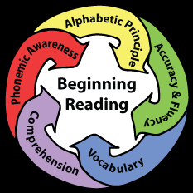
Teaching reading
U.S. National Reading Panel (2000)
Identified 5 core components to reading
Phonemic awareness
  The ability to hear, identify & manipulate individual sounds/phonemes in spoken words and understanding that spoken words and syllables are made up of speech sounds.
Alphabetic Principle
  The basic concept that words are made up of letters that represent segments of speech; the systematic relationships between letters & sounds/phonemes
Vocabulary
  Involves word knowledge, word instruction and word learning strategies & usage
Comprehension
  The process of constructing meaning from written text
Fluency
  The ability to read connected text quickly, accurately and with meaningful expression (prosody)

Slide 13
Access to library books at SCHOOL
Source: DBE (2015) Action Plan to 2019

Slide 14
Access to library books at HOME

Slide 15
Teachers do not teach reading
No individual reading by learners was seen in 83% of classes observed by NEEDU (2013)
No independent writing in 90% of classes
In NSES 2007/8/9 (268 schools) there was no paragraph writing done in the year in 44% of grade 4 and 32% of grade 5 classes (Taylor, Van der Berg & Mabogoane, 2013)
In a 2013 NEEDU survey of 214 rural schools in South Africa:
  11% of Grade 5 students could not read a single word in English in Gr5
  In the Eastern Cape 17% could not read a single word in English in Gr5
  42% were reading so slowly that they did not understand what they were reading in Gr5
  In the Eastern Cape 48% were reading so slowly that they did not understand what they were reading in Gr5
  (See Draper & Spaull, 2015)

Slide 16
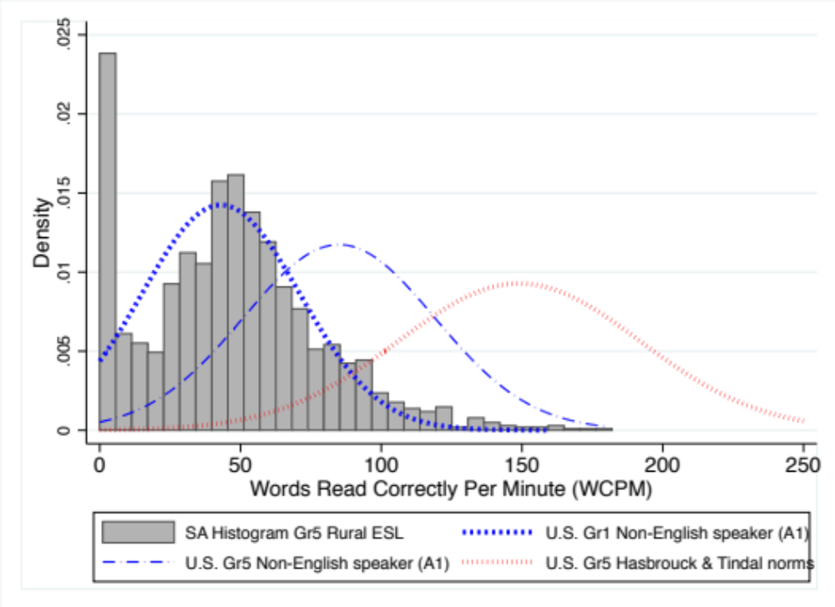
NEEDU Reading Study (2013)
Grade 5 Oral Reading Fluency in context
(Draper & Spaull, 2015)
Notes:
From Draper & Spaull, 2015.

Slide 17
Teaching reading in SA
Hoadley (2015) summarizes the SA classroom-based research and finds the following descriptive features:
  Lack of opportunities for reading and writing (oral teaching dominates)
  Classroom interaction patterns characterized by chorusing
  Weak forms of assessment and lack of feedback on student responses
Similarly Pretorius & co-authors have found that a number of instructional practices (prevalent in SA) contribute to poor reading development:
  The tendency of teachers to rely on whole class oral chorusing of reading,
  The lack of reading homework
  Minimal reading of extended texts in the early grades
  (Pretorius & Machet 2004; Pretorius & Mokhwesana 2009; Pretorius 2014).

Slide 18
Advice for VW Foundation
Excellent goal: “Ensure that every child in XYZ district is functionally literate by age 10”
Establish a base-line estimate of the current rate of functionally literate 10 year-old children in these areas (to compare to later).
Evaluation: Appoint an independent service provider to assess reading and comprehension skills of a large random sample of 10 year olds in these areas every 3 years.
  Develop/establish reading norms in isiXhosa. Set clear guidelines as to what constitutes a ‘functionally literate’ student.
  Independence of the evaluator is key.
Making mistakes is OK as long as we learn from them. Share what does AND DOESN’T work.
Incorporating ‘solutions’ into the classroom not just after-school. Students are in school for 200 days per year. We need to utilize the time they are in school. Teachers need to improve their teaching and learn how to teach reading and be given books, graded-readers etc.

Slide 19
Closing remarks
Commend VW Foundation for selecting a well-specified goal that is achievable
Be aware of the political context of the EC. You cannot solve a political problem with a technical solution.
No education system can (in the long-run) move beyond the capacity of its teachers. We need to teach our teachers how to teach reading and then monitor it
As with almost all areas of weakness in South Africa it is a function of BOTH (1) lack of capacity, and (2) lack of accountability/consequences

Slide 20
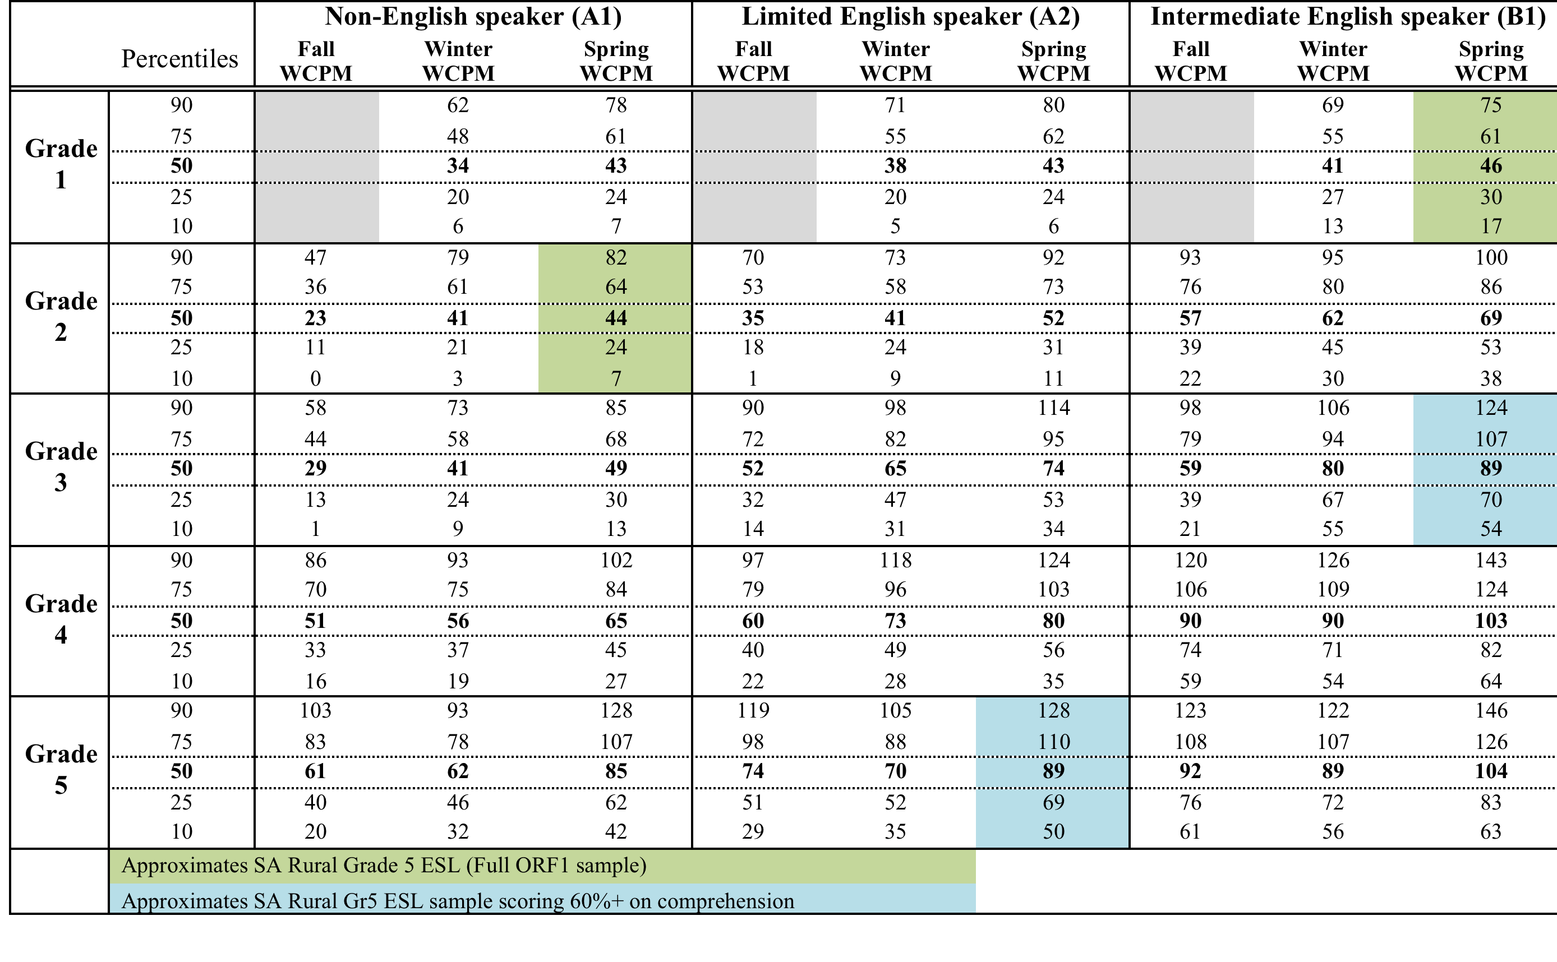
Table 13: Oral Reading Fluency scores for English Second Language (ESL/ELL) in Broward County Public Schools (Florida, US) (Broward County, 2012)

