Slide 1


Alleviating Binding Constraints to Quality Education for the Poor
Using evidence-based prioritization to overcome the implementation challenge
Research Team:
Servaas van der Berg, Nic Spaull, Martin Gustafsson, Gabrielle Wills, Chris van Wyk, Dumisane Hompashe, Hendrik van Broekhuizen, Janeli Kotze, Rapi Mogorosi
(DBE associates: Carol Nuga Deliwe & Nompumelelo Moholwane)
Grantee Policy Engagement Workshop | 17 – 18 March 2016 | Premier Hotel, Pretoria

Slide 2


Problem statement
For the past 20 years SA DBE has taken a ‘do-everything’ approach; all issues need a policy, people, budget, indicators etc.
When you have 59 priorities they are not priorities
Limited capacity and limited budget means this strategy does not work
  “The limited capacity of managers and planners to prioritise represents a further fundamental problem…Too many priorities, each linked to complex reporting procedures, are likely to overload the system. As demonstrated by the current plan, and the technical documentation that accompanies it, getting just one indicator right can involve considerable technical work. Clearly, indicators need to be chosen carefully and the number of indicators needs to be limited” (DBE Action Plan, 2015: p19).
Starting points:
  How to prioritize? → Binding Constraints Approach (Hausmann, Klinger, & Wagner, 2008)
  What to prioritize?
  Addressing the identified priorities
  Focus on our comparative advantage (existing quantitative data)
  Collaborate with qualitative education researchers

Slide 3

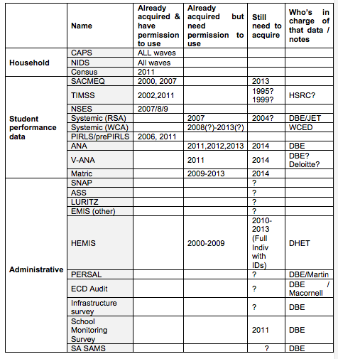
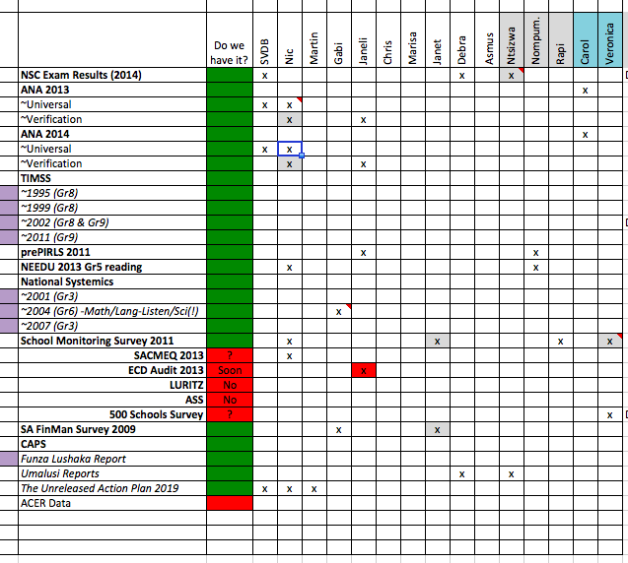


Stages in the research project
Capacity building:
5 PhD students
1.5 masters students
1.5 DBE associates
YAY: Congratulations and brain-storming ☺
Work-scheduling: Who is available to do what, when?
How much of the puzzle can we see?
  Literature review and re-review
  Meetings with ourselves, policy-makers, academics, NGOs
Which missing pieces are discoverable?
  (Focusing on answerable questions that we don’t have the answers to but can get them)
  ECD: ECD Audit 2013 – was unanalyzed
  Teacher production - HEDA data not previously available
  Reading fluency – NEEDU 2013
  Principals – PERSAL data

Slide 4
Outputs resep.sun.ac.za/outputs
7 Journal articles – special issue of SAJCE
  Kotze, J. 2015. Can pre-grade R be the stepping stone to social equality in South Africa? South African Journal of Childhood Education. Vol 5(2) pp1-27
  Van der Berg, S. 2015. What the Annual National Assessments can tell us about the learning deficits over the education system and the school career. South African Journal of Childhood Education. Vol 5(2) pp28-43
  Draper, K & Spaull, N. 2015 Examining oral reading fluency among Grade 5 rural English second Language (ESL) learners in South Africa: An Analysis of NEEDU 2013. South African Journal of Childhood Education. Vol 5(2) pp44-77
  Van der Berg, S & Shepherd, D. 2015. Continuous assessment and matriculation examination marks – an empirical examination. South African Journal of Childhood Education. Vol 5(2) pp78-94
  Wills, G. 2015 Informating principal policy reforms in South Africa through data-based evidence. South African Journal of Childhood Education. Vol 5(2) pp95-122
  Armstrong, P. 2015. Teacher characteristics and student performance: An analysis using hierarchical linear modeling. South African Journal of Childhood Education. Vol 5(2) pp123-145
  Van wyk, C. 2015 An overview of education data in South Africa: An inventory approach. South African Journal of Childhood Education. Vol 5(2) pp146-170
9 Working papers – SUN EKON WP
  All of the above except Van der Berg & Shepherd.
  Gustafsson. 2016. Teacher supply and the quality of schooling in South Africa. Patterns over space and time. Stellenbosch Working Paper Series No. WP 03/2016
  Gustafsson, M & Taylor, S. 2016. Treating schools to a new administration: Evidence from South Africa of the impact of better practices in the system-level administration of schools. Stellenbosch Working Paper Series No. WP 05/2016
  Van Broekhuizen. H. 2015. Teacher Supply in South Africa: A Focus on Initial Teacher Education Graduate Production. Stellenbosch Working Paper Series No. WP 07/2015
1 Literature review: Hoadley → Forthcoming in SAJCE
6 policy briefs

Slide 5

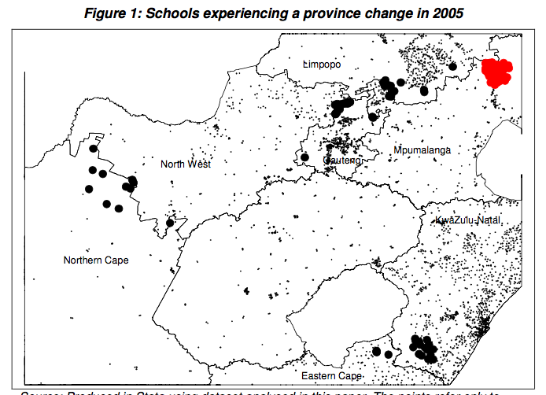
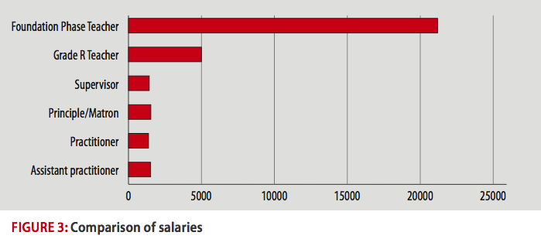
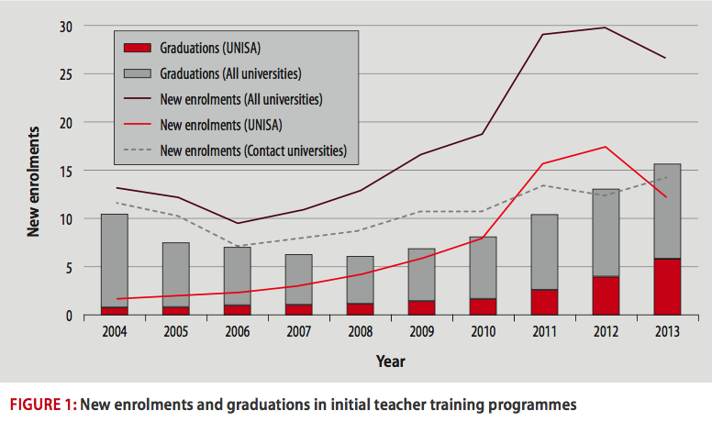
Key new puzzle pieces
Measuring the impact of a school being in a more functional provincial bureaucracy
  Gustafsson & Taylor (2015)
  Movement from NW→GP associated with a years worth of improvement in a fast-improving country
First detailed analysis of Oral Reading Fluency in South Africa
  Gr5 rural ESL students in SA are reading at approximately the same level as Gr1/2 remedial ESL students in Florida
  41% of sample were non-readers in English
3. New analysis of principal labour- market
  In 2004 17% principals ages 55+, in 2012 33%
  Low inter-quintile & inter-provincial movements
First proper analysis of ECD Audit 2013
  Kotze(2015)
  Average ECD practitioner in SA earns between R1400-R2000 per month
Analysis of teacher production
  Between 2008 and 2013 UNISA accounted for 48% of all new initial teacher enrolments and about a third of new graduates

Slide 6
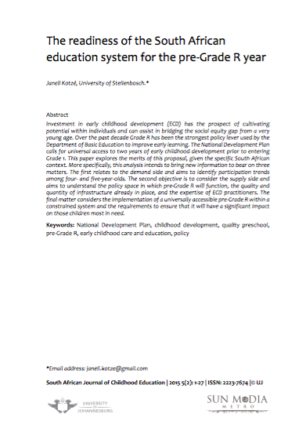
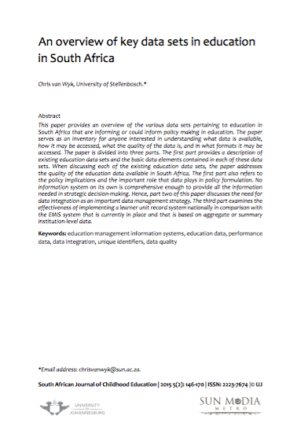
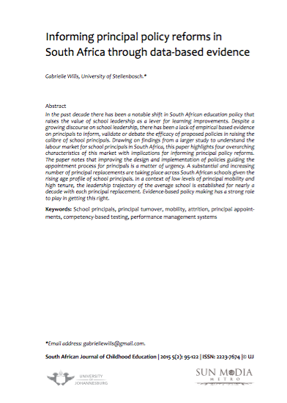

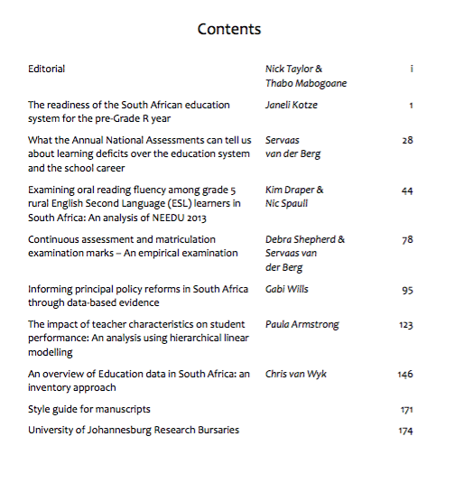
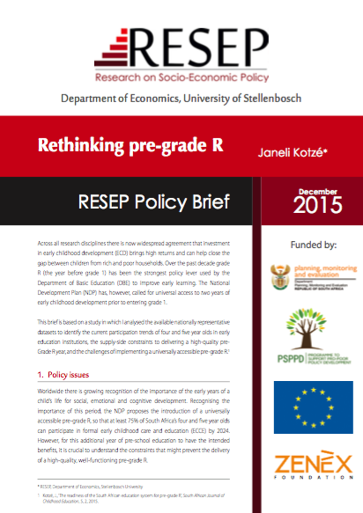
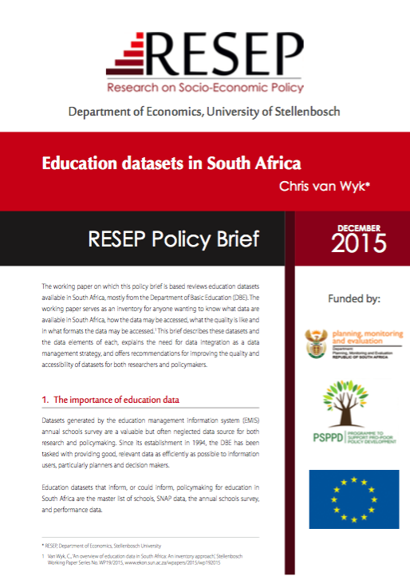
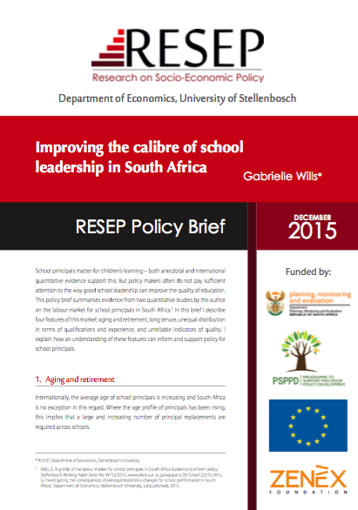

Slide 7
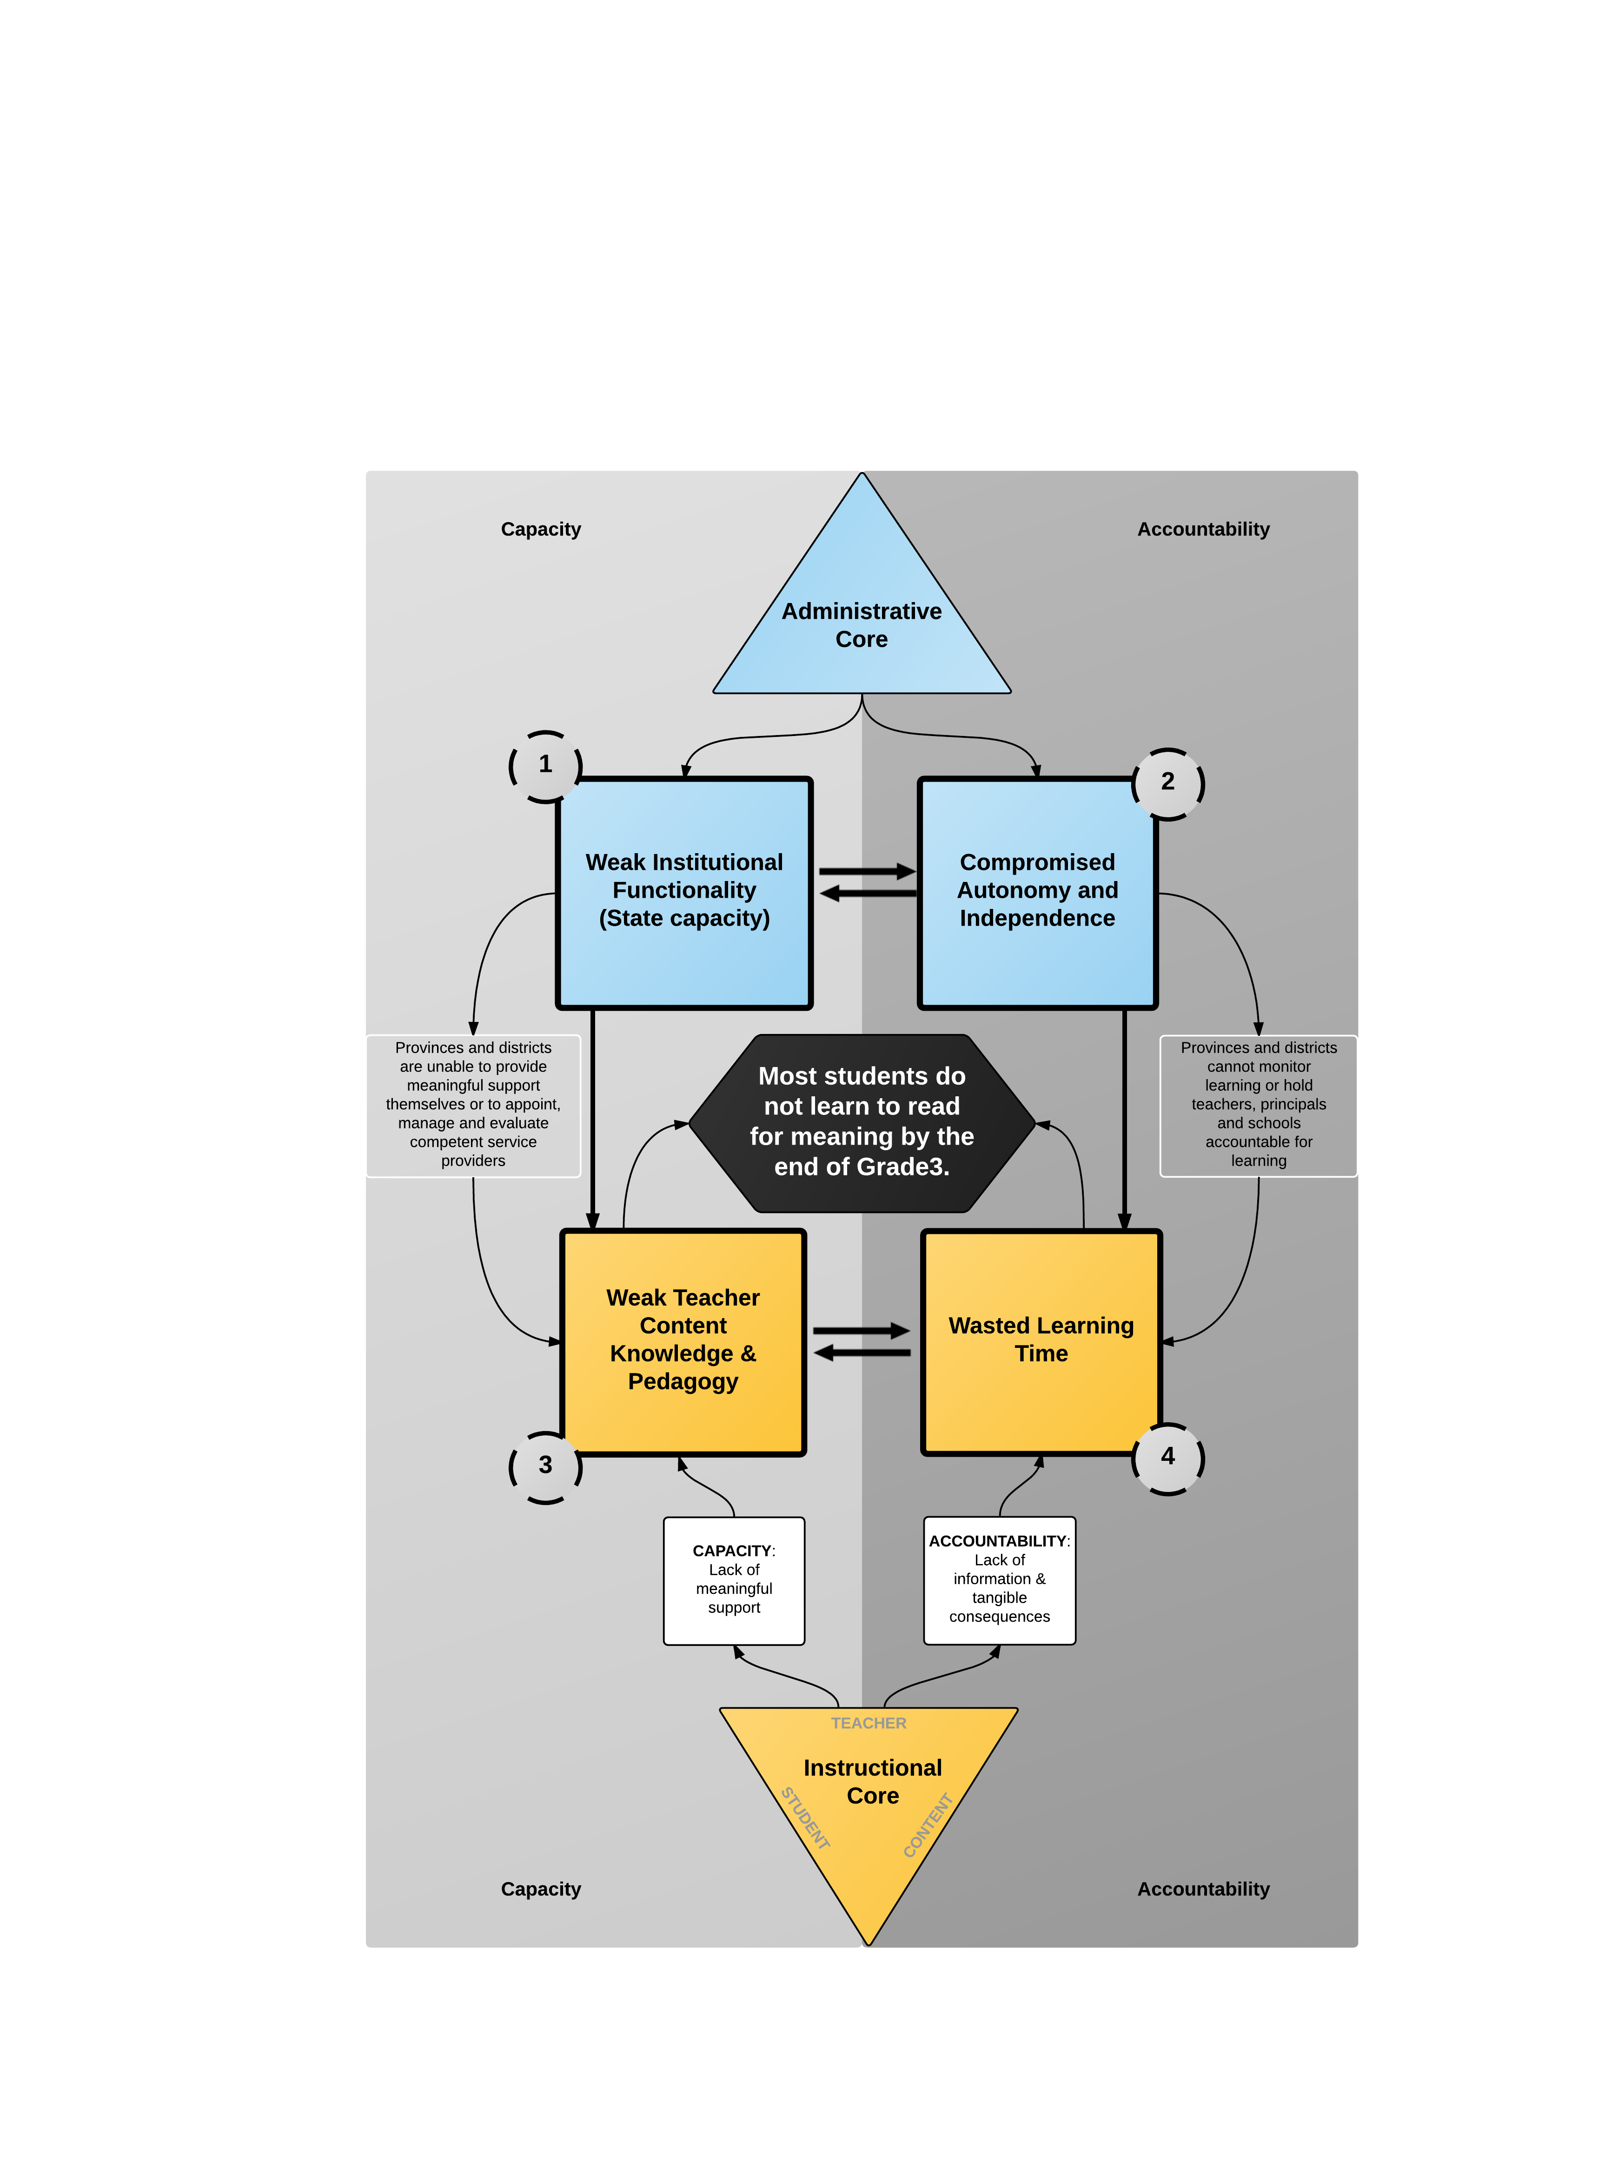
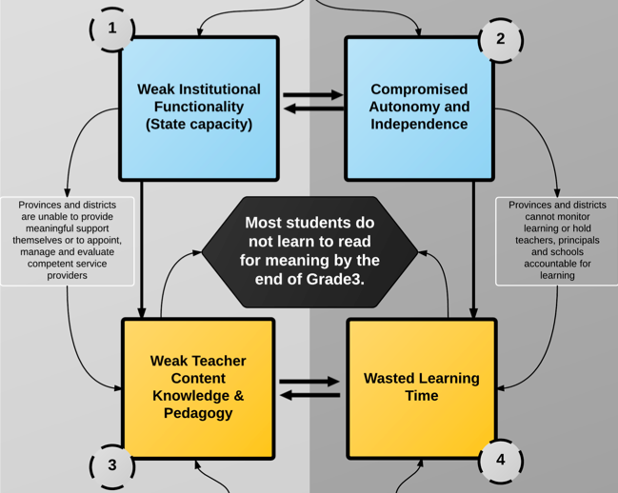

Slide 8
Tangible reading recommendations
Reading as a unifying goal for early primary schooling. The single most important goal for the first half of primary school should be the solid acquisition of reading skills such that every child can read fluently and with meani ng in their home language by the end of Grade 3 and read fluently and with meaning in English by the end of Grade 4. This goal is easily communicated and understood by parents, teachers and principals and is relatively easy to measure and monitor. The benefit of having a single unifying goal to focus attention, energy and resources should not be underestimated.
The majority of primary school teachers do not know how to teach reading in either African languages or in English. This is evidenced by the cripplingly low oral reading fluency scores in grade 5. These students cannot engage with the curriculum (which is now in English in Grade 5) and hence fall further and further behind as the reading material and cognitive demands become more and more complex. There is a clear need to convene a group of literacy experts to develop a course to teach Foundation Phase teachers how to teach reading. This course should be piloted and evaluated and if it is of sufficient quality should become compulsory for all Foundation Phase teachers in schools where more than 50% of students do not learn to read fluently in the LOLT by the end of Grade 3.
The need for evidence-based interventions, evaluations and sustained support. Much of the policy energy that has been expended in the last 10 years has been sporadic and haphazard. Successful programs (like the SMRS) are not pursued while new initiatives are funded (but not evaluated) without a clear understanding of how they improve on or learn from previous initiatives. Any new national literacy drive needs to be piloted, independently evaluated and only taken to scale if and when it is proved to be effective. This should be seen as a medium-to-long term goal rather than a short-term goal.
Declare early literacy research (particularly in African languages) a National Research Foundation (NRF) Research Priority Area. Given the scale of the reading crisis and the lack of research on African languages at South African universities (particularly relating to early literacy in African languages), the NRF should declare this to be a national priority and dedicate significant resources to those researchers and departments with the skills and expertise needed to understand more about how children learn to read in African languages and which interventions are most promising.
Establish oral reading fluency norms for South Africa’s African languages. Although there are already oral reading fluency norms for the English language, there are none for the African languages. It is also not possible to translate English norms into African language norms since the language structure (morphology) is different with English being an analytic language and African languages being agglutinating languages. Without these norms it is not possible to reliably measure and benchmark children’s oral reading fluency in African languages.

Slide 9
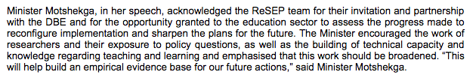


Policy Engagement Plan
(1) Special issue of SAJCE
Promote new local journal
(2) Policy Briefs
Accessible research for busy-bee policymakers yet linked to detailed peer-reviewed article
(3) Engagement Conference
About 60 invited high-level academics, government officials and media
Engage academics through peer-review
Influential guest editors: Taylor & Mabogoane
Deadlines for researchers
Teaches researchers to write in different registers
Minister was the keynote (& remained and listened to presentations)

Slide 10



Engagement lessons we’ve learned
GOVT: The demand-for and supply-of evidence/information
  Sometimes possible to create the demand for what you are supplying
  Example of progressed learners in matric
GOVT: Give credit (& criticism) where it’s due
  Gain credibility – example of ANA task-team
  Always praising →suck-up / sycophant
  Always criticizing → chip on your shoulder
MEDIA: Doing journalist’s jobs for them helps everyone
  Journalists are lazy and busy. Give them quotes/angles/boiler-plate etc. (make it interesting!)
  Keeping an excel sheet of journalists contacts
  Answering journalists ALWAYS when they ask for comment (& promptly)
MEDIA: Finding a sexy angle that doesn’t distort results can make your research news-worthy. Perfectionists and technicists aren’t media-friendly. Explaining why something is ‘new’ or ‘topical’ also helps.
(PSPPD useful channel to get data that’s otherwise ungettable)

Slide 11

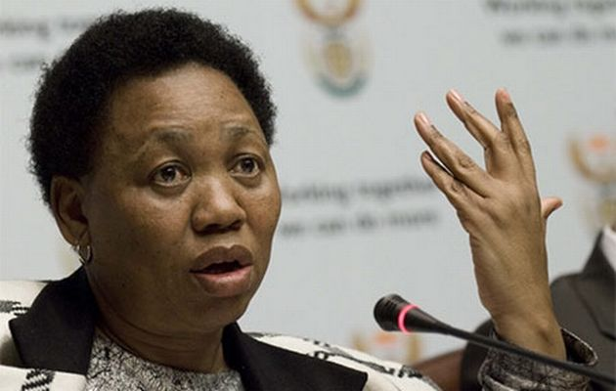



Spheres of Influence Diagram:
Mapping of actors influencing the policy arena
PARENTS
PUBLIC
ACADEMIA
MEDIA
NGOs
INTERNATIONAL COMMUNITY
UNIONS
Provincial-DOEs
Sphere of control
Sphere of Influence

Slide 12


Thoughts for PSPPD
Facilitating agenda-setting workshops with high-level academics (both within and across disciplines)
  Gaining consensus among different groups about major problems and major unknowns (FP reading vs matric) (teen-pregnancy vs obesity)
  This is a professional discussion without concrete outcomes but is highly valuable for coalition building
Seeing journalists as an explicit part of the policy stream
  Arrange for education training by academics. (M&G Bhekisisa)
Giving media-engagement workshops with PR-experts on how to package results to media
  Why is it that private sector recognises this is a professional skill and pays dearly for it. But in academia/government we think we’ll just wing it?
  PSPPD hire Ogilvy (or similar) for engagement at end of projects. Bring together similar projects like all PSPPD education and have one workshop

Slide 13
Contact details
Research on Socioeconomic Policy (ReSEP)
Economics Department
Schumann Building, Room 508
Stellenbosch University
7602
(office): 021 808 2239
(email): svdb@sun.ac.za / nicholasspaull@gmail.com
(web): resep.sun.ac.za

Slide 14
