Slide 1

AFTER SCHOOL
Dr Nic Spaull | www.NicSpaull.com | 16th Feb 2017
SYMPOSIUM
2017
Logo – Design Thinking Australia . com

Slide 2
1
The quality imperative
2
The centrality of monitoring & evaluation
4
Reasons why after-school is important
5
steps to effective interventions

Slide 3
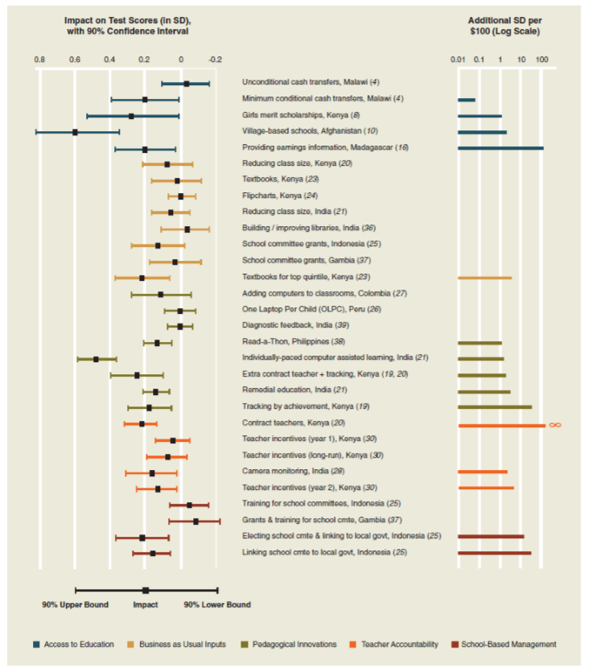
Impacts on test scores from 30 randomized control trials of primary school programs in the developing world
(Kremer, Brannen & Glennerster, 2013)

Slide 4

‘Quality in a product or service is not what the service provider puts in. It is what the child gets out … A product or service is not quality because it is hard to make and costs a lot of money, as suppliers typically believe, but because the child is demonstrably (& measurably) better off.
-Peter Drucker (with poetic license)
-Peter Drucker (with poetic license & applied to education)

Slide 5





4 Reasons why after school is important
(1) Extending opportunity to learn
(2) Crowding in resources & expertise & utilising existing resources
(3) Building socio-emotional skills
(4) Providing a space for innovation

Slide 6
5
steps to effective interventions

Slide 7
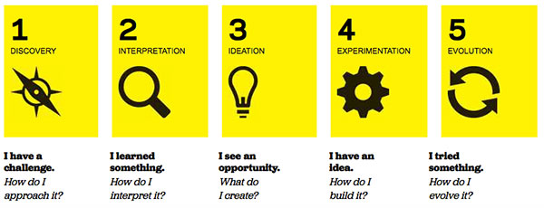
PROBLEM
BINDING CONSTRAINTS
THEORY OF CHANGE
EVALUATION
FEEDBACK LOOPS
What is the specific problem we are addressing?
We can describe the problem and know how widespread this problem is.
What are the binding constraints in this problem?
We can identify the most important causes of this problem & they are solvable.
How does our intervention address the binding constraint?
We can describe in comprehensive detail all our assumptions & how and why we think our intervention has an effect (& cost/learner).
How do we know if our intervention is working?
We have a plan for measurement, & monitoring (internal) and evaluating (external) whether our intervention is working.
What are we learning about what is & isn’t working?
We have a system of feedback loops from providers & recipients to tell us what is & isn’t working (& maybe why).

Slide 8
PROBLEM
BINDING CONSTRAINTS
THEORY OF CHANGE
EVALUATION
FEEDBACK LOOPS
What is the specific problem we are addressing?
We can describe the problem and know how widespread this problem is.
What are the binding constraints in this problem?
We can identify the most important causes of this problem & they are solvable.
How does our intervention address the binding constraint?
We can describe in comprehensive detail all our assumptions & how and why we think our intervention has an effect (& cost/learner).
How do we know if our intervention is working?
We have a plan for measurement, & monitoring (internal) and evaluating (external) whether our intervention is working.
What are we learning about what is & isn’t working?
We have a system of feedback loops from providers & recipients to tell us what is & isn’t working (& maybe why).

Slide 9
PROBLEM
BINDING CONSTRAINTS
THEORY OF CHANGE
EVALUATION
FEEDBACK LOOPS
What is the specific problem we are addressing?
We can describe the problem and know how widespread this problem is.
What are the binding constraints in this problem?
We can identify the most important causes of this problem & they are solvable.
How does our intervention address the binding constraint?
We can describe our intervention in detail (+ costs & assumptions), as well as how & why we think it will have an impact.
How do we know if our intervention is working?
We have a plan for measurement, & monitoring (internal) and evaluating (external) whether our intervention is working.
What are we learning about what is & isn’t working?
We have a system of feedback loops from providers & recipients to tell us what is & isn’t working (& maybe why).

Slide 10
PROBLEM
BINDING CONSTRAINTS
THEORY OF CHANGE
EVALUATION
FEEDBACK LOOPS
What is the specific problem we are addressing?
We can describe the problem and know how widespread this problem is.
What are the binding constraints in this problem?
We can identify the most important causes of this problem & they are solvable.
How does our intervention address the binding constraint?
We can describe our intervention in detail (+ costs & assumptions), as well as how & why we think it will have an impact.
How do we know if our intervention is working?
We have a plan for measurement, & monitoring (internal) and evaluating (external) whether our intervention is working.
What are we learning about what is & isn’t working?
We have a system of feedback loops from providers & recipients to tell us what is & isn’t working (& maybe why).

Slide 11
PROBLEM
BINDING CONSTRAINTS
THEORY OF CHANGE
EVALUATION
FEEDBACK LOOPS
What is the specific problem we are addressing?
We can describe the problem and know how widespread this problem is.
What are the binding constraints in this problem?
We can identify the most important causes of this problem & they are solvable.
How does our intervention address the binding constraint?
We can describe our intervention in detail (+ costs & assumptions), as well as how & why we think it will have an impact.
How do we know if our intervention is working?
We have a plan for measurement, & monitoring (internal) and evaluating (external) whether our intervention is working.
What are we learning about what is & isn’t working?
We have a system of feedback loops from providers & recipients to tell us what is & isn’t working (& maybe why).

Slide 12
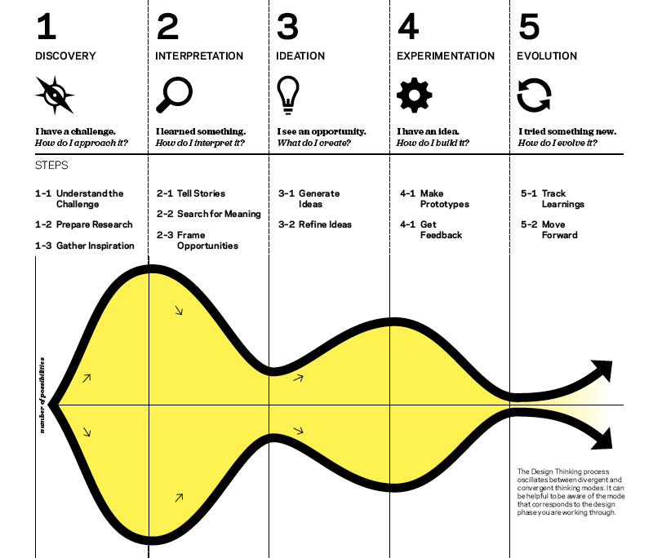
PROBLEM
BINDING CONSTRAINTS
THEORY OF CHANGE
EVALUATION
FEEDBACK LOOPS
What is the specific problem we are addressing?
We can describe the problem and know how widespread this problem is.
What are the binding constraints in this problem?
We can identify the most important causes of this problem & they are solvable.
How does our intervention address the binding constraint?
We can describe in comprehensive detail all our assumptions & how and why we think our intervention has an effect (& cost/learner).
How do we know if our intervention is working?
We have a plan for measurement, & monitoring (internal) and evaluating (external) whether our intervention is working.
What are we learning about what is & isn’t working?
We have a system of feedback loops from providers & recipients to tell us what is & isn’t working (& maybe why).

Slide 13
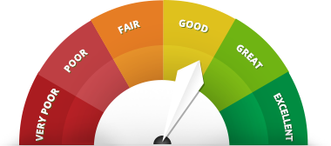
The importance of rigorous evaluation
In the absence of a rigorous independent evaluation, how can we reliably know if an intervention is working or not?
As a rule of thumb NGOs & interventions should allocate 5-10% of their overall budget for evaluation.

Slide 14
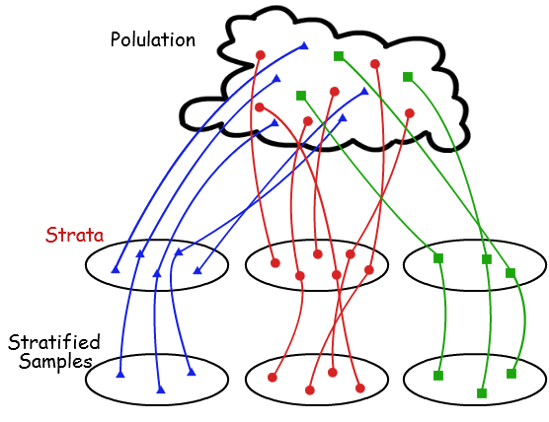
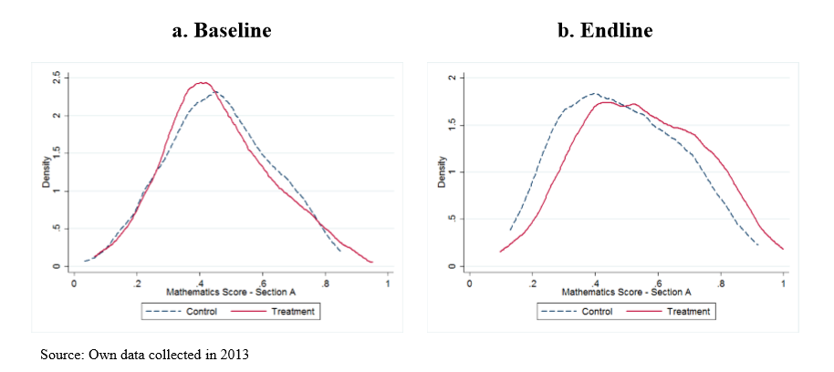
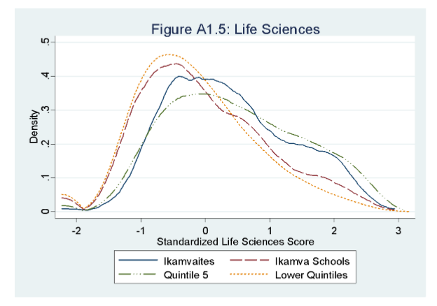
The importance of rigorous evaluation
Numeric
  Coaches and Khan Academy videos
  Randomized control trial (RCT) – 472 learners from 9 schools (Bohmer, 2014)
    236 treatment
    236 control
  Improvements of about 1 year of learning (0.25-0.32 SD)
Ikamva Youth
  Analysis of matric results & Systemic Evaluations by McLean & Van der Berg (2016) using value-added approach. (50-186 learners)
  Improvement of between 1/10th and 1.5 years gain depending on subject & sample

Slide 15
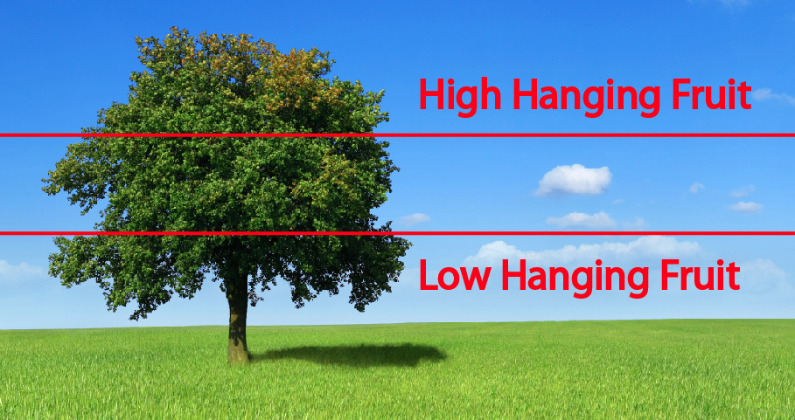
Using the WC Systemic Evaluations
Unlike the other 8 provinces, the Western Cape has a standardized, externally-marked exam conducted every year called the Systemic Evaluations.
  ALL Grade 3, 6 and 9 in WC → Mathematics & Language
A major cost to evaluation is assessment, yet this assessment is (POTENTIALLY) readily available to evaluators on an individual level.
Currently VERY difficult to get access to Systemic results from WCED even for bona-fide partners. Solvable problem.

Slide 16

Major questions we still have:
Is there enough collaboration between Department of Cultural Affairs and Sport (DCAS) and WCED? WCED clearly bigger player wrt schools.
Are our after-school interventions of high enough quality and dosage to effect change? (go deeper rather than wider!)
Are existing after-school programs being evaluated rigorously and independently?
Is there a plan to ensure the sustainability of these initiatives so they aren’t just flash-in-the-pan interventions that stop as soon as the initial grant/plan runs out?

Slide 17
AFTER SCHOOL
Dr Nic Spaull | 16th Feb 2017
www.nicspaull.com
SYMPOSIUM
2017

Slide 18


