Slide 1
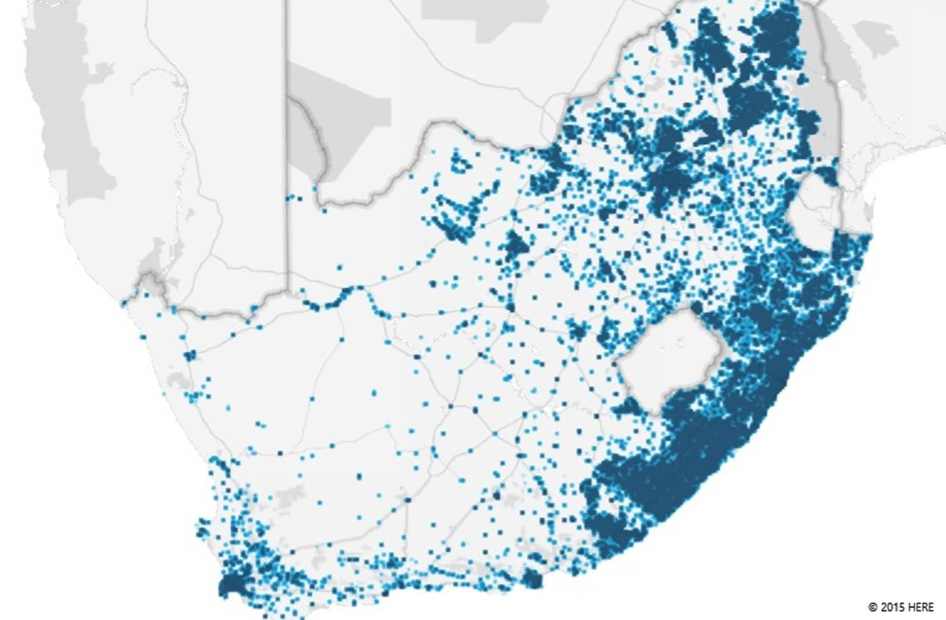
An economist’s view on education
Siyavula Science Conference
Gabrielle Wills & Nic Spaull
1 August 2015
Notes:
Thank you Mark and your team for inviting me to speak at this conference today. It is always a great privilege to speak about something that I not only feel passionate about but is a national priority, and something every South African should care about. But first, a brief introduction.
I am researcher at ReSEP which stands for Research on Social and Economic Policy at the University of Stellenbosch. In addition to various social issues that are worth investigating in South Africa, a strong research focus in our unit is education. As a researcher South African education provides a fascinating landscape to investigate. It is notably flawed and terribly underresearched from a quantitiative perspective.

Slide 2
Public schools:
24 060 schools
12,1 million children
390 000 educators
Notes:
You may be the teacher in one school and have seen students pass through your classrooms year after year. You have no doubt had your experience first hand of education in South Africa, and seen the impacts of a system on individual lives.
But for the next 40 minutes, I hope to provide you with a picture of the bigger education context, one with nearly 25000 public schools as represented by the black dots above where currently ___million children attend school and nearly 400,000 educators are employed to serve these students.

Slide 3

Road Map
A brief overview of the South African education system: Educational Attainment ≠ Educational Quality
How doe the top part of the system fare internationally?
Is system improvement possible?
Notes:
There are three broad parts to this presentation.
In the first part I will provide you with an economists perspective of the state of learning in South African schools. I will start by providing you with a brief overview of some successes in education in the past 20 years, then focus on how we are doing in terms providing education access to South African children. I first talk about this in respect of educational attainment. However the discussion on educational attainment is then contrasted against the more important notion of the quality of education, whether learning is actually taking place among those who are in school.
In the second section of the presentation, I will focus on the performance of students at the top end – the wealthiest and the best academically to see how they are faring internationally. I hope that by the end of this presentation, whether you are teaching in a poor or wealthier school, an underperforming or well-performing school that you will be challenged to see the need for substantial improvements in learning across the entire system, in every school.
Despite the reality presented to you today which to be honest can be quite despairing, I will end with another reality. One where improvement is possible. A reality that justifies why we are here today and why we do what we do.

Slide 4
A brief overview

Slide 5
Some good news first
Considerable redistribution of spending to the poorest schools… government spending is nearly equalised across the poorest and wealthiest schools.
In terms of government spending, education is prioritised in national budgets.
Amount allocated in 2014/15
+/ R189.5 billion
% of total govt. exp in 2014/15
+/ 15.2%
Expected Growth in 2015/16
7.6%
Notes:
Before we go any further, I think its necessary to celebrate some successes in our system. In post Apartheid we have seen substantial changes at an administrative level with considerable redistribution of spending to the poorest schools.
We have almost got a point where government spending has nearly equalised across the poorest and wealthiest schools.
Education has also been prioritised as identified in spending of the national budget. Nearly R190 billion was spent by government on education in the 2014/15 FY. As a % of total government expenditure this amounts to 15% and will continue to grow at above inflation in the next financial year. By developing country standards we are spending a notable amount of money on education even when expressed as a proportion of GDP. Of course whether this is being efficiently used is another question?
OLD:
Figures from 2012 Public Expenditure Analysis report for UNICEF/DBE (Oxford Policy Management / Stellenbosch Economics) Education exp = 6.1% of GDP
Personnel exp = 78% of educ exp |Personnel exp = 4.8% of GDP

Slide 6
Some good news first
Considerable redistribution of spending to the poorest schools… government spending is nearly equalised across the poorest and wealthiest schools.
In terms of government spending, education is prioritised in national budgets.
Nutrition programme expanded to 6 million learners (NPC 2012:302)
Participation in pre-school education has dramatically increased over the past decade largely due to the expansion of the Grade R programme.
Considerable improvements in access to education.
  Nearly universal access of children to schooling, even high secondary enrolment ratios relative to developing world.
  97% participation for the cohort 7 to 15 years
  83% for 16 to 18 year olds (NPC 2012:302)
Notes:
We have seen a notable expansion of the nutrition programme in post Apartheid South Africa which has expanded to 6 million learners. In this respect education is serving an important role in child nutrition.
There has also been a dramatic expansion of pre-school education and specifically, the Grade R programme.
And then of course, we have seen substantial improvements in access to education. We have achieved nearly universal access of children to schooling, and even high school secondary enrolment ratios are high relative to the developing world. Roughly 97% of children aged 7 to 15 are in school and among 16-18 year olds about 83% are in school (NPC 2012).

Slide 7
Mean years of education by race & birth cohort, 2011
Source: van der Berg (2011), Census 2011 (supercross)
Notes:
The following figure provides a strong graphical picture of the improvement in educational attainment in South Africa. In the following graph prepared by Servaas van der Berg using Census 2011 data, he provides a typical way of looking at educational access by comparing the total educational attainment of different age cohorts.
The oldest group were born in 1920 and the youngest were born in 1990, they would have been 21 at the time of the Census.
On average a person born in 1940 had 5 years of education but this had increased to 11 years for those born in 1990 (in other words 21 years old) in 2001.
What is the most evident is how educational attainment has improved considerably among non-whites, closing the race gap in educational attainment.

Slide 8
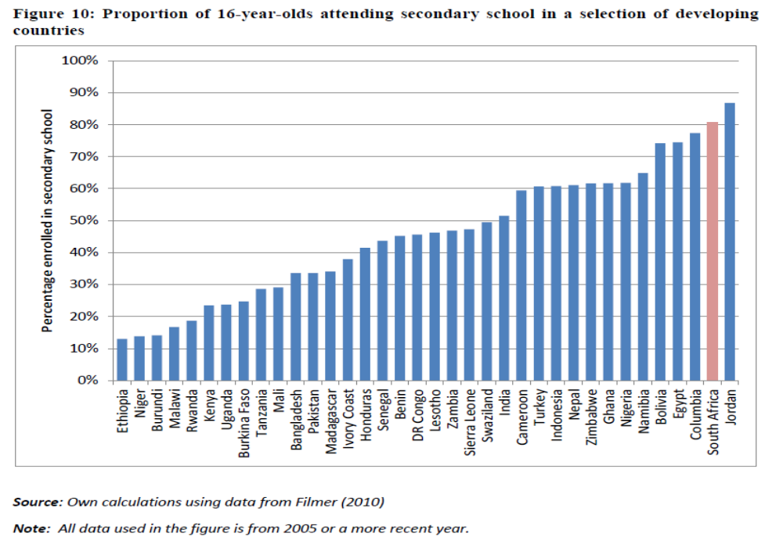
Proportion of 16 year olds attending secondary school in a selection of developing countries
Source: S. Taylor using data from Filmer (2010)
Notes:
In this next figure secondary enrolment rates in South Africa are contrasted against a select number of developing countries; it is quite clear that we have high levels of secondary enrolment by international standards.

Slide 9
But…
Enrolment rates, however, paint an overly optimistic picture of education in South Africa and mask various internal systemic inefficiencies.
Notes:
Enrolment rates, however, paint an overly optimistic picture of education in South Africa and mask various internal systemic inefficiencies.
It has become increasingly clear over time by economists and educations across the world that despite notable improvements we have seen internationally in educational attainment, this has not been met with commensurate levels of learning.
Whilst human capital as measured by years of schooling has featured as strong predictor of economic growth in cross-country analyses, the inclusion of test scores in this type of analysis has provided a stark illustration of how deceptive years of schooling can be as a measure of human capital.
This realisation has contributed towards a shift in policymaking, from years of schooling alone, to years of schooling and what children actually learn.
To be blunt, what does is matter if you have 10, 11 or 12 years of education but you are barely literature or have not achieved a basic level of numeracy? We don’t just need to provide access to schooling, we need an education system that contributes to a productive society where each and every individual has realised their potential in some way.

Slide 10
But what about quality?
Notes:
I showed you quite clearly that access too education in terms of educational attainment is not much of a problem. We are doing well in this regard. However the quality of education and learning that takes place leaves much to be desired.

Slide 11
Matric Pass “the holy grail"
Source: Compilation based on Department of Basic Education, Education Statistics in South Africa, 2006 – 2009, Taylor (2011)
Notes:
Lets start with a very poor measure of quality, the much revered matric pass rate. Since the introduction of the National Senior Certificate in 2008 we have seen a notable increasing trend in mathematics pass rates which some may take as indicator of rising levels of learnings.
The matric pass rate has historically been one of the only measures of school success, and it is no surprise that an overt emphasis has been placed on this as a metric of education quality. Regardless of whether matric rates increase, decrease or remain stagnant, it provides a highly inadequate metric for measuring the performance of education our system.

Slide 12





State of SA education since transition
“Although 99.7% of South African children are in school…the outcomes in education are abysmal” (Manuel, 2011)
“Without ambiguity or the possibility of misinterpretation, the pieces together reveal the predicament of South African primary education” (Fleisch, 2008: 2)
“Our researchers found that what students know and can do is dismal” (Taylor & Vinjevold, 1999)
“It is not an overstatement to say that South African education is in crisis.” (Van der Berg & Spaull, 2011)
Notes:
Fleisch, B. (2008). Primary Education in Crisis: Why South African schoolchildren underachieve in reading and mathematics. Cape Town. : Juta & Co.
Taylor, N., Muller, J., & Vinjevold, P. (2003). Getting Schools Working. Cape Town: Pearson Education.
South African education: the poorest choice [M&G, 8 Apr 2011] (Co-authored with Prof Servaas van der Berg)

Slide 13

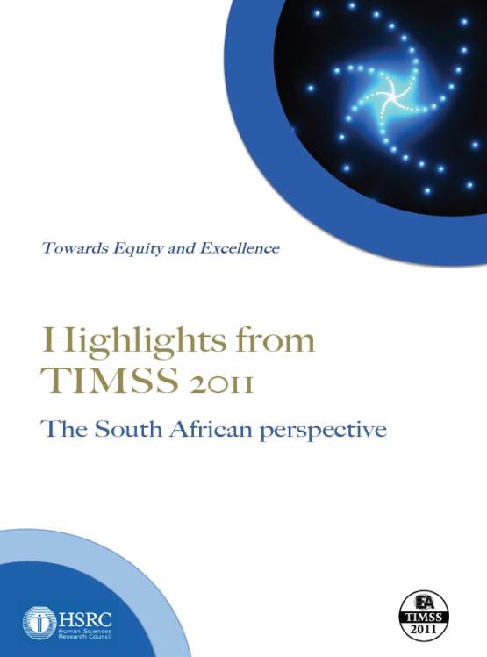






Student performance 2003-2011
TIMSS
(2003)
→ PIRLS (2006)
→ SACMEQ (2007)
TIMSS
(2011)
prePIRLS
(2011)
TIMSS 2003 (Gr8 Maths & Science)
Out of 50 participating countries (including 6 African countries) SA came last
Only 10% reached low international benchmark
No improvement from TIMSS 1999-TIMSS 2003
See Reddy et al (2006)
PIRLS 2006 (Gr 4/5 – Reading)
Out of 45 participating countries SA came last
87% of gr4 and 78% of Gr 5 learners deemed to be “at serious risk of not learning to read”
See Howie et al. (2006)
SACMEQ III 2007 (Gr6 – Reading & Maths)
SA came 10/15 for reading and 8/15 for maths behind countries such as Swaziland, Kenya and Tanzania
See Moloi & Chetty (2010) & Spaull (2012)
TIMSS 2011 (Gr9 – Maths & Science)
SA has joint lowest performance of 42 countries
Improvement by 1.5 grade levels (2003-2011)
76% of grade nine students in 2011 still had not acquired a basic understanding about whole numbers, decimals, operations or basic graphs, and this is at the improved level of performance
See Reddy et al. (2012) & Spaull (2013)
prePIRLS2011 (Gr 4 Reading)
29% of SA Gr4 learners completely illiterate (cannot decode text in any langauge)
See Howie et al (2012)
NSES 2007/8/9
  Gr 3/4/5
  See Taylor, Van der Berg & Mabogoane (2013)
Systemic Evaluations 2007
  Gr 3/6
Matric exams
  Gr 12
Notes:
Fortunately there are alternative measures of educational quality or learning that are available to view the entire iceberg structure. In post Apartheid, South Africa has participated in a number of international tests of assessment.
The most comprehensive reports for each of these datasets are as follows: SACMEQ (Moloi & Chetty, 2011), TIMSS (Reddy, 2006), PIRLS (Howie, et al., 2008), Systemic Evaluations (Department of Education, 2008), National School Effectiveness Study (Taylor, 2011b),and the Annual National Assessments (Department of Basic Education, 2011).
Now lets look at TIMSS 2011 in more detail.

Slide 14
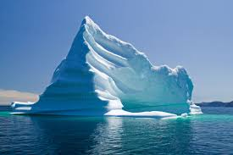
Notes:
The problem, with using the matric pass rate as a measure of quality of the system is that we are only seeing the tip of the ice berg if we use this is a our picture of quality. We are measuring the quality of the system on the basis of a very select proportion of students who actually make it to the matriculation exam.

Slide 15


What are the root causes of low and unequal achievement?
Matric pass rate
Subject choice
No. endorsements
Throughput
Media sees only this→
Quality?
MATRIC
Pre-MATRIC
50% dropout
Low curric coverage
Weak culture of T&L
Low accountability
Vested interests
Low time-on-task
No early cognitive stimulation
Low quality teachers
HUGE learning deficits…

Slide 16
Matric 2014 (relative to Gr 2 in 2004)
 | Numbers
Grade 2 (2004) | 1085570
Grade 9 (2011) | 1049904
Grade 12 (2014) | 532860
Passed (2014) | 403874
Bachelors (2014) | 150752
550,000 students drop out before matric
99% do not get a non-matric qualification (Gustafsson, 2011: p11)
What happens to them? 50% youth unemployment…

Slide 17
Maths: Insurmountable learning deficits
Figure 10b: South African mathematics learning trajectories by national socioeconomic quintiles using a variable standard deviation for a year of learning (0.28 in grade 3 to 0.2 in grade 8 with interpolated values for in-between grades (Based on NSES 2007/8/9 for grades 3/4/5, SACMEQ 2007 for grade 6 and TIMSS 2011 for grade 9, including 95% confidence interval
Spaull & Viljoen, 2015

Slide 18

Inequality: Two public schooling systems

Slide 19
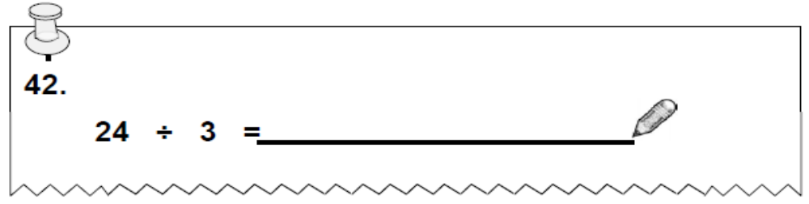
NSES question 42
NSES followed about 15000 students (266 schools) and tested them in Grade 3 (2007), Grade 4 (2008) and Grade 5 (2009).
Even at the end of Grade 5 most (55%+) quintile 1-4 students cannot answer this simple Grade-3-level problem.
“The powerful notions of ratio, rate and proportion are built upon the simpler concepts of whole number, multiplication and division, fraction and rational number, and are themselves the precursors to the development of yet more complex concepts such as triangle similarity, trigonometry, gradient and calculus” (Taylor & Reddi, 2013: 194)
(Spaull & Kotze, 2014)
Notes:
Taylor, N., & Reddi, B. (2013). Writing and learning mathematics. In N. Taylor, S. Van der Berg, & T. Mabogoane, Creating Effective Schools. Cape Town: Pearson.

Slide 20
Labour Market
15%
Legislators, managers, assoc professionals
Unemployed
(Broad - 35%)
Unskilled
(18%)
Elementary occupations & domestic workers
Semi-Skilled (32%)
Clerks, service workers, shop personnel, skilled agric/fishery workers, plant and machinery operators)
University/FET
Type of institution (FET or University)
Quality of institution
Type of qualification (diploma, degree etc.)
Field of study (Engineering, Arts etc.)
High productivity jobs and incomes (15%)
Mainly professional, managerial & skilled jobs
Requires graduates, good quality matric or good vocational skills
High quality secondaryschool
High SES background
High quality primary school
ECD
Minority (20%)
Some motivated, lucky or talented students make the transition
Unequal society
Big demand for good schools despite fees
Some scholarships/bursaries
Vocational training
Affirmative action
(few make this transition)
Majority (80%)
Quality
Low quality secondary
school
Attainment
Type
Low productivity jobs & incomes
Often manual or low skill jobs
Limited or low quality education
Low socioeconomic status background
Low quality primary school
ECD
None or
low-quality
Statistics from Quarterly Labour Force Survey (QLFS) 2014 Q4
Notes:
The QLFS classifies professions as follows: Highly skilled (legislators, senior officials and managers, professionals, technicians and associate profesionals); Semi-skilled (Clerks, service workers and shop and market personnel, skilled agricultural and fishery workers, craft and related trade workers, plant and machinery operators and assembly), Unskilled (Elementary occupations, domestic workers).

Slide 21
Mathematics and science

Slide 22
Explaining TIMMS science scores
Low
400
Students can recognize some basic facts from the life and physical sciences.They have some knowledge of biology, and demonstrate some familiarity with physical phenomena. Students interpret simple pictorial diagrams, complete simple tables, and apply basic knowledge to practical situations.
Intermediate
475
Students recognize and apply their understanding of basic scientific knowledge in various contexts
High
550
Students demonstrate understanding of concepts related to science cycles, systems,and principles.They demonstrate understanding of aspects of human biology, and of the characteristics, classification, and life processes of organisms.
Advanced
625
Students apply knowledge and communicate an understanding of human health, life cycles, adaptation, and heredity, and analyze information about ecosystems.
.
.
Students communicate an understanding of complex and abstract concepts
in biology, chemistry, physics, and earth science. Students demonstrate some conceptual knowledge about cells and the characteristics, classification, and life processes of organisms.T
.
Notes:
Given the nature of this conference, I thought I would focus a little in our performance in TIMMS – a test of mathematics and science. In 2011 this test was given to grade 9s, not grade 8s. Possible test score range from 0 to 1000.
The test is designed to be able to make some clear statements about different levels of mathematical proficiency. At a score of 400 in mathematics, the low international benchmark one can say that a student has some knowledge of whole numbers, decimals, operations and basic graphs. At the international intermediate benchmark, students can apply basic mathematical knowledge in a variety of situations; at the high benchmark students can apply their knowledge to more complex situations.

Slide 23
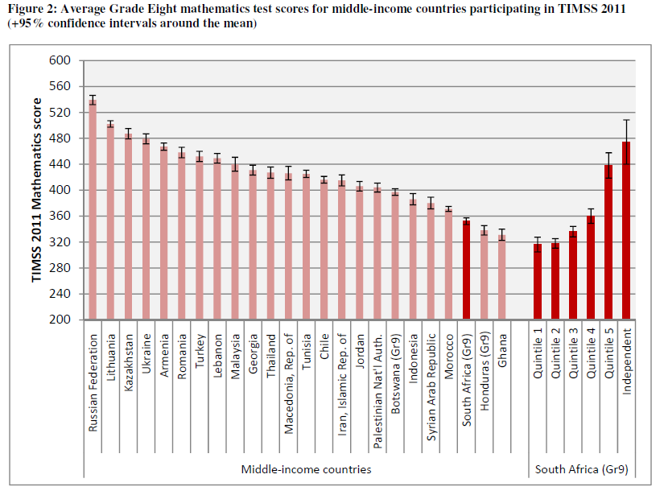
Independent schools only achieving an intermediate benchmark of 475 on average
SA is far from attaining the low international benchmark of 400 “Students have some knowledge of whole numbers and decimals, operations, and basic graphs.”
Source: Spaull, 2013 (CDE report)
Notes:
The figure here is a cross country comparison of average TIMSS scores in 2011 in Mathematics for middle-income countries that participated in the test. The short bars reflect confidence intervals.
South Africa comes out third to last in terms of our average scores here, only better than Honduras and Ghana. The mean score for the test was 360 in South Africa. What does this mean? On the average students are not faring at the low international benchmark, in other words“Students have not reached an elementary level of understanding of whole numbers, decimals, operations, and basic graphs.” On the average students have not grasped a basic level of mathematical concepts.
To make matters worse it must be noted that in South Africa grade 9s wrote the test, not grade 8s as in the all the other countries except Botswana and Honduras.
A second and very important point note is that within South Africa we see very different results. In quintile 1 to 3 schools we are seeing exceptionally low performance far below achieving the low international benchmark. Quintile 5 and independent schools are clearly performing notably better on the average reaching or nearly reaching the intermediate international benchmark.

Slide 24
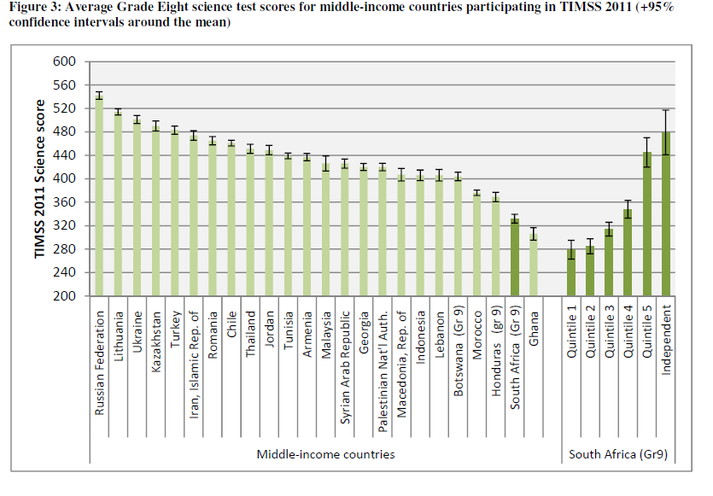
TIMSS 2011 Science
Source: Spaull, 2013 (CDE report)
Notes:
The desparity in performance across the poorest and wealthiest students, and those in independent schools is even starker contrast when we consider grade 9 performance in the science tests. And in regards to science, even grade 9s in Honduras do better than us!

Slide 25
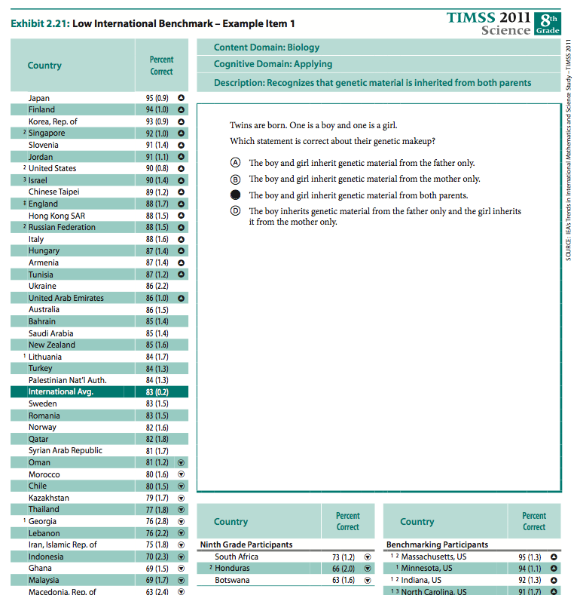
25% of SA reached LIB

Slide 26
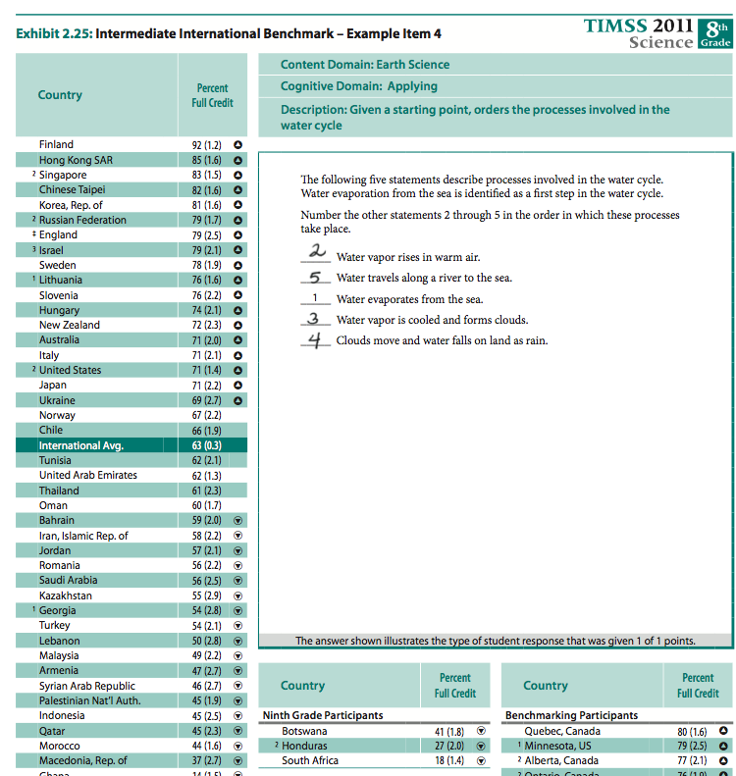
11% of SA reached IIB

Slide 27
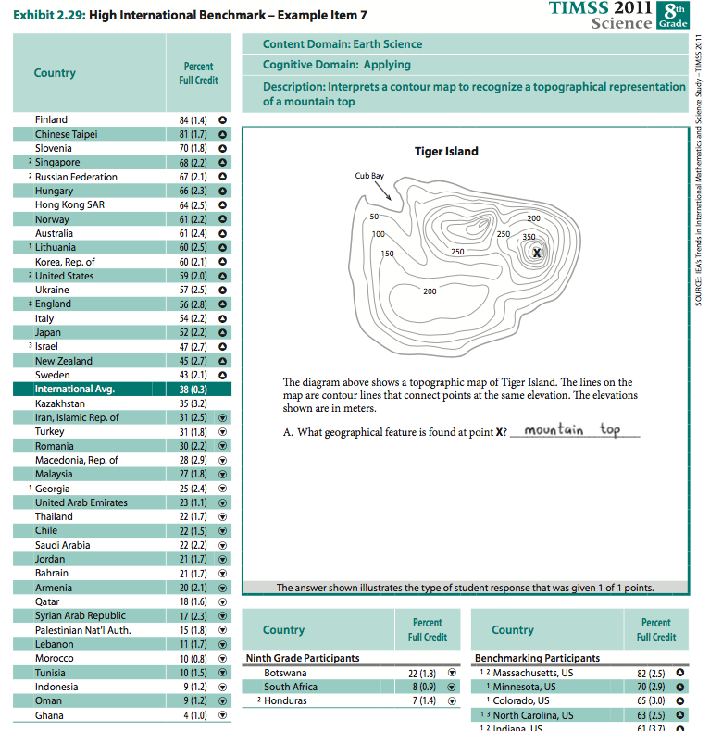
4% of SA reached HIB

Slide 28
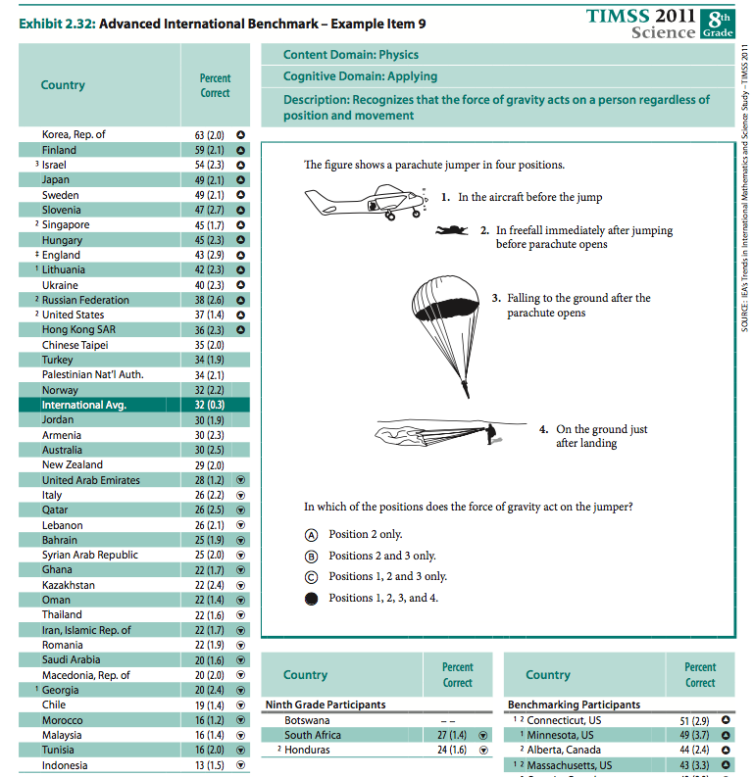

Slide 29
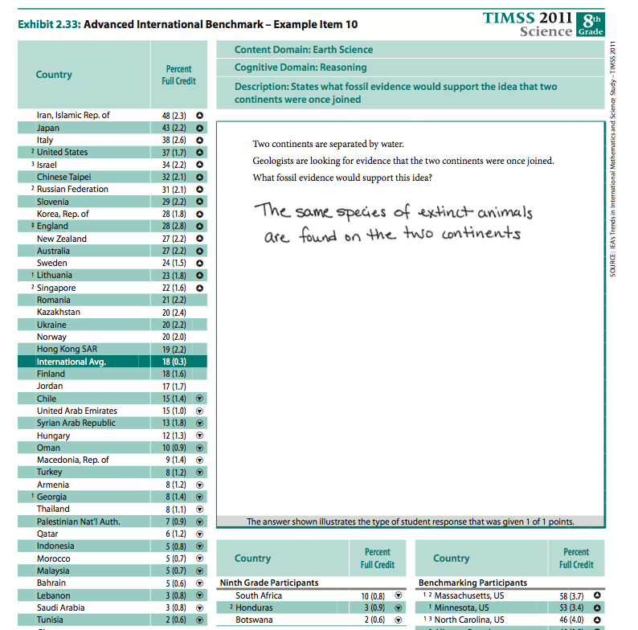
Google “released items TIMSS” “released items PISA”
1% of SA reached AIB

Slide 30
Why does this matter?
Notes:
As I have shown you earlier, there are substantial shortfalls in the system in terms of providing even the most basic levels of literacy and numeracy to the majority of South African learners. This is a major concern from the premise of well-being, human rights and in terms of economic outcomes.

Slide 31
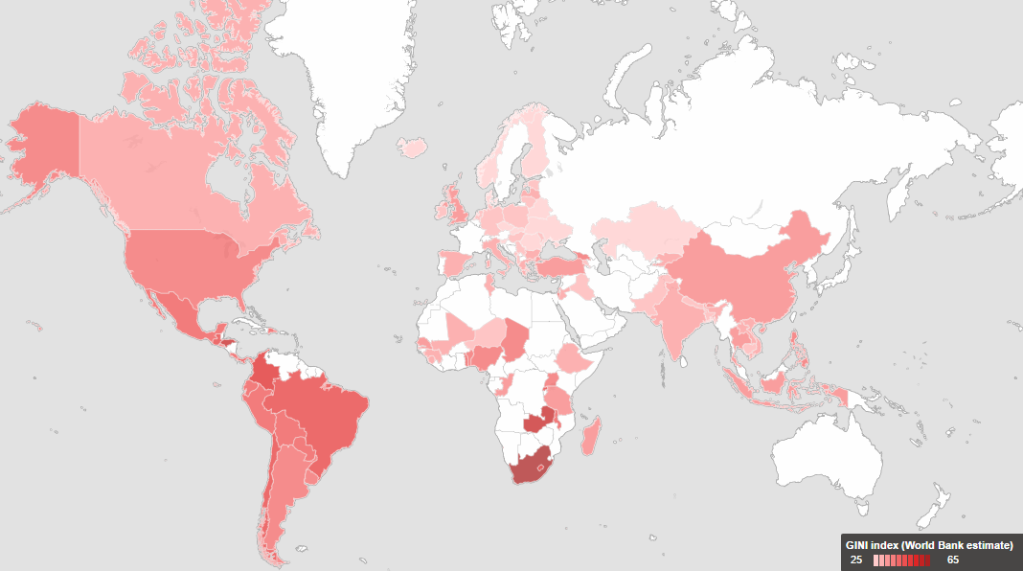
Gini Coefficients: Measure of income inequality in picture
SA has the highest income inequality in the world as measured by the Gini coefficient
Source: World Bank Estimate
Notes:
As you may be aware South Africa has the highest levels of income inequality in the world. It doesn’t take rocket science to figure that one out. Just drive from Cape Town international airport, pass Khayelitsha on your way to Clifton 4th and that becomes quite evident. But economists like to measure things and we do this using Gini Coefficients.
There are various factors that can contribute to income inequality, but in South africa the largest share of the gini coefficient measure is accounted for by wage inequality or the disparity in wages between the poorer majority and small wealthy group. Wage distribution statistically ‘explains’ about 80% of overall income inequality between households (ignoring household size). But what explains wage inequality?

Slide 32


WAGES, (RANDELLAS)
Skills shortage at top end generates a wage premium
Oversupply of unskilled labour depresses their wages
Weak cognitive skills
Strong cognitive skills ➔ skilled and highly employable
Low quality schools
Teachers with poor content knowledge
High quality schools
High quality teachers
Notes:
The majority of schools which are low quality institutions failing to produce satisfactory learning outcomes for the majority of students and resulting in weak cognitive skills for the students that attend these institutions.
Without the skills to compete for jobs in higher productivity, higher income positions or the ability to generate self-employment in highly skilled work, this results in an oversupply of unskilled labour which despresses their wages.
Even a matriculation certificate for students from these schools is not enough to get them into higher earnings positions. The certificate itself is a poor signal of quality. Conditioning on race, gender and experience a worker with Gr11 earns only 80% as much as a matriculant.
Then we have high quality schools which comprise about 10 to 15% of all schools. In these schools typically serving wealthier students, are highly functional institutions where their students acquire strong cognitive skills and are highly employable graduates. But because there are so few skilled graduates this results in a skills shortage at the top end and this generates a wage premium. Unfortunately the pattern repeats itself in the next generation, where children of the few at the top end again access high quality schools while the unemployed or low wage earners cannot afford to send their children to better schools. A cycle of inequality and poverty is perpetuated again and again.
It is quite clear that improving the quality of education for the 80% majority of students currently in schools, really needs to take on increased national priority not only at a policy level but among individual citizens. This is quite frankly not acceptable. The education system is currently exacerbating inequality our country.

Slide 33
Our best versus the world’s best?
Notes:
However for many of you sitting here today, this is not your reality. You are potentially a teacher in a well performing school where students have access to some of the best education available in this country. While our students in the wealthiest quintile of schools or independent schools are doing substantially better than the majority of students in the country, this is no reason to be complacent. While we are obviously most concerned with the majority of children who are being poorly served by the system, I am also somewhat concerned that our best schools are not necessarily producing the levels of learning that we need to be globally competitive.

Slide 34
Where are our best schools aiming
Mission/ vision statements
“Be a home of sound learning – “X” must be benchmarked against the best in the country ( and the world in the academic arena”
“Our mission is to prepare “X” boys to meet the challenges of a dynamic and changing world. ”
“Strives to instil the will in our students to become values-driven, life-long learners and leaders who will strive to make a difference to the world.”
“We are cognisant of our role...in focusing on the latest international trends in schooling.”

Slide 35
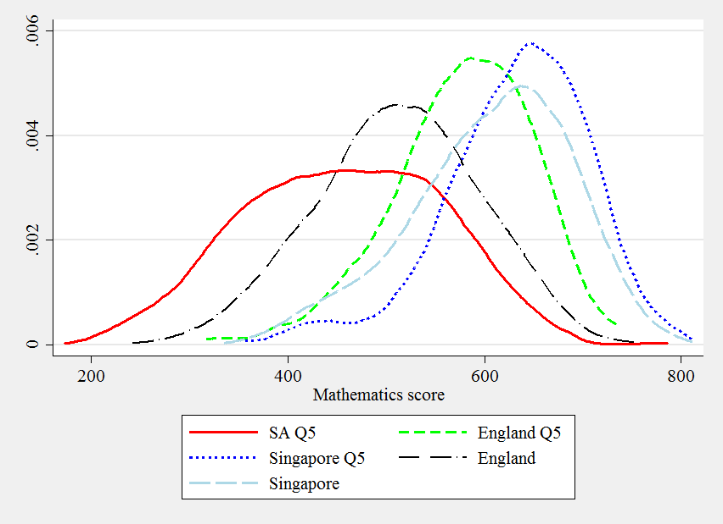
How are our wealthiest students fairing internationally?
TIMSS 2011, Mathematics scores distribution for wealthiest 20%
Source: Own calculations
Notes:
In the following graphs I have provided identified a distribution of scores in the TIMMS mathematics test of our wealthiest 20% of grade 9s against the distribution of test scores of grade 8s in selected countries. I have taken England and Singapore here. The red distribution are maths test scores of South Africa’s wealthiest 20% of grade 9s. The distribution lies to the left of the entire distribution of Englands grade 8s and substantially to the left of their wealthiest group. The difference is even more stark if you compare the test scores of our wealthiest 20% of students in grade 9 to test scores of grade 8s in Singapore.

Slide 36
How are our top 5% academically fairing?
541 < High Benchmark 550
Notes:
Now consider this graph. I have identified the mathematics score of students in selected countries at the 25th percentile, median or 50th percentile, the 75th percentile and then the 95th percentile. I’ve place a line through our score at the 95th percentile at a score of 541 which is still less than the high international benchmark of 550. A student at our 95th percentile is only doing as well as a grade 8 student at the 75th percentile in Australia or a grade 8 student at the median in Russia and more strikingly as the grade 8 student at the 25th percentile in Singapore.

Slide 37
“Patterns of research and innovation productivity at the level of the individual are highly unequal. As a consequence, research and innovation productivity is skewed, with a relatively small number of contributors accounting for a major portion of the outputs…It is these individuals who change the rules of the game, who create new technology paradigms, and who provide the necessary science that leads to technological revolutions.”
David Walwyn and Sibusiso Sibisi (2014: 113)
The few matter too
Lotka’s Law (1926)
10% of authors ⬅➔ 50% of publications
Top 5% of authors ⬅ ➔ 39% of publications
Notes:
Although we are most concerned about learning in the majority of schools, the 80 to 90% of the system, It is important to trace how we are doing at the top. Are we both producing an world class top 5% and are we retaining these students in the country? Why is this important. Because typically it is the few that are responsible for the majority of innovation in country. In a chapter in the most recent global innovation index report two South African’s contributed to a chapter “Retaining Top Innovators: An Essential Element of Competitiveness for Developing Countries”. They make this statement: They make this statement not on the basis of anecdotal evidence but this idea was formalised a long time ago by Lotka in 1926 … referred to as Lotka’s law, 10% of authors are usually reponsible for 50% of publications in a country. And 5% of authors are responsible for 39% of publications. The point I am trying to make is that the few matter too!
While the push needs to be to improve learning opportunities for the majority of South African students, we also need to be watching the top end for the few matter, and typically provide the majority of knowledge contributions to a nation.
“it is estimated that South Africa’s failure to retain the top 5% of researchers and entrepreneurs slices 20% from its potential innovation output.”
Reference: Cornell University, INSEAD, and WIPO (2014): The Global Innovation Index 2014: The Human Factor In innovation, Fontainebleau, Ithaca, and Geneva. Walwyn and Sibisi (2015) Chapter 7 Retaining Top Innovators: An Essential Element of Competitiveness for Developing Countries
A skewed distribution, as originally noted and described mathematically by Lotka (see Figure 1). This mathematical formulation, which became known as Lotka’s Law, states that the number of authors, W, making n contributions is about 1/n2 of those making a
single contribution.1 In other words, 10% of authors produce 50% of the total publications, and the top 5% of authors account for 39% of publications

Slide 38
Improvement is possible!
Notes:
After showing you this, however, the last thing I want to leave you with is a reality check that is rather hopeless and quite depressing. There is another reality, one where improvement is possible not just in terms of the figment of our imagination but in terms of real world evidence of improvements. There are many examples of education systems that have improved internationally, with notable gains in learning experienced by cohorts of students.

Slide 39
Brazil
Chile**
Indonesia
Tunisia**
Poland
Germany**
Israel
Uruguay
Hungary
Turkey**
Improving education systems
Extent of improvement
Source: Gustafsson, 2012
Notes:
In research by Martin Gustafsson he takes 113 countries that participated in different international tests of learning and through various conversions was able to place test scores on a comparable scale. [A nonlinear programming approach to transforming the average scores countries achieve in various international testing programmes so that scores become comparable across programmes. Effectively he placed 230 different test scores for over 113 countries but on the same scale which is very useful for the type of analyses we work with.
The 11 countries, in descending order of size of their annual improvement, are: Brazil, Chile, Indonesia, Tunisia, Turkey, Poland, Germany, Israel, Uruguay, Hungary and Switzerland. The countries Chile, Tunisia, Turkey and Germany each had two series of more than two points showing sustained improvements in learning (for these four countries the average improvement across the two trends was used for the ranking provided here).

Slide 40
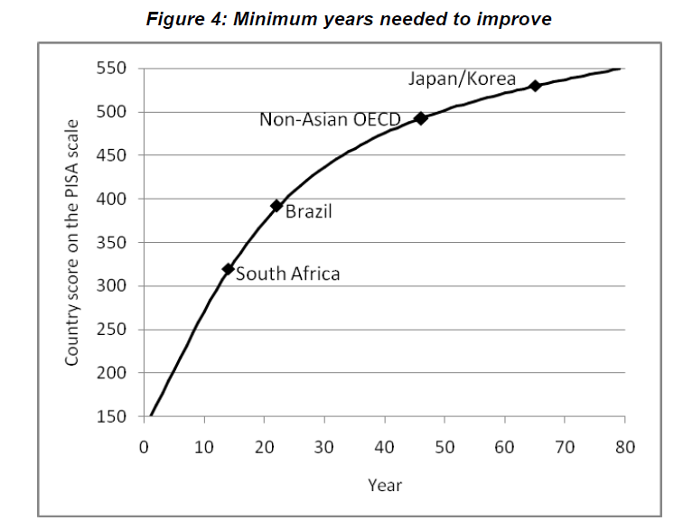
Minimum years need to improve
Best case scenario with good policies: 34 years to reach performance of Non-Asian OECD countries …in our lifetime.
Source: Gustafsson, 2012
Notes:
What is more useful is that he was able to have a look at what improvements are realistically possible in countries over time on the basis of best historical trends in growth in scores in these international tests. There were 11 countries that he identified that experienced consistent gains in international tests over 3 periods or more. Running an analysis on these he comes up with this simulated frontier of possible improvements.
The four points in the graph reflect actual recent levels of performance, in terms of PISA points. Gustafsson identifies that if optimal education policies are implemented, South Africa might attain the level of performance of non-Asian OECD countries (average of 491 on the PISA scale) after 34 years (52 minus 18 on the horizontal axis). It would take Brazil about 25 years to achieve the same. These are clearly optimistic scenarios, but not impossible ones if we implement the right policies in the right way.
“Hanushek and Woessman (2007: 44) provide a broad indication when they say that in a programme such as TIMSS, an improvement of half a standard deviation (meaning 50 points in TIMSS) is possible within a period of 10 to 30 years. From a base of 300 points,
about the average score for Qatar, the worst performing country in TIMSS at the Grade 8 level in 2007, this represents a range in annual growth of 0.6% to 1.6%. This is not incompatible with the patterns identified below. Some guidance is also provided in the 2010
McKinsey report (Mourshed, Chijioke and Barber, 2010: 16), which points to best historical trends of around 0.2% per annum in ‘PISA 2000 units’, assuming a baseline of 500.”
If however you don’t take the best case scenario, but just predict improvements on the basis of the entire sample of all countries the picture is very difficult. if the diminishing marginal rate of improvement is taken into account a simulation would indicate that it would take exceedingly long for developing countries to catch up. South Africa, for instance, would require 160 years to reach the levels found in non-Asian OECD countries. For Brazil the duration would be around 130 years.
..there is educational quality convergence between developing and developed countries.

Slide 41

Where should we be focusing our interventions?
Notes:
But what are these policies? Where should our focus be if we want to see improvement?

Slide 42
Focusing our interventions
Poor to fair
Achieving the basics of
literacy and numeracy
Fair to good
Getting the foundations
in place
Good to Great
Shaping the professional
Great to Excellent
Improving through peers and innovation
Source: Mourshed, Chijioke and Barber (Mckinsey and Company), 2010
Providing scaffolding for low-skill teachers,
bringing all the schools in the system up to a minimum quality threshold.
fulfilling all basic student needs
Notes:
In 2010, Mckinsey produced a report entitled “How the world’s most improved education systems keep getting better”.
They interviewed various stakeholders in education systems that had improved to identify if there was anything generic that one could learn from these improvement stories. One of the most logical findings coming out is that these systems first and foremost face the facts about where they were in a performance trajectory. Take stock of where we really are. This is not just the responsibility of government but we need civil awareness of the state of learning in South Africa, across all communities. This needs to become a national priority in the eyes of every citizen, that each member of society starts making it their responsibility.
Then these systems that improved designed their package of policy interventions that were commensurate with where they were in terms of learning. In systems with good or great learning to start off with they can target interventions at higher order issues. At the bottom end however one has to get to the basics. Systems with poor student performance can only improve if they focus on achieving the basics of literacy and numeracy.

Slide 43
NEEDU 2012/13 Recommendations
A functional administrative “centre”
Getting provincial spending on education under control (Personnel to non-personnel ratio of 80:20)
Monitoring
Analysis and use of assessment data
Optimising (or protecting) learning time
Fundamentals
Identifying and rolling out a primary reading and writing programme
Get the right leaders in place
Improve data collection, management and use on more consistent footing
Applying post provisioning norms and standards
Professional educator development
Identifying and rolling out a primary numeracy & mathematics programme
Source: Taylor (2014) NEEDU national report 2013…
Report available: www.education.gov.za/NEEDU/tabid/687/Default.aspx

Slide 44
Conclusion
South Africa performs extremely poorly on local and international assessments of educational achievement.
In large parts of the schooling system there is very little learning taking place.
In SA we have two public schooling systems not one. Regardless of which system you are engaged with, we need improvements in both. The few matter as much as the majority.
We need to face the facts and design policies/interventions to move from poor performance to fair. Its time to take the NEEDU recommendations seriously.
  With the right policies implemented in the right way improvement is possible.

Slide 45
Thank you
Email: gabriellewills@gmail.com

Slide 46
An imminent opportunity for Change?

Slide 47
An imminent opportunity for Change?

Slide 48
  A substantial & increasing no. of principal replacements
Age distribution of principals, 2004 & 2012
Average age of principals in 2004 was 48 years…by 2012 this was 51 years.
17% of principals were aged 55 years + in 2004, 33% were in this age category in 2012.
Over 7000 principal replacements for just retirement reasons expected between 2012-2017.

Slide 49
An aging profile of school principals
School principals in 2012 aged 55 years or older, by quintile
Source: Wills (forthcoming)

Slide 50
Teacher content knowledge
Taylor & Vinjevold (1999, p. 230) summarize the 54 studies that made up this initiative and conclude as follows: “The most definite point of convergence across the [President’s Education Initiative] studies is the conclusion that teachers’ poor conceptual knowledge of the subjects they are teaching is a fundamental constraint on the quality of teaching and learning activities, and consequently on the quality of learning outcomes.”
Carnoy & Chisholm (2008, p.33): “The relatively low level of mathematics knowledge that teachers have in all but the highest student [socioeconomic status] schools is somewhat troubling. It raises some doubts about the preparation of the teacher force”.
Taylor & Taylor (2013, p. 230): “The subject knowledge base of the majority of South African grade 6 mathematics teachers is simply inadequate to provide learners with a principled understanding of the discipline…providing teachers with a deep conceptual understanding of their subject should be the main focus for both pre- and in-service teacher training”.

Slide 51
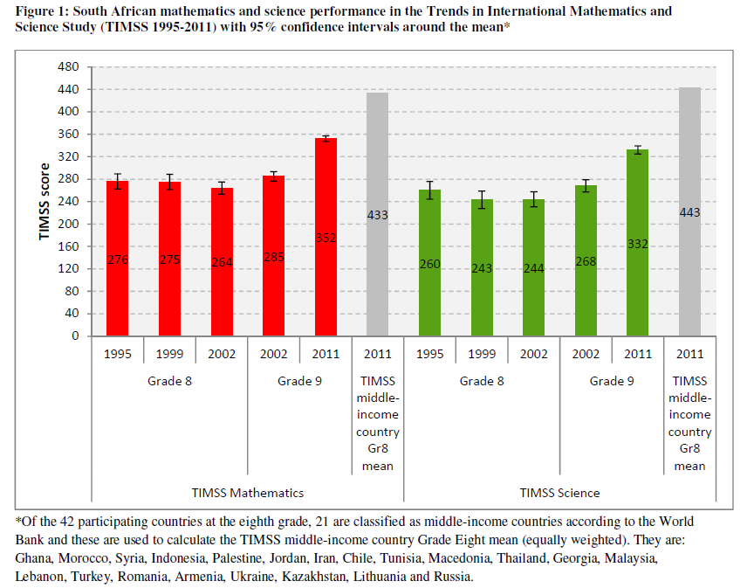

Slide 52
As far as educational outcomes go, South Africa has the worst education system of all middle-income countries that participate in cross-national assessments of educational achievement.
What is more, we perform worse than many low-income African countries.
Using the National Senior Certificate (NSC) exam in Grade 12 as a measure of system performance is very misleading they do not take into account those pupils who never make it to that point. Of 100 pupils that start school, only 50
will make it to Grade 12, 40 will pass, and only 12 will qualify for university.

Slide 53
Be an instructional leader
Use ANA!
  Use annual ANA results to identify where students and teachers are doing well and where there are areas for improvement.
    In what specific subjects and topics are doing well and need more help…?
    Grade by class analysis, subject analysis, item/question analysis
  Caution: ANA is currently not designed to be comparable over time. The difficulty of tests are not standardised from year to year.

Slide 54
International
TIMSS 2003 (Gr8 Maths & Science)
PIRLS 2006 (Gr 4/5 Reading)
SACMEQ III 2007 (Gr6 Reading & math)
TIMSS 2011 (Gr 9 – Maths & Science)
prePIRLS 2011 (Gr 4 Reading)
Local
Annual National Assessments 2011 -2014
Matriculation
National School Effectiveness Study 2007/8/9
Systemic Evaluations 2007 Gr 3//6

