Slide 1




Accountability & Capacity
Understanding the disconnect between resources and results
Nic Spaull | nicspaull.com
SAERA Conference 2014 | Durban | 13 August 2014

Slide 2

Outline
Brief overview of spending in SA & some important distinctions
Highlights from the literature
Capacity without accountability; accountability without capacity
False dichotomy between can’t and won’t
The multiple levels of accountability and capacity
Capacity without accountability
Way forward…

Slide 3



Not all schools are born equal
?
Pretoria Boys High School
SA public schools?
→ Different resources (Capacity)
→ Different pressures (Accountability)

Slide 4
Expenditure on education
2010/11
Total government expenditure
(31% GDP in 2010/11 – R733.5bn)
Government exp on education
(19.5% of Gov exp: R143.1bn)
17%
5%
A focus on teachers seems warranted both from a budgetary perspective and from the educational literature
Notes:
Figures from 2012 Public Expenditure Analysis report for UNICEF/DBE (Oxford Policy Management / Stellenbosch Economics) Education exp = 6.1% of GDP
Personnel exp = 78% of educ exp
Personnel exp = 4.8% of GDP

Slide 5
Important distinctions
Improved student outcomes
Increased resources “on-the-ground”
Increased allocation of resources
Often these 3 are spoken about interchangeably

Slide 6
Important distinctions
Improved student outcomes
Increased resources “on-the-ground”
Increased allocation of resources
Inefficiency / corruption

Slide 7
Important distinctions
Improved student outcomes
Increased resources “on-the-ground”
Increased allocation of resources
Inefficiency / corruption
Lack of capacity

Slide 8
Important distinctions
Improved student outcomes
Increased resources “on-the-ground”
Increased allocation of resources
Inefficiency / corruption
Lack of capacity
Lack of accountability

Slide 9
Accountability & Capacity

Slide 10
Accountability without capacity
“Accountability systems and incentive structures, no matter how well designed, are only as effective as the capacity of the organization to respond. The purpose of an accountability system is to focus the resources and capacities of an organization towards a particular end. Accountability systems can’t mobilize resources that schools don’t have...the capacity to improve precedes and shapes schools’ responses to the external demands of accountability systems (Elmore, 2004b, p. 117).
“If policy-makers rely on incentives for improving either a school or a student, then the question arises, incentives to do what? What exactly should educators in failing schools do tomorrow - that they do not do today - to produce more learning? What should a failing student do tomorrow that he or she is not doing today?” (Loveless, 2005, pp. 16, 26).
“People who are being asked to do things they don’t know how to do, and being rewarded and punished on the basis of what they don’t know, rather than what they are learning, become skilled at subverting the purposes and authority of the systems in which they work. Bad policies produce bad behaviour. Bad behaviour produces value for no one” (Elmore, 2004a, p. 22).

Slide 11
Capacity without accountability
“In the absence of accountability sub-systems, support measures are very much a hit and miss affair. Accountability measures provide motivation for and direction to support measures, by identifying capacity shortcomings, establishing outcome targets, and setting in place incentives and sanctions which motivate and constrain teachers and managers throughout the system to apply the lessons learned on training courses in their daily work practices. Without these, support measures are like trying to push a piece of string: with the best will in the world, it has nowhere to go. Conversely, the performance gains achieved by accountability measures, however efficiently implemented, will reach a ceiling when the lack of leadership and technical skills on the part of managers, and curricular knowledge on the part of teachers, places a limit on improved performance. Thus, the third step in improving the quality of schooling is to provide targeted training programs to managers and teachers. To achieve optimal effects, these will need to connect up with and be steered by accountability measures” (Taylor, 2002, p. 17).

Slide 12
Good description of human behaviour
“The traditions of school effectiveness research and the economics of education bring complementary perspectives to bear. While the former assumes that individual actors, and in particular school principals and teachers, are motivated by altruism and the desire to do the best for the learners in their care, economists assume that actors are motivated largely by self-interest. Taken together, these views sound like a good description of human behaviour” (Taylor, Van der Berg & Mabogoane, 2013: 24)

Slide 13

Notes:
From a forthcoming report on accountability on the

Slide 18


Slide 19
“Only when schools have both the incentive to respond to an accountability system as well as the capacity to do so will there be an improvement in student outcomes.” (p22)

Slide 20
False dichotomies
The 2013 NEEDU report makes a useful distinction between teachers who can’t and teachers who won’t teach which map quite easily onto the capacity and accountability spectra.
  “Why are schools not doing what we expect of them? Is it because they won’t or because they can’t? The implications for school improvement are very different, dependent on how this question is answered.” (NEEDU, 2013: 20)
However we have no reason to think that it has to be one OR the other, it could be both or (more likely) some combination of the two.
Can’t | Won’t
Lack of content knowledge Lack of pedagogical skill Lack of language proficiency | Lack of motivation Lack of discipline Lack of accountability/consequences

Slide 21
Capacity & Accountability at all levels
The capacity & accountability discussion are applicable at all levels of the system and usually the problems are compounded due to multiple capacity/accountability problems at each level.
For simplicity sake let’s assume that the 3 levels are:
  Classroom
    Teachers
  School
    Principal / SMT / SGB
  District/province
    Subject-advisors, bureaucrats etc..

Slide 22
 |  | Teachers CAPACITY |  | Teachers ACCOUNTABILITY
 |  | Can | Can’t | Will | Won’t | TEACHERS BOTH low capacity AND low accountability
School capacity | Low capacity | a | b | c | d
 | Sufficient capacity | e | NA | g | h
SCHOOL Accountability | Low accountability | i | j | k | l
 | Sufficient accountability | m | n | o | NA
SCHOOL BOTH low capacity AND low accountability |  |  |  |  |  | X

Slide 23
 |  | Teachers CAPACITY |  | Teachers ACCOUNTABILITY
 |  | Can | Can’t | Will | Won’t | TEACHERS BOTH low capacity AND low accountability
School capacity | Low capacity | a | b | c | d
 | Sufficient capacity | e | NA | g | h
SCHOOL Accountability | Low accountability | i | j | k | l
 | Sufficient accountability | m | n | o | NA
SCHOOL BOTH low capacity AND low accountability |  |  |  |  |  | X

Slide 24
 |  | Teachers CAPACITY |  | Teachers ACCOUNTABILITY
 |  | Can | Can’t | Will | Won’t | TEACHERS BOTH low capacity AND low accountability
School capacity | Low capacity | a | b | c | d
 | Sufficient capacity | e | f | g | h
SCHOOL Accountability | Low accountability | i | j | k | l
 | Sufficient accountability | m | n | o | p
SCHOOL BOTH low capacity AND low accountability |  |  |  |  |  | X
District/ province lacks capacity
Even if teachers and schools are completely willing and motivated, if they are situated in a broader system (district/province) that lacks capacity and/or accountability, their potential for improvement is constrained.
Currently districts and provinces lack the capacity to either increase accountability or to improve capacity due to their own low levels of capacity and accountability
 |  | Teachers CAPACITY |  | Teachers ACCOUNTABILITY
 |  | Can | Can’t | Will | Won’t | TEACHERS BOTH low capacity AND low accountability
School capacity | Low capacity | a | b | c | d
 | Sufficient capacity | e | f | g | h
SCHOOL Accountability | Low accountability | i | j | k | l
 | Sufficient accountability | m | n | o | p
SCHOOL BOTH low capacity AND low accountability |  |  |  |  |  | X
District/ province lacks accountability
District/ province lacks BOTH capacity and Accountability
 |  | Teachers CAPACITY |  | Teachers ACCOUNTABILITY
 |  | Can | Can’t | Will | Won’t | TEACHERS BOTH low capacity AND low accountability
School capacity | Low capacity | a | b | c | d
 | Sufficient capacity | e | f | g | h
SCHOOL Accountability | Low accountability | i | j | k | l
 | Sufficient accountability | m | n | o | p
SCHOOL BOTH low capacity AND low accountability |  |  |  |  |  | X
  Classroom
    Teachers
  School
    Principal / SMT / SGB
  District/province
    Subject-advisors, bureaucrats etc..

Slide 25
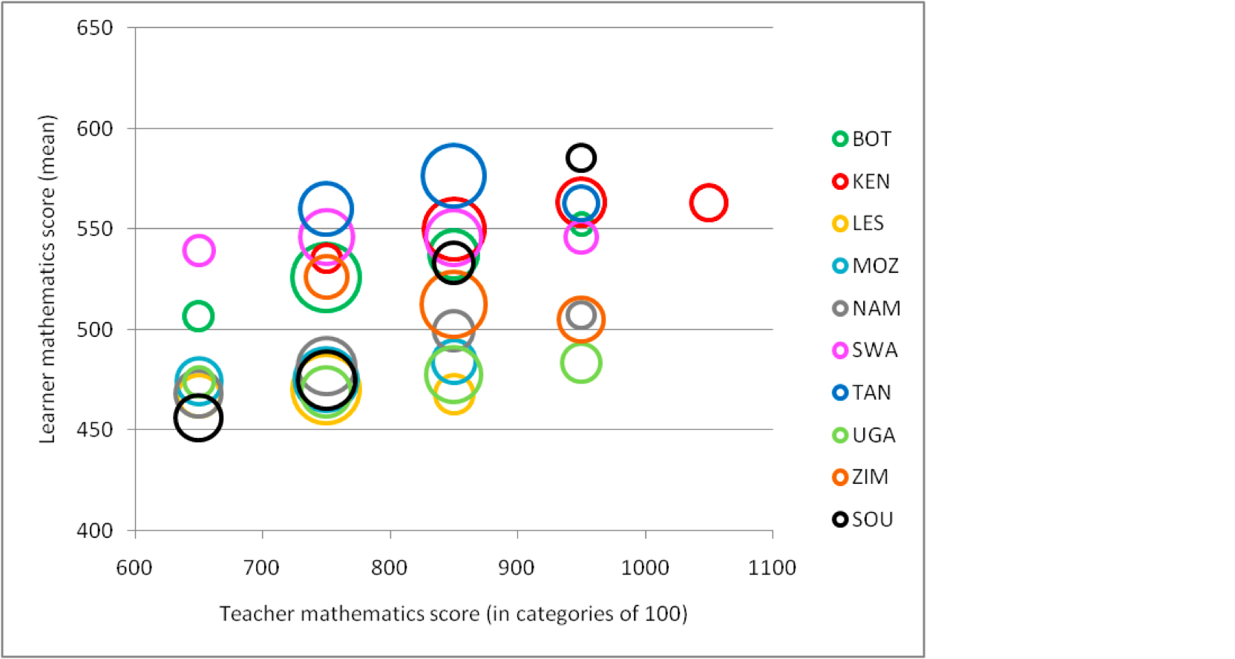
Can’t / Won’t / Constrained / ALL 3?
Relationship between learner and teacher test scores in SACMEQ 2007
Thanks to Martin Gustafsson
for sharing the graph and analysis
“This suggests that South Africa’s (SOU) weakest teachers, in terms of subject knowledge, not only produce the poorest learner results within the country (as one would expect) but also that the learner results they produce are poorer than those produced by equivalently knowledge-disadvantaged teachers in other countries. For instance, if one compares teachers in South Africa and Swaziland scoring between 600 and 700 in the teacher test, Swaziland’s teacher’s produce learner results that are 100 points higher than those produced by equivalent South African teachers”
Source: SACMEQ III dataset (2007).
Note: Teachers were grouped according to their test scores for the purposes of this graph. For instance, teachers with scores from 700 and less than 800 are pegged at the 750 level on the horizontal axis, those with scores from 800 and less than 900 are pegged at the 850 level, and so on. The area of the circles is in proportion to the percentage of learners in the country taught by these teachers.

Slide 26

Conclusion
Accountability without capacity (and vice versa) is problematic and unlikely to lead to the types of outcomes we want. We need BOTH accountability AND capacity
The can’t and won’t distinction is a helpful one but it is NOT an either / or categorization – that is a false dichotomy - it can be both.
There are multiple levels on which we can see the capacity and/or accountability deficits – teachers, schools, districts/provinces
Interventions that focus on ONLY capacity OR accountability are likely to be undermined by the lack in the other (accountability or capacity) and thus we need both!

Slide 27
Some questions to think about:
In the South African education system,
  What are the capacity-building opportunities available to teachers?
  Does a (rural) teacher have access to meaningful learning opportunities (ala Shalem ,2003)? (have they been evaluated and shown to work? No)
  What consequences (if any) revert in the event of non-performance?
  How can ANA be used for accountability? What are the prerequisites BEFORE ANA can or should be used for feedback or accountability purposes?

Slide 28
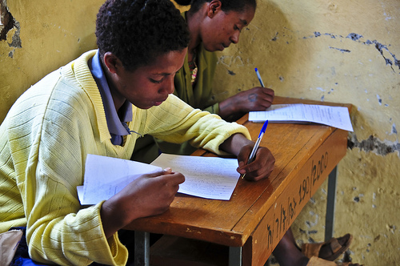
Thank you
www.nicspaull.com/research nicholasspaull@gmail.com
@NicSpaull

Slide 29
Binding constraints approach

Slide 30


Slide 33
“The left hand barrel has horizontal wooden slabs, while the right hand side barrel has vertical slabs. The volume in the first barrel depends on the sum of the width of all slabs. Increasing the width of any slab will increase the volume of the barrel. So a strategy on improving anything you can, when you can, while you can, would be effective. The volume in the second barrel is determined by the length of the shortest slab. Two implications of the second barrel are that the impact of a change in a slab on the volume of the barrel depends on whether it is the binding constraint or not. If not, the impact is zero. If it is the binding constraint, the impact will depend on the distance between the shortest slab and the next shortest slab” (Hausmann, Klinger, & Wagner, 2008, p. 17).
Notes:
Hausmann, R., Klinger, G., & Wagner, R. (2008). Doing Growth Diagnostics in Practice: A 'Mindbook'. CID Workinf Paper No. 177. Center for International Development at Harvard University.

Slide 34
Labour Market
17%
Unemployed
(Broad - 33%)
Unskilled
(19%)
Semi-Skilled (31%)
University/FET
Type of institution (FET or University)
Quality of institution
Type of qualification (diploma, degree etc.)
Field of study (Engineering, Arts etc.)
High productivity jobs and incomes (17%)
Mainly professional, managerial & skilled jobs
Requires graduates, good quality matric or good vocational skills
Historically mainly white
High quality secondaryschool
High SES background
+ECD
High quality primary school
Minority (20%)
Some motivated, lucky or talented students make the transition
Unequal society
Big demand for good schools despite fees
Some scholarships/bursaries
Vocational training
Affirmative action
Majority (80%)
Quality
Low quality secondary
school
Attainment
Type
Low productivity jobs & incomes
Often manual or low skill jobs
Limited or low quality education
Minimum wage can exceed productivity
Low SES background
Low quality primary school
cf. Servaas van der Berg – QLFS 2011
Notes:
The QLFS classifies professions as follows: Highly skilled (legislators, senior officials and managers, professionals, technicians and associate profesionals); Semi-skilled (Clerks, service workers and shop and market personnel, skilled agricultural and fishery workers, craft and related trade workers, plant and machinery operators and assembly), Unskilled (Elementary occupations, domestic workers).

Slide 35
Accountability: teacher absenteeism
  Teacher absenteeism is regularly found to be an issue in many studies
    2007: SACMEQ III conducted – 20 days average in 2007
    2008: Khulisa Consortium audit – HSRC (2010) estimates that 20-24 days of regular instructional time were lost due to leave in 2008
    2010: “An estimated 20 teaching days per teacher were lost during the 2010 teachers’ strike” (DBE, 2011: 18)
    Importantly this does not include time lost where teachers were at school but not teaching scheduled lessons
      A recent study observing 58 schools in the North West concluded that “Teachers did not teach 60% of the lessos they were scheduled to teach in North West” (Carnoy & Chisholm et al, 2012)
Notes:
Also see Chisholm (2005) and Shisana et al (2005) quoted in HSRC (2010)

Slide 36




Accountability: teacher absenteeism
(SACMEQ III – 2007 – 996 teachers)
Western Cape
Eastern Cape
Limpopo
KwaZulu-Natal
% absent > 1 week striking
32%
81%
97%
82%
% absent > 1 month (20 days)
22%
62%
48%
73%
% absent > 2 months (40 days)
5%
12%
0%
10%
1.3 days a week
Notes:
Given that SACMEQ was done in September 2007, a maximum of 159 school days could have passed, hence 3 months = 1.3 days a week

Slide 37
When faced with an exceedingly low and unequal quality of education do we….
A) Increase accountability {US model}
    Create a fool-proof highly specified, sequenced curriculum (CAPS/workbooks)
    Measure learning better and more frequently (ANA)
    Increase choice/information in a variety of ways
B) Improve the quality of teachers {Finnish model}
    Attract better candidates into teaching degrees → draw candidates from the top (rather than the bottom) of the matric distribution
    Increase the competence of existing teachers (Capacitation)
    Long term endeavor which requires sustained, committed, strategic, thoughtful leadership (something we don’t have)
C) All of the above {Utopian model}
Perhaps A while we set out on the costly and difficult journey of B??

