Slide 1




An Overview of South Africa’s
Schooling System
www.nicspaull.com/research
Michael & Susan Dell Foundation | 24 March 2014

Slide 2
Low performance
Performance on local and international assessments of educational achievement
Little learning in most classrooms
Quantifying how much learning is taking place in most classrooms – quantifying learning deficits
High dropout
Excessive dropout in Gr10/11/12
Highly unequal
  Essentially 2 schooling systems in SA

Slide 3
1) South Africa performs extremely poorly on local and international assessments of educational achievement

Slide 4





State of SA education since transition
“Although 99.7% of South African children are in school…the outcomes in education are abysmal” (Manuel, 2011)
“Without ambiguity or the possibility of misinterpretation, the pieces together reveal the predicament of South African primary education” (Fleisch, 2008: 2)
“Our researchers found that what students know and can do is dismal” (Taylor & Vinjevold, 1999)
“It is not an overstatement to say that South African education is in crisis.” (Van der Berg & Spaull, 2011)

Slide 5


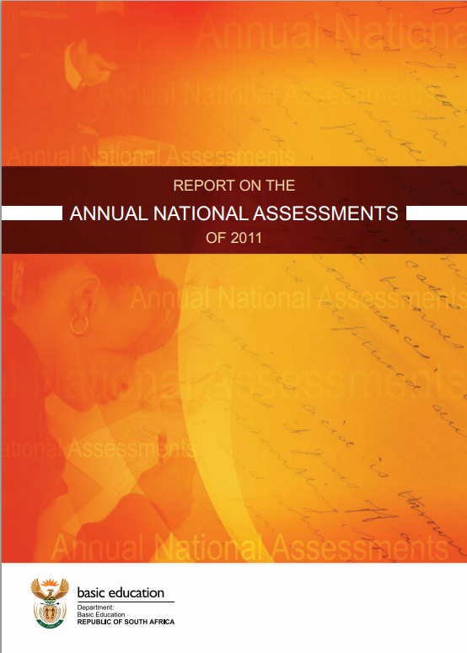






Student performance 2003-2011
TIMSS (2003)
→ PIRLS (2006)
→ SACMEQ (2007)
→ ANA (2011)
→ TIMSS (2011)
→ prePIRLS (2011)
TIMSS 2003 (Gr8 Maths & Science)
Out of 50 participating countries (including 6 African countries) SA came last
Only 10% reached low international benchmark
No improvement from TIMSS 1999-TIMSS 2003
PIRLS 2006 (Gr 4/5 – Reading)
Out of 45 participating countries SA came last
87% of gr4 and 78% of Gr 5 learners deemed to be “at serious risk of not learning to read”
SACMEQ III 2007 (Gr6 – Reading & Maths)
SA came 10/15 for reading and 8/15 for maths behind countries such as Swaziland, Kenya and Tanzania
ANA 2011 (Gr 1-6 Reading & Maths)
Mean literacy score gr3: 35%
Mean numeracy score gr3: 28%
Mean literacy score gr6: 28%
Mean numeracy score gr6: 30%
TIMSS 2011 (Gr9 – Maths & Science)
SA has joint lowest performance of 42 countries
Improvement by 1.5 grade levels (2003-2011)
76% of grade nine students in 2011 still had not acquired a basic understanding about whole numbers, decimals, operations or basic graphs, and this is at the improved level of performance
prePIRLS2011 (Gr 4 Reading)
29% of SA Gr4 learners completely illiterate (cannot decode text in any langauge)
NSES 2007/8/9
Systemic Evaluations 2007
Matric exams
Notes:
The most comprehensive reports for each of these datasets are as follows: SACMEQ (Moloi & Chetty, 2011), TIMSS (Reddy, 2006), PIRLS (Howie, et al., 2008), Systemic Evaluations (Department of Education, 2008), National School Effectiveness Study (Taylor, 2011b),and the Annual National Assessments (Department of Basic Education, 2011).

Slide 6
2) In large parts of the schooling system there is little learning taking place

Slide 7
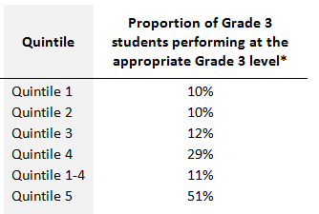
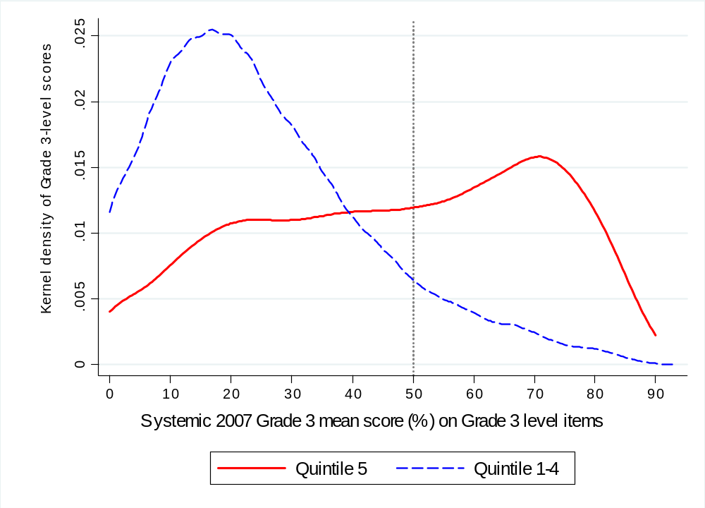
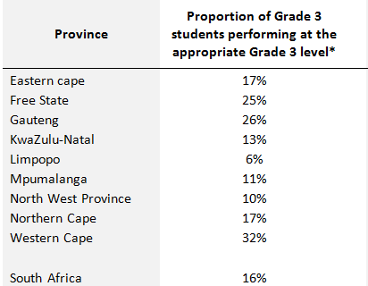
Quantifying learning deficits in Gr3
Figure 1: Kernel density of mean Grade 3 performance on Grade 3 level items by quintiles of student socioeconomic status (Systemic Evaluation 2007)
16%
Only the top 16% of grade 3 students are performing at a Grade 3 level
(Grade-3-appropriate level)
51%
11%
Following Muralidharan & Zieleniak (2013) we classify students as performing at the grade-appropriate level if they obtain a mean score of 50% or higher on the full set of Grade 3 level questions.

Slide 8

NSES question 42
NSES followed about 15000 students (266 schools) and tested them in Grade 3 (2007), Grade 4 (2008) and Grade 5 (2009).
Grade 3 maths curriculum: “Can perform calculations using appropriate symbols to solve problems involving: division of at least 2-digit by 1-digit numbers”
Even at the end of Grade 5 most (55%+) quintile 1-4 students cannot answer this simple Grade-3-level problem.
“The powerful notions of ratio, rate and proportion are built upon the simpler concepts of whole number, multiplication and division, fraction and rational number, and are themselves the precursors to the development of yet more complex concepts such as triangle similarity, trigonometry, gradient and calculus” (Taylor & Reddi, 2013: 194)
(Spaull & Viljoen, forthcoming)
Notes:
Taylor, N., & Reddi, B. (2013). Writing and learning mathematics. In N. Taylor, S. Van der Berg, & T. Mabogoane, Creating Effective Schools. Cape Town: Pearson.

Slide 9


By Gr 3 all children should be able to read, Gr 4 children should be transitioning from “learning to read” to “reading to learn”
Red sections here show the
proportion of children that are
completely illiterate in Grade 4
, i.e. they cannot read in any
language
Notes:
If we consider the performance of the learners per test language, the following observations are made:
Overall 29% of learners in SA don’t meet the low benchmark
However, in Afrikaans and English, there are only 12 and 10% who do not meet the low benchmark
Of serious concern is that more than half the learners tested in Sepedi and Tshivenda do not reach the low benchmark putting them at risk educationally.
More than 15% of learners in Afrikaans and English reach the advanced level in contrast to less than 1% in African languages.

Slide 10
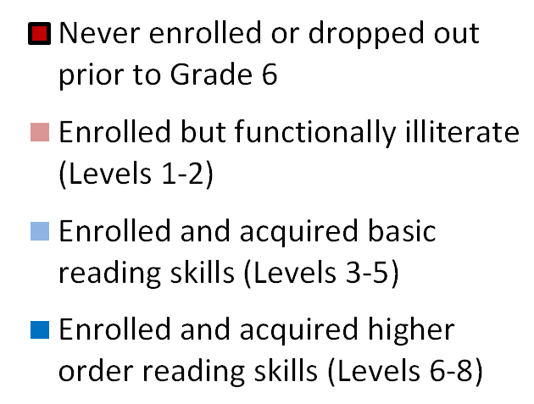
SACMEQ 2007 – Grade 6
By this definition of functional illiteracy, if students are functionally illiterate they cannot read a short and simple text and extract meaning → i.e. they cannot read for meaning

Slide 11
Insurmountable learning deficits
(Spaull & Viljoen, forthcoming – SAHRC Report 2014)

Slide 12
Insurmountable learning deficits: 0.3 SD
Spaull & Viljoen, 2014 (SAHRC Report)

Slide 13
3) In South Africa we have HIGH dropout in Gr 10/11/12

Slide 14
550,000 students drop out before matric
99% do not get a non-matric qualification (Gustafsson, 2011: p11)
What happens to them? 50% youth unemployment.

Slide 15
Dropout between Gr8 and Gr12
Of 100 Gr8 quintile 1 students in 2009, 36 passed matric and 10 qualified for university
Of 100 Gr8 quintile 5 students in 2009, 68 passed matric and 39 qualified for university
“Contrary to what some would like the nation and the public to believe that our results hide inequalities, the facts and evidence show that the two top provinces (Free State and North West) are rural and poor.” (Motshekga, 2014)

Slide 16
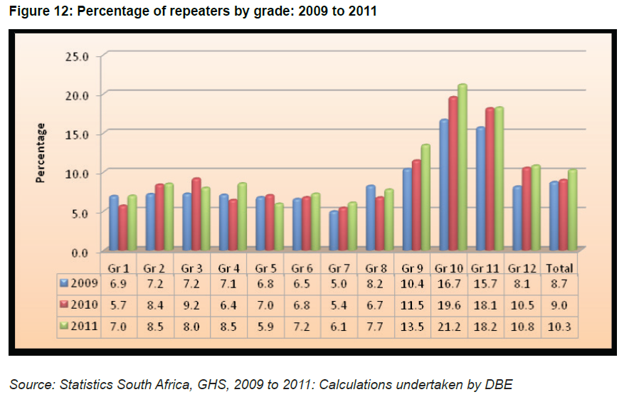
When does grade repetition happen? Why?

Slide 17


What are the root causes of low and unequal achievement?
Matric pass rate
Subject choice
No. endorsements
Throughput
Media sees only this→
Quality?
MATRIC
Pre-MATRIC
50% dropout
Low curric coverage
Weak culture of T&L
Low accountability
Vested interests
Low time-on-task
No early cognitive stimulation
Low quality teachers
HUGE learning deficits…

Slide 18


Slide 19
4) In South Africa we have TWO public schooling systems not one

Slide 20

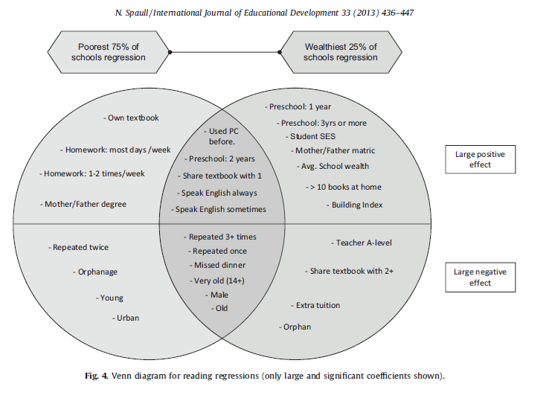
SA’s two schooling systems 75% | 25%
(Spaull, 2013)

Slide 21





Bimodality – indisputable fact
PIRLS / TIMSS / SACMEQ / NSES / ANA / Matric… by Wealth / Language / Location / Dept…

Slide 22
Education and inequality?
Duration of education
Quality of education
Type of education
IQ
Motivation
Social networks
Discrimination
SA is one of the top 3 most unequal countries in the world
Between 78% and 85% of total inequality is explained by wage inequality
Wages
Notes:
78% and 85% figures were taken from research reports by Van der Berg and Leibbrandt

Slide 23
Labour Market
17%
Unemployed
(Broad - 33%)
Unskilled
(19%)
Elementary occupations & domestic workers
Semi-Skilled (31%)
Clerks, service workers, shop personnel, skilled agric/fishery workers, plant and machinery operators)
University/FET
Type of institution (FET or University)
Quality of institution
Type of qualification (diploma, degree etc.)
Field of study (Engineering, Arts etc.)
High productivity jobs and incomes (17%)
Mainly professional, managerial & skilled jobs
Requires graduates, good quality matric or good vocational skills
Historically mainly white
High quality secondaryschool
High SES background
+ECD
High quality primary school
Minority (20%)
Some motivated, lucky or talented students make the transition
Unequal society
Big demand for good schools despite fees
Some scholarships/bursaries
Vocational training
Affirmative action
Majority (80%)
Quality
Low quality secondary
school
Attainment
Type
Low productivity jobs & incomes
Often manual or low skill jobs
Limited or low quality education
Minimum wage can exceed productivity
Low SES background
Low quality primary school
cf. Servaas van der Berg – QLFS 2011
Notes:
The QLFS classifies professions as follows: Highly skilled (legislators, senior officials and managers, professionals, technicians and associate profesionals); Semi-skilled (Clerks, service workers and shop and market personnel, skilled agricultural and fishery workers, craft and related trade workers, plant and machinery operators and assembly), Unskilled (Elementary occupations, domestic workers).

Slide 24
RECAP
Low performance
Performance on local and international assessments of educational achievement
Little learning in most classrooms
Quantifying how much learning is taking place in most classrooms – quantifying learning deficits
High dropout
Excessive dropout in Gr10/11/12
Highly unequal
  Essentially 2 schooling systems in SA

Slide 25
Way forward?
Acknowledge the extent of the problem
  Low quality education is one of the three largest crises facing our country (along with HIV/AIDS and unemployment). Need the political will and public support for widespread reform.
Focus on the basics
  Every child MUST master the basics of foundational numeracy and literacy these are the building blocks of further education – weak foundations = recipe for disaster
  Teachers need to be in school teaching (re-introduce inspectorate?)
  Every teacher needs a minimum competency (basic) in the subjects they teach
  Every child (teacher) needs access to adequate learning (teaching) materials
  Use every school day and every school period – maximise instructional time
  Have to make sure we don’t make the same mistakes with Grade R as we have with the rest of schooling
Increase information, accountability & transparency
  At ALL levels – DBE, district, school, classroom, learner
  Strengthen ANA. Get psychometrics right (so comparable across years), externally evaluate @ 1 grade
  Set realistic goals for improvement and hold people accountable
Focus on teachers
  Have to find a way of raising the quality of both (1) new, but especially (2) existing teachers
  Q&A - Prof Muller (UCT): What do you think is the most under-researched area in South African education?
    “We have no idea what it will take to make knowledgeable teachers out of clueless ones, at least not while they are actually on-the-job.”

Slide 26
Current concerns of DBE
(according to me)
Teacher content knowledge
- Extremely low
- Politically sensitive given strength of teacher unions
-Testing & training?!
Grade R & ECD
- Funding: Current exp on Grade R pupil (R3K) 1/3 of ordinary school child (R10K)
-Training/qualifications and $ of ECD teachers?
Teacher Salaries
– Make up 80% of Educ Exp ating infrastructure backlogs
- Legal implications of MN&S (provinces held to acc)
Annual National Assessments
- Ensuring they are comparable across years
- Using them to raise numeracy & literacy outcomes
-
Min Norms & Stds
- Eradicating infrastructure backlogs & providing basics (and then non-basics)
- Legal implications of MN&S (provinces held to acc)
Relations with teacher unions
- Teacher unions (esp SADTU) wield considerable power)
-Appointments (DBE/district/principal/teacher) politicised, competence not primary concern

Slide 27
Further issues we can discuss
Solution: Accountability & capacity
Solution: Identifying binding constraints
Mathematics teacher CK in SA
Grade R in SA
New and existing RESEP projects
What proportion of SA kids make it to uni?
Things to think about when introducing automated/tech solutions in SA (or anywhere)
  Especially with reference to Dell Dashboards

Slide 28
Thank you
Comments & Questions?
This presentation and papers available online at: www.nicspaull.com/research

Slide 29
Things to think about when introducing automated/tech solutions in SA (or anywhere)
Particularly with reference to DELL Dashboards
  Need for a theory of improvement
    “If policy-makers rely on incentives for improving either a school or a student, then the question arises, incentives to do what? What exactly should educators in failing schools do tomorrow - that they do not do today - to produce more learning? What should a failing student do tomorrow that he or she is not doing today? “ (Loveless, 2005)
    “Giving test results to an incoherent, atomized, badly run school doesn’t automatically make it a better school. The ability of a school to make improvements has to do with the beliefs, norms, expectations, and practices that people in the organization share, not with the kind of information they receive about their performance. Low-performing schools aren’t coherent enough to respond to external demands for accountability … Low-performing schools, and the people who work in them, don’t know what to do. If they did, they would be doing it already. You can’t improve a school’s performance, or the performance of any teacher or student in it, without increasing the investment in teachers’ knowledge, pedagogical skills, and the understanding of students. This work can be influenced by an external accountability system, but it cannot be done by that system” (Elmore, 2002, 5-6 cited in Shalem, 2003: 41).
    “In order for an accountability system to be based on improvement, it has to embody an underlying theory of how schools improve their performance. Simply constructing an incentive structure of standards and testing around the expectation of steady improvements in performance is not a theory of improvement. A theory of improvement actually has to account for how people in schools learn what they need to know in order to meet the expectations of the accountability system” (Elmore, 2004a, p. 21).
  (On this point see diagrams on Accountability and Capacity)

Slide 30
Things to think about when introducing automated/tech solutions in SA (or anywhere)
What are the checks and balances to reduce the probability of misclassification?
  Perverse incentives
    What proportion of total students wrote the ANA relative to SNAP/ASS? (potential to exclude weaker students to inflate results)
      Threshold? 95%?
    What monitoring / external evaluation procedures are in place to ensure teachers do not influence results (either directly helping or marking leniently?
      Externally evaluate the ANAs at one grade
  Data issues
    What proportion of the data was captured on which the analysis/classification rests?
      Threshold? 95%?
    What to do when the # of students writing or # of observations captured fall below threshold? Automatically categorize/downgrade?
  Campbell’s Law
    ”The more any quantitative social indicator (or even some qualitative indicator) is used for social decision-making, the more subject it will be to corruption pressures and the more apt it will be to distort and corrupt the social processes it is intended to monitor.”

Slide 31
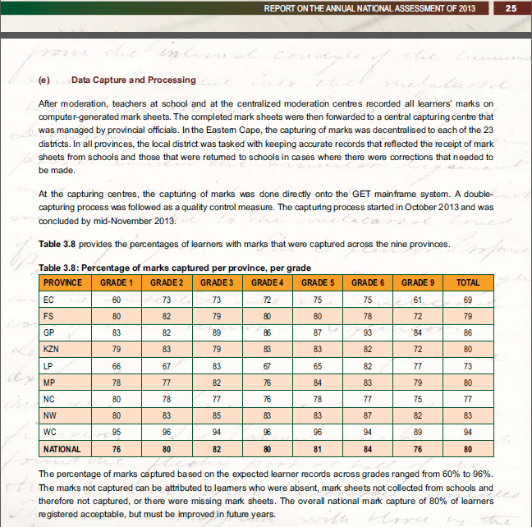
What proportion of marks captured by grade and province?!
Why so little in certain grades/provinces?
Likely to be non-random.

Slide 32
Qualifications by age (birth cohort), 2011 (Van der Berg, 2013)

Slide 33
Grade R/ECD issues needing to be fleshed out?
Qualitatively/practically, when is enrolment considered “Grade R” and when just child-minding?
Where should Grade R teachers be trained?
  Universities? More of the same?
  FET colleges? Quality problems? Status?
Practically, how does one monitor quality of ECD? What instruments? What surveys?
What should Grade R teachers be paid?
  Teacher salaries (and class sizes) obviously major cost-drivers

Slide 34
SOLUTION?
Accountability AND
Capacity

Slide 35

Notes:
From a forthcoming report on accountability on the

Slide 40


Slide 41
“Only when schools have both the incentive to respond to an accountability system as well as the capacity to do so will there be an improvement in student outcomes.” (p22)

Slide 42
Binding constraints approach

Slide 43


Slide 46
“The left hand barrel has horizontal wooden slabs, while the right hand side barrel has vertical slabs. The volume in the first barrel depends on the sum of the width of all slabs. Increasing the width of any slab will increase the volume of the barrel. So a strategy on improving anything you can, when you can, while you can, would be effective. The volume in the second barrel is determined by the length of the shortest slab. Two implications of the second barrel are that the impact of a change in a slab on the volume of the barrel depends on whether it is the binding constraint or not. If not, the impact is zero. If it is the binding constraint, the impact will depend on the distance between the shortest slab and the next shortest slab” (Hausmann, Klinger, & Wagner, 2008, p. 17).
Notes:
Hausmann, R., Klinger, G., & Wagner, R. (2008). Doing Growth Diagnostics in Practice: A 'Mindbook'. CID Workinf Paper No. 177. Center for International Development at Harvard University.

Slide 47
4 “Take-Home” points
Many things we have not discussed – Grade-R/ECD, teacher unions, LOLT, teacher training (in- and pre-), RCTs etc.
South Africa performs extremely poorly on local and international assessments of educational achievement.
In large parts of the schooling system there is very little learning taking place.
In SA we have two public schooling systems not one.
Strategies for improvement need to focus on 1) accountability, 2) capacity, 3) alignment.

Slide 48
Insurmountable learning deficits: 0.3 SD

Slide 49
Decreasing proportion of matrics taking mathematics
 | Numbers wrote maths | Numbers passed maths | Maths pass rate | Proportion taking maths | Proportion passing maths
2008 | 298 821 | 136 503 | 45,7% | 56,1% | 25,6%
2009 | 290 407 | 133 505 | 46,0% | 52,6% | 24,2%
2010 | 263 034 | 124 749 | 47,4% | 48,8% | 23,2%
2011 | 224 635 | 104 033 | 46,3% | 45,3% | 21,0%
Table 4: Mathematics outputs since 2008 (Source: Taylor, 2012, p. 4)
Notes:
Table 4: Mathematics outputs since 2008 (Source: Taylor, 2012, p. 4)

Slide 50

South African teacher content knowledge

Slide 51
Teacher Content Knowledge
  Conference Board of the Mathematical Sciences (2001, ch.2) recommends that mathematics teachers need:
  “A thorough mastery of the mathematics in several grades beyond that which they expect to teach, as well as of the mathematics in earlier grades” (2001 report ‘The Mathematical Education of Teachers’)
Ball et al (2008, p. 409)
  “Teachers who do not themselves know the subject well are not likely to have the knowledge they need to help students learn this content. At the same time just knowing a subject may well not be sufficient for teaching.”
Shulman (1986, p. 9)
  “We expect that the subject matter content understanding of the teacher be at least equal to that of his or her lay colleague, the mere subject matter major”

Slide 52
South Africa specifically…
Taylor & Vinjevold’s (1999, p. 230) conclusion in their book “Getting Learning Right” is particularly explicit:
“The most definite point of convergence across the [President’s Education Initiative] studies is the conclusion that teachers’ poor conceptual knowledge of the subjects they are teaching is a fundamental constraint on the quality of teaching and learning activities, and consequently on the quality of learning outcomes.”

Slide 53
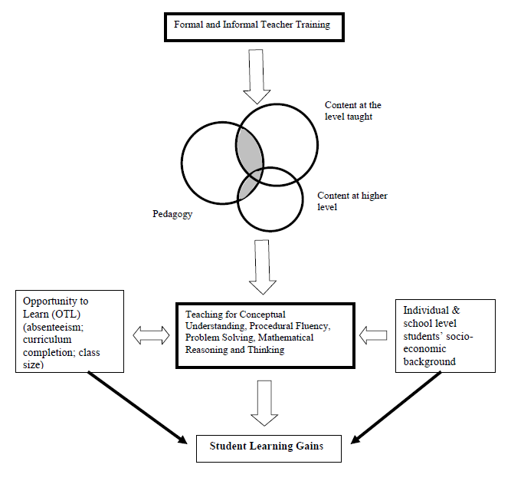
Carnoy & Chisholm (2008: p. 22) conceptual framework

Slide 54
Teacher knowledge
Teachers cannot teach what they do not know.
Student understands & can calculate fractions
PCK – how to teach fractions
CK – How to do fractions
Demonizing teachers is popular, but unhelpful
“For every increment of performance I demand from you, I have an equal responsibility to provide you with the capacity to meet that expectation. Likewise, for every investment you make in my skill and knowledge, I have a reciprocal responsibility to demonstrate some new increment in performance”
(Elmore, 2004b, p. 93).
Notes:
Elmore, R. (2004b). School reform from the inside out: Policy, practice and performance. Cambridge, MA: Harvard Education Press.

Slide 55
Distribution of mathematics teacher CK by geographical location
South Africa is the only country (amongst SACMEQ countries) where rural mathematics teachers know statistically significantly less than urban teachers.

Slide 56
Distribution of mathematics teacher CK by school SES quintile

Slide 57
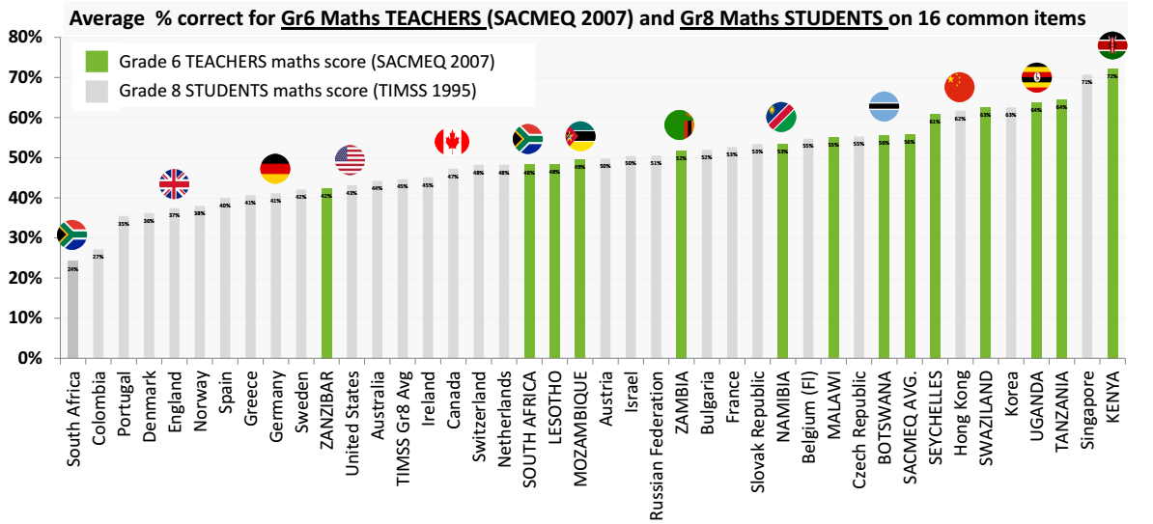
Maths teacher CK in 12 African countries

Slide 58
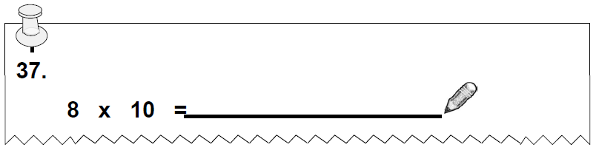
NSES question 37
NSES followed about 15000 students (266 schools) and tested them in Grade 3 (2007), Grade 4 (2008) and Grade 5 (2009).
Grade 3 maths curriculum: “Can perform calculations using approp symbols to solve problems involving: MULTIPLICATION of at least 2-digit by 1-digit numbers”
At the end of Grade 5 more than a third of quintile 1-4 students cannot answer this simple Grade-3-level problem.
Notes:
Taylor, N., & Reddi, B. (2013). Writing and learning mathematics. In N. Taylor, S. Van der Berg, & T. Mabogoane, Creating Effective Schools. Cape Town: Pearson.

Slide 59
Solutions?

Slide 60
Possible solution…
The DBE cannot afford to be idealistic in its implementation of teacher training and testing
  Aspirational planning approach: All primary school mathematics teachers should be able to pass the matric mathematics exam
    (benchmark = desirable teacher CK)
  Realistic approach: (e.g.) minimum proficiency benchmark where teachers have to achieve at least 90% in the ANA of the grades in which they teach, and 70% in Grade 9 ANA
  (benchmark = basic teacher CK)
First we need to figure out what works!
Pilot the system with one district. Imperative to evaluate which teacher training option (of hundreds) works best in urban/rural for example. Rigorous impact evaluations are needed before selecting a program and then rolling it out
Tests are primarily for diagnostic purposes not punitive purposes
Notes:
Implement a nation-wide system of minimum-proficiency diagnostic teacher testing and capacitation for numeracy and literacy starting with the Foundation Phase.
“The existing body of evidence suggests that a large proportion of South African teachers have below-basic content knowledge in the subjects that they teach – largely as a result of inadequate apartheid-era teacher training and the ineffectiveness of in-service teacher training initiatives. In light of this, and following the premise that teachers cannot teach what they do not know, it is a logical imperative that a system of identifying which teachers need what help is urgently required. Given the current state of teacher content knowledge in poor and rural schools, the Department cannot afford to be idealistic in its implementation of this system of teacher testing and training. Rather than ascribing to the aspirational planning approach that has become characteristic of South African policy - where one might set an impractically high benchmark for desirable teacher content knowledge - one should first aim to ensure that every teacher in the system has the basic content knowledge required to cover the curriculum that they currently teach. For example, rather than decreeing that every primary school mathematics teacher should be able to pass the matric mathematics exam, it would be far more realistic to take an incremental approach and set the minimum-proficiency benchmark at a 70% mark on the grade nine annual national assessment, combined with at least a 90% mark in the ANA of the grade which they are currently teaching. If a grade six mathematics teacher cannot achieve 70% on the grade nine ANA for mathematics, and achieve 90% for the grade six mathematics ANA, one can say that they do not currently possess the requisite content knowledge to teach grade six mathematics. As a matter of urgency, they should be required to undergo minimum-proficiency teacher training for the subjects which they teach and then re-assessed at the end of the training. Before trying to get every teacher to a desirable level, first ensure that all teachers have the basic content knowledge in the subjects that they teach.
Given the logistics involved with implementing a testing and training operation of this scale, it is advisable to pilot the system with one district and then to roll out the system nationally in a progressive way. For example the Department could start with Foundation Phase (FP) mathematics teachers in a particular district and require all FP maths teachers to register and write the minimum proficiency test within six months. Teachers who do not meet the minimum-proficiency benchmark for the subjects that they teach should be given six months to complete the minimum-proficiency training which should be free of charge and accessible. Importantly, the training provided should be dignified, highly practical, structured and sequenced, with formative testing built into each module to assess whether or not the teacher has acquired the necessary knowledge and skills.
In order to get teacher and union buy in, it will need to be made explicit that these tests are primarily for diagnostic rather than punitive purposes. Through a variety of mechanisms (such as contracts and confidentiality clauses) it is possible to reassure all parties involved that these tests are truly developmental in nature. The ultimate aim of such a system should not be to vilify and demean teachers and the teaching profession, but to increase the capacity and dignity of teachers. Elmore (2004b, p. 93) provides a useful description of the interplay between accountability and capacitation:
“For every increment of performance I demand from you, I have an equal responsibility to provide you with the capacity to meet that expectation. Likewise, for every investment you make in my skill and knowledge, I have a reciprocal responsibility to demonstrate some new increment in performance.”
Spaull 2013 CDE Report

Slide 61
Accountability stages...
SA is a few decades behind many OECD countries. Predictable outcomes as we move from stage to stage. Loveless (2005: 7) explains the historical sequence of accountability movements for students – similar movements for teachers?
  Stage 1 – Setting standards
  (defining what students should learn),
      CAPS
  Stage 2 - Measuring achievement
  (testing to see what students have learned),
      ANA
  Stage 3 - Holding educators & students accountable
  (making results count).
      Western Cape performance agreements?
Stages in accountability movements:
3) Holding accountable
2) Measuring achievement
1) Setting standards
TRAINING
“For every increment of performance I demand from you, I have an equal responsibility to provide you with the capacity to meet that expectation. Likewise, for every investment you make in my skill and knowledge, I have a reciprocal responsibility to demonstrate some new increment in performance” (Elmore, 2004b, p. 93).

Slide 62
When faced with an exceedingly low and unequal quality of education do we….
A) Increase accountability {US model}
    Create a fool-proof highly specified, sequenced curriculum (CAPS/workbooks)
    Measure learning better and more frequently (ANA)
    Increase choice/information in a variety of ways
B) Improve the quality of teachers {Finnish model}
    Attract better candidates into teaching degrees → draw candidates from the top (rather than the bottom) of the matric distribution
    Increase the competence of existing teachers (Capacitation)
    Long term endeavor which requires sustained, committed, strategic, thoughtful leadership (something we don’t have)
C) All of the above {Utopian model}
Perhaps A while we set out on the costly and difficult journey of B??

Slide 63
Way forward?
Acknowledge the extent of the problem
  Low quality education is one of the three largest crises facing our country (along with HIV/AIDS and unemployment). Need the political will and public support for widespread reform.
Focus on the basics
  Every child MUST master the basics of foundational numeracy and literacy these are the building blocks of further education – weak foundations = recipe for disaster
  Teachers need to be in school teaching (re-introduce inspectorate?)
  Every teacher needs a minimum competency (basic) in the subjects they teach
  Every child (teacher) needs access to adequate learning (teaching) materials
  Use every school day and every school period – maximise instructional time
Increase information, accountability & transparency
  At ALL levels – DBE, district, school, classroom, learner
  Strengthen ANA
  Set realistic goals for improvement and hold people accountable

Slide 64
3 biggest challenges - SA
Failure to get the basics right
  Children who cannot read, write and compute properly (Functionally illiterate/innumerate) after 6 years of formal full-time schooling
  Often teachers lack even the most basic knowledge
Equity in education
  2 education systems – dysfunctional system operates at bottom of African countries, functional system operates at bottom of developed countries.
  More resources is NOT the silver bullet – we are not using existing resources
Lack of accountability
  Little accountability to parents in majority of school system
  Little accountability between teachers and Department
  Teacher unions abusing power and acting unprofessionally

Slide 65

Conclusion
Ensuring that public funding is actually pro-poor and also that it actually reaches the poor.
Understanding whether the motivation is for human dignity reasons or improving learning outcomes.
Ensuring that additional resources are allocated based on evidence rather than anecdote.
The need for BOTH accountability AND capacity.

Slide 66
NSES question 37
NSES followed about 15000 students (266 schools) and tested them in Grade 3 (2007), Grade 4 (2008) and Grade 5 (2009).
Grade 3 maths curriculum: “Can perform calculations using approp symbols to solve problems involving: MULTIPLICATION of at least 2-digit by 1-digit numbers”
Even at the end of Grade 5 more than a third of quintile 1-4 students cannot answer this simple Grade-3-level problem.
“The powerful notions of ratio, rate and proportion are built upon the simpler concepts of whole number, multiplication and division, fraction and rational number, and are themselves the precursors to the development of yet more complex concepts such as triangle similarity, trigonometry, gradient and calculus” (Taylor & Reddi, 2013: 194)
(Spaull & Viljoen, forthcoming)
Notes:
Taylor, N., & Reddi, B. (2013). Writing and learning mathematics. In N. Taylor, S. Van der Berg, & T. Mabogoane, Creating Effective Schools. Cape Town: Pearson.

Slide 67
South African teacher content knowledge

Slide 68
Importance of basic content knowledge
Mathematics teachers need “a thorough mastery of the mathematics in several grades beyond that which they expect to teach, as well as of the mathematics in earlier grades” (Conference Board of the Mathematical Sciences, 2001, ch.2).
Carnoy & Chisholm’s (2008: p. 22) conceptual model distinguishes between basic content knowledge and higher level content knowledge.

Slide 69
What do South African teachers know relative to other teachers in Africa?

Slide 70
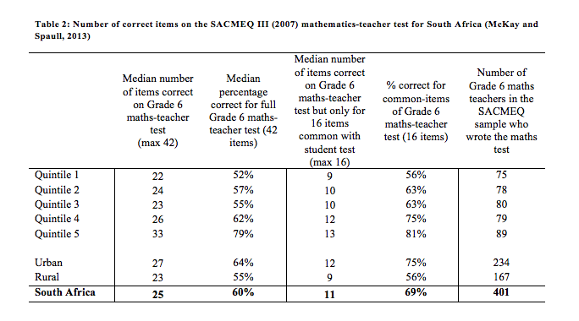
SA Grade 6 Mathematics teacher performance on SACMEQ mathematics-teacher test

Slide 71
SACMEQ III (2007) Mathematics-teacher mathematics test-scores for SACMEQ countries and South African quintiles of school wealth (95% confidence interval incl.)

Slide 72
Which content areas do South African teachers struggle with?

Slide 73
Figure 2: Mathematics teacher performance by content area (SACMEQ III - 2007)

Slide 74
Percentage of Grade 6 mathematics teachers with correct answer on Q17 of the SACMEQ III (2007) mathematics teacher test

Slide 75
What do South African teachers know relative to international Gr8 students?

Slide 76
SACMEQ Grade 6 teachers’ average correct response (dark red) and TIMSS Grade 8 average correct response (light red) on 16 items common to Gr 8 TIMSS Mathematics test 1995 and SACMEQ Grade 6 mathematics teachers test 2007

Slide 77
Conclusions
Ball et al (2008, p. 409): “Teachers who do not themselves know the subject well are not likely to have the knowledge they need to help students learn this content. At the same time just knowing a subject may well not be sufficient for teaching.”
What can Siyavula do about low teacher CK?
NDP suggests that interventions should not expect a high degree of capacity/competence – i.e. they should be tailored to work in low capacity contexts (i.e. majority of SA)

