Slide 1

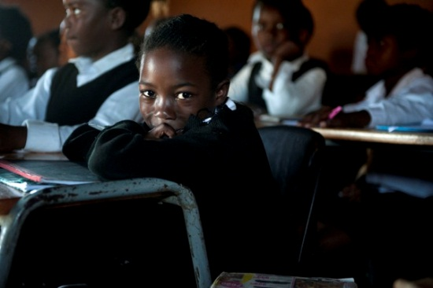


Starting behind and staying behind
The case of insurmountable learning deficits in South Africa
Nic Spaull & Janeli Viljoen
4 December 2014

Slide 2

Outline
Rationale
Data
Learning deficits in Grades 3,4,5
Learning trajectories in maths
Conceptual model of education and the labour market
Policy implications

Slide 3
Rationale
Learning is a cumulative process that builds on itself i.e. it follows a hierarchical structure (see Gagne, 1962; Aubrey, Dahl, & Godfrey, 2006; Aubrey & Godfrey, 2003; Aunio & Niemivirta, 2010).
Mathematics, in particular, follows a coherent, explicit and systematically principled structure (vertically integrated subject – Bernstein, 1999)
With respect to South Africa, Taylor et al. (2003, p. 129):
“At the end of the Foundation Phase, learners have only a rudimentary grasp of the principles of reading and writing... it is very hard for learners to make up this cumulative deficit in later years...particularly in those subjects that...[have] vertical demarcation requirements (especially mathematics and science), the sequence, pacing, progression and coverage requirements of the high school curriculum make it virtually impossible for learners who have been disadvantaged by their early schooling to ‘catch-up’ later sufficiently to do themselves justice at the high school exit level.” (see also Schollar, 2008)

Slide 4
Data
Systemic Evaluation 2007 (Grade 3)
  51 000+ Gr3 students wrote the test in September in the mother tongue
NSES 2007/8/9 (Grade 3/4/5)
  15 000 students tested using the SE Gr3 test in Gr 3/4/5 (same test), but test administered in English in each grade.
  NSES Grade 3 test conducted in October (1 month after SE)
SACMEQ 2007 (Grade 6)
  9071 Gr6 students wrote the test in Eng/Afr
TIMSS 2011 (Grade 9)
  11969 Gr9 students wrote the TIMSS Gr8 exam in 2011

Slide 5
To provide examples of “learning” between Grades 3,4,5

Slide 6
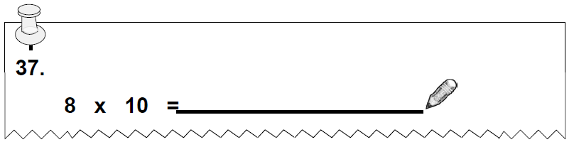
NSES question 37
NSES followed about 15000 students (266 schools) and tested them in Grade 3 (2007), Grade 4 (2008) and Grade 5 (2009).
Grade 3 maths curriculum: “Can perform calculations using approp symbols to solve problems involving: MULTIPLICATION of at least 2-digit by 1-digit numbers”
At the end of Grade 5 more than a third of quintile 1-4 students cannot answer this simple Grade-3-level problem.
Notes:
Taylor, N., & Reddi, B. (2013). Writing and learning mathematics. In N. Taylor, S. Van der Berg, & T. Mabogoane, Creating Effective Schools. Cape Town: Pearson.

Slide 7

NSES question 42
NSES followed about 15000 students (266 schools) and tested them in Grade 3 (2007), Grade 4 (2008) and Grade 5 (2009).
Grade 3 maths curriculum: “Can perform calculations using appropriate symbols to solve problems involving: division of at least 2-digit by 1-digit numbers”
At the end of Grade 5 most (55%+) quintile 1-4 students cannot answer this simple Grade-3-level problem.
Notes:
Taylor, N., & Reddi, B. (2013). Writing and learning mathematics. In N. Taylor, S. Van der Berg, & T. Mabogoane, Creating Effective Schools. Cape Town: Pearson.

Slide 8
Insurmountable learning deficits: 0.3 SD
Spaull & Viljoen, 2014 (SAHRC Report)

Slide 9
550,000 students drop out before matric
99% do not get a non-matric qualification (Gustafsson, 2011: p11)
What happens to them? 50% youth unemployment…

Slide 10
Labour Market
17%
Legislators, managers, assoc professionals
Unemployed
(Broad - 33%)
Unskilled
(19%)
Elementary occupations & domestic workers
Semi-Skilled (31%)
Clerks, service workers, shop personnel, skilled agric/fishery workers, plant and machinery operators)
University/FET
Type of institution (FET or University)
Quality of institution
Type of qualification (diploma, degree etc.)
Field of study (Engineering, Arts etc.)
High productivity jobs and incomes (17%)
Mainly professional, managerial & skilled jobs
Requires graduates, good quality matric or good vocational skills
Historically mainly white
High quality secondaryschool
High SES background
+ECD
High quality primary school
Minority (20%)
Some motivated, lucky or talented students make the transition
Unequal society
Big demand for good schools despite fees
Some scholarships/bursaries
Vocational training
Affirmative action
Majority (80%)
Quality
Low quality secondary
school
Attainment
Type
Low productivity jobs & incomes
Often manual or low skill jobs
Limited or low quality education
Minimum wage can exceed productivity
Low SES background
Low quality primary school
cf. Servaas van der Berg – QLFS 2011
Notes:
The QLFS classifies professions as follows: Highly skilled (legislators, senior officials and managers, professionals, technicians and associate profesionals); Semi-skilled (Clerks, service workers and shop and market personnel, skilled agricultural and fishery workers, craft and related trade workers, plant and machinery operators and assembly), Unskilled (Elementary occupations, domestic workers).

Slide 11
Policy implications – the earlier the better
Large inequalities in educational outcomes are already present by age 8
Relatively higher marks in grades 1-3 in ANA are misleading and shouldn’t be taken seriously.
  Grades 1 and 2 were not verified & large nonresponse (see pp 6 in 2013 report)
  Not calibrated to curriculum. Orally administered in Gr1 (&2 sometimes)
  Not psychometrically calibrated to be comparable. Changes in ANA results year-on-year absolutely CANNOT be interpreted as trends or improvements/deteriorations
Need to adopt a national goal “All children must read and write fluently by the end of grade 3”

Slide 12
Wisdom…
"Policies that seek to remedy deficits incurred in early years are much more costly than early investments wisely made, and do not restore lost capacities even when large costs are incurred. The later in life we attempt to repair early deficits, the costlier the remediation becomes" (Heckman, 2000, p. 5).

Slide 13
Thank you
Comments, questions?
This presentation and papers available online at: www.nicspaull.com/research

Slide 14
Learning trajectories
In order to develop learning trajectories we need data on student performance at multiple points in the system.
No existing longitudinal study covering the full range of school.
Solution: Use within-survey benchmarks
  How do students perform relative to average quintile 5 student?
  Convert these differences into “grade-level” using the assumption of 0.3/0.4 / 0.5 grades = 1 year of learning (see Hill, Bloom, Black, & Lipsey, 2007).
  In NSES from Grade 3-Grade 4 average student performance increased by 0.28-0.61 SD

Slide 15
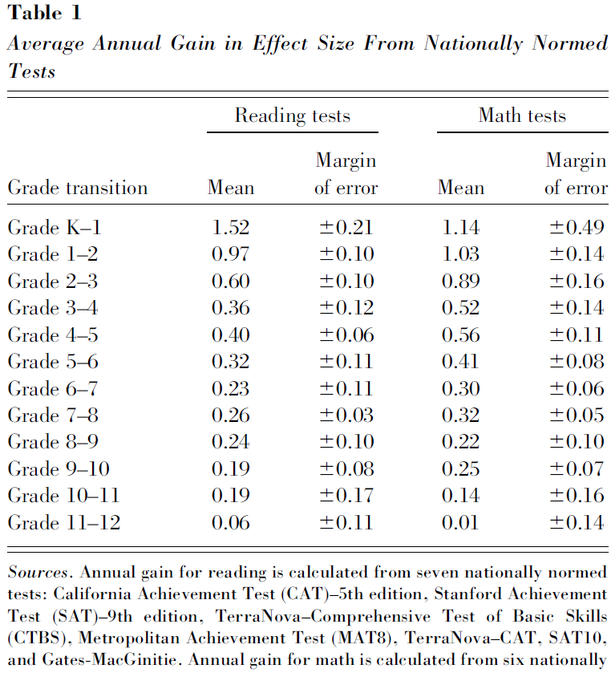
Hill, Bloom, Black, Lipsey 2007 - USA

Slide 16
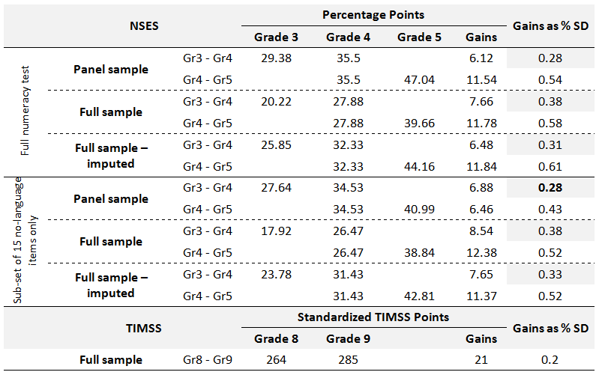
Quantifying learning in a year in SA

Slide 17
Insurmountable learning deficits: 0.3 SD

Slide 18
Insurmountable learning deficits: 0.3 SD

Slide 19
Insurmountable learning deficits: 0.3 SD

Slide 20
This is a nice graph ☺
Clear differences between Q1-3 & Q4/5, particularly with respect to exemptions.

Slide 21
Policy recommendations
Make the Annual National Assessments reliable.
Short-term interventions: determine which early-learning interventions work and implement only these.
Longer-term interventions: identify the most promising ways of raising teacher quality, especially Foundation Phase teacher quality.
“Policies that seek to remedy deficits incurred in early years are much more costly than early investments wisely made, and do not restore lost capacities even when large costs are incurred. The later in life we attempt to repair early deficits, the costlier the remediation becomes” (Heckman, 2000, p. 5).

Slide 22
Conclusion
Learning deficits are large, systemic and grow over time
  Grade-level diffs between Q1/2/3 and Q5 ranges 3-5 years behind
Clear motivation for early intervention:
  Epistemologically – mathematics content structure
  Pedagogically – hierarchical learning (ala Maloney & Confrey, 2010)
  Economically – ala Heckman (2000) and brain plasticity

Slide 23
Questions
Are the assumptions underlying trajectories tenable?
  Constant learning? 0.3SD Correct?
Policy implications
  Suspending the curriculum (ala GPLMS?)
  Being more ‘realistic’ about the curriculum (ala Pritchett)
  Is it the curriculum or is it teachers? Adjusting teachers expectations (both their expectations of what’s possible and what is expected of them)

Slide 24
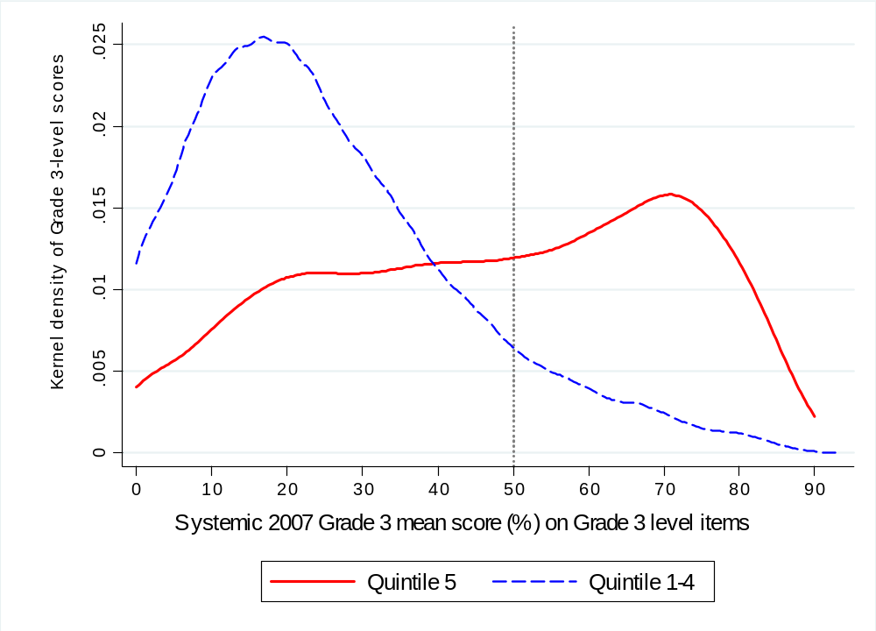
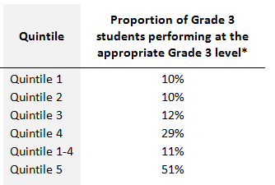
Quantifying learning deficits in Gr3
Following Muralidharan & Zieleniak (2013) we classify students as performing at the grade-appropriate level if they obtain a mean score of 50% or higher on the full set of Grade 3 level questions.
Figure 1: Kernel density of mean Grade 3 performance on Grade 3 level items by quintiles of student socioeconomic status (Systemic Evaluation 2007)
(Grade-3-appropriate level)
51%
11%

Slide 25
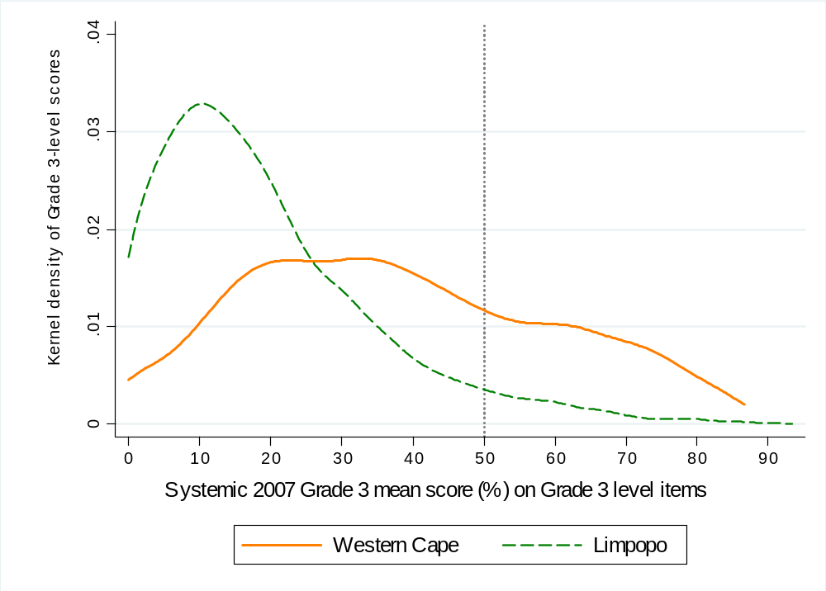
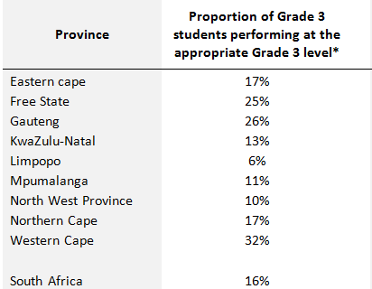
Quantifying learning deficits in Gr3
Given South Africa’s history, socioeconomic inequalities will also necessarily extend to provincial inequalities
Kernel density of mean Grade 3 performance on Grade 3 level items by province (Systemic Evaluation 2007)
(Grade-3-appropriate level)
32%
6%
← NB. Only the top 16% of South African Gr3 students are at a Gr3 level

Slide 26
Learning deficits in Grades 3,4,5
To compare learning deficits between Grade 3,4,5 we need to use NSES
Problematic due to language of testing (English) since most children only switch to Eng in Gr4.
  EG→ isiZulu child scores 13% in NSES Gr3 and 20% in NSES Gr4,
    Was the due to increased mathematical proficiency? Increased English language fluency/familiarity? Some combination?
Therefore we use only no-language items in our analysis

Slide 27
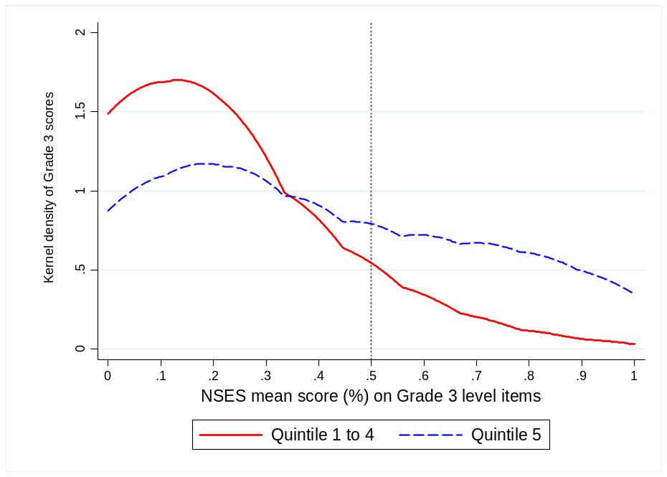
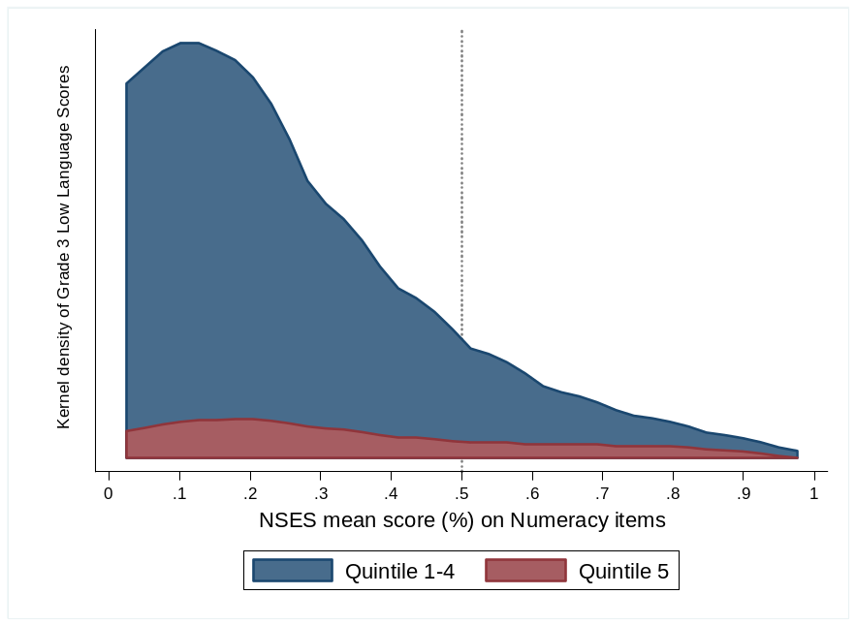
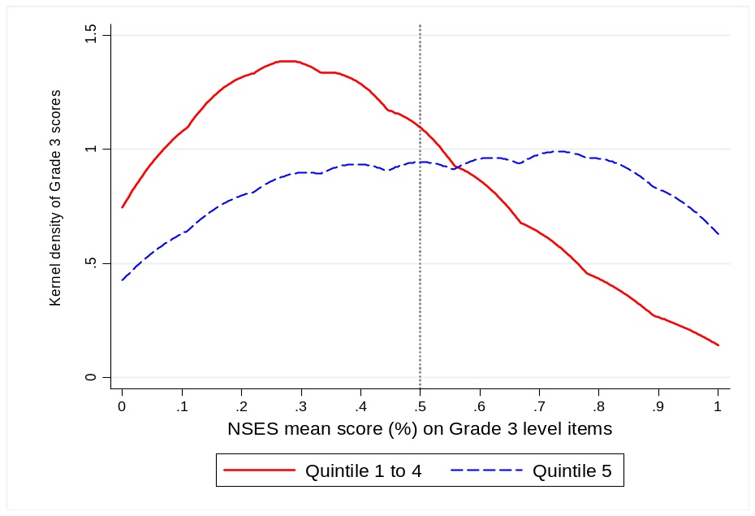
NSES Gr3 & 5 performance on no-language Gr3-level items
(Grade-3-appropriate level)
(Grade-3-appropriate level)
GRADE 3 NSES
GRADE 5 NSES
Proportion functioning at Gr3 level
Q1-4 Gr3 (8%) → Gr5 (26%)
Q5 Gr3 (25%) → Gr5 (55%)

Slide 28
Over Aged Students

Slide 29
Using ANA 2012
‘Over aged’ = appropriate + 1
‘Too old’ = appropriate +2+

Slide 30
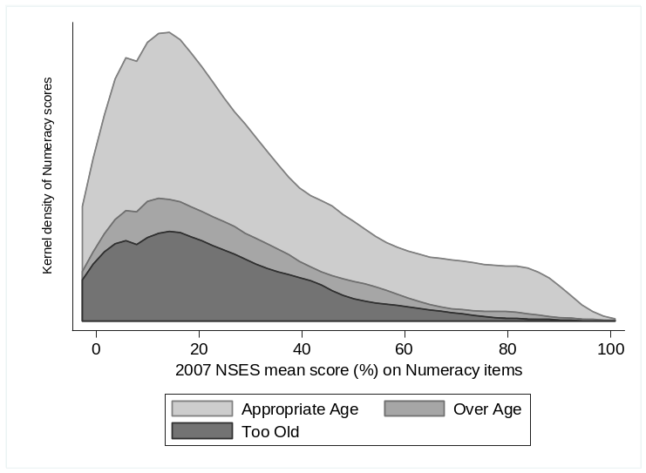
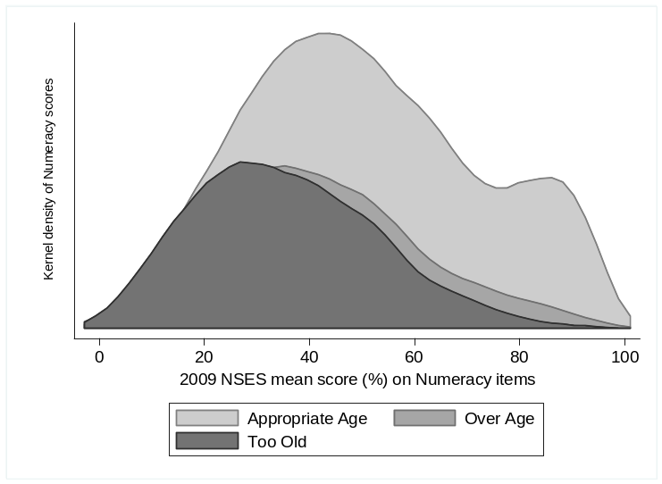
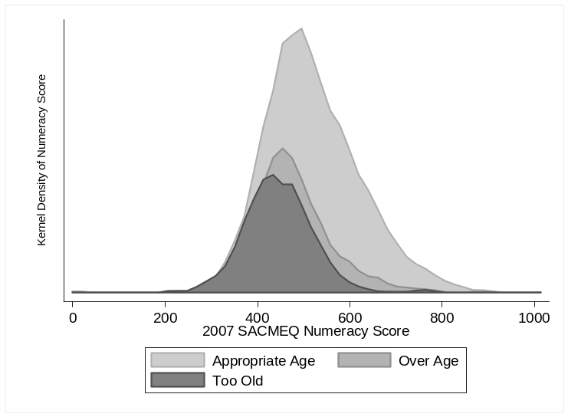
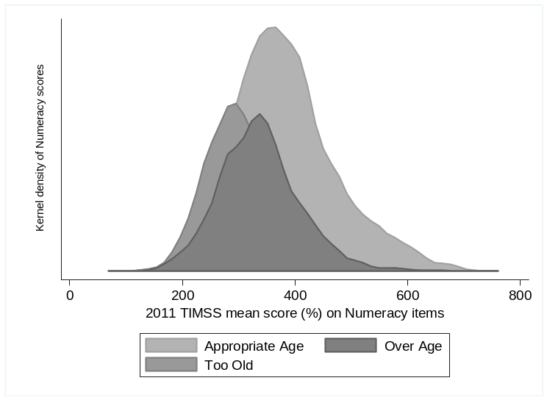
Over Aged Students – Across data sets
Grade 3
Grade 5
Grade 6
Grade 9
(Spaull & Viljoen, forthcoming)
Notes:
How can we make the graphs more comparable?

Slide 31
Over Aged Students – Across data sets
 |  | Proportion | Mean Score | SE | % Points behind | SD behind
NSES 2007 | Appropriate | 61% | 29.6 | 0.249
 | Over Age | 23% | 25.3 | 0.331 | 4.3 | 0.2
 | Too Old | 16% | 23.1 | 0.371 | 6.4 | 0.3
NSES 2008 | Appropriate | 57% | 37.4 | 0.247
 | Over Age | 24% | 30.4 | 0.305 | 7.0 | 0.3
 | Too Old | 20% | 26.2 | 0.303 | 11.2 | 0.5
NSES 2009 | Appropriate | 54% | 50.3 | 0.256
 | Over Age | 24% | 41.2 | 0.327 | 9.1 | 0.4
 | Too Old | 22% | 35.4 | 0.309 | 14.9 | 0.7
SACMEQ | Appropriate | 57% | 520.5 | 1.416
 | Over Age | 24% | 472.3 | 1.837 | 48.2 | 0.5
 | Too Old | 19% | 445.9 | 1.755 | 74.6 | 0.8
TIMSS | Appropriate | 54% | 385.0 | 0.800
 | Over Age | 24% | 338.0 | 0.972 | 47.0 | 0.5
 | Too Old | 22% | 307.0 | 0.854 | 78.0 | 0.9
(Spaull & Viljoen, forthcoming)

Slide 32
Over Aged Students – Across data sets
(Spaull & Viljoen, forthcoming)

Slide 33
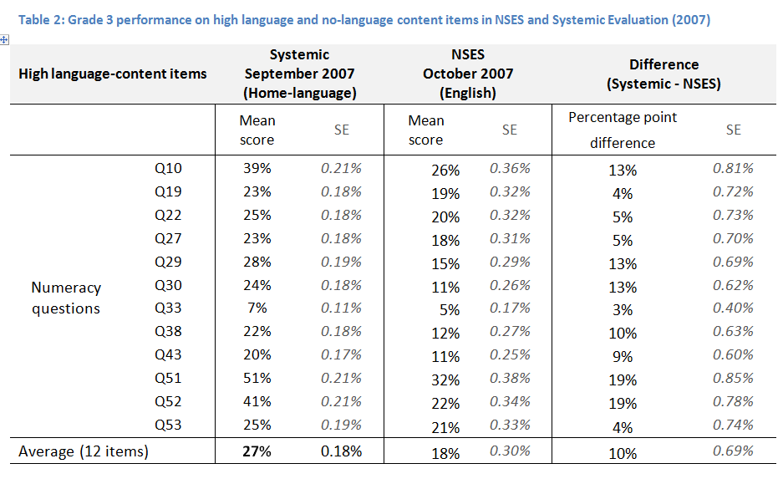
Home-language vs. English

Slide 34
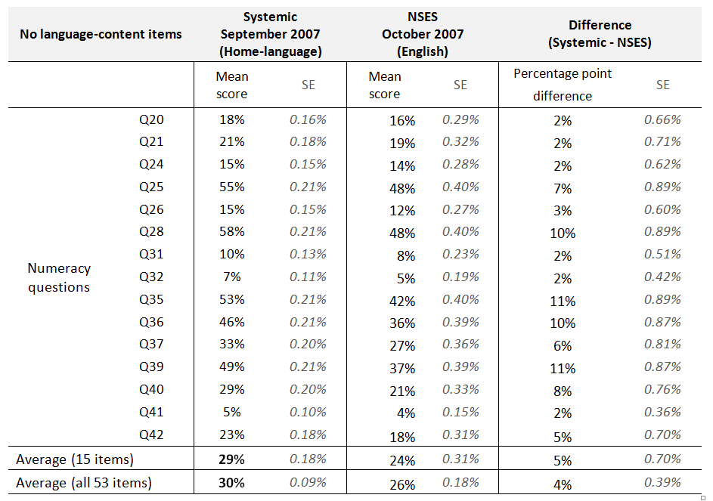

Slide 35
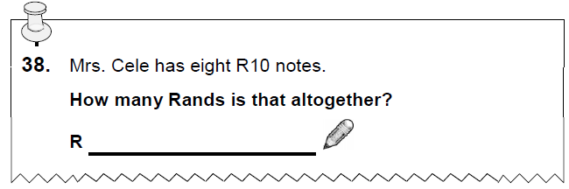
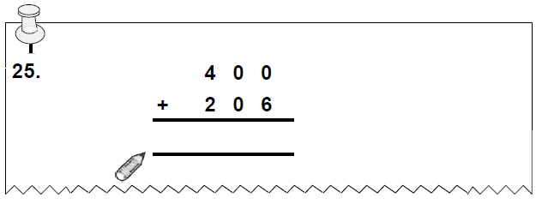
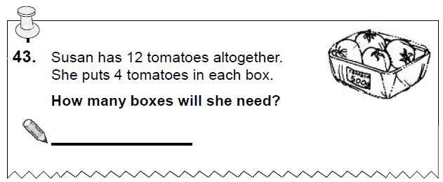
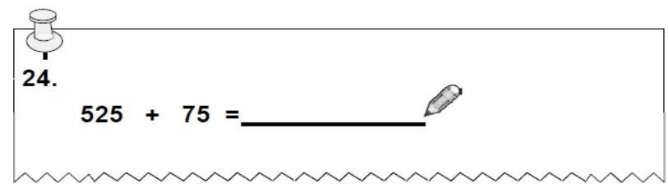
Examples of high and no language items
 | Grade 1 | Grade 2 | Grade 3 | Grade 4 | Total
High language | 1 | 5 | 6 | 0 | 12
No language | 1 | 2 | 9 | 3 | 15
Other | 1 | 7 | 15 | 3 | 26
Total | 3 | 14 | 30 | 6 | 53
High language content items
No language content items

Slide 36
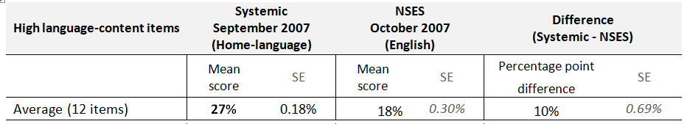
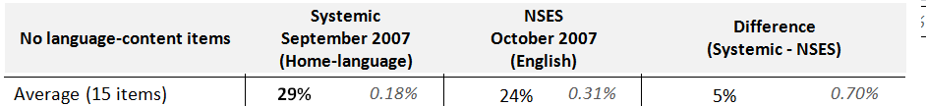
“quasi-Difference-in-Difference”
Clearly some of the underperformance in NSES Gr3 maths is due to language
Problematic for learning trajectory analysis
Solution? Only use nine Gr3-level no-language items for Gr3-4-5 learning trajectories from now on

