Slide 1
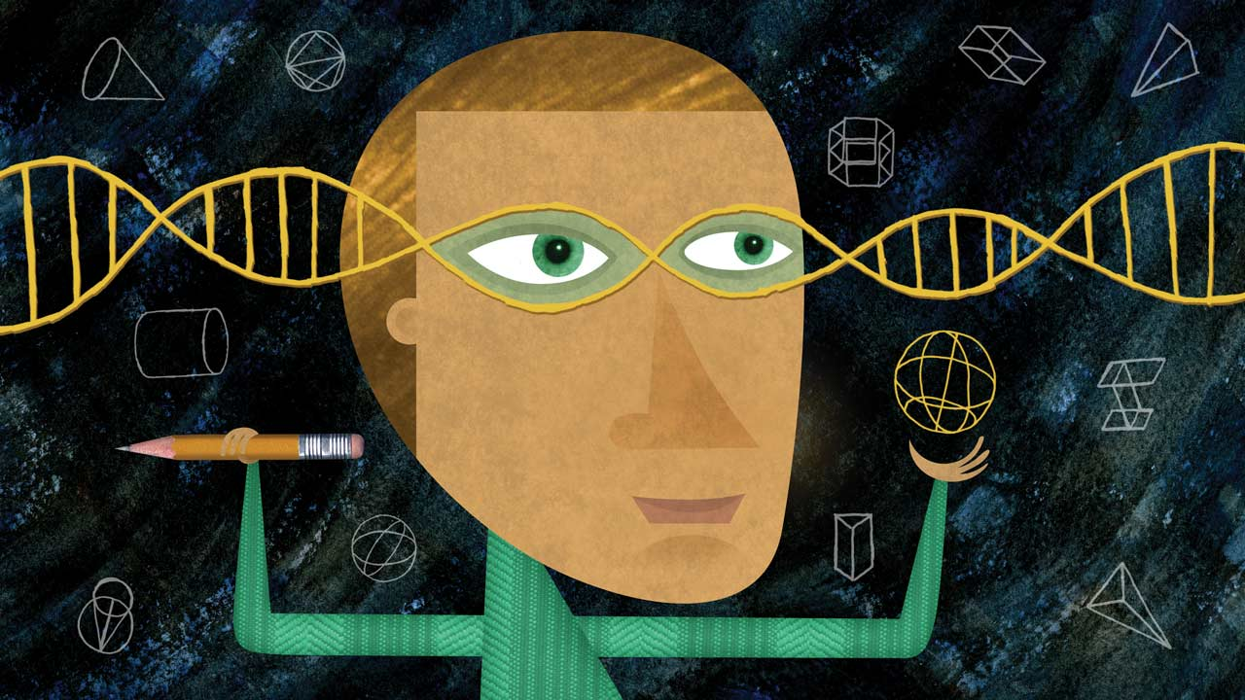
Assessment: Helping or Hurting the Academic Project?
Dr Nic Spaull | Herzlea High School | 20 April 2016 www.nicspaull.com
Stellenbosch University | University of Johannesburg | OECD
Notes:
Image from: http://www.amplify.com/viewpoints/7-apps-and-websites-to-strengthen-21st-century-skills

Slide 2

Overview
What is assessment & why is it important?
Assessment problems as both symptom and cause. Solution?
Rethinking assessment and the academic project itself
What can Herzlea do going forward?
Q&A

Slide 3
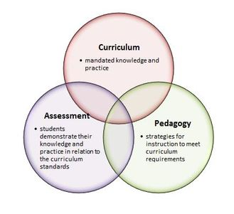
What is assessment & why is it important?
Assessment is one of the core components of schooling:
Curriculum: What counts as legitimate knowledge and practice?
  (What do you need to learn)
Assessment What constitutes a legitimate output or production?
  (Did you learn it?)
Assessment is important primarily because
  it is used to sort, select & certify students for programs, university, professions, life (think NSC, MBChB, CA etc.)
  It’s influence on teaching and learning. End point reverberates through the system
Academic Project

Slide 4
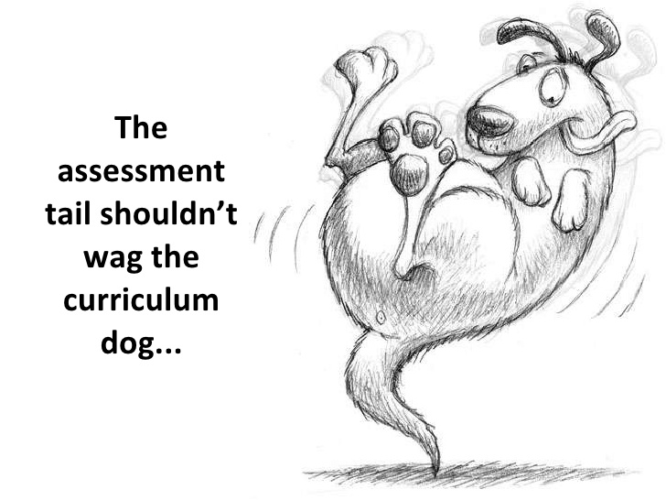
Assessment problems as both cause and symptom. Solution?
Rethinking the way we assess the academic project
Cause: The way that we assess influences and many times dictates what we teach and how we teach it. This can mean
‘Teaching to the test’ in terms of curriculum content (narrowed down curriculum)
Teaching to the test in terms of assessment type (proliferation of MCQ tests)
Symptom: If the NSC is an accurate reflection of the curriculum, and one can excel in the NSC without certain skills, typically they won’t be taught.
Higher-order thinking skills
Social-emotional skills
Values and attitudes
Rethinking the academic project
“What is assessed is what gets taught, which becomes or defines the curriculum.”
Sergiovanni & Starratt (2007)

Slide 5
“The top 10 in-demand jobs in the future don’t exist today. We are currently preparing students for jobs that don’t yet exist, using technologies that haven’t been invented, in order to solve problems we don’t even know are problems yet.”
-Richard Riley

Slide 6

Rethinking assessment and the academic project

Slide 7
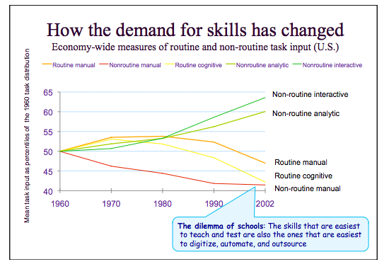
Linda Darling-Hammond 2010 – Lessons from Reform Around the World

Slide 8
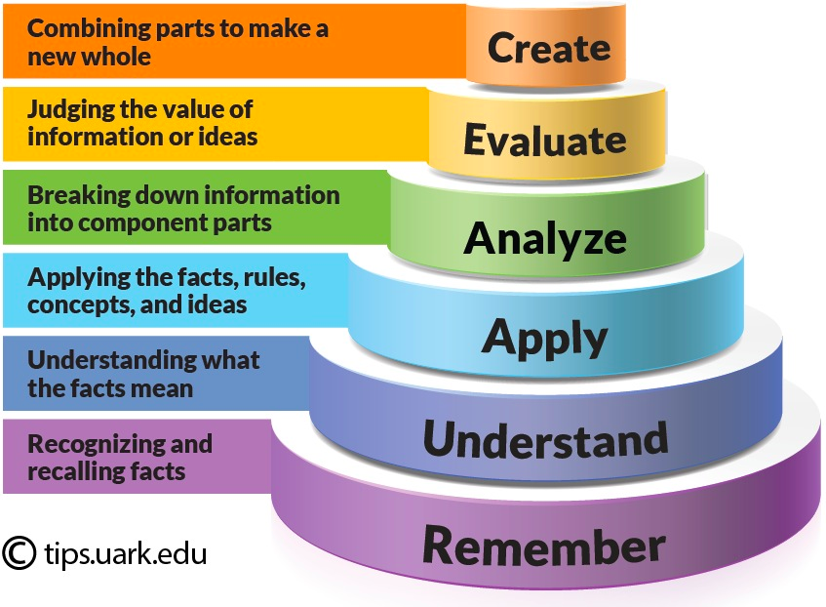
Bloom’s Taxonomy: Cognitive

Slide 9
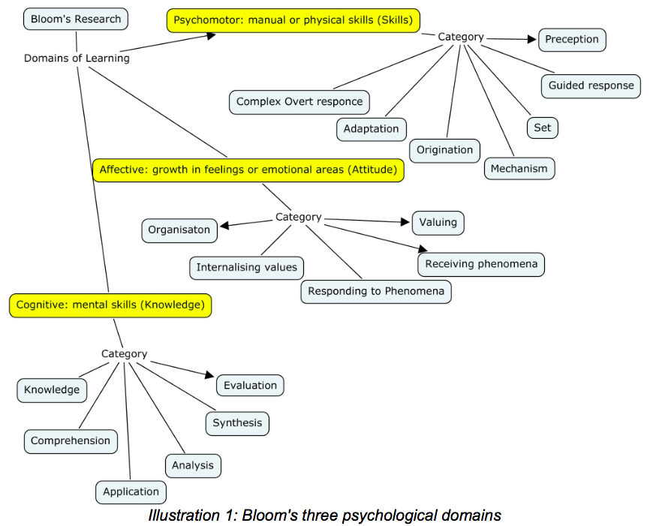
Bloom’s 3 psychological domains
Source: Andrew Churches – Bloom’s Digital Taxonomy
Notes:
Andrew Churches – Bloom’s Digital Taxonomy

Slide 10
Linda Darling-Hammond
“Genuine readiness for college and 21st century careers requires the ability to find, evaluate, synthesize and use knowledge in new contexts to frame and solve non-routine problems and produce new products.
This requires a base of robust, transferable – not inert – knowledge, deeply understood, organized around big ideas and the connections among them.
It also requires well-developed thinking, problem solving, design, and communication skills”
Notes:
https://vimeo.com/40895671

Slide 11
Expectations for Learning are Changing
The new context means new expectations. Most studies include:
Ability to communicate
Adaptability to change
Ability to work in teams
Preparedness to solve problems
Ability to analyse and conceptualise
Ability to reflect on and improve performance
Ability to manage oneself
Ability to create, innovate and criticise
Ability to engage in learning new things at all times
Ability to cross specialist borders
Chris Wardlaw, "Mathematics in Hong Kong/China – Improving on Being First in PISA"

Slide 12
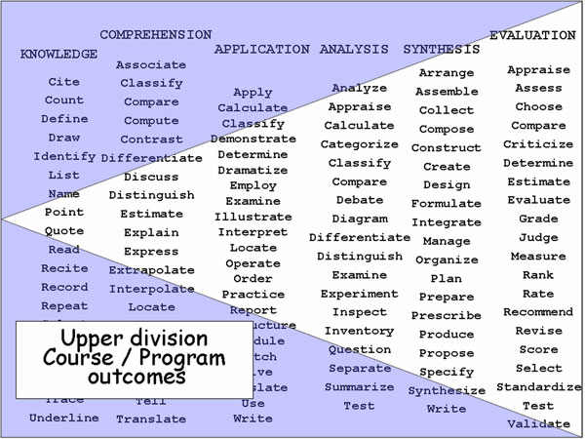

Slide 13
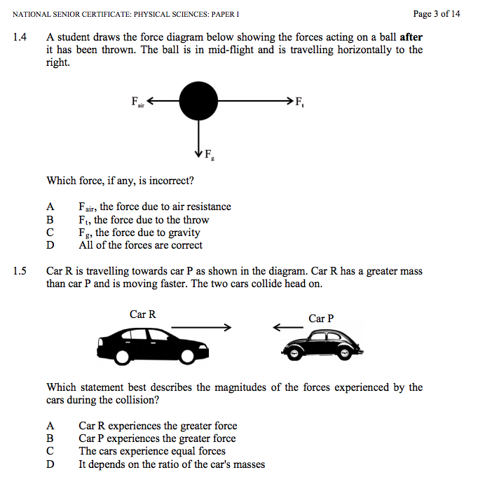
IEB NSC Physics P1 2015

Slide 14
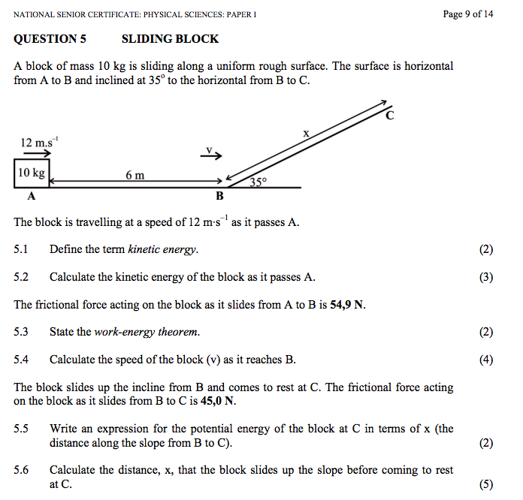

Slide 15
Expectations for Learning are Changing
The new context means new expectations. Most studies include:
Ability to communicate
Adaptability to change
Ability to work in teams
Preparedness to solve problems
Ability to analyse and conceptualise
Ability to reflect on and improve performance
Ability to manage oneself
Ability to create, innovate and criticise
Ability to engage in learning new things at all times
Ability to cross specialist borders
Chris Wardlaw, "Mathematics in Hong Kong/China – Improving on Being First in PISA"

Slide 16
Queensland Australia Gr9 Maths - Instruction to Students:
Your task is to design a space to store enough stackable chairs to seat all the staff and students in your school.
You will:
follow a series of steps to help you design a suitable space
use a research journal to record your ideas and rough working
write a report on the process and solutions.
Questions
1. Develop mathematical models for each dimension of a stack of chairs, where the number of chairs is unknown.
2. To help you think about the practicalities of storing chairs, use your mathematical models to find:
a. the greatest number of chairs in one stack that can fit into a storage area with a 4 m high ceiling
b. the number of stacks that fit across a 3.2 m wide area if there are 10 chairs in each stack
c. the height of a stack, if all the chairs for the school are put into one stack.
3. Use the understanding of the practicalities of storing chairs you developed in Question 2 to find a practical storage area for the chairs.
To answer these questions, work through the steps set out on the following pages. As you work, record everything you do in your research journal.
Using a research journal
A research journal is a record of what you and your group do. Your research journal should include:
what you and your group do in each class session, ideas, questions, plans, difficulties faced, how difficulties are managed, data collected, calculations, mathematical language, acknowledgment of any help you receive from friends, teachers or other people.
Your research journal should contain all the information you need to write your report. It will also help your teacher decide what you can do by yourself, and what you can do as part of a group.
Communicating your Findings
Write a report on your investigation. Your report should include:
(1) an introduction providing an overview of the scenario and the questions, (2) your solutions to the questions, (3) using mathematical language, data, calculations, diagrams, graphs and phrases or sentences that provide enough information for a person to know what you are calculating without having to read the questions, (4) a conclusion, summarising: your reflection on the practicalities of your solutions, any assumptions made or limitations to your answers, and suggestions for improving the investigation or strategies used.
Note: We are still testing the content and whether students have mastered the underlying skills

Slide 17
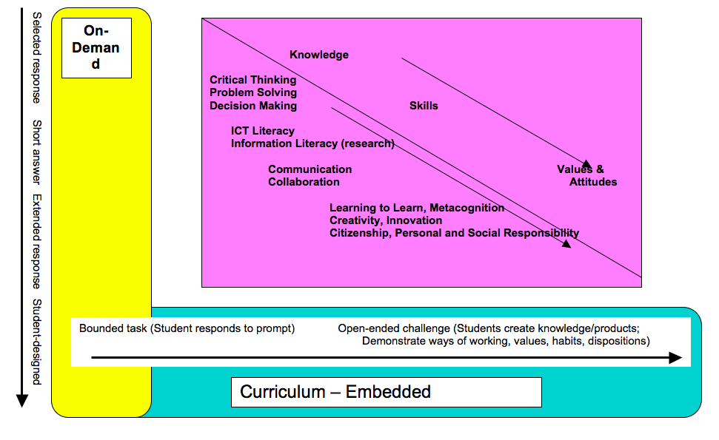
Draft White Paper 5 - Policy frameworks for new assessments
Linda Darling-Hammond

Slide 18
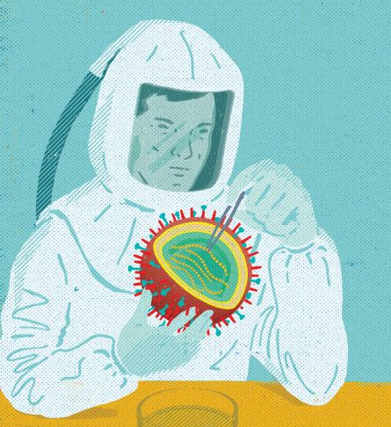
Rethinking the academic project itself
Clearly current assessments are not assessing the types of skills and ways of knowing that are valuable in the current (& future) world of work.
Expanding our understanding of what schooling is for and why we do it the way we do.
Sage on the stage: 1 adult in front of 20-30 younger people
  Collaborative teaching & learning
  Students as teachers
  Parents as teachers
Grade-based grouping & progression
  Competency-based progression
Siloed subjects
  Cross-curricular teaching
  Project-based or phenomena-based learning (PBL)
Schooling is for cognitive learning only
  Social-emotional skills are important and teachable
  Figuring out ho to teach empathy, curiosity, grit

Slide 19
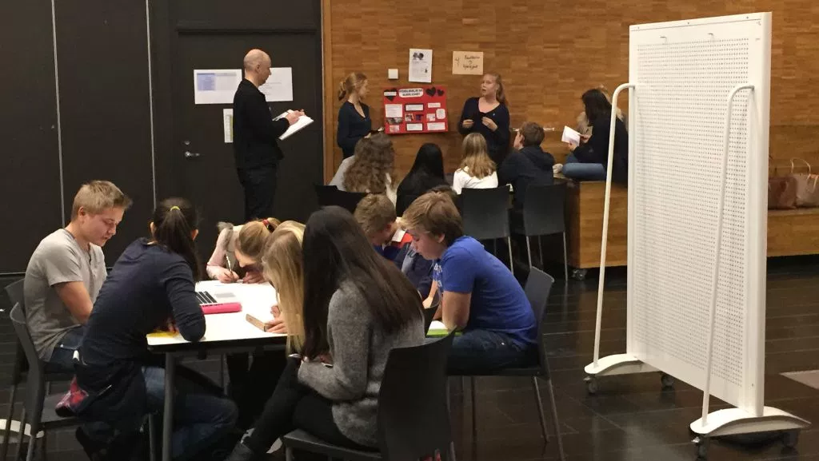

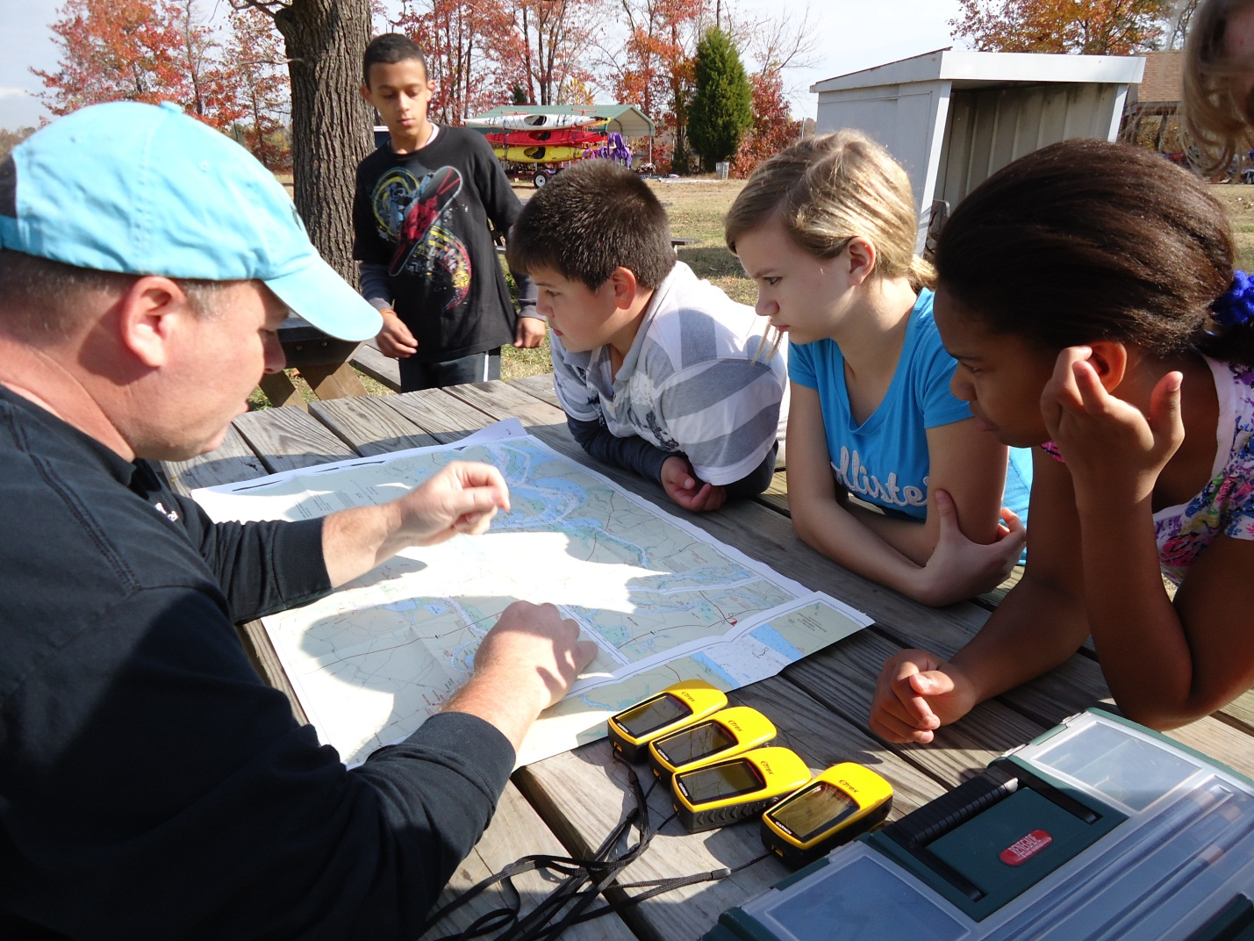
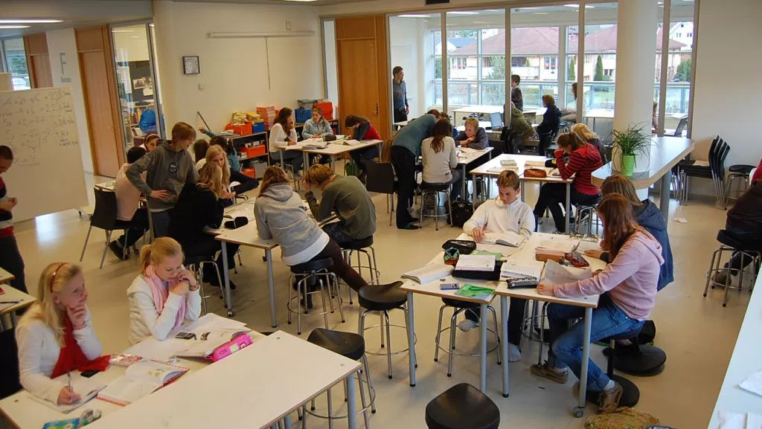
“Each team consists of four to six teachers and is responsible for 60 to 75 pupils. As an example of how they work, students in the eighth grade (13-year-olds) will often study earthquakes, volcanos and other earth forces - normally considered part of a geography or natural science lesson.
Now, however, teachers will come up with several different storylines for the lesson - encompassing other subjects In one, they pretend they have to climb Mount Everest.
It includes the study of maps, weather and climate, make a list of the equipment they need, calculate the time they will need, make a budget for the trip and apply for funding in English (a foreign language).”
Notes:
http://qz.com/377742/this-school-in-norway-abandoned-teaching-subjects-40-years-ago/

Slide 20
Bloom’s 3 psychological domains
Source: Andrew Churches – Bloom’s Digital Taxonomy
Notes:
Andrew Churches – Bloom’s Digital Taxonomy

Slide 21
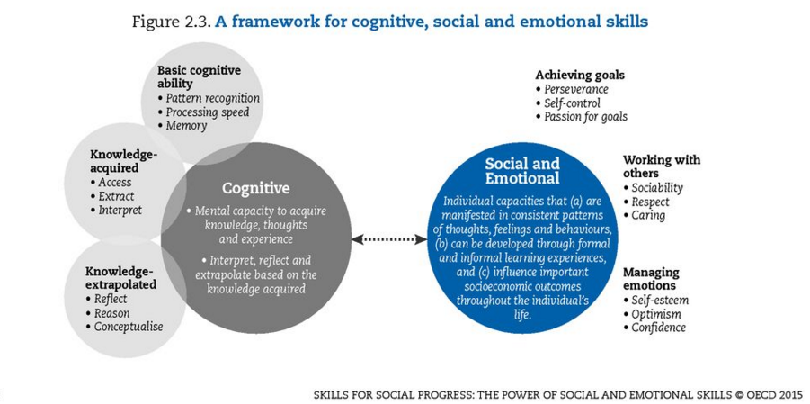
Importance of socio-emotional skills

Slide 22
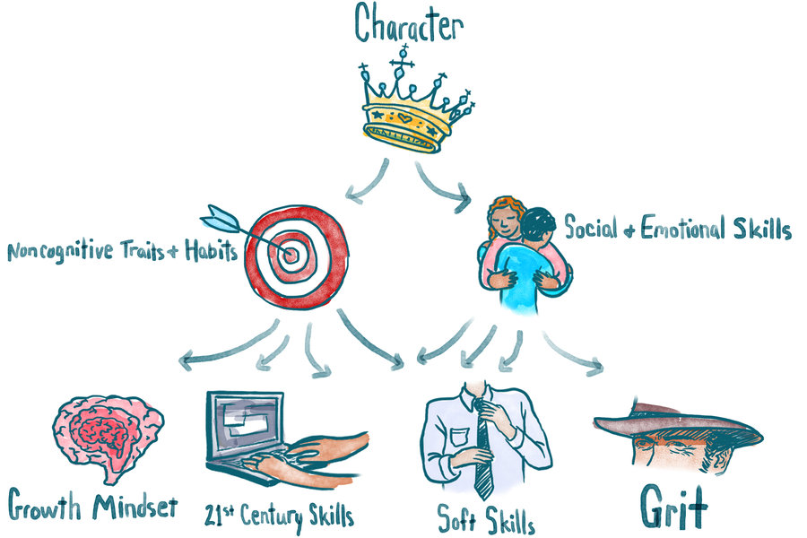
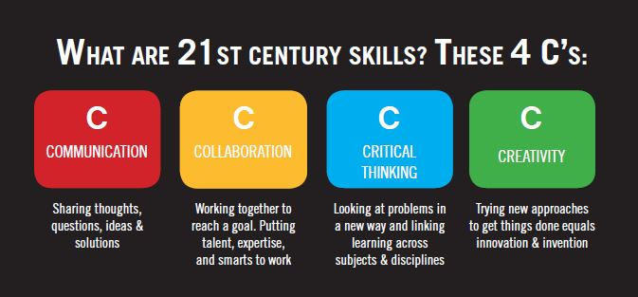
Notes:
http://www.npr.org/sections/ed/2015/05/28/404684712/non-academic-skills-are-key-to-success-but-what-should-we-call-them

Slide 23
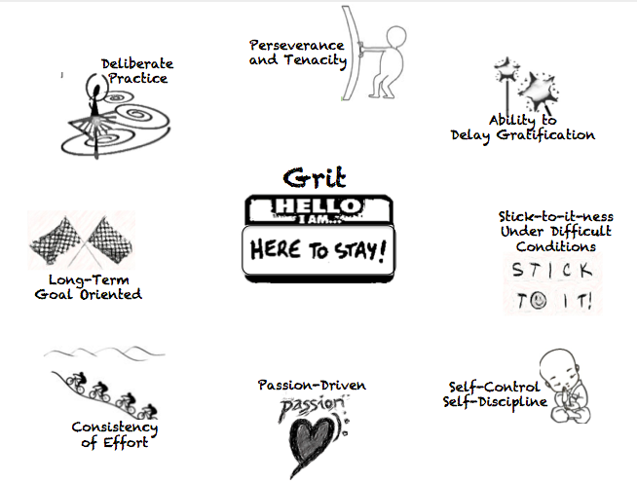
New research: Grit
Angela Duckworth – U Penn
Carol Dweck - Stanford

Slide 24
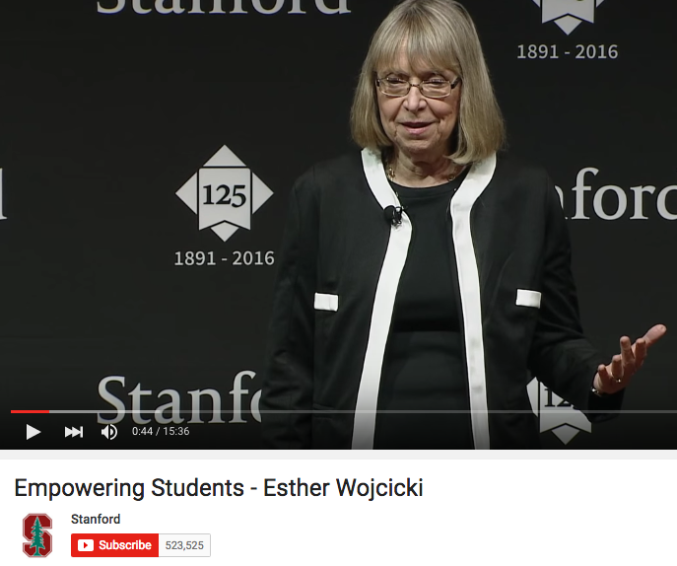
Esther Wojcicki – Palo Alto High School’s journalism program
Student newspaper, website, magazine, videos etc.
Videography
Photography
Deadlines
Collaboration
Inter-personal relations management
Design
Planning
Writing
Editing
Project-management
Printing
Budgeting
Formatting
Students are judged by more complex outputs over a longer period of time.

Slide 25
Draft White Paper 5 - Policy frameworks for new assessments
Linda Darling-Hammond

Slide 26
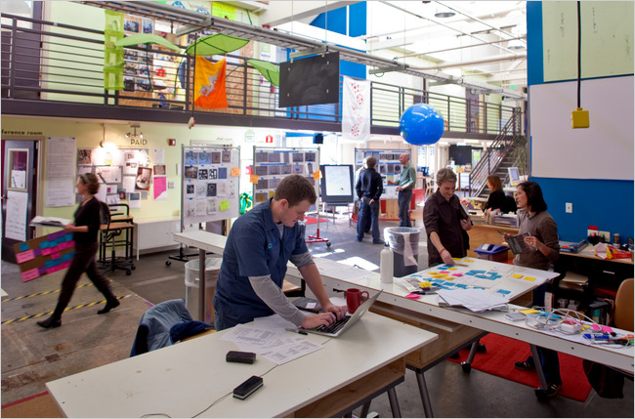
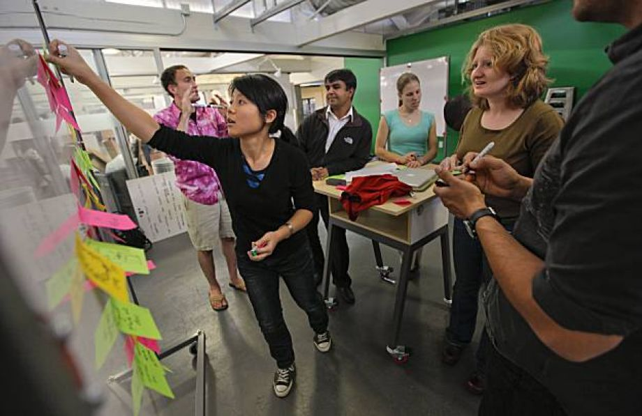
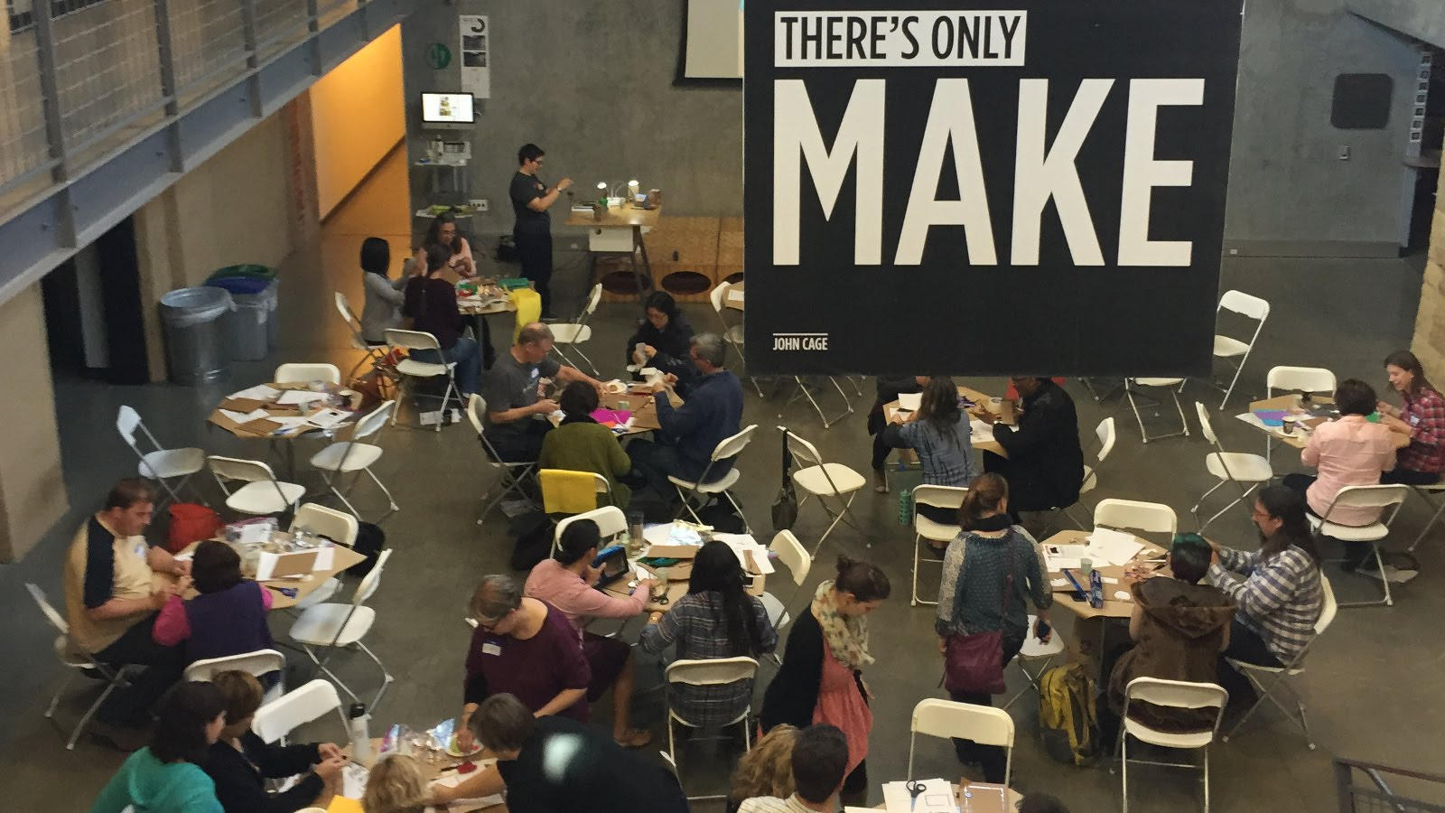
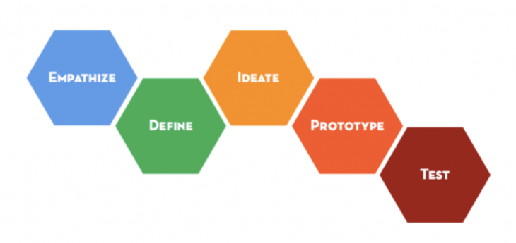

Slide 27
What does this look like for Herzlea?
Some questions/suggestions:
To what extent do we have a shared understanding of what the academic project is at Herzlea?
  Is this shared by most staff? Most parents? Most students?
To what extent does our current curriculum (and way of implementing/teaching that curriculum) foster or hinder the academic project as we have defined it?
To what extent do our current assessments foster or hinder the academic project as we have defined it?
To what extent are we doing things the way that we are currently doing them because this is the way we’ve always done it and change will be difficult?
Which schools do we look to when we compare ourselves?
Is there sufficient appetite or demand for reform in the way we see the academic project here and/or assessment?
  Could this be created?
Is there an academic leader who wants to own this process?
  New ways of learning often ruffle feathers, require an open-handed ‘we’re figuring this out’ approach, sometimes look chaotic, require a deep-seated belief that this is the way forward, can articulate why this is happening and what the expected outcomes are, can show the continuities and the breaks with old ways of doing things.

Slide 28
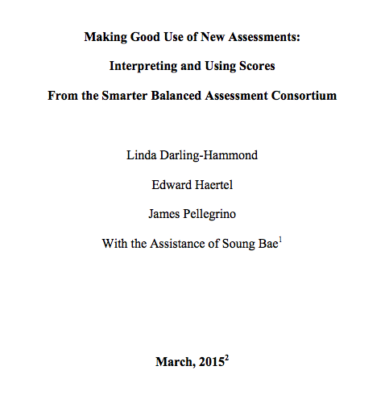
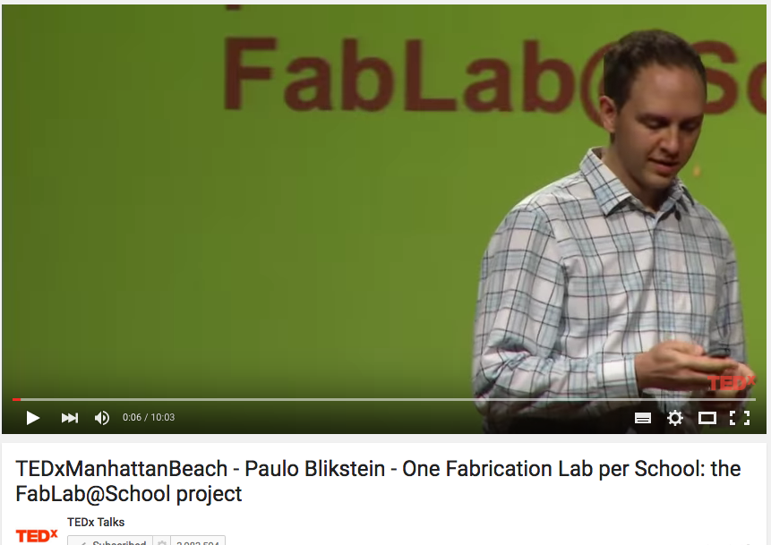
Resources
https://www.ideo.com/expertise/education/
https://vimeo.com/40895671
http://education.vermont.gov/documents/EDU-WhitePaper-Making_Good_Use-of_New_Assessments.pdf
Michael Fullan, Ken Robinson, Linda Darling-Hammond, Alaine De Botton, Carnegie Mellon University, d.school at Stanford
Released items - https://www.oecd.org/pisa/pisaproducts/PISA2015-Released-FT-Cognitive-Items.pdf

Slide 29
Comments and questions?

Slide 30
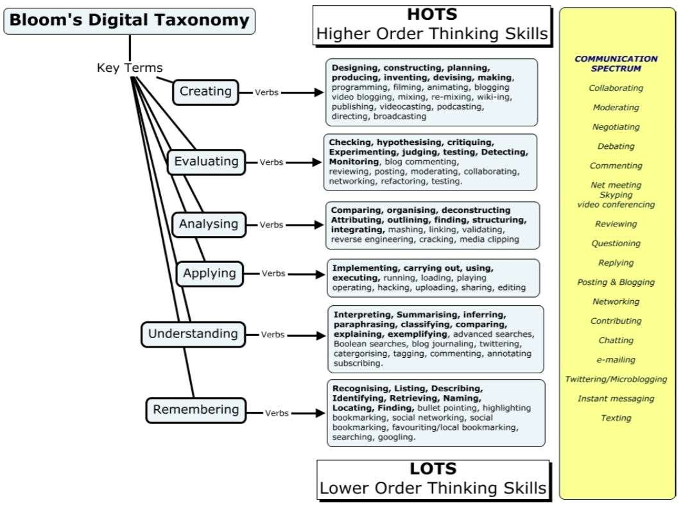
Applying this to technology?
Source: Andrew Churches – Bloom’s Digital Taxonomy
Notes:
Andrew Churches – Bloom’s Digital Taxonomy

Slide 31
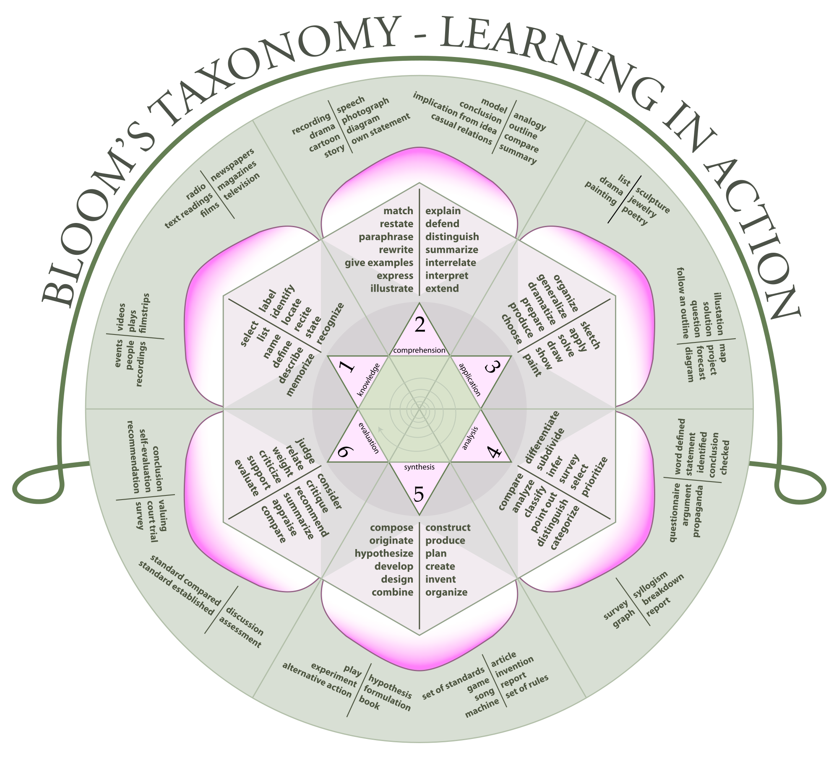

Slide 32
