Slide 1
An Analysis of the Grade 3 Department of Basic Education workbooks as curriculum tools
Ursula Hoadley & Jaamia Galant
University of Cape Town
Presentation at the launch of the PSPPD & Zenex reports, Stellenbosch, 24 May 2016

Slide 2
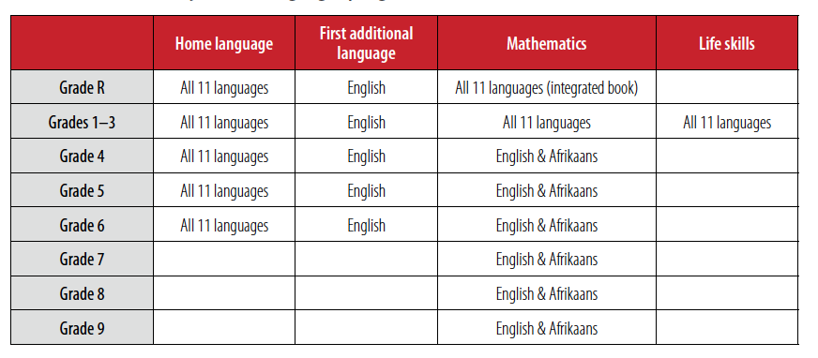
Workbook development
Notes:
First developed in 2011
Available in 11 languages
Reach 9 million children
Revised each year to aligned with CAPS
Potentially an extremely important resource. Our question was in what ways? What was it most suitable for in use, or as what we call a curriculum tool?

Slide 3
What purpose best suited to?
“to provide learners with worksheets to practice language and numeracy skills that they have been taught in class. They are also meant to help teachers track the progress of learners and provide extra support if needed. They are a simple way to structure learning activities for learners” (DBE, 2015).
System-wide curriculum coverage monitoring
Notes:
We are interested in this paper in the nature of the workbooks as a curriculum tool.
By curriculum tool we mean a resource that supports the implementation of the curriculum.
Do the workbooks conform to uses intended by the DBE? Are they potentially useful in ways other than specified by the DBE?

Slide 4
Curriculum tools
A practice tool is a resource that provides opportunities for the learner to rehearse content, concepts and skill through tasks and activities. Progression in relation to increasing complexity may be present if a wide range of contents over time is addressed.
An assessment tool makes explicit the content, concepts and skills to be taught and demonstrates what constitutes an appropriate production. An assessment tool would allow for monitoring learner performance and progression over time.
A monitoring tool ascertains how much curriculum content is being covered and at what levels of cognitive demand. It would require strong alignment with the curriculum and explicit content progression.
A teaching tool is used to structure learning activities for students and to present and explain content.
Notes:
By curriculum tool we mean a resource that supports the implementation of the curriculum.
Our analysis aimed to evaluate the extent to which the workbooks represent effective tools for practicing curriculum content and monitoring and assessing student work. We have interpreted ‘track the progress of learners’ in this context to mean not only monitoring of coverage, but also a tool for assessment of learners’ performance and progression.
We make no claims about whether they constitute an effective learning tool. In other words we don’t look at the workbooks in relation to their textual function with respect to learning.
i.e. We evaluated the workbooks as teacher (and possibly, system) tools, not a tool from the perspective of the student.
While a practice, teaching and an assessment tool as defined above would be effective curriculum tools at the level of the classroom, i.e. used by the teacher, a monitoring tool, as defined above, may also be used as an effective curriculum tool at a systemic level.

Slide 5
Sample
Two Grade 3 Language workbooks, 2015,
  Term 1 & 2
  Term 3 & 4
Two Grade 3 Mathematics workbooks, 2015
  Term 1 & 2
  Term 3 & 4
The Curriculum and Assessment Policy Statement (CAPS) English Home Language Foundation Phase Grades R-3 (2011)
Curriculum and Assessment Policy Statement (CAPS) Mathematics Foundation Phase Grades R-3 (2011).
Notes:
the English home language text is the basis on which other languauge books are developed. Also, most developed of the books. Wanted to see them at their best stage of development. FAL though used by majority of learners.
Because the focus is on English, the study cannot pick up on one of the most widely reported problems in the workbooks (albeit anecdotal): that of poor translation. Further, Mackay (2015, personal comment), reports that one of the central problems encountered with African languages “pertains to the lack of standardization of the African languages and the fact that many language teachers expect the text to be the language/dialect that they “speak””.
We selected grade 3 as a critical point as the summation of the foundation phase.

Slide 6
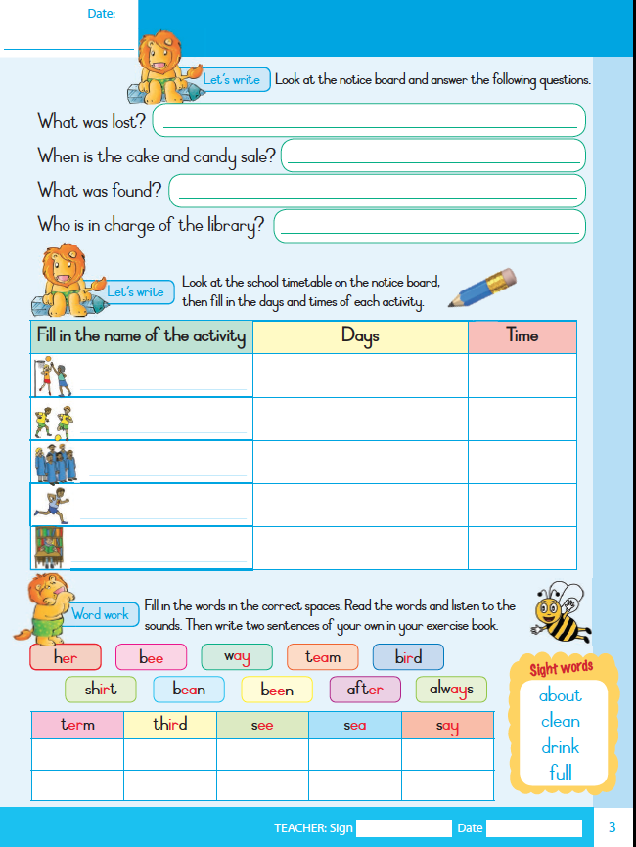
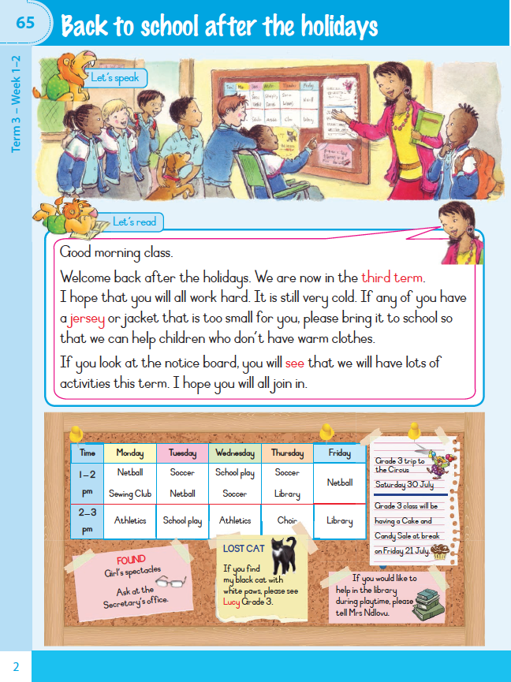
Grade 3 English Home Language 2015
Notes:
Double page colourful spreads. 125 activities organised into weeks and terms.
Each activity covers a two-page spread, and generally consists of a piece of extended text, comprehension questions, writing activities and language and phonics tasks.
8 themes – 2 per term

Slide 7
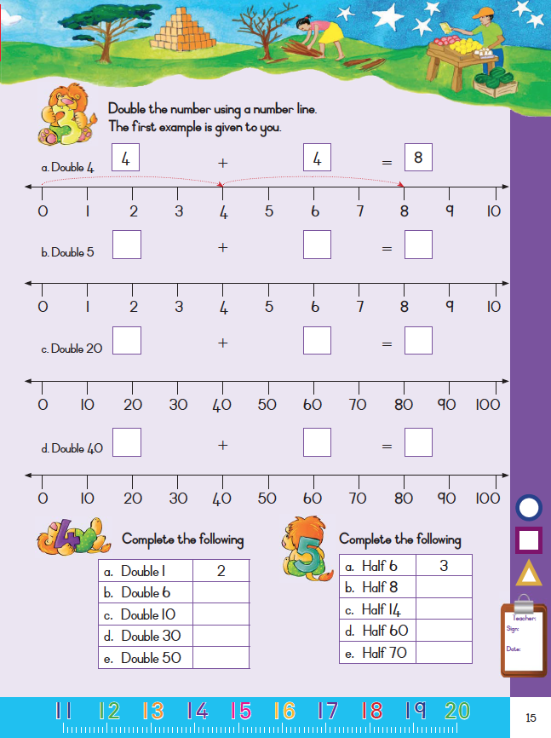
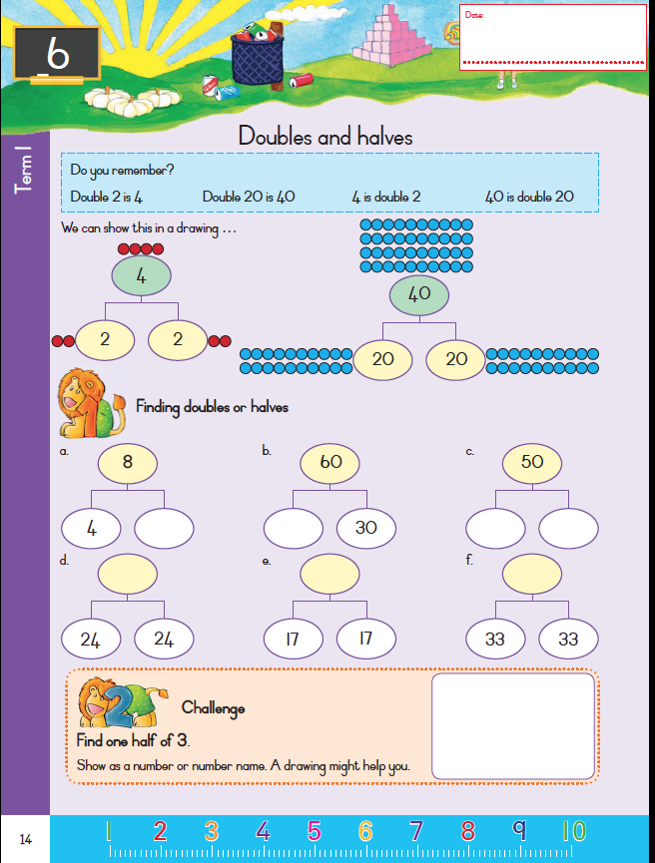
Grade 3 Mathematics 2015
Notes:
138 numbered activities across the two workbooks. Each activity has a heading and spreads across two pages, with numbered tasks on each page.
No themes, rather mathematics topics organise the workbook content

Slide 8
Unit of analysis
A task is defined as an activity with a single goal or theme that the learner is required to complete. It may refer to a single action (such as reading an extended piece of text), or a number of actions (completing six multiplication sums).
Language = 593 tasks
Mathematics = 613 tasks

Slide 9
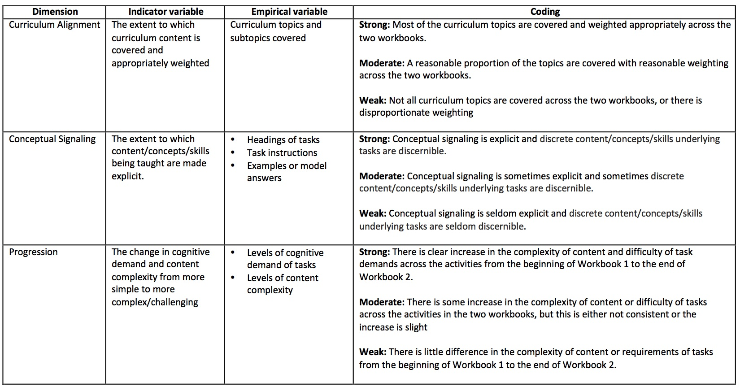
Analytic framework
Notes:
Curriculum alignment, we focused on coverage of curriculum contents in the workbooks, and the weighting given to different content OR to what extent did the workbooks match the content and weighting of content in the curriculum?
Conceptual signaling – to what extent was it clear in the workbooks what content/concepts/skills were being taught? Conceptual signaling may occur in explanatory text, headings, subheadings, text boxes and teacher notes. Or it may only be possible to derive the underpinning concept /content/ skill by reading it off a set of given tasks (implicit).
A curriculum document entails progression, usually elaborated through increasing levels of cognitive demand and content complexity, over the course of a year for a particular grade. We were interested in the extent to which content progression is explicit in the workbooks. Do the tasks indicate increase in the cognitive demand over the course of the workbooks? Does the complexity or challenge of the content/concept/skills introduced increase over the course of the tasks as presented in the workbooks?
In short, we used curriculum alignment (content coverage and weighting), conceptual signaling and content progression as the dimensions against which to evaluate the workbooks as effective practice, assessment and monitoring tools.

Slide 10
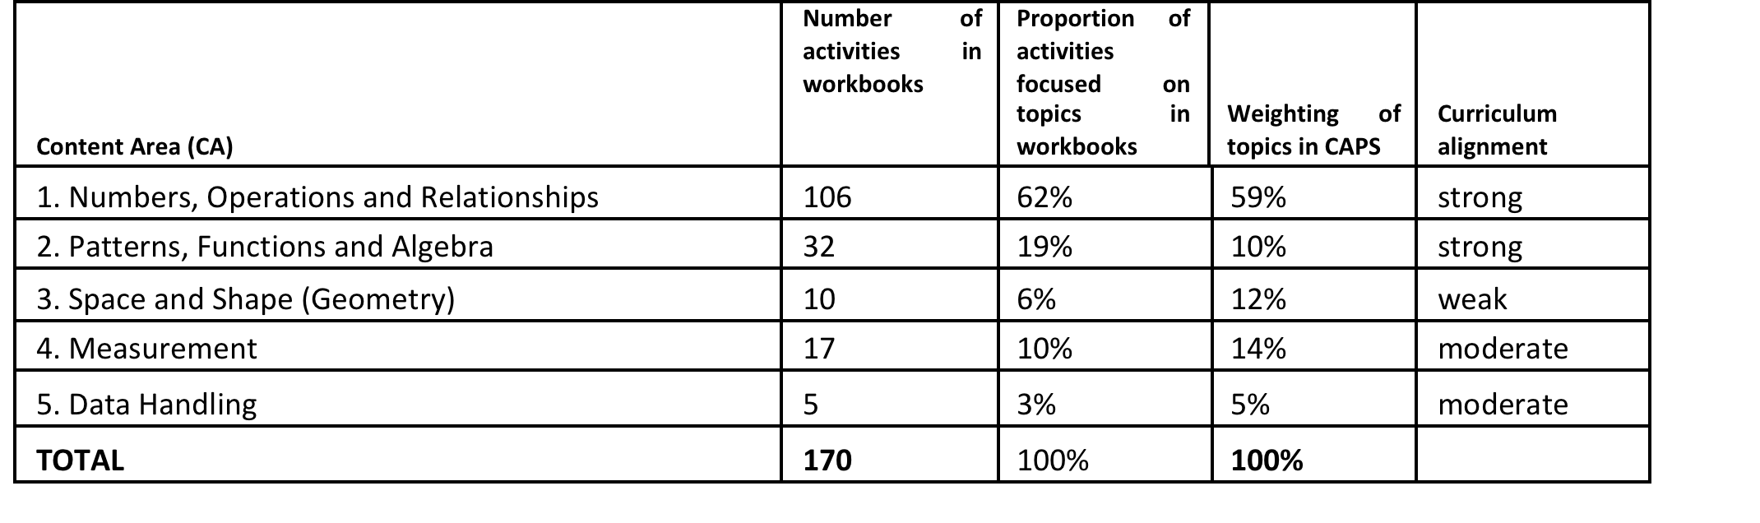
Curriculum alignment
Language – moderate to strong
Mathematics – moderate to strong
Notes:
There is no specification of weighting of curriculum content areas in the EHL CAPS document. A count of tasks relevant to particular topics in the workbooks indicates, however, a range and spread of tasks across the curriculum content areas. The emphasis in the workbooks is on reading and writing. The workbooks do not cover handwriting or listening as skill areas. They do not deal explicitly with vocabulary development. However, considering the writing, language structure, use and grammar and phonics components especially, the workbook represents comprehensive compliance with the EHL CAPS curriculum. Comprehension questions mainly literal – involving factual recall from the text which departs from the emphasis in the CAPS. Further, language, sounds, sight words and spelling are contrary to the EHL CAPS requirements, taught separately from extended text readings and comprehension tasks. This potentially restricts students’ understanding that these language features have real textual function and meaning (see also NEEDU, 2013).
Maths – strong in numbers and patterns functions and algebra, weaker in the other content areas for maths.

Slide 11
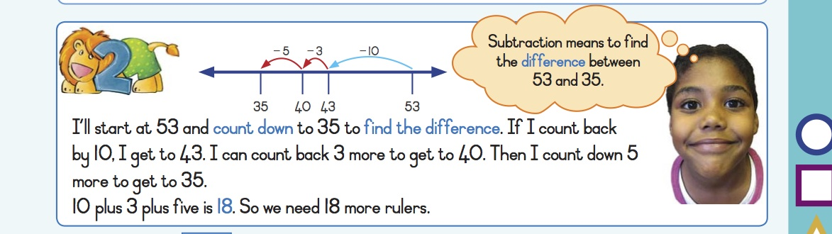
Conceptual signalling
Language – weak
Mathematics - moderate
Notes:
The broader language learning purposes of the extended texts are mostly implicit (e.g. tense, narrative structure), and are generally not spelt out in the text or in the teacher notes. Most extended texts have highlighted words, however, which refer to the words taught in the phonics section.
In short, conceptual signaling in the EHL Workbooks is not strong. The concepts / skills / language components underpinning most tasks and texts are not made explicit.
Overall, conceptual signaling in the Mathematics Workbooks is moderate. The content/ concepts / skills / components underpinning most tasks are made explicit in headings and ‘talking heads’ as shown in the example here. but instructions are not always clear and definitions and worked examples occur only occasionally.

Slide 12
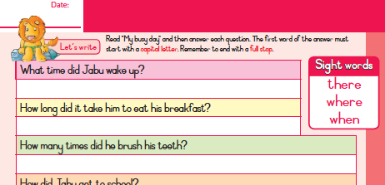
Progression
Language – moderate to strong
Mathematics - strong
Notes:
Overall, one can conclude that progression in the EHL workbook is moderate to strong. Phonics become more difficult, texts longer and more complex. task demands of writing activities are pretty similar across the workbooks, likewise comprehension tasks generally require predominantly literal comprehension across the books. In writing progression is weak. The same conceptual demands are made in writing activities that are very similar across the books.
In short, progression in the Mathematics workbook varies across the different content areas, but is strong in relation to the key content area of both the CAPS and the workbooks, namely Numbers, Operations and Relationships.

Slide 13
Practice tool ✔
Language
The Grade 3 EHL workbooks offer opportunities for learners to read and engage with texts. These workbooks also offer opportunities for practising writing, including writing extended text, and practising phonics, language structures, grammar and usage.
BUT
the texts are fairly basic, mainly comprising narrative fiction dealing with everyday and familiar themes, and the comprehension questions require mainly literal understanding of the texts.
Mathematics
The Grade 3 mathematics workbooks offer multiple opportunities to practise the curriculum content areas of number concept development, basic operations and rudimentary algebra. More than 80% of the tasks in the workbooks cover these areas.
BUT
they offer only limited opportunities for practising geometry, measurement and data analysis.
Notes:
For both these content areas they provide a solid resource for practice and consolidation, with clear progression and comprehensive curriculum alignment.
More than 80% of the activities cover these two content areas.

Slide 14
Assessment tool ✗
Do not consistently make explicit the contents or the concepts on which the tasks are based, i.e. they do not always make it clear what is to be assessed in a particular task. They do not provide model answers, solutions or assessment rubrics. Do not provide sufficient conceptual signaling to allow teachers to gauge and track student progress.
Notes:
Also, they do not contain activities that draw together tasks from discrete content areas to be completed in one activity the way assessment tasks do, i.e. they do not model assessment texts.
Further, the limitations to progression in some areas of learning makes the workbooks’ use in tracking the progress of learners, and as an assessment tool to diagnose whether learners require intervention as the DBE intention suggests, limited.

Slide 15
Monitoring tool ✔
The overall high level of curriculum compliance of the Grade 3 workbooks suggests they could be an effective monitoring tool across the education system. A crude measure of coverage in key content areas could be obtained by calculating the number of pages or exercises completed in the workbooks.
BUT
This quantitative measure of curriculum coverage across classrooms will not indicate the quality of the work being completed or give a reliable indication of learners’ progress (NEEDU, 2013). This would require a more in-depth investigation of how well students are completing the workbooks.
Notes:
Moreover, the limitations of progression in the workbooks, as discussed above, precludes using the workbooks as a tool for monitoring learner performance over time in certain areas of learning. Counting the number of pages completed in the workbook will not give a reliable indication of learners’ progress.
i.e. Monitoring only curriculum coverage, not learner performance!

Slide 16
Teaching tool ✗
The DBE suggests that the workbooks present a simple way to ‘structure learning activities for learners’. We suggest that if they are to be used to support teaching, they will need further development to make the content, concepts and skills on which the activities are based more explicit.
This could be done in various ways: by improving the activity overview notes in the workbooks; providing more
comprehensive in-text notes, definitions and model answers; producing an aligned teacher guide; or using the workbook alongside a carefully aligned textbook.

Slide 17
Conclusions
Curriculum tools
Workbooks are a well- entrenched and critical tool to assist curriculum implementation and support instruction
Need to be clear about their use, and extend and strengthen these uses
Workbooks well suited for use as a practice tool and simple, quantitative monitoring tool for curriculum coverage
Tracking Learner Progress
The possibilities of teachers using the workbooks to track the progress of learners and provide extra support where necessary are limited. i.e. the workbooks do not provide sufficient conceptual signaling to allow teachers to gauge and track student progress.
Notes:
Alignment, for example he recently proposed single textbook.
THERE TENDS TO BE A CONFLATION OF TRACKING COVERAGE AND PERFORMANCE. SO HERE WE JUST STRESS THAT
Differentiation and remediation
Workbooks are strictly grade level texts and do not offer differentiated learning opportunities. Distribution of additional workbooks could however facilitate their use across grades as a resource to be used in assisting learners who have fallen behind to catch up, or used to provide extension activities for faster learners.

Slide 18
Conclusions
Alignment
The moderate to strong alignment between the CAPS and the workbooks is very positive. A strong statement of learning requirements (in the CAPS and ANAs), as well as support to meet these requirements (in textbooks and the workbooks), can potentially be made available to teachers in improving instructional offerings in the classroom. In a system where there is widespread learner failure, a set of strong and well-aligned curriculum elements holds great potential to support teachers in implementing the curriculum and improving learning outcomes.

