Slide 1
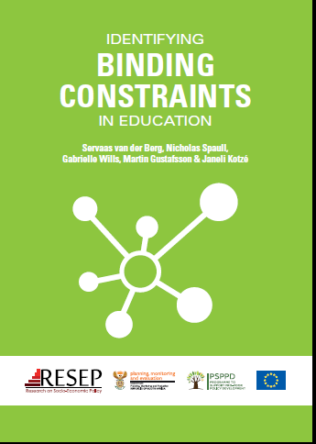
An overview of the PSPPD ‘Binding Constraints’
research programme
Servaas van der Berg
ReSEP,
University of Stellenbosch

Slide 2
Researchers
Paula Armstrong
Annika Bergbauer
Carol Nuga Deliwe*
Jaamia Galant
Janet Graaff
Martin Gustafsson
Ursula Hoadley
Dumisani Hompashe
Janeli Kotzé
Nompumelelo Mohohlwane*
Megan Sager
* - DBE personnel
Debra Shepherd
Nicholas Spaull
Stephen Taylor*
Hendrik van Broekhuizen
Servaas van der Berg
Surette van Staden
Chris van Wyk
Ntsizwa Vilakazi*
Marisa von Fintel
Gabrielle Wills

Slide 3
Introduction
Research for these two reports (for PSPPD & Zenex) has (already) also generated:
  10 journal articles
  12 policy briefs
  11 working papers
  1 concept note outlining structure and content of a course to teach FP teachers how to teach reading
  2 policy engagement workshops
Research was given added stimulus by conference and by Learning Exchange
This report provides an overview of this research through two conceptual lenses:
  Prioritisation, focus on binding constraints
  Acknowledgment that root causes of low educational outcomes are (1) a lack of accountability, and/or (2) a lack of capacity
From existing literature and new research, four binding constraints emerge:
  (1) Weak institutional functionality
  (2) Undue union influence
  (3) Weak teacher content knowledge and pedagogical skills
  (4) Wasted learning time and insufficient opportunity to learn
These lead to weak educational outcomes

Slide 4
Cumulative performance in in England and SA

Slide 5
Some V-ANA responses in 2011
In 2011 V-ANA, only 16% of Gr3s could answer this question:
  72 – 37 = …
Almost half (46%) could not identify the tallest member of this team
Only 9% of Gr6s could answer
  10% of 180 is equal to …

Slide 6
Data from NSES
Only 24% of South African Gr5 children can answer this Gr2 level question
Pam has R40.
She spends R28.
How much money does she have left?
Is language perhaps the barrier?
Then how can one explain that only 14% of Gr5s could answer this Gr3-level question?
105
̶ 7
Source: Janeli Kotzé, 2013

Slide 7
The centrality of learning to read
60% of SA children do not learn to read for meaning in any language by the end of Gr3
That, by itself, then becomes another constraint to further learning
Students who have failed to learn to read cannot subsequently read to learn
For all subjects, the curriculum assumes that children have learned how to read by the end of Gr3
  But most SA children do not acquire the most basic reading skills, thus never fully accessing the curriculum despite being promoted to higher grades
Thus we recommend that DBE’s foundational goal should be: “Every child must learn to read for meaning by the end of Grade 3.”
  This goal is measurable, understandable, pedagogically sound

Slide 8
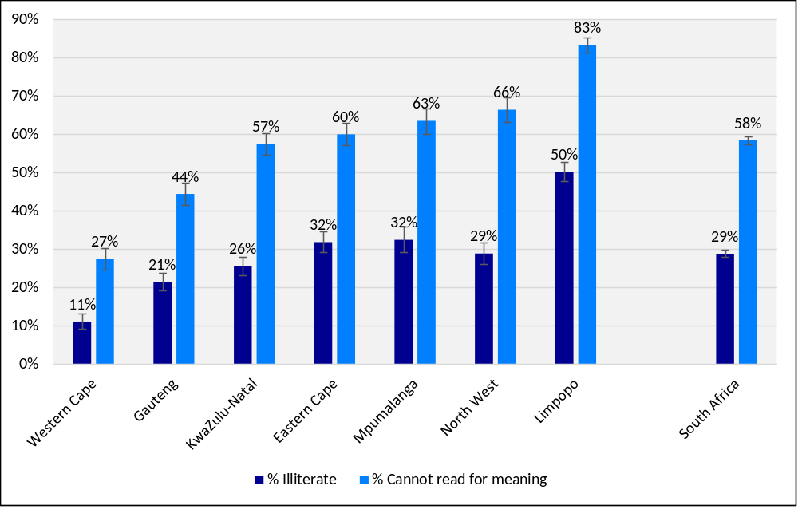
% of Gr4 students that are (1) illiterate and (2) cannot read for meaning in the FP LOLT of the school
Source: Based on prePIRLS 2011

Slide 9
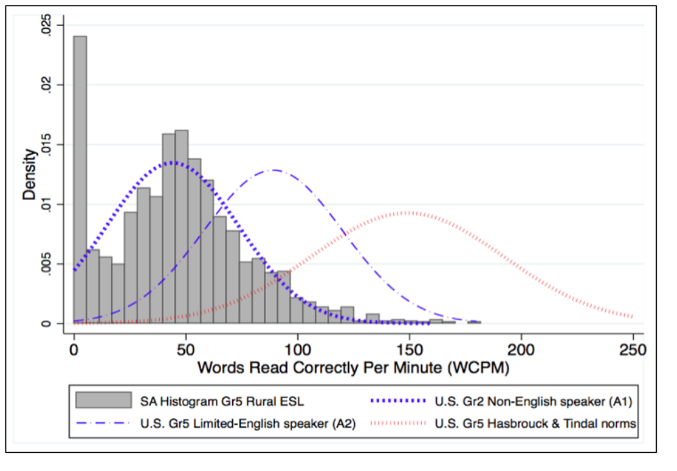
Oral reading fluency scores for rural SA African English Language Students (ESL) relative to Broward County ESL Students (Florida, US)
Source: Draper & Spaull 2015, using NEEDU data

Slide 10
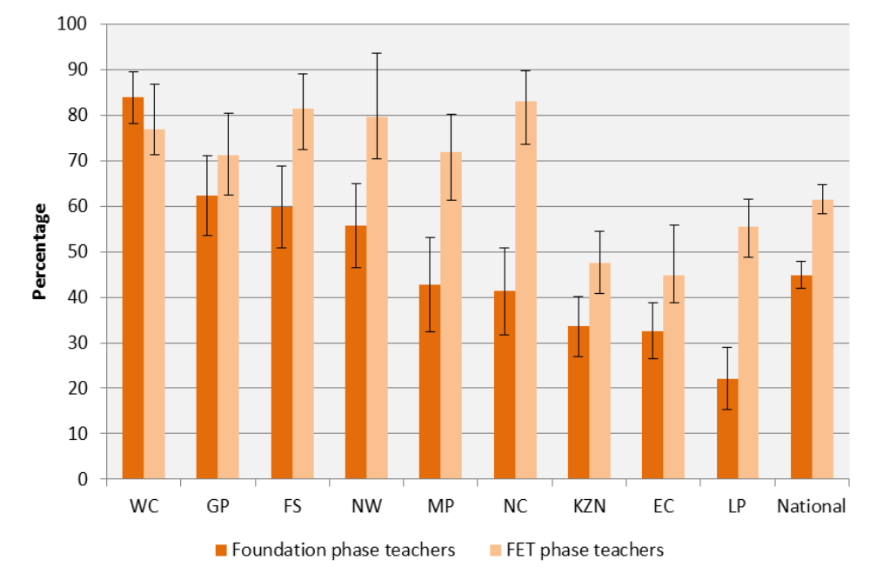
Neglect of Foundation Phase: FP and FET phase teachers visited by a subject/curriculum advisor during 2011
Source: Wills 2015, using SMS data

Slide 11
The Binding Constraints Approach
Not all constraints bind equally, thus need to prioritise
  “... senior public officials should focus most of their attention on a few strategic priorities” (NDP)
Certain things must be tackled first, as they preclude progress in other areas
Impossible for government to focus on many interventions at once – better to do a few well

Slide 12
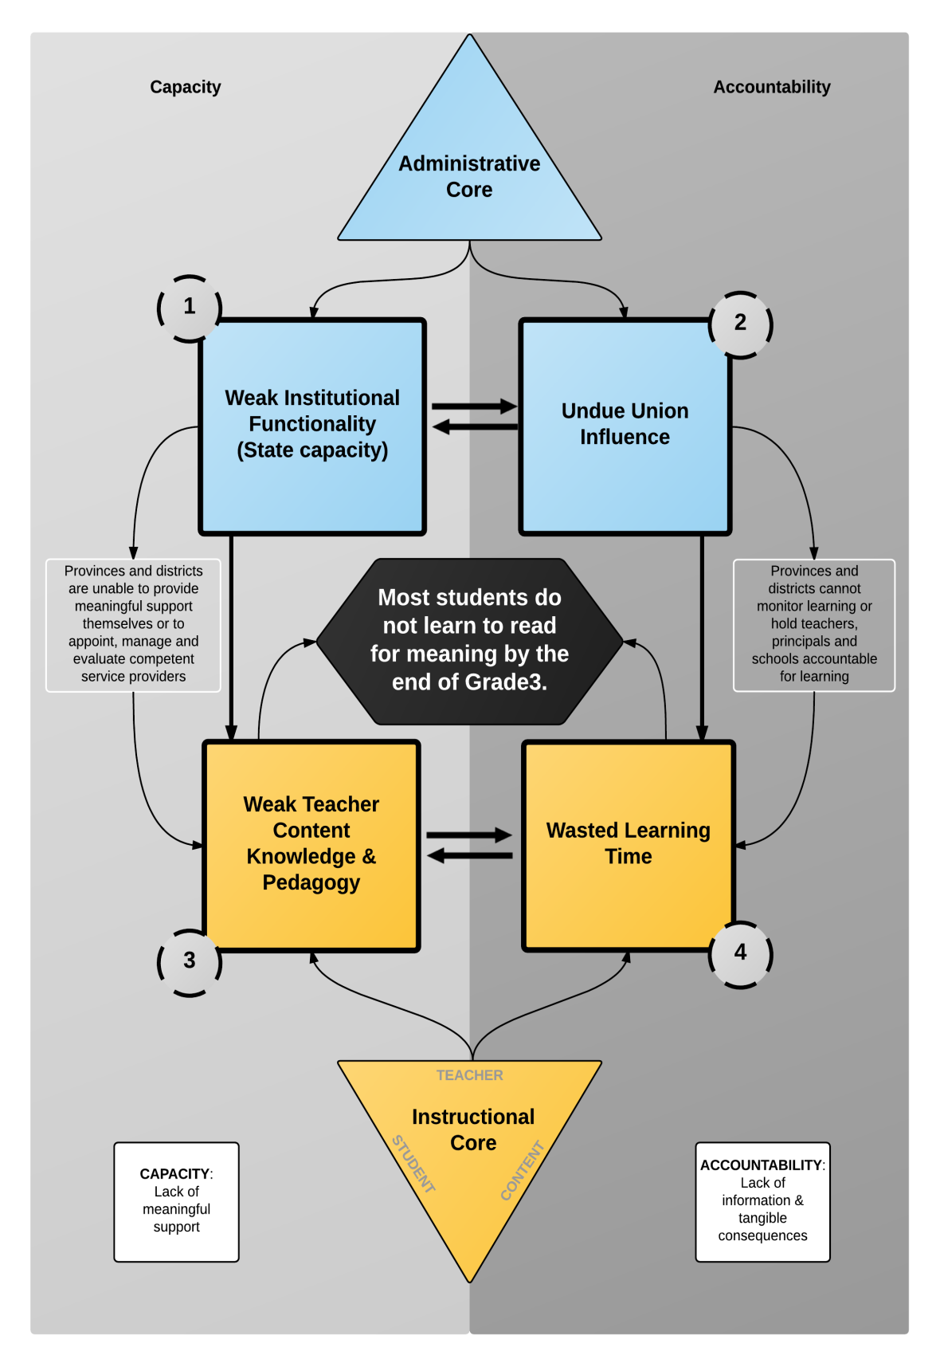

Slide 13
Binding Constraint #1: Weak Institutional Functionality
Given education decentralisation, implementation depends on provincial functionality
Difficult to quantify importance of state functionality
  Due to border changes in 2005, some schools changed provinces. Gustafsson & Taylor (2016) used this to measure improvements in matric results over five years for schools transferred from Northwest to Gauteng
This shows the clear importance of improving administration of under-performing provinces

Slide 14
Binding Constraint #2: Undue union influence
Concern that influence of trade unions, specifically SADTU, interferes with the system’s ability to act in the best interests of children
This undermines efforts to implement more accountability and compromises capabilities
Mechanisms of undue union influence:
  (1) Compromised post-provisioning, thus overspending on teacher salaries
  (2) Compromised design and implementation of accountability systems
  (3) Compromised independence and accountability function of SACE
  (4) Compromised bureaucratic accountability
  (5) Compromised levels of citizen trust in the public education sector
Especially important in appointments and promotions
Nepotistic or corrupt appointments linked serious and systemic; Volmink Commission makes some important recommendations
Addressing this is even more urgent given that large number of principals will retire in the next five years (Wills (2015))

Slide 15
Binding Constraint #3: Weak teacher content knowledge & pedagogical skills
Many teachers lack basic content knowledge and pedagogical skills
  SACMEQ 2007 showed that only 32% of Gr6 maths teachers in SA had desirable subject knowledge, compared with Kenya (90%), Zimbabwe (76%), Swaziland (55%)
    In Mpumalanga only 4%, in WCape 64%
  79% of Gr6 maths teachers have content knowledge level below Gr6/7 level, especially in poorest four quintiles
Hoadley’s (2016) literature review, in combination with existing research, confirms that weak teacher knowledge creates a low ceiling

Slide 16
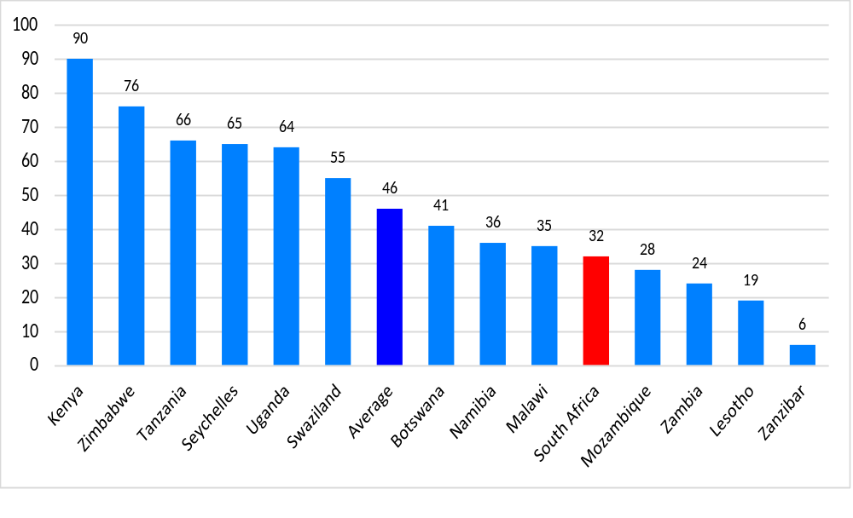
% of Gr6 students with teachers with desirable levels of maths subject knowledge (SACMEQ, 2007)
Source: Own analysis using Hungi et al. (2011)

Slide 17
Binding Constraint #4: Wasted learning time and insufficient opportunity to learn (OTL)
Low OTL could result from either lack of capacity (teachers lack the knowledge to teach some content areas) or of accountability (no monitoring by principal, district officials)
SA studies show less than half of curriculum is covered, fewer than half lessons taught
  NSES study showed most Gr5s write in their books at most once per week; only 3% did so every day
  In Gr4 and Gr5 exercise books, about half of all exercises were single word exercises
    “Of greatest concern is how little extended writing there is in the books…, learners write one paragraph every month and a half of school.” (Dechaisemartin, 2013)
  44% of Gr4 students had not written any paragraphs during the entire school year
2011 School Monitoring Survey shows only 53% of Gr6 & Gr9 students had covered the minimum exercises needed for curriculum coverage: Gauteng 85%, WCape 76%, ECape27%, 24% North West
Hoadley & Galant (2016) explored workbook use as a practice, assessment or monitoring tool:
  “The overall high level of curriculum compliance of the workbooks suggests they could be effective as a monitoring tool at a systemic level. It would be possible to gain a crude measure of coverage in key content areas.”
They also comment on the potential complementarity of textbook and workbook:
  “… (the) textbook could usefully be aligned with the workbooks. The textbook could then function as a primary transmission text, with clear conceptual signalling as well as relevant tasks, and the workbook could function as a practice tool, either for use in class or as a homework resource.”

Slide 18
‘Roadmap for Reading’
Policy recommendations related to reading specifically (Ch10) and five other areas of policy concern (Ch11)
Chapter 10, “Roadmap for Reading”, outlines four stages for successful implementation of a national reading strategy:
  (1) Prioritisation
  (2) Preparation
  (3) Implementation
  (4) Sustainability
Across each stage six core components must be aligned:
  (1) Beginning
  (2) Collaboration
  (3) Capacity
  (4) Accountability
  (5) Alignment
  (6) Budget
This involves detailed and concrete steps, as set out in ‘Roadmap for Reading’

Slide 19
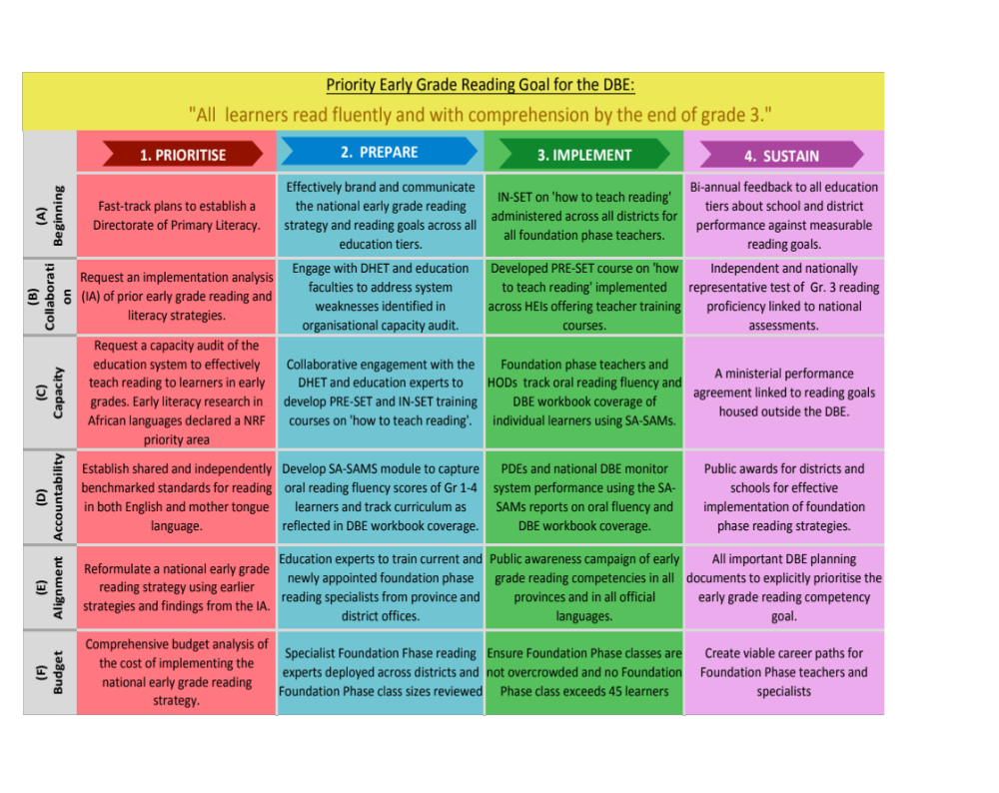

Slide 20
Five further policy recommendations
(1) Agreeing on minimum norms and standards for post-provisioning and implementing them within five years
(2) Utilising DBE Workbooks as a basic measure of curriculum coverage, and reformulating the ANAs as a measure of learning outcomes in primary schools
(3) Increasing the calibre of school principals by instituting independent competency assessments and performance management contracts for principals, and meritocratic appointment and promotion processes
(4) Stabilising ECD by increasing funding and developing appropriate training for ECD practitioners
(5) Better utilisation of data, inter alia to eliminate understaffing in primary schools

Slide 21
Are policy recommendations implemented?
In 2010 study for WCED, we recommended that Foundation Phase classes should not exceed forty
This was accepted and steps announced to put this into practice (building of classrooms, appointment of FP teachers)
Not quite achieved, but now far the best placed of all provinces
% of FP students in classes larger than 45

Slide 22
Are policy recommendations implemented?
“In the Foundation Phase, Professor Servaas van der Berg and his team … in 2010 carried out research on language and mathematics. The WCED is also currently implementing the recommendations that this research produced.
“These recommendations include, for example, regularly observing classroom practice for extended periods, specifically to observe levels of cognitive demand, pacing and time on task. Since the release of this research, Foundation Phase curriculum advisors have also undergone training in effective monitoring of classroom practice.” (Donald Grant, MEC, speech at 21st Annual SAARMSTE Meeting, 14 January 2013)

Slide 23
Conclusions
Four binding constraints:
  Weak institutional functionality
  Undue union influence
  Weak teacher content knowledge and pedagogical skill
  Wasted learning time
Lack of accountability and lack of support interact – thus both need attention
Constraints and their influence cause extremely weak outcomes
  The most alarming is the failure of most children to learn to read fluently and with comprehension in Foundation Phase
At all other levels and for all subjects, this failure then becomes an additional binding constraint that ruins the life chances of millions of children
Thus this report paid much attention to remedying this situation in early reading, as to other binding constraints
    If the effect of these four binding constraints can be reduced and progress made towards the goal that all children should read fluently and with comprehension at the end of Grade 3, the education system would be well placed to make rapid progress on a broad front

Slide 24
(a) Journal articles
Taylor, N & Mabogoane, T. (2015) Editorial: Policy research comes of age in South Africa. South African Journal of Childhood Education 5(2) ppi-xvi
Kotzé, J. (2015) Can pre-grade R be the stepping stone to social equality in South Africa? South African Journal of Childhood Education 5(2) pp1-27
Van der Berg, S. (2015) What the annual national assessments can tell us about the learning deficits over the education system and the school career. South African Journal of Childhood Education 5(2) pp28-43
Draper, K & Spaull, N. (2015). Examining oral reading fluency among Grade 5 rural English second Language (ESL) learners in South Africa: An Analysis of NEEDU 2013. South African Journal of Childhood Education 5(2) pp44-77
Van der Berg, S & Shepherd, D. (2015). Continuous assessment and matriculation examination marks – an empirical examination. South African Journal of Childhood Education 5(2) pp78-94
Wills, G. (2015). Informing principal policy reforms in South Africa through data-based evidence. South African Journal of Childhood Education 5(2) pp95-122
Armstrong, P. (2015). Teacher characteristics and student performance: An analysis using hierarchical linear modeling. South African Journal of Childhood Education 5(2) pp123-145
Van Wyk, C. (2015) An overview of education data in South Africa: An inventory approach. South African Journal of Childhood Education 5(2) pp146-170
Pretorius, E. & Spaull, N. (2016). Exploring relationships between oral reading fluency and reading comprehension amongst English second language readers in South Africa. Reading and Writing. April.

Slide 25
(b) Policy briefs
Hoadley, U & Galant, J. (2016). The DBE’s workbooks as a curriculum tool.
Kotzé, J. (2015). Rethinking pre-grade R.
Mohohlwane, N. (2016). Adding randomized control trials (RCTs) to the education research toolkit
Nuga Deliwe, C. (2016). Building an evidence base for inclusive education in South Africa: Focusing on learners with disabilities
Shepherd, D. & Van der Berg, S. (2015). Is school based assessment in matric achieving its potential?
Spaull, N. (2016a). Learning to read and reading to learn
Spaull, N. (2016b). Excessive class sizes in the Foundation Phase
Van Broekhuizen, H. (2015). Increasing the supply of teacher graduates
Van der Berg, S. (2015). What the ANAs tell us about socioeconomic learning gaps in South Africa
Van Wyk, C. (2015). Education datasets in South Africa
Wills, G. (2015). Improving the calibre of school leadership in South Africa
Wills, G. (2016). The misallocation of district resources to the Foundation Phase

Slide 26
(c) Working Papers
Shepherd, D. (2015). Learn to teach, teach to learn: A within-pupil across-subject approach to estimating the impact of teacher subject knowledge on South African grade 6 performance. Stellenbosch Working Paper Series No. WP01/2015. Dept of Economics, Stellenbosch University
Van Broekhuizen, H. 2015. Teacher Supply in South Africa: A focus on initial teacher education graduate production. Stellenbosch Economic Working Paper Series 07/2015. Dept of Economics, Stellenbosch University
Wills, G. (2015). A profile of the labour market for school principals in South Africa: Evidence to inform policy. Stellenbosch Working Paper Series No. WP12/2015. Dept of Economics, Stellenbosch University
Wills, G. (2016). Investigating the consequences of principal leadership changes for school performance in South Africa. Stellenbosch Working Paper Series No. WP01/2016. Dept of Economics, Stellenbosch University
Gustaffson, M. (2016). Teacher supply and the quality of schooling in South Africa: Patterns over space and time. Stellenbosch Economic Working Papers: WP03/2016. Dept of Economics, Stellenbosch University
Gustafsson, M. & Taylor, S. (2016). Treating schools to a new administration: Evidence from South Africa of the possible impact of better practices in the system-level administration of schools. Stellenbosch Economic Working Papers: WP05/2016. Dept of Economics, Stellenbosch University
Hoadley, U. (2016). A review of the research literature on teaching and learning in the foundation phase in South Africa. ReSEP Working Paper Series 01/2016. Dept of Economics, Stellenbosch University
Hoadley, U. & Galant, J. (2016). An analysis of the Grade 3 Department of Basic Education workbooks as curriculum tools. ReSEP Working Paper Series 02/2016. Dept of Economics, Stellenbosch University
Van Staden, S. (2016). Language and Grade 4 reading literacy achievement in prePIRLS 2011. ReSEP Working Paper Series 03/2016. Dept of Economics, Stellenbosch University
Graaff, J. (2016). Governance in the poorer public schools in South Africa from the perspective of the parent governor. ReSEP Working Paper Series 04/2016. Dept of Economics, Stellenbosch University
Bergbauer, A. (2016). The role of non-conventional inputs in South African education: An analysis of prePIRLS 2011. ReSEP Working Paper Series 05/2016. Dept of Economics, Stellenbosch University

