Slide 1
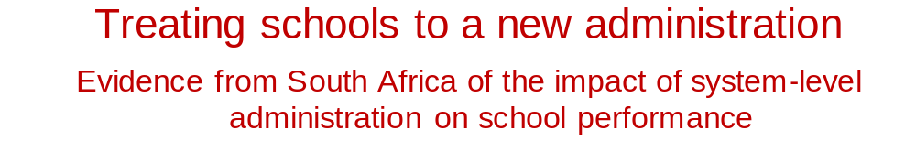
24 May 2016
Martin Gustafsson
Stephen Taylor
Department of Economics, University of Stellenbosch
Department of Basic Education

Slide 2
Rationale
Low quality education in many developing countries, including SA
Important research describes the nature of the problem
Growing literature using experimental methods to measure impact of various resources and interventions
Pritchett critique: piecemeal interventions will not make enough of an impact on the gap
We need to understand the contribution of system-level administration and how to create system-level change
But this is near impossible to measure applying standards of the experimental literature
  WC vs EC

Slide 3
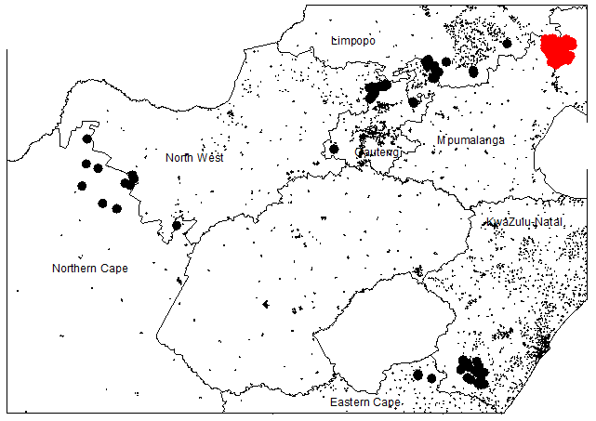
A rare natural experiment

Slide 4
Methodology
Boundary changes of 2005 – official transfer 2007
Education administration in SA quite decentralised
Municipalities do not play a major role – the reasons for the changes were not educational
About 150 experimental schools
Analyse matric data (2005 – 2013)
  Data aggregated at school-level
  Challenges linking schools due to EMIS number issues

Slide 5
Data
We focus on mathematics outcomes

Slide 6
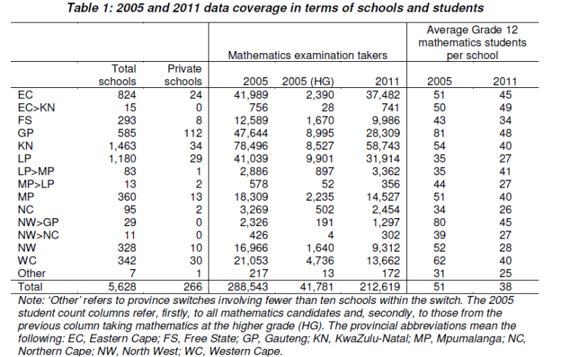
Data

Slide 7
Data
Three selection effects at play:
Selection into Grade 12 by not dropping out earlier.
Selection into mathematics.
Selection into a specific school via commuting.

Slide 8
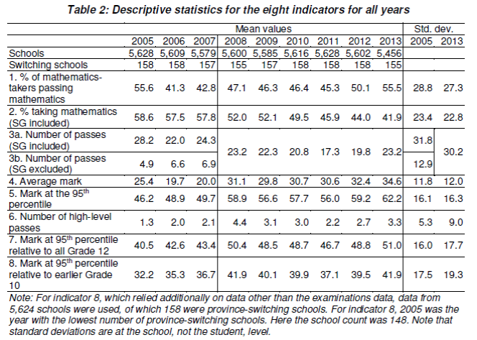
Data

Slide 9
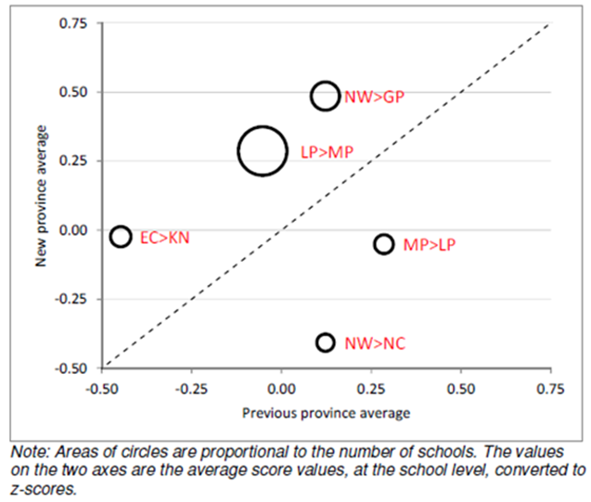
How much of a treat?

Slide 10
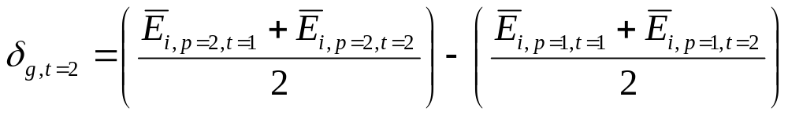
Results: Regression models

Slide 11
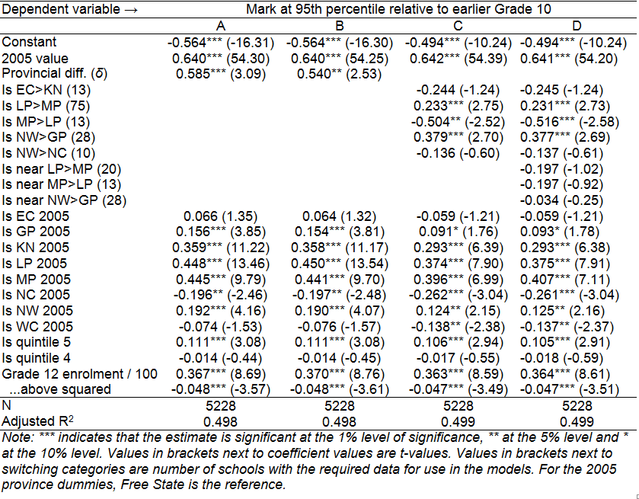
Results: Regression models
Remains significant if outcome is 2010, 2011, 2012
Distance up to 30km
Lower for other indicators

Slide 12
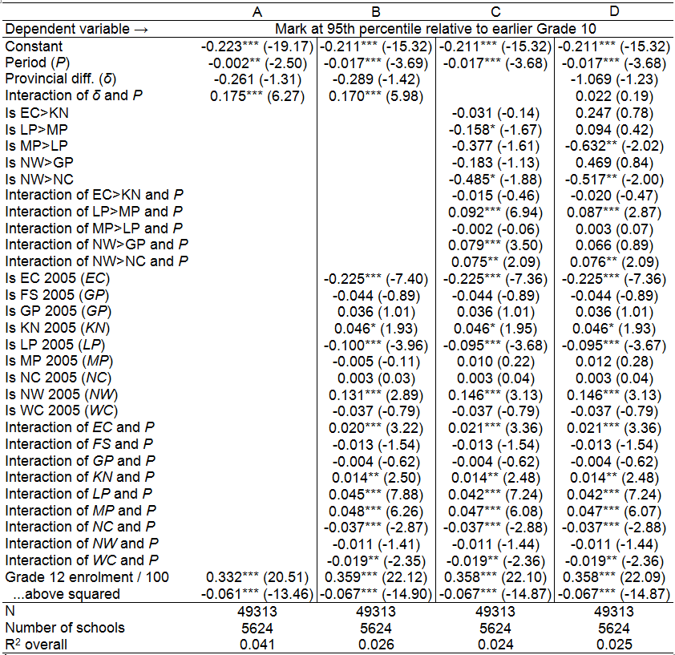
Adding school fixed effects

Slide 13
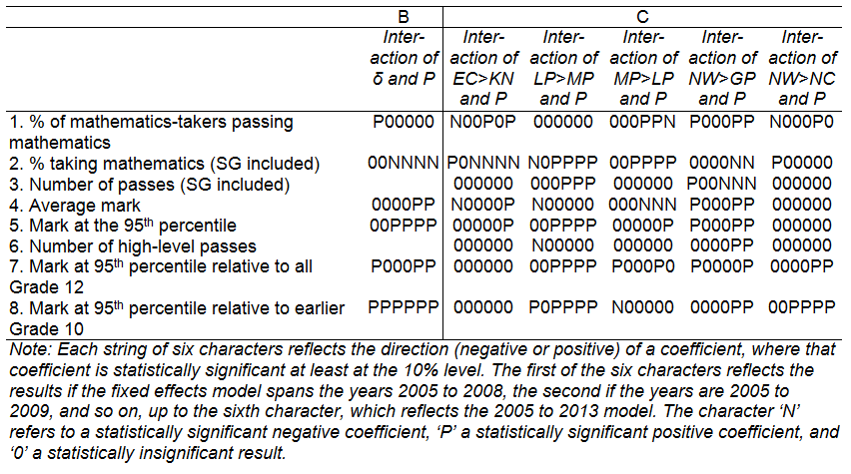
Summary of fixed effects regressions with different endpoints

Slide 14
Summary of fixed effects regressions with different endpoints

Slide 15
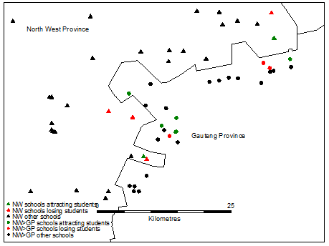
Was migration driving the effects?
Note: Only schools remaining in North West and which moved to Gauteng are marked. Schools which were in Gauteng in all years are not marked.

Slide 16
How meaningful are these effect sizes?
Overall, around 0.07 SD if translated to student-level standard deviations

Slide 17
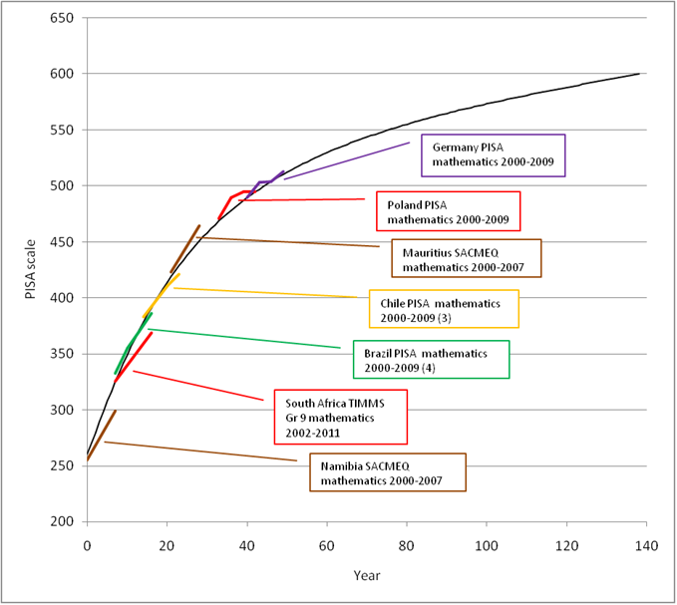
Best possible trajectories
0.08 SD per year

Slide 18
What explains the administration effect?
Our analysis cannot say with empirical certainty
Average public funding per student virtually the same across provinces, so explanation not here.
More efficient use of non-personnel funds, especially for educational materials
Brokering of pacts between stakeholders, including teacher unions, schools and communities
Better monitoring and support to schools from officials
Fixed term contracts for GT management

Slide 19
Implications
“What interventions?” is only part of the question
Rather, “Who intervenes”
  Link to coach-specific effect in RCUP
But, replicating the “who” is harder than the “what”
Strong focus on improving administrative functionality could be an effective way to effect large-scale change

