Slide 1


Understanding the distribution and mobility of principals in South Africa
Gabrielle Wills
24 May 2016

Slide 2
Principals matter for learning
Education literature
Economics literature
Notes:
Whether you are in educaton, economics or if you just have common sense, I have no doubt that there is convincing evidence that school principals matter considerably for student learning across both education & economics literature

Slide 3
Education literature
Principals are 2nd
to teachers
In terms of their importance for student learning & school effectiveness .
  “Indeed, there are virtually no documented instances of troubled schools being turned around without intervention by a powerful leader. Many other factors may contribute to such turnarounds, but leadership is the catalyst”
  (Leithwood et al., 2004:7 review of case studies of
  school leadership in the U.S. and Europe)

Slide 4
Economics literature
Principals are 2nd
to teachers
In terms of their importance for student learning & school effectiveness .
After isolating out the contribution of students’ background, school characteristics, teacher quality…
A highly effective principal can raise the achievement of the average student by 2-7 months of learning in a year. A highly in ineffective one can lower achievement by the same amount.
(Branch, Hanushek & Rivkin 2012; see also Coelli & Green 2012;
Grissom, Kalogrides & Loeb 2012; Chiang, Lipscomb & Gill 2012)
Notes:
In the economics literature, a new and emerging evidence-base using large-scale datasets and value-added models provide convincing evidence that school principals matter considerably for student learning (Branch, Hanushek & Rivkin 2012; Chiang, Lipscomb & Gill 2012; Coelli & Green 2012; Grissom, Kalogrides & Loeb 2012).
Value-added models identify the additional value that principals bring to student learning after isolating out the contributions of individual teachers, the school and the ability and backgrounds of individual students.
Widely cited research by Branch et al (2012) in Texas schools suggests that highly effective principals can raise the achievement of the average student in their schools by between two and seven months of learning in a school year; ineffective principals lower achievement by the same amount.
These are educationally significant effects, only second to the direct effects of individual teacher quality on student learning.

Slide 5
Economics literature
Principals are 2nd
to teachers
In terms of their importance for student learning & school effectiveness .
Impact:
>
Quality of principal
Quality of individual teacher
Notes:
But the difference between teachers and principals is that principals affect all students in a school rather than just the students a single teacher instructs.
The overall impact from increasing principal quality therefore substantially exceeds the benefit from a comparable increase in the quality of a single teacher (Branch, Hanushek & Rivkin 2013).
The obvious implication of this international evidence is that the effective placement and distribution of principals across schools really matters for school effectiveness and student learning.
Policy has an important role to play in ensuring that principals are distributed as equitably as possible across the school system, ensuring that the right principals are appointed and in raising the performance of existing leadership.

Slide 6

What about policy?
“Principals form part of a strategic sector that has not been duly explored in its potential for contributing to education progress.” - Weinstein, Munoz & Raczynski 2011:298
In SA, there have been shifts towards raising the value of school leadership as critical for educational improvement
  Amendments to legislation (EAA 2007)
  Statements & action of the DBE
  Recent “Standards for Principalship”
  Personnel Admin. Measures (PAM) Feb, 2016
  In national policy plans, NDP
But there remains an urgent need to prioritise and accelerate policy development in this area
Notes:
However, often too little policy attention is given to harnessing the benefits of school leadership for educational improvements. In reference to Chile, Jose Weinstein notes that “principals form part of a strategic sector that has not been duly explored in its potential for contributing to education progress”.
In SA, however there have been notable shifts in the past decade in raising the value of school leadership & management as critical levels for learning gains. There have been amendments to legislation, statements and actions of the DBE and in national policy plans.
The need to strengthen the policy framework governing principals has arguably gained traction where the NDP explicitly identifies the importance of strengthening school leadership as a national priority (NPC, 2012: 309-310).

Slide 7
“…the Task Team has picked up in its deliberations the central importance of principals to the quality and nature of education offered in schools.”
        Volmink Report 2016, p. 83

Slide 8
The National Development Plan
Improve principal appointment process
Competency based-testing
Increase min. qualifications to include having an ACE in school management and leadership
Managing their performance
Performance contracts for school principals
Replace underperforming principals with better ones
Greater powers over school management
More autonomy for principals in functional schools
But hiring and firing remains at the provincial level
Proposes policy improvements in three areas:
See: NPC (2012), pp 309-310
Notes:
The need to strengthen the policy framework governing principals has arguably gained traction through the NDP which proposes policy improvements in three areas:

Slide 9
Research Objectives
But there has been a lack of empirical evidence in SA to guide & support policy developments in this area.
Objective 1)
Identify the overarching quantitative characteristics of the “labour market for school principals” in SA.
Objective 2)
Using this evidence to inform, support and debate recent policy developments.
Evaluate the NDP policies in light of the evidence and propose additional policy recommendations.
Use payroll data on the POPULATION of public school principals in SA.
Notes:
Despite the policy and planning progress made in this respect, quantitative research has not kept abreast with needed policy improvements governing school principals. There is a lack of empirical evidence in the local context to guide and support policy implementation in this area. There is little to no research that has provided any systematic quantiative evidence linking school principals to school performance in the South African context.

Slide 10
Data
Constructed panel dataset with 4 “waves”
Persal
Sept 2004, Oct 2008,
Oct 2010, Nov 2012
EMIS
Masterlist of schools
Annual Survey of Schools SNAP over time
Matric Examination
Data
(Gustafsson & Taylor, 2013)
79-89% matched
(6-10% of non-matching due to vacancies)

Slide 11
  Ageing profile of SA school principals
Age distribution of SA public school principals: 2004, 2012, Mar 2016
+/ 7000 principal retirements
2012-2017
Notes:
The first characteristic and what really needs to be highlighted more here today is that principals are getting older. Internationally teachers and principals are getting older and South Africa is no exception in this regard (Pont, Nusche & Moorman 2008). The average principal was aged 48 years in 2004. In 2012 this average had increased to 51 years…
The figure compares the age distribution of principals in 2012 to that in 2004. Whereas 17 per cent of senior school principals were aged 55 or older in 2004, two thirds were this age by 2012.
In absolute terms if almost a third of principals were 55 years or older in 2012 and we assume they are likely to retire at 60 years, over 7 000 outgoing principals would have to be replaced between 2012 and 2017 just for retirement replacements alone.
I have more recently however been considering which of these two distributions is more likely to reflect the norm. And its more likely to the 2012 distribution. First, with the rationalisation of the teaching profession in in the late 90’s there was likely to have been a large resignation of principals. This was a shock to the system that would have altered the distribution, particularly for principals. Second, recent persal data for March 2016 suggests that the distribution is even more skewed towards older principals.

Slide 12
Age profile by province 2016
8%
are >=60 years
#1 691 principals
27%
are 55-59 years
#5 631 principals
Notes: All principals (not just those in ordinary schools).
Notes:
You may be interested in the provincial differences in the proportion of principals that are older 55 or older or 60 years or older currently. WC and GP are likely to be facing the largest relative number of principal retirements, particularly when you consider the proportion of principals that are 60 years or older. For the country as a whole about 8% of principals are 60+ representing 1700. If we consider those that are 55 to 59. Another 5600 principals are added to the potential retirement number.

Slide 13
Age profile of principals by quintile 2012
School principals in 2012 aged 55 years or older, by quintile
Notes:
Proportionally, more principal replacements will need to take place in wealthier schools given differences in the age profile of principals across schools. In 2012, nearly a half of quintile five schools had incumbent principals aged 55 years or older as opposed to 27 per cent of quintile one schools as identified in this Figure.
However the demand for new principal replacements is considerably higher in poorer schools simply because there are more poor schools. Despite use of the term ‘quintile’ in the ranking of school wealth by the DBE, there is an unequal share of schools represented in lower quintiles.
The system needs to be prepared now for substantial numbers of retirements particularly in poorer schools (where we want to see the biggest improvements in student achievement)
But we need right policies and processes in place to ensure that the right principal candidates are appointed and to protect these positions, particularly in light of concerns about corruption and irregularities in principal appointment process.

Slide 14
An opportunity and challenge
"The imminent retirement of the majority of principals brings both challenges and new opportunities … While it means a major loss of experience, it also provides an unprecedented opportunity to recruit and develop a new generation of school leaders with the knowledge, skills and disposition best suited to meet the current and future needs of education systems“
(Pont, Nusche and Moorman, 2008: 29)

Slide 15
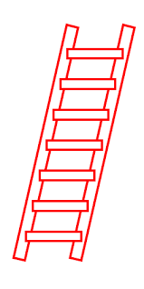
1. Corruption and nepotism affecting appointment process.
See Volmink Report May 2016, NEEDU 2013, Zengele 2013
5. Leadership disruption effects: Managing the leadership succession process – no policy guidance in this regard
CHALLENGES
3. Gender discrimination in school leadership
4. How do we attract/develop a pool of principal candidates to poorer/less desirable schools?
2. How do we identify who is a better candidate over another? Current criteria NOT helpful
Notes:
“All sectors (Health & Social Work, Police and the General Public Service) with the exception
of Education, follow similar practices when it comes to the recruitment of staff. In all but
this one sector the processes acknowledge the critical nature of acquiring competent
professionals and thus they use special tools, processes to give credibility and validity to the
process.” Volmink 2016 p 17

Slide 16
“…promotion posts are heavily contested owing to their significance for personal income, status and influence. The integrity of this process of selection and appointment needs to be carefully protected. It is imperative that positions of school management should be subjected to selection processes which ensure that competent and qualified candidates are appointed.”
(Volmink Report 2016:23)
Particularly when principal mobility is low and tenure is long! With each principal replacement you establish the leadership trajectory of the average school in South Africa for the next decade!
Notes:
In recent release of the Volmink report, they state the problem very eloquently.

Slide 17
1. Corruption and nepotism affecting appointment process.
See Volmink Report May 2016, NEEDU 2013, Zengele 2013
5. Leadership disruption effects: Managing the leadership succession process – no policy guidance in this regard
CHALLENGES
3. Gender discrimination in school leadership
4. How do we attract/develop a pool of principal candidates to poorer/less desirable schools?
2. How do we identify who is a better candidate over another? Current criteria NOT helpful
Notes:
“All sectors (Health & Social Work, Police and the General Public Service) with the exception
of Education, follow similar practices when it comes to the recruitment of staff. In all but
this one sector the processes acknowledge the critical nature of acquiring competent
professionals and thus they use special tools, processes to give credibility and validity to the
process.” Volmink 2016 p 17

Slide 18
Challenge 2: How do we determine who is a better principal candidate over another?
National policy (PAM 2002) requires that to apply for a principal post you have
At least 7 years of experience
REQV 13 (Gr 12 + 3yrs relevant training)
  Schools may have other specific requirements in advertisements.
87% of teachers in 2012 had at least 7 years of experience
and REQV 14!
Q: So do we increase qualification criteria?
Notes:
Little international evidence to support the notion that principal and teacher qualifications are systematically linked to higher student performance.
(Clotfelter, Ladd & Vigdor, 2010; Hanushek, 1986; Hanushek 2007, Ballou & Podursky 1995; Clark, Martorell & Rockoff 2009).

Slide 19
REQV
Years of
service
School results
in matric examinations
?
?
      Traditional credentials as measured in payroll are not a useful signal of principal quality in the majority of South African schools.
No systematic link between higher principal REQV or years of service and school performance as measured by matric examinations in Q1-3 schools even after controlling for observed and unobserved school differences (See Wills, 2015)

Slide 20
What other sifting criteria could be used?
“RECOMMENDATION 8: It should not be possible for a person to be promoted to principal from a post-level 1 position. Insofar as this happens at present, regulations should prohibit it.”
(Volmink 2016:26)
New Feb PAMS 2016 does not specify a jump from any teacher post level 1 position to principal post as a viable career promotion path (pg. 92)
Q: What has been the current practice?
Notes:
In the recent Volmink 2016 report recommendation 8 raises the point of imposing another selection criteria: namely that a person can only be promoted into a principal role from a deputy or HOD role. One caution: Principals in very small schools with only 1 educator are considered post-level 1. These principals would not be able to apply for a post in a school with 2 or more educators.

Slide 21
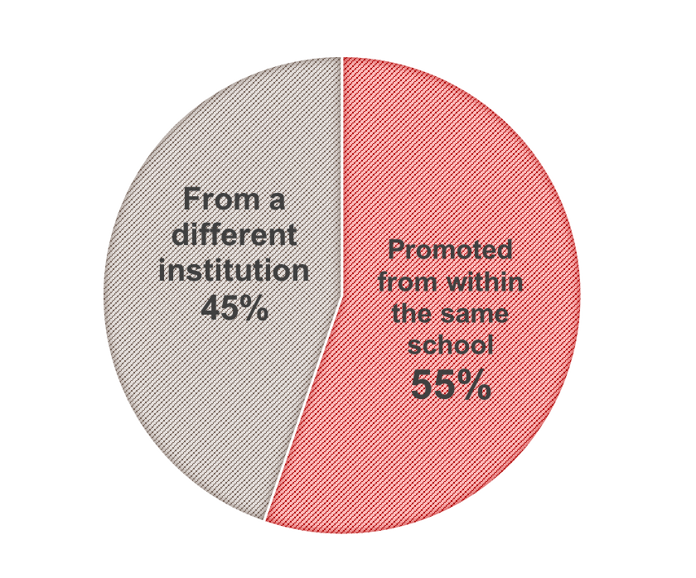
Position of newly appointed principals (2010, 2012) two years prior to appointment
Source: Persal-EMIS matched dataset (2008, 2010 and 2012). Notes: Calculations are for
5 262 newly appointed (incoming) principals who are identified in either 2010 or 2012 as
principals but were not identified as principals in Persal in previous periods (2008 and/or 2004).

Slide 22
Challenge 2: How do we determine who is a better principal candidate over another?
“RECOMMENDATION 7: Principals should be selected by means of panels which have the resources to evaluate the competence and suitability of the candidates for their leadership, management as well as their academic, experiential and professional abilities. The panels should include educators of suitable rank and experience. The pre-interviewing testing of candidates should occur and the results should be available to the panel members…”
(Volmink Report 2016)
Q: But what competencies should they have? Not enough evidence on what it is that makes a better principal. More research needed.

Slide 23
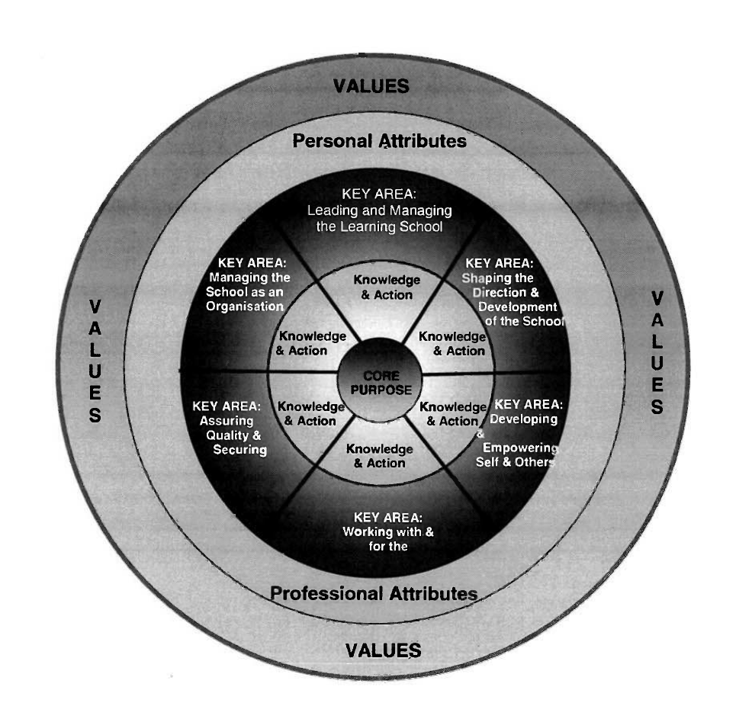
The South African Standard for Principalship
Leading the Learning School
Shaping the direction and development of the school
Managing Quality and Securing Accountability
Development and Empowering Self and Others
Managing the school as an organisation
Working with and for the immediate school community
Managing Human Resources
Management and advocacy of extra-curricular activities
Notes:
The framework identifies 8 key areas of principalship

Slide 24

Who meets these standards for Principalship?

Slide 25
Challenge 3: Gender discrimination
Gender distribution in public education, 2012
Source: Persal-EMIS matched dataset, 2012
Notes: Teachers exclude HoDs, Deputy principals or principals.
Notes:
Unfortunately one of the criteria that is potentially informing appointment decisions is the gender of the principal despite labour legislation that favours the hiring of women over men.

Slide 26
Challenge 4: Unequal distribution of principals
Principal qualifications (REQV), 2012
Source: Persal-EMIS matched dataset, own calculations. Notes: …Percentages add up to 100 per cent in each sub-group.
Notes:
A defining feature of South Africa’s labour market for principals is that they are unequally distributed across schools with typically less qualified and less experienced principals overly represented in poorer schools. Consider the following figure which presents a descriptive breakdown of the qualifications of principals as measured by their REQV values.
As a point of clarification, in the education payroll data qualifications of educators are identified using the Relative Educational Qualifications Value (REQV) system. This is a value ranking on a scale of 10 to 17, where the determination of the REQV ranking is based primarily on the number of recognised full-time professional or academic years of study at an approved university, technikon or college of education while taking into account the level of school education attained (RSA DoE 2003). Higher rankings are assigned to more advanced qualifications with implications for promotions, the permanency of contracts and salary levels. A REQV 10 level, for example, is associated with having at most a Grade 12 academic qualification and no teachers’ qualification. At the other end, a REQV 17 level is equivalent to having Grade 12 plus seven years relevant training which includes at least a recognised master’s degree.

Slide 27
Challenge 4: Unequal distribution of principals
Educational qualification of outgoing & newly appointed principals, 2010 & 2012
Source: Persal-EMIS matched dataset. Notes: …Percentages add up to 100 per cent in each sub-group.
Notes:
This figure presents the qualifications by school quintile of principals newly appointed in the period 2008 to 2012 (incoming) and those of principals exiting the system (outgoing) over the same period.
With the exception of quintile five schools, newly appointed principals have fewer qualifications than outgoing principals.
Wealthier schools have historically have had more qualified principals and continue to appoint increasingly more qualified candidates in comparison to poorer schools.

Slide 28
Challenge 4: Unequal distribution of principals
Average years of service of outgoing, newly appointed and incumbent principals
Principal post reached on ave.
3 yrs earlier in Q1 schools than in Q4/5 schools
Average school principal serves in post for almost a decade.
Notes:
The observed differences in appointment across poorer and wealthier schools are reiterated when considering the years of service of newly appointed principals.
The only available measure of experience available to the author is ‘years of service’. The typical educator in South Africa has roughly 20 years of service before accessing a principal position for the first time, as shown.
On average they will serve 10 years in a principal post before exiting the system as implied through differencing years of service of newly appointed (incoming) principals from exiting or outgoing principals. In the poorest (quintile one) schools, however, principal positions can be reached on average three years earlier compared with positions in quintile four and five schools.
Access to principal promotion posts in poorer schools is therefore possible with lower qualifications and fewer years of experience. This finding holds even when controlling for compositional differences (including primary and secondary level, school size and teacher numbers) across schools.

Slide 29
School to school moves among principals
Movements across quintiles
Lateral movements are most common (45%)
Wealthier schools are more attractive than poorer ones: Upward moves (31%) > downward moves (23%)
Movements across phase level & school size
Considerable movement across phase levels.
Movements across province
Very little!
But barriers to entry to wealthier schools: strong lateral movement among Q5 principals
Primary school principals to secondary school principal post and vice versa
Move to bigger schools: Financial incentives for moving to bigger schools.
Less than 3% of school-to-school principal moves are cross provincial.
Compare Gustafsson (2016)
Barriers to cross-provincial movement of teachers
Notes:
Lateral movements are most common, comprising 45 percent of all moves followed by upward moves to wealthier schools which account for 31 percent of school-to-school moves. A remaining 23 percent of transitions are downwards to poorer schools. Where upward mobility does occur, this is concentrated at the bottom end with principals in initially quintile one or two schools moving into marginally wealthier schools. Lateral moves are most evident among principals in quintile five schools creating a barrier to upward mobility for principals in poorer schools especially where the number of quintile five schools is considerably smaller than the number of poorer schools

Slide 30
Challenge 5: Principal turnover may create instability
Loss of institutional knowledge.
Adjustment period: new principal must adjust to the new role and ‘social organisation’ of the school.
Takes time for principal to have their full effect on the school environment
(Coelli and Green, 2012).
Alters lines of communication, realigns relationships of power, equilibrium of the organisation disturbed
(Miskel and Cosgrove 1985, Hart 1991)
Contestation around appointment
Altered staff dynamics

Slide 31
Challenge 5: Leadership disruption effects
Principal Leadership changes impacts
Decline in school performance in the short –medium run
Wills (2016)
Rising teacher turnover
Wills (2016)
Principal attrition:
1.5% point decline in NSC pass rate in Q1-5 schools
3.2% point decline in NSC pass rate in poorer Q1-3 schools
Larger negative impacts on NSC math. scores
Principal mobility:
Marginal increase in the probability that a teacher leaves a school if the principal moves to another principal post.

Slide 32
1. Corruption and nepotism affecting appointment process.
See Volmink Report May 2016, NEEDU 2013, Zengele 2013
5. Leadership disruption effects: Managing the leadership succession process – no policy guidance in this regard
CHALLENGES
3. Gender discrimination in school leadership
4. How do we attract/develop a pool of principal candidates to poorer/less desirable schools?
2. How do we identify who is a better candidate over another? Current criteria NOT helpful
NDP: Competency based testing…but more research here!
a. Incentives?
b. Leadership development/ mentorship in these schools
District and provincial level initiatives to engage in leadership succession planning
Notes:
“All sectors (Health & Social Work, Police and the General Public Service) with the exception
of Education, follow similar practices when it comes to the recruitment of staff. In all but
this one sector the processes acknowledge the critical nature of acquiring competent
professionals and thus they use special tools, processes to give credibility and validity to the
process.” Volmink 2016 p 17

Slide 33
NDP: Performance Management for principals
Performance contracts for school principals
Replace underperforming principals with better ones
HIGH
With low levels of principal mobility, it is necessary to improve the calibre of incumbent principals over the course of their tenure.
Reward performance rather than qualifications. (or managing a larger school)
But careful thought to design and implementation!
Relevance

Slide 34
Conclusion
The urgency to implement policy to support the right appointments of new principals cannot be reiterated enough in light of the substantial & increasing number of principal replacements to be made in schools.
  Volmink Report findings and recommendations need to be taken seriously.
With each principal placement, the leadership trajectory of the average school is established for almost a decade. Evidence-based policy making has a strong role to play in getting this right.

Slide 36
ADDITIONAL Reference slides

Slide 37


Slide 38
Credentials as a signal of quality?
All Q1-5 Schools
1 unit ↑REQV
Q1-3 Schools
1 unit ↑REQV
No significant relationship with ave. matric maths % or pass rate in the NSC
Q4-5 Schools
1 unit ↑REQV
Years of service negatively related
No significant relationship with pass rate in NSC
Years of service negatively related
0.5% point ↑ ave. matric maths %
Years of service negatively related
No significant relationship with pass rate in the NSC
1.2% point ↑ in ave. matric maths %

Slide 39
Provincial dimension to principal turnover (1)
Principal turnover between 2008 and 2012 disaggregated by type
 | EC | FS | GP | KZN | LP | MP | NC | NW | WC | Total
Mobility (sub-total) | 19% | 57% | 21% | 23% | 17% | 32% | 46% | 35% | 34% | 28%
Moves to a principal post in another institution | 10% | 17% | 11% | 12% | 11% | 15% | 27% | 20% | 16% | 13%
Moves to a post in administration, incl. FET/ABET | 2% | 3% | 7% | 6% | 4% | 2% | 7% | 5% | 11% | 4%
Moves to lower rank in same institution | 3% | 25% | 1% | 0% | 0% | 0% | 3% | 2% | 1% | 4%
Moves to lower rank in another institution | 5% | 13% | 2% | 5% | 3% | 15% | 9% | 8% | 6% | 6%
Attrition (sub-total) | 81% | 43% | 79% | 77% | 83% | 68% | 54% | 65% | 66% | 72%
Retirement related (>=56 years in 2008) | 48% | 23% | 56% | 42% | 61% | 39% | 32% | 43% | 35% | 45%
Non-retirement related (<56 years or less in 2008) | 33% | 20% | 23% | 35% | 22% | 29% | 22% | 22% | 30% | 28%
Total (percentage) | 100% | 100% | 100% | 100% | 100% | 100% | 100% | 100% | 100% | 100%
Total (N) | 1511 | 677 | 600 | 1402 | 1063 | 516 | 183 | 578 | 403 | 6933
Source: Persal-EMIS matched dataset Notes: Compulsory retirement age for educators in South Africa is 65 years; but pensions can be accessed at 60 years without reducing take-home pension amounts. It follows that 60 is likely to be the de jure retirement age. Where turnover is identified between year t and t+4 then a principal is identified as likely to retire over the period if they are 56 years or older in year t. Principals are not limited to those who are the institutional leader of the school if there is more than one principal per school.

Slide 40
Provincial dimension to principal turnover (2)
Percentage of principals 55 years or older, 2012
 | EC | FS | GP | KZN | LP | MP | NC | NW | WC | Total
55 years or older (%) | 31.54 | 31.02 | 37.76 | 28.77 | 36.91 | 32.48 | 28.98 | 34.39 | 39.77 | 32.99
Under 55 years (%) | 68.46 | 68.98 | 62.24 | 71.23 | 63.09 | 67.52 | 71.02 | 65.61 | 60.23 | 67.01
Total | 100 | 100 | 100 | 100 | 100 | 100 | 100 | 100 | 100 | 100
55 years or older (#) | 1 658 | 380 | 816 | 1 608 | 1 295 | 581 | 171 | 584 | 610 | 7 703
Under 55 years (#) | 3 599 | 845 | 1 345 | 3 982 | 2 214 | 1 208 | 419 | 1 114 | 924 | 15 650
Total | 5 257 | 1 225 | 2 161 | 5 590 | 3 509 | 1 789 | 590 | 1 698 | 1 534 | 23 353
Source: Persal-EMIS matched dataset Notes: Principals are not limited to those who are the institutional leader of the school if there is more than one principal per school.

Slide 41
4) Low levels of principal turnover
Notes:
The fourth feature of South Africa’s labour market for principals is low levels of turnover. Although this has started to change in recent years, principal turnover rates, which include both attrition and mobility related movements, have historically been low.

Slide 42
Low levels of churning
Turnover rates for principals
 | Turnover over the period | Average yearly turnover rates (lower bound) over the period
2004-2008 | 23.4 | 5.8
2008-2012 | 28.7 | 7.2
2008-2010 | 13.6 | 6.8
2010-2012 | 16.6 | 8.3
Source: Persal-EMIS matched data Notes:… ^Other educators include teachers, departmental heads and deputy principals who can be matched to an ordinary school in EMIS data.
Low levels of principal turnover compared with other local benchmarks on employee turnover the public sector & then the U.S. (Miller 2013, Beteille et al 2012)
Notes:
The average rate of turnover among principals ranged between five to eight per cent between 2004 and 2012 as reflected in this table. These rates of turnover are not dissimilar to those observed among teachers in general; but compared to employee turnover benchmarks in the local public sector and internationally they are comparatively low.
For example, using 12 months of public sector payroll data over a one year period, Pillay, De Beer and Duffy (2012) calculate annual employee turnover rates across 33 South African public sector departments that range between nine per cent and 32 per cent. As an international benchmark, about 20 to 30 per cent of public school principals leave their positions each year in the United States (Beteille, Kalogrides & Loeb 2012; Miller 2013:71).
Notes to table: A principal is identified as transitioning by determining whether the school institution at which they held a principal post in the first period was different to their position in the second period. Therefore the calculation considers both mobility and attrition related turnover, not just attrition. Using principals as the unit of analysis, the turnover rate is calculated by dividing the number of principals who transition as a proportion of all identified principals in the first period. Excluded from the denominator and numerator are principals who were identified in the payroll data in the second period but could not be matched to a school. This prevents ratios being inflated due to data matching problems.
It is noted that yearly rates are arguably lower bound estimates as some principals may have moved more than once in each period. Martin Gustafsson’s report produced for the Department of Basic Education for example in 2009 entitled "Teacher supply patterns in the payroll data", identifies 6 per cent year-on-year attrition for educators in South Africa. However he finds that attrition is halved if you exclude 'churners' being those that exit then return to public education. It is important to note that depending on the definition of attrition used and the data years considered in calculations, rates of attrition may vary notably. Multiple years of data are required to fully account for multiple entries and exits of individuals (Gustafsson, 2009). The turnover rates that have been calculated in this paper for principals only calculate turnover between two points of data. There may be churning that occurs within these data points.

Slide 43
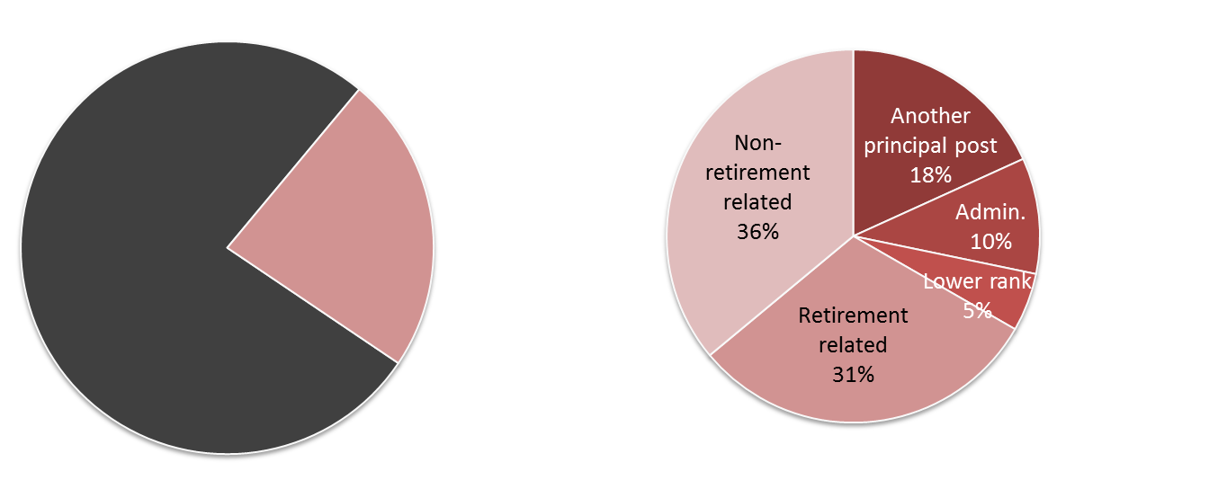
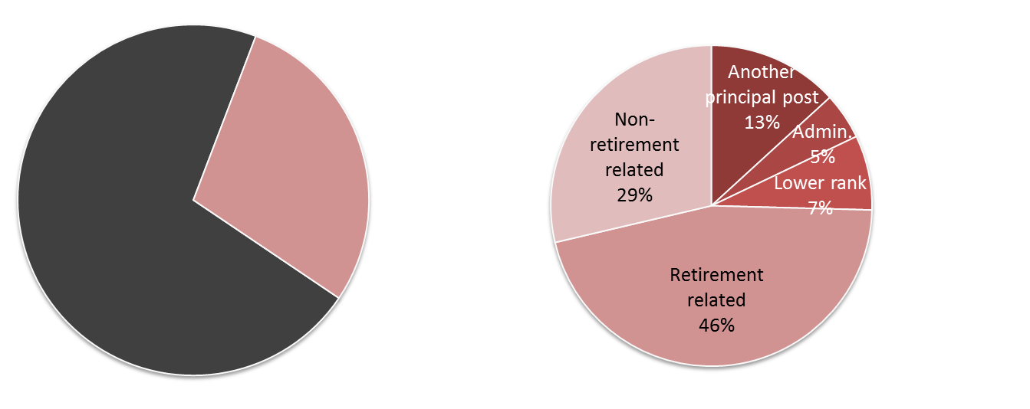
2004-2008
77 %
“Stay put”
23 %
Turnover
Attrition: 67%
2008-2012
29 %
Turnover
71%
“Stay put”
Attrition: 75%
Notes:
A key reason for low levels of principal turnover is that principal moves within the system are uncommon. Rather the majority of the turnover is accounted for by attrition (i.e. moves out of the public education system).
Between 2004 and 2008, two thirds of principal turnover was accounted for by attrition. This rose to three quarters between 2008 and 2012 with rising retirement-related turnover. With little churning across schools, principal tenure among incumbent school principals closely follows their total years of principal experience.

Slide 44
Low levels of turnover
Low levels of mobility implies high tenure.
Two added features of low levels of mobility:
  Over 55% of principals are promoted from within schools
  Less than 3% of moves are across provincial moves
Various reasons for low mobility incl. lack of accountability measures affecting principals.
  In the U.S. job security concerns incentivize principals to move from weaker performing to better performing schools.
  Despite IQMS, less than 1 in 1000 principals were dismissed in SA in 2011.
  BUT there are other incentives at play that affect mobility patterns e.g. larger schools for higher pay.
Notes:
An added feature of the low levels of mobility in the sector is that over half of newly appointed principals at 55 per cent are promoted from within the same school. Moreover less than 3% of all moves are cross provincial moves.
There are likely to be various reasons for low levels of principal mobility; to name a few low relocation benefits, language and cultural factors or nepotistic appointment arrangements. The international literature also indicates that low mobility may be strongly related to a lack of accountability measures affecting principals.
Where the current design of performance management systems for principals in IQMS is weakly linked to threats to job security or very favourable monetary rewards, it is unlikely to have driven mobility related principal moves.
When hard-stakes performance management systems are in place with principal performance evaluations based on school performance, job security concerns incentivise principals to move schools. To avoid low performance ratings, they are more likely to move from worse to better performing schools, which usually involves moving from poorer to wealthier schools (Branch et al 2012; Gates et al. 2006; Loeb, Kalogrides & Horng 2010).
Yet evidence suggests that there may be other incentives at play that affect mobility patterns.

Slide 45
Features of the principal labour market
Rising age profile of principals implies a substantial & increasing no. of principal replacements in schools.
  proportionally more retirements are taking place in wealthier schools, but higher absolute demand for principal replacements in the poorest schools.
Principals are unequally distributed across schools with less qualified & less experienced principals overly represented in poorer schools.
  Initial matching of new principals to schools continues to persist in line with historical patterns.
The value principals bring to schools is not signalled through their observed credentials as captured in payroll: REQV levels and years of service.
Despite rising levels of retirement related attrition, low levels of mobility & high levels of average tenure characterise this market. While the no. of within sector transfers is low transfer patterns tend to operate in the same direction as existing inequalities.
Gender disparity in principal leadership appointments

Slide 46
Policy recommendations
Broad recommendation 1)
Broad recommendation 2)
Policies should be aimed at improving the initial match of principals to schools while developing incumbent principals over the length of their tenure.
Where qualifications and experience provide weak signals of quality, policies guiding the selection or principals and those that reward performance should extend beyond observed credentials to identify expertise and skills that may be better quality signals.

Slide 47
A) Improve the principal appointment process
Competency based-testing
Increase min. qualifications to having an ACE in school management &leadership
LOW TO MEDIUM
HIGH
Substantial & increasing no. of principal replacements
Target the initial sorting of principal into schools to address unequal distribution
Traditional academic qualifications are poor signals of principal quality. Other competencies are likely to matter more.
Will this reduce the available pool of candidates?
Relevance

Slide 48
C) Providing principals with greater power?
Providing principals with greater powers over school management
No local evidence linking management powers to increased learning in schools.
International evidence generally supports the decentralisation of decision making to the school-level in raising school outcomes (Hanushek & Woesmann 2007).
However increased autonomy must be packaged with accountability measures
“Local autonomy without strong accountability may be worse than doing nothing” -Hanushek & Woesmann, 2007:74
Relevance

Slide 49
Acknowledgements
Acknowledge the support of the
the Zenex foundation
the Programme to Support Pro-Poor Policy Development (PSPPD), a joint initiative between the Department of Planning, Monitoring and Evaluation (DPME) and the European Union.
The author is grateful for the assistance given by Dr Martin Gustafsson at the Department of Basic Education in understanding the data used for this study, and providing comments on draft papers of this work.

Slide 50
Education Amendment Act 2007
Increased accountability for principals:
requirement to plan for academic improvements and report against targets set.
But does this induce the kind of behavioural change that results in more learning?
Allows for temporary replacement of principals in underperforming schools.
Standards for Principalship
Redefines the roles and responsibilities of school principals
More focus on instructional leadership than PAMS job description
Tends to be idealistic – who lives up to these standards?

Slide 51
Performance Management systems
Implementation challenges with IQMS. 41% CMs not evaluating principals; too easy to get high ratings (DBE, 2012: 44*)
Are ‘carrots & sticks’ effective to induce the right kind of behavioural change?
Promising performance contract (June 2011) for principals withdrawn at ELRC negotiations.
**DBE (2012) IQMS Annual Report 2011/12, Pretoria: Department of Basic Education.

Slide 52
Similar age profiles by school phase level
Age profile of SA public school principals in 2012 by the phase level
2.6 X
Replacements:
primary schools
Replacement secondary schools
Notes:
A surprising feature of this age profile of principals in 2012 is that it does not vary much by the phase level of the school principals lead. But we have far more primary schools than secondary schools so that the replacement requirements between 2012 and 2017 for retiring principals in absolute terms is about 2.6 times greater in primary schools than in secondary schools.

