Slide 1
Distributional implications of student fees
Servaas van der Berg
ReSEP Brown Bag Lunch seminar
12 January 2015

Slide 2



Distributional implications of student fees
Servaas van der Berg
ReSEP,
Department of Economics,
University of Stellenbosch
BBL seminar, 12 January 2015

Slide 3
Fiscal incidence
Spending incidence estimates ‘at best approximations’ (De Wulf 1975, 75)
Early work focused on racial incidence, “apartheid bookkeeping”:
  Native Economic Commission (1932), Social and Economic Planning Council (1944), Leistner (1968), Tomlinson Commission (1955), Spandau (1971), Theron Commission (1976), Terreblanche (1978), McGrath (1983, 1984), Simkins, Abedian, Hendrie & Le Roux (1985), Van der Berg (1991, 1992a, 1992b), Lachmann & Bercuson (1992)
Post-apartheid estimates allow for discrepancies in per person spending:
  Janisch (1996), Castro-Leal (1998, 1999), Castro-Leal et al. (1998), Van der Berg (2000, 2001a, 2001b, 2005, 2009), Gustafsson & Patel (2006), Van der Berg & Moses (2012)
Recent studies assume differentials eliminated:
  World Bank (2015), Inchauste, Lustig, Maboshe, Purfield & Woolard (2015) largely

Slide 4
SA Incidence trends
Massive racial differentials started narrowing from mid-1970s, through more social spending and redistribution
Social spending as share of non-interest govt spending increased sharply:1982 38.7%, 1992 44.4%, 2009 48.1%
Most social spending now well targeted:
  Social transfers extremely well targeted, partly through household formation
  Tertiary education not very well targeted
Targeting occurs mainly through three mechanisms:
  School enrolment almost universal, the poor have more children
  The means test targets spending on grants
  The affluent opt out of public health service
Fiscal incidence ignores service quality
Weak link between spending and outcomes

Slide 5
Social spending by race, 1949-2006

Slide 6
Real value of maximum annual social pension (1990 Rand)

Slide 7
Education spending share by race, 1910-1991

Slide 8
Growth of real social expenditure per capita, 1995-2006 (in 2015 Rand values)

Slide 9
Historical change in real per capita social spending (2015 Rand values)

Slide 10
Lorenz & concentration curves
Arrange population from poorest to richest
Lorenz curve: Plot cumulative income vs. cumulative population share
  Lorenz Curve further from diagonal: more inequality
Concentration curve: Plot cumulative benefit vs. cumulative population share
  CC above Lorenz Curve: redistributive
  CC above diagonal: targeting poor (“per capita redistributive”)
Concentration coefficient = % of area between concentration curve and diagonal (similar to Gini)
Concentration curves can lie above the diagonal – area above diagonal is subtracted (i.e. contributes negative value)

Slide 11
Lorenz curve & social transfers concentration curve, SA 1995

Slide 12
Concentration curves, all social services 2006

Slide 13
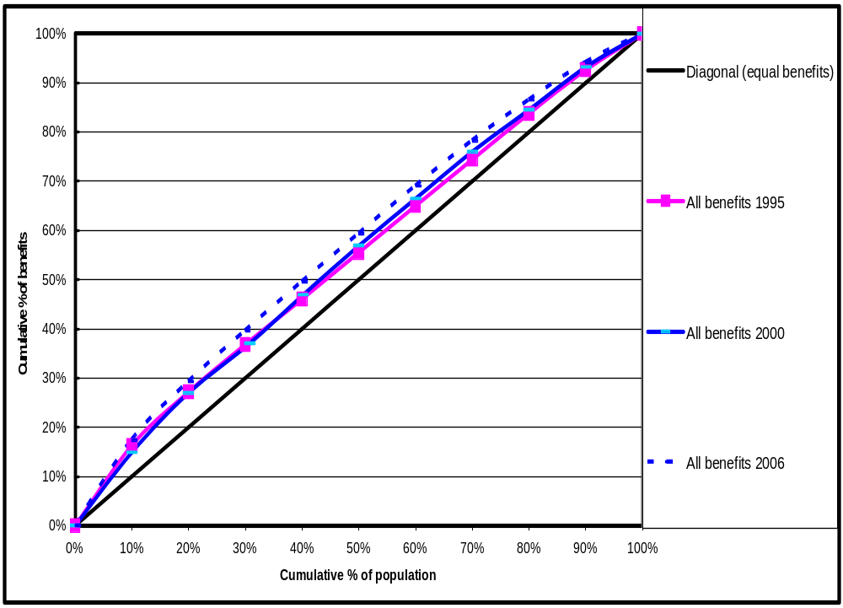
Targeting of social spending in SA 1995, 2000 & 2006

Slide 14
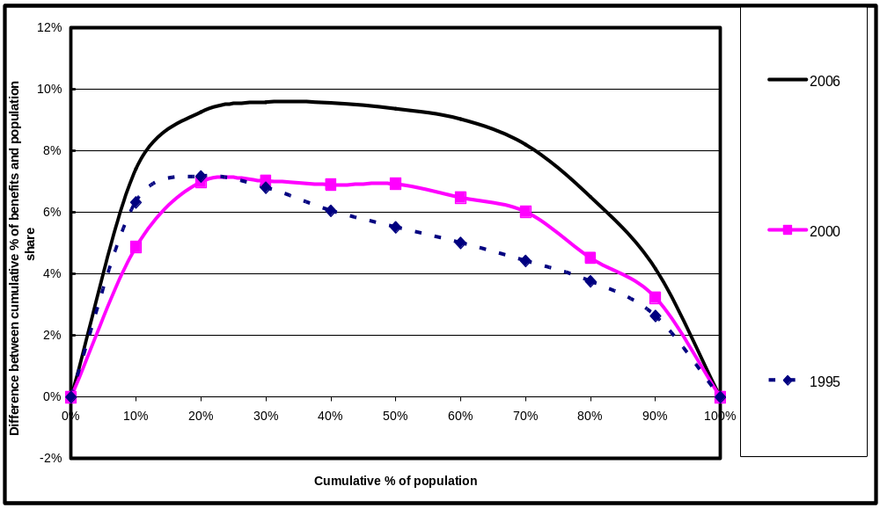
Targeting of SA social spending 1995, 2000 & 2006 (alternative representation of concentration curves – distance above diagonal)
Notes:
Alternative representation (area above the diagonal)

Slide 15
Per capita benefits of social spending by pre-grant income quintile, 1995, 2000 & 2006 (in constant 2015 Rand values)(2000 R values inflated by 2.313)

Slide 16
Per capita benefits of social spending by race, 1995, 2000 & 2006 (in constant 2015 Rand values)(2000 R values inflated by 2.313)

Slide 17
Share of the poorest 40% in social spending benefits, 2006
80%
70%
70%
62%
60%
59%
57%
50%
49%
50%
43%
40%
30%
24%
20%
10%
5%
0%
Housing
services
grants
Public clinics
Total across
Child support
Disability grants
Public hospitals
School education
Tertiary education
Old-age pensions

Slide 18
Useful to consider three welfare measures:
Income before grants (Bromberger’s “primary income”, Lustig’s “market income”)
Income plus social spending
Income plus social spending minus personal taxes (Bromberger’s “secondary income”)
“Secondary income” is the power of disposal over private and public goods and services through market and fiscal processes
  – but consumer sovereignty applies only to income actual income

Slide 19
Changing effect of fiscal processes on distribution
(assuming unchanged distribution of pre-transfer income)
Notes:
Assume fixed pre-transfer distribution of income

Slide 20
Effect of improved targeting
(assuming unchanged distribution, taxes)

Slide 21
Concentration and Gini coefficients, 1995, 2000 & 2006
 | 1995 | 2000 | 2006
Total social spending | -0.095 | -0.106 | -0.146
Total income (without grants) | 0.666 | 0.707 | 0.690
Taxes paid | 0.755 | 0.829 | 0.829
Income + Benefits | 0.578 | 0.576 | 0.526
Income – Taxes + Benefits | 0.528 | 0.528 | 0.470
Net effect of fiscal process | -0.138 | -0.178 | -0.220

Slide 22
SA concentration indices in perspective
 | South Africa 2006 | Developing country sample
 |  | Mean | Most targeted at poor | Least targeted at poor | Sample size
Lower (primary) level | .. | -0.14 | -0.44 | 0.19 | 34
Secondary) level | .. | 0.12 | -0.23 | 0.72 | 38
School education: Total | -0.128 | .. | .. | .. | ..
Tertiary education | 0.479 | 0.39 | 0.04 | 0.76 | 31
All education: Total | .. | 0.01 | -0.27 | 0.30 | 25
Health | -0.110 | 22.7 | 4.0 | 51.2 | 31
Social grants | -0.357 | .. | .. | .. | ..
Housing | 0.070 | .. | .. | .. | ..
Total | -0.146 | .. | .. | .. | ..

Slide 23
Conclusion on fiscal incidence
Govt spending well targeted, but does not necessarily produce intended social outcomes:
  Social service delivery hampered by inefficiencies - limited capacity to efficiently utilise increased public spending
  Social grants not well converted into intended social outcomes (e.g. child outcomes) (due to intra-household inequalities, perverse incentives, hhold formation)
  Social spending not subject to consumer sovereignty
Limits to how much govt can improve social outcomes if market fails to redistribute

Slide 24
University subsidies: Rationale & incidence

Slide 25
The nature of university education
Education has a number of properties which make the analysis of the demand for it both interesting and complex. … (Education is) …a consumption good and a capital good, i.e., although much of the expenditure is justified in terms of the effects on the individual’s income in the future, many of the activities of educational institutions are primarily justifiable in terms of their immediate consumption benefits. Moreover, education affects individuals’ future incomes.
(Stiglitz 1974: 349)

Slide 26
The nature of university education (cont)
Not a merit good?
A merit good is assumed to be under-consumed:
MIT definition: “A good the consumption of which is deemed to be intrinsically desirable. In the case of such goods it is argued that consumer sovereignty does not hold and that if consumers are unwilling to purchase ‘adequate’ quantities of such goods they should be compelled… to do so.”
Musgrave: “The term ‘merit goods’ has no generally agreed application. It is best applied where individual choice is restrained by community values.”
University education very different: it is nowhere universal or compulsory (41% tertiary education completion amongst 25-34 year olds in OECD)

Slide 27
The nature of university education (cont)
Not a public good?
Externalities (enhanced productivity, economic growth acceleration, and expanding employment for the less educated) give university education some characteristics of a public good, but it is excludable (not a pure public good like a lighthouse)
A private good?
Large benefits accrue to recipients:
A university graduate earns 2½ times as much as a matriculant with similar attributes
(Figure 1 shows the great convexity of SA earnings structure)

Slide 28
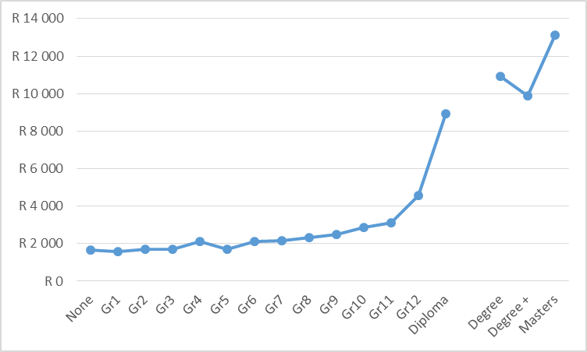
Expected monthly wage for 30 year old black male by level of education, 2010
Source: Own estimates from Labour Force Surveys, 2010. The gap between a diploma and degree course is left so that the values on the horizontal axis also show years of education

Slide 29
Who benefits? Evidence from earlier studies
Tertiary education is by far the least targeted social programme
But estimates could be biased
As they were “based on household surveys, but many students were no longer resident in their families of origin, so this may have led to inaccurate capturing of their home background in surveys” (Van der Berg & Moses 2012)
World Bank (2014) concurs: “Note that students are captured in surveys at the places they find themselves when studying, which in some cases may not be the same as their households of origin. As a result, it may appear that some students from very poor households are not actually appearing in the survey as poor.”
Thus fiscal incidence data may exaggerate the extremely high share of richest deciles:
Almost half from top decile (World Bank, based on IES 2011), two-thirds from top quintile (fifth)

Slide 30
Other qualifications of findings on tertiary education
Not uncommon for tertiary education spending to benefit the rich:
  “Our findings for South Africa are not unique, since much of tertiary education spending in Armenia, Bolivia, and Brazil benefits higher income groups in as well.” (World Bank 2014)
University subsidies do not benefit only students – universities also have other roles that society may want to fund (e.g. research)
  But this argument naturally relates to funding of tertiary education as a whole, not of the students

Slide 31
Towards an alternative estimate of who benefits
SACMEQ III data (Grade 6 survey in 2007) used to identify most likely candidates for university exemption (the top 15%)
Community Survey 2007 used to determine % of 12 year olds in each population decile
SACMEQ SES measures then used to classify exemption candidates into population deciles
SACMEQ exemption candidates then compared to 2006 and 2011 fiscal incidence estimates (see figures)

Slide 32
Estimated university subsidy shares by decile
 | 2006 | 2011 | SACMEQ A (deciles of students) | SACMEQ B (deciles of population attending)
Decile 1 | 0.4% | 2.5% | 1.9% | 0.2%
Decile 2 | 1.1% | 1.1% | 1.9% | 0.6%
Decile 3 | 1.7% | 1.7% | 2.3% | 1.4%
Decile 4 | 2.1% | 1.8% | 3.1% | 3.1%
Decile 5 | 3.5% | 3.4% | 5.4% | 2.3%
Decile 6 | 5.7% | 3.3% | 4.4% | 4.0%
Decile 7 | 9.1% | 7.2% | 7.4% | 7.7%
Decile 8 | 13.7% | 11.8% | 13.7% | 13.0%
Decile 9 | 28.8% | 19.2% | 22.1% | 22.5%
Decile 10 | 33.9% | 48.0% | 37.7% | 45.2%
Total | 100% | 100% | 100% | 100%
Source: For 2006, Van der Berg 2009; for 2011, World Bank 2014 & Inchauste et al 2014; for SACMEQ, own calculations, SACMEQ A refers to the estimated numbers per population decile that would get university exemption; SACMEQ B refers to those among these most likely to be attending university, based on exemptions and 2007 Community Survey university attendance of matriculants with exemptions

Slide 33
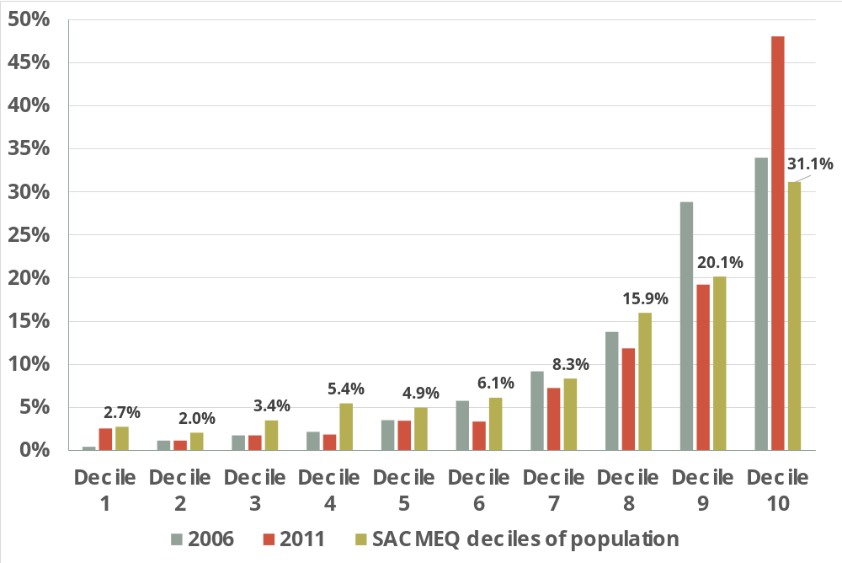
Estimated university subsidy shares by decile

Slide 34
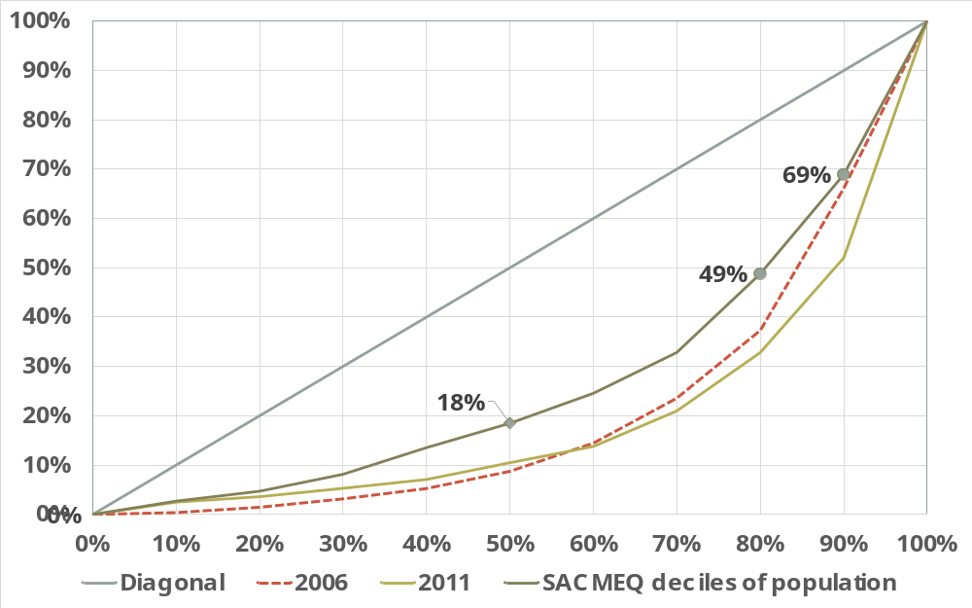
Three alternative incidence curve for student funding at universities

Slide 35
Those who qualify versus those who attend
Exemption estimates based on SACMEQ show less concentration
  But not all who obtain exemptions enter universities
Community Survey records matrics with or without exemption
  77 111 of 21 year olds reported having matric with exemption (versus 86 531 actual exemptions in 1985)
  University attendance pattern as expected, but 2/3 of exempted attend university, but in survey only 42% reported attending; scaled up in further calculations.
Applying decile attendance rates to SACMEQ-based exemption candidates generates new estimate of university attendance (SACMEQ B)
Results similar to 2011 IES: University attendance highly concentrated
  The caveats regarding the accuracy of survey data for determining fiscal incidence of university subsidies may have been in error
Those who qualify and attend university remain a small elite

Slide 36
University attendance of 21 year olds with exemptions, 2007

Slide 37
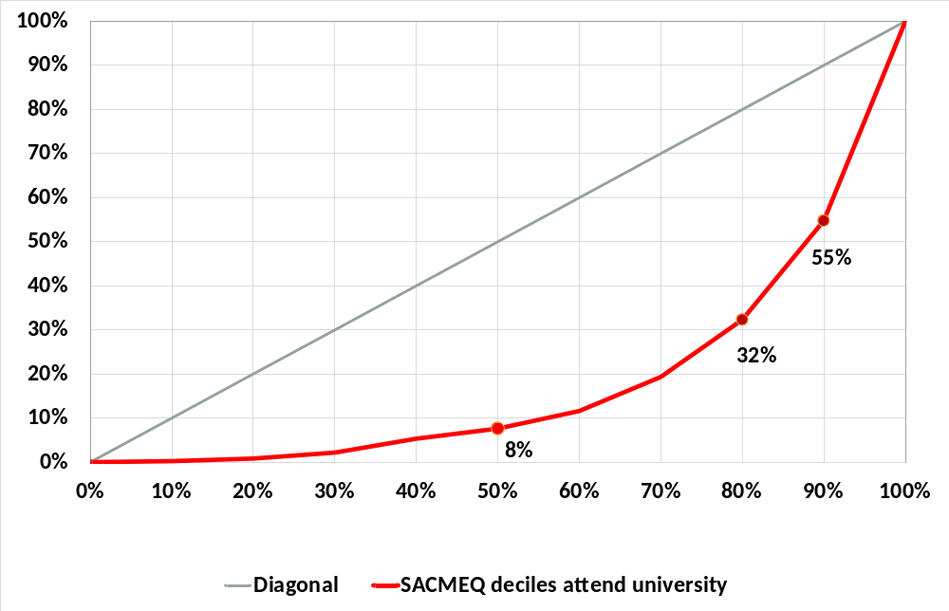
Incidence curve for estimated student attendance at university based on SACMEQ and Community Survey, 2007

Slide 38
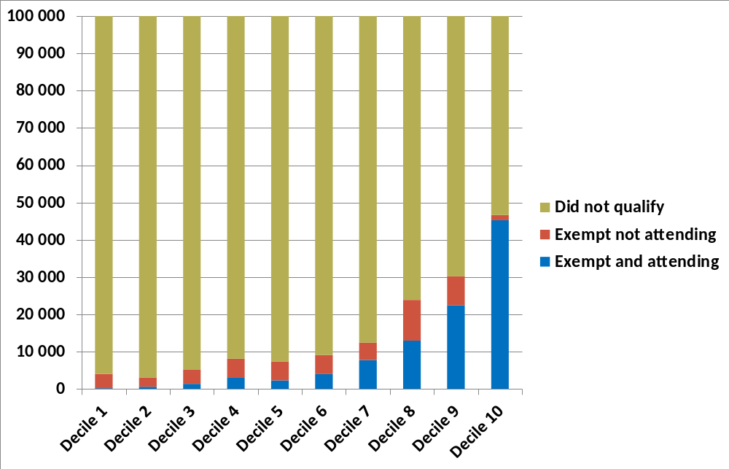
Approximate distribution of those who attend, qualified but do not attend, and did not qualify for university for a recent matric cohort

Slide 39
Dealing with the missing market
Equity concerns and budgetary limitations make much bigger public funding of students problematic (e.g. compared to R12 000 per school child)
Yet social mobility requires that more poor children must gain university access
Problem is high cost of studying:
  Perhaps R100 000 per year, considering student fees and living expenses
  Few households earning below R500 000 (95% of population) can afford university studies without drawing on savings or borrowing
  Borrowing not possible for most
Missing financial market makes it difficult to regard university education as potentially adequately self-funded (Arrow 1993)
  NSFAs too limited, recovery rate too low
Thus some form of state guarantee and recovery mechanism (e.g. linked to tax system) are needed to involve financial institutions

