Slide 1


University Fees in South Africa:
A story from evidence
SALDRU, UCT, 10 August 2016
Nico Cloete, Charles Sheppard & Francois van Schalkwyk
UWC Institute of Post-School Studies

Slide 2
Aims of this presentation
Move the debate from ‘surplus’ ideology to evidence:
Money is not the main problem in the current SA political, economic and higher education debate about funding and fees
Political contestations
The functioning and structure of the Higher Education Sector
Higher education and inequality
Invest in higher education
Who benefits from university subsidies?
The Trilemma of trade-offs
A differentiated fees structure
The need for a Pact and the loss of confidence of the academics

Slide 3
Political Contestations about Role of HE
In SA competing models of functions/roles for HE:
      Redress (race and poverty) vs development
      Undergraduate access vs knowledge economy skills
In the deteriorating economic climate, HE is increasingly seen as individual mobility, not as key to economic growth.
Politically in SA there is conflict between modernisers who push the development agenda and traditionalists who see HE as redress (Mamdani, and Fanon)
In government there is a similar divide between DST and DHET
      DST focus: development, knowledge economy, postgraduate
      DHET focus: redress (institutional, individual), undergraduate
      (Cloete 2016b).
During the crisis university leadership acted in an un-coordinated manner and handed the problem to the police and the government.
A “Third Force’’ in student politics?
Where are the academics? (Student leader: we only talk to the VC and the Cops)

Slide 4
South Africa: The best postgraduate HE system in Africa
SA has the most diverse and differentiated HE system in Africa.
Times Higher (2015) rated BRICS and developing countries.
In the Top 12 BRICS:
    SA 3 universities (UCT 4th; Wits 6th; SU 12th)
    Brazil and Russia 1 university each
    India with a billion people has 0
    China 6 (massification with 30 World Class)
4. PhD transformation from 1996-2012:
      Proportion of black graduates increased from 13% to 58%
      African women graduates increased by 960%
      No increase in white male graduates for the same period
      In 2012, more African than white graduates (Cloete, 2015)
5. The reputation of SA HE is based on the postgraduate system. It is crucial for development in SA, and Africa, that SA maintain and strengthen the new knowledge producing subsector of HE.

Slide 5
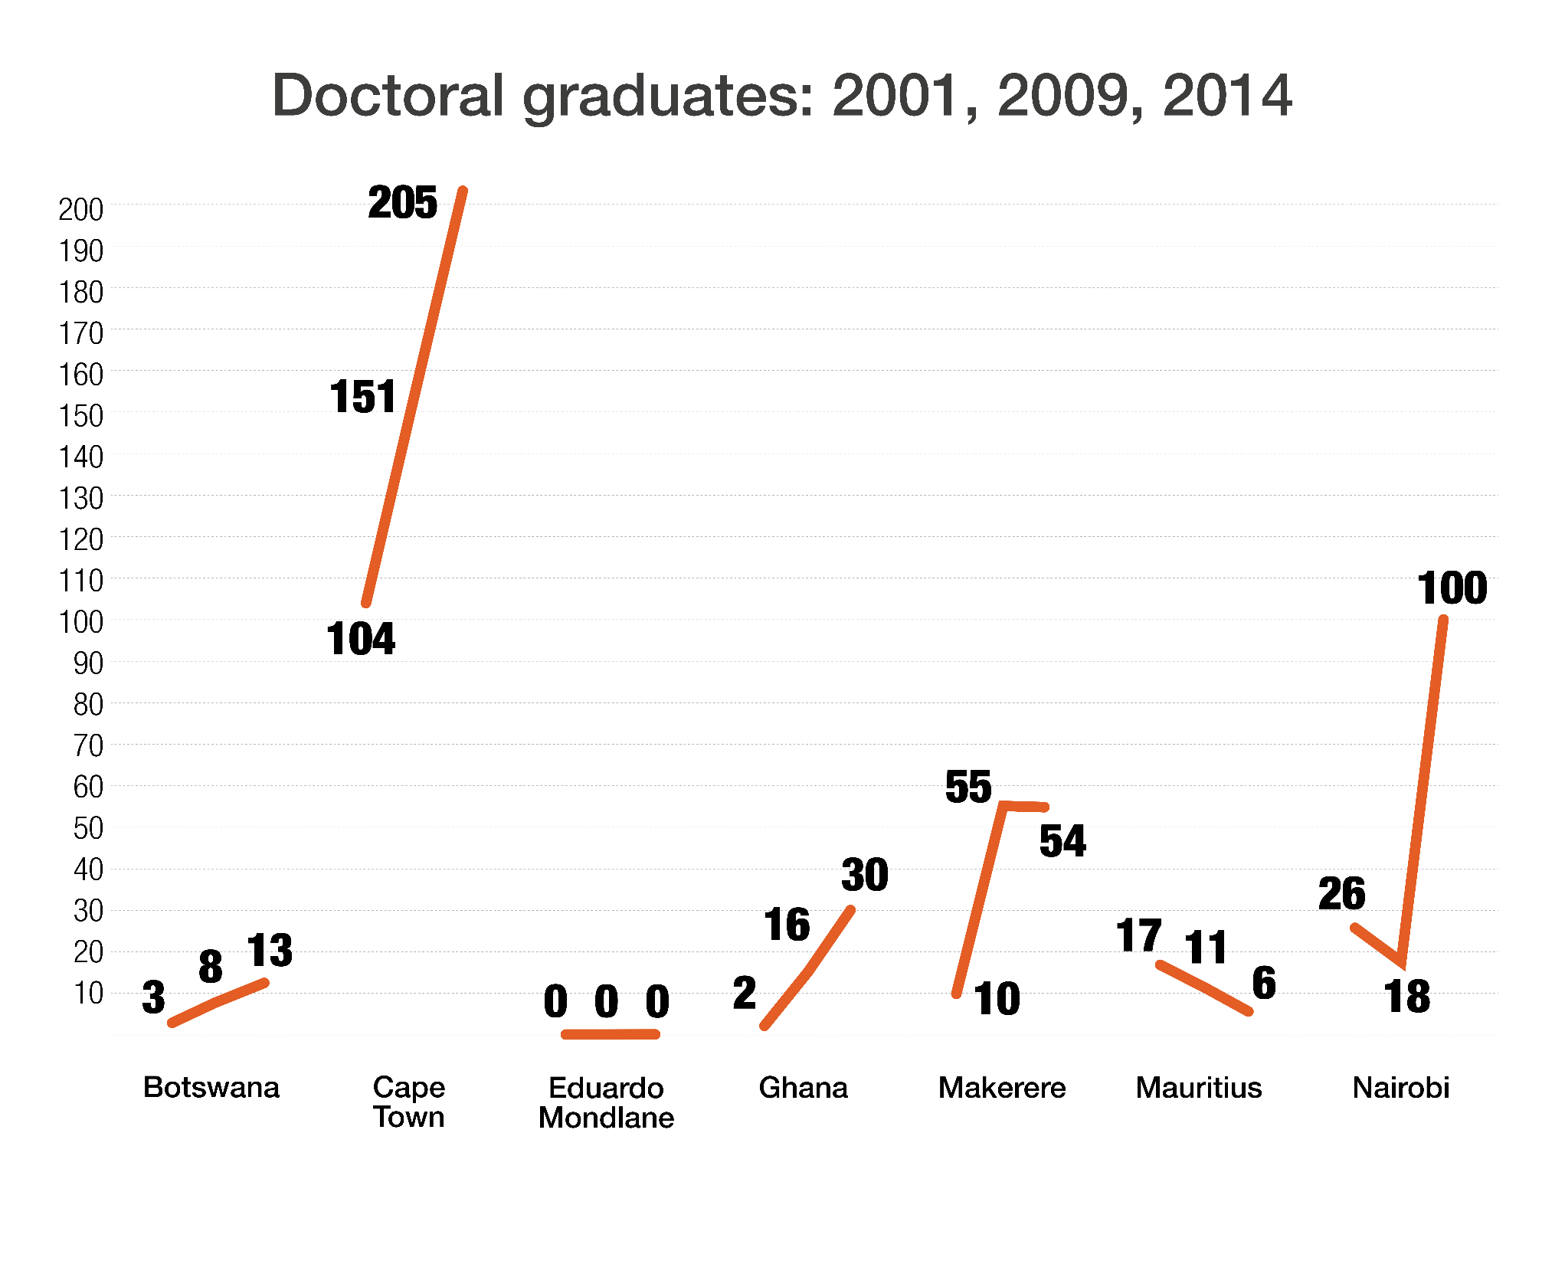

Slide 6
Inefficiencies in the best HE system in Africa
Fast expanding (massifying) education systems all over the world have inefficiencies as capacity cannot cope with demand. In SA this starts in the school system and runs through the undergraduate system.
Of the 1 million kids who enter Grade 1, only 100 000 will enter university, and 53 000 will graduate after 6 years (Van den Berg, 2015).
Very poor graduation rates – 30% graduate in 3 years, 56% in 5 years (if UNISA included it drops well below 50%). National diploma even worse: below 50%.
2006-2013: 1.7% growth for new entrants; average annual growth for returning undergraduates 4%. Too many students stay in the undergraduate system for too long.
All or nothing system: drop out or graduate. With high premium on tertiary certificates, associate degrees (after 2 years) must be considered.
The Honours degree is not funded by NRF or NSFAS, and is a major blockage for black students to masters and PhD study.
There are too many academically “poor” students in the university system.
The current university undergraduate system is inefficient and unsustainable and needs to be restructured.

Slide 7
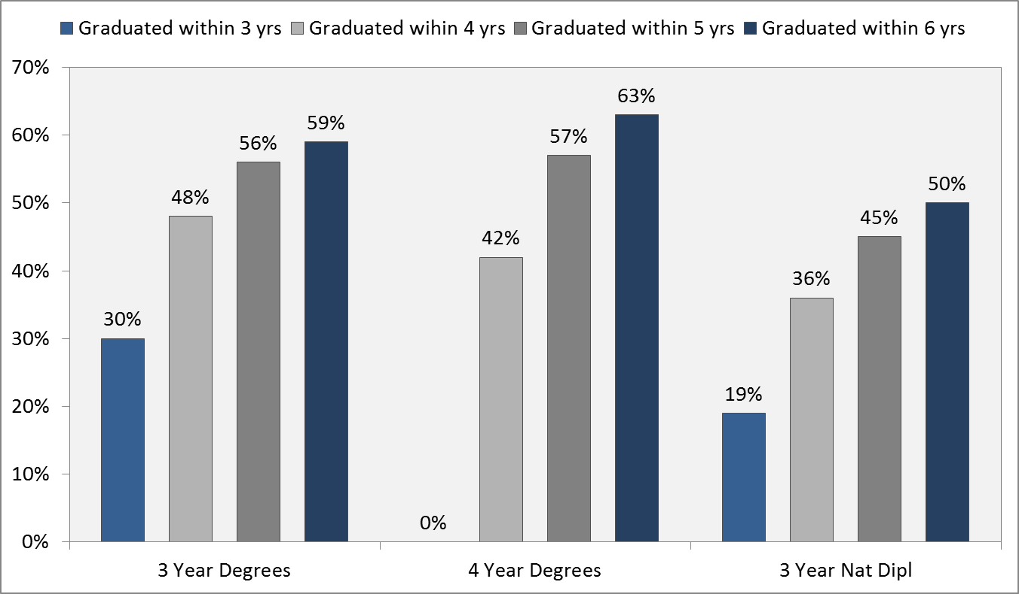
Cumulative completion rate of the 2008 first-time entering undergraduate cohort (Unisa excluded)
Source: CHE & DHET (2015) Cohort studies.

Slide 8
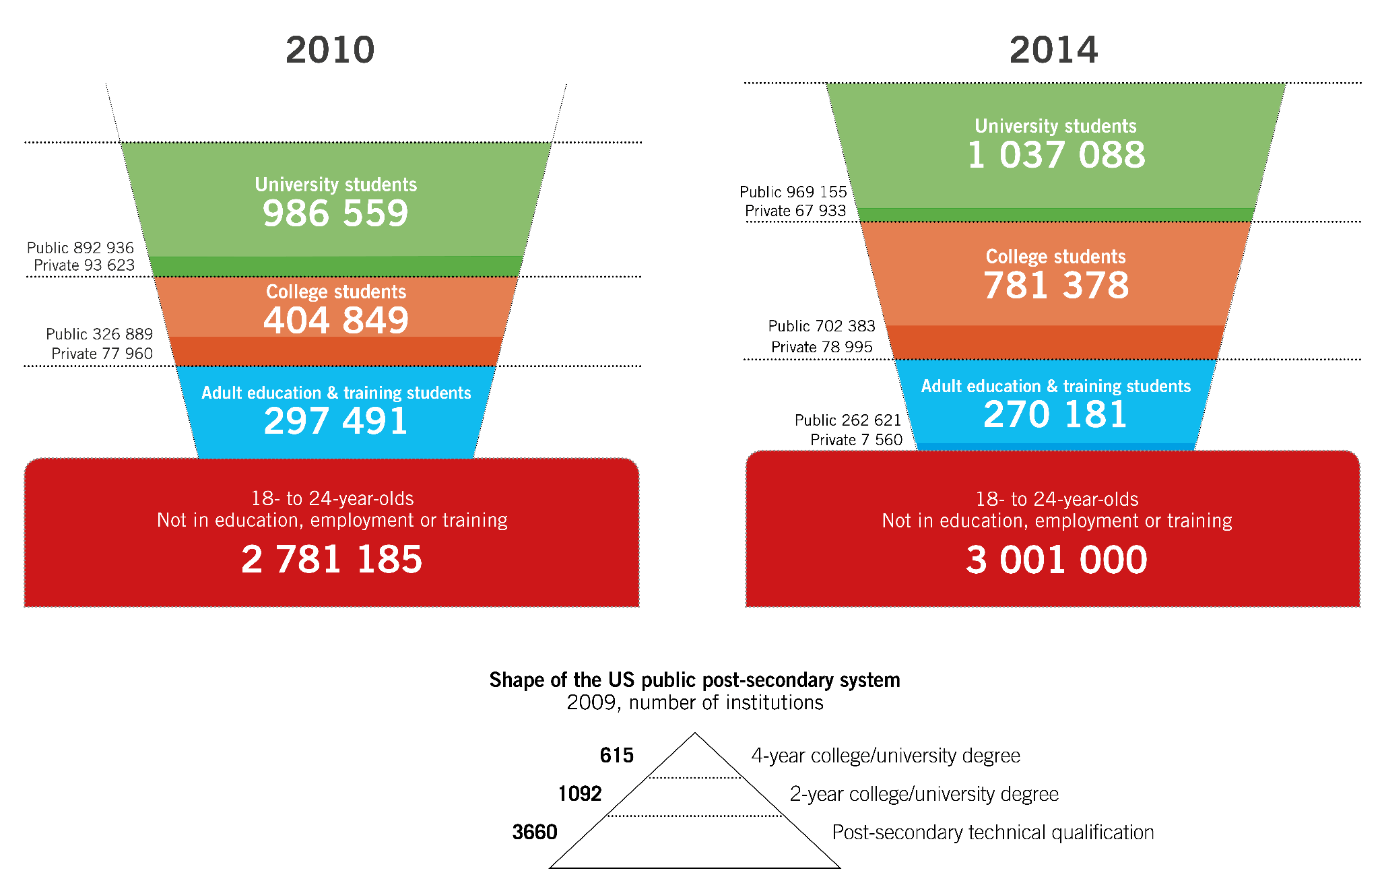

South Africa post-school system, 2010 vs 2014
Source: DHET HEMIS 2012. Compiled by Charles Sheppard. Graphic by CHET/Francois van Schalkwyk.

Slide 9
A diverse and differentiated HE system
The so-called knowledge economy requires a great diversity of skills programmes, and differentiation in the levels of skills and performance.
Broadly this means:
    high percentage of labour with post-matric qualifications for people to work in jobs that require higher than matric-level information processing and problem-solving: “In the coming years, jobs requiring at least an associate degree are projected to grow twice as fast as jobs requiring no college experience.” (Obama 2010)
    A strata of a university system that offers solid general and vocational-orientated education, mainly, but not exclusively, at the undergraduate level to produce what Castells (2001) calls ‘self-programmable labour’, meaning skills that enable workers to adapt to and change working conditions.
    A group of universities that concentrate on high-level professional training and new knowledge production with a high percentage of staff with doctorates (70%), and with more than 40% of students in postgraduate programmes (currently 7 universities produce 70% of all PhDs; 6 universities 1%) (Cloete et al. 2015).

Slide 10
Higher education and inequality
Access to tertiary education is regarded by the ‘haves’ as a means to maintain privilege, and by the ‘have‐nots’ as a means to get out of poverty.
In 1970 in the US, 10% of students from the lowest income quintile went to university in contrast to 40-50% from quintiles four and five. Thirty years later (2010), still only 10% of quintile one went to university, but for quintiles four and five the percentage had increased to 80-90%. Higher education in the US has thus become part of the ‘iron cage of privilege’ (Piketty, 2014).
The Hamilton Project in the US: “Why more education wont fix economic inequality” shows more education increases income for everybody, but does not reduce overall inequality (Leonhardt, 2015).
While HE offers a ladder out of poverty for a limited few it is not a efficient mechanism to reduce inequality. Universities are much better at contributing to development through high skills training and new knowledge production.

Slide 11
Invest in higher education
“To maintain a competitive edge in a rapidly transforming knowledge economy, countries need to invest more in quality education. Not even minimum wage schedules can multiply wages by factors of five or ten: to achieve that level of progress, education and technology are the decisive factors.” (Thomas Piketty, 2014)
But historically SA has not invested enough in HE, nor has it reached its own target of 1% of GDP on R&D.
Treasury officials may say that with the latest injection of funding SA is now well over 1% over GDP for HE; but this is “bailout” money. No clear new target for HE expenditure has been set yet.
Stagnation in growth and more expensive borrowing means there will not be substantial additional money, which means for greater investment in HE there will have to be budget reprioritisation in the treasury
International research is clear: the question is not just MORE investment because investments can have different outcomes in different countries as the slides on the trilemma of trade-offs will show.

Slide 12
Expenditure on higher education as % of GDP, 2012
Compiled by Charles Sheppard
Source: OECD (2016), Public spending on education (indicator). doi: 10.1787/f99b45d0-en (Accessed on 12 May 2016)

Slide 13
State budget for universities and R&D as % of GDP
Gross domestic expenditure
on R&D as % of GDP
Government budget
for universities as % of GDP
Government expenditure
on R&D as % of GDP
Source: R&D data: M Kahn

Slide 14
Streams of university income (ZAR bn), 2000 and 2013
NSFAS 2% (0.51)
Private 22%
NSFAS 13% (6.73)
Private 20%
Source: DHET – Annual Financial Statements of universities & DHET – Annexure 3, 2nd National Higher Education Summit 15-17 October 2015.

Slide 15
Different increases in student fees
Increases in tuition fee income per student*
% increase in tuition fee income per student (2010-2014)
* The tuition fee income per student is calculated by dividing the total reported tuition fee income with the total number of full-time equivalent students
Source: Charles Sheppard. Graphic by CHET/Francois van Schalkwyk.

Slide 16
SA university and state revenue 2007–2014
Source: Bunting, M (2016). The financial condition of South African public universities: A framework for nonprofit financial analysis in a small-N context. Rhodes University Department of Accounting Working Paper Series 2016/01. Available at http://papers.ssrn.com/sol3/papers.cfm?abstract_id=2790758; downloaded 14 June 2016.

Slide 17
Who benefits from university subsidies?
There is broad agreement amongst economists of higher education funding that government subsidies are “regressive”, meaning subsidies favour the rich (Garritzmann, 2014).
In OECD countries, public universities consistently argue that low or no tuition fees provide greater equality of educational opportunity by providing greater access ... But the overwhelming subsidy in public universities accrue to students from the middle and high income families (Nicholas Barr 2004).
Blanket university fee reduction benefits the wealthy – and slows change (Fourie, 2015).
Not uncommon for tertiary education spending to benefit the rich:
“Our findings for South Africa are not unique, since WB research shows much of tertiary education spending in Armenia, Bolivia, and Brazil benefits higher income groups as well” (Van den Berg, 2014).

Slide 18
Private/public returns to HE
Globally, and in Africa, there are considerable benefits to HE.
In Sub-Saharan Africa, private returns to HE are higher than returns to primary and secondary education.
The region with the highest private returns to HE is Sub-Saharan Africa.
South Africa has the highest private returns to HE in the world:
      South Africa 40, Ghana 28; Uganda 23
      Mauritius 21, Mexico 20, Brazil 17,
      Turkey 14, US 14, Spain 11, Norway 10
Higher education also has numerous private benefits such as higher salaries, savings, professional mobility, life expectancy and quality of life. Public benefits include greater productivity, increased consumption, workforce flexibility, reduced crime rates, greater appreciation of diversity and improved ability to new technologies.
SA high returns to tertiary education and high levels of inequality
(Gini coefficient 0.70) mean that free higher education will proportionally privilege the privileged (Patrinos 2015).

Slide 19
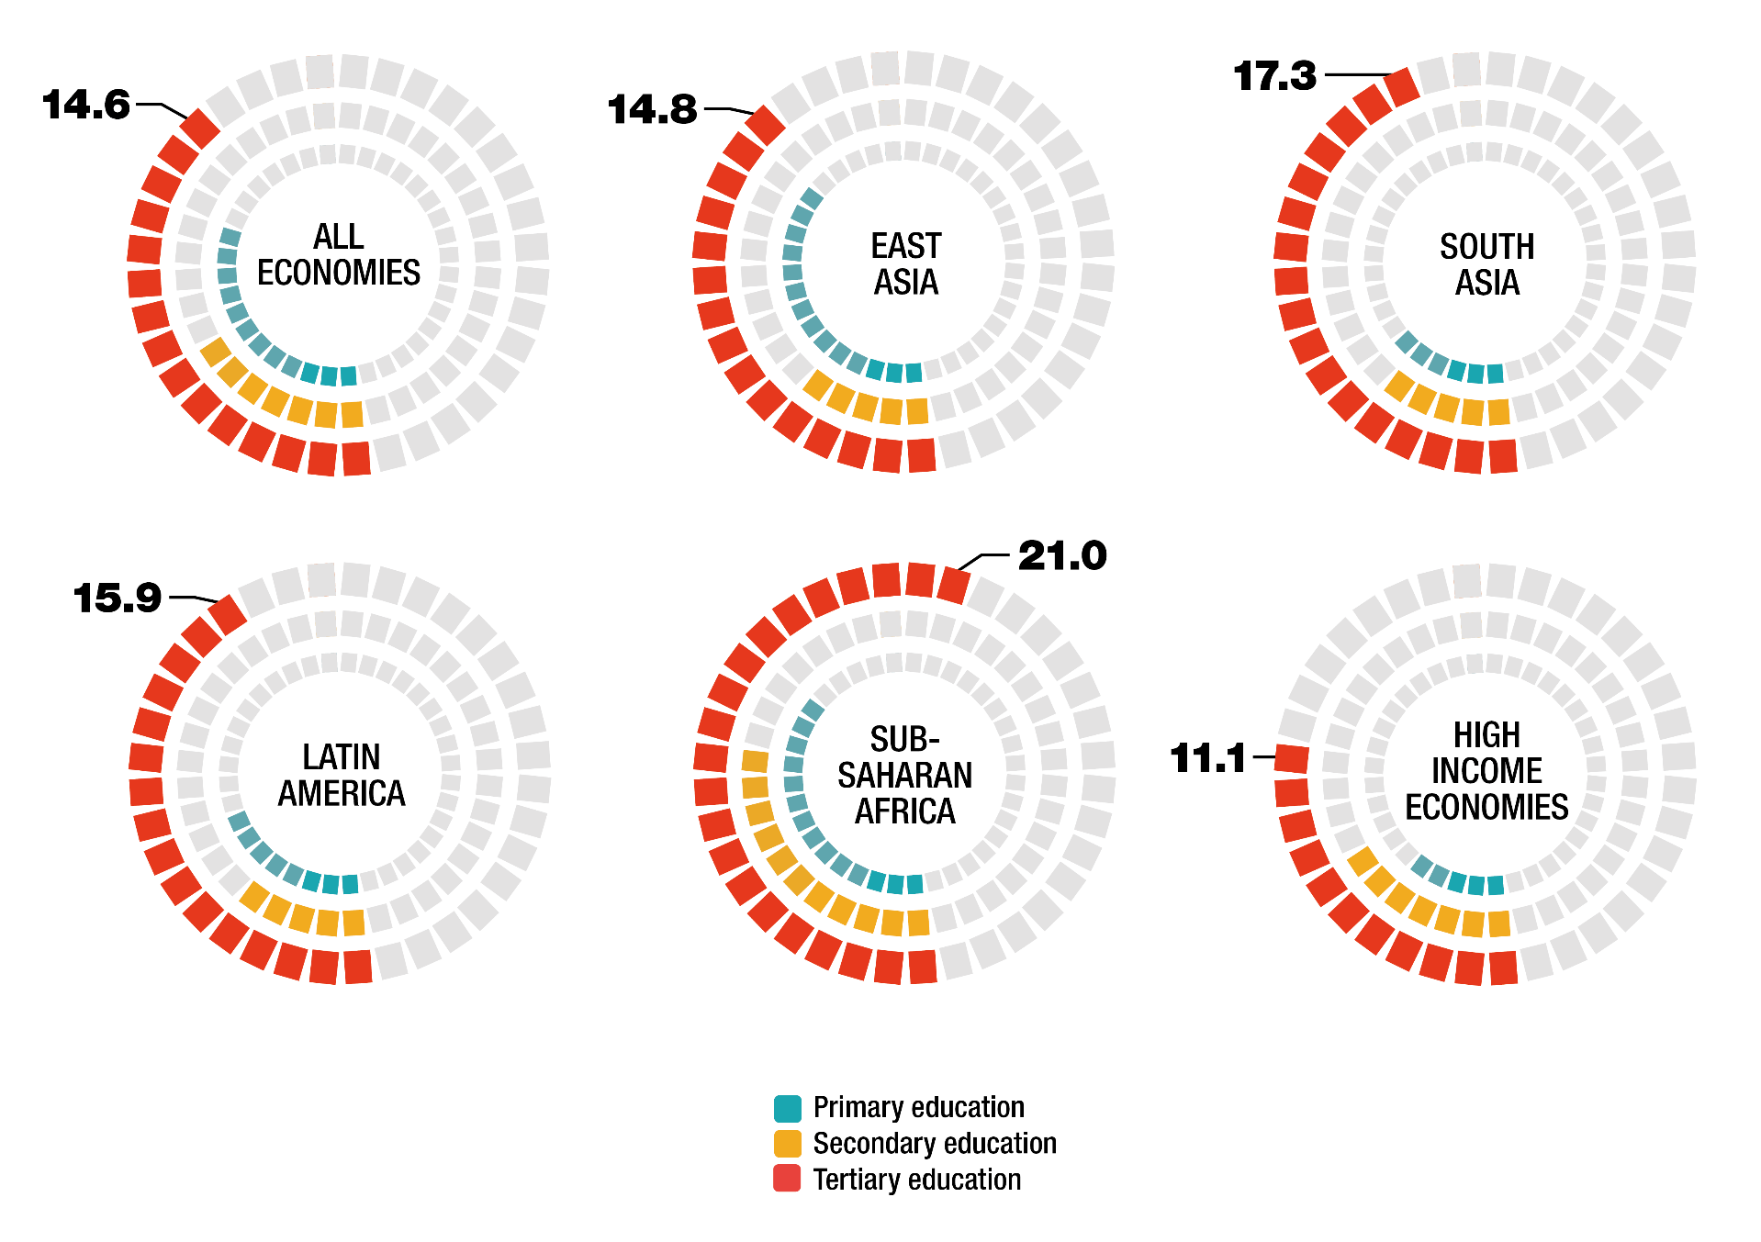
Private returns to education by level and region (2014)
Source: Montenegro & Patrinos (2014). Graphic by CHET/Francois van Schalkwyk.

Slide 20
Higher education, employment & wages in SA
After controlling for a range of variables, education does bring rewards, but below matric very low with very little gain in benefits between grades 1 and 12. But it improves after matric, and returns for degrees are extremely high; both in wages but especially in employment probability.
“The large differentials in earnings and access to jobs between the highly educated and the less educated lies at the heart of income inequality. The high wage premium to educated workers derives from a combination of a skills shortage at the top end of the educational spectrum, driving up wages of the educated, and a surfeit of poorly-educated workers competing for scarce unskilled jobs, thus dampening unskilled wages.”
Of particular importance is certificates; matric (validated by a national exam) and tertiary certificates that signal to employers reliable cognitive gains.
(Van den Berg, 2014)

Slide 21
Conditional probability of employment and conditional log of wages by years of education
Source: Van den Berg (2014). Graphic by CHET/Francois van Schalkwyk.

Slide 22
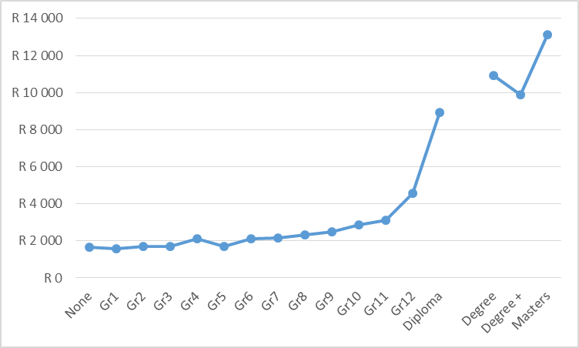
Expected monthly wage for 30-year-old black male
by level of education, 2010
Notes: Own estimates from Labour Force Surveys, 2010. The gap between a diploma and degree course is left so that the values on the horizontal axis also show years of education.
Source: Van den Berg (2016).

Slide 23
Evidence from SA household surveys
Using a range of South African databases, such as Stats SA Community Survey, SA Conditions of Schooling (SAQMEC), National Income Dynamics (NIDS) and World Bank Data, Van den Berg concludes that:
From a matric class of 100 000 students from deciles 1-5 about 90% do not even qualify for university.
The total number from deciles 1-5 who gain exemption and attend university is just over 10 000.
In contrast, around 75 000 of the class who have exemption and attend university come from deciles 8 and 9.
Those who qualify and attend university come from a small elite, the come majority from the affluent middle class and the elite.
The reason there are so few students from deciles 1-7 in higher education is not that they don’t have funding, but because they don’t qualify – and that is a global trend.
Next slide is a graphic illustration of the incidence of university attendance according to family income.

Slide 24
Approximate distribution of university attendance for a recent matric cohort
Did not
qualify
Exempt
but NOT
attending
Exempt
and
attending
Source: Van den Berg (2015).

Slide 25
Trilemma of trade-offs
and effects on growth and inequality
Enrolment
Inequality/
Economic growth
Public
investment
Private
cost

Slide 26
Politics & higher education systems: China
Equality in education:
“In education, there is no distinction between classes of men.” (Confucius [500 BC]) “HE increasingly stands out in the stratification of the society.” (Jingyi, 2004)
Economist Tang Min: “Higher education enrolment expansion will turn out to be a measure that entails less state investment, stimulates domestic consumption greatly and satisfies the urgent demand from the masses.” (Jingyi, 2004)
Three principles:
    High tuition to increase investment in higher education and to spur consumption
    Large-scale loan systems to help poor students – Rural Credit Cooperatives (10-15 year pay-back) and China Development Bank
    Increased scale of scholarship (30 world-class universities)
Trade-off: High: Government spending (3.5% GDP) – mass – private
Resulted in the fastest expansion of HE in history. From 18 000 PhDs in 1978 to
50 000 in 2008. (40% STEM). China is distorting the global high-skills labour market.

Slide 27
Politics & higher education systems: Africa
“The purpose of post colonial flagship universities was to train a tiny elite on full scholarships which included tuition, board, health insurance, transport and personal needs”. Makerere was described as a “devaluation of higher education into a form of low-level training with no research” (Mamdani, 2008).
For government “free higher education is highly visible and populist, and encourages the perception that the state is providing something people want ... free higher education in Africa was built on inequitable social structures. It reproduced these inequalities ... free higher education in highly unequal societies mainly benefits the already-privileged (new political and business elite), who have the social, cultural and economic capital required to access, participate and succeed in education. (Langa, Wangenge-Ouma, Jungblut and Cloete, 2016)
Trade-off: Low: Government spending – elite – private
Dual system: Small public (free) universities and private colleges with high private spending and low quality.

Slide 28
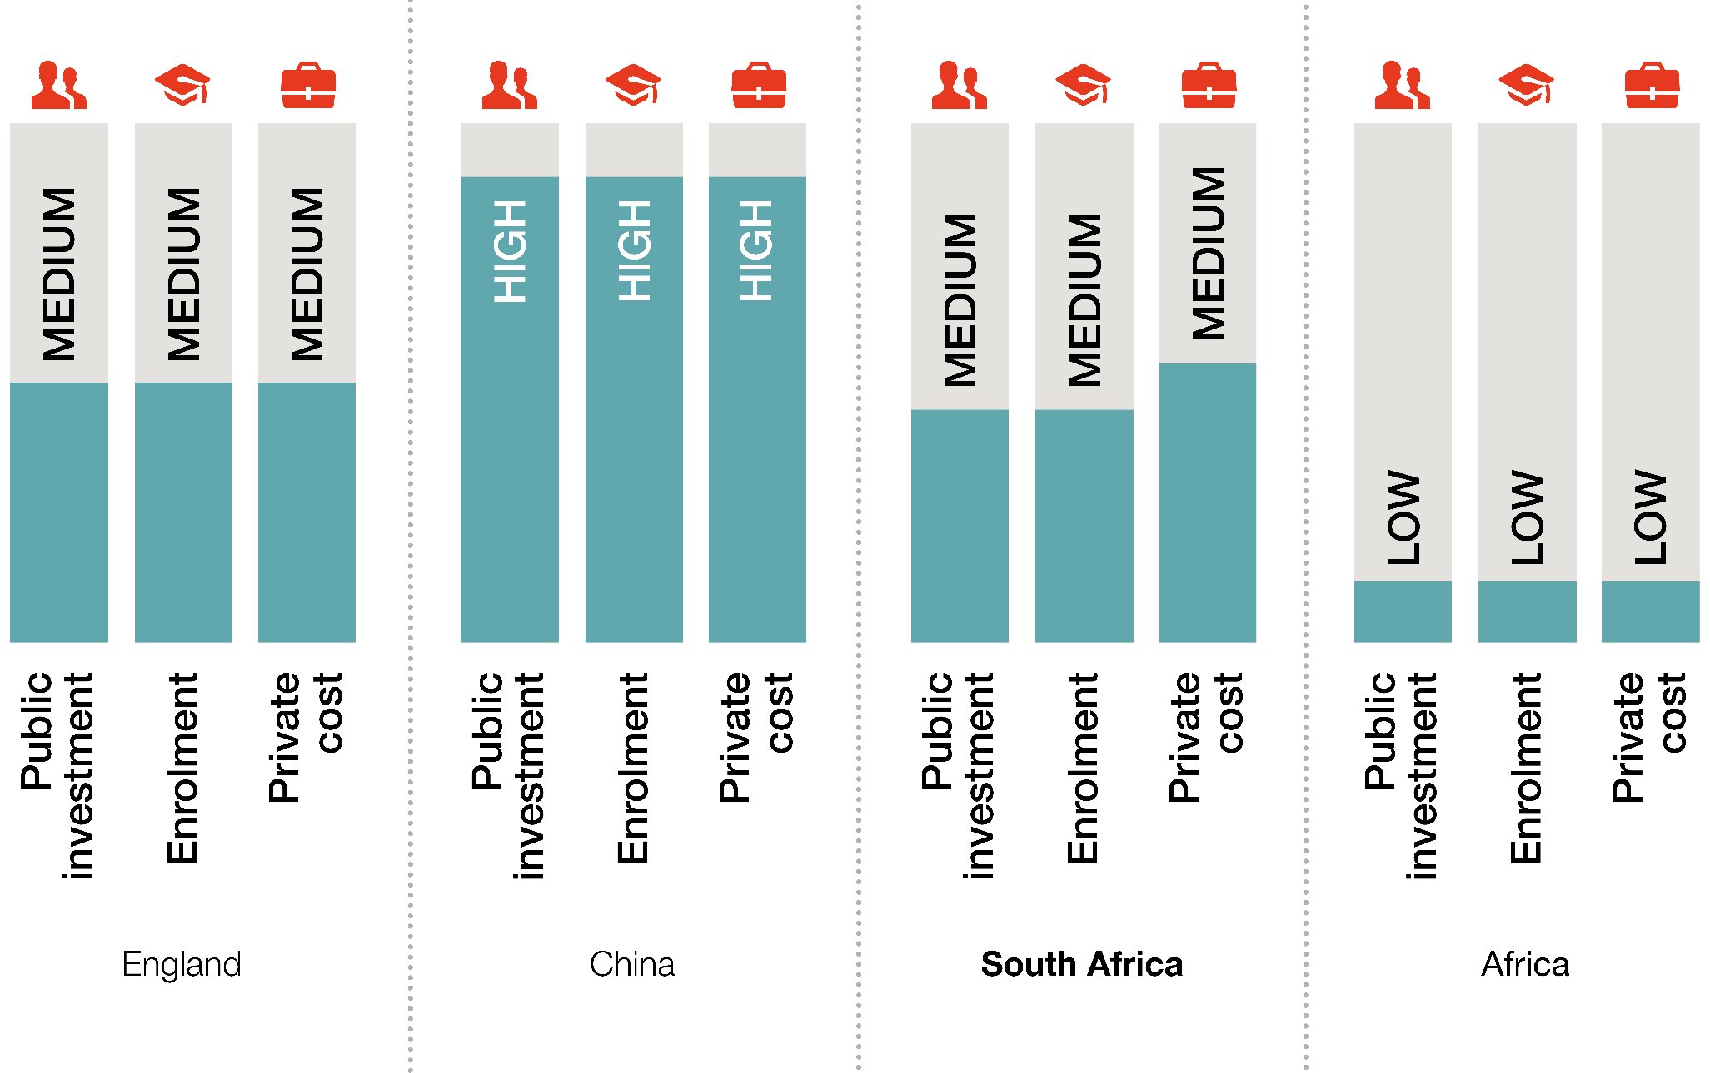
Trilemma of trade-offs: England, China, SA & Africa
Source: Busemeyer (2015). Graphic by CHET/Francois van Schalkwyk.

Slide 29
Three bands of fees:
Almost free higher education for the Poor
Very few of the poor (deciles 1-5) ever get to university.
A government committee (Swartz) recommended free higher education for this group. The unanswered, but very important, question is where the poor income-line is drawn.
There is considerable evidence that poor students on NSFAS grants are passing courses, but completion rates are very low. The implication is that the poor are in a “revolving door” situation: admitted to HE but don’t graduate which leaves them “poor with debt” – and some are clearly angry (Cloete, 2016a).
Barr (2004) advised the UK government that poor students should not get loans; to pay back loans keep them in a disadvantaged position.
There must be a much larger range of reputable post-matric alternatives (TVET college, employment/internships) so that university is not the “only” path out of poverty. If this pressure is not relieved it will destabilise the whole university system.
Poor students must be better selected, and when admitted, better supported, not only financially and academically, but also socially (for example REAP).
If HE is totally free, SA will have an exacerbated European problem: students linger in HE and do not complete their studies.

Slide 30
Different schemes for the different middle classes
The middle class can be conceptualised as the “actual” middle class which is above R60 000 p.a. or the “relatively affluent” middle class (R200 000 - R500 000) (Visagie 2013).
To qualify for NSFAS (less than R150 000) means that most of the actual middle class could be classified as “poor” – and they account for 75% of the population.
The “missing middle” consist of one group who are not poor enough for NSFAS but not affluent enough to qualify for bank loans and the Relatively Affluent who qualifies for bank loans, but they can often only afford one child at university – SA’s own one child policy.
Worldwide, the children of the working class (artisans, teachers, nurses, police) have a strong aspiration to, and considerably greater success at university than the poor. Neither the economy nor the ruling party can abandon this group.
With parents in employment, middle class students have a better success rate, and better labour market opportunities. This group needs loans, grants (for success) or deferred payments which, in addition to UK and Australia, is under serious discussion by a number of OECD countries (Bakarat 2015).
Deferred payments (tax) depends on high completion rates, high graduate employment and high tax collection.

Slide 31
NFAS: Actual loan recoveries vs normal growth trajectory
Inadequate revenue supplementation: Between 2010 and 2014 the collapse in NSFAS debtors repaying their loans has cost NSFAS (and government) an estimated R3.7 billion in uncollected recoveries. (Treasury 2015)
Rand Millions
1800
1 659
1600
1400
1200
1 131
1000
800
771
636
600
542
540
400
329
200
248
32
92
0
1998 1999 2000 2001 2002 2003 2004 2005 2006 2007 2008 2009
Loans recovered Normal trend in recoveries
2010 2011 2012 2013 2014

Slide 32
High fees for the elite
Only 4% of households earn more than R500 000 p.a.
Contrary to popular belief, in countries like Norway and Germany, it is not the rich who pay for free HE, it is the middle class with more than 95% employment and almost 100% pay taxes. The combined wealth of Motsepe, Rupert and the Gupta’s will not fund NSFAS for more than a few years. (The proposal of the Left- behind Left or what Habib called the ‘’Pol-Pots’’ in HE)
It is this elite group who are “born” into HE (over 80% attend) and is most successful – free HE will advantage them even more.
In SA, HE fees are a bargain for the elite; only affordable for the relatively affluent middle class with loans and debt, and totally unaffordable for the actual middle class and the poor.
Fourie (2015) proposes a fees sliding scale that ranges from R150 00 for the elite to R15 000 for the poor.
An important question to be determined is what percentage of their budgets the government, business and civil society must contribute to HE.

Slide 33
Pact
In a study on HE systems that have successfully linked HE to development, the main feature was a PACT that link HE to an economic development model (Pillay 2011).
In a study of 8 flagship universities in Africa, it was concluded that three interrelated factors need to be in place in order for universities to make a sustainable contribution to development:
      Broad agreement amongst the major actors about the functions of universities in development; (Castells, 2009)
      Academic core capacity in universities; and
      Co-ordination between the policies and activities of government, universities and external groupings (Cloete et al., 2011).
Braun (2008) in an international review concludes that ‘policy coordination of knowledge policies across ministries and agencies requires a minimum agreement amongst key political actors across ministries involved in HE, science, technology and innovation and those responsible for economic development and planning.
In SA the lack of coordination in knowledge policies have been lamented by a number of studies (Stumpf 2011) Currently there are at least four different (independent) groups investigating the fees crisis.
The structure most strategically placed for this key coordination function is the National Planning Commission in the Presidency.

Slide 34
Selected CHET publications
Cloete, N (2016) Sustainable higher education funding. CHET: Cape Town. View online.
Cloete N, Mouton J & Sheppard C (2015) Doctoral Education in South Africa. Cape Town: African Minds. View online.
Cloete N (2015) Flawed ideology of free higher education. View online.
Cloete N (2016a) Free higher education: Another self-destructive South African policy. View online.
Cloete N (2016b) For sustainable funding and fees, the undergraduate system in South Africa must be restructured. South African Journal of Science (March/April). View online.
Langa P, Wangenge-Ouma G, Jungblut J & Cloete N (2016). South Africa and the illusion of free higher education. View online.
Pillay P (2011) Linking Higher Education and Development. Cape Town: CHET. View online.

Slide 35

Nico Cloete | ncloete@chet.org.za
Charles Sheppard
François van Schalkwyk
www.chet.org.za

