Slide 1

Back to Basics
Foundations for the Future
Dr Nic Spaull | www.NicSpaull.com | 29 May 2018
Logo – Design Thinking Australia . com

Slide 2

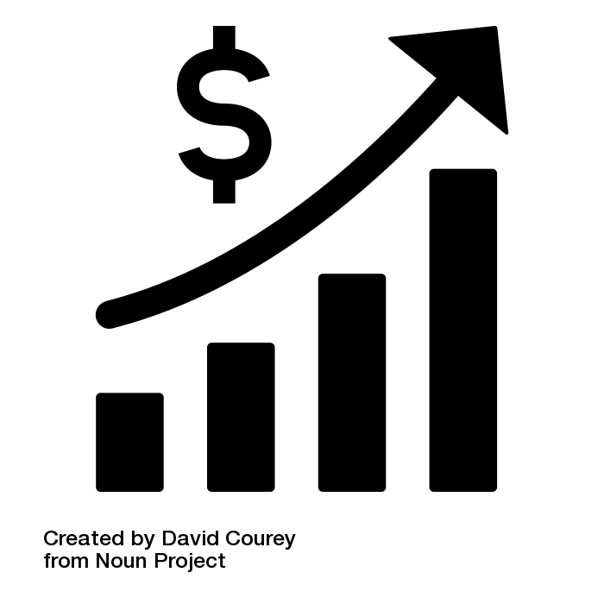


LEVERAGE
PRIORITISE
FOUNDATIONS
1
2
3

Slide 3
“
The best use of private money is influencing how public money is spent.
“
LEVERAGE
R351 Billion
R4,5 Billion
(1,2%)
2018 SA Government expenditure on education
Trialogue estimate of
all education CSI in SA

Slide 4
“
What is the binding constraint to progress in this area?
“
PRIORITISE
“The binding constraints approach is based on the idea that not all constraints bind equally, and that a sensible and practical strategy consists of identifying the most serious constraints at work”
- Professor Dani Rodrik (2009: 6)

Slide 5

“The volume in the first barrel depends on the sum of the width of all slabs. Increasing the width of any slab will increase the volume of the barrel. So a strategy on improving anything you can, when you can, while you can, would be effective.”
(Hausmann, Klinger, & Wagner, 2008, p. 17).

Slide 6
“The volume in the second barrel is determined by the length of the shortest slab. Two implications of the second barrel are that the impact of a change in a slab on the volume of the barrel depends on whether it is the binding constraint or not. If not, the impact is zero”
(Hausmann, Klinger, & Wagner, 2008, p. 17).

Slide 8

“
What is the binding constraint to progress in this area?
“
PRIORITISE
Accountability
Capacity
The incentives to do what is in your job description.
The ability to do what is in your job description.
Improvement

Slide 9
“
“
Prevention is better than cure
FOUNDATIONS
“The later in life we attempt to repair early deficits, the costlier the remediation becomes’’
Nobel Laureate James Heckman (2000, p. 5).

Slide 10


#FeesMustFall

Slide 11

How many students actually make it to university?
PREVENT
FOUNDATIONS

Slide 12

How many students actually make it to university?
PREVENT
FOUNDATIONS

Slide 13

How many students actually make it to university?
PREVENT
FOUNDATIONS

Slide 14

How many students actually make it to university?
PREVENT
FOUNDATIONS

Slide 15

How many students actually make it to university?
PREVENT
FOUNDATIONS
Source: Van Broekhuizen & Van der Berg, 2016 (Higher Education Access and Outcomes for the 2008 National Matric Cohort)

Slide 16
How many students actually make it to university?
}
PREVENT
FOUNDATIONS
?
Source: Van Broekhuizen & Van der Berg, 2016 (Higher Education Access and Outcomes for the 2008 National Matric Cohort)

Slide 17


22%
of Grade 4 children in South Africa can read for meaning in at least one language.
PIRLS Literacy 2016 (Howie et al., 2017)

Slide 18
78%
How does this differ by school wealth?
Spaull & Pretorius (2018) Falling at the first hurdle. Springer.

Slide 19
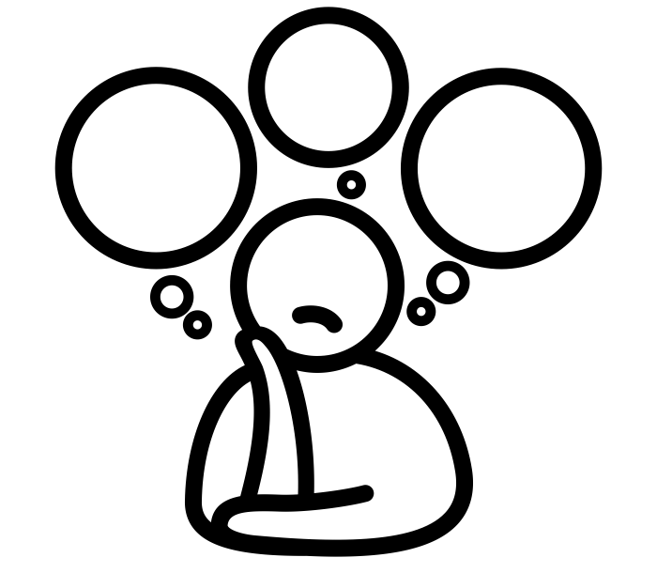
What does this look like in reality?

Slide 20

FOUNDATIONS
Reading 40 Words Correct Per Minute
(starting point for reading comprehension in English)
NEEDU Grade 5 Rural SA

Slide 21
Reading speed…
Many
years
ago
Leopard
was
a
creature
with
no
spots.
Recommended rate at Gr5
One
day,
he
was
relaxing
in
the
shade
of
a
thorn
tree
when
Zebra
walked
past.
Many
years
ago
Leopard
was
a
creature
with
no
spots.
40% of SA rural Gr5 learners (<40WCPM) WCPM
One
day,
he
was
relaxing
in
the
shade
of
a
thorn
tree
when
Zebra
walked
past.
Draper, K., and Spaull, S. (2015). Examining oral reading fluency among grade 5 rural English Second Language (ESL) learners in South Africa: Analysis of NEEDU 2013. South African Journal of Childhood Education 5(2) pp.44-77.
Notes:
40 words in 60s = 1,5s/word
130 words in 60s = 0,46s/word

Slide 22
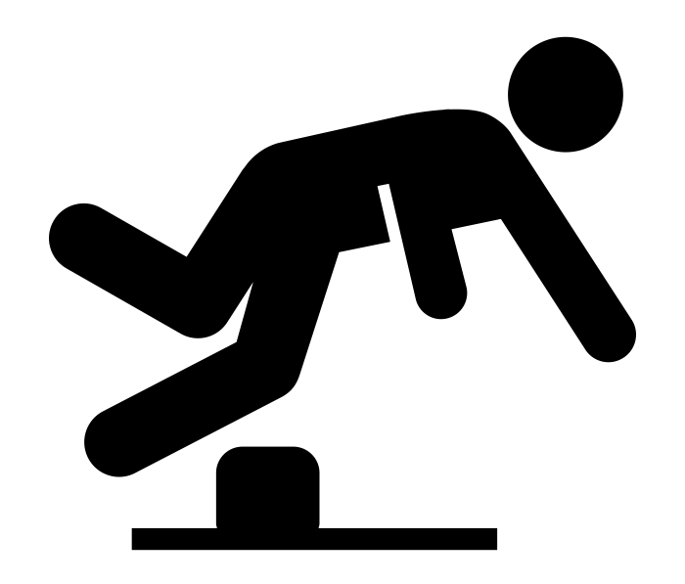
Falling at the first hurdle…
If children do not learn-to-read in Grades 1-3, they cannot read-to-learn in Grade 4 onwards
Spaull & Pretorius (2018) Falling at the first hurdle: Early grade reading in South Africa. Springer.

Slide 23
78%
Falling at the first hurdle…
Spaull & Pretorius (2018) Falling at the first hurdle. Springer.

Slide 24


Funda Wande
A high-quality multimedia course to teach isiXhosa Foundation Phase teachers (Gr R-3) how to teach reading.
2017-2023

Slide 25
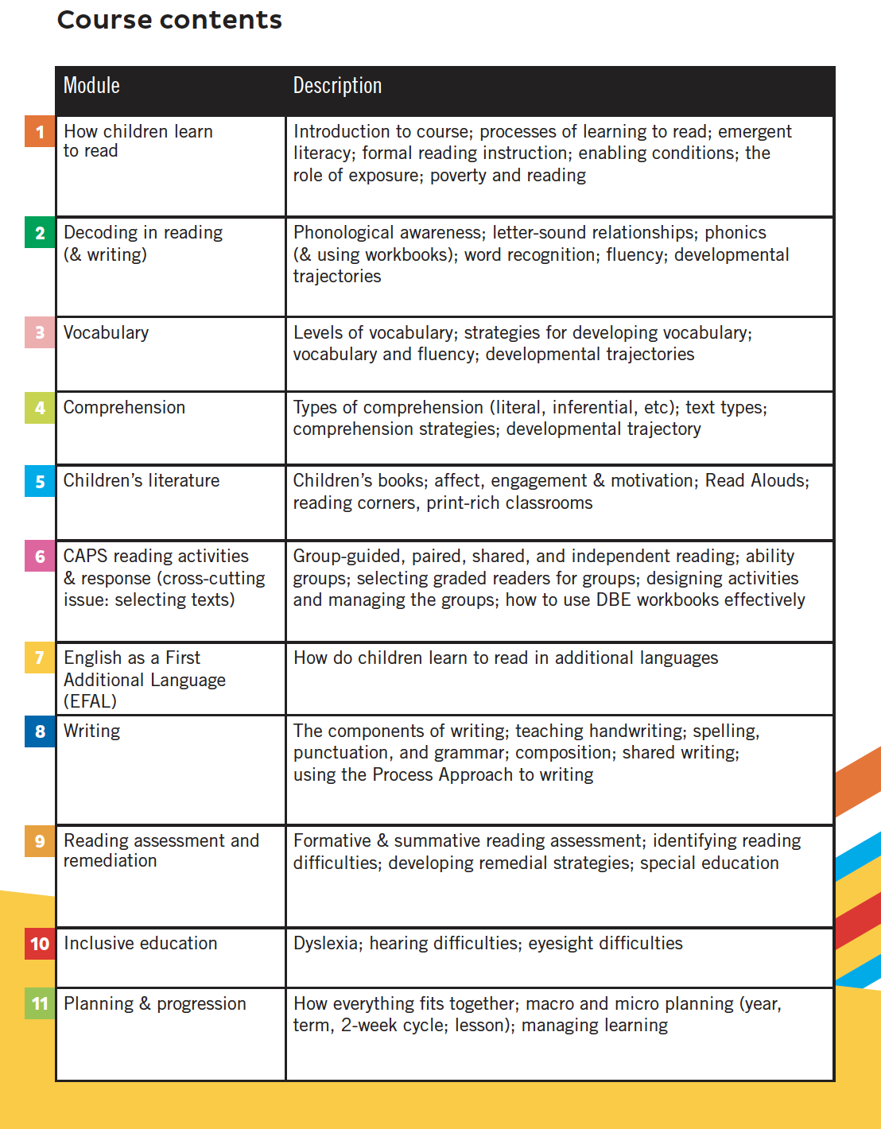


Slide 26
“
(1) The best use of private money is influencing how public money is spent.
“
LEVERAGE
“
(2) Avoid a ‘do everything’ strategy. Prioritize & identify the binding constraint. Address that.
“
PRIORITISE
“
(3) Focus on the foundations. ECD & early literacy are the foundations upon which all other learning depends.
“
FOUNDATIONS

Slide 27
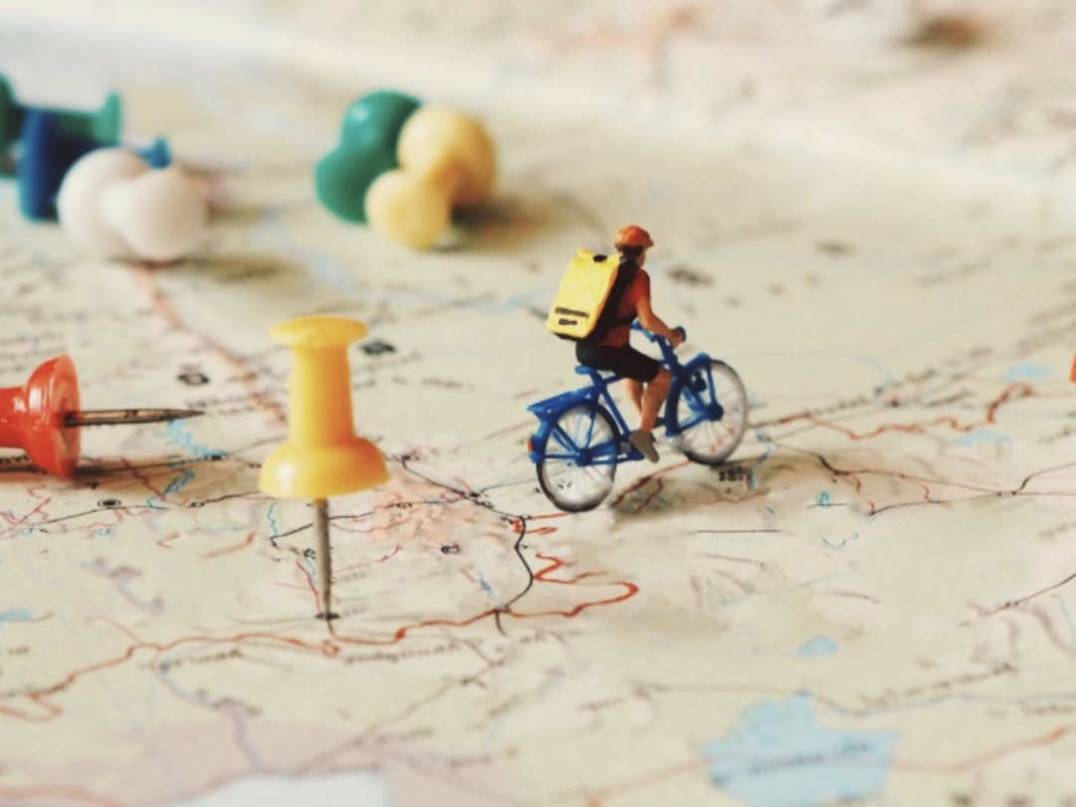
www.NicSpaull.com/presentations
Thank you
Other topics:
Evaluation
Assessment
Technology
Early Literacy

Slide 28
The Goldilocks Zone
A framework for thinking about evidence
Goldilocks zone for evidence
IDEAL
Goldilocks zone for policy
y
Measurement rigor
Consensus
Policy
Conclusive
5
Rigor of the Evidence
Causal
A
4
Small but rigorous
Confirming
3
Suggestive
☹
2
B
Large but weak evidence
Proof of concept
1
x
5
10
25
75
250
1500
5000+
Independence
Scale

Slide 29
SA PIRLS 2016 results in context
+
richest 10% of SA schools (71%)
Mullis et al. 2017

Slide 30
How do things actually work?
Is evidence the binding constraint to improved policy on paper and improved implementation in practice?
  Probably not: “There is massive evidence that governments do not implement many many many projects/proposals/programs that are cost effective and do spend budget on items known to be not cost effective. The model of a benign social welfare planner hampered by lack of rigorous evidence on effectiveness whose behavior an RCT will change is complete wack nonsense. “ (Pritchett, 2018)
Primacy of politics
  Budget cycles → Feb/March splurge in SA
  Election cycles (new party/president/minister → new policy)
Role of culture, values and tradition
  The exact same evidence in US and Denmark will not have the same impact on policy (think about studies on (1) for-profit education, (2) competition/choice.)
Role of social networks
  Often policies are implemented or not implemented based on the Minister’s Whatsapp contacts or who’s in her calendar
Role of unpredictable factors
  Minister makes a trip overseas and loves the school(s) she sees. Changes policy.

Slide 31

EVALUATE

