Slide 1

Higher Education Funding, Access and Returns: Policy lessons from England
Lorraine Dearden
University College London and Institute for Fiscal Studies
KEYNOTE ADDRESS
XXVII AEDE Meeting (Barcelona, Spain)
28 June 2018
Notes:
Slide Title 1
Presentation template 2

Slide 2
Introduction
    Talk is largely based on three areas of work that I have long been associated with:
    Higher Education Financing – what is the best way to fund HE in a fair, affordable and sustainable way that doesn’t discourage participation, particularly for poor students
    Higher Education Access – how can we improve access and success of students in university, particularly those from poor socio-economic backgrounds
    The Returns to Higher Education - what are the returns to going to university/HE and does this vary by socio-economic background and/or subject studied and/or where you go to university?

Slide 3
Higher Education Financing

Slide 4
Many countries HE funding system in crisis
US – high default rates on government backed student loans means system is in crisis
In Ireland and Scotland, full state funding of HE means excess demand for HE and no money for expansion (rationing and cash strapped HE providers) – true in some parts of Europe as well
In Brazil, there are no student loans and rationed high quality public sector ‘free’ universities which means significant number of low-SES students can’t go to HE
    Can’t pay fees for private provision and can’t access highly competitive state funded universities
In Colombia, badly designed student loan system (where students have to start paying back in final year) means system is also in crisis
Japan, Vietnam, South Korea, …..

Slide 5
Challenge for economic policy: how to fund HE in a fair way?
Does this mean 100% subsidy i.e. ‘Free’ Higher Education? The European solution?
    Graduates on average earn more and therefore pay higher taxes
    But ‘Free’ HE is regressive as involves non graduates subsidising high earning graduates – not good use of limited resources?
    Clearly social benefits of HE so should be some subsidy
    Graduates are also benefitting from something which not everyone has access to and from which they derive personal benefit
What is the right balance between public and private contributions that minimises risks for low socio-economic students and is affordable?

Slide 6
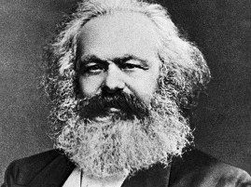
“ If … higher education institutions are also “free”, that only means in fact defraying the cost of education of the bourgeoisie from the general tax receipts..”
Karl Marx, Critique of the Gotha Program, 1875

Slide 7
The English/Australian solution: Fees plus income contingent loans (ICLs) works
England has tuition fees (currently maximum of £9,250 per year) but access to university is free at the point of access through generous loan system
    England has income contingent loans (ICLs) – fees paid directly for students and then student loan repaid only if student earns above £25,000 (9% of earnings above £25,000 i.e. if earn £30,000 pay 0.09x5000=£450 per year)
    Also loans for maintenance
    No default – if don’t pay back loan within 30 years then written off
    ICL involves social insurance and consumption smoothing
    Has allowed affordable expansion in HE without compromising university funding
    Means those graduates who do well in the labour market pay more for their degree than those who don’t – as we will see – huge variation in returns to undertaking HE in England and I expect worldwide

Slide 8
Impact on funding per student at HE (per degree)
(£2017)

Slide 9
ICL solution very successful worldwide
Operating now in Australia (since 1988), New Zealand (since 1992), Hungary, Netherlands, Japan, …….
Why do they work?
    Simple to administer as collection is through employer-withholding (like tax) – cost is about 3% of total loan value cf situation in US
    Simple for student – sign up for loan and give social insurance number and that is it – do nothing else
    When unemployed, having child - pay nothing and when you are back in labour market start contributing again cf other loans systems where have default (and never get money back)
    Argue fees plus well designed loan system much fairer and equitable way to partially fund HE than so-called ‘free’ HE

Slide 10
How large are the SES gaps in HE participation in England and what drives them?

Slide 11
English Administrative Data
    Individual school data for every student in state schools from 2001/02 with some exam results going back to 1996 (National Pupil Database (NPD))
      Have census data that measures characteristics of students plus exam data at the ages of 5, 7, 11, 16 and 18
      Also have exam data for private schools students at 16 and 18
    This data has been linked to Higher Education Statistics Authority (HESA) data that measures where student goes, subject studied, whether they drop-out and their final outcome (1st class honours, 2(1), 2(2), 3, fail)
    NPD/HESA data has now been linked to HMRC earnings data and DWP benefits data and can see earnings up until the age of 28
    Have Student Loan Data from 1998 until today linked to HMRC tax data.
      Around 90% of students take out student loans and can see earnings into early 30s

Slide 12
HE participation overall and at high status institutions, by socio-economic background
Notes:
Suggest briefly commenting on data when discussing the graph (rather than having a separate slide on it)
May also be worth mentioning that there is no clear pattern in terms of subject differences by SES

Slide 13
Why are these gaps so large?
    One factor which has been a big concern in recent years is the cost of university – and in particular the amount of fees charged as just mentioned
    Recent reforms have increased the cap on annual tuition fees from £1,000 (in the early 2000s) to £3,000, to £9,000 in (2012/13) and now £9,250 (in 2017-18)
    What has happened to the socio-economic gaps in participation over this period?
    Measure this in various ways but descriptive evidence suggests largest increase in participation has been for poorest students

Slide 14
HE participation rates over time, by a measure of local area disadvantage
Source: Figure 4.3 of Crawford et al. (2017)
Notes:
Suggest briefly commenting on data when discussing the graph (rather than having a separate slide on it)

Slide 15
Participation gaps have been falling while tuition fees have been rising – why?
    Answer is because students can borrow money to cover their fees whilst at university (and a contribution towards living costs) and do not have to pay it back until they are in work with reasonable income
      No upfront fees for students
      Generous support for living costs for low income students
      Those who go on to be low income graduates are relatively protected from the costs of university (insurance)
      ICLs are right policy and progressive (compared to ‘free’ higher education though certain design elements of the English ICL/student loan system are not right

Slide 16
If not funding, what else?
    Fees are not a major part of the reason why poorer students are less likely to go to university than richer students – at least among young HE entrants
      Not least because there were even larger gaps even when HE was “free”
    What else could explain the gaps?
    Prior attainment potentially a big part of the story
      If SES differences in HE participation were entirely explained by attainment earlier in the school system, then policy (and resource) focus must be on improving these earlier outcomes amongst low SES children
      But if they are only part of the explanation then policy must have a wider focus – attainment plus . . .

Slide 17
How important is attainment at different ages in explaining SES gaps in HE participation?
Source: Figure 5.1 of Crawford et al. (2017)

Slide 18
Prior attainment is vital – but not the whole story for high status institutions
    Attainment at end of secondary school can explain the whole gap in HE access between richest and poorest 20% of state school students
    But not quite the whole gap in terms of entry to high status institutions amongst those who go to HE
      Still small SES differences in applications/offers/entry to these universities
    Should we care about these gaps?
      Yes, to the extent that – as we will see– students from these institutions go on to earn more, on average, in labour market
    What other gaps might there be that we should worry about?

Slide 19
Socio-economic gaps in university outcomes

Slide 20
Is getting more poor pupils to HE enough?
    Large socio-economic gaps in university access
    Are there further socio-economic differences in these outcomes?
    What about beyond graduation? Do richer and poorer students benefit equally from higher education?

Slide 21
% of students who drop-out, complete degree and graduate with 1st or 2:1, by SES percentile
Source: Figure 5.1 of Crawford et al. (2017)

Slide 22
What explains SES gaps in HE outcomes?
Source: Figure 7.1 of Crawford et al. (2017)

Slide 23
Further SES differences in outcomes at university
    Those from lower socio-economic backgrounds are more likely to drop out, less likely to complete their degree, and less likely to get a 1st or 2:1
    True even comparing students from different SES backgrounds:
      With the same attainment and other characteristics on entry to HE
      On the same courses (same subject at same institution)
      At high status institutions
    Suggests SES gaps in university access understate gaps amongst cohort as a whole in terms of degree acquisition and degree class

Slide 24
Is university worth it for everyone?

Slide 25
The value of higher education
    If we are concerned about access, we have to ask – is going to university worth it based on earnings (only part of the story but important part).
    Broadly yes . . . average graduate earnings have remained high despite expansion of student numbers
    But variation in graduate outcomes has increased, with differences by institution, subject and degree class increasingly important
    Importantly there are SES differences in these outcomes too – even for those doing the same course at the same university with the same background characteristics

Slide 26
Evidence from English administrative data
Have done work on this using student loan data linked to tax records and benefit records
    Advantages – see graduates into their early 30s
    Have crude measure of parental income – whether high income (get minimum loan amount – top 20% of students from families with income around £65k and above) vs low income
    Limited background characteristics for HE students and no background characteristics for non-graduates
  Also have school data linked to HE data linked to tax and benefit data for all students who went to school in England
  Advantages – can control for prior ability and socio-economic background much better
  Can look at returns relative to non-graduates (haven’t released this work yet but we have done this)
  Disadvantage – only see people until the age of 28 so very early in career

Slide 27
Variation in graduate earnings
    Big differences in earnings by institution and subject
    Largely but not entirely driven by differences in entry requirements/background characteristics but not entirely
    But even contingent on going to the same university and attending the same course there are differences in earnings by socio-economic status even after controlling for difference in characteristics
      This difference is around 8% by the age of 28 and around 13% by age 32
      Potentially larger at higher ages?

Slide 28
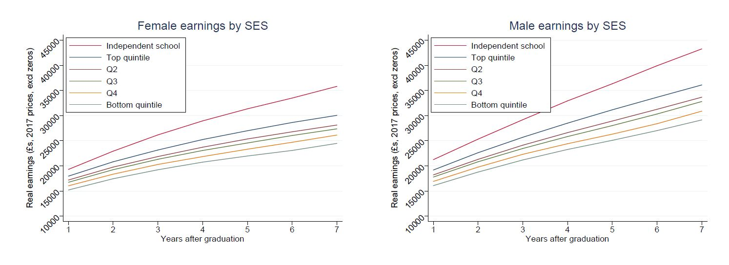
SES raw differences in earnings

Slide 29
Big problem - selection
These partly driven by differences in background, subject choice and institution choice but see still significant gap even if we control for all characteristics
Also how do you meaningful compare a student studying physics at Cambridge University with somebody study English at Wolverhampton University?
      graduates’ earnings and employment affected both by their pre-university characteristics and by the impact of studying a particular degree at a certain university
      subjects may have very high average graduate earnings simply because they take high-ability students rather than because of the impact of the degree itself
  Richness of our data allows us to do this using inverse probability weighted regression adjustment (IPWRA)
      This process weights individuals in each treatment group (university-subject combination) who look more similar to individuals not in that treatment group more heavily (Wooldridge (2007))
  Of course doesn’t control for selection on unobservables

Slide 30
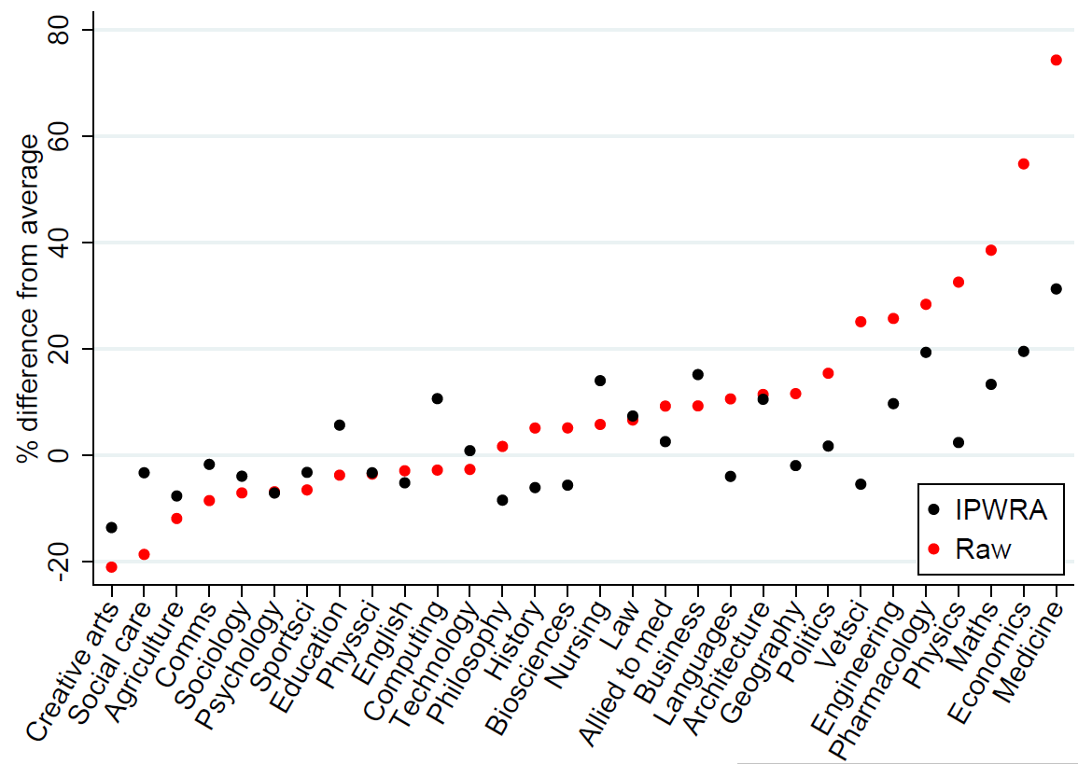
Differences by subject at age 28 (females)

Slide 31
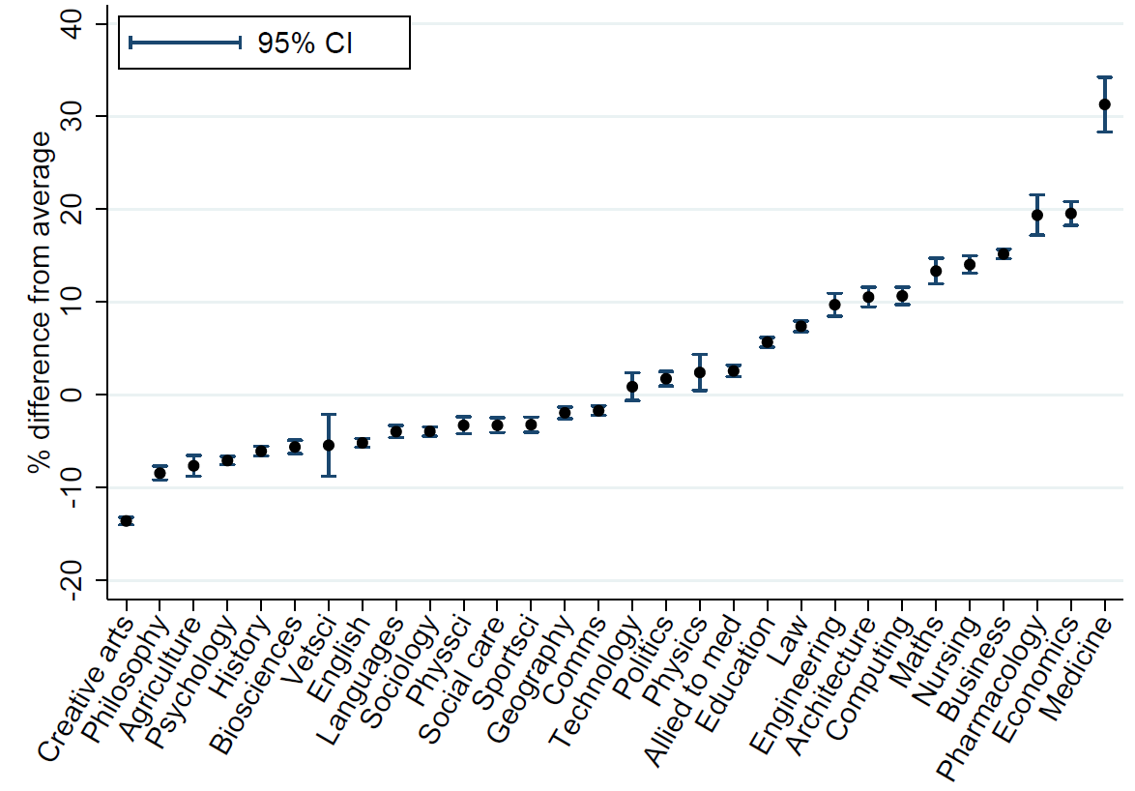
IPWRA estimates for women - subjects

Slide 32
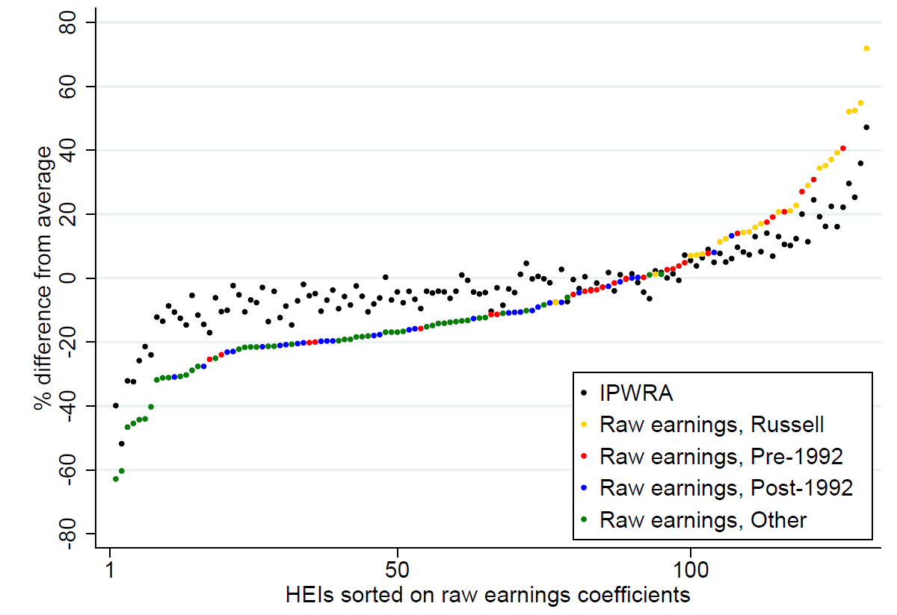
Differences by institution (males)

Slide 33
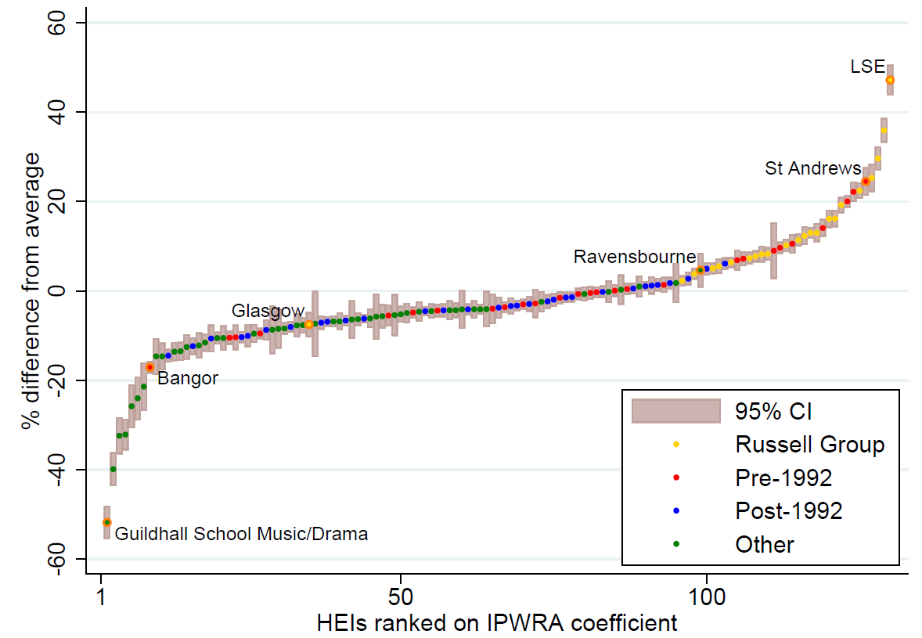
IPWRA estimates for men - Universities

Slide 34
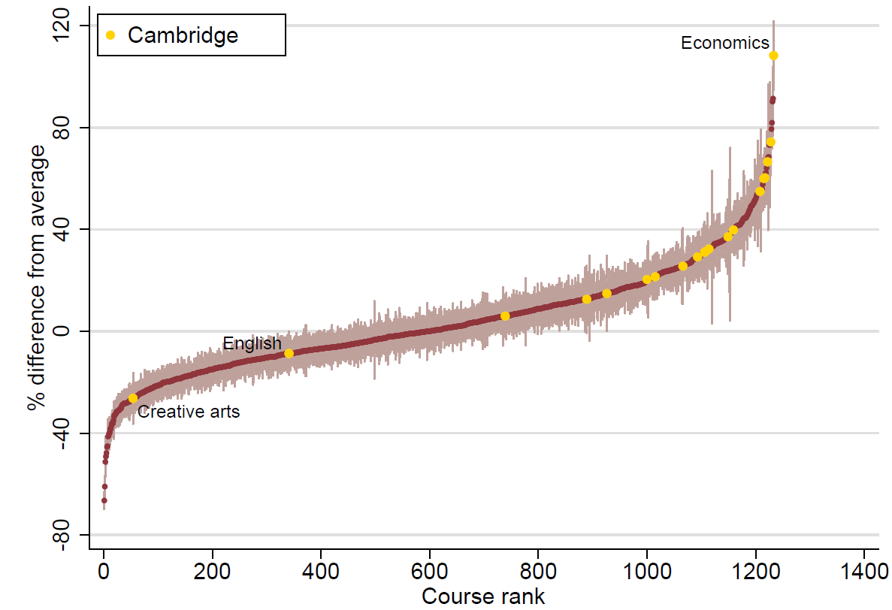
Subject by HEI – Cambridge Males vs other HEIs

Slide 35
Implications
    A degree offers a pathway to relatively high earnings for many – but not all
    Ensuring equal access to HE clearly first order priority
    But access to institutions and subjects with higher earnings also important
    But still not enough – still SES gaps in earnings even if do same course at same institution
    What is behind this?
      Better connections/career decisions?
        Potentially look at this as we know industry of job
      Other unobservable characteristics?
      Discrimination?

Slide 36
Does this mean low SES students shouldn’t go to university?
    Comparing otherwise identical graduates, those from higher socio-economic backgrounds earn more, on average
    But graduates from low income families still earn more, on average, than those who don’t go to university
      And some work suggests that poor graduates earn more relative to poor non-graduates than rich graduates do compared to rich non-graduates
    University still seems to offer an average earnings boost, so don’t want lower earnings for poor graduates to deter them from going
    But clearly more work is required to reduce the SES gaps at every stage in order for HE to be a true ‘engine of social mobility’

Slide 37
Policy implications

Slide 38
Access
    Recent changes to the HE funding system have not widened socio-economic gaps (at least for young f/t students)
      If anything, SES gaps have fallen rather than risen over this period
      Highest percentage increase in HE participation is for low SES students
      Funded increase in enrolments and funding for universities
    Design not perfect but ICL model with fees is something that rest of world should consider drawing on Australian and English experience
    To fix SES gaps in HE participation need action earlier on to ensure the school qualifications of low SES students are improved
    Contextualising on basis of school characteristics may be good way to start?
      On average, amongst pupils with same attainment, those from lower performing schools do better at university than those from higher performing schools
    If contextualising based on family or neighbourhood characteristics (which some universities do), universities must ensure they support students on arrival

Slide 39
Later success
    And the challenges continue beyond university as well
    Students who look similar when they leave undergraduate studies have different labour market outcomes depending on their socio-economic background
    Need to understand why
      Could more be done by university careers services?
      Efforts by some large employers to use ‘blind’ admissions and to monitor the socio-economic background of their employees
      But more research needed to understand what is driving this
    Finally worth remembering that higher SES students will not be standing still while all this is happening, so no guarantee that gaps will close

Slide 40
Thank you

