Slide 1
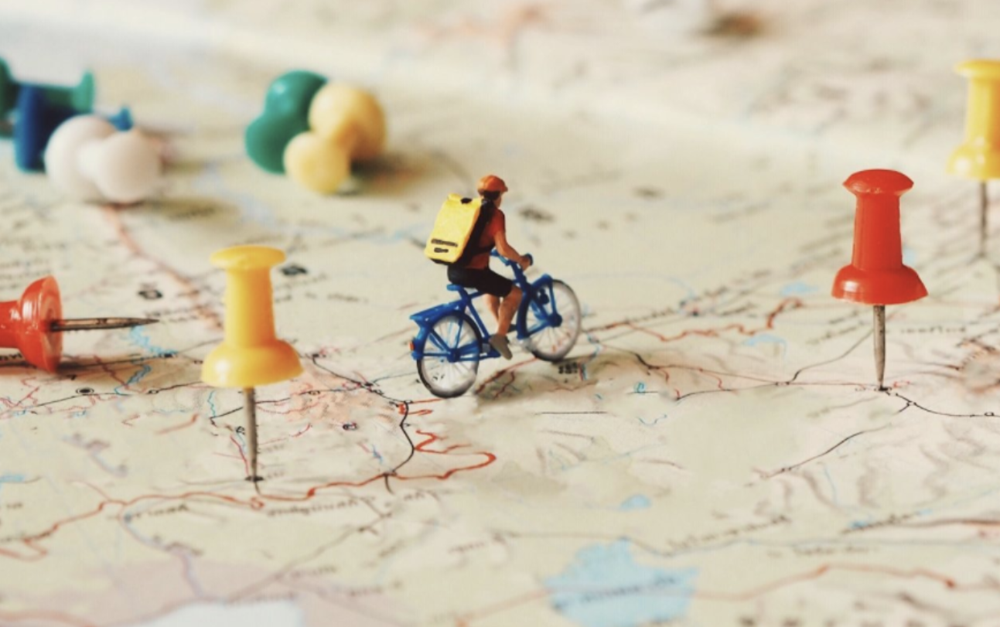
Research methods and evaluation
How do we know if/when something works?
Nic Spaull
Stellenbosch University & Allan Gray Orbis Foundation Endowment
nicspaull@gmail.com www.nicspaull.com
Global Schools Forum
28 May 2018

Slide 2
Overview
An overview of evaluation: the counterfactual
Randomised control trials
Scale, evidence and context
A cheat sheet for grant-making bodies interested in interventions and evaluations
A framework for thinking about evidence
How things actually work in the real world
SPARK as a case-study
Partner/group activity

Slide 3
Not all evaluations are created equal
Independence
Sample-size
Causality
Measurement
Interpretation

Slide 4
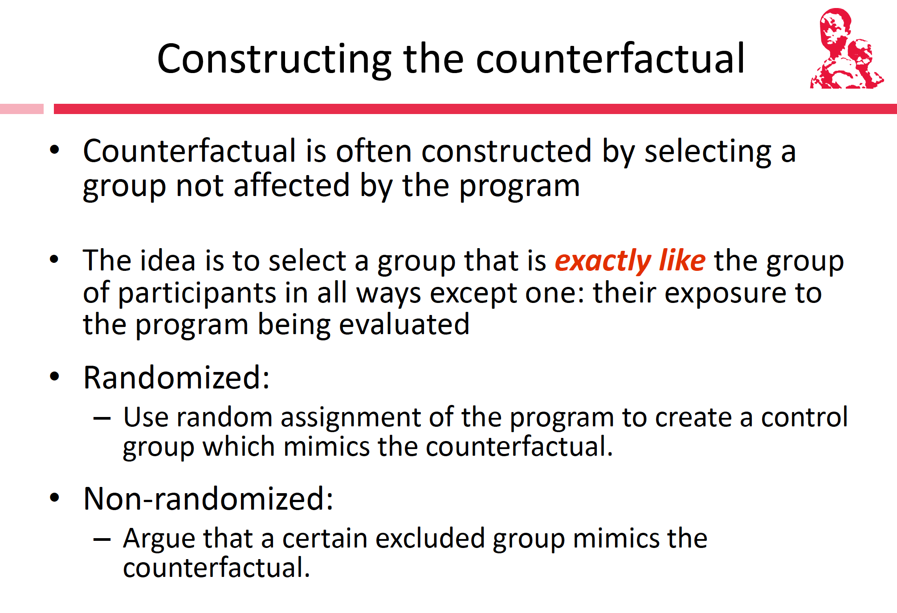

Slide 5
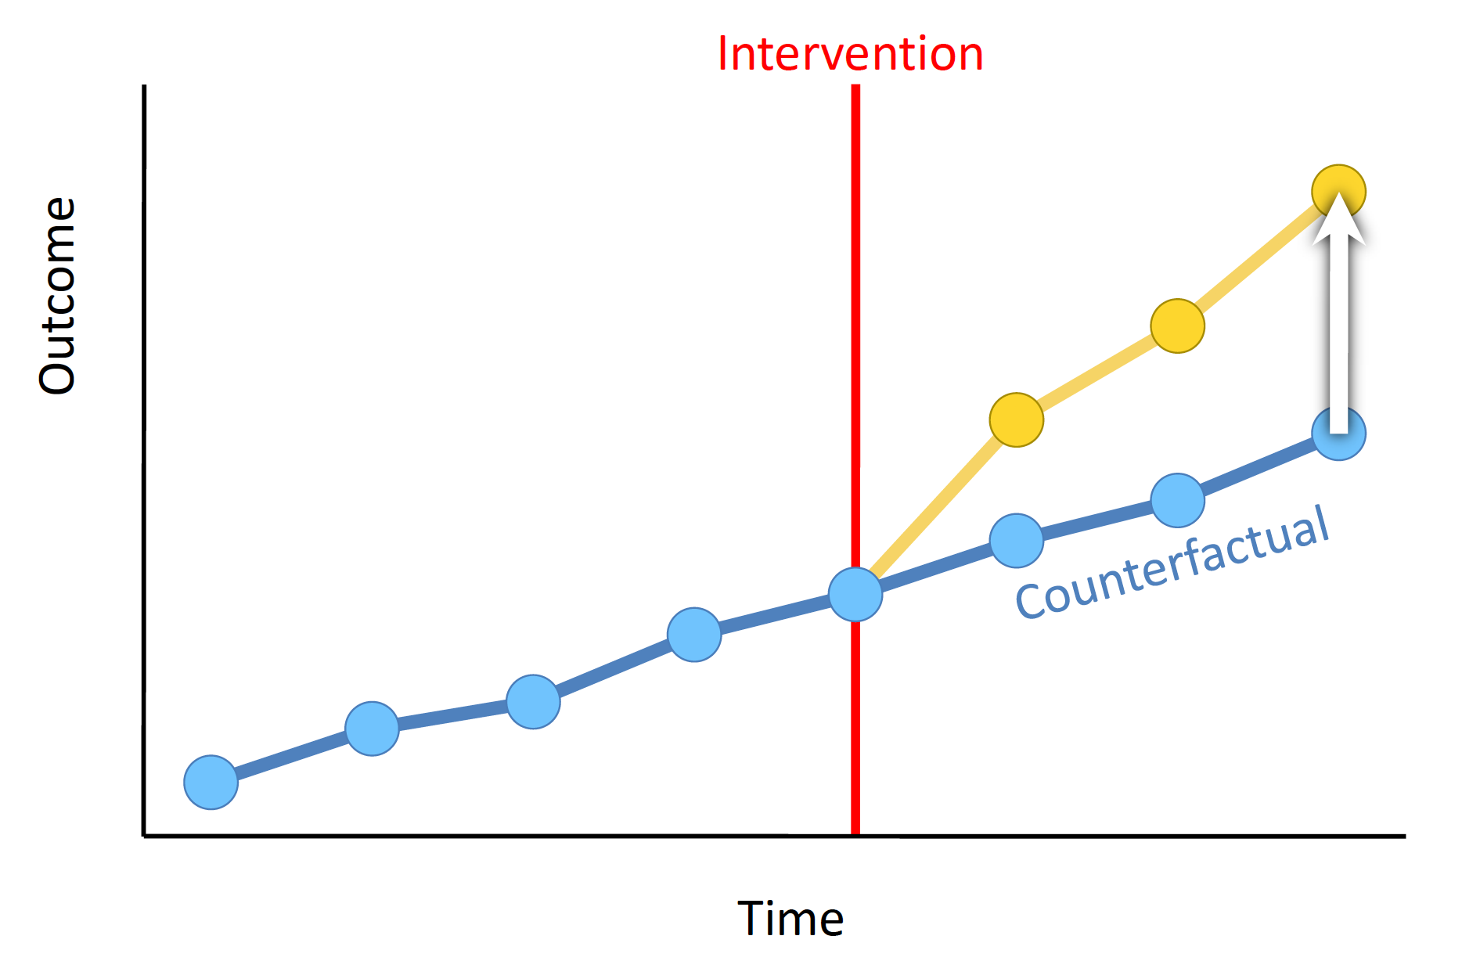

Slide 6
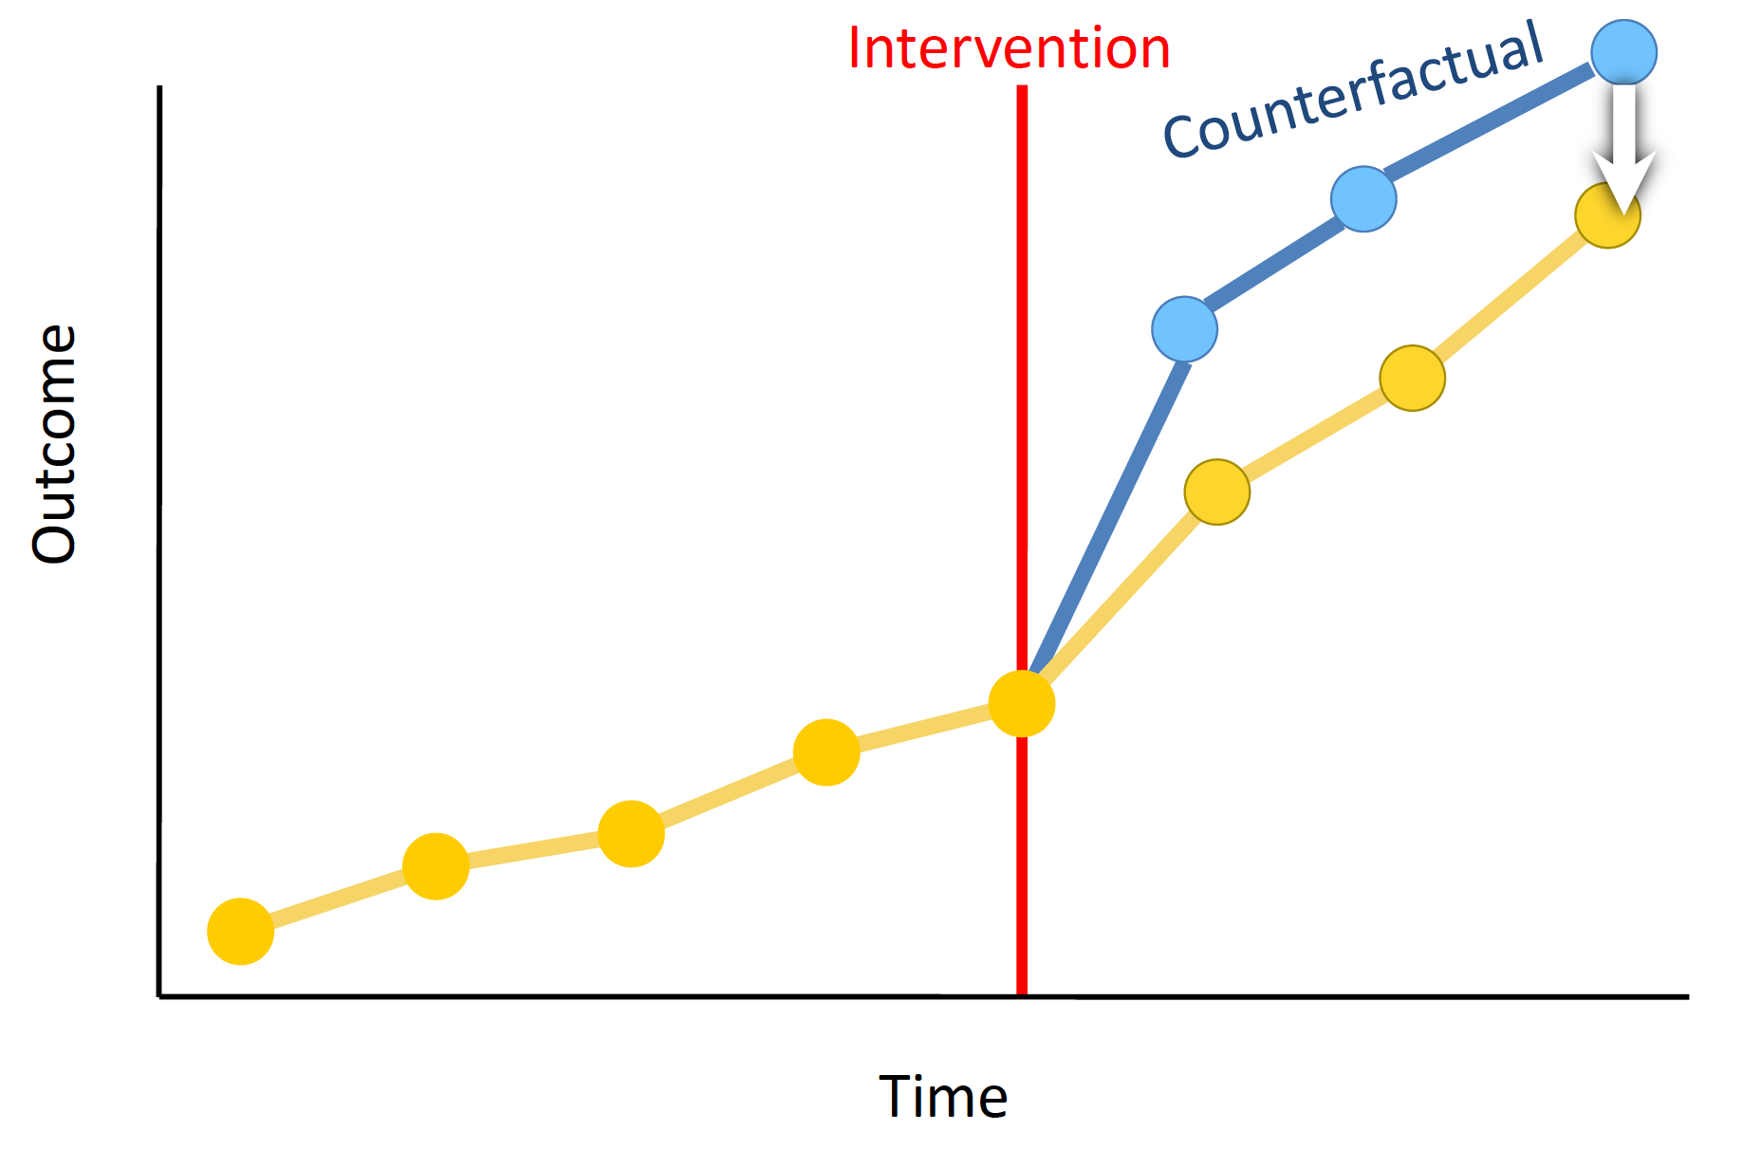

Slide 7
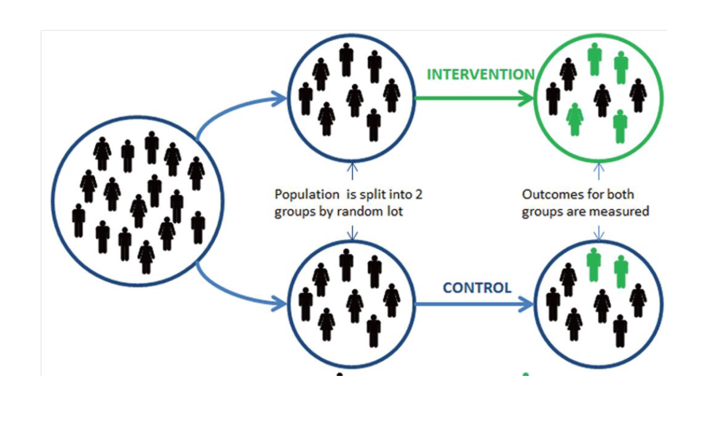
Randomised Control Trials
(note on generalizability)

Slide 8
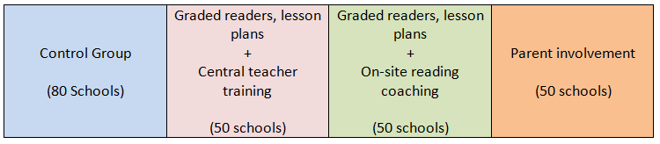
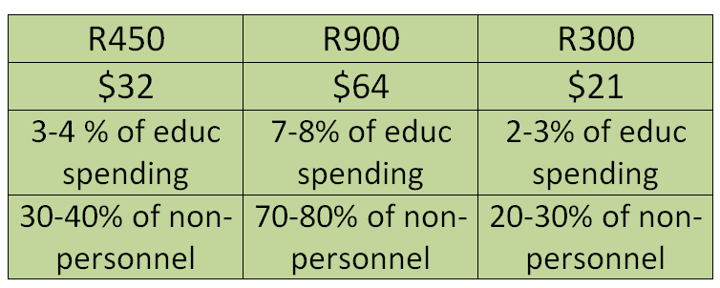

Description of Interventions
230 schools in North West
Per learner costs
Notes:
The point here is that we will look not only at impact but also at cost-effectiveness. The cost estimates are shown in relation to overall education spending per learner. While 7-8% of overall spending makes our most expensive intervention sound affordable especially if it substantially shifts learning. However, since about 90% of spending goes to salaries, the cost of this intervention is about 70-80% of existing non-personnel spending. In this light, it may be more expensive. Alternatively, it may need to be implemented through re-arranging the salary bill. The final point to make is that “scaling up” is not necessarily an all-or-nothing process. For a provincial department to target the programme to 100 schools, for example, would only cost about R8million, and this could easily be secured.

Slide 9
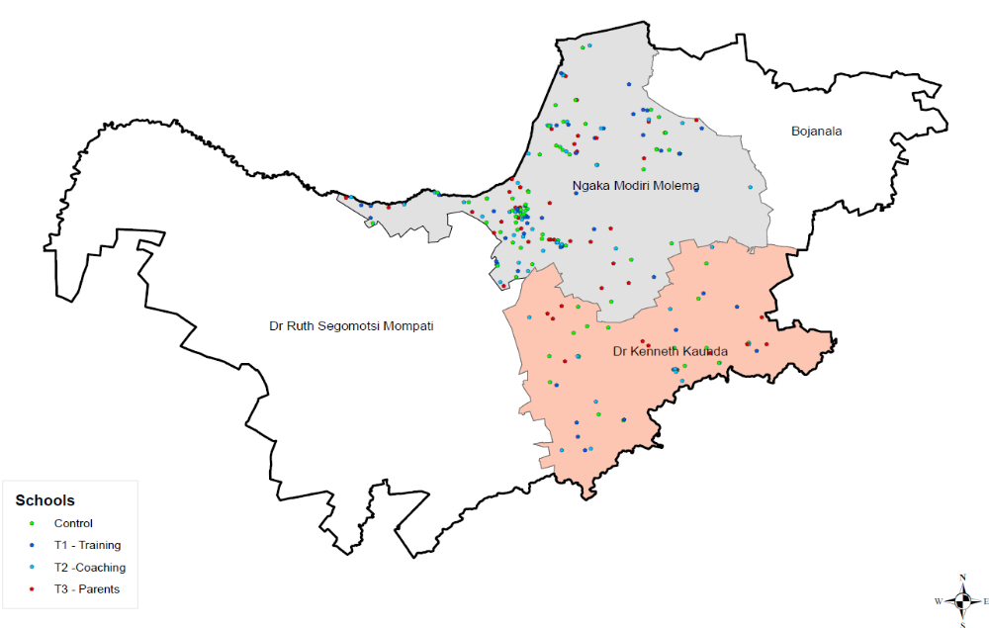
Sample: 230 schools in North West

Slide 10
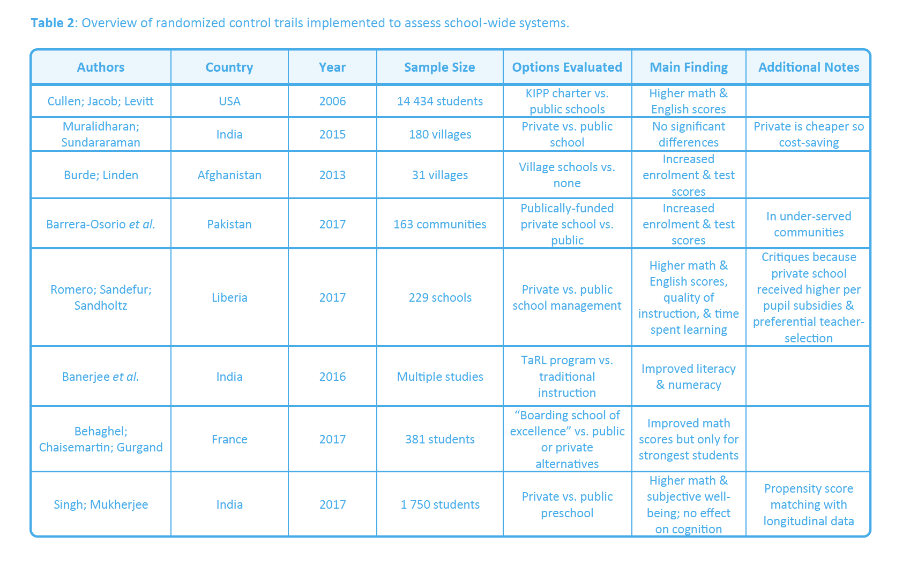

Slide 11
Where do RCTs fit in the types/stages of evaluation?

Slide 12
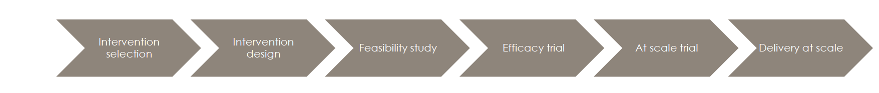
Cheat sheet: interventions
Proof of concept
  One site, multi-year, intensive, often costly/child
  Aim: putting the idea on the map
  Evidence: smorgasboard of measures)
  Main challenge: does it actually work?
  FYI: heavily dependent on individual champions (one funder, one leader, one academic)
Multi-site intervention
  5-50 sites,
  Aim: to show that “the ‘model’ works & tweak model
  Evidence: few core measures
  Main challenge: Maintaining fidelity at 5-50 & causality of evidence
  FYI: the one funder/founder may still be driving
Causal evidence
  250+ sites
  Aim: The ‘model’ works in multiple different contexts
  Evidence: few core measures
  Main challenge: Maintaining fidelity & causality & heterogeneous effects
  FYI: HR & technical expertise becoming a binding constraint
Scale-up & government implementation
  500+ sites
  Aim: The ‘model’ should become national policy
  Evidence: few core measures
  Main challenge: Maintaining fidelity when integrating into government
  FYI: politics, fidelity, external validity, unintended consequences

Slide 13
Context and scale
4
3
Context
1
2
5
25
250
1000
Scale

Slide 14
The Goldilocks Zone
A framework for thinking about evidence
Goldilocks zone for evidence
IDEAL
Goldilocks zone for policy
y
Measurement rigor
Consensus
Policy
Conclusive
5
Rigor of the Evidence
Causal
A
4
Small but rigorous
Confirming
3
Suggestive
☹
2
B
Large but weak evidence
Proof of concept
1
x
5
10
25
75
250
1500
5000+
Independence
Scale

Slide 15
How do things actually work?
Is evidence the binding constraint to improved policy on paper and improved implementation in practice?
  Probably not: “There is massive evidence that governments do not implement many many many projects/proposals/programs that are cost effective and do spend budget on items known to be not cost effective. The model of a benign social welfare planner hampered by lack of rigorous evidence on effectiveness whose behavior an RCT will change is complete wack nonsense. “ (Pritchett, 2018)
Primacy of politics
  Budget cycles → Feb/March splurge in SA
  Election cycles (new party/president/minister → new policy)
Role of culture, values and tradition
  The exact same evidence in US and Denmark will not have the same impact on policy (think about studies on (1) for-profit education, (2) competition/choice.)
Role of social networks
  Often policies are implemented or not implemented based on the Minister’s Whatsapp contacts or who’s in her calendar
Role of unpredictable factors
  Minister makes a trip overseas and loves the school(s) she sees. Changes policy.

Slide 16
PROBLEM
  What is the problem we are trying to alleviate?
  Why has this problem remained a problem (i.e. recognizing that the status quo is an equilibrium of forces and not just a random shitty outcome)
AIM
  What are we hoping to achieve or change with funding XYZ?
THEORY OF CHANGE
  What are ALL our assumptions about (1) the problem, (2) the way the intervention addresses the problem.
MEASUREMENT & EVALUATION
  What will we know and be able to say after the evaluation?
  How will we know if it worked? (‘impact’)
  How will we know where & when it works? (‘external validity’)
  How long/much does it take for it to work? (‘dosage’)
  How sure will we be of the results? (evaluation methodology)
  How defensible are the results of the evaluation (‘independence’)
  What instrument are we using to measure? Is it legit/validated/used elsewhere?
  How comparable are these figures to others looking at the “same” thing?
COST
  What is our cost per learner/school/teacher per year?
  What in-kind costs (particularly human expertise/networks) have we not included?

Slide 17

Q&A with Stacey Brewer
Why does SPARK want to be evaluated?
Who is the audience of the SPARK evaluation results?
What are some of the challenges that you faced / are facing?
What would you do differently now?

Slide 18
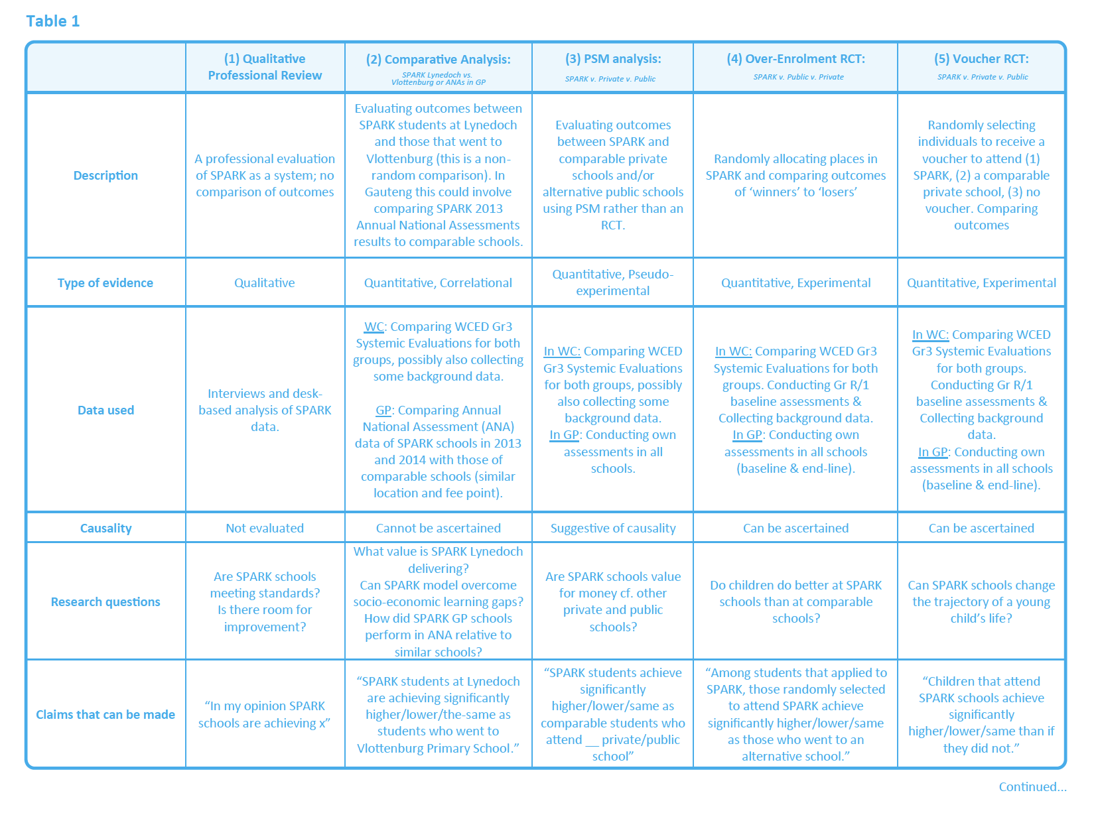

Slide 19
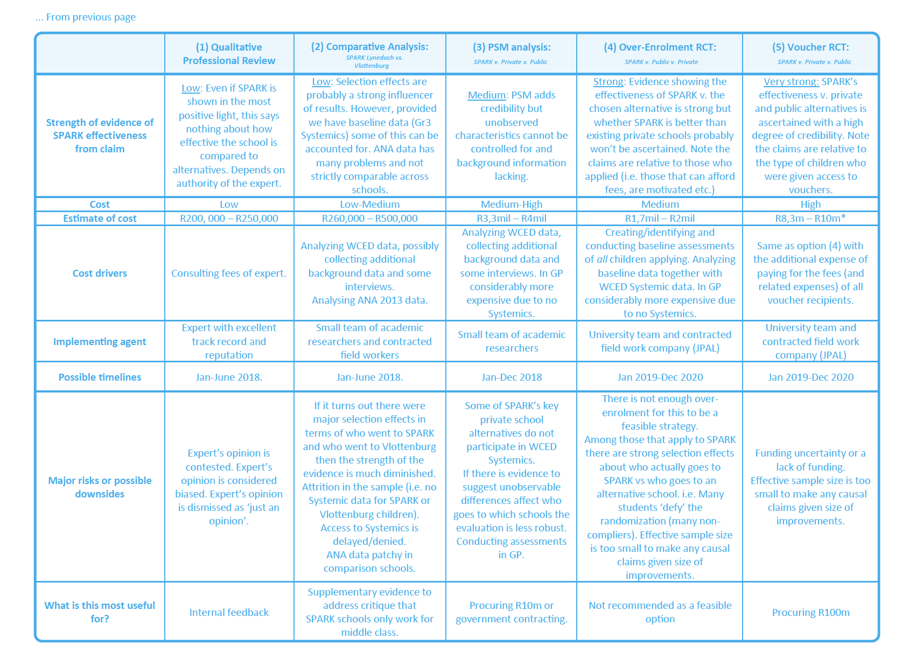

Slide 20
Partner exercise
One-sentence statement of activity
  E.g. “We are a low-cost chain of 43 primary schools in India”
The MAIN measurable outcome that we care about
  E.g. Mathematics and language outcomes at Gr3 and Gr6
The causal claim that we would like to make
  E.g. “Children that attend a SPARK school do better than if they had attended a government school”

Slide 21
Questions to ask about a school network:
School:
Does this school charge fees?
What % of the population can afford these fees?
What is different about the way this school does school?
Teachers
Where do they recruit their teachers from?
How much do they pay their teachers (& relative to other/government schools?)
What is the average age of their teachers compared to other/government schools?
What is teacher turnover like at these schools?
Students:
Where do they recruit their students from?
What % of students leave before completing the full course of schooling? Why do they leave? What are comparable figures at other/government schools
Selection effects:
  How are our students different to average students? Do we select? (age/race/income/parents/language/location/religion/culture/ability)
Outcomes:
What does the system currently use to measure outcomes?
What outcomes are important to the school/parents/funders? (learning outcomes, socio-emotional, maths, graduation rates etc.)
Has the school been evaluated before? If so by who? When? How rigorous?
Costs:
What is the cost/learner? (does this include in-kind contributions?)
What is the cost/outcomes?
How does the cost and the cost/outcome compare to otherwise-equivalent schools?

Slide 23
Conducting an evaluation
If we were to evaluate what we do, we would…
(type of evaluation)
by measuring…
2. (what we would measure)
So that we could make the following claim:
3. (claim we want to make)

